Slide 1



对撞机上新物理寻找
Electroweak Corrections to Higgs boson production and decay
毕业论文答辩
陈龙斌
2026-4-19
答辩人：小不点 答辩时间：5.5 指导老师：大不点
With: Hai Tao Li, Wen-Long Sang, JHEP 10,194(2025)
With: Zi-qiang Chen, Cong-Feng Qiao, Ruilin Zhu, PRD 110, L051301(2024)

Slide 2

OutLine
Motivation
Electroweak corrections to Higgs boson + jet production
Precise Higgs boson rare decay study
Conclusion and Outlook

Slide 3
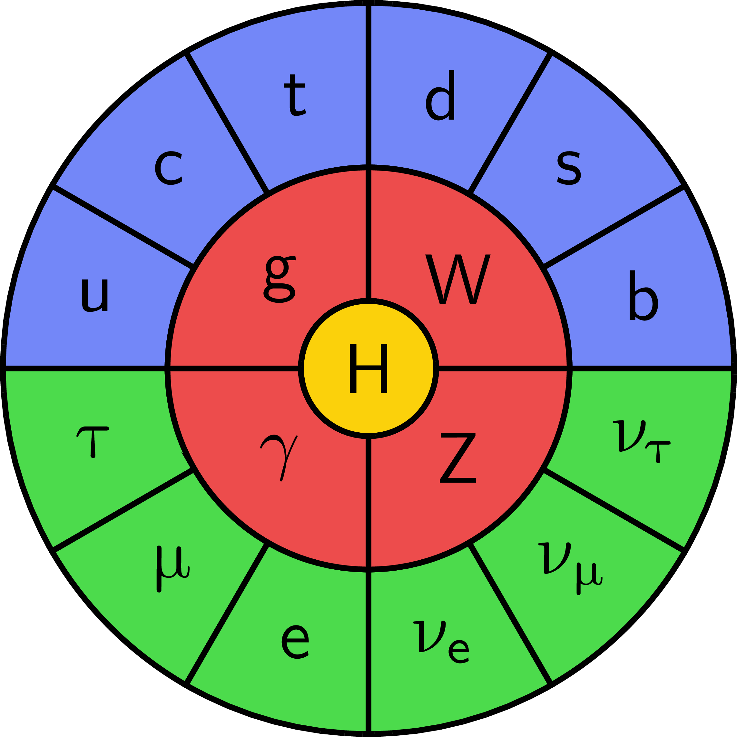
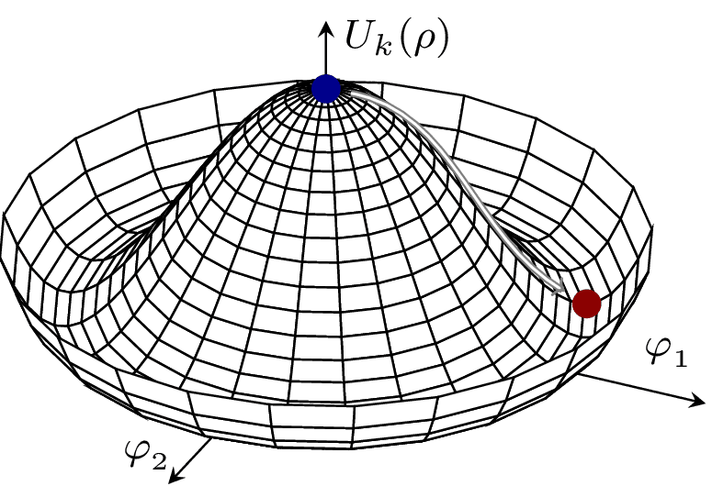
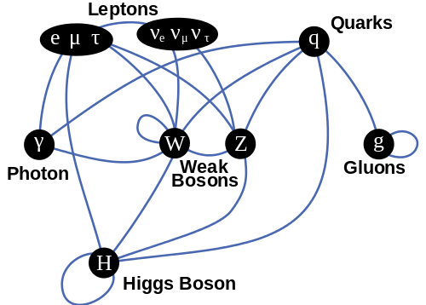
毕业论文答辩
Standard Model
答辩人：小不点 答辩时间：5.5 指导老师：大不点
SU(3) × SU(2) × U(1)
The Higgs boson enables mass via electroweak symmetry breaking, underpinning the Standard Model and linking to vacuum stability via its potential.
Interactions between particles

Slide 4
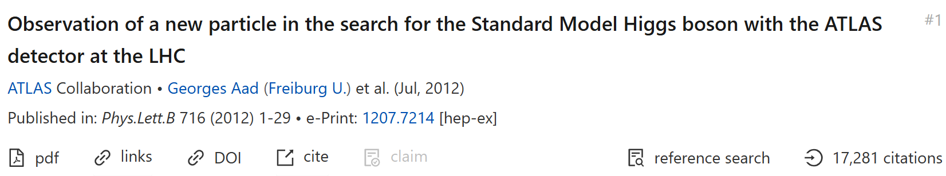
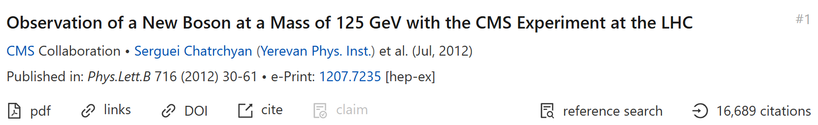
01
Motivation
Discovery of Higgs boson
毕业论文答辩
答辩人：小不点 答辩时间：5.5 指导老师：大不点

Slide 5
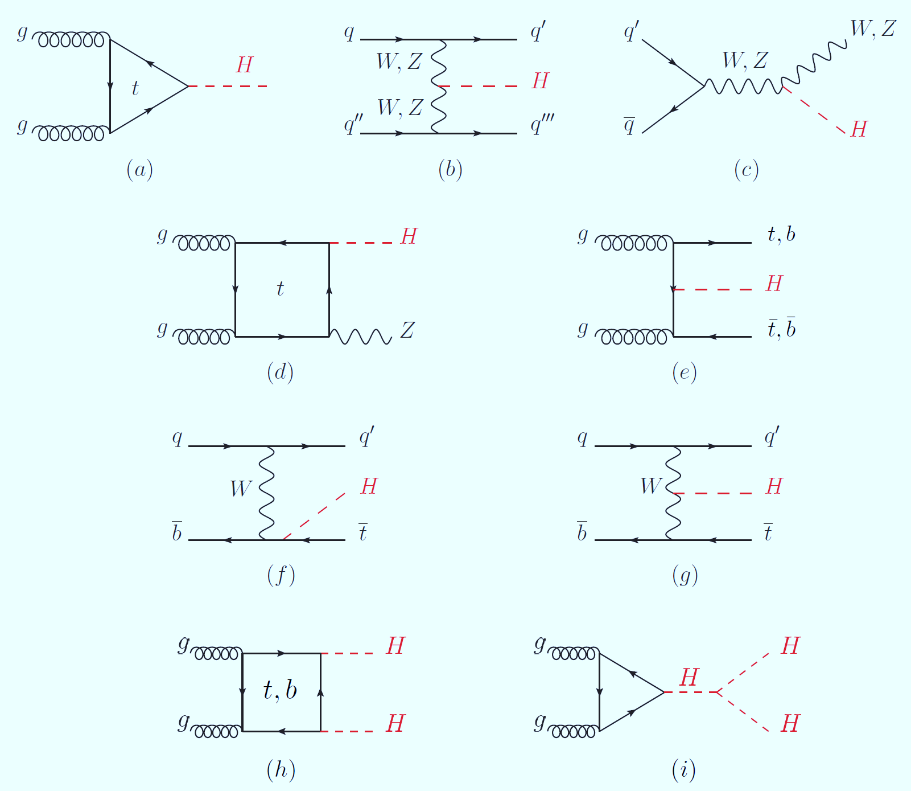
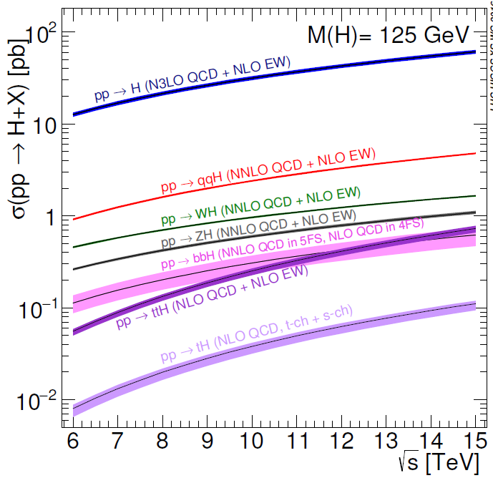
Higgs boson production at LHC
Higgs isn’t everything. It’s the only thing.—Michael E. Peskin
Precise Higgs boson physics study is crucial to understand SM and probe new physics.
Notes:
希格斯玻色子是标准模型（SM）的核心，其场为 W/Z 玻色子、夸克、轻子等粒子提供质量来源。但 SM 无法解释希格斯场真空期望值的起源、正反物质不对称、暗物质等关键问题，而这些问题的答案均与希格斯玻色子的相互作用特性紧密相关，因此高精度测量其性质是粒子物理的首要任务。

Slide 6
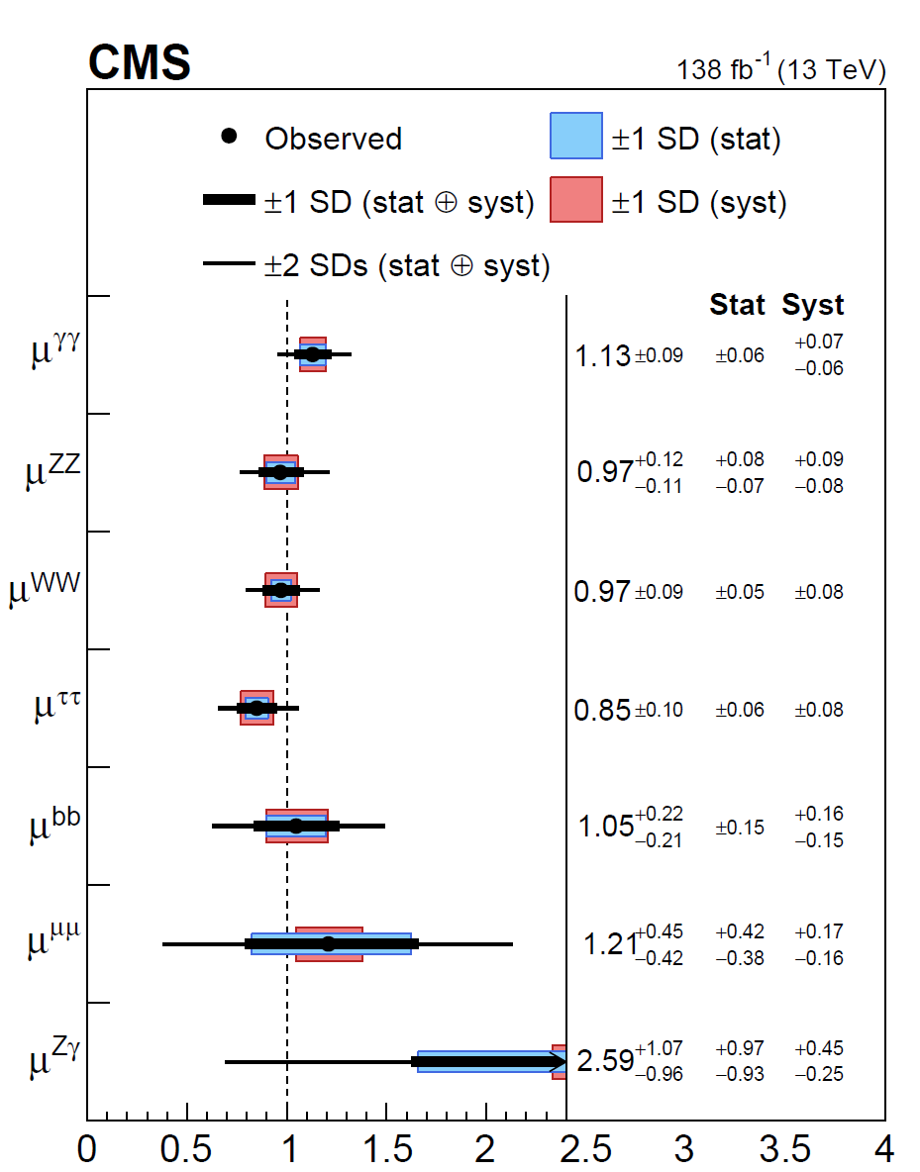
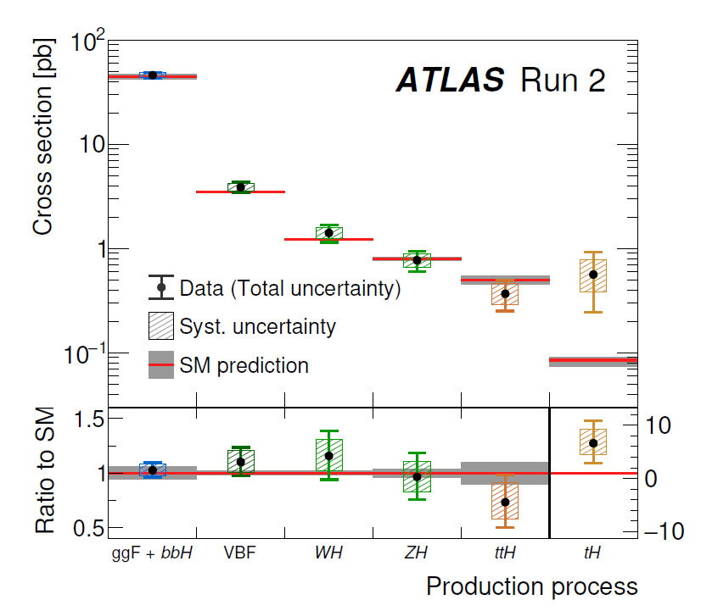
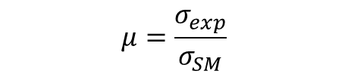
States of Higgs measurement
$$μ=\frac{σ_{exp}}{σ_{SM}}$$
ATLAS
CMS
毕业论文答辩
答辩人：小不点 答辩时间：5.5 指导老师：大不点
Nature 2022

Slide 7

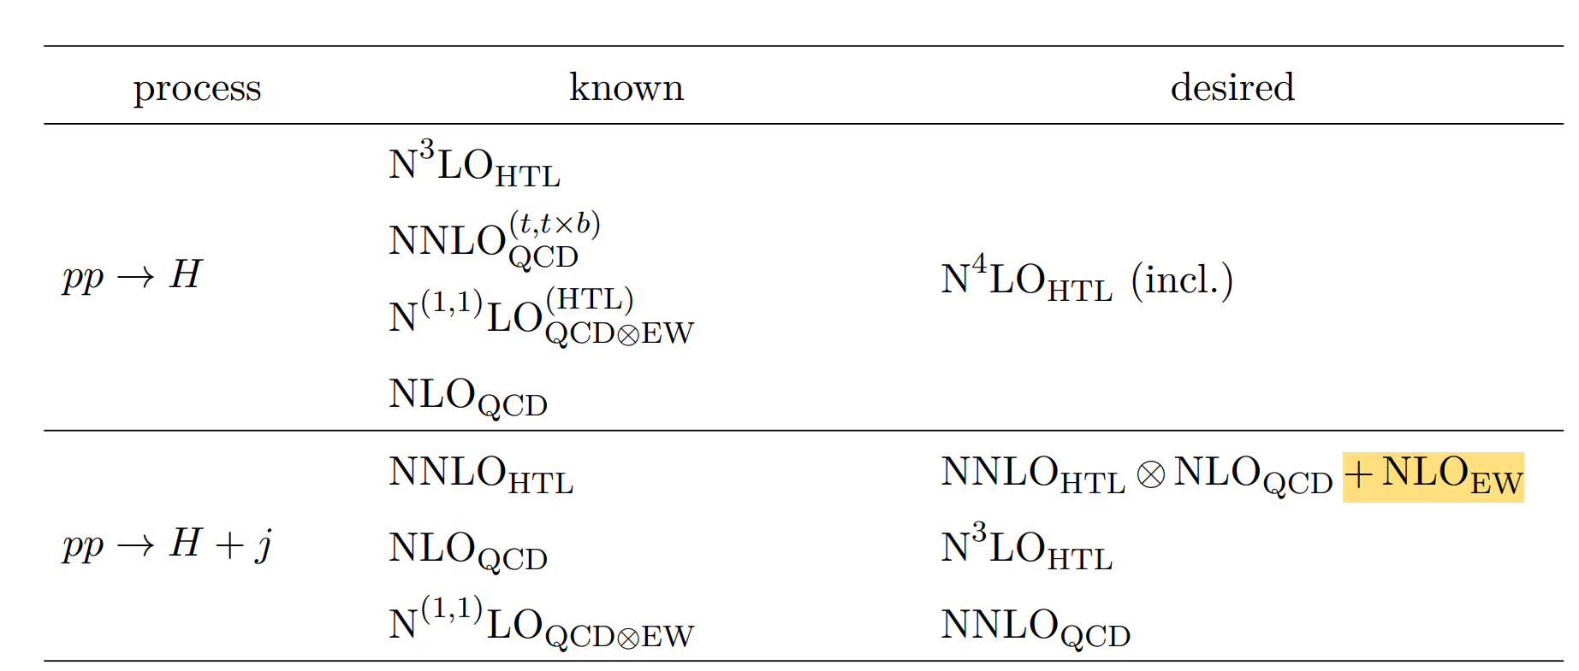
The purpose of precision is discovery, not just improving the error bars.
02
毕业论文答辩
EW corrections to Higgs+jet production in gluon fusion
答辩人：小不点 答辩时间：5.5 指导老师：大不点
With: Hai Tao Li, Wen-Long Sang, JHEP 10,194(2025)

Slide 8
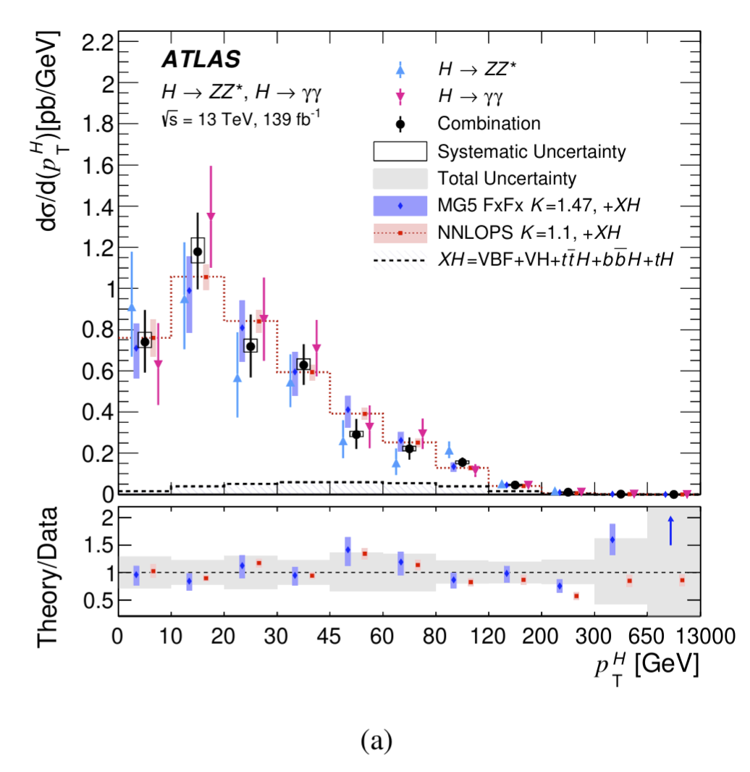
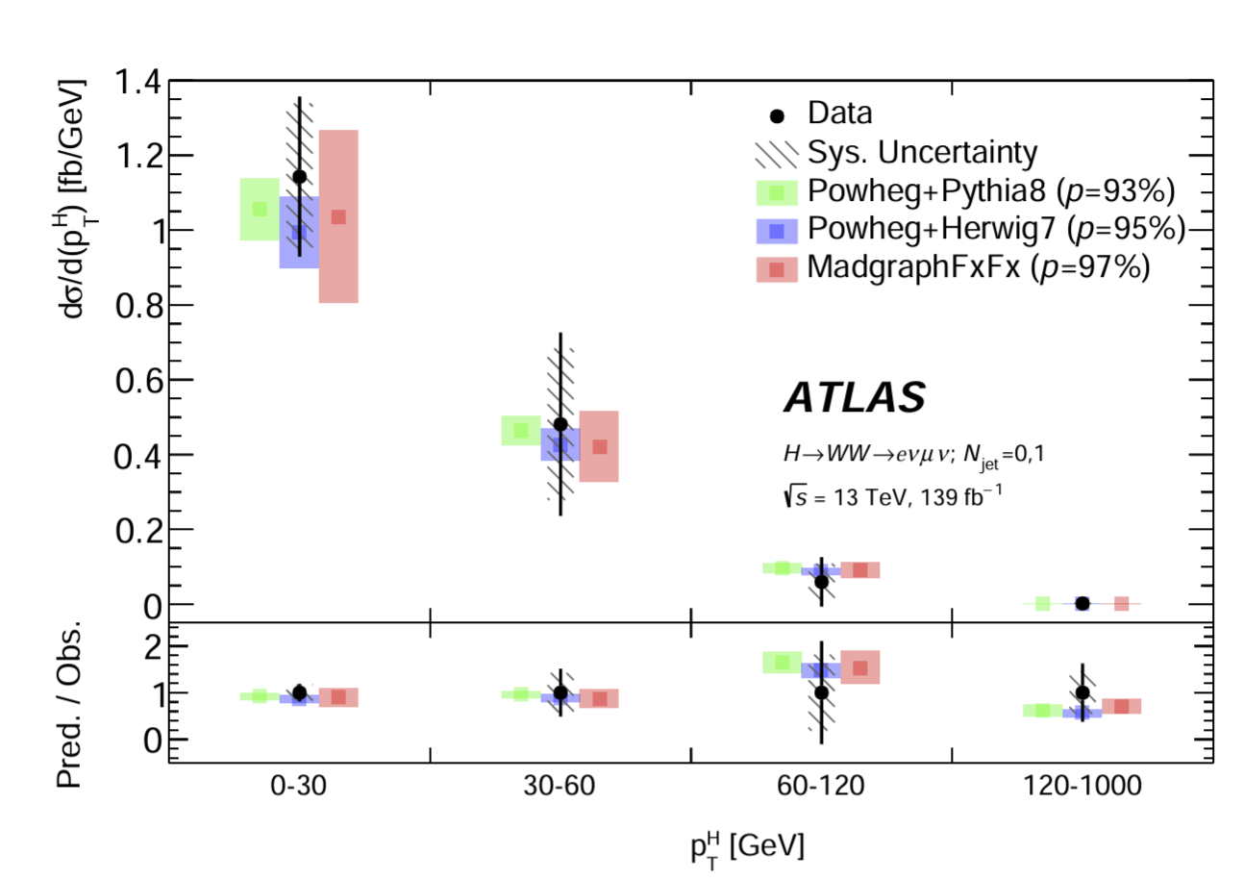

Higgs boson $p_{T}$ distribution measurement
produce an even more accurate calculation within
the SM.
ATLAS 2301.06822
ATLAS 2207.08615

Slide 9
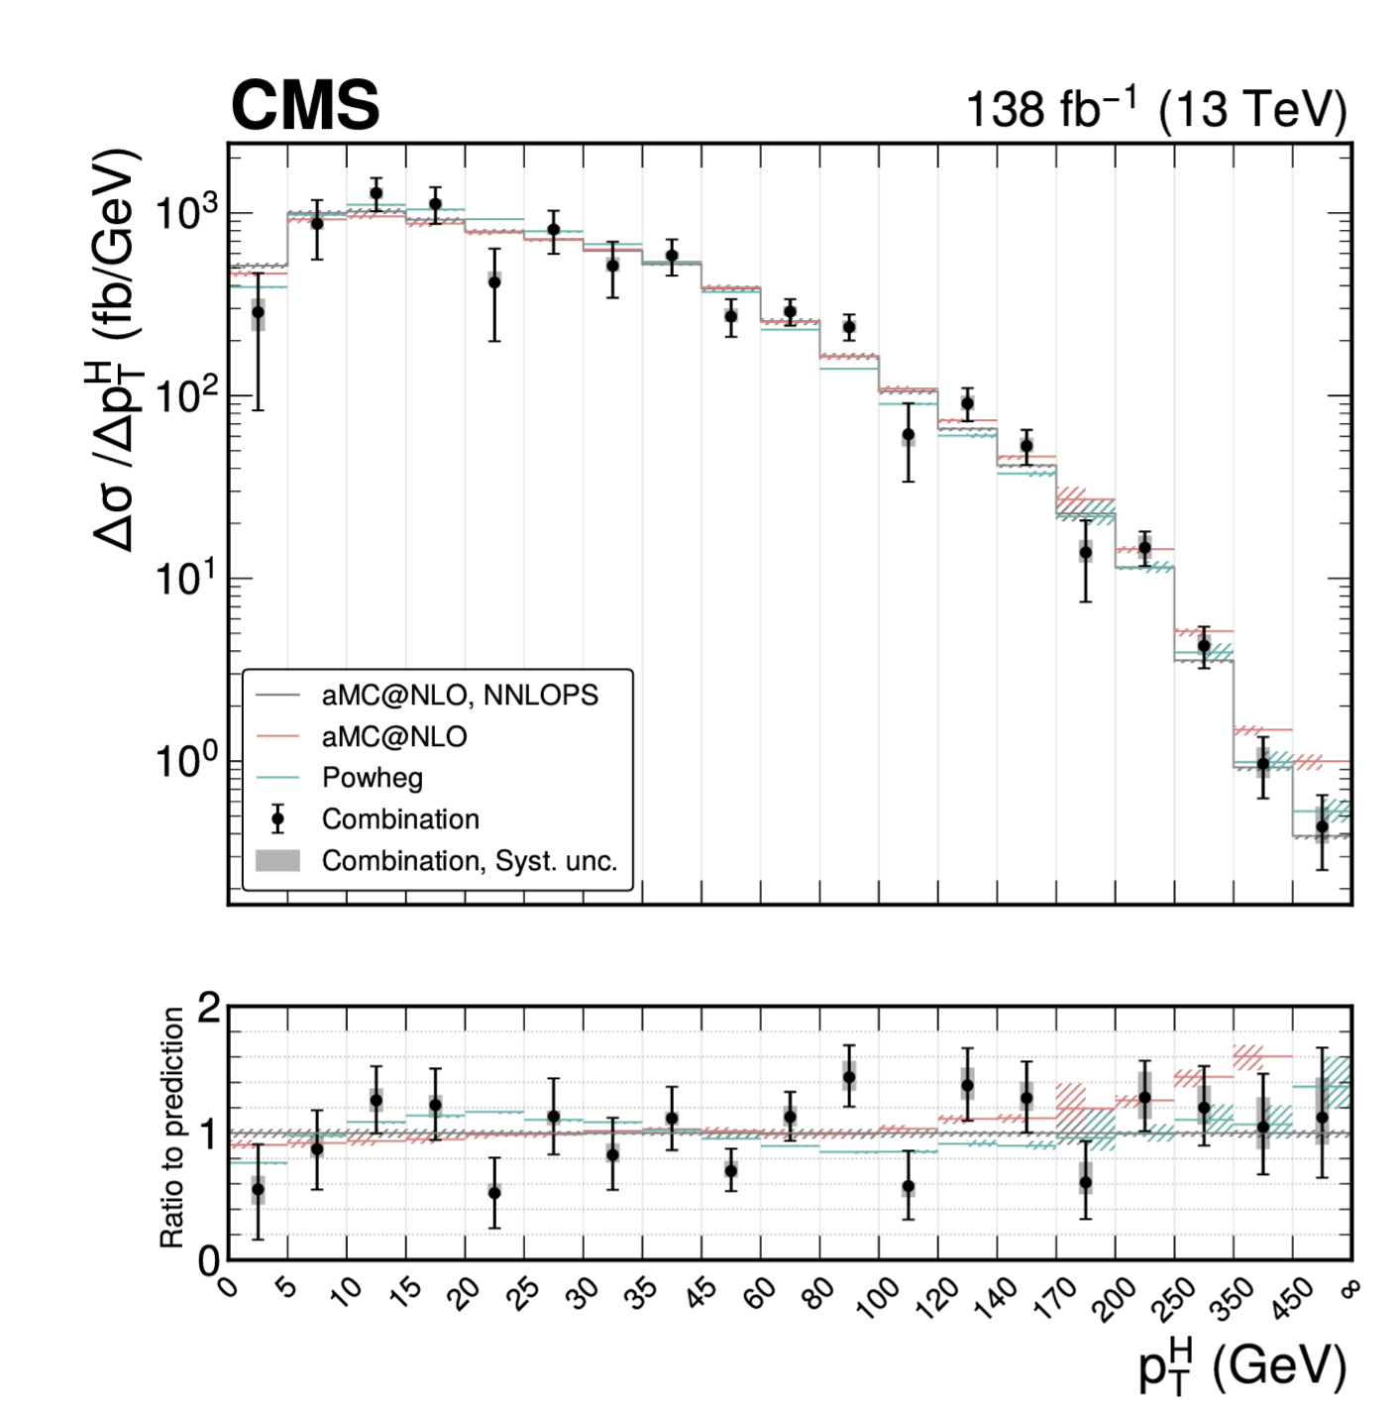
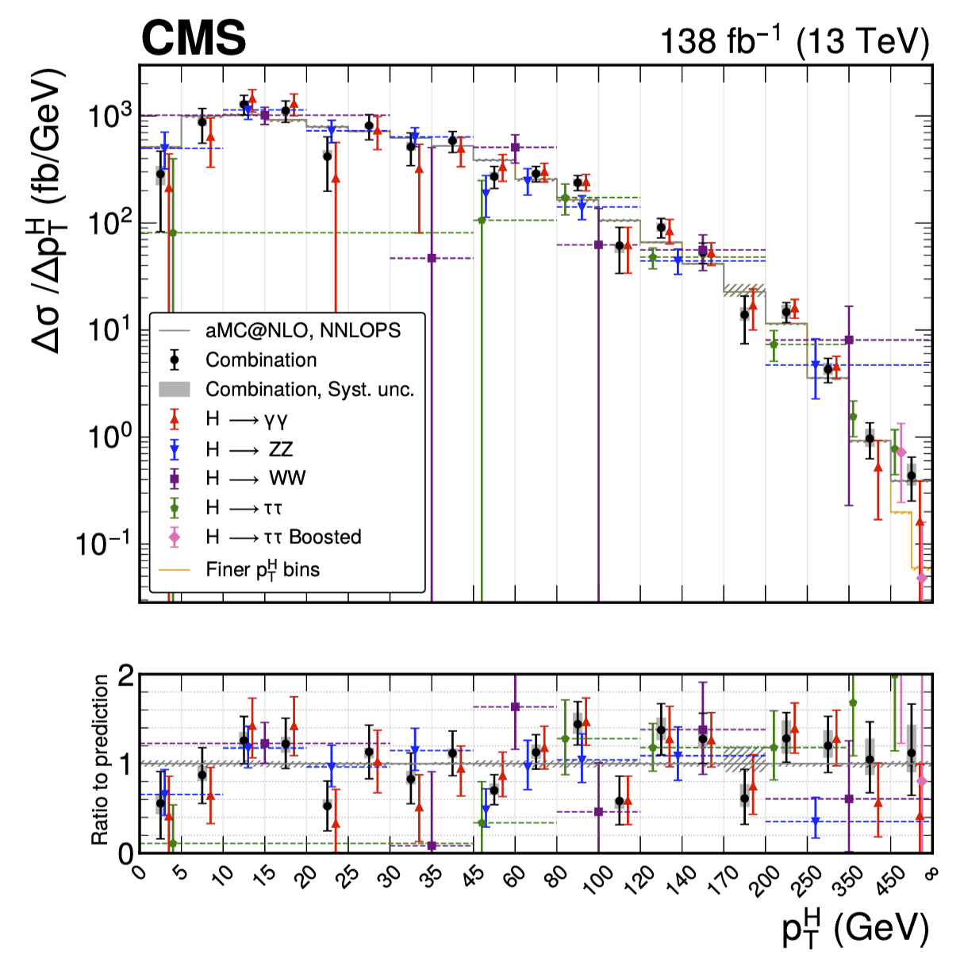

Higgs boson $p_{T}$ distribution measurement
produce an even more accurate calculation within
the SM.
CMS 2504.13081

Slide 10
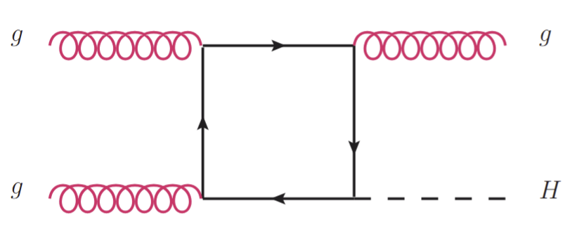
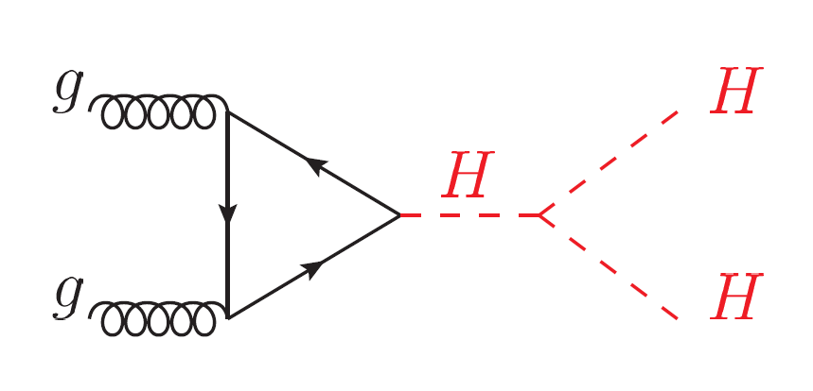
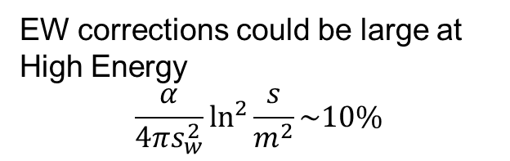
Status of Higgs+jet production perturbative calculation
NLO QCD with full top mass dependence,
Jones et al. 1802.00349, Chen et al. 2110,06953, Bonciani et al. 2206.10490.
NNLO QCD (Heavy top limit)
Boughezal et al. 1302.6216, Chen et al. 1408.5325
Boughezal et al. 1504.07922, Chen et al. 1607.08817
NLO EW (Heavy top limit / Light quark contribution/Trilinear self-coupling)
Bonetti et al. 2007.09813, Gao et al. 2302.04160,
Davis et al. 2007.09813, Haisch et al. 2007.09813.
Resummation
Huang et al. 1406.2591, Becher et al. 1407.4111.
produce an even more accurate calculation within
the SM.
EW corrections for Higgs pair production
Bi et al. 2311.16963,
Li et al. 2407.14716.
EW corrections could be large at High Energy
$$\frac{α}{4πs_{w}^{2}}\ln^{2}{\frac{s}{m^{2}}\sim 10\%}$$

Slide 11
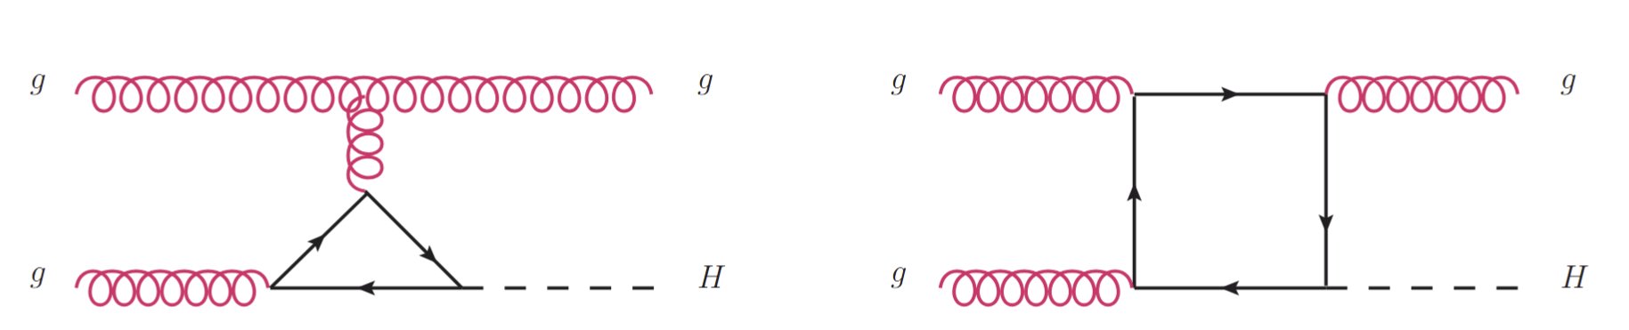
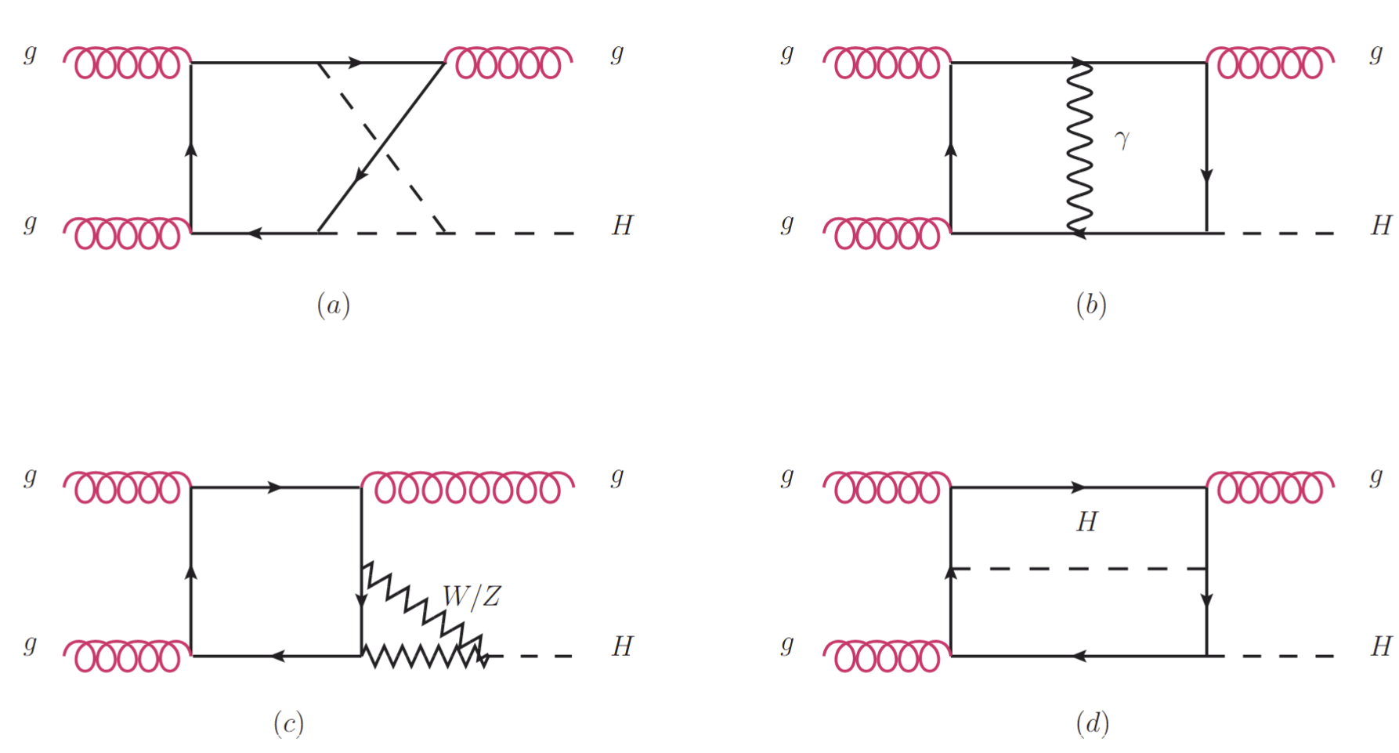
Leading-Order
12 Feynman Diagrams
produce an even more accurate calculation within
the SM.
Next-to-Leading-Order EW
1416 Feynman Diagrams

Slide 12
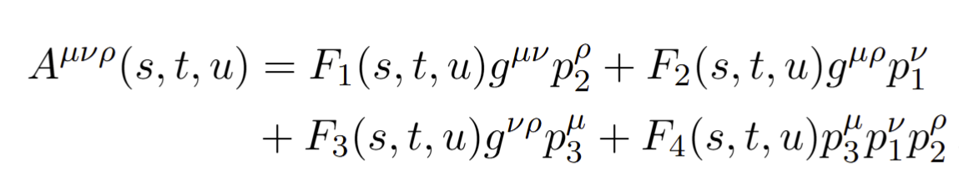

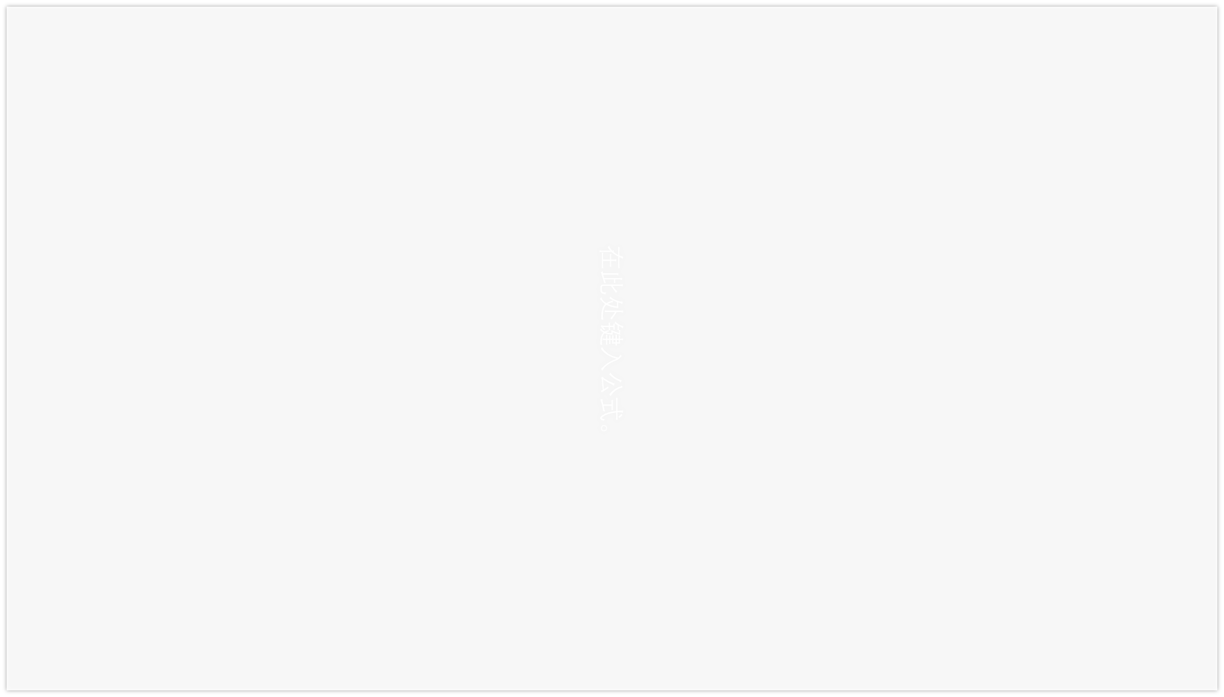
Calculation Framework
$$g\left(p_{1}\right)g\left(p_{2}\right)→g\left(p_{3}\right)H(p_{4})$$
produce an even more accurate calculation within
the SM.
Amplitude Structure $M^{abc}=f^{abc}ε_{1,μ}ε_{2,ν}ε_{3,ρ}^{∗}$
FeynCalc/FormLink
Fire&Kira
&Blade
Feynarts
DEs
EW-Renormalization

Slide 13
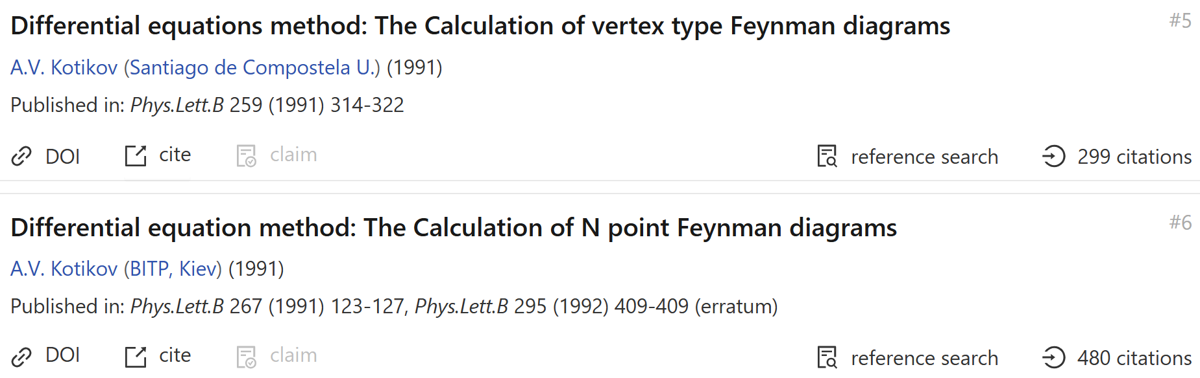
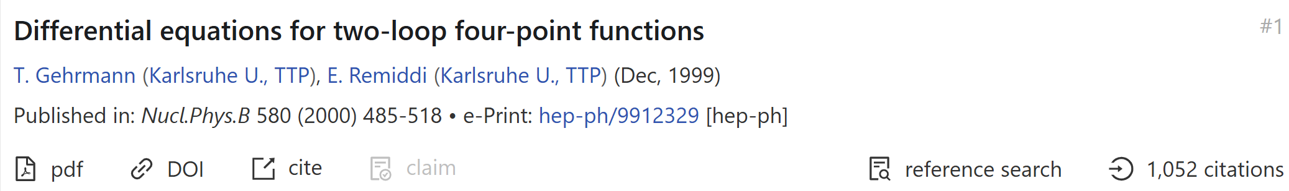
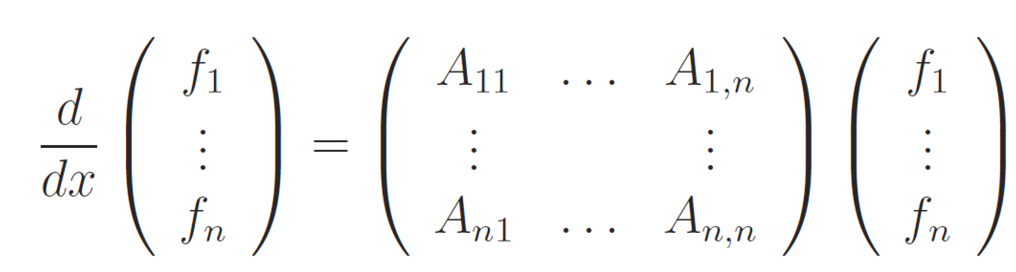
Method of Differential Equations
$f_{i}:$master integrals, x:Lorentz invariant kinematics

Slide 14
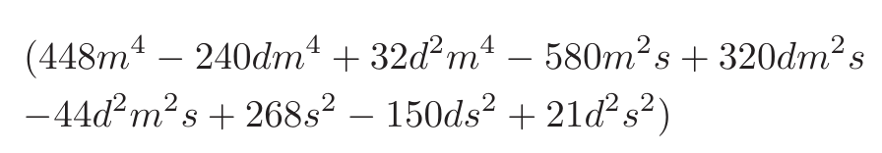
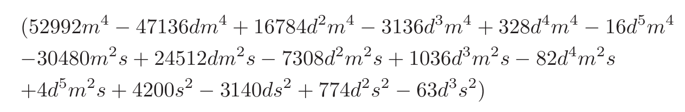
Choosing Good Basis
Bad Denominator could appear in the IBP reduction
Improvement
Develop a method to search good basis more efficient
Construct good basis for all 108 families
Derive More simple DEs
AMFLOW to Calculate boundary conditions
Solving DEs numerically at all phase space points
produce an even more accurate calculation within
the SM.
Slow down the IBP reduction, results in more complicate DEs.
Good Basis: basis whose IBP coefficients without bad denominators .
A.V. Smirnov, V.A. Smirnov, 2002.08042
Johann Usovitsch, 2002.08173

Slide 15
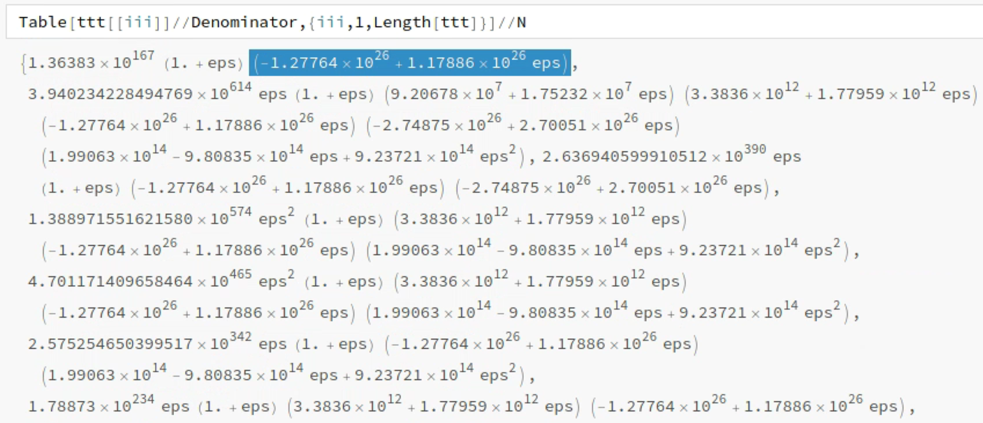
Choosing Good Basis More Efficient
Assign values (some big primes) to the variables (s, t, mt, mw, mh, mz)
Reduction Time: Only a few minutes
produce an even more accurate calculation within
the SM.
Select Out Bad Denominators
Obtain good basis for all 108 families

Slide 16
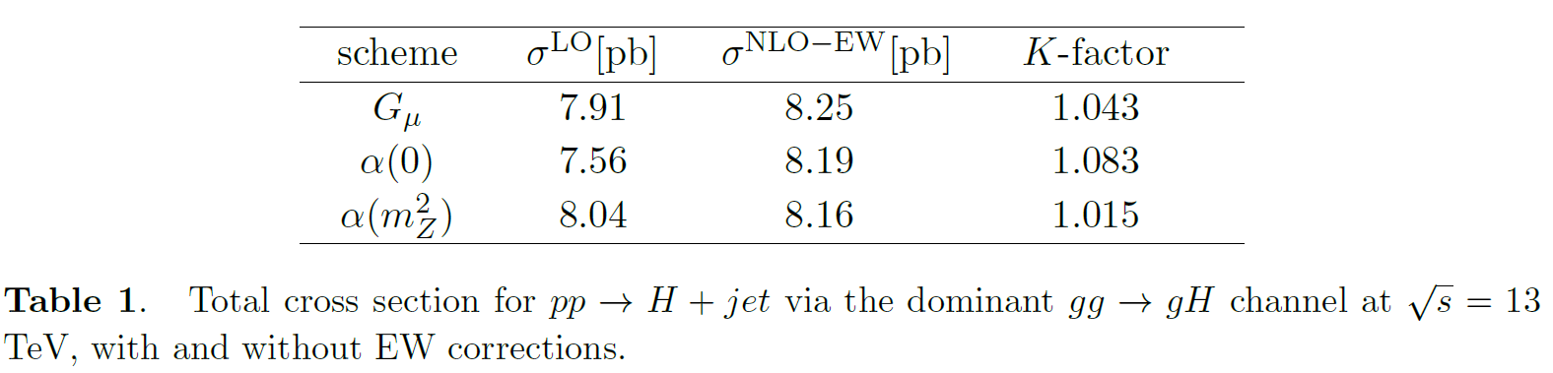
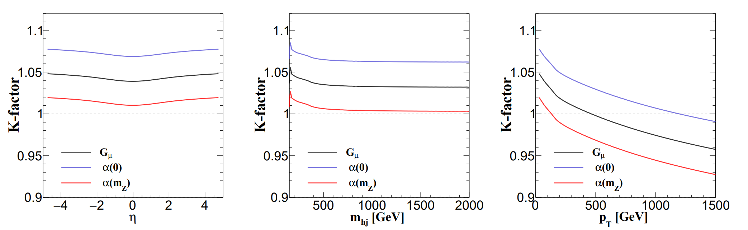
Results
produce an even more accurate calculation within
the SM.

Slide 17
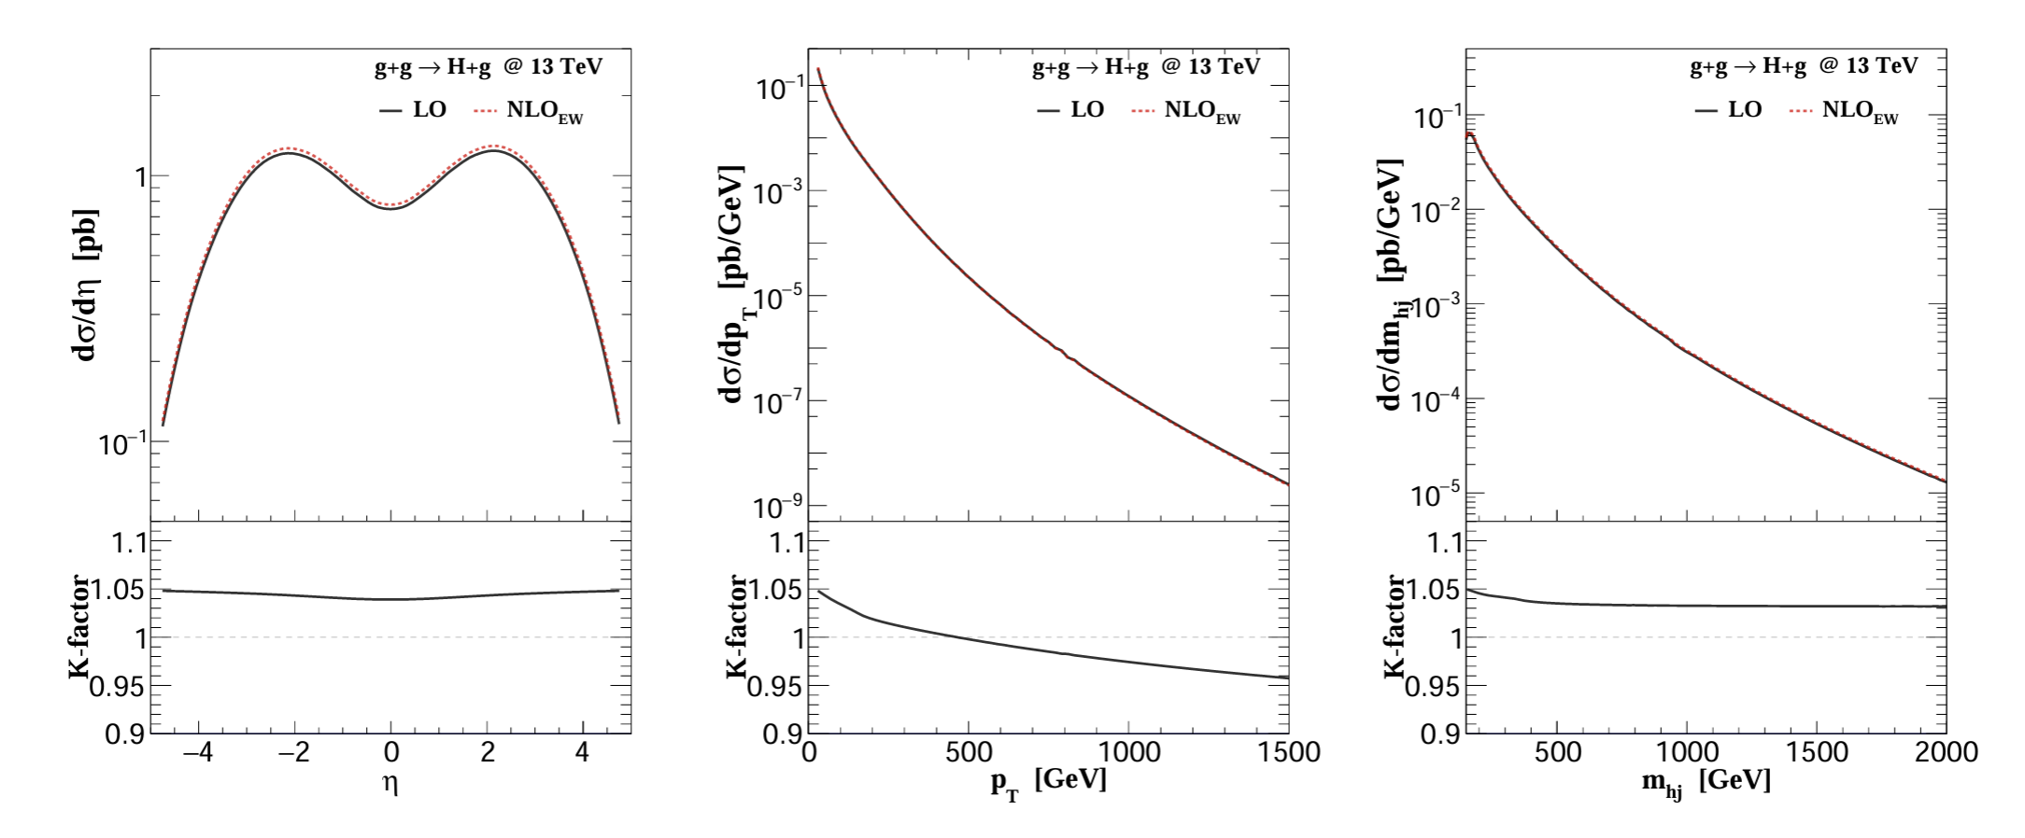
Results
produce an even more accurate calculation within
the SM.
Differential cross section with and without NLO EW corrections in Gµ scheme.

Slide 18
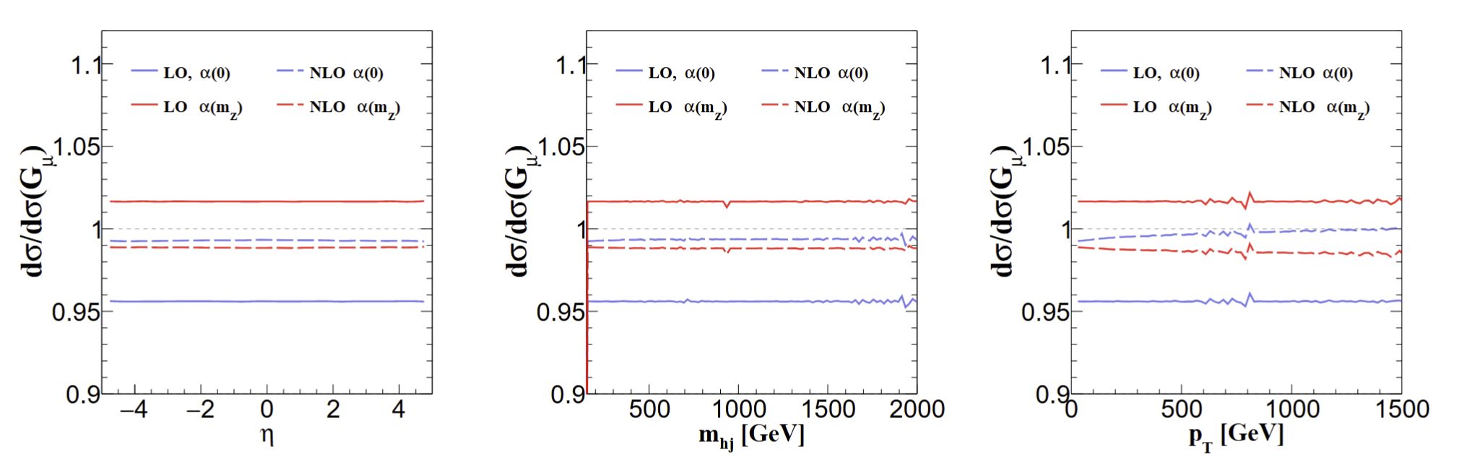
Significantly reduce the theoretical uncertainty
produce an even more accurate calculation within
the SM.
EW corrections bringing the theoretical uncertainty under much tighter control.
Agree with:
Bi, Ma, Mu, 2508.02588

Slide 19
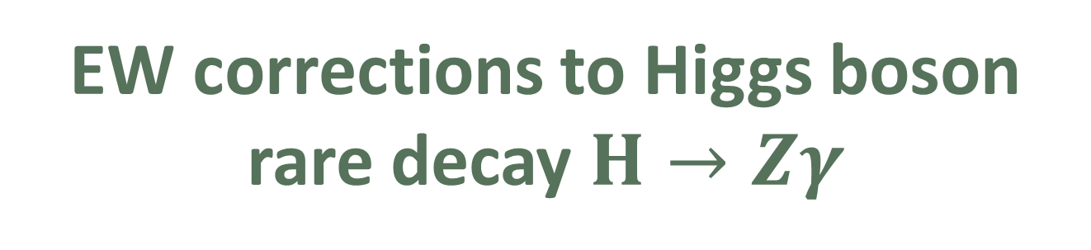
03
毕业论文答辩
EW corrections to Higgs boson rare decay $H→Zγ$
答辩人：小不点 答辩时间：5.5 指导老师：大不点
With: Zi-qiang Chen, Cong-Feng Qiao, Ruilin Zhu, PRD 110, L051301(2024)

Slide 20
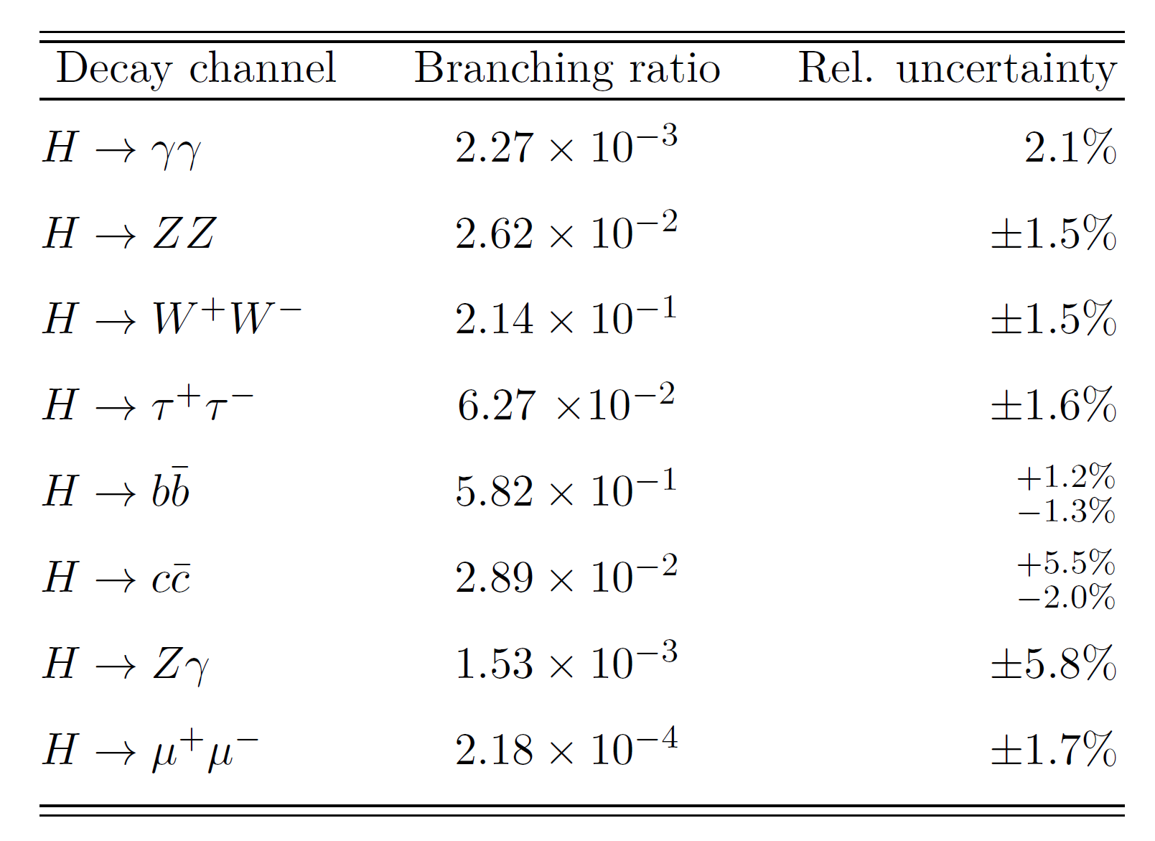
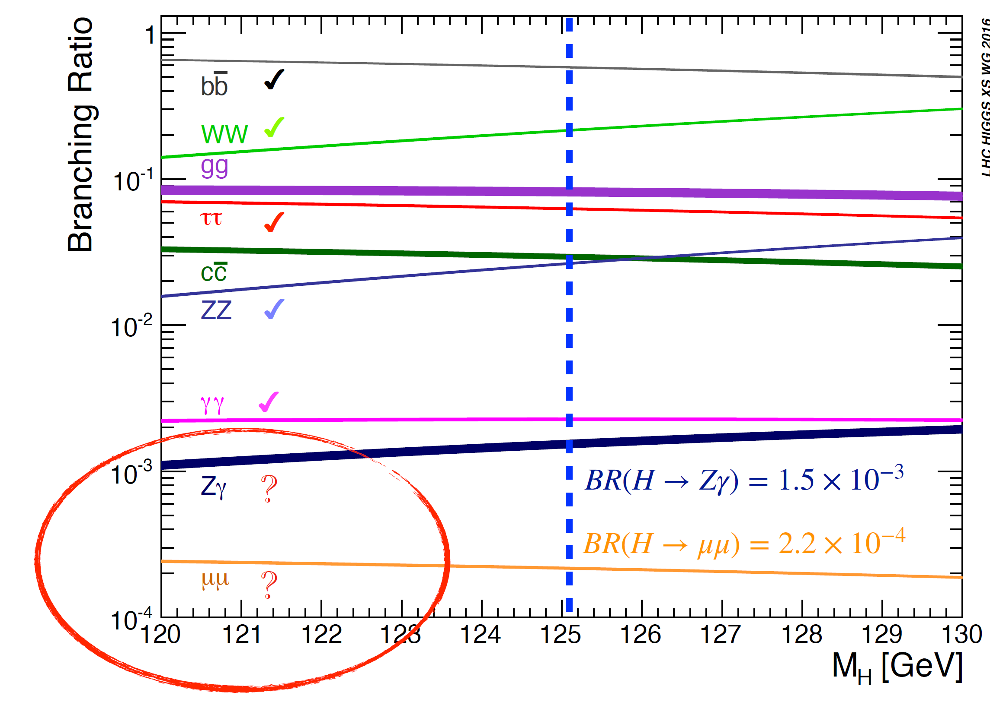
Decay Channels of Higgs boson
毕业论文答辩
答辩人：小不点 答辩时间：5.5 指导老师：大不点
New particles of heavy masses M can generate a difference between the SM prediction and the measured value of the couplings, but this will be proportional to $\frac{m_{h}^{2}}{M^{2}}$.

Slide 21
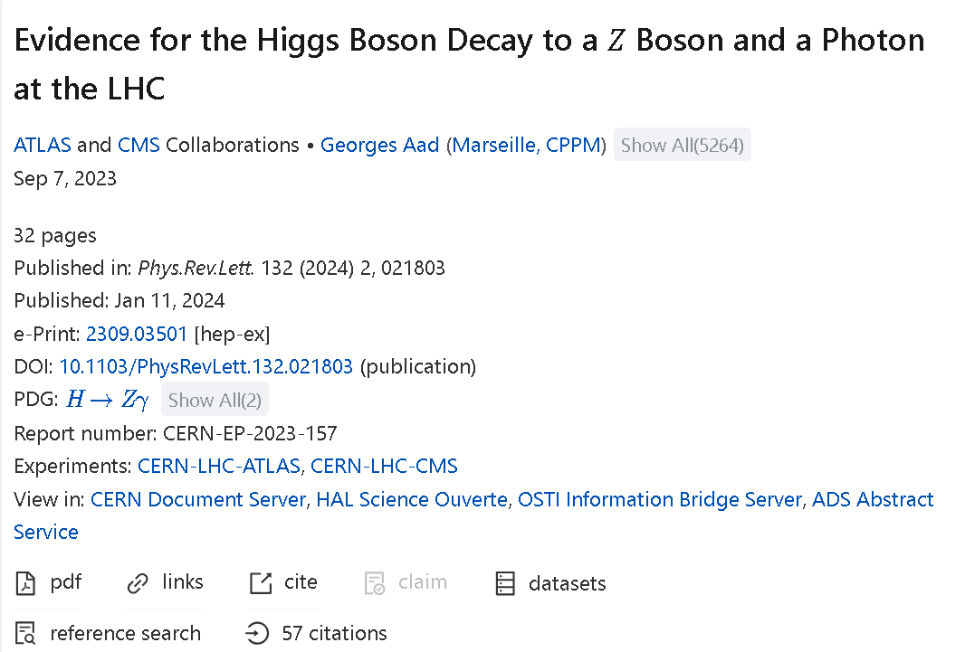

Experimental evidence
3.4 $σ$
Evidence (2309.03501) obtained from a combination of ATLAS (2005.05382) and CMS (2204.12945).
Previous searches: 1806.05996, 1402.3051, 1307.5515, 0806.0611 ...
毕业论文答辩
答辩人：小不点 答辩时间：5.5 指导老师：大不点
ATLAS and CMS, PRL 132 (2024) 021803 [2309.03501]

Slide 22
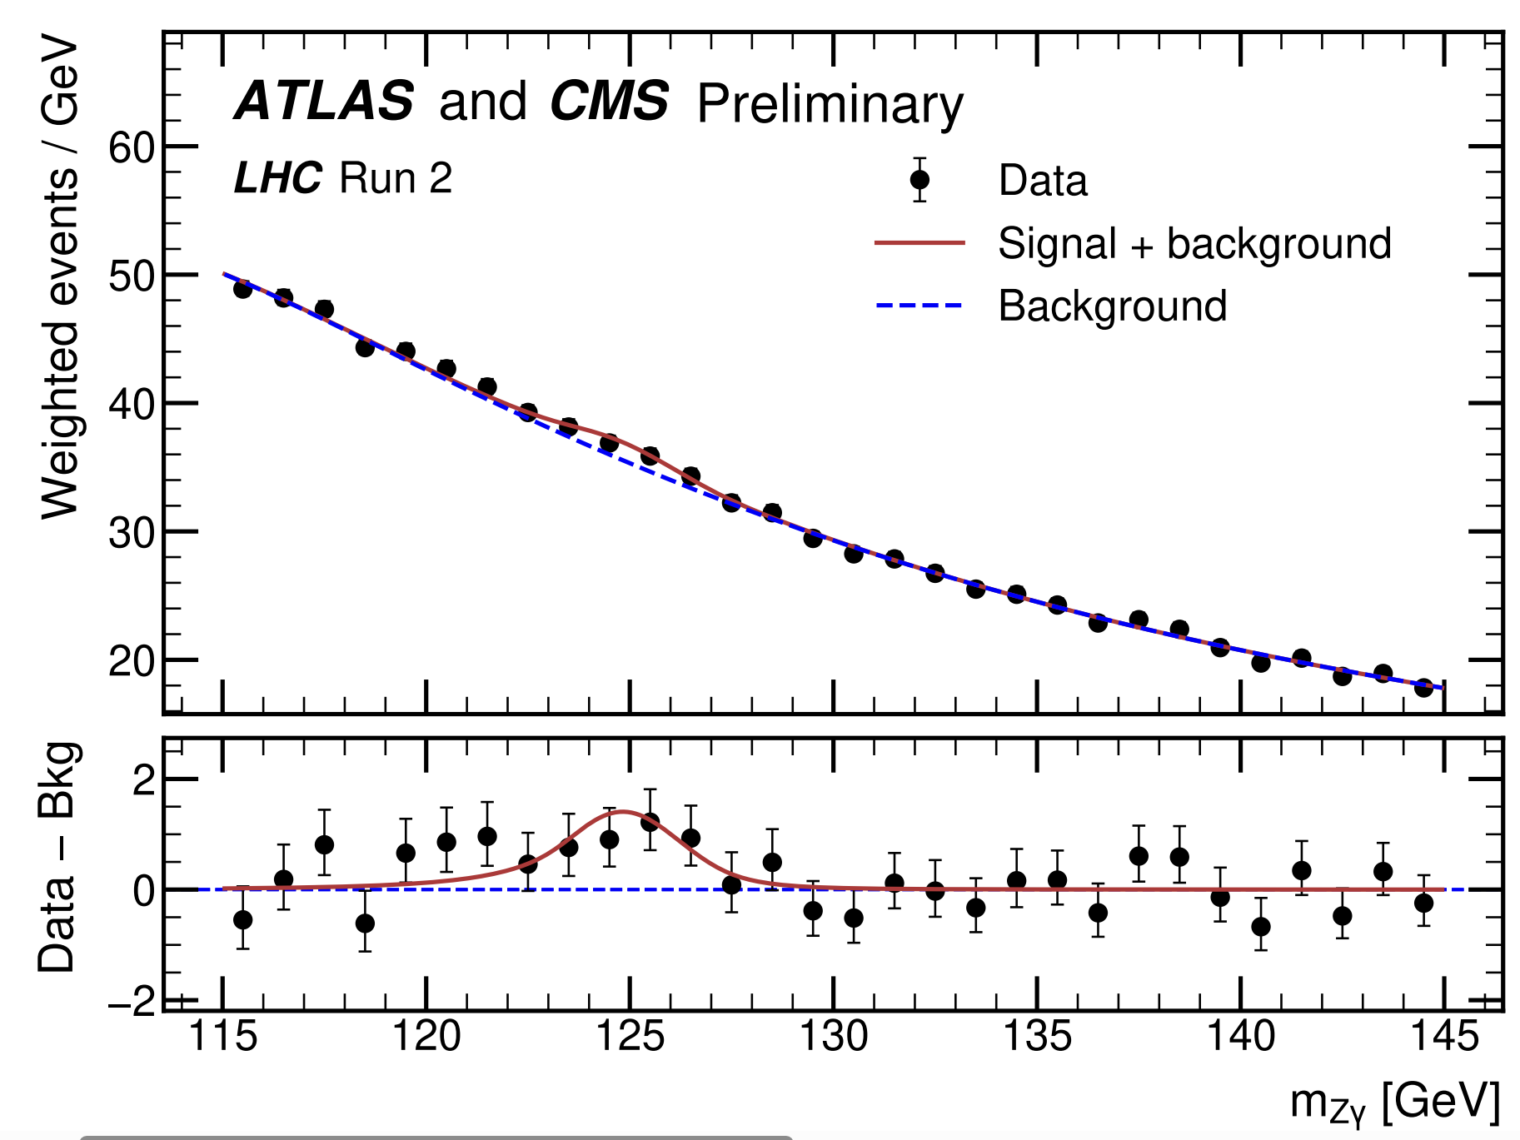


Experimental evidence
Branching Ratio:
$(3.4±1.1)×{10}^{−3}$
Signal Strength:
$μ=2.2±0.7$
produce an even more accurate calculation within
the SM.
$$(μ=σ_{exp}/σ_{SM})$$
Motivation: Provide SM prediction as precise as possible.
ATLAS and CMS, PRL 132 (2024) 021803 [2309.03501]

Slide 23
Previous calculations
Leading order:
J.R. Ellis, M. K. Gaillard, D. V. Nanopoulos, Nucl. Phys. B 106 (1976) 292
R.N. Cahn, M. S. Chanowitz, N. Fleishon, Phys. Lett. B 82 (1979) 113-116
QCD corrections:
M. Spira, A. Djouadi, P. M. Zerwas, Phys. Lett. B 276 (1992) 350-353
T. Gehrmann, S. Guns, D. Kara, JHEP 09 (2015) 038 [1505.00561]
R. Bonciani, V. D. Duca, et al, JHEP 08 (2015) 108 [1505.00567]
Having found that the two-loop QCD corrections, which correct
the heavy–quark loop, equal about 0.22% of the leading order width, it is reasonable to
expect that the two-loop electroweak corrections, which correct the electroweak loop, will
yield a larger contribution
Numerical
Analytic
Analytic

Slide 24
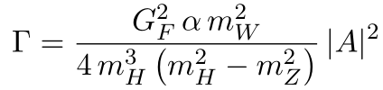



Why NLO EW?
The QCD corrections amount to 0.22% of the LO width. It is resonable to expect that the EW corrections will yield a larger contribution.
The theoretical uncertainty has not been fully discussed
1505.00561:
1505.00567:
Having found that the two-loop QCD corrections, which correct
the heavy–quark loop, equal about 0.22% of the leading order width, it is reasonable to
expect that the two-loop electroweak corrections, which correct the electroweak loop, will
yield a larger contribution
$$7.09 keV$$
$$6.68 keV$$

Slide 25
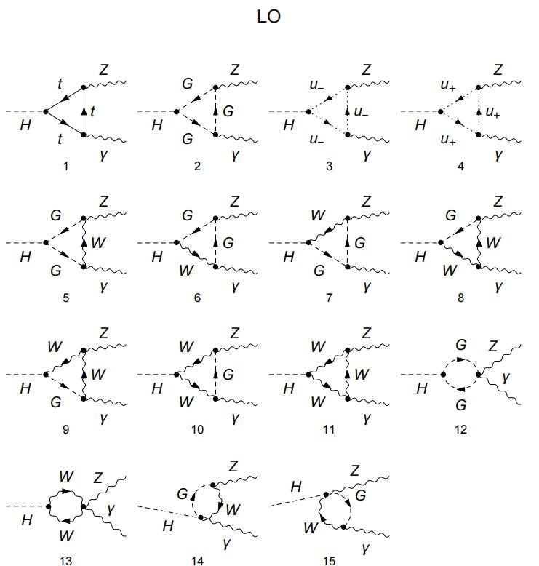
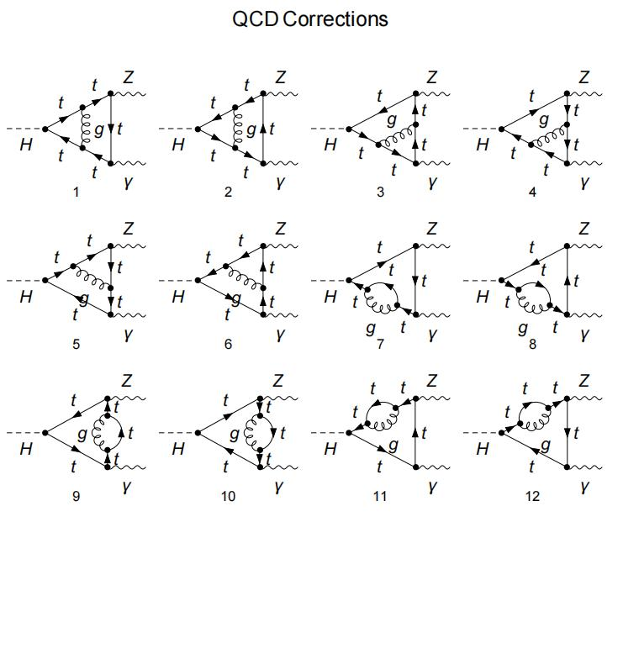

$${\left|Dia 1\right|}^{2}+intf. \sim −10\%$$
Why NLO EW?
The QCD corrections amount to 0.22% of the LO width. It is resonable to expect that the EW corrections will yield a larger contribution.
The theoretical uncertainty has not been fully discussed
1505.00561:
1505.00567:
Having found that the two-loop QCD corrections, which correct
the heavy–quark loop, equal about 0.22% of the leading order width, it is reasonable to
expect that the two-loop electroweak corrections, which correct the electroweak loop, will
yield a larger contribution
$$7.09 keV$$
$$6.68 keV$$

Slide 26
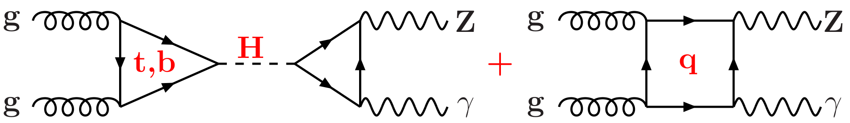
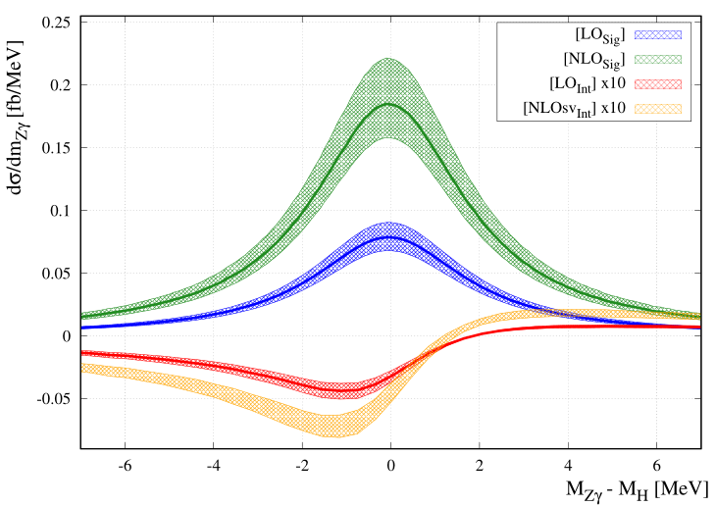
Previous work
Signal background interference: F. Buccioni, F. Devoto, A. Djouadi, et. al, Phys. Lett. B 851 (2024) 138596 [2312.12384]
Having found that the two-loop QCD corrections, which correct
the heavy–quark loop, equal about 0.22% of the leading order width, it is reasonable to
expect that the two-loop electroweak corrections, which correct the electroweak loop, will
yield a larger contribution
Interference effects (Higgs resonance & nonresonance) are small...

Slide 27
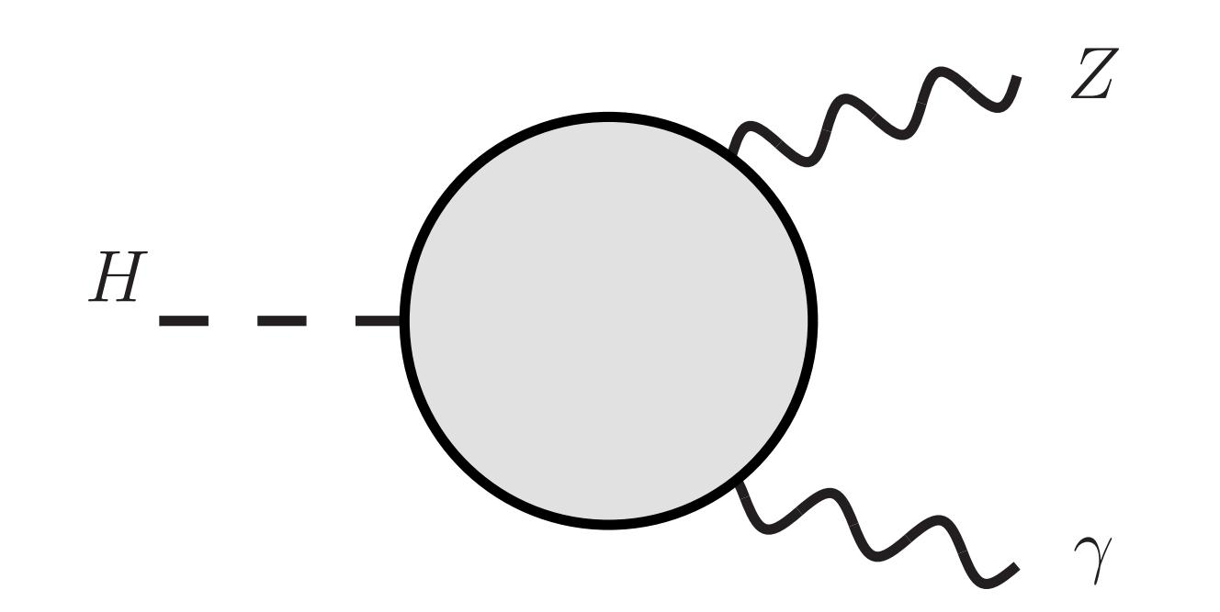
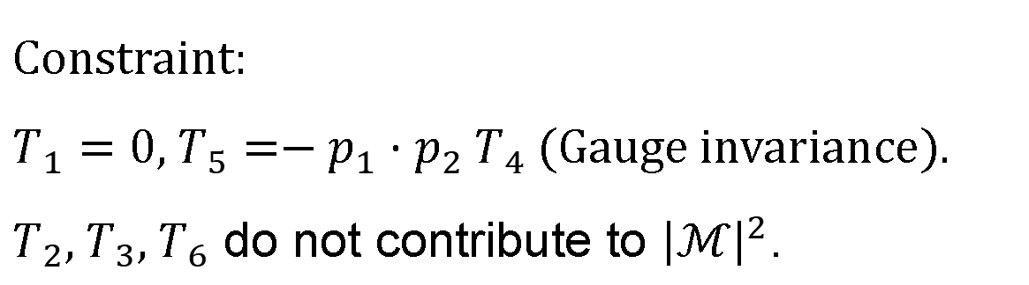

Lorentz structure
$H→Z(p_{1})γ(p_{2})$
$ℳ=T^{μν}ε_{μ}^{∗}(p_{1})ε_{ν}^{∗}(p_{2})$
毕业论文答辩
$$T^{μν}=T_{1}p_{1}^{μ}p_{1}^{ν}+T_{2}p_{2}^{μ}p_{2}^{ν}+T_{3}p_{1}^{μ}p_{2}^{ν}+T_{4}p_{2}^{μ}p_{1}^{ν}+T_{5}g^{μν}+T_{6}ε^{μνρσ}p_{1ρ}p_{2σ}$$
答辩人：小不点 答辩时间：5.5 指导老师：大不点
Constraint:
$T_{1}=0$, $T_{5}=−p_{1}⋅p_{2} T_{4}$ (Gauge invariance).
$T_{2}, T_{3}, T_{6}$ do not contribute to ${\left|ℳ\right|}^{2}$.

Slide 28
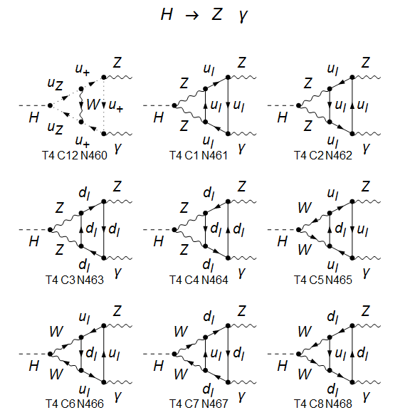
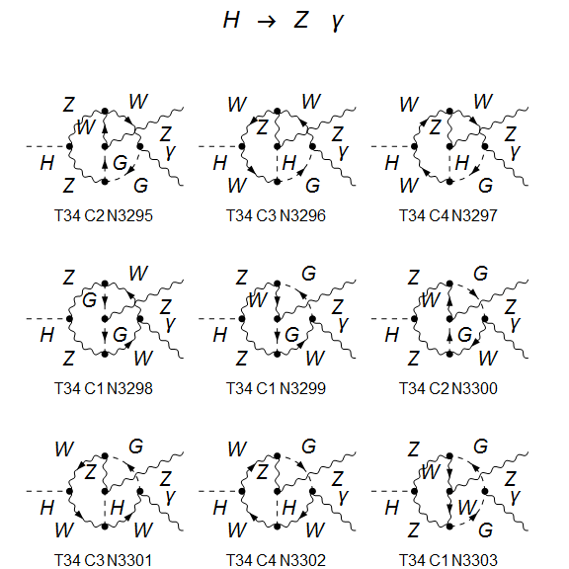
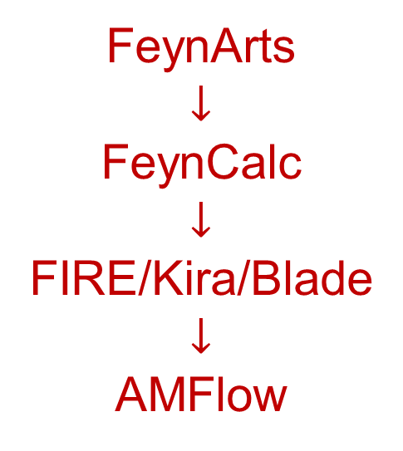
Calculation Framework
About 5000 Feynman diagrams (Feynman gauge)
FeynArts
$$↓$$
FeynCalc
$$↓$$
FIRE/Kira/Blade
$$↓$$
AMFlow

Slide 29
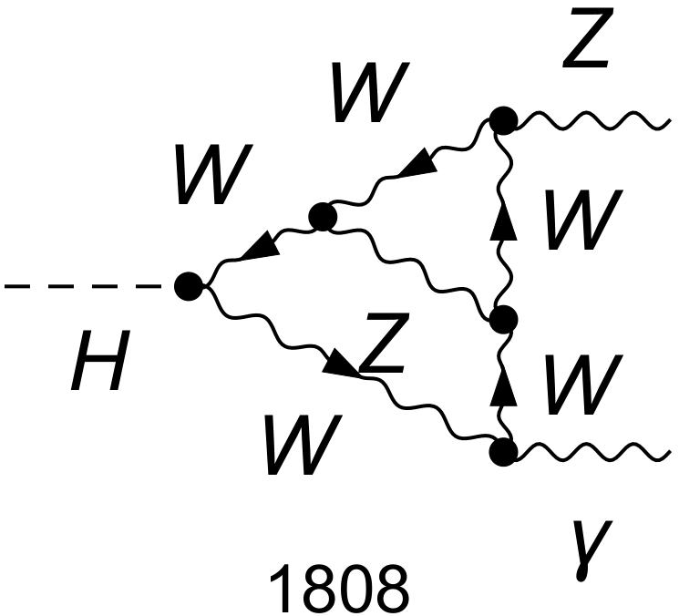


Electroweak coupling
Renomalization
Denner, arXiv:0709.1075
We work in the on-shell renormalization scheme.
Use five different electroweak coupling schemes:
$α(0)$ scheme: all to $α(0)$;
$α(M_{Z}^{2})$ scheme: all to $α(M_{Z}^{2})$;
$α_{G_{μ}}$ scheme: all to $α_{G_{μ}}$;
mixed 1: the one connecting to the external photon to $α(0)$, others to $α(M_{Z}^{2})$;
mixed 1: the one connecting to the external photon to $α(0)$, others to $α_{G_{μ}}$.
no $ln(m_{f})$ terms
毕业论文答辩
答辩人：小不点 答辩时间：5.5 指导老师：大不点

Slide 30



Numerical results
毕业论文答辩
答辩人：小不点 答辩时间：5.5 指导老师：大不点
$Γ^{LO}={6.364}_{−0.444}^{+0.909} keV$, $Γ_{EW}^{NLO}={6.316}_{−0.082}^{+0.027} keV$.
Agree with:
Sang, Feng, Jia, 2405.03464

Slide 31

Numerical results
The EW corrections
more significant than the QCD corrections
greatly suppress the theoretical uncertainty
毕业论文答辩
答辩人：小不点 答辩时间：5.5 指导老师：大不点
$Γ^{LO}={6.364}_{−0.444}^{+0.909} keV$, $Γ_{EW}^{NLO}={6.316}_{−0.082}^{+0.027} keV$.

Slide 32

Numerical results
Combining EW, QCD, $b$-mass corrections: $Γ^{H→Zγ}={6.348}_{−0.085}^{+0.028} keV$
Branching ratio (with SM total width):
毕业论文答辩
答辩人：小不点 答辩时间：5.5 指导老师：大不点

Slide 33
Numerical results
Combining EW, QCD, $b$-mass corrections: $Γ^{H→Zγ}={6.348}_{−0.085}^{+0.028} keV$
Branching ratio (with SM total width):
毕业论文答辩
The EW corrections exacerbate the tension.
答辩人：小不点 答辩时间：5.5 指导老师：大不点

Slide 34

https://indico.cern.ch/event/1567538/
毕业论文答辩
答辩人：小不点 答辩时间：5.5 指导老师：大不点

Slide 35



Recent experiment results
Run 3
毕业论文答辩
Run 2+Run3
答辩人：小不点 答辩时间：5.5 指导老师：大不点
Agree with SM prediction.
ATLAS arXiv: 2507.12598

Slide 36

Conclusion and Outlook
Electroweak corrections are non-negligible for the precise testing of the SM and the search for new physics.
For gg->Hg production, EW corrections amount to a few percent enhancement of the total cross section, with a value of approximately 4.3% in the $G_{μ}$scheme. The differential distributions reveal non-trivial kinematic dependence.
We calculate NLO electroweak corrections to $H→Z γ$, obtain most precise prediction for this channel. The SM prediction agree with the most recent measurement.
毕业论文答辩
答辩人：小不点 答辩时间：5.5 指导老师：大不点

Slide 37


毕业论文答辩
Thank You！
答辩人：小不点 答辩时间：5.5 指导老师：大不点

