Slide 1


基于电荷交换反应测量Gamow-Teller跃迁强度
高丙水
中国科学院近代物理研究所
第二届原子核从头计算与贝塔衰变前沿研讨会
Jan. 10 – 12, 2026, 重庆

Slide 2
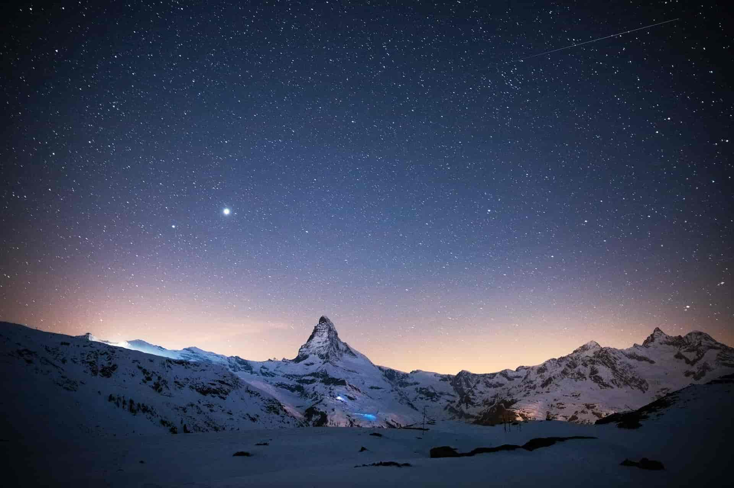
01
Introduction to charge-exchange reactions
CONTENTS
02
Isospin mixing
03
Double beta decay
04
Excited state beta decay
05
Summary

Slide 3
01
Introduction to charge-exchange reactions
CONTENTS
02
Isospin mixing
03
Double beta decay
04
Excited state beta decay
05
Summary

Slide 4
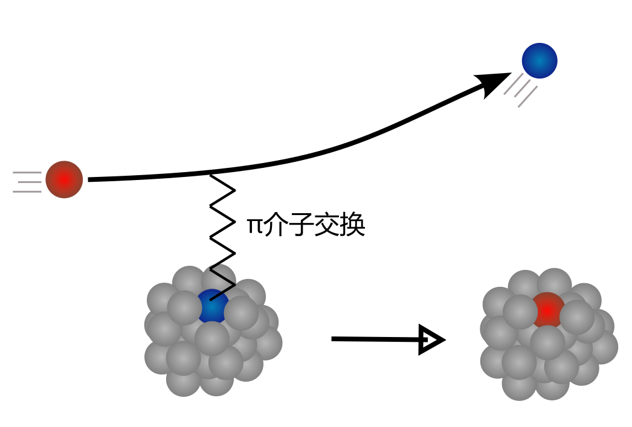

(Hadronic) Charge-exchange reaction
E ≥ 100 MeV/u
one/two pion exchange
4/20

Slide 5
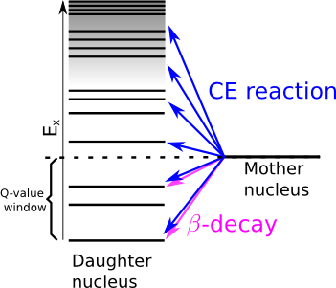
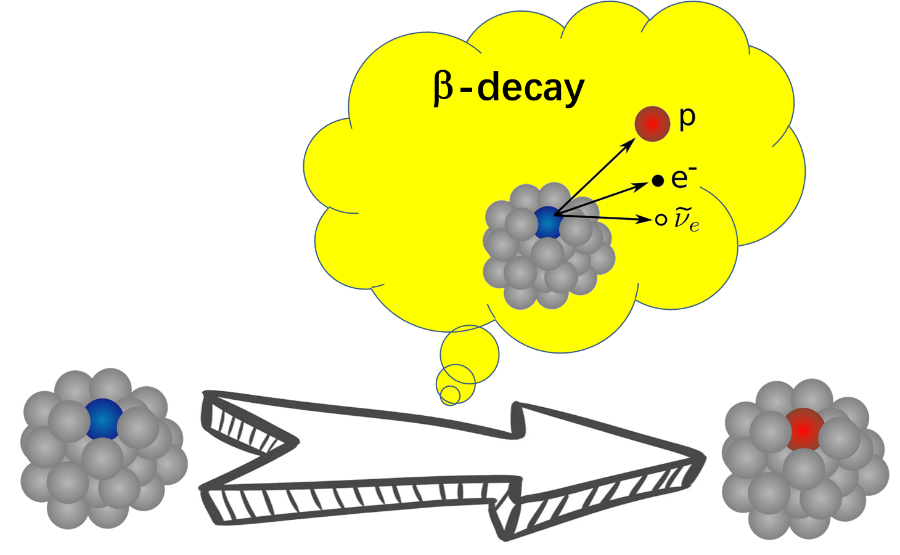
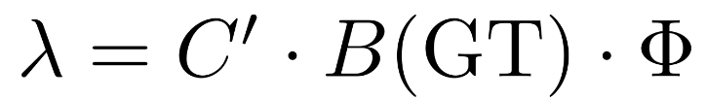

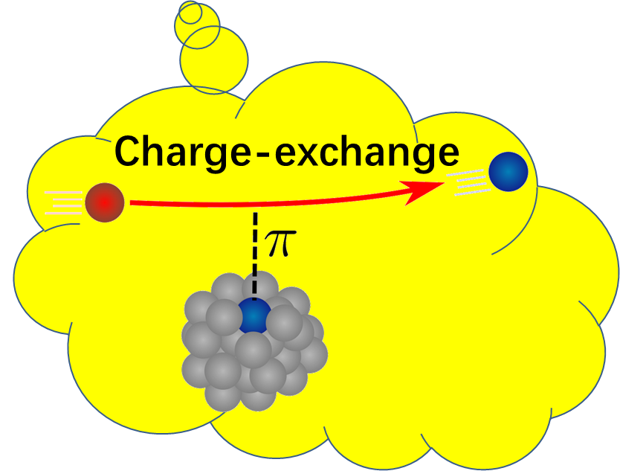
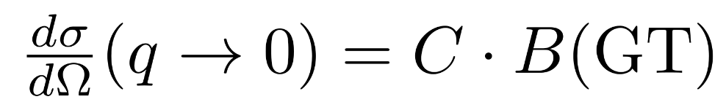
(Hadronic) Charge-exchange reaction
Both charge-exchange reaction and beta-decay measurements provide information of B(GT),
but charge-exchange reaction is not limited by the Q-value window.
Ex
Charge-Ex
Nuclear transition
Q-value
window
β-decay
5/20

Slide 6
01
Introduction to charge-exchange reactions
CONTENTS
02
Isospin mixing
03
Double beta decay
04
Excited state beta decay
05
Summary

Slide 7
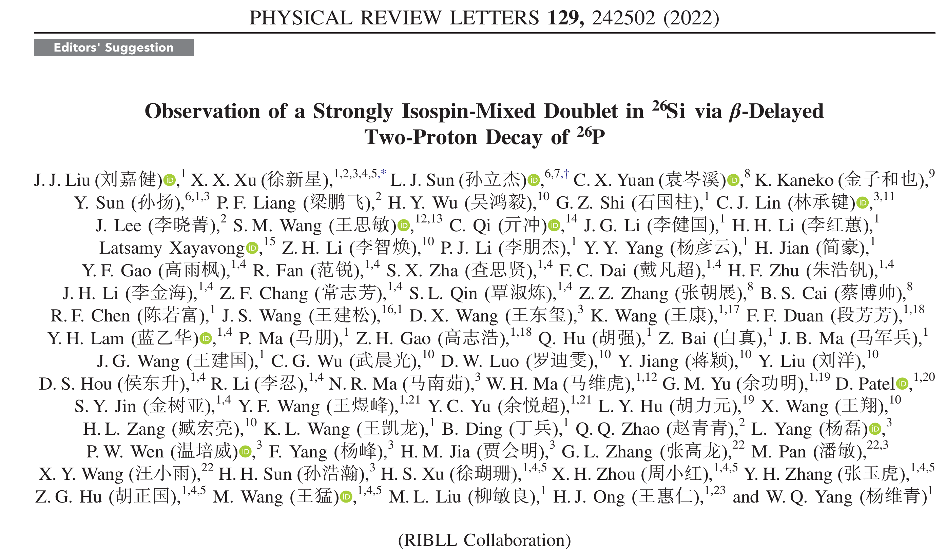
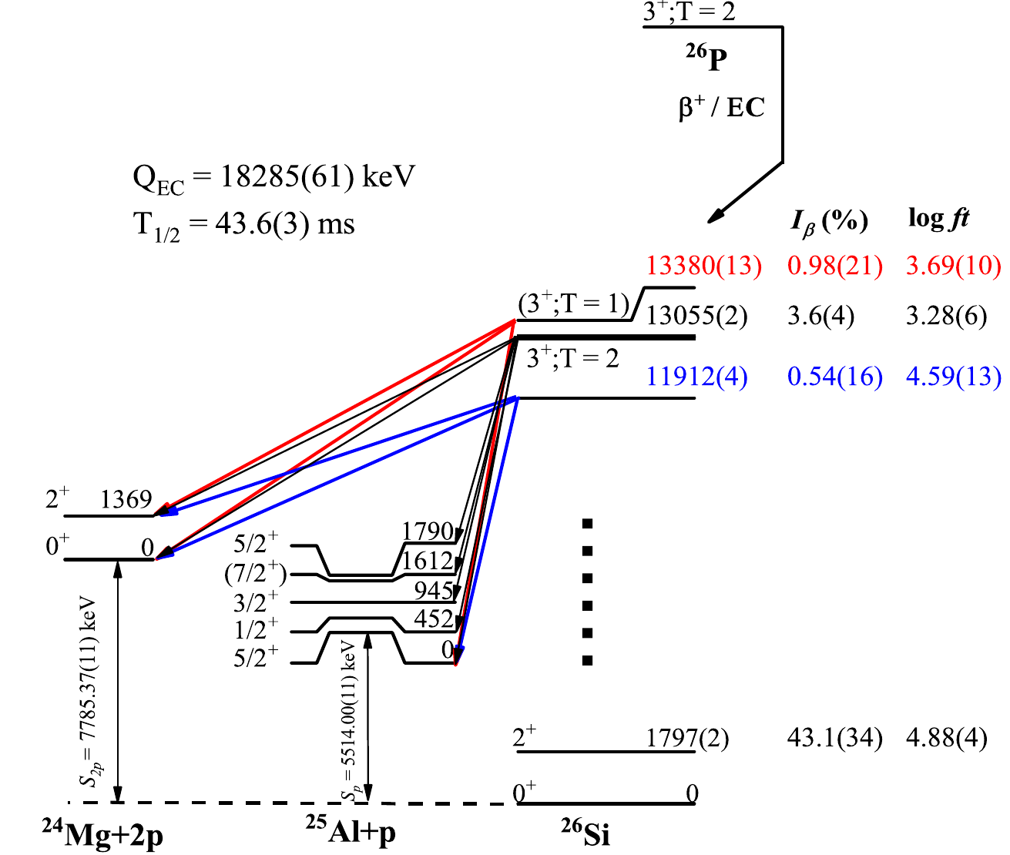
7/20

Slide 8

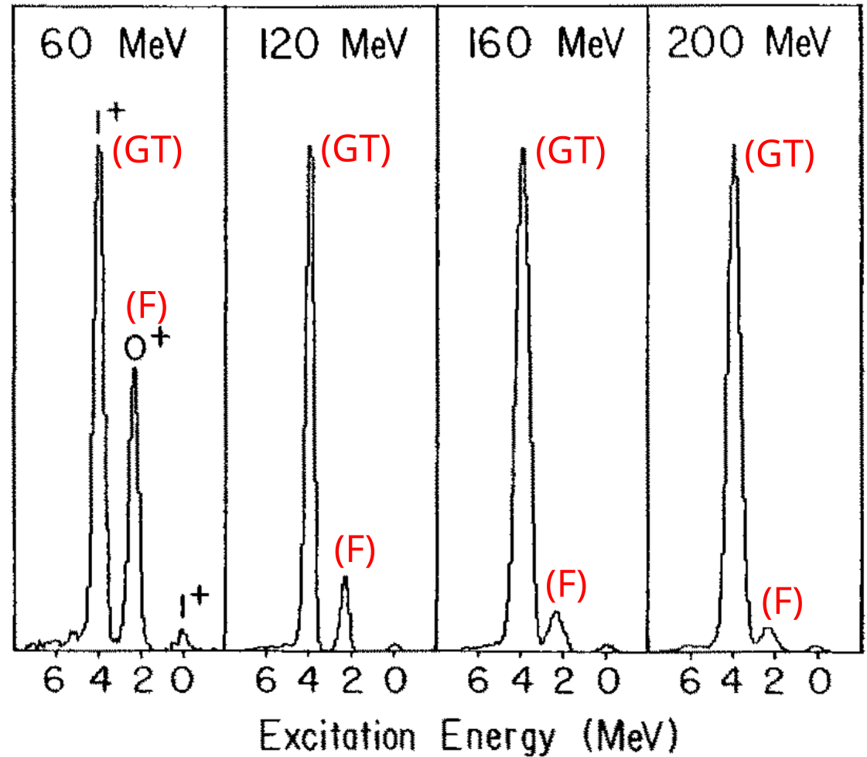
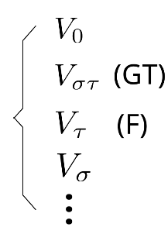
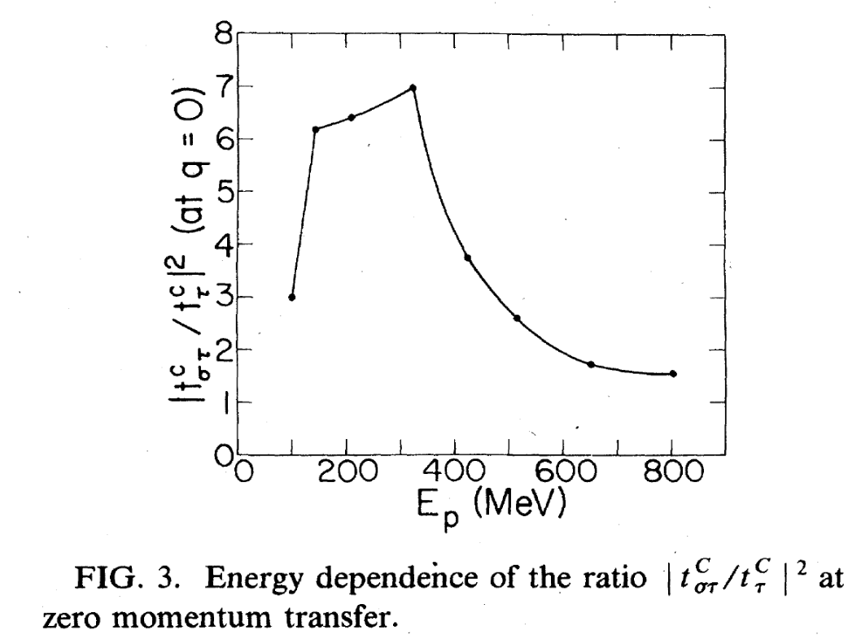
π介子交换势中的V_{στ}和V_{τ}相互作用强度随入射能量变化趋势不同，可用来区分Fermi跃迁和GT跃迁。
T.N. TADDEUCCI, NPA 469, 125 (1987)
Love&Franey, PRC 24, 1073 (1981)
8/20

Slide 9
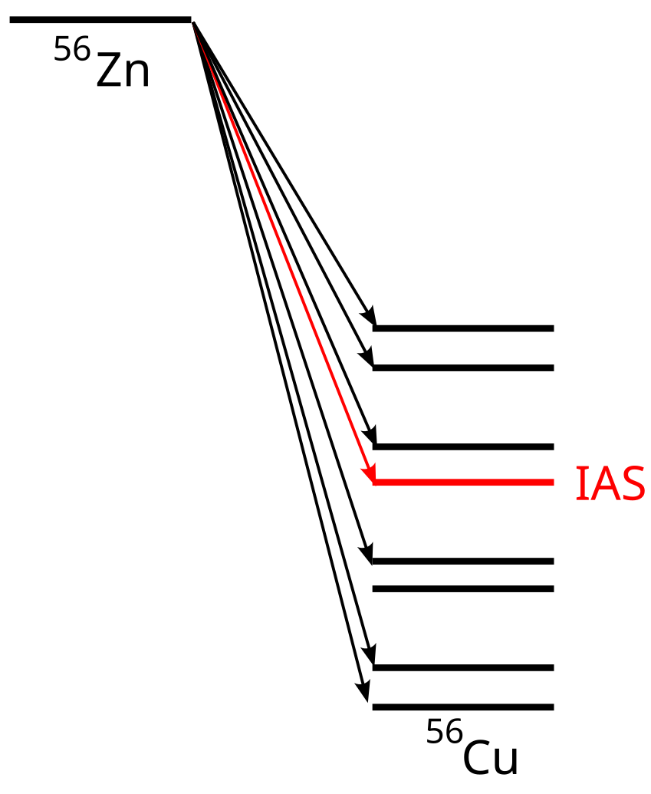
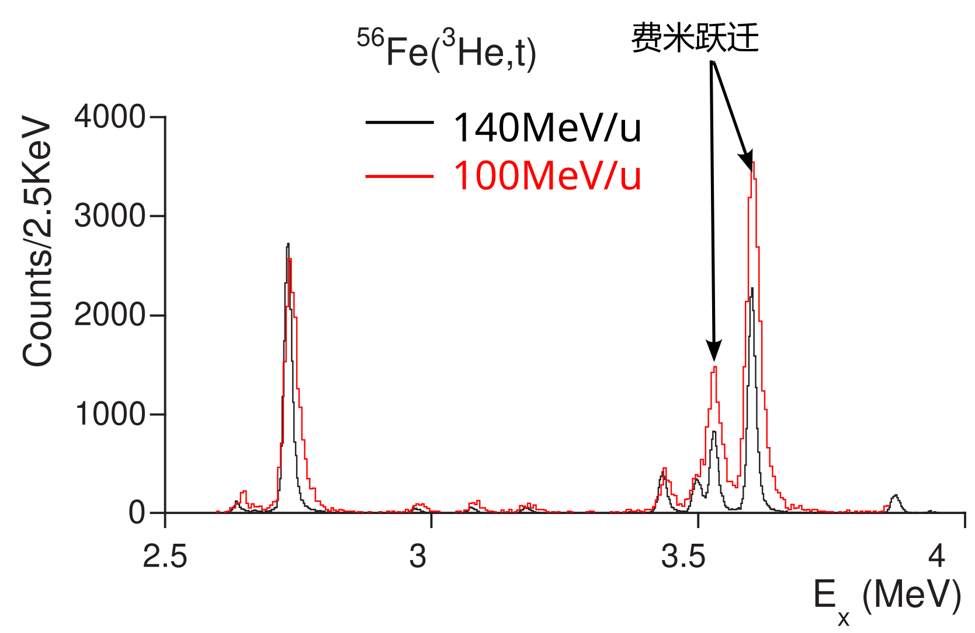
⁵⁶Co
GT
贝塔衰变难以直接指认跃迁类型(GT/F)，但可通过电荷交换反应清晰辨认
Fujita et al., PRC 88, 054329 (2013)
9/20

Slide 10
01
Introduction to charge-exchange reactions
CONTENTS
02
Isospin mixing
03
Double beta decay
04
Excited state beta decay
05
Summary

Slide 11
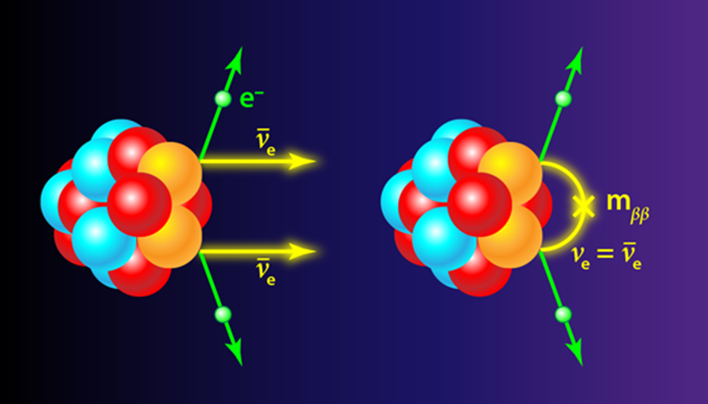
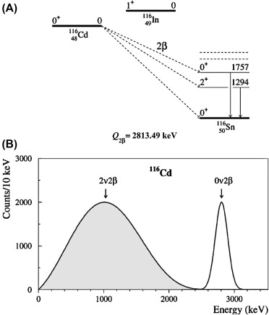
Application: Double beta decay
absolute neutrino mass scale
Majorana particles
matter-antimatter asymmetry of the Universe
New physics…
2νββ
0νββ
2νββ have been observed and T_{1/2} obtained for ⁴⁸Ca, ⁷⁶Ge, ⁸²Se, ⁹⁶Zr, ¹⁰⁰Mo, ¹¹⁶Cd, ¹²⁸Te, ¹³⁰Te, ¹³⁶Xe, ¹⁵⁰Nd, ²³⁸U, ⁷⁸Kr, ¹²⁴Xe and ¹³⁰Ba have been obtained.
11/20

Slide 12
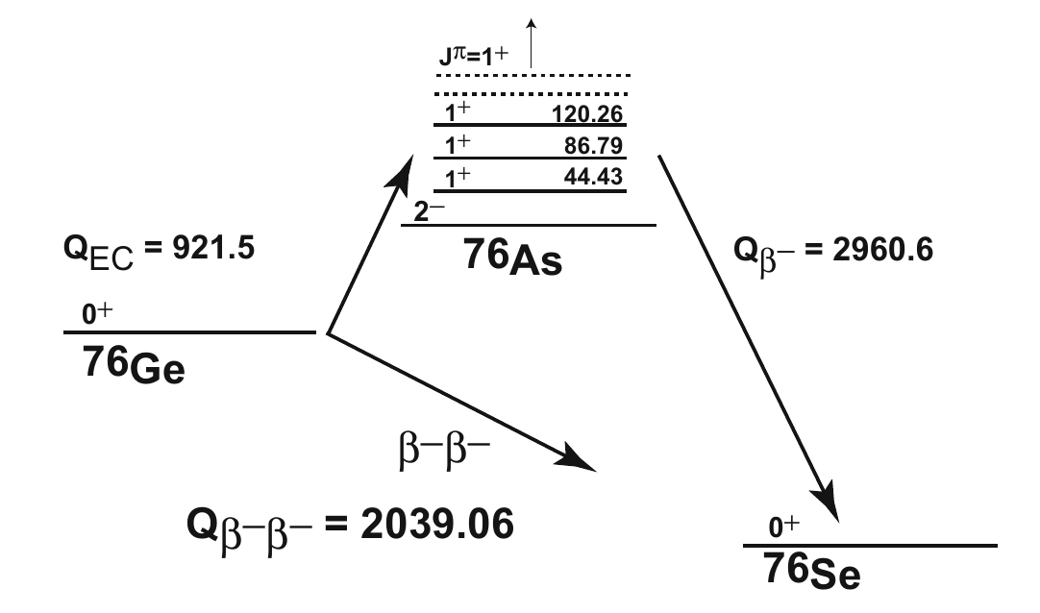
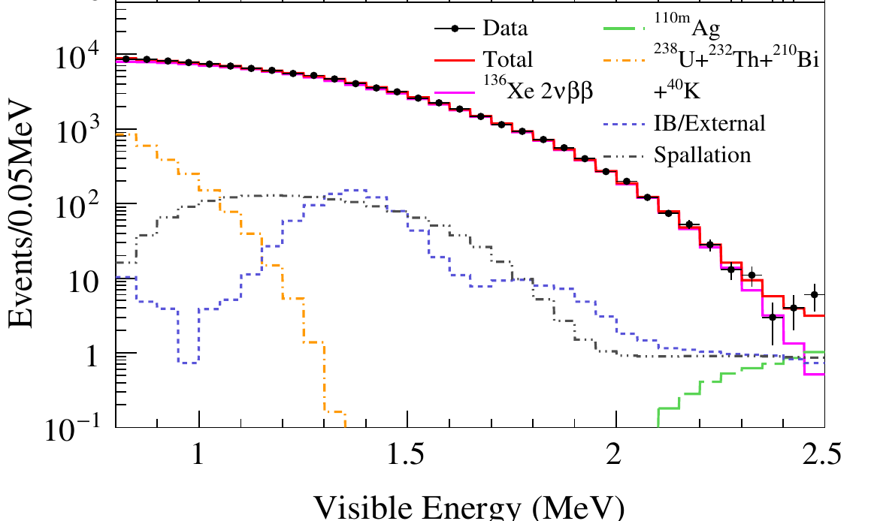
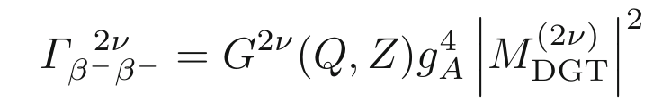
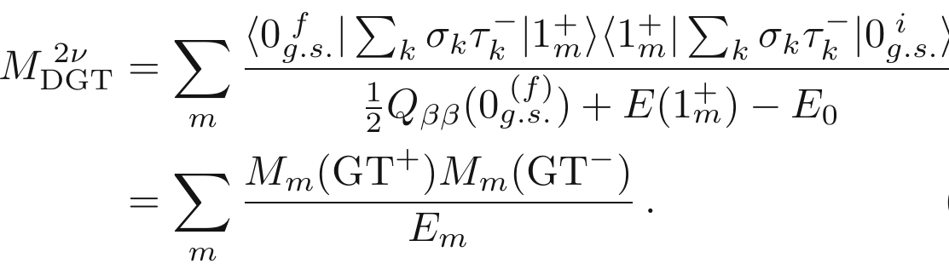
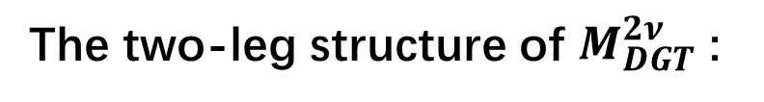
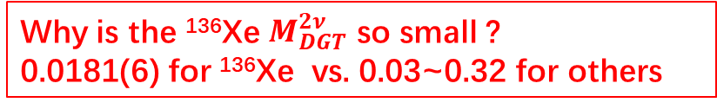
Application: Double beta decay
The two-leg structure of $M_{DGT}^{2ν}$ :
¹³⁶Xe ββ decay: EXO-200, nEXO, KamLAND-Zen, NEXT PandaX-III etc.
850
Gando et al., PRL 122, 192501 (2019)
590
90.3 keV
¹³⁶Cs
2548.2 keV
¹³⁶Xe
2451.9 keV
¹³⁶Ba
Why is the ¹³⁶Xe $M_{DGT}^{2ν}$ so small ?
0.0181(6) for ¹³⁶Xe vs. 0.03~0.32 for others
12/20

Slide 13
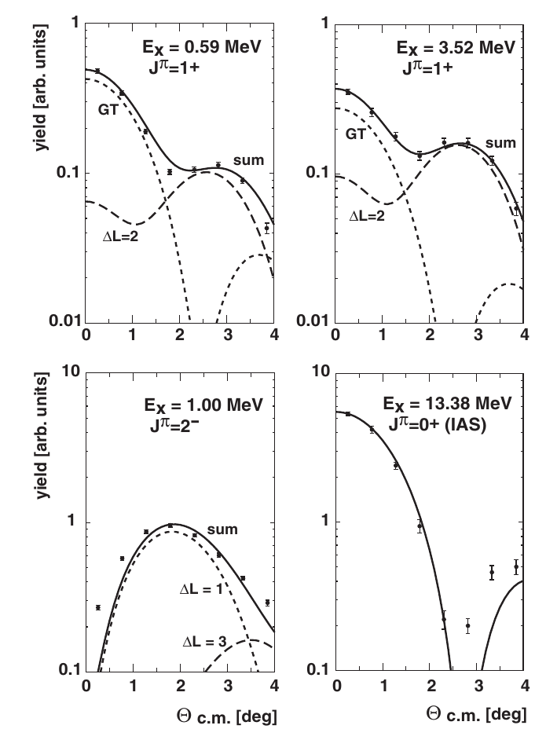
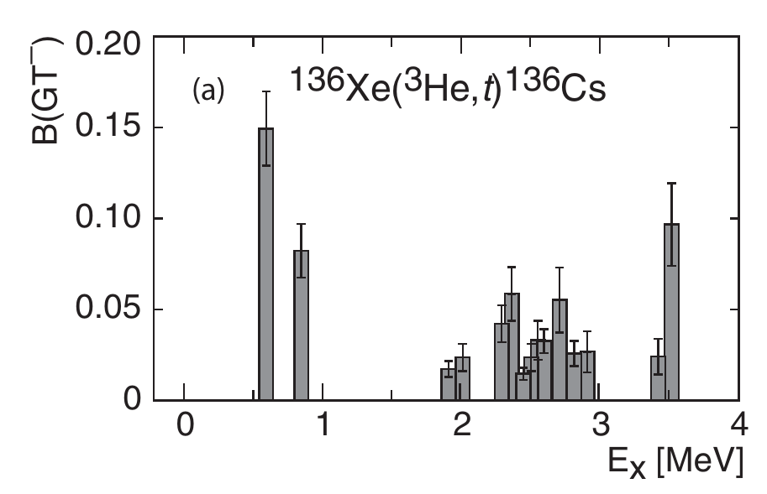
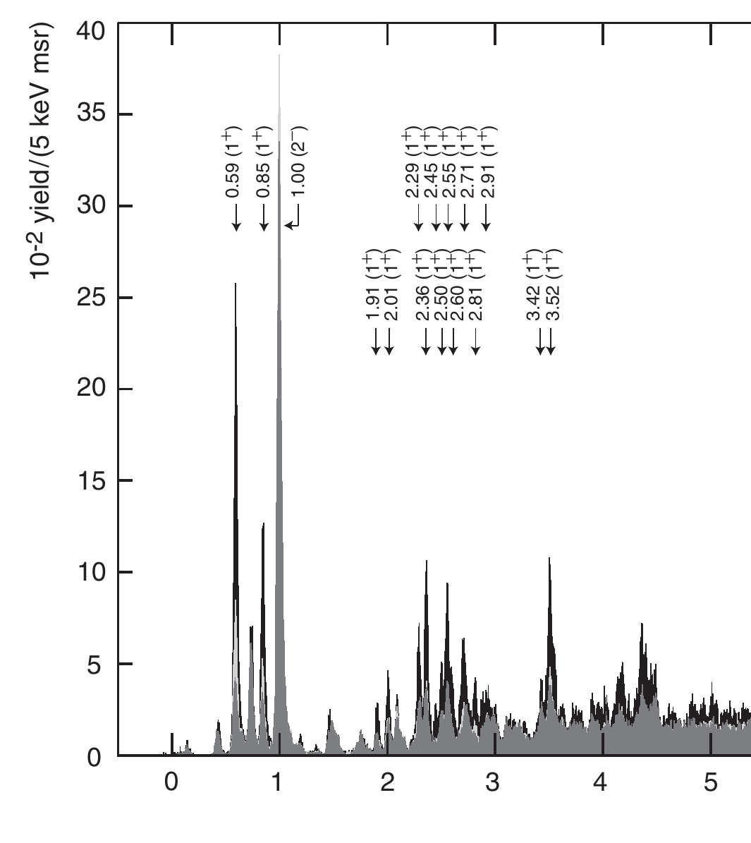
Application: Double beta decay
One leg is known for ¹³⁶Xe
Puppe et al., PRC 84, 051305(R) (2011)
Ex (MeV)
13/20

Slide 14
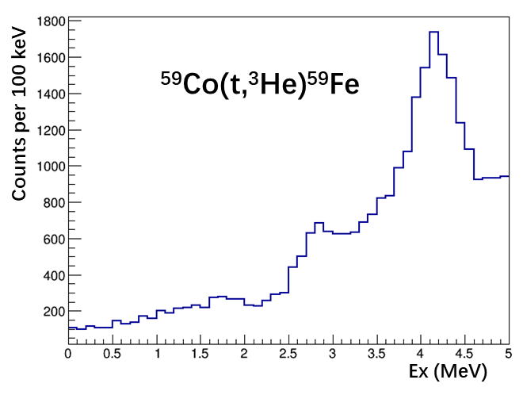
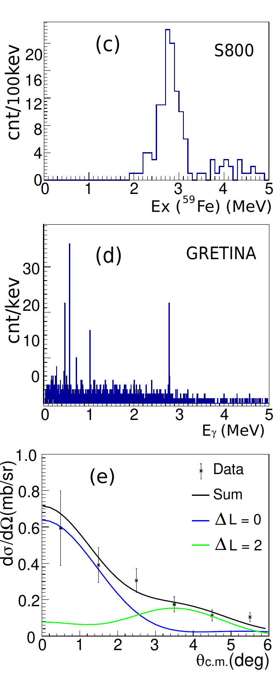
Application: Double beta decay
Let’s measure the other leg via ¹³⁶Ba(t,³He)¹³⁶Cs charge-exchange reaction!
14/20

Slide 15
01
Introduction to charge-exchange reactions
CONTENTS
02
Isospin mixing
03
Double beta decay
04
Excited state beta decay
05
Summary

Slide 16
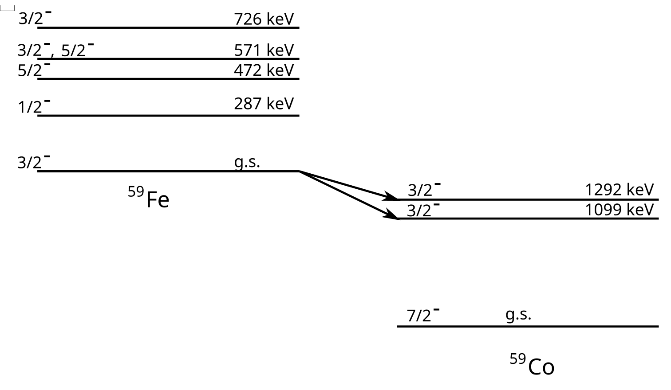
Thermal population of excited states
T_{1/2} ~ 44 days
16/20

Slide 17
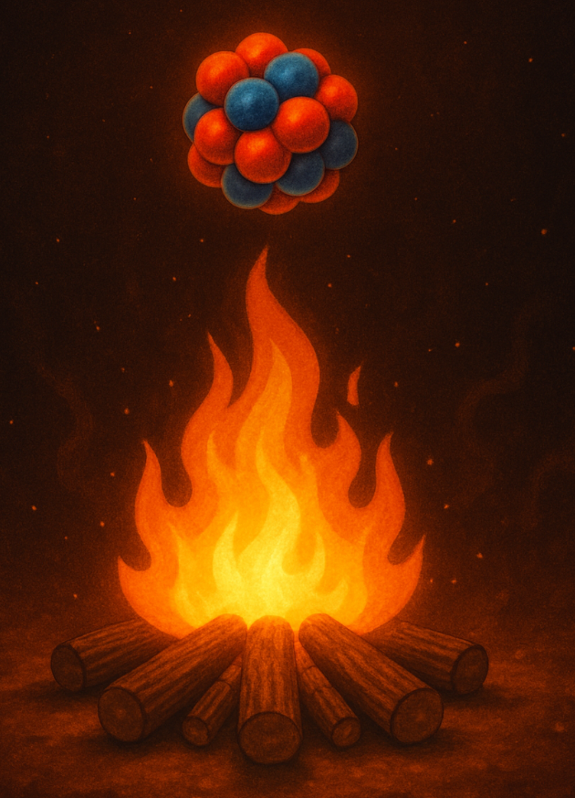
Thermal population of excited states
T ~ GK
T_{1/2} ~ 44 days
17/20

Slide 18
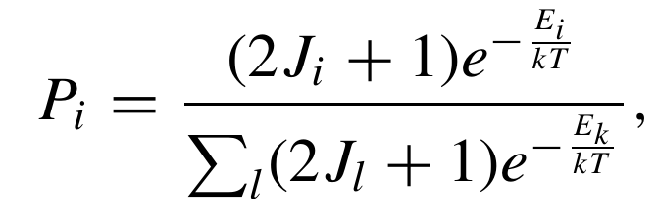
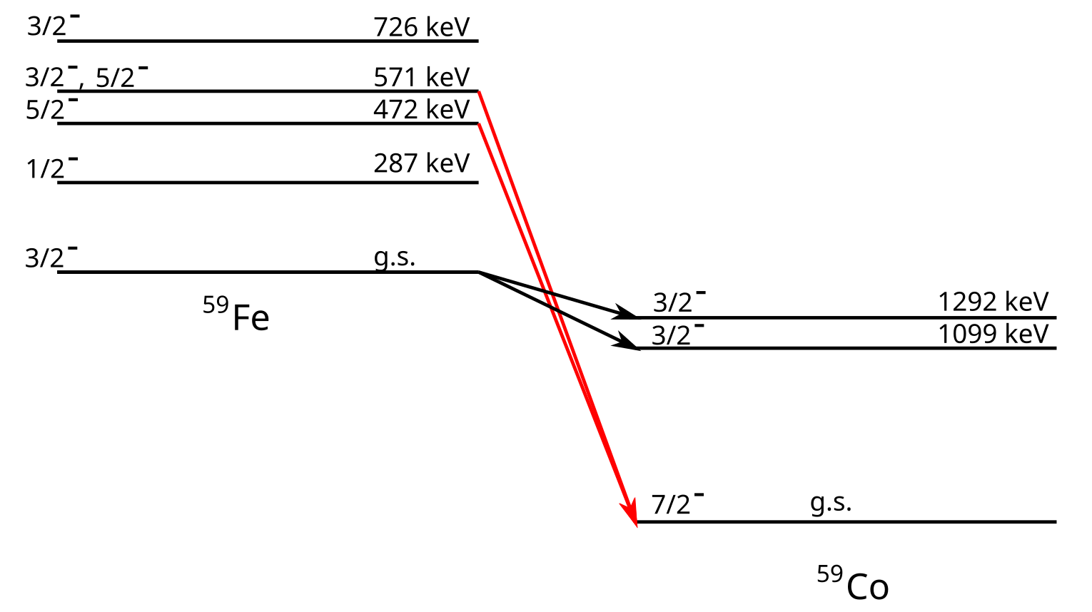


Thermal population of excited states
T ~ GK
T_{1/2} ~ 44 days
T_{1/2} ~ 0.5 days
18/20

Slide 19
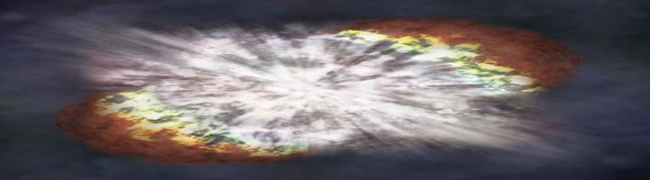
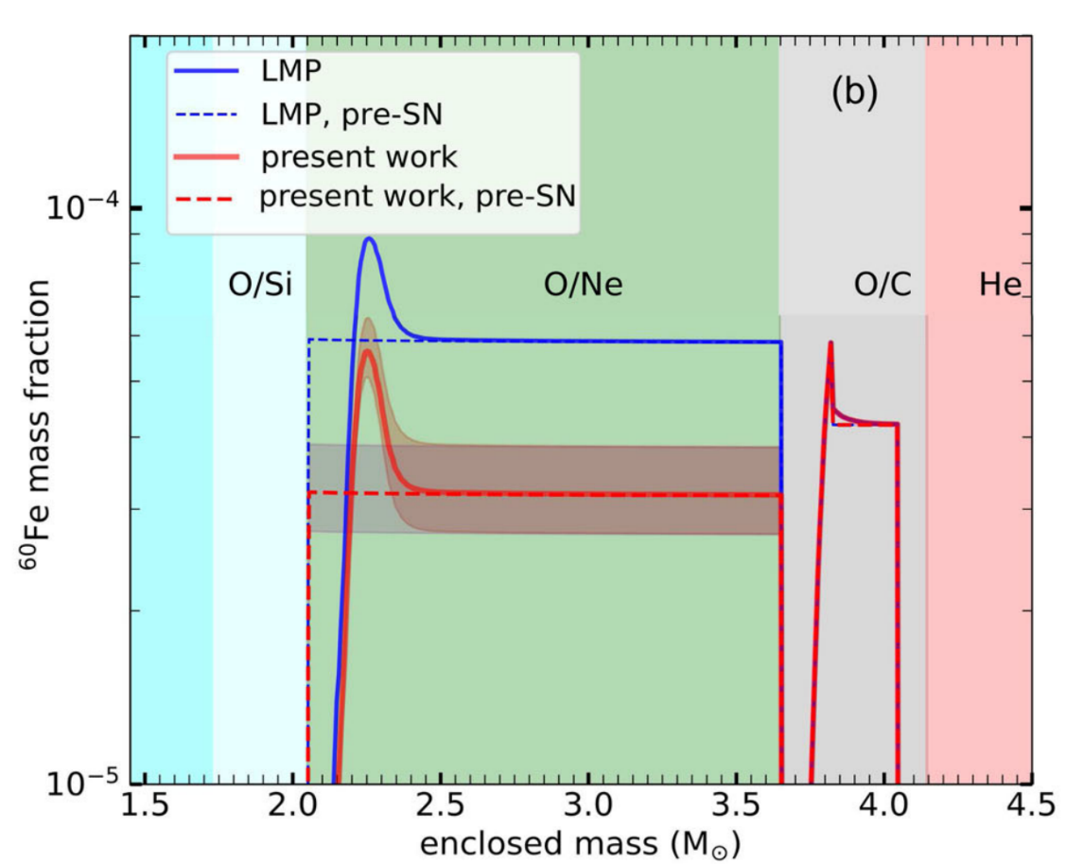




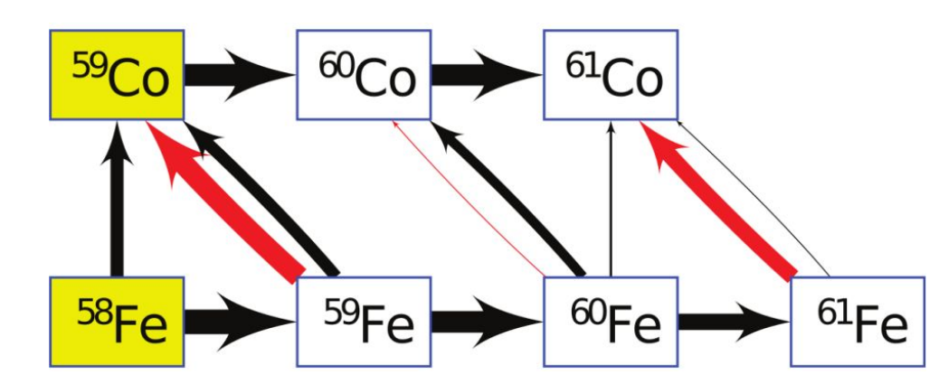
The ²⁶Al/⁶⁰Fe in the Galaxy
B. Gao et al., PRL 126, 152701 (2021)
²⁶Al
⁶⁰Fe
⁶⁰Fe yield decrease by 40% (18 M⊙ model), the right direction towards solving the ²⁶Al/⁶⁰Fe discrepancy.
Decrease of the ⁵⁹Fe(n,γ) rate further enhances the effect…
Other uncertainties like ¹²C(α,γ), ²²Ne(α,n), stellar and Galactic chemical evolution models etc.
19/20

Slide 20
Summary
Charge-exchange reaction is powerful tool to study B(GT)
Useful in many nuclear structure studies such as isospin mixing, double beta decay, excited-state beta decay, and many other applications…
Thanks!

Slide 21
01
Introduction to charge-exchange reactions
CONTENTS
02
Electron capture rates in CCSNe
03
Excited-state beta decay
04
Geochemical neutrino detectors and CCSNe rates
05
Summary

Slide 22
01
Introduction to charge-exchange reactions
CONTENTS
02
Electron capture rates in CCSNe
03
Excited-state beta decay
04
Geochemical neutrino detectors and CCSNe rates
05
Summary

Slide 23
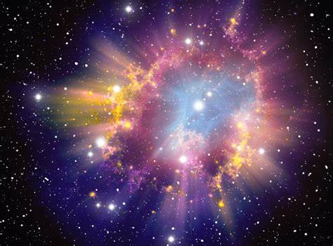
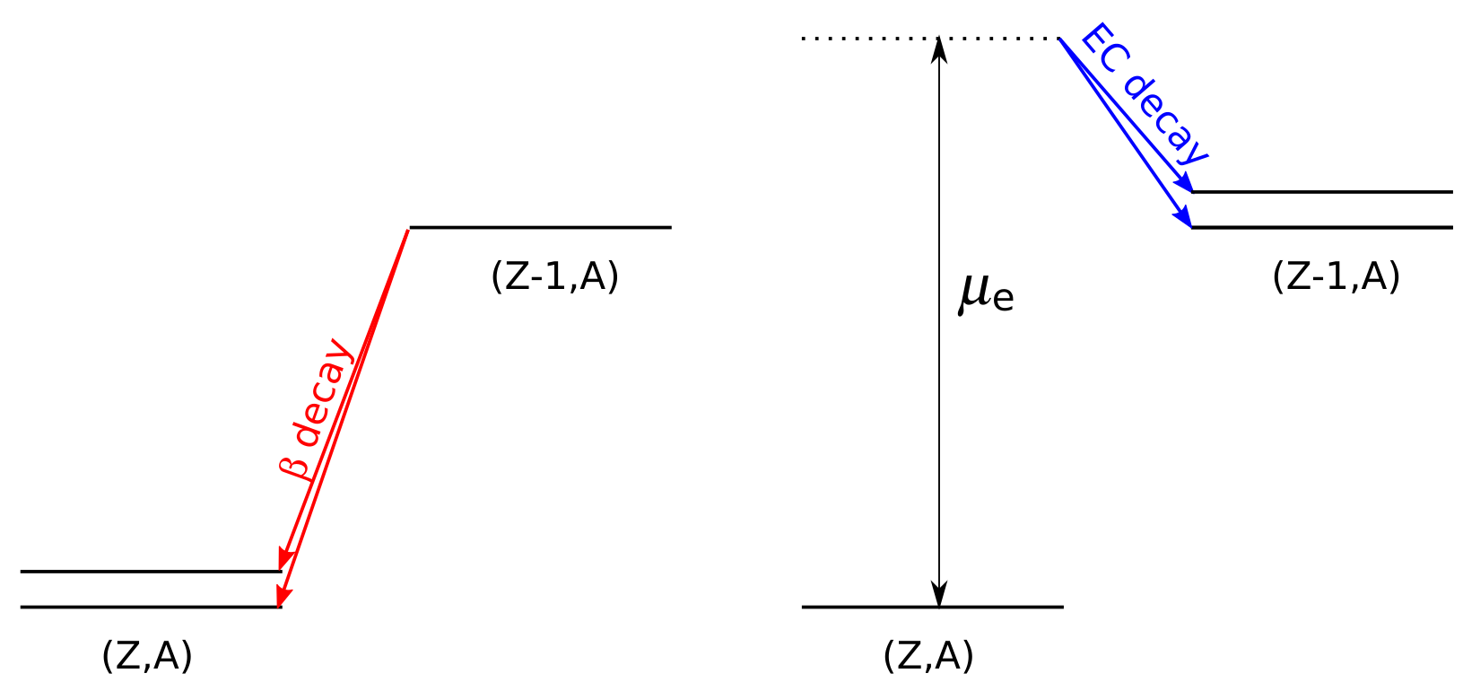
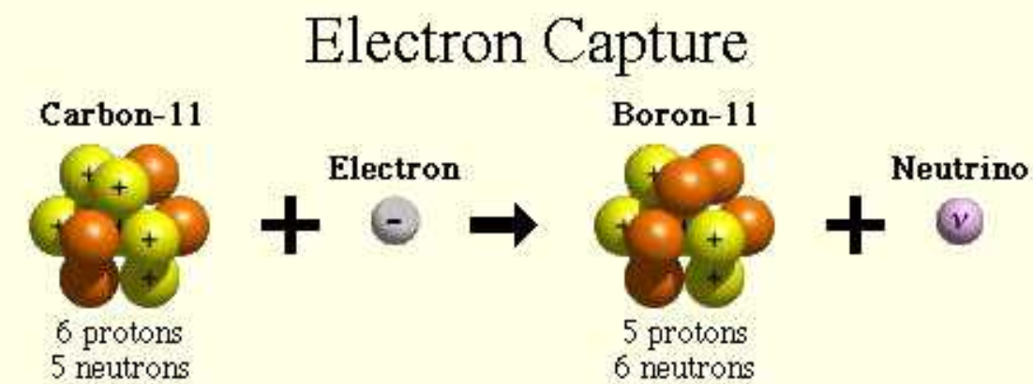
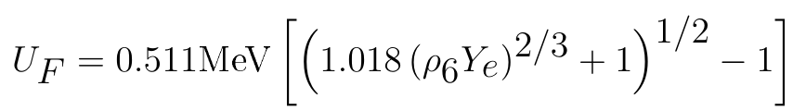
Electron Captures in CCSNe
Q values of different electron captures：
Free e-： Q = M_{11C} + M_{e-} – M_{11B}
Atomic shell e-： Q = M_{11C} + M_{e-} – M_{11B} – B_{e-} (binding energy)
Degenerate e-： Q = M_{11C} + M_{e-} – M_{11B} + μ_{e-} (Chemical potential)
The high density in CCSNe forces electrons to occupy high energy levels (high μ_{e} ~ MeV)
μ_{e}
7/20

Slide 24
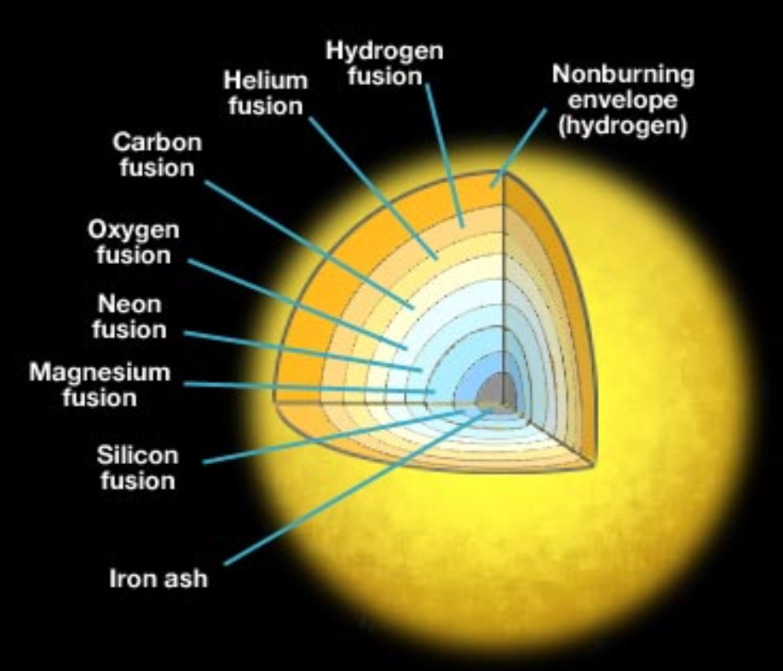
Electron Captures in CCSNe
Q values of different electron captures：
Free e-： Q = M_{11C} + M_{e-} – M_{11B}
Atomic shell e-： Q = M_{11C} + M_{e-} – M_{11B} – B_{e-} (binding energy)
Degenerate e-： Q = M_{11C} + M_{e-} – M_{11B} + μ_{e-} (Chemical potential)
The high density in CCSNe forces electrons to occupy high energy levels (high μ_{e} ~ MeV)
μ_{e}
(pf-shell nuclei)
8/20

Slide 25
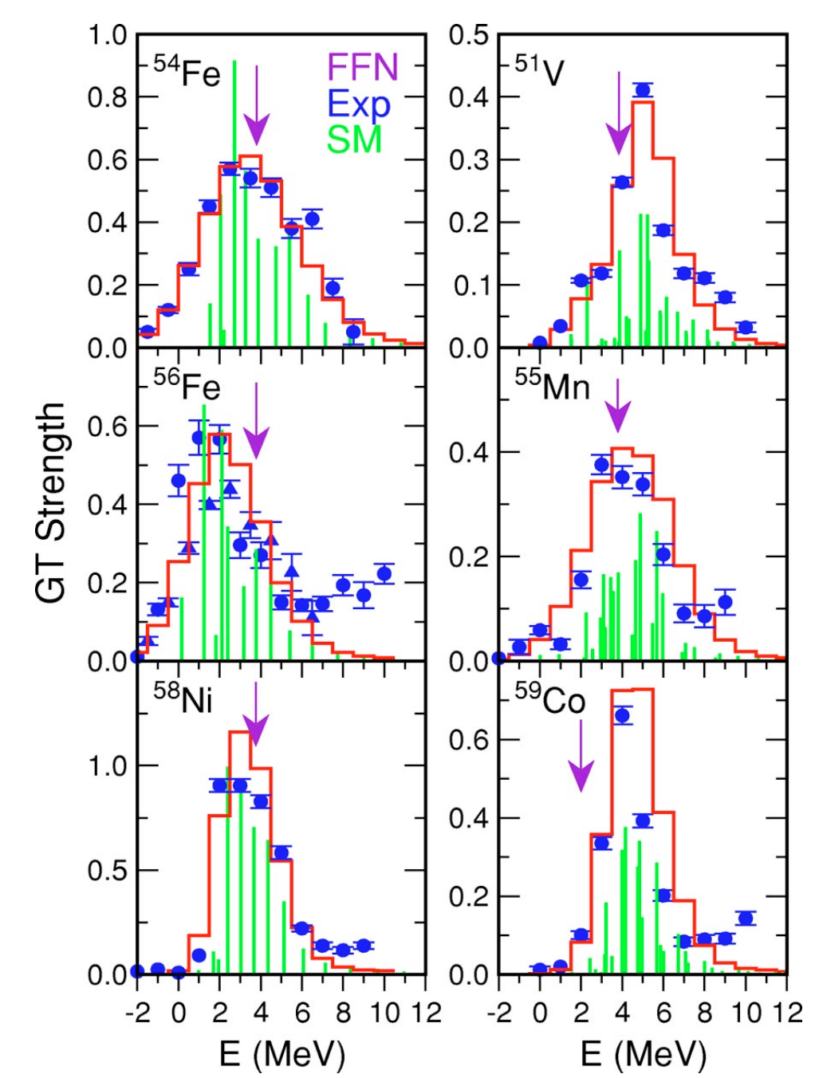

Electron captures in CCSNe
To calculate the electron capture rates:
Need to calculate the B(GT):
Independent Particle Model (IPM)
Interacting Shell Model (SM)
The B(GT) distributions are well reproduced by SM. Electron capture rates are reliably calculated by SM.
K. Langanke and G. Martı́nez-Pinedo, Rev. Mod. Phys., 75, 819 (2003)
9/20

Slide 26
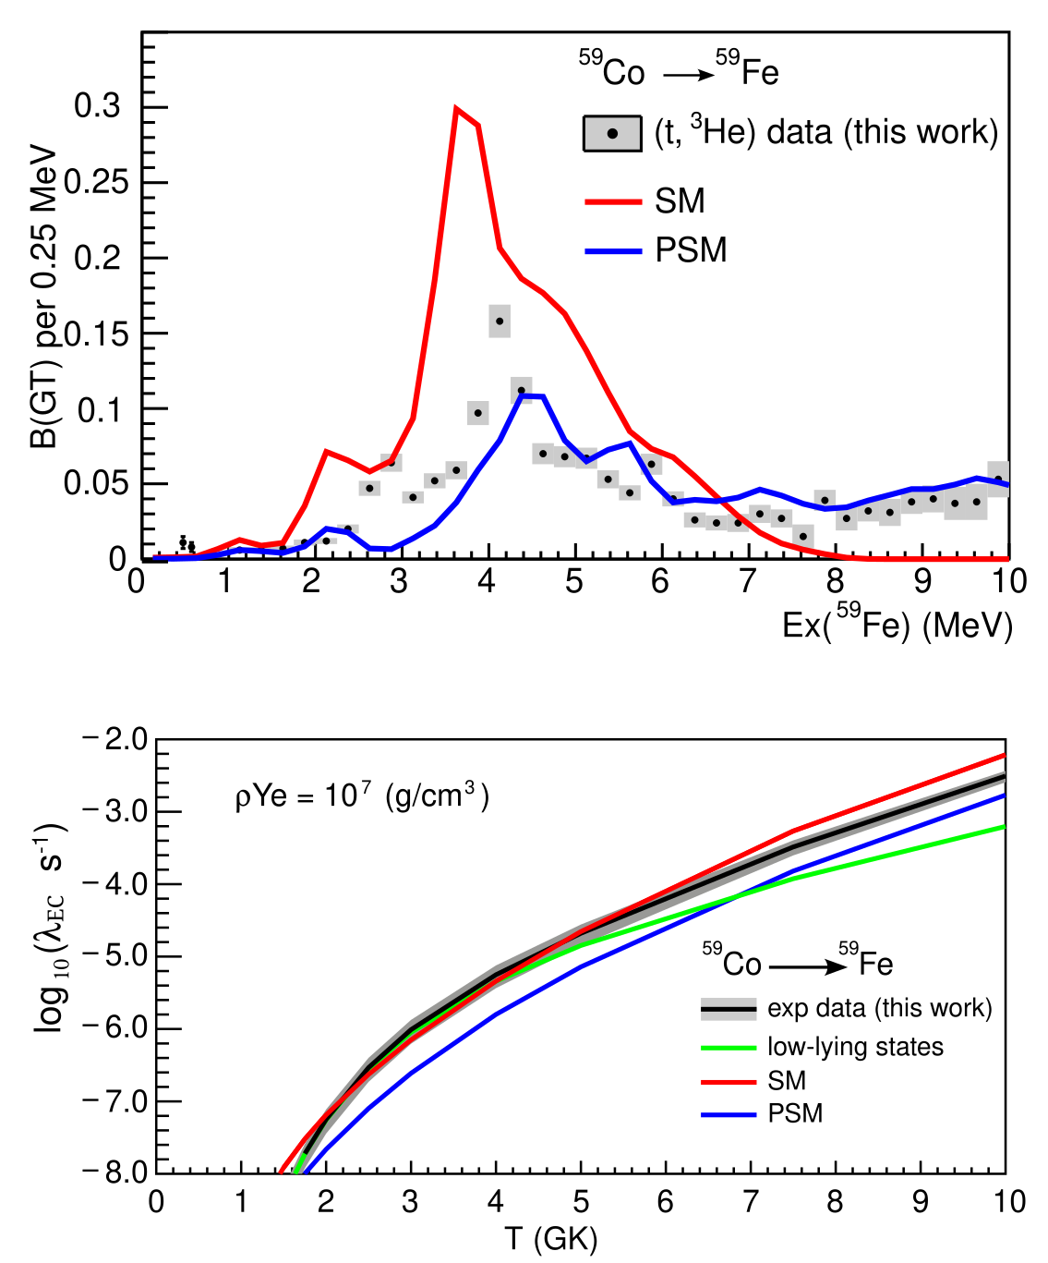
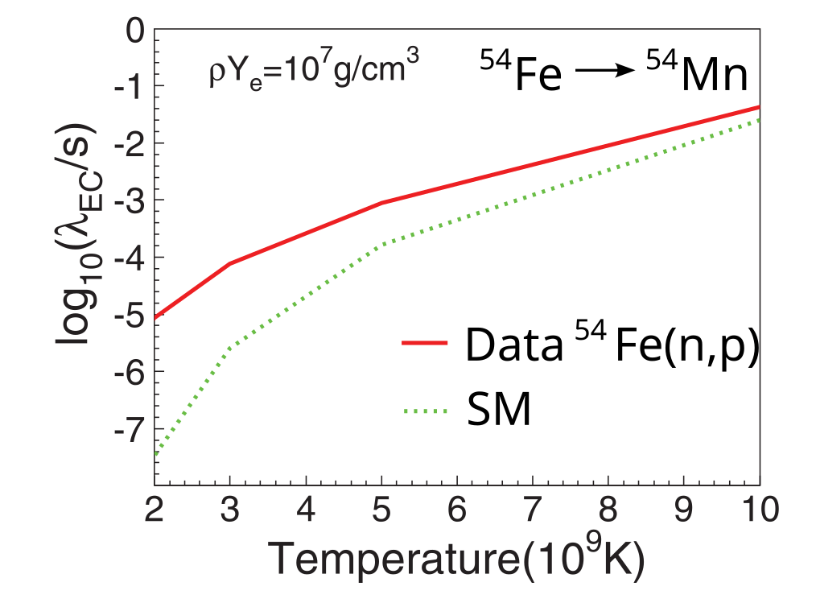
Electron captures in CCSNe
Closer look into the details of the B(GT) in low-energy region is needed!
→ Higher resolution data wanted!!
A. L. Cole et al, PRC 86, 015809 (2012)
B.Gao et al., PRC, 112, 024615 (2025)
10/20

Slide 27
01
Introduction to charge-exchange reactions
CONTENTS
02
Electron capture rates in CCSNe
03
Excited-state beta decay
04
Geochemical neutrino detectors and CCSNe rates
05
Summary

Slide 28
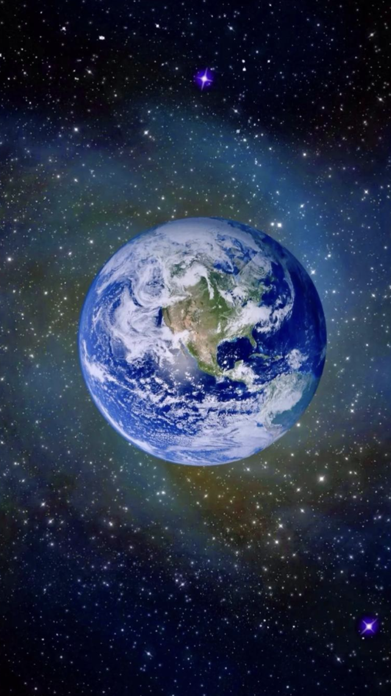
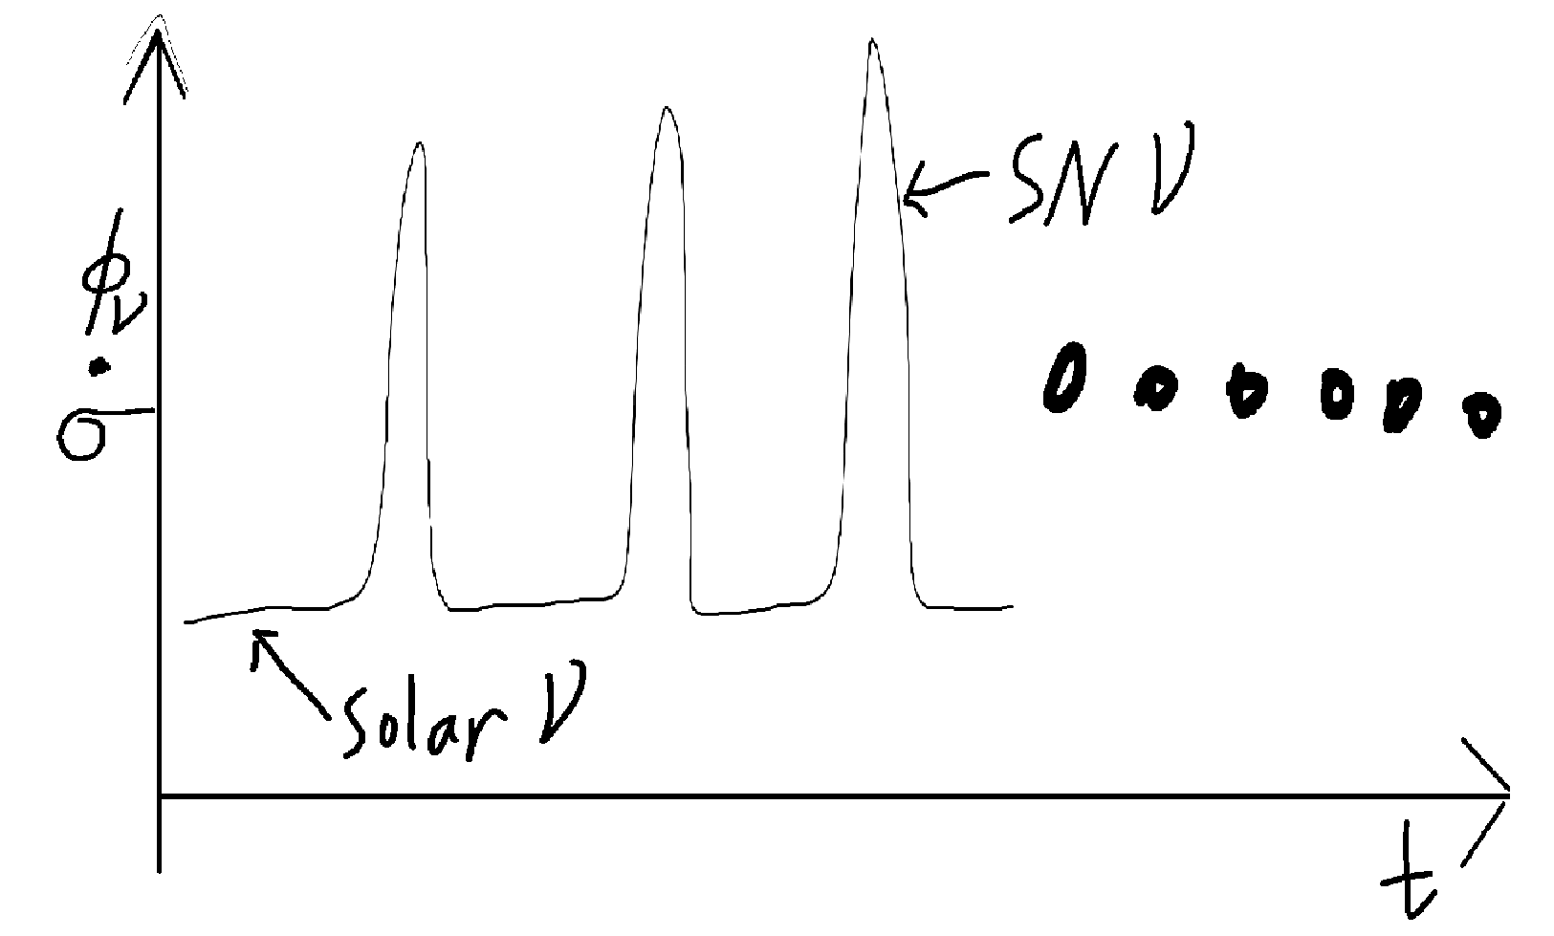
Neutrinos from the Sun and Galaxy
Neutrinos
Number of ν-induced reaction φ_{ν} • σ
17/20

Slide 29
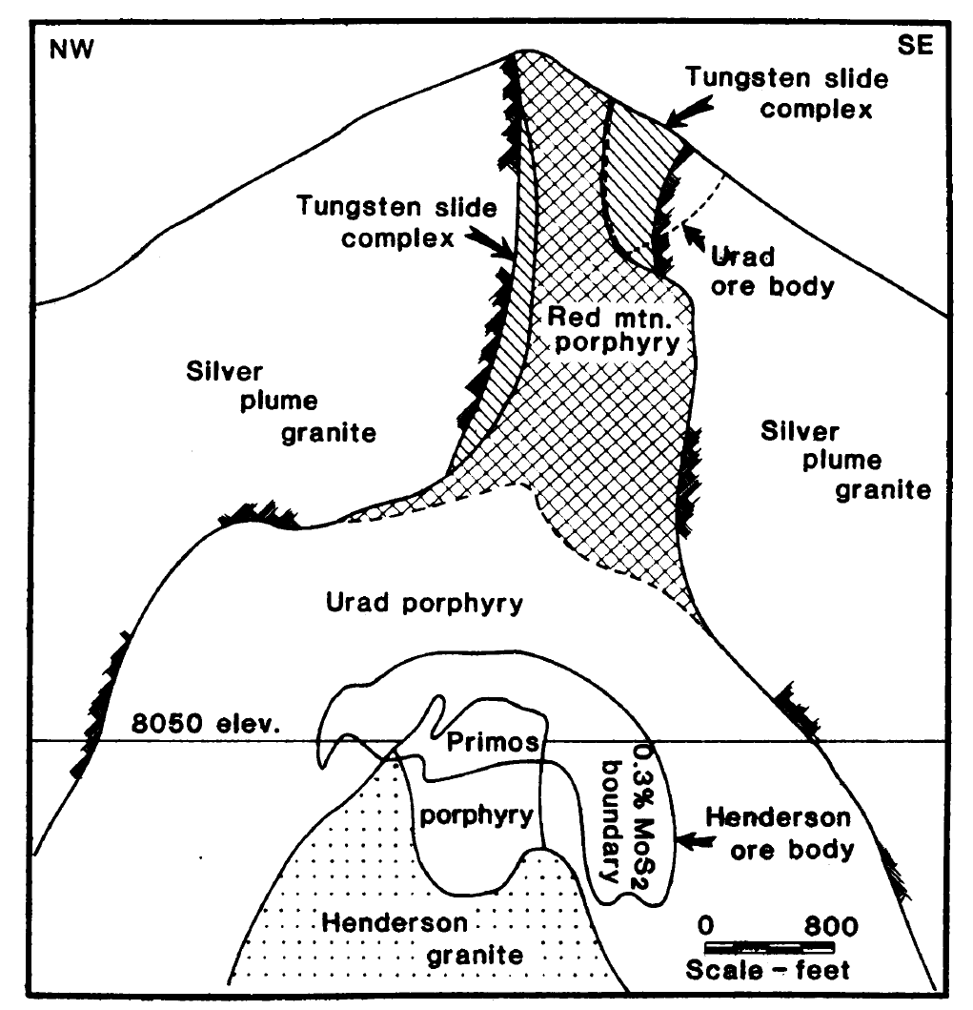
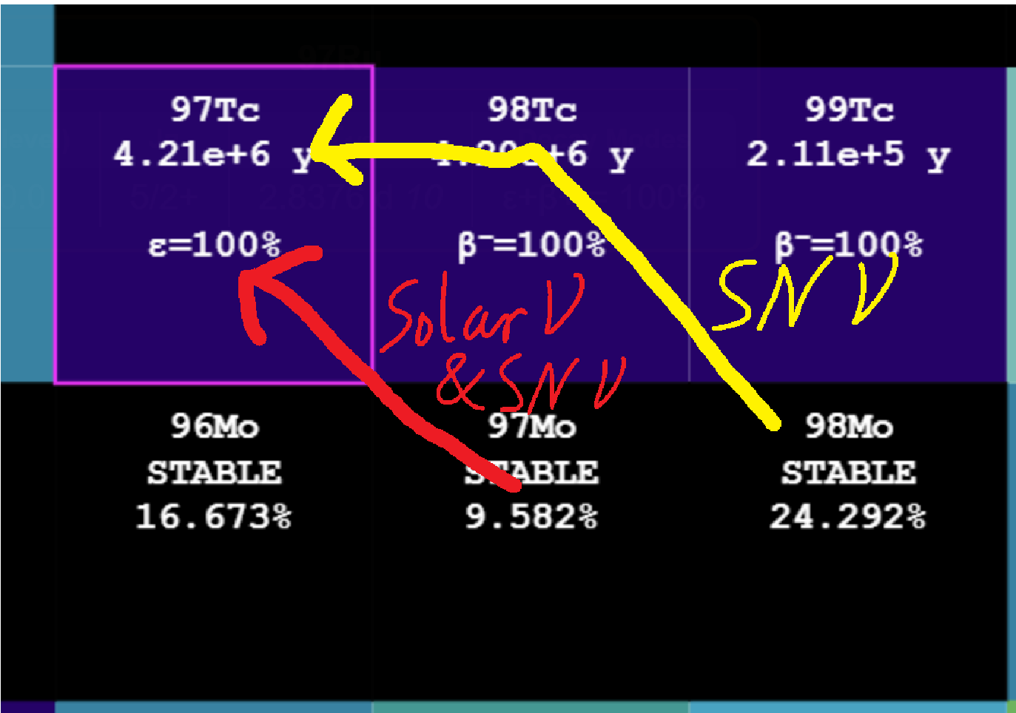

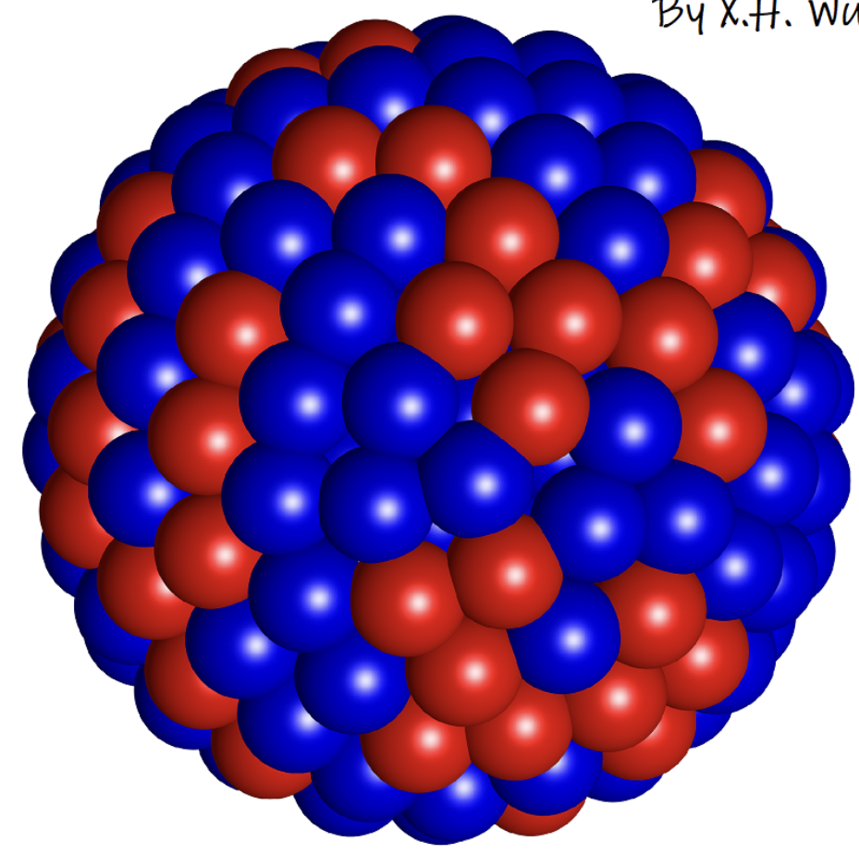
Neutrinos from the Sun and Galaxy
⁹⁷Tc
Count the number of ⁹⁷Tc atoms, get the number of SN events!
Cowan & Haxton Science 216, 51 (1982)
Haxton et al., Nature 333, 325 (1988)
18/20

Slide 30
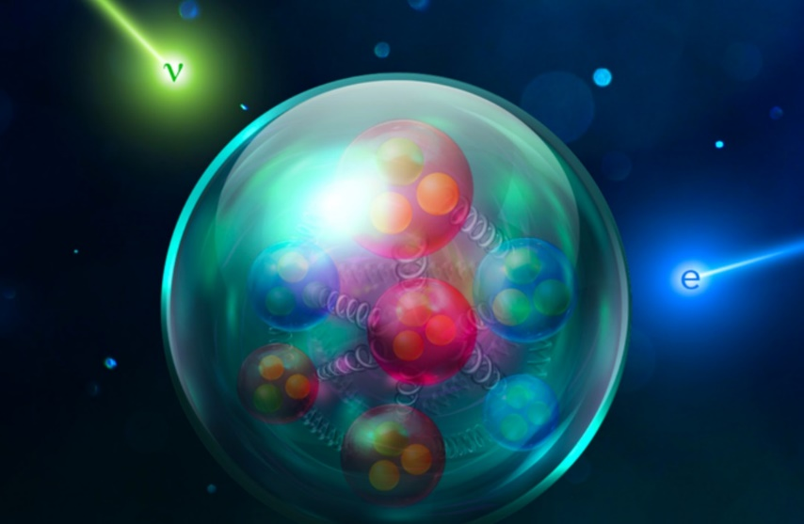
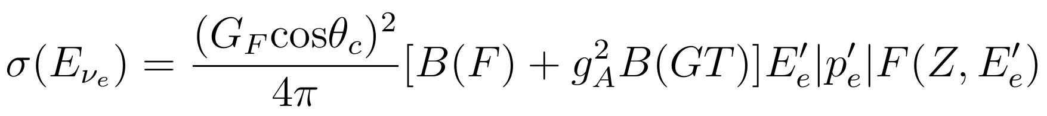
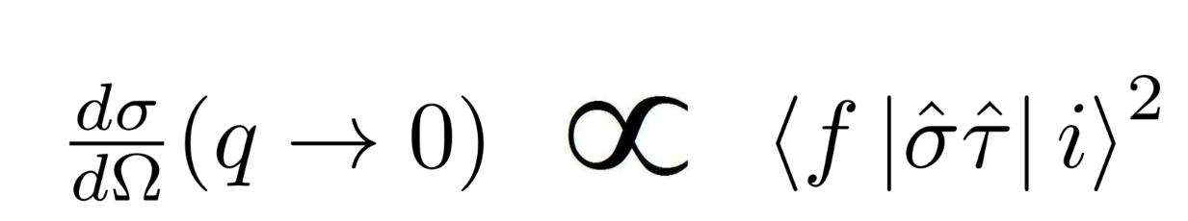
Neutrino interaction cross sections
Allowed transition:
B(F): N-Z
B(GT):
Use charge-exchange reaction to measure B(GT) and get σ(E_{νe}) (to be done soon at RCNP!)
Forbidden transition: rely on theories!

