Slide 1
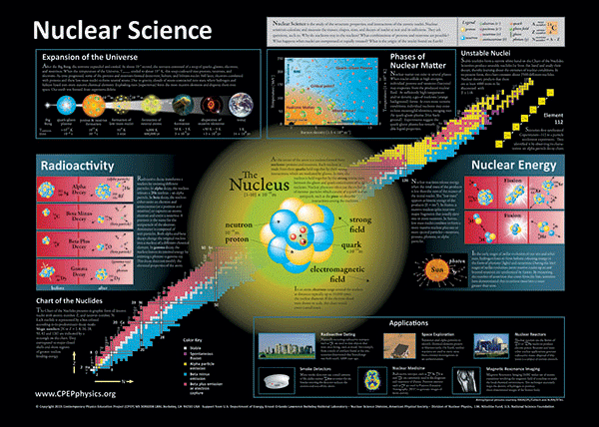
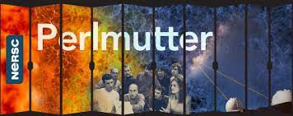
Light nuclei properties with ab initio no-core shell model
尹鹏
河南科技大学
Collaborators:
李贺，左维, 赵行波, 王惠仁, 房栋梁 (近物所)
周波 （复旦大学）
陈洁 （南方科技大学)
James P. Vary, Pieter Maris (Iowa State University)
Mark Caprio (University of Notre Dame)
Andrey Shirokov (Moscow State University)
Patrick Fasano (Argonne National Laboratory)
Sonia Bacca (Johannes Gutenberg-Universität Mainz)
第二届原子核从头计算与贝塔衰变前沿讨论会
重庆 2026.1.10-12

Slide 2
Outline
Introduction
No-Core Shell Model (NCSM)
Properties of light nuclei with NCSM
Notes:
介绍一种非相对论的第一性原理方法NCSM，第二部分和第三部分介绍一下我们用NCSM做的两个工作，一个工作是求和规则的计算，另一个工作是最近理论和实验比较关心的4He monopole form factor的问题。

Slide 3
Introduction

Slide 4
What is ab initio?
Nearly all of the visible matter in the universe is made of atomic nuclei, yet we do not know how the fundamental laws of physics govern their basic properties such as their binding energy, their size and their reactions.
Given our physics “first principles”, i.e. knowledge of the microscopic forces, relativity and quantum mechanics, we would like to calculate these basic properties and test for agreement with experimental measurements, without additional assumptions. This is also called “ab initio” (from the beginning) theoretical physics.
When we are successful, we can claim to understand the atomic nucleus from first principles. Any discrepancies would point to the exciting prospect for the discovery of new physics which is expected and is needed to explain outstanding puzzles such as dark matter and dark energy.
Supercomputer Era. Collaborative efforts of physicists, computer scientists, and mathematicians. Quantum computing Era?

Slide 5
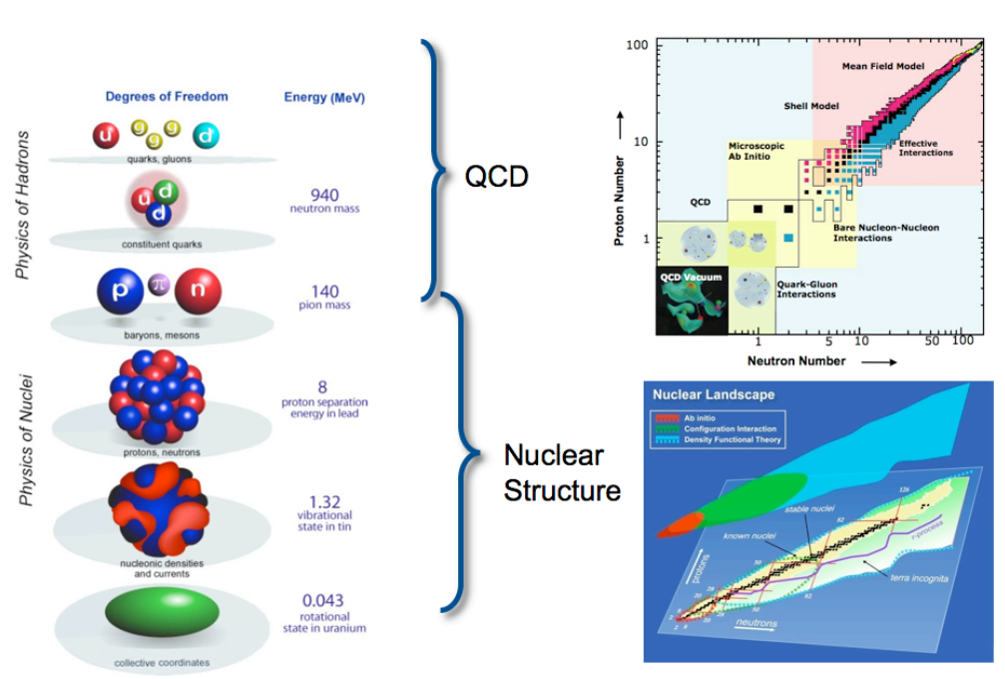
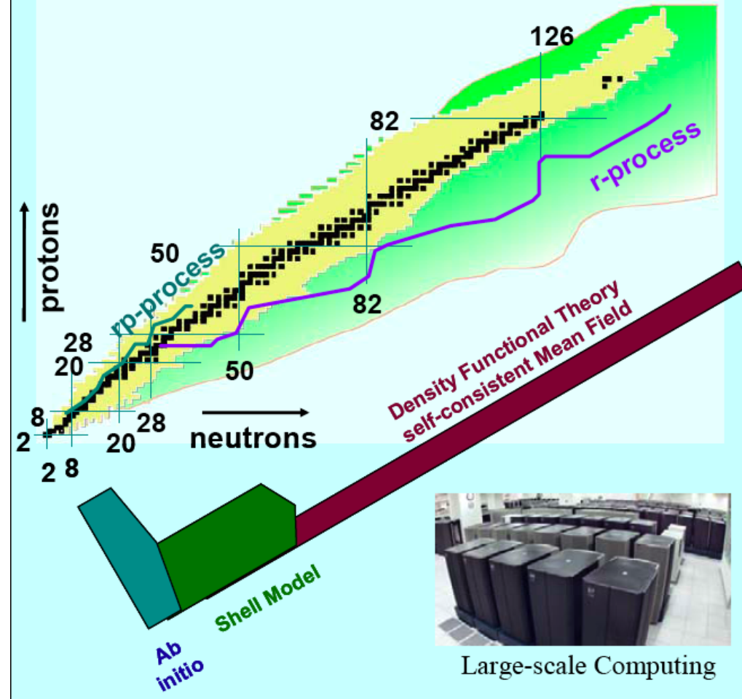
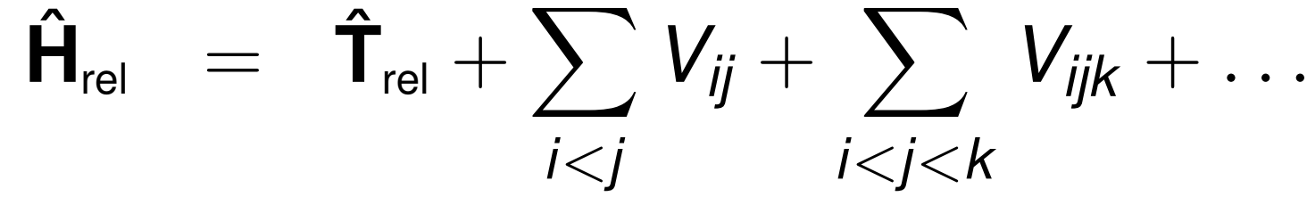

Slide 6
Challenges
Self bound quantum many-body problem,
with 3A degrees of freedom in coordinate (or momentum) space,
as well as spin degree of freedom
Strong interactions, with both short-range and long-range pieces
Not only 2-body interactions, but also intrinsic 3-body interactions and possibly 4- and higher N-body interactions
Uncertainty quantification for calculations needed
for comparison with experiments
for comparison between different methods
Sources of numerical uncertainty
statistical and round-off errors
systematical errors inherent to the computational method:
Configuration interaction methods: finite basis space
Monte Carlo method: sensitivity to the trial wave function
uncertainty in the nuclear interactions

Slide 7
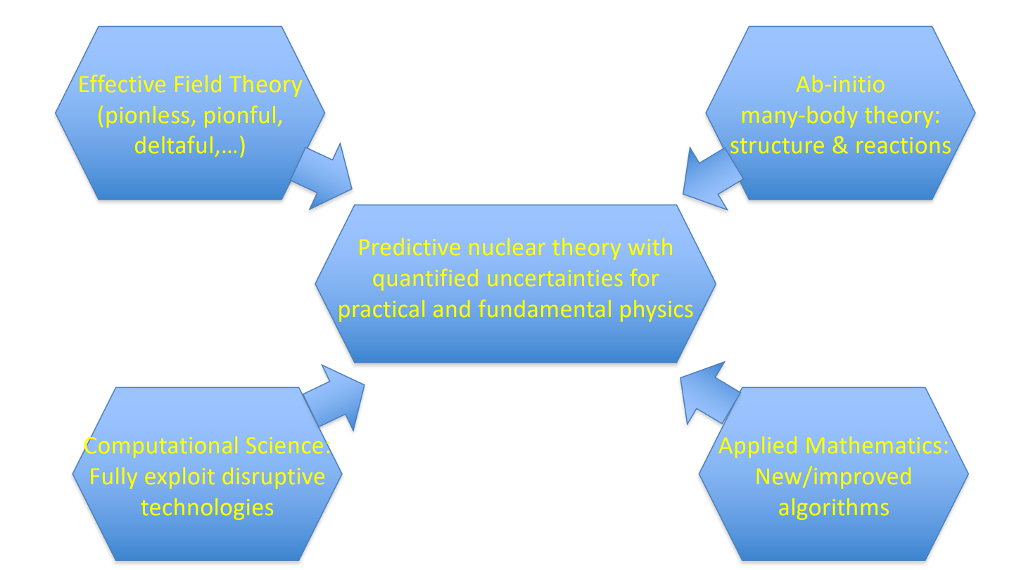

Slide 8
No-Core Shell Model
Notes:
赵鹏巍老师和申时行老师已经介绍了两种相对论第一性原理方法，这里我介绍一种非相对论的第一性原理方法NCSM

Slide 9
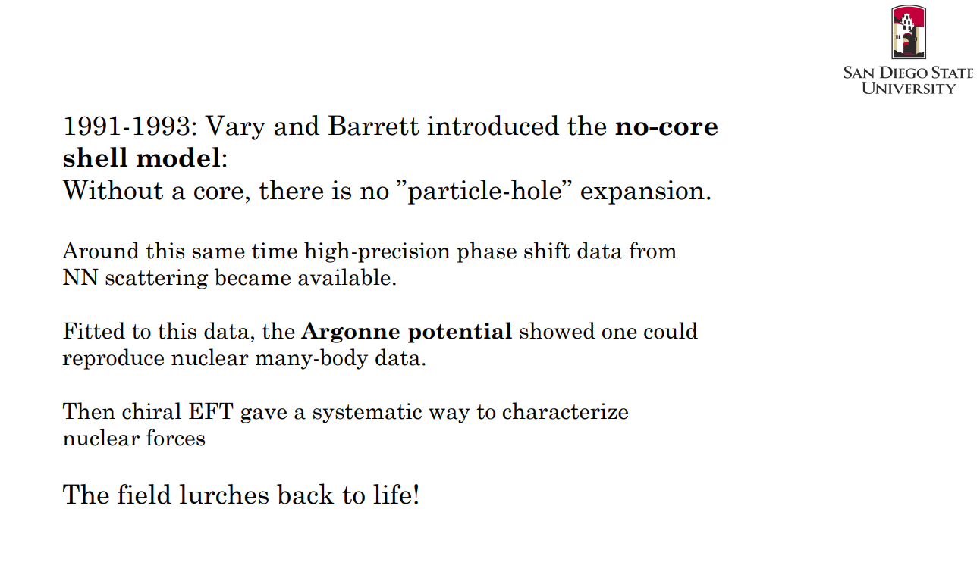



Slide 10
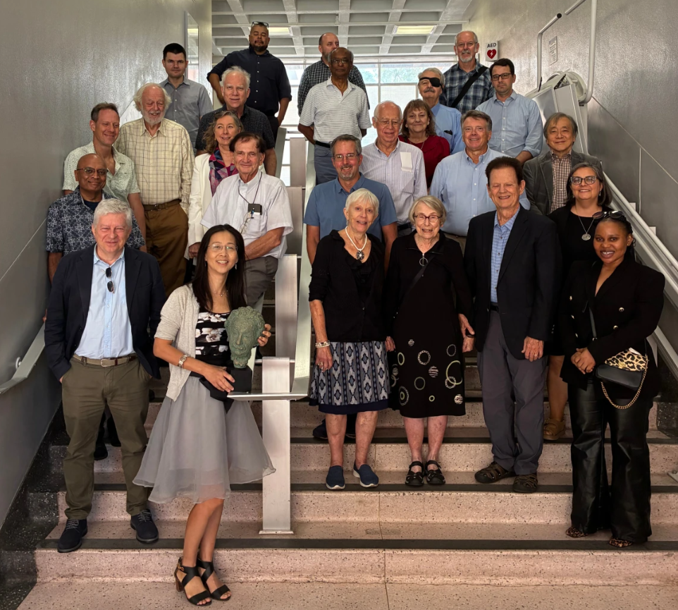


Slide 11
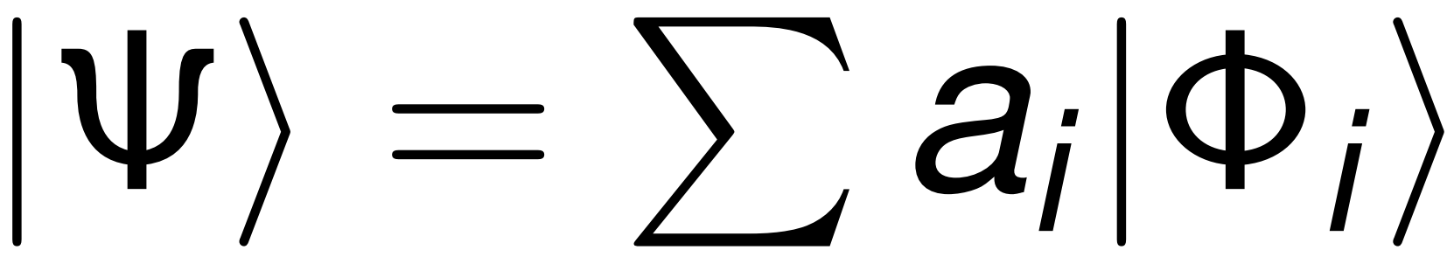

No-Core Shell model
Expand wavefunction in basis states
Express Hamiltonian in basis
Diagonalize Hamiltonian matrix H_{ij}
No-Core: All A nucleons are treated equally
Complete basis: exact results (Caveat: complete basis is infinite dimensional)
In practice:
Truncate basis
Study behavior of observables as function of truncation
Computational challenge:
Construct large (10¹⁰×10¹⁰) sparce symmetric matrix
Obtain lowest eigenvalues&-vectors corresponding to low-lying spectrum and eigenstates
Notes:
我简要介绍一下NCSM方法的主要思路。我们的出发点是哈密顿量，包括核子间相对运动的动能，以及核子间的相互作用，相互作用可以是两体力，也可以加入三体力和更多体的相互作用。为了求解能谱和波函数，我们需要选一个基矢对原子核的波函数做展开，基矢选定以后，我们可以把哈密顿量写成一个矩阵的形式，通过对角化哈密顿量的矩阵，我们可以得到能谱和波函数，进一步再去计算其他观测量。No core主要是与传统的壳模型做一个区分，我们把所有的核子做同等处理，没有把原子核拆分成core和valence。原则上基矢展开需要做到无穷大才能得到精确解，实际上因为计算资源有限，我们需要对基矢做截断，我们考察观测量随截断的收敛性。做NCSM计算主要面临的挑战还是计算量，通常我们要处理10*10的稀疏矩阵，怎么样对角化得到最低几个能级的能量和波函数。

Slide 12
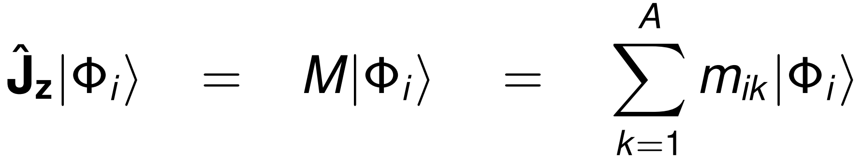
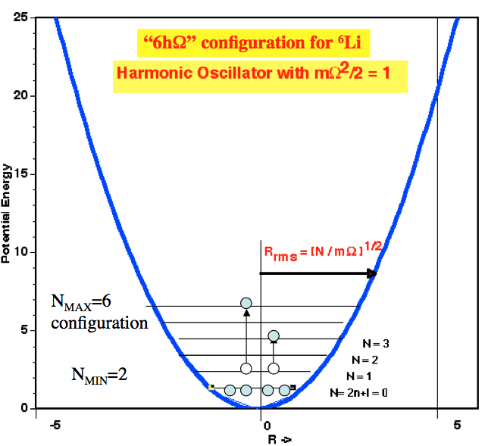
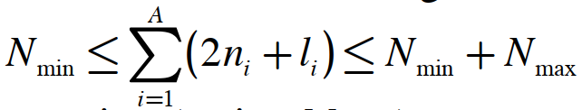
Truncation Schemes
M-scheme: Many-body basis states eigenstates of J_{z}
Two runs (positive and negative parity) gives entire spectrum
J-scheme (more basis states)
Since the Hamiltonian commutes with 𝐽, these eigenstates will have a definite 𝐽 value; one needs just to calculate the expectation value 〈Ψ_{A} |𝐽² | Ψ_{𝐴} 〉=𝐽(𝐽+1) to find 𝐽.
N_{max} truncation: Many body basis states satisfy
Exact factorization of CoM in HO basis
Suitable for excited states
Center of Mass (a common challenge in ab initio)

Slide 13
Light nuclei properties with NCSM

Slide 14
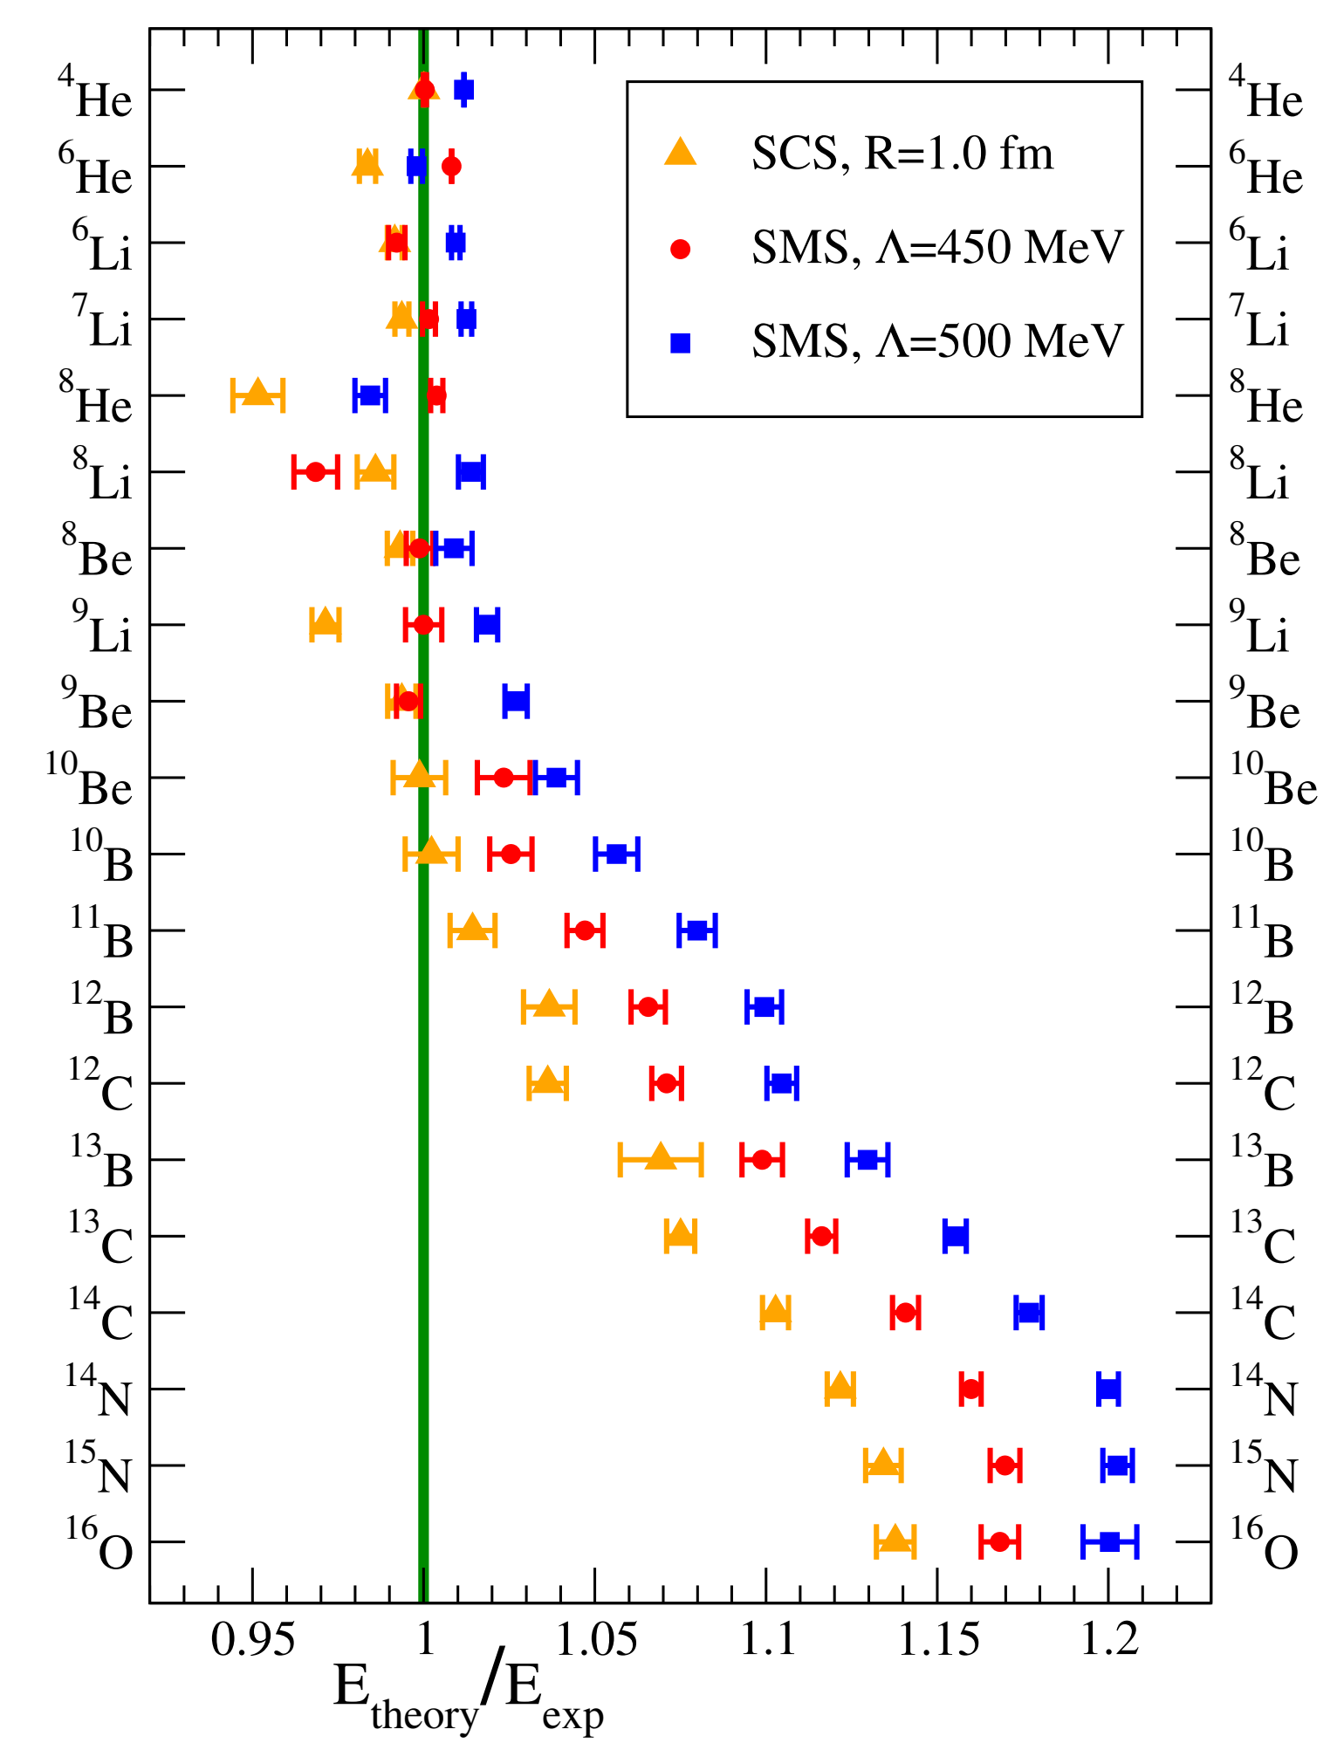
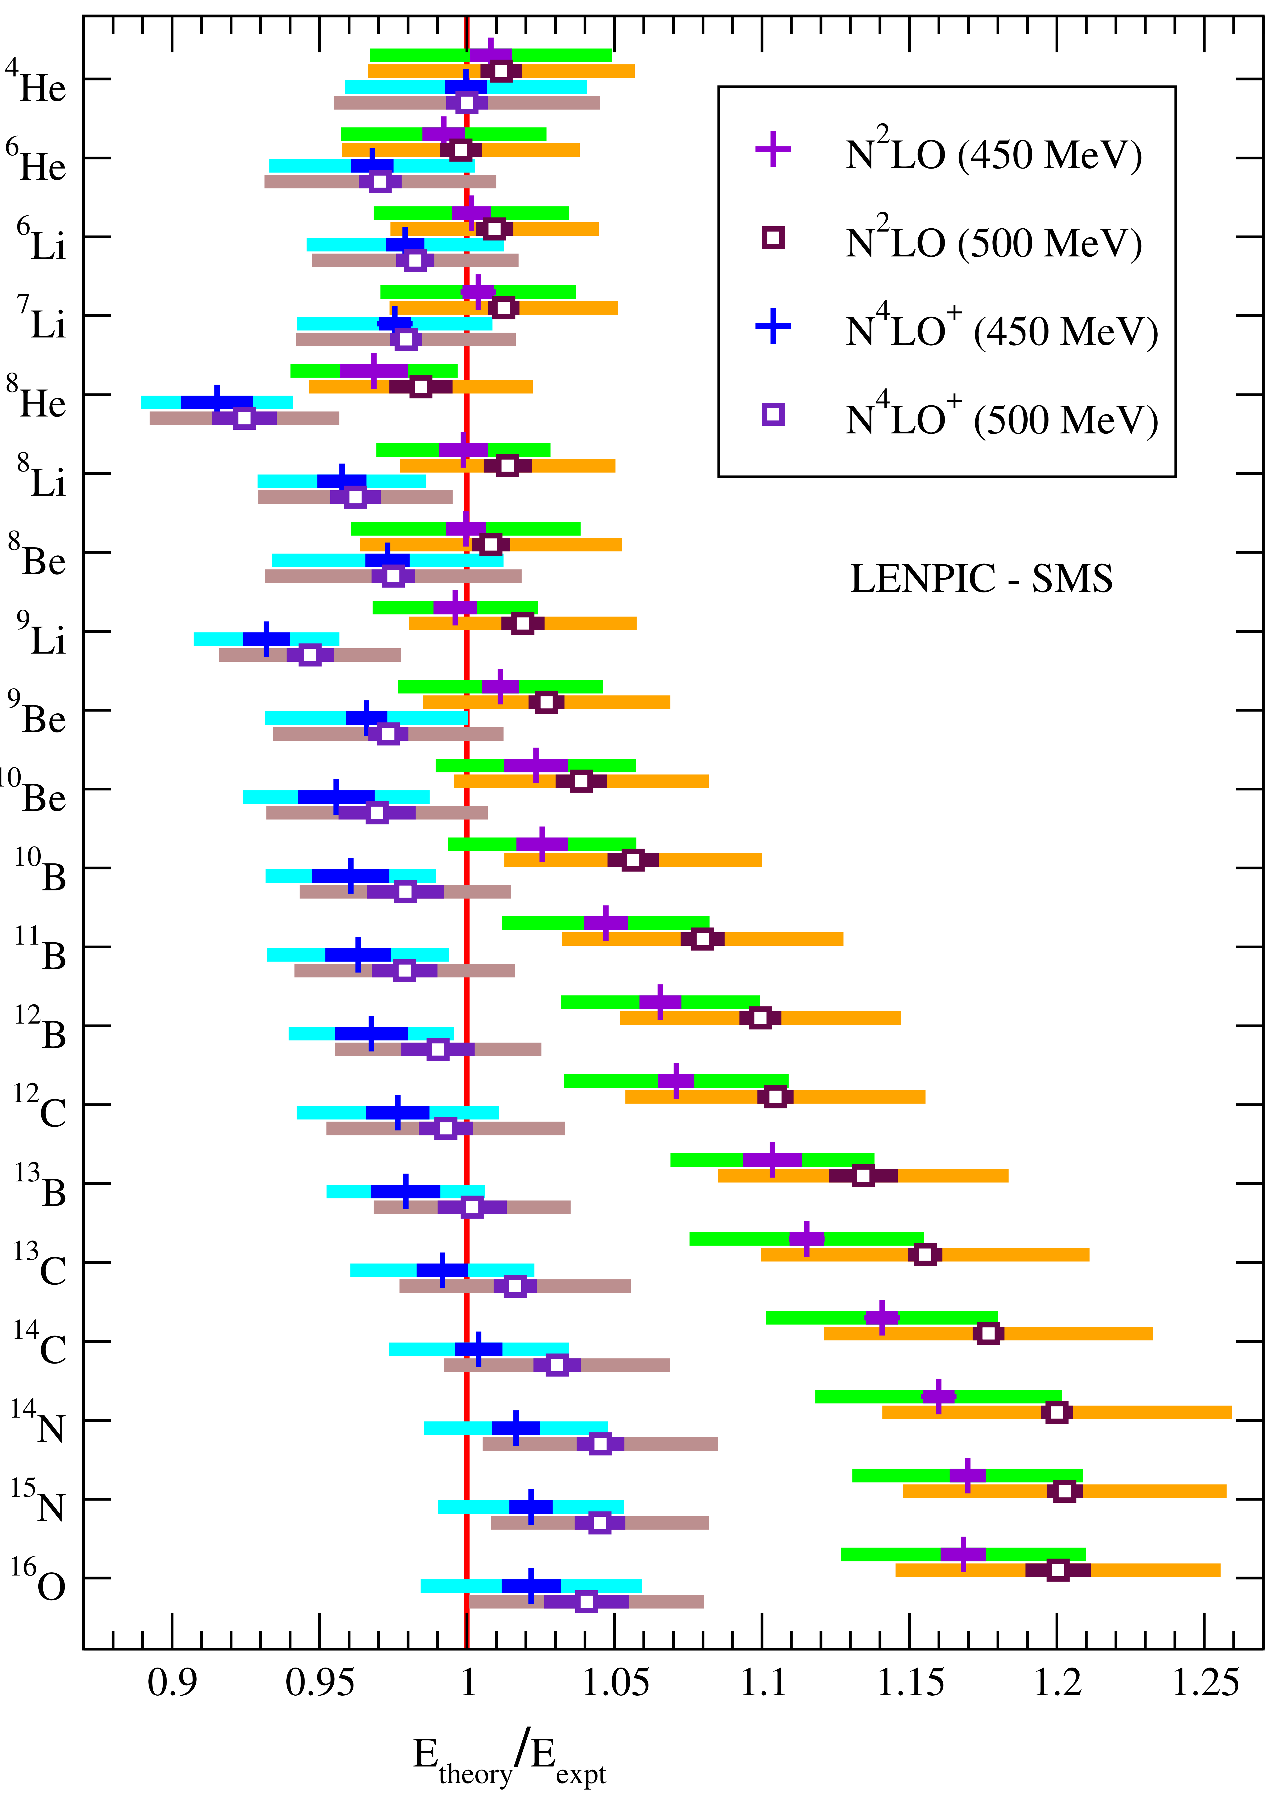
Ground State Properties of Nuclei with NCSM
LENPIC Collaboration,
Phys.Rev.C 103, 054001 (2021)
LENPIC Collaboration,
Phys. Rev. C 106, 064002 (2022)

Slide 15
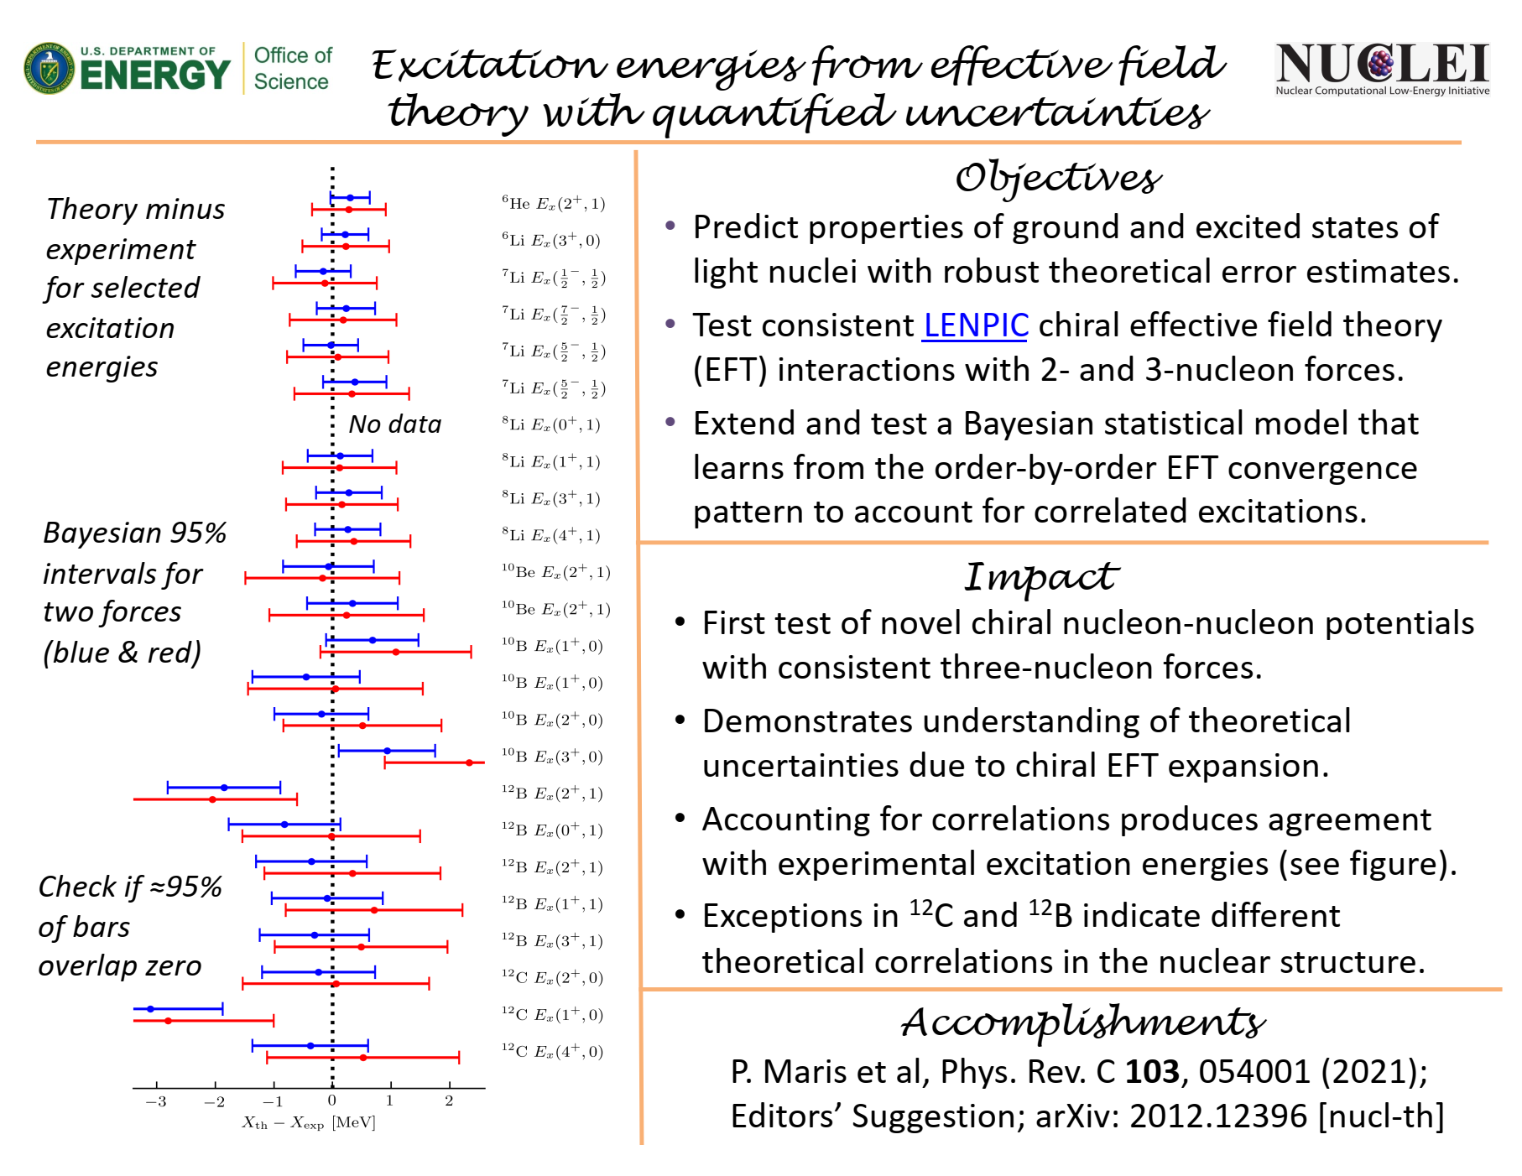

Slide 16

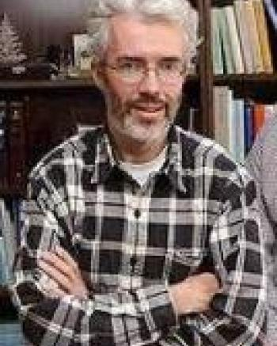
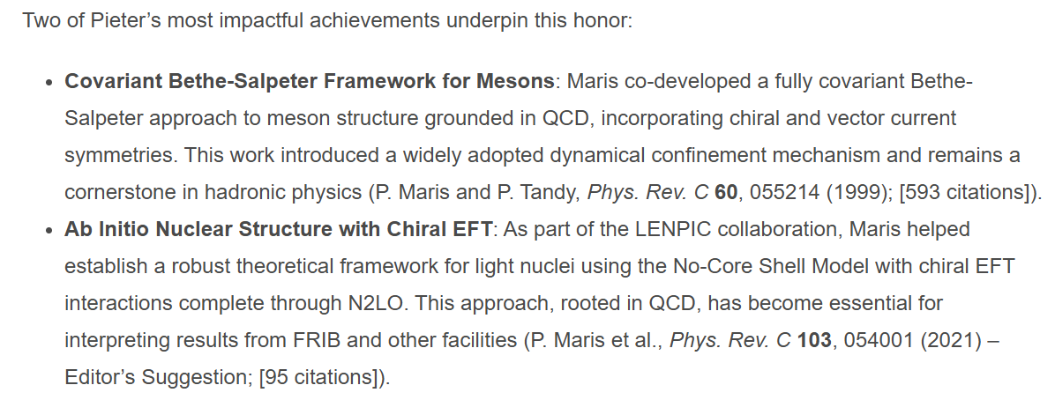

Slide 17
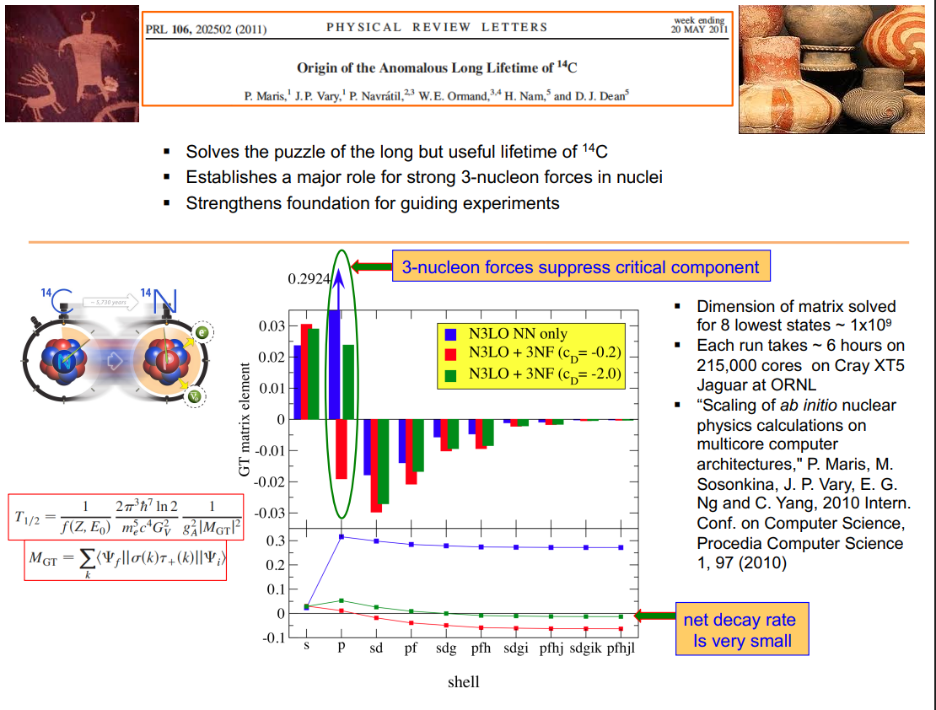

Slide 18




$B(GT)$ from Daejeon16 using the wave functions from ¹³C or ¹³N (based on isospin symmetry)
¹³C
¹³N
$$\frac{3}{2}−;\frac{1}{2}$$
3.68 MeV
B(GT)
3.5 MeV
$$\frac{3}{2}−;\frac{1}{2}$$
$$\frac{1}{2}−;\frac{1}{2}$$
g.s.
g.s.
$$\frac{1}{2}−;\frac{1}{2}$$

Slide 20
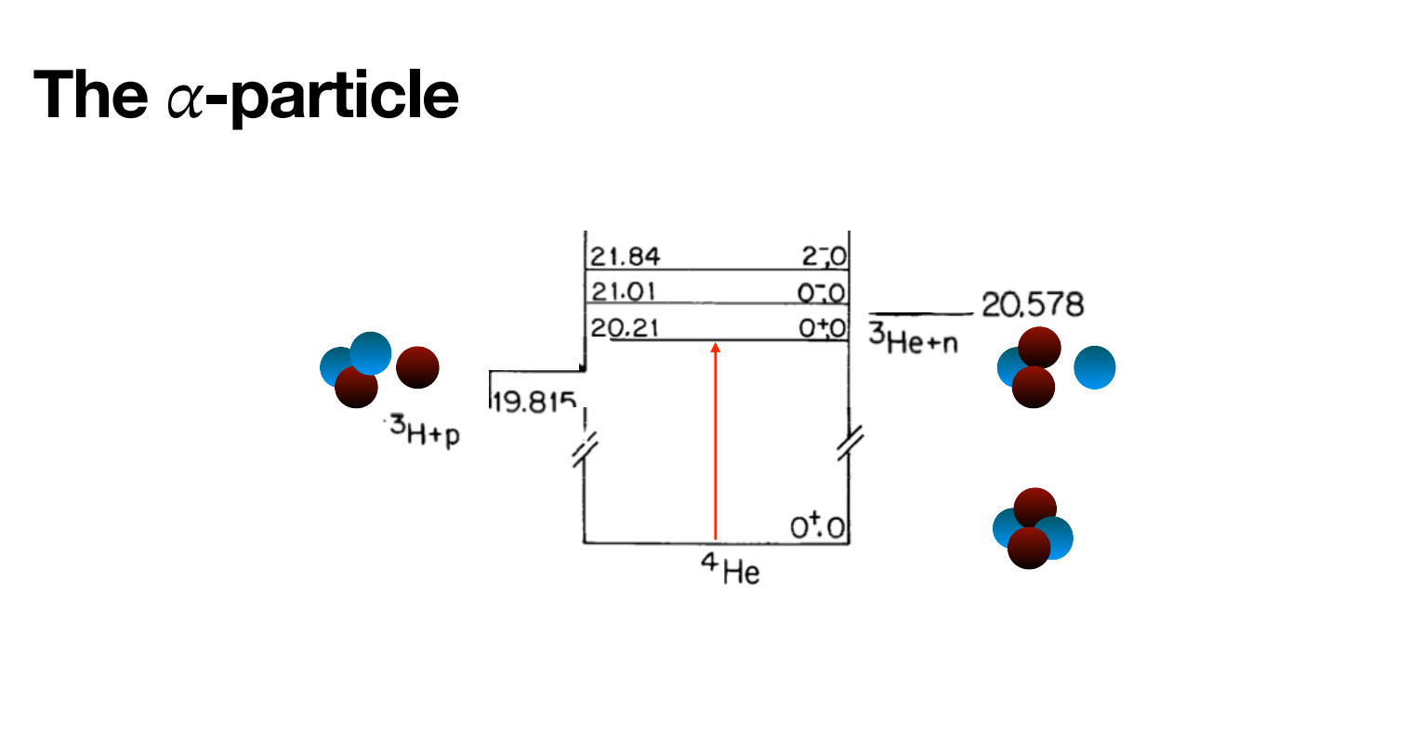
Transition monopole form factor of ⁴He

Slide 21
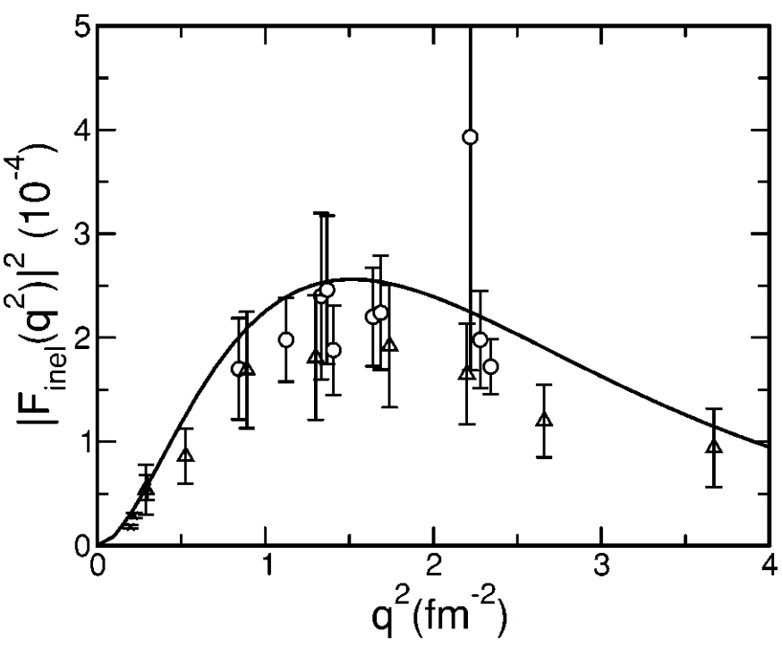
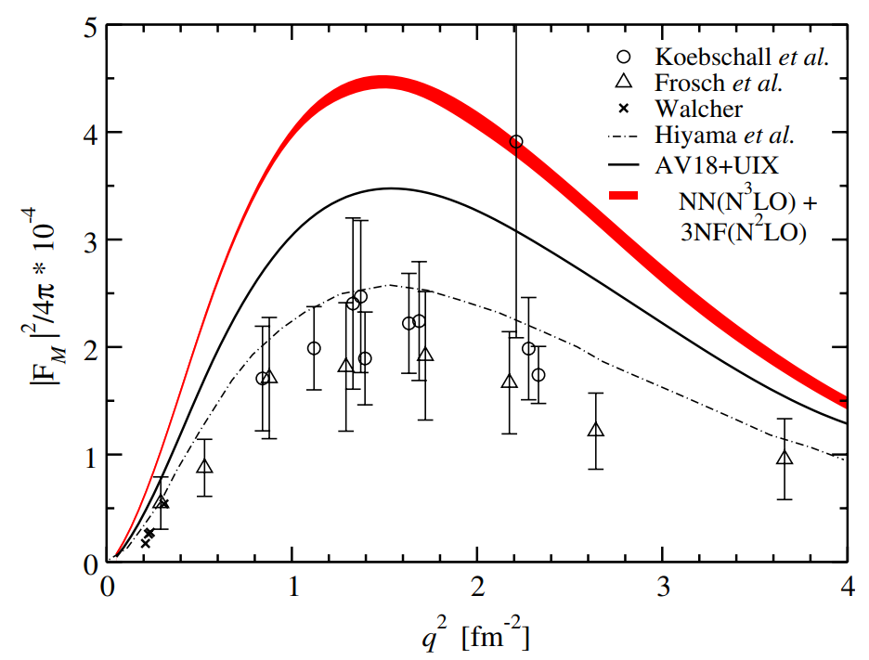
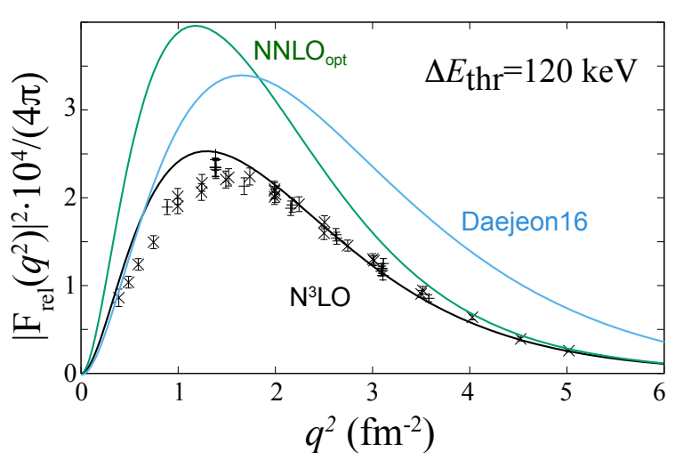
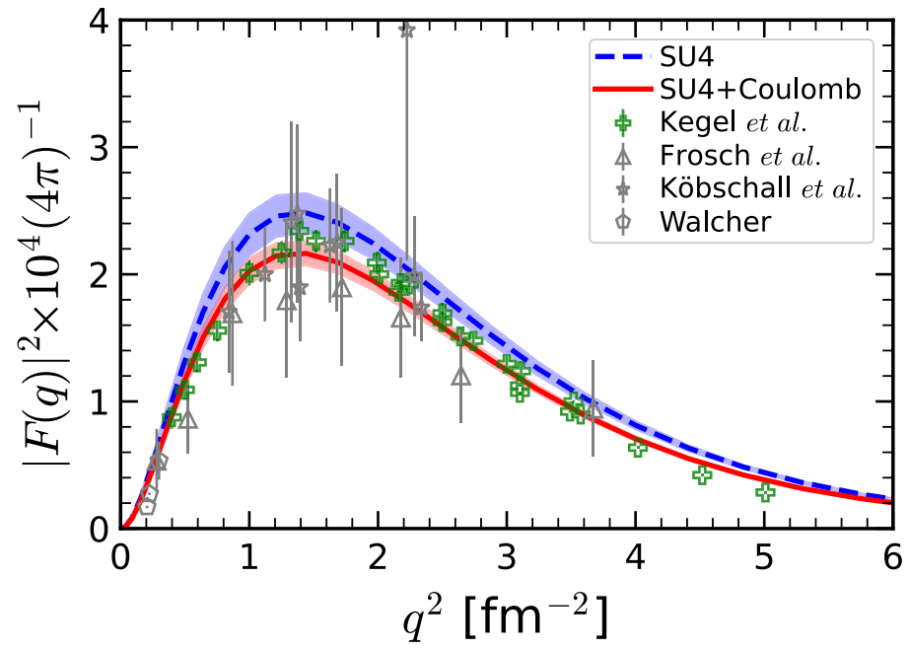
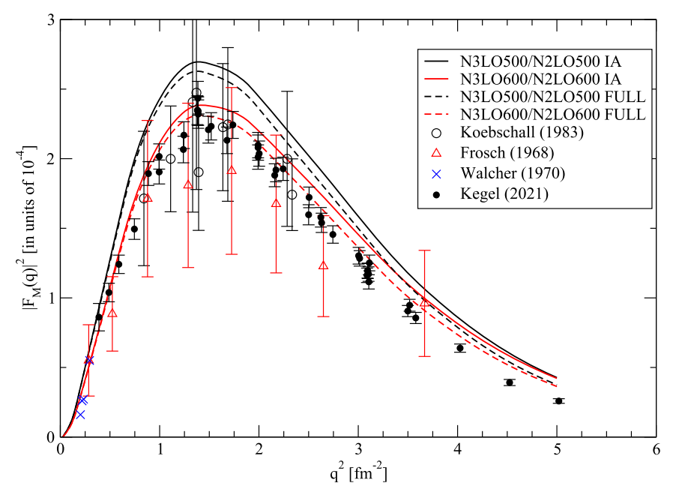
E. Hiyama et al., Phys. Rev. C 70, 031001(R) (2004)
S. Bacca et al., Phys. Rev. Lett. 110, 042503 (2013)
N. Michel et al., Phys. Rev. Lett. 131, 242502 (2023)&
Erratum(2025)
Meissner, et al., Phys. Rev. Lett. 132, 062501 (2024)
Viviani, et al., Few-Body Syst 65, 74 (2024)
P. Yin et al., Phys. Rev. C 112, L031303 (2025)

Slide 22
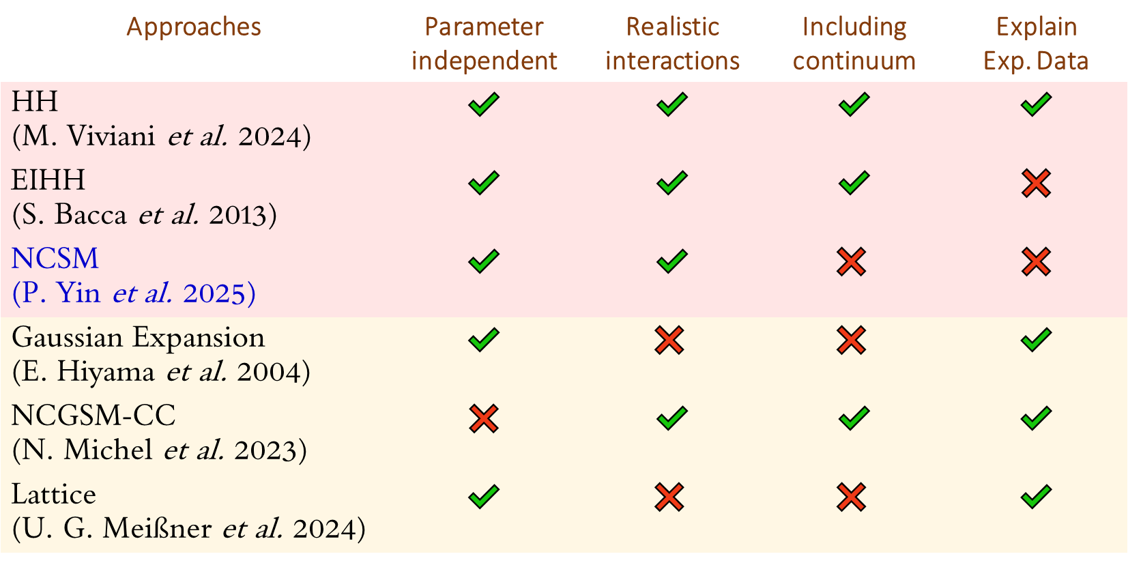
Approaches | Parameter independent | Realistic interactions | Including continuum | Explain Exp. Data
HH (M. Viviani et al. 2024) | ✔️ | ✔️ | ✔️ | ✔️
EIHH (S. Bacca et al. 2013) | ✔️ | ✔️ | ✔️ | ❌
NCSM (P. Yin et al. 2025) | ✔️ | ✔️ | $$\text{❌}$$ | ❌
Gaussian Expansion (E. Hiyama et al. 2004) | ✔️ | $$\text{❌}$$ | $$\text{❌}$$ | ✔️
NCGSM-CC (N. Michel et al. 2023) | ❌ | ✔️ | ✔️ | ✔️
Lattice (U. G. Meißner et al. 2024) | ✔️ | $$\text{❌}$$ | $$\text{❌}$$ | ✔️
Parameter independent
and
Realistic interactions
Parameter dependent
or
Unrealistic interactions
Puzzle not resolved!

Slide 23
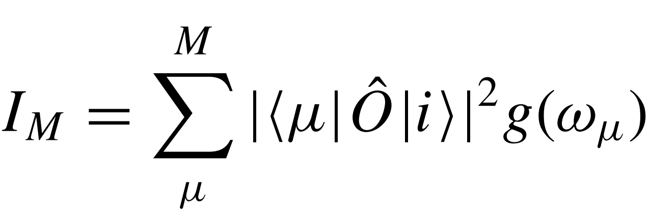
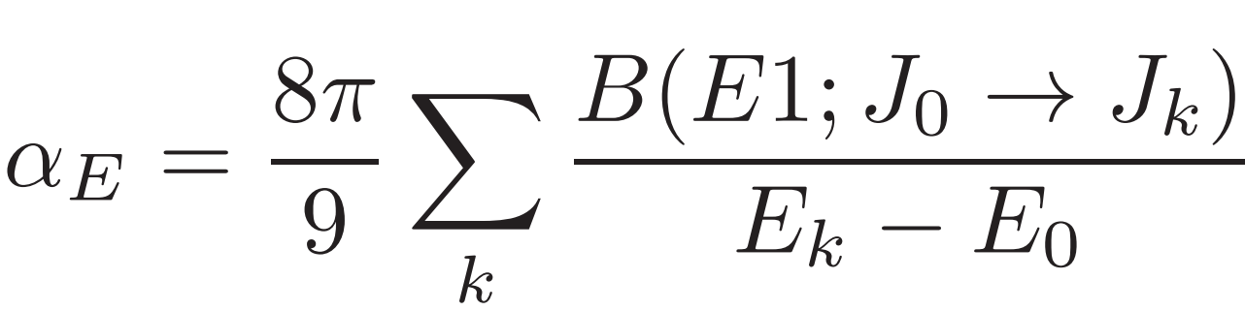
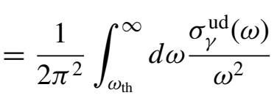
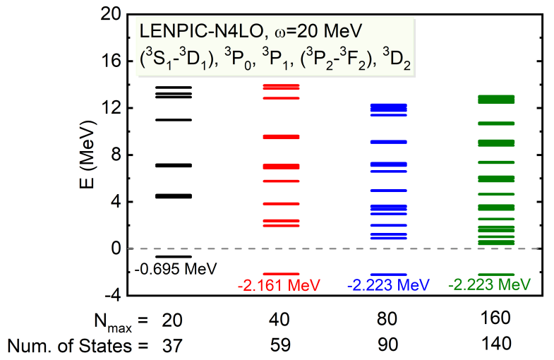
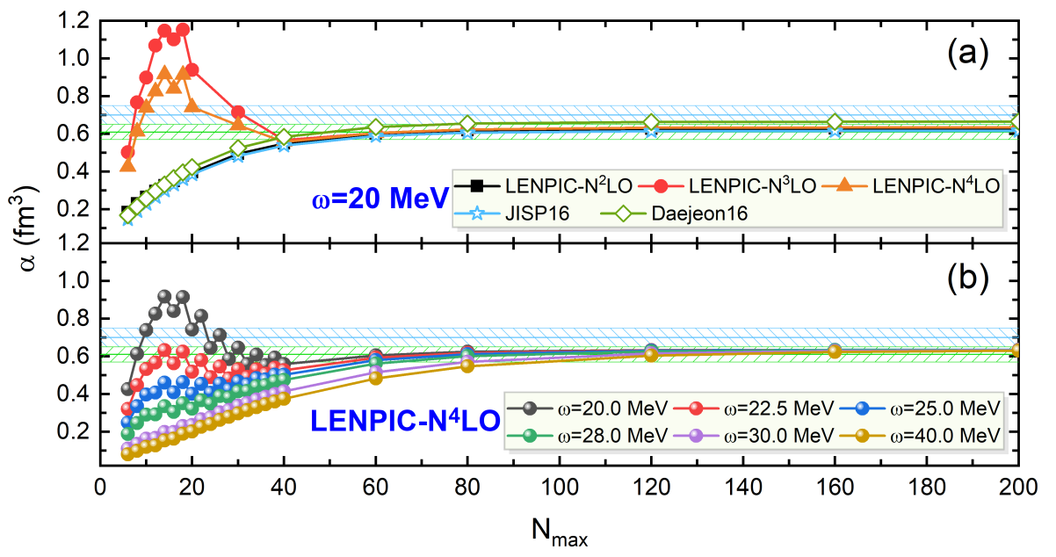
Sum rules with NCSM
Sum rule: response of nuclei to external field probe
Direct techniques: only available for deuteron
Indirect techniques: Lorentz integral transform, Lanczos sum rule method
A>2, direct calculation?
P. Yin et al, J.Phys.G 49, 125102 (2022)
P. Yin et al, [arXiv:2208.00267 [nucl-th]]
Notes:
求和规则是这样定义的，i是原子核的基态波函数，mu是激发态波函数，g是激发能的能量权重，算符可以是电磁跃迁算符，GT算符等等。我们需要对所有末态做求和。这个量反映了原子核对于一个外场的响应。比如原子核极化度是跟E1跃迁相关的一个求和规则，实验上可以通过光核反应或者原子核的库仑分解来测量。
原则上，计算求和规则最直接的办法是解出所有可能的激发态波函数，但是计算量太大，目前只对氘核能够实现，比如这张图上我们对氘核极化度做了一个计算，用不同的核力都得到了收敛的结果，但是对于A>2的原子核，直接计算数值上还没有实现，一般通过间接的方法，比如LIT或者LSR等方法来求解，这些方法都没有直接去求解激发态波函数。

Slide 24
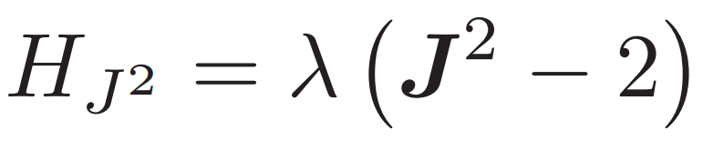
E1 polarizability of ⁴He with NCSM
⁴He: polarizability
E1 selection rule: 1⁻ states
Retain only 1⁻ states
M-scheme with M=1 (1⁻,2⁻,…)
Lagrangian multipler
Up through 100 MeV
N_{max}=15, hΩ=10 MeV
5522 1- states
30 GPU nodes, 16800 Lanczos iterations, 21 hours
P. Yin, A. M. Shirokov, P. Maris, P. J. Fasano, M. A. Caprio, H. Li,
W. Zuo, J. P. Vary, Phys. Lett. B 855, 138857 (2024)
Notes:
我们以4He为例，尝试用NCSM方法直接计算极化度这样一个求和规则。4He的基态是0+，根据E1选择定则，我们只用算出来1-态即可，如果我们用M-scheme求解的话，我们除了1-态，还能算出来一些2-，3-等等，这些态是我们不需要的态，所以我们在哈密顿量中加入了这样一项，加入这一项之后我们得到的能谱只有1-态。极大地降低了计算量。同时，我们计算的时候不可能取无穷多的1-态，我们计算的时候对激发能做一个截断，我们去了100 MeV激发能的截断，激发能截断造成的误差在10的-4次方量级。在左边这个图上我们画了一下100MeV以下1-态数量随Nmax的变化，可以看出来，1-态数量随Nmax增加基本上表现出指数增长，同时谐振子频率hw越小，产生的1-态就越多，要求的计算量也就越大，计算量最大的一个点是hw=10， Nmax15，我们需要在30个GPU节点上跑一天，最终能够得到5500个1-态。
100 MeV激发能的截断够不够，我们从右边两张图上能够看出，上面这个图，我们画了一下所谓的running sum，也就是极化度随激发能的演化，可以看出来随着激发能增加，计算能够达到收敛。

Slide 25
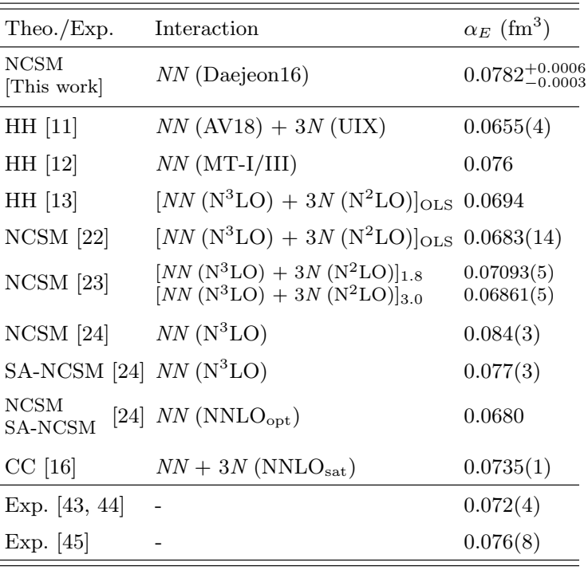
E1 polarizability of ⁴He with NCSM
Robust convergence with respect to N_{max}
Uncertainty due to N_{max} truncation and energy truncation
P. Yin, A. M. Shirokov, P. Maris, P. J. Fasano, M. A. Caprio, H. Li, W. Zuo, J. P. Vary, Phys. Lett. B 855, 138857 (2024).

Slide 26
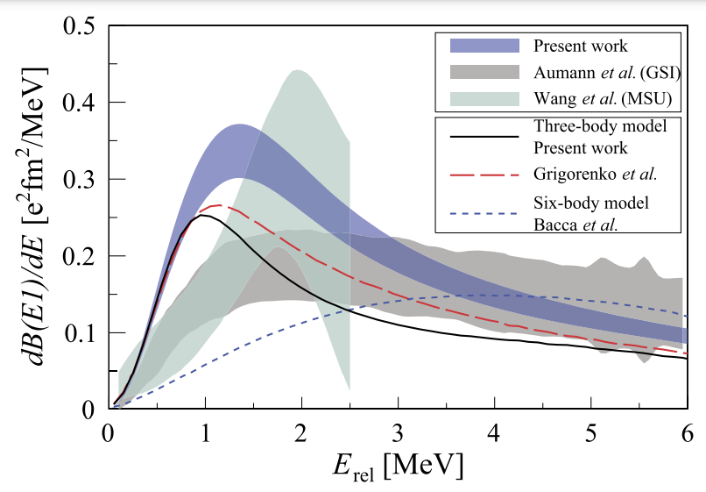
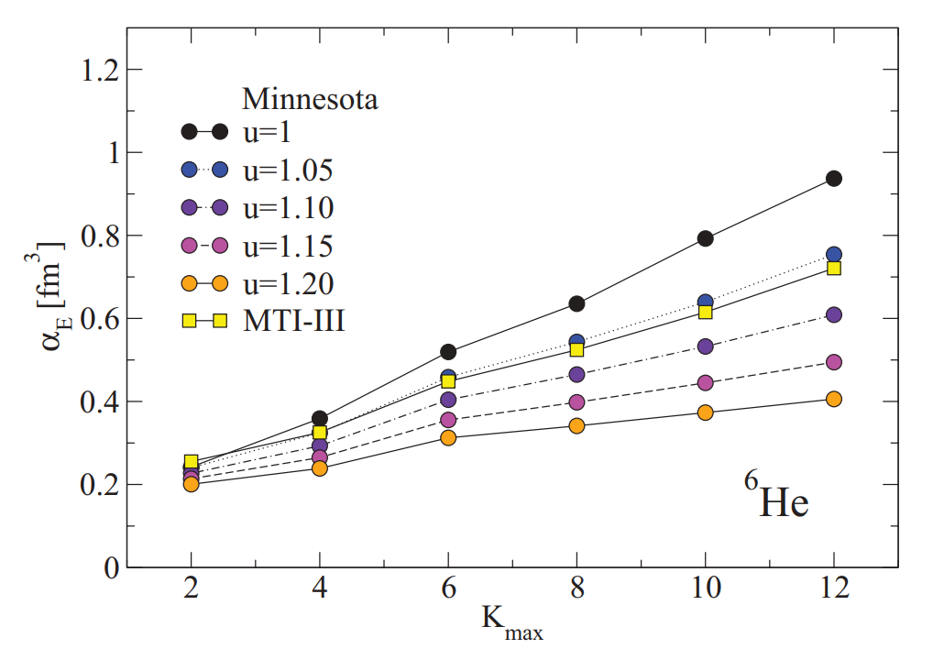
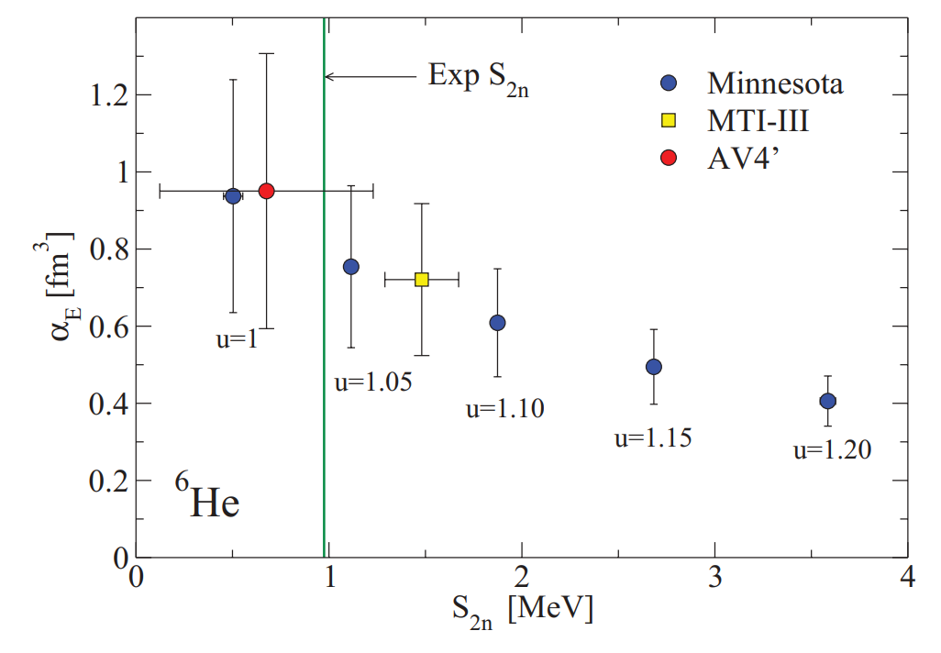
E1 polarizability of ⁶He with NCSM
R. Goerke, S. Bacca, N. Barnea PRC (2012)

Slide 27
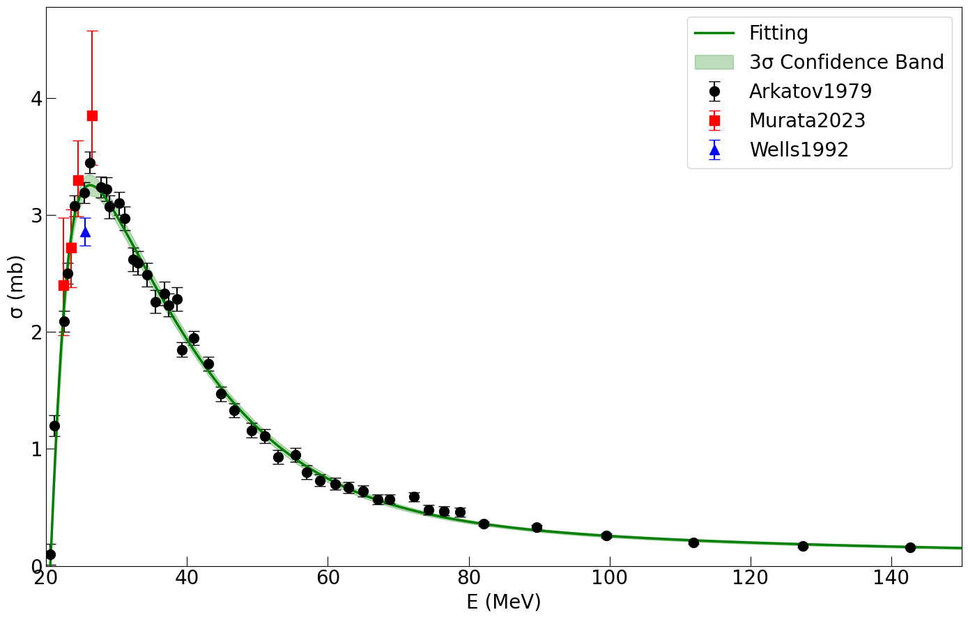
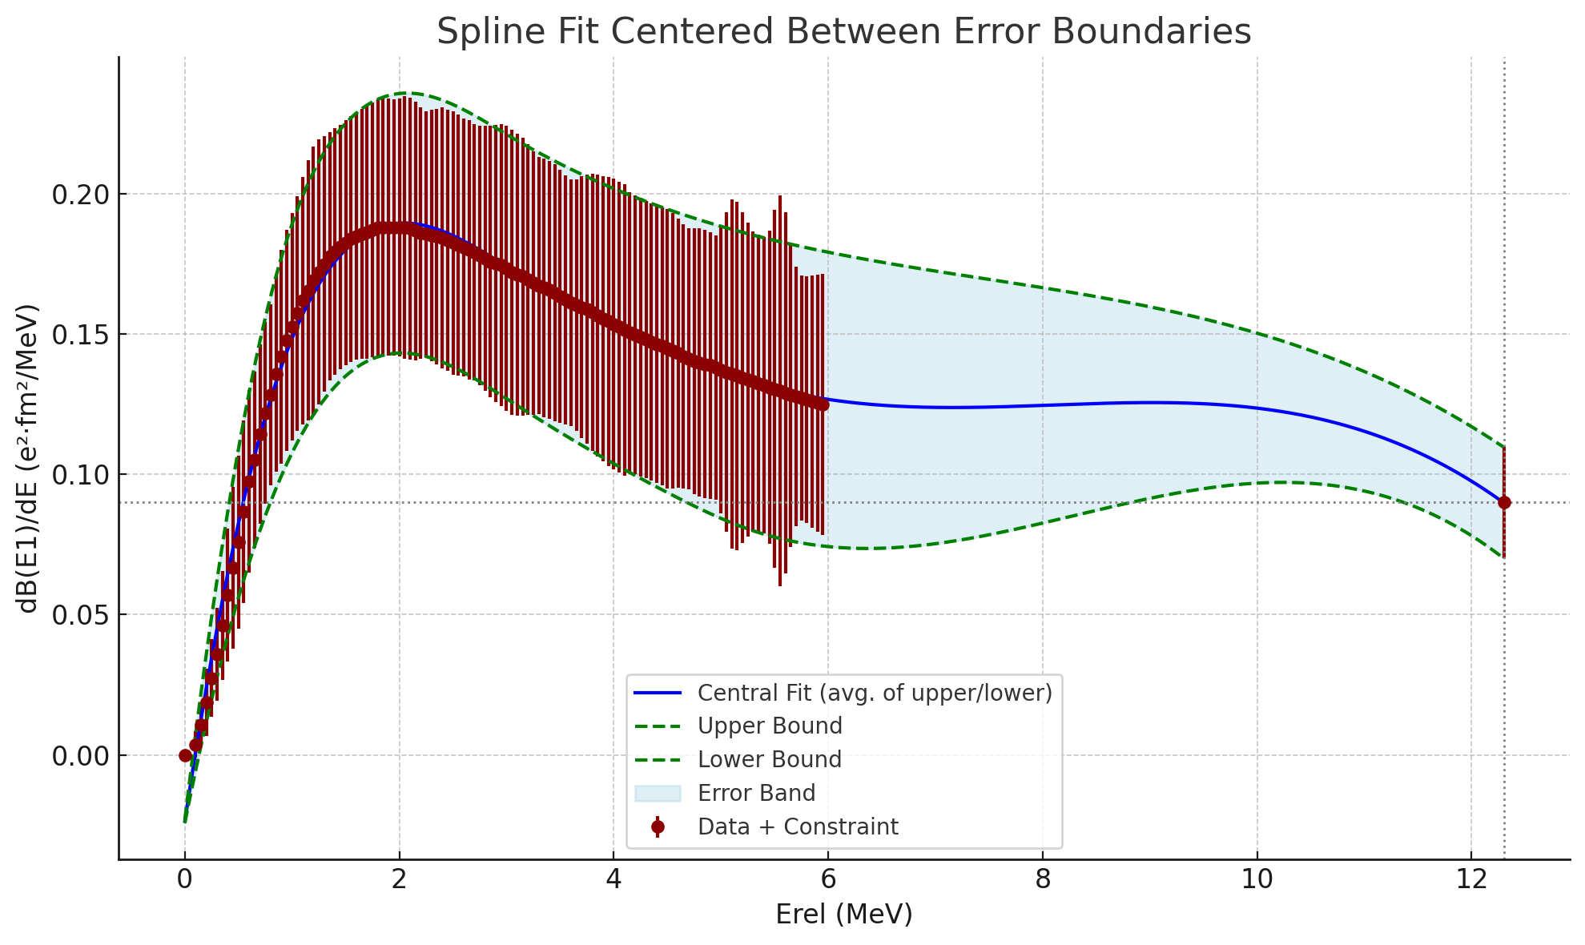
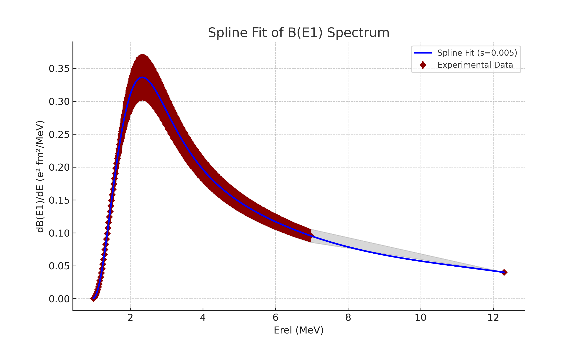
Σ^{BSR}=6.2+2.3=8.5 mb
Σ^{BSR}=5.83+2.3=8.2 mb
NCSM: ~6-7 mb

Slide 28
Summary
Introduction to ab initio NCSM
Applications: β-decay, Form factor, Sum rules
Outlook
Photoabsorption reaction (LIT, GIT)
Atomic hyperfine structure/Lamb shift
Two-body current

Slide 29
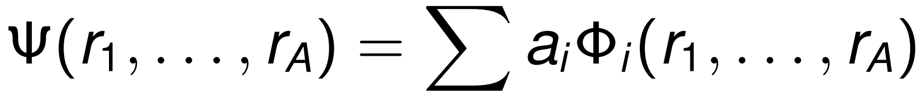
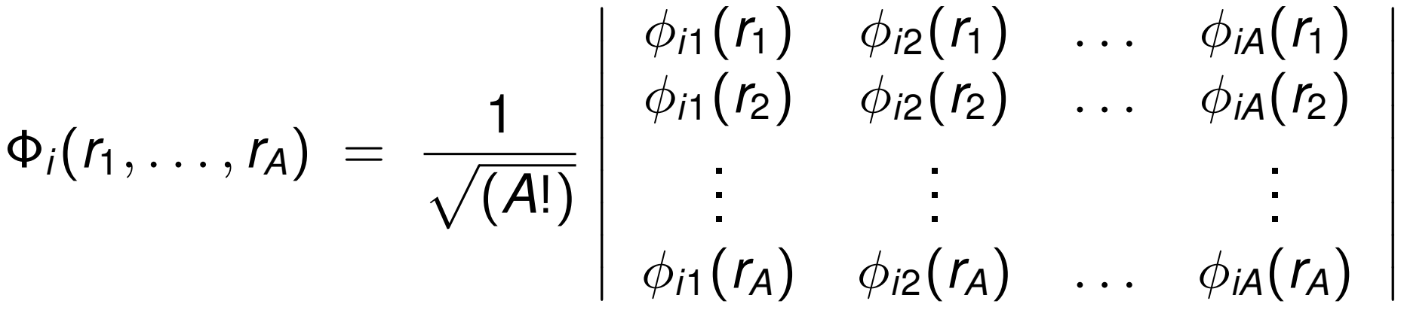
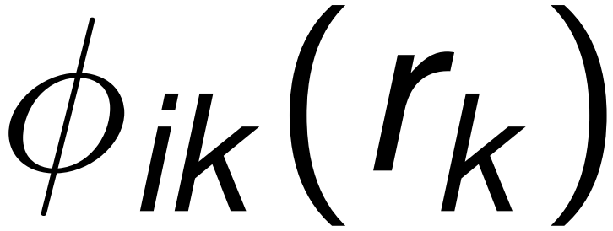
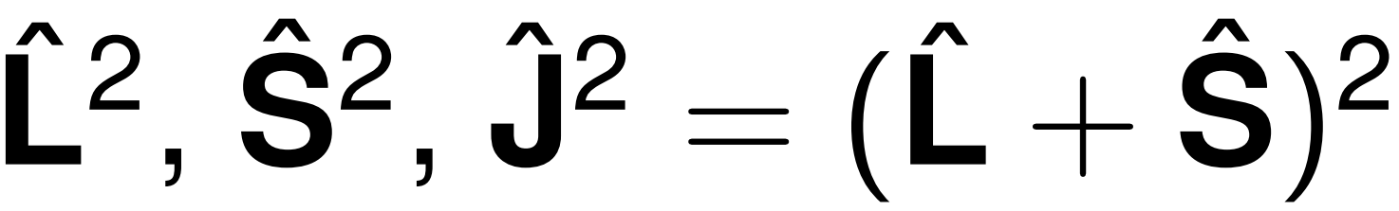


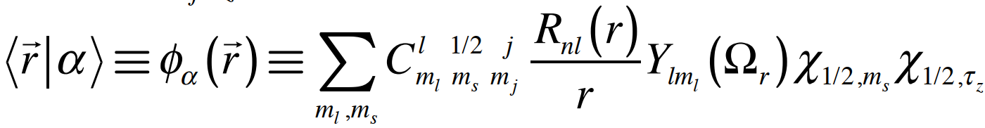
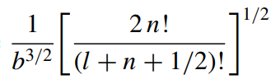

Basis Expansion
Expand A-body wave function in basis functions
Use basis of single Slater Determinants of Single-Particle states
Single Particle basis states
Eigenstates of operators , and
Radial wavefunctions:
Harmonic Oscillator (HO): allows for exact factorization of Center-of-Mass
Coulomb-Sturmian
Natural orbitals
HO radial:

Slide 30
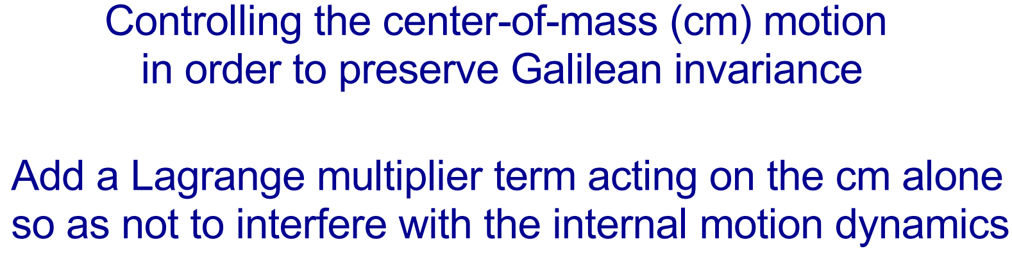
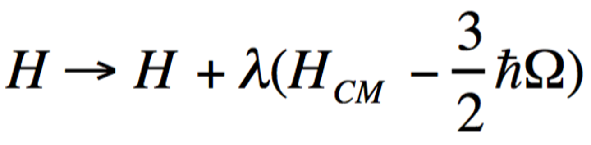
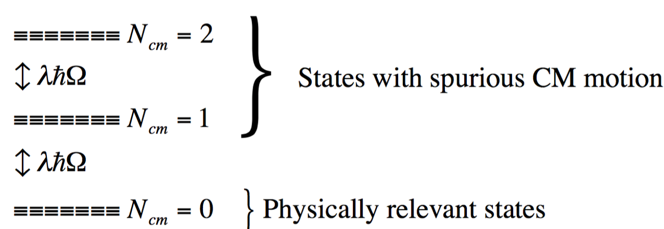
Remove spurious CM motion
Liplin-Lawson project method

Slide 31
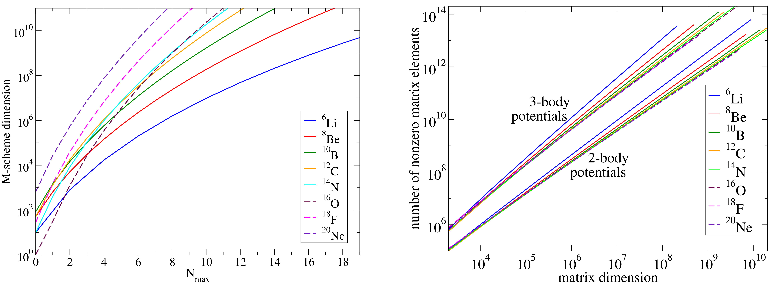
Main Challenges
Increase of basis space dimension with A and N_{max}
Need calculations up to at least N_{max}=8, preferably N_{max}=10 for meaningful extrapolation and numerical error estimates
More relevant measure for computational needs
Number of nonzero matrix elements
Notes:
通常做计算之前，我们需要大致估算一下我们需要多少计算资源。左边这个图上，我们看到哈密顿量矩阵的维度随截断参数Nmax指数增加，同时，核子数越大，矩阵的维度也就越大。通常我们需要算到Nmax=8-10才能观察到收敛的趋势，所以我们一般要达到10*10的维度。实际计算的时候我们更关心矩阵当中的非零矩阵元，我们不存储等于0的矩阵元，右边这张图上可以看到非零矩阵元与矩阵维度是基本上是一个线性相关的关系，加入三体力之后，非零矩阵元会增加1到2个量级。

Slide 32

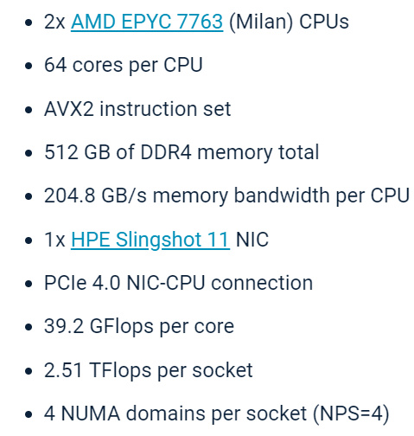
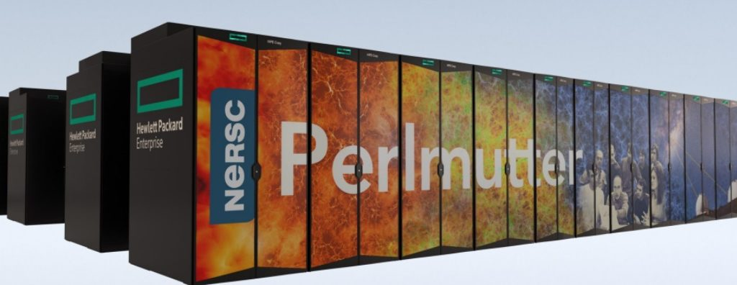


Main Challenge
Computationally demanding => needs new algorithms & high-performance computers
Requires convergence assessments and extrapolation tools to retain predictive power
Current limit 10¹⁴ (Perlmutter):
¹²C (N_{max}=12), ⁶He (N_{max}=22)
Achievable for nuclei up to A~20 with largest computers available
Notes:
我们以目前用的Perlmutter这台超算为例，看一下我们的计算上限，我们以CPU节点为例，3000个节点，每节点512G内存，我们最多能够计算大概10的14方量级的非零矩阵元，12C我们能够算到Nmax=12，6He能够算到Nmax=22。对于核子数小于20的原子核，我们都能做一些计算并且提供误差的估计。

Slide 33

Monopole transition form factor of ⁴He
Ground state: benchmark with few-body methods
Hiyama: Gaussian expansion, simplified force
Bacca: HH+LIT, realistic NN+3N from chiral EFT
E. Hiyama et al., Phys. Rev. C 70, 031001(R) (2004)
S. Bacca et al., Phys. Rev. Lett. 110, 042503 (2013)

Slide 34


Slide 35




Slide 36


Slide 37


Slide 38


Slide 39





Meissner, et al., Phys. Rev. Lett. 132, 062501 (2024)

Slide 40

Viviani: HH ³He+n, ³H+p, chiral NN+3N
Two-body current
First successful calculation with chiral EFT?
Strong isospin mixing of T=0 and T=1.
Viviani, et al., Few-Body Syst 65, 74 (2024)

Slide 41
Transition monopole form factor of ⁴He
Puzzle not resolved!
P. Yin, A. M. Shirokov, H. Li, B. Zhou , X. Zhao,
S. Bacca, J. P. Vary, arXiv2412.18037

Slide 42

Transition monopole form factor of ⁴He
Puzzle not resolved!

