Slide 1
ORBIT FEEDBACK SYSTEMS and XBPMs
Workshop on Accelerator R&D for Ultimate Storage Rings
30 October – 01 November 2012
Beijing
J-C. Denard, N. Hubert * and L. Cassinari*
* Diagnostics Group
Synchrotron SOLEIL, France
On behalf of the OFB team

Slide 2
Outline
Orbit Stability
USR stability requirements
Perturbation sources
SOLEIL design for stability
BPM system for USR
BPM supports
Vacuum issues
Electronics
Orbit Feedback systems
Feedback Bandwidth
Short term stability
Slow drifts
XBPMs and photon beam feedback systems
Existing XBPMs in e-beam FB loops
XBPM developments needed
Other kind of photon beam feedback systems

Slide 3
USR Stability Requirements
The minimum attainable beam size is the diffraction limited photon beam
Photon beam dimensions from an undulator:
10 keV photons
w/ 2m undulator
Size σ = 1.8 µm
Div. σ’ = 5.6 µrad
σ/10 requirements
∆ position ≤ 180 nm
∆ angle ≤ 560 nrad
E (keV)

Slide 4
Sources of Perturbations (4)
Beamline Acquisition Time:
If T_{PERTURBATION} > T_{INTEGRATION} → Emittance growth
If T_{PERTURBATION} < T_{INTEGRATION} → Drifts
N
O
I
S
E
S
O
U
R
C
E
S
Experimental hall activities
Ground vibrations
Insertion Devices
Cycling Booster
operation
mains +harmonics
Thermal effects
Frequency (Hz)
10⁻²
10⁻¹
1
10
10²
10³
Time Period (s)
10²
10
1
10⁻¹
10⁻²
10⁻³
Drift
Emittance growth only
1/T_{i}
An orbit feedback is needed to stabilize the beam position from DC up to ~200 Hz

Slide 5
Soleil Design for Stability (1)
Machine & expérimental hall on a common concrete slab made on top of 11 to 17 m long pilars resting on compact « Fontainebleau » sand.
Building structure and crane supports are decoupled from the stable slab.
Machine tunnel air and machine water cooling stabilized to 21±0.1°C. Actual air temperature is not exactly at that temperature. Stabilization is closer to ±0.25 °C around average values that can be different from 21°C. The important thing is to keep the temperatures stable whatever they are.
Girder rigidity in order to have all resonances above ground excitation frequencies (> 50 Hz)
The BPMs must be stable (beam stability cannot be better than that of the BPM system.)
The BPM is the fixed point of its vacuum chamber section; the rest of vacuum chamber can move during beam delivery and during baking. There is a bellow on at least one side of each BPM. Bellows are shielded for low vacuum chamber impedance
The BPM supports are rigid in transverse directions, the vertical stability of 4 BPMs (for the long beamlines) is garanteed by INVAR supports.
The BPM blocks are water cooled.

Slide 6
Soleil Design for Stability (2)
The golden orbit is done with respect to the quadrupole magnetic center (via Beam Based Alignment). But after that, the reference becomes the concrete slab via the BPMs adjacent to each straight section. With a perfect orbit feedback algorithm, only slab deformation could spoil beam stability.
Top up operation
Feedforward corrections for changes of undulator gap and phase, to better than 10 µm (should be down to 2 µm for USRs)
Booster compensation cables have been installed for correcting a 3 Hz spectrum line due to Booster ramping power supply cables. Cooling fans have been displaced for suppressing 47 to 108 Hz spectrum lines.
Orbit feedback systems. This is the last stone of the stability building blocks. It suppresses the ID feedforward residuals, small temperature variation effects in the tunnel, but not large ones. The FOFB is not very efficient above 70 Hz (with a 200 Hz BW).

Slide 7
Outline
Orbit Stability
USR stability requirements
Perturbation sources
SOLEIL design for stability
BPM system for USR
BPM supports
Vacuum issues
Electronics
Orbit Feedback systems
Feedback Bandwidth
Short term stability
Slow drifts
XBPMs and photon beam feedback systems
Existing XBPMs in e-beam FB loops
XBPM developments needed
Other kind of photon beam feedback systems

Slide 8
BPM Mechanical and Vacuum Design
Mechanical design:
Thermal expansion coefficients of steel is 11ppm/°C => at 1.2 m height and 0.1°C drift, one gets 1.3 µm drift.
INVAR is ~10 times better. A solution could be Invar BPM supports, at least at the critical locations.
Vacuum BPM Design:
With 20 mm diameter vacuum chambers, the button BPMs might loose too much sensitivity
New BPM design for small round pipe
Shielded bellows matching the small round tubes.

Slide 9
BPM Electronics for USRs
The Libera commercialized by Instrumentation Technologies is the state of the art.
Libera fulfills the USR requirements:
Low temperature drifts
Low beam current dependence (< 200 nm in top-up mode)
Low bunch pattern dependence
Position interlock built in
Fast orbit feedback features built in (for BW up to ~200 Hz; it is possible to go up to 500 Hz, like at Petra III)
Post mortem data available
High reliability
(thanks to the electrode switching
scheme)

Slide 10
USR Orbit Feedback Systems
Probably similar to existing systems
Bandwidth extension to 500 Hz would supress better the 50Hz spectrum lines of the mains (60 Hz in Americas)
Vacuum chamber space with thin stainless steel walls need to be reserved for fast correctors
If a square correction matrix is not possible, the correction algorithm should favor the few beamlines with tightest stability requirements

Slide 11
SOLEIL Feedback Characteristics
Parameters (H,V) | SOFB | FOFB
BPM # | 122, 122 | 122, 122
Corrector # | 57, 57 arcs | 50, 50 Straight sections
Sing. Value # | 57, 57 | 46, 47
Corrector max. | 1.0, 0.7 mrad | 28, 23 µrad
Correction rate | 0.1 Hz | 10 kHz
Bandwidth | 0-0.05 Hz | 0-200 Hz
Efficiency | IDs and arcs | Mostly IDs

Slide 12
Slow orbit feedback system
Orbit stability requirements
1/10th of beam sizes (H: 20 µm, V: 0.8 µm)
122 BPMs
50 with supports on tunnel slab (4 of them on INVAR stands)
72 with supports bolted on top of the girders
Libera Electronics noise: 0.02 µm rms (0.1-10 Hz)
57 Horizontal and vertical steerers
Cut-off frequency a few 10’s of Hz (Al Chamber)
RF-frequency Algorithm: SVD 57 singular values in both plane
correction rate: every 10 s
5 s averages of 10Hz BPM data
RF frequency correction step size : 0.3 Hz
Matlab based control application
Libera module
Steerers are made with secondary coils in sextupole magnets

Slide 13
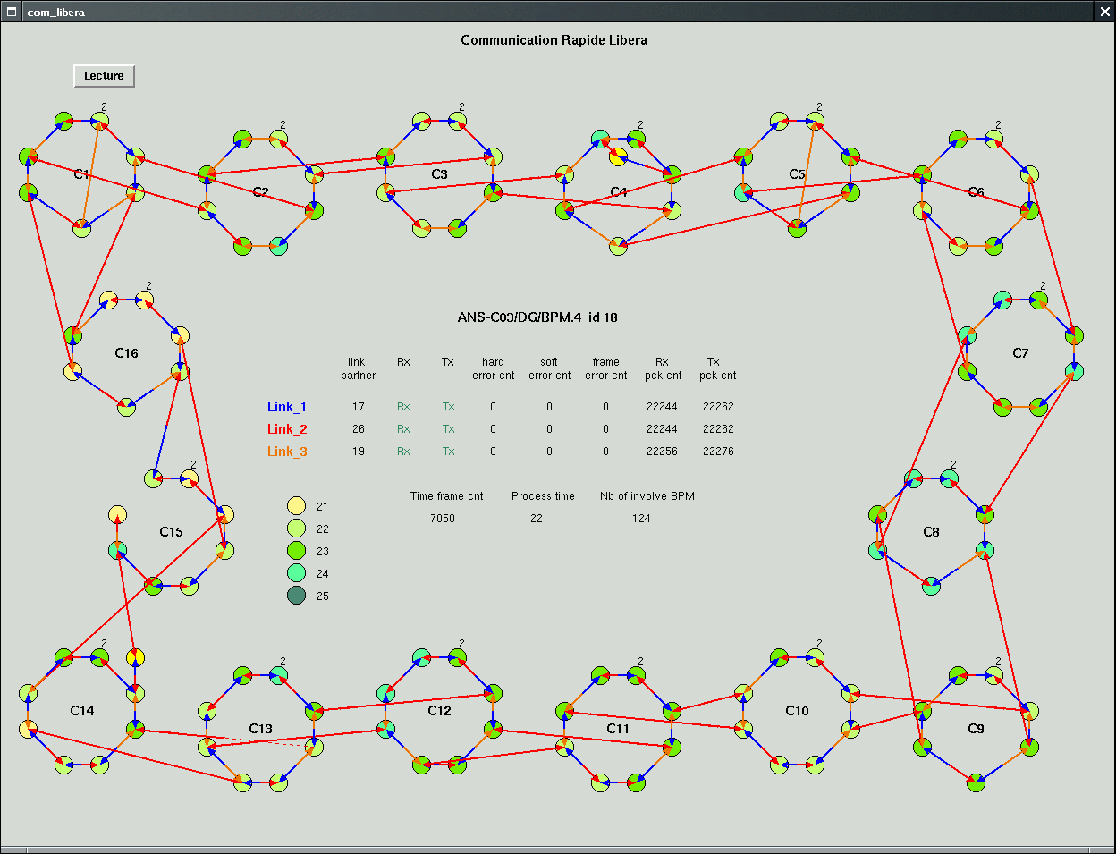
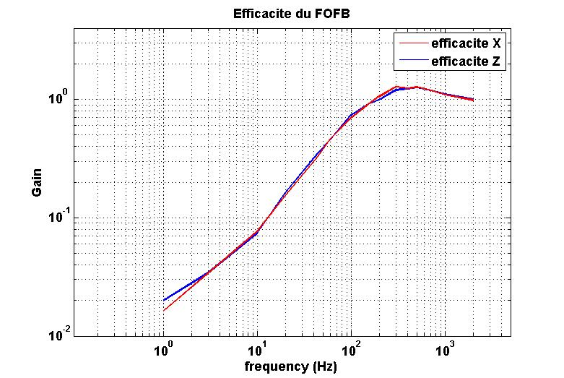
Fast Orbit Feedback System
An all-embedded and distributed solution
Diamond Communication Controller for data distribution
Computation done inside Libera FPGA (1 H&V corrector ↔ 1 Libera)
Corrector power supplies controlled by Libera modules
122 LIBERA modules
122 BPMs
0 dB gain
50 fast correctors
100 power-supplies
200 Hz

Slide 14
Both Slow and Fast Systems work together
The Soleil orbit feedback systems are unique so far : they have two distinct sets of correctors for the slow and the fast system.
Advantages: air correctors over a thin stainless steel pipe can make fast corrections.
An algorithm periodically unloads the fast (and weak) correctors onto the slow (and more powerful) correctors.
The slow feedback benefits from its larger number of correctors for better correcting slow drifts.
It looks like the best way to go for future USRs.

Slide 15
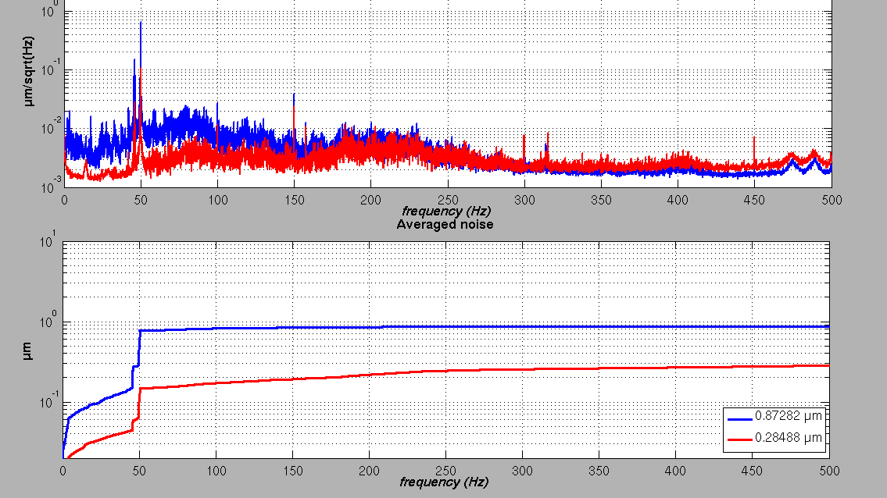
SOLEIL Fast Orbit Feedback System
Vertical plane
FOFB ON
FOFB OFF
FOFB OFF
FOFB ON
Vertical beam motion averaged on all e-BPMs ~300 nm (0.1-500 Hz )
It means 200 nm RMS in the middle of the straight sections

Slide 16
Fast Orbit Feedback Bandwidth
N. Hubert
SR Facility | FB type (users operation) | Sets of correctors | Bandwidth
ALBA* | Fast | Strong | DC - 130 Hz
BESSY II * | Fast | Strong | DC - 40 Hz
DIAMOND | Fast | Strong | DC - 130 Hz
ELETTRA | Fast | Strong | DC - 150 Hz
ESRF-U* | Fast | Strong | DC - 150 Hz
SLS | Fast | Strong | DC - 100 Hz
SPEAR3 | Fast | Strong | DC - 100 Hz
ALS | Slow + Fast | Strong ( + Fast as a subset of slow ones) | DC - 60 Hz
APS | Slow + Fast | Strong (+ Fast as a subset of slow ones) | DC - 100 Hz
ESRF | Slow + Fast | Strong + Fast | DC - 150 Hz
NSLS II* | Slow + Fast | Strong + Fast | DC - 500 Hz
PETRA III | Slow + Fast or Fast | Strong + Fast | Dead-band or DC - 500 Hz
SOLEIL | Slow + Fast | Strong + Fast | DC - 20 Hz
SSRF | Slow + Fast | Strong + Fast | DC - 100 Hz
Bandwidth Limitations:
BPM electronics latency
Correctors & Power supplies
Vacuum Chamber Eddy Currents
Fast network Latency
SOLEIL noise suppression requires BW > 150 Hz
No real need for BW > 500 Hz
* Feedback system not yet commissioned

Slide 17
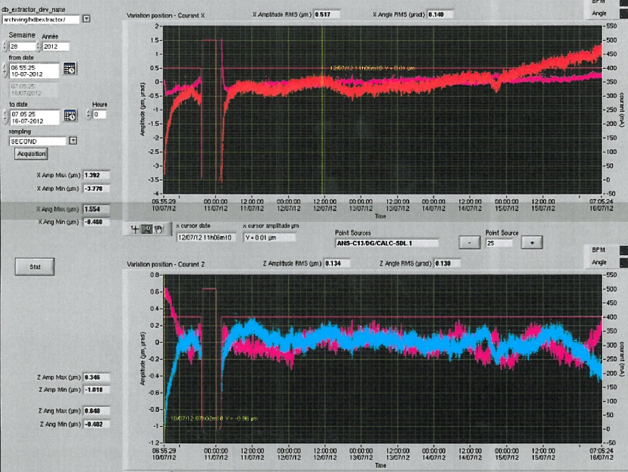
Slow Drifts
Horizontal plane
X
1-week rms Drifts
∆X = 0.517 µm rms
∆X’ = 0.140 µm rms
∆Y = 0.134 µm rms
∆Y’ = 0.130 µm rms
X’
1 µm or µrad
1 week Beam Delivery
NanoTomography source point position and angle during 1 week
Vertical plane
peak to peak values
∆X = 5.16 µm p to p
∆X’ = 2.01 µm p to p
∆Y = 1.36 µm p to p
∆Y’ = 1.05 µm p to p
Y
Y’
1 µm or µrad

Slide 18
Outline
Orbit Stability
USR stability requirements
Perturbation sources
SOLEIL design for stability
BPM system for USR
BPM supports
Vacuum issues
Electronics
Orbit Feedback systems
Feedback Bandwidth
Short term stability
Slow drifts
XBPMs and photon beam feedback systems
Existing XBPMs in e-beam FB loops
XBPM developments needed
Other kind of photon beam feedback systems

Slide 19
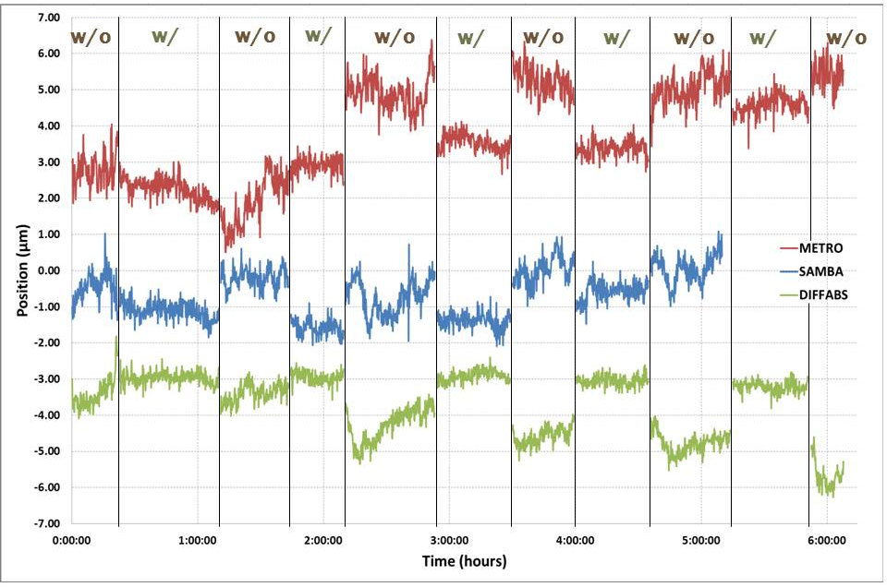
Photon BPMs of BM Beamlines in OFB at SOLEIL
Introduction of photon XBPMs in the orbit feedback loop
Stabilization of the Photon beam position on Bending Magnet Beamlines
XBPM in the global loop
XBPM is considered as an e-BPM
Possible only if XBPM measurement is reliable at any time (no gap/phase dependence)
Fully tested; will be in routine operation in November 2012
Variation (RMS) of the vertical position on x-BPM N°2 with and without x-BPM N°1 in the slow feedback loop (experiment duration = 6 hours).
Beamline | RMS drift w/o XBPMs | RMS drift w/ XBPMs | Stability Gain
ODE | 1.25 µm rms | 0.37 µm rms | 3.3
METRO | 0.46 µm rms | 0.24 µm rms | 1.9
SAMBA | 0.38 µm rms | 0.23 µm rms | 1.7
DIFFABS | 0.33 µm rms | 0.16 µm rms | 2.1
Vertical beam position measured on second x-BPMs (not included in the feedback loop) at the METRO, SAMBA and DIFFABS bending magnet beamlines. First x-BPM is alternatively included or excluded from the slow feedback loop. Improvement on vertical stability can be seen when the SOFB runs with the x-BPMs

Slide 20
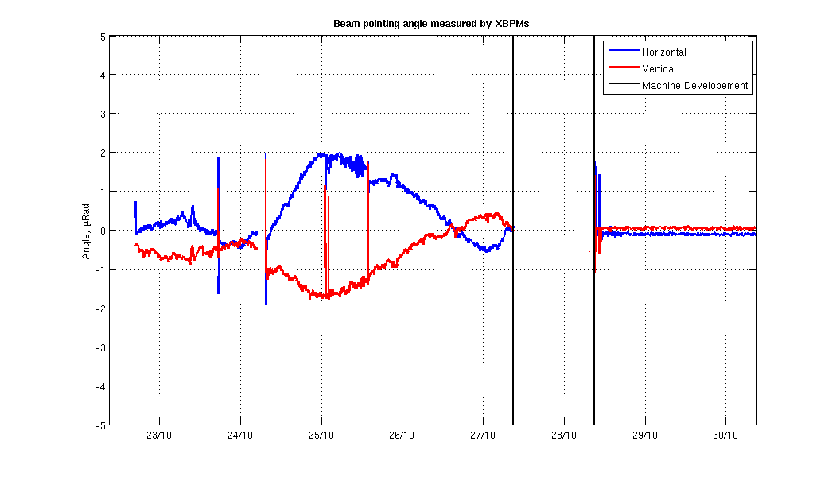
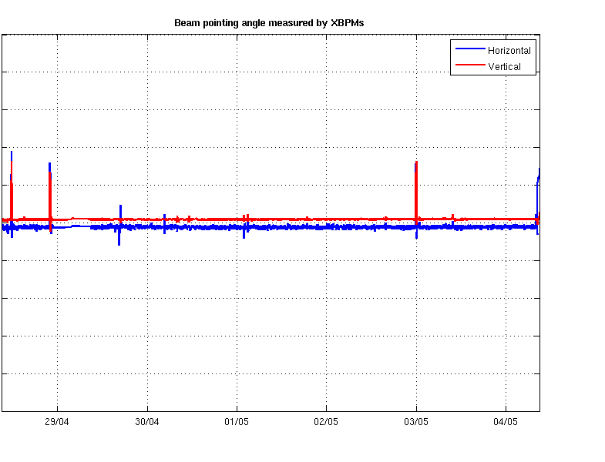
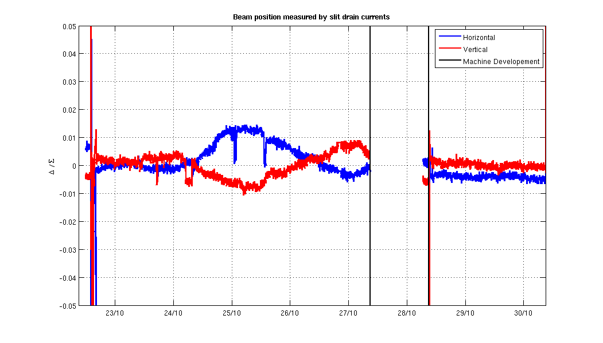
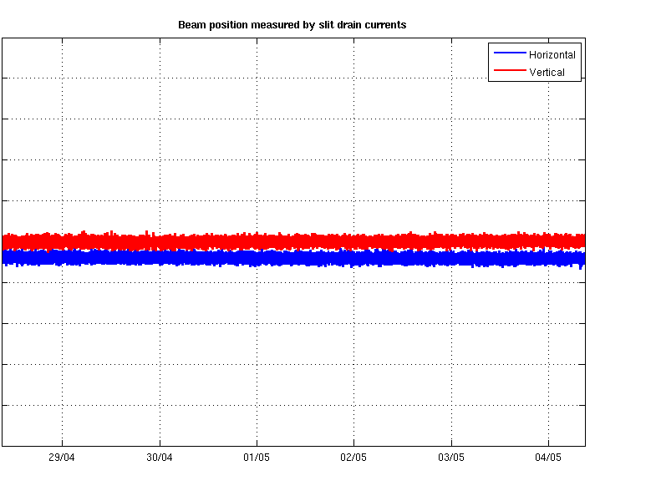
XBPMs in Slow OFB at Diamond
Without XBPM feedback.. ..with XBPM feedback.
Front End XBPMs
Courtesy C. Bloomer
Beamline slit currents
(Data from beamline I19)

Slide 21
XBPMs, State of the Art
There are Reliable XBPMs; maybe not at the 200 nm level yet.
BM beamline XBPMs (blade type) OK in vertical plane only
ID XBPMs (blades type) OK in both planes at fixed gap.
Most XBPMs are in stainless steel and are sensitive to temperature variations.
Present Development SOLEIL/LNLS of a stable blade XBPM at the 200 nm level, even after a beam loss. Not yet tested.

Slide 22
XBPM R&D for USRs
Need hard X-ray photon BPMs stable with gap changes. Not an easy tasks
Need soft X-ray XBPMS stable with gap/phase changes. This is even more difficult
A better way might be to maximize the white beam flux through the beamline like it is done in some beamlines after the monochromator (exemple at DLS, Bloomer SRI2012)
One should be able to do better by improving communication between machine and beamlines.
Then one could install a sensor in the Beamline for a feedback on the electron beam.

Slide 23
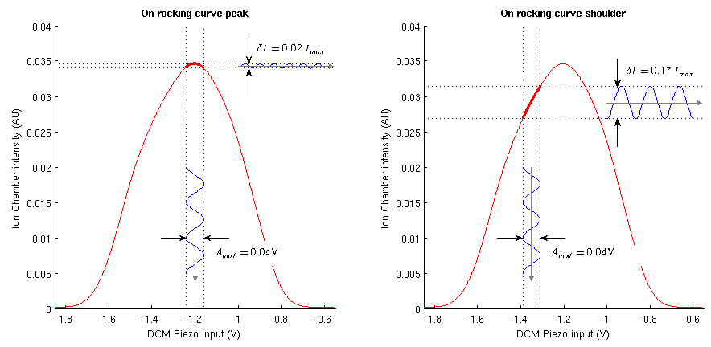
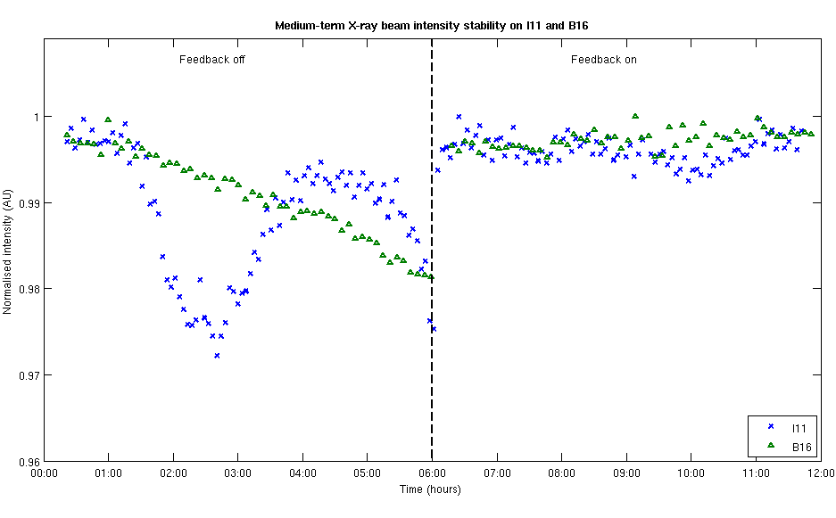
Using DCM pitch modulation and feedback to improve long term X-ray beam stability
SRI2012, courtesy of C Bloomer (DLS)
Using this system the beam intensity at the sample point can be maintained for several hours to 0.1% r.m.s., an improvement of a factor of 5.

Slide 24
White Beam XBPM: Tentative Requirements for USRs
ID Gap and Phase independence
Beam current independence (for all XBPM current range)
Stability ≤ 10 µm during acquisition time for XBPM performing 560 nrad angular control at 20 m from the source point.
But in order to measure the real machine stability with an instrument outside the orbit feedback loop one needs better than 200 nm resolution and stability like for eBPMs.
Stability should be evaluated in the worse case : Difference (before – after) a beam loss at full current. It takes thermal inertia into account.

Slide 25
XBPM for checking Machine Stability
Ring
BL Frontend
Beamline
upstream
e-BPM
downstream
e-BPM
X-BPM
#1
X-BPM
# 2
undulator
slits
~10 m
~10 m
~3 m
HLS
Concrete slab
The second XBPM for Feedback; the first one outside the FB loop monitors machine
stability
The HLS monitors slab deformation; it could eventually correct for it via a dedicated
slow feedback

Slide 26
XBPM electronics Requirements
Stable within its environment temperature range
Compatible with orbit feedback systems (slow and fast). A « photon-Libera » is commercialized (IT/Soleil collaboration) with these specifications
Beam current dependence (measured with a simulated 0.5 mm off-centered beam) over the useful beam current dynamic range (includes all XBPMs, BM and IDs)

