Slide 1
Optimization of dynamic aperture for the ESRF upgrade
Andrea Franchi
on behalf of the
ASD Beam Dynamics Group
Workshop on Accelerator R&D for Ultimate Storage Rings
October 30-November 1, 2012 Huairou, Beijing

Slide 2
Outlines
The Hybrid Multi-Bend (HMB) lattice
Nonlinear optics: existing ESR SR Vs HMB lattice
Optimizing dynamic aperture

Slide 3
Outlines
The Hybrid Multi-Bend (HMB) lattice
Nonlinear optics: existing ESR SR Vs HMB lattice
Optimizing dynamic aperture

Slide 4
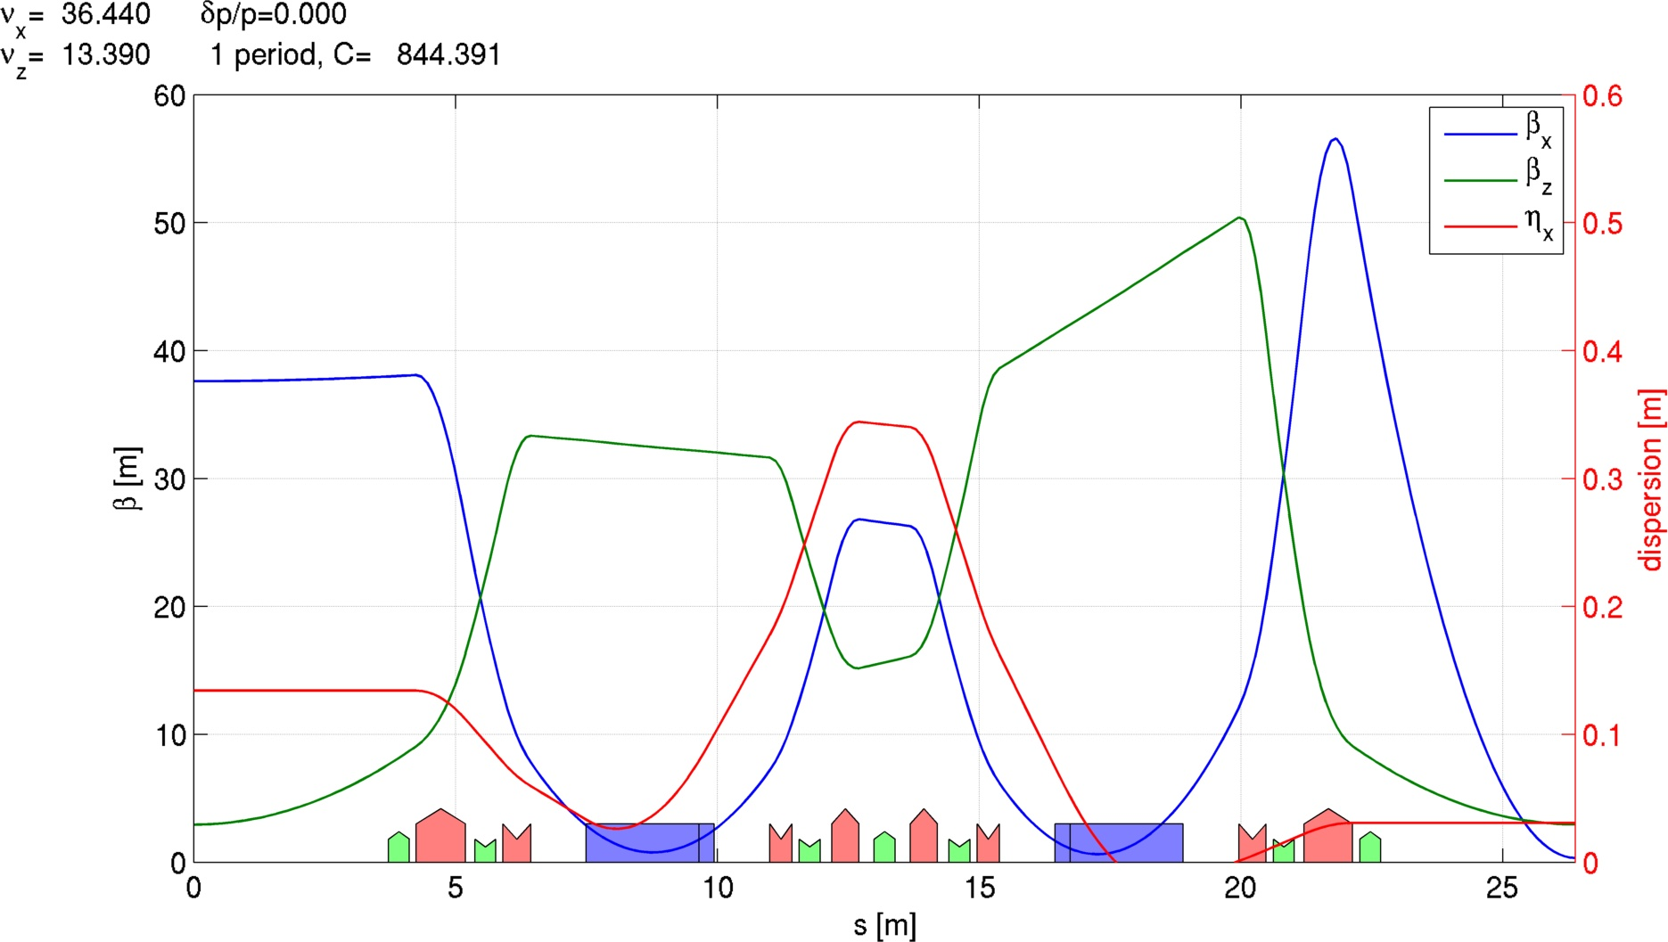
The Hybrid Multi-Bend (HMB) lattice
Double-Bend Achromat (DBA)
Many 3rd gen. SR sources
Local dispersion bump (originally closed) for chromaticity correction

Slide 5
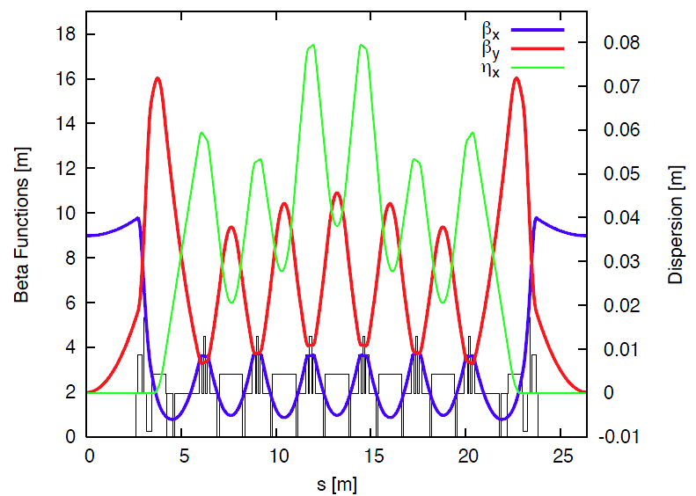
The Hybrid Multi-Bend (HMB) lattice
Double-Bend Achromat (DBA)
Many 3rd gen. SR sources
Local dispersion bump (originally closed) for chromaticity correction
Multi-Bend Achromat (MBA)
MAX IV and other USRs
No dispersion bump, its value is a trade-off between emittance and sextupoles (DA)

Slide 6
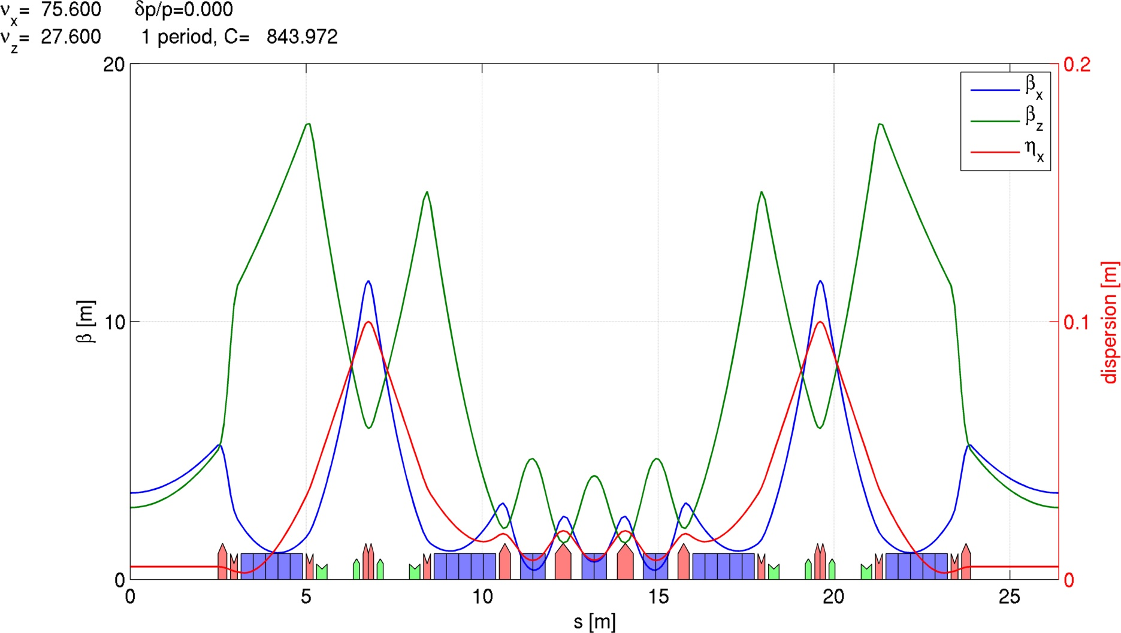
The Hybrid Multi-Bend (HMB) lattice
multi-bend for lower emittance

Slide 7
The Hybrid Multi-Bend (HMB) lattice
multi-bend for lower emittance
dispersion bump for efficient chromaticity correction => “weak” sextupoles (<0.6kT/m)

Slide 8
The Hybrid Multi-Bend (HMB) lattice
multi-bend for lower emittance
dispersion bump for efficient chromaticity correction => “weak” sextupoles (<0.6kT/m)
no need of “large” dispersion on the three inner dipoles => small Hx and Ex

Slide 9
The Hybrid Multi-Bend (HMB) lattice
ESRF existing (DBA) cell
Ex = 4 nm•rad
tunes (36.44,13.39)
nat. chromaticity (-130, -58)
Proposed HMB cell
Ex = 160 pm•rad
tunes (75.60, 27.60)
nat. chromaticity (-97, -79)

Slide 10
Outlines
The Hybrid Multi-Bend (HMB) lattice
Nonlinear optics: existing ESR SR Vs HMB lattice
Optimizing dynamic aperture

Slide 11
Nonlinear optics: the HMB lattice
HMB lattice V107
phase advance between pairs of (chrom.) sextupoles:
Δφ_{x}=(2n+1)π Δφ_{y}=nπ
Δφ_{x}=(2n+1)π to minimize at the cell ends the Resonance Driving Terms from x³ (f₃₀₀₀ and f₁₂₀₀ ≈ 0) => elliptical horizontal phase space

Slide 12
Nonlinear optics: the HMB lattice
HMB lattice V107
phase advance between pairs of (chrom.) sextupoles:
Δφ_{x}=(2n+1)π Δφ_{y}=nπ
Δφ_{x}=(2n+1)π to minimize at the cell ends the Resonance Driving Terms from x³ (f₃₀₀₀ and f₁₂₀₀ ≈ 0) => elliptical horizontal phase space
+
Δφ_{y}=nπ minimize those from xy² (f₁₀₂₀ and f₀₁₂₀ ≈ 0) rendering vertical phase space elliptical too [ f₀₁₁₁ ≈ 0 from Δφ_{x}=π] …

Slide 13
Nonlinear optics: the HMB lattice
HMB lattice V107
phase advance between pairs of (chrom.) sextupoles:
Δφ_{x}=(2n+1)π Δφ_{y}=nπ
Δφ_{x}=(2n+1)π to minimize at the cell ends the Resonance Driving Terms from x³ (f₃₀₀₀ and f₁₂₀₀ ≈ 0) => elliptical horizontal phase space
+
Δφ_{y}=nπ minimize those from xy² (f₁₀₂₀ and f₀₁₂₀ ≈ 0) rendering vertical phase space elliptical too [ f₀₁₁₁ ≈ 0 from Δφ_{x}=π] …
… provided that second-order (octupolar-like) RDTs are kept low
no harmonic sextupoles

Slide 14
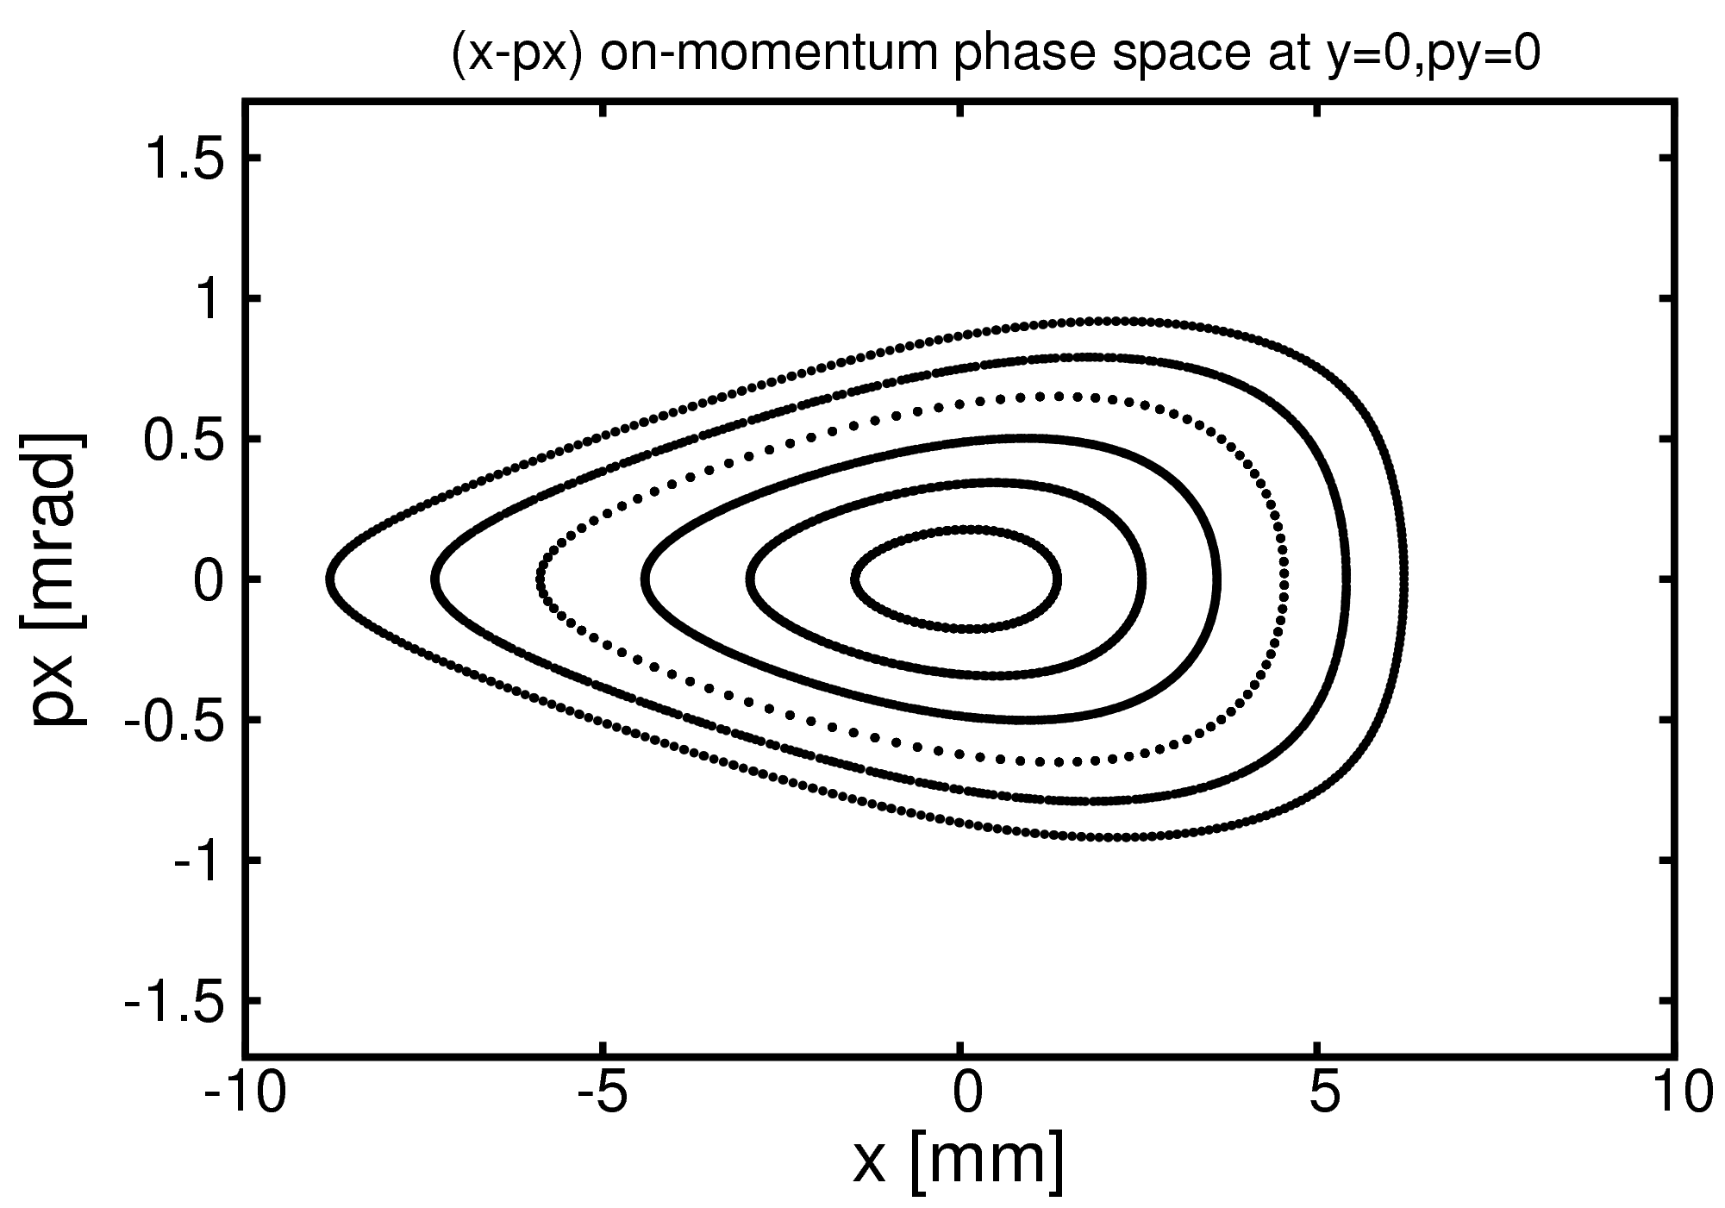
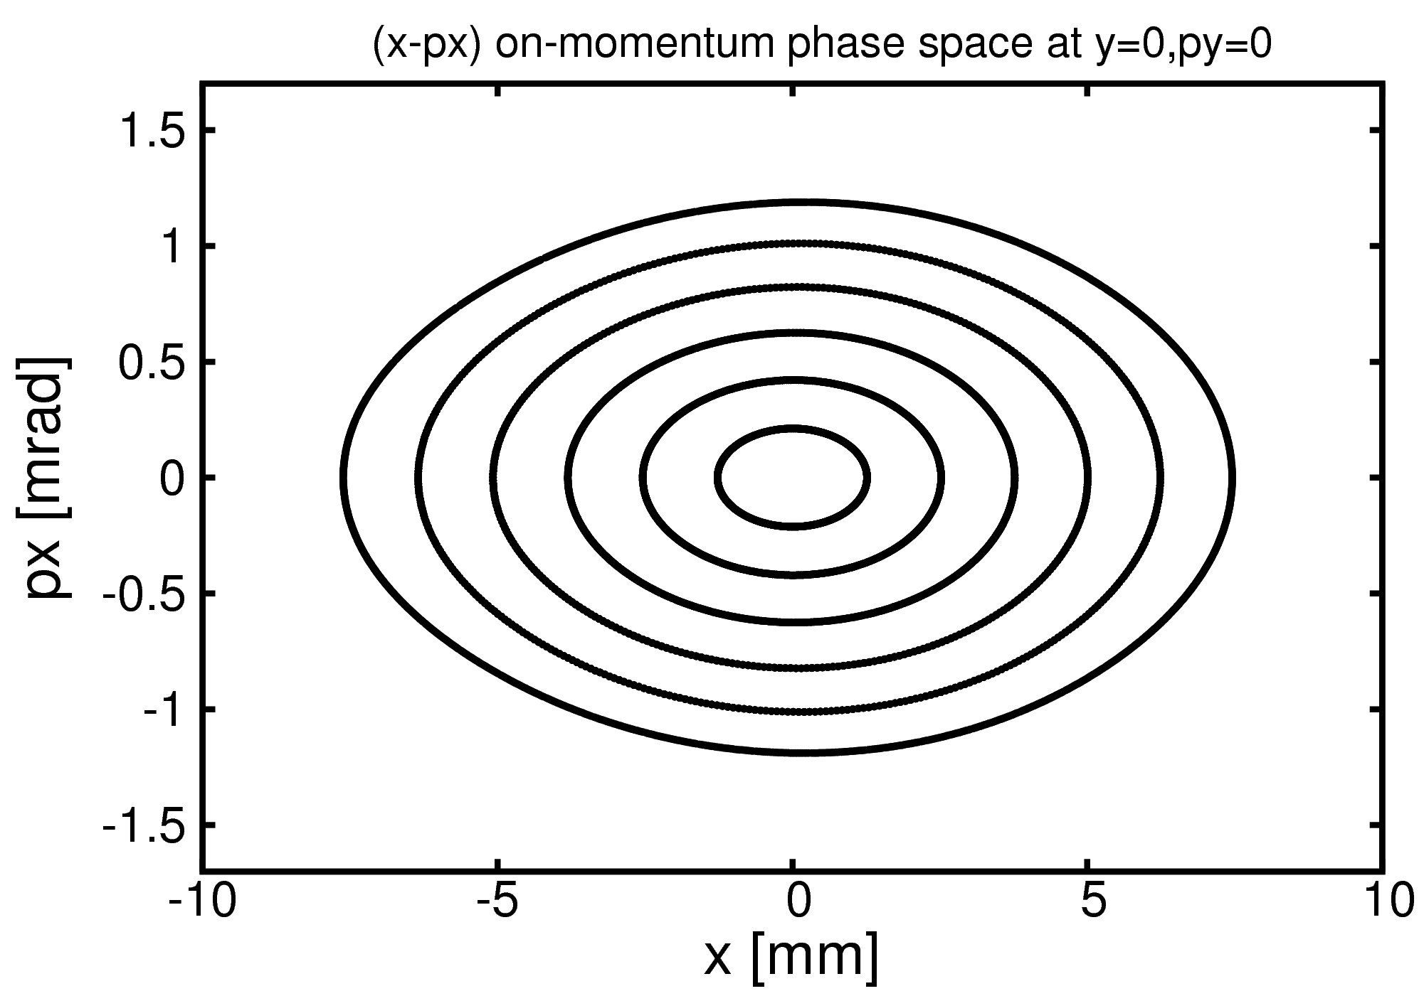
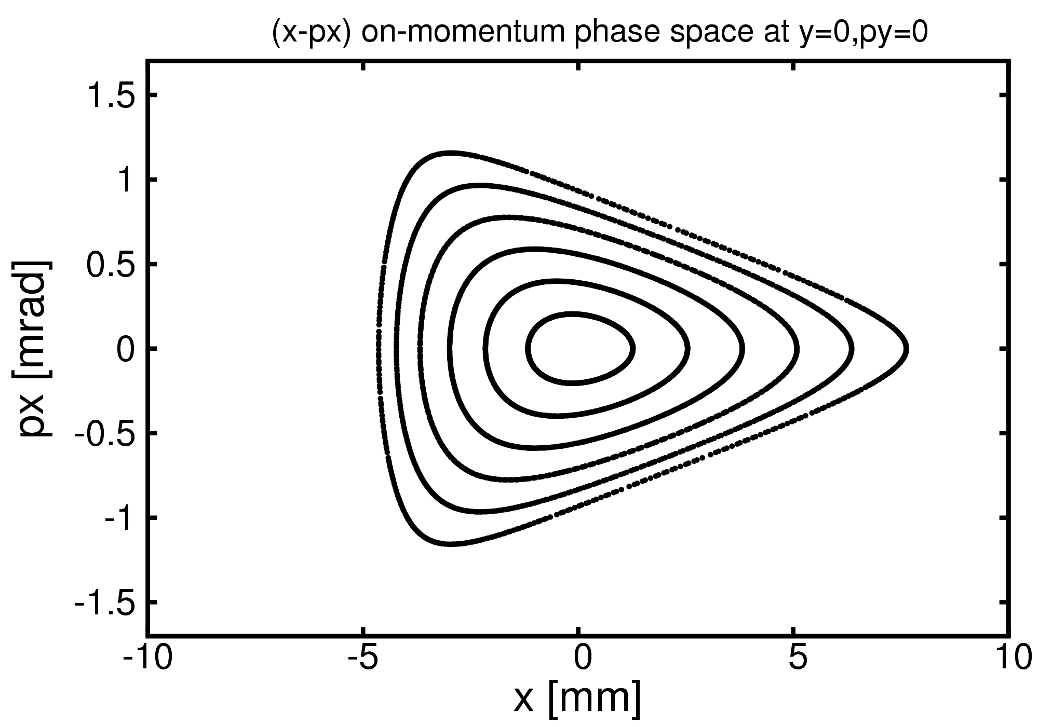
Nonlinear optics: the HMB lattice
HMB lattice V107
phase advance between pairs of (chrom.) sextupoles:
Δφ_{x}=(2n+1)π Δφ_{y}=nπ
Δφ_{x}=(2n+1)π to minimize at the cell ends the Resonance Driving Terms from x³ (f₃₀₀₀ and f₁₂₀₀ ≈ 0) => elliptical horizontal phase space
Δφ_{x}<3π
Δφ_{x}=3π
Δφ_{x}>3π
no harmonic sextupoles

Slide 15
Nonlinear optics: the HMB lattice
HMB lattice V107
phase advance between pairs of (chrom.) sextupoles:
Δφ_{x}=(2n+1)π Δφ_{y}=nπ
This constraint does not help minimize amplitude-dependent detuning generated by second-order cross-products of sextupolar terms within the cell [∝ cos(Δφ_{x}), sin(3Δφ_{y}), … ] and across other cells.
no harmonic sextupoles

Slide 16
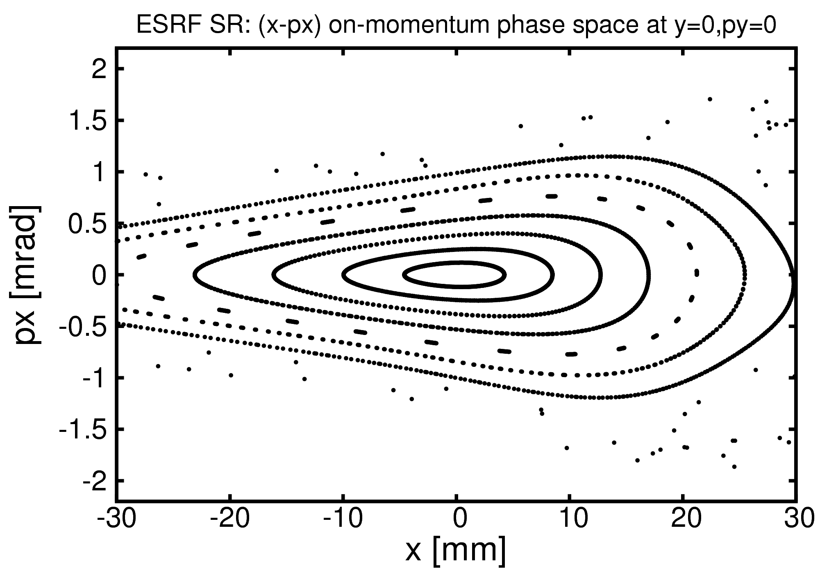
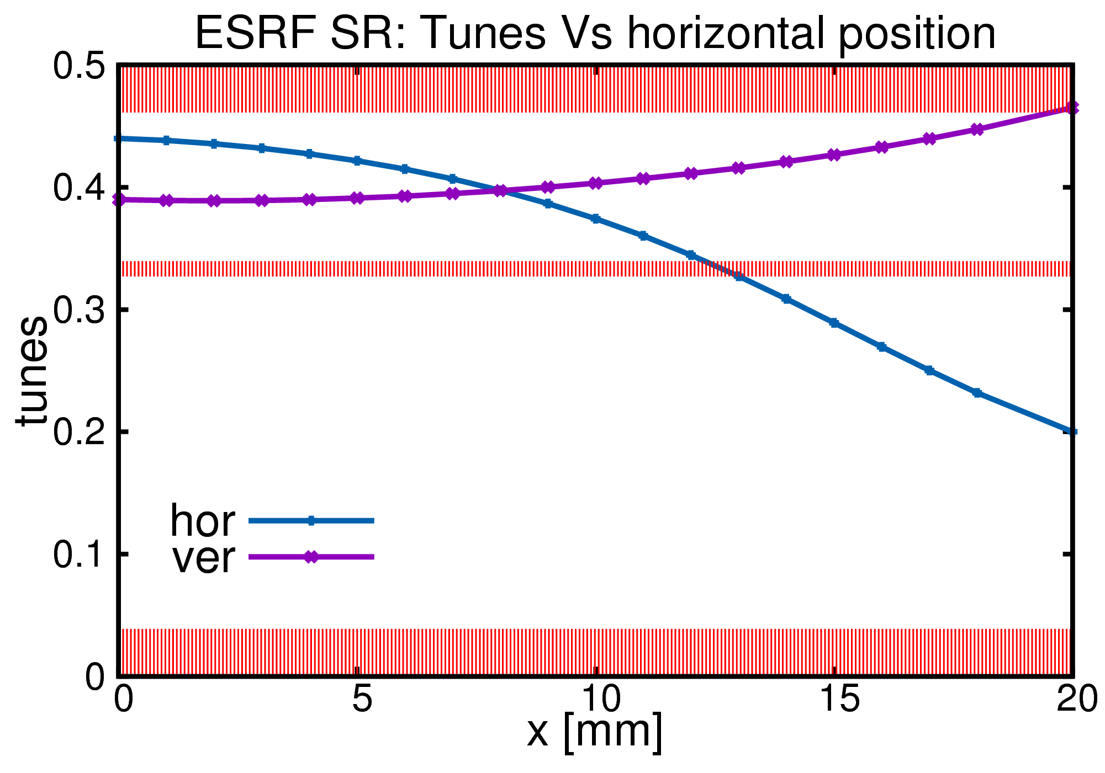
Nonlinear optics: existing ESR SR Vs HMB lattice
dQx/dJx = -15x10³ d²Qx/dJx²= 0.3x10⁹
dQy/dJx = -11x10³ d²Qy/dJx²= 0.2x10⁹
dQy/dJy = 12x10³ d²Qy/dJy²= 0.2x10⁹
ESR (DBA) Storage Ring
3 chromatic and 4 harmonic sextupoles
βx=37m @ injection !
septum blade @ -5mm (20σ) with inj bump
3σ contour
inj. beam

Slide 17
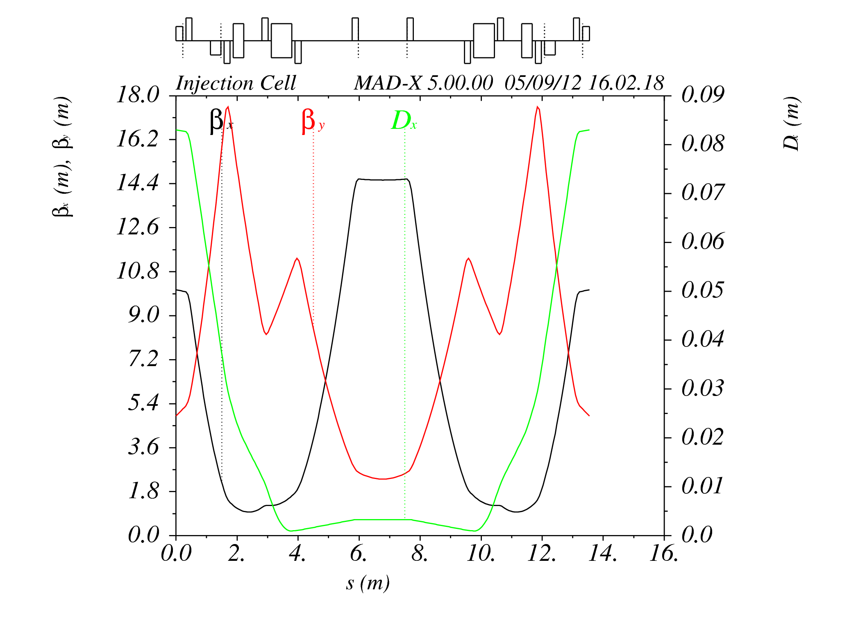
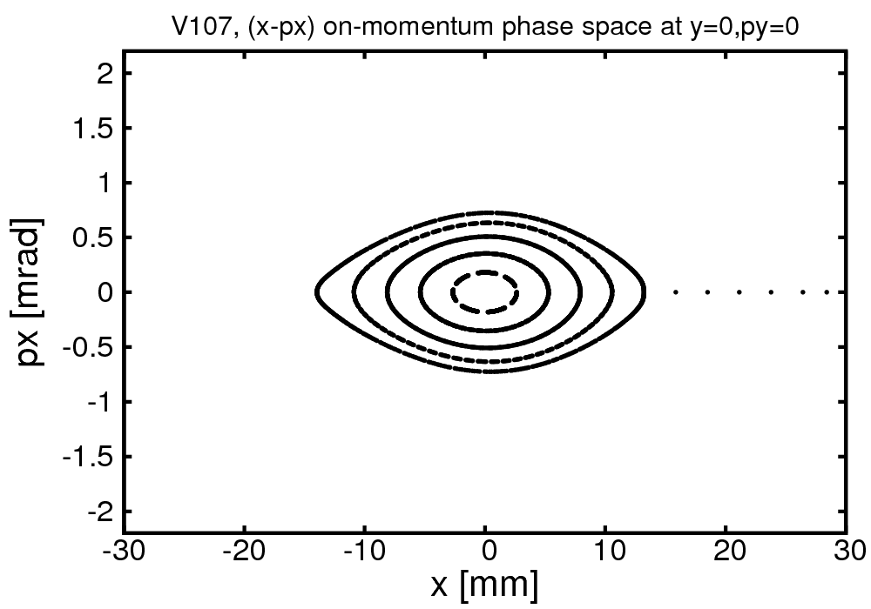
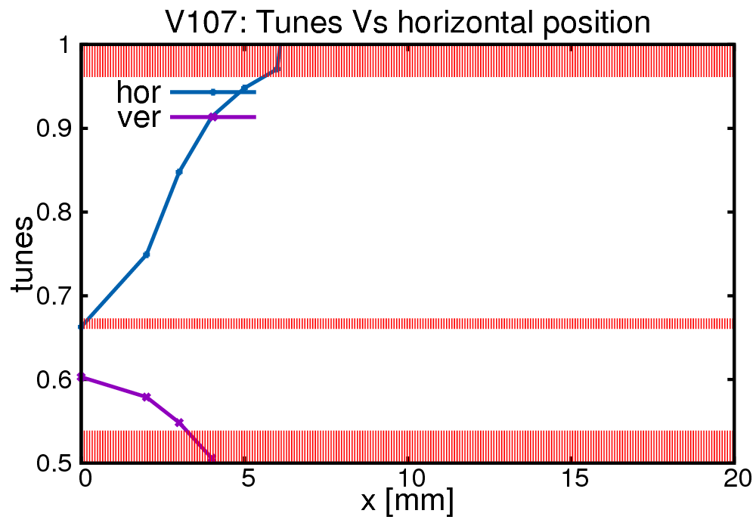
Nonlinear optics: existing ESR SR Vs HMB lattice
dQx/dJx = 100x10³ d²Qx/dJx²= 5.9x10⁹
dQy/dJx = -80x10³ d²Qy/dJx²=29.3x10⁹
dQy/dJy = 40x10³ d²Qy/dJy²= 0.9x10⁹
HMB lattice (V107)
2+4 chromatic sextupoles, no harmonic sextupoles
βx=14.4m @ injection
septum blade @ -2mm (40σ) with inj bump
3σ contour
inj. beam

Slide 18
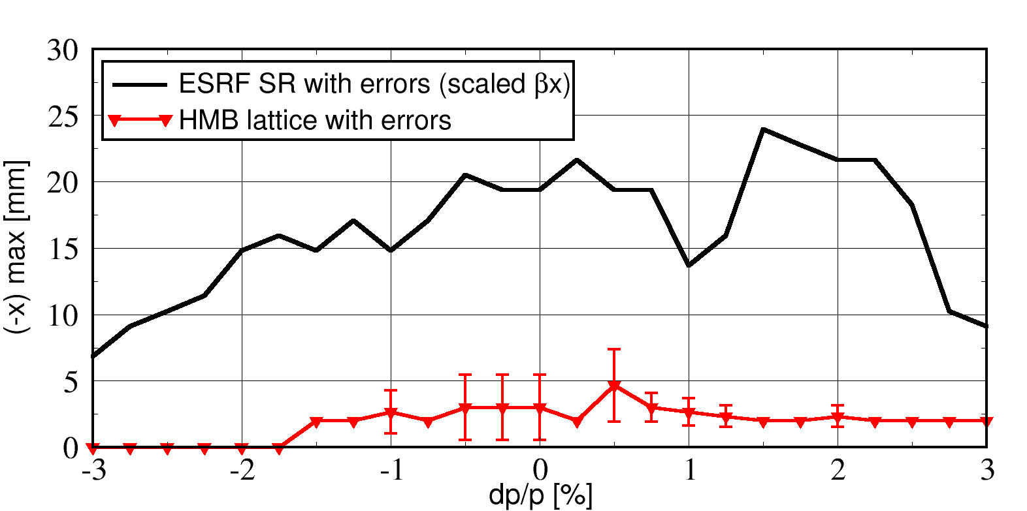
Nonlinear optics: existing ESR SR Vs HMB lattice
dQx/dJx = 100x10³ d²Qx/dJx²= 5.9x10⁹
dQy/dJx = -80x10³ d²Qy/dJx²=29.3x10⁹
dQy/dJy = 40x10³ d²Qy/dJy²= 0.9x10⁹
HMB lattice (V107)
2+4 chromatic sextupoles, no harmonic sextupoles
βx=14.4m @ injection
septum blade @ -20mm

Slide 19
Nonlinear optics: existing ESR SR Vs HMB lattice
dQx/dJx = 100x10³ d²Qx/dJx²= 5.9x10⁹
dQy/dJx = -80x10³ d²Qy/dJx²=29.3x10⁹
dQy/dJy = 40x10³ d²Qy/dJy²= 0.9x10⁹
HMB lattice (V107)
2+4 chromatic sextupoles, no harmonic sextupoles
βx=14.4m @ injection
septum blade @ -20mm
HMB lattice V107
How can we reduce amplitude-dependent detuning?

Slide 20
Outlines
The Hybrid Multi-Bend (HMB) lattice
Nonlinear optics: existing ESR SR Vs HMB lattice
Optimizing dynamic aperture

Slide 21
Outlines
The Hybrid Multi-Bend (HMB) lattice
Nonlinear optics: existing ESR SR Vs HMB lattice
Optimizing dynamic aperture
very preliminary, focused on horizontal DA only, not yet optimized in vertical plane and energy deviation.
Lattice errors: focusing errors from H & V (6μm RMS) displacement of sextupoles generating ~2% peak beta-beating & 5% coupling, no sext. field errors, orbit corrected.

Slide 22
Optimizing dynamic aperture
HMB lattice (V107)
dQx/dJx = 100x10³ d²Qx/dJx²= 5.9x10⁹
dQy/dJx = -80x10³ d²Qy/dJx²=29.3x10⁹
dQy/dJy = 40x10³ d²Qy/dJy²= 0.9x10⁹
Δφ_{x}=3π
HMB lattice V107

Slide 23
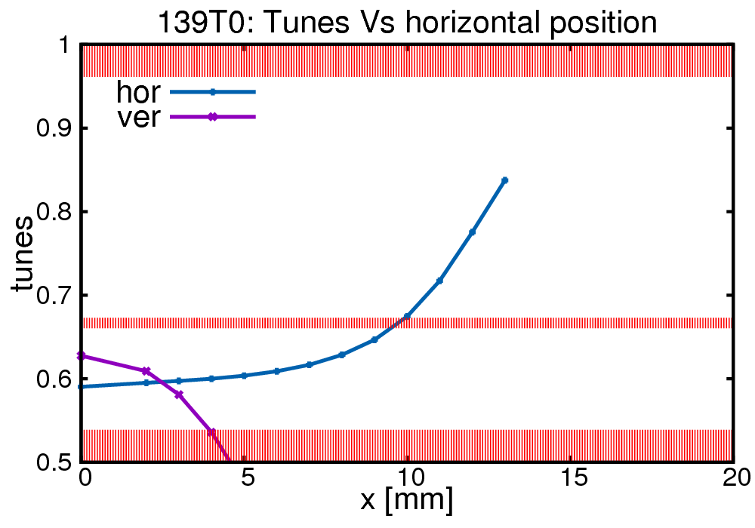
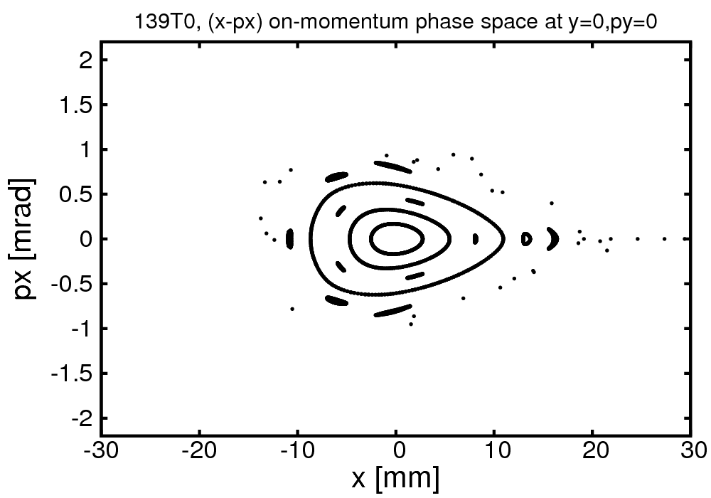
Optimizing dynamic aperture
HMB lattice (V139)
shorter bends for equipment
lower hor. and ver. detuning
cross-term detuning still too large
dQx/dJx = -2x10³ d²Qx/dJx²= 2.7x10⁹
dQy/dJx = -82x10³ d²Qy/dJx²=30.6x10⁹
dQy/dJy = -1x10³ d²Qy/dJy²= 0.6x10⁹
Δφ_{x}>3π
HMB lattice V139

Slide 24
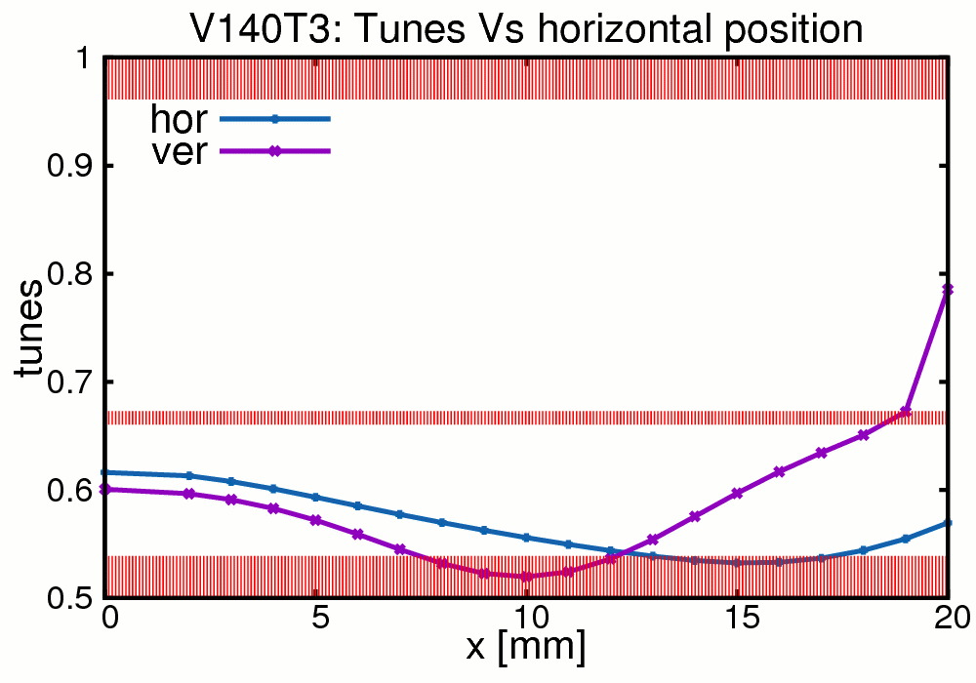
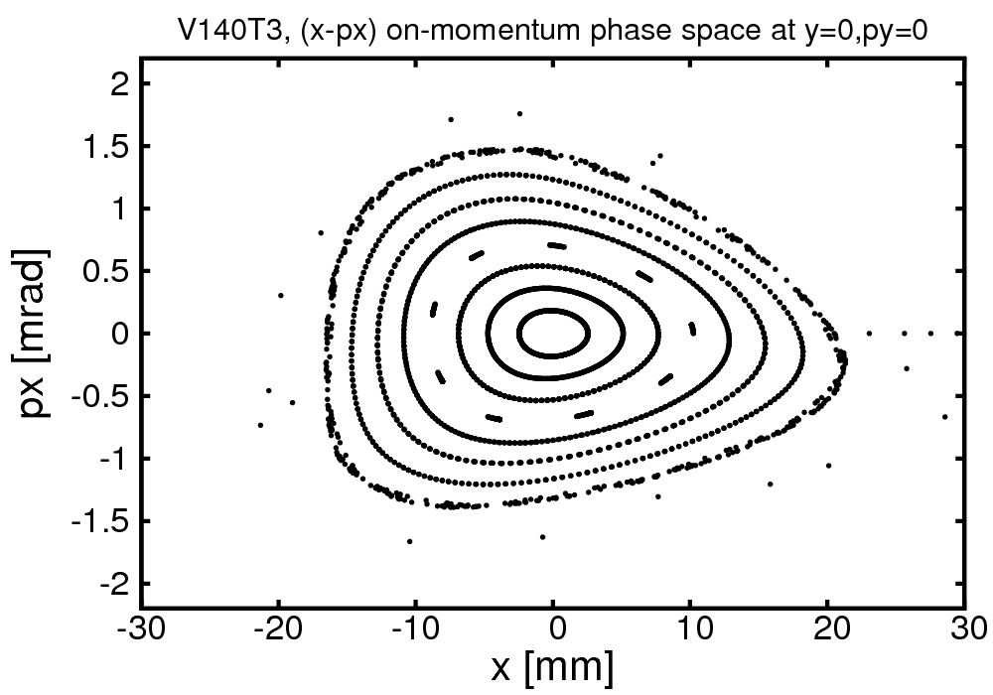
Optimizing dynamic aperture
HMB lattice (V140-T3)
swapped centre quad <-> sext.
added thin octu- and dodeca-pole
lower cross-term detuning
dQx/dJx = -11x10³ d²Qx/dJx²= 0.6x10⁹
dQy/dJx = -15x10³ d²Qy/dJx²=19.3x10⁹
dQy/dJy = -9x10³ d²Qy/dJy²= 4.1x10⁹
Δφ_{x}>3π
HMB lattice V140-T3

Slide 25
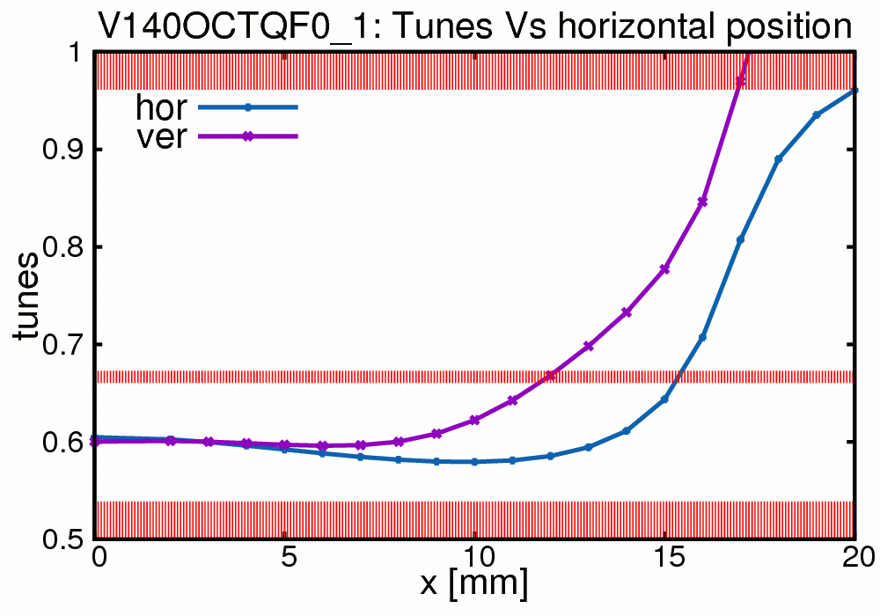
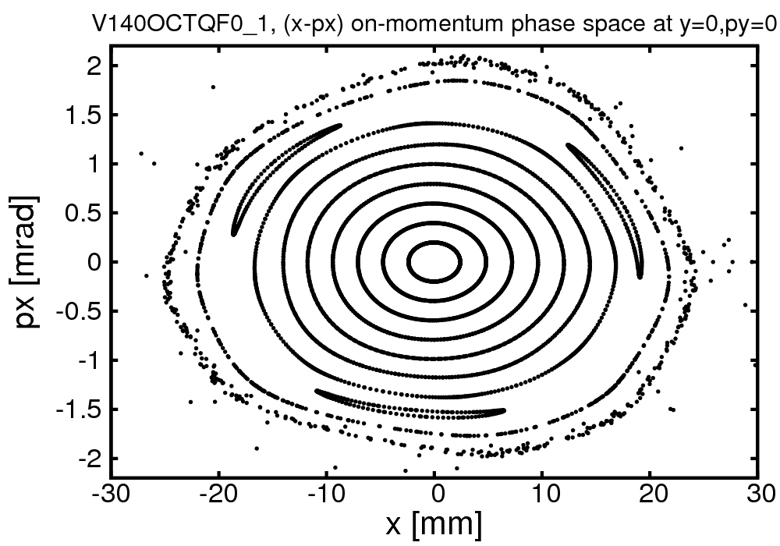
Optimizing dynamic aperture
HMB lattice (V140-1)
octupole component in QF0 added
dodecapole removed
lower cross-term detuning
dQx/dJx = -5x10³ d²Qx/dJx²= 0.6x10⁹
dQy/dJx = -3x10³ d²Qy/dJx²=17.7x10⁹
dQy/dJy = -6x10³ d²Qy/dJy²= 3.8x10⁹
Δφ_{x}=3π
HMB lattice V140-1

Slide 26
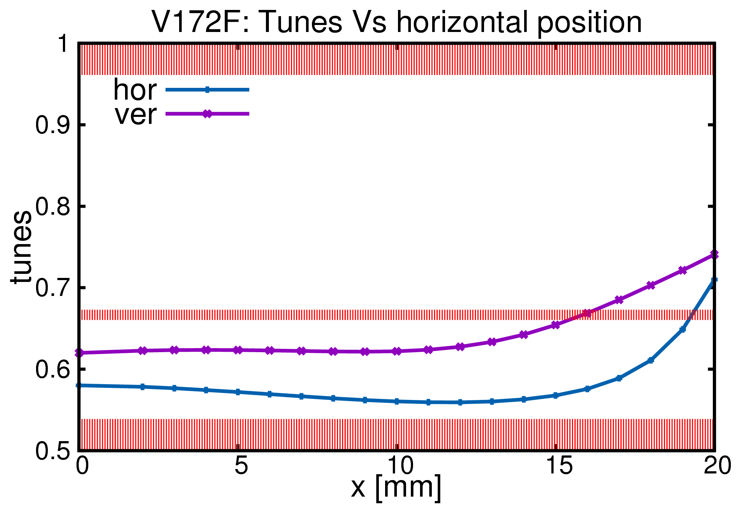
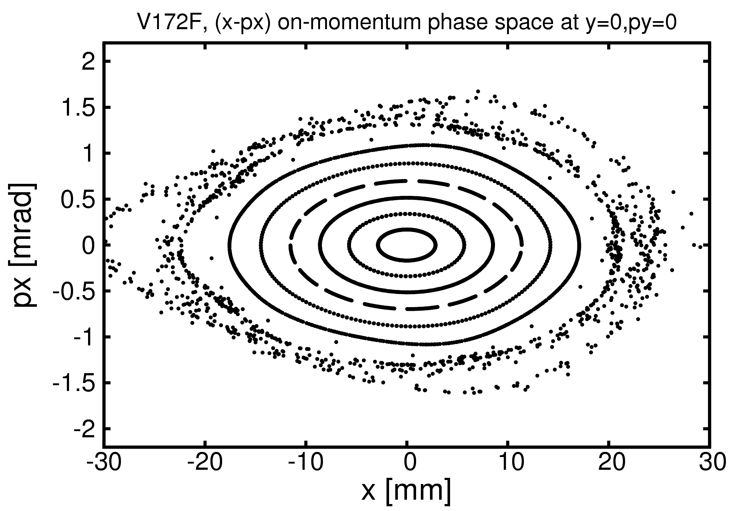
Optimizing dynamic aperture
HMB lattice (V172-F)
octupole component in QD0 added
long. gradient in dipoles
lower cross-term detuning
dQx/dJx = -4x10³ d²Qx/dJx²= 0.5x10⁹
dQy/dJx = -3x10³ d²Qy/dJx²= 0.1x10⁹
dQy/dJy = -5x10³ d²Qy/dJy²= 1.0x10⁹
Δφ_{x}<3π
HMB lattice V172-F

Slide 27
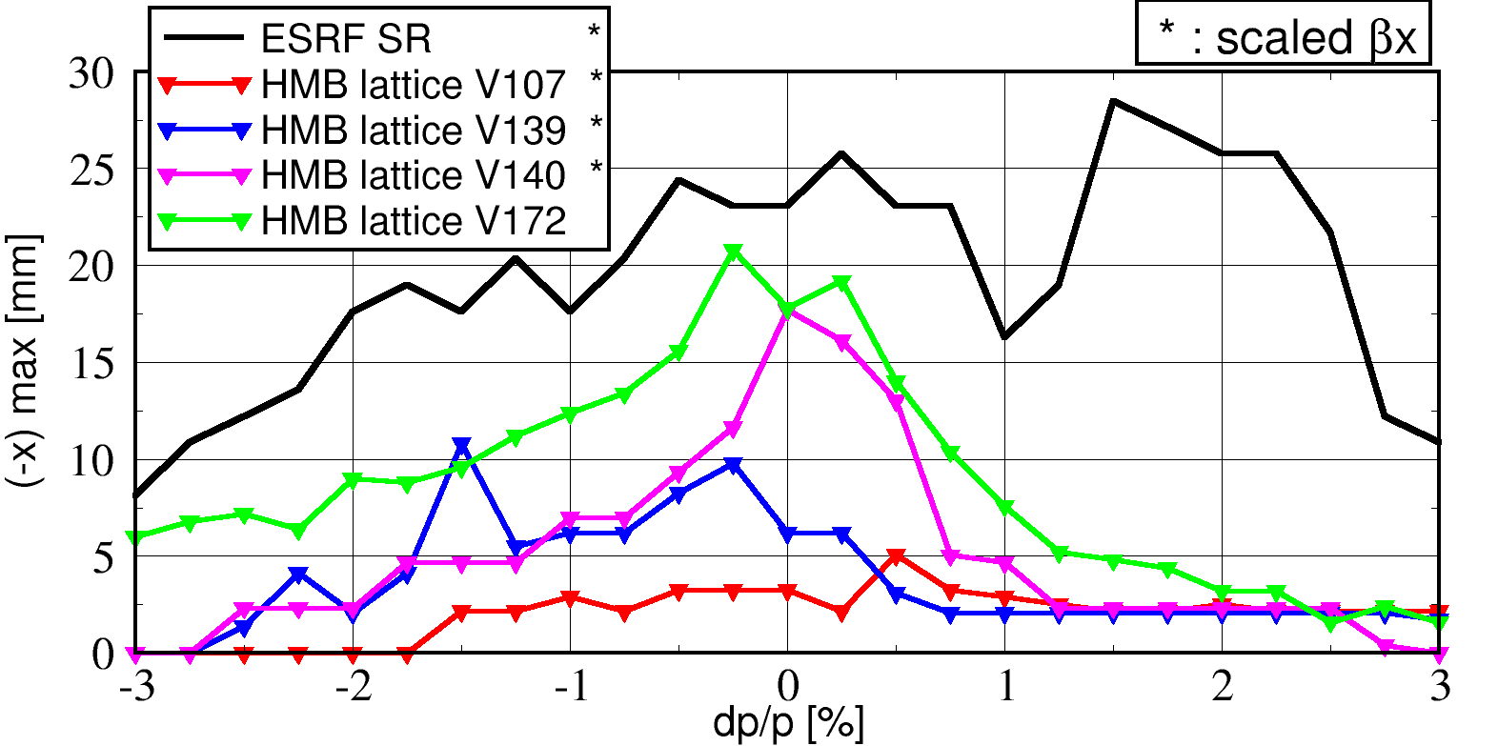
Optimizing dynamic aperture
HMB lattice (V172-F)
octupole component in QD0 added
long. gradient in dipoles
lower cross-term detuning
dQx/dJx = -4x10³ d²Qx/dJx²= 0.5x10⁹
dQy/dJx = -3x10³ d²Qy/dJx²= 0.1x10⁹
dQy/dJy = -5x10³ d²Qy/dJy²= 1.0x10⁹
Δφ_{x}< π
HMB lattice V172-F

Slide 28
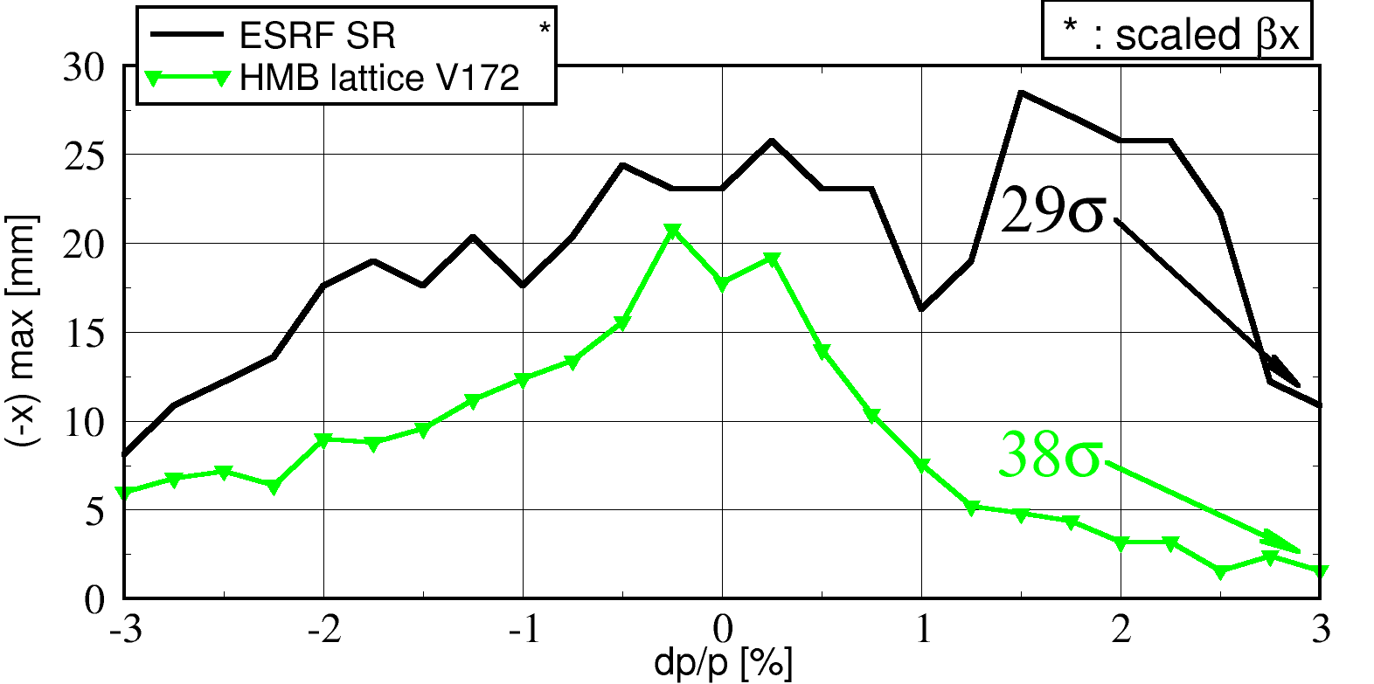
Optimizing dynamic aperture
HMB lattice (V172-F)
octupole component in QD0 added
long. gradient in dipoles
lower cross-term detuning
dQx/dJx = -4x10³ d²Qx/dJx²= 0.5x10⁹
dQy/dJx = -3x10³ d²Qy/dJx²= 0.1x10⁹
dQy/dJy = -5x10³ d²Qy/dJy²= 1.0x10⁹
good for injection efficiency
Δφ_{x}< π
good for Touschek lifetime
HMB lattice V172-F

Slide 29
Conclusion
lattice design in advanced status of development
(standard) magnet requirements within reach of existing technology (100 T/m for quads, 2kT/m² for sexts)
dynamic properties already compatible with present injection system
good energy acceptance
lattice still evolving to further improve its performances and to match hardware constraints (diagnostic, vacuum, front ends, etc…)

Slide 31
# NAME | L | ANGLE | R0 | B0 | G1 | G2 | G3L | BETX | BETY | DX
# | [m] | [mrad] | [m] | [T] | [T/m] | [T/m^2] | [T/m^2] | [m] | [m] | [mm]
"QFMA" | 0.25 |  |  |  | 93.71 |  |  | 4.16 | 7.21 | 4.3
"QDMA" | 0.20 |  |  |  | -87.77 |  |  | 2.33 | 11.39 | 2.9
"BPI1E" | 0.35 | 9.89 | 35.38 | 0.57 |  |  |  | 1.52 | 12.67 | 3.4
"BPI1D" | 0.35 | 6.89 | 50.76 | 0.40 |  |  |  | 1.16 | 13.73 | 7.2
"BPI1C" | 0.35 | 5.40 | 64.86 | 0.31 |  |  |  | 1.03 | 14.85 | 13.1
"BPI1B" | 0.35 | 4.20 | 83.40 | 0.24 |  |  |  | 1.15 | 16.03 | 20.6
"BPI1A" | 0.35 | 3.60 | 97.30 | 0.21 |  |  |  | 1.50 | 17.27 | 29.6
"QDID" | 0.20 |  |  |  | -38.35 |  |  | 2.13 | 17.04 | 39.1
"SD1A" | 0.30 |  |  |  |  | -1808 |  | 3.84 | 13.44 | 55.4
"SF1A" | 0.18 |  |  |  |  | 1885 |  | 10.05 | 6.87 | 92.9
"QF0" | 0.15 |  |  |  | 55.29 |  |  | 11.59 | 5.86 | 100.0
"OCF0" | 0.00 |  |  |  |  |  | -13215 | 11.59 | 5.86 | 100.0
"QF0" | 0.15 |  |  |  | 55.29 |  |  | 10.85 | 6.16 | 97.0
"SF1A" | 0.18 |  |  |  |  | 1885 |  | 8.43 | 7.50 | 85.7
"OCF" | 0.10 |  |  |  |  |  | -11646 | 4.30 | 10.92 | 61.5
"SD1B" | 0.30 |  |  |  |  | -1808 |  | 2.17 | 13.99 | 43.1
"QD0" | 0.20 |  |  |  | -57.82 |  |  | 1.39 | 14.52 | 33.0
"BPI1A" | 0.35 | 3.60 | 97.30 | 0.21 |  |  |  | 1.11 | 10.58 | 24.5
"BPI1B" | 0.35 | 4.20 | 83.40 | 0.24 |  |  |  | 1.16 | 7.98 | 19.4
"BPI1C" | 0.35 | 5.40 | 64.86 | 0.31 |  |  |  | 1.42 | 5.76 | 15.9
"BPI1D" | 0.35 | 6.89 | 50.76 | 0.40 |  |  |  | 1.91 | 3.94 | 14.7
"BPI1E" | 0.35 | 9.89 | 35.38 | 0.57 |  |  |  | 2.61 | 2.52 | 16.3
"QF1" | 0.32 |  |  |  | 102.68 |  |  | 2.24 | 2.33 | 15.8
"BPI2E1" | 0.35 | 12.74 | 27.47 | 0.73 | -44.04 |  |  | 0.36 | 4.68 | 7.4
"BPI2E2" | 0.35 | 12.74 | 27.47 | 0.73 | -44.04 |  |  | 0.74 | 3.40 | 10.9
"QF2" | 0.45 |  |  |  | 96.52 |  |  | 2.06 | 1.75 | 16.7
"BPI2E1" | 0.35 | 12.74 | 27.47 | 0.73 | -44.04 |  |  | 0.68 | 4.02 | 7.5
HMB lattice

Slide 32
# NAME | L | ANGLE | R0 | B0 | G1 | G2 | BETX | BETY | DX
# | [m] | [mrad] | [m] | [T] | [T/m] | [T/m^2] | [m] | [m] | [mm]
SBEND | 2.45 | 98.00 | 24.96 | 0.86 |  |  | 1.77 | 32.16 | 79.40
g1.qf2 | 0.94 |  |  |  | 7.86 |  | 26.48 | 16.34 | 111.60
g1.qd3 | 0.53 |  |  |  | -12.14 |  | 7.81 | 33.34 | 59.54
g1.qd4 | 0.42 |  |  |  | -12.10 |  | 10.87 | 28.24 | 219.10
g1.qf5 | 0.52 |  |  |  | 14.78 |  | 26.81 | 15.17 | 344.30
g1.qd6 | 0.52 |  |  |  | -16.47 |  | 20.53 | 41.27 | 9.45
g1.qf7 | 0.92 |  |  |  | 13.71 |  | 52.41 | 9.08 | 30.79
g2.s04 | 0.40 |  |  |  |  | 124.31 | 38.00 | 8.16 | 134.30
g2.s06 | 0.40 |  |  |  |  | -165.15 | 18.85 | 22.20 | 93.90
g2.s13 | 0.40 |  |  |  |  | -88.02 | 15.39 | 23.32 | 260.90
g2.s19 | 0.40 |  |  |  |  | 443.32 | 26.53 | 15.61 | 342.30
g2.s20 | 0.40 |  |  |  |  | -419.43 | 14.37 | 27.19 | 250.60
g2.s22 | 0.40 |  |  |  |  | -95.81 | 30.47 | 30.16 | 15.43
g2.s24 | 0.40 |  |  |  |  | 132.33 | 44.47 | 8.15 | 30.80
ESRF SR

Slide 33
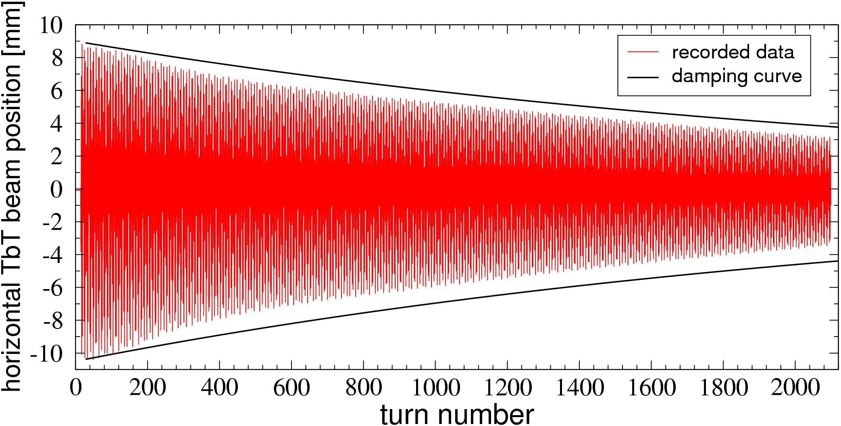
Beam response after horizontal kick …

Slide 34
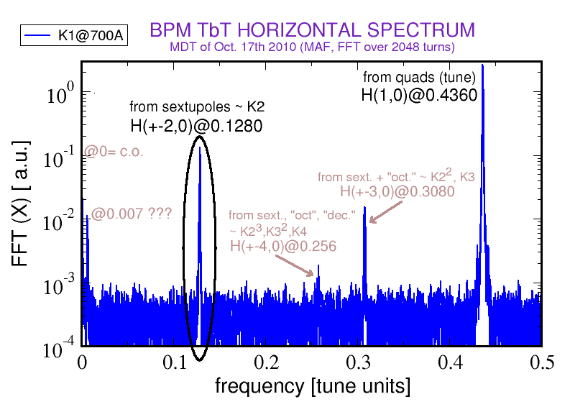
… and its spectrum (FFT) measured

Slide 35
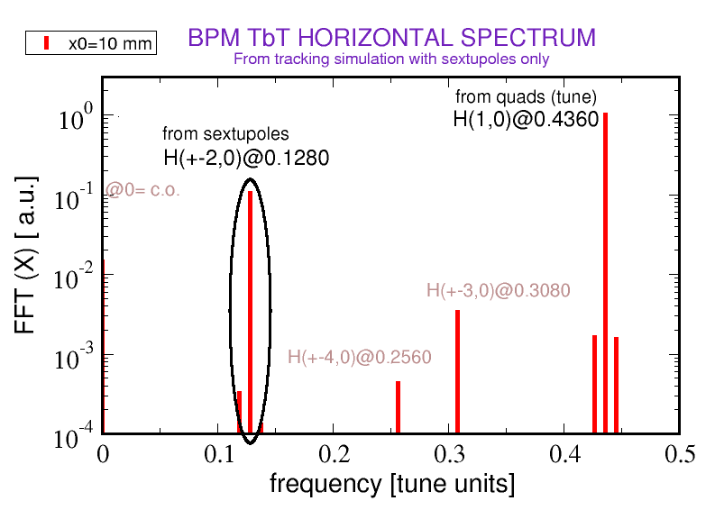
… and its spectrum (FFT) simulated

Slide 36
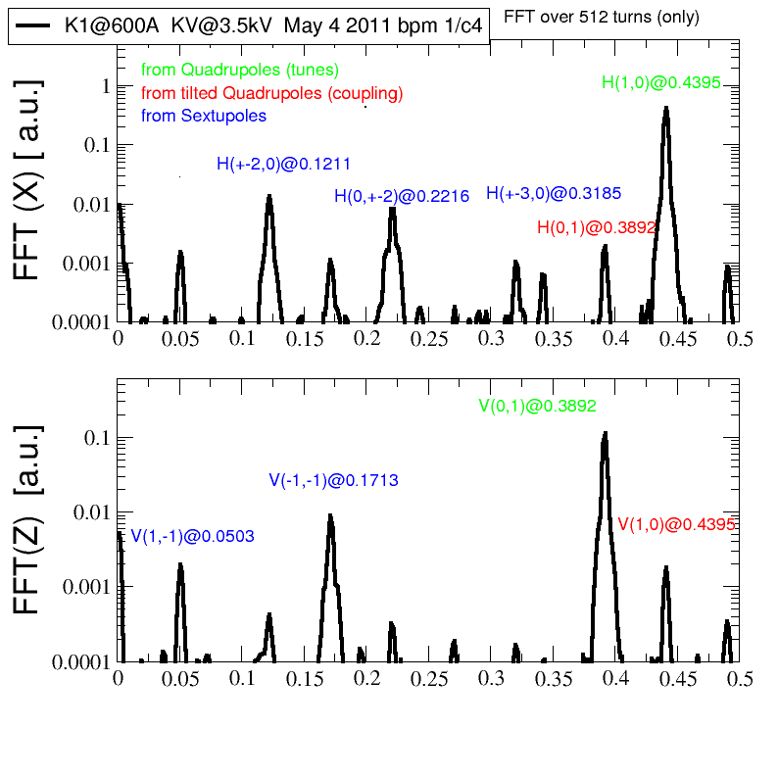
… and its spectrum (FFT) measured

Slide 37
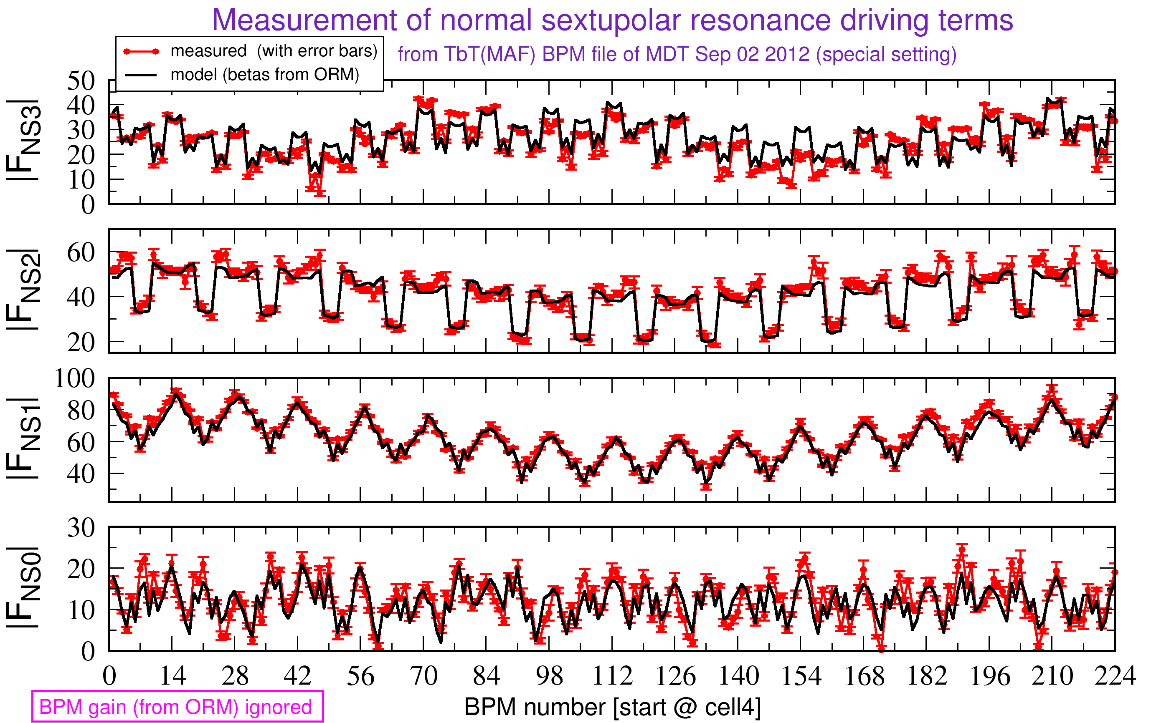
its normal sextupolar RDTs measured

Slide 38
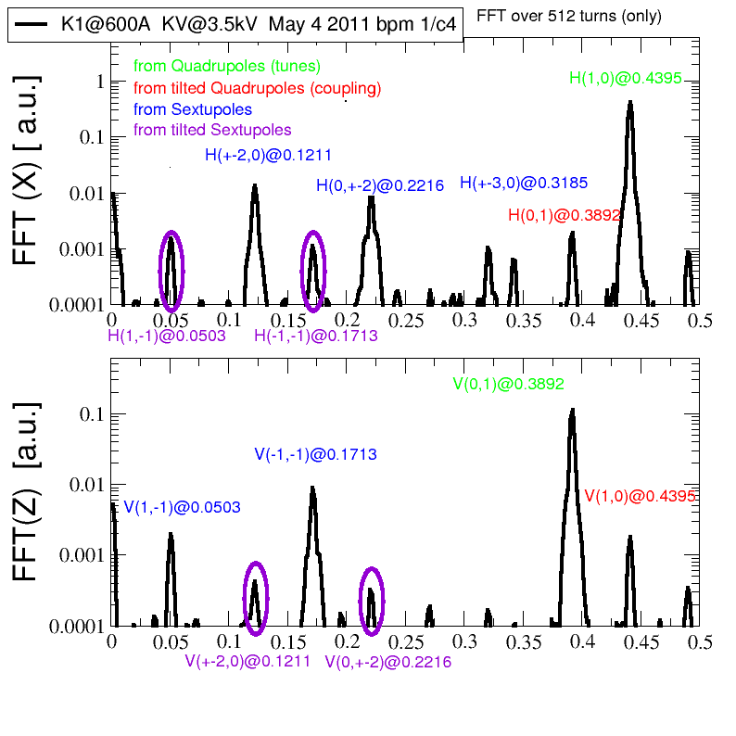
… and its spectrum (FFT) measured

Slide 39
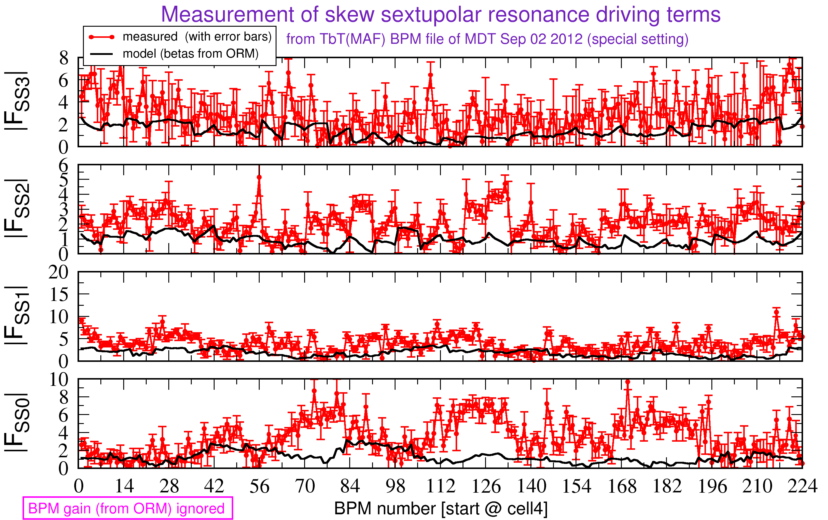
its skew sextupolar RDTs measured

