Slide 1
Advanced Photon Source
Undulator Technology for Ultimate Storage Rings (USRs)
By Mark Jaski

Slide 2
Outline
Thermal review
  APS Photon shutter
  Heat loads from undulators
    APS 7.0 GeV, 200 mA, 2.4 m long straight, 10 mm thick chamber
    PEP-x^{[1]} 4.5 GeV, 200 mA, 5.0 m long straight, 10 mm OD beam tube
    τUSR^{[2]} 9.0 GeV, 200 mA, 5.0 m long straight, 10 mm OD beam tube
Comments on undulators for ultimate storage rings
Room temperature electromagnetic undulators at the APS
  Electromagnetic variably polarizing undulator with quasi-periodic capabilities
  Electromagnetic variably polarizing undulator (EMVPU)
    10 Hz switching between left- and right-circular polarizations
    Prototype
Room temperature electromagnetic undulators (general)
  Planar electromagnetic undulators (EMU)
  Circular electromagnetic undulators (CEMU)
Superconducting electromagnetic undulators at the APS
  Planar
  Helical
[1] Y. Nosochkov et al., Proc. IPAC 2011, 3068-3070 (2012)
[2] M. Borland, Proc. IPAC 2012, 1035-1039

Slide 3
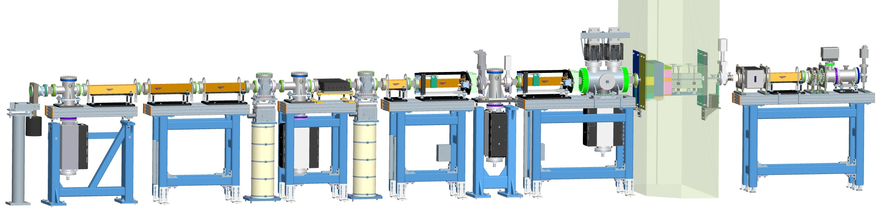
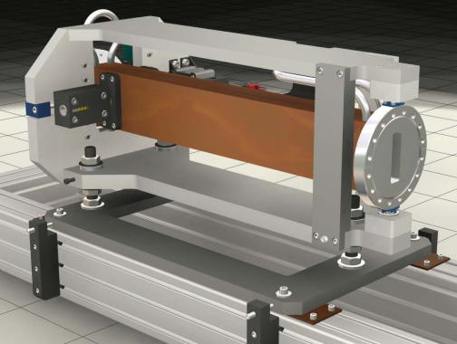
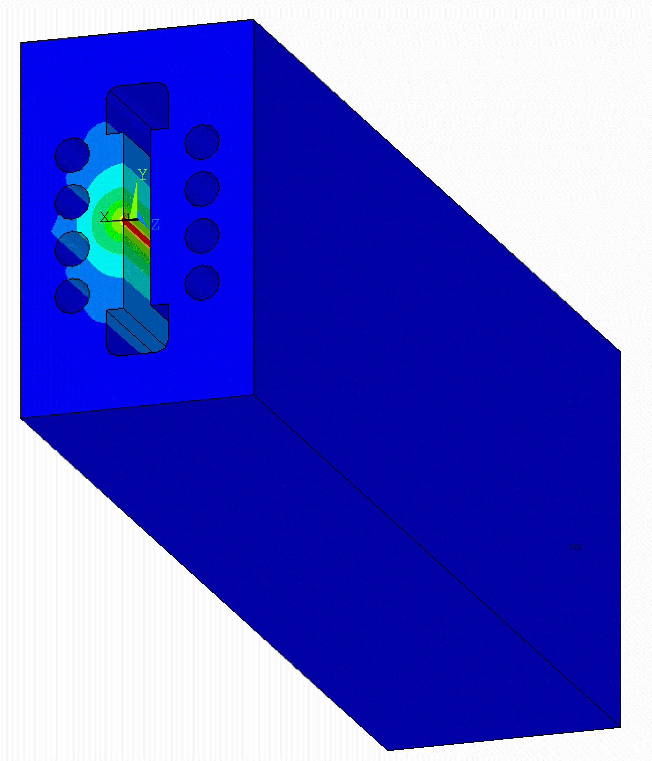
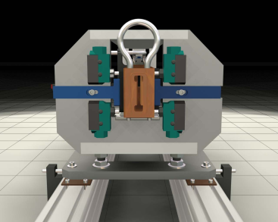
Function of the Photon Shutter
Photon shutters stop the radiation from inside the storage ring to allow access in the First Optics Enclosure downstream of ratchet wall
Photon shutter
Beam
22.4 m from the source
Images courtesy of Y. Jaski
At APS the high heat load photon shutter has heat load limits of 21 kW and 590 kW/mrad²

Slide 4
Total Power for Various Undulators
Evaluated at closed gap or highest current
Data courtesy of R. Dejus

Slide 5
Total Power for Various Undulators
Evaluated at closed gap or highest current
Helical devices are evaluated using NbTi wire
Data courtesy of R. Dejus

Slide 6
Total Power for Various Undulators
Evaluated at closed gap or highest current
Helical devices are evaluated using NbTi wire
Data courtesy of R. Dejus

Slide 7
On-Axis Power Density for Various Undulators
Evaluated at closed gap or highest current
Data courtesy of R. Dejus

Slide 8
On-Axis Power Density for Various Undulators
Evaluated at closed gap or highest current
Helical devices are evaluated using NbTi wire
Data courtesy of R. Dejus

Slide 9
On-Axis Power Density for Various Undulators
Evaluated at closed gap or highest current
Helical devices are evaluated using NbTi wire
Data courtesy of R. Dejus

Slide 10
First Harmonic Energy for Various Undulators
Data courtesy of R. Dejus

Slide 11
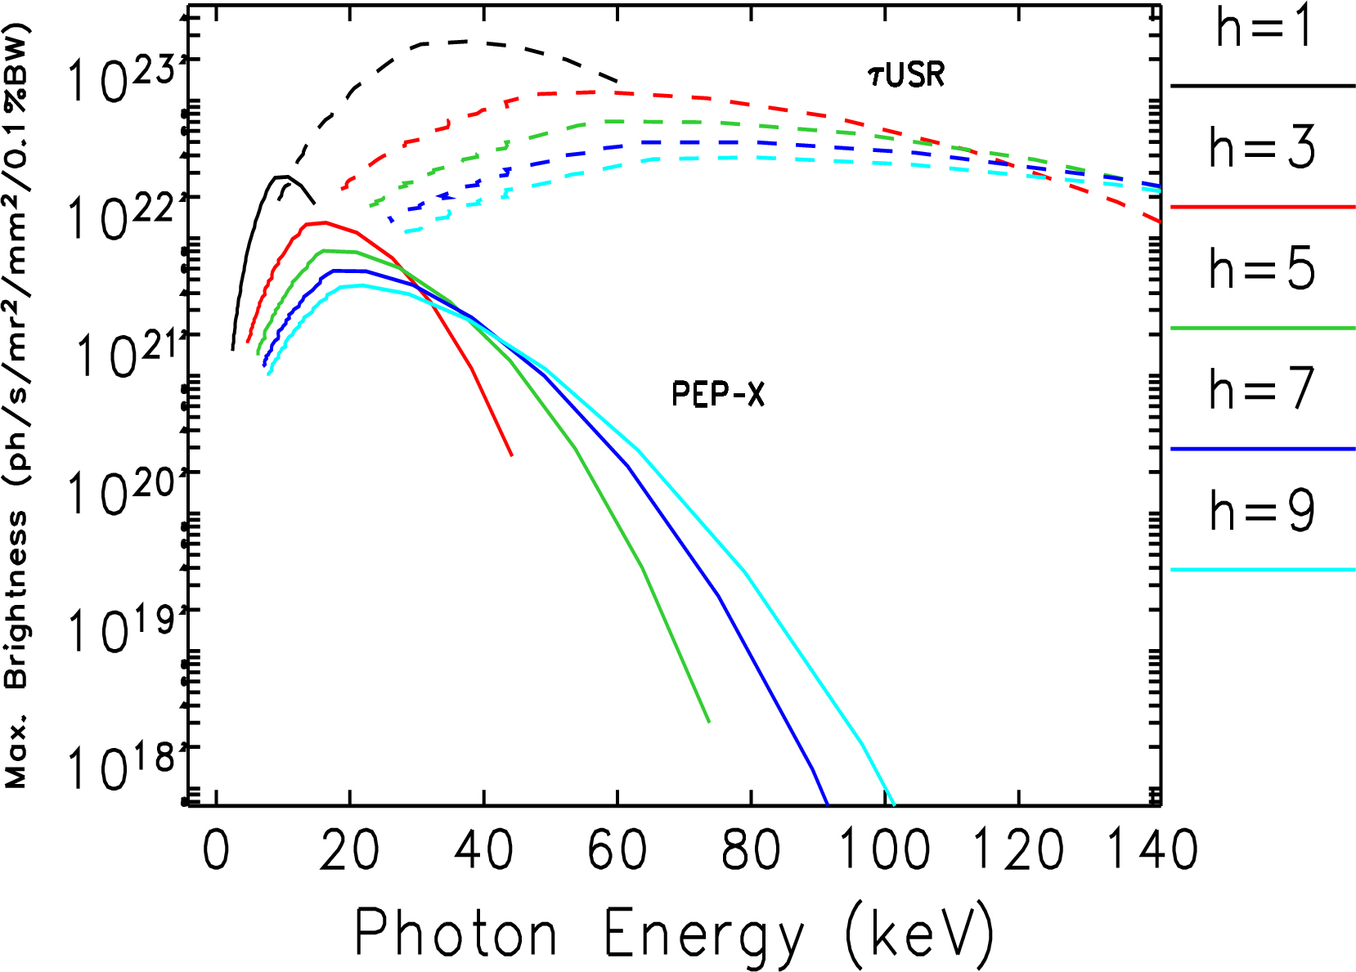
Brightness Plots for superconducting planar undulator 4.2 m long, various periods from 1.2 cm to 5.5 cm period
Superconducting IDs used in USRs can offer brightness 3 orders of magnitude higher than 3rd generation light sources such as the APS.
Data courtesy of M. Borland

Slide 12
Undulators for Ultimate Storage Rings
For the high heat load photon shutter at APS
  The maximum heat load is 21 kW.
  The maximum power density is 590 kW/rad².
Several undulators exceed this maximum heat load limit for USRs
Some of the methods to overcome this issue are:
  Improve the heat load capacity of the photon shutter. This may not be an easy task.
  Insert masks to partially absorb some of the heat load such as done in reference [3]
  Increase the distance of the photon shutter from the source.
  Another method is to reduce or turn off the power from the undulator as the photon shutter is closed.
    This can be done by either opening the gap on a permanent magnet undulator
    Or Reduce the current on an electromagnetic undulator.
There are also heat load issues with the beam line optics but are not discussed here.
[3] S. Takahashi, H. Aoyagi, T. Mochizuki, M. Oura, Y. Sakurai, A. Watanabe, H. Kitamura, Nucl. Instr. And Meth. A 467–468 (2001)

Slide 13
Undulators for Ultimate Storage Rings
The benefits of Electromagnetic undulator are:
  Electromagnetic undulators can be switched off in order to reduce the heat load on the photon shutter when the photon shutter is closed. This applies mostly to superconducting devices where the heat load is high. At APS superconducting devices can be switched off reasonably quick but we have not yet determined if they can be switched on faster than 10 A/s.
  The good field region is much reduced in USRs. This applies to all devices electromagnetic or not.
  For room temperature Electromagnetic IDs the heat load to the front end and beam line is more manageable.
  Electromagnetic IDs can be made capable of fast switching between right- and left-handed polarizations.
  Electromagnetic IDs can be made such that quasi-periodicity can be implemented and turned on or off
  Electromagnetic IDs can be made such that the direction of planar polarization can be switched to either vertical or horizontal.
  Small ID beam tubes in USRs provide capabilities to us helical devices.
The remainder of this talk will focus on electromagnetic undulator development at the APS.

Slide 14
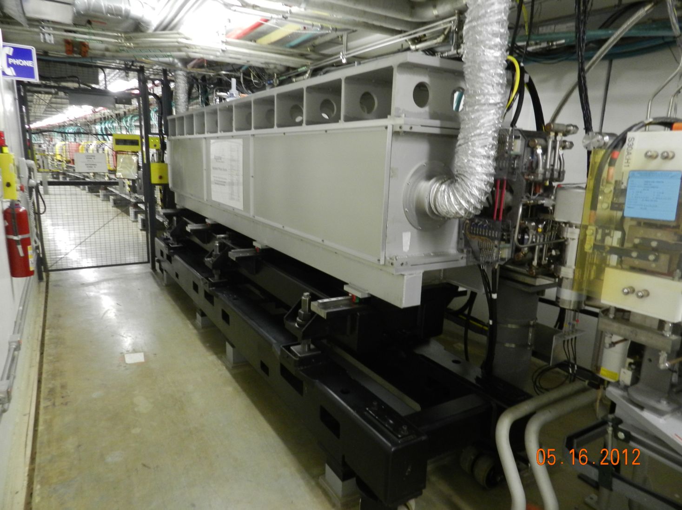
Electromagnetic Variably Polarizing Undulator With Quasi-periodic Capabilities
Installed in April 2012

Slide 15
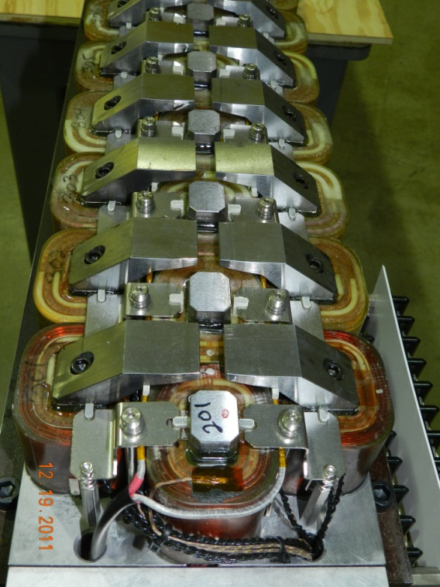
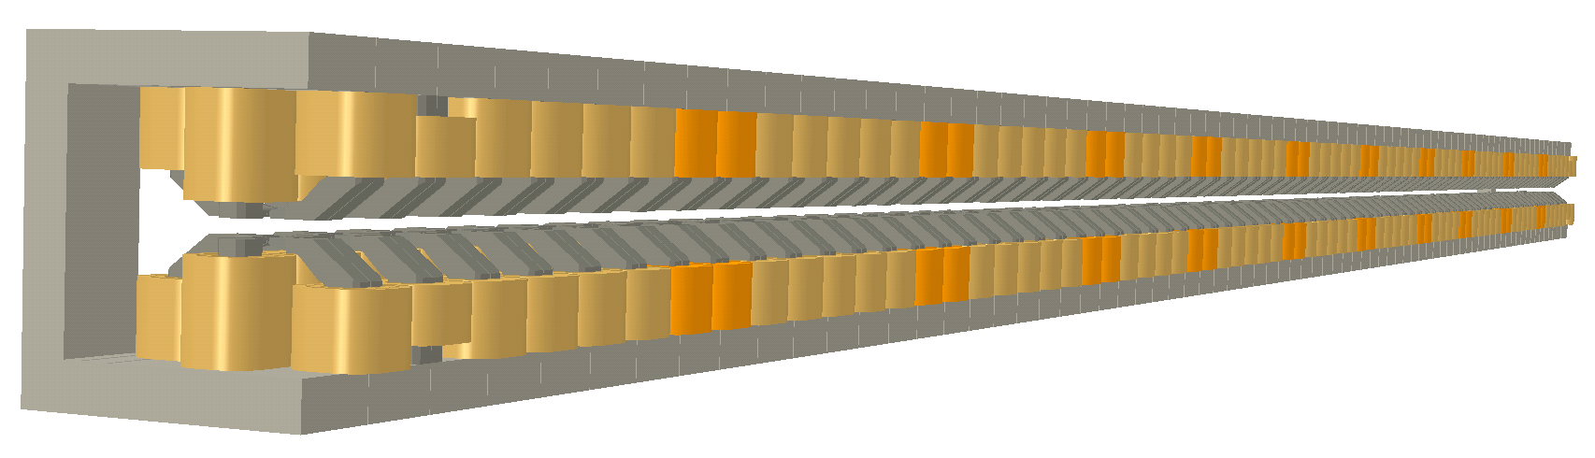
Electromagnetic Variably Polarizing Undulator With Quasi-periodic Capabilities
Quasi-periodic coils
Quasi-periodic [4] - Reduced magnetic fields at every 6-7 pole by ~15% so that the higher harmonics (3,5) are shifted in energy and will only show an intensity of few percent of its initial intensity at harmonics of the fundamental.
[4] S. Sasaki, Overview of Quasi-periodic Undulators, PAC09

Slide 16
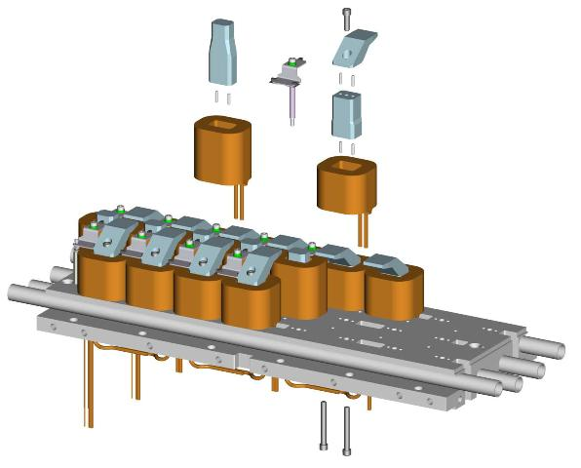
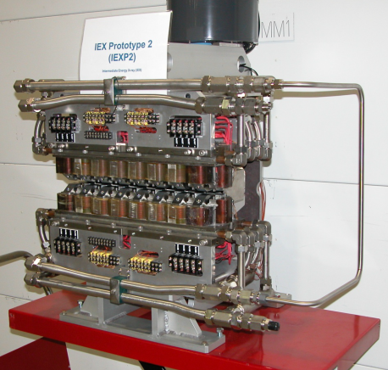
Electromagnetic Variably Polarizing Undulator With Quasi-periodic Capabilities
Prototype was built in 2009
  Roll off was large
A second prototype was built and tested in 2010
  Tested very well
  Fields matched predictions
Final device was built and tested and then installed in April 2012
  Commissioning studies have been successfully completed and show the device is ready for storage-ring-friendly operation
  Users are expected to take first light November 2012
  Showed current densities of 4-5 A/mm² in the copper conductor cross section can be achieved for indirectly water cooled coils

Slide 17
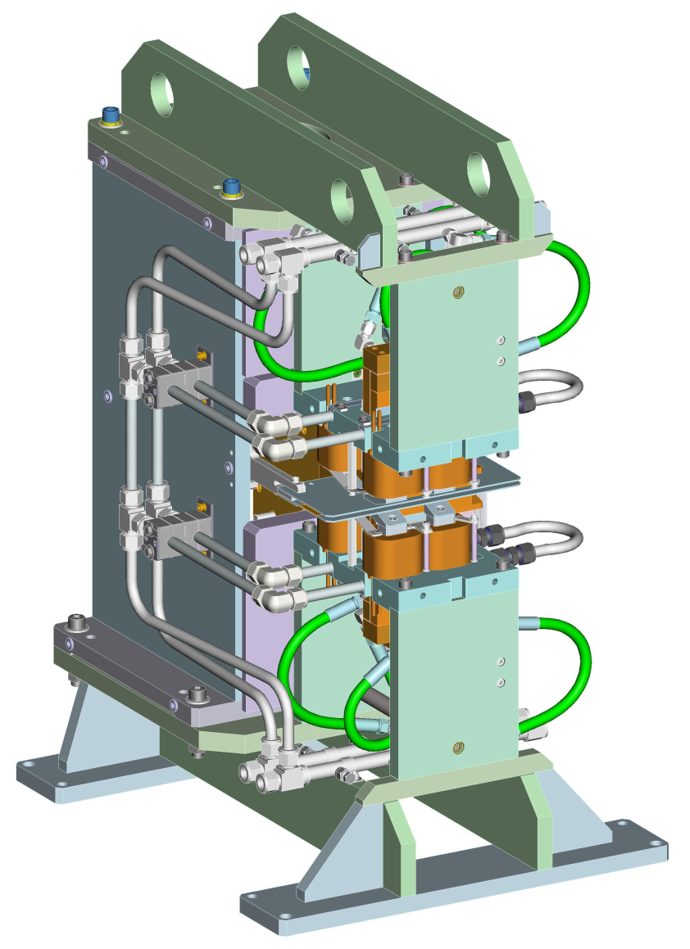
ElectroMagnetic Variably Polarizing Undulator (EMVPU)
10 Hz switching speed from right-hand to left-hand circular polarization.
Development of this device will take a similar path as the quasi-periodic device:
  Build and test a 1 period prototype
    Parts are being ordered now.
    Test the fast switching properties, field strength, etc.
  Build and test a 4-period prototype
    The 4-period test model is long enough to build in realistic end configurations and to confirm the concept.
  Build and install the final device
1 Period Prototype

Slide 18
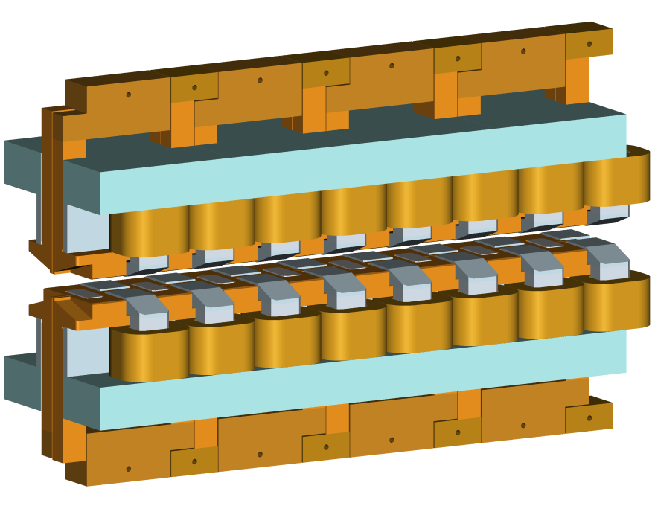
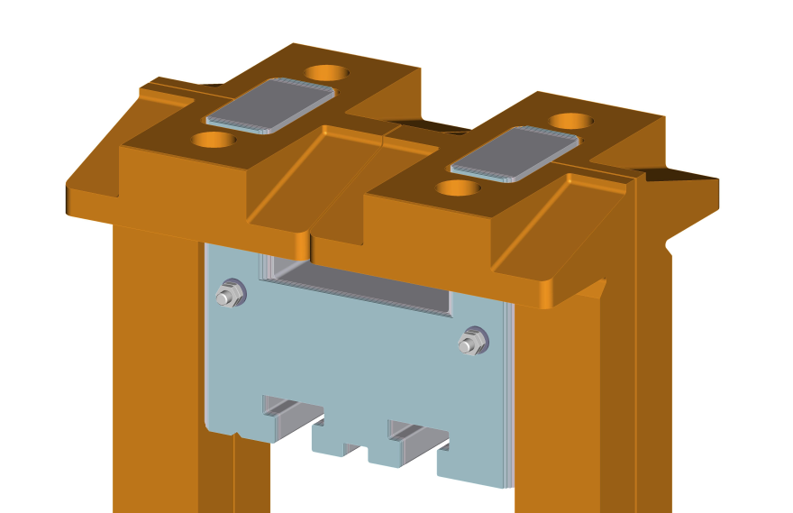
ElectroMagnetic Variably Polarizing Undulator (EMVPU)
4 period model
By Poles and coils

Slide 19
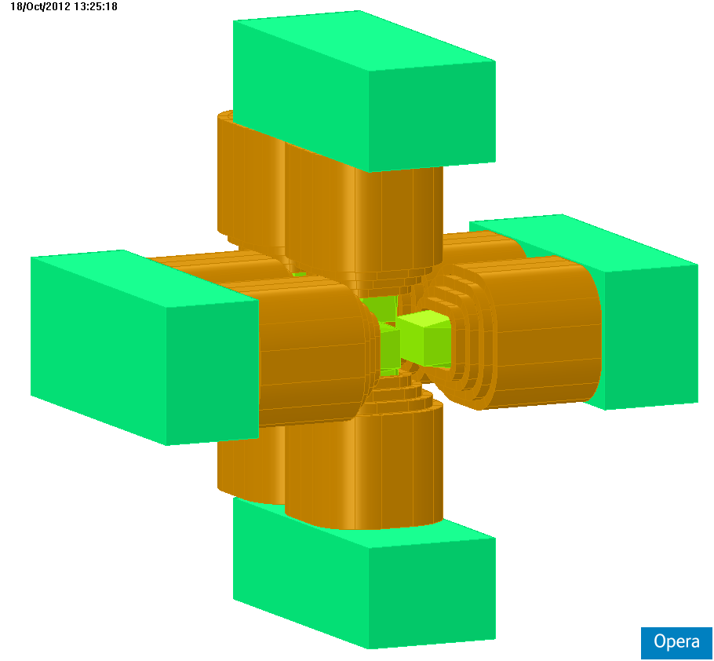
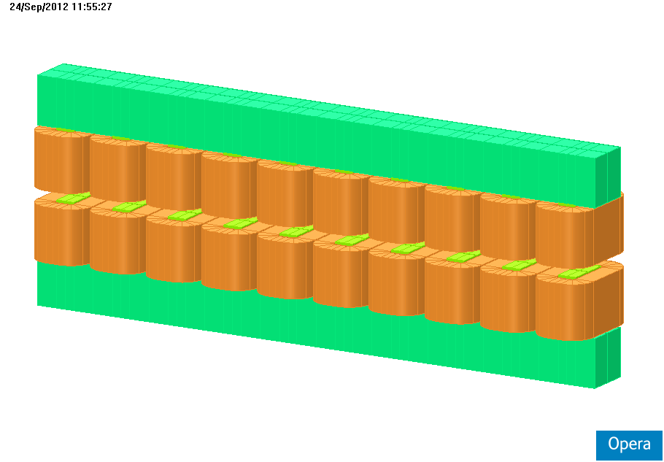
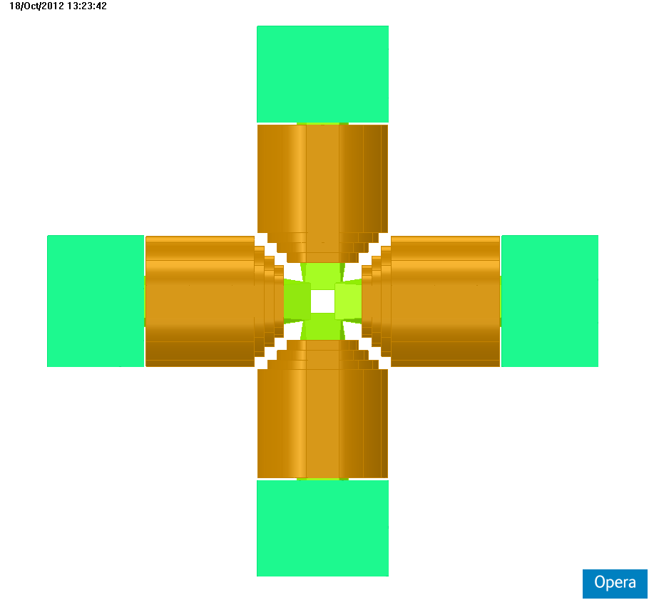
Electromagnetic Undulator (general) - Planar (EMU) and Circular (CEMU)
Magnetic field analysis only.
Give an idea of the achievable fields of different periods for EMUs and CEMUs
EMU fields were calculated using a current density 4 A/mm²
CEMU fields were calculated using a current density 3 A/mm²
CEMU
EMU

Slide 20
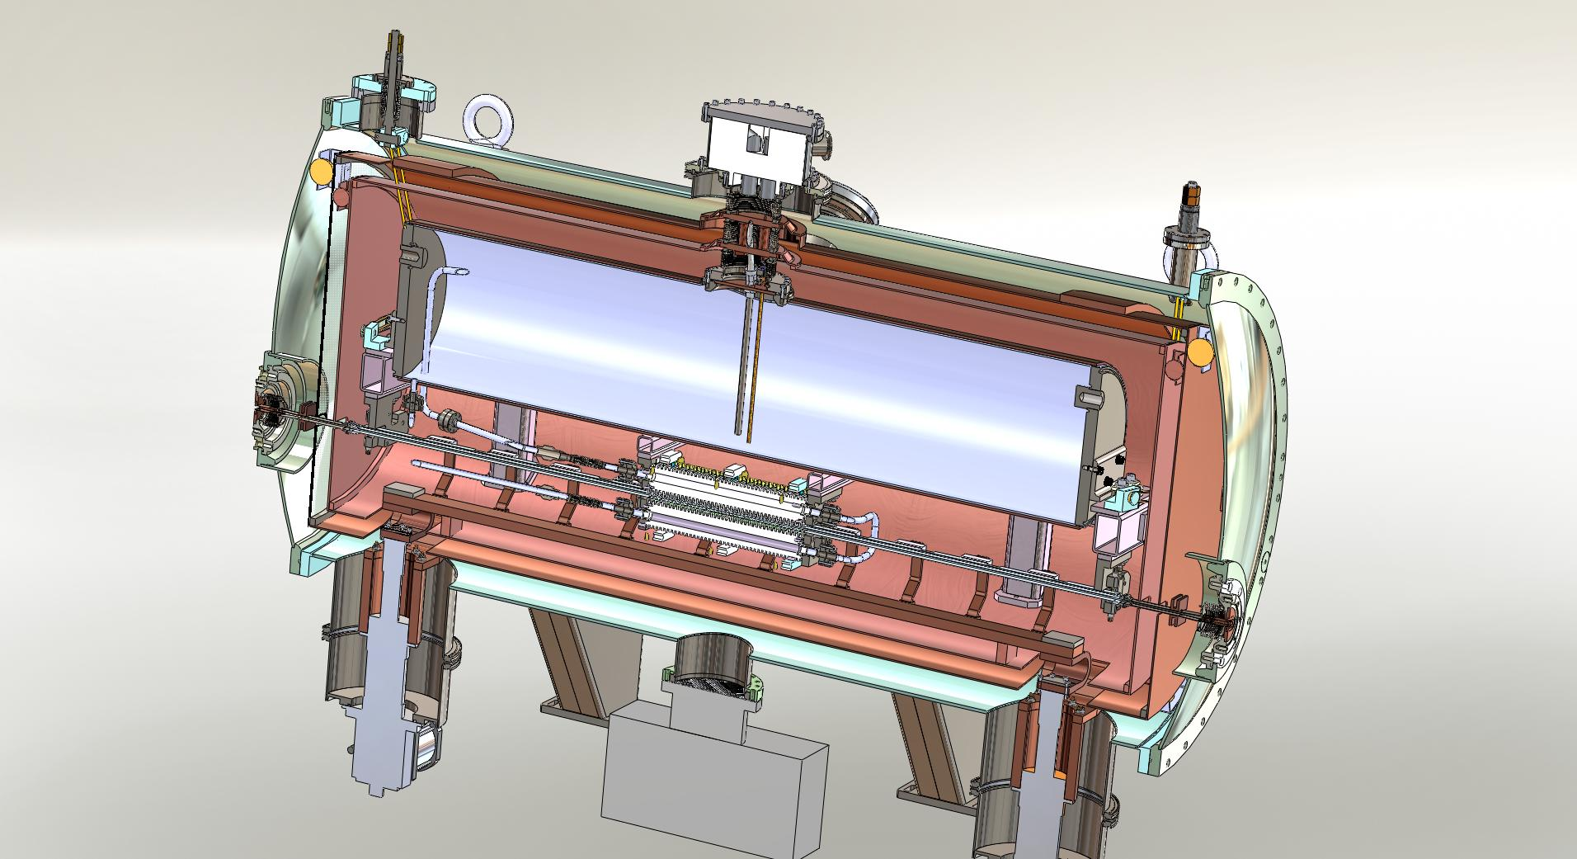
Superconducting Undulator^{[5]} at APS
SC magnet
He fill/vent turret
LHe vessel
LHe piping
20 K radiation shield
60 K radiation shield
Beam chamber
Beam chamber
thermal link to cryocooler
[5] Y. Ivanyushenkov et al., Proc. IPAC 2012, 745-746

Slide 21
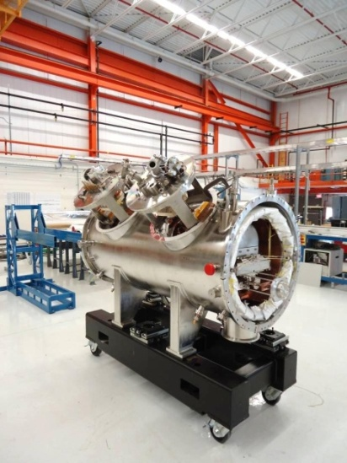
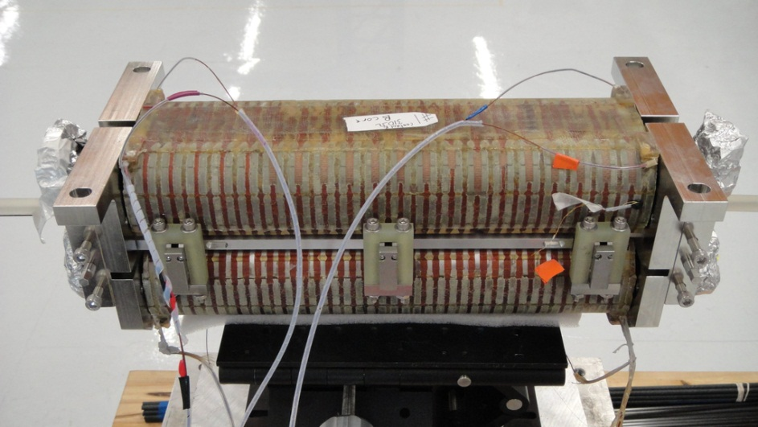
Superconducting Undulator
SCU has been built at the APS
Beff = 0.64 T at 500 A
Installation is scheduled for December 2012
Fit test of cold mass and current lead assemblies in cryostat
Completed magnet assembly

Slide 22
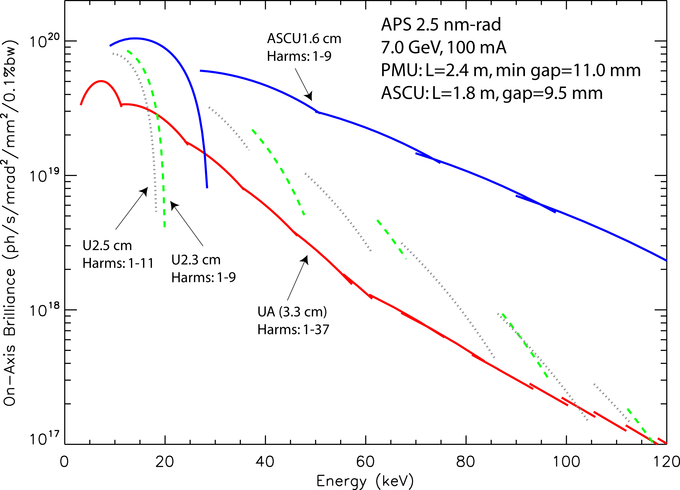
Beyond APS-U: Advanced SCU
ASCU is an Advanced SCU with peak field increased by factor of 2 as compared to SCU.
Design / Operation Change | Peak Field Gain Factor
Nb₃Sn conductor | 1.4
Higher operating current | 1.2
Decreased operating temperature | 1.1
Better magnetic poles | 1.1
Decreased magnetic gap | 1.1
Total: | 2.2
x20
Tuning curves for odd harmonics for planar permanent magnet hybrid undulators and one superconducting undulator.
The ASCU 1.6 cm surpasses the revolver-type undulator by a factor of 20 above 100 keV !
This slide courtesy of Y. Ivanyushenkov

Slide 23
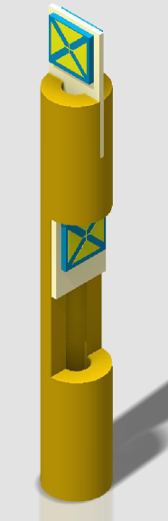
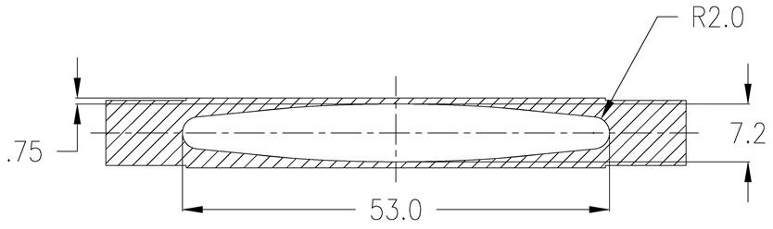
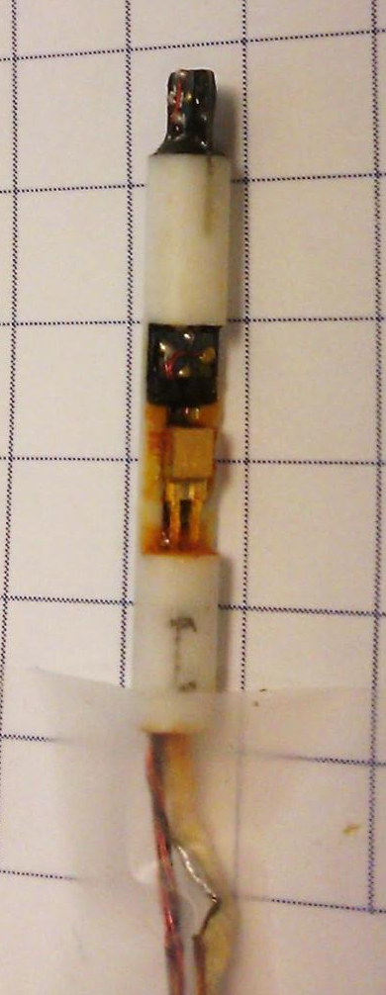
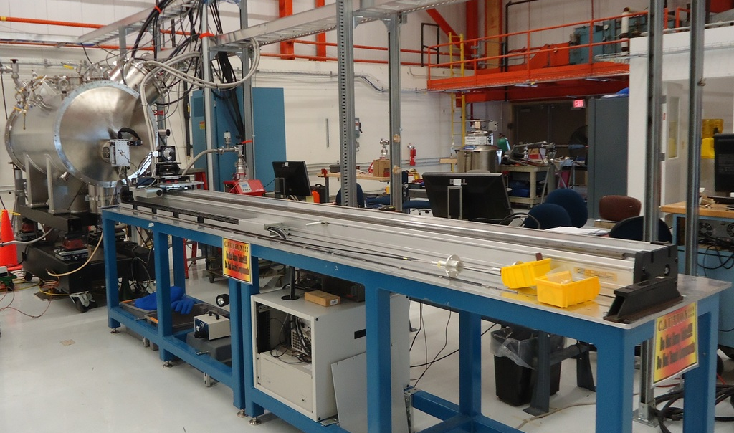
Superconducting Undulator Magnetic Measurement System (newly developed)
Provides capability to magnetically measure IDs with a small round beam pipe that is expected to be used in USRs.
Hall probes
carbon fiber tube holding Hall probe
guiding tube
B_{y1}
beam chamber
3.8 mm OD
29 mm length
B_{x}
Developed by C. Doose et al.

Slide 24
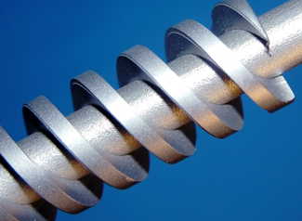
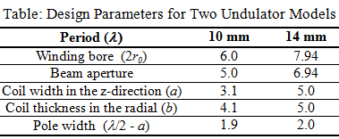
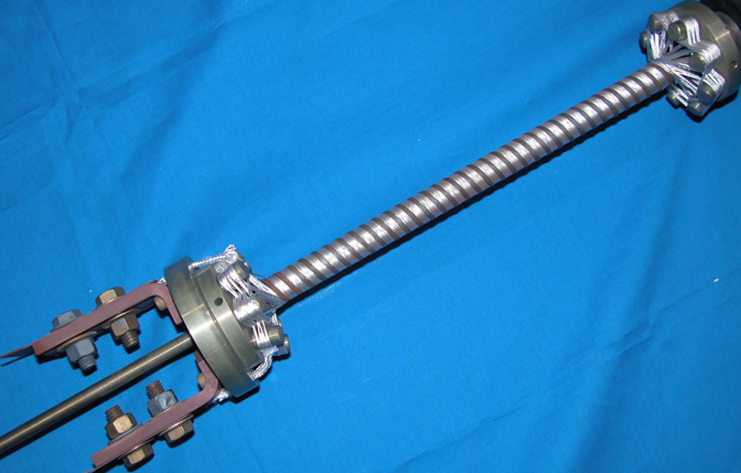
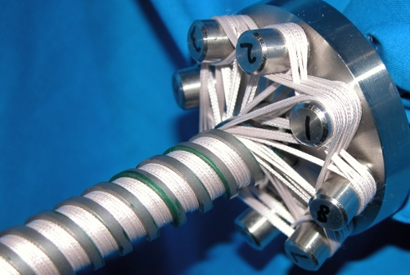
Helical Undulators at APS^{[6]}
Can take advantage of the small round beam pipes in the USR IDs
Prototype built at APS
High-permeability steel poles installed (λ = 14 mm)
0.5-mm Nb₃Sn SC wire with S-glass insulation for the 39-turn coils
Undulator ends were designed for continuous winding without conductor joints
[6] S.H. Kim and C.L. Doose, Proc. 2007 PAC (2007) p.1036

Slide 25
Closing Remarks
This was a review of advances in electromagnetic undulator technology at the APS.
There are many other types of electromagnetic undulator not discussed here.
Recent APS progress in electromagnetic undulators can be applied to the development of IDs for USRs
Electromagnetic undulator technology is continuously improving.

