Slide 1
High Precision Magnet Production for NSLSII at IHEP
Wen Kang
Magnet Group, IHEP
2012, 10, 30
Huai Rou, Beijing

Slide 2
Contents
The Specifications of the NSLSII magnets
The quadrupole magnet production
The wide sextupole magnet production
General remarks

Slide 3
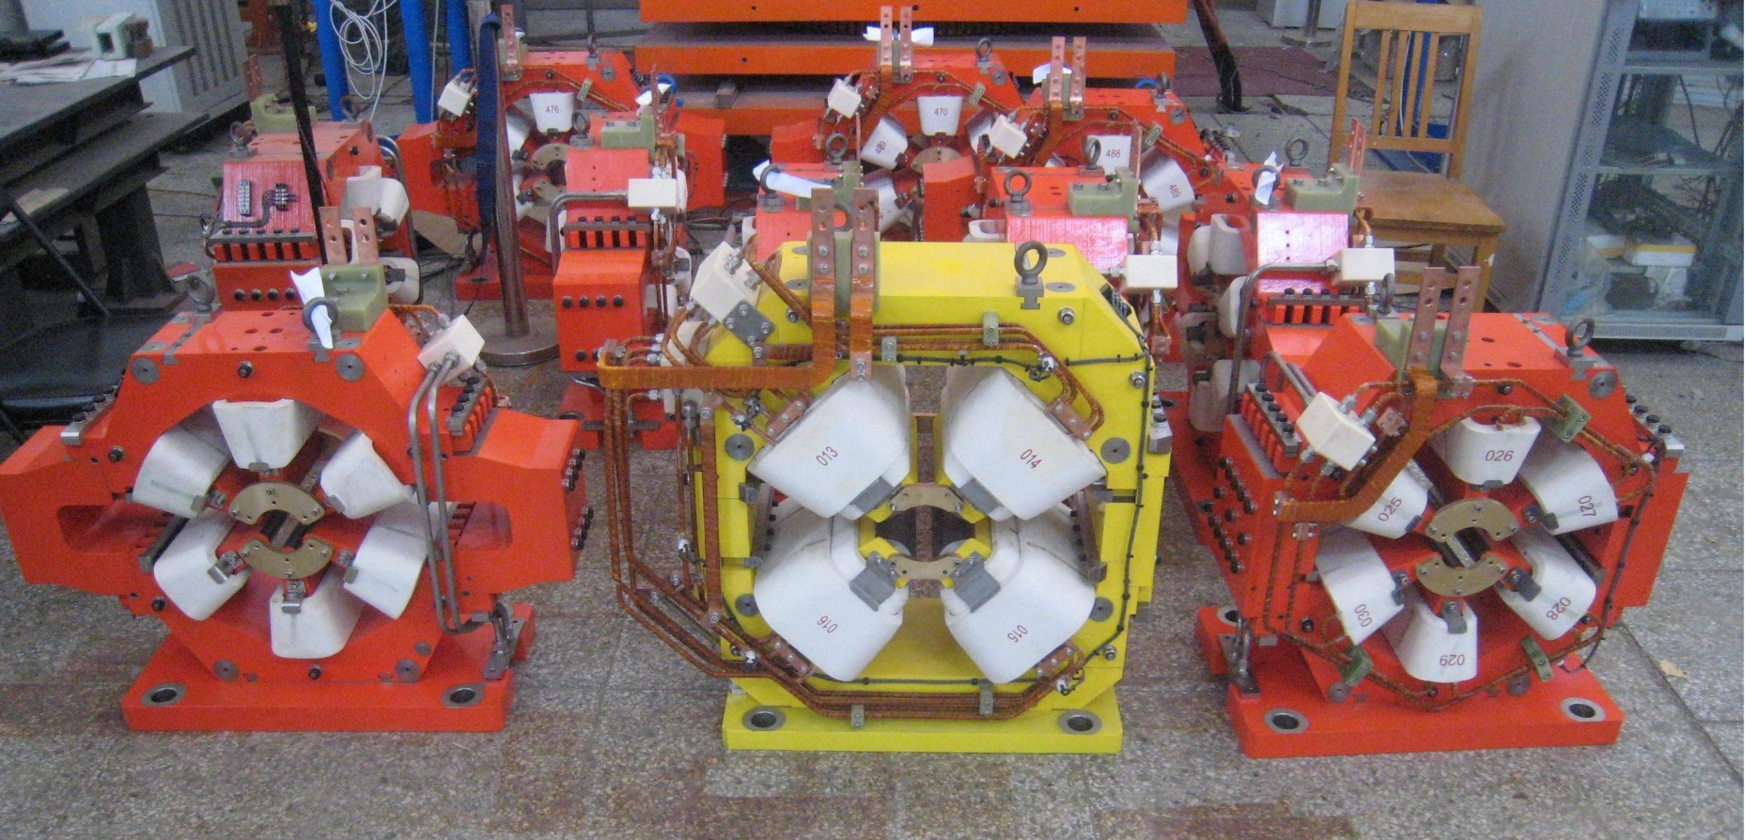
High precision magnets made in IHEP
As one of the famous magnet producers in the world, IHEP had gotten an opportunity to manufacture the high precision magnets for NSLS-II. These magnets are 76 wide sextupole magnets, 4 large aperture quadrupole magnets and 6 large aperture sextupole magnets.

Slide 4
Specifications of the magnets
The specifications of these magnets are listed in the table.
 |  | W-S | L-A-S |  | L-A-Q
Magnetic Length | mm | 200 | 248 | mm | 277
Aperture, min | mm | 68 | 76 | mm | 90
Maximum Operative Field Grad. | T/m² | 400 | 400 | T/m | 14
Maximum Field Integral | T/m | 80 | 100 | T | 3.79
Iron Yolk Length, approx | mm | 178 | 225 | mm | 238
Harmonic @25mm×10⁻⁴ (1 unit=1×10⁻⁴) | b₉ | 1.0 | 1.0 | b₆ | 0.5
 | b₁₅ | 0.5 | 0.5 | b₁₀ | 0.5
 | b₁ | 30.0 | 15.0 | b₁₄ | 0.1
 | b₄ | 2.5 | 3.0 | b₃ | 3.0
 | b₅ | 1.0 | 1.0 | b₄ | 2.0
 | b₆ | 0.5 | 1.0 | b₅ | 0.3
 | b₇ | 1.0 | 0.5 | b₇-b₉ | 0.1
 | b₈ | 0.5 | 0.5 | b₁₁- b₁₃ | 0.1
 | b₁₀- b₁₁ | 0.2 | 0.2 | b₁₅- b₂₁ | 0.1
 | b₁₂ -b₁₄ | 0.1 | 0.1 | a₃ | 1.5
 | a₁ | 15 | 10 | a₄ | 1.0
 | a₄-a₅ | 1.0 | 1.0 | a₅-a₈ | 0.1
 | a₆-a₇ | 0.2 | 0.2 | a₉-a₂₁ | 0.1
 | a₈-a₁₅ | 0.1 | 0.1

Slide 5
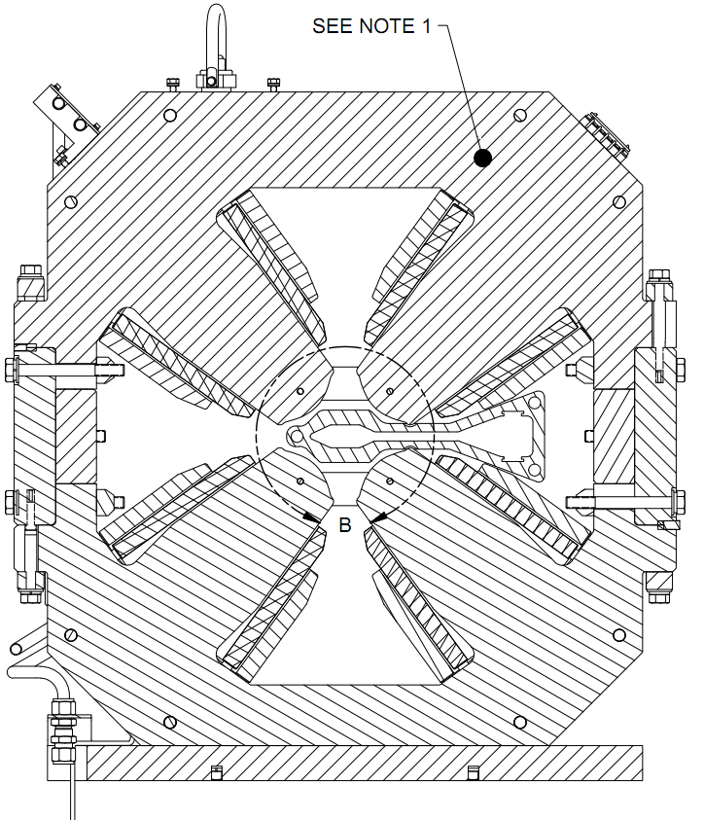
Production of the large aperture quadrupole magnets
In three types of the magnets, the large aperture quadrupole magnet is the easiest one to be produced.
As it has a thick yoke and 90mm large aperture, its magnetic field is not much sensitive to the mechanical errors.
The pole profile was machined by EDM, the pole ends were chamfered to reduce the allowed harmonic errors. And the precision of the field had easily met the requirements.
Cross section of LAQ magnet

Slide 6
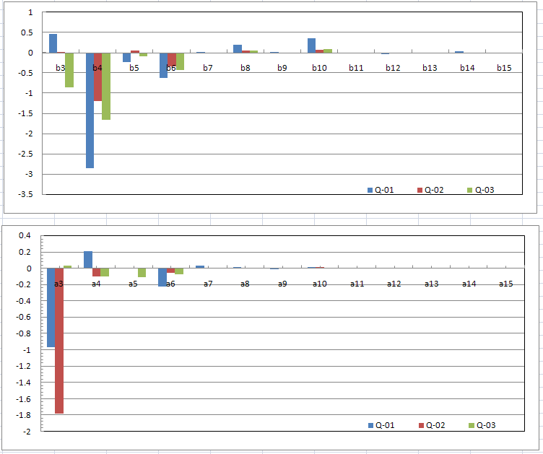
Production of the large aperture quadrupole magnets
Harmonic errors of 3 large aperture quadrupole magnets.

Slide 7
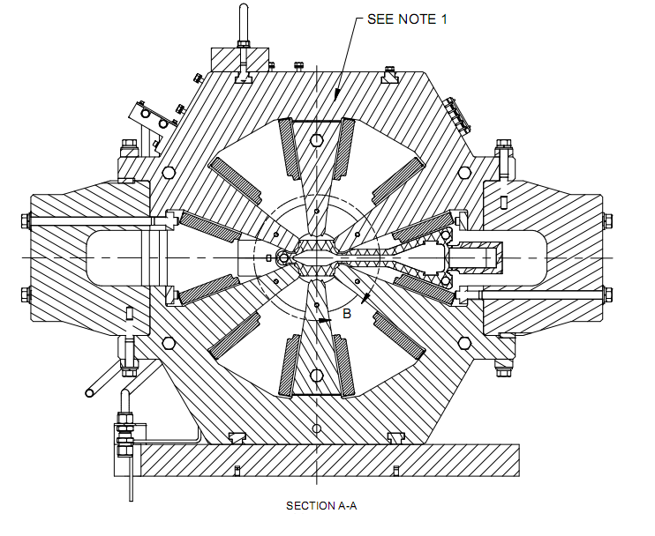
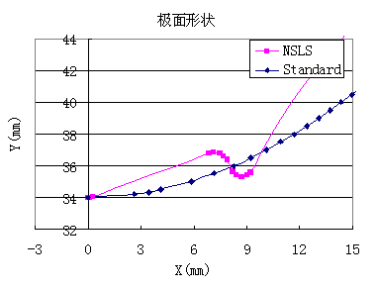
Production of the wide sextupole magnets
The wide sextupole magnet is the most difficult one in three types of the magnets to be produced
The pole profile is different from conventional sextupole magnet. It is good to suppress the allowed harmonic errors such as b9, b15, but it makes the field of the magnet very sensitive to mechanical errors
The side U blocks ruin the 6-fold symmetry of the sextupole magnet, which makes odd order harmonic errors of b1, b5, b7… become “allowed”.

Slide 8
Field simulation of the sextupole magnet
The TOSCA program was used to simulate the field of the magnet. As previous analysis, the simulated b1 and b5 were larger than the required value.
n | Calculated | Required
b1 | -35.08 | 30
b2 | 0.00 | 0.00
b3 | 10000 | 10000
b4 | 0.00 | 2.50
b5 | -5.06 | 1.00
b6 | 0.00 | 0.50
b7 | -0.15 | 1.00
b8 | 0.00 | 0.50
b9 | 0.43 | 1.00
b10 | 0.00 | 0.20
b11 | 0.35 | 0.20
b12 | 0.00 | 0.10
b13 | 0.10 | 0.10
b14 | 0.00 | 0.10
b15 | 0.26 | 0.50

Slide 9
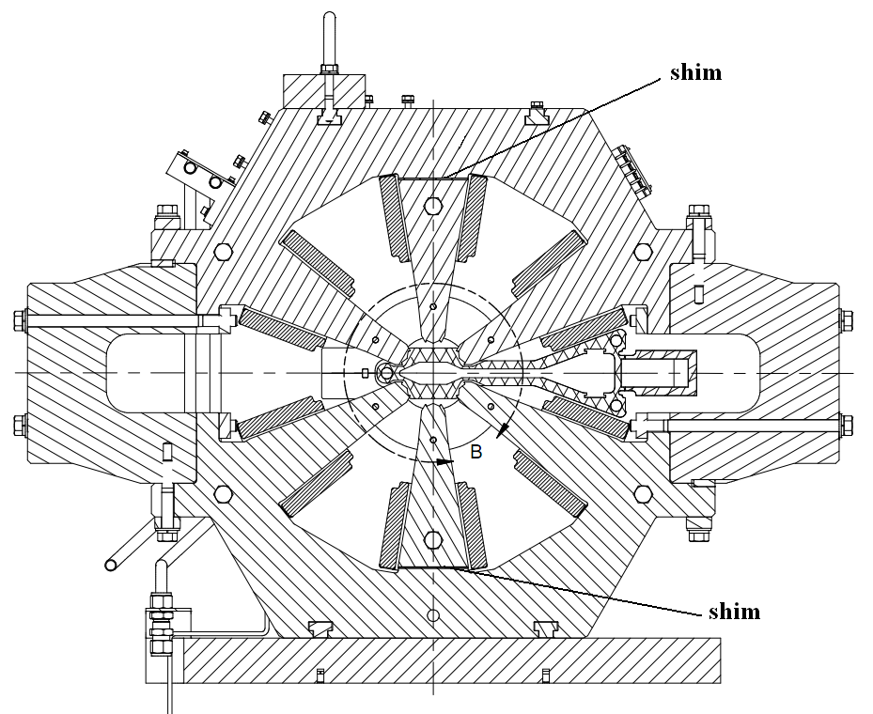
A method to shim the field
In order to suppress b1 and b5, a method of adjusting the distance between the upper and lower poles was adopted. Two shims in the roots of the upper and lower poles were used to adjust the distance.

Slide 10
TOSCA simulation shows that b1 changes about 5 units while the thickness of the shims changes 10 microns, and at the same time b5 changes 0.8 unit.
Δthk | 0.0mm | -0.04mm | -0.05mm | -0.06mm | -0.07mm | Required
b1 | -35.08 | -25.39 | -19.27 | -16.51 | -13.31 | 30.00
b2 | 0.00 | 0.00 | 0.00 | 0.00 | 0.00 | 0.00
b3 | 10000 | 10000 | 10000 | 10000 | 10000 | 10000
b4 | 0.00 | 0.00 | 0.00 | 0.00 | 0.00 | 2.50
b5 | -5.06 | -2.27 | -1.03 | -0.43 | 0.36 | 1.00
b6 | 0.00 | 0.00 | 0.00 | 0.00 | 0.00 | 0.50
b7 | -0.15 | 0.08 | 0.07 | 0.04 | 0.04 | 1.00
b8 | 0.00 | 0.00 | 0.00 | 0.00 | 0.00 | 0.50
b9 | 0.43 | 0.37 | 0.32 | 0.80 | 0.22 | 1.00
b10 | 0.00 | 0.00 | 0.00 | 0.00 | 0.00 | 0.20
b11 | 0.35 | 0.55 | 0.56 | 0.59 | 0.65 | 0.20
b12 | 0.00 | 0.00 | 0.00 | 0.00 | 0.00 | 0.10
b13 | 0.10 | 0.02 | 0.02 | 0.01 | -0.02 | 0.10
b14 | 0.00 | 0.00 | 0.00 | 0.00 | 0.00 | 0.10
b15 | 0.26 | 0.23 | 0.21 | 0.24 | 0.19 | 0.50

Slide 11
The key issues of the magnet production
There are three key issues in the magnet production. The first is how to make the magnet fabrication and assembly errors within the required tolerance.
To control the length and stacking factor errors of the magnet yokes.
To control the fabrication errors of the pole profile by using high precision EDM.
The high precision inspecting tools such as CMM are used to check the key dimensions of the magnet aperture.
The mechanical tolerance of the G1-G6 and Φ1- Φ3 is ±0.01mm.

Slide 12
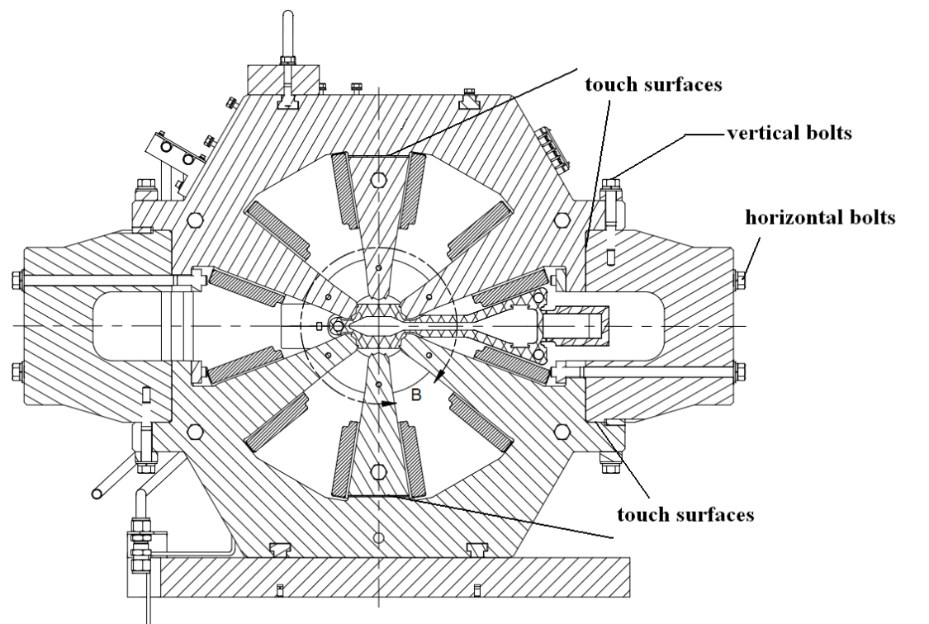
The key issues of the magnet production
The second issue is how to make the magnetic field reproducible when the magnet is re-assembled.
To make the touch surfaces smooth .
To keep the torque on the side vertical and horizontal bolts uniform and constant.
To follow the specified sequence when tightening the side bolts .

Slide 13
The key issues of the magnet production
The third issue is how to compensate the field errors if they are out of the specifications after the magnet is finished. This kind of problem had almost existed in all finished magnets since it was very hard to meet all mechanical tolerance after the magnet yokes were installed the coils and assembled again. The harmonic errors of some real magnets are shown in the figures. Besides b1 and b5, the low order harmonic errors, such as a1, b4, a4, and a5 are also larger than the specifications.

Slide 14
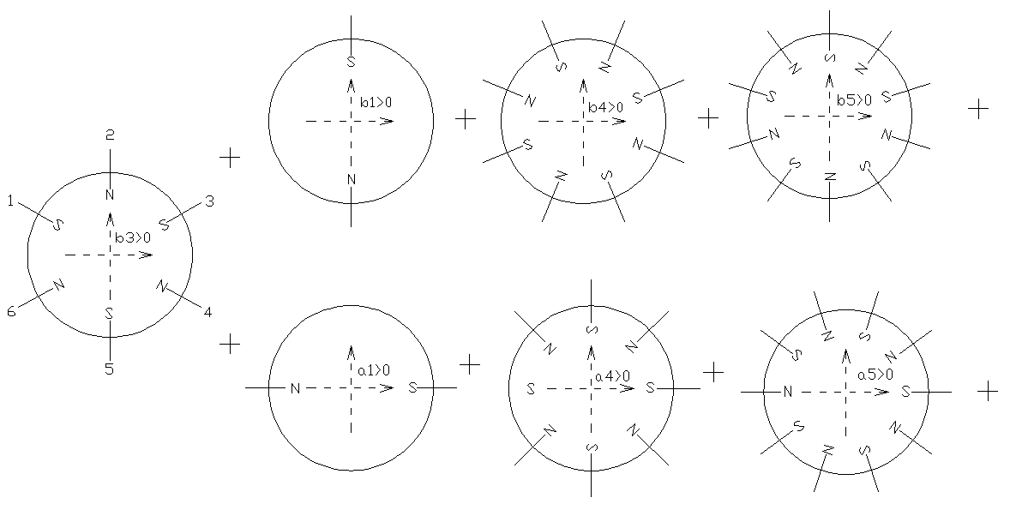
The key issues of the magnet production
At first, we know we could compensate b1 and b5 by adjusting the distance between upper and lower poles, but we didn’t know how to compensate a1, a4, a5 and b4, sometimes b7. Fortunately, through theoretical analysis and experimental study, we found a fast effective method to compensate these low order harmonic errors of the sextupole magnets for NSLS-II. The method is based on the principle of magnetic field superposition.

Slide 15
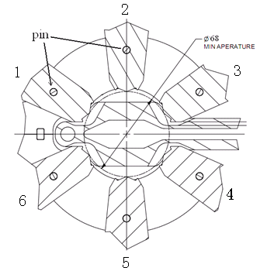
According to the field superposition, the harmonic field could strengthen or weaken the field of the poles of sextupole magnet. In the case of the NSLS-II sextupole magnet, there is one pin in each pole. Therefore, by changing the magnetic property of the pins, we could compensate the effect of the harmonic field errors. For example, if the harmonic field weaken the field of one pole, we can compensate it by inserting a steel pin instead of a stainless steel pin in the pole.

Slide 16
Through the field measurement study, we have achieved the precise influence of the steel pin in each pole on the harmonic field of b1, a1, b4, a4, b5 and a5. It can be seen that the steel pin in any poles changes several harmonic field at the same time, so the final solution to suppress all harmonic field is some kind of combination of the steel pins in the different poles.
Table: Influence of the steel pins (b3 is positive)
Harmonic field | Pole 1# | Pole 2# | Pole 3# | Pole 4# | Pole 5# | Pole 6#
Δb1(unit) | +6 | -13 | +6 | +6 | -13 | +6
Δa1(unit) | -11 | * | +11 | -11 | * | +11
Δb4(unit) | -2.1 | * | +2.1 | +2.1 | * | -2.1
Δa4(unit) | -1.5 | -2.5 | -1.5 | +1.5 | +2.5 | +1.5
Δb5(unit) | +0.5 | -1 | +0.5 | +0.5 | -1 | +0.5
Δa5(unit) | +1 | * | -1 | +1 | * | -1
‘+’ means increasing, ‘-’ decreasing and ‘*’ no influence.

Slide 17
This method had played a key role in manufacturing the sextupole magnets for NSLS-II at IHEP. As long as harmonic errors of b4, a4, b5, a5 are not larger than 5 units, they can be suppressed to 1 unit easily and effectively by using this method. It makes the production of the high precision sextupole magnets easier.

Slide 18
General Remarks
For high precision magnet design, a good solution is the one that is not so sensitive to the mechanical errors .
High precision field means tight mechanical tolerance, and the tight tolerance means high cost and long production time.
A right method of the field adjustment based on the field measurement is always needed to get the specifications.
Field measurement becomes an integral part of the manufacturing process, and magnet quality is directly related to the quality of magnetic field measurement.

Slide 19
Thank you for your attention!

