Slide 1
Workshop Charge
Qing Qin
Institute of High Energy Physics
10/30/2012

Slide 2
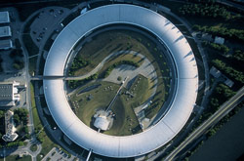
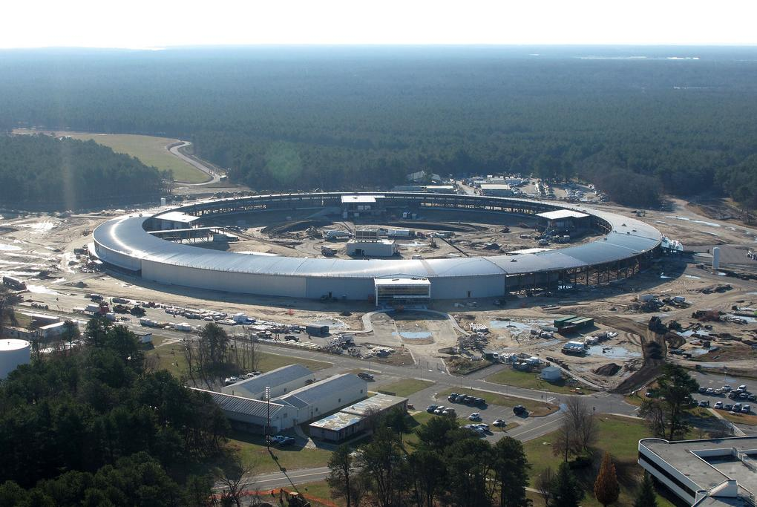
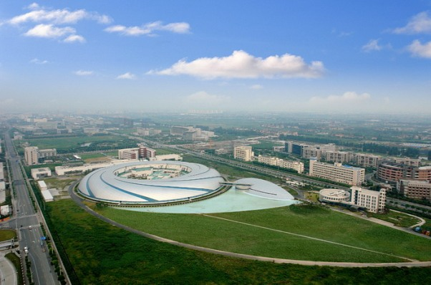
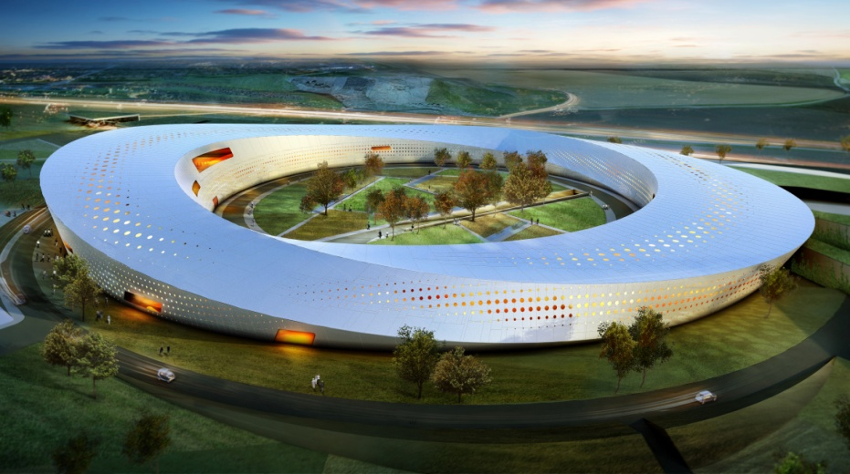
3rd Generation Light Sources
Existing Under construction
SSRF
NLSL-II
SSRF
Max-IV
Notes:
Range of energy and emittance
Mention undulator

Slide 3
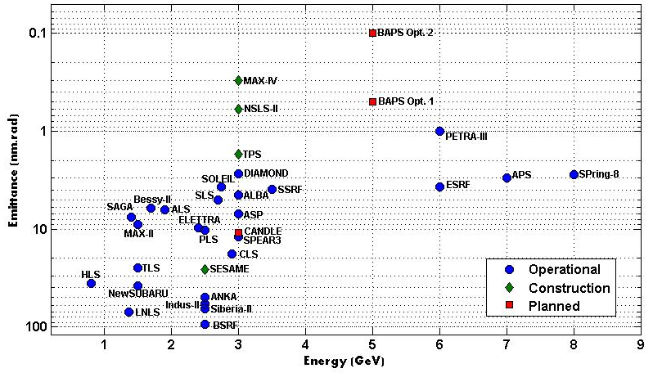
Storage ring light sources
USR
Courtesy Y. Jiao

Slide 4
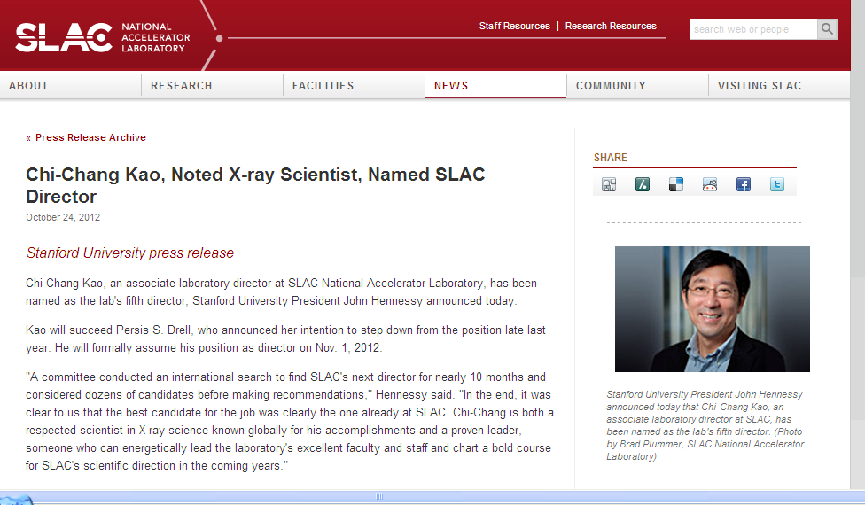
Light sources are more and more important…

Slide 5
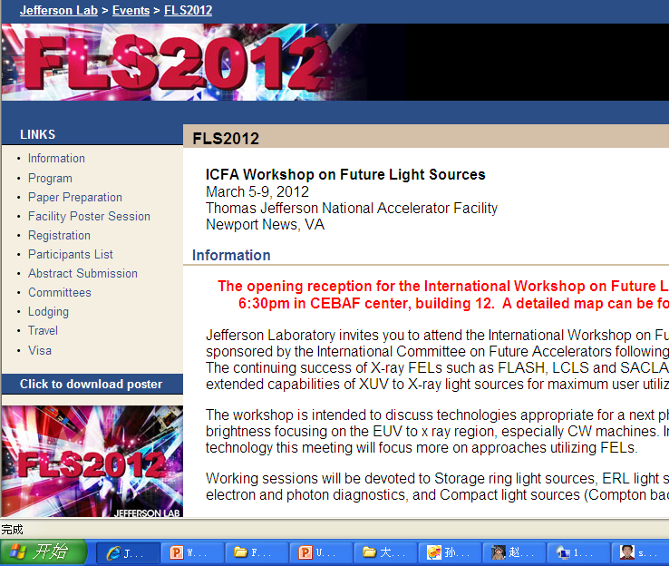
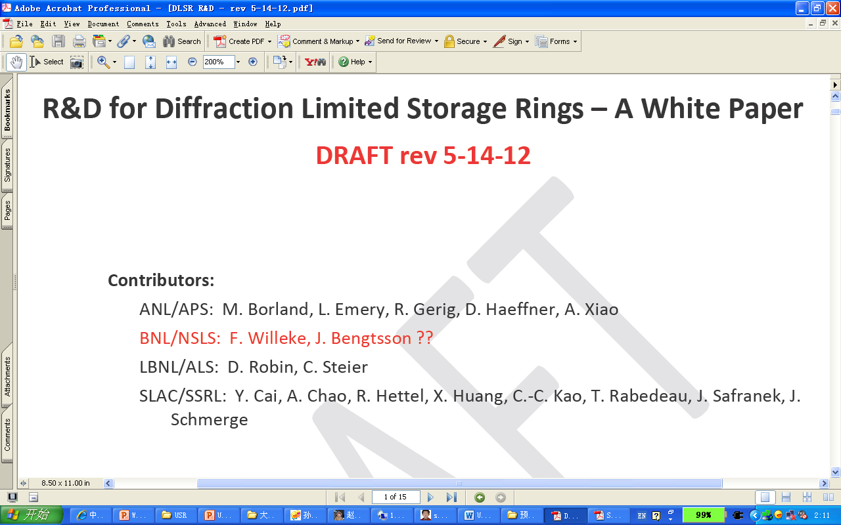
Progress already done
A USR was described by Ropert et al in 2000
Several machines reduce emittance towards USRs

Slide 6
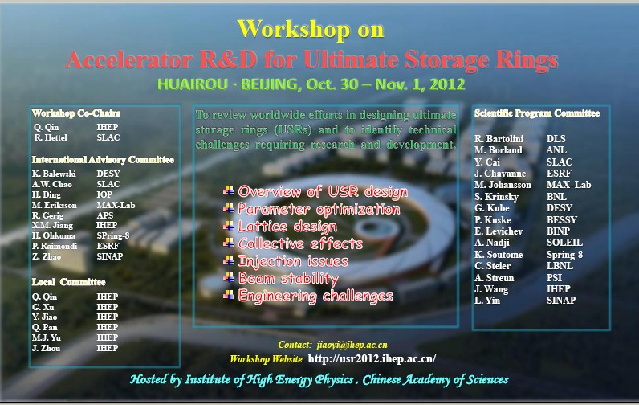
We are now here:

Slide 7
What we will do in our workshop
Survey conceptual designs and compare the performance goals for USRs worldwide
PEP-X, Tevatron USR, etc.
Spring-8 II, ESRF upgrade, ALS upgrade, DLS-II
BAPS
Get experiences from being-constructed and running machines
MAX-IV, SIRUS, NSLS-II, TPS, BESSY-II, PETRA-III, SLS, SOLEIL, etc.

Slide 8
Identify technical challenges and R&D requirements associated with:
Ring dimensions and lattice design
Collective effects, impedances and lifetime
Injection methods
Accelerator component and system design
Beam stability
Insertion devices and damping wigglers.
Prioritize R&D topics and define critical studies that should start imminently.

Slide 9
How to work
Six technical sessions are formed.
Every attendee is involved in these topical sessions, working with co-chairs, including talks, discussions, close-out preparation, etc.
The purpose of this workshop is not necessarily to provide answers to the design challenges facing the implementation of future diffraction limited storage rings, but to identify and prioritize those challenges so that an R&D plan, possibly on an international scale, can be devised.

Slide 10
USRs: design questions and challenges
Is there an optimal M for a greenfield MBA lattice?
What are limits to high gradient magnets and small aperture vacuum chambers?
Can there be a leap in combined function magnet technology?
Can short beam lifetime (~1 h) being accommodated with top-up injection?
Can on-axis injection satisfy top-up current constancy needs?
  Injection from accumulator/booster?
  Injection from linac (that can be used for FEL too)?
  What is optimal RF frequency or combination of frequencies?
Can short bunches be propagated for several turns?
Can the USR lattice be modified for ERL implementation?

Slide 11
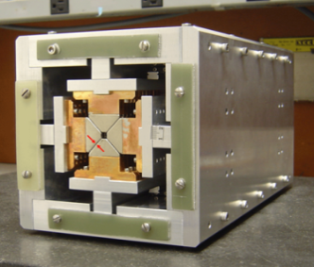
USRs: design questions and challenges – cont.
Can longitudinal emittance be reduced?
Can lasing be achieved? (requires very long straight sections)
  can energy spread be < ~0.05%?
  can peak current be >200 Apk (e.g. with temporary compression)?
  Should emittance exchange technology be developed (RF and laser)?
  are XFELOs possible (using TGUs)?
Can USRs accommodate vertical or delta IDs?
Can beam stability requirements be met?
Can beam line technology preserve source brightness and coherence properties?
What should be the emittance goal for a new 1.2-1.5 km ring in the near future?

Slide 12
Working groups at the workshop
Group | Lattice Design | Accelerator Physics | Accelerator Engineering | Injection | Instrumentation and Feedback | IDs
Conveners | Ohkuma & Xu | Riamondi & Qin | Eriksson & Qu | Hettel & Jiao | Zhao & Cao | Gerig & Wu
Participants | S. Yoshito A. Nadji L. Rivkin H. Bahrdt D.H. Ji Q. Qin | M. Boscolo E. Levichev J.Q. Wang S.Q. Tian S.K. Tian Q. Qin M. Borland K. Bane | R. Bariolini G. Kulipano Ashraq F.S. Chen C. Zhang N. Wang G.H. Lwo | L. Liu A. Franchi K. Alexader K. Soutome K. Zolotarev Y. Jiao M. Johansson W. Kang J.H. Chen S. Leemann | J. Denard C. Steier Z.T. Zhao J.H. Yue Y.B. Leng S. Kurokawa T. Fujita B. Hettel | L.X. Yin M. Li Q.G. Zhou H.H. Lu M. Jaski J. Chavanne

Slide 13
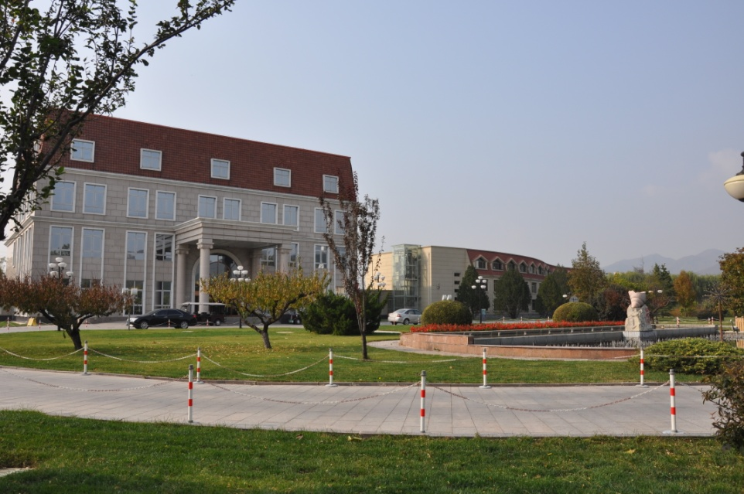
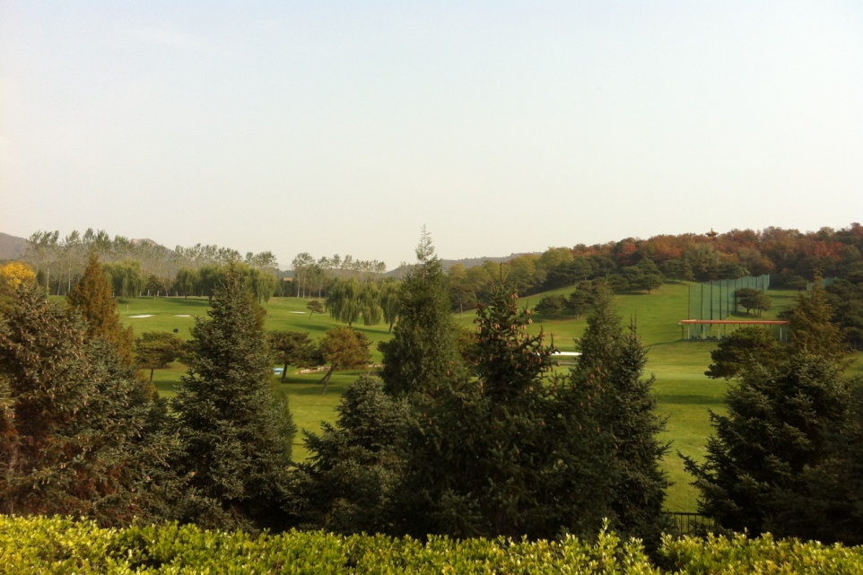
What we have now…
Beautiful garden
Delicious food
Experts from labs around
world
Working on the USR together
Construct an international
USR machine in future

Slide 14
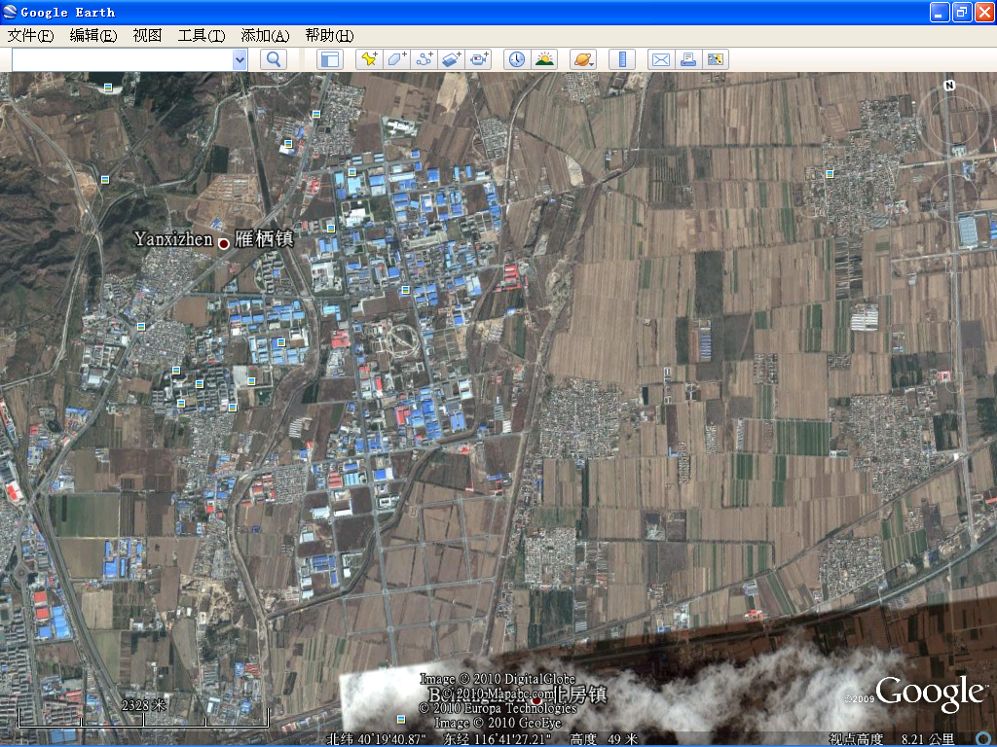

Slide 16
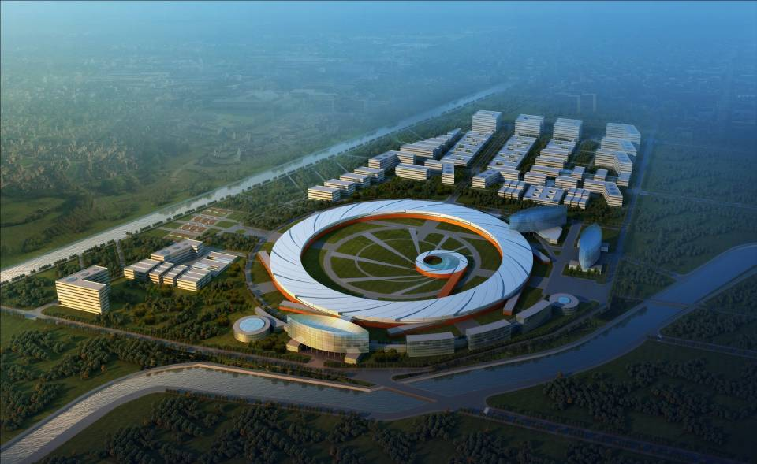

Slide 17
All the light source people unite !
Thanks!

