Slide 1
Vacuum System of MAX IV
Eshraq Al-Dmour
Workshop on Accelerator R&D for Ultimate Storage Rings
31st Oct. 2012
Huairou, Beijing

Slide 2
Contents
MAX IV Vacuum system constrains, challenges and considerations.
Vacuum system layout.
NEG coating issues.
Installation.
Conclusion.

Slide 3
MAX IV Vacuum system constrains, challenges and considerations.
Vacuum system layout.
NEG coating issues.
Installation.
Conclusion.

Slide 4
Constrains and requirements
Compact lattice.
Closed solid magnet block.
Small aperture of the magnets.
Target pressure with beam.
Removal of the power from SR.
Stable positioning for BPM.

Slide 5
Vacuum System of MAX IV considerations
Small aperture for the magnets
Compact lattice
No lumped absorbers nor antechamber
+
Distributed pumping
conductance limited tubes
Beam to FE
NEG coating
Distributed absorbers
Strict surface preparation
Copper vacuum chambers
Etching and cleaning process
flexible
Installation difficulties
Careful preparation for installation!
Welded bellows on
Chambers’ extremities
Manufacturing process complication.
But w. stable BPM

Slide 6
MAX IV Vacuum system constrains, challenges and considerations.
Vacuum system layout.
NEG coating issues.
Installation.
Conclusion.

Slide 7
The vacuum system layout
The vacuum chamber inside diameter is 22 mm (27 mm in the dummy straight sections), 1mm thickness.
Copper vacuum chambers OFS (resistance to activation cycles).
Areas with St. steel for fast corrector coils.
Distributed cooling.
Distributed pumping all along the chamber length, using NEG coating.
One Lumped absorber per achromat is needed to extract the photon beam to the front ends.
Welded bellows to allow the VC to expand without affecting the BPM position.

Slide 8
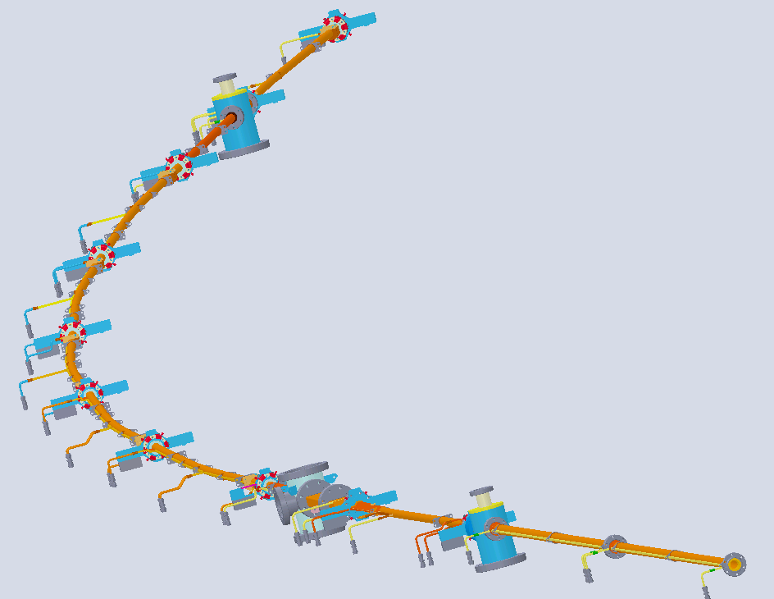
The vacuum system layout
BPM
Ion pump location
VC9
Absorber location
Sector valve location
VC8
One achromat
VC7
VC6
VC5
VC4
VC3
VC2
Beam direction
VC1
VC10

Slide 9
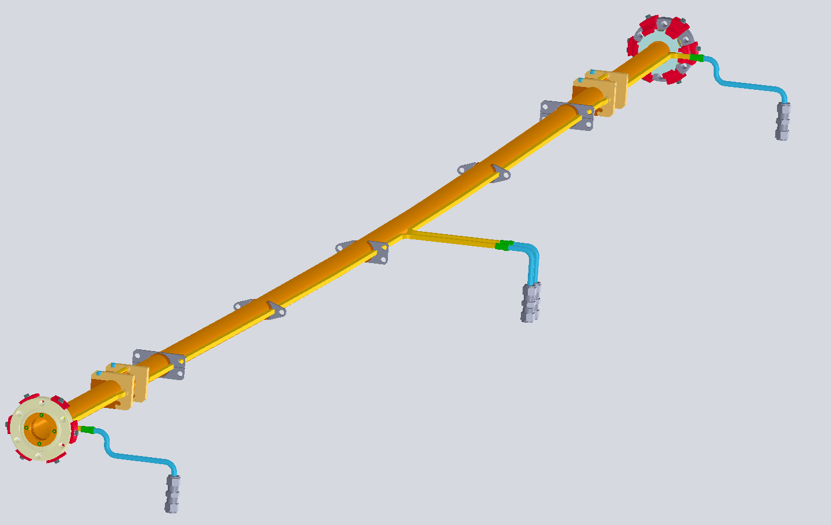
General Vacuum chamber geometry
Welded bellows
Chamber body
Beam direction
Cooling for corrector area
Ribs
Welded bellows
Distributed cooling
Ribs
Cooling for corrector area

Slide 10
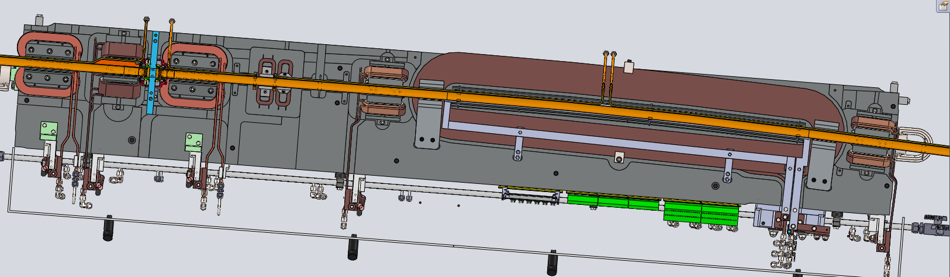
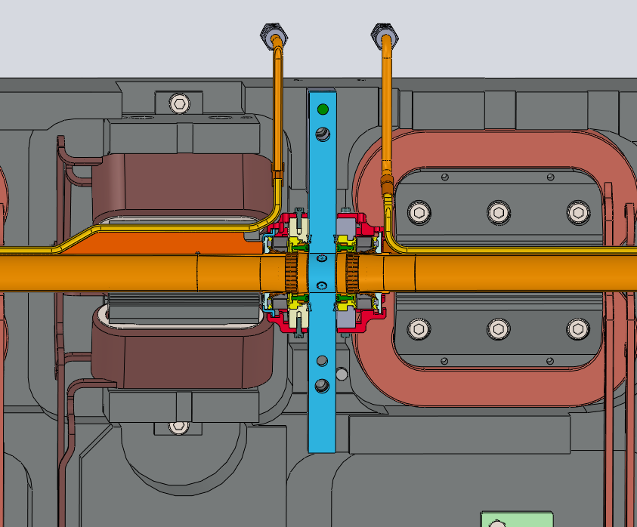
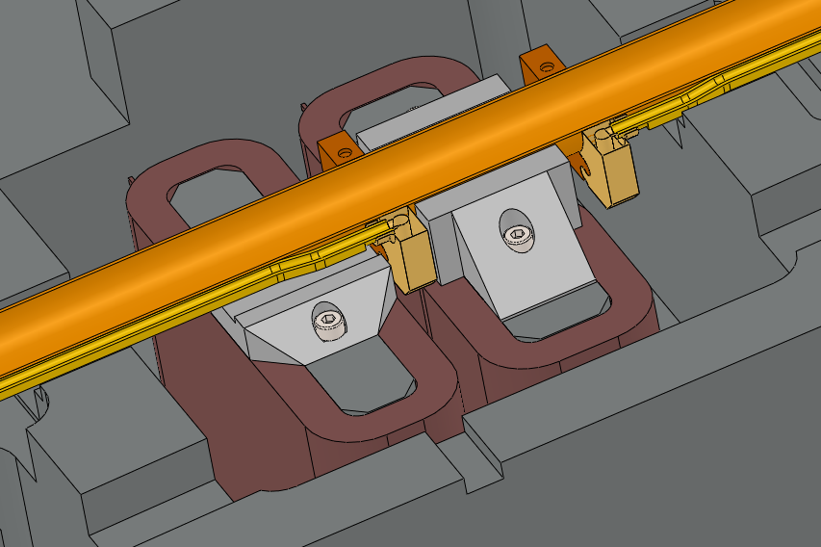
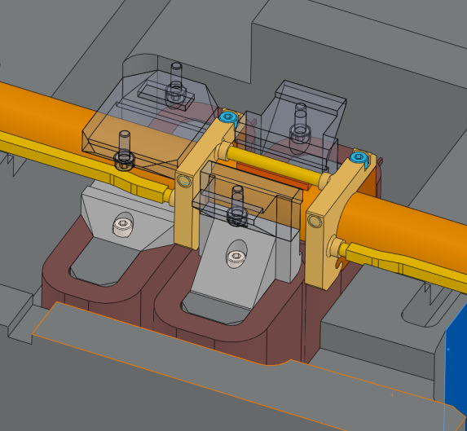
Vacuum chamber layout and the magnets

Slide 11
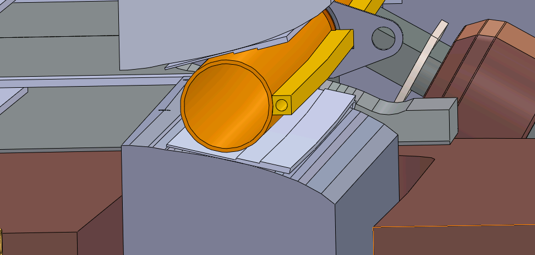
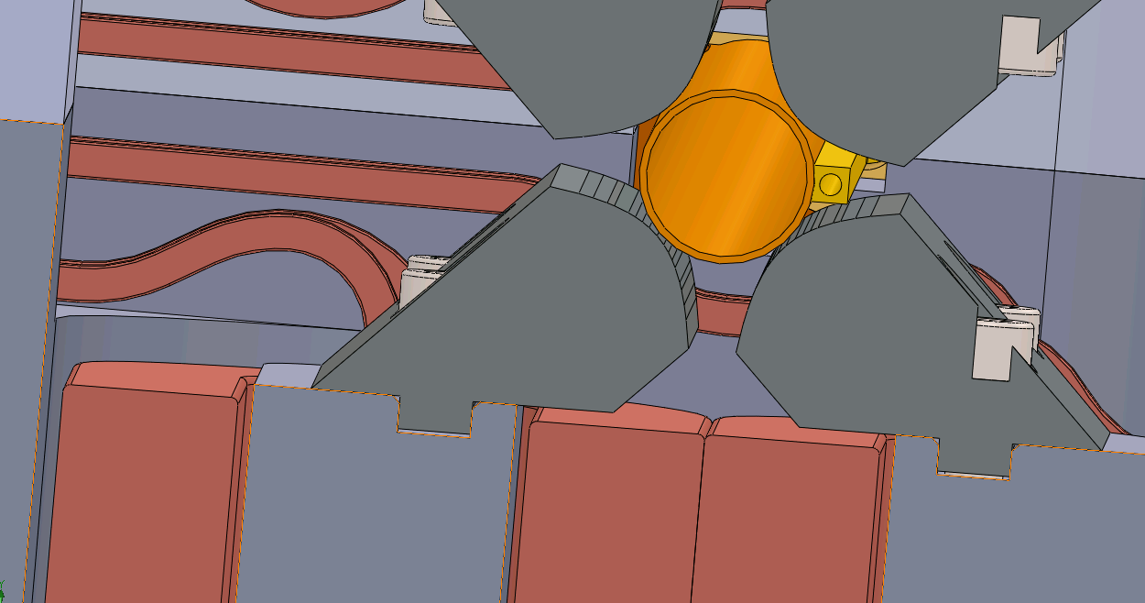
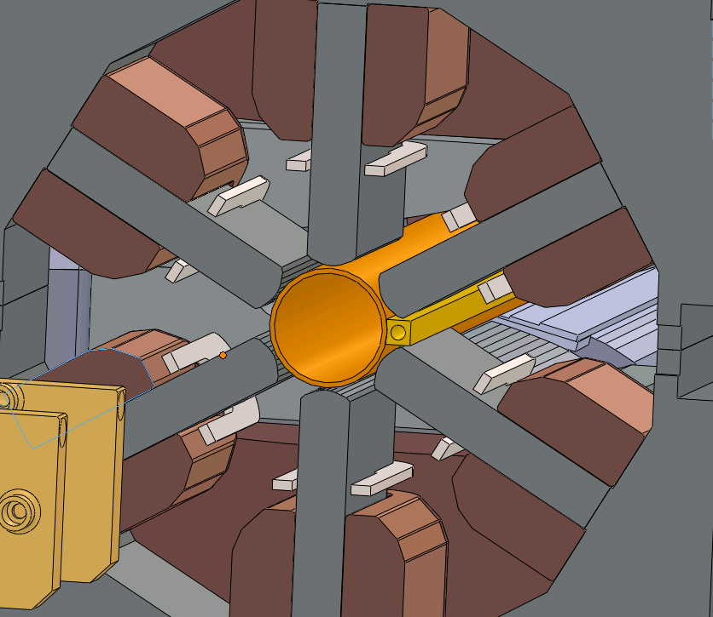
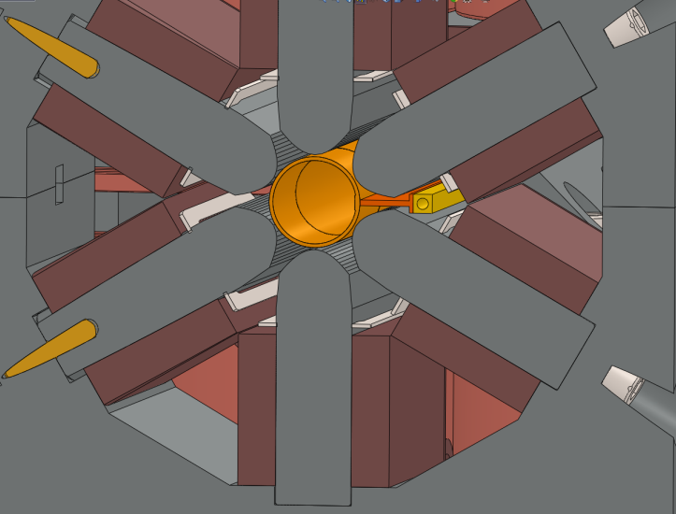
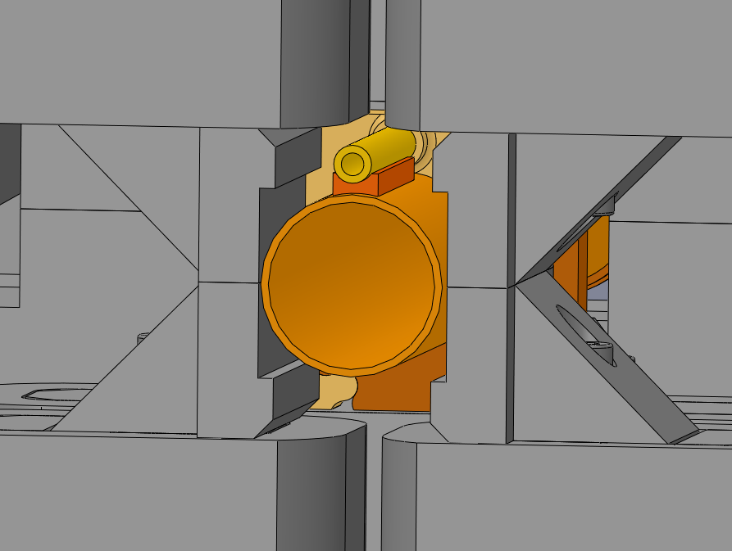
Vacuum chamber layout and the magnets
Min. clearance with the iron | 0.5 mm
Min. clearance with the coils | 2 mm
Cooling rib

Slide 12
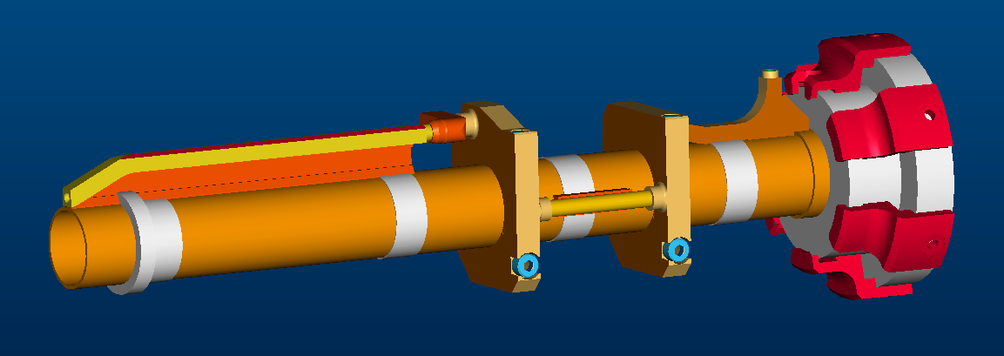
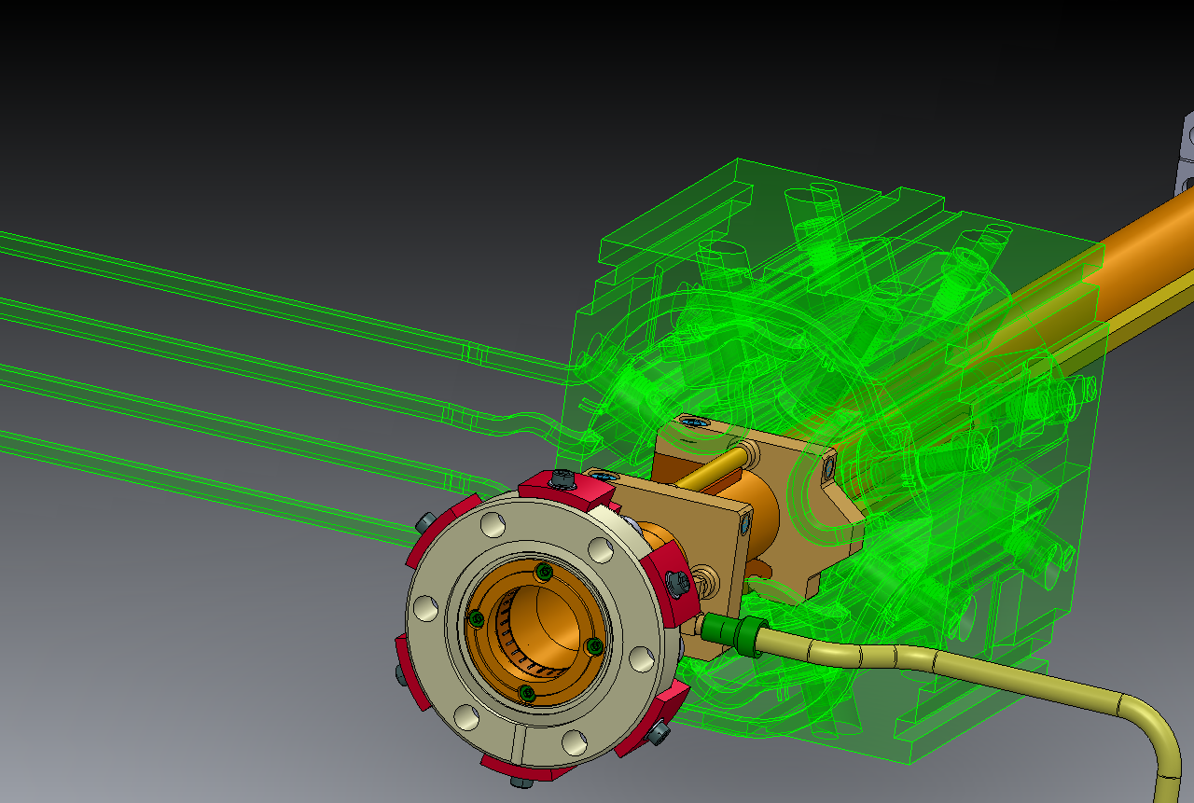
Vacuum chamber layout and the magnets
3D printing for parts of the vacuum chamber made of plastic for the magnets’ suppliers.
Gauges with the outer shape of the magnets by the supplier of the vacuum chambers.

Slide 13
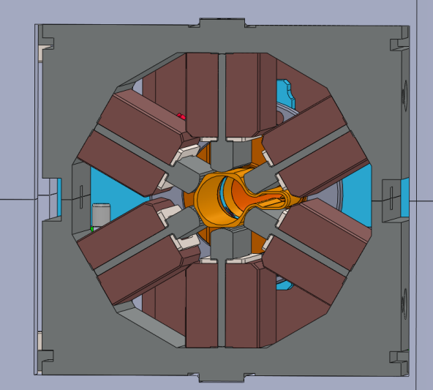
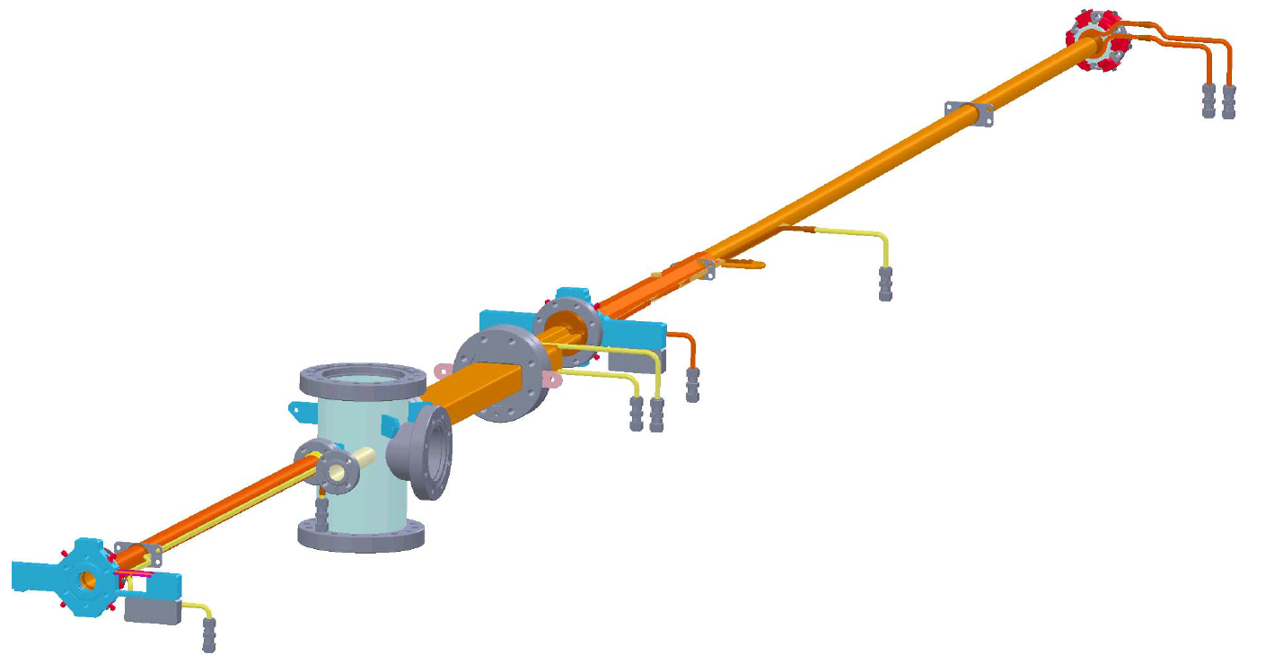
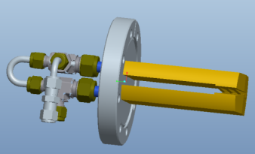
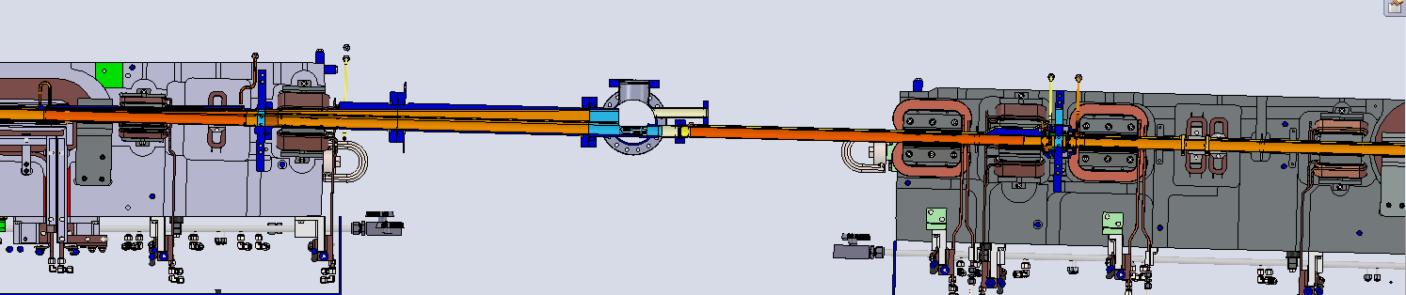
Vacuum chamber for beam extraction
Crotch
Absorber
Technologies applied:
  Wire erosion.
  TIG welding.
  E-beam welding
  Bending.
  Brazing.
  Milling.
  Etching.
  Turning.
  Etc..
Beam direction
One vertical corrector removed
Location of crotch
Absorber for bending magnet radiation
Cut in iron for FE pipe to pass
Fast
corrector
position

Slide 14
Thermal and mechanical FEA
Calculations being performed to assure safe design for:
Distributed absorbers.
Bellows RF fingers.
BPM stability.
Crotch absorbers (bending magnet radiation).
Insertion devices absorbers.
Deformation of VC.

Slide 15
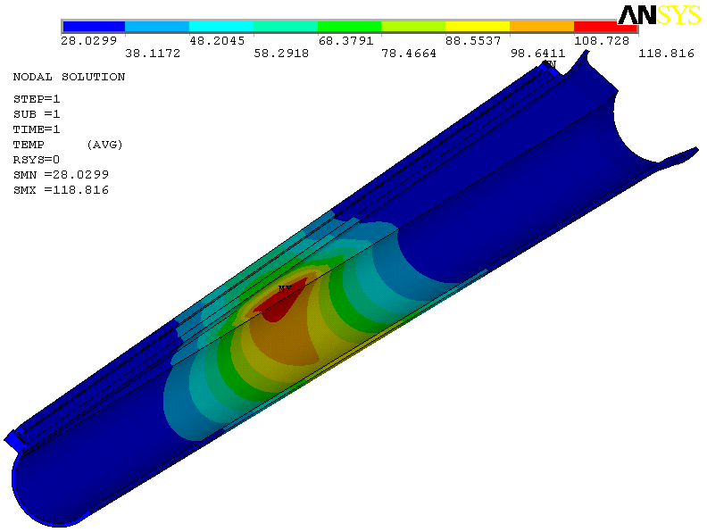
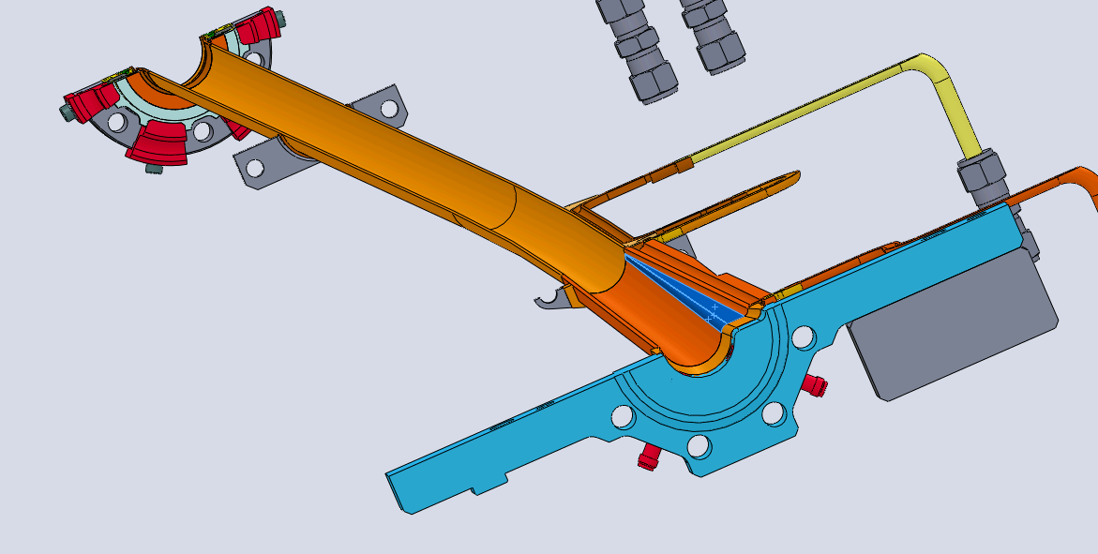
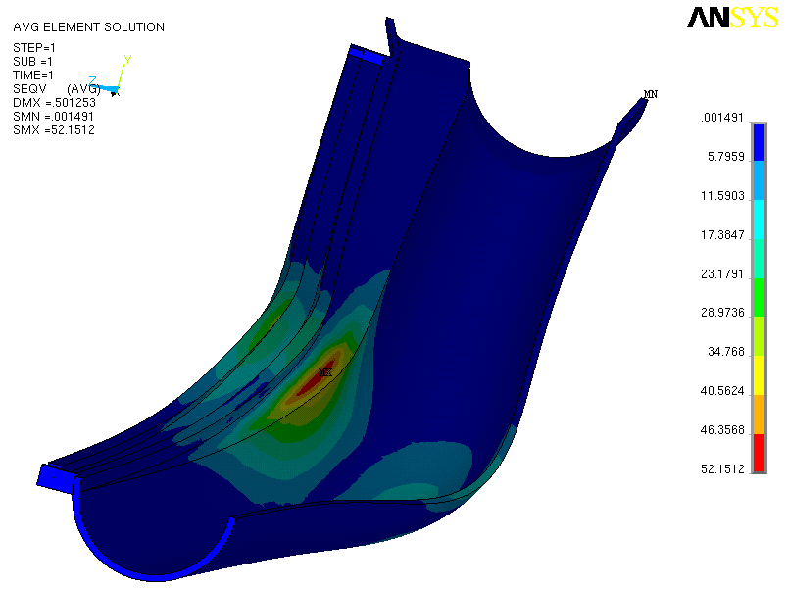
Thermal and mechanical FEA
Example: absorber for ID SR.
Temperature (°C)
Stress (MPa)

Slide 16
MAX IV Vacuum system constrains, challenges and considerations.
Vacuum system layout.
NEG coating issues.
Installation.
Conclusion.

Slide 17
NEG coating
Effect on the vacuum system design, manufacturing and installation:
Design consideration:
  e.g. space for the coating cathodes.
Manufacturing consideration:
  e.g. Manufacturing processes should not be contaminating.
  e.g. Wire erosion process.
Surface preparation, etching of copper.
Cleaning procedure, testing and certification of process.
Handling before and after coating and storing.
Installation: activation needs.

Slide 18
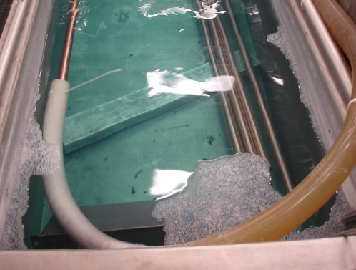
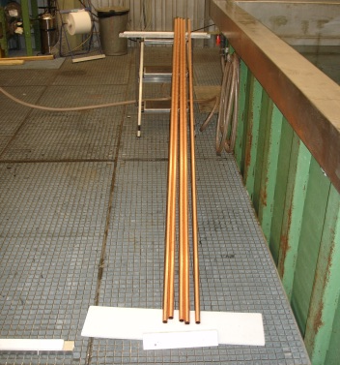
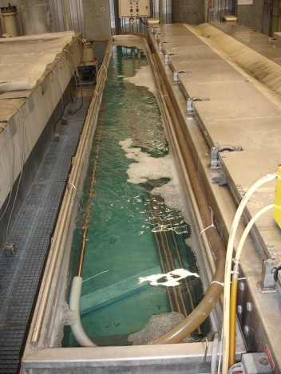
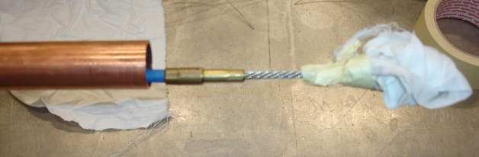
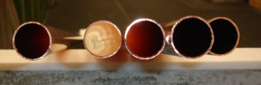
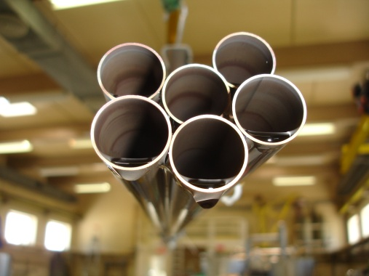
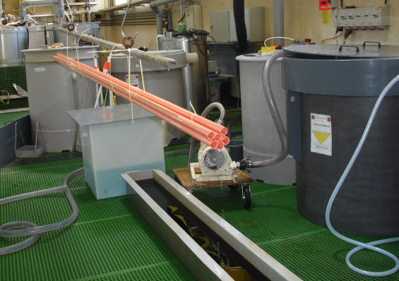
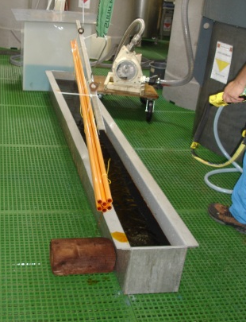
NEG coating - surface preparation at CERN
Degreasing:
Ethanol/Acetone soaked rag cleaning,
2. High-pressure rinsing with demineralised water using rotary nozzle (Kärcher),
3. Immersion in detergent solution with solution circulation for 5-20 minutes each tube and ultrasonic agitation
(NGL 17.40 sp Alu III at 15 g/l at 55 °C),
4. Rinsing with demineralised
water and drying with N₂.
Etching and passivation:
1. Etching at room temp. for 30 minutes (100 g/l ammonium persulphate solution), rinsing,
2. Passivation at room temperature for 5 minutes (chromic acid solution at 80 g/l + 3 ml of Sulphuric acid 96%), rinsing with water and ethanol, drying.

Slide 19
NEG coating: R&D at CERN
Purpose of the R&D:
Test coating for small diameter tubes.
Test coating for bent tubes.
Test coating for chambers with antechamber.
Verifying the effect of etching and cleaning on NEG coating.
Validation of manufacturing processes on NEG coating, e.g. wire erosion.

Slide 20
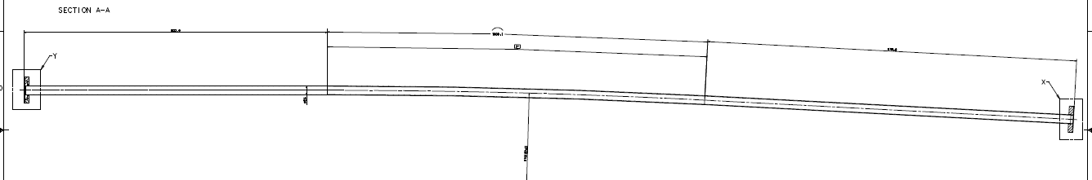
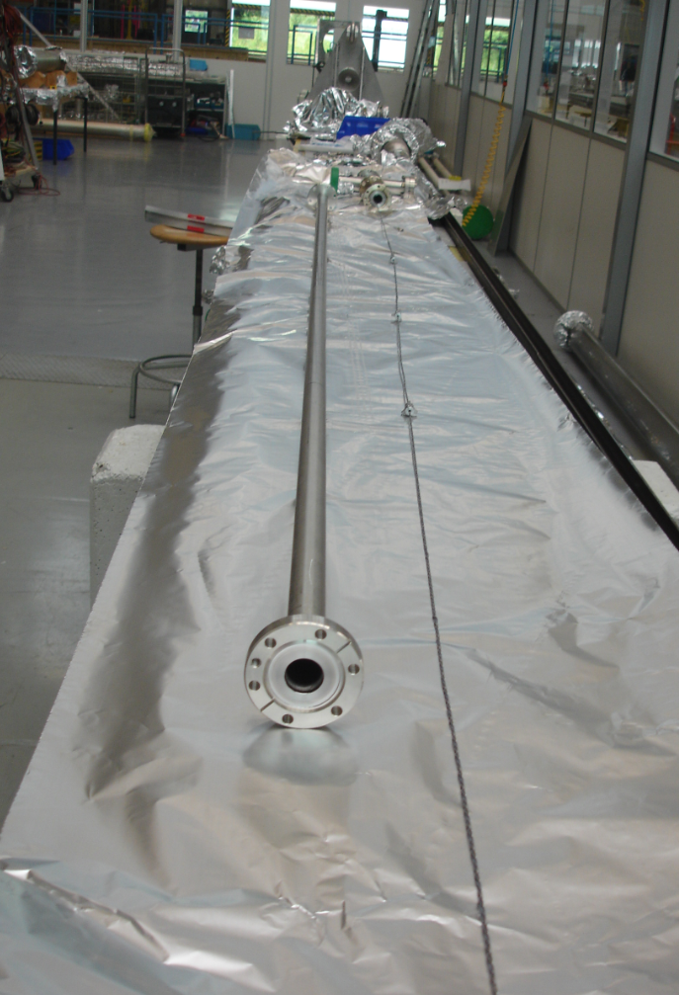
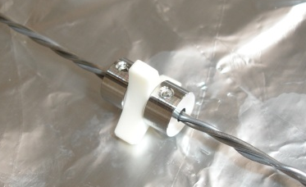
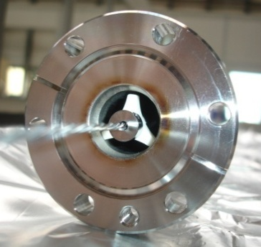
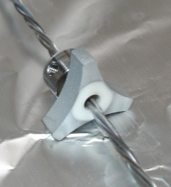
NEG coating: R&D at CERN
0.65 m
1m
0.65 m
Bent VC:
3⁰
r=19m
Ceramic spacers fixed with two Titanium discs
Coating clearly visible on ceramic spacers
Coating thickness

Slide 21
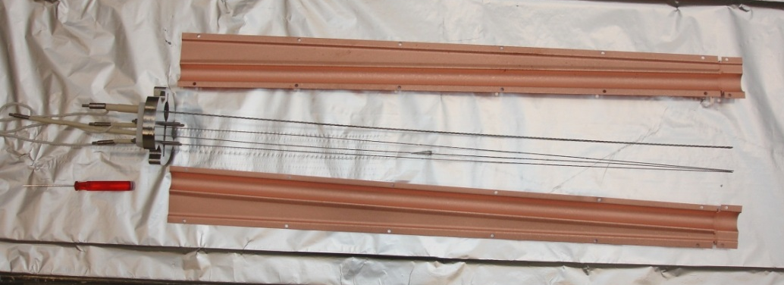
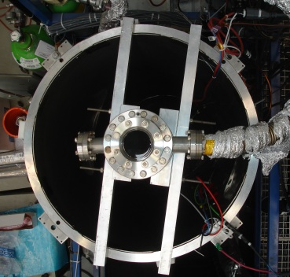
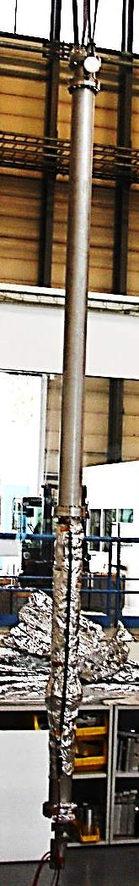
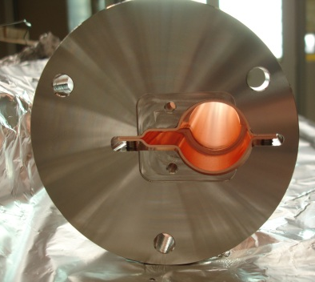
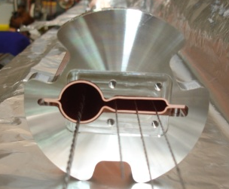
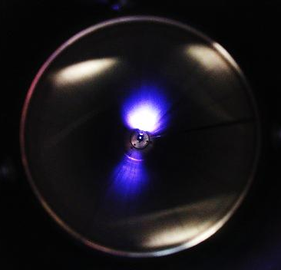
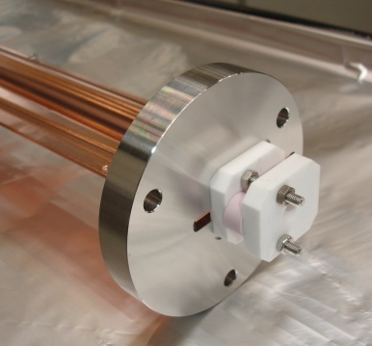
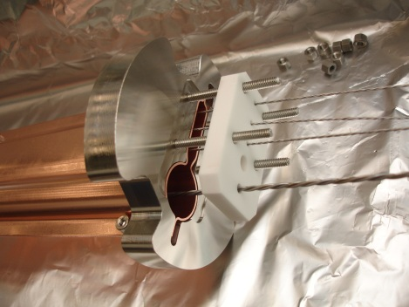
NEG coating: R&D
VC with antechamber:
Chambers:
Solenoid
section:
#1
2m
0.74m
d25
d22
7
#2
VC-2
0.8m
5
3
0.5m
#3

Slide 22
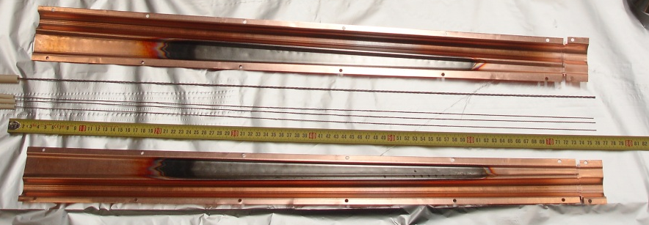
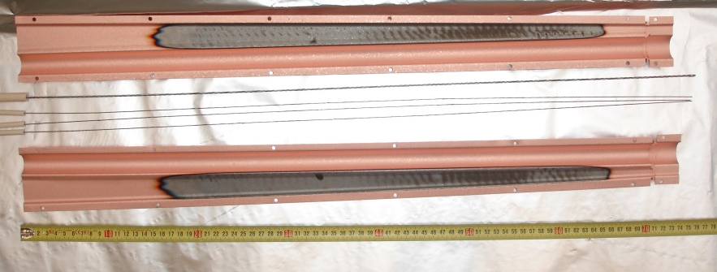
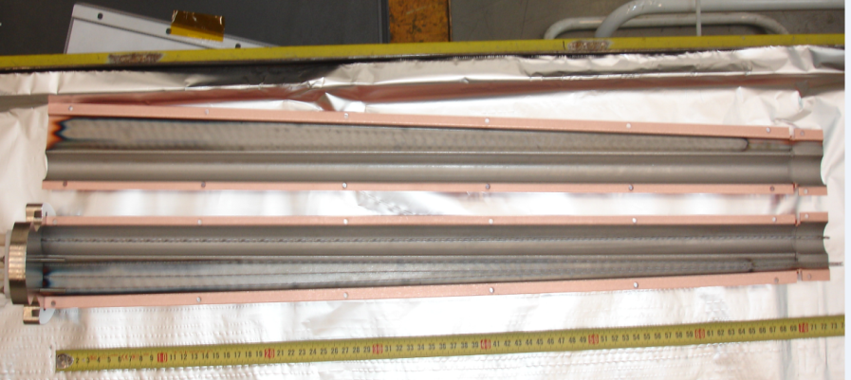
NEG coating: R&D
VC with antechamber:
2nd trial
1st trial
3rd trial

Slide 23
MAX IV Vacuum system constrains, challenges and considerations.
Vacuum system layout.
NEG coating issues.
Installation.
Conclusion.

Slide 24
Installation
One achromat should be assembled, baked, activated and placed under vacuum inside the magnet block.
Assembly tables: for assembly of one achromat of 23 m.
Lifting tool: for handling flexible copper tubes (mainly after activation) + free expansion during bakeout, space inside the tunnel?
Heater jackets: for activation of NEG, occupy less space.
Protection for bellows during movement.

Slide 25
MAX IV Vacuum system constrains, challenges and considerations.
Vacuum system layout.
NEG coating issues.
Installation.
Conclusion.

Slide 26
Conclusion
Challenging design: technical solutions supported with FEA and tests…etc.
Challenging manufacturing: varies manufacturing techniques, need of follow up, acceptance tests…etc.
Complication due to NEG coating: extensive testing and inspection is needed.
Careful handing and installation.

Slide 27

Thanks for your attention
Acknowledgment:
Jonny Ahlbäck, Marek Grabski, ALBA, CERN
MAX IV staff

