Slide 4
Q_{b} = 1 nC δE/E =0.1% σ_{z} = 0.1 mm (0.3 ps rms)

Slide 7
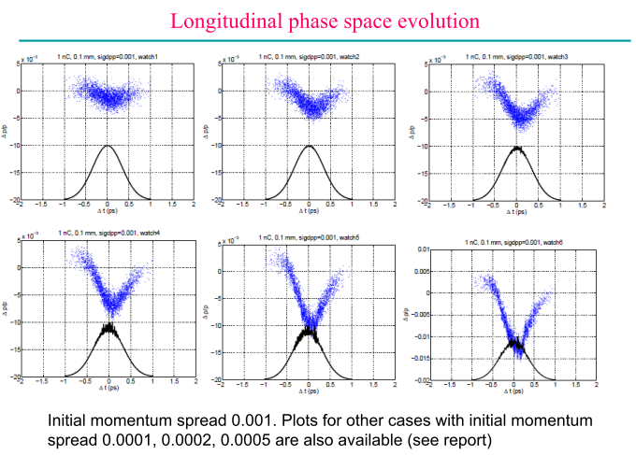

Slide 8
Q_{b} = 77 pC δE/E =0.02% σ_{z} = 2 ps rms

Slide 9
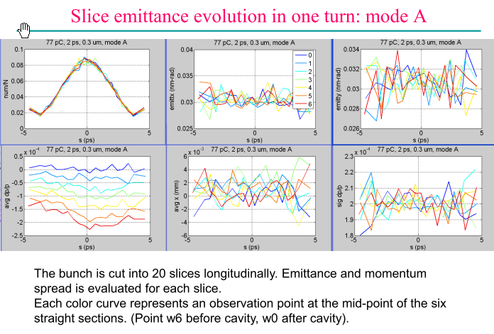

Slide 10
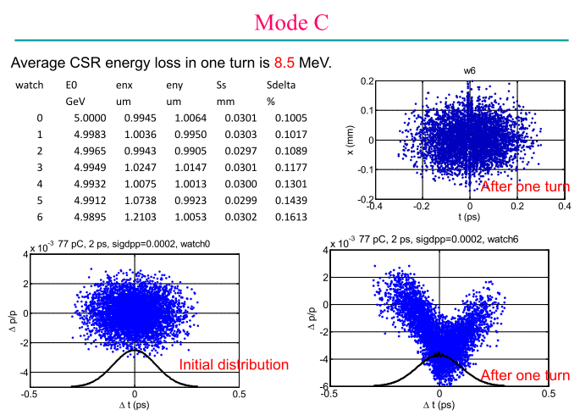
0.1 ps
0.1 ps
Q_{b} = 77 pC δE/E =0.02% σ_{z} = 0.1 ps rms

Slide 11
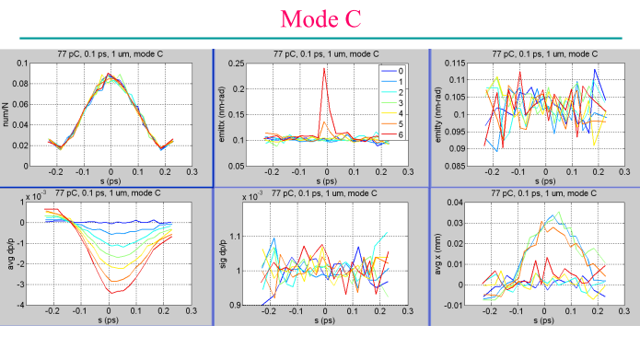

Slide 13
To reach >200 Apk for lasing:
σ_{z} = 2 ps Q_{b} > 1 nC
σ_{z} = 0.3 ps Q_{b} > 150 pC
σ_{z} = 0.1 ps Q_{b} > 50 pC
Can bunch be temporarily compressed for lasing?
decompress
compress

