Slide 1
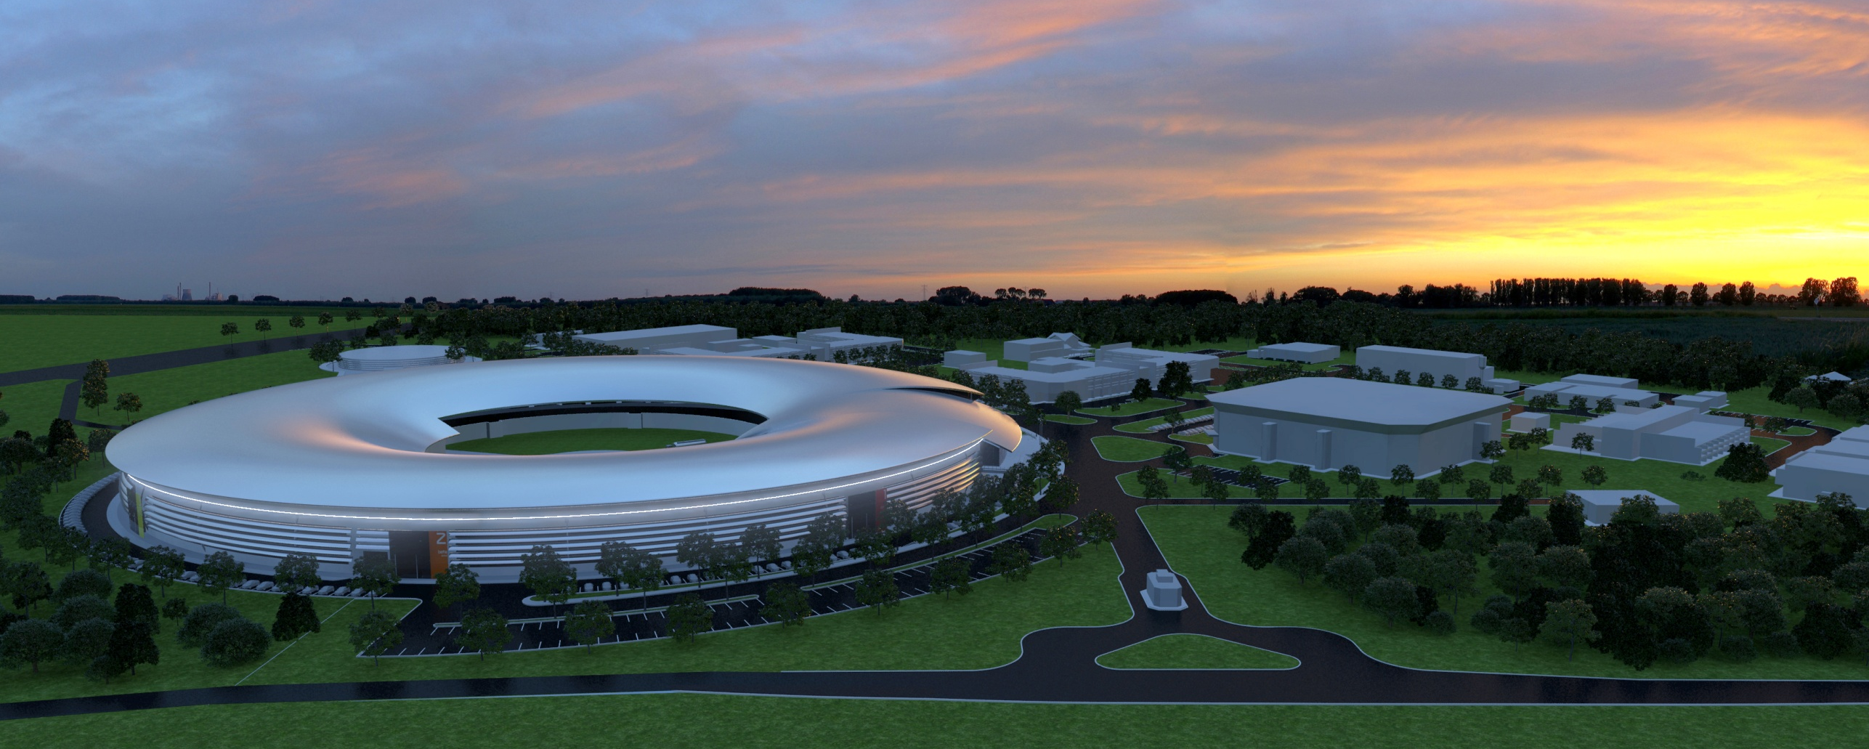
A compact low emittance lattice with superbends for Sirius
Liu Lin （刘 琳 ）
LNLS Accelerator Physics Group

Slide 2
A Penultimate Storage Ring lattice for Sirius
Liu Lin （刘 琳 ）
LNLS Accelerator Physics Group

Slide 3
Why Penultimate SR ?
Not yet diffraction limited for X-rays.
ε ≈ 0.25 nm.rad
Challenging but will become reality in the near future with technology ‘available’ today at reasonable cost.
Sirius Budget:
building US$ 100 M
accelerators US$ 100 M Total: US$ 320 M
13 beamlines US$ 120 M
Sirius Schedule:
2009 Initial design and prototypes
12 / 2010 Sirius receives green light from the Brazilian Federal Government
07 / 2012 New 5BA low emittance design
09 / 2013 Start of building construction
09 / 2015 Start of machine installation
05 / 2016 1st beam
λ | = ε
4π

Slide 4
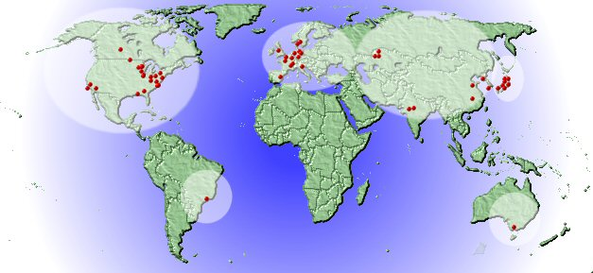
Sirius – a new Brazilian Light Source
LNLS
Campinas – São Paulo
Source: SRS Daresbury Laboratory
About Brazil
Area | 8.5 x 10⁶ km² | World rank 5th
Population | 195 million people | World rank 5th
GDP | $2.48 trillion per year | World rank 6th

Slide 5
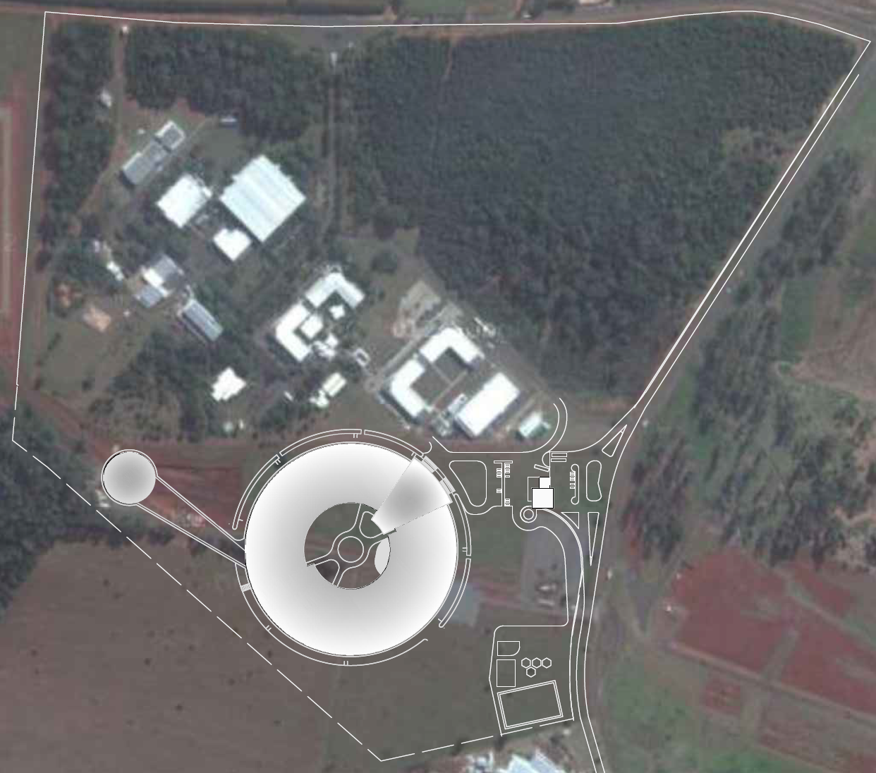
LNLS campus today
1.37 GeV – 100 nm.rad
Designed and built in Brazil
Constructed from 1987 – 1997
UVX
Sirius

Slide 6
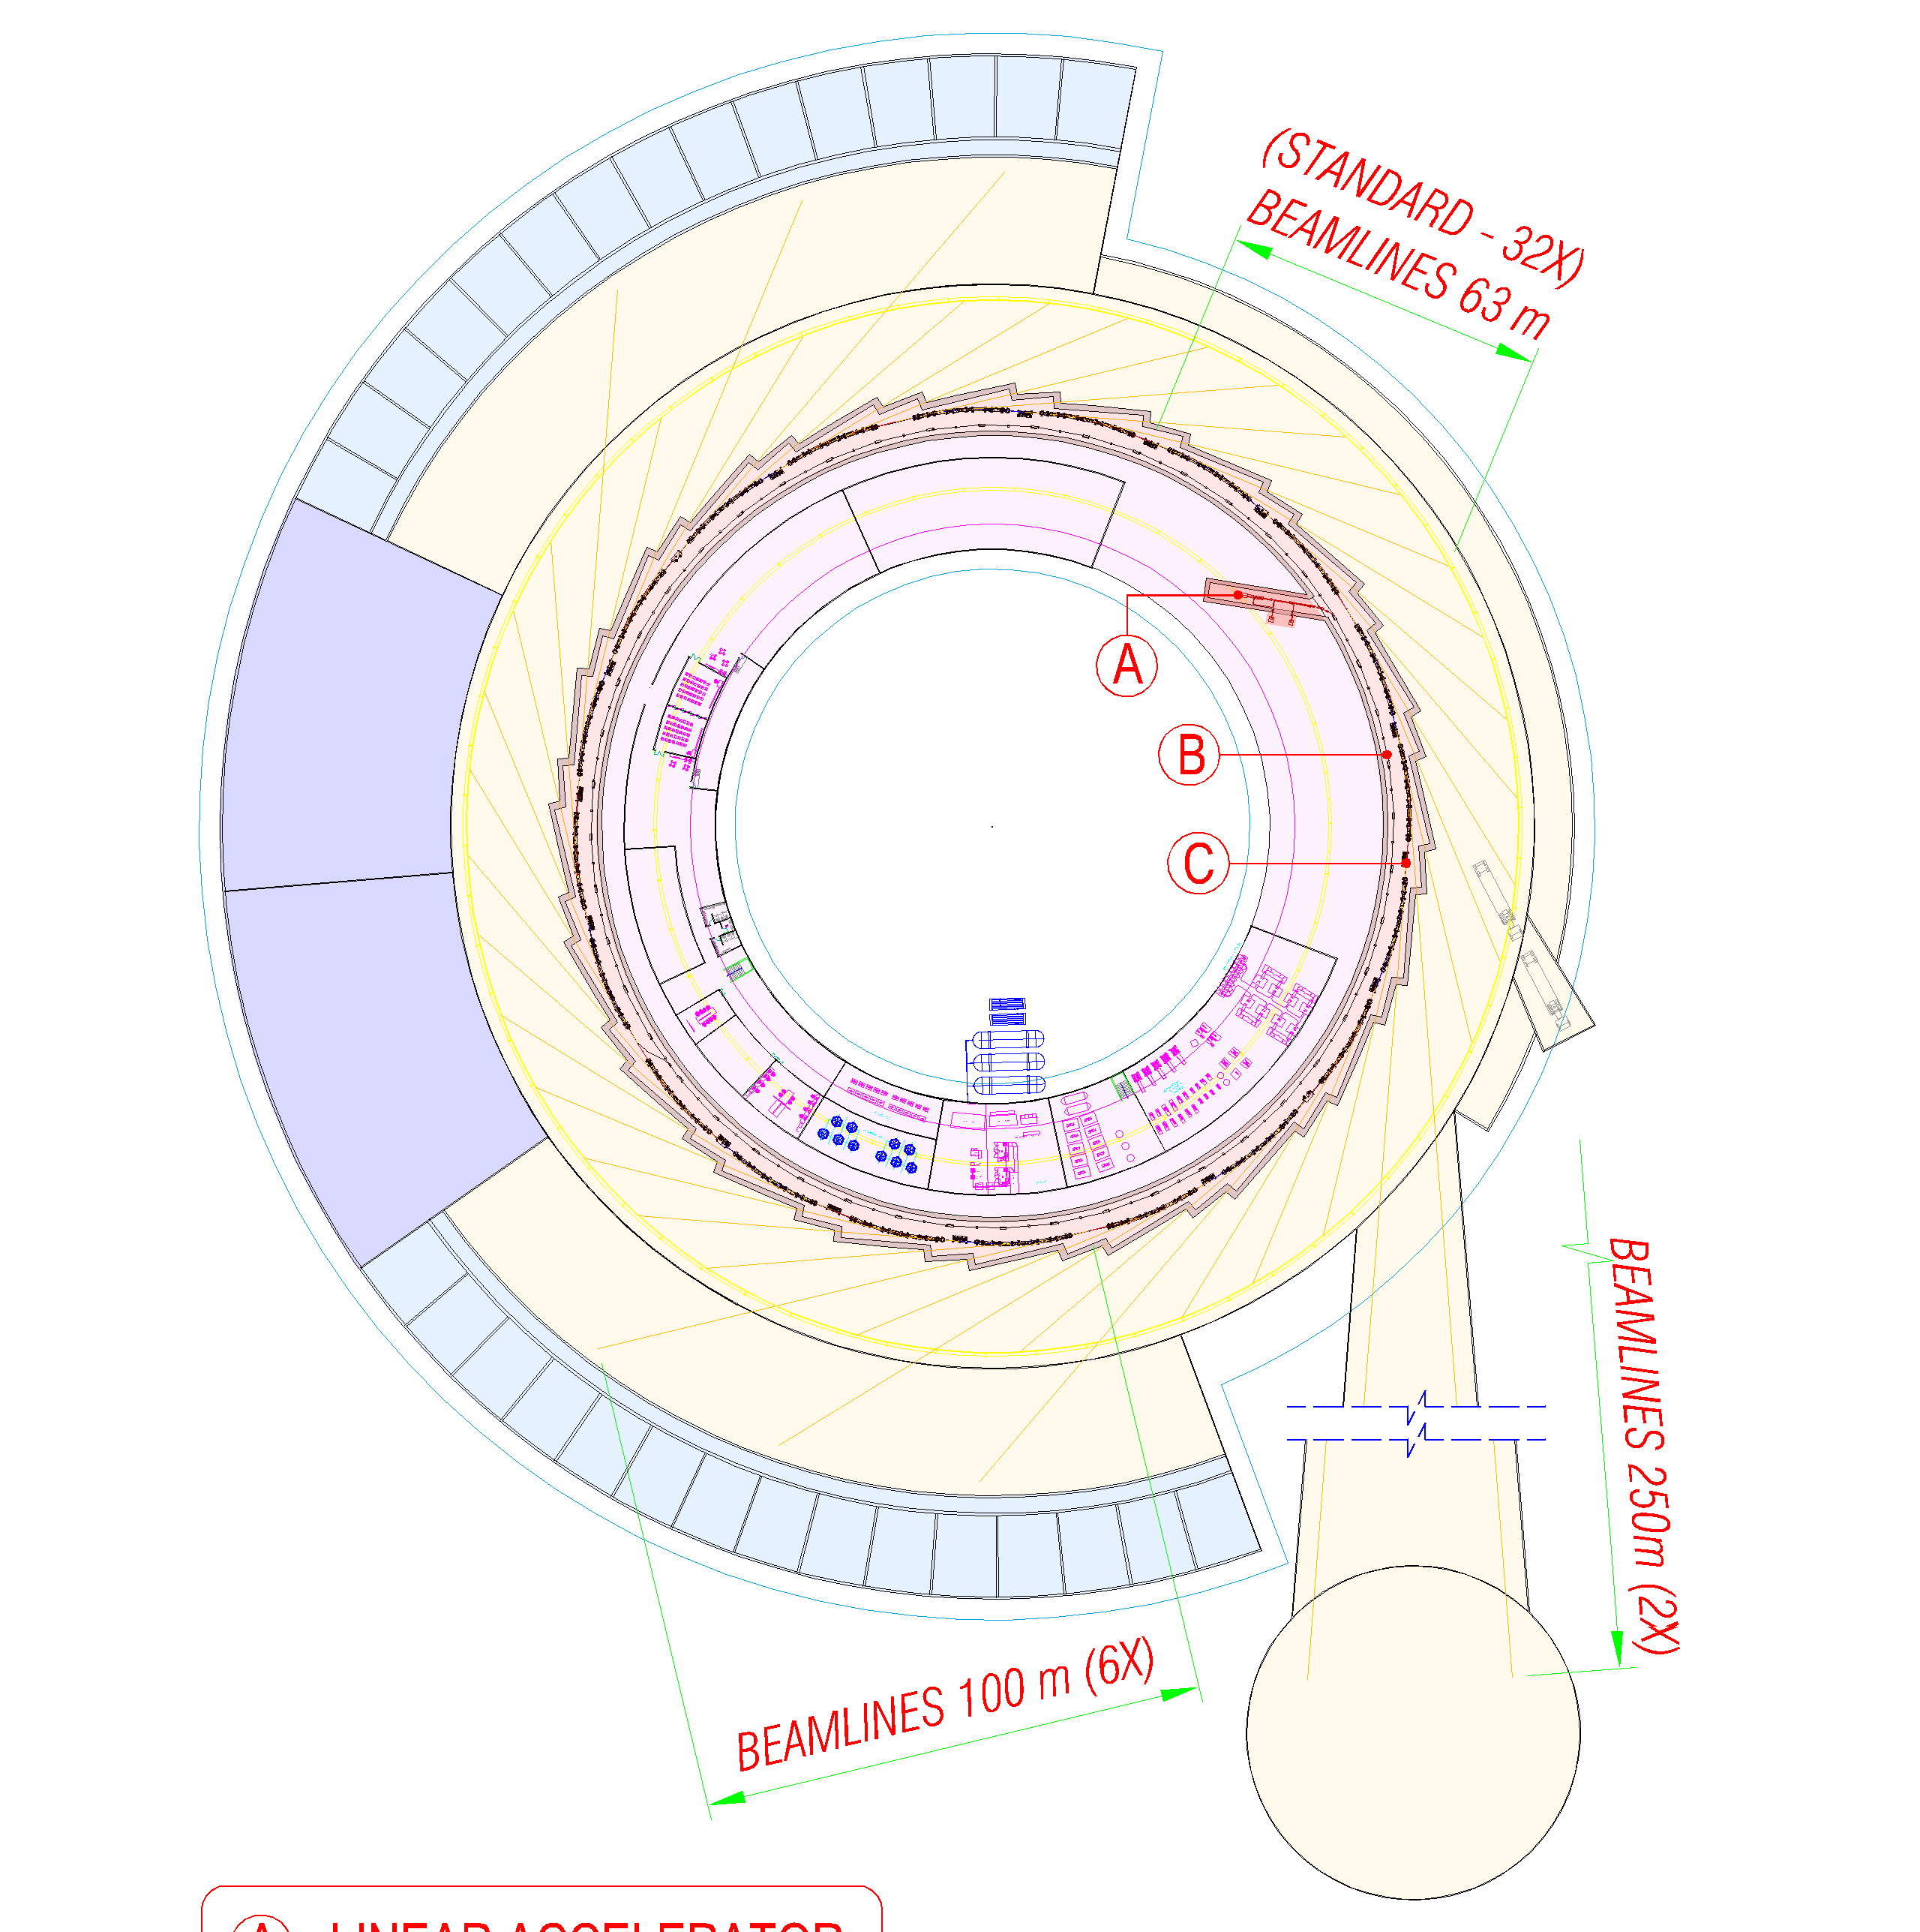
Sirius layout
STORAGE RING
3 GeV
LINAC
150 MeV
Energy | 3.0 | GeV
Circumference | 518.2 | m
Emittance no IDs | 0.28 | nm.rad
Straight sections | 10 x 7-m 10 x 6-m
BOOSTER
3 GeV

Slide 7
The Sirius low emittance storage ring lattice
Energy: 3 GeV
20 modified 5BA cells with low field main dipoles (0.58 T) ⇨ 100 dipoles.
Split central dipole to accommodate a 2 T “superbend” ⇨ longitudinal field gradient.
Use of permanent magnet technology for the dipoles ⇨ more compact lattice.
Dipoles with transverse gradient to increase J_{x}.
Low field dipoles ⇨ lower energy dispersion ⇨ smaller beam size.
Low field dipoles ⇨ efficient use of damping wigglers.
Straight sections: 10 x 7-m, 10 x 6-m
2 T dipole, θ=1.4°
superbend
7-m SS
6-m SS
quadrupole
doublet
quadrupole
triplet
0.58 T dipole
θ=16.6°

Slide 8
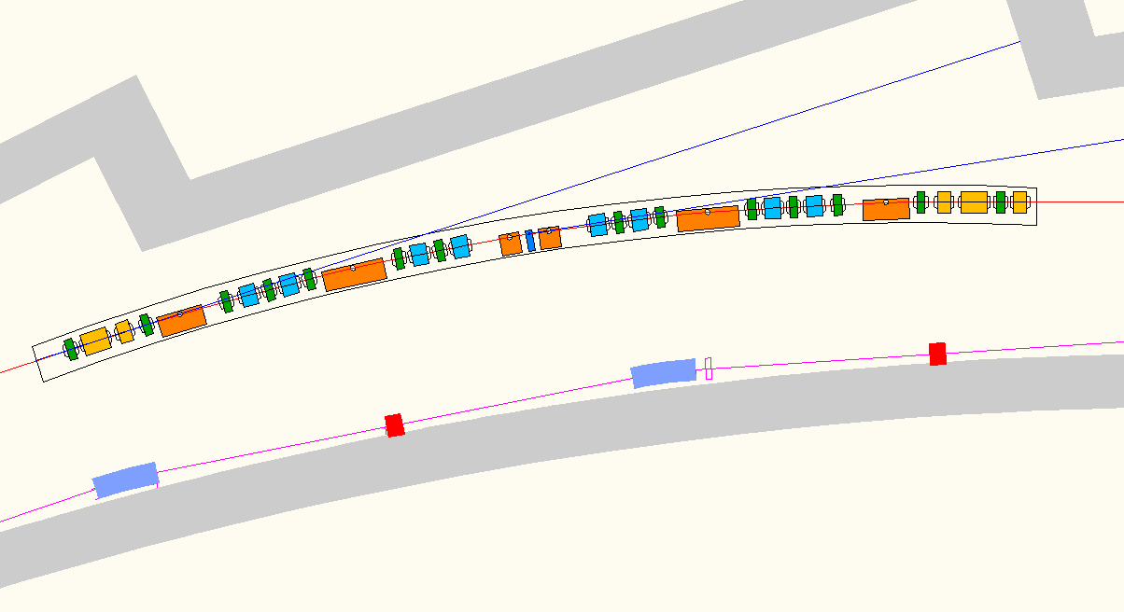
Superbends: hard X-ray source
2T superbend
12 keV critical energy
Beam size @ 1% coupling
straight section | 68 x 3 | μm²
superbend | 11 x 4 | μm²
Hard X-ray dipole source with modest total energy loss
X-rays are produced only at beamline exit

Slide 9
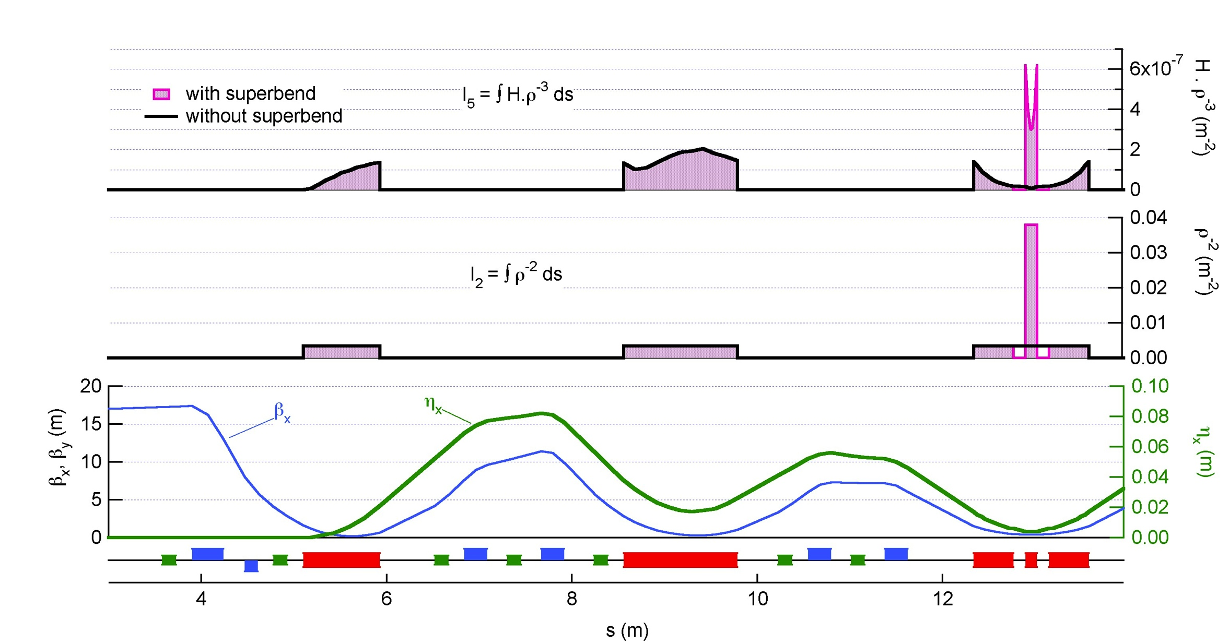
Superbends: longitudinal gradient
- without superbends: ε = 0.31 nm.rad
with superbends: ε = 0.28 nm.rad 10% reduction
Same effect as one 5.5-m damping wiggler

Slide 10
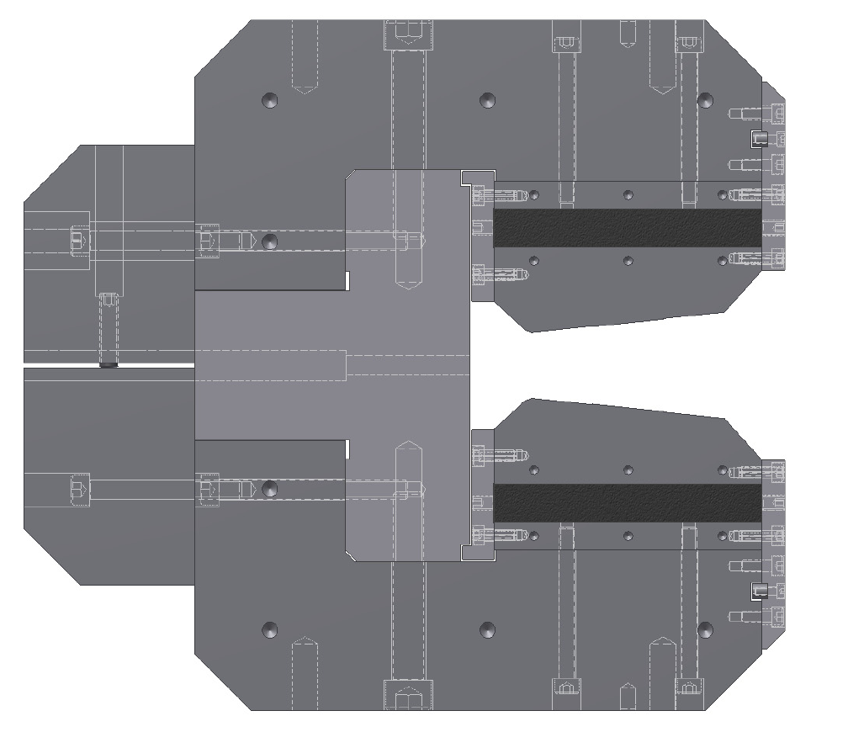
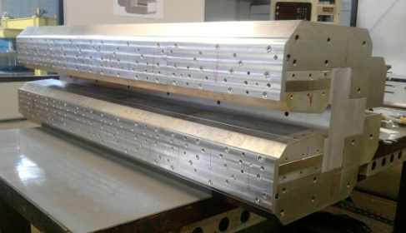
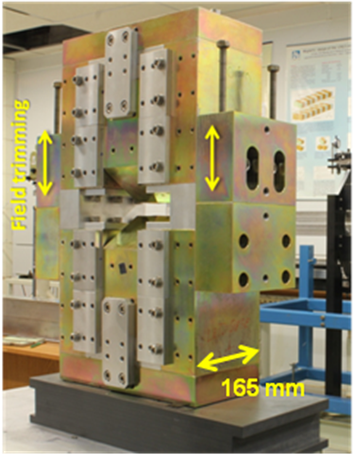
Permanent magnets for dipoles
Strong magnetic field (hard X-ray) only at beamline exit
Lower radiation power from dipoles
→ Lower investments in high power RF equipment.
→ Lower investments in vacuum equipment.
Lower operational costs (RF power generation and cooling) .
Permanent magnet dipoles
Lower investments in power supplies and cooling systems.
Lower operational costs.
Higher reliability.
NdFeB
Field trimming
Low carbon steel
Aluminum
366 mm

Slide 11
Storage ring operation modes – 1
AC20 Mode
Users want low β_{x} sections

Slide 12
Storage ring operation modes – 2
AC10 Mode

Slide 13
Parameters
 | AC20 | AC10
Horizontal betatron tune | 44.60 | 46.25
Vertical betatron tune | 11.64 | 14.15
Natural horizontal chromaticity | -108.0 | -113.2
Natural vertical chromaticity | -72.8 | -80.1
Momentum compaction factor | 1.74 x 10⁻⁴ | 1.74 x 10⁻⁴
Touschek Lifetime @ 500 mA, 1% coupling | 5.6 | 4.9 | h
Dipole field gradient | -7.8 | -7.8 | T/m
Maximum quadrupole gradient, B’ | 33.5 | 39.6 | T/m
Maximum sextupole gradient, B”/2 | 1900 | 1800 | T/m²

Slide 14
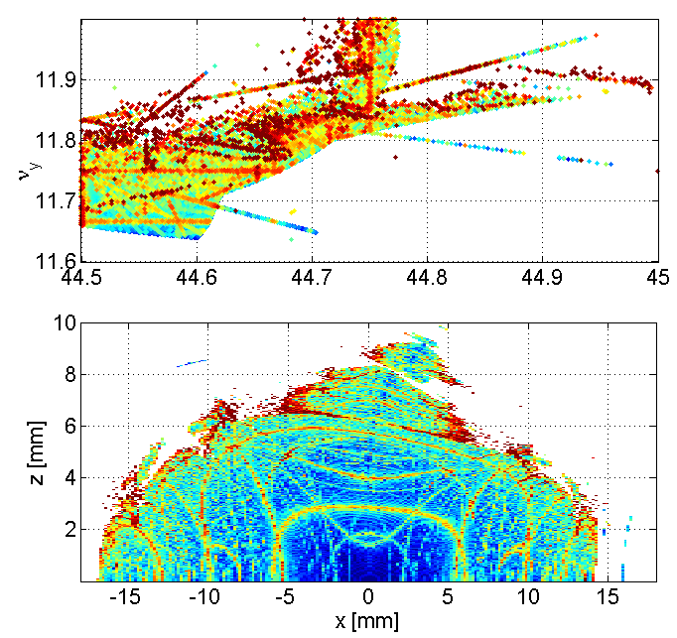
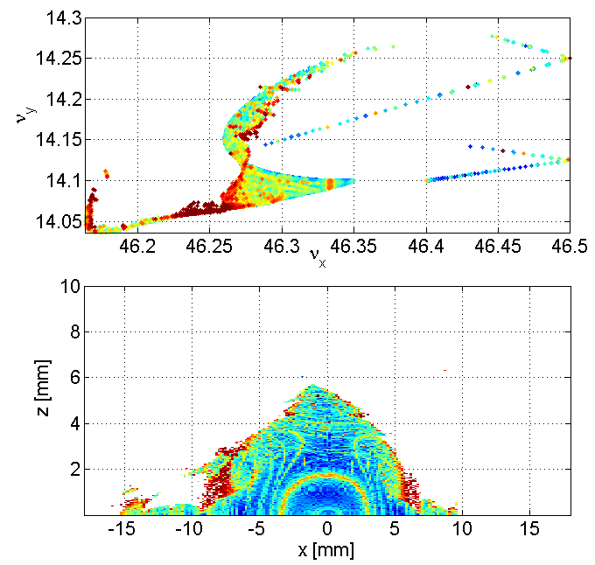
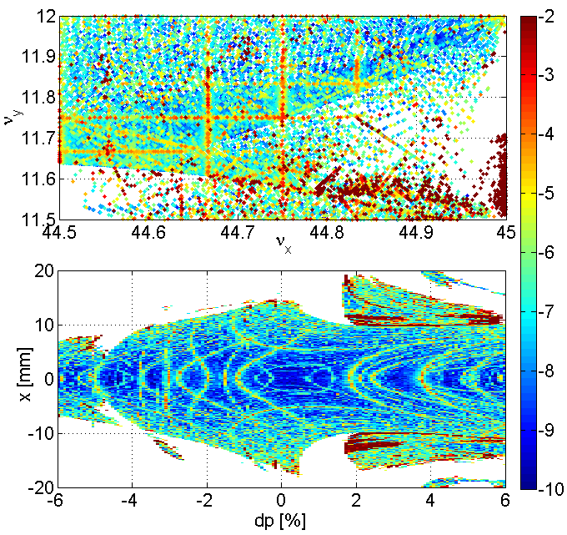
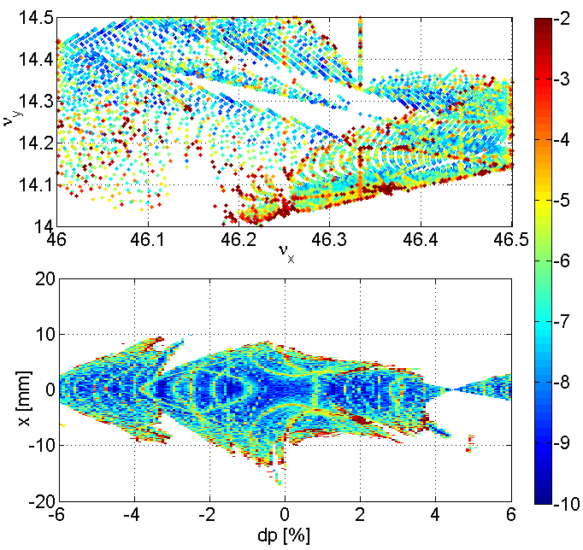
Non-linear optics optimization – 1
Optimization using MAD (CERN), OPA (SLS), Tracy3 (Soleil) and AT
AC20 Mode
AC10 Mode

Slide 15
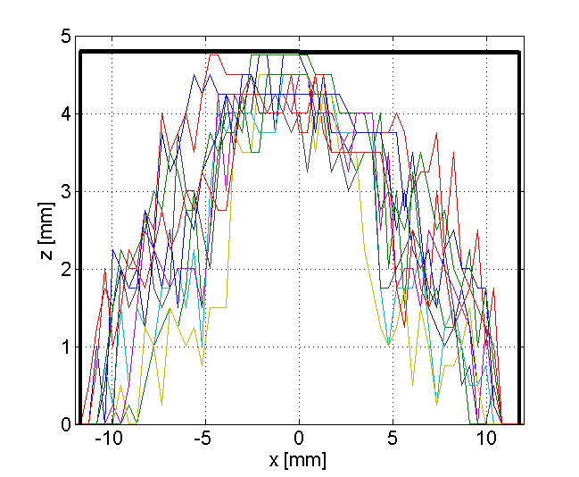
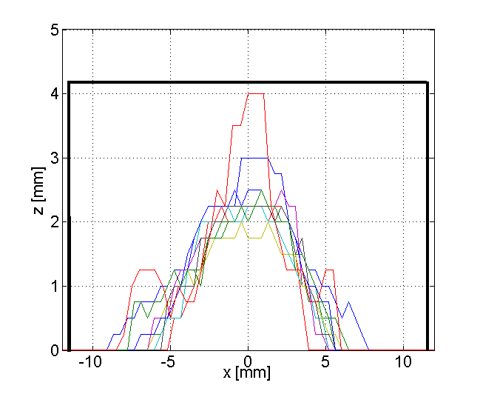
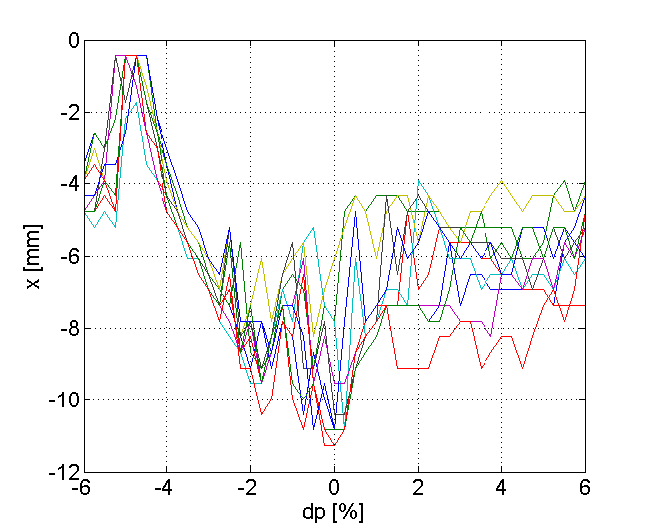
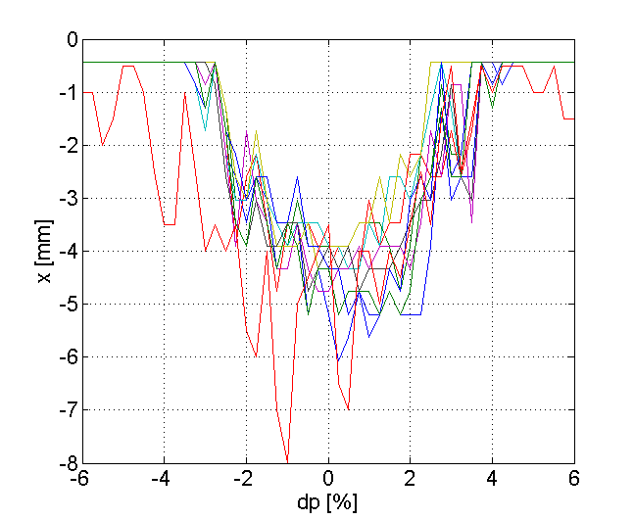
Non-linear optics optimization – 2
AC20 Mode
AC10 Mode
Dynamic aperture calculations
- Tracking for 5000 turns.
Alignment and excitation errors.
Systematic multipole errors.
Random multipole errors.
Results up to now
- Alignment errors dominate DA reduction. Optics is affected by off-centered orbit in sextupoles.
DA improves by restoring design optics.
Special care with orbit correction at sextupoles. Place BPMs close to strong sextupoles.
Still need to improve AC10 mode.

Slide 16
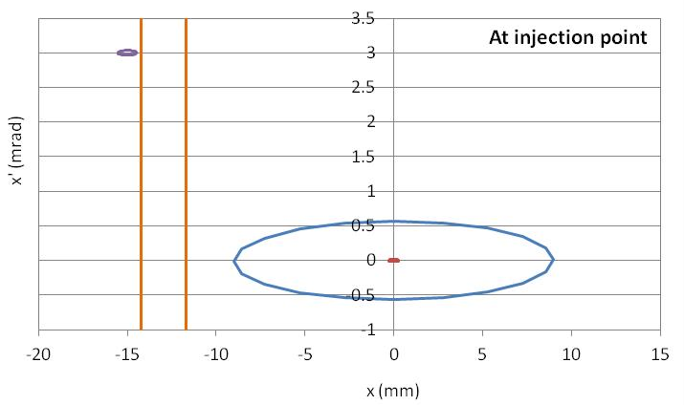
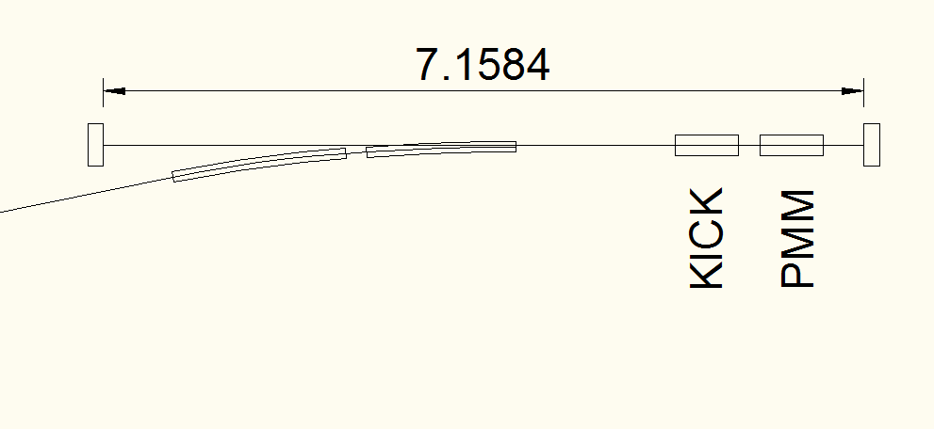
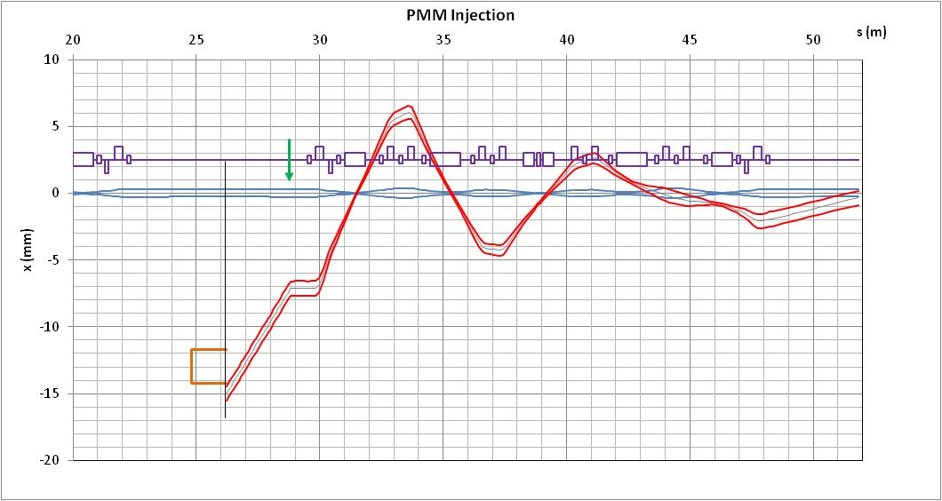
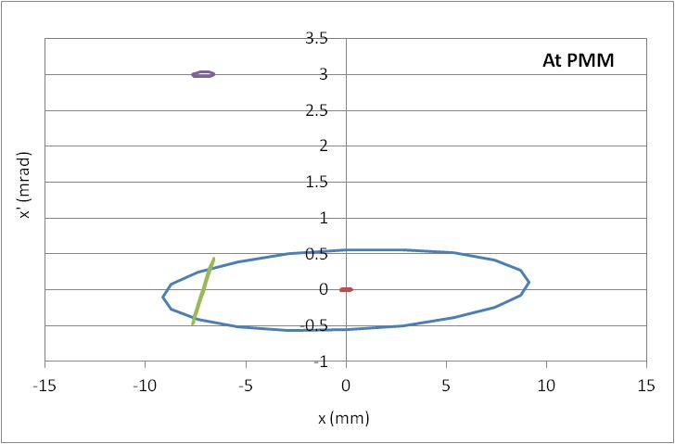
Injection
For the time being we keep up the 2 possibilities:
– Local bump with 4 kickers
– Injection with pulsed multipole magnet (PMM) + on-axis kicker
PMM Injection

Slide 17
Present challenges for Sirius
Strong magnets ⇨ small bore dadius ⇨ Small aperture for vacuum chamber ⇨ copper chambers + NEG coating
Small ring emittance ⇨ small booster emittance ⇨ in-tunnel booster
Beam stabillity ⇨ tight alignment tolerances ⇨ floor stabillity ⇨ BPM stability and accuracy ⇨ power supply stability
Injection ⇨ PMM design
Dynamic aperture optimization especially for AC10 mode, centering of the orbit at sextupoles
Effects of IDs, instabilities, IBS, ...

Slide 18
Thank you !

