Slide 1
USR Workshop (Beijing) 2012/10/30
High Gradient Magnet Design
for SPring-8 Upgrade Plan
K.Soutome (based on slides by K.Fukami)
on behalf of
SPring-8 Upgrade Working Group
Magnet and Vacuum System Team:
K.Fukami, Y.Okayasu, C.Mitsuda, T.Nakamura

Slide 2
Magnet Arrangement (Half Cell)
Present ring （2-Bend）
Upgrade plan（6-Bend Achromat）
·Required integrated fields of multi-pole magnets are very high.
→ Strong field gradient at the center are required.
·Huge number of magnets are needed.

Slide 3
Required Field
Specification of the magnets
Parameter | Dipole | Quadrupole | Sextupole
Center field | 0.7 [T] | ∼ 80 [T/m] | ∼ 13,000 [T/m²]
Length [m] | 0.41, 0.82 | 0.2 ∼ 0.5 | 0.15 ∼ 0.3
Gap or Bore [mm] | 26 | 26 | 26
Good field region [mm] | ±3 | ±3 | ±3
Field tolerance (±3 mm) | 10⁻⁴ | 10⁻⁴ | 10⁻⁴
Total number | 264 | 1,144 | 1,012
Dynamic aperture ∼ ±2 mm

Slide 4
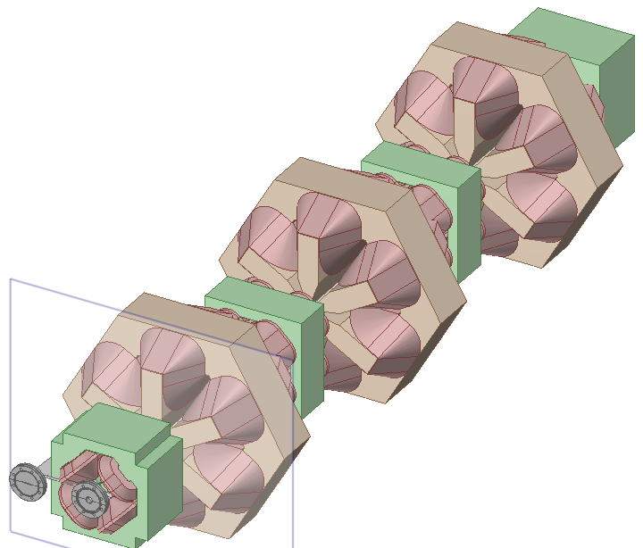
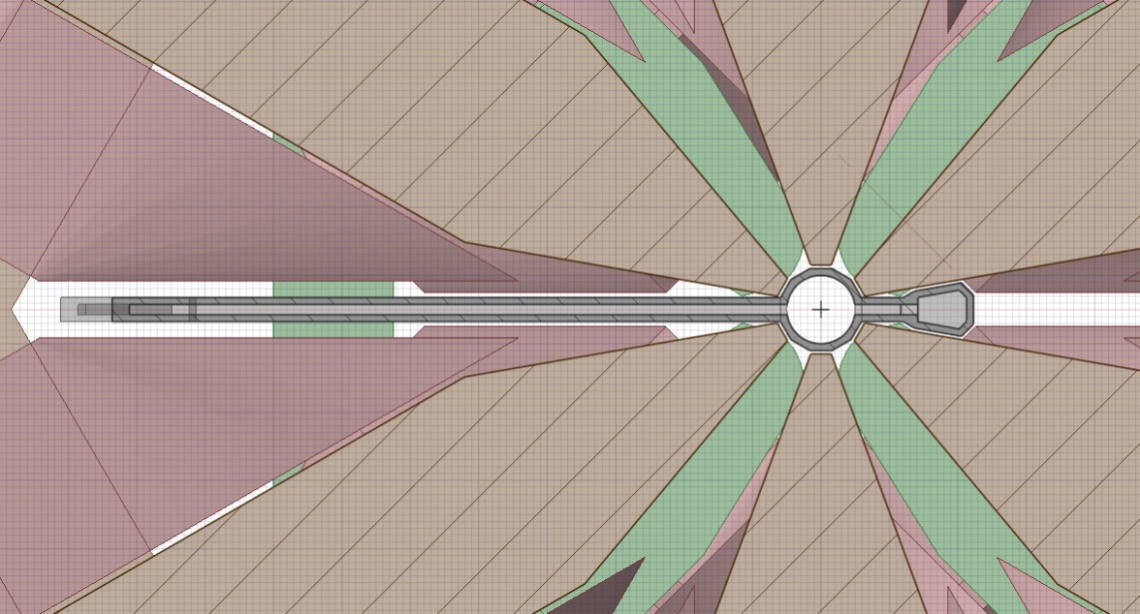
Design – Minimum Bore Diameter
To keep a space for vacuum chamber
Beam
Typical unit
Quadrupole
Bore dia.=26mm
Sextupole
20 cm
SR
Pole
Beam
NEG
Cross-sectional view of the magnetic
pole and vacuum chamber

Slide 5
Coil winding
To reduce the paking factor of the magnets, two types coil winding were designed. In case of the special winding, the total length including coils and supports is the same as that of the core.
Beam
critical
Normal winding
Special winding
Two types of coil winding for the sextupole magnets

Slide 6
Critical Issues
(1) How to get high field gradient of sextupole （max. 13,000 T/m²）
Bore dia. = 26 mm （cf. Present ring : 92 mm）
(2) How to align sextupoles （< 20 μm）

Slide 7
Critical Issues
(1) How to get high field gradient of sextupole （max. 13,000 T/m²）
Bore dia. = 26 mm （cf. Present ring : 92 mm）
→ Special Core Material (high saturated flux density)
(2) How to align sextupoles （< 20 μm）
→ Vibrating Wire Method in the Tunnel
→ Beam-Based Alignment by Remote Controlled x-y Stages

Slide 8
Core Material
For a generic soft-magnetic iron core,
saturation in the core cannot be avoided
(even if a shape of magnetic pole is optimized.)
→ Some unique materials are required.
e.g. Co-Fe alloy ^{#)}
Field was calculated by “MAFIA” with
(i) generic soft-magnetic iron
(ii) 20%Co-Fe alloy
(iii) 49%Co, 49%Fe, 2%V alloy (called Permendur)
B-H Curve for
·Generic soft-magnetic iron
·20%Co-Fe
·49%Co-Fe (Permendur)
#) Y. Okayasu, et al. “High field gradient multi-pole magnets with permendur alloy for the
SPring-8 upgrade”, Proc. of the 8-th Annual Meeting of Particle Acc. Society of Japan.

Slide 9
Core Material
Quadrupole
Sextupole
Calculated excitation curve
For the generic iron, max. field gradients are estimated to be
< 80 T/m (Quad.), < 10,000T/m² (Sext.).
For the permendur, required field gradient is satisfied.
NB: Machining higher-Co alloy → much harder
We recently made a pilot sextupole magnet with 20%Co-Fe alloy
and field measurement is in progress.

Slide 10
Good Field Region (Quadrupole)
160 mm
Cross-sectional view of quadrupole magnet (left) and calculated field flatness (right)
Field flatness < 0.15 % (±3 mm) without any shim.
Optimization of shim shape is ongoing for improvement.

Slide 11
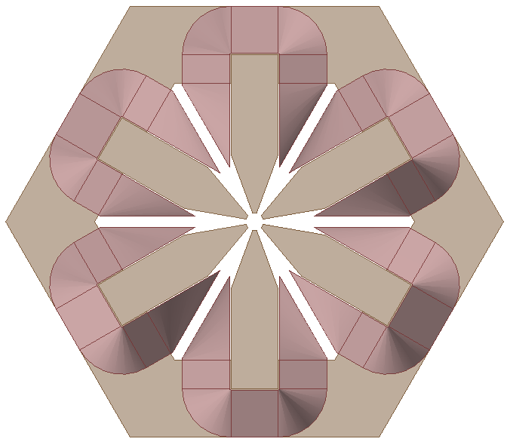
Good Field Region (Sextupole)
370 mm
Cross-sectional view of sextupole magnet (left) and calculated field flatness (right)
Field flatness < 3.5 % (±3 mm) without any shim.
Optimization of shim shape is ongoing for improvement.

Slide 12
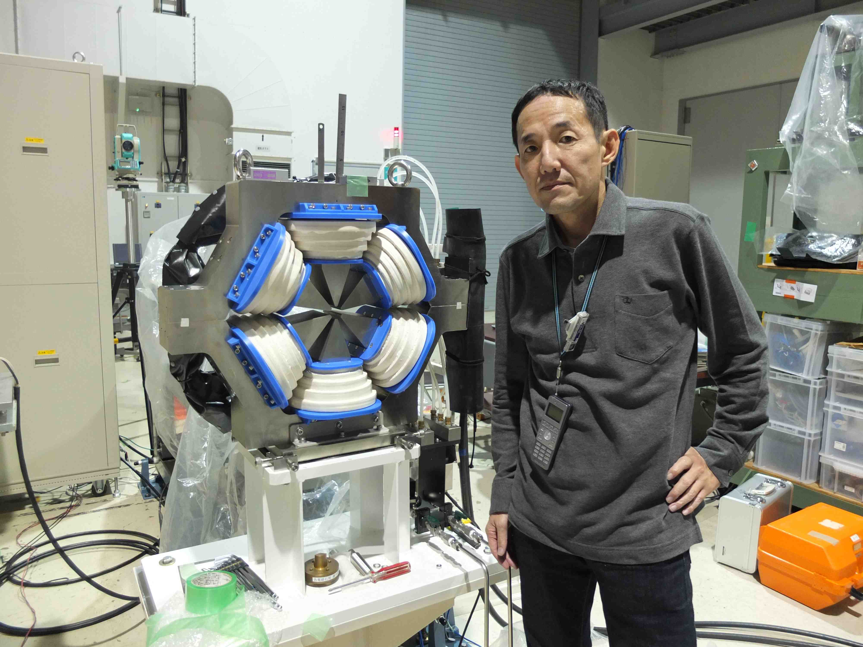
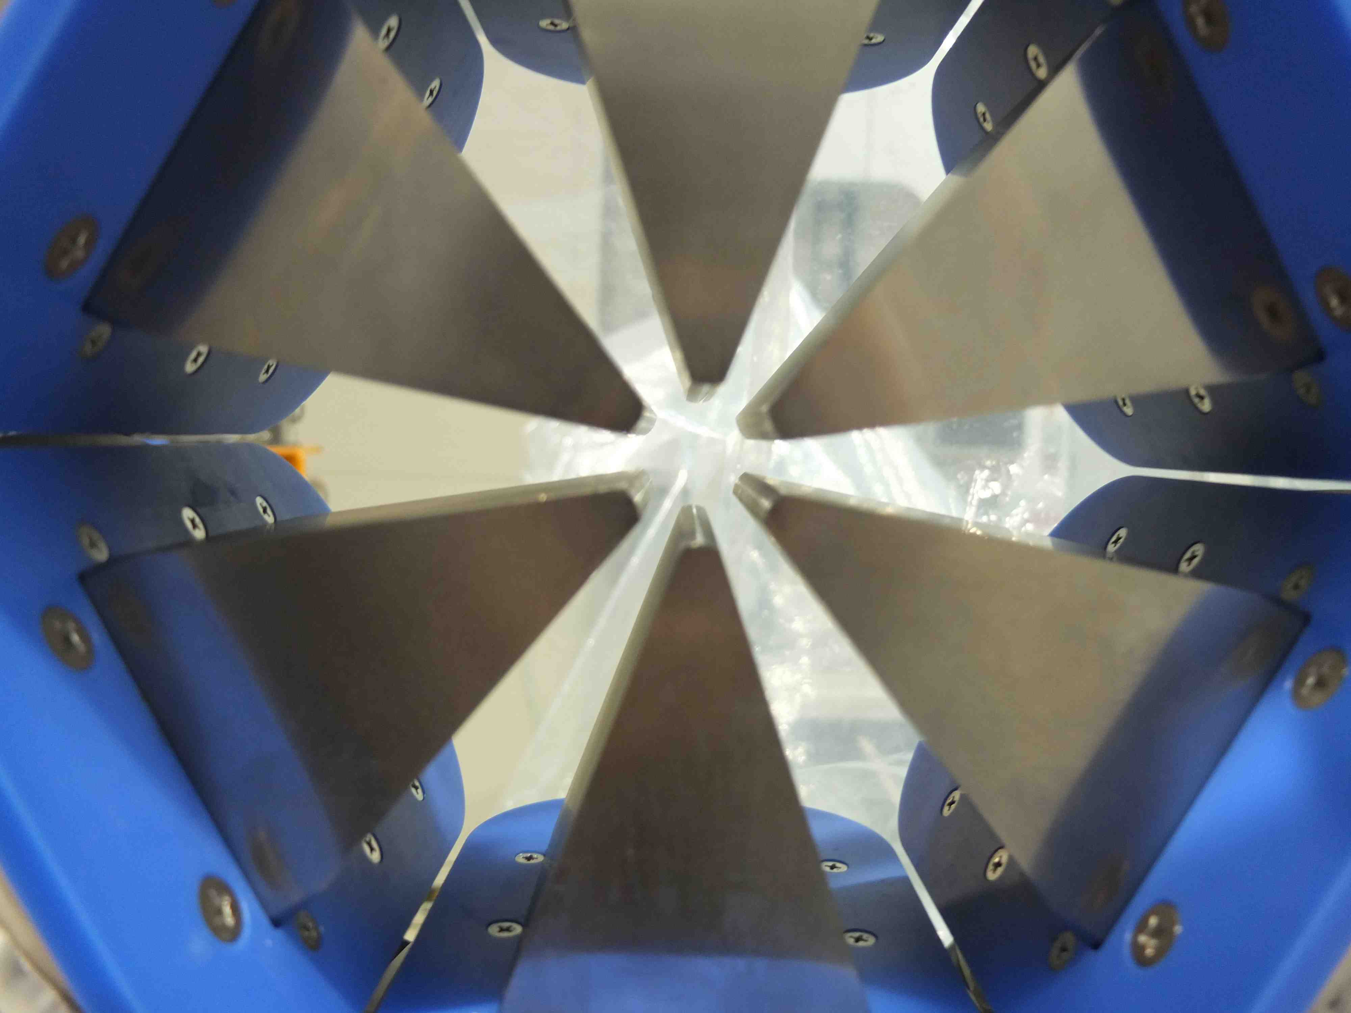
Pilot Magnet
Pilot Magnet (Sextupole) with 20%Co–Fe alloy
Now field measurement is in progress ...
Kenji Fukami

Slide 13
Alignment in Tunnel
Tolerances for the sextupole magnet : Δx, Δy = 20 μm
(1) Pre-alignment tool : Vibrating Wire Method ^{#)}
... R&D in test stand
(2) Beam-Based Alignment tool : Remote controlled x-y stage
... under discussion
Beam
Vibration wire
girder
Side view of multi-pole magnets and vibration wire
#) A. Jain, et al. “Vibrating wire R&D for alignment of multipole magnets in NSLS-II”,
The 10-th IWAA 2008.

Slide 14
Summary
(1) High Field Gradient
Quadrupole: 80 T/m
Sextupole: 13,000 T/m²
Bore diameter: 26 mm （cf. Present ring : 92 mm）
→ Special Core Material (Co-Fe Alloy) for High Saturated Flux Density
(2) Precise Alignment
Tolerance: < 20 μm
→ Vibrating Wire Method in the Tunnel
→ Beam-Based Alignment by Remote Controlled x-y Stages
Iterations between lattice design and technology developments

