Slide 1
Anticipated Limits on Machine Stability and some Consequences on Machine and Beamline Designs
Jean-Claude Denard
Workshop on Accelerator R&D for USRs
Hairou, Beijing, Oct. 30 – Nov. 1, 2012

Slide 2
Outline
What stability is needed ?
  Position & angle
  Size and divergence
Beam stability achieved at existing light sources (Soleil data as an example)
  Position & angle
  Size and divergence
Accelerator & Beamline design issues for USR stability

Slide 3
Can the Present Machines Stability Suit USR Needs?
The issues are known, can we take much better care than existing machines?
  Building
  Temperature control
  Girder rigidity
  Power Supply stability
  Vacuum chamber with BPMs stable in transverse position
  BPM stability: mechanics and electronics
  Orbit feedback systems
But the result is not known in advance (we also need luck ☺)
Once the machine is built, there is little margin for improvement
It is useful to see what can be done with present machines stability

Slide 4
Contents
What stability is needed
  Position & angle
  Size and divergence
Beam stability achieved at existing light sources (Soleil data as an example)
  Position & angle
  Size and divergence
Accelerator & Beamline design issues for stability

Slide 5
Size and Divergence of Photon Beams with 2m undulator
The minimum attainable beam size is the diffraction limited photon beam
Photon beam dimensions from an undulator:
10 keV photons
σ = 1.8 µm
σ’ = 5.6 µrad
E (keV)
keV

Slide 6
Position & Angle Stability Requirements
Standard requirements of 1/10 beam size and divergence
(10 keV photons out of a 2 m undulator)
σ/10 = 180 nm
σ’/10 = 560 nrad
both planes
I will use that requirement for the rest of the talk

Slide 7
Size & Divergence Requirements
For many Beamlines, the photon flux stability is directly proportional to:
  Size
  Divergence
There are also coherence issues
At SOLEIL, several users require less than 2% for:
  Size AND Divergence.
  For the sake of simplicity, one neglects the energy dispersion contribution and we get:
  Δε / ε ≤ 4% in both H & V planes

Slide 8
Contents
What stability is needed
  Position & angle
  Size and divergence
Beam stability achieved at existing light sources (Soleil data as an example)
  Position & angle
  Size and divergence
Accelerator & Beamline design issues for stability
USR Workshop
Beijing 29 Oct.- 1 Nov. 2012
(#)

Slide 9
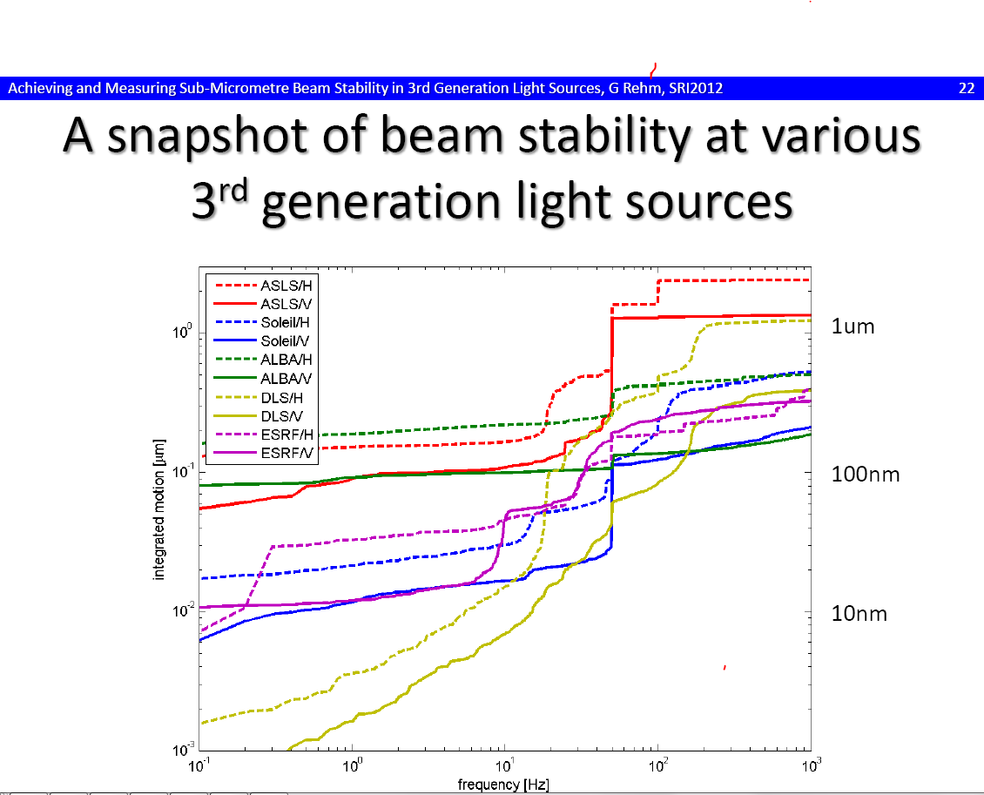
Courtesy G. Rehm, SRI2012
200 nm in
0.1-1000Hz
Bandwidth

Slide 10
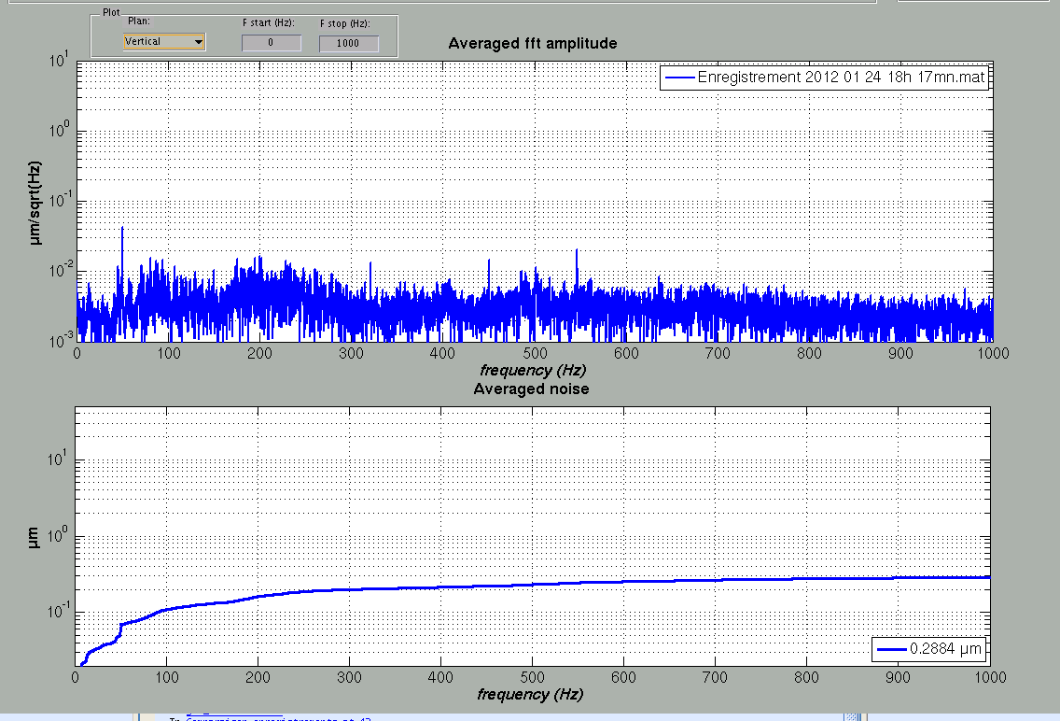
Example of short term stability (SOLEIL)
FFT on a 5 s acquisition @ 10 kHz
RMS spectral Density
BPM 13-2 SDL13
50 nm rms @ 50 Hz
Integrated noise
0.288 µm rms
0,2 -1000 Hz
Vertical noise
Measured on BPM 13-1: 0.288 µm
Undulator beamline source pt: < 0.200 µm
Bending magnet beamlines < 0.500 µm
≈ σ_{z} / 40

Slide 11
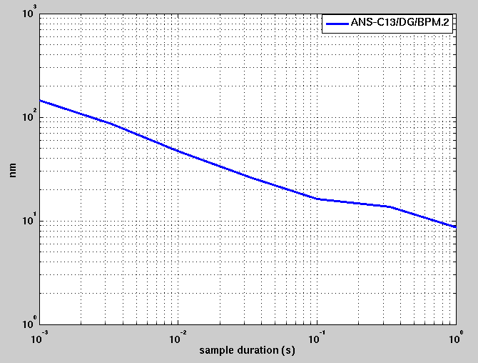
RMS Short Term Stability Versus Acquisition Time
(position is averaged during that time)
180 nm rms
<180 nm @1 ms

Slide 12
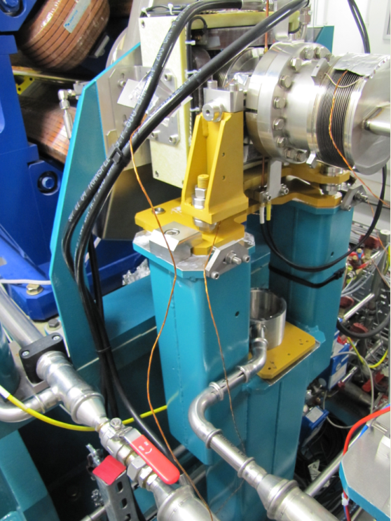
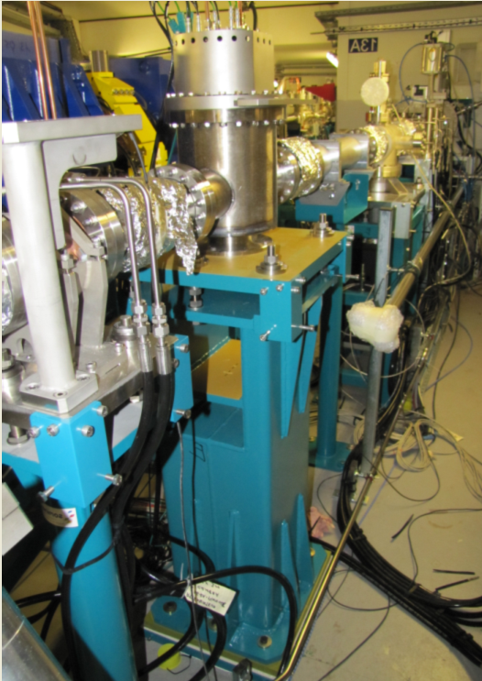
Special Invar BPM and XBPM Stands for two long Beamlines: NanoTomography and NanoScopium
4 Invar BPM stands and cradles for Reliable measurements of long term beam stability (at each end of the two undulators)
1 XBPM and its stand in Invar on NanoScopium Frontend (FMB design with Invar vacuum chamber).
XBPM came in operation last month, but a local stability problem has yet prevented evaluation of the machine stability based on that key source point (N2 gaz perturbs the electronics BPM rack and BPM measurements by more than 1 µm)
Today, the best machine stability evaluation comes from BPMs on NanoTomo straight section (but no XBPM yet)

Slide 13
Slow drifts: Tolerance Examples for SOLEIL Beamlines
Il faut ajouter SEXTANT aux 4 lignes ci-dessous
Beam parameter ↓ | SDL13-2 | SDL13-1 | SDC10 | SDM11 | Tightest wrt Beam size
Time frame | 8 hours | 10 mn | 5 mn | 10 mn 90% users 30 mn 10% users
Position H | ± 5 µm | ± 12 µm | 35 µm rms | 30 µm rms | ∼σ_{x}/70 *
Angle H | ± 5 µrad | ± 4 µrad | 3 µrad rms | 4 µrad rms | ∼σ’_{x}/11 *
Position V | ± 1.5 µm | ± 1 µm | 1 µm rms | 1.3 µm rms | ∼σ_{z}/13 *
Angle V | ± 1.5 µrad | ±1 µrad | 1 µrad rms | 0.9 µrad rms | σ’_{z}/8 *
Size | ± 2%, gated for peaks >2% | ± 5% for 99% of 6 h time | / | Not tight
Divergence | ± 2% gated for peaks >2% | / | / | ± 2%
∗ σ is the beam size and σ’ the divergence of the PHOTON Beam at its source point
and the highest user energy. Equivalence: 1 µm rms (or µrad) ≡ ± 1.4 µm (or µrad rms)

Slide 14
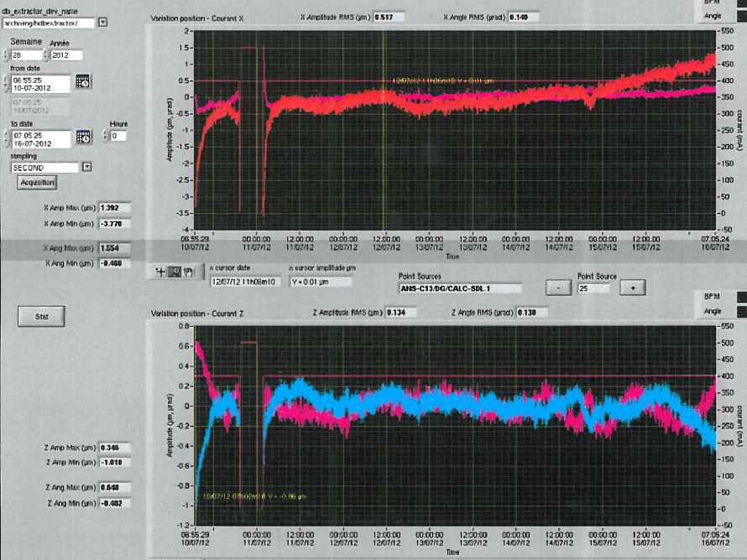
∆X = 517 nm RMS
∆X’ = 140 nrad RMS
Horizontal plane
X
X’
1 µm or µrad
1 week
SDL13-1 source point position and angle during 1 week
∆Y = 134 nm RMS
∆Y’ = 130 nrad RMS
Vertical plane
Y
Y’
1 µm or µrad

Slide 15
~1-minute-to-8-hour Beam Stability Versus Acq. Time
± tolerances in position AND angle that result in 90% useful beam time versus acquisition time
(based on previous slide record)
±560 nrad
±180 nm
100s
8h
Time in seconds

Slide 16
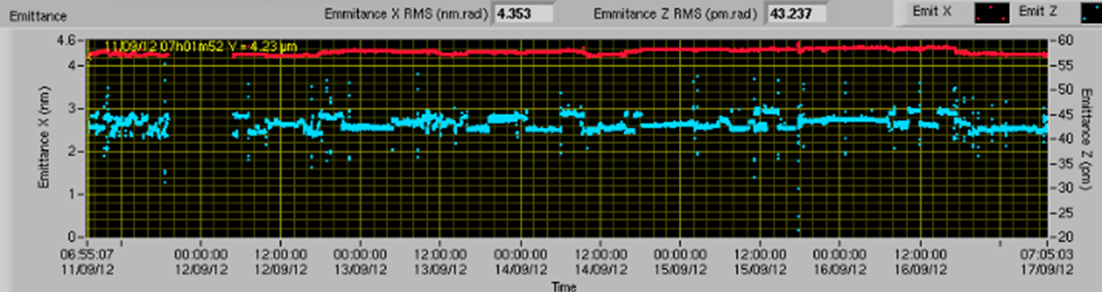
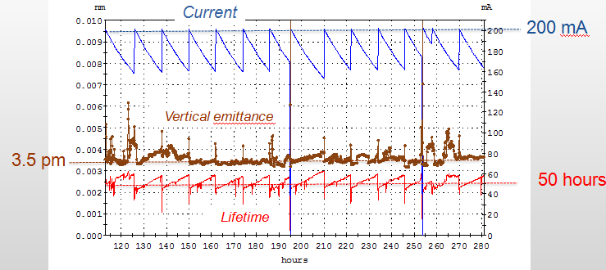
Beam Size and Divergence (ESRF & Soleil examples)
First implementation of Coupling Feedback
at Soleil (Sept. 2012)
Local Feedforward at ESRF
J-L. Revol (SRI 2012)
Courtesy M-A. Tordeux
USR Workshop
(#)
Vertical size control seems to be the most critical parameter for several
future BL at Soleil:
Simulations showed low useful beam time with present beam delivery.
Beijing 29 Oct.- 1 Nov. 2012

Slide 17
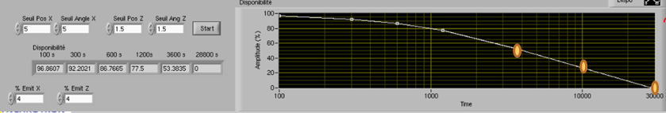
Vertical Emittance Variations and « Useful Beam Time »
Simulations of « Useful Beam Time » with Δκ/κ ≤ ±4% and three different acquisition times.
1h → 53%
% of Useful Beam Time
3h → 30%
8h → 0%
Time with Δκ/κ within ±4%
Developments are in progress on the Machine in order to fulfill these size & divergence requirements

Slide 18
Summary of beam stability Issues that Might Become USR Challenges (for discussion; not an exhaustive list)
Slow drifts < ±180 nm AND ±560 nrad in both planes of the source point for acquisition times over a few minutes.
Possible solutions: machine stability further improvements and/or Beamline ajustments for shorter acquisition times and/or photon beam feedback on electron beam
Gap dependence of the photon beam pointing direction: some BL include it in the ±560 nrad tolerance.
Possible solution: fine ID tuning and/or photon beam feedback
Beam size and divergence variations for acquisition times over a few minutes.
Possible solution: Better control of the machine emittance and/or beamline finding a way to shorten the acquisition time and/or post acquisition treatment of the experiment data

Slide 19
Contents
What stability is needed
  Position & angle
  Size and divergence
Beam stability achieved at existing light sources (Soleil data as an example)
  Position & angle
  Size and divergence
Accelerator & Beamline design issues for stability
USR Workshop
Beijing 29 Oct.- 1 Nov. 2012
(#)

Slide 20
Undulator Technology
Low residual position and angle offsets variations versus Gap: with the rule of thumb that the fast Orbit Feedback damps the gap variations effects by no more than a factor of 10, the defects the undulators introduce in beam orbit have to be less than 2 µm.
Seems feasable
Photon beam pointing direction stability versus gap changes: Needs to be < 560 nrad when added to angular drift.
Feasable
Low coupling component variations with gap and phase changes is needed for constant beam sizes and divergences.
The most critical and the most difficult in ID construction

Slide 21
Machine Emittance
The electron beam sizes and divergences do not need to be much smaller than those of the single photon
However, if they are about twice smaller, it will suppress the electron beam emittance variation problem

Slide 22
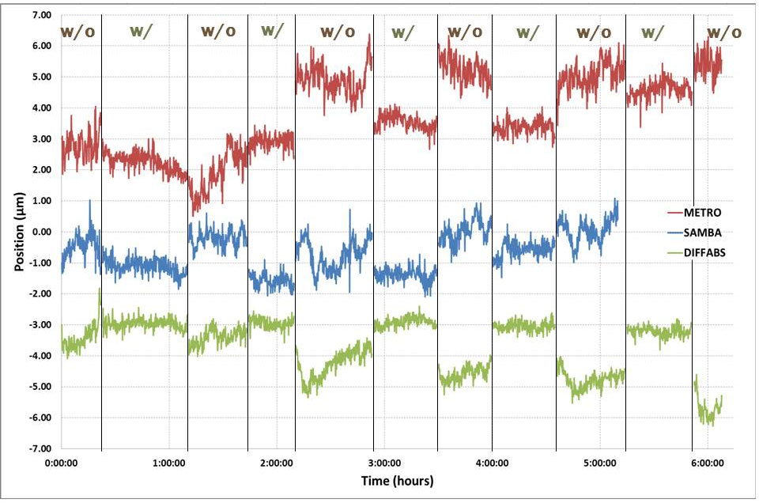
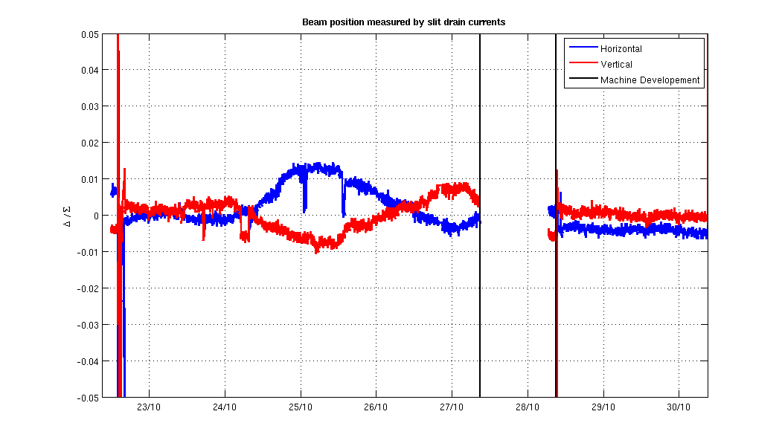
Better Stability with XBPMs in Global OFB loop
Possible only if XBPM measurement is reliable at any time
(no ID gap/phase dependence)
SOLEIL : bending magnet XBPMs
(vertical plane only)
gain in stability : factor 2 to 3
Diamond: ID XBPM (fixed ID gap
gain in stability: an order of magnitude
XBPM out of loop
XBPM in
Courtesy C. Bloomer
Courtesy N. Hubert
Strong need for ID XBPMs independant of ID gap/phase

Slide 23

Beamline Schematic
Ring
BL Frontend
Beamline
upstream
e-BPM
downstream
e-BPM
undulator
X-BPM
slits
~10 m
~10 m
~3 m
HLS
Concrete slab

Slide 24
X-BPM and Primary Slits on Same Support
Ring
BL Frontend
Beamline
upstream
e-BPM
downstream
e-BPM
X-BPM
#1
X-BPM
# 2
undulator
slits
~10 m
~10 m
~3 m
HLS
Concrete slab
The second XBPM for Feedback; the first one for stability monitoring
The HLS monitors slab deformation; it could eventually correct for it.
USR Workshop
Beijing 29 Oct.- 1 Nov. 2012
(#)

Slide 25
Hydrostatic Leveling System (HLS)
These systems already bring submicron stability for response times of a few seconds
They can correct for slab deformations
They are potential candidates for sensors in vertical position and angle feedback systems
They can equip several critical items of the machine (BPMs), the Frontend (XBPMs) and the Beamline (entrance slits, mirrors etc…)

Slide 26
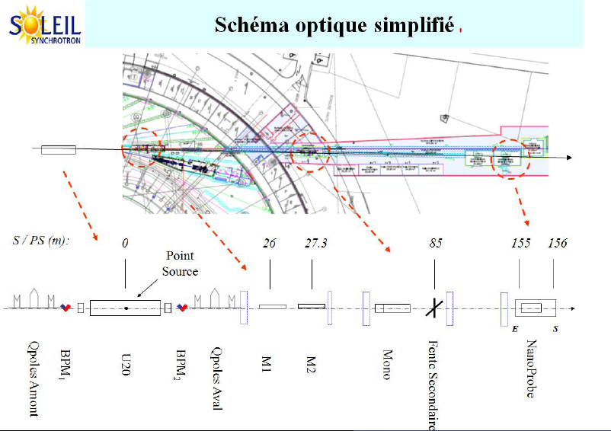
Courtesy: C. Bourgoin (gogle: hls roscoff)
A. Somogyi (EXP-RA-1302-APS

Slide 27
Needed Developments
For ID Beamlines: XBPMs independant of gap and phase changes
XBPM near the 1st Beamline critical item could be used in global feedback loop ?
Corrections of IDs
  skew quad components
  Better suppression of electron orbit perturbations with gap and phase changes
  Supression of photon beam pointing direction changes with gap and phase
High performance HLS or on-line survey/alignment systems

Slide 28
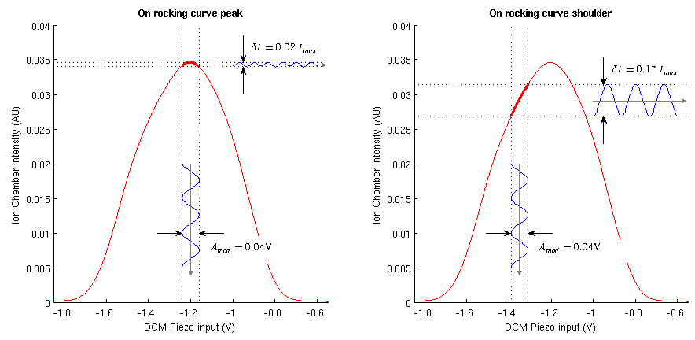
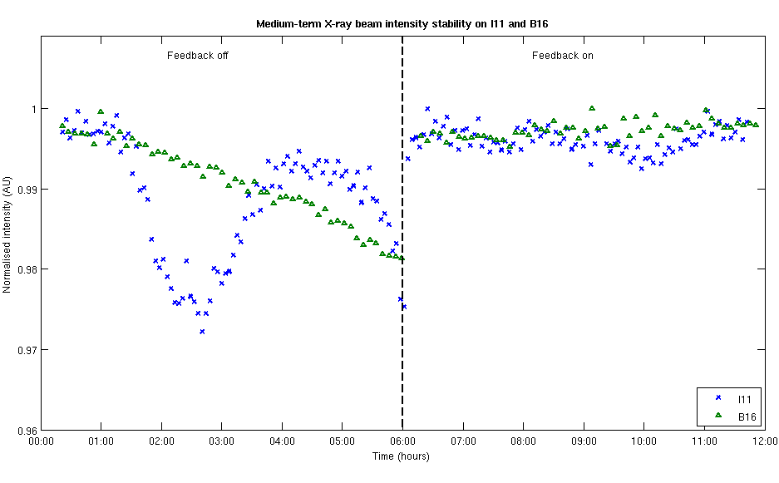
Using DCM pitch modulation and feedback to improve long term X-ray beam stability
SRI2012, courtesy of C Bloomer
Using this system the beam intensity at the sample point can be maintained for several hours to 0.1% r.m.s., an improvement of a factor of 5.

Slide 29
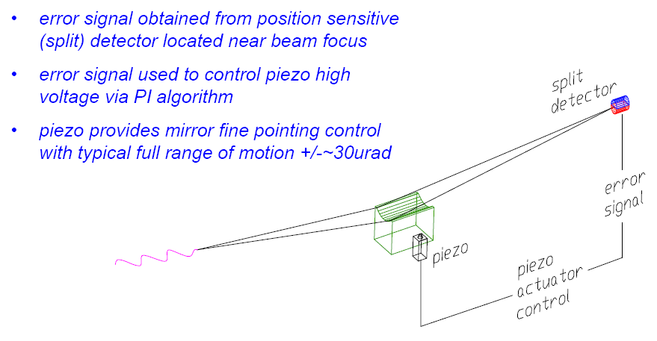
Mirror Pointing Feedback
Van Campen et al. SSRL 2008

Slide 30
Conclusions
The stability of existing machines is already good for demanding experiments on USRs if the user acquisition times stay reasonably short.
The beam emittance stability is the most critial item
Some developments in the ID field will certainly help.
We need better XBPMs, or find other ways of controlling the beam direction on entrance slits or on mirrors with an acceptance smaller than the beam size at their entrance.

Slide 31
QUESTIONS AND DISCUSSION

