Slide 1
Pulsed Sextupole Injection for Beijing Advanced Photon Source
Yi Jiao
Institute of High Energy Physics, CAS
2012-10

Slide 2
Brief History
The Photon Factory Advanced Ring (PF-AR) at KEK, Japan, successfully designed and commissioned pulsed sextupole magnet (PSM) in 2010.
Pulsed sextupole injection (PSI) can evidently reduce the dipole oscillation amplitude and improve the performance of the light source with “top-up” injection scheme.
Typical contributions:
Y. Kobayashi, and K. Harada, EPAC2006, THPLS107
H. Takaki, et al., PAC07, MOPAN034
H. Takaki, et al., Phys. Rev. ST Accel. Beams 13, 020705 (2010)
C. Sun, et al., IPAC10, WEPEA068
X.R. Resende, et al., IPAC11, THPC139
S.C. Leemann, Phys. Rev. ST Accel. Beams 15, 050705 (2012)
…

Slide 3
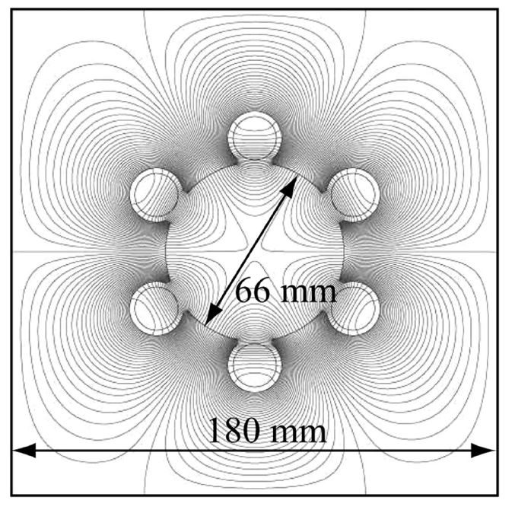
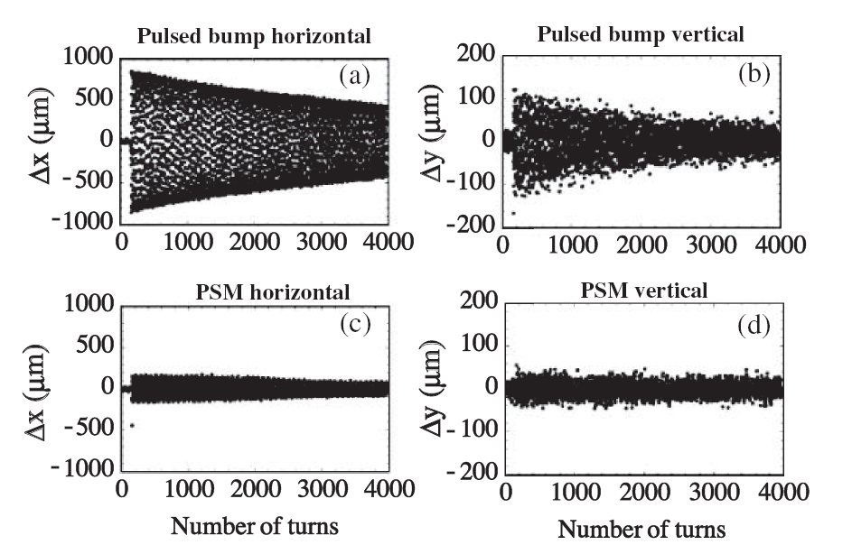
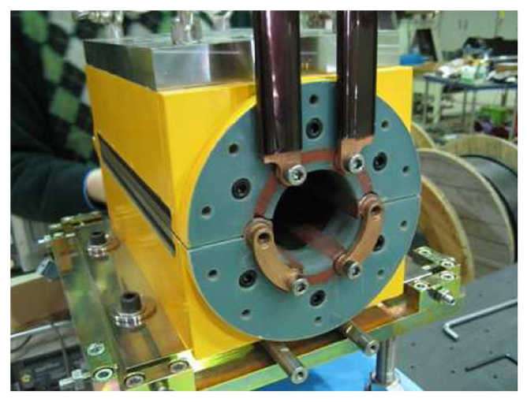
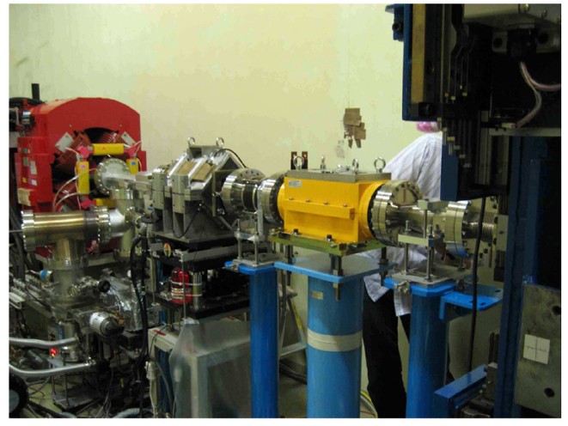
Pulsed Sextupole Injection in KEK PF
Cross section view and 2D magnetic field distribution
Beam oscillations of the stored beam immediately after injection
Front view of the PSM
Installation of PSM in the PF ring
H. Takaki, et al., Phys. Rev. ST Accel. Beams 13, 020705 (2010)

Slide 4
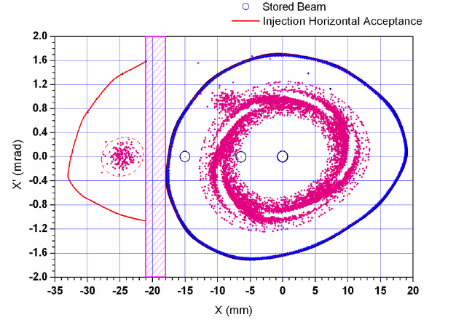
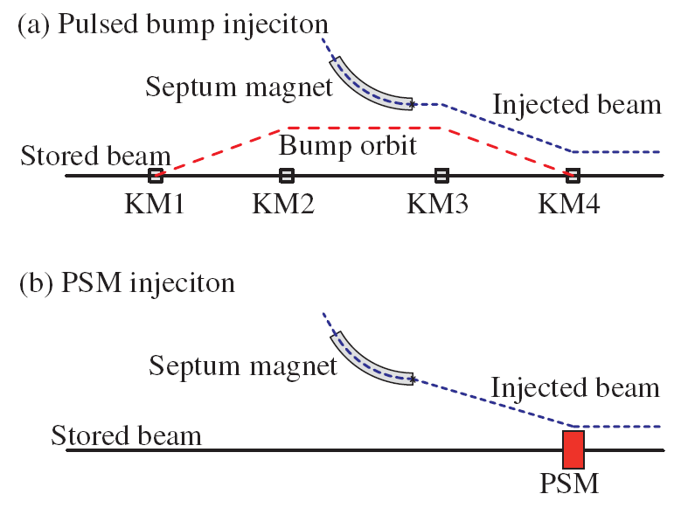
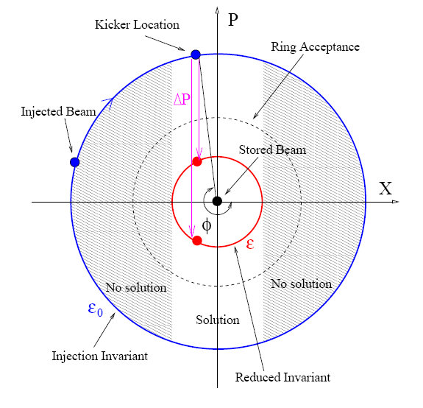
Principle
PBI (using kicker magnet) vs. PSI (using pulsed sextupole magnet) in electron storage rings
SSRF design

Slide 5
Principle
Injection emittance (at septum)
in terms of normalized coordinates
Injection emittance (at PSM, before kick)
If considering only linear optics
Reduced emittance (at PSM, after kick)
φ is the phase advance between the septum and the PSM
To ensure the beam is accepted by the ring, the reduced emittance should be smaller than the ring acceptance
The kick of the PSM

Slide 6
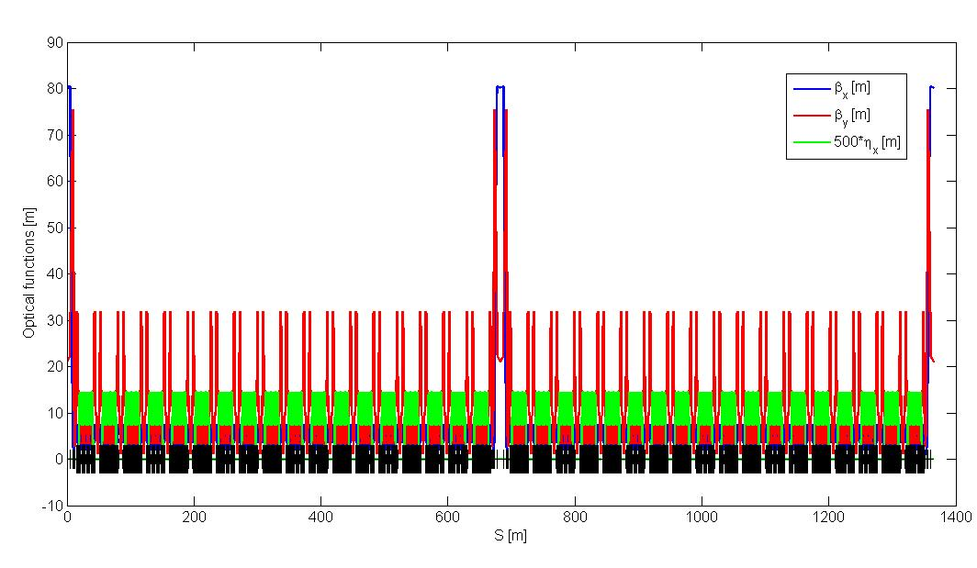
Beijing Advanced Photon Source (BAPS)
Linear Optics
Two high-beta 10-m straight sections for injection,
in the middle β_{x/y} = (80, 21) m
Circumference: 1364.8 m, 2 superperiods, 36 supercells
Working point: 111.39, 39.30
Natural chromaticity: -184, -181
Natural emittance: 51 pm.rad

Slide 7
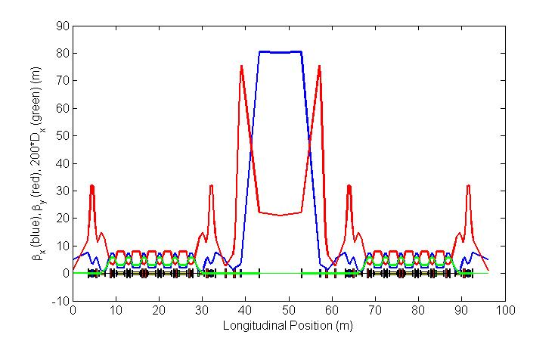
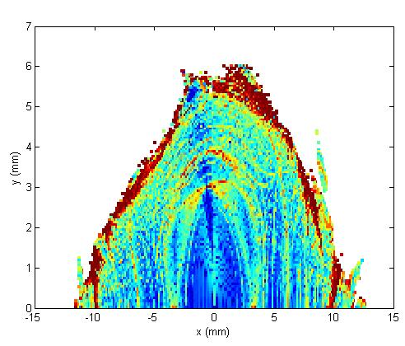
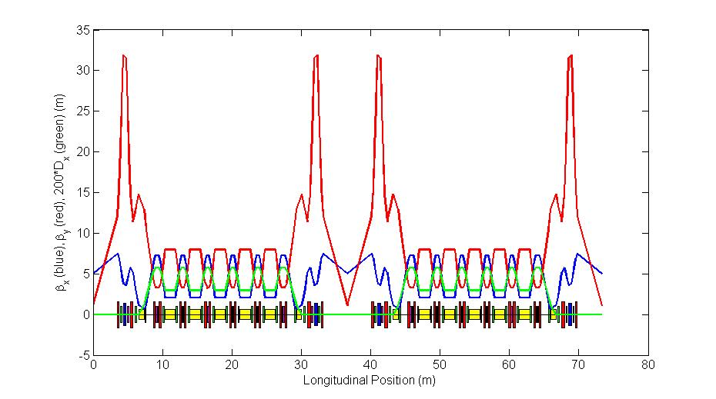
Nonlinear Optimization
Supercell w/ Inj. Sec.
Phase advance (supercell w/ Inj. Sec.) H/V =
Phase advance (supercell w/ ID Sec.) + 2π/0
Every 12 supercells forms a quasi-3rd-order achromat
Large On-momentum DA
Supercell w/ ID Sec.
The pulsed sextupole is located in the straight section.

Slide 8
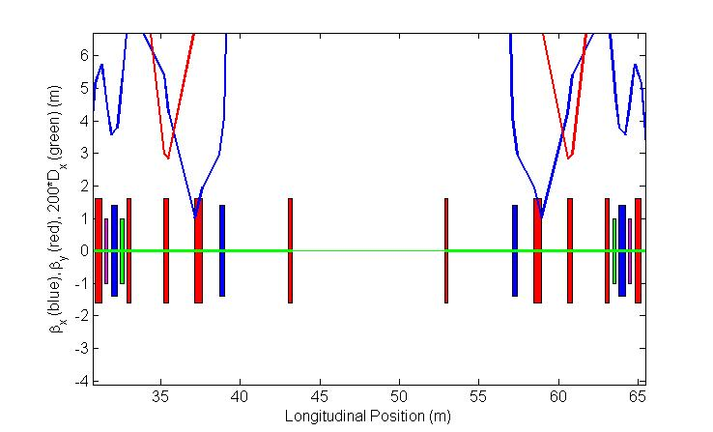
Pulsed Sextupole Injection for BAPS
Injected beam: 4 nm.rad from booster
Vacuum chamber half gap: 11 mm
Injection in the High-beta 10-m Straight section, promising moderate sextupole strength.
PSI options:
Option 1: Between injection point (end of the septum) and kick point (location of the pulsed sextupole), only drift space.
--- If required, needs to use only a larger-aperture vacuum chamber in the drift space.
---Small phase advance, strict requirements for the injection angle and pulsed sextupole strength.
Pulsed sextupoles
Septum magnets

Slide 9
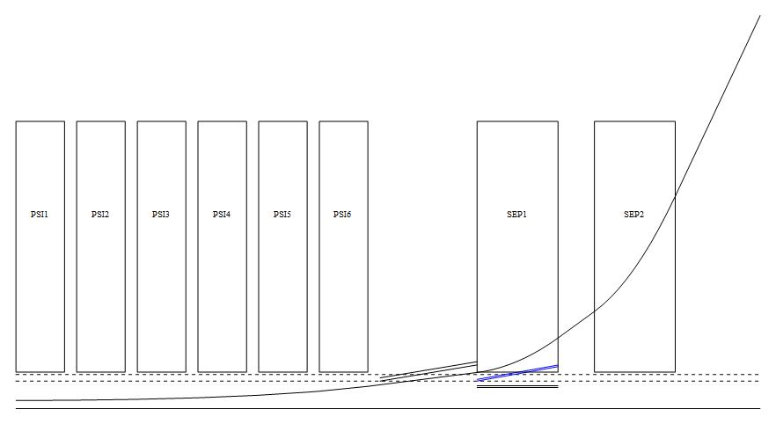
Pulsed Sextupole Injection Option 1
Large injection angle and large pulsed sextupole strength,
→ thick septum magnet and thick pulsed sextupole
→ Detailed study for the trajectory in the pulsed sextupole is required
Start point
x = 243 mm, x’ = 106 mard
Injected beam central orbit
Six PSMs
Two Septums
Vacuum chamber of the transfer line
End point
Vacuum chamber of the ring
x = 5 mm, x’ = 0 mard
9.2 m
PSM: r = 24mm, L=0.6 m, k₂ = B’’/Bρ = 59.3 m⁻³, B’’ = 1000 T/m²
SEP1: L=1m, angle=30 mrad
SEP2: L=1m, angle=70 mrad
Total mechanical length < 8 m
Courtesy of XU Gang

Slide 10
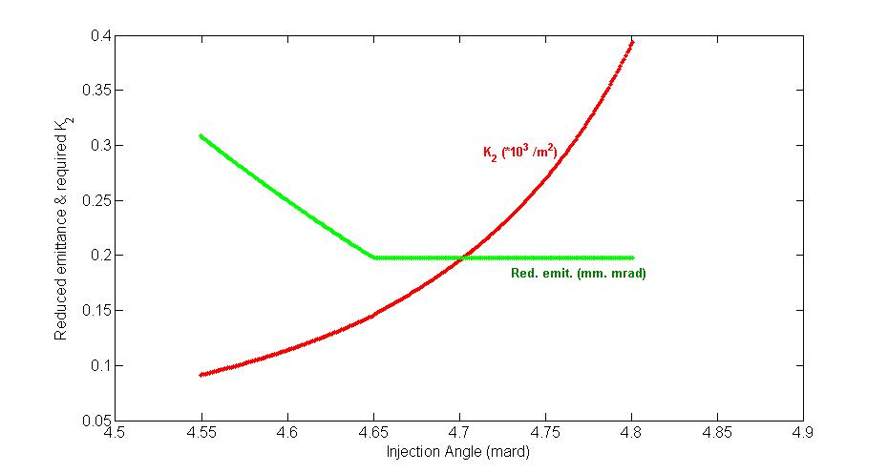
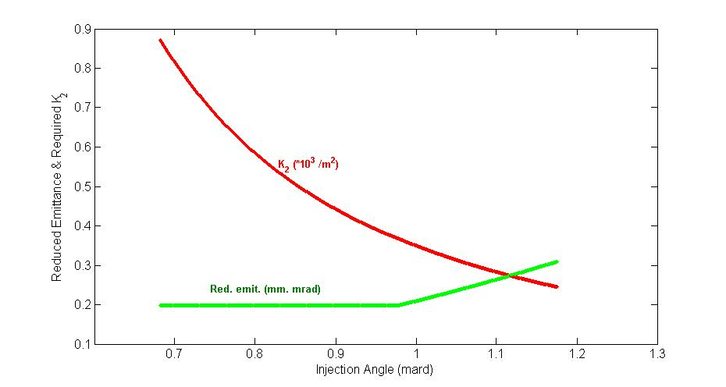
Pulsed Sextupole Injection for BAPS
Option 2: Between injection point (end of the septum) and kick point (location of the pulsed sextupole), a few quadrupoles.
--- It may needs to use a larger-apeture vacuum chamber as well as a few larger-aperture magnets.
---The phase advance is relatively large, less pulsed sextupole strength.
2 m
4 m
Pulsed sextupole
Sep.1
Sep.2
Inj. w/ sep. mag. 2
Injection with Sep.2, relatively small injection angle (typical angle 1 mard), but large sextupole strength (typical K₂ = 360 m⁻²)
Injection with Sep.1, relatively large injection angle (typical angle 4.6 mard), but small sextupole strength (typical K₂ = 150 m⁻²)
Inj. w/ sep. mag. 1

Slide 11
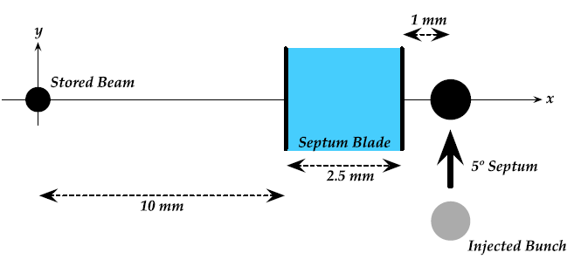
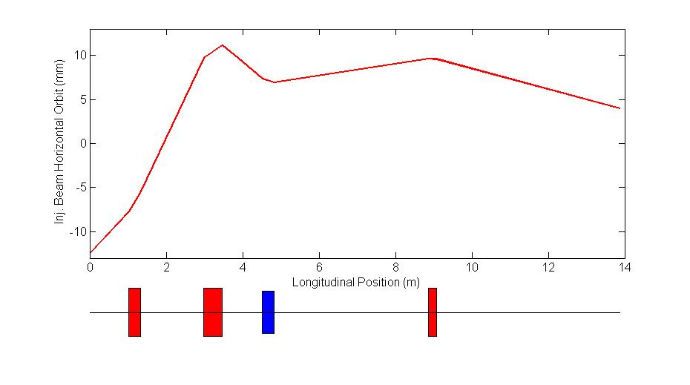
Pulsed Sextupole Injection Option 2
The injection point is Sep. 1, while the PSM is in the middle of the 10-m drift space.
MAX-IV Design
Initial offset -12.5 mm
Septum magnet, angle = 4.65 mard
Offset at PSM is x = 4 mm
Between septum magnet and PSM, vacuum chamber ~ 26 mm in horizontal plane
BAPS Design
Horizontal offset between Sep. 1 and PSM
0.27°Septum
9 mm
Sep.1
PSM

Slide 12
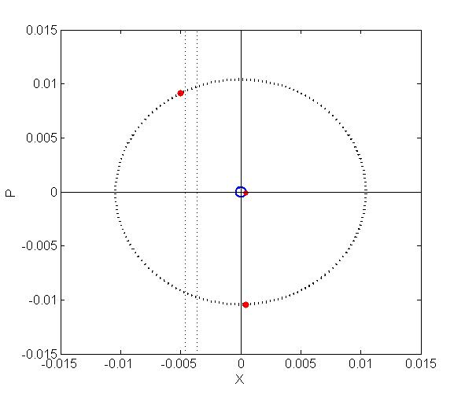
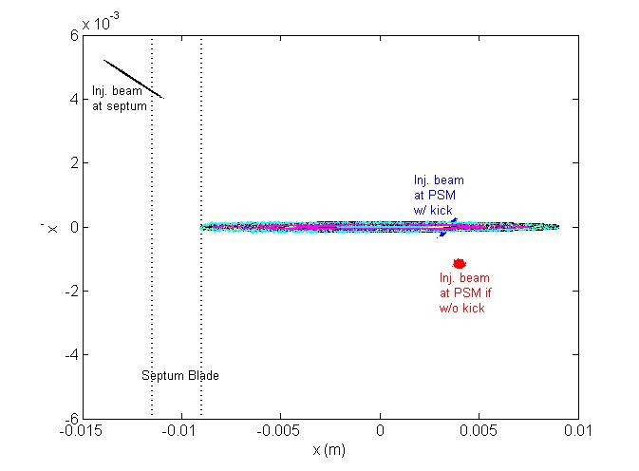
Pulsed Sextupole Injection Option 2
Injected emittance at septum : 108 mm.mrad,
Reduced emittance after kick : 0.2 mm.mrad
Required gradient K₂ : 144 m⁻²
(KEK PF: 13 m⁻² MAX-IV: 106 m⁻²)
2 m sextupole, 36 mm bore diameter, B’’ = 1200 T/m², field gradient 1350 Gauss @ x= 15 mm,
field gradient 1944 Gauss at pole face @ x= 18 mm.
Large β_{x} cause large σ_{x}, and also small acceptance to x’, leading to rather low capture efficiency.
Inj. Beam emittance, X/Y = 4 nm.rad, 4 nm.rad*2%.
Matched beam, capture efficiency, ~ 20%.
Unmatched beam, optimal case, capture efficiency ~ 60%.
Septum Blade
Inj.
2%
20% 1st turn
PSM after kick
ΔP
PSM

Slide 13
Summary
We discuss the possible injection options using pulsed sextupole.
A large enough dynamic aperture is necessary for and benefits pulsed sextupole injection.
With septum and pulsed sextupole in one drift space, the required septum and sextupoles strength are strong but feasible. With appropriate phase advance between septum and pulsed sextupole, one can reduce the magnetic strength.
For pulsed sextupole injection in BAPS, capture efficiency is not high, ~60%.
Further study is under way.

