Slide 1
Fast pulsed power supply for ILC damping ring kicker
Jinhui Chen
Accelerator Research Center , IHEP ,CAS , China
International Workshop on Accelerator R&D for USR Huairou, Beijing from Oct. 30 to Nov. 1, 2012

Slide 2
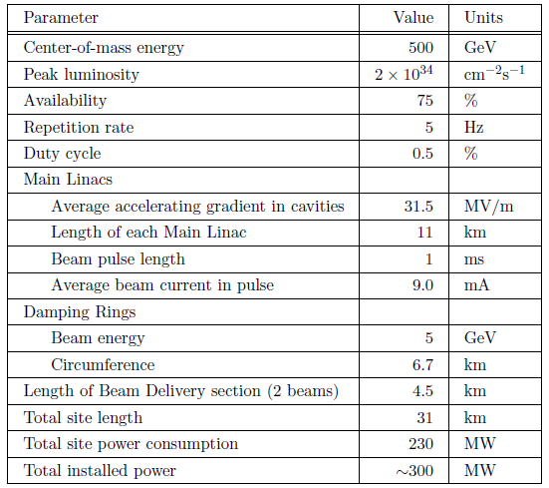
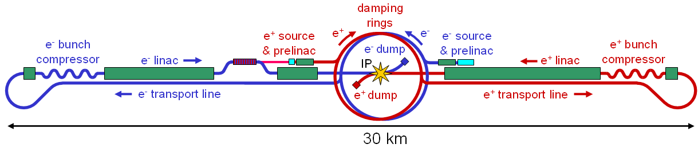
International Linear Collider(ILC)
ILC is a high luminosity linear collider at E_{CM}=500GeV, which consists of:
two 11 km long main linacs;
a 5GeV electron and positron damping rings with C=6.7km;
a 4.5 km long beam delivery system.
a polarized electron source;
an undulator-based positron source;
beam transport line and bunch compressor system;

Slide 3
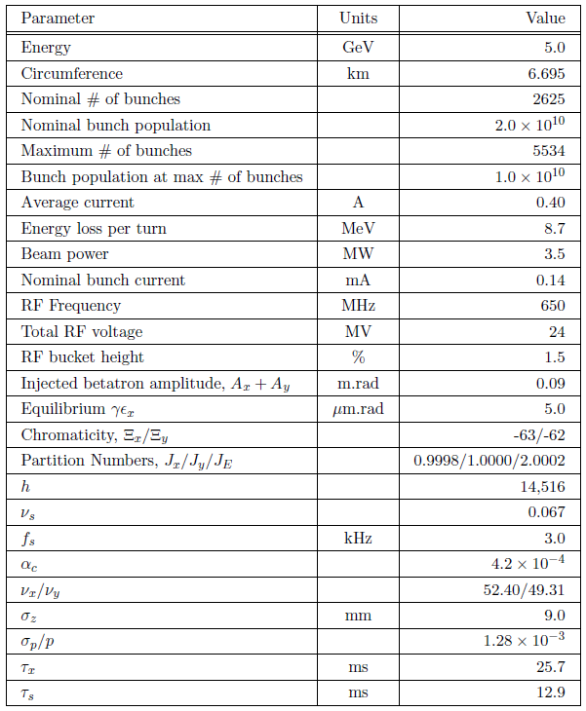
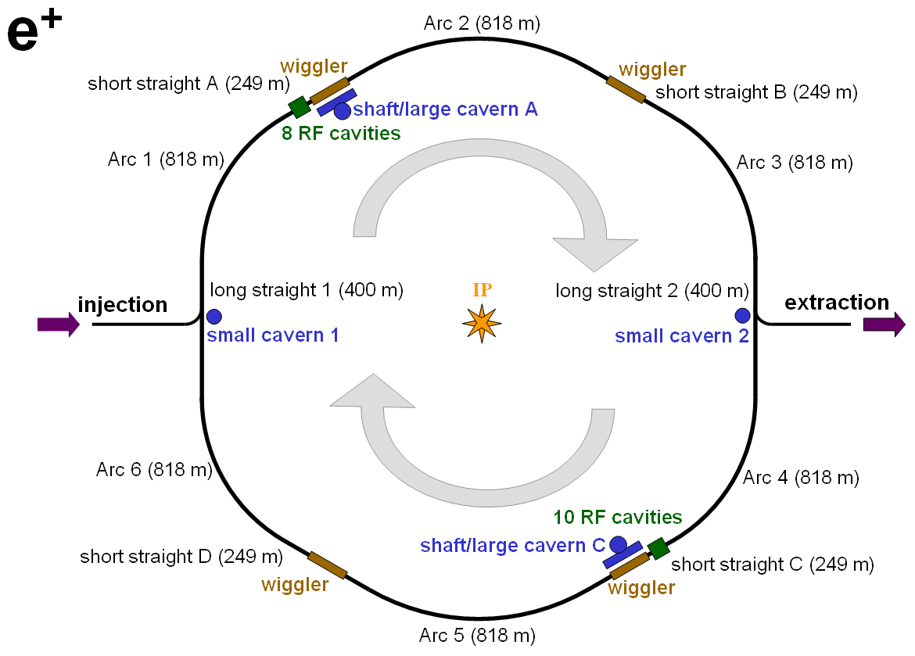
ILC damping ring(DR)
ILC damping rings is designed mainly to damp the incoming beam emittance and jitter to low level and provide highly stable beams for downstream systems.
6.7 km, 5 GeV Damping Ring

Slide 4
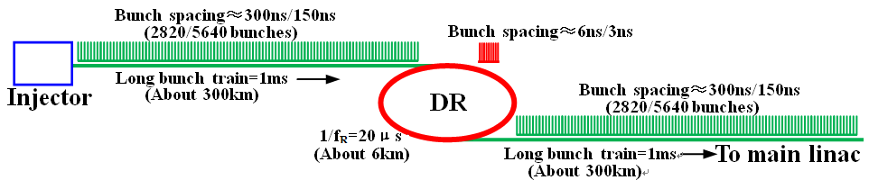
ILC DR injection and extraction
The length of the bunch train from the ILC injector is very long, about 300km. If bunch train was injected into DR without compressed, the DR should be very huge. To control the cost, the bunch train compression and decompression are necessary. So, the beam bunches must be injected into and extracted from DR bunch-by-bunch. Then, the width of kicker pulse must be less than double of DR bunch spacing.
According to the baseline design of ILC, the circumference of DR is 6.7km, and bunch spacing is about 6ns/3ns.
What kind of fast kicker is required?

Slide 5
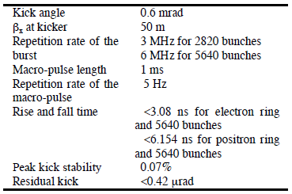
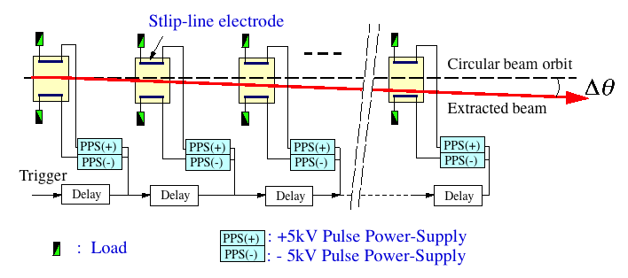
ILC DR kicker system
Parameters of the ILC DR kicker
The main features of DR kicker:
Very short pulse (<12ns/6ns)
High repetition rate in burst mode(=3M/6MHz)
A strip-line kicker system with fast pulser was proposed. There are 21 kickers for injection and 11 for extraction, so a long straight section is needed.
10ns/4ns
300ns/150ns
1ms
200ms

Slide 6
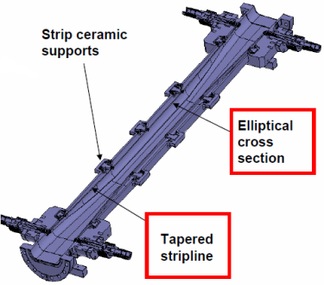
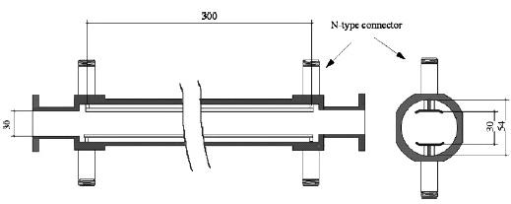
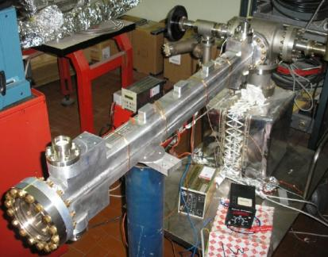
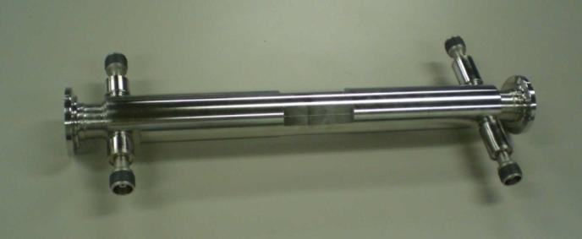
Strip-line kicker for ILC DR
There are 2 strip-line kickers for ILC under beam test:
ATF , KEK
DAФNE , LNF-INFN

Slide 7
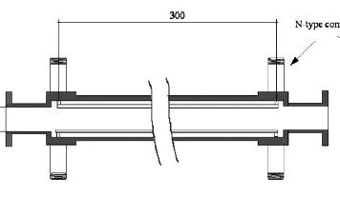
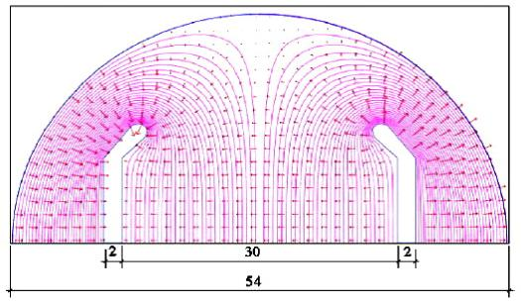
What is strip-line kicker?
Strip-line kicker is different with the conventional kicker magnet. The charged particle is deflected by travelling electro-magnetic wave, not by stand magnetic field. So, it can be called TW kicker.
There are 2 parallel strip transmission lines in vacuum chamber, which used to transmit pulse EM wave in TEM mode. If a charged particle travels a direction opposite to that of the TEM wave with v=c, the particle experiences a transverse kick due to both electric field and magnetic field with F_{E}=F_{B}.
+
beam
-
TEM
B
E

Slide 8
How fast is strip-line kicker?
In order to kick individual bunches by maximum deflection without affecting the adjacent bunches, the electrical pulse width (t_{p} ) and length(l) of strip-line kicker must meet:
There τ is bunch spacing, τ_{g}=2l/c is call kick growth time.
U（t）
t
deflection
t_{p}
2l/c
t_{f}
2l/c
t
preceding
bunch
bunch to
extract
following
bunch
So, for ILC DR, τ =3ns/6ns :
l =300mm<450mm,
2ns<t_{p}<4ns/10ns.
Obviously, a sets of short strip-line kicker can achieve this, but the drive pulser is still a big challenge.
10ns/4ns
300ns/150ns
1ms
200ms

Slide 9
Potential fast pulse technologies
Commercial MOSFET
(DEI-IXYS )
Inductive adder
(LLNL,IHEP)
Power
RF MOSFET
Die form MOSFET
Transmission line adder
(SLAC)
MOSFET module
(BEHLKE Gmbh)
Repetition Rate
Shift phase adder
(DESY)
Solid-state
switches
Drift Step Recovery Diode(DSRD) +FID
(FID Gmbh)
Special Diode
(Russia, Non commercial)
Drift Step Recovery Diode (DSRD)+MOSFET
(SLAC+DTI+Ioffe Institute)
`
opening
CSD、DSRD、IRD、SOS
Others
`
closing
SAS (DBD)、 FID、 RSD

Slide 10
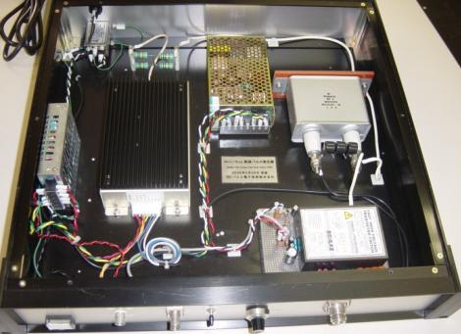
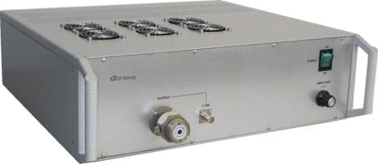
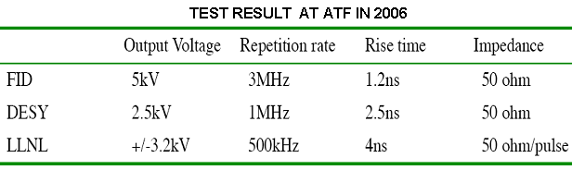
Three typical fast pulser for ILC kickers
BEHLKE MOSFET
SWITCH MODULE
FID GmbH. （FPG 5-3000M）
DESY（HTS-50-08-UF）
LLNL
switch
FID/DSRD
MOSFET module
(BEHLKE)
RF power MOSFET
(DEI_IXYS)

Slide 11
Fast pulsed power supply R&D for ILC DR kicker in IHEP
The activity of R&D on fast pulsed source began in IHEP from 2009 supported by National Natural Foundation of China.
The goal of our research is to build a performance evaluation prototype with:
Width of pulse <10ns,
Amplitude of pulse >±5kV into 50 Ω,
Burst repetition rate >1MHz.
Our research mainly focuses on the principle and the method of fast pulse technologies, such as:
Pulse power stacking topology,
RF MOSFET driver circuit,
By commercial electronics as possibly, no patent components.
Here, we’ve some experiences on fast pulsed source R&D to be shared:

Slide 12
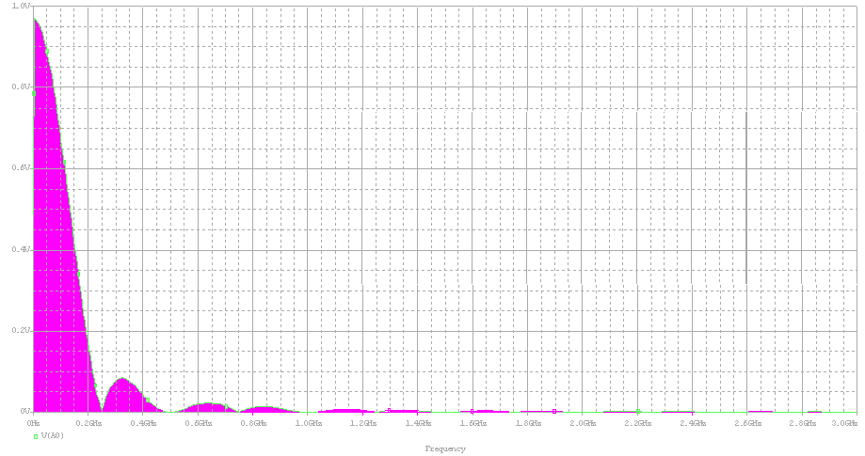

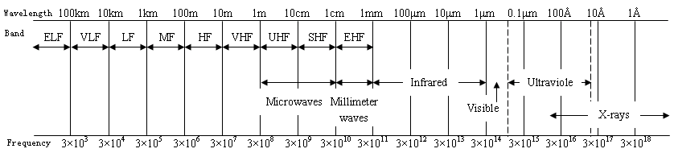
The characteristics of ultra-short pulse
Fourier transform graph of pulse of :
Easy to know, an ultra-short pulse has extended into microwave range. Generally, the analysis method:
2ns
2ns
2ns
“circuit”and
“lumped parameter”
If size>λ/20
“wave”and
“distributed parameter”
0.2GHz
1GHz
2GHz
(There, λ is wavelength of the highest order harmonic )

Slide 13
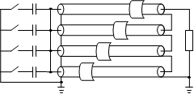
1. Fast pulse stacking topology
There are 3 popular topologies for fast pulse stacking:
Series switch (The BHELKE switch module maybe?)
Inductive adder (It’s mature tech. researched in LLNL for more than 15 years.)
Transmission line transformer adder (It’s an old concept in microwave tech.,
but still need to R&D for real application. )
On the first step, we selected inductive adder solution to start our research.
Series switch topology
Inductive adder topology
Transmission line adder topology

Slide 14
Topology study by PSPICE
10-stage inductive adder schematics in PSPICE

Slide 15
2. Coaxial transformer design
The coaxial transformer design is a key to inductive adder. A coaxial structure is an efficient method to reduce the leakage inductance of transformer. Besides it, the magnetic material of core is also critical for the fast pulse transformer. The nano-crystal core annealed in transverse magnetic field was selected.
The stacking transformer is a kind of fraction ratio transformer :
T_{p}:T_{s}=(1/N):1=1:N.

Slide 16
Considerations from the view of “circuit”
As a lumped component , the length of coaxial transformer cell must meet:
A stacking transformer is equivalent to a LC low-pass filter net, so:
C₁₂
L_{S1}
L_{S2}
L_{S2}
L_{S2}
2C₁₂
2C₁₂
2C₁₂
L_{M}
2C₁₂
2C₁₂
2C₁₂
C₁₂
L_{S2}
L_{S2}
L_{S2}
C₁₂
C₁₂
C₁₂

Slide 17
Considerations from the view of “wave”
Every cell of the coaxial transformer can be regarded as a pulse source, which drives into the load by a length of coaxial transmission line. So, the transmission line effect of the coaxial transformer must be considered:
At the load end, the superposed pulse must be slowed down because of the deference of transmission delay Δτ.
The coaxial structure must meet TEM mode transmission condition:
Impedance of coaxial structure must match to the load:
first stage
Last stage
every stage pulse transmit to load end

Slide 18
Physical design of coaxial transformer
It is optimal physical design for a single cell of coaxial transformer with taking all considerations mentioned above:
10mm
12mm
23mm
58mm
There are 3 coaxial structures : R1&R2, R1&R3, R4&R5.
R₅
conductor
R₄
dielectric
R₃
B
B
R₂
B
B
R₁
R₁
core
conductor
Cross section of coaxial transformer

Slide 19
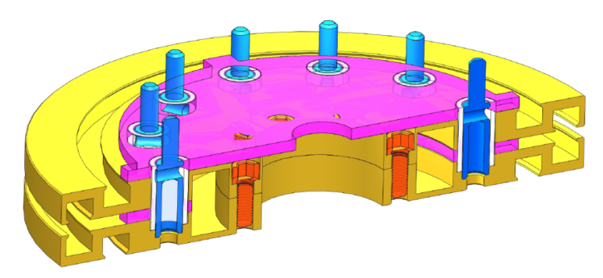
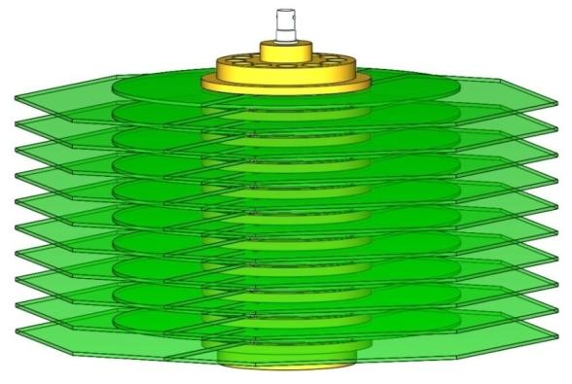
Structural design of coaxial transformer
The structure design by SolidWorks:
Cross-section of a single cell
Cross-section of 10-stage module
Assembled inductive adder

Slide 20
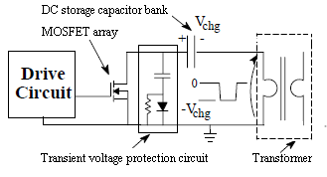
3. RF switch circuit design
RF switch circuit technology is the other key to all kind of adders. Usually, The switch circuit includes:
  MOSFET array
  (easy to parallel because R_{ON} is positive temperature coefficient)
  Storage capacitor bank
  (work in DC mode)
  Drive circuit
  Transient voltage protection circuit

Slide 21
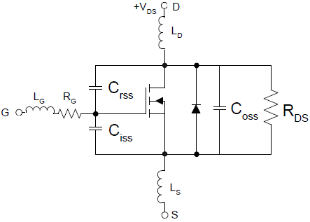
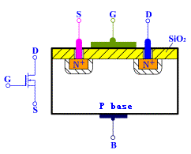
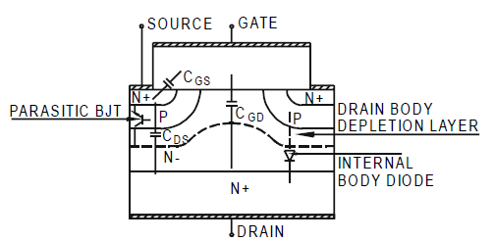
Power MOSFET
At present, Power MOSFET is the fastest switching device in commercial electronics. Its switching speed limit is imposed by two factors:
transit time of electrons across the drift region
(It is about 20-200ps depending on size of the device. )
the time required to charge and discharge the input Gate and ‘Miller’ capacitances
(It is limit by die package and drive circuit.)
C_{GD}=C_{RSS}
C_{GS}=C_{ISS}-C_{RSS}
C_{DS}=C_{OSS}-C_{RSS}
Power MOSFET: Double-diffused MOS
Complete MOSFET model

Slide 22
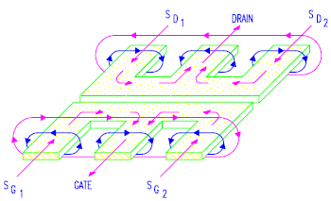
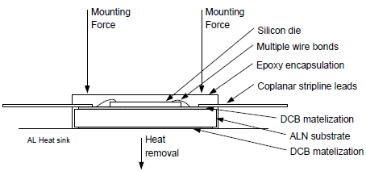
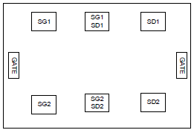
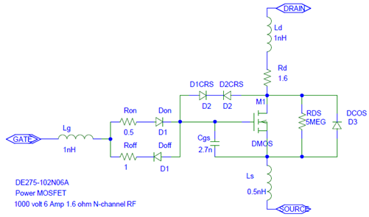
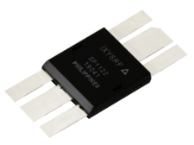
DE-series RF Power MOSFET
DE-series MOSFET(IXYS-DEI) is special designed for RF application, with specially die package, die topology and thermal dissipation structure.
The selected MOSFET is:
DE275-102N06A
BV_{DSS} | 1000V | C_{ISS} | 1800pF
I_{D} | 48A | C_{OSS} | 130pF
P_{DC} | 590W | C_{RSS} | 25pF
Td(on) | 3ns | R_{DS} | 1.6Ω
T_{ON} | 2ns | L_{G} | 1nH
Td(off) | 4ns | L_{D} | 1nH
T_{OFF} | 5ns | L_{S} | 0.5nH

Slide 23
Power MOSFET driver circuit
As a switch, MOSFET must be driven from a low impedance source capable of sourcing and sinking sufficient current to provide for fast insertion and extraction of the controlling charge.
There are 2 classes driver:
Integrated driver (drive ability is limited, Io<20A)
Discrete component driver (usually a totem-pole topology)
Driver type | EL7158 | IXDN414 | IXDD415 | DEIC420
V_{o} | 12V | 4.5-35v | 8-30V | 8-30V
I_{o} | 12A | 14A | 15A | 20A
Drive ability (capacitor load/charge voltage） | 12ns （2nf/12v） | 22ns (15nf/18v) | 4.5ns (4nf/15v) | 4ns (4nf/15v)
Delay time(T_{ONDLY}/T_{OFFDLY}) | 22ns/22.5ns | 30ns/31ns | 32ns/29ns | 32ns/29ns
Min. pulse length | 8ns | 10-15ns | 6ns | 8ns
Output impedance | 0.5Ω | 0.6Ω | 0.8Ω | 0.4Ω
Power | - | 12.5W | 12W | 100W
Level of input trigger | TTL(>3.5V) | TTL(>3.5V) | TTL(>3.5V) | TTL(>3.5V)
DE275 switch speed 1kV into 50Ω（T_{ON}/T_{OFF}） | -/- | 10ns/15ns | 10ns/15ns | 6ns/14ns

Slide 24
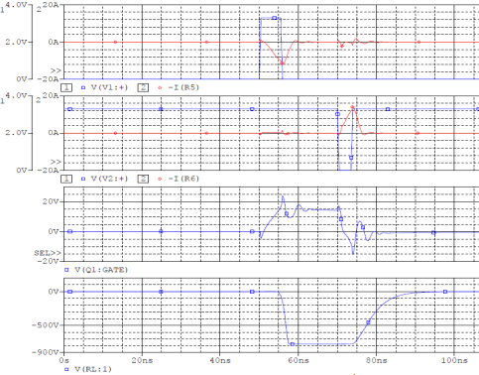
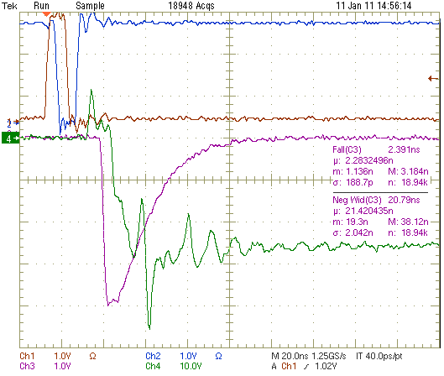
Bipolar totem-pole Driver
In this driver, the power MOSFET is turned on and off by two sequential clocks independently via bipolar driving totem-pole. It is a current source driver instead of the traditional voltage source driver.
The key difference is that:
drive voltage: ±V_{SS} > Max. of V_{GS} of Q₁ ,
drive current: I = V_{SS} /(R_{g} of Q₁+ R_{on} of M₁).

Slide 25
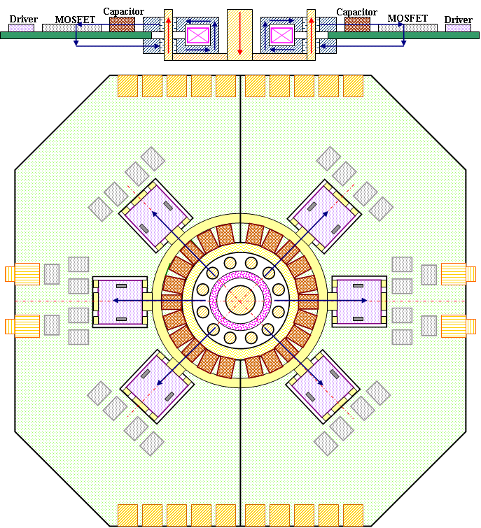
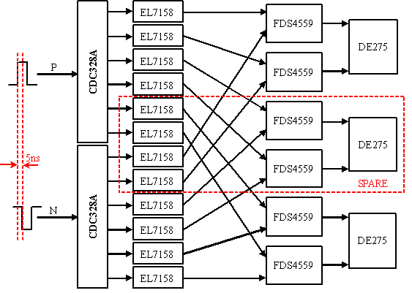
MOSFET switch circuit PCB layout
sink
DE275
storage
capacitor
transformer

Slide 26
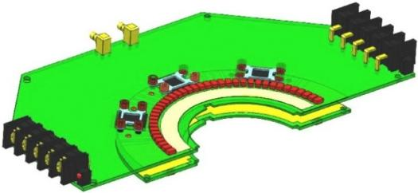
MOSFET protective circuit
There are 2 popular protective circuits:
The circuit (B) is selected for convenience of assembling. The circuit is designed as an independent PCB, which is directly connected to the primary of coaxial transformer for lower stray inductance.
＋
－
＋
－
storage capacitor
storage capacitor
primary
secondary
primary
secondary
protective
circuit
protective
circuit
(A)
(B)
Switching circuit board
Protective circuit board

Slide 27
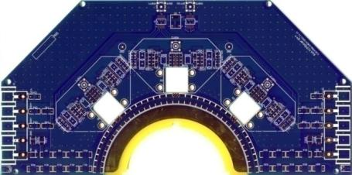
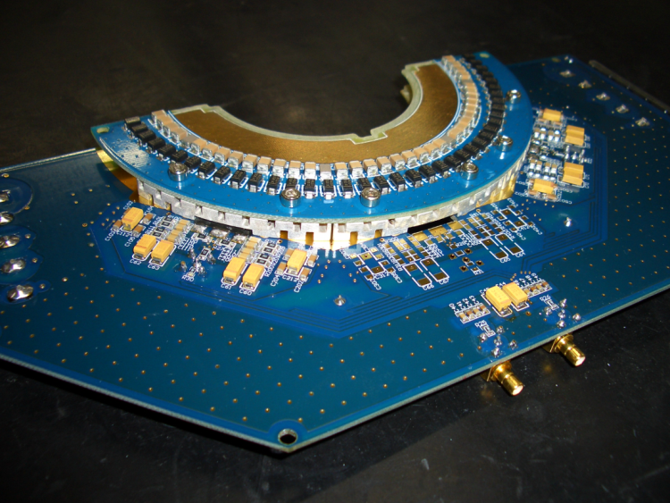
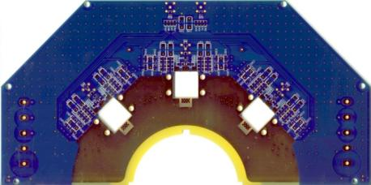
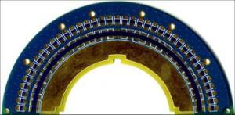
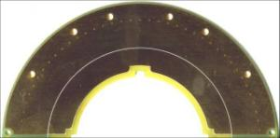
Final PCB designs of prototype
Switching board and protector board

Slide 28
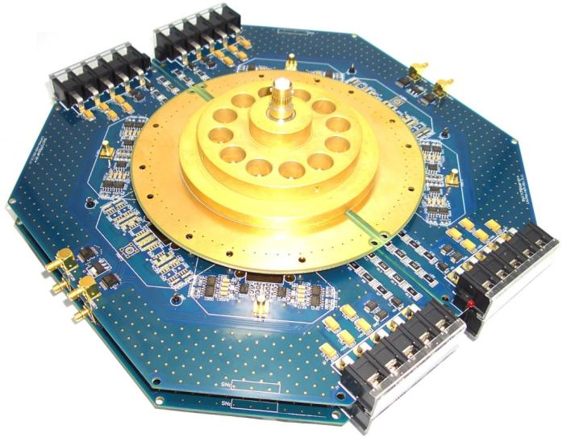
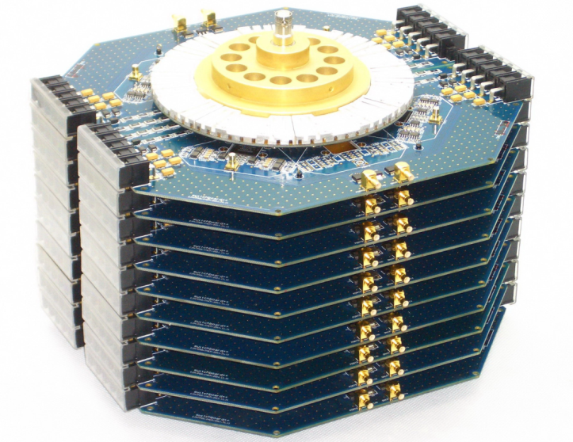
The prototype assembling
2-staget inductive adder
10-stage inductive adder

Slide 29
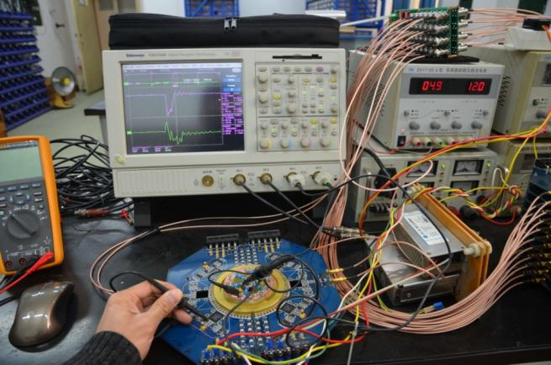
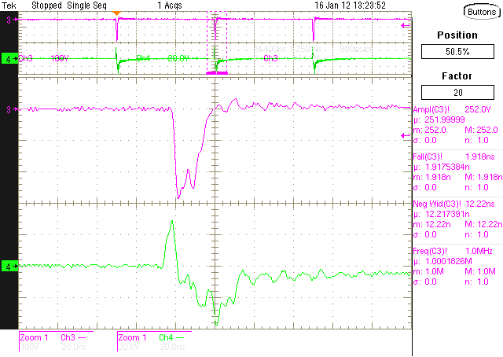
1-stage inductive adder test result
Conditions：U=250V，PRF=1MHz，R_{L}=7.7Ω，10X attenuation
Result： Front edge of pulse(10%-90%）=1.9ns
Width of pulse(FWHM) ≈10ns
PRF=1MHz

Slide 30
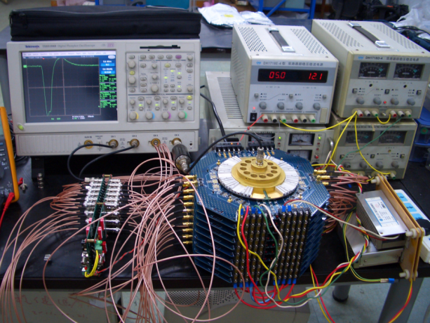
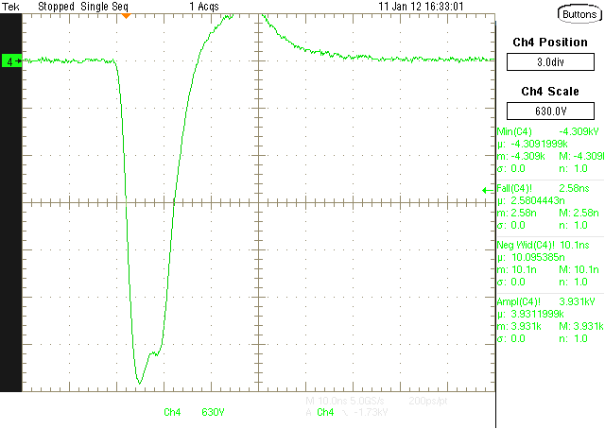
10-stage inductive adder test result
Conditions：U=610V，PRF=1kHz，R_{L}=50Ω，30dB attenuation
Result： Front edge of pulse(10%-90%）=2.58ns
Width of pulse(FWHM) ≈10ns
Pulse amplitude ≈4kV

Slide 31
References
ILC Global Design Effort and World Wide Study, International Linear Collider Reference Design Report, 2007
T. Naito, KEK, Development of Strip-line Kicker System for ILC Damping Ring, Proceedings of PAC07, Albuquerque, New Mexico, USA, 2007
David Alesini, LNF-INFN, Fast RF Kicker Design, ICFA Mini-Workshop on Deflecting/Crabbing Cavity Applications in Accelerators, Shanghai, April 23-25, 2008
T. Naito, KEK, Fast kicker study, TB meeting, 2011/01/14
Craig Burkhart, SLAC. Ed Cook, C. Brooksby LLNL. Inductive Adder Modulators for ILC DR Kickers, ILC DR workshop, September 26, 2006
T. Tang, and C. Burkhart, SLACK, Hybrid MOSFET/Driver for Ultra-Fast Switching

Slide 32


Thank you
for attention!

