Slide 1
Recent CP violation results from LHCb
钱文斌
中国科学院大学
2026/04/25
第八届全国重味物理与量子色动力学研讨会
2026/04/25
UCAS, Wenbin Qian
1

Slide 2
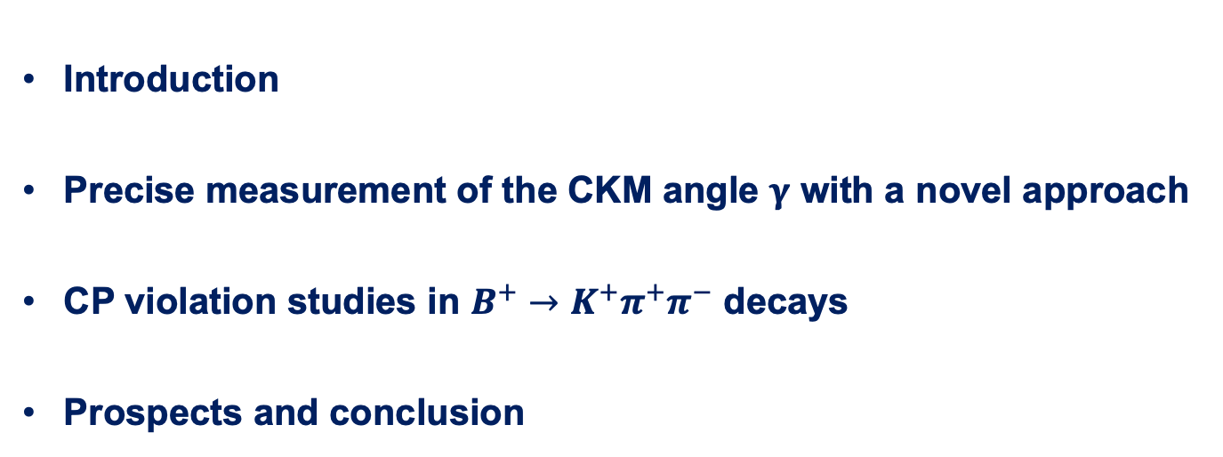
Outline of the talk
Introduction
Precise measurement of the CKM angle $γ$ with a novel approach
CP violation studies in $B^{+}→K^{+}π^{+}π^{−}$ decays
Prospects and conclusion
Disclaimer: results are selected based on personal taste
2026/04/25
UCAS, Wenbin Qian

Slide 3
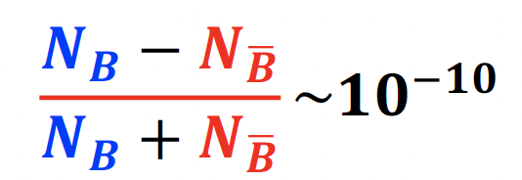


Why CP violation
SM model very successful;
Still an effective theory, many unexplained phenomena;
One standing-out quest: understanding matter and antimatter asymmetry in the Universe
Extra sources of CP violation needed
Higgs sector?
Neutrino sector? PMNS matrix
Quark sector?
Other places?
$≪{10}^{−17}$ predicted by CKM mechanism
All requires New physics
2026/04/25
UCAS Wenbin Qian
3

Slide 4
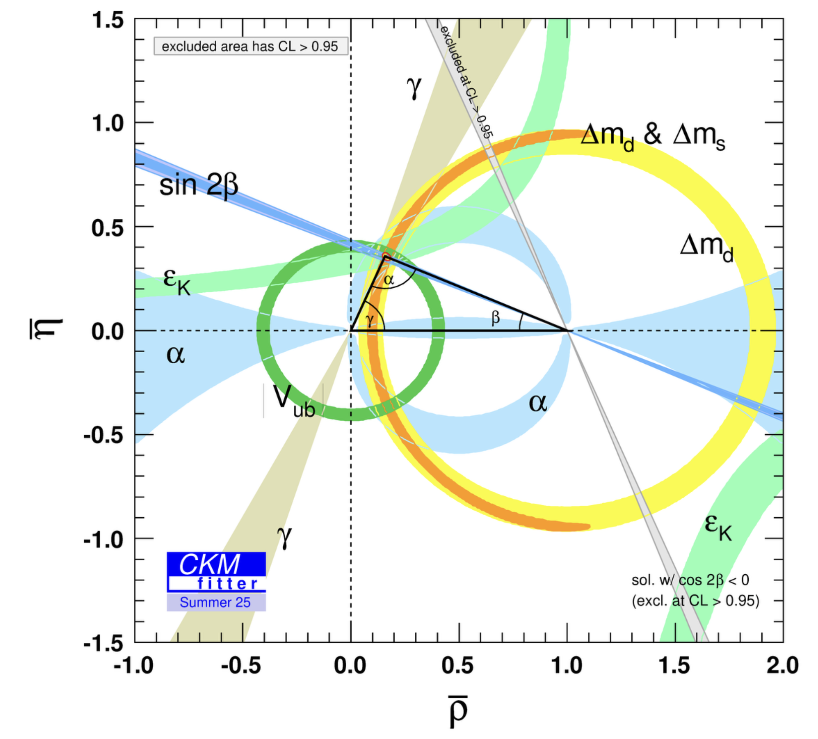
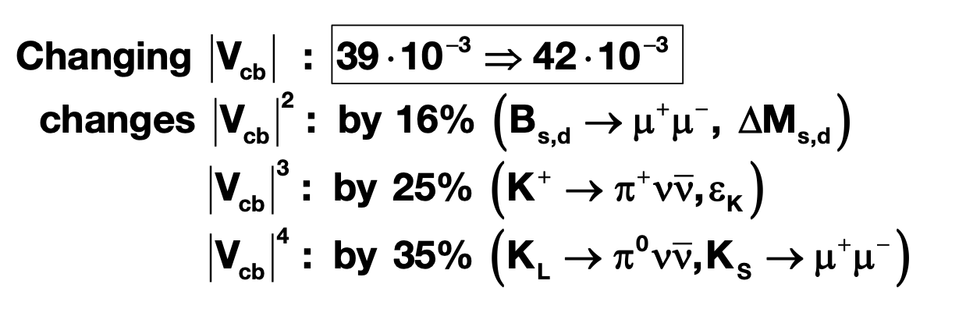

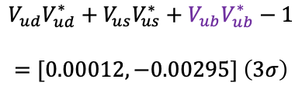


Precision measurements
Precision essential to find the footprint of NP
NP scale: $Λ$
Energy scale for SM: $v \sim 100$ GeV
Unitarity test: precision driven!
Is current precision enough? No
Disaster for new physics searches if CKM elements not precise
$${10}^{−5}$$
$$V_{ud}V_{ud}^{∗}+V_{us}V_{us}^{∗}+V_{ub}V_{ub}^{∗}−1$$
$$=[0.00012,−0.00295] \left(3σ\right)$$
Cabbibo anomaly?
From A. Buras
Precise measurements in NP sensitive decays
2026/04/25
UCAS Wenbin Qian
4

Slide 5
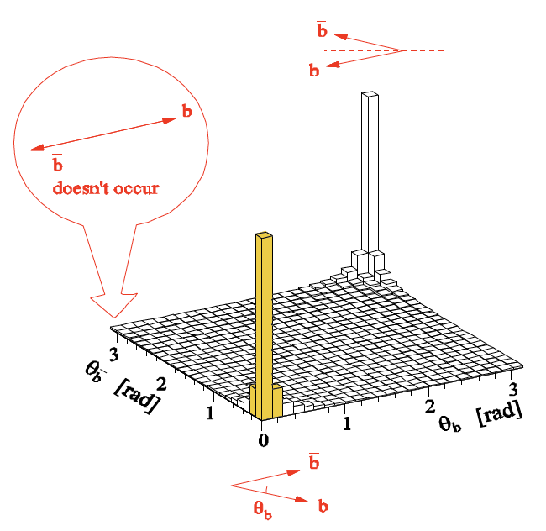
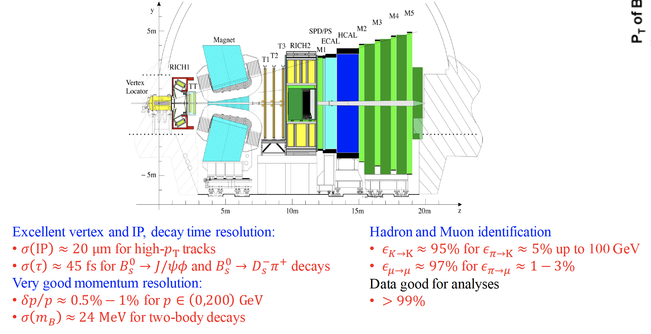
The LHCb detector (Run 1+2)
2008 JINST 3 S08005
Designed for CP violation and heavy flavor studies
2026/04/25
国科大 钱文斌
5

Slide 6
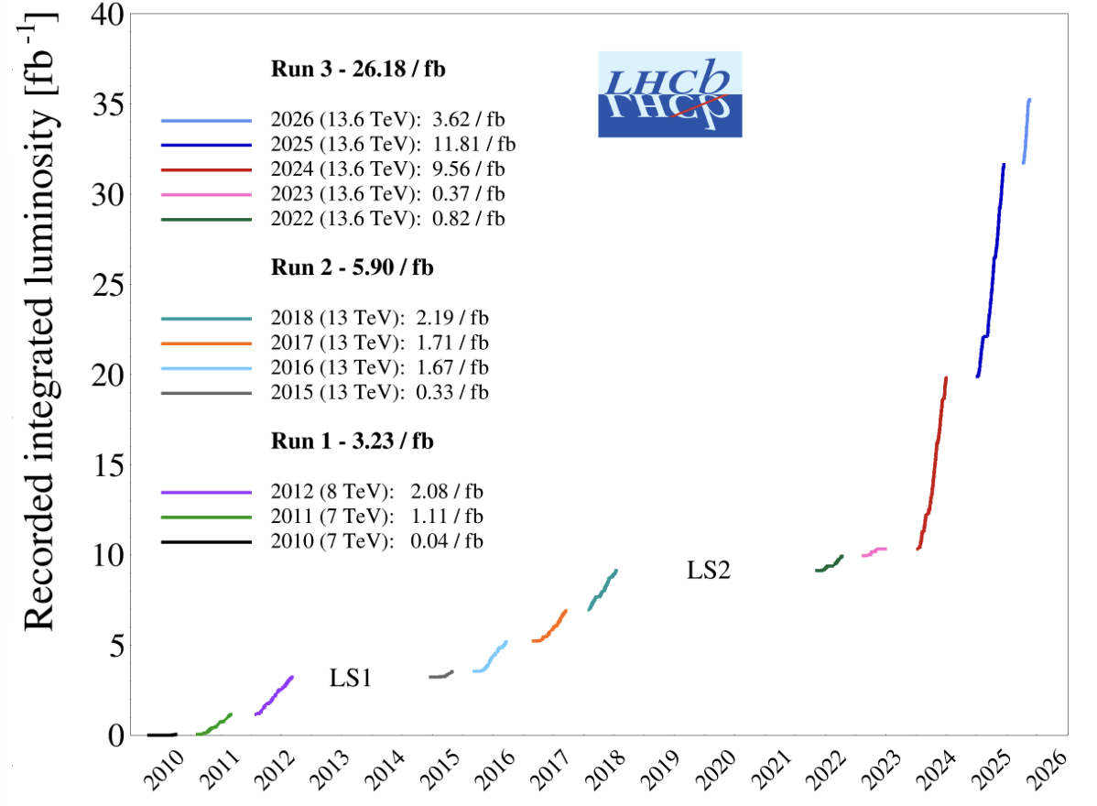
The LHCb status
Run 1:
2011 (7 TeV): 1 fb⁻¹
2012 (8 TeV): 2 fb⁻¹
Run 2:
2015-2018 (13 TeV): 6 fb⁻¹
Run 3:
2024 alone (13.6 TeV): 9.56 fb⁻¹
2025 (13.6 TeV): 11.81 fb⁻¹
2026 (13.6 TeV): >3.62 fb⁻¹
A new LHCb detector for Run 3 operates at $×5$ higher instantaneous luminosity
Similar performance, while efficiency for hadron final states increased by a factor of 2
2026/04/25
国科大 钱文斌
6

Slide 7
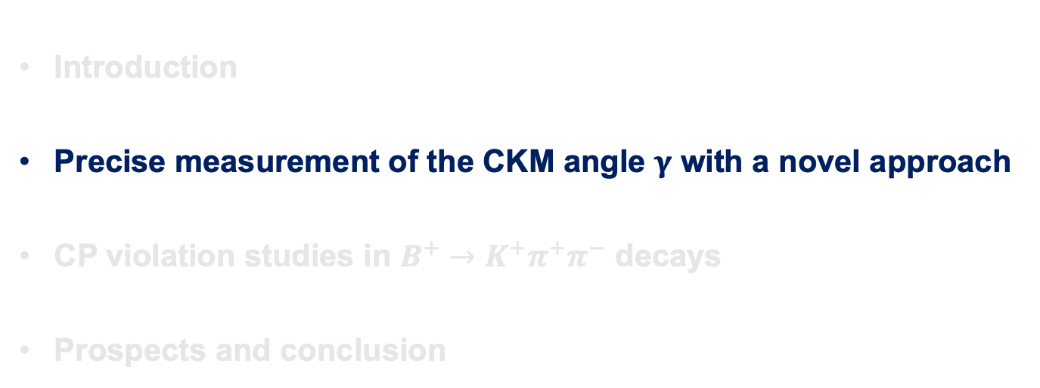
Outline of the talk
Introduction
Precise measurement of the CKM angle $γ$ with a novel approach
CP violation studies in $B^{+}→K^{+}π^{+}π^{−}$ decays
Prospects and conclusion
Disclaimer: results are selected based on personal taste
2026/04/25
UCAS, Wenbin Qian

Slide 8
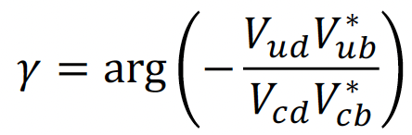




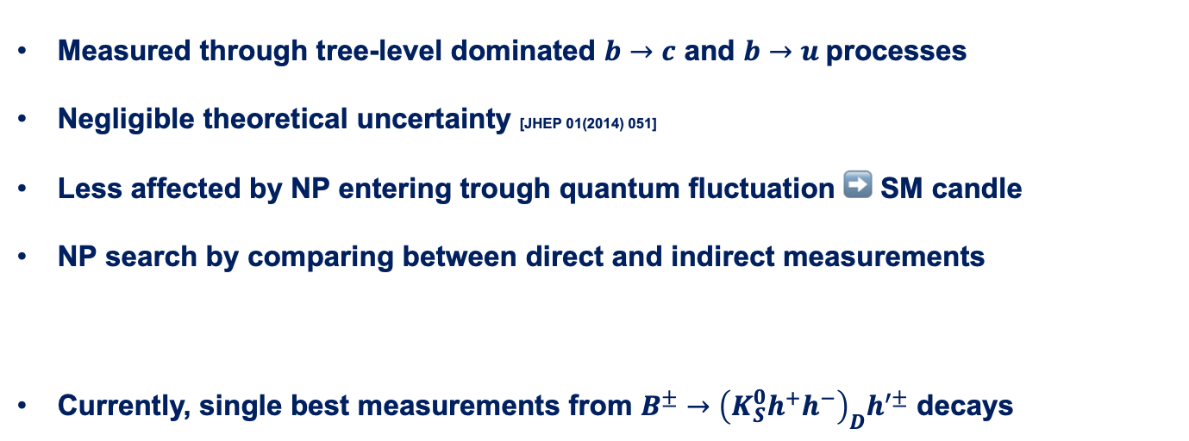
CKM angle $γ$
Measured through tree-level dominated $b→c$ and $b→u$processes
Negligible theoretical uncertainty [JHEP 01(2014) 051]
Less affected by NP entering trough quantum fluctuation ➡️ SM candle
NP search by comparing between direct and indirect measurements
Currently, single best measurements from $B^{±}→{\left(K_{S}^{0}h^{+}h^{−}\right)}_{D}h^{′±}$ decays
$$γ_{ind.}={\left({66.16}_{−3.20}^{+0.78}\right)}^{∘}$$
[CKMfitter 2025]
$$γ_{dir.}={\left(62.8±2.6\right)}^{∘}$$
[LHCb-CONF-2025-003]
$$γ_{GGSZ}={\left({68.7}_{−5.1}^{+5.2}\right)}^{∘}$$
[LHCb-PAPER-2020-019]
Statistical uncertainty dominated
Sensitivity loss due to binned approach
A novel approach developed using unbinned MI method
2026/04/25
UCAS Wenbin Qian
8

Slide 9
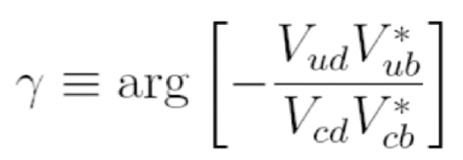
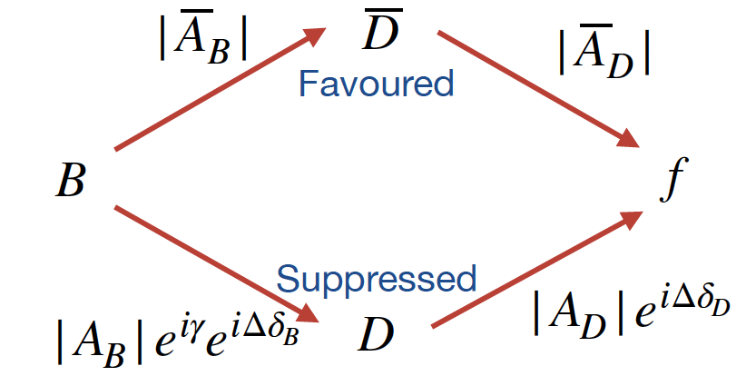



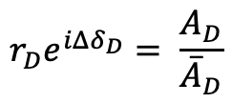







Joint measurement between LHCb and BESIII
$b→c:$
$$\overline{A}\left(D\right):{\overline{D}}^{0}→f$$
$$r_{D}e^{iΔδ_{D}}= \frac{A_{D}}{{\overline{A}}_{D}}$$
$$A\left(D\right):D^{0}→f$$
$$D^{0}(\vec{p})$$
$b→u:$
$γ$ measurements
$$ψ\left(3770\right)$$
First joint analyses between LHCb and BESIII collaborations
QC data
$$\overline{D^{0}}(−\vec{p})$$
2026/04/25
UCAS Wenbin Qian
9

Slide 10
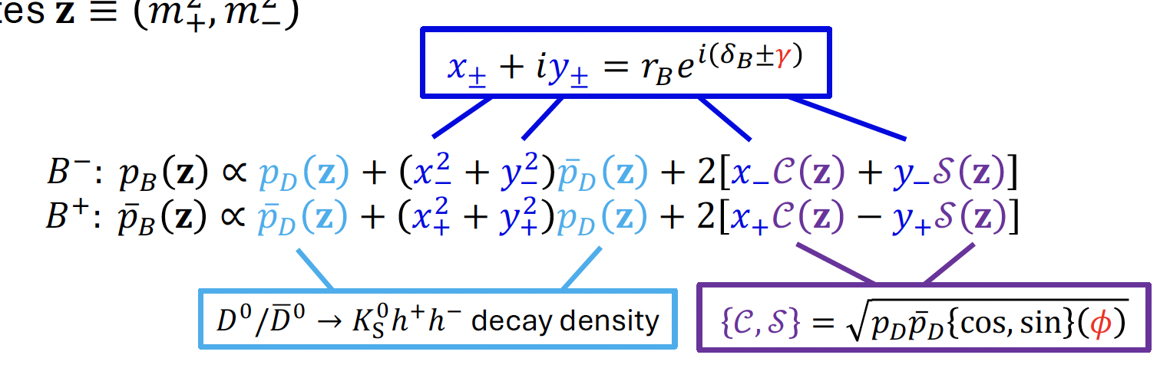
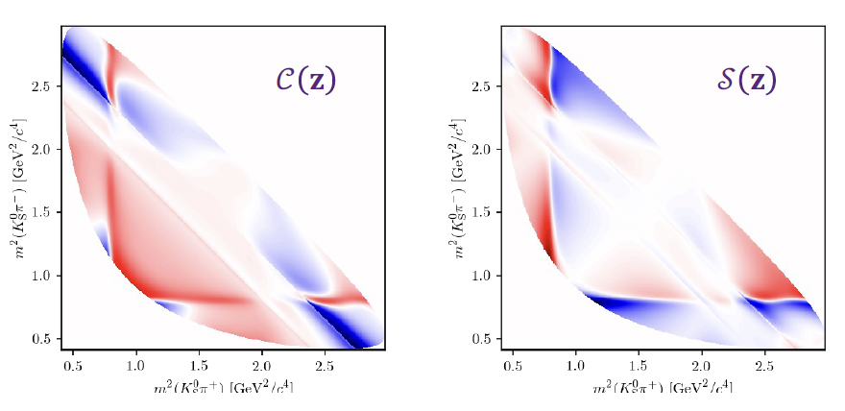
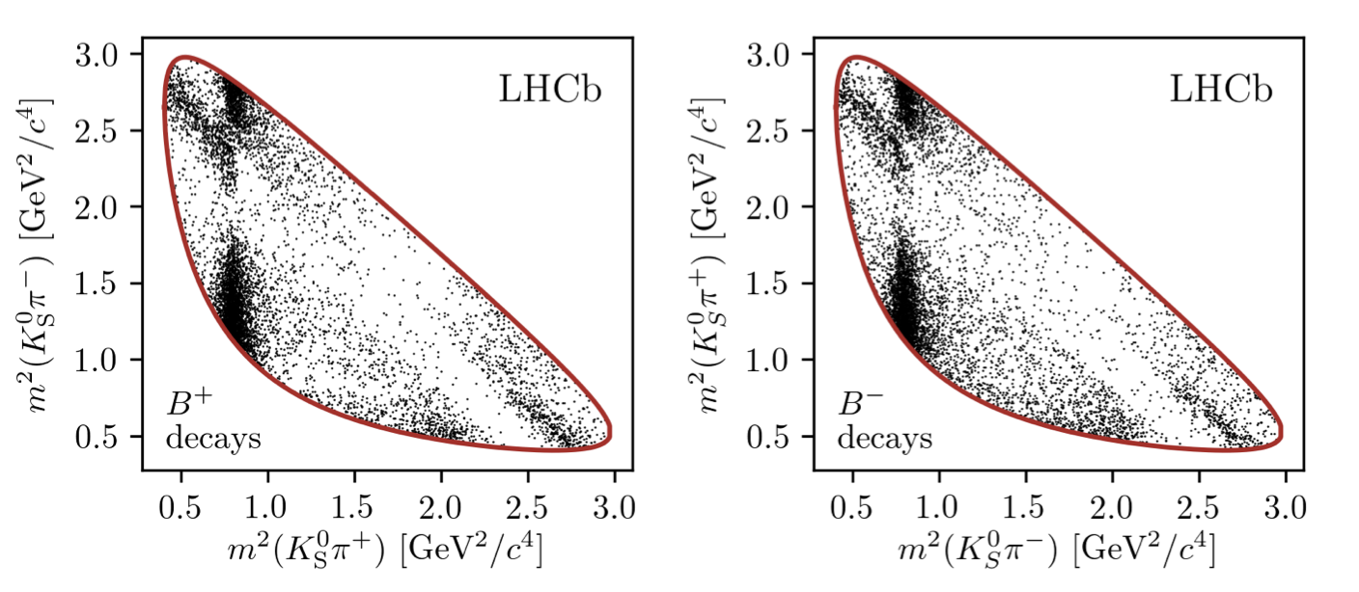
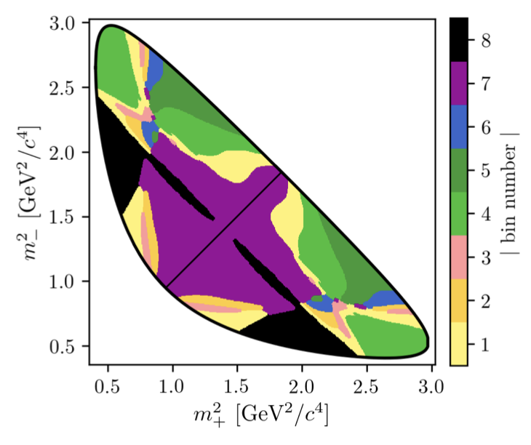
Logic of the new method (1)
Novel approach: fourier transformation
[EPJC78 (2018) 2, 121]
Density difference indicates CP violation
Traditional method: binning
~10% loss of sensitivity
2026/04/25
UCAS Wenbin Qian
10

Slide 11
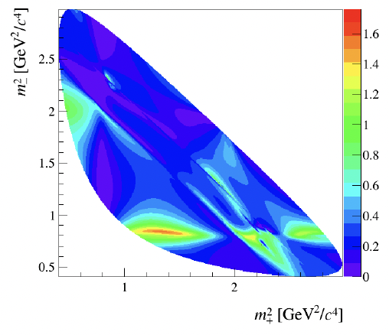
Logic of the new method (2)
Novel approach: fourier transformation
[EPJC78 (2018) 2, 121]
Density difference indicates CP violation
Only considering phase information
A further weight added to take into account amplitude, purity, efficiency information
2026/04/25
UCAS Wenbin Qian
11

Slide 12
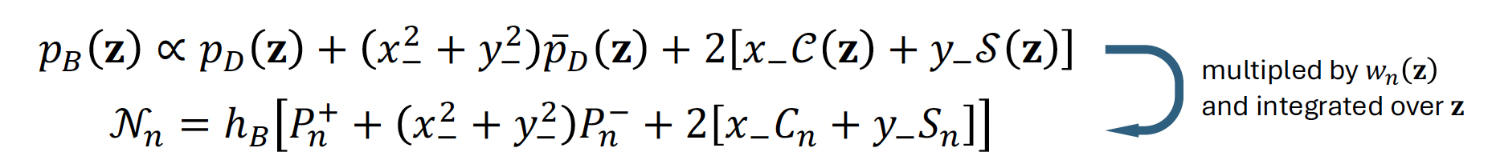
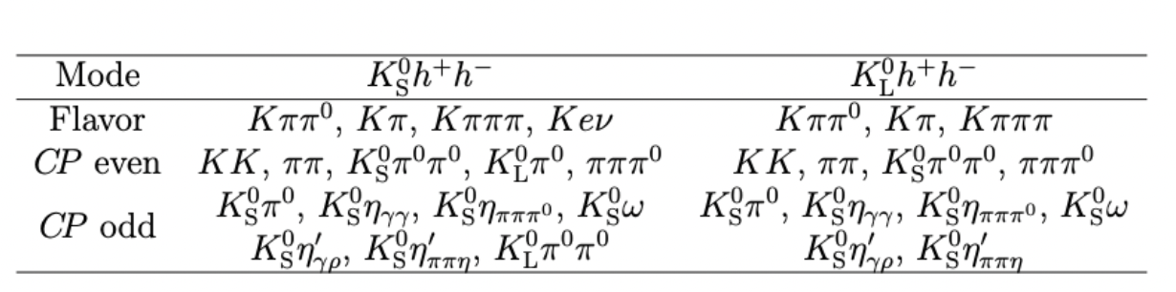
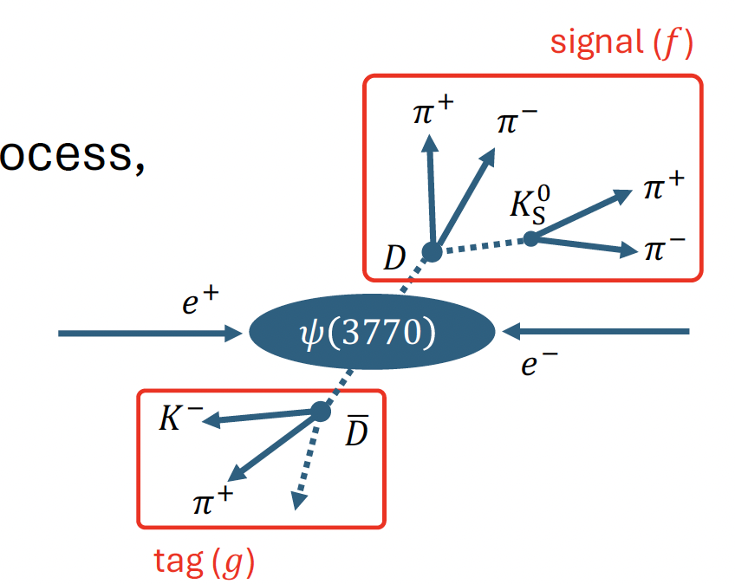
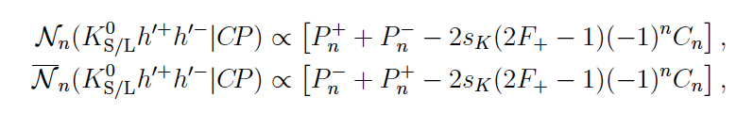
Weights and BESIII inputs
Why weights works? Equation holds when multiplying both sides by the same constant
BESIII QC data: $ψ\left(3770\right)→D\overline{D}$
Example: CP tagged $K_{S}^{0}h^{+}h^{−}$
2026/04/25
UCAS Wenbin Qian
12

Slide 13
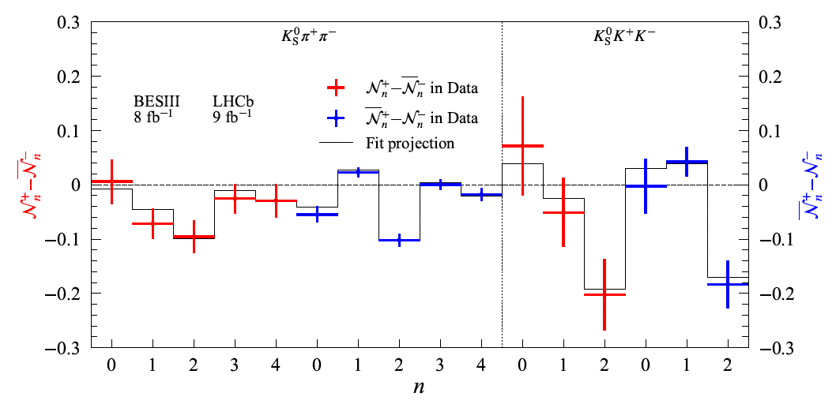
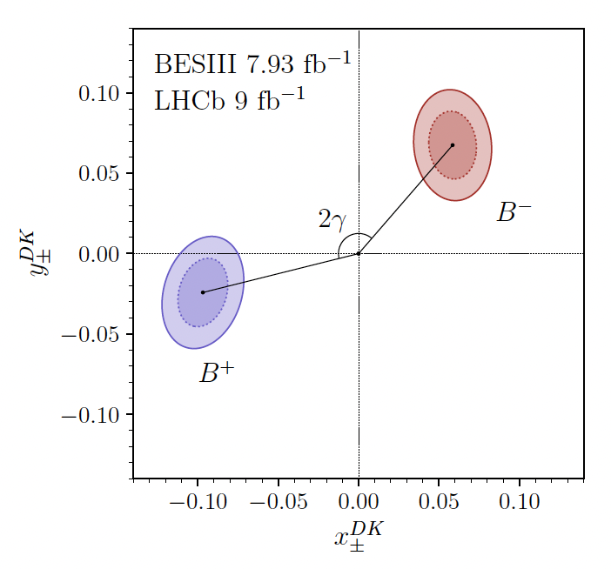
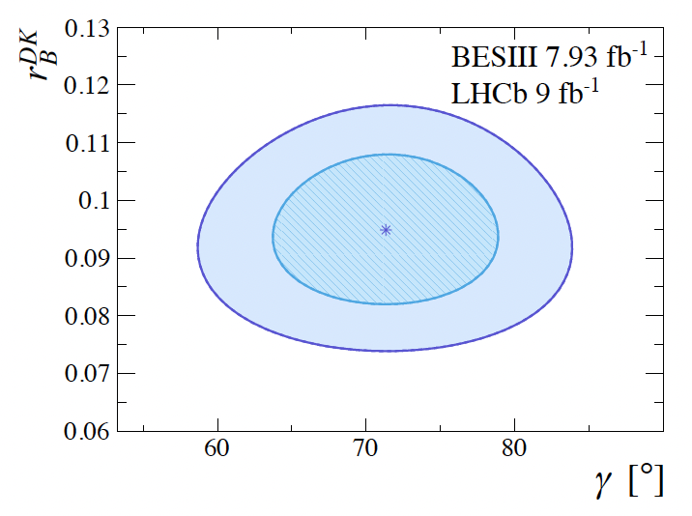
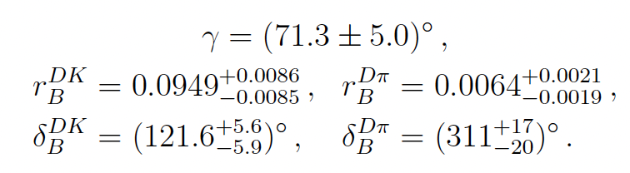
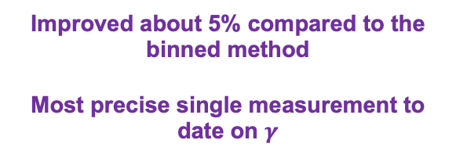
CP observables and results
Observables from B decays, indicating CP violation effects
Results on $γ$ and strong parameters
Improved about 5% compared to the binned method
Most precise single measurement to date on $γ$
Opens new possibilities for $γ$ measurements in other multibody decays
2026/04/25
UCAS Wenbin Qian
13

Slide 14
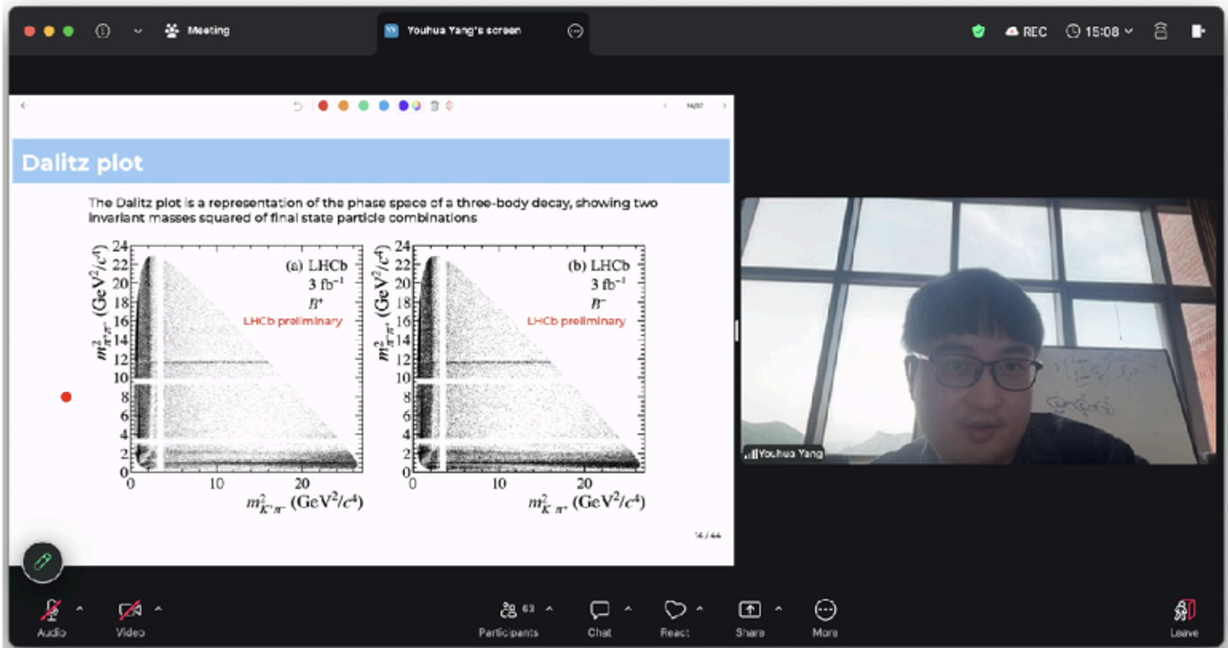
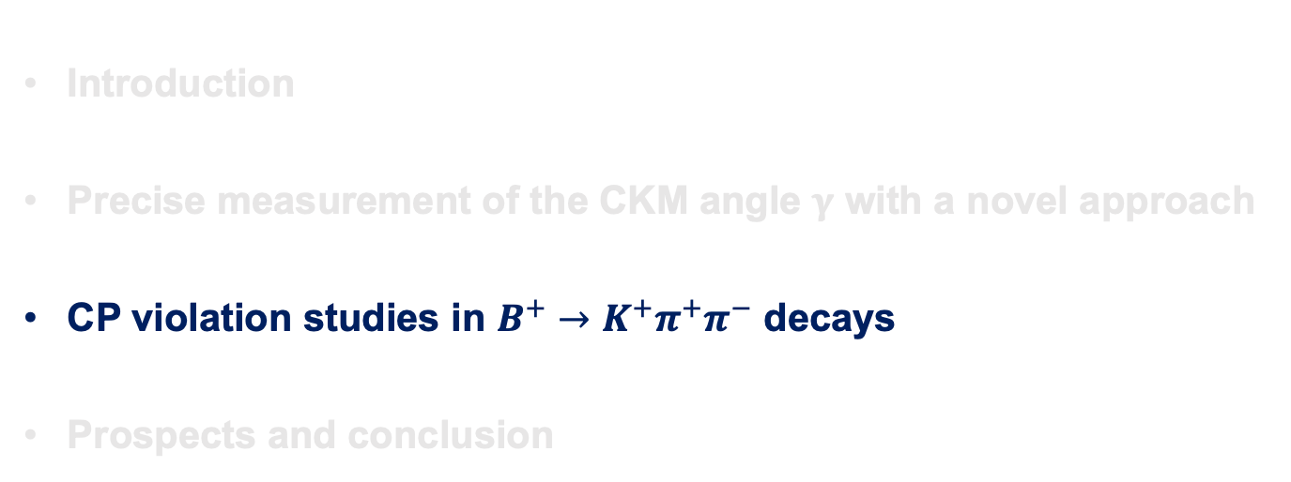
Outline of the talk
Introduction
Precise measurement of the CKM angle $γ$ with a novel approach
CP violation studies in $B^{+}→K^{+}π^{+}π^{−}$ decays
Prospects and conclusion
CERN LHC seminar by Youhua Yang
2026/04/25
UCAS, Wenbin Qian

Slide 15
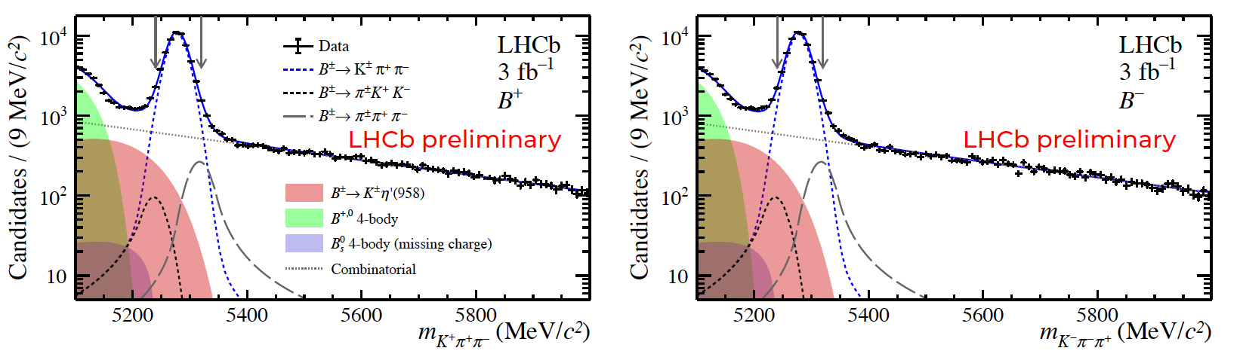

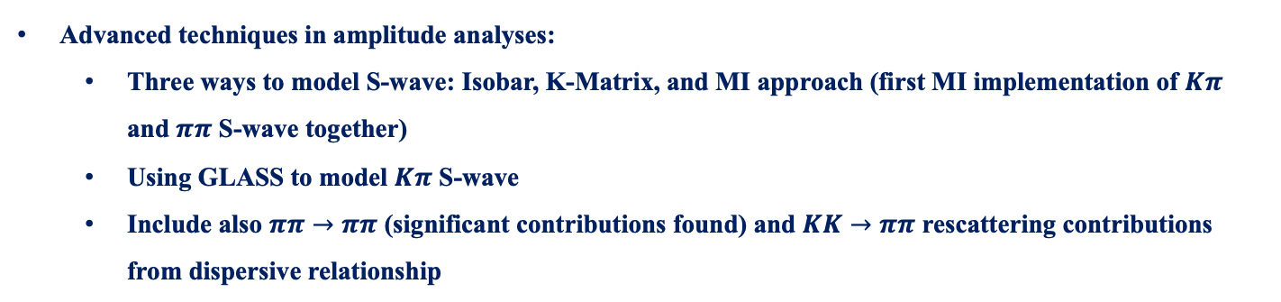
CP violation in $B^{+}→K^{+}π^{−}π^{−}$ decays
Around 40 $×$ data than B-factories using only Run 1 data
Advanced techniques in amplitude analyses:
Three ways to model S-wave: Isobar, K-Matrix, and MI approach (first MI implementation of $Kπ$ and $ππ$ S-wave together)
Using GLASS to model $Kπ$ S-wave
Include also $ππ→ππ$ (significant contributions found) and $KK→ππ$ rescattering contributions from dispersive relationship
2026/04/25
UCAS, Wenbin Qian
15

Slide 16
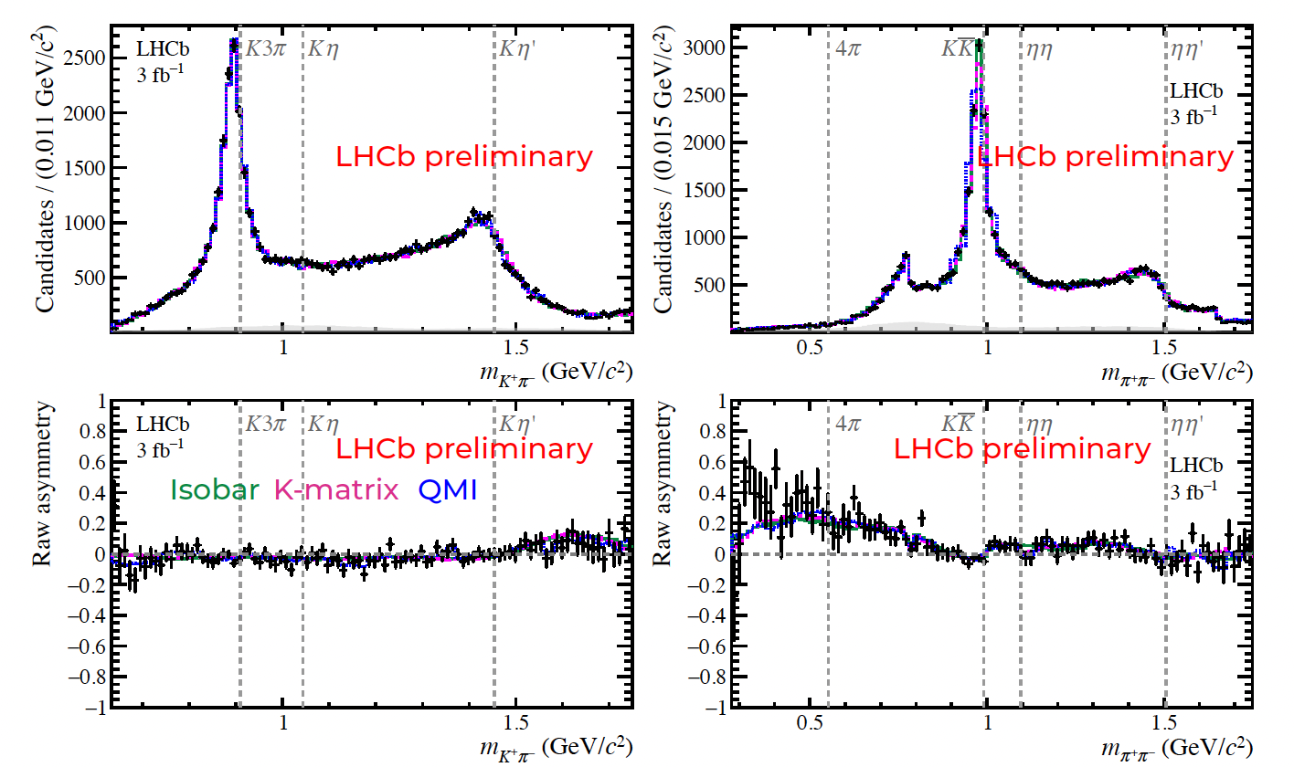


A glance of results (1)
$$Kπ$$
$$ππ$$
Projections
Asymmetry
2026/04/25
UCAS, Wenbin Qian
16

Slide 17
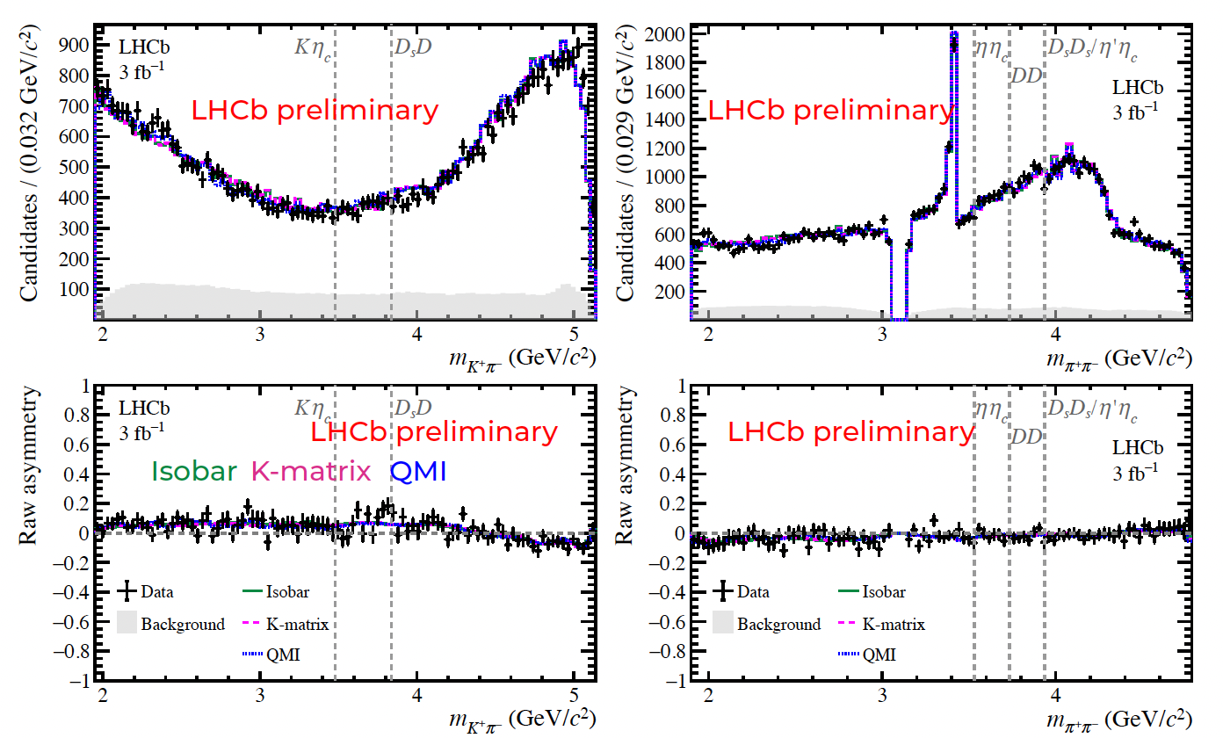
A glance of results (2)
$$Kπ$$
$$ππ$$
Projections
Asymmetry
2026/04/25
UCAS, Wenbin Qian
17

Slide 18
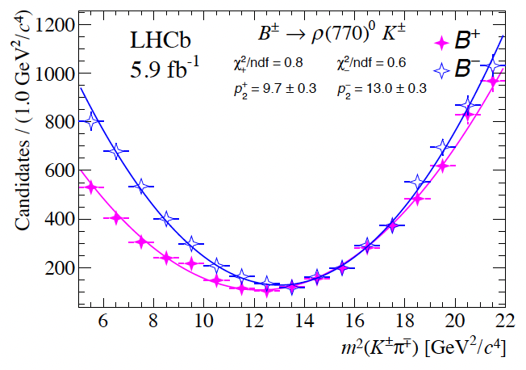
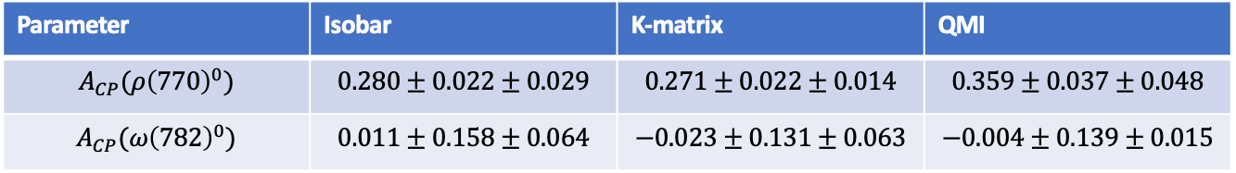
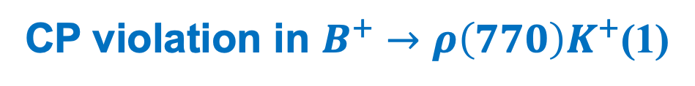

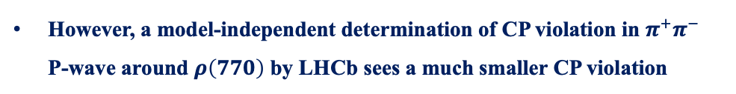


CP violation in $B^{+}→ρ\left(770\right)K^{+}$(1)
Measured by BaBar [PRD78 (2008) 012004] and Belle [PRL96 (2006) 251803] using amplitude analysis
$0.44±{0.10}_{−0.14}^{+0.06}$ (BaBar)
$0.30±{0.11}_{−0.04}^{+0.11}$ (Belle)
However, a model-independent determination of CP violation in $π^{+}π^{−}$ P-wave around $ρ\left(770\right)$ by LHCb sees a much smaller CP violation
$$0.150±0.022$$
Our results from amplitude analysis:
Parameter | Isobar | K-matrix | QMI
$$A_{CP}(ρ{\left(770\right)}^{0})$$ | $$0.280±0.022±0.029$$ | $$0.271±0.022±0.014$$ | $$0.359±0.037±0.048$$
$$A_{CP}(ω{\left(782\right)}^{0})$$ | $$0.011±0.158±0.064$$ | $$−0.023±0.131±0.063$$ | $$−0.004±0.139±0.015$$
Consistent with BaBar and Belle, higher than model-independent which contains dilution from $ω\left(782\right)$ with CP violation consistent with zero
2026/04/25
UCAS, Wenbin Qian
18

Slide 19
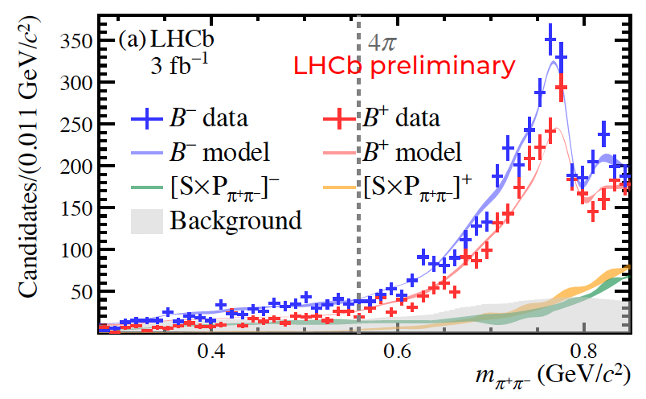
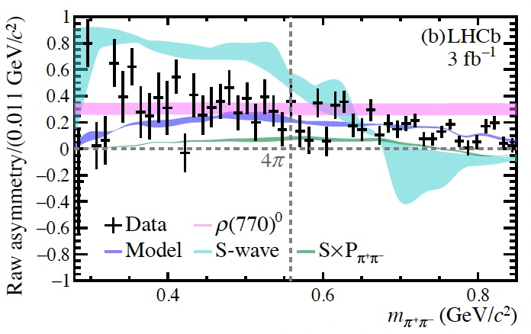
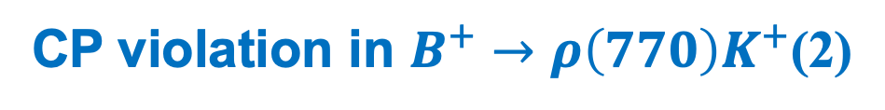
CP violation in $B^{+}→ρ\left(770\right)K^{+}$(2)
CP violation in $ρ\left(770\right)$ region clearly visible
Predictions from theory:
QCDF | pQCD | SCET | FS
31.7% [NPB675 (2003) 333] 45.4%[PRD80 (2009) 114008] | 71% [PRD74 (2006) 094020] | 16%[PRD78 (2008) 034011] | 30.6%[PRD91 (2015) 014011]
2026/04/25
UCAS, Wenbin Qian
19

Slide 20
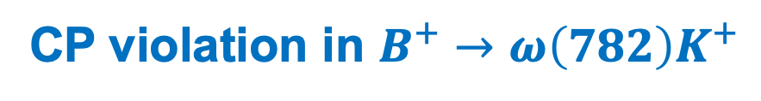
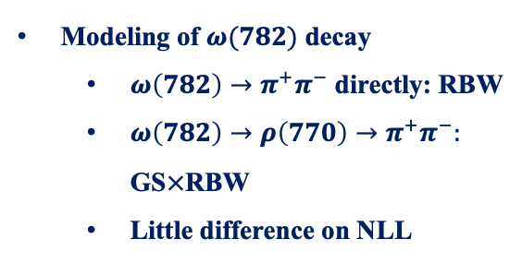
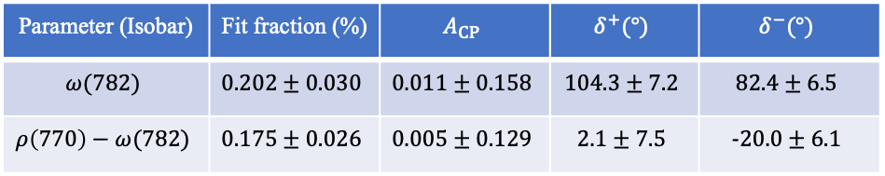
CP violation in $B^{+}→ω\left(782\right)K^{+}$
Quite some predictions gave very large CP violation
QCDF | pQCD | SCET | FS
19.3% [NPB675 (2003) 333] 22.1%[PRD80 (2009) 114008] | 32% [PRD74 (2006) 094020] | 12.3%[PRD78 (2008) 034011] | 1.0%[PRD91 (2015) 014011]
Our measured results, consistent with zero, but with large uncertainties
Parameter | Isobar | K-matrix | QMI
$$A_{CP}(ω{\left(782\right)}^{0})$$ | $$0.011±0.158±0.064$$ | $$−0.023±0.131±0.063$$ | $$−0.004±0.139±0.015$$
Modeling of $ω(782)$ decay
$ω\left(782\right)→π^{+}π^{−}$ directly: RBW
$ω\left(782\right)→ρ\left(770\right)→π^{+}π^{−}:$ GS$×$RBW
Little difference on NLL
Parameter (Isobar) | Fit fraction (%) | $$A_{CP}$$ | $$δ^{+}(°)$$ | $$δ^{−}(°)$$
$$ω(782)$$ | $$0.202±0.030$$ | $$0.011±0.158$$ | $$104.3±7.2$$ | $$82.4±6.5$$
$$ρ\left(770\right)−ω(782)$$ | $$0.175±0.026$$ | $$0.005±0.129$$ | $$2.1±7.5$$ | $$-20.0±6.1$$
2026/04/25
UCAS, Wenbin Qian
20

Slide 21
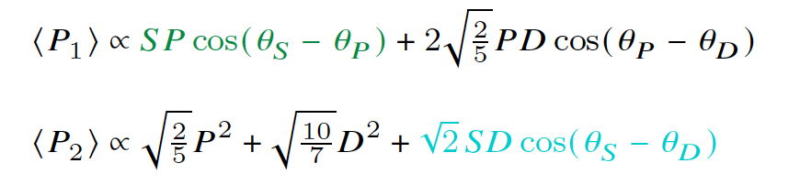
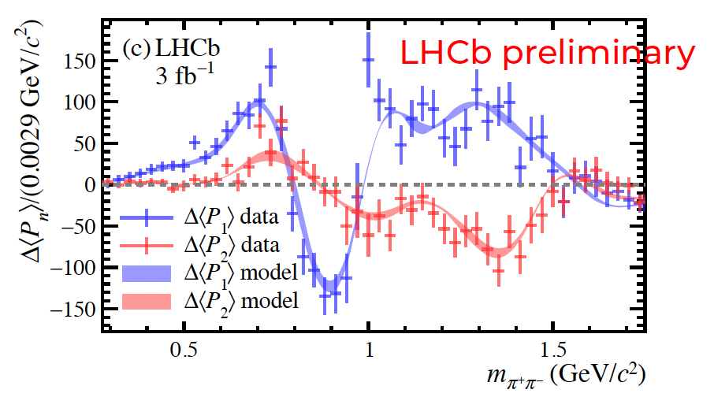



CP violation through interference between different waves
Legendre polynomial weighted CP violation
CP violation in interference between S-P waves (discovery) and S-D waves (evidence)
Almost flat vs $m(π^{+}π^{−})$
S-P waves
$$\cos{(θ_{S}−θ_{P})}$$
Phase shift of $π$ around $ρ(770)$ pole
P wave + D wave + possible S-D wave interference
2026/04/25
UCAS, Wenbin Qian
21

Slide 22
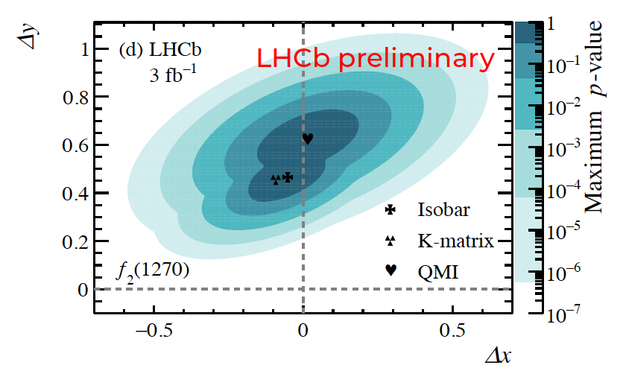

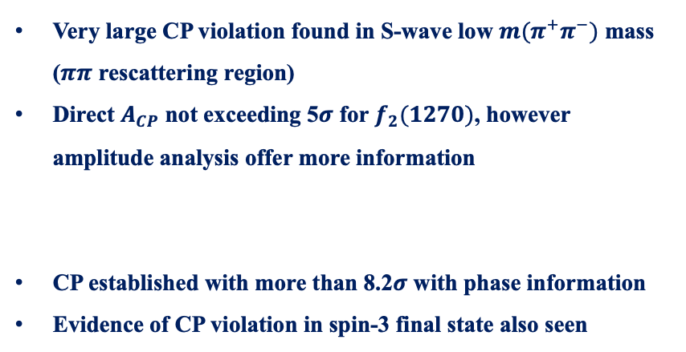


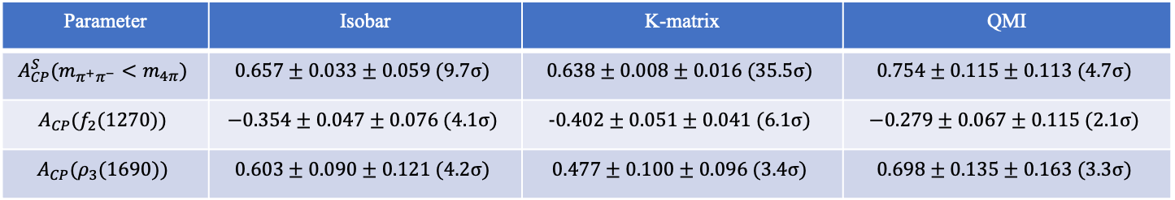
More CP violation results
Parameter | Isobar | K-matrix | QMI
$$A_{CP}^{S}(m_{π^{+}π^{−}}<m_{4π})$$ | $$0.657±0.033±0.059 (9.7σ)$$ | $$0.638±0.008±0.016 (35.5σ)$$ | $$0.754±0.115±0.113 (4.7σ)$$
$$A_{CP}(f_{2}(1270))$$ | $$−0.354±0.047±0.076 (4.1σ)$$ | $$-0.402±0.051±0.041 (6.1σ)$$ | $$−0.279±0.067±0.115 (2.1σ)$$
$$A_{CP}(ρ_{3}(1690))$$ | $$0.603±0.090±0.121 (4.2σ)$$ | $$0.477±0.100±0.096 (3.4σ)$$ | $$0.698±0.135±0.163 (3.3σ)$$
Very large CP violation found in S-wave low $m(π^{+}π^{−})$ mass ($ππ$ rescattering region)
Direct $A_{CP}$ not exceeding 5$σ$ for $f_{2}(1270)$, however amplitude analysis offer more information
CP established with more than 8.2$σ$ with phase information
Evidence of CP violation in spin-3 final state also seen
$$A=∑c_{i}F_{i}, \overline{A}=∑\overline{c_{i}}F_{i}$$
$$c_{i}=\left(x_{i}+Δx_{i}\right)+i(y_{i}+Δy_{i})$$
$$\overline{c_{i}}=\left(x_{i}−Δx_{i}\right)+i(y_{i}−Δy_{i})$$
2026/04/25
UCAS, Wenbin Qian
22

Slide 23
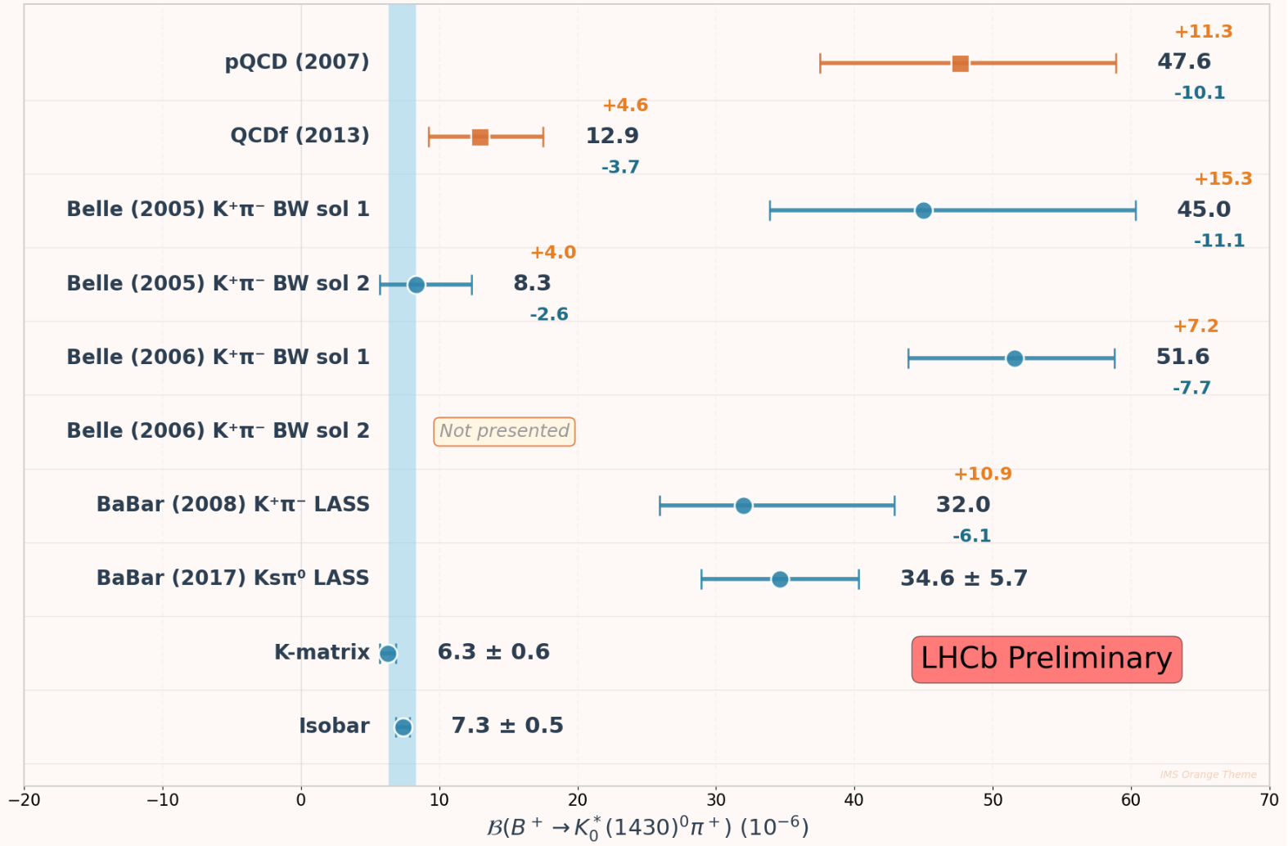



Branching fraction of $B^{+}→K_{0}^{∗}\left(1430\right)π^{+}$
Different predictions from pQCD[EPJC50 (2007) 877] and QCDf[PRD87 (2013) 114001]
Two solutions from Belle measurements, one agree with pQCD, other with QCDf; the one with larger branching fraction presented in later Belle paper
BaBar also favors larger branching fraction (pQCD)
Predictions with QCDf agree better with $B→K_{0}^{∗}\left(1430\right)[η^{\left(′\right)},ρ,ω,φ]$
Our results favors QCDf!
Two improvements:
Larger datasets: same model as Belle also favor QCDf
Model improvements: GLASS instead of LASS
LASS: $a_{ER}=1, φ_{nonres}=0$
$$φ_{ER}=0$$
2026/04/25
UCAS, Wenbin Qian
23

Slide 24



Extra benefit: $f_{X}(1300)$
With LASS parameterization, BaBar and Belle also need a scalar $f_{X}(1300)$
In Belle study[PRD71 (2005) 092003]，different spin-parity tried, $1^{−}$gives best NLL while $0^{+}$ consistent with $f_{0}(1370)$
$$J^{P}$$ | Mass (MeV) | Width (MeV) | NLL
$0^{+}$(solution1, L) | $$1369±26$$ | $$185±52$$ | -4041.8
$0^{+}$(solution2, S) | $$1400±28$$ | $$165±48$$ | -4024.4
$$1^{−}$$ | $$1330±19$$ | $$210±48$$ | -4048.1
$$2^{+}$$ | $$1337±38$$ | $$85±31$$ | -4013.0
In BaBar study[PRD78 (2008) 012004]， $0^{+}$gives a mass consistent with $f_{0}(1500)$ with $m=1479±8$ MeV and $Γ=80±19$ MeV, while $1^{−}$ also fits well with mass consistent with $ρ(1450)$
Fit fraction of $f_{X}(1300)$ in Belle varies from 3.7% to 6.7%, while in BaBar, it is around 1.3%
Theoretical interpretations: known scalar $f_{0}(1370)$ or $f_{0}(1500)$; Artefact from glueball; unknown scalar etc.
2026/04/25
UCAS, Wenbin Qian
24

Slide 25




Our results on $f_{X}(1300)$
Our results when using LASS model, also need $f_{X}(1300)$ with $m=1454±2$ MeV and $Γ=120±5$ MeV
Model | $$Δ(−2NLL)$$
LASS + $f_{X}(1300)$ (free mass + width) | $$1521$$
LASS + $f_{0}\left(1370\right)+f_{0}(1500)$ (fixed mass + width) | $$1598$$
BETTER
Our results when using GLASS
No need to include $f_{X}(1300)$
$Δ(−2NLL)$ more than 1500 better
FF$\left(f_{0}\left(1370\right)\right)=\left(16.8±1.0±0.8\right)\%$
FF$\left(f_{0}\left(1500\right)\right)=\left(1.9±0.2±0.3\right)\%$
2026/04/25
UCAS, Wenbin Qian
25

Slide 26


New decays and improved branching fractions
Quite some new decays found;
Almost all the branching fractions are improved
2026/04/25
UCAS, Wenbin Qian
26

Slide 27

Outline of the talk
Introduction
Precise measurement of the CKM angle $γ$ with a novel approach
CP violation studies in $B^{+}→K^{+}π^{+}π^{−}$ decays
Prospects and conclusion
Disclaimer: results are selected based on personal taste
2026/04/25
UCAS, Wenbin Qian

Slide 28
Prospects on flavor physics programs
Belle II
0.4 ab⁻¹
1 ab⁻¹
10 ab⁻¹
50 ab⁻¹
250 ab⁻¹
2019-2022
2024-2032
Run 1
LS1
Run 2
LS2
Run 3
upgrade
2015-2018
2019-2022
2022-2026
2027-2029
2030-2033
2034-2035
2036-future
Run2
LS2
Run3
LS3
Run4
LS4
Run5-6
Phase I
Upgrade
Phase Ib
Upgrade
Phase II
Upgrade
LHCb
24+ fb⁻¹
50 fb⁻¹
300 fb⁻¹
HL-LHC
CMS/ATLAS
200 fb⁻¹
3000 fb⁻¹
BESIII/super $τ$-charm/CEPC
BEPCII upgrade + running of super $τ$-charm/CEPC
2026/04/25
UCAS, Wenbin Qian

Slide 29





Future of flavor physics
1995
2023
2040?
New physics may probably arrive soon!
2026/04/25
UCAS, Wenbin Qian

Slide 30
Thank you for your attention!
2026/04/25
国科大 钱文斌
30

Slide 31








CP violation in SM
Complex phases in CKM matrix and PMNS matrix
CKM matrix：unitary matrix connecting interaction and mass eigenstates
Interaction eigenstates
Mass eigenstates
Matrix pattern very different？ Why？
Jarlskog invariant:
Related to mass hierarchy? Relation between Yukawa and CKM?
$$d$$
$$u$$
$$s$$
$$c$$
$J_{exp}$~ 3x10⁻⁵ < $J_{max}=1/6\sqrt{3}$~0.1
$$b$$
$$t$$
2026/04/25
UCAS Wenbin Qian
31

Slide 32



A new LHCb detector
With our new LHCb detector, already collected more data than Run1+2
More importantly, full software trigger ➜ better performance on hadronic final states
New pixel Velo
New UT
New SciFi
Removed M1 and new readout
Similar PID performance
Twice trigger efficiencies (hadronic)
Removed PS/SPD and new readout
New RICH optics and PMS
2026/04/25
国科大 钱文斌
32

Slide 33
Next LHCb detector from 2030
2026/04/25
UCAS, Wenbin Qian

