Slide 1
第八届全国重味物理与量子色动力学研讨会
QCD and Electroweak corrections for collider physics
Long-Bin Chen(陈龙斌)
Guangzhou University
2026年4月26日

Slide 2
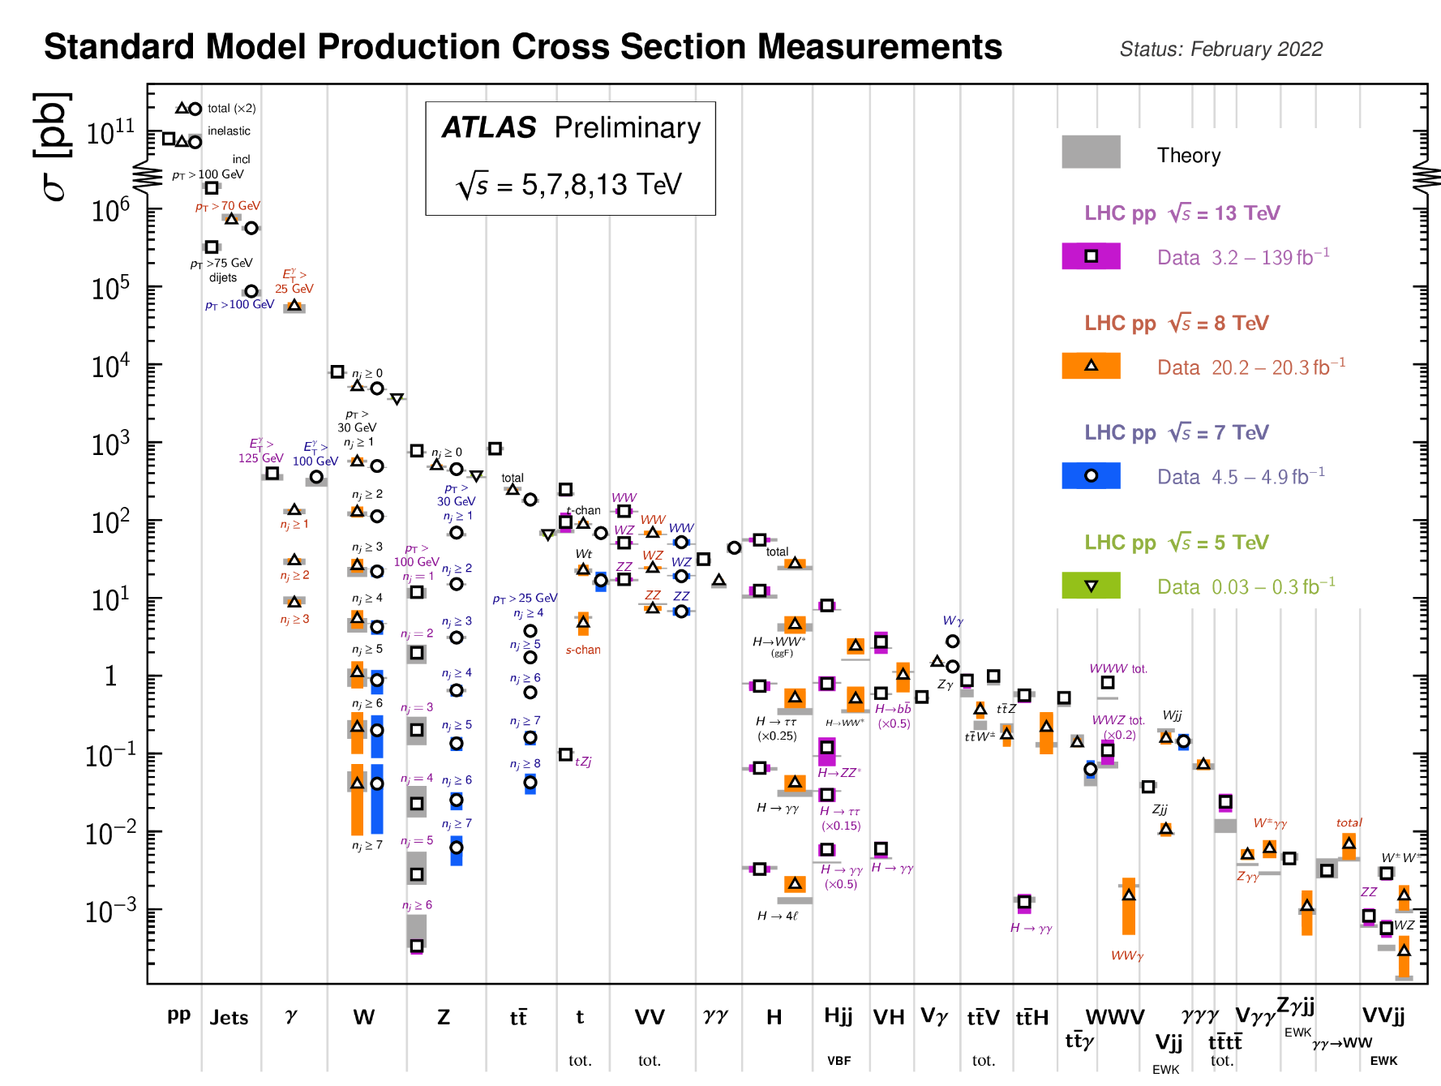
ATLAS-Measurements
Many orders of precision test for Standard Model

Slide 3
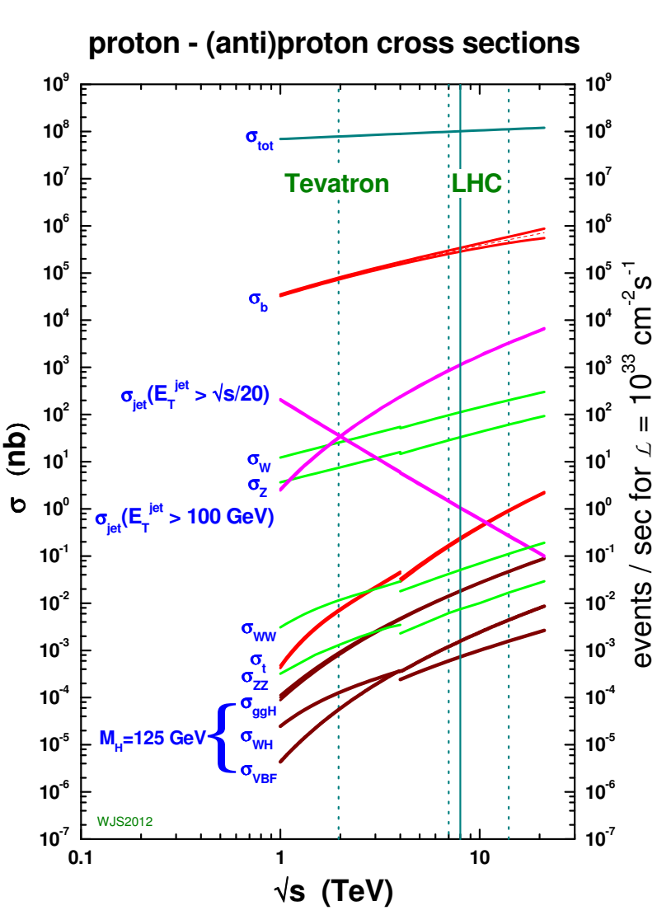
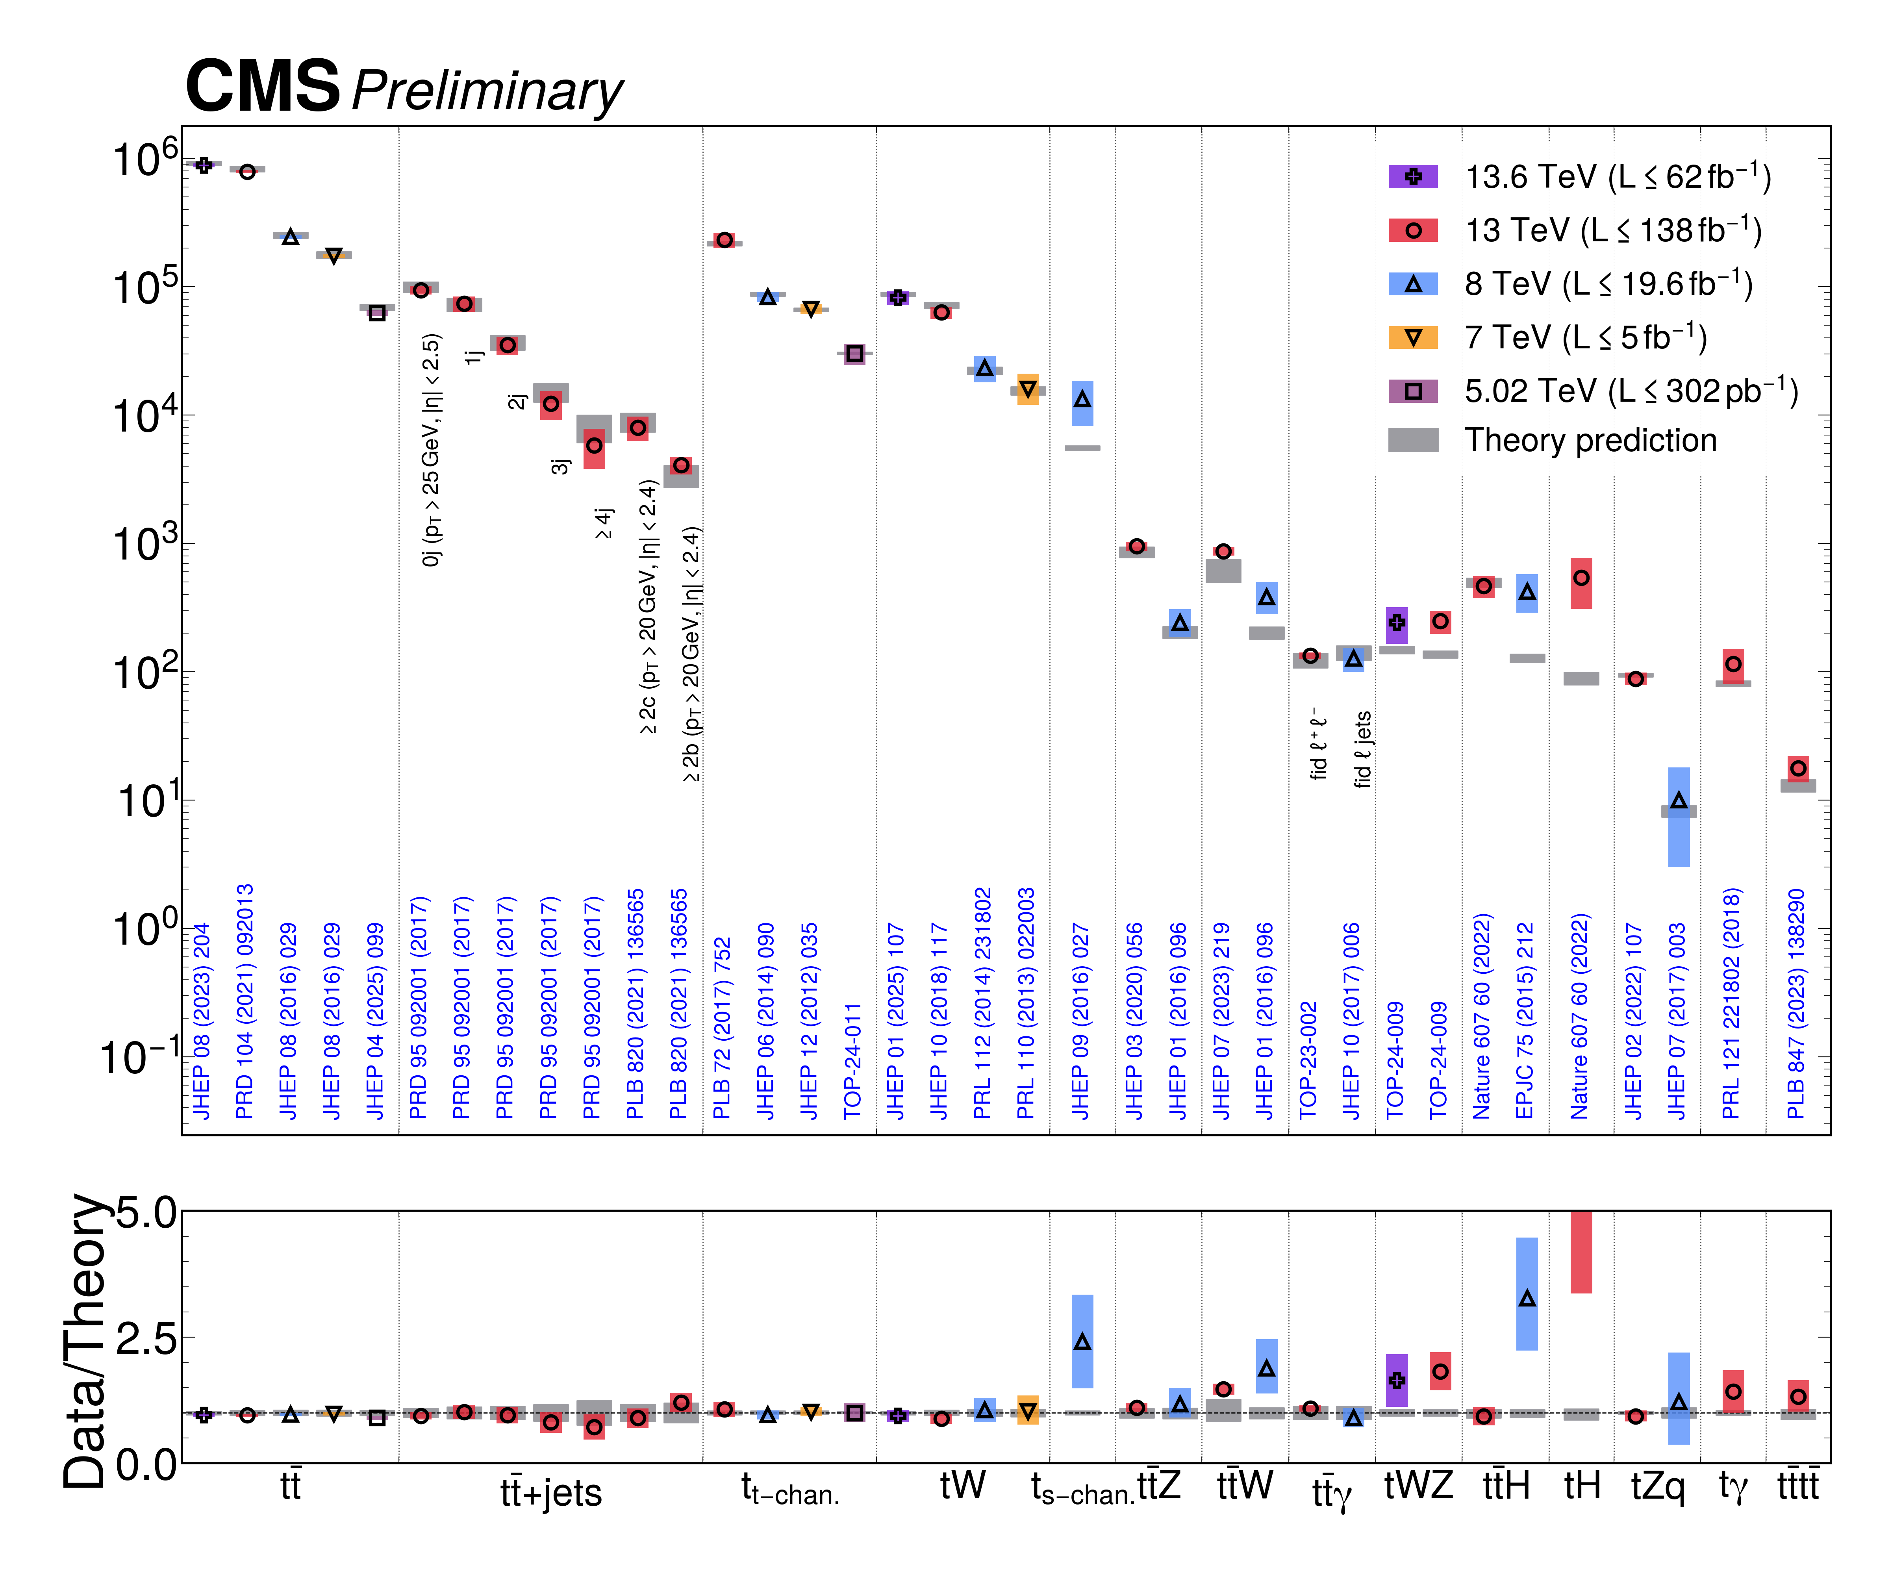
CMS-Measurements
SM have been tested at 15 orders!

Slide 4


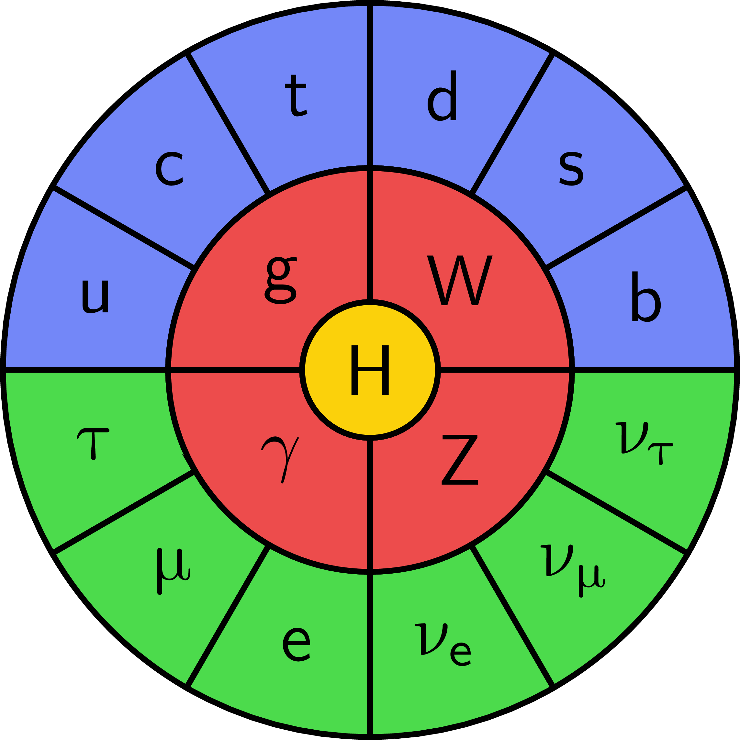
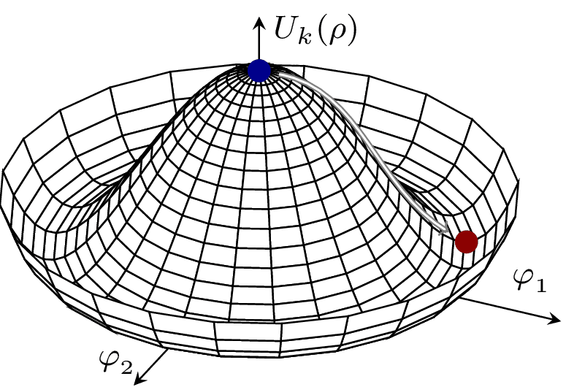
Higgs isn’t everything. It’s the only thing.
—Michael E. Peskin
毕业论文答辩
Standard Model
答辩人：小不点 答辩时间：5.5 指导老师：大不点
SU(3) × SU(2) × U(1)
The Higgs boson enables mass via electroweak symmetry breaking, underpinning the Standard Model and linking to vacuum stability via its potential.

Slide 5
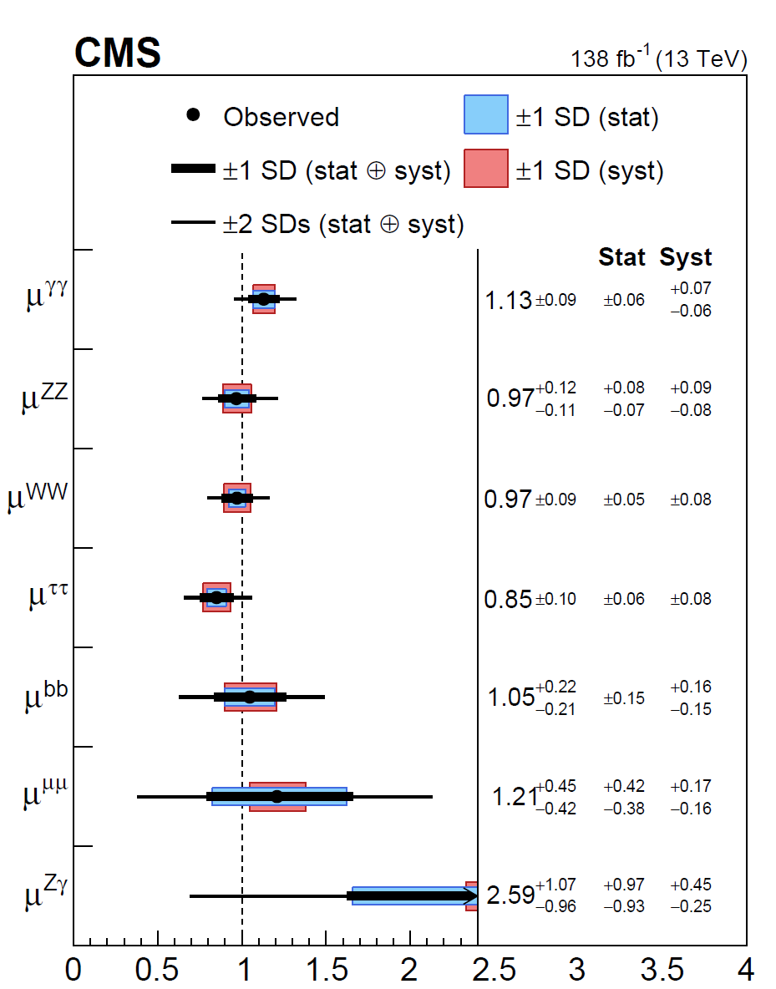
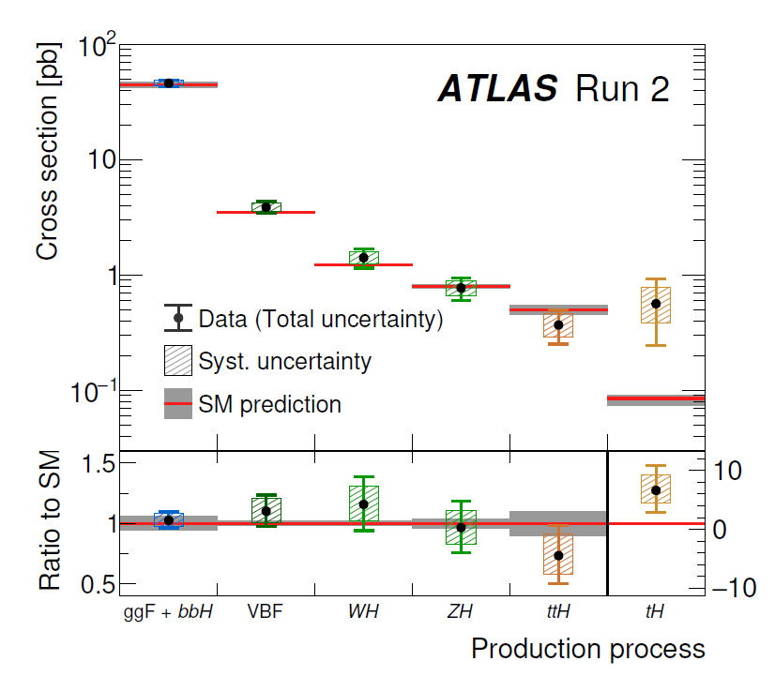

States of Higgs measurement
$$μ=\frac{σ_{exp}}{σ_{SM}}$$
ATLAS
CMS
Nature 2022

Slide 6
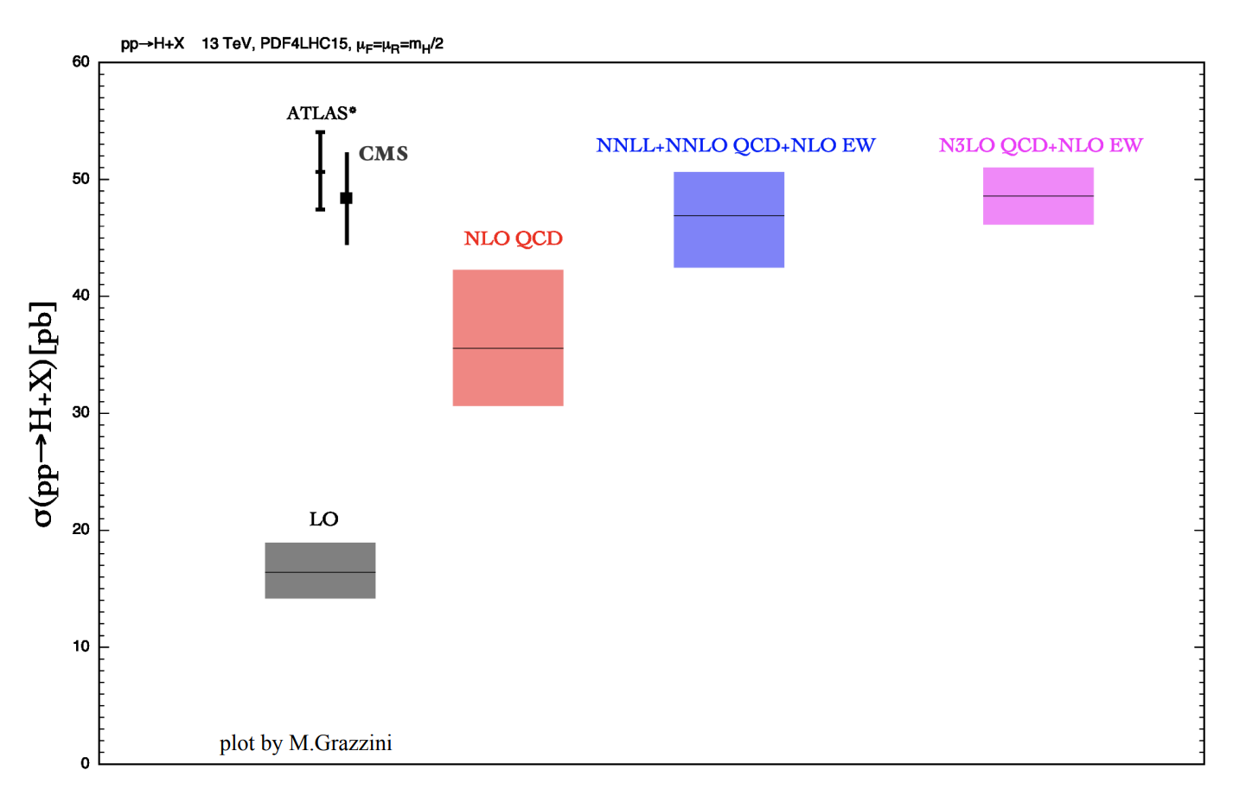
Why precision?-Higgs production
Why is precise theoretical prediction necessary?
Considering the Higgs production cross sections

Slide 7
Why precision?-Higgs production
Why is precise theoretical prediction necessary?
Considering the Higgs production cross sections

Slide 8
Why precision?-Higgs production
Quantum corrections up to the third order are required for a meaningful, accurate, and precise comparison.

Slide 9
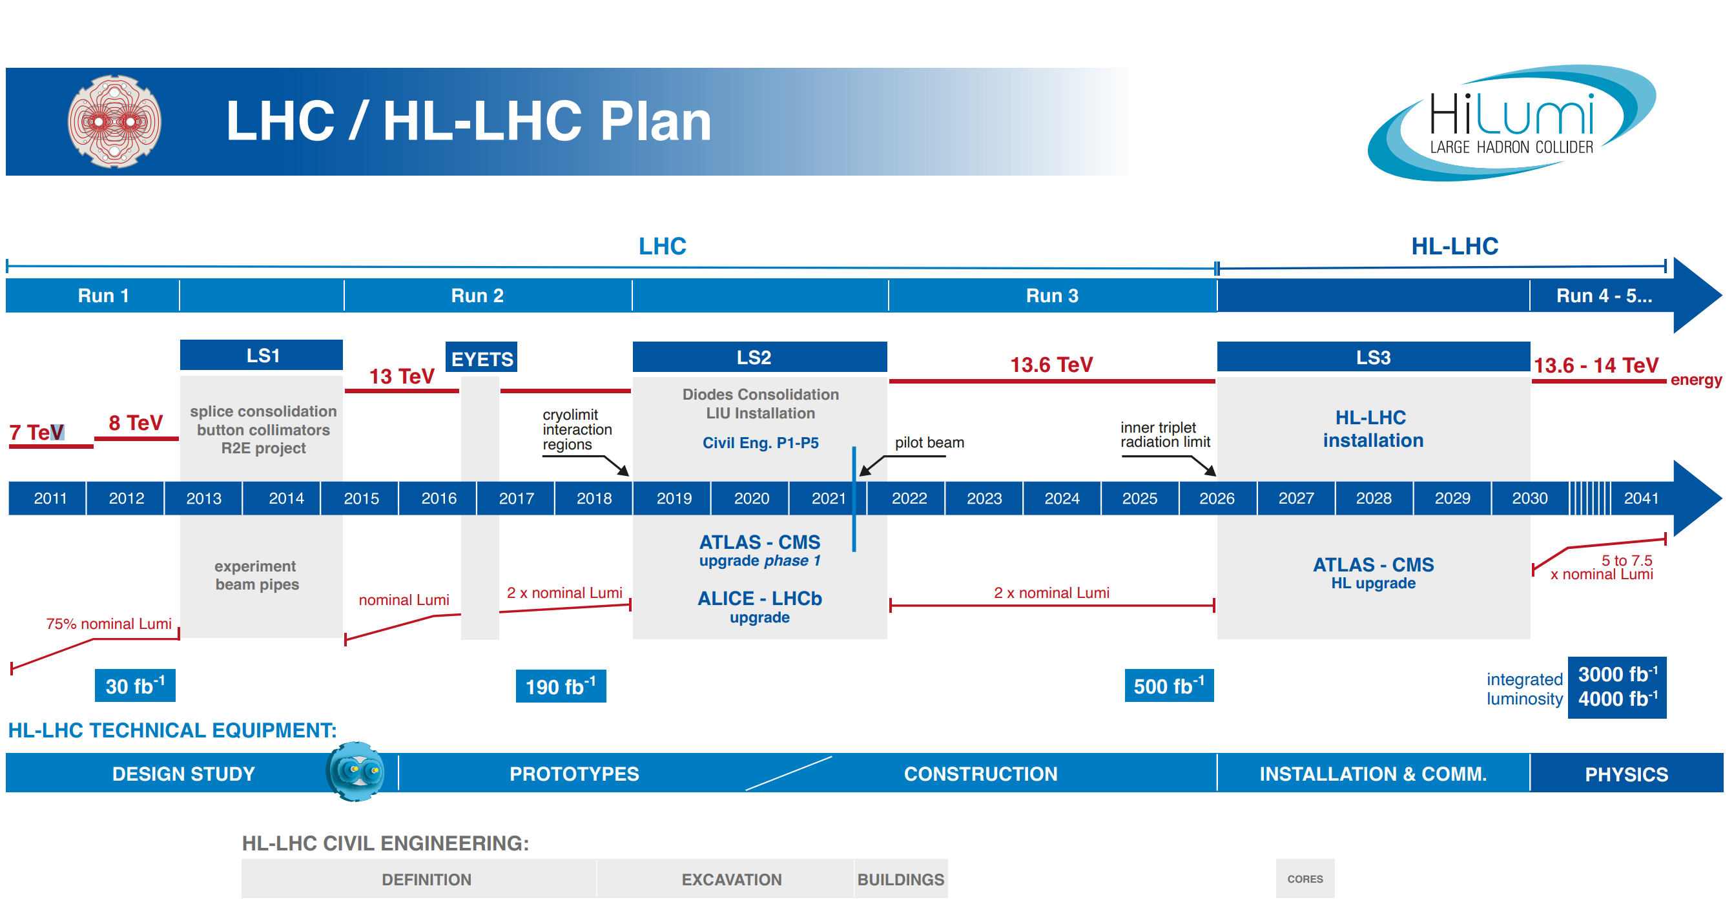
HL-HLC
The HL-LHC phase offers an excellent testing ground of SM

Slide 10
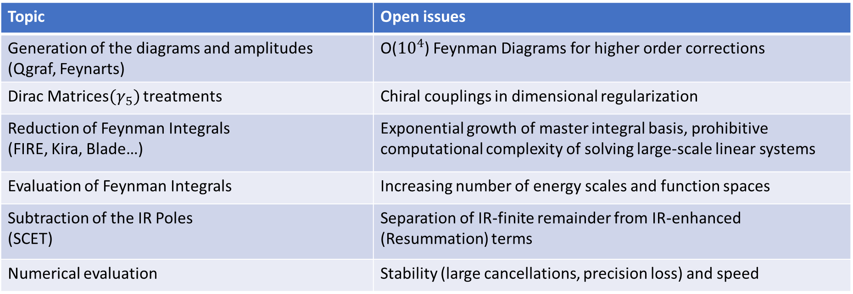
Theoretical challenges in the high order calculations
Topic | Open issues
Generation of the diagrams and amplitudes (Qgraf, Feynarts) | O(${10}^{4}$) Feynman Diagrams for higher order corrections
Dirac Matrices${(γ}_{5})$ treatments | Chiral couplings in dimensional regularization
Reduction of Feynman Integrals (FIRE, Kira, Blade…) | Exponential growth of master integral basis, prohibitive computational complexity of solving large-scale linear systems
Evaluation of Feynman Integrals | Increasing number of energy scales and function spaces
Subtraction of the IR Poles (SCET) | Separation of IR-finite remainder from IR-enhanced (Resummation) terms
Numerical evaluation | Stability (large cancellations, precision loss) and speed
……
AI agent for Perturbative Calculations?

Slide 11
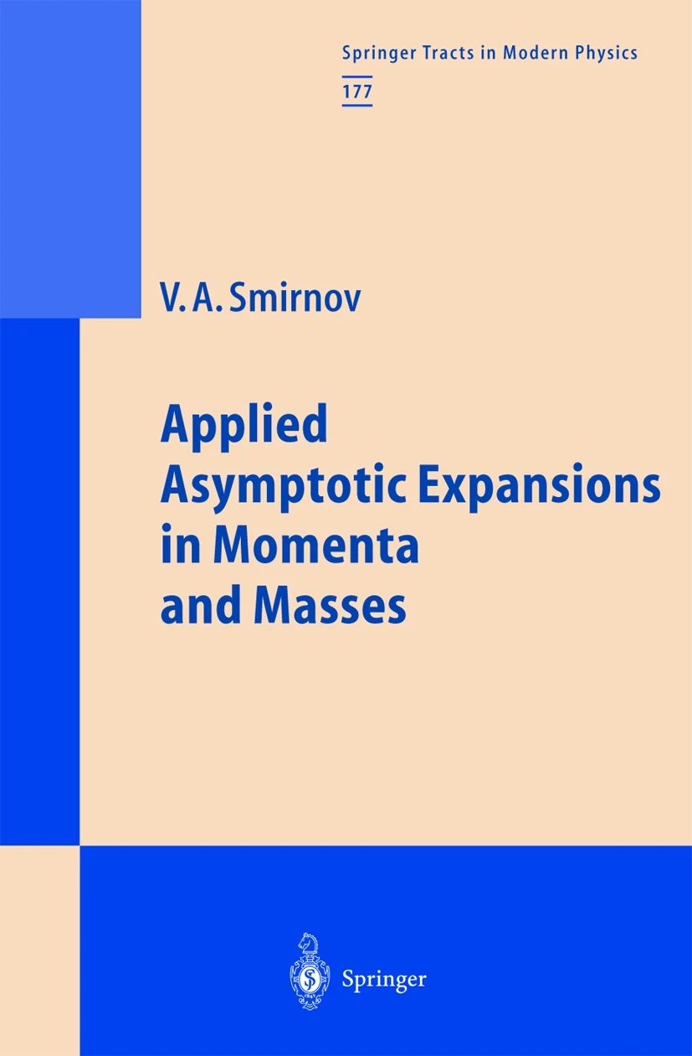

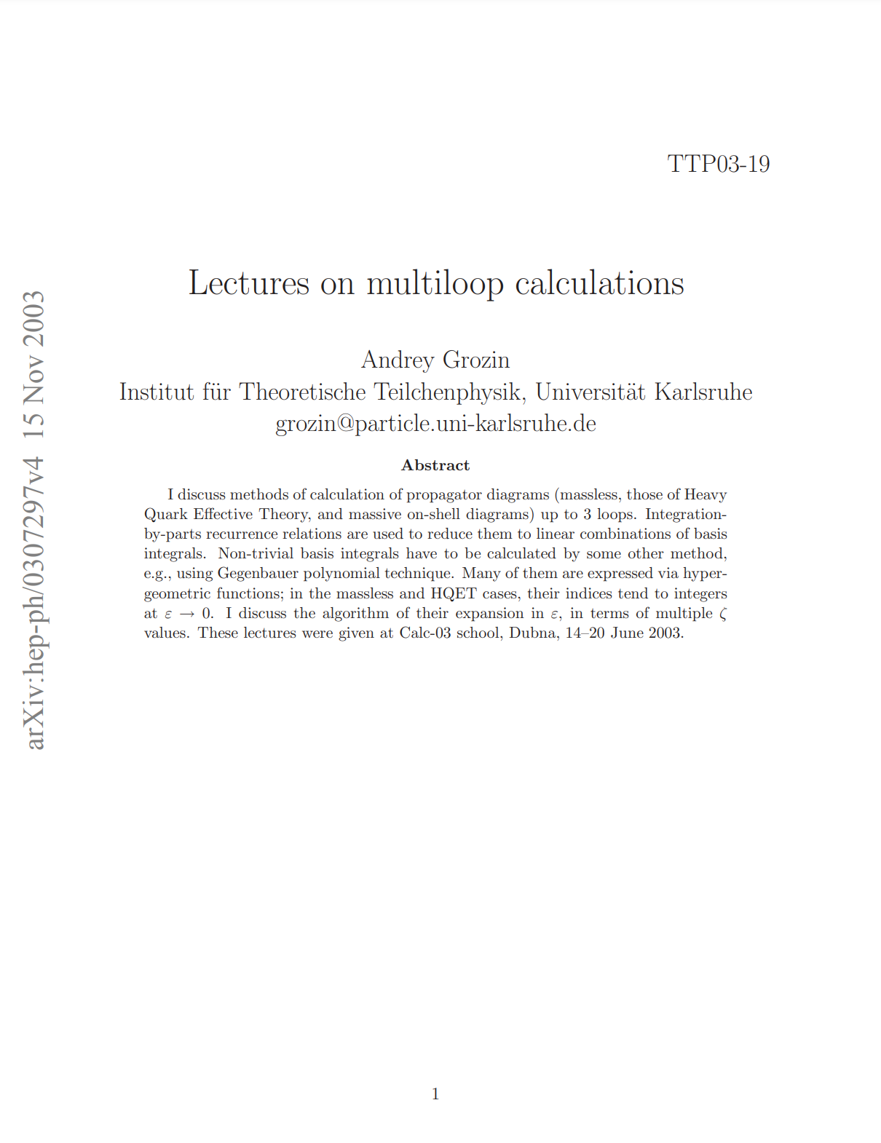
Methodology

Slide 12
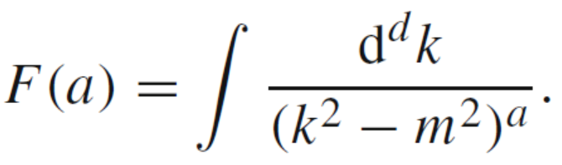
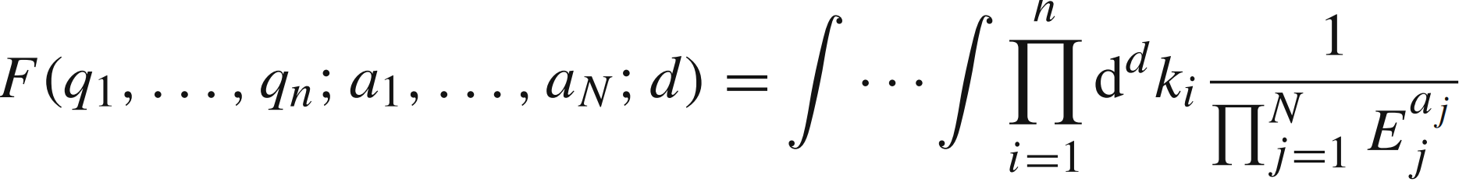
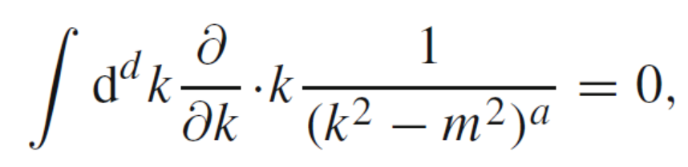
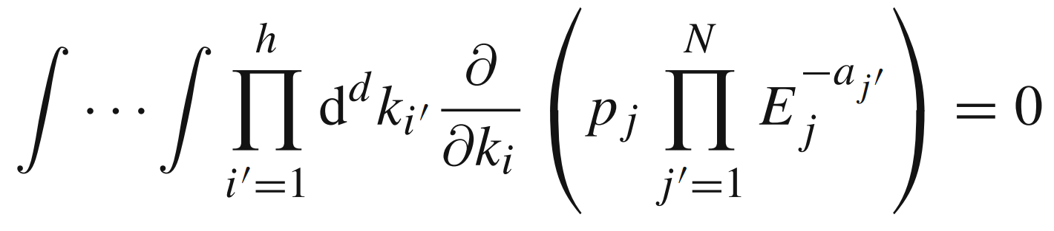
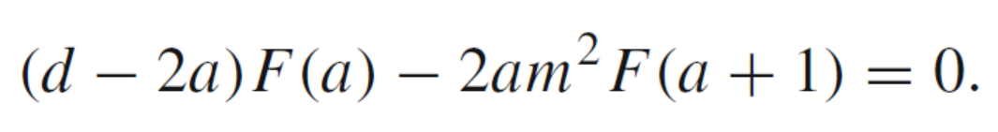
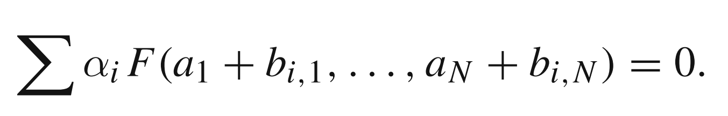
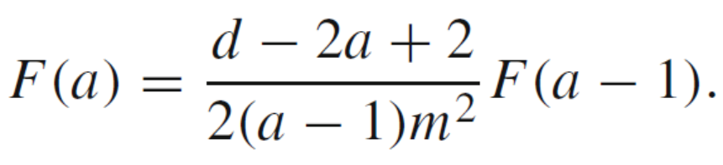
Integrals Reduction: IBP
The number of MIs is finite [Smirnov, Petukhov, 2011]
K.G. Chetyrkin, F.V. Tkachov, Nucl. Phys. B 192, 159 (1981)

Slide 13
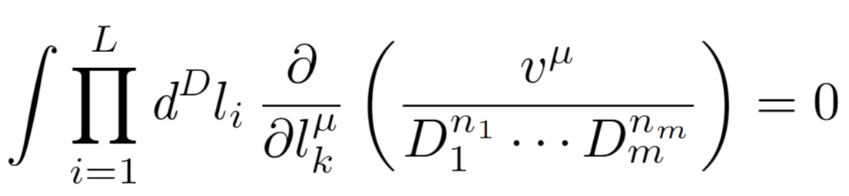
Feynman Integrals Reduction-IBP
Feynman integrals are related by IBP identities [Chetyrkin, Tkachov,1981]
Systematic solution: Laporta Alrorithm [Laporta, 2000]
Finite-fields method [Manteufell, Schabinger, Peraro, Abreu, Page, Ita, Klappert, Lange...,2015,...]
Algebraic geometry methods-syzygy [Zhang, Bohem …]
Intersection theory [Mizera, Mastrolia, Frellesvig, Ma, Yang…]
Block-triangular form [Guan, Liu, Ma,Wu, 2024]
Generating functions [Guan, Li, Ma, Hu, Feng, Zhang, Liu, Zhang, 2025] Also see Bo Feng’s talk
Redution Packages:
FIRE, Kira, Blade, Ampred, NeatIBP…
Notes:
。

Slide 14
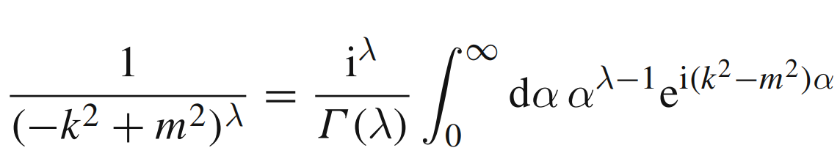
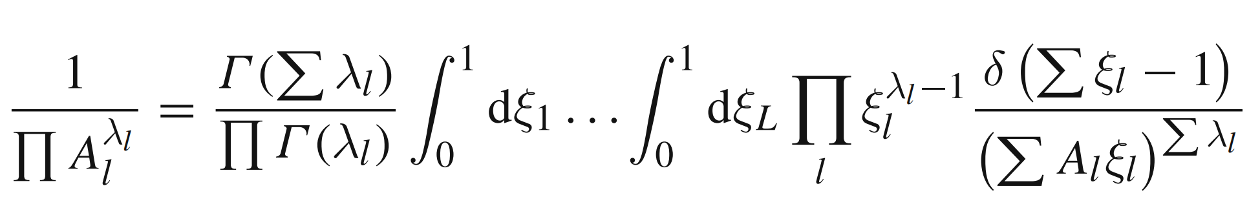
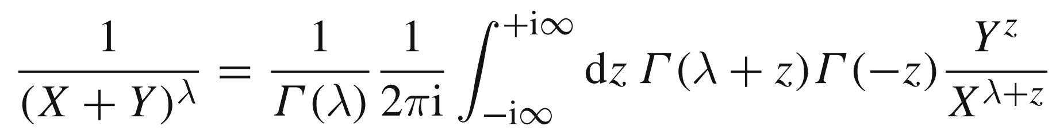
Evaluation of Feynman Integrals
Alpha and Feynman parameters
Sector decomposition
[Binoth, Heinrich, 2000]
Mellin-Barnes representation
Change the order of integration over loop momentum and parameters
V. A. Smirnov, Analytic Tools for Feynman Integrals(2013)

Slide 15
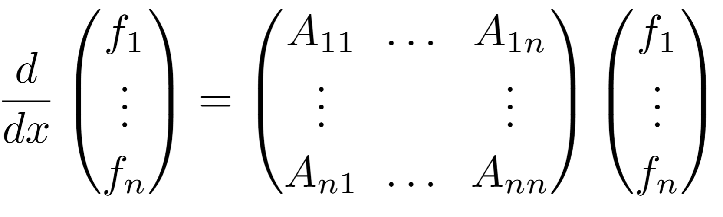
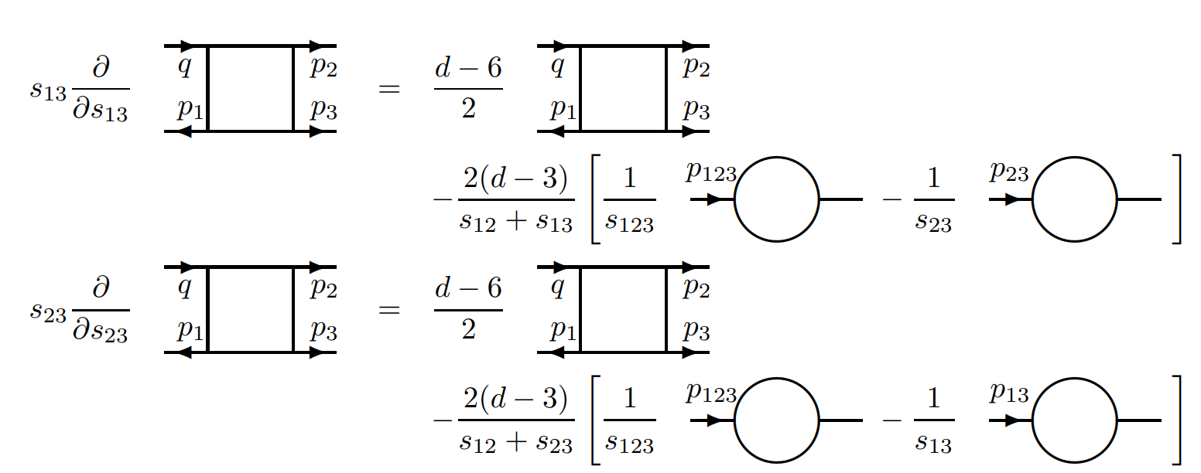

Differential Equations
First Proposed in 1991 by A.V. Kotikov,
Extend to calculate 2-loop 4-points integrals [T. Gehrmann, E. Remiddi, 1999]
PLB, 254, 158 (1991)
$f_{i}$ are master integrals, x is kinematics.

Slide 16
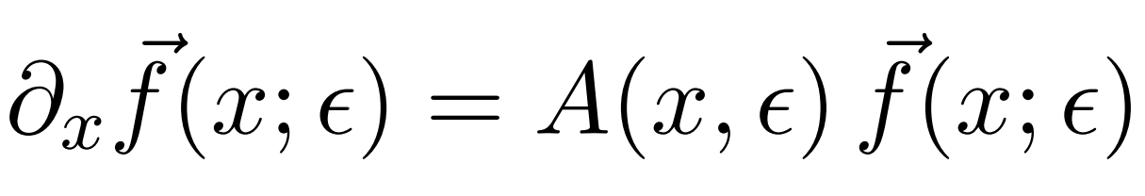
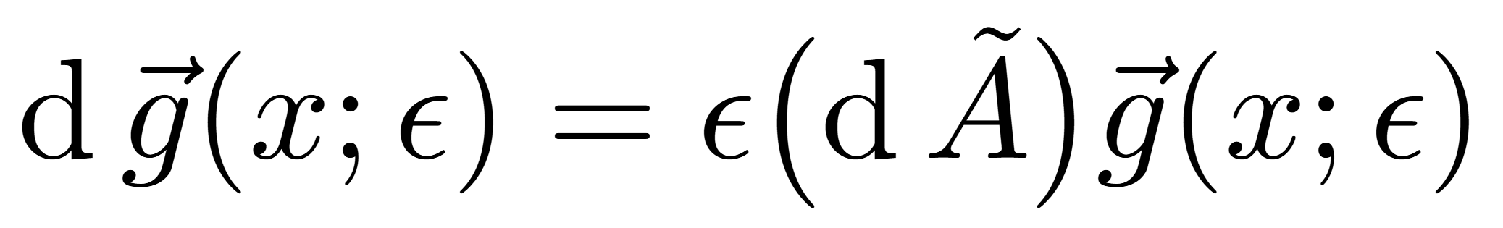


Canonical-Differential Equations
Construction of Canonical Basis (basis with Uniform Transcendentality) [Henn,2013](arXiv:1304.1806)
Basis Transformation $f→g$
Can also be achieved for integrals beyond PolyLogs.
See Xing Wang’s talk
Streamline the solution process for differential equations
$f_{i}$ are master integrals, x is kinematics.

Slide 17

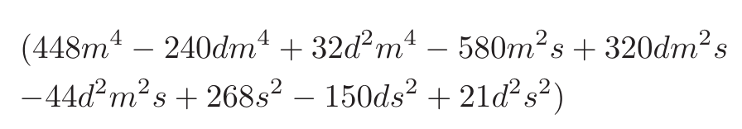
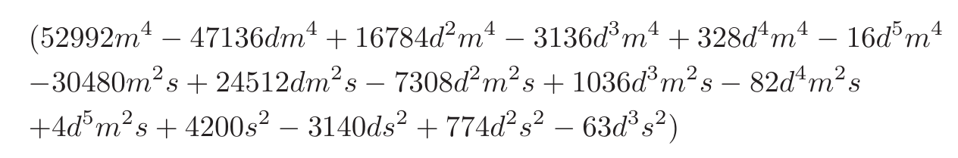
Choosing Good Basis
Bad Denominator could appear in the IBP reduction
Improvement
Develop a method to search good basis more efficient
Construct good basis for all families
Derive More simple DEs
AMFLOW to Calculate boundary conditions
Solving DEs numerically at all phase space points
produce an even more accurate calculation within
the SM.
Slow down the IBP reduction, results in more complicate DEs.
Good Basis: basis whose IBP coefficients without bad denominators .
A.V. Smirnov, V.A. Smirnov, 2002.08042
Johann Usovitsch, 2002.08173

Slide 18
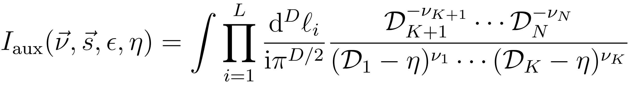
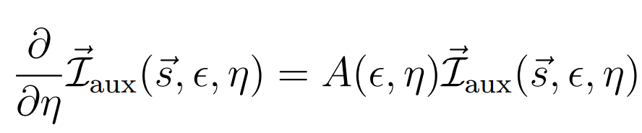
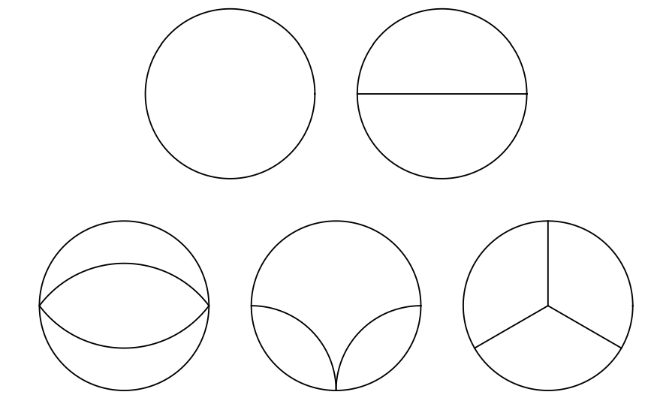
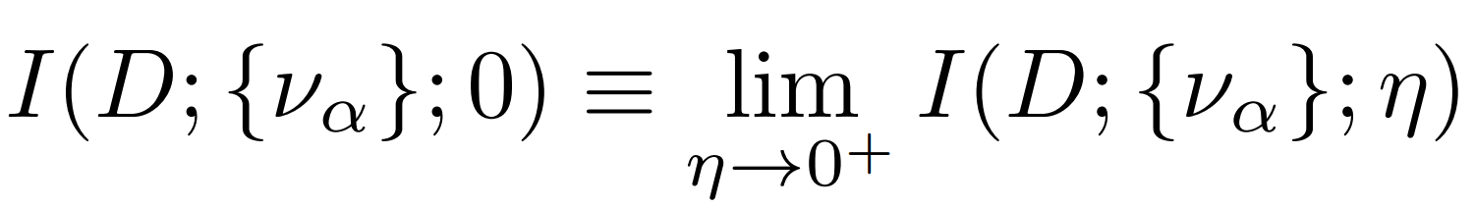
Auxiliary Mass Flow-AMFLOW
Determination of boundary conditions automatically
[Liu, Ma, Wang, 2017;
Liu, Ma， 2022] AMFLOW packages
Liu, Ma, Wang, 1711.09572
Liu, Ma, 2201.11669

Slide 19
Status of perturbative calculations
 | 2 → 1 | 2 → 2 | 2 → 3 | 2 → 4 | 2 → 5
One-Loop | known | known | known | known | known
Two-Loop | known | Most Known | Some Results | Some Results | ❌
Three-Loop | known | Some Results | Some Results | ❌ | ❌
Four-Loop | known | ❌ | ❌ | ❌ | ❌
………

Slide 20
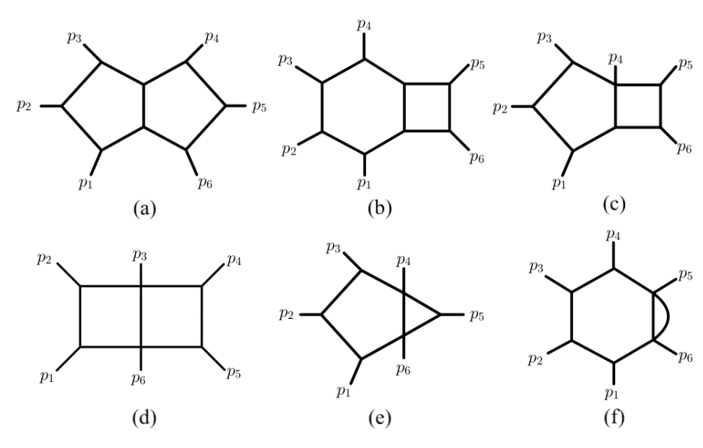
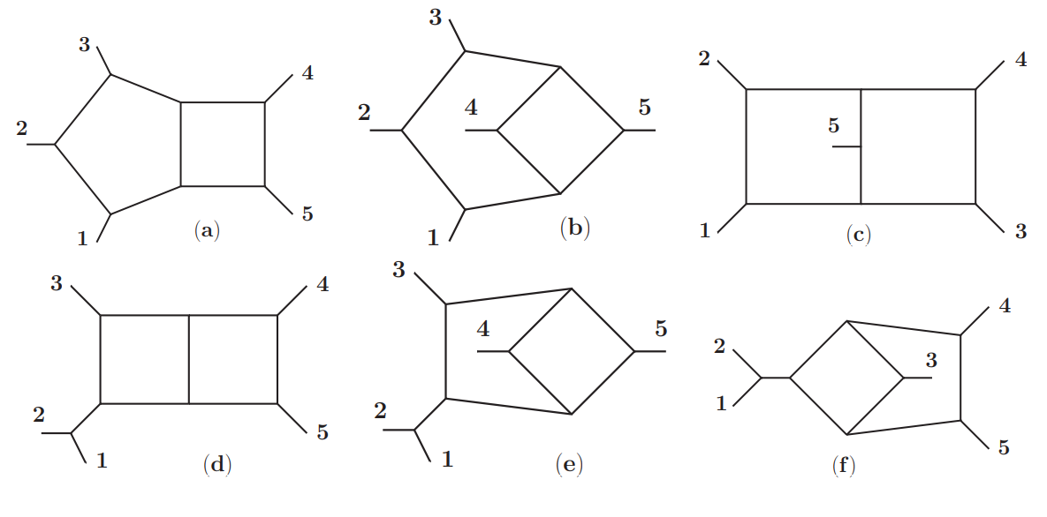
Recent Progress on Frontier Calculations
2-loop 5-leg
[Chicherin, Gehrmann, Henn, Wasser, Zhang, Zoia, …]
Massless-finished
One off-shell leg, Leading color
2-loop 6-leg
Massless-planar integrals
[Henn, Matijasic, Miczajka, Peraro, Xu, Zhang, 2025]
See Yang Zhang’s talk

Slide 21
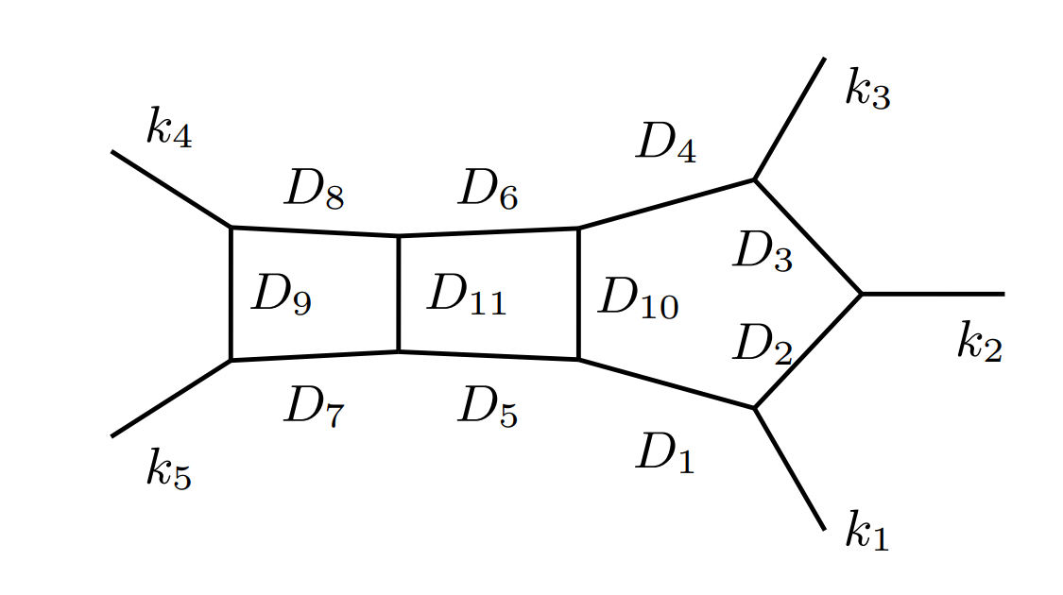
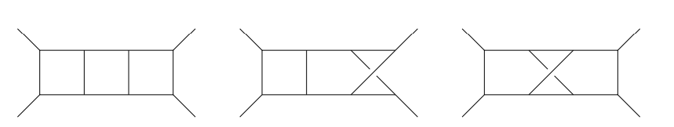
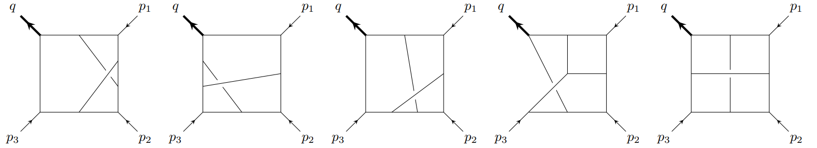
Recent Progress on Frontier Calculations
3-loop 4-leg
Massless, known
[Henn, Mistlberger, Smirnov, Wasser, 2020]
One offshell-leg, closed to finished
[Gehrmann, Henn, Jakubcik… 2024;
Guan, Mistlberger, Ruf, 2025]
3-loop 5-leg
Massless, planar
[Liu, Matijasic, Miczajka, Xu, Xu, Zhang, 2025]
See Yang Zhang’s talk

Slide 22
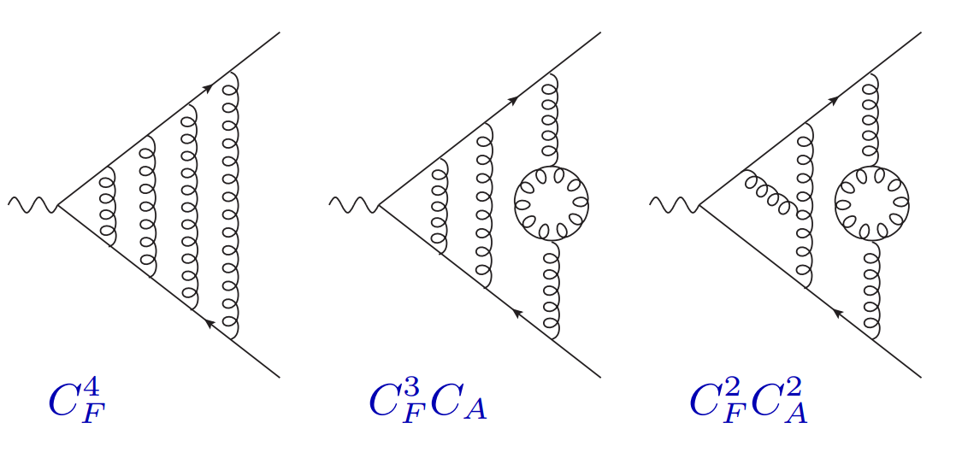
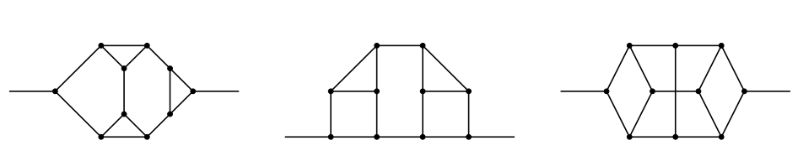
Recent Progress on Frontier Calculations
4-loop 3-leg
Massless, known
[Lee, Manteuffel,Schabinger, Smirnov, Smirnov, Steinhauser,2022,2023]
5-loop 2-leg
Massless, known
[Georgoudis, Goncalves, Panzer, Pereira, Smirnov, Smirnov,2021…].
Cut and Glue
Four loop splitting function, see Tongzhi’s talk

Slide 23
Progress in specific calculations
Sorry for the one-sided, incomplete selection
Notes:
。

Slide 24
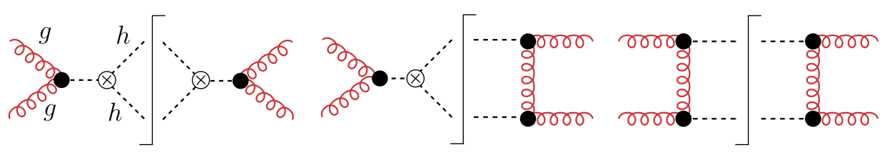
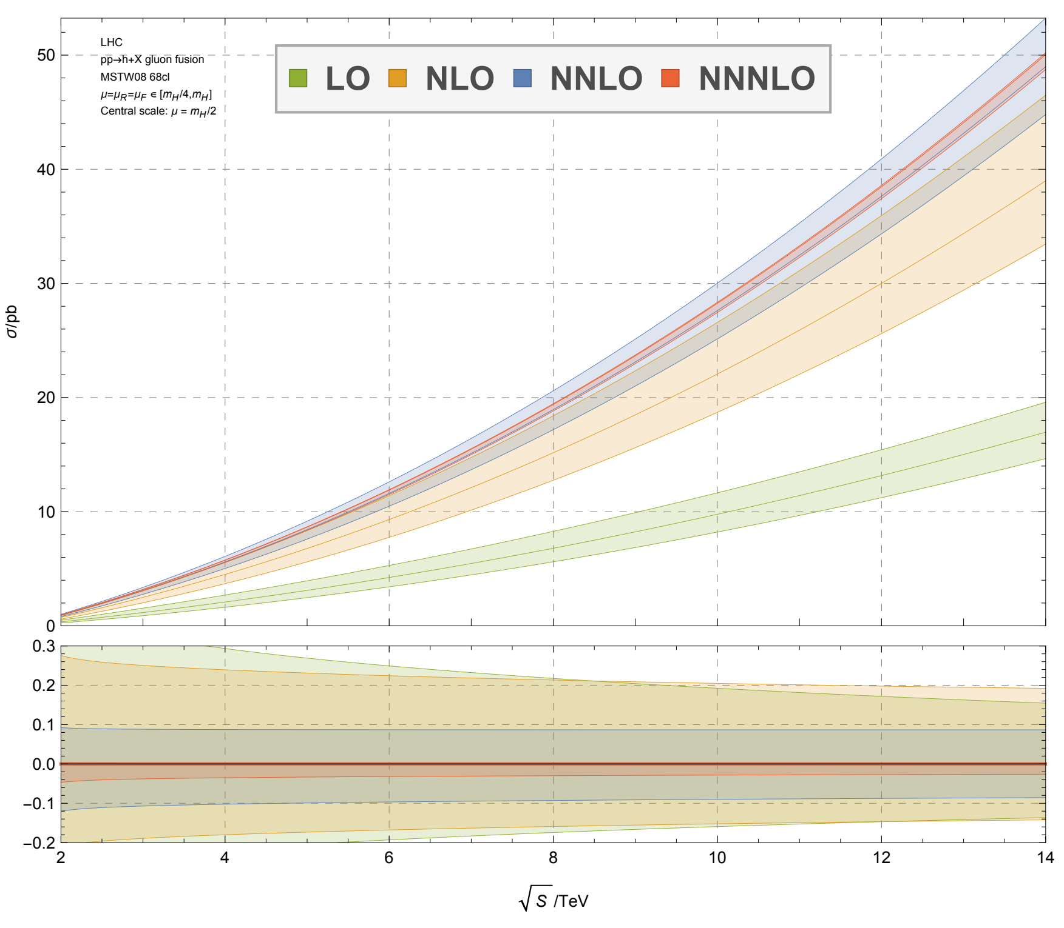
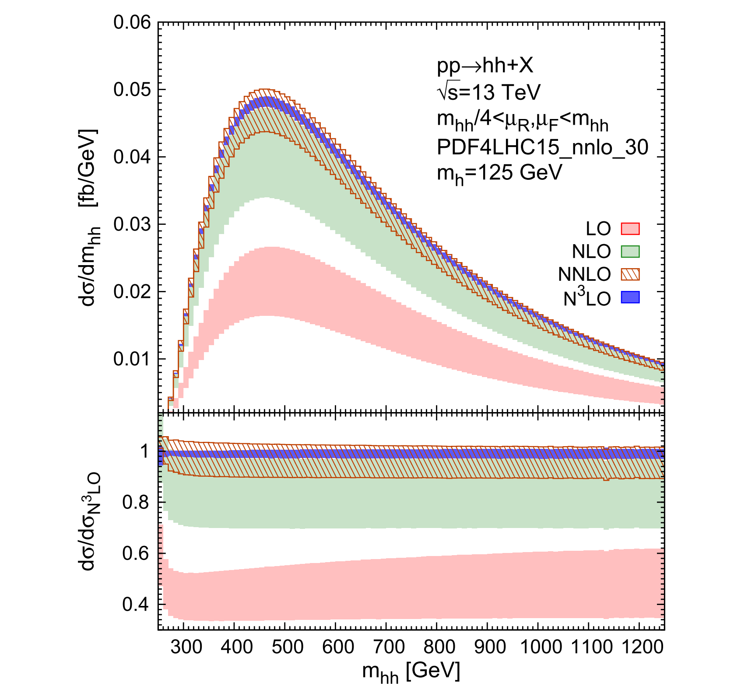
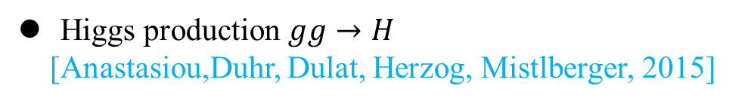
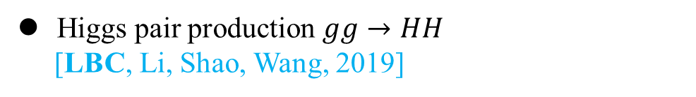
Higgs boson-QCD corrections
Higgs production $gg→H$
[Anastasiou,Duhr, Dulat, Herzog, Mistlberger, 2015]
Higgs pair production $gg→HH$
[LBC, Li, Shao, Wang, 2019]
Scale uncertainty reduces significantly, finite top mass effects required.

Slide 25
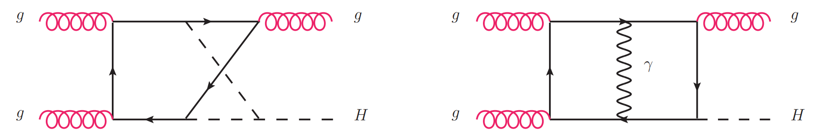
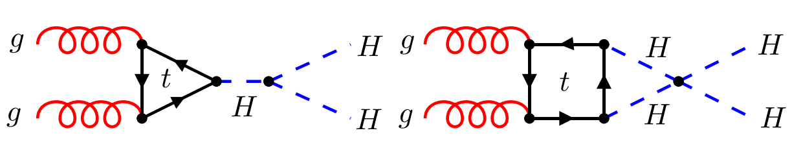
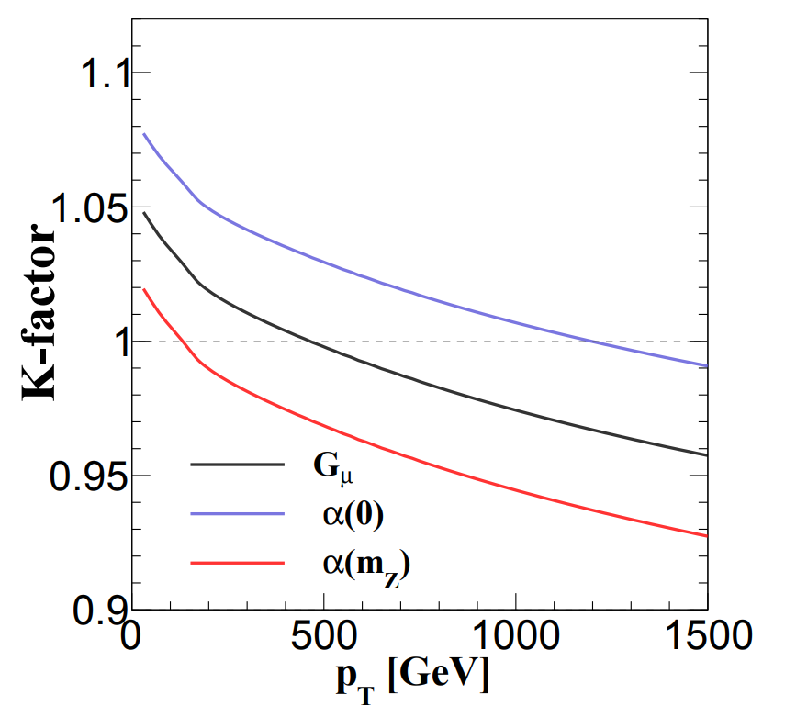
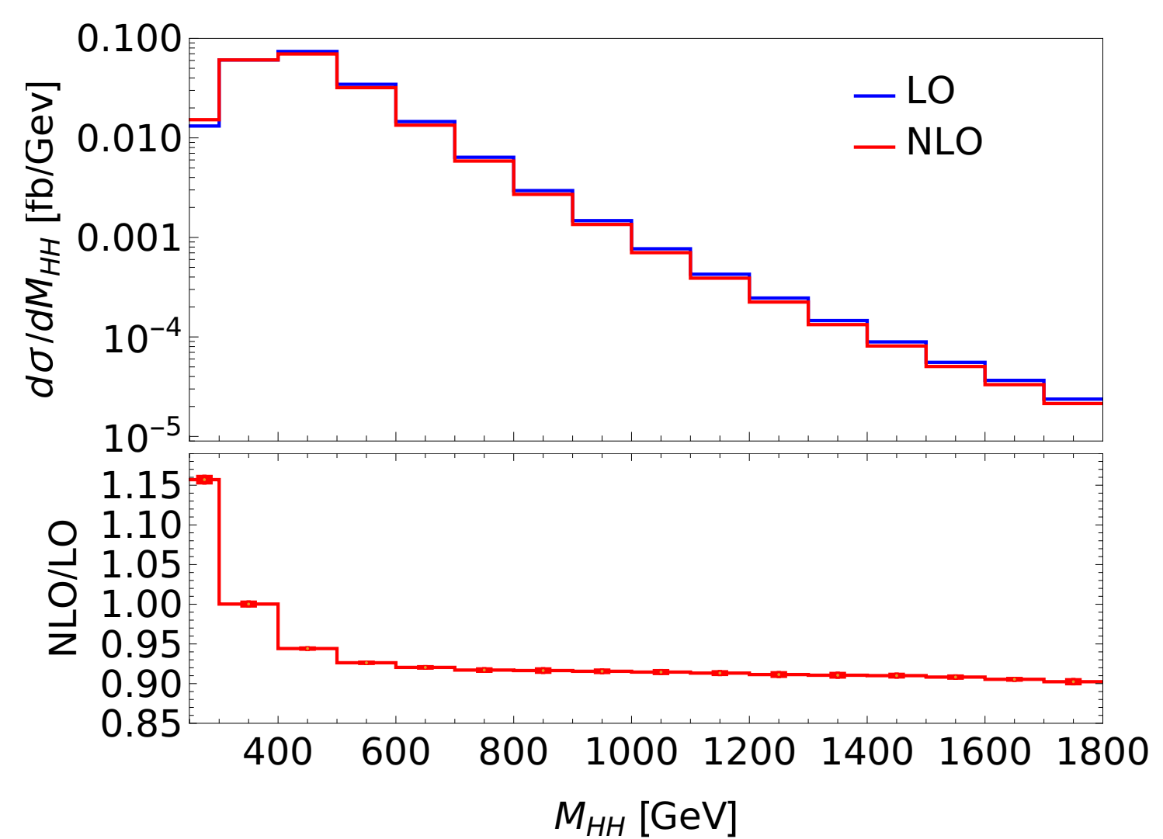
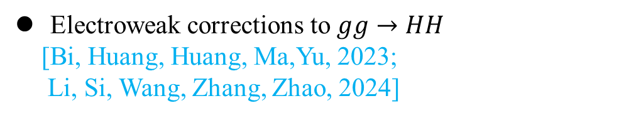

Higgs production Electro-weak corrections
Electroweak corrections to $gg→HH$
[Bi, Huang, Huang, Ma,Yu, 2023;
Li, Si, Wang, Zhang, Zhao, 2024]
Electroweak corrections to $gg→gH$
[LBC,Li,Sang, 2025; Bi,Ma,Mu,2025]

Slide 26







Higgs boson decay
Electroweak corrections to $H→Zγ$
[Chen, LBC, Qiao, Zhu, 2024, Feng, Jia, Sang, 2024]
Mix EW-QCD corrections to $H→γγ$
[Feng, Jia, Sang, 2025]
For Higgs decay into $\overline{b}b$, see Yefan’s talk.
Notes:
希格斯衰变

Slide 27




Top quark production and decay
$t\overline{t}$ cross section, NNLO
[Czakon, Fiedler, Mitov, 2013]
$t\overline{t}$H, $t\overline{t}W,aNNLO$ [Catani, Devoto, ... 2023]
Top quark decay, NNNLO
[LBC, Li, Li, Wang, Wang, Wu, 2023;
Chen, Chen, Guan, Ma, 2023]

Slide 28






Semi inclusive DIS and SIA
SIDIS @NNLO
[Bonino, Gehrmann, Lochner, Schonwald, Stagnitto,2024..; Goyal, Lee, Moch, Pathak, Rana, Ravindran,2024..]
$e^{+}e^{−}→Hardron+X$ to NNNLO
[He, Xing, Yang, Zhu, 2025]
See Jun Gao’s talk

Slide 29













Colliders to measure EM Form factors
878 s
>1029 years
10⁻¹⁰ s
10⁻²¹ s
10⁻¹¹ s
N = Λ, Σ ...
Leading order
10⁻¹⁰ s
10⁻¹⁰ s
10⁻¹⁰ s
CLEO-c
CMD-3

Slide 30






Hard Exclusive Processes relate to hadron EM form factors-QCD corrections to Pion and Proton FFs
Pion and Baryon EM Form factors
[LBC, Chen ,Feng, Jia, Hu, 2024;
Huang, Ji, Shi, Wang, …, Zhao, 2024]
$$Q^{2}$$

Slide 31






Classical Gravitational Wave from Perturbative QFT
[Dlapa, Kalin, Liu, Neef, Porto, Yang, 2020-2025;
Bern, Ita, Kosmopoulos, Luna, Roiban, Teng…]
Pictures taken from Zhengwen Liu’s Talk

Slide 32
Summary and Outlook
High-order corrections play a crucial role in conducting precise tests of the Standard Model and searching for new physics.
Much progress has been achieved over the past few years.
Further exciting advancements are on the horizon—stay tuned for updates!

