Slide 1


第八届重味物理与量子色动力学研讨会
CP asymmetries in charmed baryon decays into neutral kaons
报告人： 王 迪
合作者：于福升，张振华，闻思佳

Slide 2
第八届重味物理与量子色动力学研讨会
Contents
1
Motivation
2
CPV in charmed baryon decays
3
Phenomenological analysis
4
Summary

Slide 3
第八届重味物理与量子色动力学研讨会
Contents
1
Motivation
2
CPV in charmed baryon decays
3
Phenomenological analysis
4
Summary

Slide 4
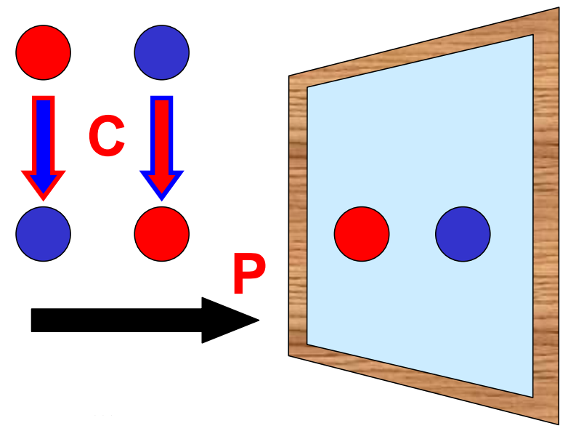
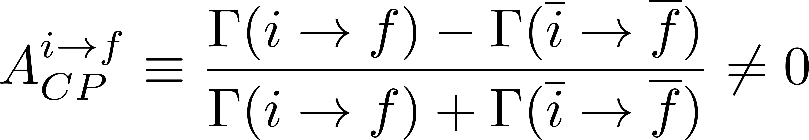
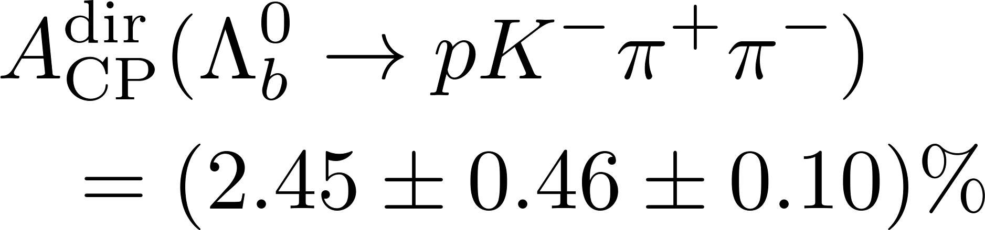
第八届重味物理与量子色动力学研讨会
CP Violation
A crucial element for interpreting the matter-antimatter asymmetry in the Universe and provides a window for new physics
have been well established in K, B, D meson systems
Recently, the LHCb Collaboration reported the first observation of CP violation in bottom baryon decays
R. Aaij et al. [LHCb], Nature 643, no.8074, 1223-1228 (2025).
Charmed baryon ?
4

Slide 5
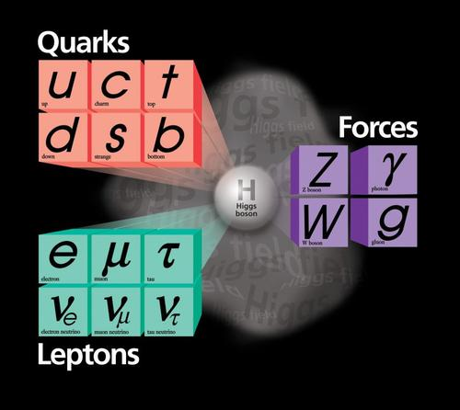
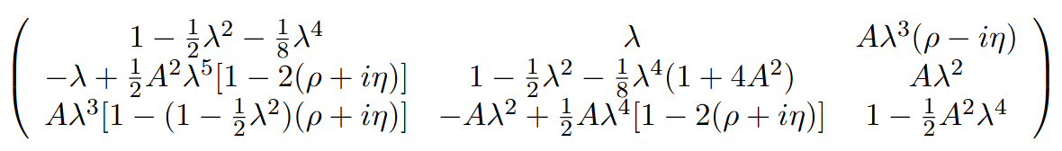
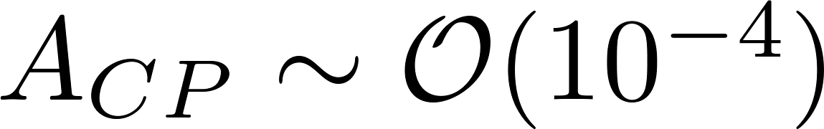
第八届重味物理与量子色动力学研讨会
CPV in charmed baryon sector
Tree
Penguin
Experimental efforts
R. Aaij et al. [LHCb], JHEP 03, 182 (2018).
M. Ablikim et al. [BESIII], Phys. Rev. Lett. 121, no.6, 062003 (2018).
Y. B. Li et al. [Belle], Phys. Rev. Lett. 127, no.12, 121803(2021).
L. K. Li et al. [Belle], Sci. Bull. 68, 583-592 (2023).
M. Ablikim et al. [BESIII], Phys. Rev. Lett. 132, no.3, 031801 (2024).
M. Abumusabh et al. [Belle-II], [arXiv:2509.25765 [hep-ex]].
5

Slide 6
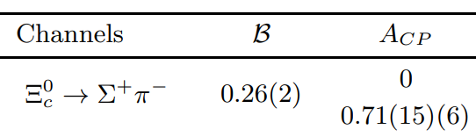


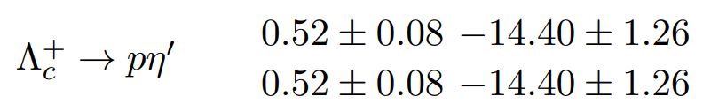
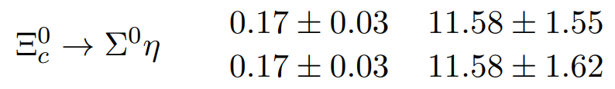
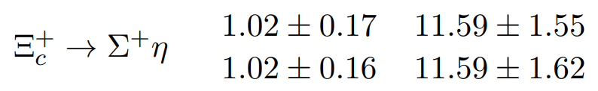
第八届重味物理与量子色动力学研讨会
CPV in charmed baryon sector
CPAs are 10⁻⁴ order in most decay modes, might be 10⁻³ in several modes with small branching fractions
X. G. He and C. W. Liu, Sci. Bull. 70, 2598-2603 (2025).
C. P. Jia, H. Y. Jiang, J. P. Wang and F. S. Yu, JHEP 11, 072 (2024).
10⁻³
10⁻³
？
H. Y. Cheng, F. Xu and H. Zhong, Phys. Rev. D 112, no.5, 054022 (2025).
6

Slide 7
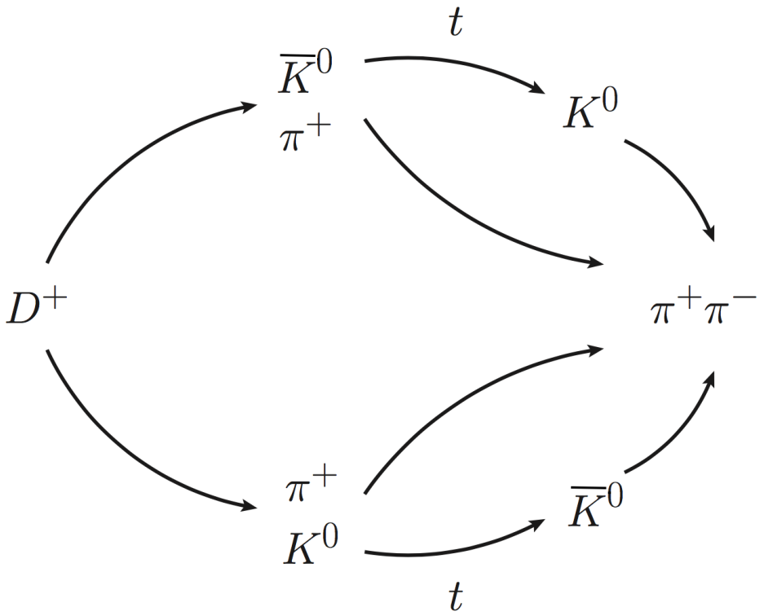
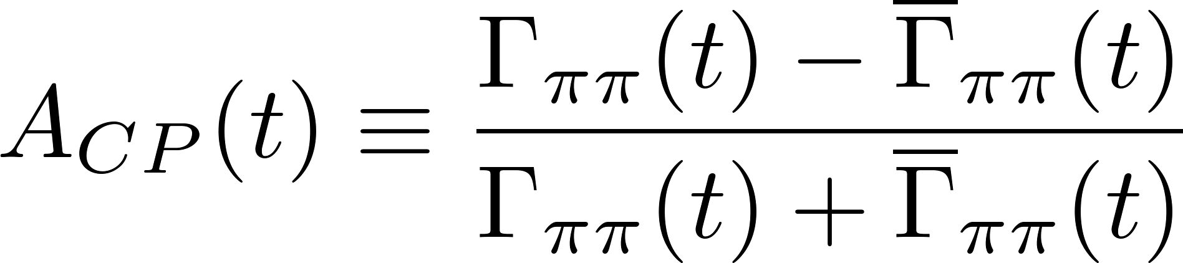
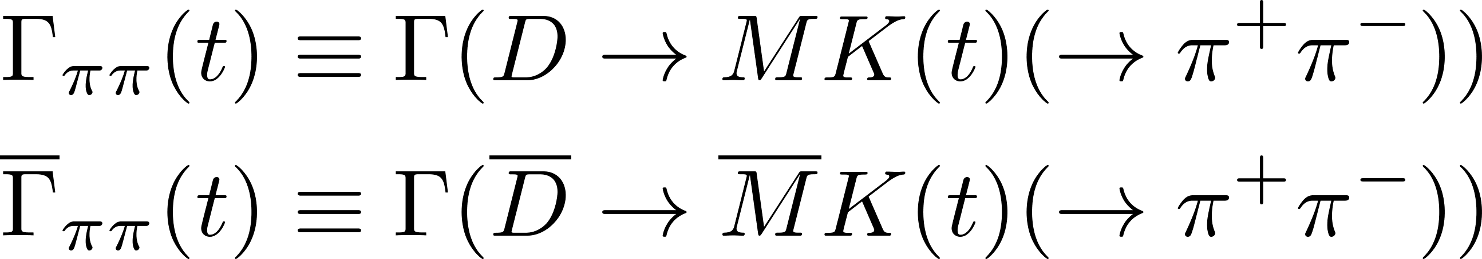
第八届重味物理与量子色动力学研讨会
CPV in charm decays into neutral kaons
KS candidate is reconstructed from its decay into two pions at a time close to its lifetime in experiments;
Not only K_{S}, but also K_{L} serve as intermediate states through K_{S}-K_{L} oscillation
F. S. Yu, D. Wang and H. n. Li, Phys. Rev. Lett. 119, no.18, 181802 (2017).
7

Slide 8
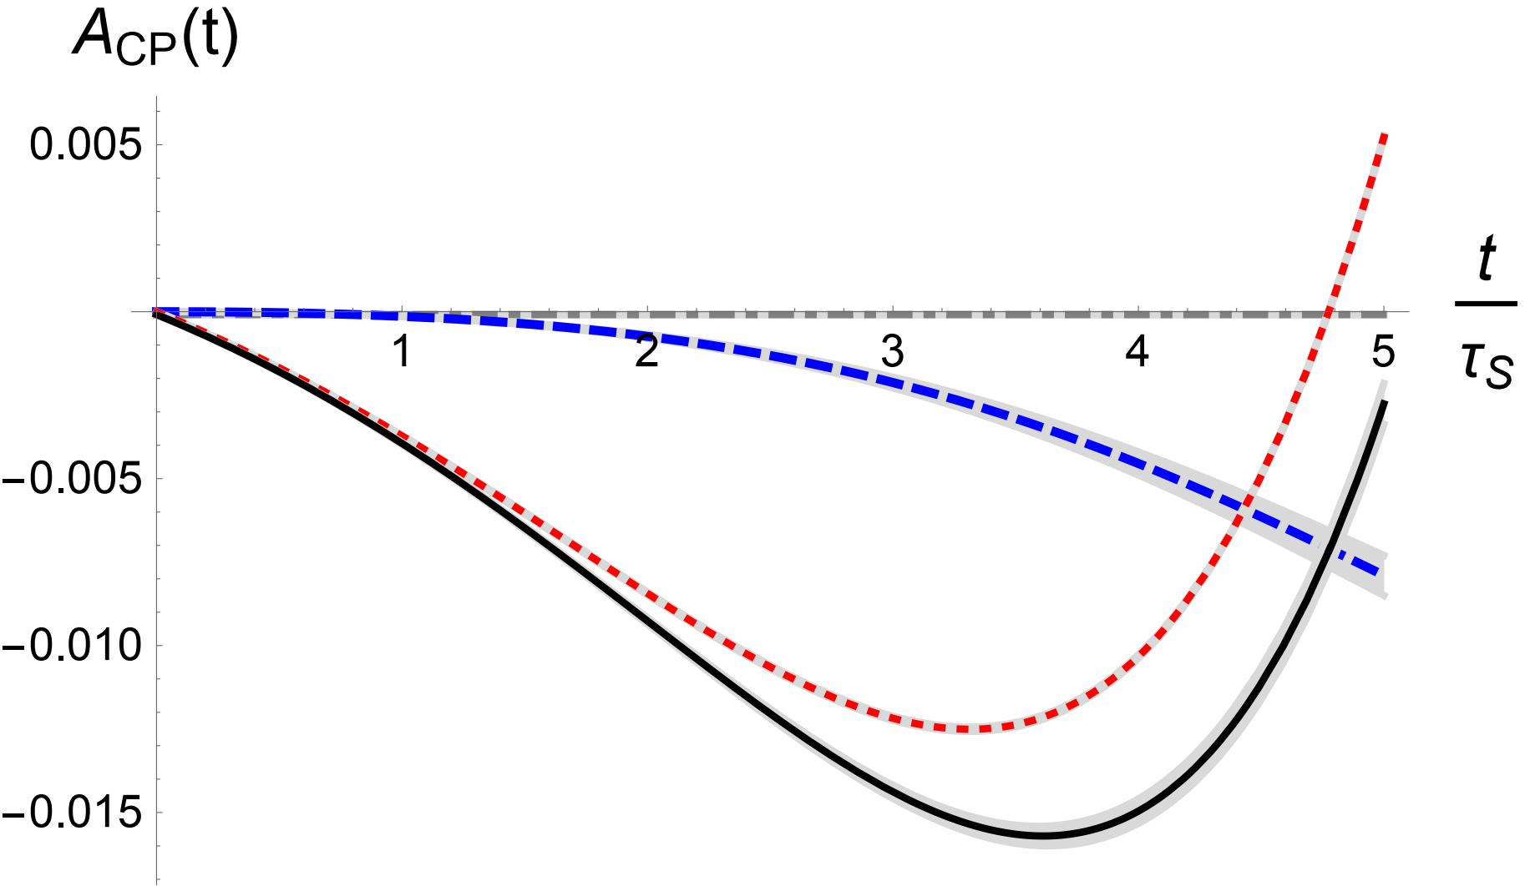
第八届重味物理与量子色动力学研讨会
CPV in charm decays into neutral kaons
CPV in neutral kaon mixing
Direct CPV
Interference between neutral kaon mixing with CF and DCS amplitudes
Charmed baryon decays ?
F. S. Yu, D. Wang and H. n. Li, Phys. Rev. Lett. 119, no.18, 181802 (2017).
8

Slide 9
第八届重味物理与量子色动力学研讨会
Contents
1
Motivation
2
CPV in charmed baryon decays
3
Phenomenological analysis
4
Summary

Slide 10
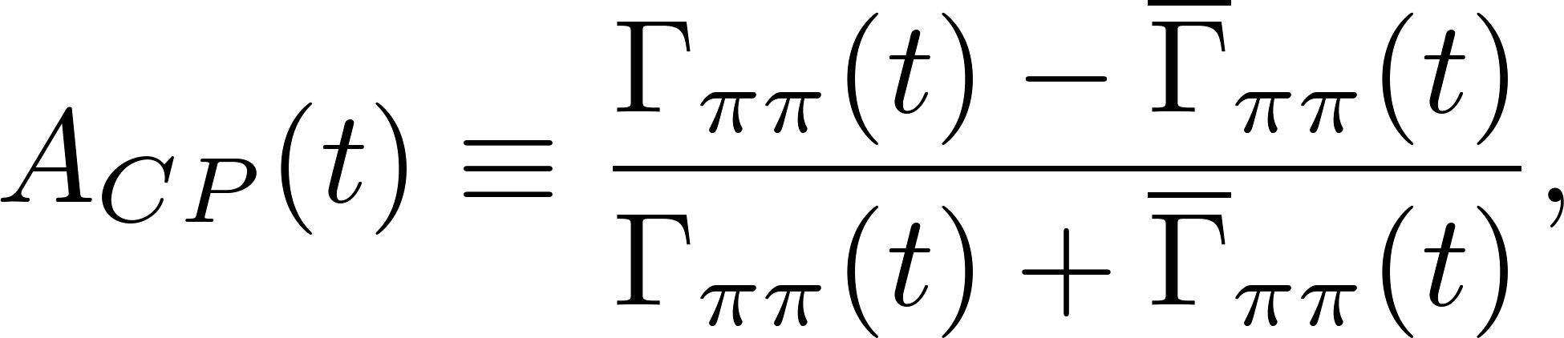
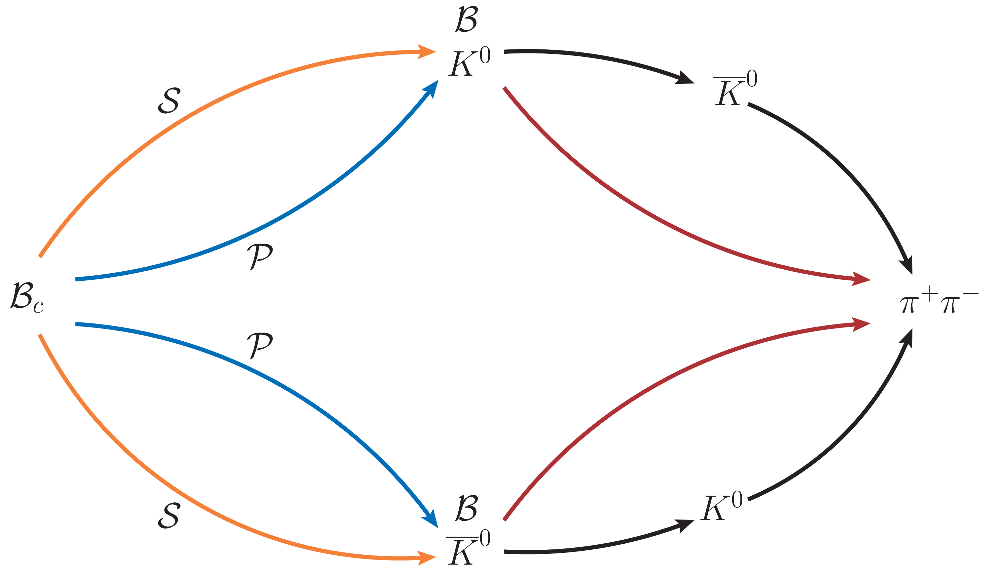
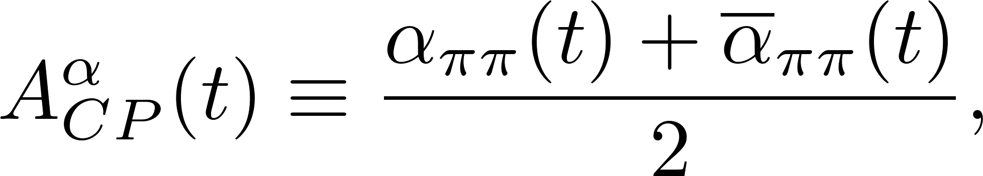
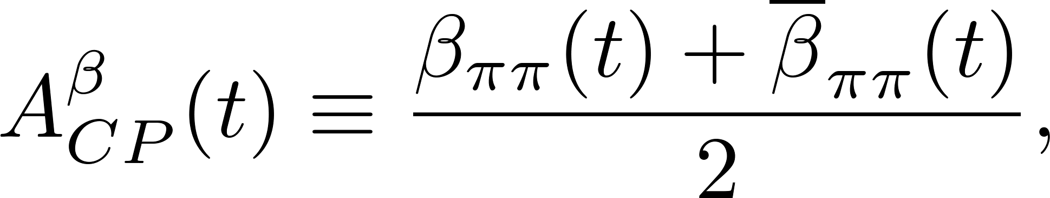
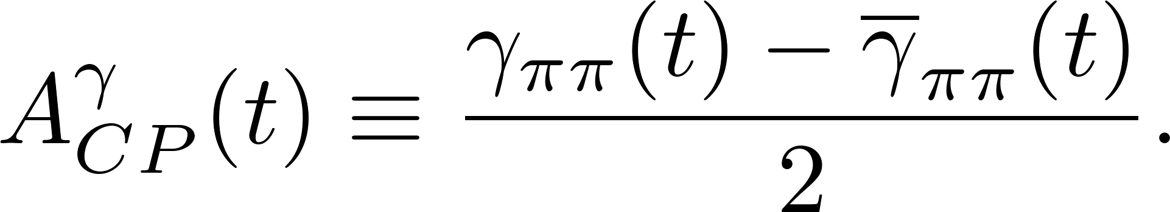
第八届重味物理与量子色动力学研讨会
Charmed baryon decays into neutral kaons
Charmed baryon decays involve S- and P-wave amplitudes. The rich interference patterns provide more CP observables compared to meson decays
10

Slide 11
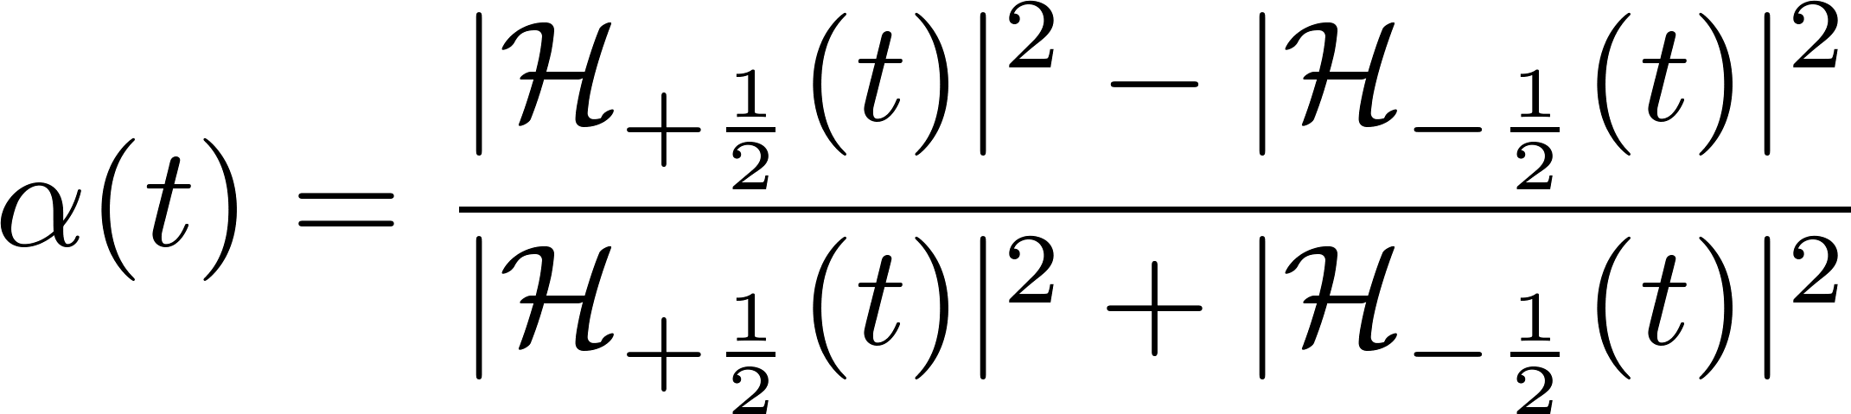
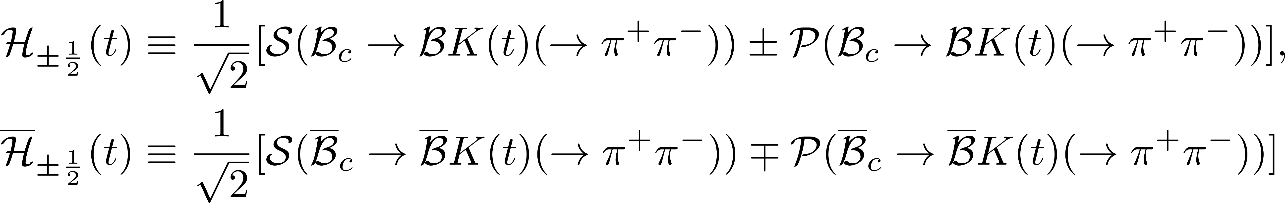
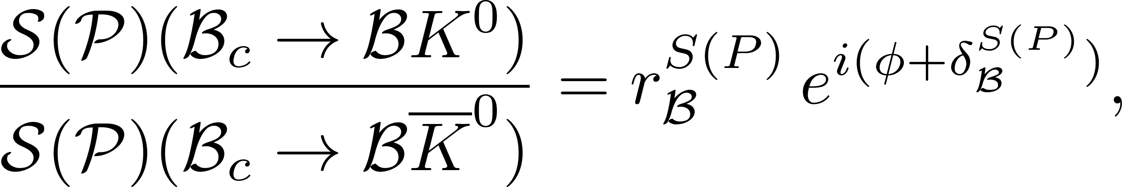
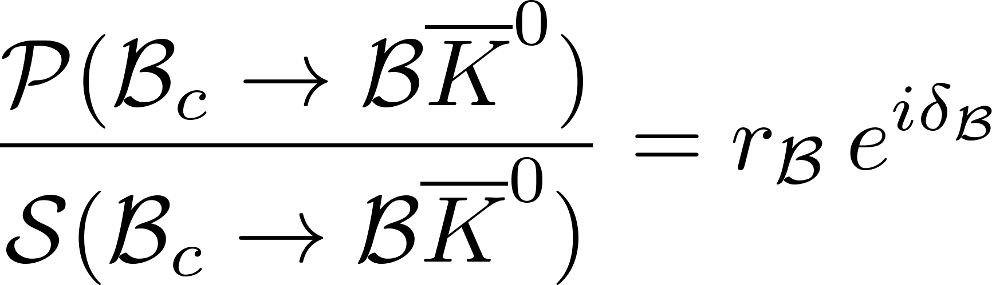
第八届重味物理与量子色动力学研讨会
Time-dependent CPV
Time-dependent Angular Distribution induced CP asymmetry
Ratios of DCS and CF amplitudes/Ratio of CF P- and S-wave amplitudes
11

Slide 12
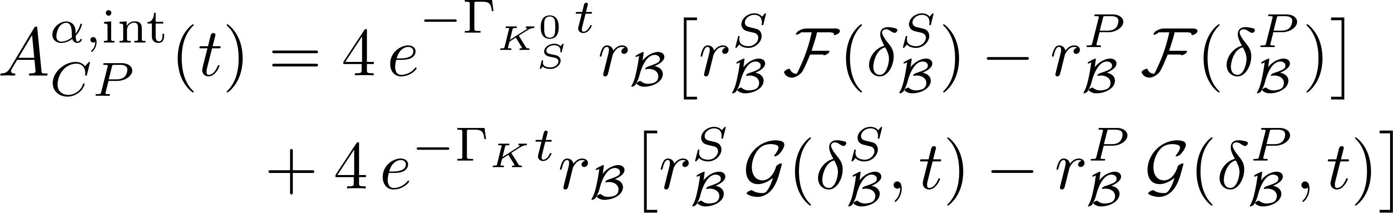
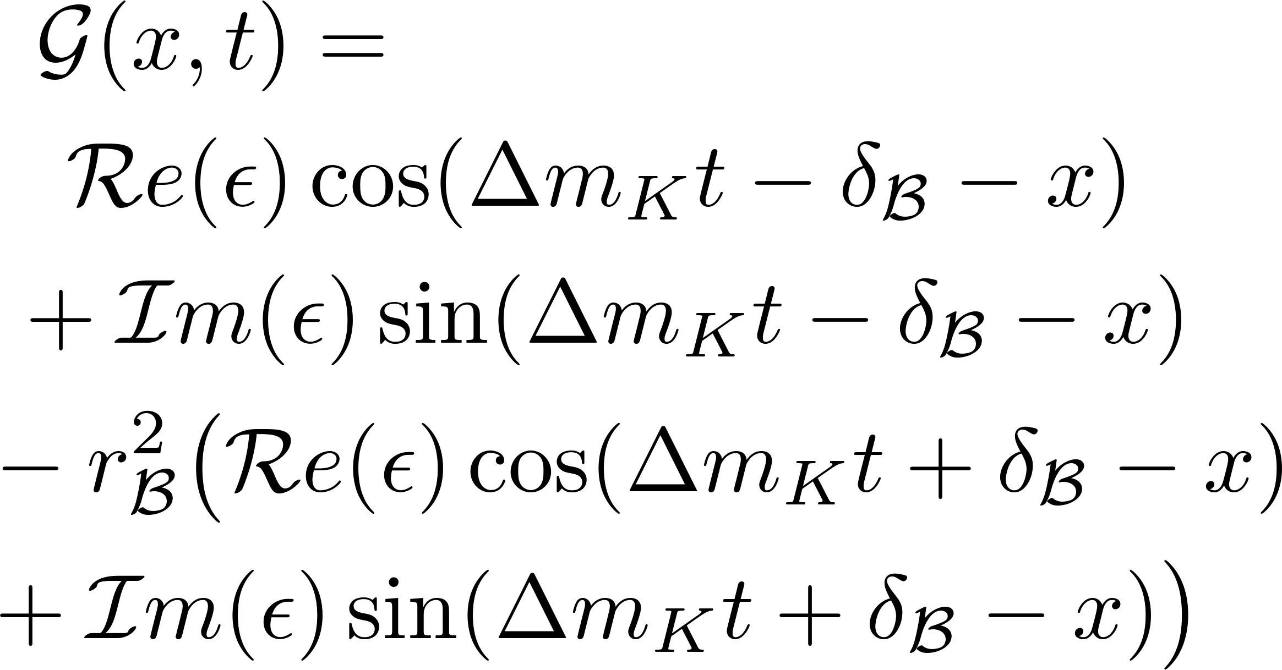
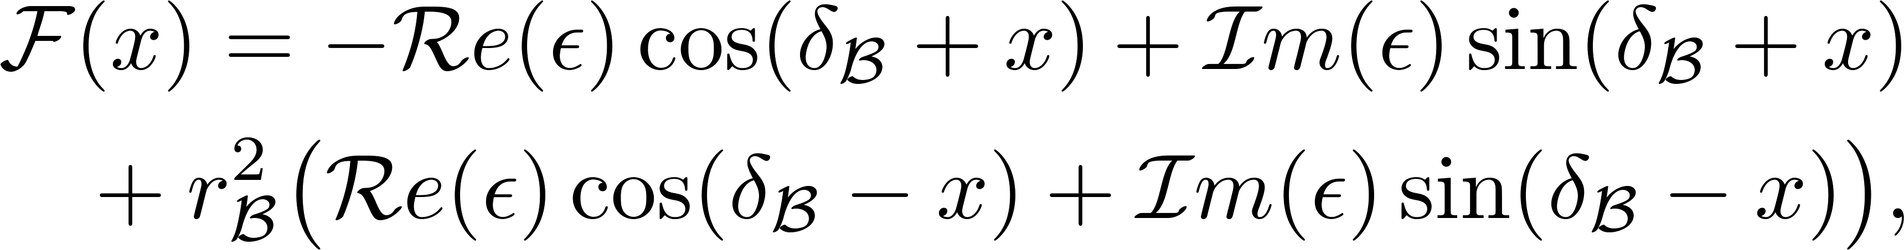
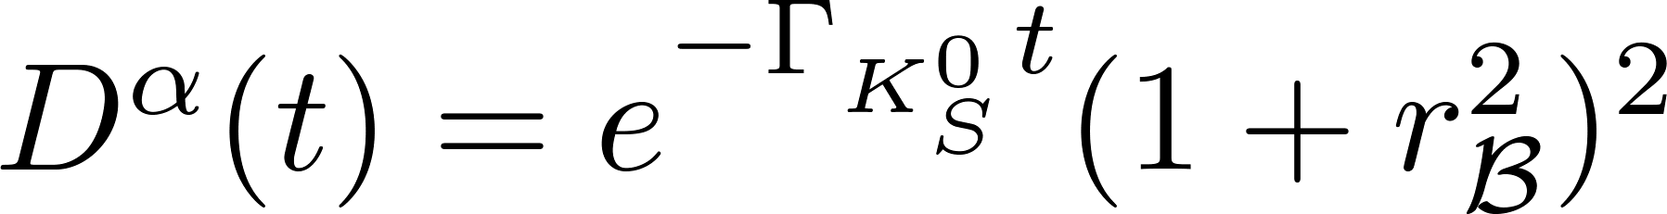
Interference between CF and DCS amplitudes:
Interference between the CF and DCS amplitudes with the neutral kaon mixing:
Denominator:
12

Slide 13
第八届重味物理与量子色动力学研讨会
Other observables
CP asymmetry in neutral kaon mixing cancels exactly in the angular distribution induced CP observables;
Interference between CF and DCS amplitudes is small;
Angular distribution induced interference between CF and DCS amplitudes with neutral kaon mixing is the dominated term !
13

Slide 14
第八届重味物理与量子色动力学研讨会
Contents
1
Motivation
2
CPV in charmed baryon decays
3
Phenomenological analysis
4
Summary

Slide 15
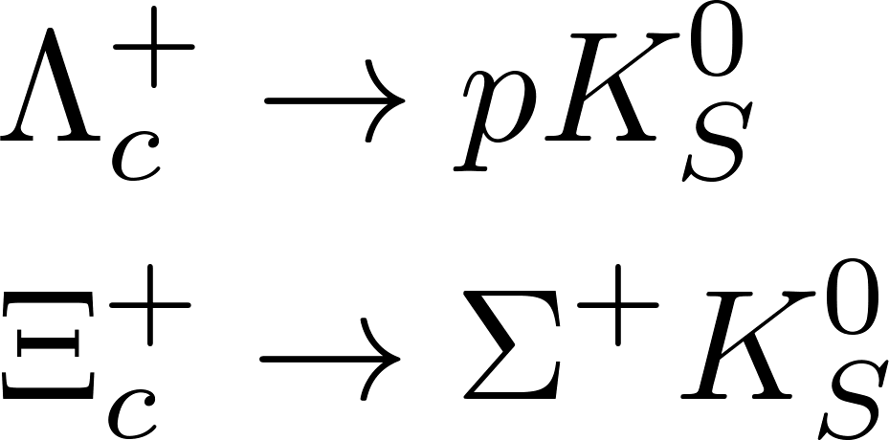
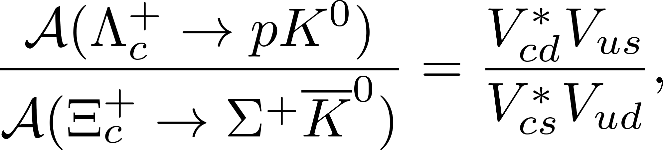
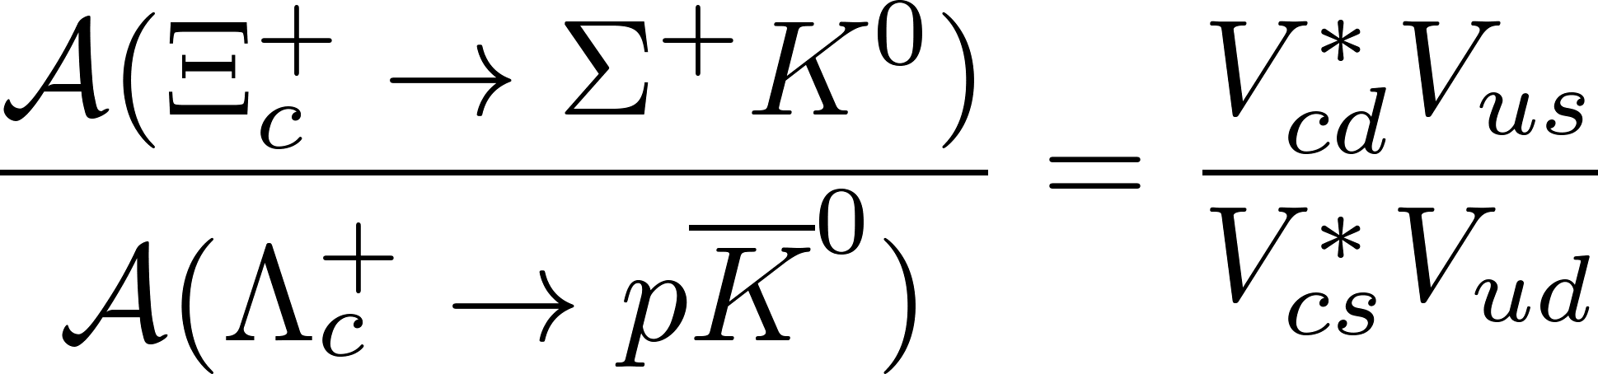
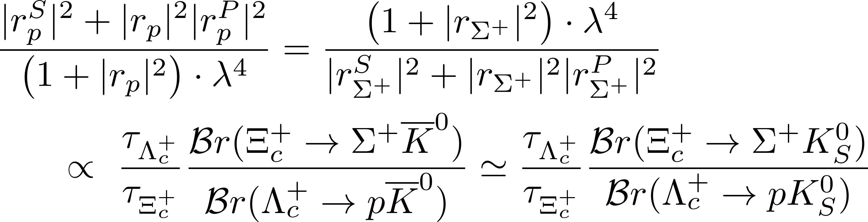
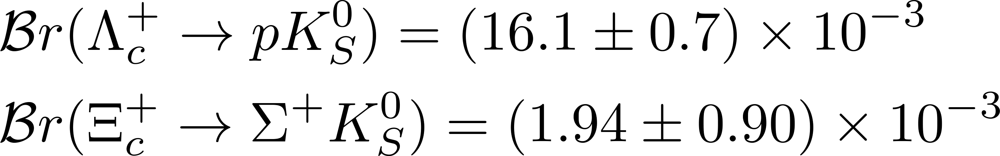
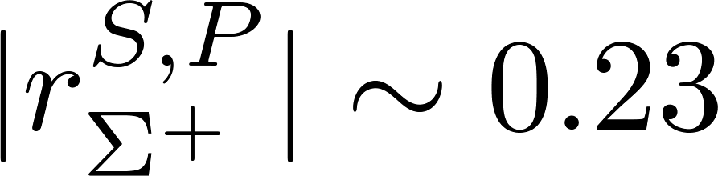
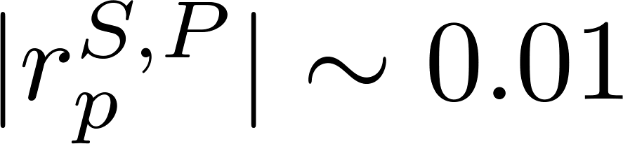
第八届重味物理与量子色动力学研讨会
Phenomenological analysis
U-spin relations
I. Adachi et al. [Belle-II and Belle], [arXiv:2503.17643 [hep-ex]].
.vs. Meson: r ~ 0.05
15

Slide 16
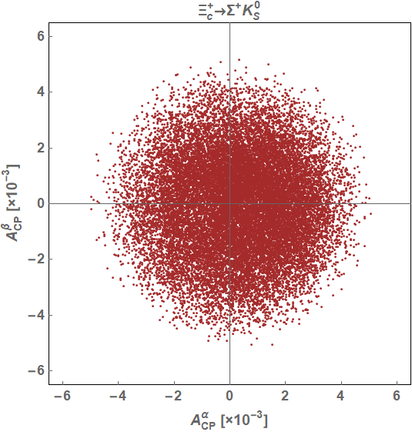
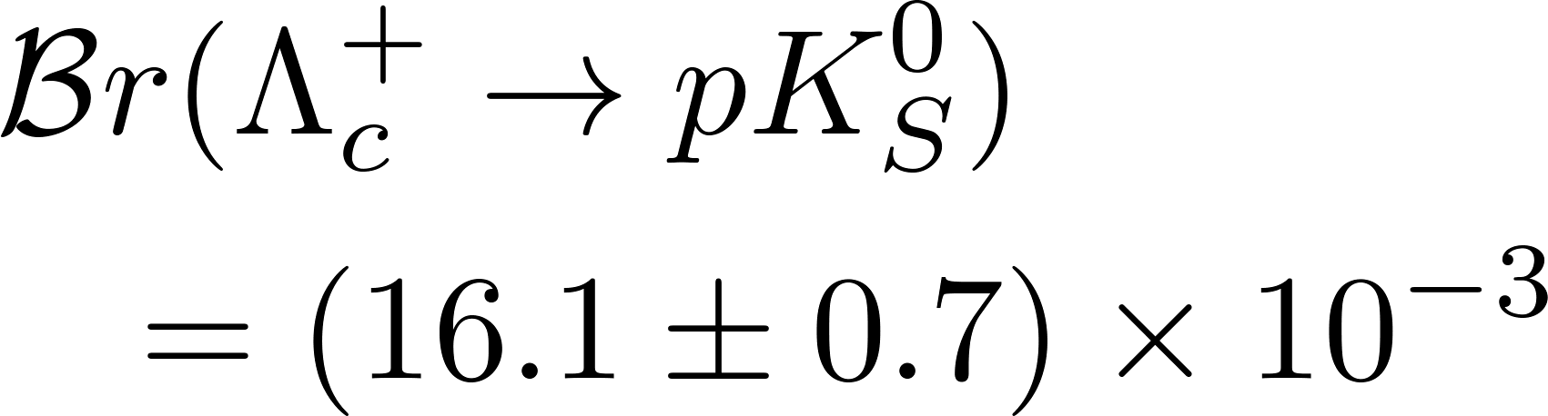
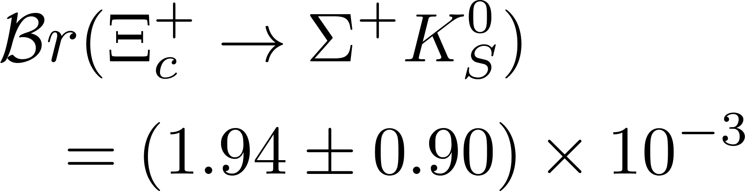
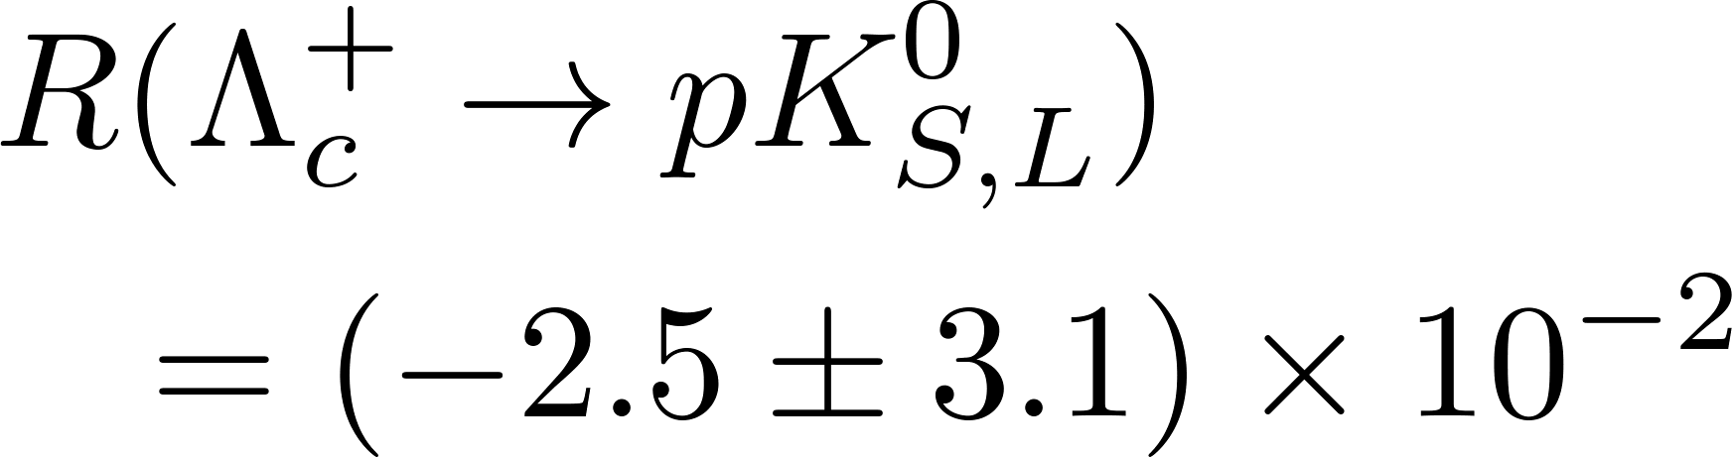
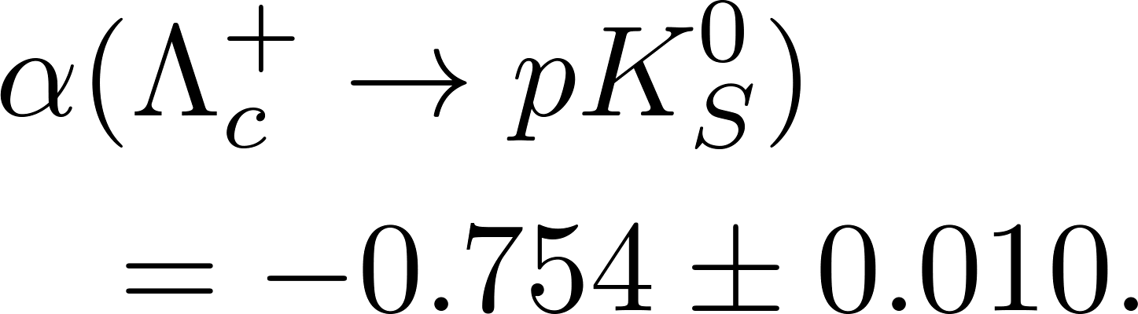
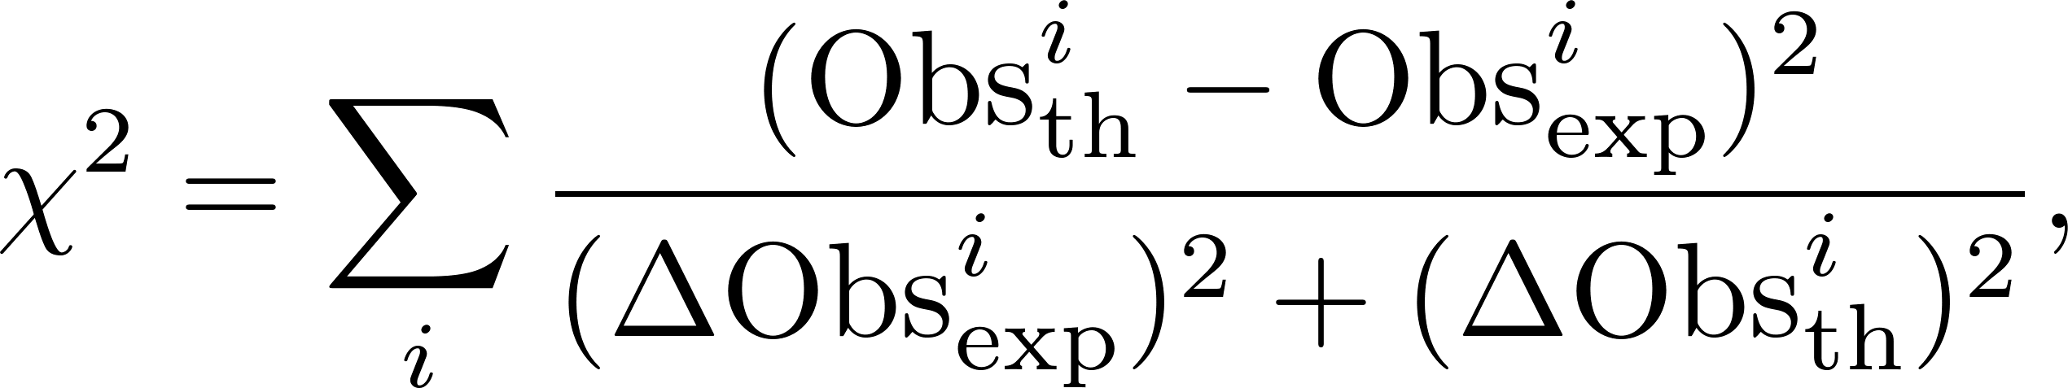
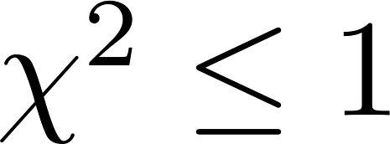
第八届重味物理与量子色动力学研讨会
CPV
16

Slide 17
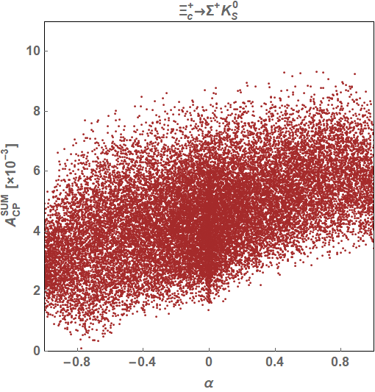
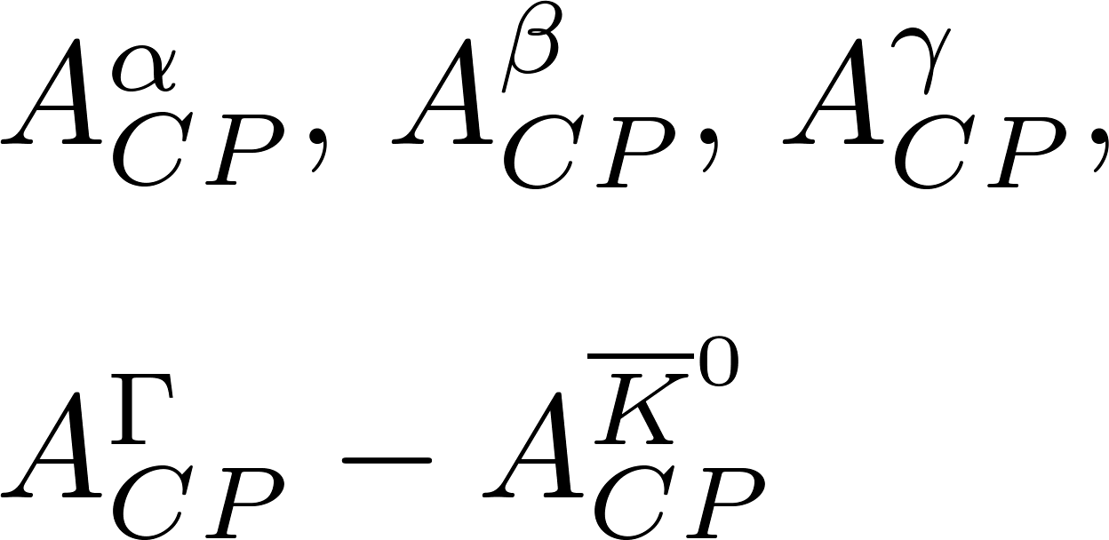
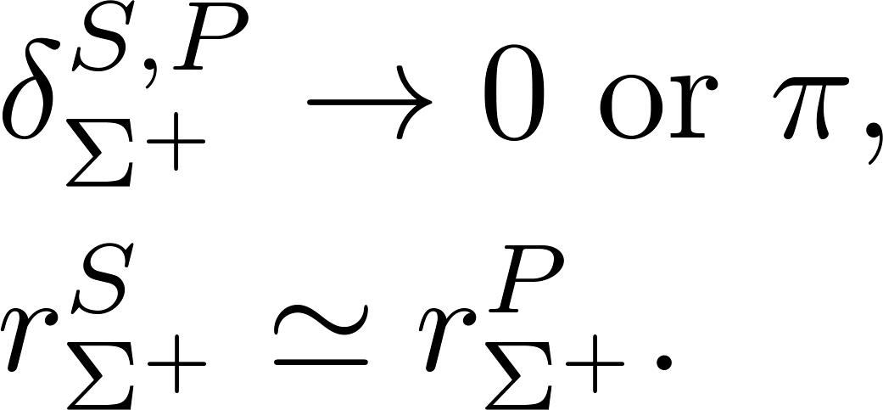
第八届重味物理与量子色动力学研讨会
Complementary observables
Four observables
All four observables are suppressed
17

Slide 18
第八届重味物理与量子色动力学研讨会
CPV
By excluding data from several K_{S} mean lifetimes, the CP asymmetry could be enhanced to the level of 10⁻²
Discovery channel for both CPV in charmed baryon sector and the novel CPV effect
18

Slide 19
第八届重味物理与量子色动力学研讨会
Contents
1
Motivation
2
CPV in charmed baryon decays
3
Phenomenological analysis
4
Summary

Slide 20
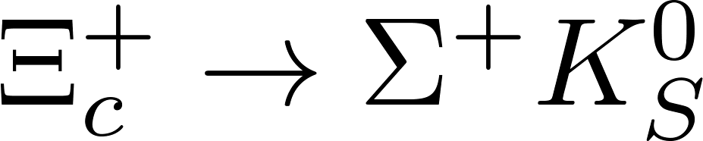
第八届重味物理与量子色动力学研讨会
Summary
A new CP-violating effect in the charmed baryon decays into neutral kaons: angular distribution induced interference between CF and DCS amplitudes with neutral kaon mixing;
CPV in decay could reach to 10⁻², a discovery channel for both CPV in charmed baryon sector and the novel CPV effect.
Thanks for your attention!
20

