Slide 1
Recent developments and applications of NeatIBP
A package for IBP reduction of Feynman integrals
吴子昊
华南师范大学
第八届全国重味物理与量子色动力学研讨会
2026.4 重庆

Slide 2
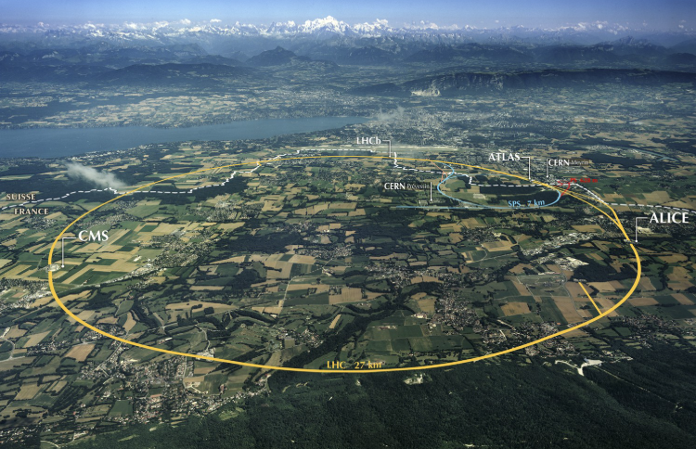



Advances in HEP
High precision Higgs physics,
New physics beyond standard model,
…
High-precision experimental measurements
High-precision theoretical predictions
Phase space integration,
IR subtraction,
…
…
LHC
(picture from the internet)
Computing fixed-order amplitudes for scattering processes remains a key obstacle to producing precise predictions for the LHC and HL-LHC. – Les Houches Wish List 2023
In the future…
High-order Amplitudes
HL-LHC
CEPC
perturbation
FCC
……
QFT

Slide 3

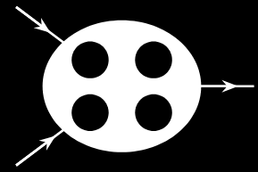

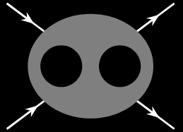
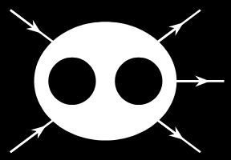
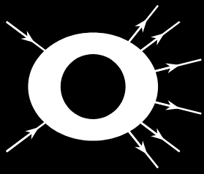
In the recent years, most of the useful NNLO 2→2 amplitudes has been obtained
Amplitudes with higher complexity are still needed now
Perturbation Order
4-loop 2→1
Some of the desired amplitudes in the current stage
3-loop 2→2
2-loop 2→3
1-loop 2→6
2-loop 2→2
With many internal
masses
Multiplicity

Slide 4
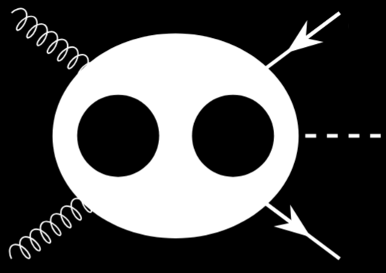
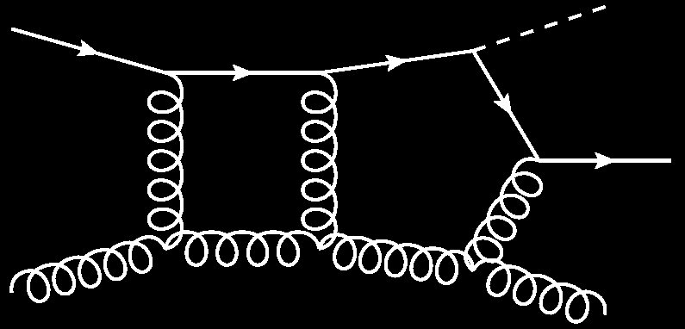
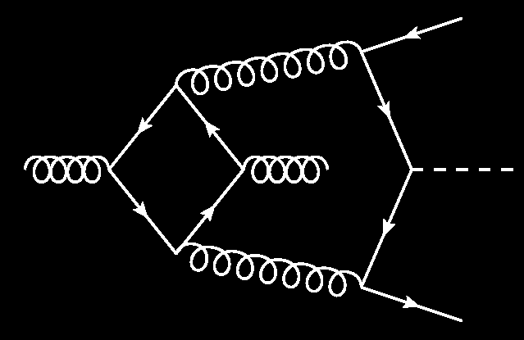
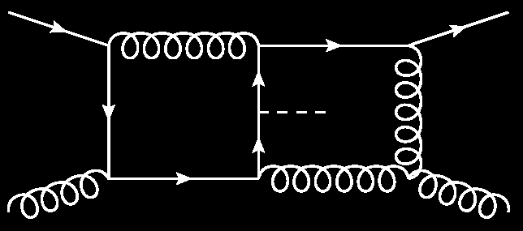
Amplitudes from multi-loop Feynman integrals
Amplitudes (in high order expansion)
Σ
…
Multi-loop Feynman diagrams
Σ
Multi-loop Feynman integrals
Multi-loop Feynman integrals are key objects to evaluate high-order amplitudes.
It is also the bottleneck for plenty of amplitude computations in precision frontier.

Slide 5
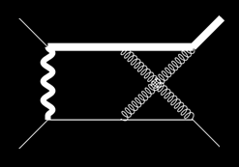
Workflow of analytic computation of Feynman integrals
Feynman diagrams
Feynman rules
Feynman integrals
Tensor reduction
Scalar integrals
Integration-by-parts (IBP) reduction
Master Integrals
Analytic functions
Analytic evaluation methods
A linear independent basis of the scalar integrals

Slide 6
Integration by parts reduction
Feynman integral family
IBP relations
IBP reduction
Master integrals
Gaussian
Elimination
Linear system of IBP relations
Coefficients

Slide 7
Integration by parts reduction
High computation cost for reduction
3
4
Target integrals with degree-5 numerators
Quantity: 2483
# of IBP (FIRE6): 11207942
2
Example
5
1
Gaussian elimination of a HUGE matrix with Analytic elements
…
…
s12 + s23
…
…
…
We cannot finish the reduction analytically in a tolerable time
…
…
…
10^7 × 10^7

Slide 8
Traditional IBP algorithm
Linear system of IBP relations (large)
Linear solver
Traditional IBP generators
IBP reduction results
Computational expensive
NeatIBP:
Linear solver
IBP generators from syzygy
Linear system of IBP relations (small)
IBP reduction results
Computational less expensive

Slide 9
The work flow and program package NeatIBP
Laporta IBP generators
Seeding
IBP system
Reduced IBP
IBP reduction

Slide 10
The work flow and program package NeatIBP
Syzygy equations
Computational algebraic geometry
Nicer IBP generators
Seeding
Smaller IBP system
Minimal-needed IBP system
Reduced IBP
Refining
system
IBP reduction

Slide 11
The work flow and program package NeatIBP
Syzygy equations
NeatIBP
Seeding
Based on:
Mathematica
Singular
IBP generators
https://github.com/yzhphy/NeatIBP
IBP system
Minimal-needed IBP system
Refining
system

Slide 12
NeatIBP in/out
IBP relations
kinematics
NeatIBP
./run.sh
target integrals
master integrals
configurations
relative integrals

Slide 13
I/O of NeatIBP with Kira interface
kinematics
NeatIBP
./run.sh
Kira
target integrals
IBP Table (reduced)
PerformIBPReduction = True;
IBPReductionMethod = “Kira”;
KiraCommand = “/some/path/kira”;
FermatPath = “/some/path/fer64”;
configurations

Slide 14
NeatIBP Applications

Slide 15
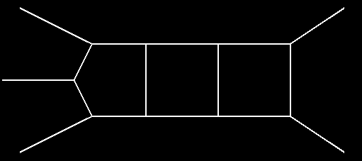
Applications of NeatIBP
A three-loop five-point planar diagram
Yuanche Liu, Antonela Matijašić, Julian Miczajka, Yingxuan Xu, Yongqun Xu, Yang Zhang, Phys.Rev.D 112 (2025) 1, 016021
“On a laptop, NeatIBP finds about 85000 IBP identities in full kinematics dependence within several hours. These relations are sufficient to derive the differential equation. As a comparison, standard IBP tools would generate three orders of magnitude more IBP relations, which make the reduction computation impossible.”
Traditional (Laporta) IBPs | NeatIBP
~ 1 0000 0000 IBPs | ~ 85000 IBPs
IBP reduction impossible | IBP reduction doable

Slide 16
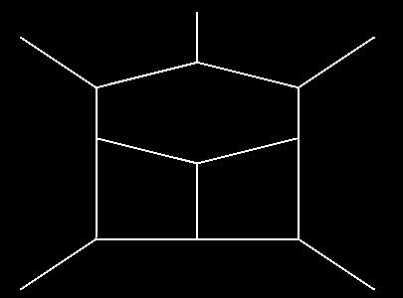
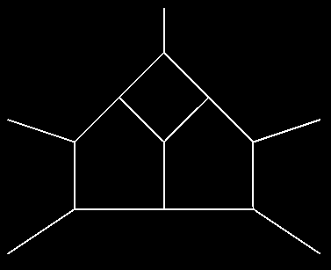
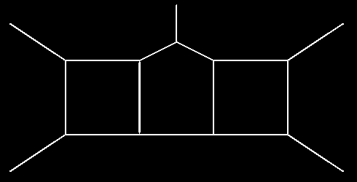
Applications of NeatIBP
More three-loop five-point planar diagrams
Dmitry Chicherin, Yu Wu, Zihao Wu, Yongqun Xu, Shun-Qing Zhang, Yang Zhang, 2512.17330
With the spanning cuts method developed in the latest version of NeatIBP (1.1), there are break throughs on the above diagrams.

Slide 17
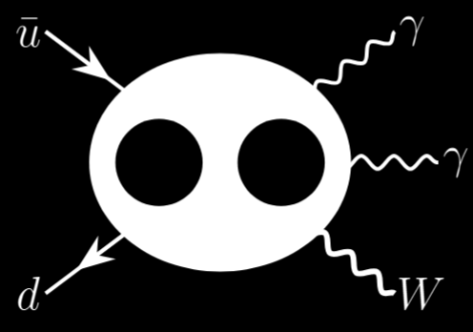
Applications of NeatIBP
𝑊𝛾𝛾 production at LHC
Cross section measurements
ATLAS
CMS
Phys. Rev. Lett. 115 (2015) 031802
Phys. Lett. B 848 (2024) 138400
JHEP 10 (2017) 072
JHEP 10 (2021) 174
Latest amplitude progress: NNLO correction in QCD
Simon Badger, Heribertus Bayu Hartanto, ZW, Yang Zhang and Simone Zoia, JHEP 03 (2025) 066

Slide 18
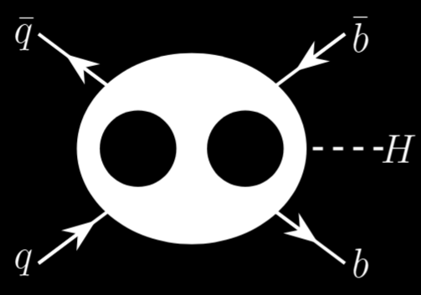
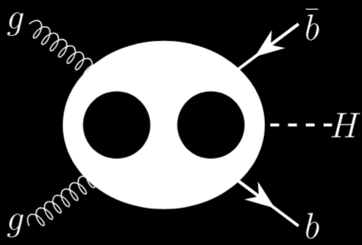

Applications of NeatIBP
$b\overline{b}H$ production at LHC
Cross section measurements
CMS
Phys. Lett. B 860 (2025) 139173
Latest amplitude progress: two-loop five-point amplitudes in 5FS
Simon Badger, Heribertus Bayu Hartanto, Rene Poncelet, ZW, Yang Zhang and Simone Zoia, JHEP 12 (2025) 221

Slide 19
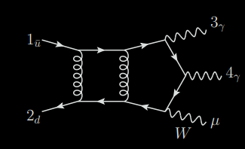
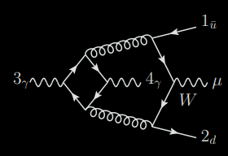
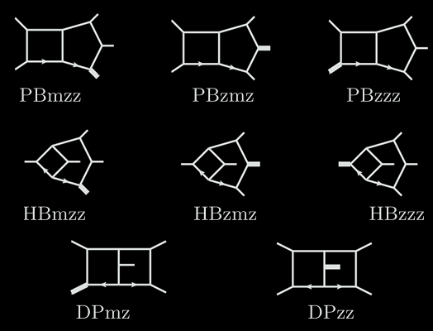
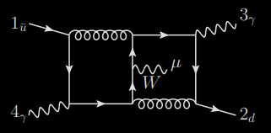
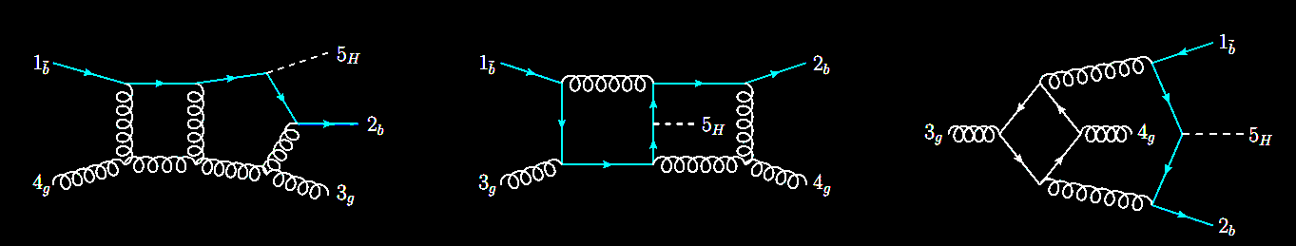
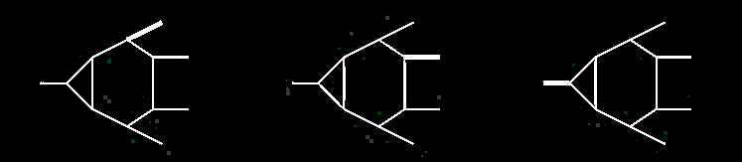
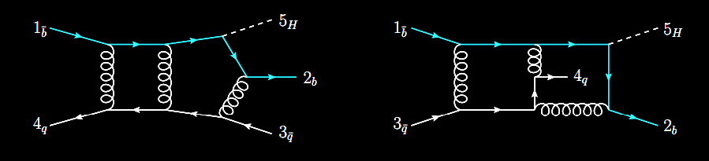
Scalar integral families
Wγγ
…
Tensor
reduction
$$b\overline{b}H$$
…

Slide 20
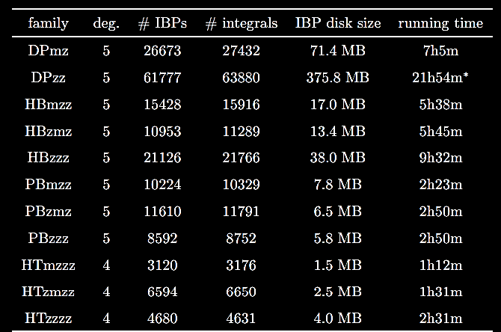
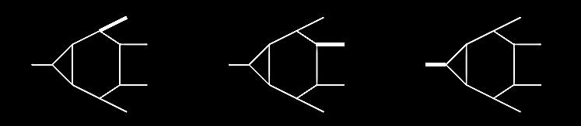
Workflow and performance of the tools
IBP systems from NeatIBP

Slide 21
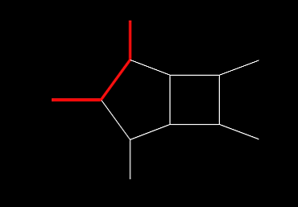
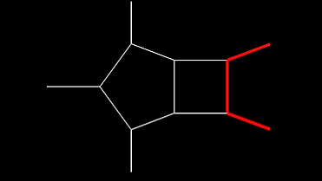
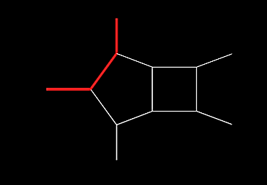
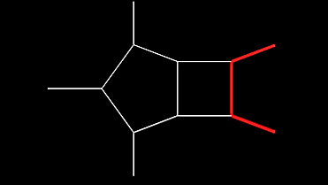
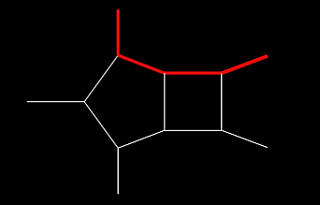
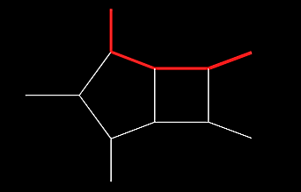
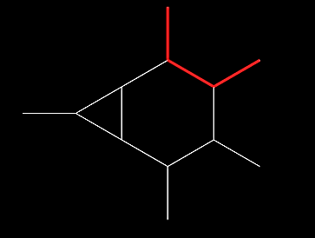
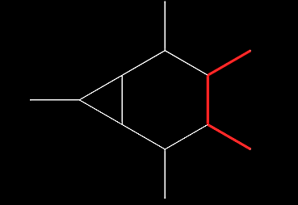
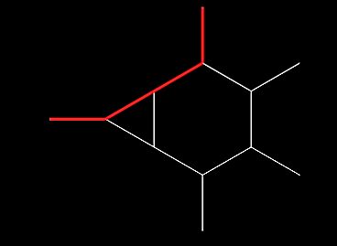
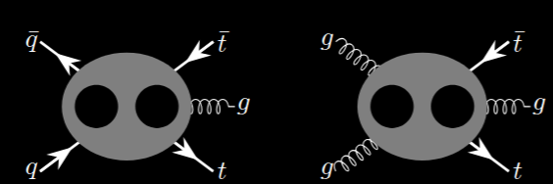

Applications of NeatIBP
Two-loop five-point diagrams with massive propagators
Applications:
$t \overline{t} j$ production
JHEP 07 (2024) 073
SciPost Phys. 19 (2025) 6, 165
JHEP 03 (2025) 070
2511.11424
2411.10856

Slide 22
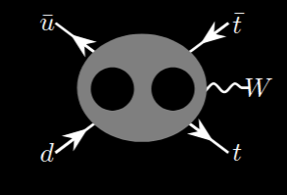

Applications of NeatIBP
Two-loop five-point diagrams with massive propagators
Applications:
$t \overline{t} W$ production
JHEP 07 (2025) 001

Slide 23
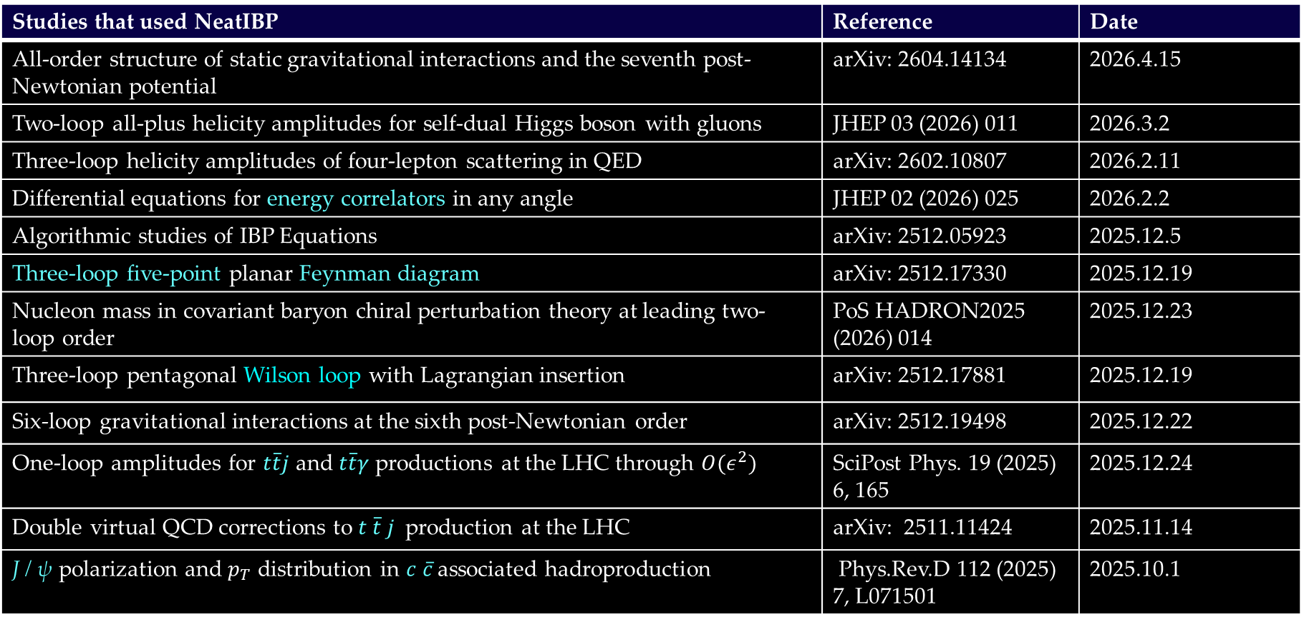
Applications of NeatIBP (1/2)
Studies that used NeatIBP | Reference | Date
All-order structure of static gravitational interactions and the seventh post-Newtonian potential | arXiv: 2604.14134 | 2026.4.15
Two-loop all-plus helicity amplitudes for self-dual Higgs boson with gluons | JHEP 03 (2026) 011 | 2026.3.2
Three-loop helicity amplitudes of four-lepton scattering in QED | arXiv: 2602.10807 | 2026.2.11
Differential equations for energy correlators in any angle | JHEP 02 (2026) 025 | 2026.2.2
Algorithmic studies of IBP Equations | arXiv: 2512.05923 | 2025.12.5
Three-loop five-point planar Feynman diagram | arXiv: 2512.17330 | 2025.12.19
Nucleon mass in covariant baryon chiral perturbation theory at leading two-loop order | PoS HADRON2025 (2026) 014 | 2025.12.23
Three-loop pentagonal Wilson loop with Lagrangian insertion | arXiv: 2512.17881 | 2025.12.19
Six-loop gravitational interactions at the sixth post-Newtonian order | arXiv: 2512.19498 | 2025.12.22
One-loop amplitudes for $t\overline{t}j$ and $t\overline{t}γ$ productions at the LHC through $O(ε^{2})$ | SciPost Phys. 19 (2025) 6, 165 | 2025.12.24
Double virtual QCD corrections to $t \overline{t} j$ production at the LHC | arXiv: 2511.11424 | 2025.11.14
J / ψ polarization and $p_{T}$ distribution in $c \overline{c}$ associated hadroproduction | Phys.Rev.D 112 (2025) 7, L071501 | 2025.10.1

Slide 24
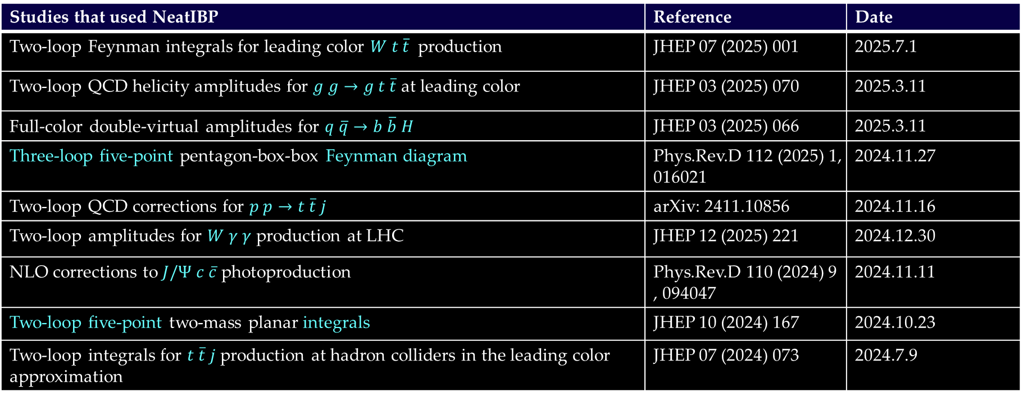
Applications of NeatIBP (2/2)
Studies that used NeatIBP | Reference | Date
Two-loop Feynman integrals for leading color $W t \overline{t}$ production | JHEP 07 (2025) 001 | 2025.7.1
Two-loop QCD helicity amplitudes for $g g→g t \overline{t}$ at leading color | JHEP 03 (2025) 070 | 2025.3.11
Full-color double-virtual amplitudes for $q \overline{q}→b \overline{b} H$ | JHEP 03 (2025) 066 | 2025.3.11
Three-loop five-point pentagon-box-box Feynman diagram | Phys.Rev.D 112 (2025) 1, 016021 | 2024.11.27
Two-loop QCD corrections for $p p→t \overline{t} j$ | arXiv: 2411.10856 | 2024.11.16
Two-loop amplitudes for $W γ γ$ production at LHC | JHEP 12 (2025) 221 | 2024.12.30
NLO corrections to $J/Ψ$ $c \overline{c}$ photoproduction | Phys.Rev.D 110 (2024) 9, 094047 | 2024.11.11
Two-loop five-point two-mass planar integrals | JHEP 10 (2024) 167 | 2024.10.23
Two-loop integrals for $t \overline{t} j$ production at hadron colliders in the leading color approximation | JHEP 07 (2024) 073 | 2024.7.9

Slide 25
NeatIBP New Developments

Slide 26

NeatIBP new developments: flexible degree bound in Singular
NeatIBP uses
to solve syzygy equations
Use degree bound to terminate too-high-degree computations
Too high: slow
Usually, we can set it globally.
But for hard problems one needs to tune, in different sectors…
A nice range of degree bound
Too low: incomplete solutions

Slide 27
NeatIBP new developments: flexible degree bound in Singular
To use the flexible degree bounds in NeatIBP
Start with:
Initial degBound: b
2. Time limit: T
3. Decrease limit: d
Solve syzygy at degBound=b-i
It finishes in time T?
Y
Return result
i=0
N
i > d?
i++
Return $Failed
N
Y
FlexibleNeatIBPIntersectionDegreeBound=True;
NeatIBPIntersectionTimeConstraintForFlexibleDegreeBound=[number of seconds];
NeatIBPIntersectionDegreeBoundDecreaseLimit=2;

Slide 28
NeatIBP new developments: flexible degree bound in Singular
To use the flexible degree bounds in NeatIBP
Start with:
Initial degBound: b
2. Time limit: T
3. Decrease limit: d
Solve syzygy at degBound=b-i
It finishes in time T?
Y
Return result
i=0
N
i > d?
i++
Return $Failed
N
Y
This feature is important in the recent three-loop five-point computations

Slide 29


NeatIBP new developments: IBP coefficients in Horner Form
An example
Form | Expression | + | ×
Expand |  | 2 | 8
HornerForm |  | 2 | 3
Benefit: less cost substituting numbers
Reduce an IBP system
Substituting numbers
Gaussian elimination of numerical matrix
Analytical reconstruction
In NeatIBP:
IBPCoefficientForm = HornerForm;

Slide 30
NeatIBP ongoing work
The spanning cuts consistency problem

Slide 31
Three-loop five-point planar diagrams
Rely on spanning cuts method developed in the latest version of NeatIBP (1.1)

Slide 32
The spanning cuts method
{1,3} - cut
{2,4} - cut
A spanning cuts is defined so that for all nonzero sector in a family, , such that
SpanningCutsMode=True;
Step 1: Run NeatIBP on each cut
Current version of NeatIBP avoids cutting multiple propagators. Thus, for integrals such that , means
Benefit：
1. Split a difficult problem into simpler pieces
2. Parallelizable
Step 2: Reduce the IBP system on each cut
Kira
Step 3: Merge the reduced IBP system of all cuts

Slide 33
The consistency problem
{1,3} - cut
{2,4} - cut
merge
Currently, NeatIBP uses a “direct” merging strategy:
Consistency condition
NeatIBP checks consistency conditions before merging the spanning cut systems. This step cannot be omitted because the condition is NOT always guaranteed according to our observation.

Slide 34
A first look into the diagrams with inconsistency
TBA in ZW, Yingxuan Xu, Yang Zhang, 26xx.xxxx
A pattern:
Safter: without internal massive propagators
Less safe: with internal massive propagators

Slide 35
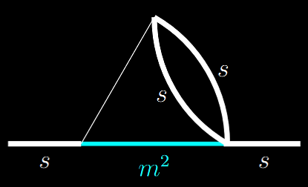
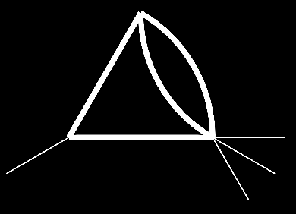

A first look into the diagrams with inconsistency
TBA in ZW, Yingxuan Xu, Yang Zhang, 26xx.xxxx
A problematic structure: one external massless momentum with massive propagators
Corresponding diagrams
Diagram with such sub-structure

Slide 36
Some of the NeatIBP future plans

Slide 37
NeatIBP Future plan: a better seeding strategy?
IBP reduction work flow
Find IBP generators
Seeding
NeatIBP improves the generators
The seeding becomes a relatively more important bottleneck recently
IBP system
Solve system
Reduction results

Slide 38
NeatIBP Future plan: build an automized framework via interface developments
A framework that automatically evaluates Feynman integrals with the procedures:
1. Generating IBP system
2. Solving IBP system
3. Evaluating master integrals
Kira
AMFlow
Xiao Liu, Yan-Qing Ma, Comput.Phys.Commun. 283 (2023) 108565
NeatIBP
FiniteFlow
AmpRed
Wen Chen,
Comput.Phys.Commun. 312 (2025) 109607,
2505.13540
Tiziano Peraro, JHEP 07 (2019) 031
……
……

Slide 39
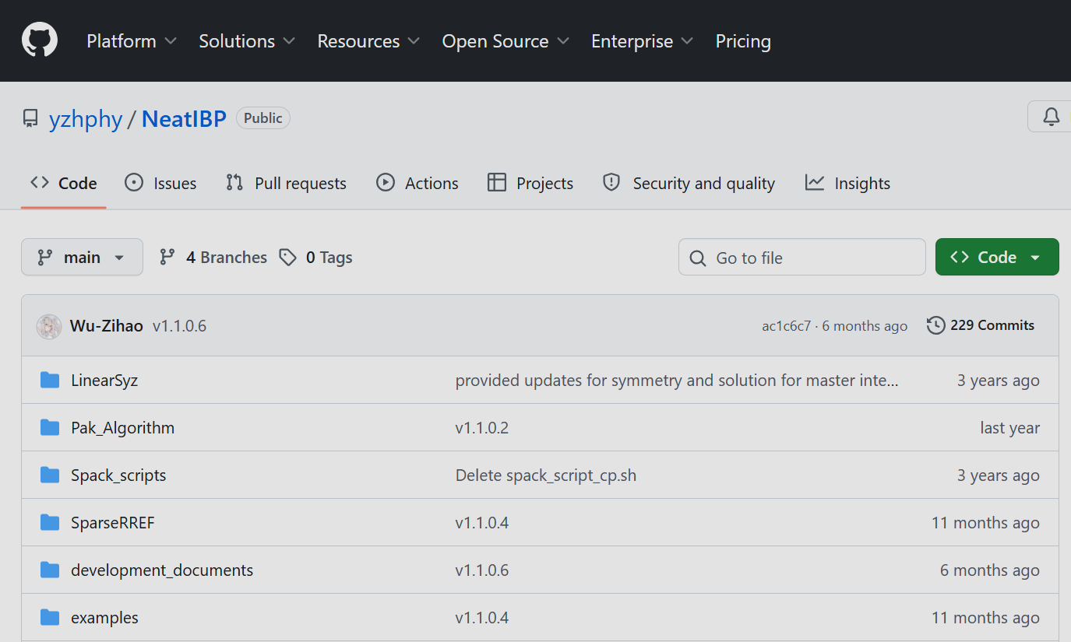
Thank you!
Welcome to have a try!
https://github.com/yzhphy/NeatIBP

