Slide 1

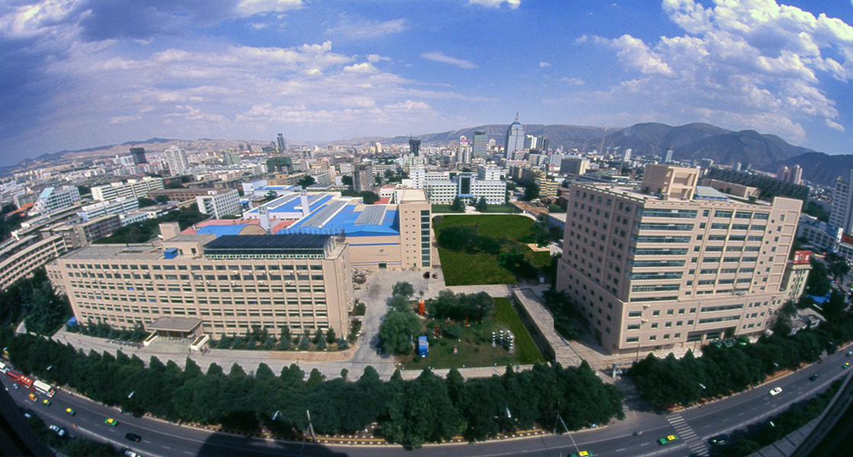






Heavy Meson on the Light-front
$$†$$
$$†$$
$$†$$
Xingbo Zhao, Jiatong Wu, Hengfei Zhao,
Kaiyu Fu, James P. Vary
Institute of Modern Physics, CAS, Lanzhou, China
Iowa State University, Ames, US
$$†$$
*
$$†$$
*
第八届全国重味物理与量子色动力学研讨会 重庆 2026年4月27日

Slide 2
Outline
Basis Light-front Quantization
Application to heavy mesons
Summary

Slide 3




Light-front Quantization
Equal time quantization
Light-front quantization
[Dirac, 1949]
Time variable
Quantization surface
Coordinate space
$$x^{1},x^{2},x^{3}$$
$${x^{−}=x}^{0}−x^{3},$$
$$x^{⊥}=x^{1,2}$$
Momentum Space
$$P^{0},\overset{⃑}{P}$$
$${P^{−}=P}^{0}−P^{3},$$
${P^{+}=P}^{0}+P^{3}$,$P^{⊥}=P^{1,2}$
Dispersion relation
Notes:
Light front was first proposed by Dirac, at 1949.
1. First, what is light-front. Different from equal time theory. We define light-front time as a linear combination of the regular time and one of the spatial coordinate, usually we choose z direction.
So our field quantized at this equal light-front time plane. Where in equal time quantization, they quantized at this equal time plane.
X minus is longitudinal coordinate. P minus is light front Hamiltonian. P plus is longitudinal momentum.
This is light front version of schordinger equation.
Please note that it is not just a coodernate transformation, it is a new theory in a different quantization.
Why go to light front? For we can get Frame Independent wavefunction. Which encods all the information of the bound state structure. It has simple vacuum structure. The theory is boost invariant. And there is no square root in Hamiltonian p minus.

Slide 4
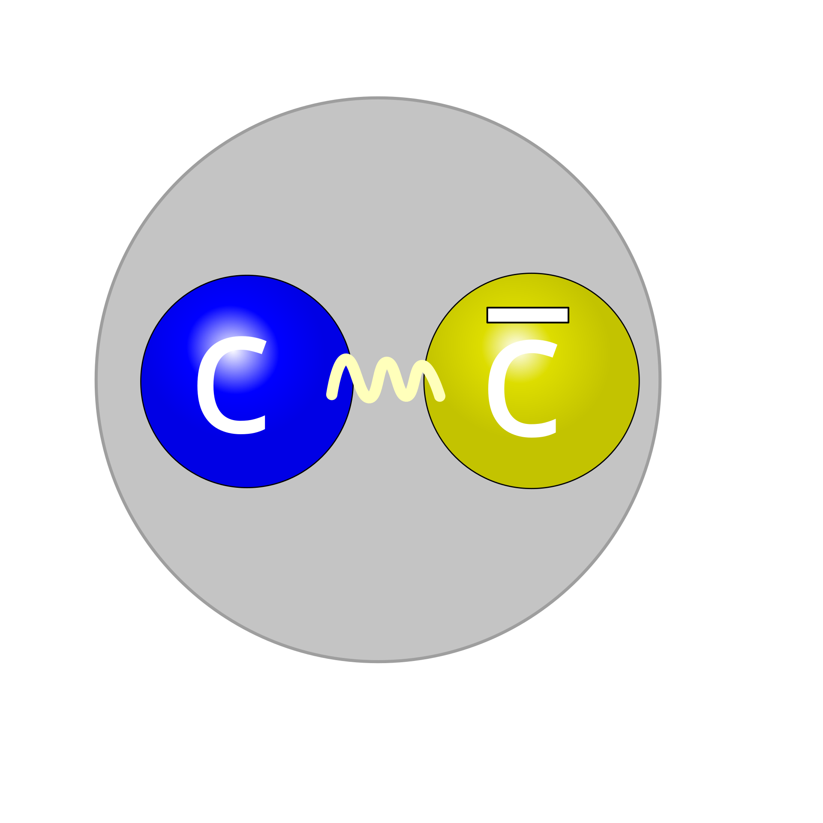
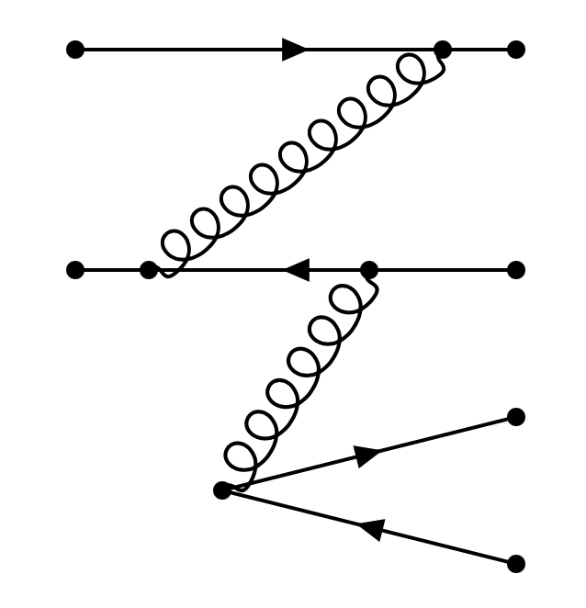
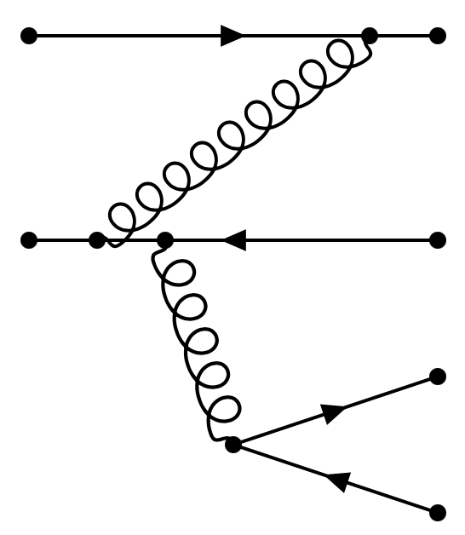






Retardation Effect on Light Front
Equal-time vs. light-front quantization
  Proton wave function in Fock space:
  $$\left|Ψ\right\rangle =a\left|q\overline{q}\right\rangle +b\left|q\overline{q}g\right\rangle +c\left|q\overline{q}q\overline{q}\right\rangle +…$$
Equal-time quantization
Light-front quantization
$$x^{0}=const$$
$$x^{+}=const$$
Vacuum:
$$k_{vac}=0$$
$$k_{vac}^{+}=0$$
Particle:
$k^{3}≥0$ or $k^{3}<0$
$$k^{+}=k^{0}+k^{3}>0$$
Higher Fock sectors:
vacuum bubbles
retardation effect
Wave function:
snapshot
hologram of hadron structure
For on-shell particles, $k^{0}≥k^{3}$, so $k^{+}=k^{0}+k^{3}≥0$
Simple vacuum in LF quantization hologram of hadron structure
Higher Fock sectors reflect retardation effect
Equal-time wave function contaminated by vacuum
ET wave function: conceptually incorrect; numerically challenging

Slide 5
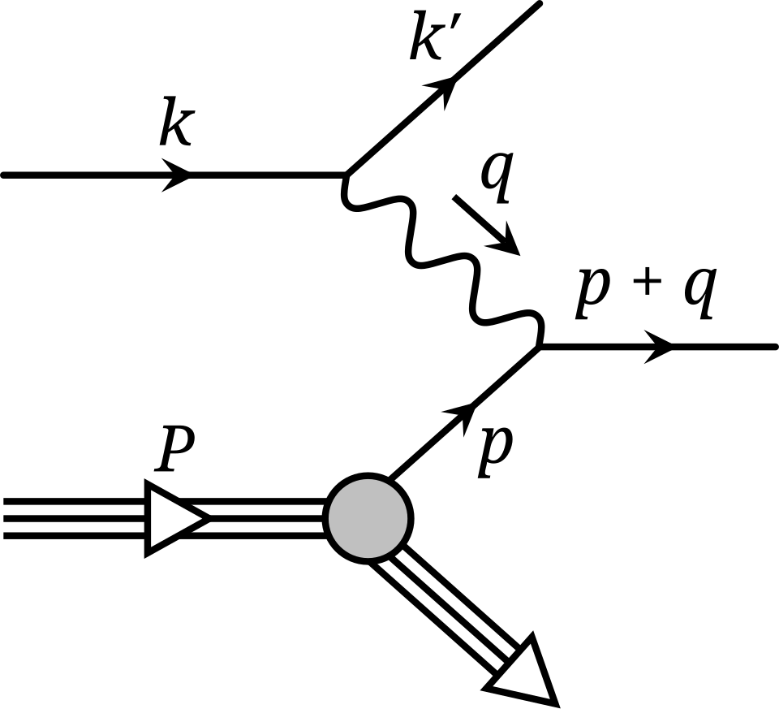
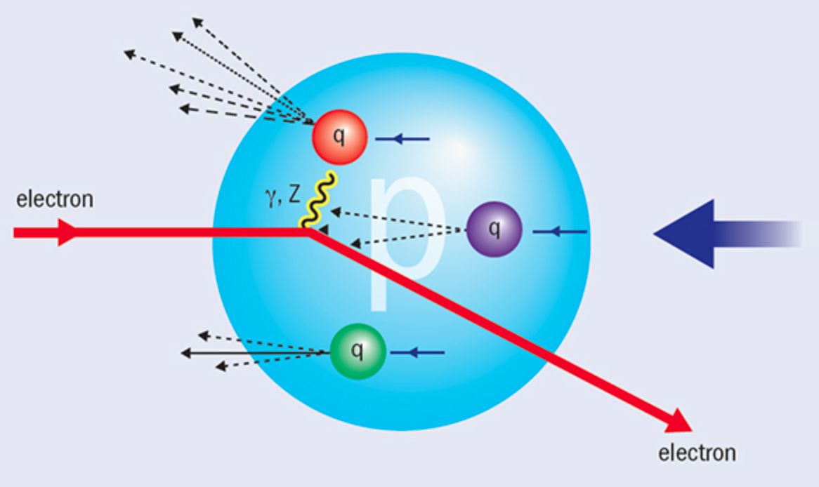

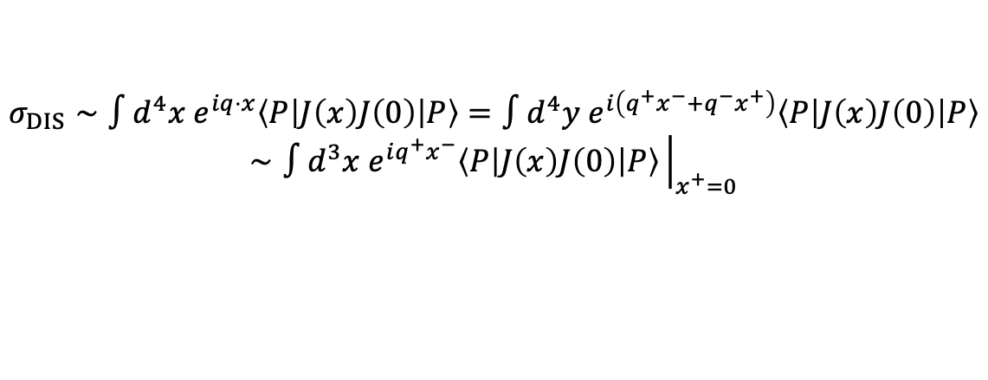
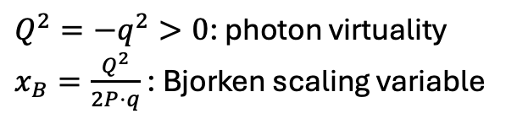
Deep Inelastic Scattering
Modern Rutherford Experiment – DIS (SLAC 1968)
$Q^{2}=−q^{2}>0$: photon virtuality
$x_{B}=\frac{Q^{2}}{2P⋅q}$ : Bjorken scaling variable
Bjorken limit: $Q^{2}→∞$ and $x_{B}$ fixed large $q^{+}$ direction
Select $x^{+}=0$ (light front) probes physics on the light front
$$σ_{DIS}∼∫d^{4}x e^{iq⋅x}\left\langle P\left|J\left(x\right)J\left(0\right)\right|P\right\rangle =∫d^{4}y e^{i\left(q^{+}x^{−}+q^{−}x^{+}\right)}\left\langle P\left|J\left(x\right)J\left(0\right)\right|P\right\rangle$$
$$∼∫d^{3}x e^{iq^{+}x^{−}}\left\langle P\left|J\left(x\right)J\left(0\right)\right|P\right\rangle {\left.​\right|}_{x^{+}=0}$$

Slide 6
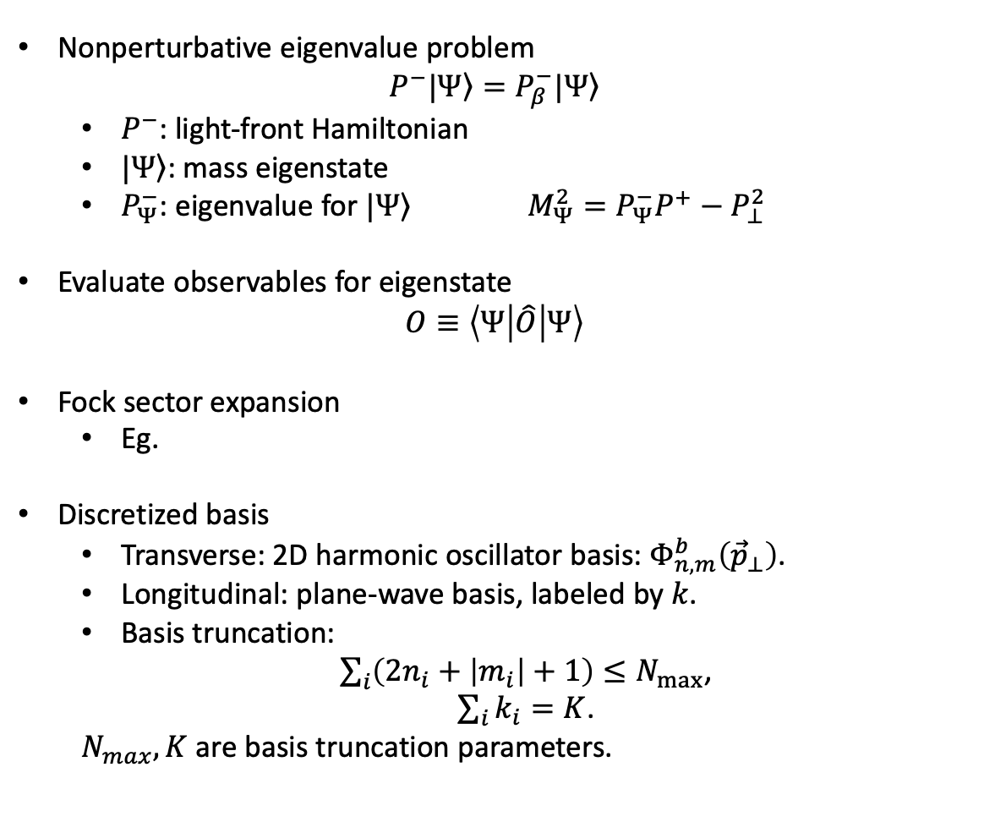

Basis Light-front Quantization
[Vary et al, 2008]
Nonperturbative eigenvalue problem
$$P^{−}|\left.Ψ\right\rangle =P_{β}^{−}|\left.Ψ\right\rangle$$
  $P^{−}$: light-front Hamiltonian
  $|\left.Ψ\right\rangle$: mass eigenstate
  $P_{Ψ}^{−}$: eigenvalue for $|\left.Ψ\right\rangle$ $M_{Ψ}^{2}=P_{Ψ}^{−}P^{+}−P_{⊥}^{2}$
Evaluate observables for eigenstate
$$O≡\left\langle Ψ | \hat{O} | Ψ\right\rangle$$
Fock sector expansion
  Eg.
Discretized basis
  Transverse: 2D harmonic oscillator basis:${ Φ}_{n,m}^{b}\left({\vec{p}}_{⊥}\right)$.
  Longitudinal: plane-wave basis, labeled by $k$.
  Basis truncation:
  $\sum_{i}{\left(2n_{i}+\left|m_{i}\right|+1\right)}≤N_{max}$,
  $\sum_{i}{k_{i}}=K$.
  $N_{max}, K$ are basis truncation parameters.
  $$\left|Ψ\right\rangle =a\left|q\overline{q}\right\rangle +b\left|q\overline{q}g\right\rangle +c\left|q\overline{q}q\overline{q}\right\rangle +…$$
Large $N_{max}$ and $K$ : High UV cutoff & low IR cutoff
Notes:
1.

Slide 7
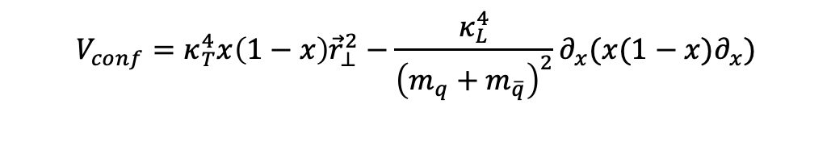
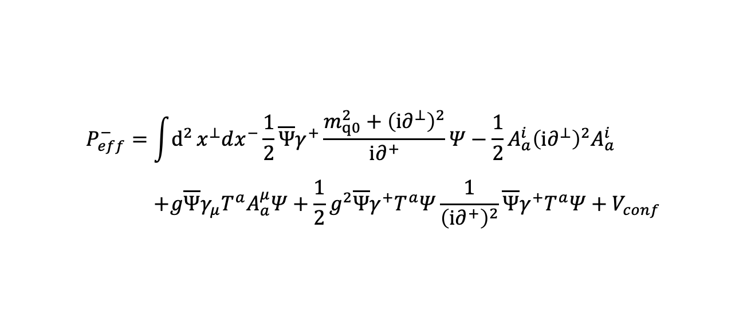
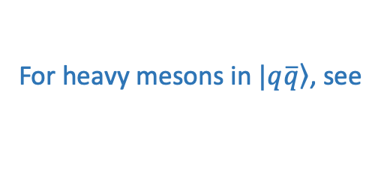
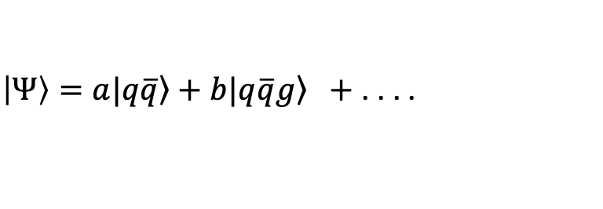
Heavy Meson
For heavy mesons in $\left.|q\overline{q}\right\rangle$, see
$\left|Ψ\right\rangle =a\left.|q\overline{q}\right\rangle +b\left.|q\overline{q}g\right\rangle +$ . . . .
[Yang Li, et al, 2017]
[arXiv:2603.08114]
[Shuo Tang, et al, 2020]
Light-front QCD Hamiltonian + effective confining potential:
$$\begin{aligned}P_{eff}^{−}=&\int{d^{2}}x^{⊥}dx^{−}\frac{1}{2}\overline{Ψ}γ^{+}\frac{m_{q0}^{2}+{\left(i∂^{⊥}\right)}^{2}}{i∂^{+}}Ψ−\frac{1}{2}A_{a}^{i}{\left(i∂^{⊥}\right)}^{2}A_{a}^{i} \\ & \\ &+g\overline{Ψ}γ_{μ}T^{a}A_{a}^{μ}Ψ+\frac{1}{2}g^{2}\overline{Ψ}γ^{+}T^{a}Ψ\frac{1}{{\left(i∂^{+}\right)}^{2}}\overline{Ψ}γ^{+}T^{a}Ψ+V_{conf}\end{aligned}$$
Confining potential:
Long-distance
$$V_{conf}=κ_{T}^{4}x\left(1−x\right){\vec{r}}_{⊥}^{2}−\frac{κ_{L}^{4}}{{\left(m_{q}+m_{\overline{q}}\right)}^{2}}∂_{x}(x(1−x)∂_{x})$$
Inspired by light-front holographic QCD
Longitudinal confinement
[Brodsky, et al, 2015]
[Yang Li, et al, 2016]

Slide 8
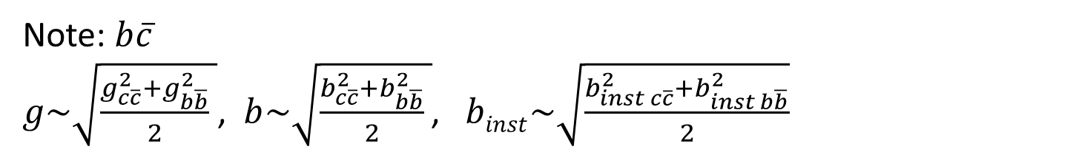
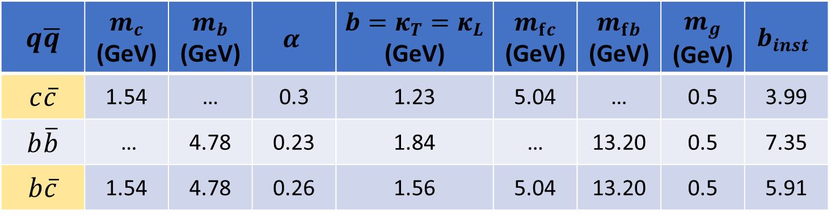

Parameters
$$q\overline{q}$$ | $$m_{c}$$ (GeV) | $$m_{b}$$ (GeV) | $$α$$ | $${b=κ}_{T}=κ_{L}$$ (GeV) | $$m_{fc}$$ (GeV) | $$m_{fb}$$ (GeV) | $$m_{g}$$ (GeV) | $$b_{inst}$$
$$c\overline{c}$$ | 1.54 | … | 0.3 | 1.23 | 5.04 | … | 0.5 | 3.99
$$b\overline{b}$$ | … | 4.78 | 0.23 | 1.84 | … | 13.20 | 0.5 | 7.35
$$b\overline{c}$$ | 1.54 | 4.78 | 0.26 | 1.56 | 5.04 | 13.20 | 0.5 | 5.91
Note: $b\overline{c}$
$g\sim \sqrt{\frac{g_{c\overline{c}}^{2}+g_{b\overline{b}}^{2}}{2} }$, $b\sim \sqrt{\frac{b_{c\overline{c}}^{2}+b_{b\overline{b}}^{2}}{2} }$, $binst\sim \sqrt{\frac{b_{inst c\overline{c}}^{2}+b_{inst b\overline{b}}^{2}}{2}}$
This Work: $N_{max}=12,K_{max}=17,M_{J}=0$

Slide 9
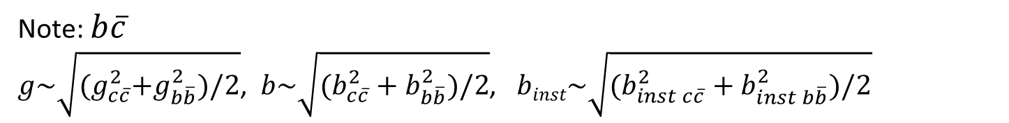
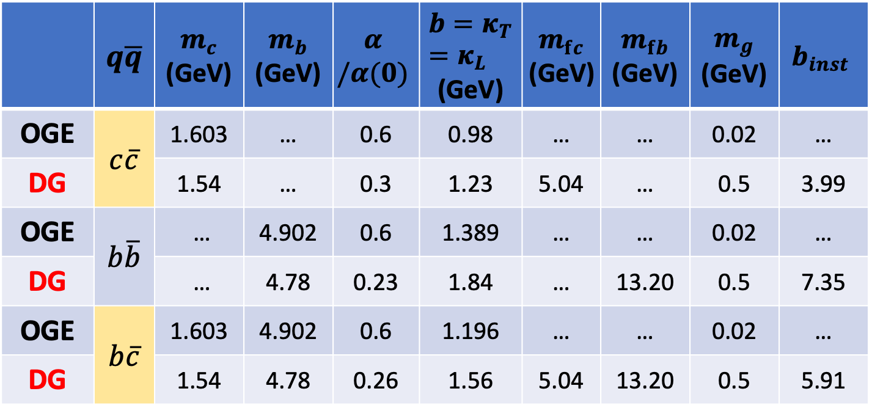
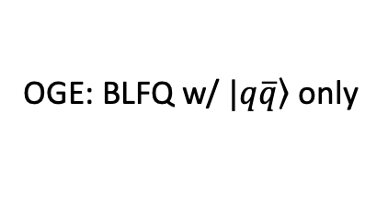

Parameters
 | $$q\overline{q}$$ | $$m_{c}$$ (GeV) | $$m_{b}$$ (GeV) | $$α$$ $$/α(0)$$ | $${b=κ}_{T}=κ_{L}$$ (GeV) | $$m_{fc}$$ (GeV) | $$m_{fb}$$ (GeV) | $$m_{g}$$ (GeV) | $$b_{inst}$$
OGE | $$c\overline{c}$$ | 1.603 | … | 0.6 | 0.98 | … | … | 0.02 | …
DG |  | 1.54 | … | 0.3 | 1.23 | 5.04 | … | 0.5 | 3.99
OGE | $$b\overline{b}$$ | … | 4.902 | 0.6 | 1.389 | … | … | 0.02 | …
DG |  | … | 4.78 | 0.23 | 1.84 | … | 13.20 | 0.5 | 7.35
OGE | $$b\overline{c}$$ | 1.603 | 4.902 | 0.6 | 1.196 | … | … | 0.02 | …
DG |  | 1.54 | 4.78 | 0.26 | 1.56 | 5.04 | 13.20 | 0.5 | 5.91
Note: $b\overline{c}$
$g\sim \sqrt{{(g}_{c\overline{c}}^{2}+g_{b\overline{b}}^{2})/2}$, $b\sim \sqrt{(b_{c\overline{c}}^{2}+b_{b\overline{b}}^{2})/2}$, $binst\sim \sqrt{(b_{inst c\overline{c}}^{2}+b_{inst b\overline{b}}^{2})/2}$
This work: $N_{max}=12,K_{max}=17,M_{J}=0$
OGE: BLFQ w/ $\left.|q\overline{q}\right\rangle$ only
[Yang Li, et al, 2017]
[Shuo Tang, et al, 2020]

Slide 10
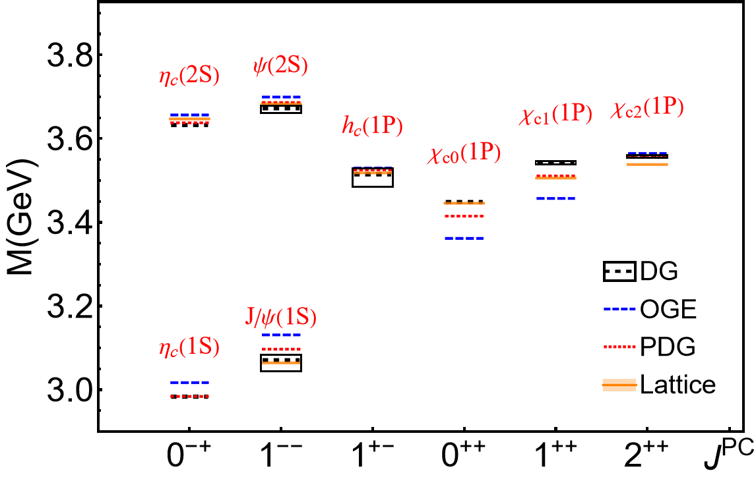
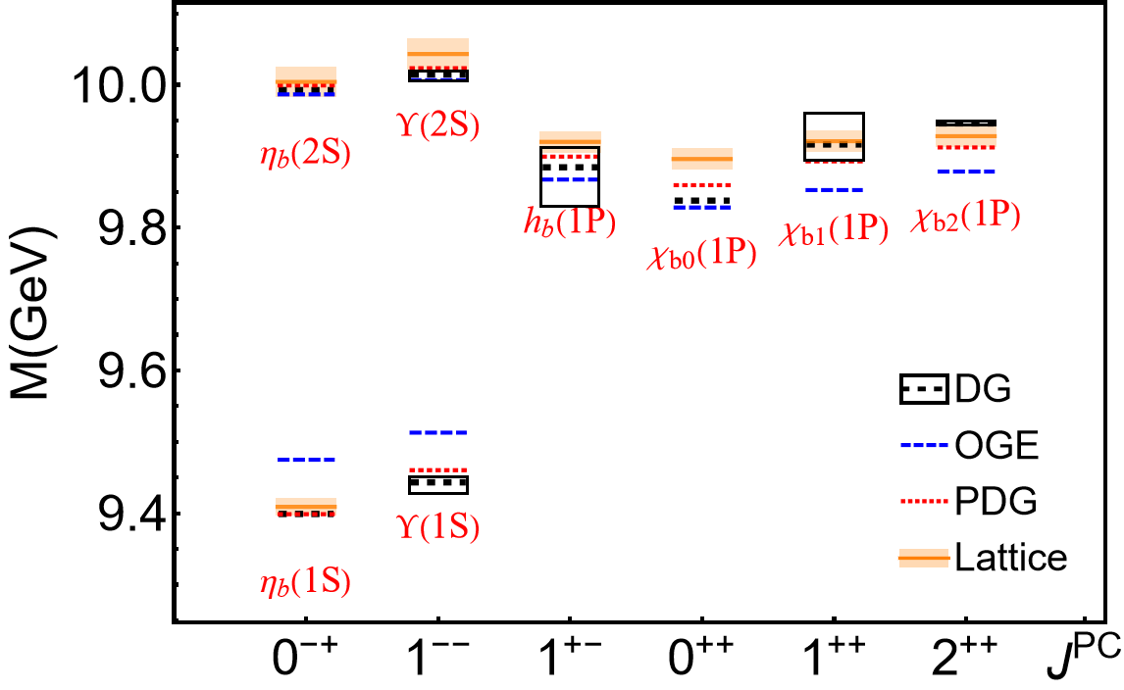
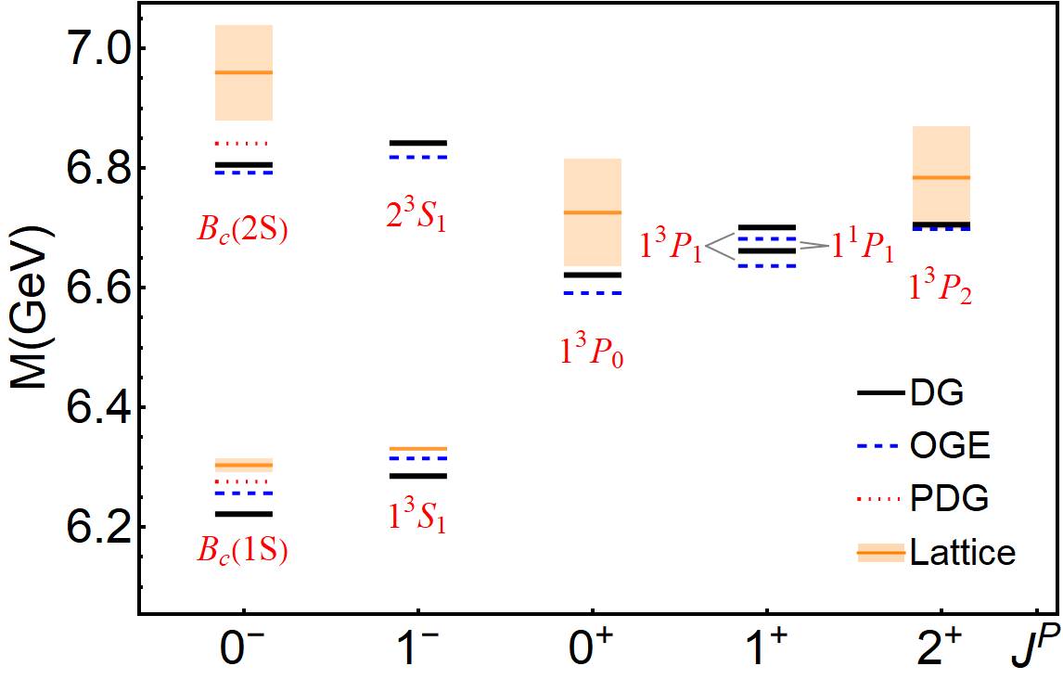




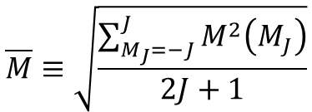
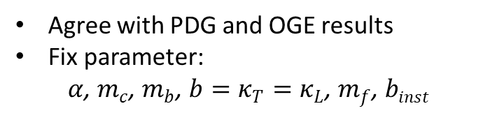

Mass spectrum
Charmonium
Bottomonium
$$\overline{M}≡\sqrt{\frac{\sum_{M_{J}=−J}^{J}{M^{2}\left(M_{J}\right)}}{2J+1}}$$
$B_{c}$meson
$$δM_{J}≡\max\left[M\left(M_{J}\right)\right]−\min\left[M\left(M_{J}\right)\right]$$
Agree with PDG and OGE results
Fix parameter:
$α$, $m_{c}$, $m_{b}$, $b=κ_{T}=κ_{L}$, $m_{f}$, $binst$
Lattice: [Davies, et al, 1996, Allison, et al, 2005,
Gregory, et al, 2010, Liu, et al, 2012, Aarts, et al, 2014]
OGE($c\overline{c} and b\overline{b}$) : [Yang Li, et al, 2017]
This Work: $N_{max}=12,K_{max}=17,M_{J}=0$
OGE($b\overline{c}$) : [Shuo Tang, et al, 2018]

Slide 11
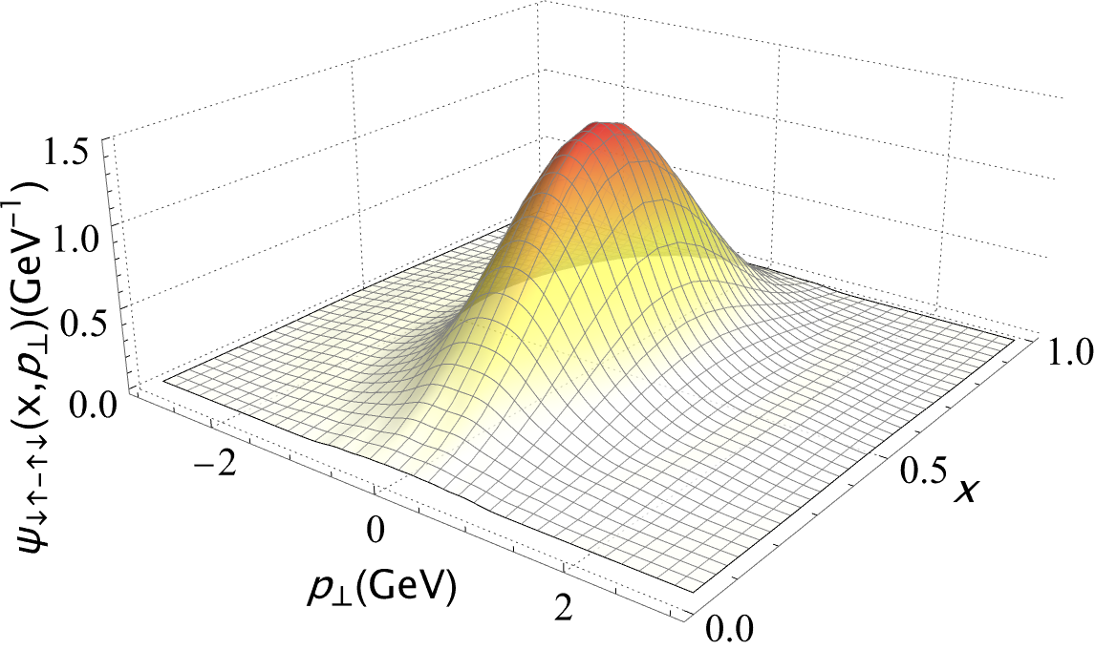
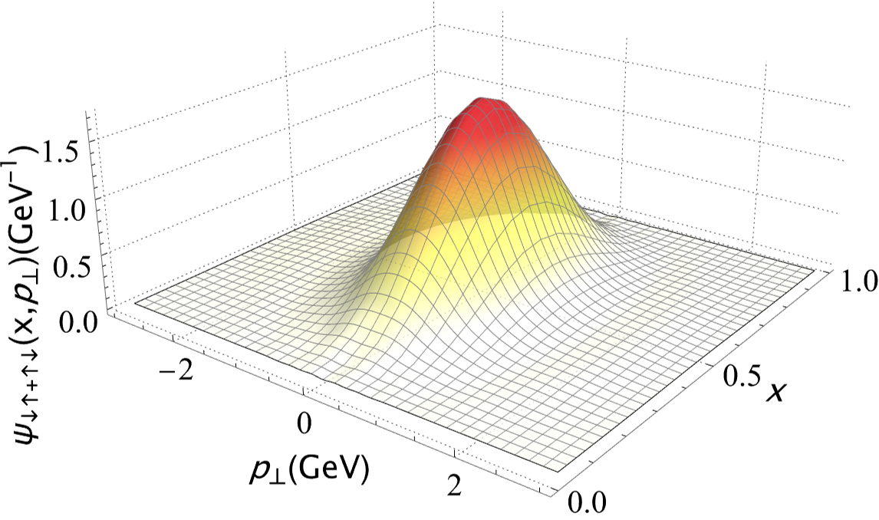
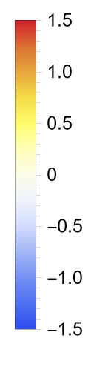
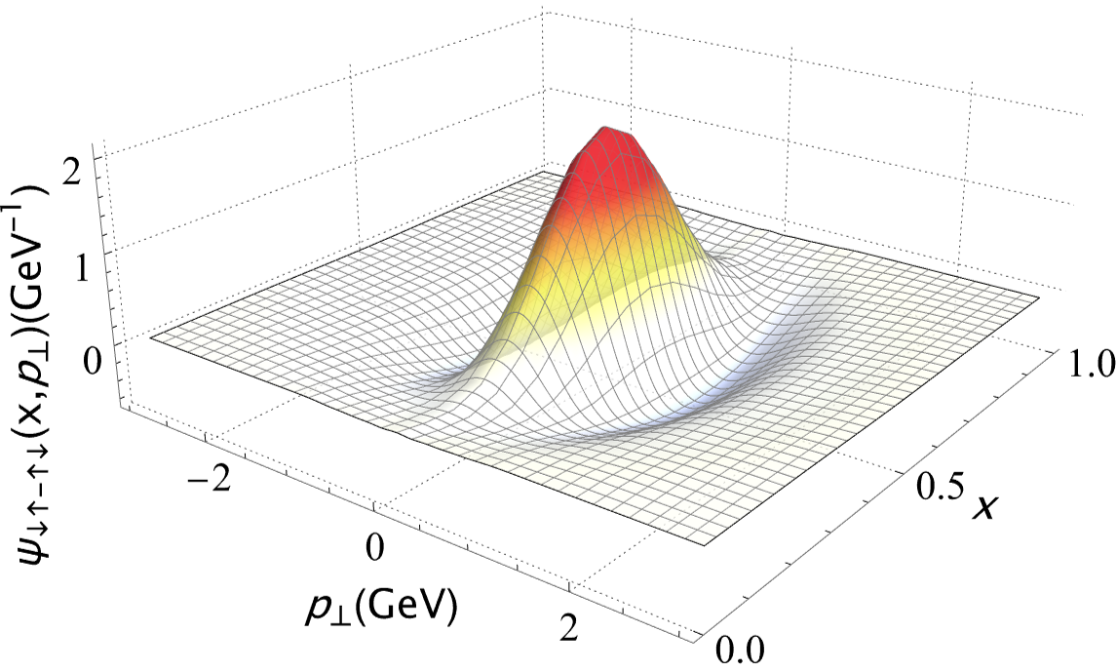
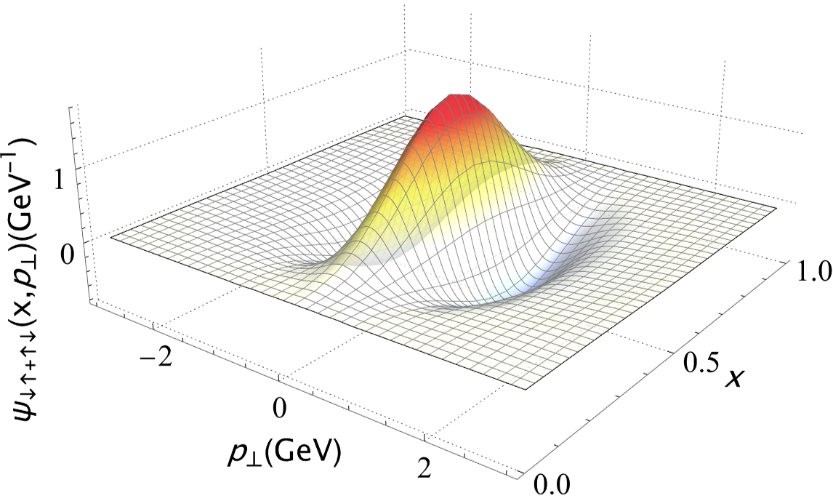


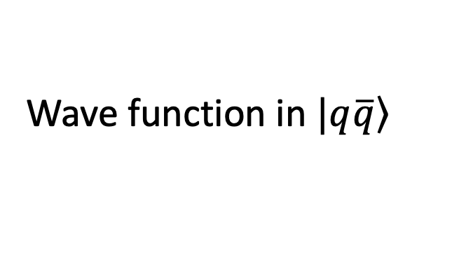






Wave function in $\left.|q\overline{q}\right\rangle$
[arXiv:2603.08114]
$$η_{c}\left(1S\right)$$
$$J/ψ\left(1S\right)$$
$$Norm_{q\overline{q}}=0.643$$
$$Norm_{q\overline{q}}=0.639$$
Charmonium S-wave
$$η_{c}\left(2S\right)$$
$$ψ\left(2S\right)$$
$$Norm_{q\overline{q}}=0.504$$
$$Norm_{q\overline{q}}=0.529$$
Longitudinal direction nodal structure is less pronounced
Absence of explicit rotational symmetry

Slide 12
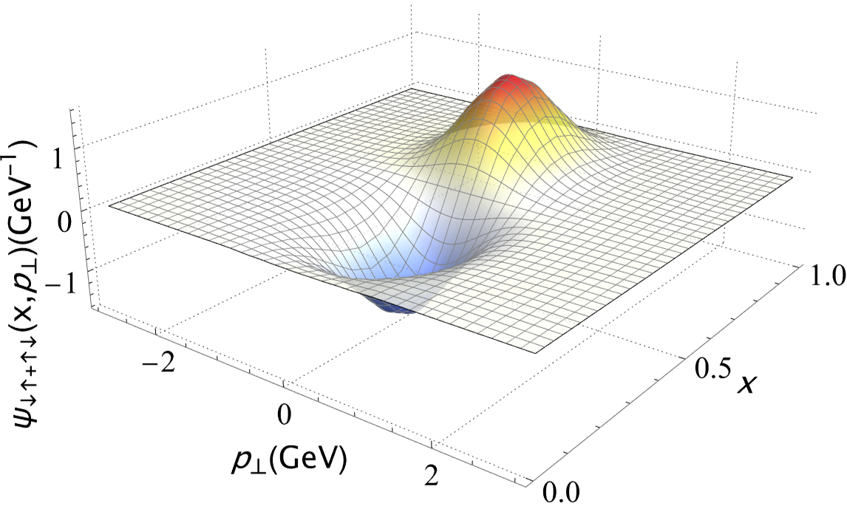
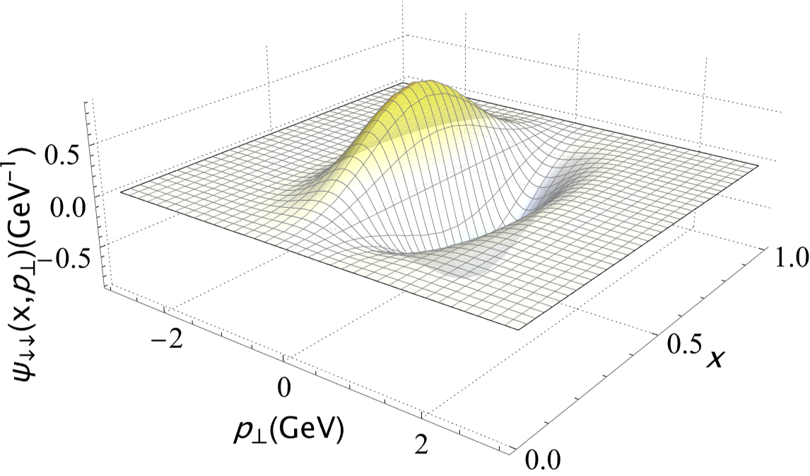

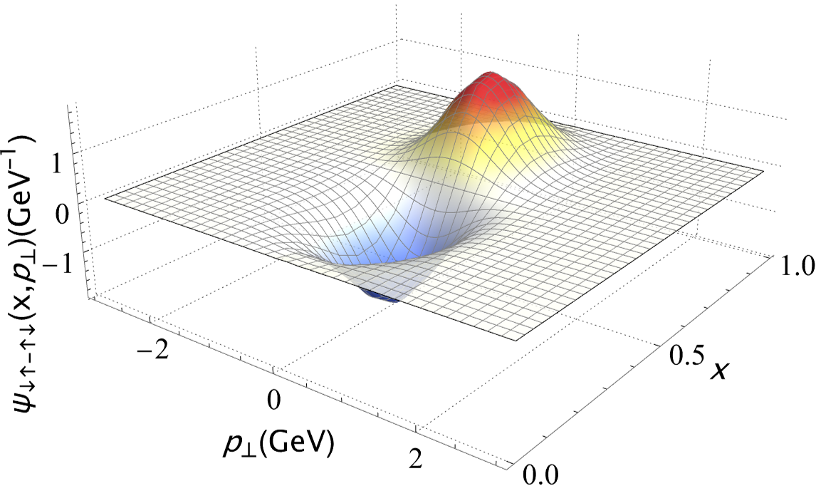
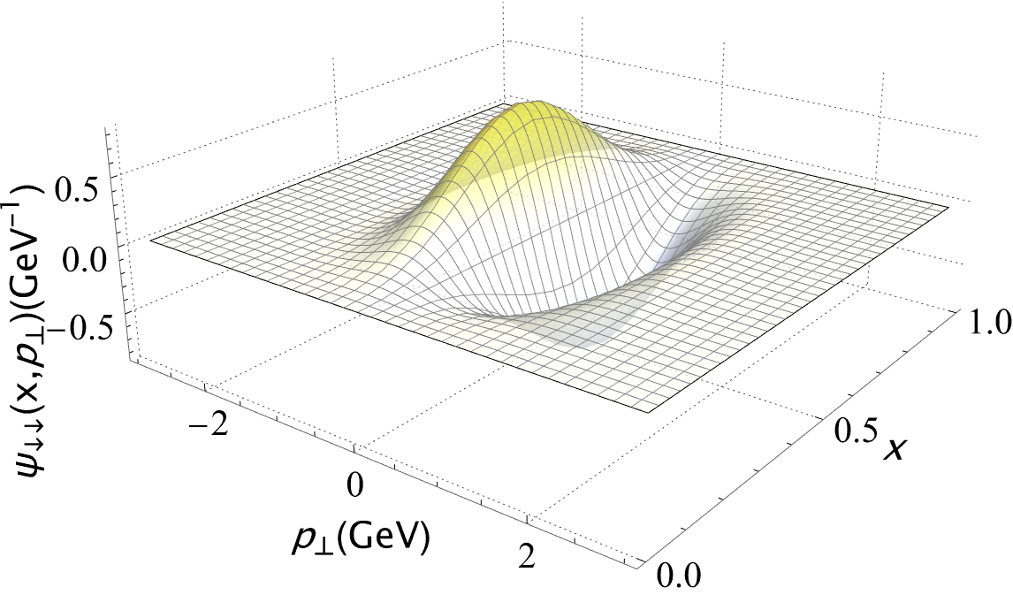







Wave function in $\left.|q\overline{q}\right\rangle$
[arXiv:2603.08114]
$$χ_{c0}\left(1P\right)$$
$$χ_{c1}\left(1P\right)$$
$$Norm_{q\overline{q}}=0.533$$
$$Norm_{q\overline{q}}=0.501$$
Charmonium P-wave
$$h_{c}\left(1P\right)$$
$$χ_{c2}\left(1P\right)$$
$$Norm_{q\overline{q}}=0.531$$
$$Norm_{q\overline{q}}=0.503$$
$Norm_{q\overline{q}}$is larger in the longitudinal excited state

Slide 13
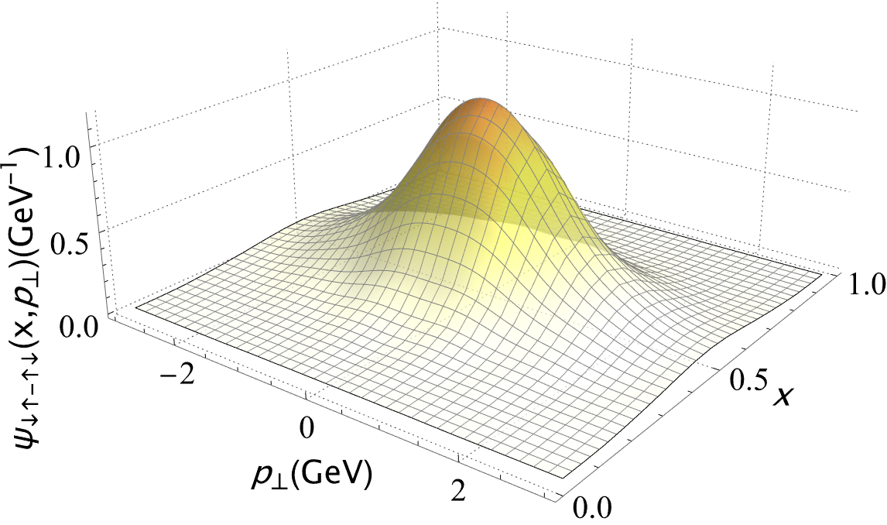

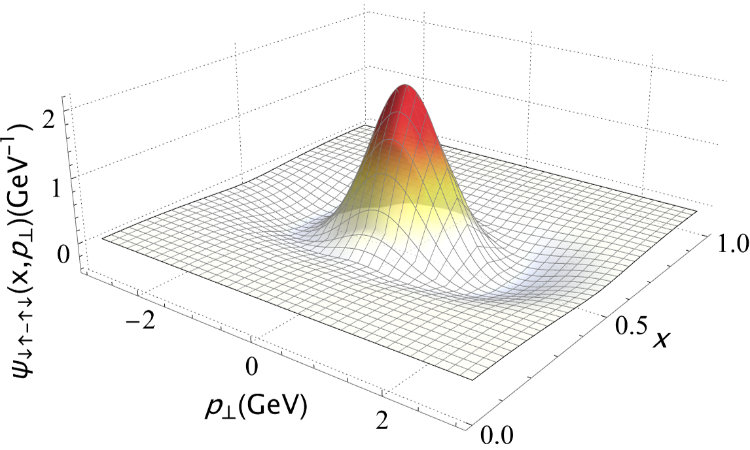
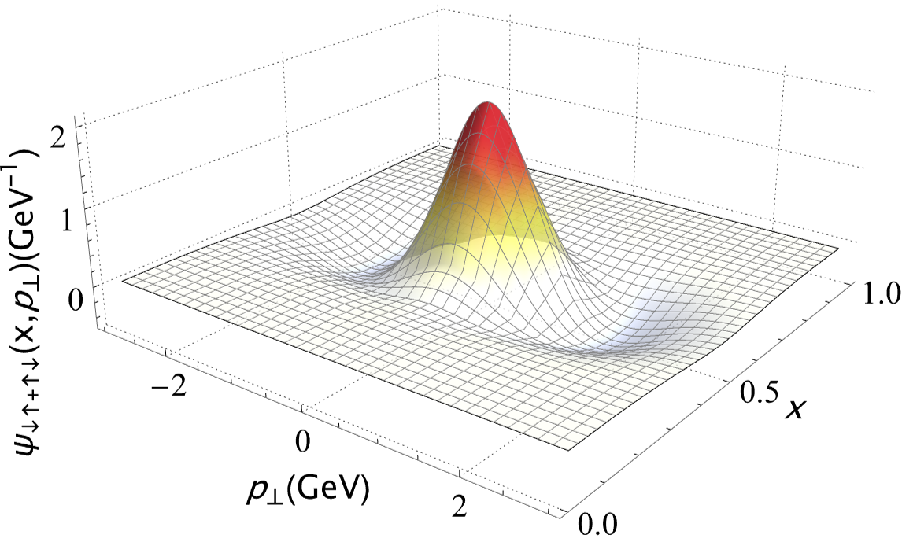


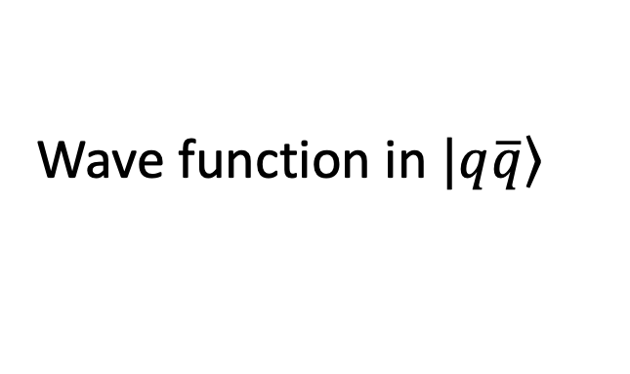






Wave function in $\left.|q\overline{q}\right\rangle$
[arXiv:2603.08114]
$$η_{b}\left(1S\right)$$
$$Υ\left(1S\right)$$
$$Norm_{q\overline{q}}=0.811$$
$$Norm_{q\overline{q}}=0.815$$
Bottomonium
S-wave
$$η_{b}\left(2S\right)$$
$$Υ\left(2S\right)$$
$$Norm_{q\overline{q}}=0.688$$
$$Norm_{q\overline{q}}=0.698$$
Broader distribution in the transverse momentum space compared to the charmonium
$Norm_{q\overline{q}}$is larger, due to larger mass scale

Slide 14
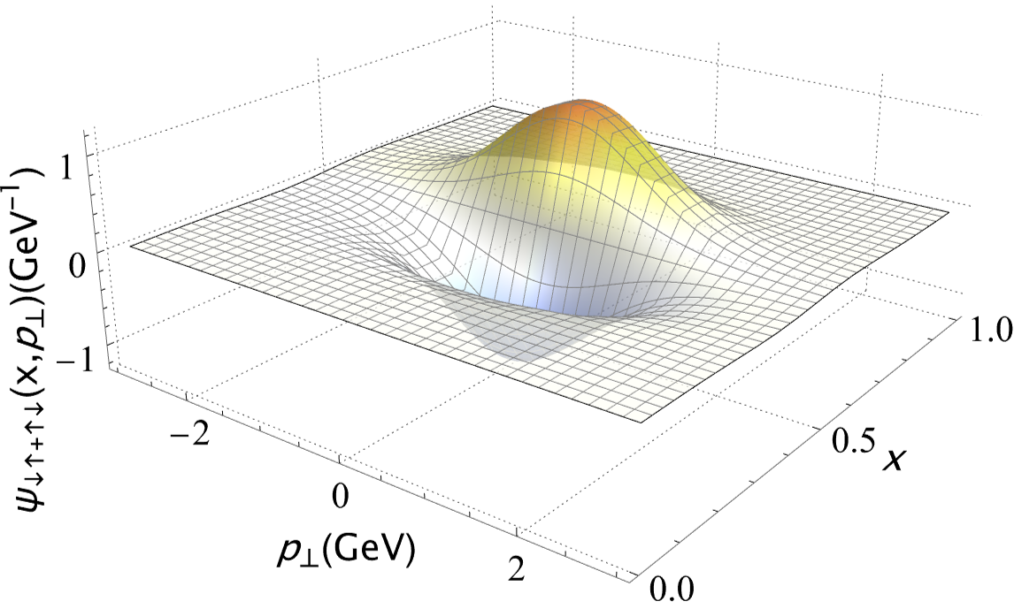
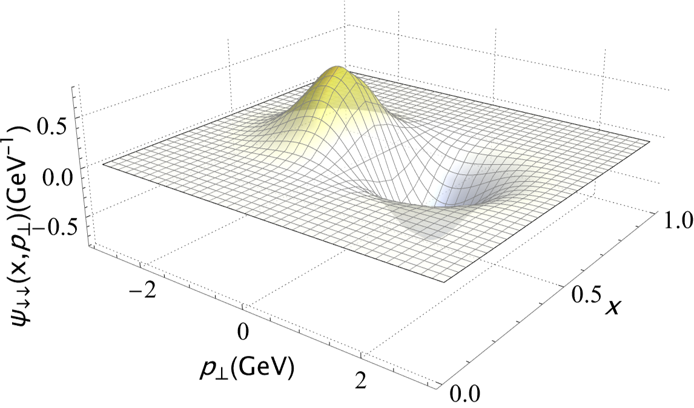
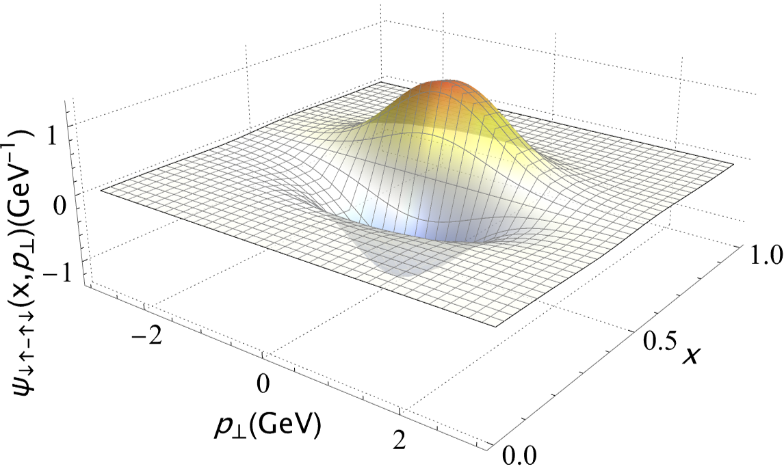









Wave function in $\left.|q\overline{q}\right\rangle$
[arXiv:2603.08114]
$$χ_{b0}\left(1P\right)$$
$$χ_{b1}\left(1P\right)$$
$$Norm_{q\overline{q}}=0.713$$
$$Norm_{q\overline{q}}=0.690$$
Bottomonium
P-wave
$$h_{b}\left(1P\right)$$
$$χ_{b2}\left(1P\right)$$
$$Norm_{q\overline{q}}=0.711$$
$$Norm_{q\overline{q}}=0.690$$
Same excitation pattern for the P-wave charmonium

Slide 15
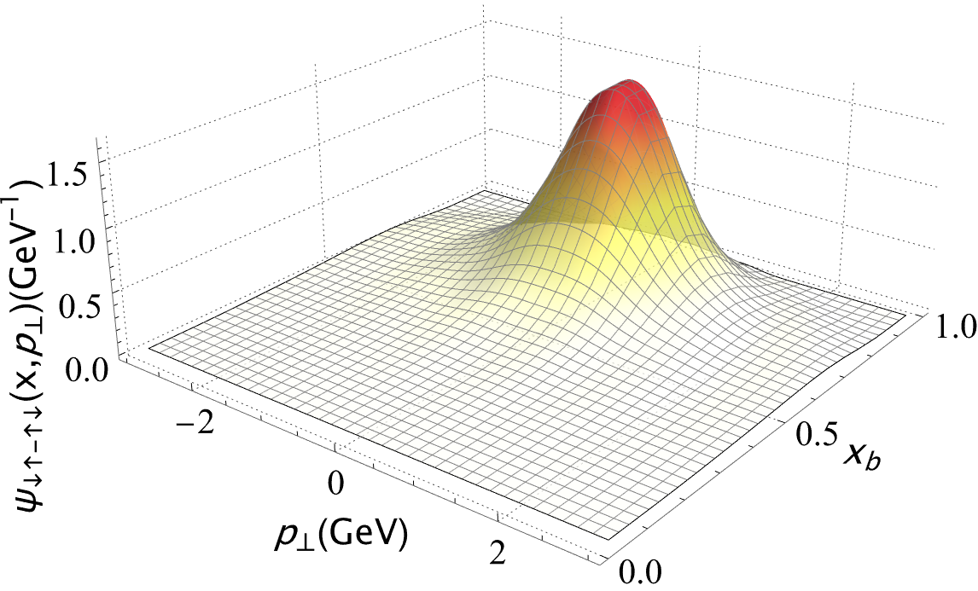

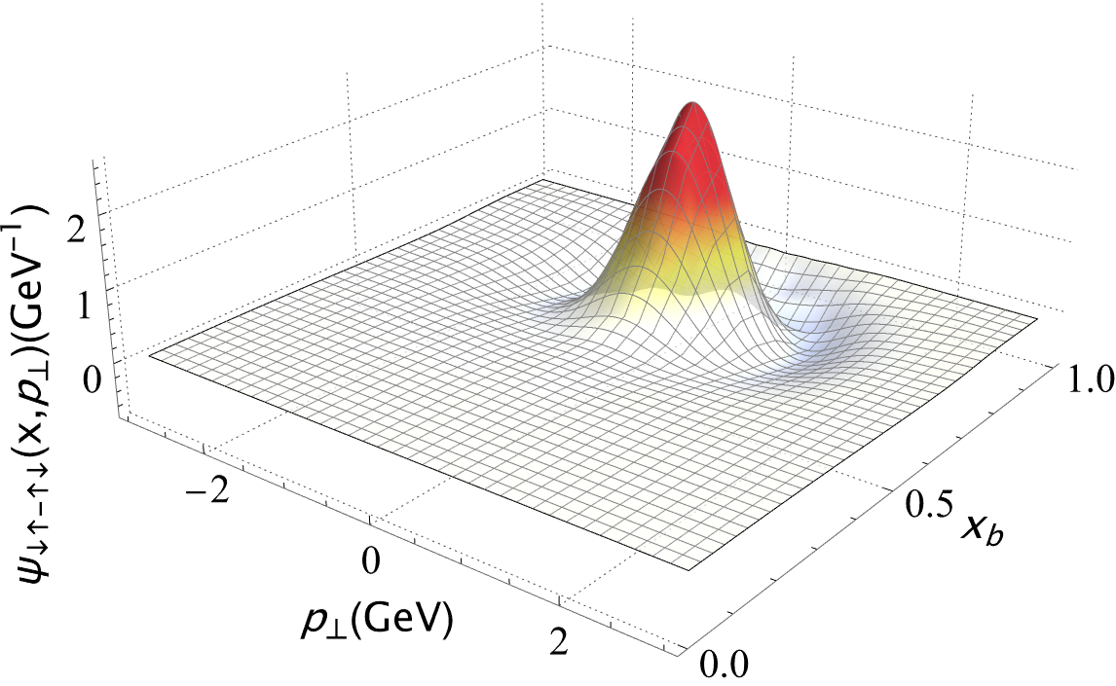
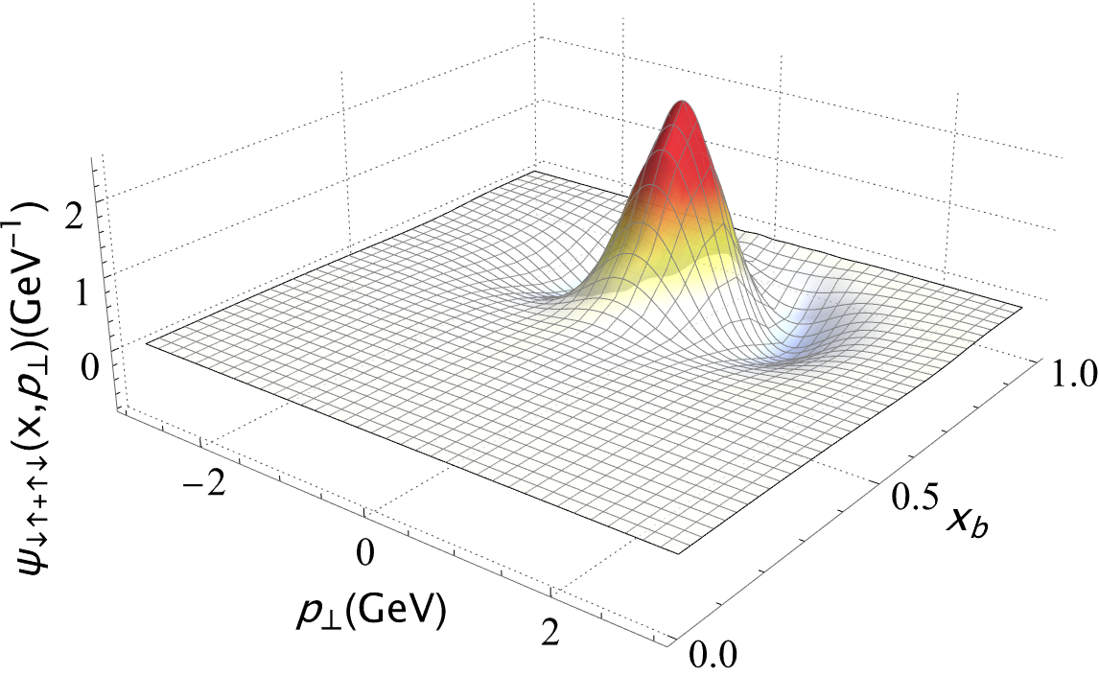


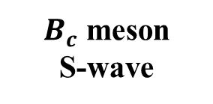




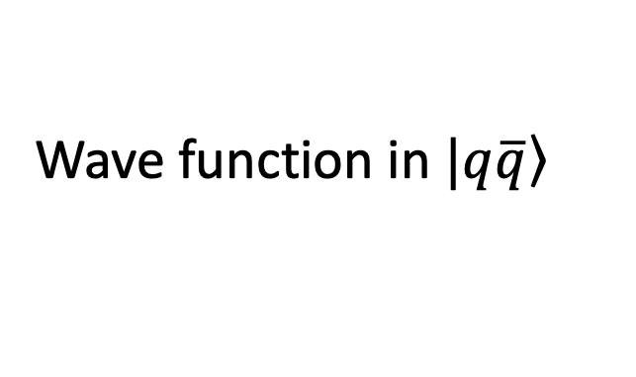


Wave function in $\left.|q\overline{q}\right\rangle$
[arXiv:2603.08114]
$$B_{c}\left(1S\right)$$
$$1^{3}S_{1}$$
$$Norm_{q\overline{q}}=0.724$$
$$Norm_{q\overline{q}}=0.722$$
$B_{c}$ meson
S-wave
$$B_{c}\left(2S\right)$$
$$2^{3}S_{1}$$
$$Norm_{q\overline{q}}=0.591$$
$$Norm_{q\overline{q}}=0.604$$
Unequal mass leads to asymmetry.
$x_{b}$ represents the $x$ of b quark

Slide 16
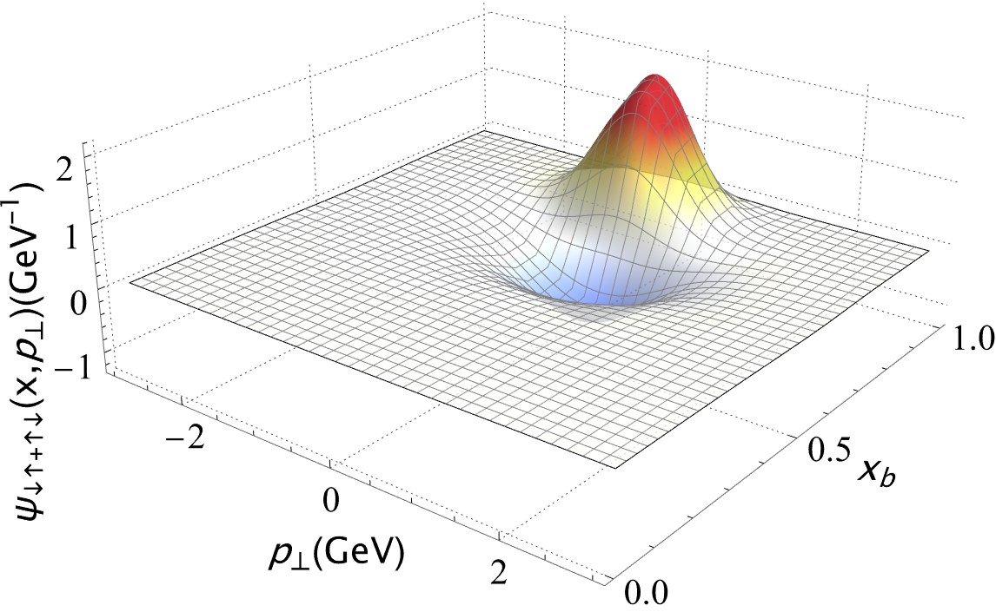
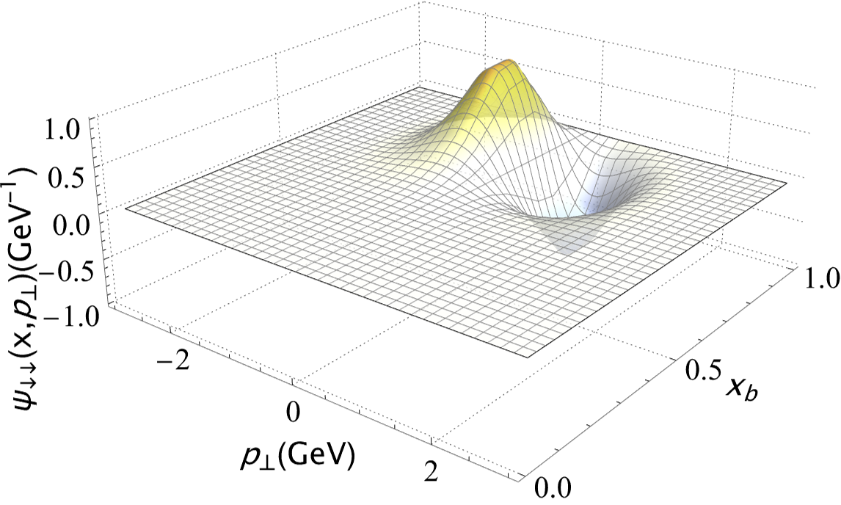
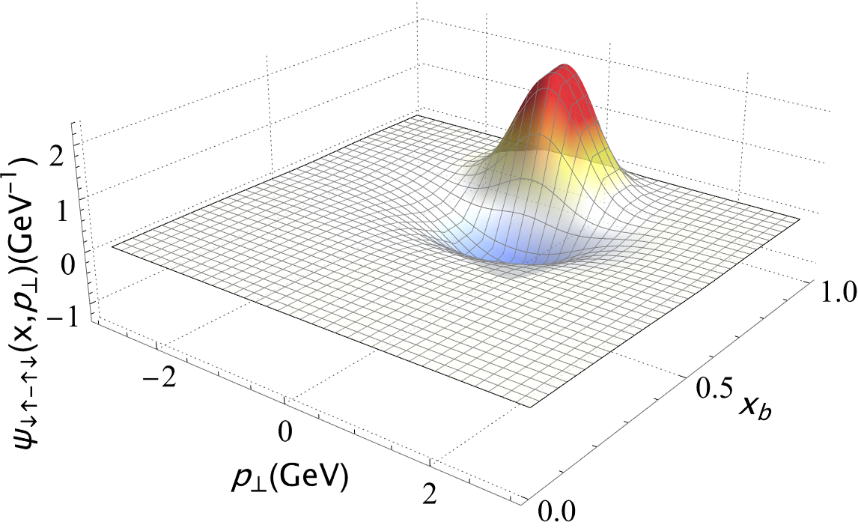
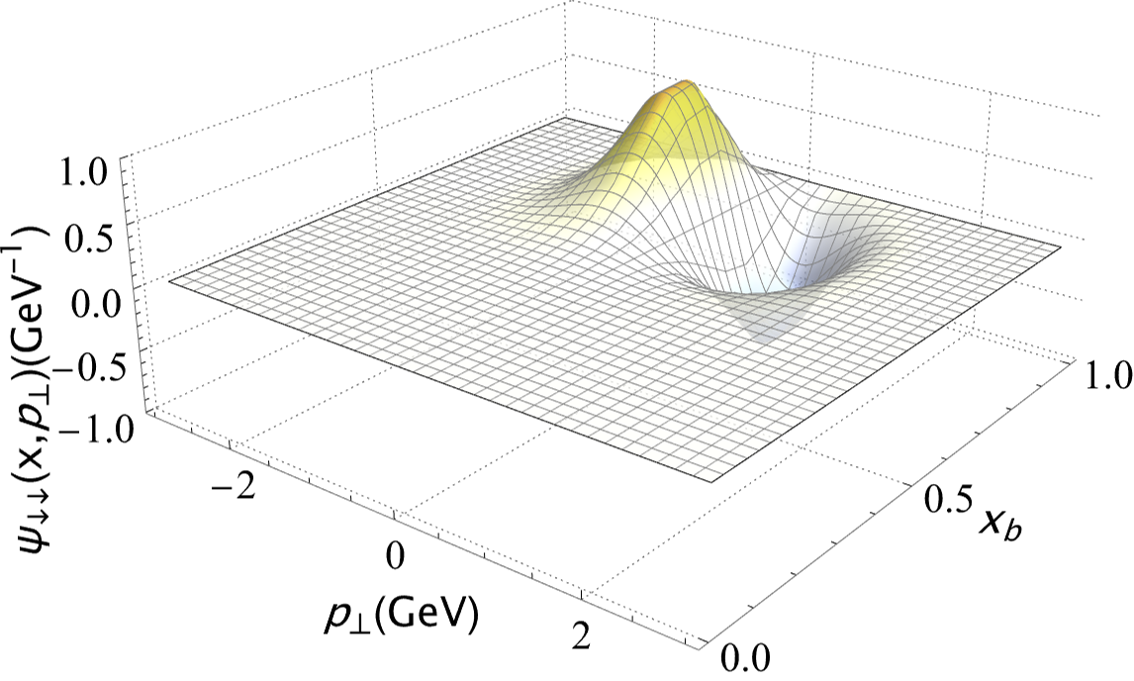


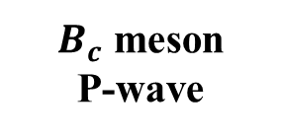






Wave function in $\left.|q\overline{q}\right\rangle$
[arXiv:2603.08114]
$$1^{3}P_{0}$$
$$1^{3}P_{1}$$
$$Norm_{q\overline{q}}=0.629$$
$$Norm_{q\overline{q}}=0.605$$
$B_{c}$ meson
P-wave
$$1^{1}P_{1}$$
$$1^{3}P_{2}$$
$$Norm_{q\overline{q}}=0.629$$
$$Norm_{q\overline{q}}=0.605$$
The characteristic pattern of quarkonium is used to identify the $B_{c}$ meson P-waves

Slide 17















Electromagnetic Form Factor & Radii
Lattice : [Dudek ‘06]
OGE : [Yang Li, FBS ‘17]
[ Brodsky ’06]
Dyson-Schwinger equations : [Mari ‘07]
$$<r_{c}^{2}> =−6\frac{∂}{∂Q^{2}}F_{ch} (Q^{2})$$
$$F\left(Q^{2}\right)=∫dx_{i}H(x_{i},0,Q^{2})$$
Charmonium FF
[arXiv:2603.08114]
Charmonium
Bottomonium
Bottomonium FF
$B_{c}$ meson FF
$B_{c}$ meson
$F\left(Q^{2}\right)$ extraction: single-quark for charmonium/bottomonium
charge-weighted for $B_{c}$meson
Large-${\text{Q}}^{2}$ decrease due to 2D-HO Gaussian tails
Agree with Lattice, DSE, and OGE results
Unconfined $\left|q\overline{q}g\right\rangle$ inflates total radii

Slide 18







Decay constants
$$\frac{f_{P,V}}{2\sqrt{2N_{c}}}=\int{\frac{dxd^{2}k_{⊥}}{2{(2π)}^{3}}Ψ_{↑↓∓↓↑}^{λ=0}(x,{\vec{k}}_{⊥}) }$$
Charmonium
Bottomonium
[arXiv:2603.08114]
$B_{c}$meson
Agree with PDG, Lattice, DSE and OGE
Calculated $J/ψ\left(1S\right)<η_{c}\left(1S\right)$ suggests Fock space might be insufficient
OGE : [Yang Li, et al, 2017 and Shuo Tang, et al, 2018]
Lattice : [C. McNeile et al, 2012]
Dyson-Schwinger equations : [M. Blank, et al, 2011]
This Work: $N_{max}=12,K_{max}=17,M_{J}=0$

Slide 19










Distribution amplitudes
$$\frac{f_{P,V}}{2\sqrt{2N_{c}}}φ_{P,V}(x;μ)=\int{\frac{d^{2}k_{⊥}}{2{(2π)}^{3}}Ψ_{↑↓∓↓↑}^{λ=0}(x,{\vec{k}}_{⊥}) }$$
[arXiv:2603.08114]
Charmonium
S-wave
Bottomonium
S-wave
$B_{c}$meson
S-wave
Agree with OGE results
Single-peak in $η_{c}\left(2S\right)/ψ\left(2S\right)$
Less pronounced longitudinal nodal structures
This Work: $N_{max}=12,K_{max}=17,M_{J}=0$
OGE : [Yang Li, et al, 2017 and Shuo Tang, et al, 2018]

Slide 20










PDF
[arXiv:2603.08114]
$$f_{q,g}\left(x\right)=\sum_{𝒩=2,3 }{\int{{\left[d^{3}k\right]}_{𝒩}δ\left(x−x_{i}\right){\left|Ψ_{𝒩}^{λ=0}\left(\{x,{\vec{k}}_{⊥}\}\right)\right|}^{2}}}$$
Charmonium
S-wave
Charmonium
P-wave
All results are at the initial scale
Gluon presence breaks $x=0.5$ symmetry in quark distribution
Enhanced gluon distribution in excited states
This Work: $N_{max}=12,K_{max}=17,M_{J}=0$

Slide 21









PDF
[arXiv:2603.08114]
$$f_{q,g}\left(x\right)=\sum_{𝒩=2,3 }{\int{{\left[d^{3}k\right]}_{𝒩}δ\left(x−x_{i}\right){\left|Ψ_{𝒩}^{λ=0}\left(\{x,{\vec{k}}_{⊥}\}\right)\right|}^{2}}}$$
Bottomonium
S-wave
Bottomonium
P-wave
Quark PDFs narrower with increasing mass
Gluons suppressed with faster $x$-decay
Heavier quark mass reinforcing $\left|q\overline{q}\right\rangle$ dominance
This Work: $N_{max}=12,K_{max}=17,M_{J}=0$

Slide 22











PDF
[arXiv:2603.08114]
$$f_{q,g}\left(x\right)=\sum_{𝒩=2,3 }{\int{{\left[d^{3}k\right]}_{𝒩}δ\left(x−x_{i}\right){\left|Ψ_{𝒩}^{λ=0}\left(\{x,{\vec{k}}_{⊥}\}\right)\right|}^{2}}}$$
$B_{c}$ meson
S-wave
$B_{c}$ meson
P-wave
Higher small-$x$ gluon peak in excited $B_{c}$ meson
Mass asymmetry suppresses gluon radiation cancellation
This Work: $N_{max}=12,K_{max}=17,M_{J}=0$

Slide 23
Conclusions
Basis Light-front Quantization
  relativistic approach, heavy and light hadrons treated on equal footing
  light-cone observables, such as LFWFs, PDFs, PDAs, GPDs, TMDs…
  parton picture/higher Fock sectors such as gluons and sea quarks
One dynamical gluon + confining interaction work reasonably well
Significant gluon component for charmonium states
Thank you!

