Slide 1


A Series Journal of the Chinese Physics Society Distributted by IOP Publishing
EDITOR-IN- CHIEF: YIFANG WANG
CHINESE PHYSICS C
High Energy and Nuclear Physics
Managing Editor: Hairong Dong( 董海荣 ) Email: donghr@ihep.ac.cn
2026-4-27 Chongqing
Chinese Physics Society | Institute of High Energy Physics, CAS | Institute of Modern Physics, CAS

Slide 2
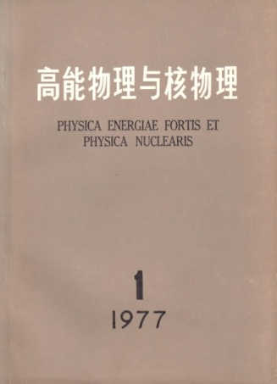
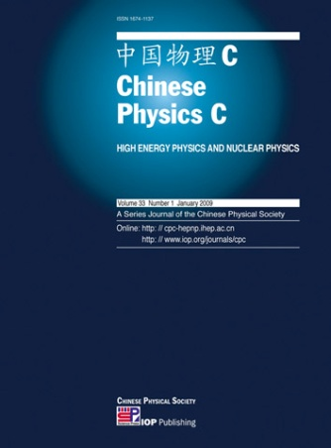
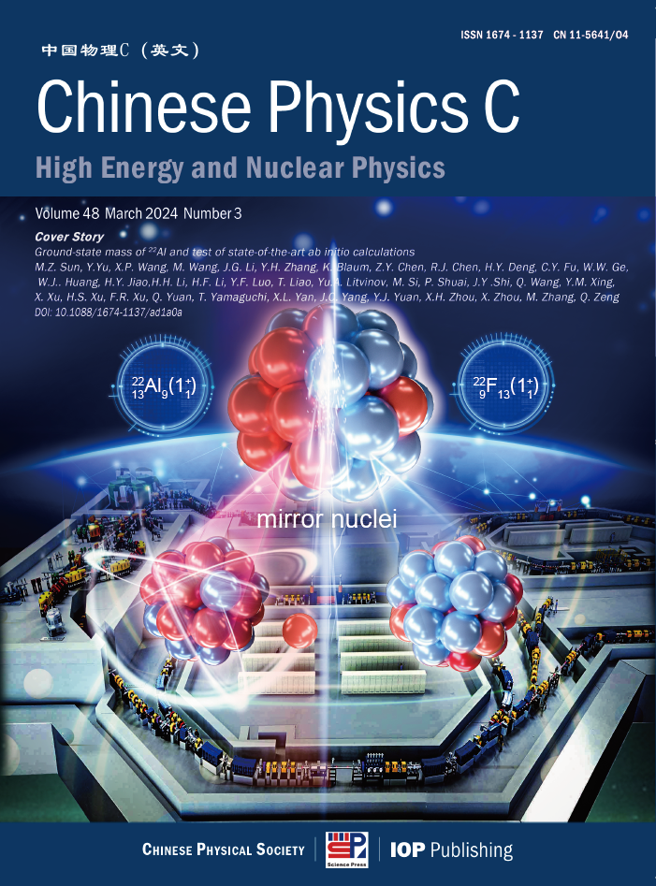
About CPC
Impact on the Field
Sponsor and Publisher
Since publication of its first issue in 1977, it has been one of China’s leading journals in high energy and nuclear physics, and continues to grow in international impact and recognition.
It is sponsored by the Chinese Physical Society, and supported by the Institute of high Energy Physics and the Institute of Modern Physics of the Chinese Academy of Sciences. Internationally, it is published in partnership with IOP Publishing .
2026
1977
2008

Slide 3
Scope & Topics
Particle Physics
Lepton/neutrino physics, heavy flavor physics, QCD/Lattice, TeV physics/new physics
Nuclear Physics
Nuclear structure, Hadron physics, Heavy ion, Nuclear force/light nuclear structure, Nuclear reaction
Particle and nuclear astrophysics
Astroparticle, Gravity, Nuclear astrophysics
Cosmology
Cosmology, cosmic ray, dark matter

Slide 4
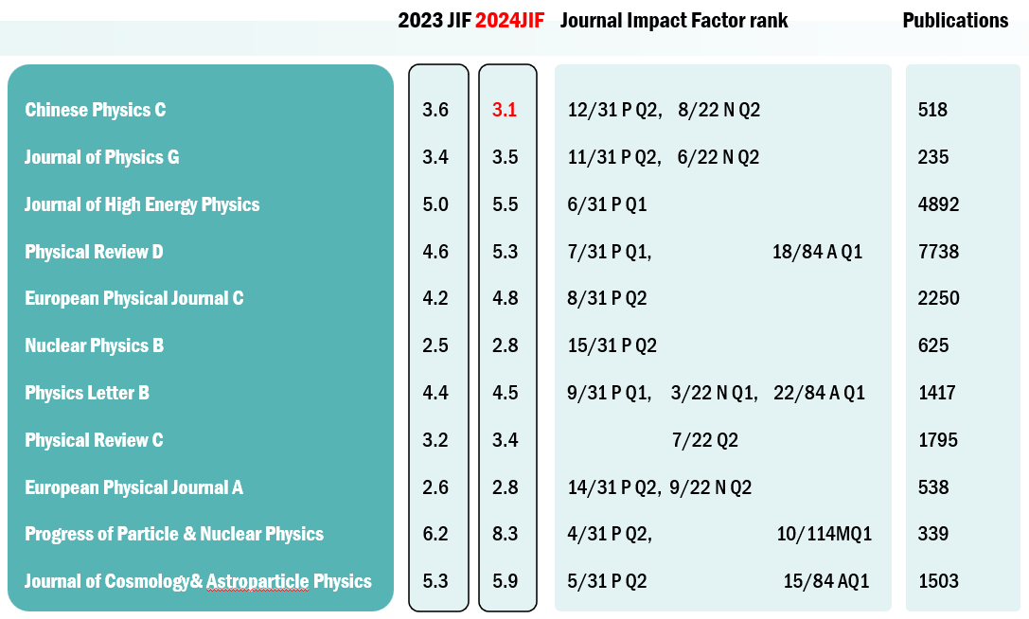
SCIE
Indexing & Journal Metric
WOS-JCR Impact Factor： 3.1
Physics
- Particles & Fields: Q2
- Nuclear: Q2
Scopus-CiteScore: 6.9
Physics and Astronomy
- Nuclear and High Energy Physics: Q1
- Astronomy and Astrophysics: Q1
- Instrumentation: Q1
中国科技期刊卓越行动计划一期、二期入选期刊
中国科协高质量科技期刊分级——核物理领域-T1

Slide 5








Editorial Board
Hokkaido University
Fudan University
Institute of Theoretical physics,CAS
王贻芳
Yifang Wang Editor-in-Chief
IHEP
Shandong University
Peking University
University of Chinese Academy of Sciences
Institute of Modern Physics,CAS
Uppsala University
Osaka University
Indiana University
吕才典
Caidian Lv
Associate EIC
IHEP
左维
Wei Zuo
Associate EIC
IMP
Beihang University
INFN
Durham University
Universita di Pisa
Grand Accélérateur National d'Ions Lourd
Institute of High Energy Physics, CAS
Particles Theory
Nuclear Theory
Queen Mary University of London
Nanjing University
Northeastern University
University of Arizona
Tokyo University
李海波
Haibo Li
Associate EIC
IHEP
周小红
Xiaohong Zhou
Associate EIC
IMP
University of Wisconsin
Nankai University
Univertita di Bari
Shanghai Jiao Tong University
NCTU
Tsinghua University
Iowa State University
Particle Experiment
Nuclear Experiment
University of Science and Technology of China
Ruhr-Universitat Bochum
China Institute of Atomic Energy
The University of Hong Kong

Slide 6
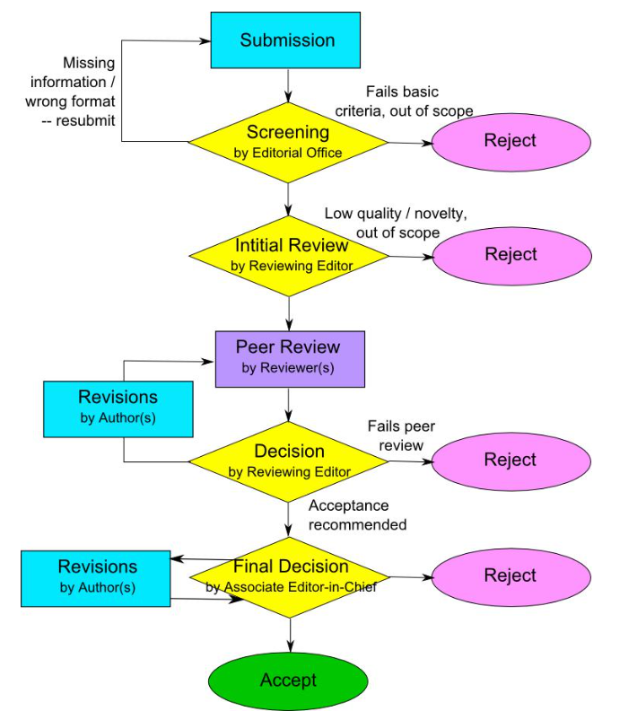
Peer Review Process
01
02
Rigorous Review Standards
Ensuring Academic Excellence
The journal follows a rigorous peer review process to ensure the quality and relevance of published research. Manuscripts are evaluated by experts in the field, ensuring high scientific standards.
The Editorial Board is committed to maintaining the highest standards of academic excellence. Regular training and updates for reviewers ensure consistency and quality in the review process.

Slide 7
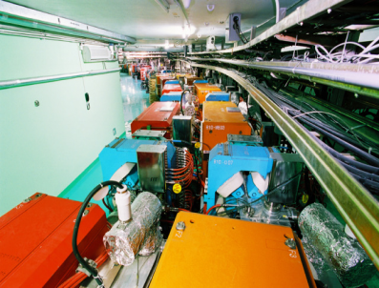
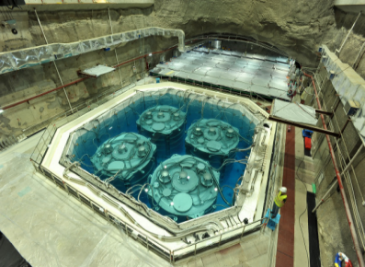
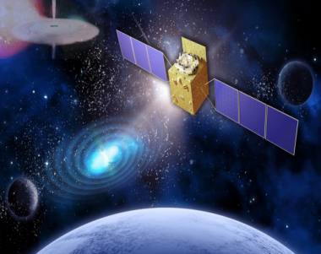
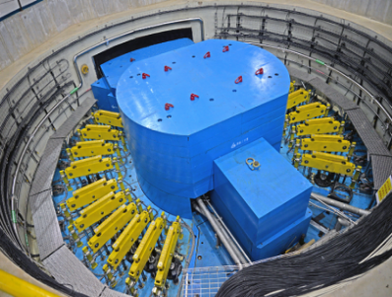
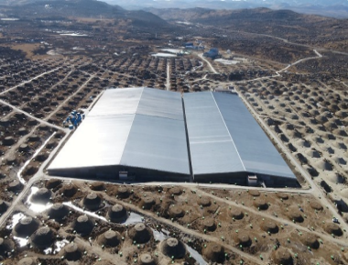
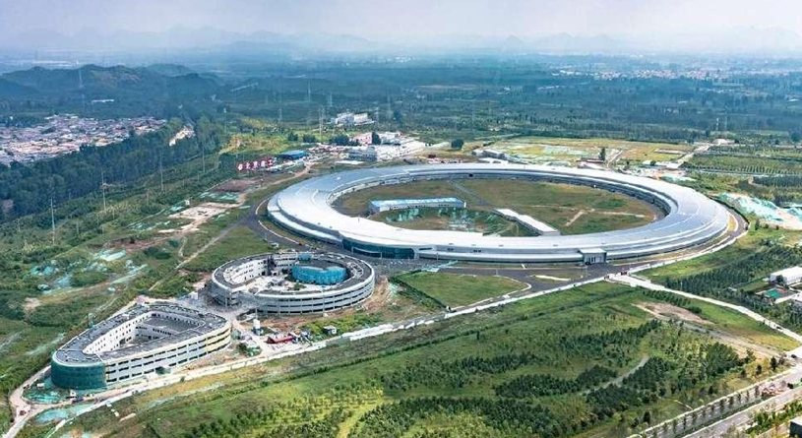
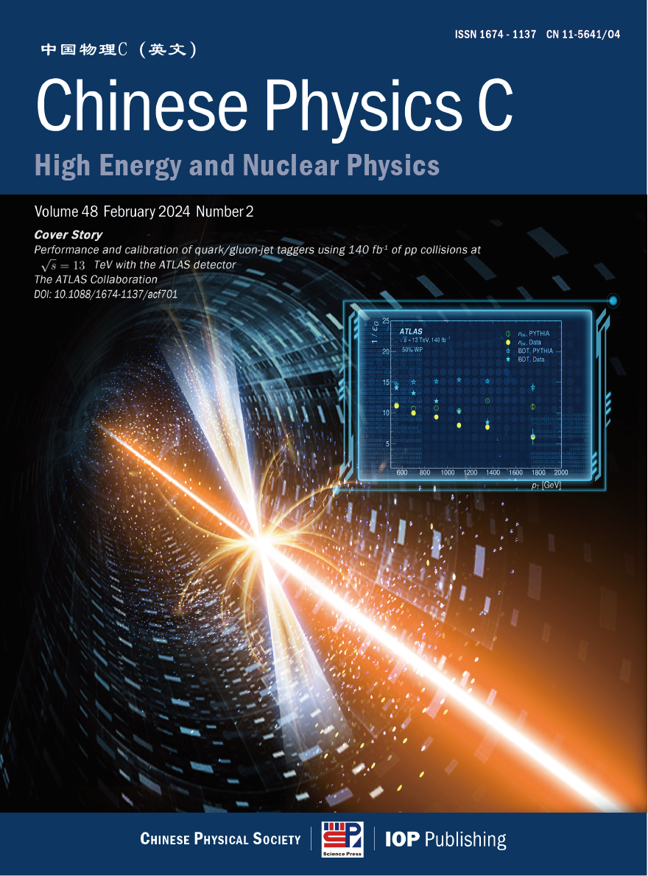
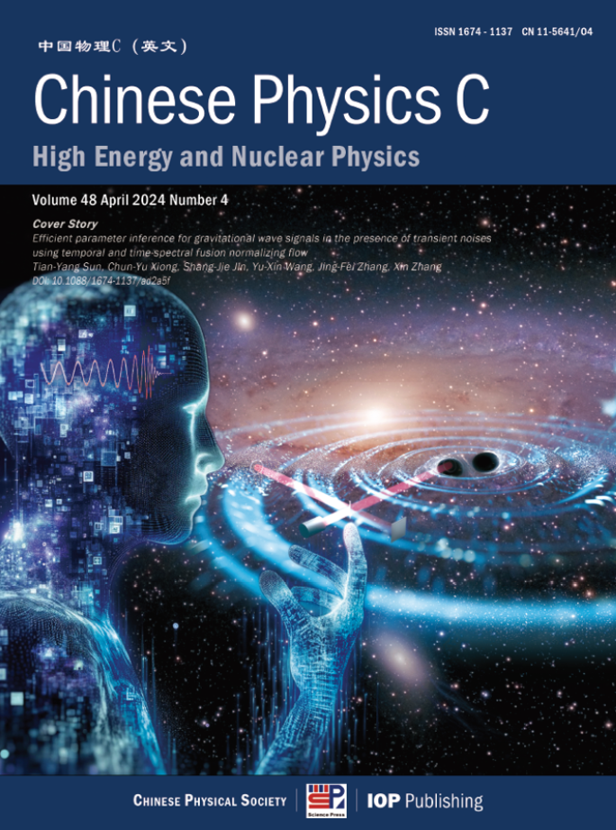
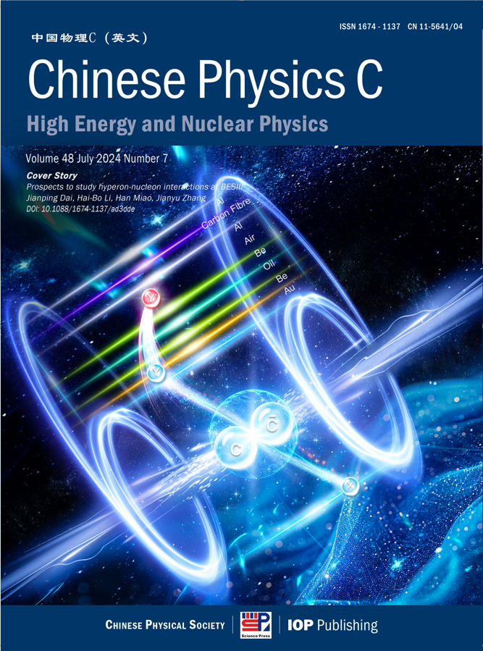
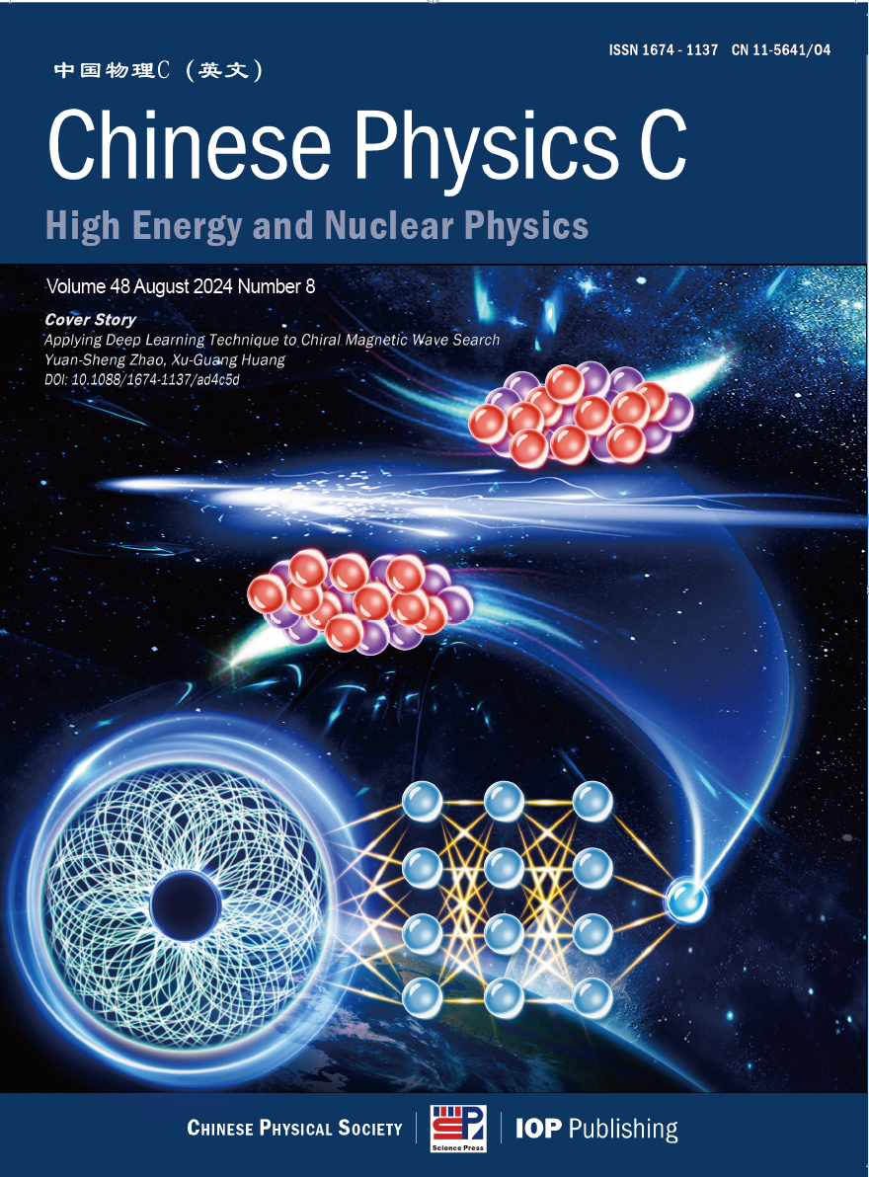
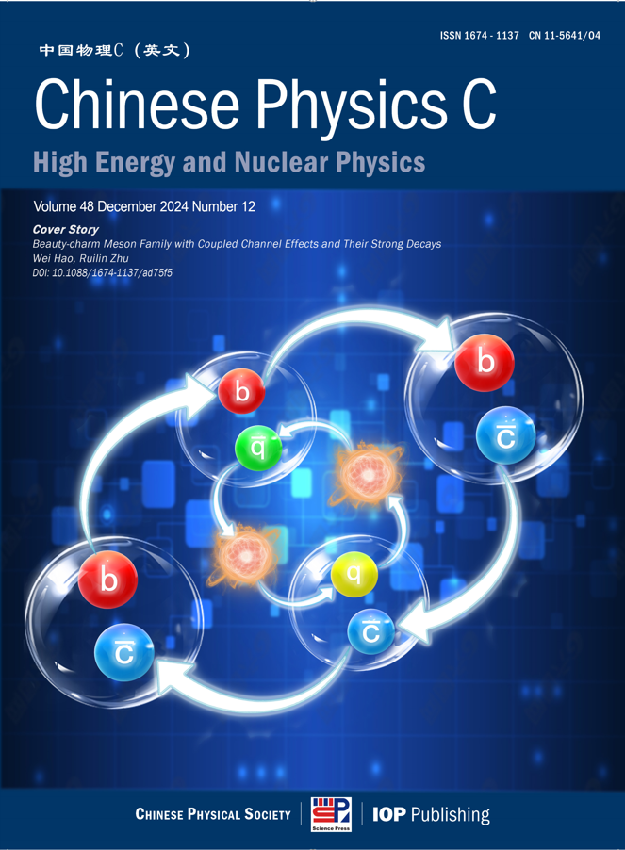
7
Highlight & Cover Story

Slide 8
Collaboration article
BESIII Collaboration | 2024 issue 8 | Amplitude Analysis of D0→π+π-π+π- and π+π-π0π0
LHAASO Collaboration | 2024 issue 6 | Optimization of performance of the KM2A full array using the Crab Nebula
BESIII Collaboration | 2024 issue 9 | Determination of the number of $\psi$(3686) events taken at BESIII
ATLAS Collaboration | 2024 issue 3 | Performance and calibration of quark/gluon-jet taggers using 140 fb$^{-1}$ of $pp$ collisions at $\sqrt{s} = 13$ TeV with the ATLAS detector
CDEX Collaboration | 2024 issue 10 | Searching for 76Ge neutrinoless double beta decay with the CDEX-1B experiment
CSNS Collaboration | 2024 issue 8 | Measurement of the neutron total cross section of 9Be at the Back-n white neutron source of CSNS
PandaX Collaboration | 2024 issue 7 | Detecting Neutrinos from Supernova Bursts in PandaX-4T
JUNO Collaboration | 2025 issue 1 | Prediction of Energy Resolution in the JUNO Experiment
BESIII Collaboration | 2024 issue 12 | Measurement of the integrated luminosity of the data collected at 3.773 GeV by BESIII from 2021 to 2024
PandaX Collaboration | 2024 issue 9 | Measurement of Solar $pp$ Neutrino Flux using Electron Recoil Data from PandaX-4T Commissioning Run
BelleII Collaboration | 2025 issue 1 | Measurement of the integrated luminosity of data samples collected during 2019-2022 by the Belle II experiment
ᵡQCD Collaboration | 2024 issue 12 | Charm physics with overlap fermions on 2+1-flavor domain wall fermion configurations
BESIII Collaboration | 2025 issue 4 | Search for the lepton number violation decay $\phi \to \pi^+ \pi^+ e^- e^-$ via $J/\psi\to \phi\eta$
νGeN Collaboration | 2025 issue 5 | New constraints on coherent elastic neutrino–nucleus scattering by the νGeN experiment
Neutron Magnetic Moment

Slide 9
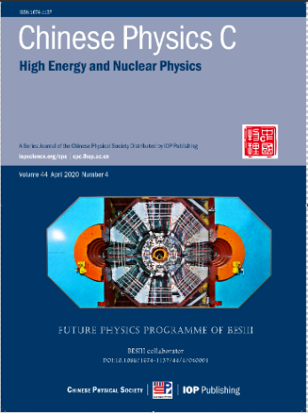
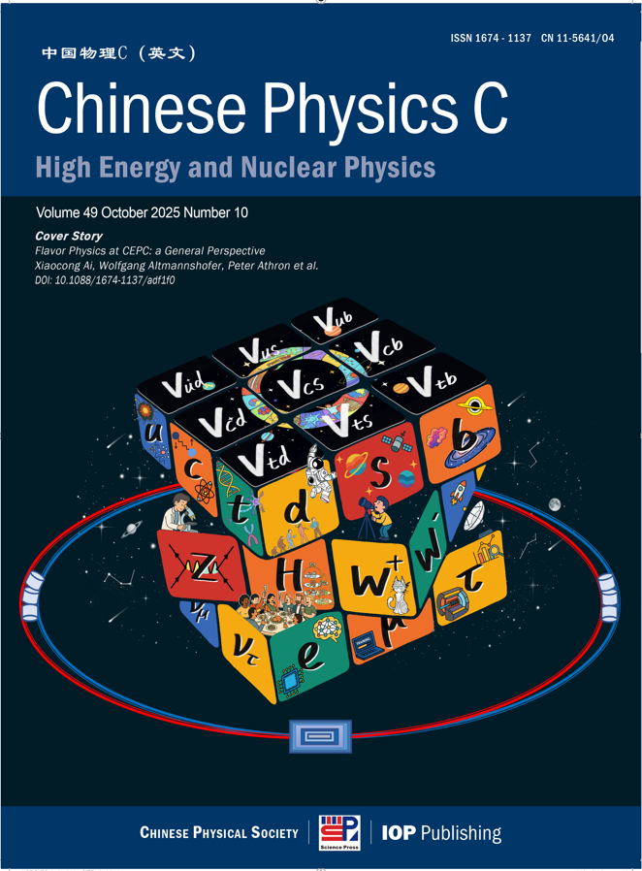
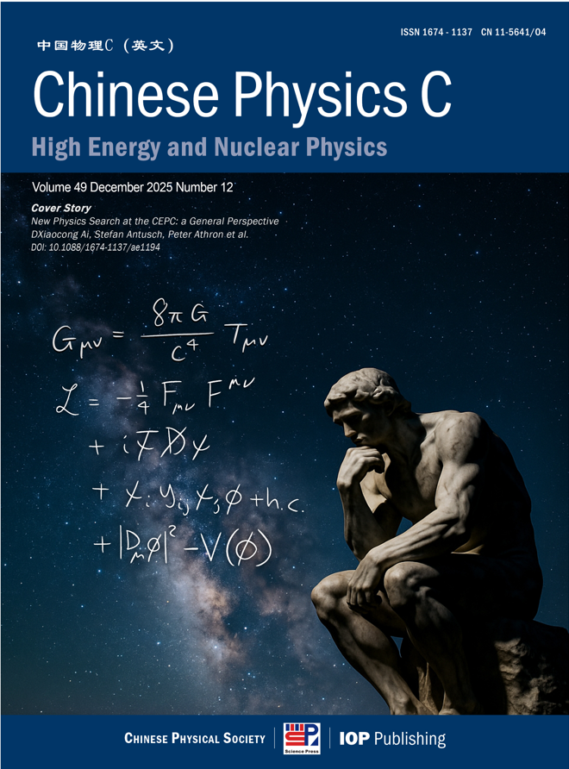
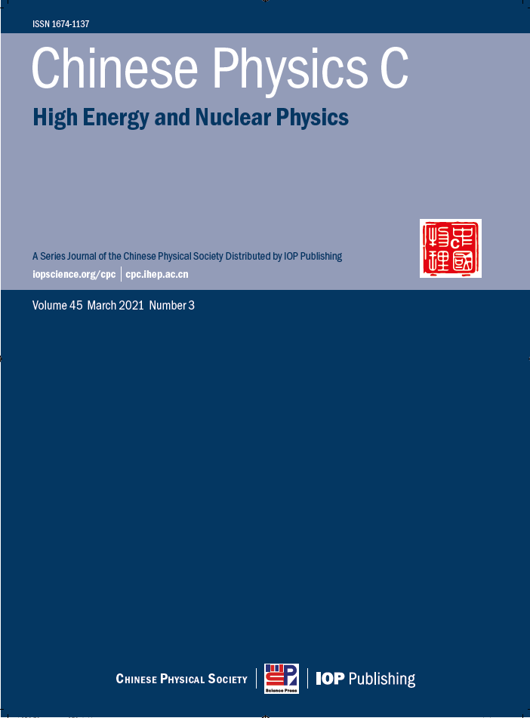
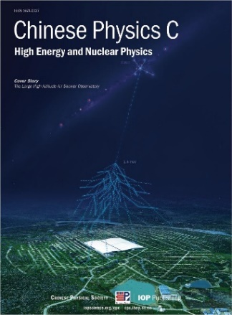
Special Issue
2020 No 4
Future Physics
Programme of BESIII
2025 No 10
Flavor Physics at CEPC: a General Perspective
2025 No 12
New Physics Search at the CEPC: a General Perspective

Slide 10
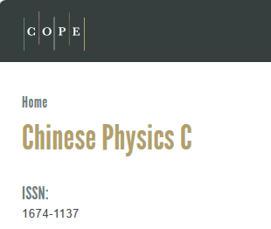
Review and Publication Time
Review Timeline
Publication Process
The peer review process typically takes 24 days from submission to first decision. Authors are kept informed of the progress throughout the review process.
Once accepted, manuscripts online within 24 hours. The journal offers efficient publication timelines to ensure timely dissemination of research.
Criteria for Acceptance
Manuscripts are evaluated based on originality, scientific rigor, clarity, and relevance to the journal’s scope.
The reviewer pool comprises over 4,000 experts from 57 countries and regions, with international reviewers accounting for 49%. The Editorial Board ensures that accepted papers meet the highest standards.

Slide 11
Author benefits
SCOAP³
Free Open Access publication for qualifying articles
The only journal from China participating in SCOAP3
（Sponsoring Consortium for Open Access Publishing in Particle Physics）
Fast track
English polish
The journal tries to promptly publish :
the progress and achievements of large science facilities
Other influential and important articles
Free English editing on all accepted articled
High visibility
Cover Story
Subscription at over 3000 institutes worldwide
Annual downloads surpass 200,000
Provide free cover design for featured articles, and promote them through multiple channels.

Slide 12
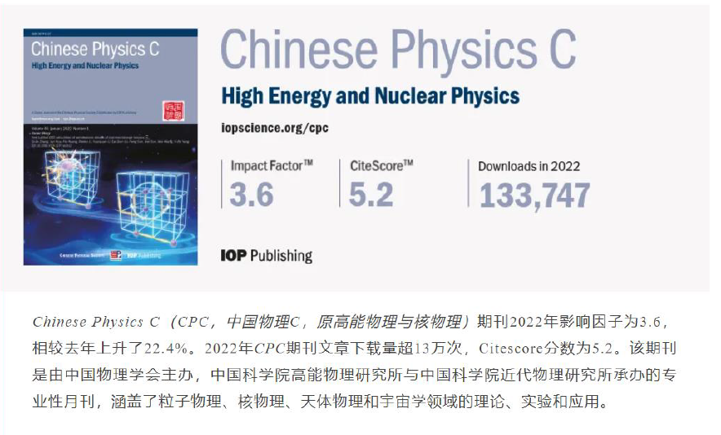
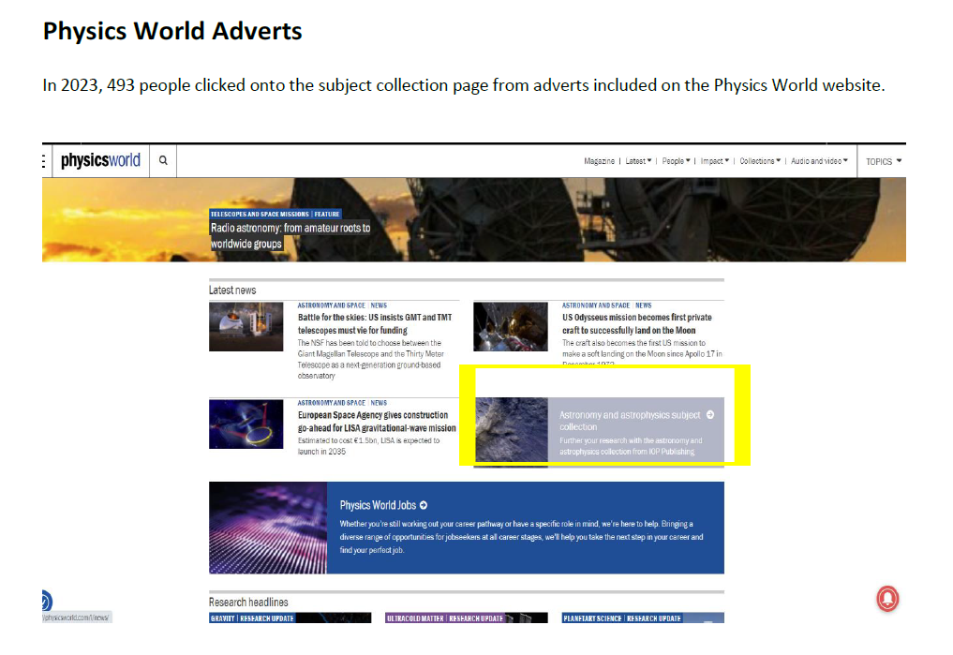
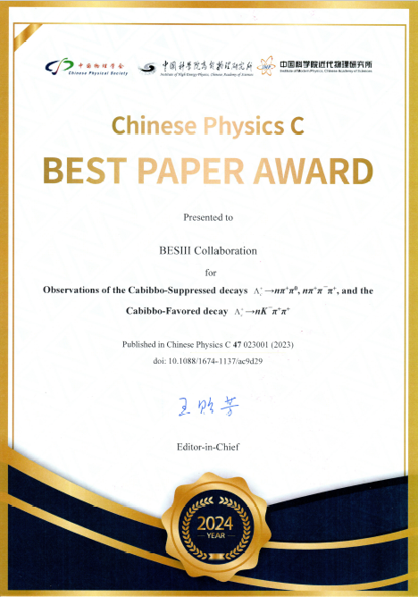

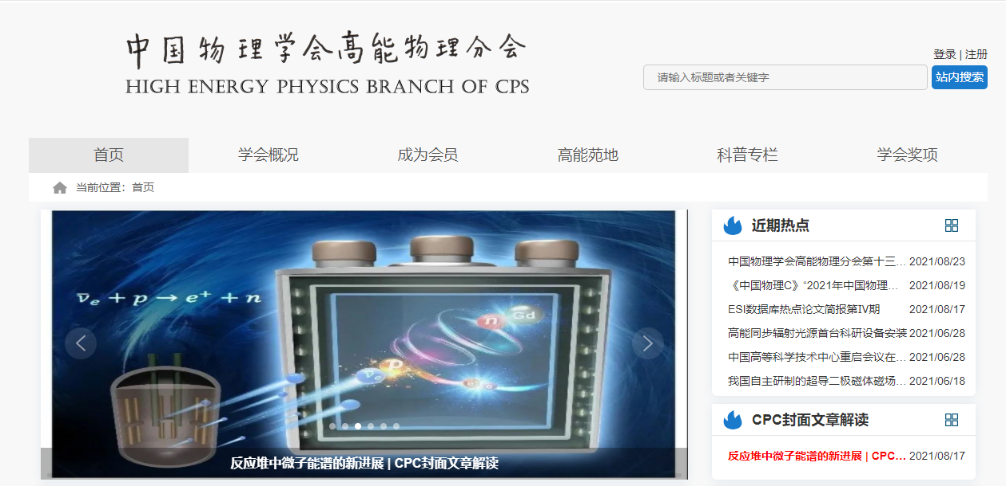
Promotion
WeChat/Twitter/Email
Physics World/《现代物理知识》高能物理学会/Researcher APP
CPC
供应商的选择
The total number of full-text downloads for CPC was over 200,000 in 2024.

Slide 13
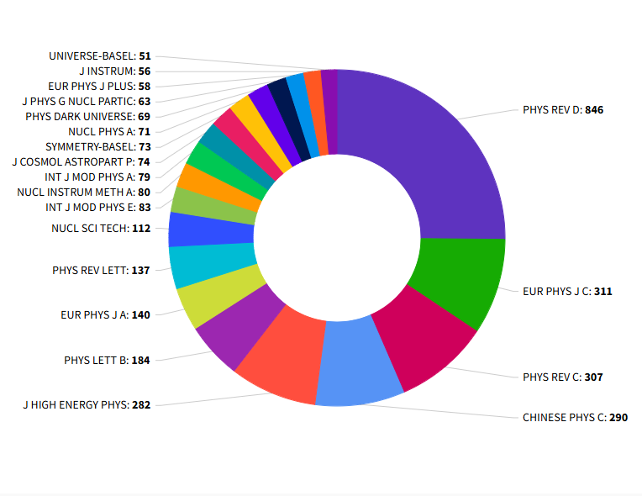
Citation & Usage
Neutron Mass and Spin
Neutron Magnetic Moment
Excluding China, the top five countries citing CPC are the United States, Germany, India, Italy, and the United Kingdom.
The top five journals citing CPC are Physical Review D， European Physics Journal C，Physical Review C，CPC，and Journal of High Energy Physics.
The top four international research institutions downloading CPC papers are: CERN、TelAviv University，Brookhaven National Laboratory and Michigan State University

Slide 14

Ways to Get Involved
”
Submit Your Research
Join the Editorial Board
We invite researchers to submit their work to Chinese Physics C for publication.
Authors can submit their manuscripts through the journal’s online submission system.
Opportunities are available to join the Editorial Board, contributing to the journal’s direction and quality. Board members play a crucial role in shaping the journal’s future and supporting authors.
Serve as a Reviewer
Researchers can also serve as reviewers, helping maintain the journal’s high standards. Reviewers provide valuable feedback and contribute to the scientific integrity of published research.
cpc.ihep.ac.cn
cpc@ihep.ac.cn
Please visit our booth or website to learn more about CPC

Slide 15

Chinese Physics C
Join CPC and contribute to advancing scientific excellence!
Cpc.ihep.ac.cn
iopscience.iop.org/journal/1674-1137

