Slide 1
Honorary Editor-in-Chief:
Prof. Dr. Ronggen Cai
Prof. Dr. Jiping Zhang

Slide 2


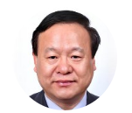
Journal Information
2009
2013
2016
Covered by the Science Citation Index Expanded (SCIE)
Changed to monthly publication
Journal launched
2020
2019
2017
Editor-in-Chief:
Prof. Dr. Sergei D. Odintsov
Symmetry published its 5,000th paper
The 2nd International Conference on Symmetry
The 1st International Conference on Symmetry
2021
2023
2025
The 3rd International Conference on Symmetry (online);
One Editorial Board Member of Symmetry, the Nobel prize winner Prof. Dr. Steven Weinberg passed away.
The 4th International Conference on Symmetry
The 5th International Conference on Symmetry
Prof. Dr. Ronggen Cai
Prof. Dr. Jiping Zhang

Slide 3

Journal Information
Aims and Scope
Symmetry (ISSN 2073-8994) is a peer-reviewed, open access journal published monthly online by MDPI.
Symmetry covers research on symmetry/asymmetry phenomena wherever they occur in all aspects of natural sciences. The research scope includes six broad subjects comprising the following sections:
Mathematics Section;
Computer Section;
Engineering and Materials Section;
Physics Section;
Life Sciences Section;
Chemistry: Symmetry/Asymmetry Section.
Article Processing Time
16
days submission to revision
5
days acceptance to publication
40
days submission to publication
*Note: median values for papers published in this journal in 2025.

Slide 4
Journal Information
JCR category rank
Q2: Multidisciplinary Sciences
SCIE
IMPACT
FACTOR
2.2
CiteScore category rank
Q1: General Mathematics
Q1: Physics and Astronomy (miscellaneous)
Q2: Computer Science (miscellaneous)
Q2: Chemistry (miscellaneous)
CITESCORE
5.3
2025 Rejection rate: 64%
Notes:
目前我们的影响因子是2.2，JCR二区

Slide 5
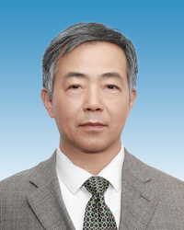
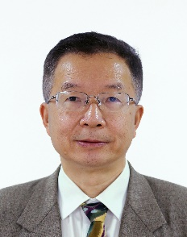
Symmetry Team
Academic Editors (Editorial Board Members, Topical Advisory Panel, Guest Editors): Academic Evaluation
马余刚 院士
邹冰松 院士

Slide 6



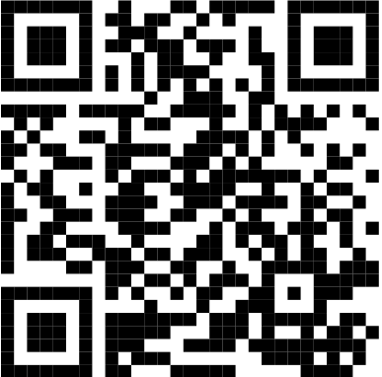
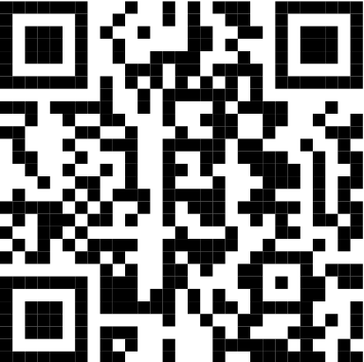
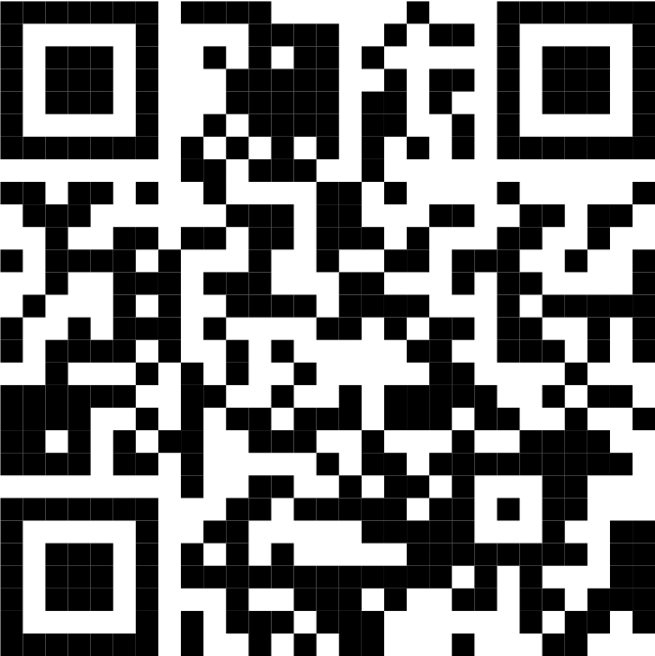
Journal Awards
In order to reward the academic community, especially young researchers, and to enhance communication among scientists, Symmetry regularly offers various awards to researchers in the field of symmetry/asymmetry phenomena in natural sciences. These awards, serving as a source of inspiration and recognition, help to increase the influence of talented individuals who have been credited with outstanding achievements and are marking a significant contribution to the advancement of their field.
Application deadline: 2026-07-31
Application deadline: 2026-10-31
Application deadline: 2026-12-31
https://www.mdpi.com/journal/symmetry/awards

Slide 7
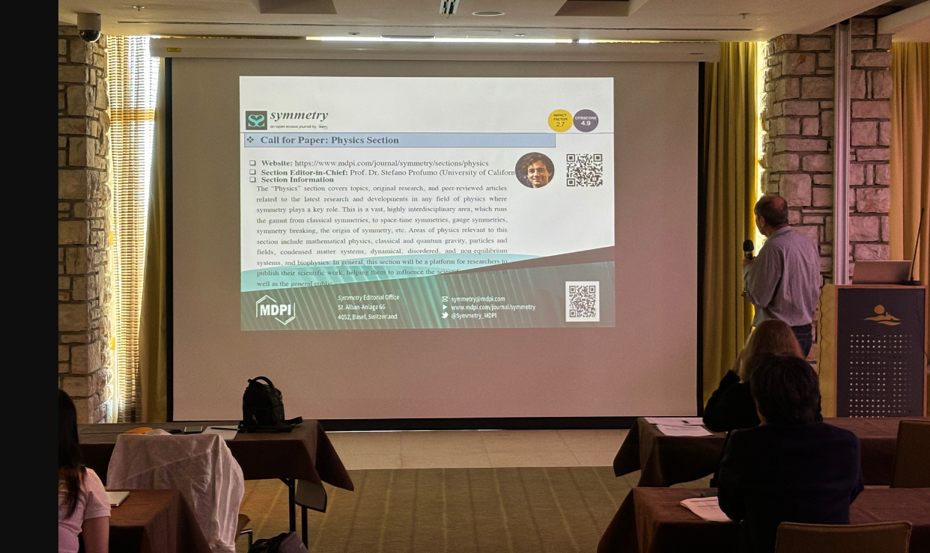
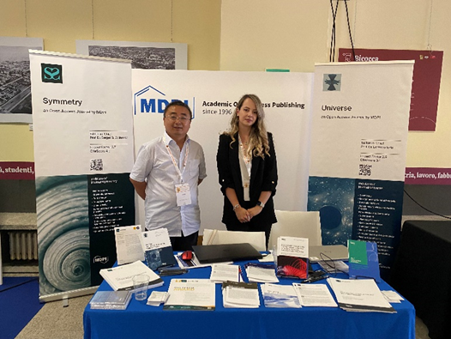
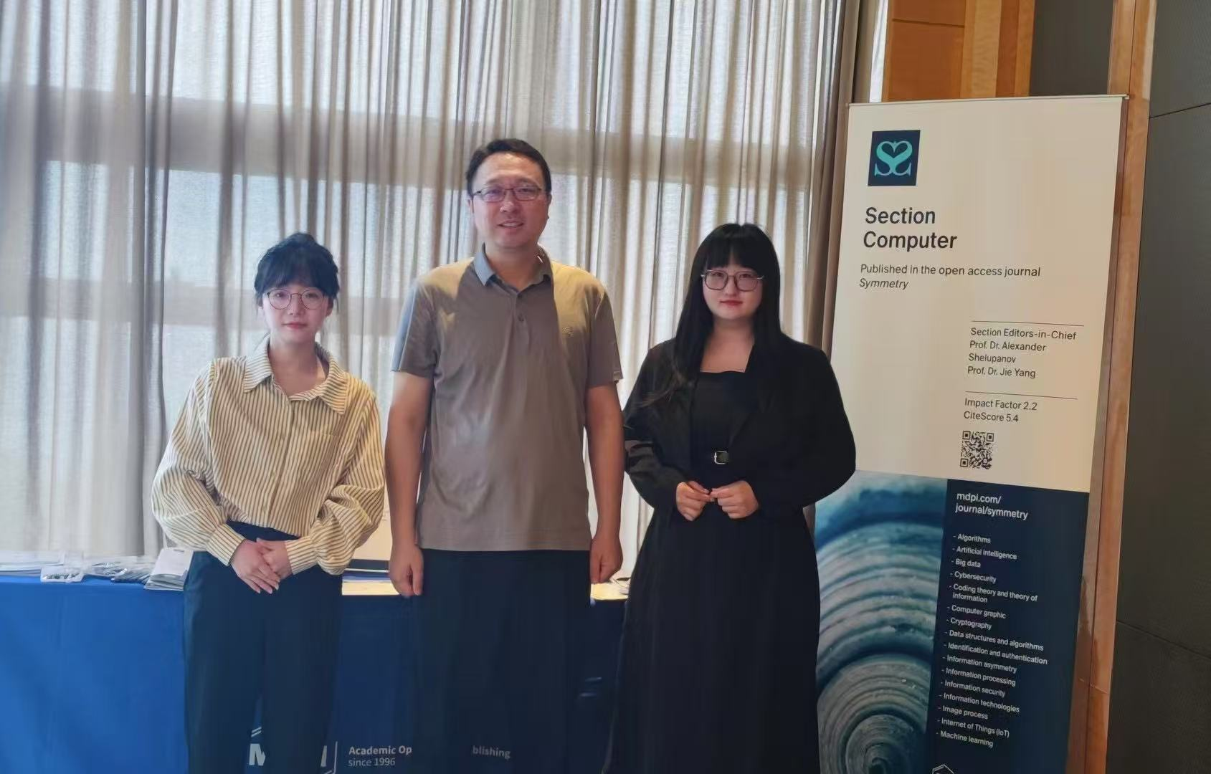
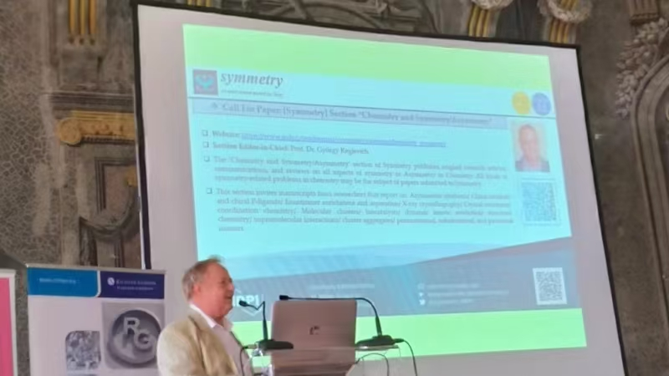
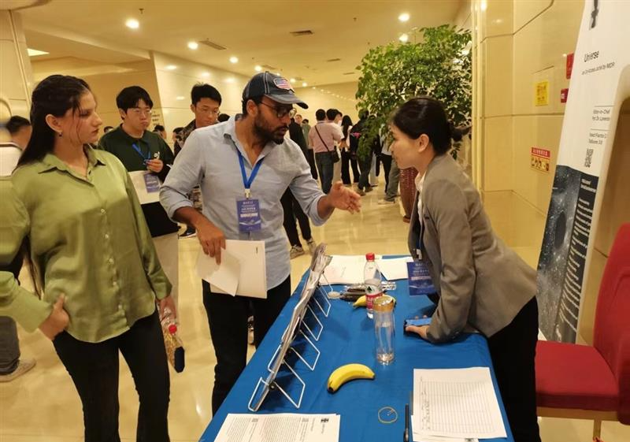
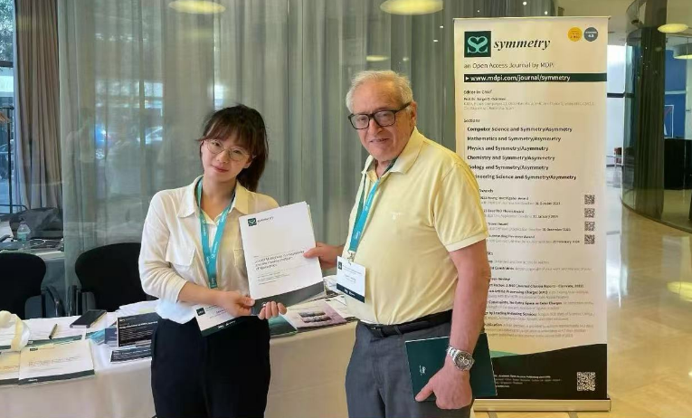
Market Activities – Conferences

Slide 8
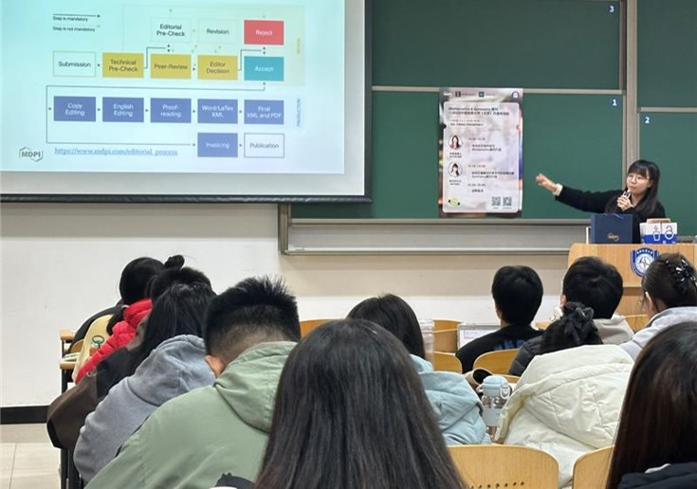



Market Activities – Academic Publishing Workshop
Professional Workshops
We collaborate with renowned institutions to organize academic publishing workshops, providing professional insights to assist young scholars in scientific writing.
Empowering Young Scholars
Over 700 scholars and young students have benefited in 2025.
Partner Institutions
Peking University
Beihang University
Beijing Normal University
University of Science and Technology Beijing
Beijing University of Posts and Telecommunications
China University of Geosciences
Beijing Forestry University
Institute of Chemistry, Chinese Academy of Sciences
Southeast University
Nankai University
Wuhan University of Technology
Shanghai University
North China Electric Power University

Slide 9
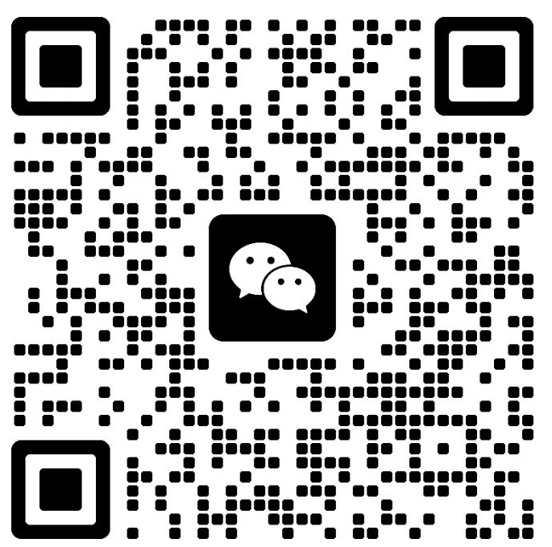
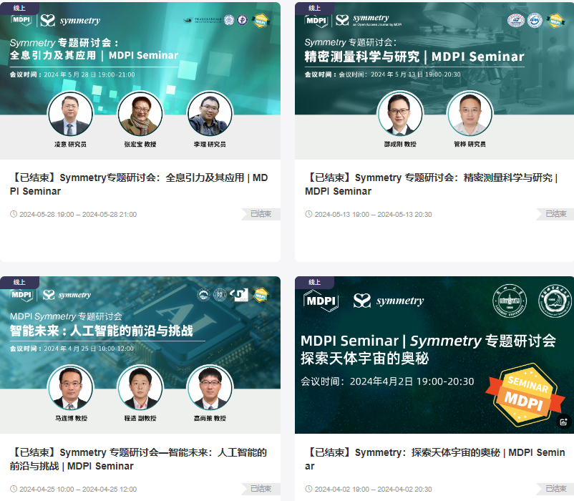
Market Activities – Webinars
Upcoming Webinar
28 July 2026, 8.00 am EDT | 8:00 pm CST Asia
Speaker/Presentation | Time (EDT)
Prof. Dr. Victor I. Mokeev Chair Introduction | 8:00 am – 8:25 am
Prof. Dr. Craig D. Roberts Presentation Title: Insight into the Emergence of Hadron Mass and Structure from N* Electroexcitation Studies | 8:25 am – 9:05 am
Prof. Dr. Ralf W. Gothe Presentation Title: Nucleon Resonance Structure in Exclusive Meson Electroproduction Experiments: From Strong to Perturbative QCD Regimes | 9:05 am – 9: 45 am
Dr. Daniel S. Carman Presentation Title: Studies of Nucleon Resonances at JLab in the 12 GeV Era and Beyond | 9: 45 am – 10:25 am

Slide 10

添加微信，与我联系：
期刊学者交流群：
Thank you for your time!

