Slide 1


Decoding $Z_{c}(4430)$and $Z_{c}(4200)$：The Crucial Role of P-wave Charmed Mesons
汇报人：程剑波
汇报时间：2026.4.26
报告地点：重庆山城国际会议中心
arXiv:2601.20740,
Accepted by PRD

Slide 2
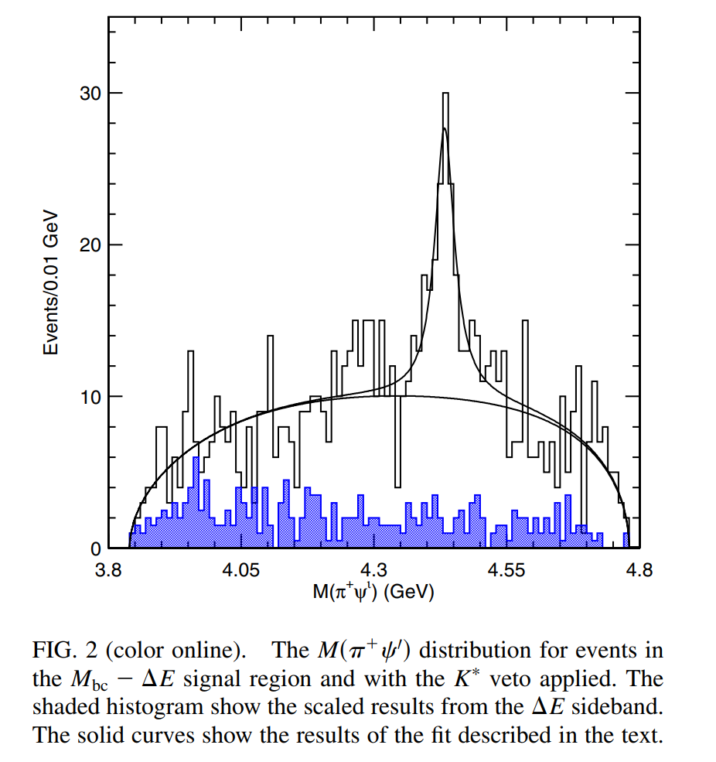
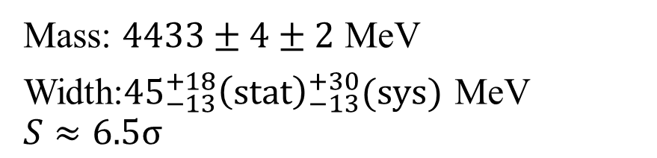
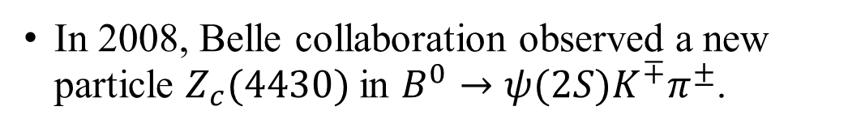

Background
Framework
Results
Summary
Belle, Phys. Rev. Lett 100, 142001 (2008)
In 2008, Belle collaboration observed a new particle $Z_{c}(4430)$ in $B^{0}→ψ(2S)K^{∓}π^{±}$.
Mass: $4433±4±2$ MeV
Width:${45}_{−13}^{+18}{\left(stat\right)}_{−13}^{+30}(sys)$ MeV
$$S≈6.5σ$$
Belle and LHCb successively confirmed its spin-parity as
$$J^{P}=1^{+}$$
$$S>13.9σ$$
Belle, Phys. Rev. D 88, 074026 (2013)
LHCb, Phys. Rev. Lett. 112, 222002 (2014)
2/25

Slide 3
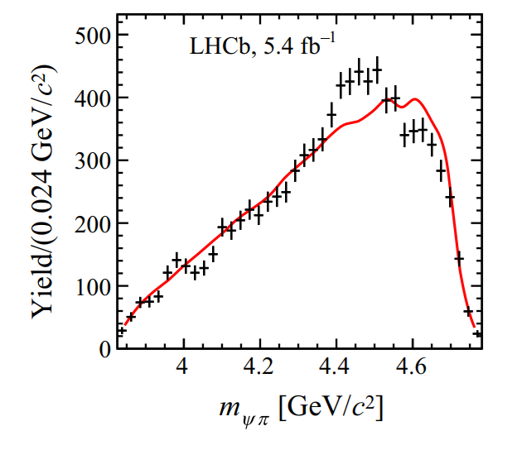
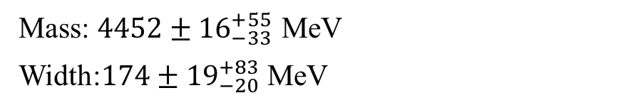
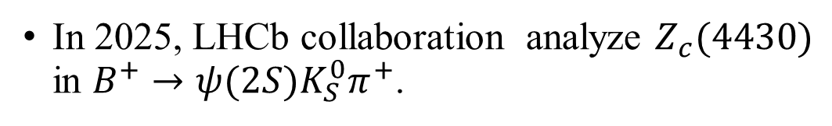

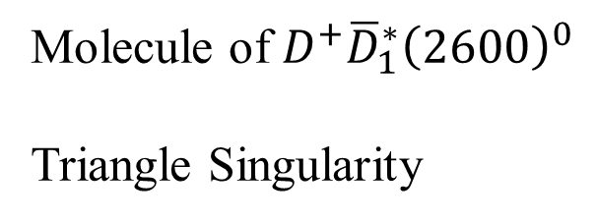
Background
Framework
Results
Summary
In 2025, LHCb collaboration analyze $Z_{c}(4430)$ in $B^{+}→ψ(2S)K_{S}^{0}π^{+}$.
LHCb, Phys. Rev. D 113, L071101 (2026)
Mass: $4452±{16}_{−33}^{+55}$ MeV
Width:$174±{19}_{−20}^{+83}$ MeV
Explanation:
Molecule of $D^{+}{\overline{D}}_{1}^{∗}{\left(2600\right)}^{0}$
Triangle Singularity
Fig: Invariant mass projection of $ψ\left(2S\right)π^{+}$.
3/25

Slide 4
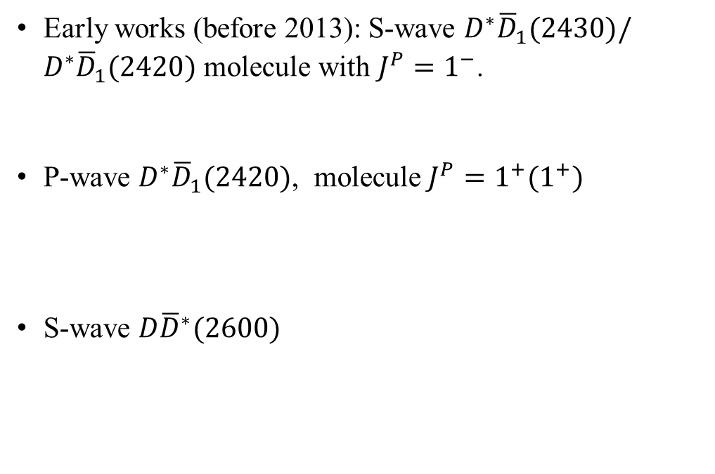
Background
Framework
Results
Summary
Theoretical Explanation
Molecule
Compact tetraquark states
Early works (before 2013): S-wave $D^{∗}{\overline{D}}_{1}(2430)/D^{∗}{\overline{D}}_{1}(2420)$ molecule with ${J^{P}=1}^{−}$.
P-wave $D^{∗}{\overline{D}}_{1}(2420)$, molecule ${J^{P}=1^{+}(1}^{+})$
S-wave $D{\overline{D}}^{∗}(2600)$
Triangle singularities
Liu et.al., Phys. Rev. D 77, 094015 (2008).
Liu et.al., Phys. Rev. D 77, 034003 (2008).
Threshold effects
He et.al., Chin. Phys. C 40, 043101 (2016).
He et.al., Eur. Phys. J. C 77, 4973 (2017).
Molecular state
Liu et.al., Phys. Rev. D 90, 074020 (2014).
4/25

Slide 5
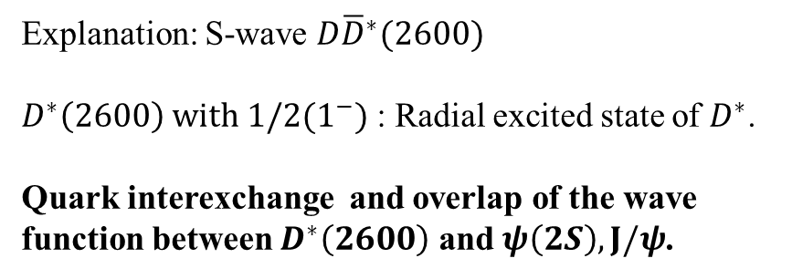
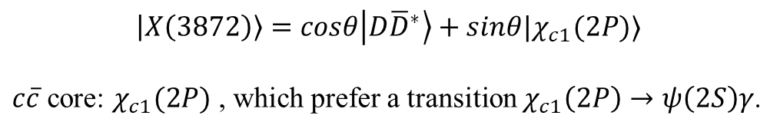
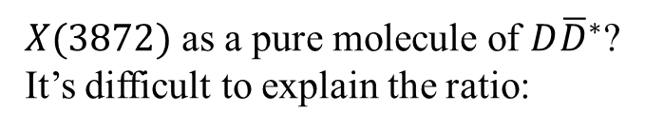

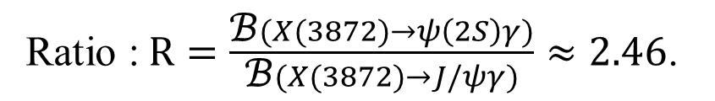

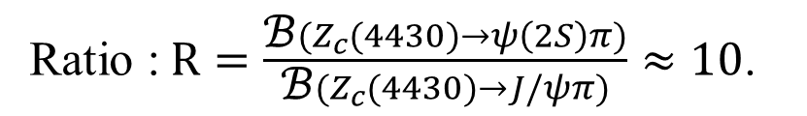
Background
Framework
Results
Summary
A puzzle for $Z_{c}(4430)$:
Overwhelming Preference: $ψ\left(2S\right)π$
$X(3872)$ as a pure molecule of $D{\overline{D}}^{∗}$?
It’s difficult to explain the ratio:
Ratio : $R=\frac{\text{ℬ}(Z_{c}(4430)→ψ\left(2S\right)π)}{\text{ℬ}(Z_{c}(4430)→J/ψπ)}≈10$.
Ratio : $R=\frac{\text{ℬ}(X(3872)→ψ\left(2S\right)γ)}{\text{ℬ}(X(3872)→J/ψγ)}≈2.46$.
Belle, Phys. Rev. D 88, 074026 (2013)
Belle, Phys. Rev. D 90, 112009 (2014).
LHCb Collaboration, Nucl. Phys. B 886, 665 (2014)
Explanation: S-wave $D{\overline{D}}^{∗}(2600)$
$D^{∗}\left(2600\right) with 1/2(1^{−})$ : Radial excited state of $D^{∗}$.
Quark interexchange and overlap of the wave function between $D^{∗}\left(2600\right)$ and $ψ\left(2S\right), J/ψ$.
$$\left|X\left(3872\right)\right\rangle =cosθ\left|D{\overline{D}}^{∗}\right\rangle +sinθ|χ_{c1}(2P)⟩$$
$c\overline{c}$ core: $χ_{c1}(2P)$ , which prefer a transition $χ_{c1}\left(2P\right)→ψ\left(2S\right)γ$.
Overlap of the wave function between$χ_{c1}(2P)$and $ψ\left(2S\right), J/ψ$.
Liu et.al., Phys. Rev. D 90, 074020 (2014).
5/25

Slide 6
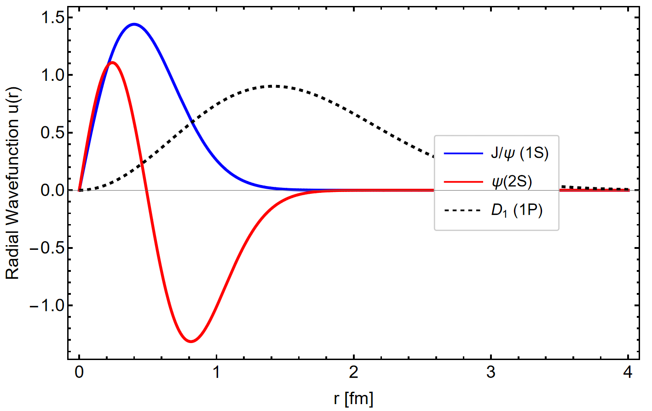
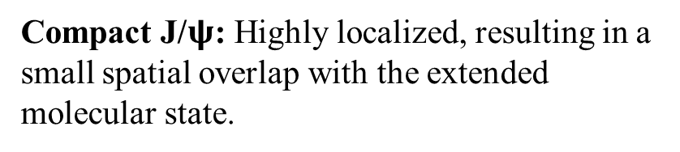
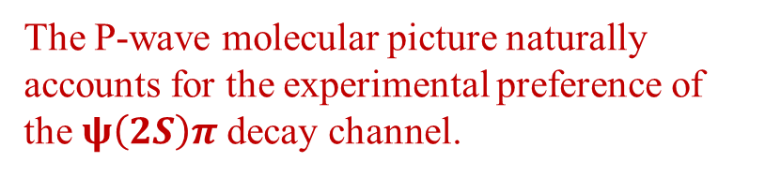
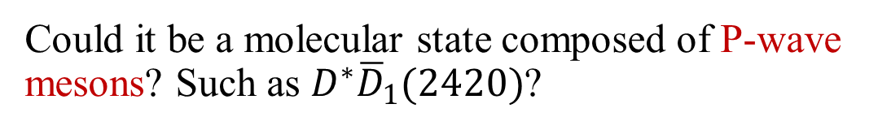
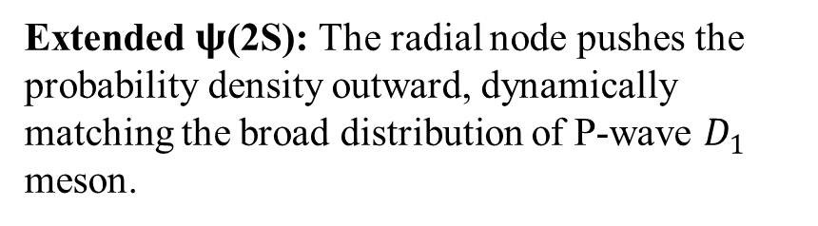

Background
Framework
Results
Summary
Analysis
Could it be a molecular state composed of P-wave mesons? Such as $D^{∗}{\overline{D}}_{1}(2420)$?
Compact J/$ψ$: Highly localized, resulting in a small spatial overlap with the extended molecular state.
Extended $ψ$(2S): The radial node pushes the probability density outward, dynamically matching the broad distribution of P-wave $D_{1}$ meson.
The P-wave molecular picture naturally accounts for the experimental preference of the $ψ\left(2S\right)π$decay channel.
Fig: Spatial distributions of $J/ψ$, $ψ(2S)$, $D_{1}$.
6/25

Slide 7
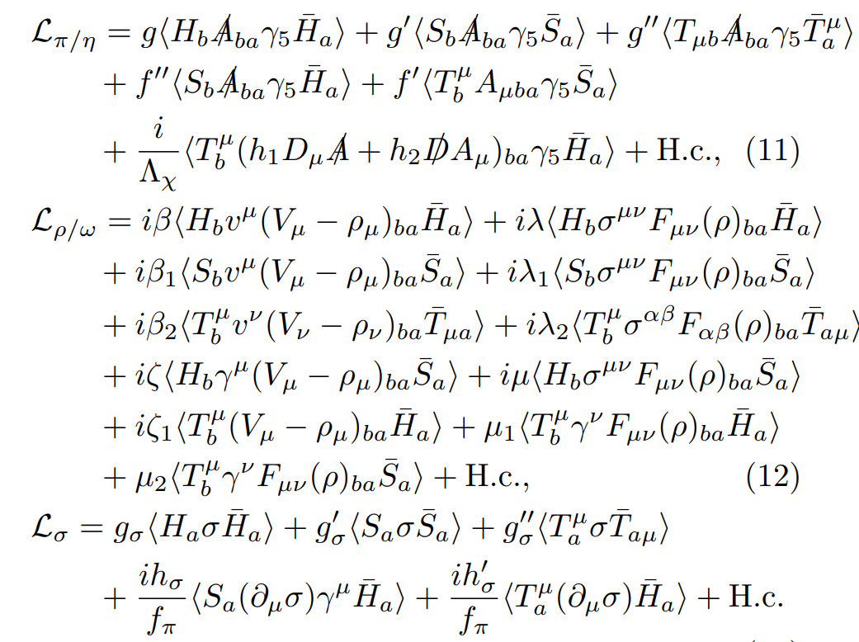
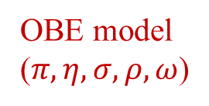
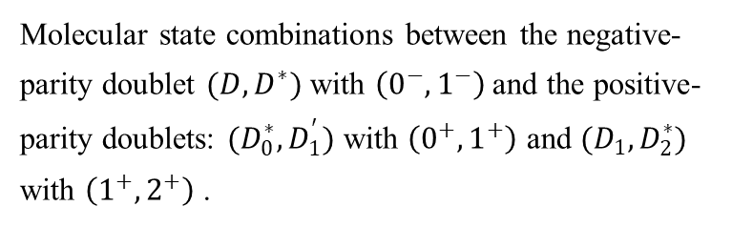
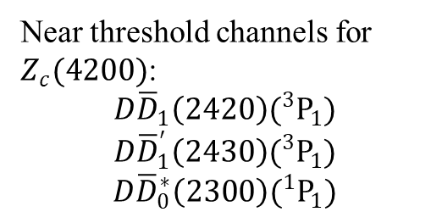
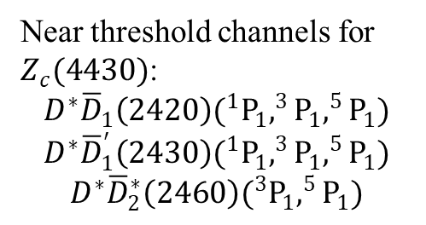
Background
Framework
Results
Summary
Channels
Lagrangians
OBE model
($π,η,σ,ρ,ω$)
Molecular state combinations between the negative-parity doublet $(D,D^{∗})$ with $\left(0^{−},1^{−}\right)$and the positive-parity doublets: $(D_{0}^{∗},D_{1}^{′})$ with $\left(0^{+},1^{+}\right)$ and $(D_{1},D_{2}^{∗})$ with $\left(1^{+},2^{+}\right)$ .
Near threshold channels for $Z_{c}(4430)$:
$$D^{∗}{\overline{D}}_{1}\left(2420\right)(^{1}P_{1},^{3}P_{1},^{5}P_{1})$$
$$D^{∗}{\overline{D}}_{1}^{′}\left(2430\right)(^{1}P_{1},^{3}P_{1},^{5}P_{1})$$
$$D^{∗}{\overline{D}}_{2}^{∗}\left(2460\right)(^{3}P_{1},^{5}P_{1})$$
Near threshold channels for $Z_{c}(4200)$:
$$D{\overline{D}}_{1}\left(2420\right)(^{3}P_{1})$$
$$D{\overline{D}}_{1}^{′}\left(2430\right)(^{3}P_{1})$$
$$D{\overline{D}}_{0}^{∗}\left(2300\right)(^{1}P_{1})$$
7/25

Slide 8
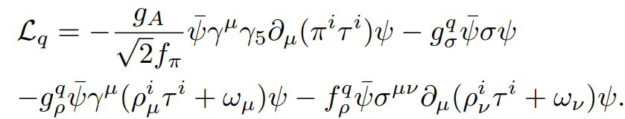
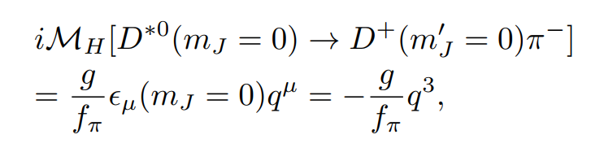
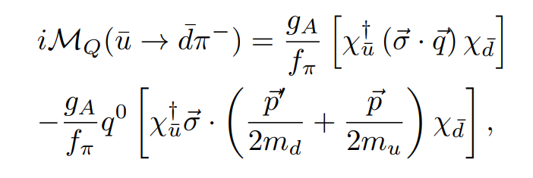
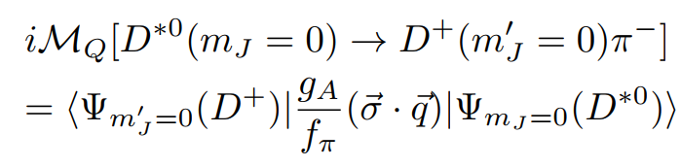
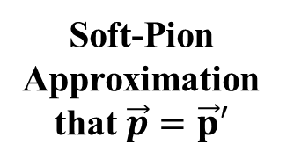


Background
Framework
Results
Summary
Coupling constants
Quark model:
Consider $D^{∗}→Dπ$
Hadron level:
Soft-Pion Approximation that $\vec{p}=\vec{p}′$
Quark level:
$$g_{A}=−g$$
8/25

Slide 9
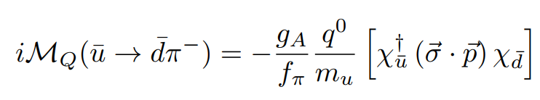
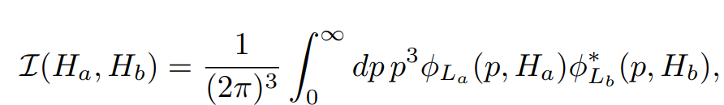
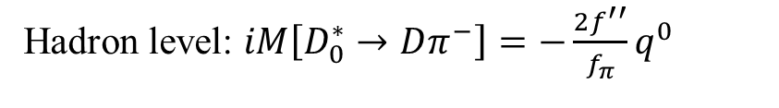


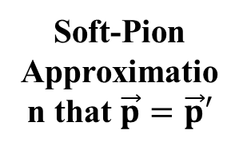
Background
Framework
Results
Summary
Coupling constants
Soft-Pion Approximation that $\vec{p}=\vec{p}′$
Consider $D_{0}^{∗}→Dπ$
Quark level:
Hadron level: $iM\left[D_{0}^{∗}→Dπ^{−}\right]=−\frac{2f^{′′}}{f_{π}}q^{0}$
$$f^{′′}=\frac{1}{3}\frac{g_{A}}{m_{u}}I(D_{0}^{∗},D)$$
9/25

Slide 10
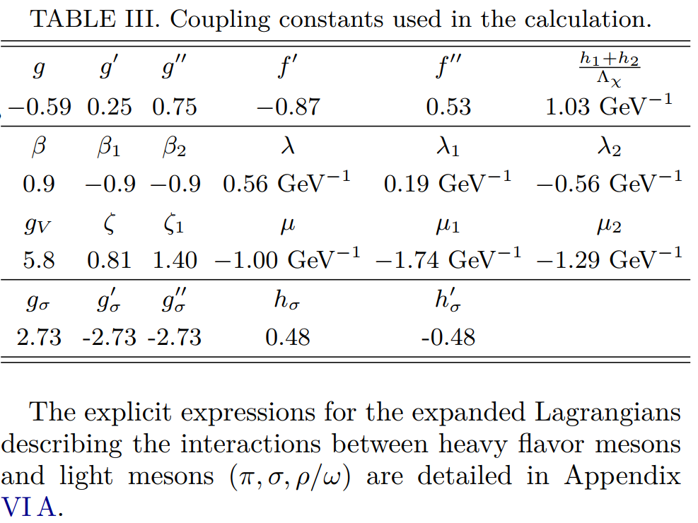



Background
Framework
Results
Summary
Coupling constants
$$g_{A}=0.75$$
Manohar et.al., Nucl. Phys. B 234, 189 (1984)
$$g_{V}=5.8, β=0.9, λ=0.56 GeV^{−1}$$
Bando et.al., Phys. Rep. 164, 217 (1988)
Isola et.al., Phys. Rev. D 68, 114001 (2003)
$$g_{σ}?$$
10/25

Slide 11
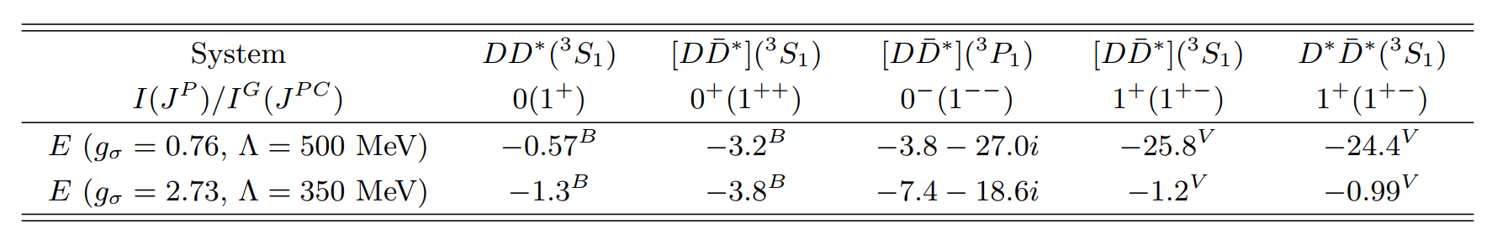
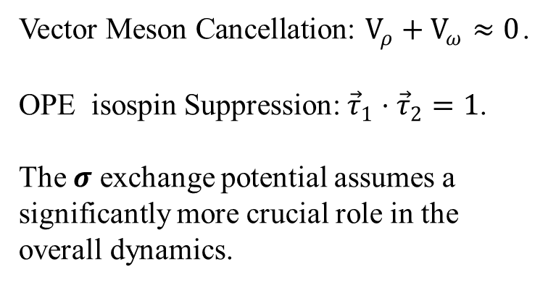
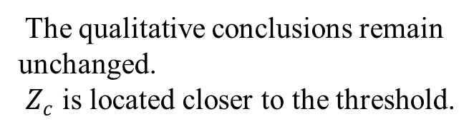

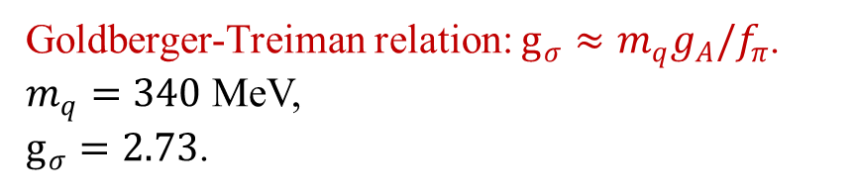
Background
Framework
Results
Summary
$$g_{σ}$$
LHCb, Phys. Rev. Lett. 133, 241903 (2024)
Extracted poles for exotic candidates $T_{cc}^{+}, X\left(3872\right), G\left(3900\right), Z_{c}\left(3900\right), Z_{c}(4020)$
under the instantaneous approximation ($q_{0}=0$).
Vector Meson Cancellation: $V_{ρ}+V_{ω}≈0$.
OPE isospin Suppression: ${\vec{τ}}_{1}⋅{\vec{τ}}_{2}=1$.
The $σ$ exchange potential assumes a significantly more crucial role in the overall dynamics.
Goldberger-Treiman relation: $g_{σ}≈m_{q}g_{A}/f_{π}$.
$m_{q}=340$ MeV,
$g_{σ}=2.73$.
The qualitative conclusions remain unchanged.
$Z_{c}$ is located closer to the threshold.
11/25

Slide 12
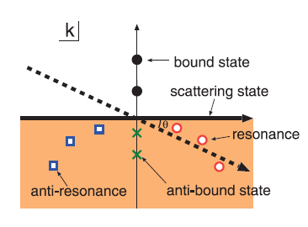

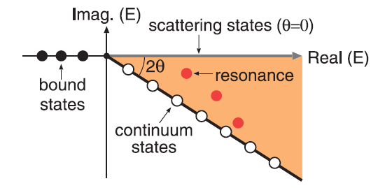

Background
Framework
Results
Summary
Complex scaling method (CSM)
Operation: $U\left(θ\right)r=re^{iθ},U\left(θ\right)k=ke^{−iθ}$
Character:
(1) CSM LSE
(2) faster
(3) more intuitive
Aguilar, Balslev and Combes (ABC theorem)
Commun. Math. Phys. 22, 269 (1971); Commun. Math. Phys. 22, 280 (1971);
12/25

Slide 13
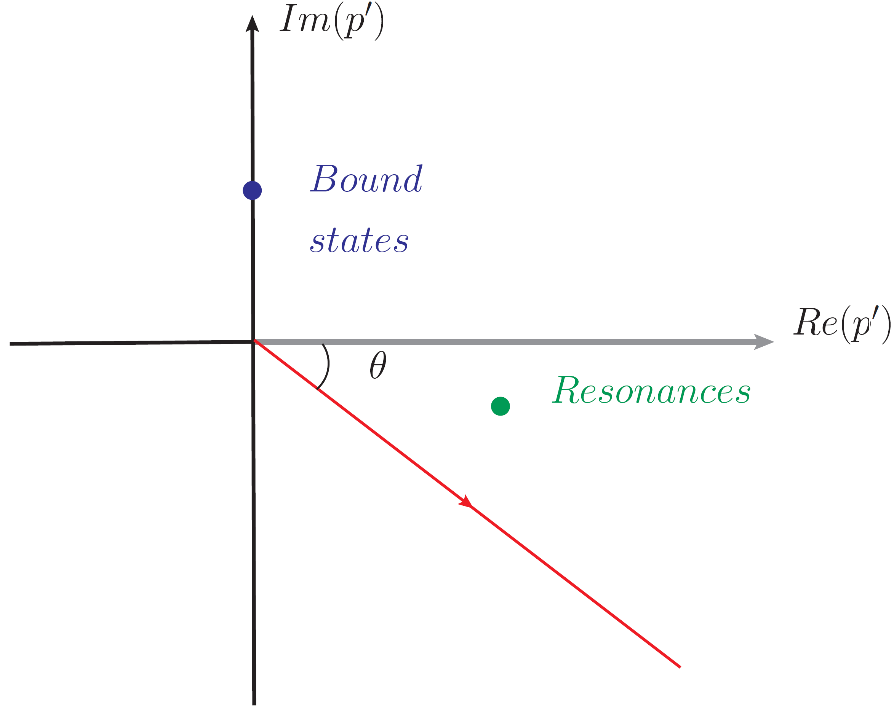
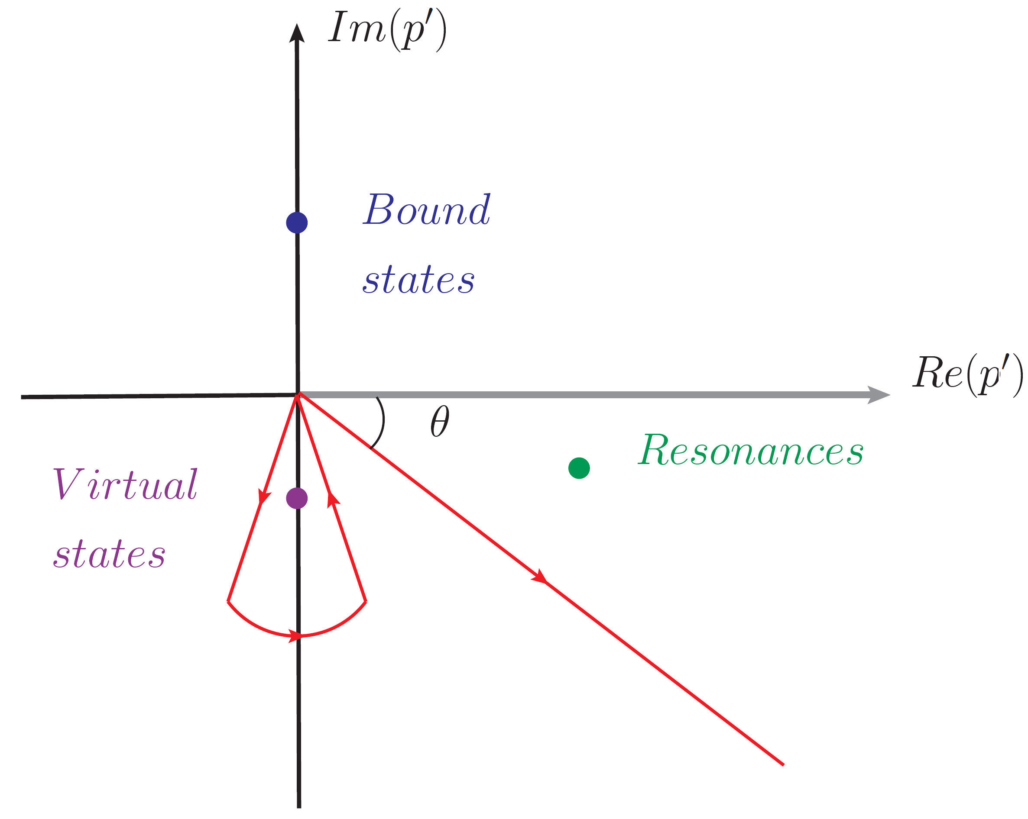
Background
Framework
Results
Summary
Improved CSM (ICSM)
CSM contour
ICSM contour
Deal with virtual states
Chen et.al., Phys. Rev. D 109, 034006 (2024);
13/25

Slide 14
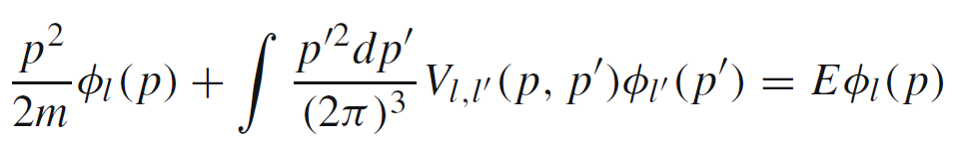
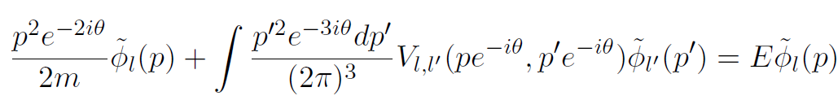
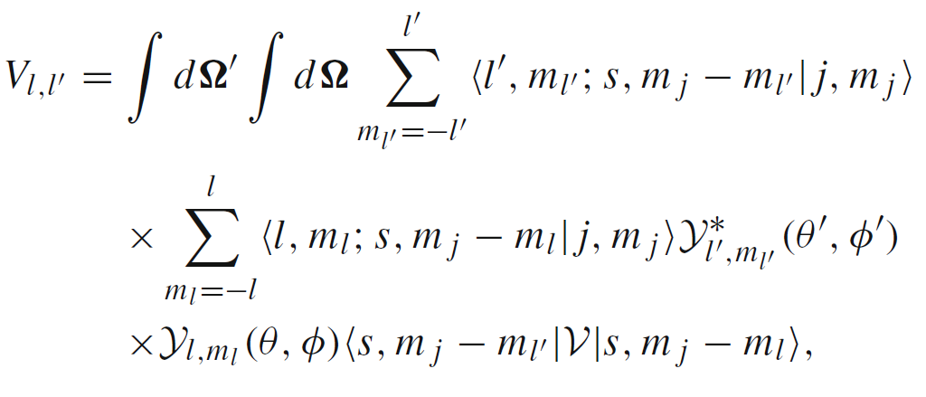
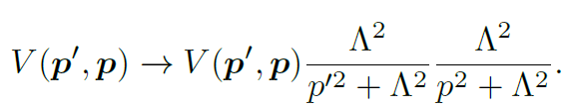
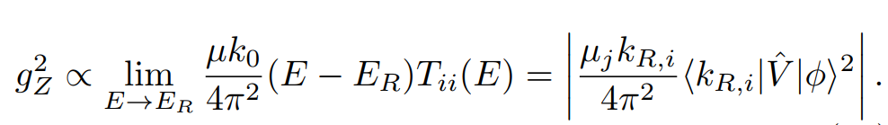



Motivation
Framework
Results
Summary
Schr$\ddot{o}$dinger Equation
Schr$\ddot{o}$dinger Equation:
$$p→pe^{−iθ},p′→p′e^{−iθ}$$
Partial wave decomposition:
Nonlocal Regulator:
T matrix residue:
14/25

Slide 15
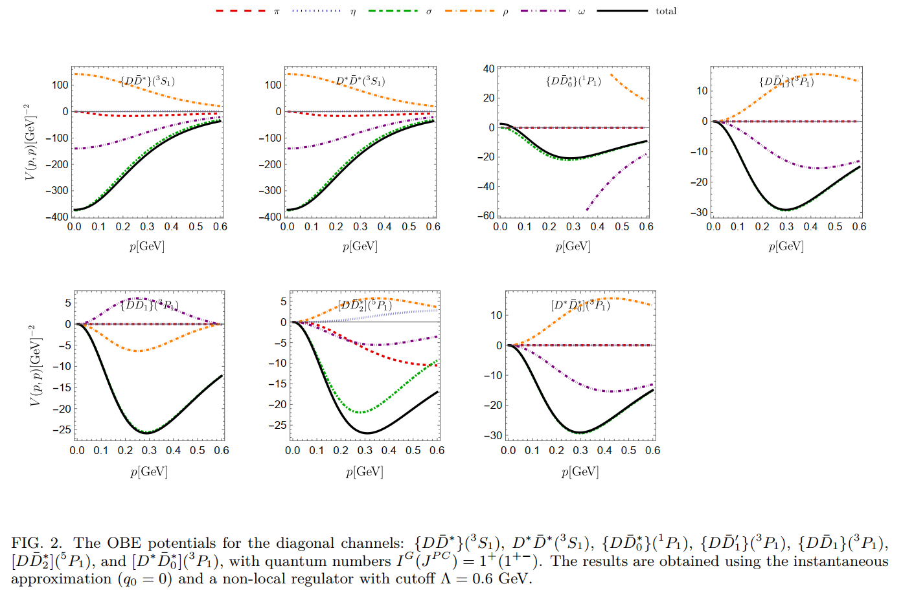

Background
Framework
Results
Summary
Potential $q_{0}=0$
15/25

Slide 16
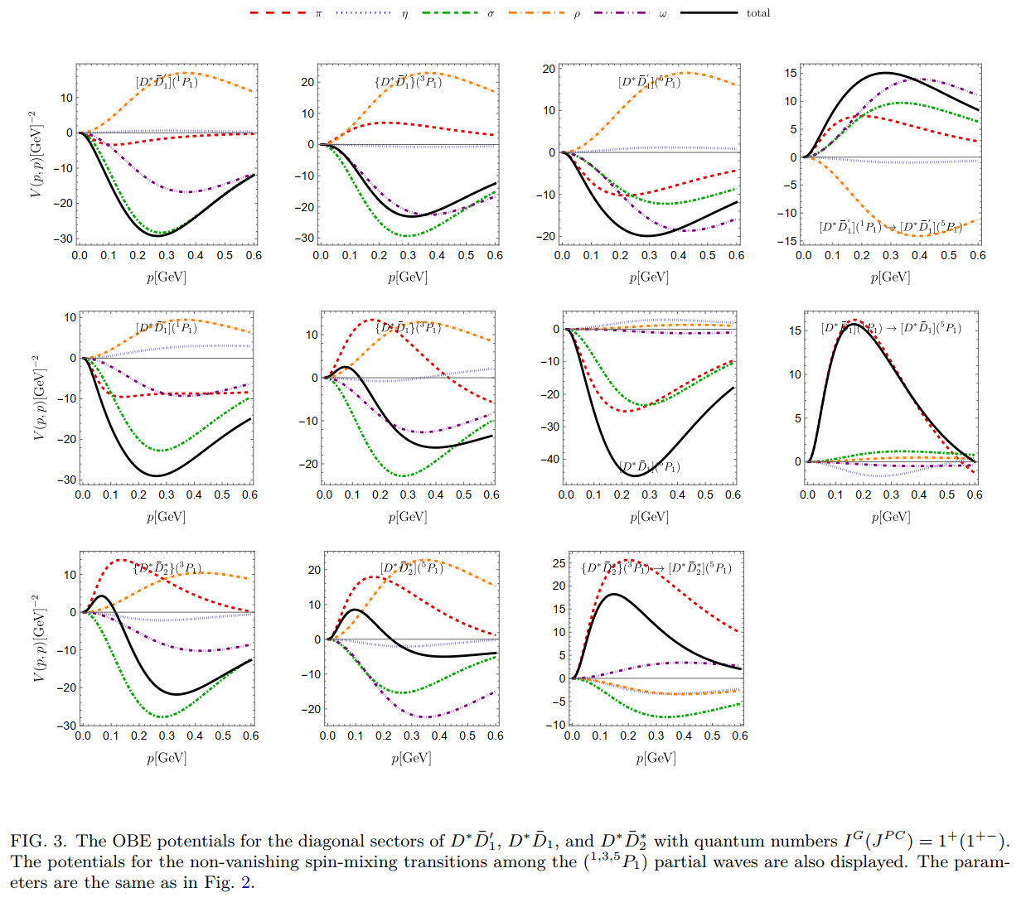
Background
Framework
Results
Summary
16/25

Slide 17
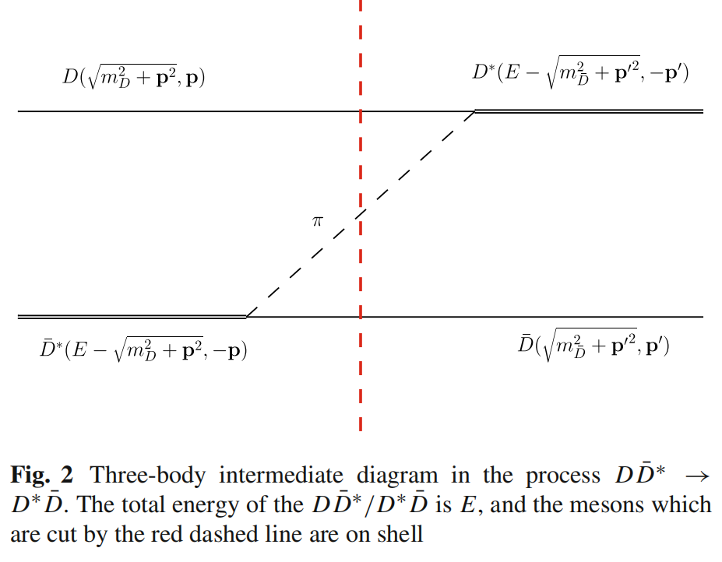
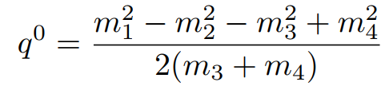



Background
Framework
Results
Summary
Three-body effect
1. Instantaneous approximations: $q_{0}=0$
2. Static limit:
3. Self-Energy Corrections:
17/25

Slide 18



Background
Framework
Results
Summary
Instantaneous approximations $q_{0}=0$
1. Heavy quark Symmetry: Highly similarity.
2. $D^{∗}{\overline{D}}_{1}^{′}(^{1}P_{1},^{5}P_{1})$: two pole affected by coupled channel effect.
That 1st : $(88.2+6.4i ,11.8−6.4i)\%$, and 2nd:$(15.2−1.3i ,84.8+1.3i)\%$
3. The behaviors of $D^{∗}{\overline{D}}_{1}(^{1}P_{1},^{5}P_{1})$ are largely similar to the cases above.
4. $D^{∗}{\overline{D}}_{2}^{∗}$: two pole are closer in energy, and ratio of residue and probabilities $≈1:1$.
Strong mixing!
18/25

Slide 19

Background
Framework
Results
Summary
Static Limit
1. The pole behavior remain largely unchanged.
2. $D^{∗}{\overline{D}}_{2}^{∗}$: two pole’s ratio of residue and probabilities becomes very different.
Pole1: $(105.5−5.2i ,−5.5+5.2i)\%$,
Pole2: $(−5.5+5.3i, 105.5−5.3i)\%$,
19/25

Slide 20

Background
Framework
Results
Summary
Self-energy Corrections:
1. The imaginary part of the energy is significantly enhanced, while the real part moves closer to the threshold.
2. Pole A of $D^{∗}{\overline{D}}_{2}^{∗}$, candidate of $Z_{c}(4430)$:
$$E=−8.1−76.1i$$
3. Pole of $D{\overline{D}}_{0}^{∗}$, candidate of $Z_{c}(4200)$:
$$E=8.7−184.2i$$
20/25

Slide 21



Background
Framework
Results
Summary
Self-energy Corrections and multichannel coupling
$$Z_{c}(4430)$$
$$Z_{c}(4200)$$
While coupled-channel effects introduce quantitative variations, the qualitative conclusions of the single-channel analysis remain unchanged.
21/25

Slide 22


Background
Framework
Results
Summary
Line shape of the $Z_{c}(4430)$ candidate
Construct effective Lagrangian:
Flatté-like parameterization:
T matrix residue:
22/25

Slide 23


Background
Framework
Results
Summary
Line shape of the $Z_{c}(4430)$ candidate
3. Three-Body Decay: Consistent with the two-body profile, offering theoretical predictions for future open-charm searches.
4. Narrower Width (< 180 MeV): Form factors are strictly required to suppress the divergent P-wave ($p^{3}$) phase space.
Hidden-Charm: Symmetric peak near the threshold.
Open-Charm: Asymmetric peak around 4510 MeV (driven by threshold effects).
23/25

Slide 24

Background
Framework
Results
Summary
Summary
Framework: Systematically Investigated $1^{+}(1^{+ −})$ tetraquarks as S-wave + P-wave hadronic molecules via OBE potential and Complex Scaling Method.
Three-Body Dynamics: Rigorous inclusion of self-energy and static limit approximations successfully reproduces the large experimental widths..
The $P$-wave Molecular Picture: We identify several broad resonances in the $D^{∗}{\overline{D}}_{1}(2420)$ and $D^{∗}{\overline{D}}_{2}^{∗}(2460)$ systems as candidates of the $Z_{c}\left(4430\right)$ , while the $D{\overline{D}}_{0}^{∗}(2300)$ and $D{\overline{D}}_{1}(2430)$ system as candidates of the $Z_{c}\left(4200\right)$.
Predictions: Flatté-like parametrization provides clear open-charm decay profiles to guide future experimental searches.
24/25

Slide 25
Thanks!

