Slide 1

Status of the error correction to the Higgs lattice with local solenoid compensation
Bin Wang
2025.12.26

Slide 2
Correction scheme and error settings
Software: SAD and Matlab-based accelerator toolbox (AT)
Closed-orbit distortion (COD) correction is performed with sextupoles off, then the sextupoles were turned on and the COD correction repeated.
The dispersion correction using dispersion free steering principle (DFS).
beta-beating correction (LOCO), coupling and vertical dispersion correction
The vertical emittance is calculated in each step of correction, and ‌only auto-corrected seeds were included in the performance evaluation‌.
‌Taking the Higgs mode correction as an example‌.
Component | Δx (mm) | Δy (mm) | Δθ_{z} (mrad) | Field error
Dipole | 0.10 | 0.10 | 0.10 | 0.01%
Quadrupole | 0.10 | 0.10 | 0.10 | 0.02%
Sextupole | 0.10* | 0.10* | 0.10 | 0.02%

Slide 3
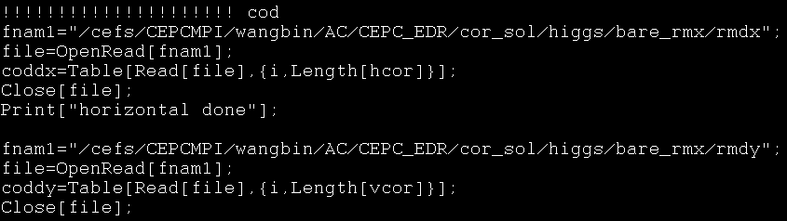
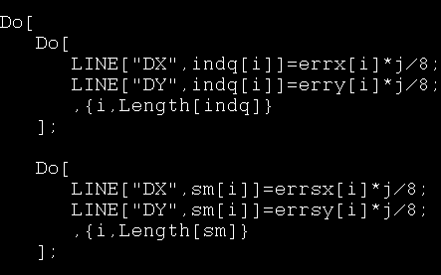
Closed orbit correction
Closed orbit correction to lattice without solenoid
  Adjust the iteration step and update the response matrix upon non-convergence.
  The lattice without solenoid can obtain an orbit distortion value of less than 50mm after reducing the misalignment errors, which allows subsequent matrix operations. However, the lattice with solenoid cannot.​

Slide 4
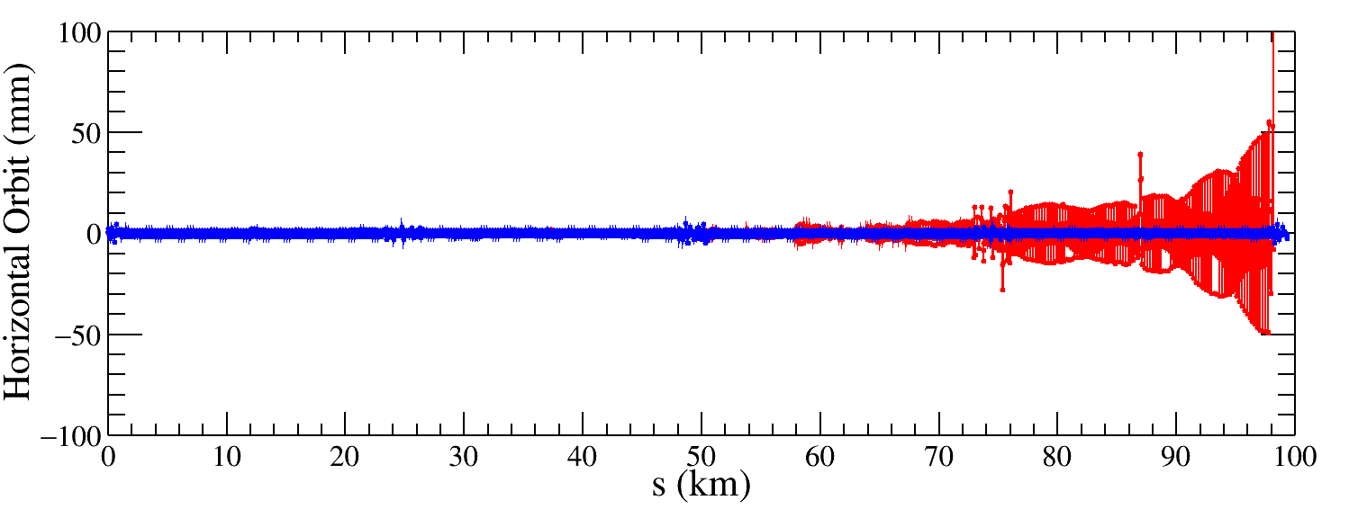
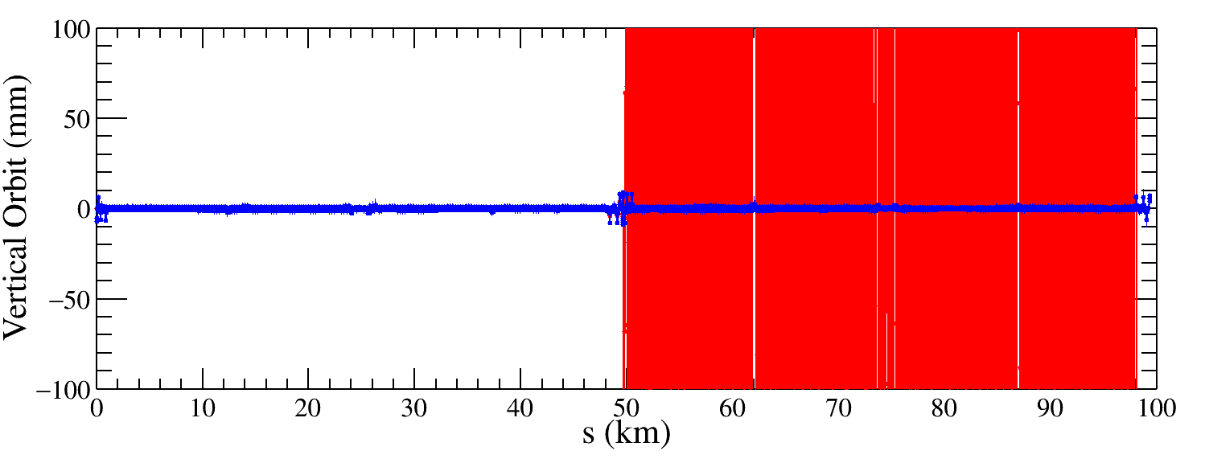
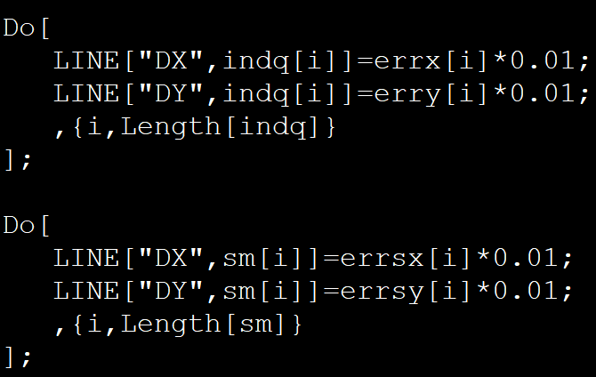
Result of the COD correction
Residual Orbit Distortion at 100× Reduced Misalignment Errors
  Lattice without solenoid: Achieves residual orbit distortion <10 mm, enabling subsequent matrix operations (see blue curve).
  Lattice with solenoid: Residual orbit remains significantly larger than 50 mm​ (see red curves).
  Conclusion: The conventional approach of error scaling followed by orbit correction fails for solenoid-integrated lattices.
Notes:
毅伟：
改到注入点开始。
含sol的差别是有边缘处，多一个bx，在垂直方向会有一个kick，在对撞点的会很快左右kick一下，轨道直接跑没了。
在一个小区域内的轨道变化，从注入点到对撞点这样的情况是如何的变化的，目前的总图是看不出那个小区间的轨道变化。
魏源源：
把第一块Q铁的误差去掉试试？
徐刚：
这里没有六极铁，可能有一些共振。
此外还可以check一下相位的情况。
下一步：
把局部的轨道放大，可以看到具体元件的结果。

Slide 5
Challenges of existing correction scheme
Repeat the error sensitivity analysis
  Focus on Quadrupole magnets in the interaction region (IR) and FF-quadrupoles near the IP.
Develop Closed-Orbit correction​
  Implement single-turn trajectory approximation​ for closed-orbit estimation.

