Slide 1
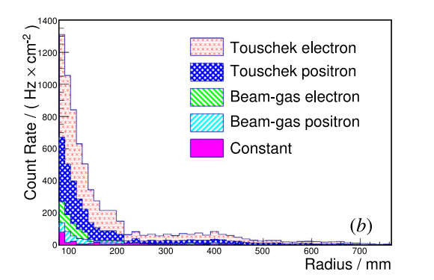
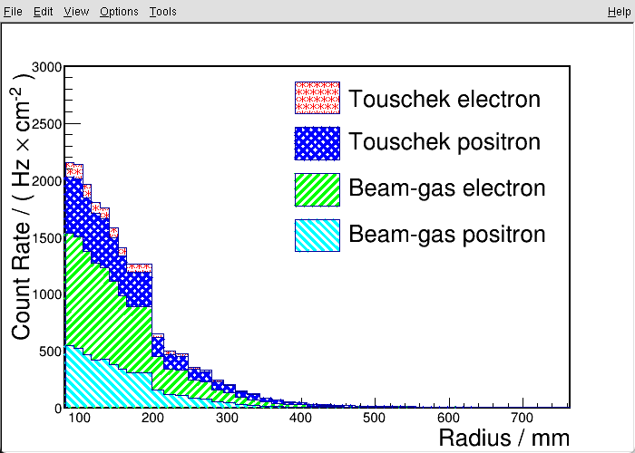
Touschek e scale: 3.44
Beam-gas e scale: 2.67
Touschek p scale: 3.18
Beam-gas p scale: 2.94
experiment
Question:
1.Why does the proportion of different types of background events relative to experiments differ?
2.Why is the decline of the simulated distribution so gradual?

