Slide 1

Hyperparameter Optimization For Deep Learning Models
Ph.D candidate
Asif Ali
Tutors
Prof. Nicola De Filippis
Dr. Guang Zhao

Slide 2
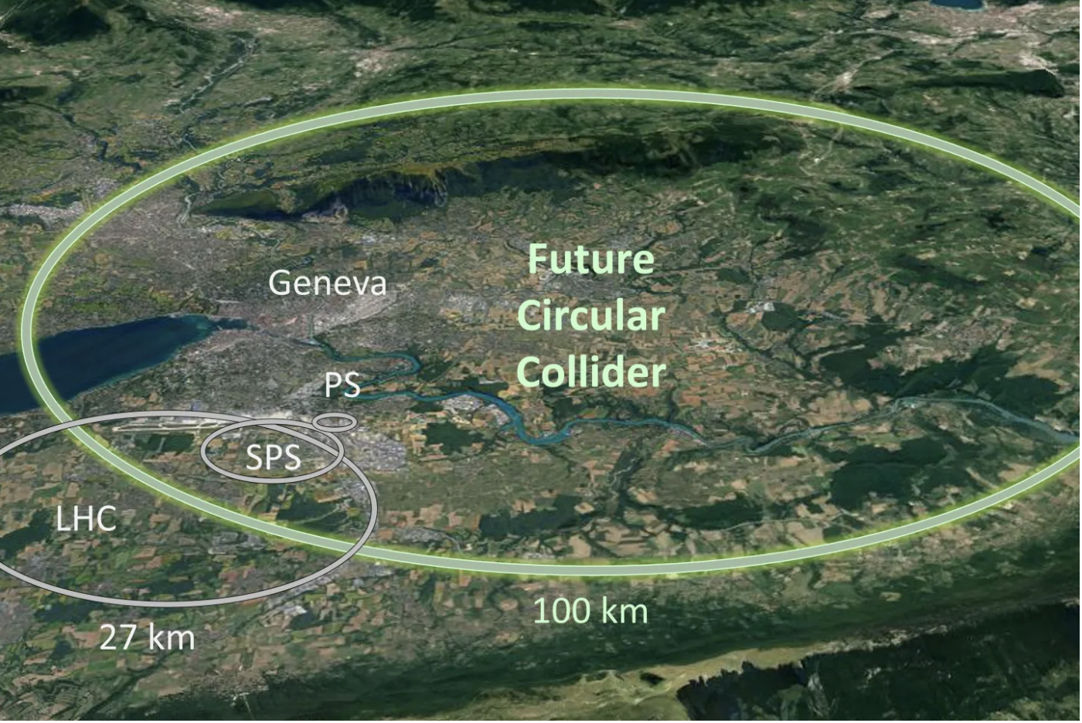
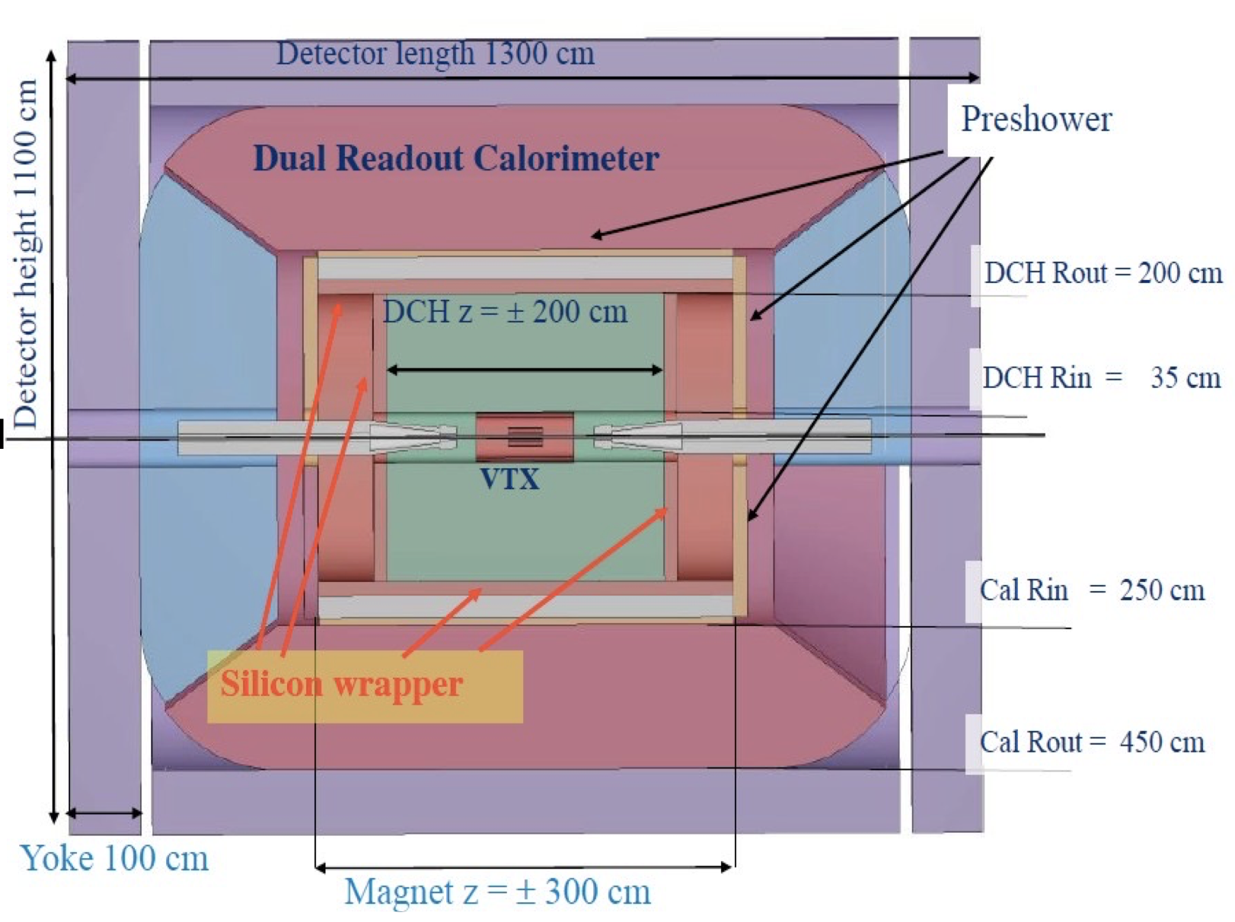
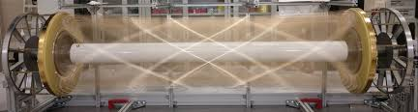
Future Circular Collider (FCC), the IDEA Detector and Drift Chamber
The IDEA Drift Chamber provides:
IDEA is a general-purpose detector designed for FCC
High-efficiency tracking
Future high-precision collider
Main sub-detectors from inner to outer
Precise momentum measurement
100 km circular tunnel
Silicon Vertex Detector
Excellent particle identification and separation
Two main operation modes:
FCC-ee: electron–positron collisions (very clean)
Silicon Tracker Wrapper
Drift Chamber (DCH)
Gas mixture: 90% Helium & 10% Isobutane
Preshower Detector
Dual-Readout Calorimeter
Inner Radius: 0.35 m
FCC-hh: proton–proton collisions (very high energy)
Superconducting Solenoid Magnet
Outer Radius: 2.0 m, Length: 4.0 m
Muon Detection System

Slide 3
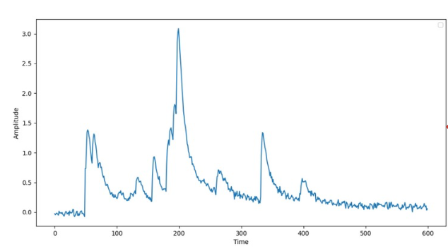
Cluster Counting
Drift Tube
Sense Wire
Muon
Determine the number of primary ionization clusters (dN/dx) in digitized drift-tube waveforms using a two-step Transformer-based reconstruction.
1. Peak finding: Find all peaks (primary and secondary) in the waveform.
2. Clusterization: From the detected peaks, identify only the true primary ionization clusters.

Slide 4
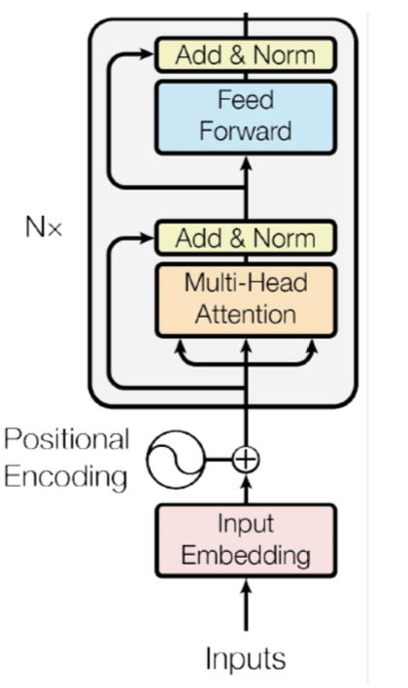
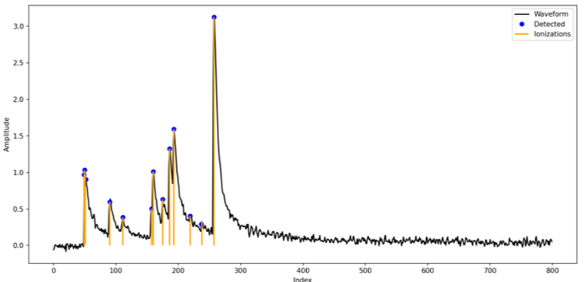
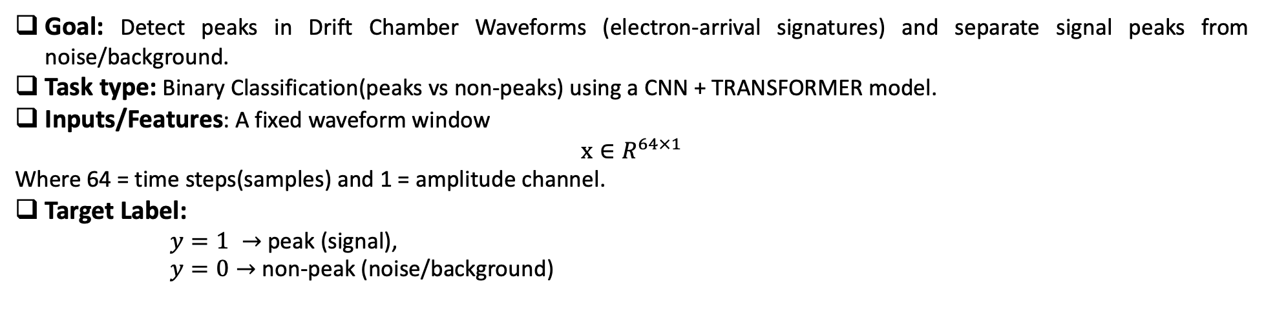
Peak Finding using CNN + Transformer Model
Goal: Detect peaks in Drift Chamber Waveforms (electron-arrival signatures) and separate signal peaks from noise/background.
Task type: Binary Classification(peaks vs non-peaks) using a CNN + TRANSFORMER model.
Inputs/Features: A fixed waveform window
$$x{∈R}^{64×1}$$
Where 64 = time steps(samples) and 1 = amplitude channel.
Target Label:
$y=1 →$ peak (signal),
$y=0→$ non-peak (noise/background)
Detected peaks corresponding to both primary and secondary electrons as identified by the CNN + Transformer model.
Waveform
Transformer-Model Architecture

Slide 5
Hyperparameters Configurations
Test_size | 0.4 | Hidden Activation | GeLu
No. of Heads | 8 | Output_activation | Sigmoid
Key_Dim | 8 | Optimizer | AdamW
Learning_rate | 2e-5 | Batch_Size | 256
Epochs | 60 | Fixed_threshold | 0.5
The above table shows us different hyperparameters configurations.

Slide 6
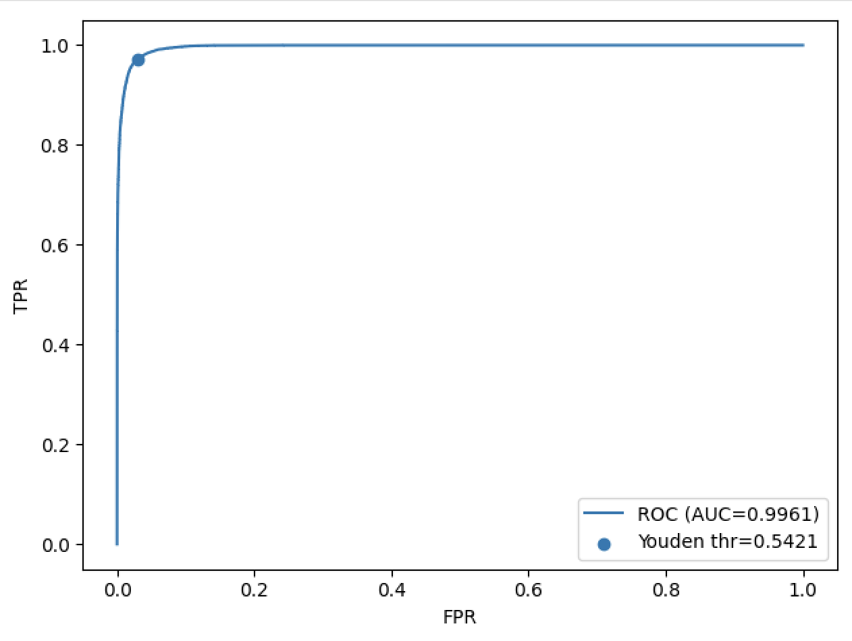
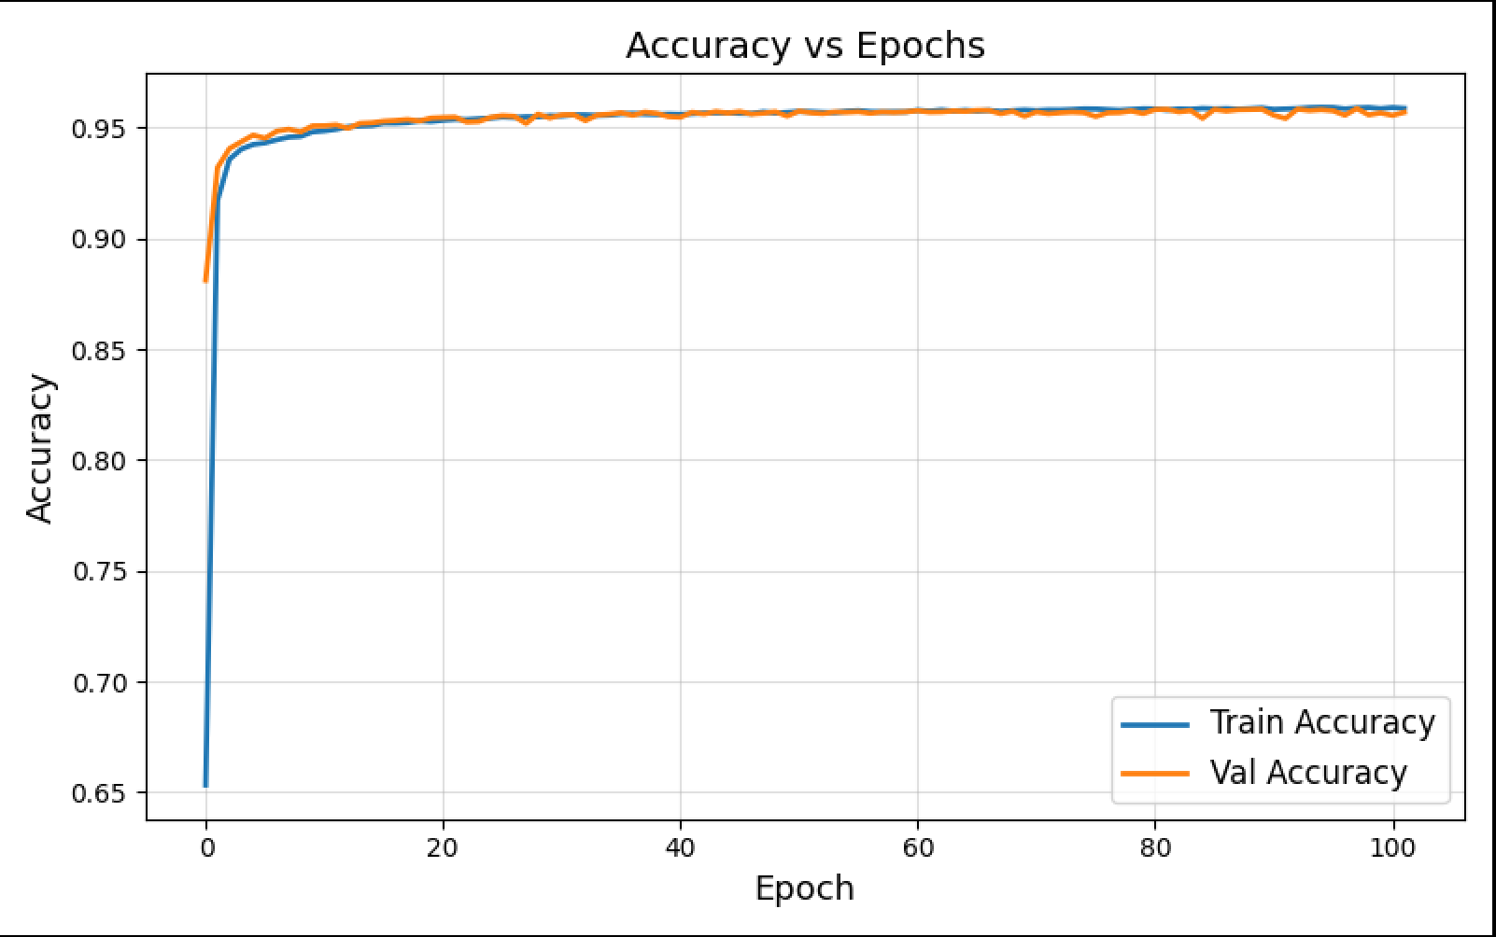
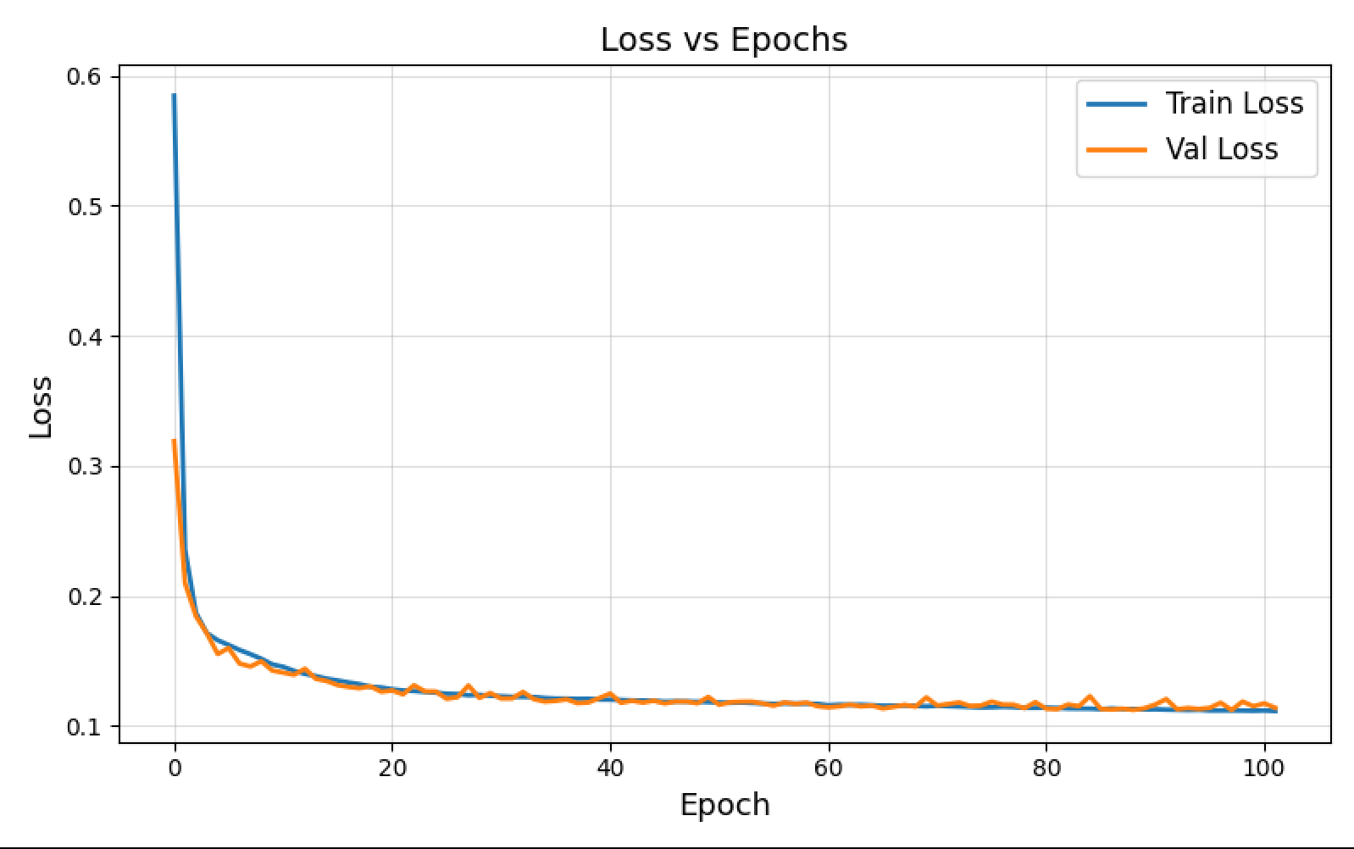
Performance Of The Best Transformer Model
The above plot shows ROC curve for the best Transformer model with Area under the curve value 0.9961 which show a best classification to discriminate signal from background.
The above plot Accuracy VS Epoch shows us that the training and validation accuracy increases over the epochs and then it become approximately constant which shows a best trained model.
The above plot loss VS epoch show us that the training and validation loss decreases over the epochs and then it become approximately constant which shows a best trained model.
Youden threshold = 0.5421 (optimal probability cut that maximizes TPR−FPR on the ROC curve)

Slide 7
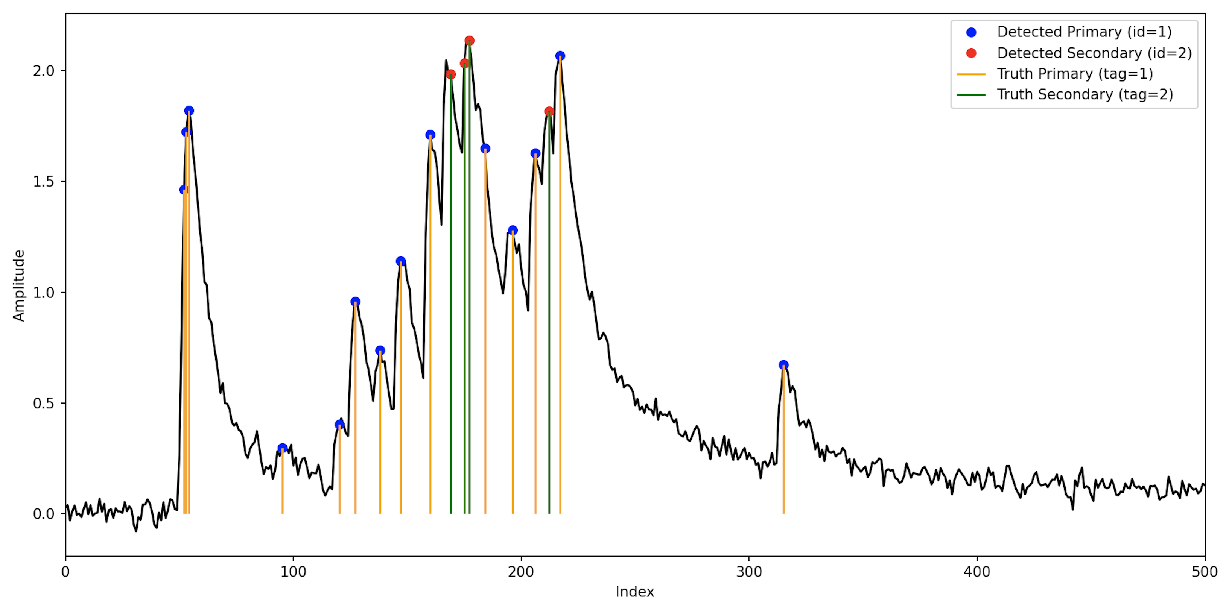
CNN + Transformer For Clusterization
Detected peaks from both primary and secondary electrons are shown above using the CNN + Transformer model.
A regression problem to detect number of primary clusters based on detected peaks by using (CNN + TRANSFORMER) model.
Labels: Number of clusters from MC truth.
Features: Time list of the detected times in the previous step.

Slide 8
Best Hyperparameters Configurations
Test_size | 0.4 | Hidden neuron | 128
Optimizer | Adam | Learning_rate | 10-3
epochs | 100 | Transformer_blocks | 2
Patience | 20 | Attention_Head | 2
The above table shows us different hyperparameters Configurations.

Slide 9
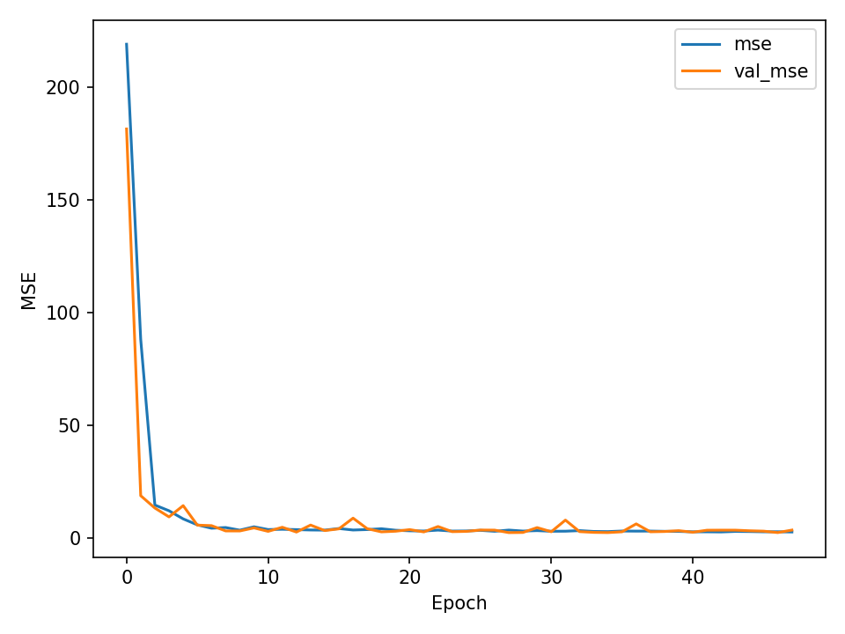
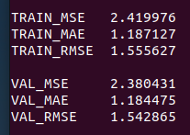
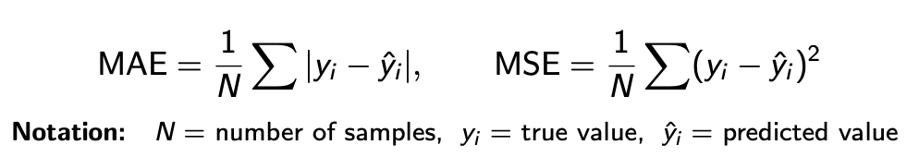
Model Performance Overview for Clusterization
Fast convergence in the first 5 epochs.
Training and validation curves overlap ⇒no overfitting.
Stable MSE indicate strong generalisation.

Slide 10
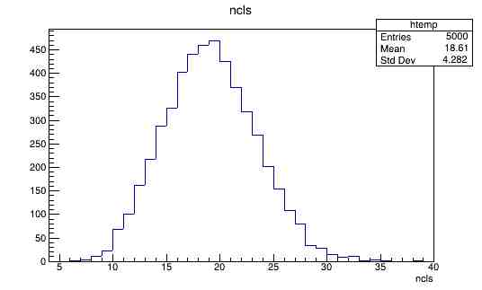
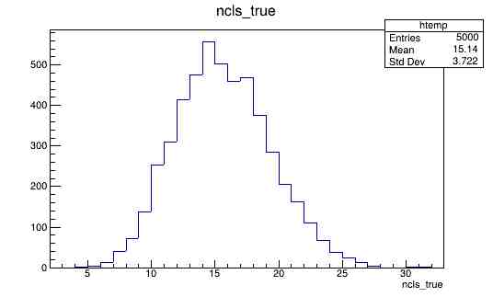
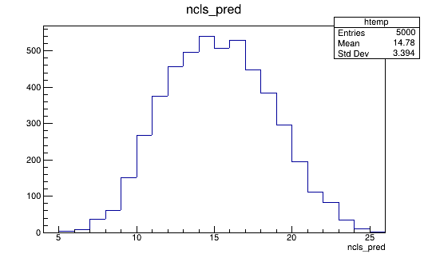
Reconstruction Results for 10 GeV Momentum of Muons
Number of Primary Clusters from Peak Finding (CNN + Transformer) — Target
Predicted Number of Primary Clusters from Regression (CNN + Transformer)
Number of Primary Clusters(MC)

Slide 11
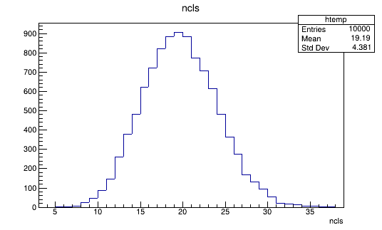
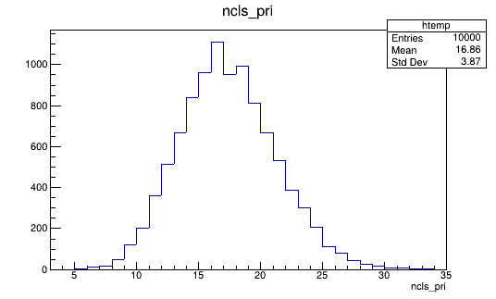
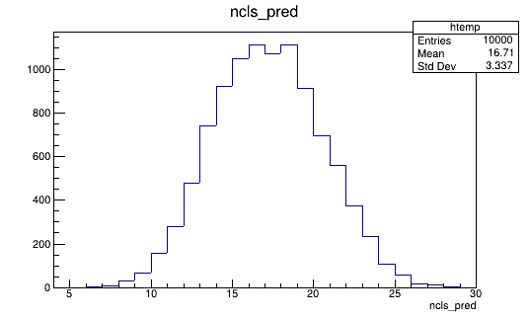
Reconstruction Results for 180 GeV Momentum of Muons
Number of Primary Clusters from Peak Finding (CNN + Transformer) — Target
Predicted Number of Primary Clusters from Regression (CNN + Transformer)
Number of Primary Clusters(MC)

Slide 12
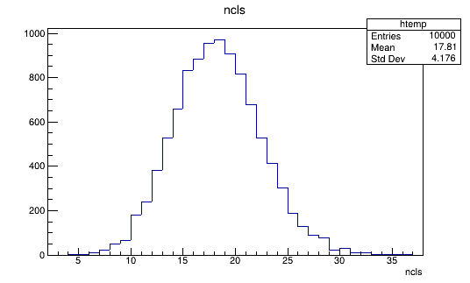
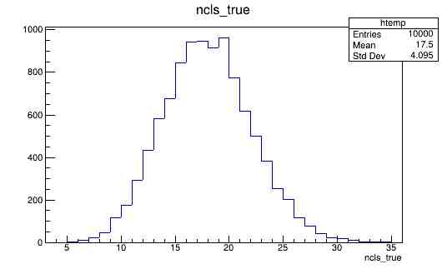
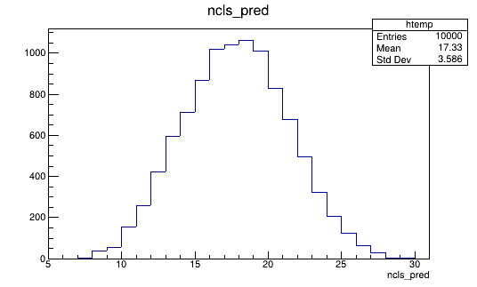
Reconstruction Results for 6 GeV Momentum of Muons
Number of Primary Clusters from Peak Finding (CNN + Transformer) — Target
Predicted Number of Primary Clusters from Regression (CNN + Transformer)
Number of Primary Clusters(MC)

Slide 13
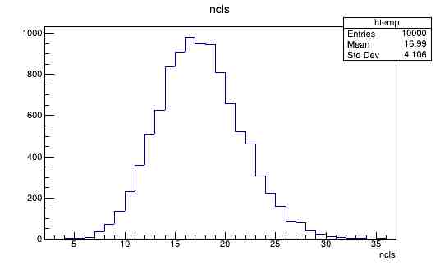
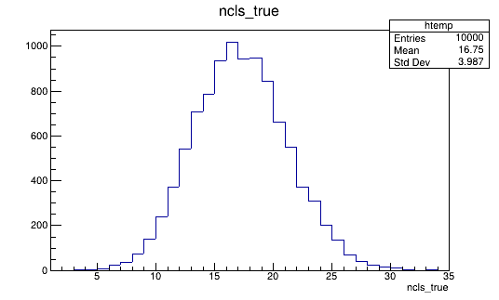
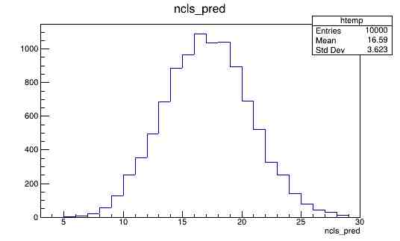
Reconstruction Results for 4 GeV Momentum of Muons
Number of Primary Clusters from Peak Finding (CNN + Transformer) — Target
Predicted Number of Primary Clusters from Regression (CNN + Transformer)
Number of Primary Clusters(MC)

Slide 14
Final Table of the Reconstruction for Different Momenta
Different Momenta of Muon(GeV) | Primary Clusters (MC) | Standard Deviation(MC) | Primary Clusters(1st Step – CNN + Transformer - Classification) | Standard Deviation(1st Step – CNN + Transformer - Classification) | Primary Clusters(2nd Step – CNN + Transformer - Regression) | Standard Deviation(2nd Step – CNN + Transformer - Regression)
4 GeV | 16.99 | 4.10 | 16.75 | 3.98 | 16.59 | 3.62
6 GeV | 17.81 | 4.17 | 17.50 | 4.09 | 17.33 | 3.58
10 GeV | 18.61 | 4.28 | 15.14 | 3.72 | 14.78 | 3.39
180 GeV | 19.19 | 4.38 | 16.86 | 3.87 | 16.71 | 3.33

Slide 15
Thank you for your attention!

