Slide 1
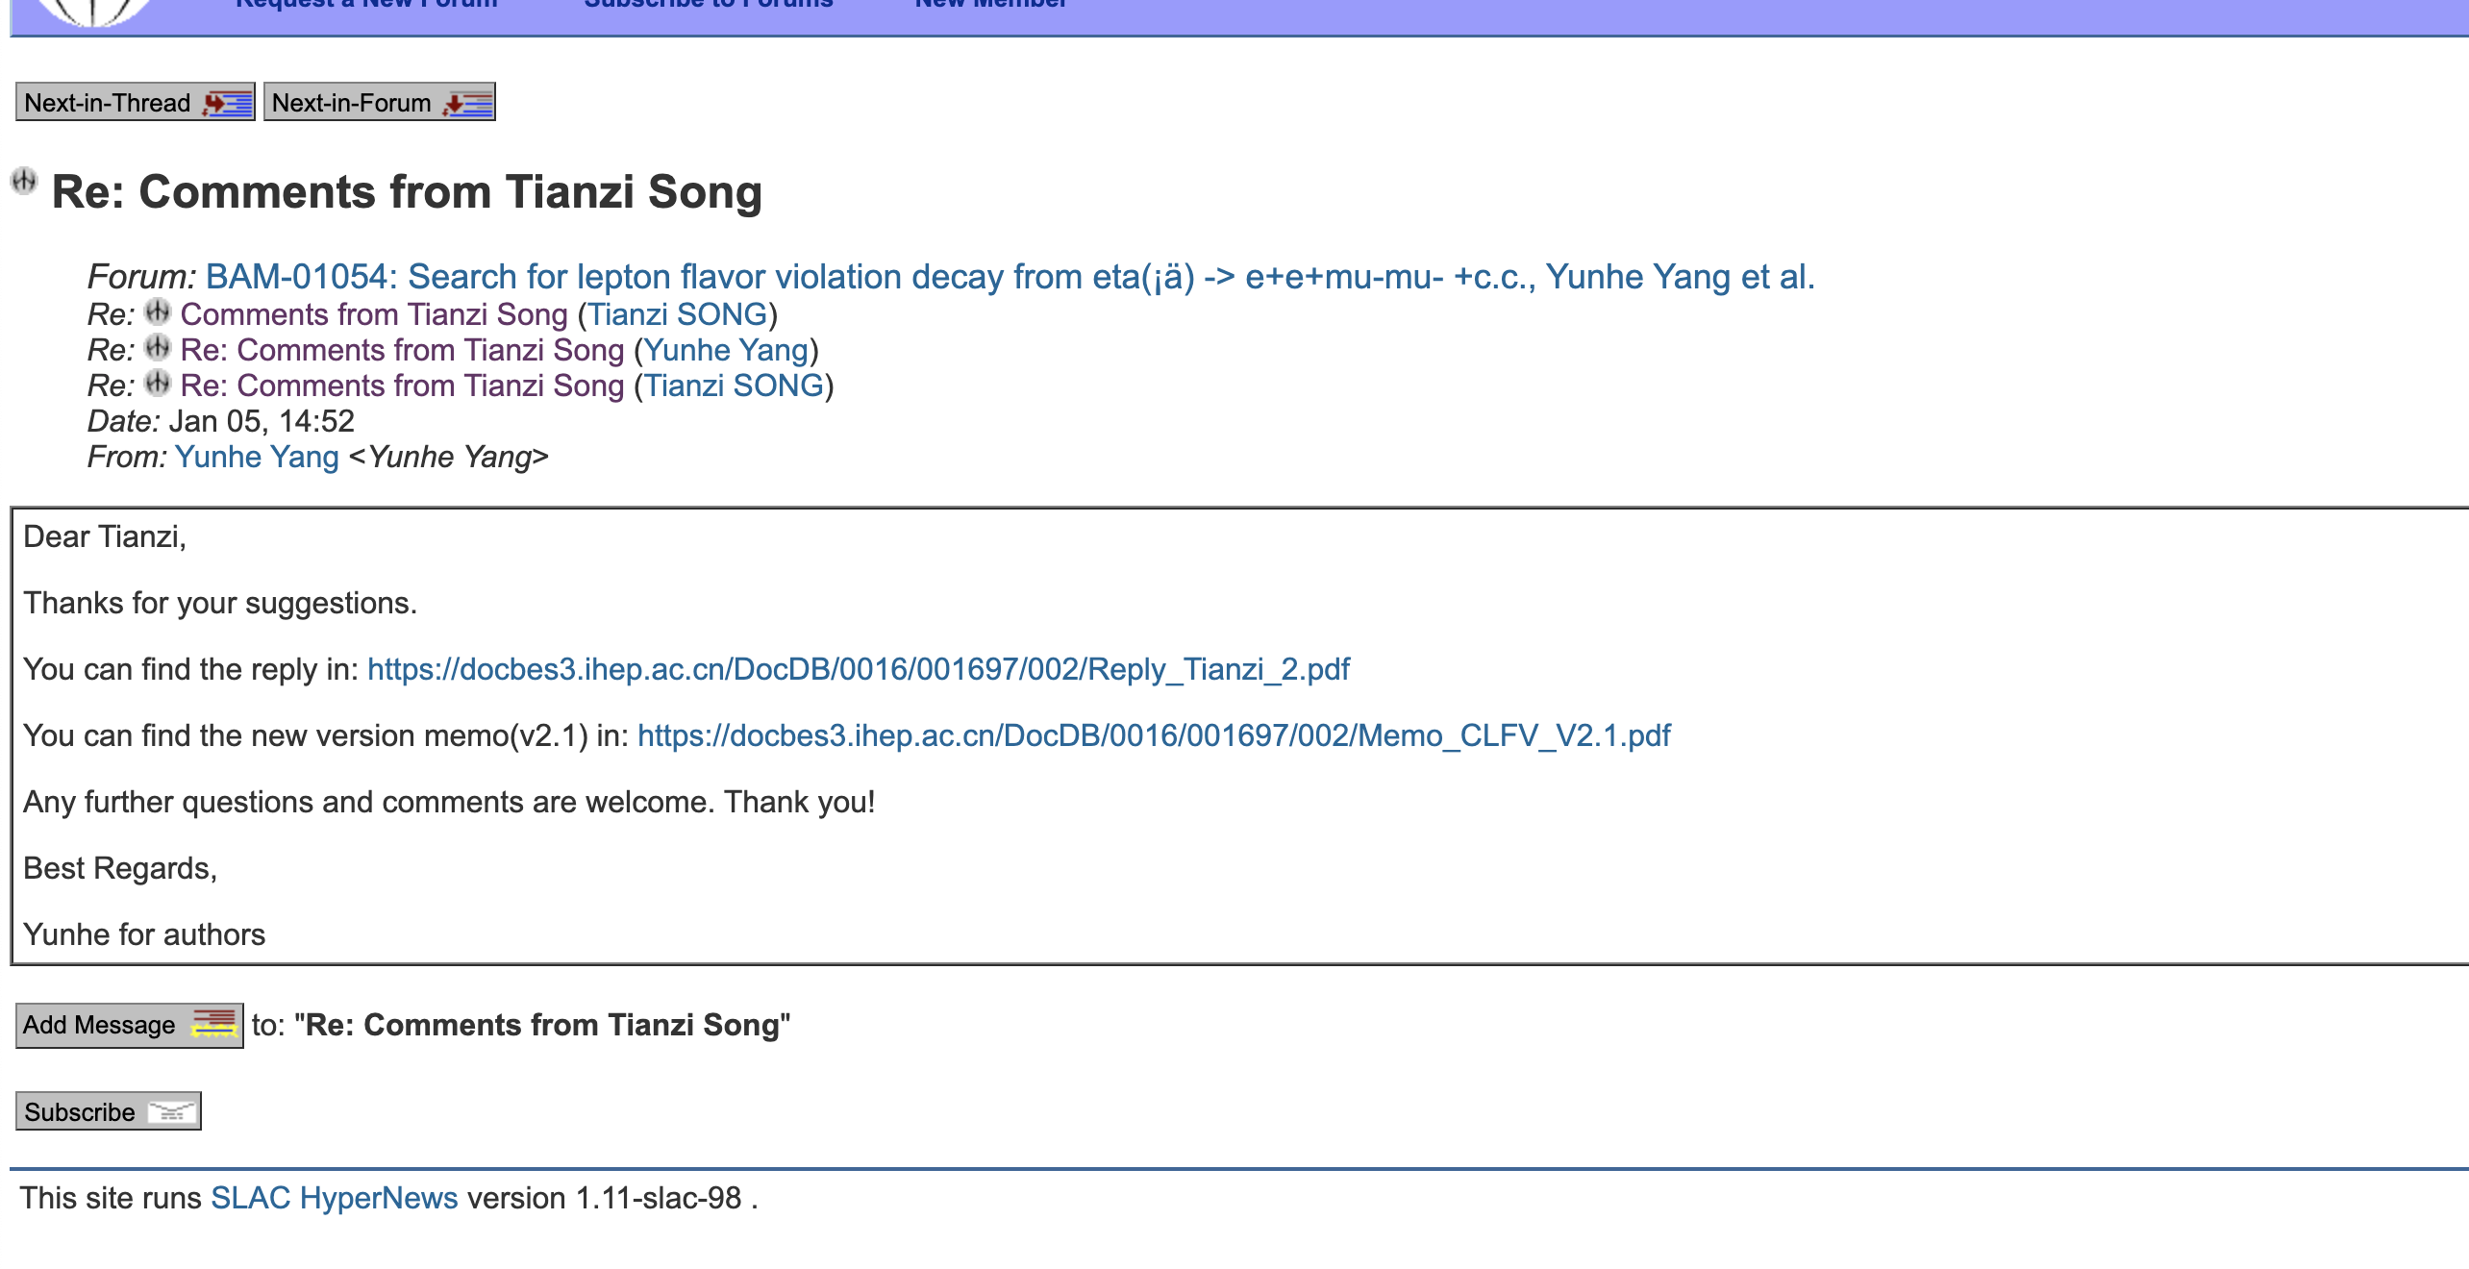
CLFV
I replied to Song Tianzi's question.

Slide 2
CPV
Waiting for group review.

