Slide 1
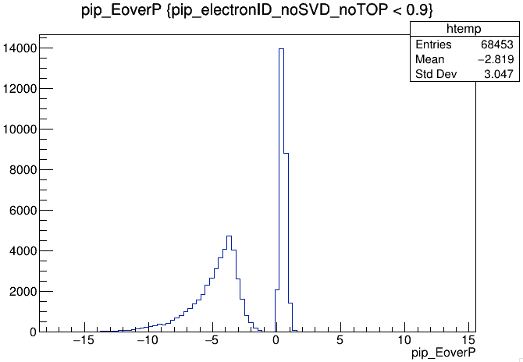
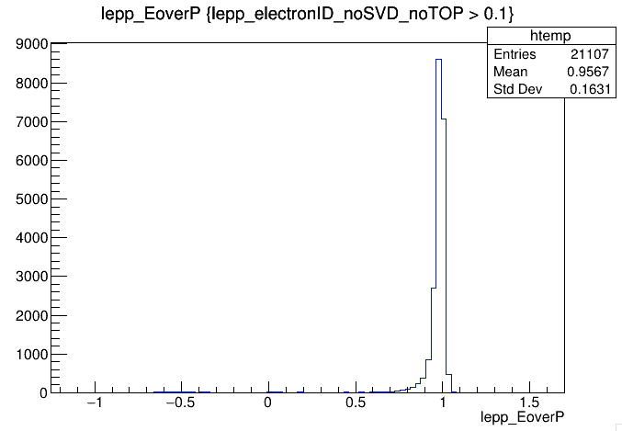
EoverP’= 'formula(ifNANgiveX(clusterE, -1)/p)'

Slide 2
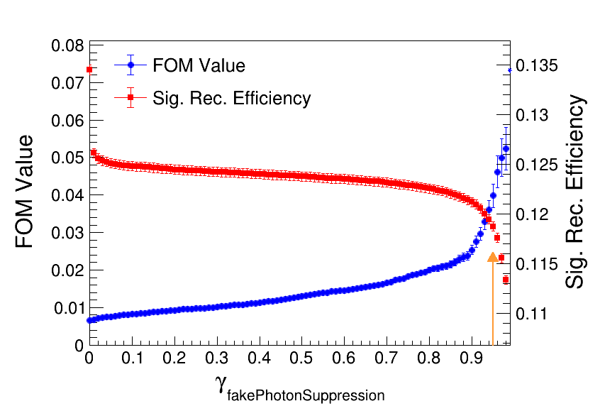
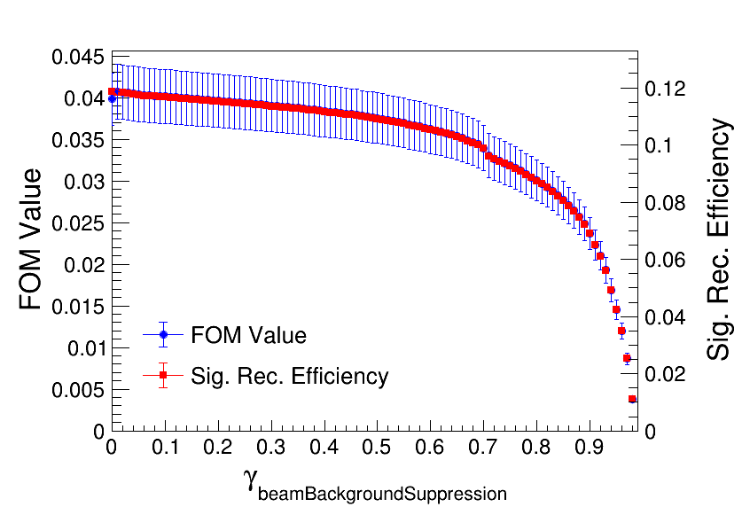
Photon MVA

Slide 3
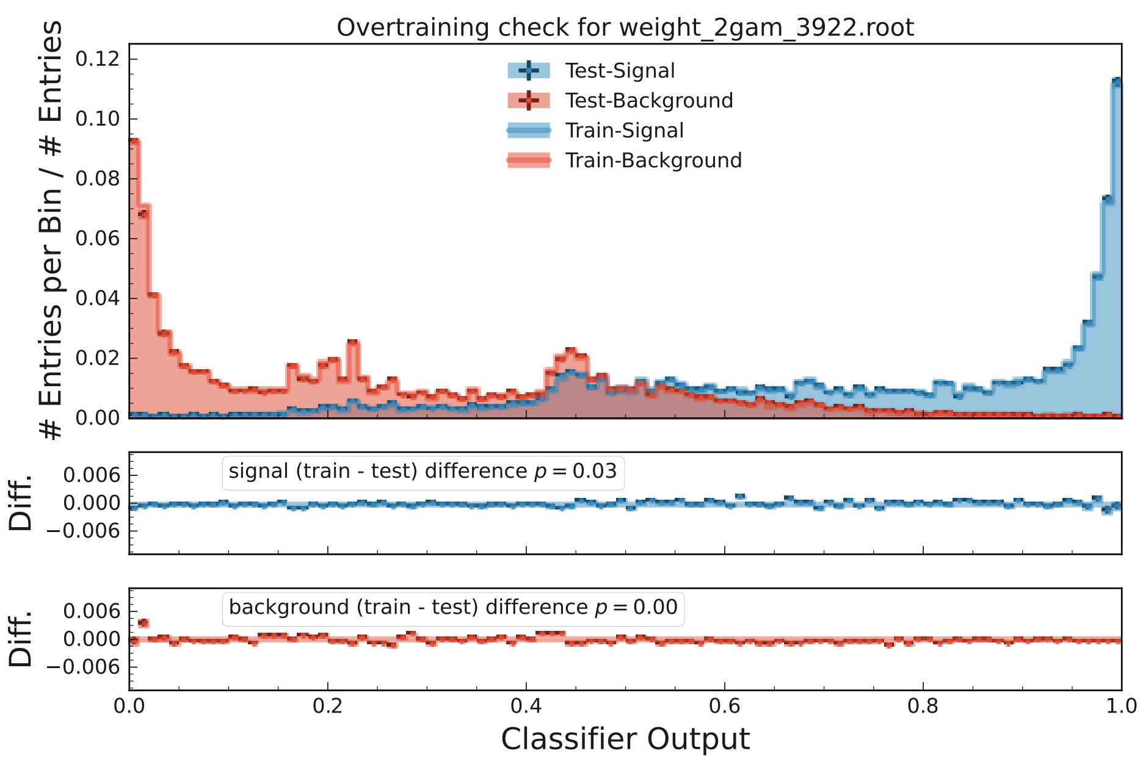
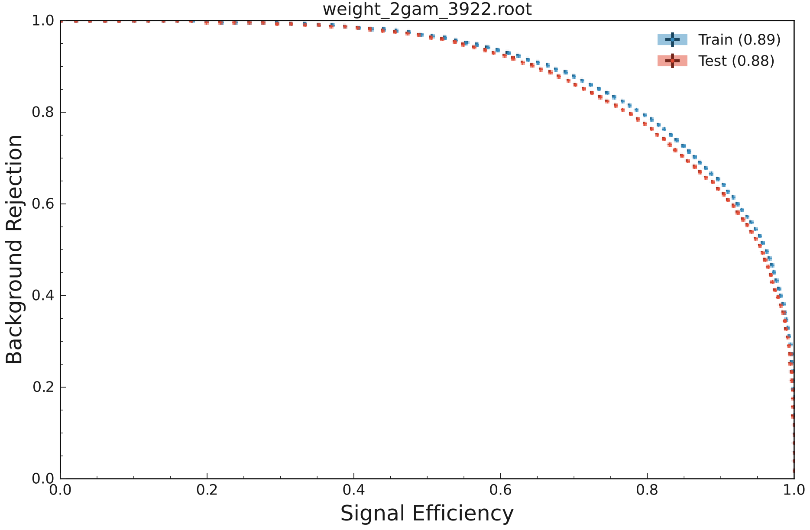
fastbdt_options.m_nTrees = 1000
fastbdt_options.m_nLevels = 2
fastbdt_options.m_nCuts = 20
fastbdt_options.m_shrinkage = 0.2

Slide 4
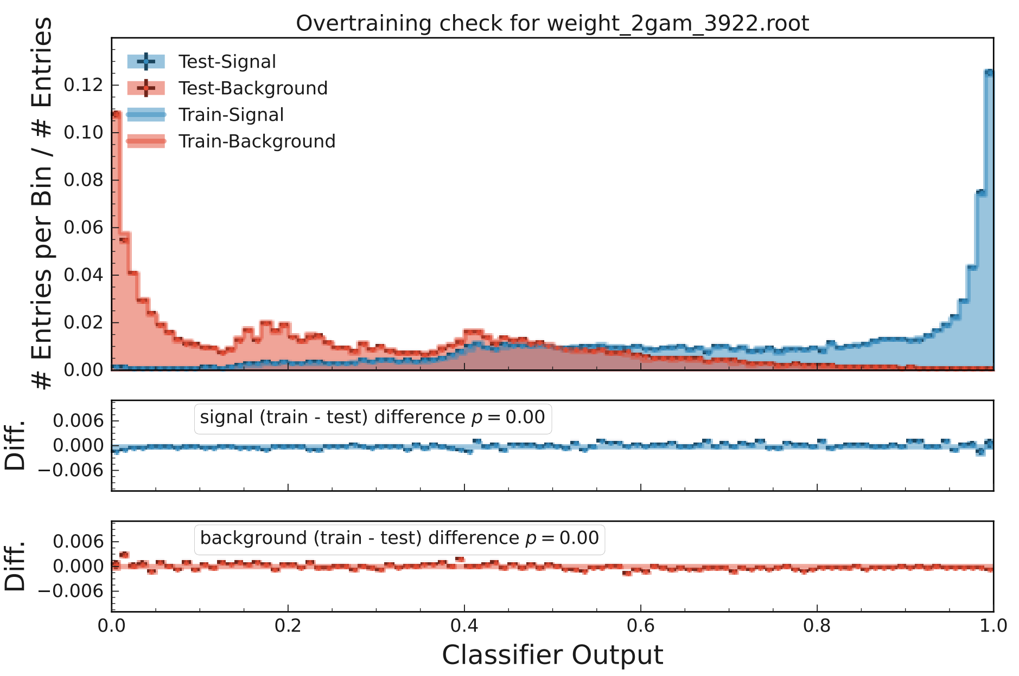
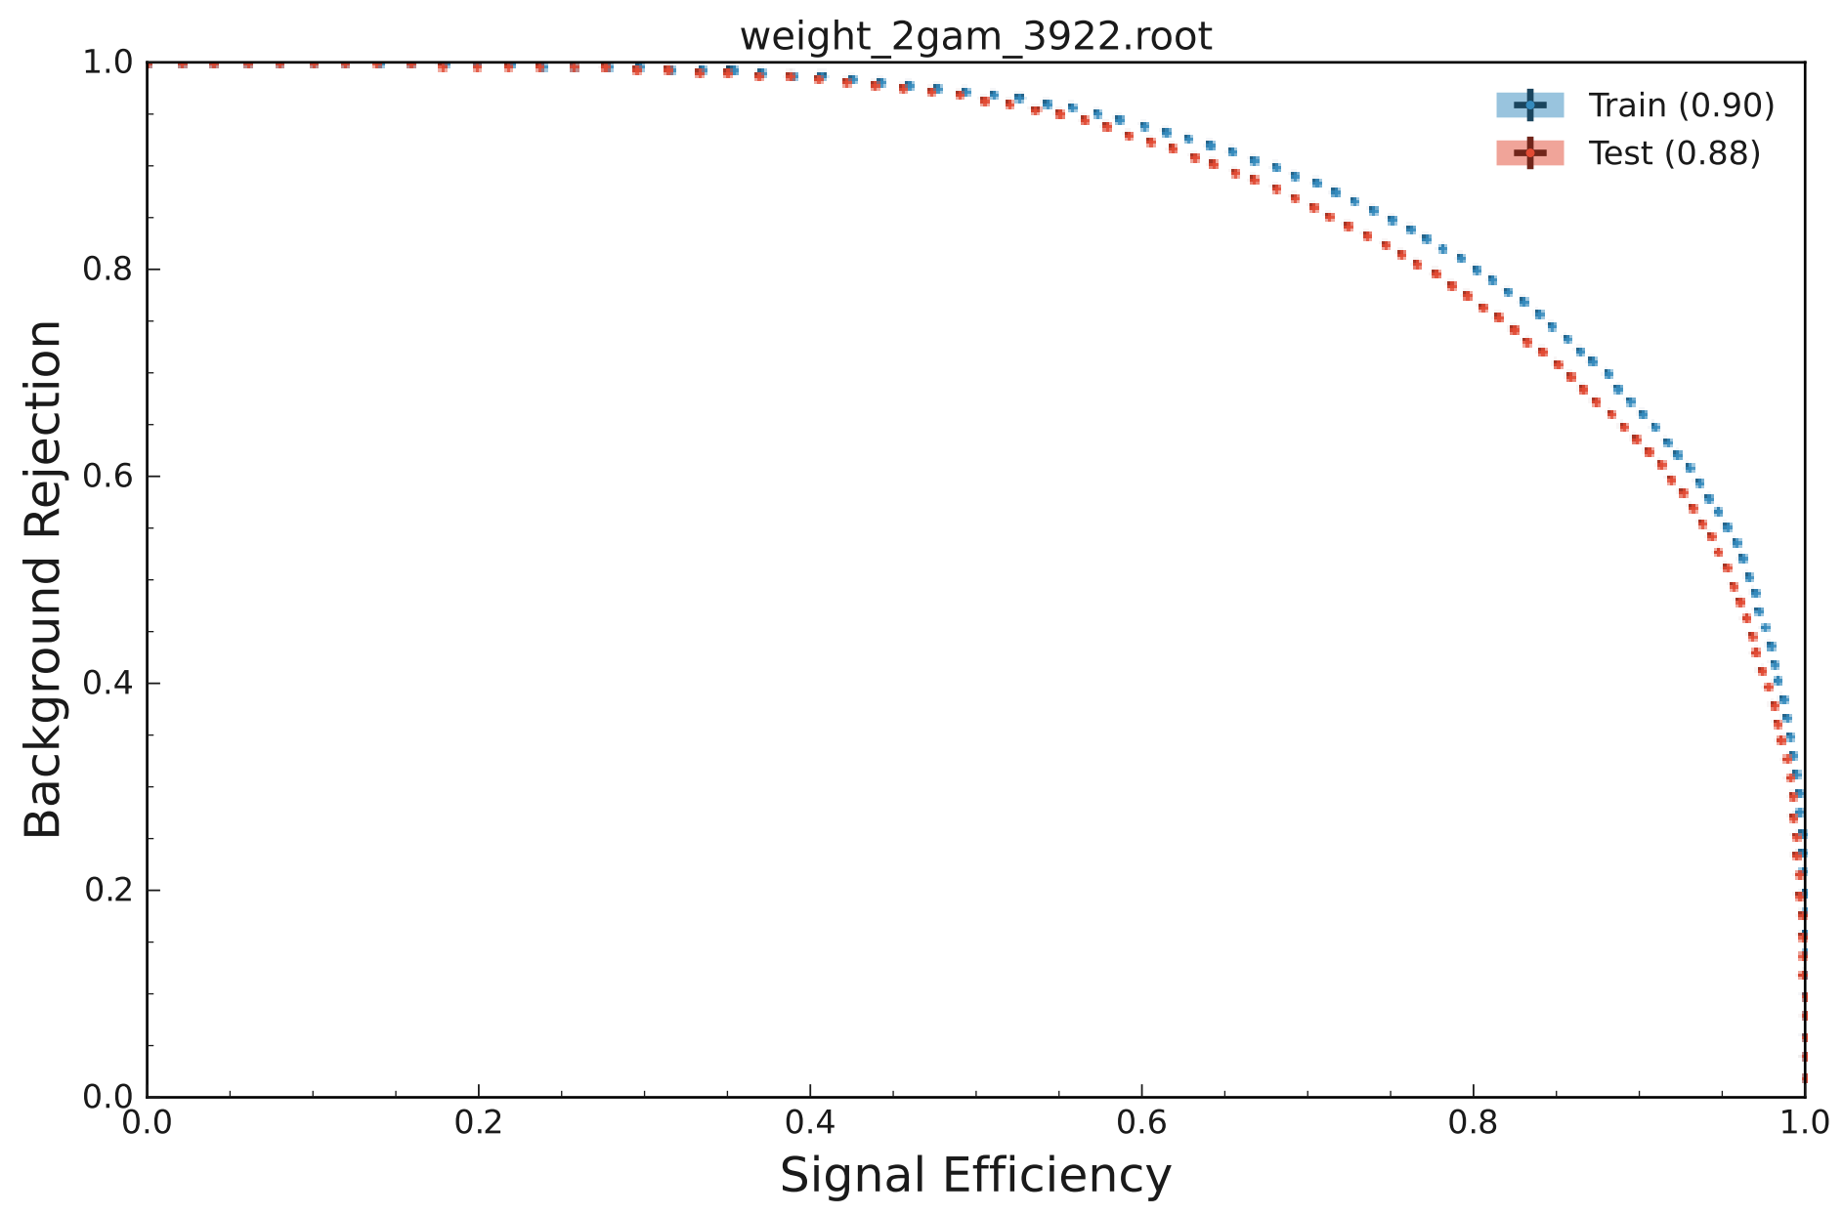
fastbdt_options.m_nTrees = 2000
fastbdt_options.m_nLevels = 2
fastbdt_options.m_nCuts = 20
fastbdt_options.m_shrinkage = 0.2

Slide 5
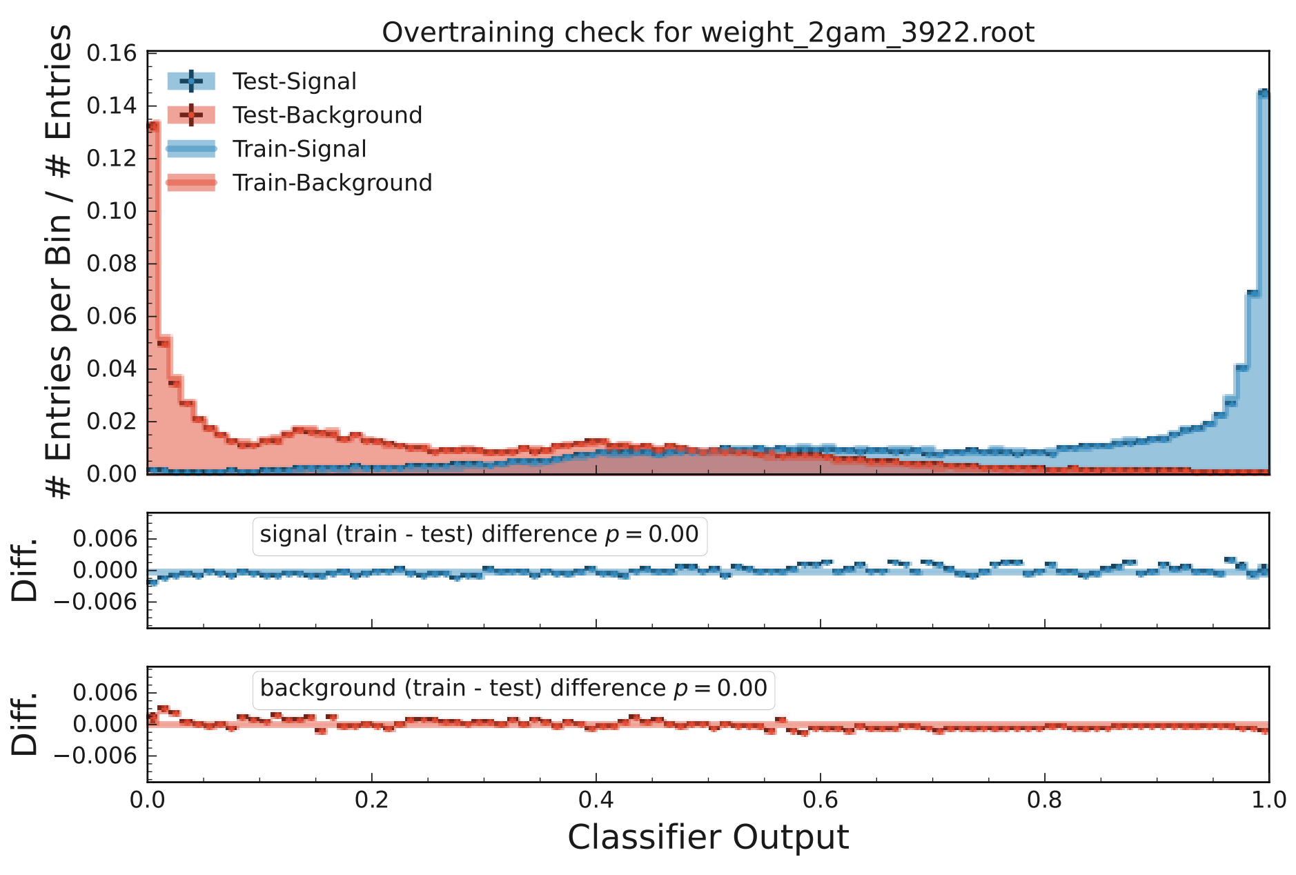
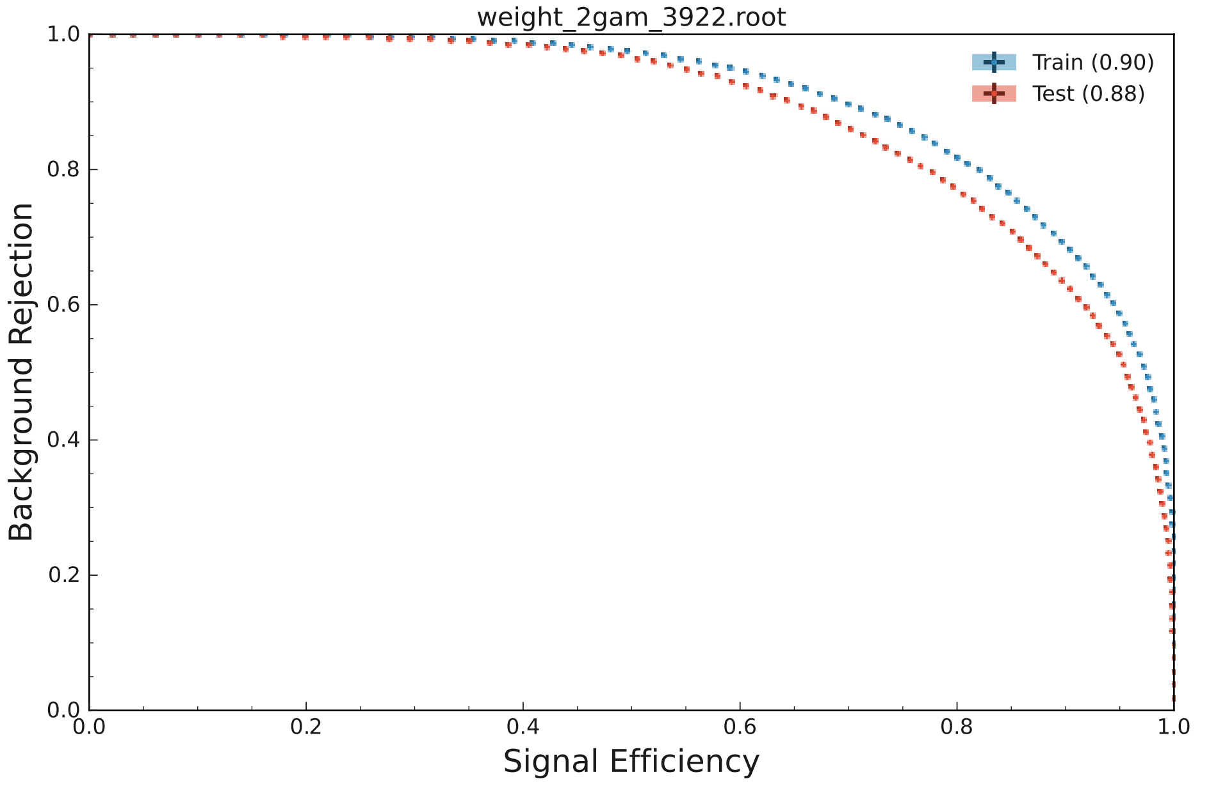
fastbdt_options.m_nTrees = 4000
fastbdt_options.m_nLevels = 2
fastbdt_options.m_nCuts = 20
fastbdt_options.m_shrinkage = 0.2

