Slide 1
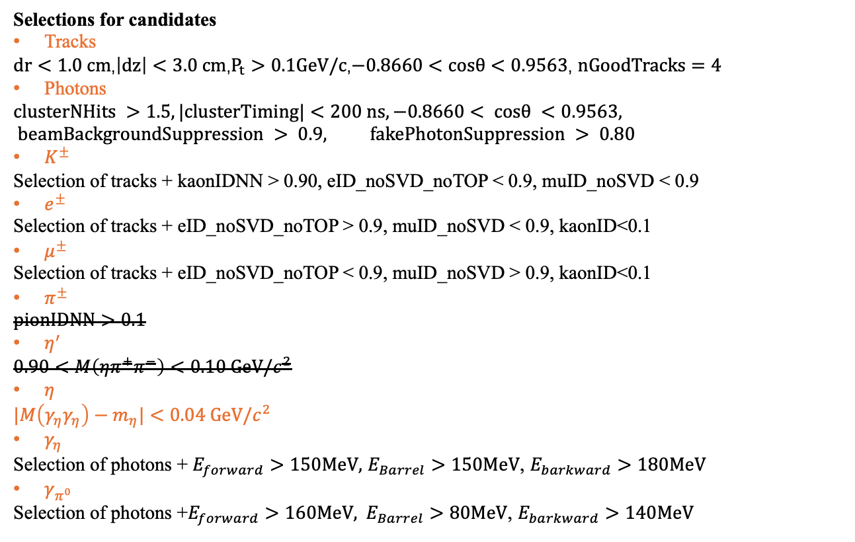
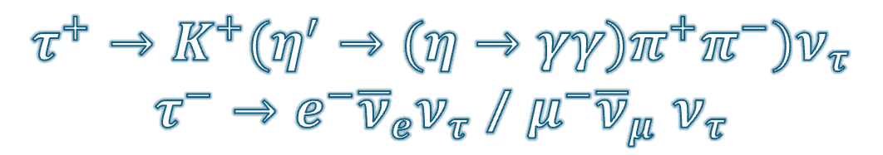
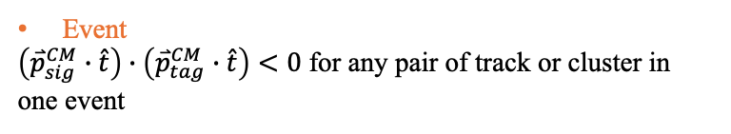
$$τ^{+}→K^{+}(η^{′}→(η→γγ)π^{+}π^{−})ν_{τ}$$
$τ^{−}→e^{−}{\overline{ν}}_{e}ν_{τ}$ / $μ^{−}{\overline{ν}}_{μ}$ $ν_{τ}$
Selections for candidates
Tracks
$dr<1.0 cm$,$\left|dz\right|<3.0 cm$,$P_{t}>0.1GeV/c$,$−0.8660<cosθ<0.9563$, $nGoodTracks=4$
Photons
$$clusterNHits >1.5, |clusterTiming|<200 ns, −0.8660< cosθ <0.9563, beamBackgroundSuppression > 0.9, fakePhotonSuppression > 0.80$$
$K^{±}$
Selection of tracks + kaonIDNN > 0.90, eID_noSVD_noTOP < 0.9, muID_noSVD < 0.9
$e^{±}$
Selection of tracks + eID_noSVD_noTOP > 0.9, muID_noSVD < 0.9, kaonID<0.1
$μ^{±}$
Selection of tracks + eID_noSVD_noTOP < 0.9, muID_noSVD > 0.9, kaonID<0.1
$π^{±}$
$$pionIDNN>0.1$$
$η^{′}$
$$0.90<M\left(ηπ^{+}π^{−}\right)<0.10 GeV/c^{2}$$
$η$
$$|M\left(γ_{η}γ_{η}\right)−m_{η}|<0.04 GeV/c^{2}$$
$γ_{η}$
Selection of photons + $E_{forward}>150MeV,$ $E_{Barrel}>150MeV$, $E_{barkward}>180MeV$
$γ_{π^{0}}$
Selection $\text{of} \text{photons}\text{ +}E_{forward}>160MeV, E_{Barrel}>80MeV\text{,} E_{barkward}>140MeV$
Event
$\left({\overset{⃑}{p}}_{sig}^{CM}∙\hat{t}\right)∙\left({\overset{⃑}{p}}_{tag}^{CM}∙\hat{t}\right)<0$ for any pair of track or cluster in one event

Slide 2
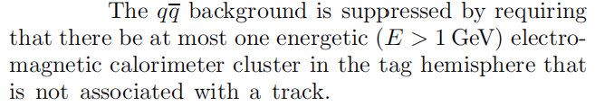
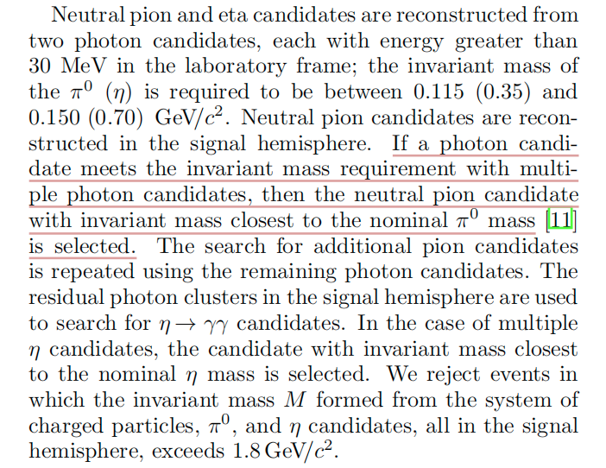
Comparison our selections with previous BARBAR’s

Slide 3
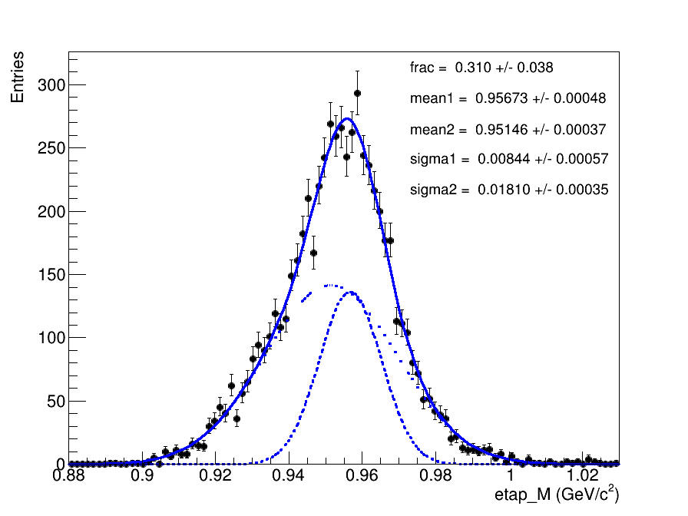
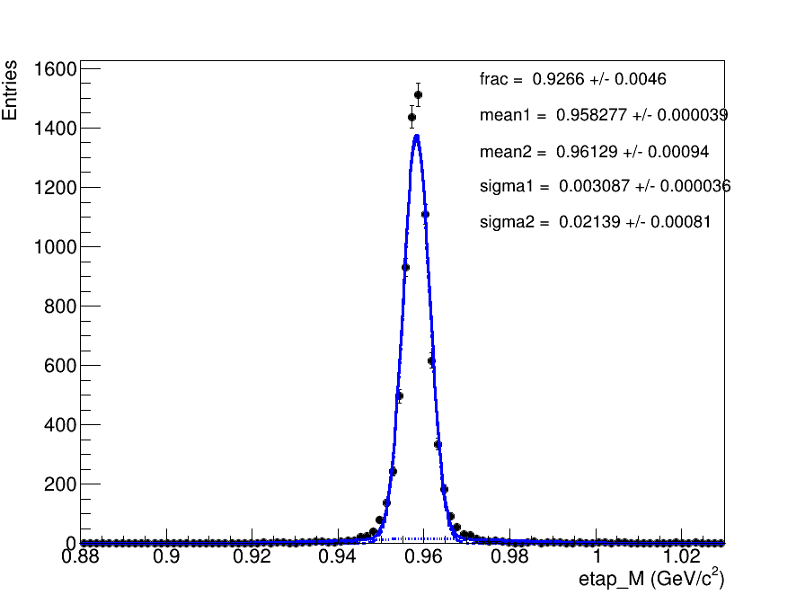
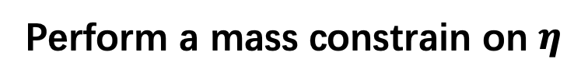
Perform a mass constrain on $η$

Slide 4
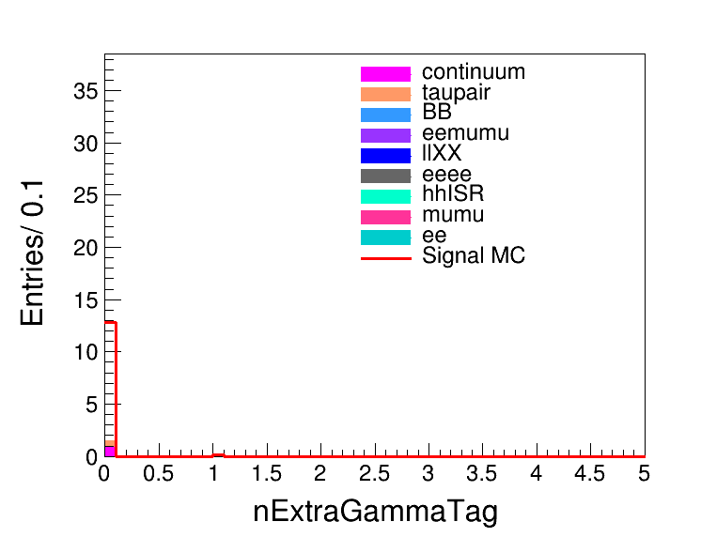
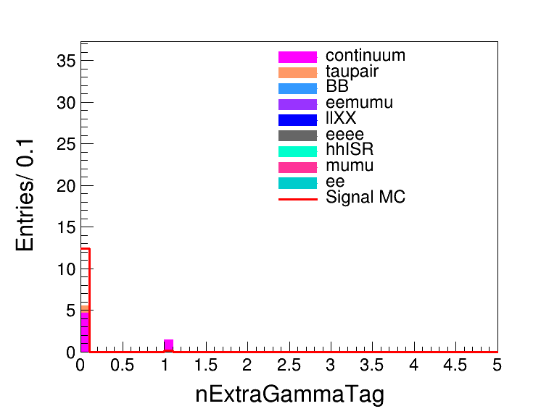

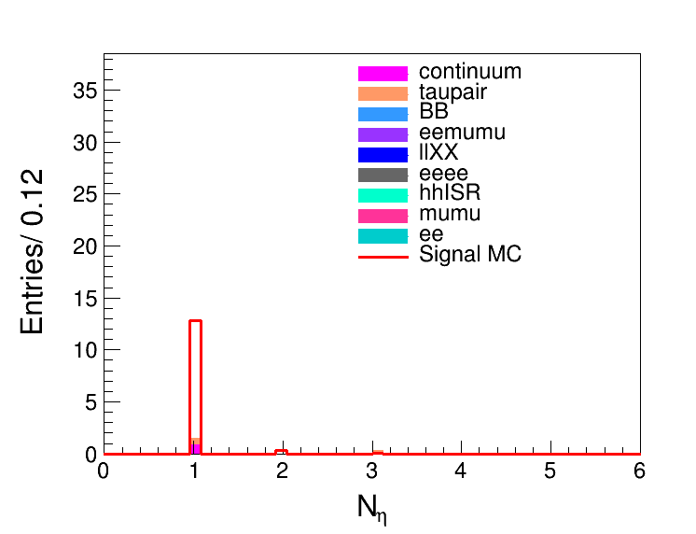
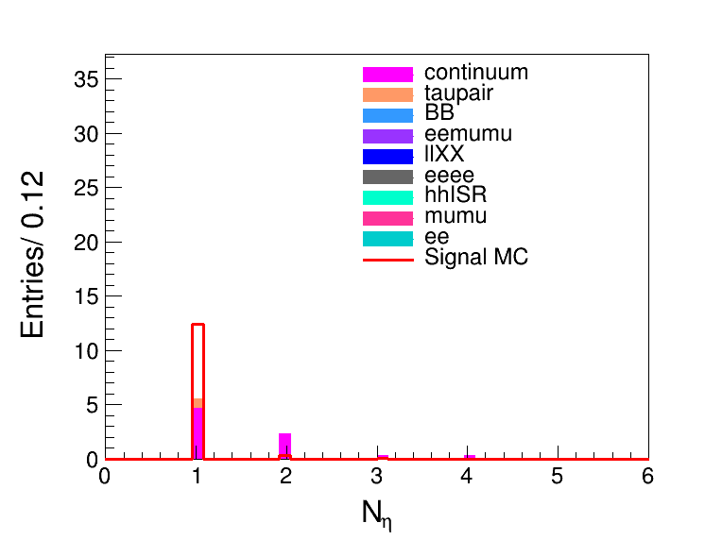

e
mu
both
e
mu
both

Slide 5
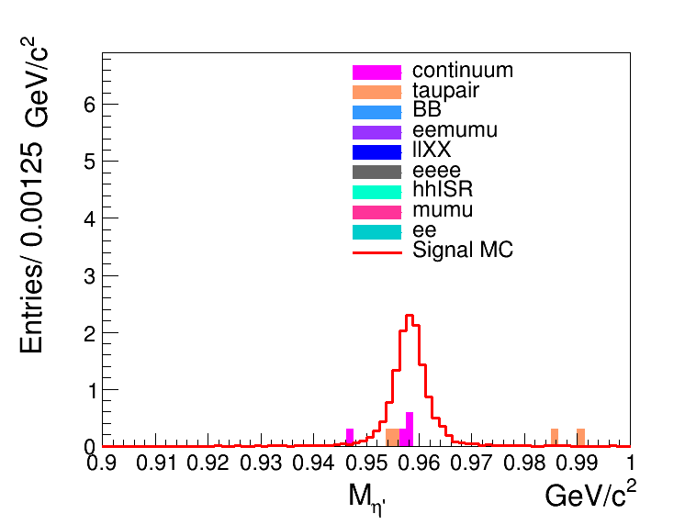
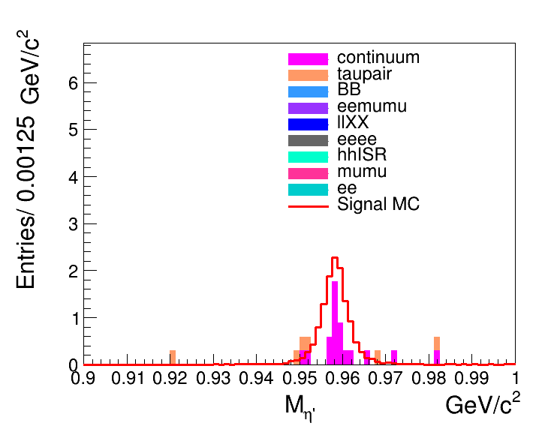
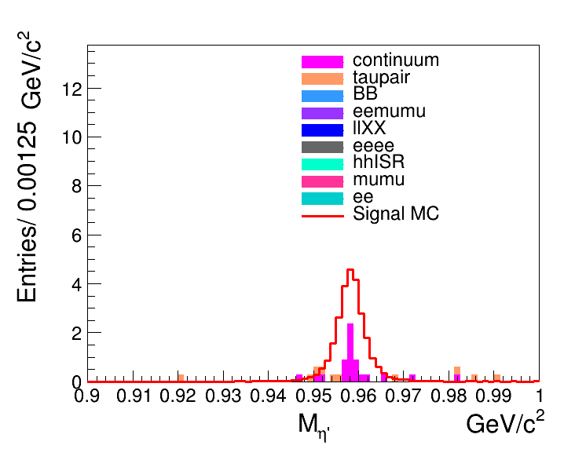
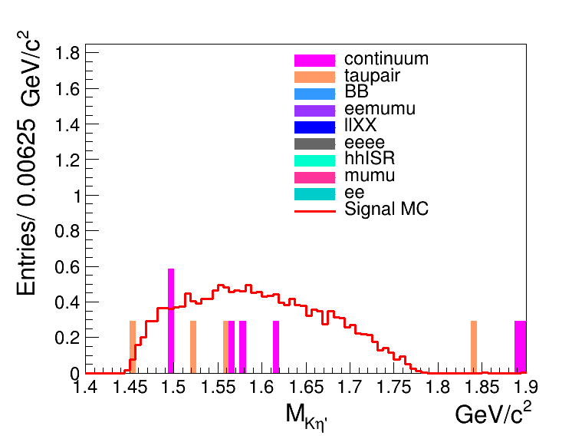
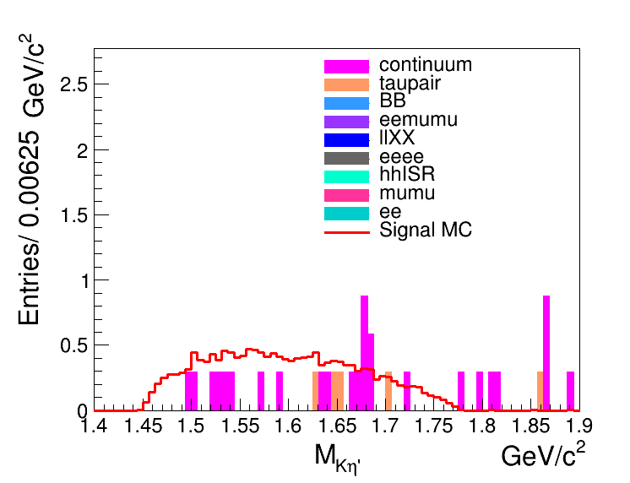
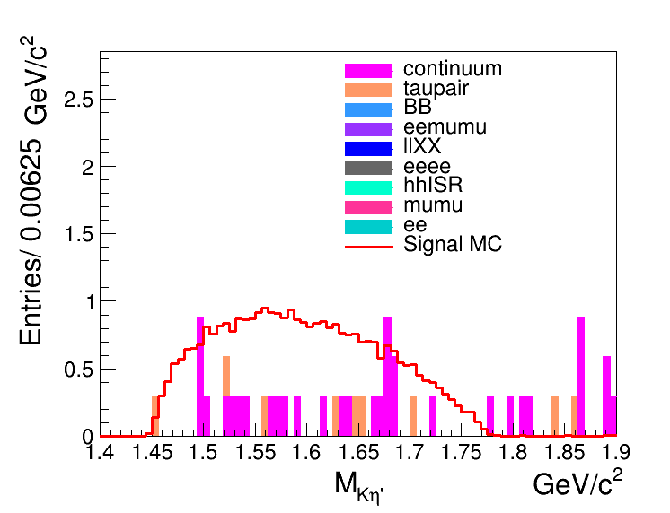
e
mu
both
e
mu
both

Slide 6

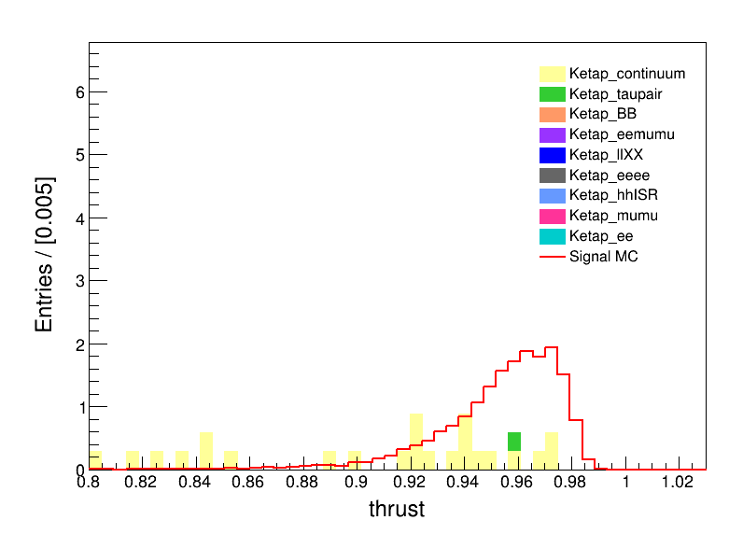
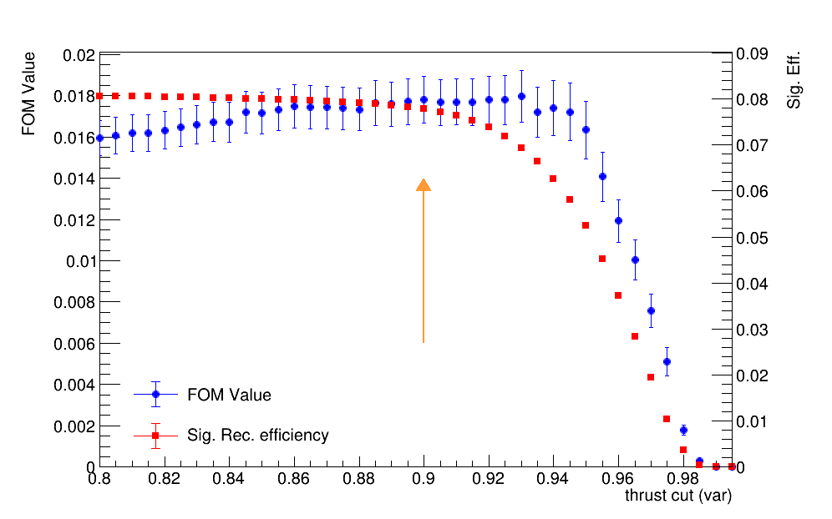
Comparison our selections with previous BARBAR’s
From previous BarBar’s paper:
FOM=0.01585067 +/- 0.00085996
FOM=0.01770263 +/- 0.00110840
eff=0.080105 +/- 0.000664
eff=0.077319 +/- 0.000653

Slide 7
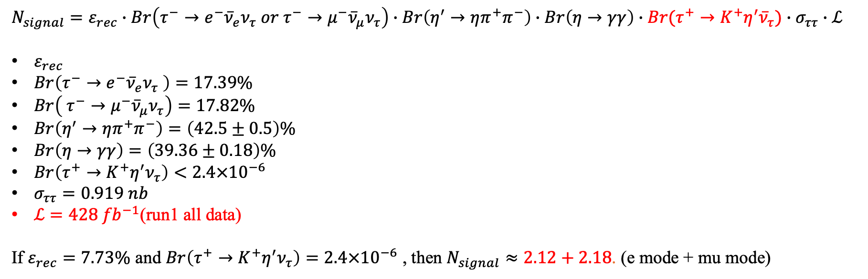
Evaluation of signal yield
$$N_{signal}=ε_{rec}∙Br\left(τ^{−}→e^{−}{\overline{ν}}_{e}ν_{τ} or τ^{−}→μ^{−}{\overline{ν}}_{μ}ν_{τ}\right)∙Br\left(η^{′}→ηπ^{+}π^{−}\right)∙Br\left(η→γγ\right)∙Br(τ^{+}→K^{+}η^{′}{\overline{ν}}_{τ})∙σ_{ττ}∙ℒ$$
$ε_{rec}$
$Br\left(τ^{−}→e^{−}{\overline{ν}}_{e}ν_{τ} \right)=17.39\%$
$Br\left( τ^{−}→μ^{−}{\overline{ν}}_{μ}ν_{τ}\right)=17.82\%$
$Br\left(η^{′}→ηπ^{+}π^{−}\right)=\left(42.5±0.5\right)\%$
$Br\left(η→γγ\right)=\left(39.36±0.18\right)\%$
$Br\left(τ^{+}→K^{+}η^{′}ν_{τ}\right)<2.4×{10}^{−6}$
$σ_{ττ}=0.919 nb$
$ℒ=428 {fb}^{−1}$(run1 all data)
If $ε_{rec}=7.73\%$ and $Br\left(τ^{+}→K^{+}η^{′}ν_{τ}\right)=2.4×{10}^{−6}$ , then $N_{signal}≈2.12+2.18$. (e mode + mu mode)
$FOM=\frac{ε_{sig}}{\frac{3}{2}+\sqrt{N_{exp}}}$, $FOM=0.0149±0.0009$, $ε_{sig}=0.06636±0.0006⟹N_{exp}=8.22±1.58$

Slide 8
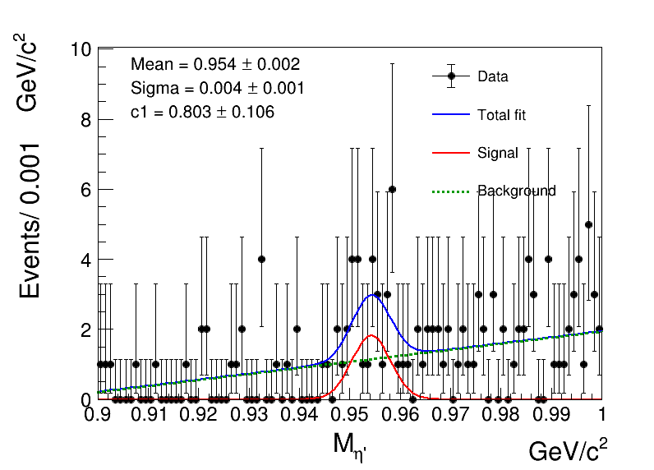
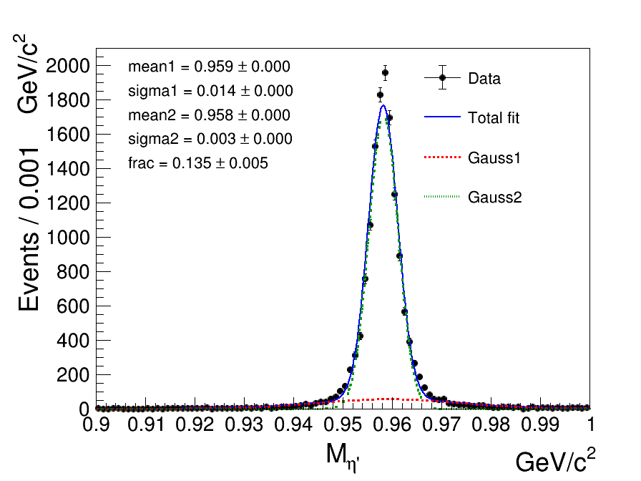
Fit to background
Fit to signal

Slide 9
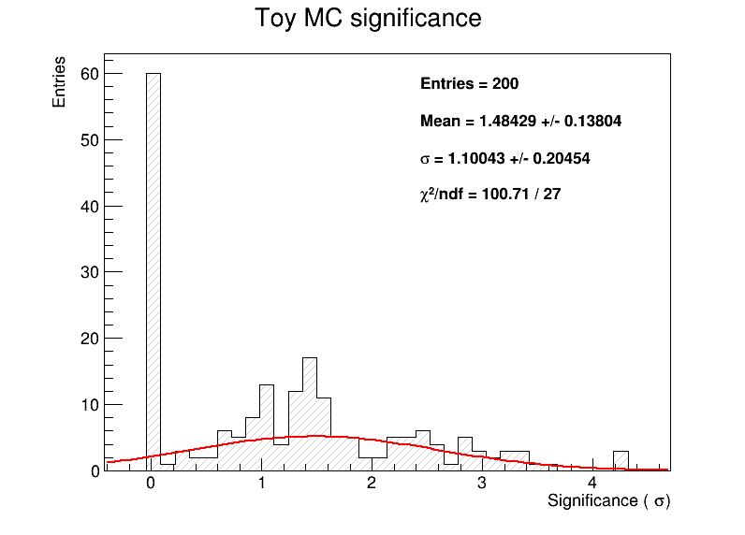

Significance=1.1$σ$

Slide 10
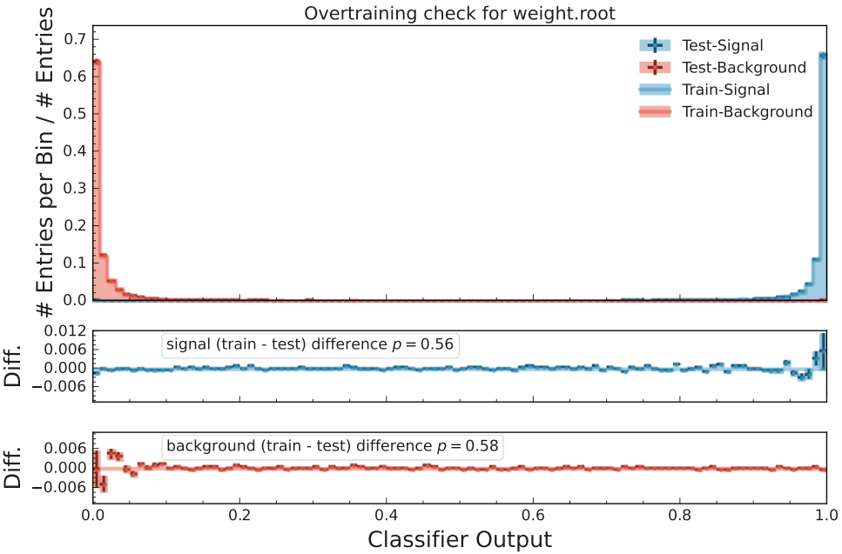
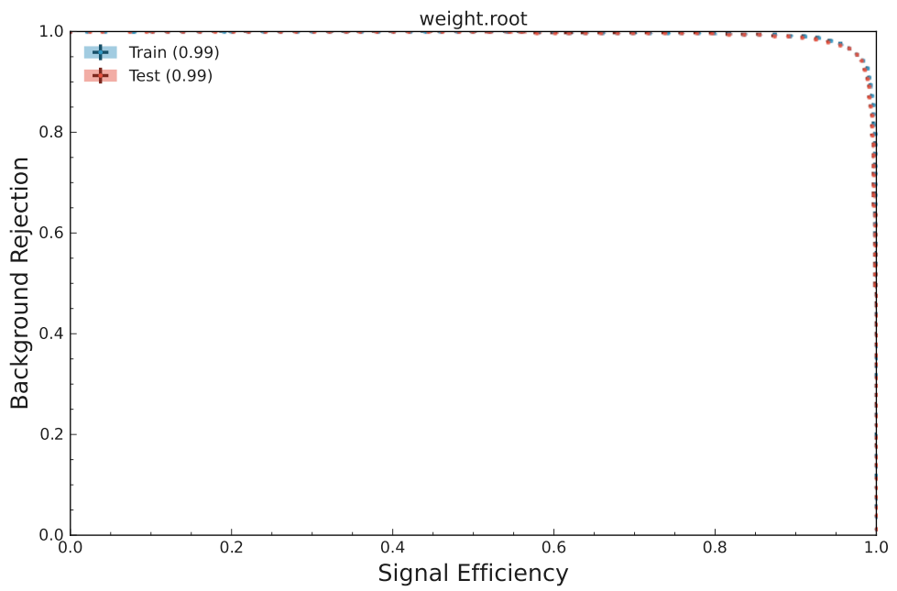

Slide 11
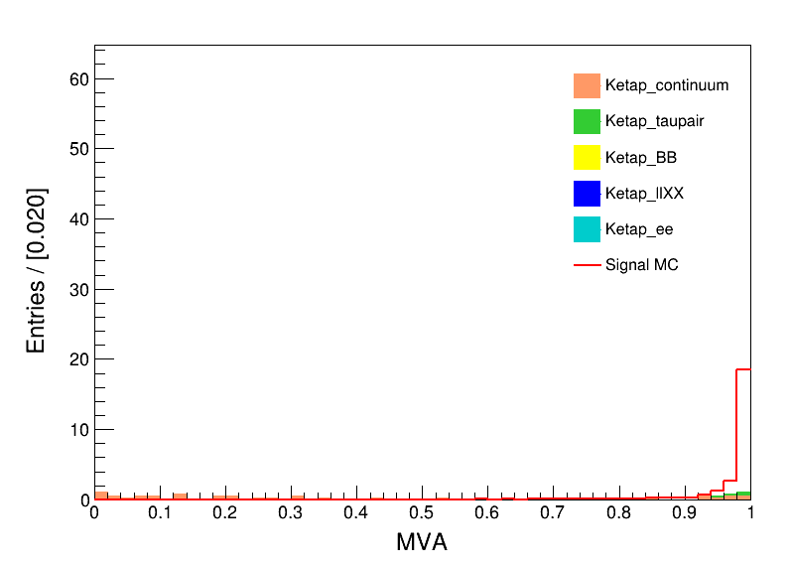
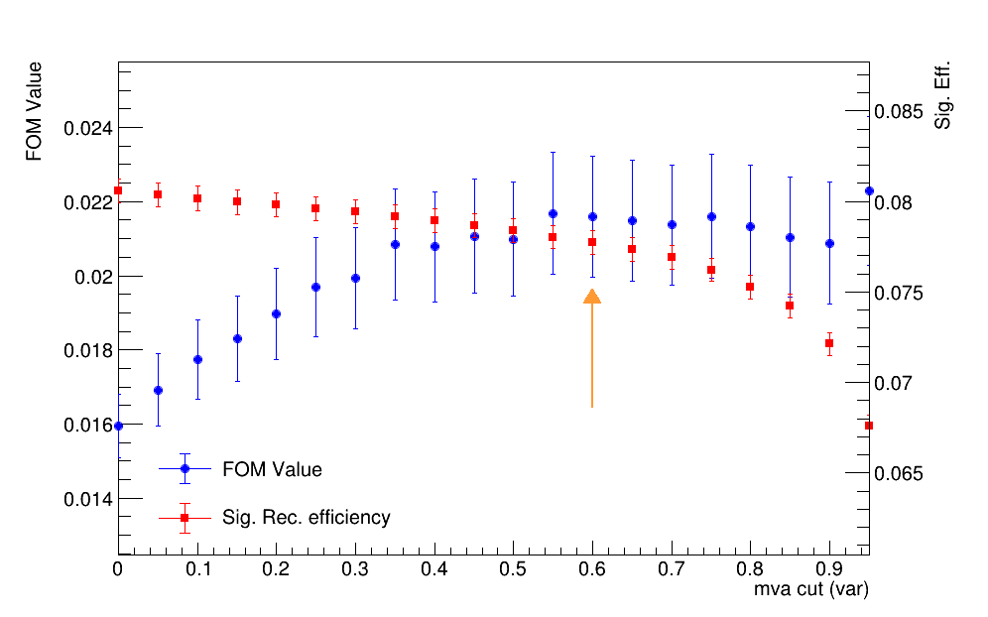
FOM=0.02159199 +/- 0.00163585
eff=0.077708 +/- 0.000655

Slide 12
Evaluation of signal yield
$$N_{signal}=ε_{rec}∙Br\left(τ^{−}→e^{−}{\overline{ν}}_{e}ν_{τ} or τ^{−}→μ^{−}{\overline{ν}}_{μ}ν_{τ}\right)∙Br\left(η^{′}→ηπ^{+}π^{−}\right)∙Br\left(η→γγ\right)∙Br(τ^{+}→K^{+}η^{′}{\overline{ν}}_{τ})∙σ_{ττ}∙ℒ$$
$ε_{rec}$
$Br\left(τ^{−}→e^{−}{\overline{ν}}_{e}ν_{τ} \right)=17.39\%$
$Br\left( τ^{−}→μ^{−}{\overline{ν}}_{μ}ν_{τ}\right)=17.82\%$
$Br\left(η^{′}→ηπ^{+}π^{−}\right)=\left(42.5±0.5\right)\%$
$Br\left(η→γγ\right)=\left(39.36±0.18\right)\%$
$Br\left(τ^{+}→K^{+}η^{′}ν_{τ}\right)<2.4×{10}^{−6}$
$σ_{ττ}=0.919 nb$
$ℒ=428 {fb}^{−1}$(run1 all data)
If $ε_{rec}=7.73\%$ and $Br\left(τ^{+}→K^{+}η^{′}ν_{τ}\right)=2.4×{10}^{−6}$ , then $N_{signal}≈2.12+2.18$. (e mode + mu mode)
$FOM=\frac{ε_{sig}}{\frac{3}{2}+\sqrt{N_{exp}}}$, $FOM=0.0216±0.0016$, $ε_{sig}=0.077±0.0007⟹N_{exp}=4.4±1.2$

Slide 13
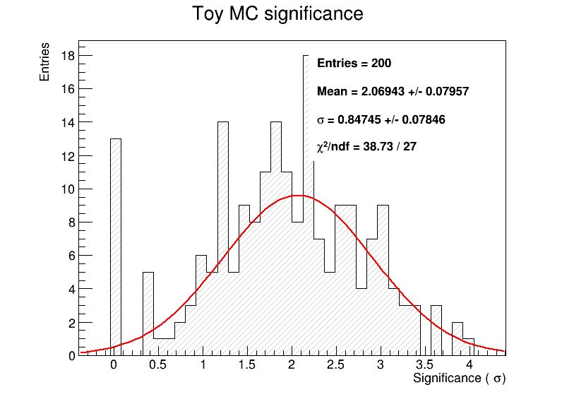

Significance=2.1$σ$

Slide 14
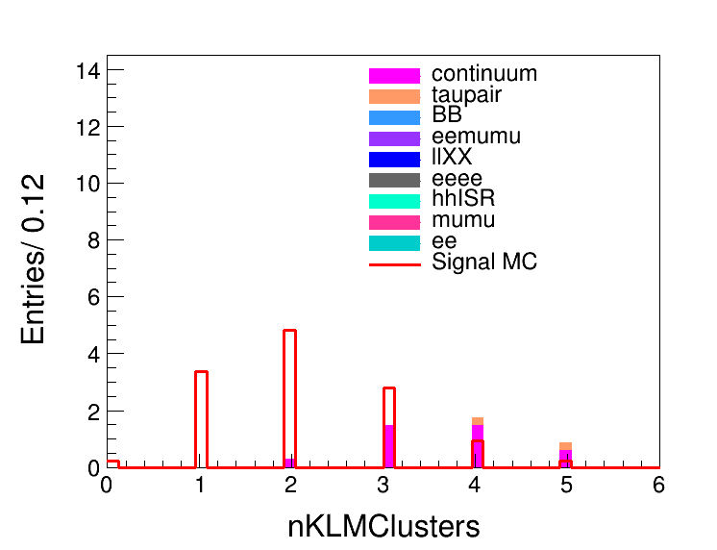
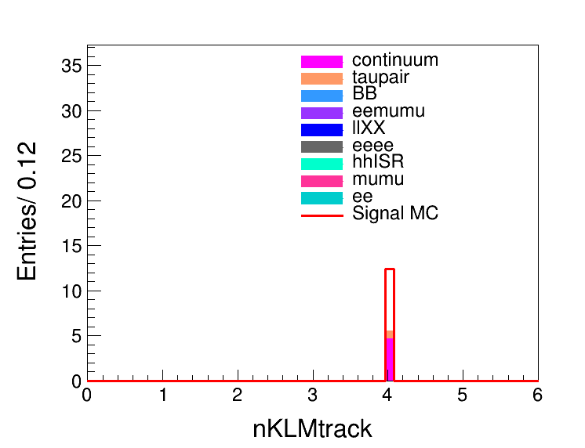
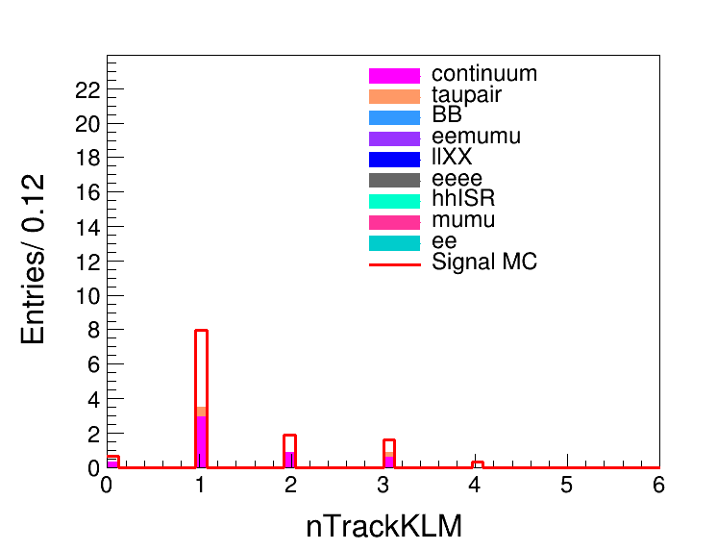
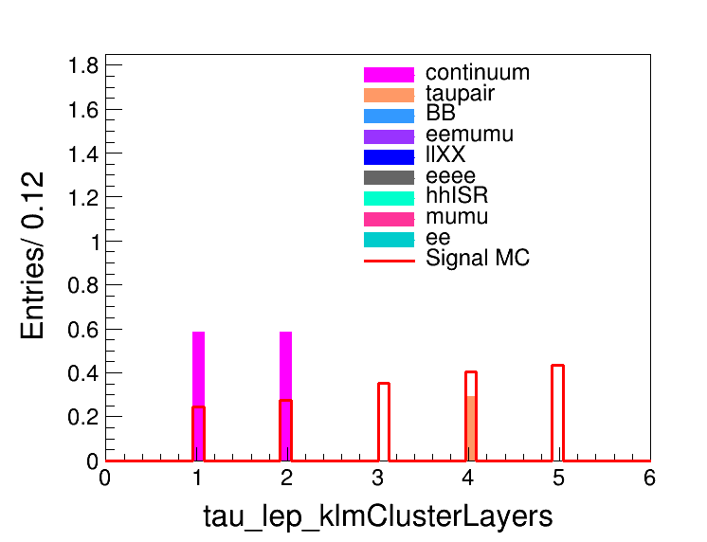
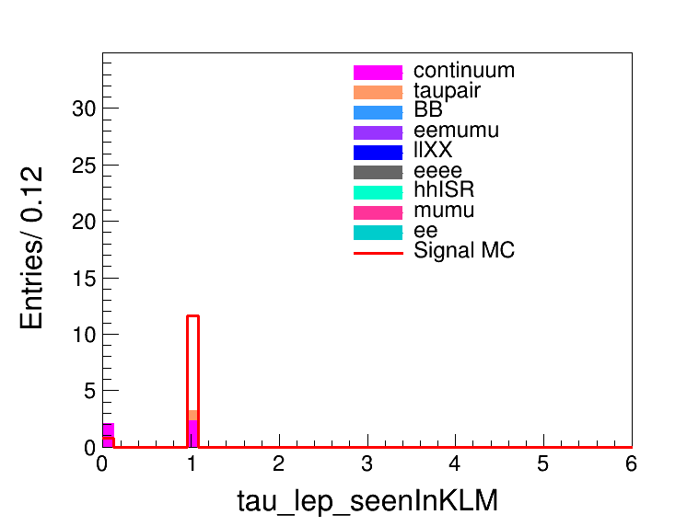
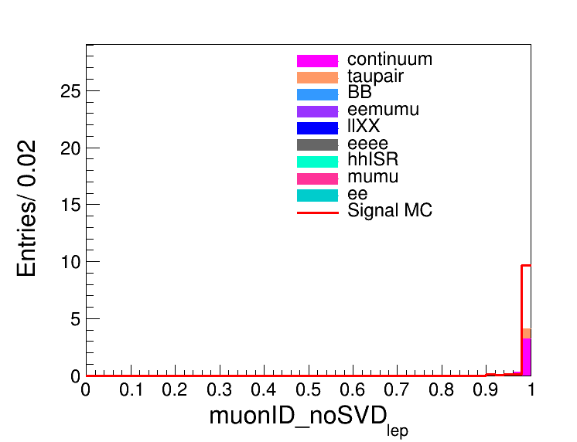
大部分的mu tag的continuum是由于pi被误判为mu导致的

Slide 15
加入KLM相关的变量去除mu/pi误判，专门给mu tag训练bdt.

