Slide 1

magnetic monopole bounds updated by acceleration in cosmic magnetic fields
D. Perri, K. Bondarenko, MD, T. Kobayashi
Phys. Dark Univ. 46 (2024), 101704
D. Perri, MD, T. Kobayashi
Phys. Dark Univ. 50 (2025) 102134
Michele Doro (Associate professor University of Padova),
Daniele Perri (SISSA, U. Warsaw), Takeshi Kobayashi (SISSA)
Experiments: MAGIC, CTAO/LST1, SWGO, Trinity ← ask me if curious

Slide 2
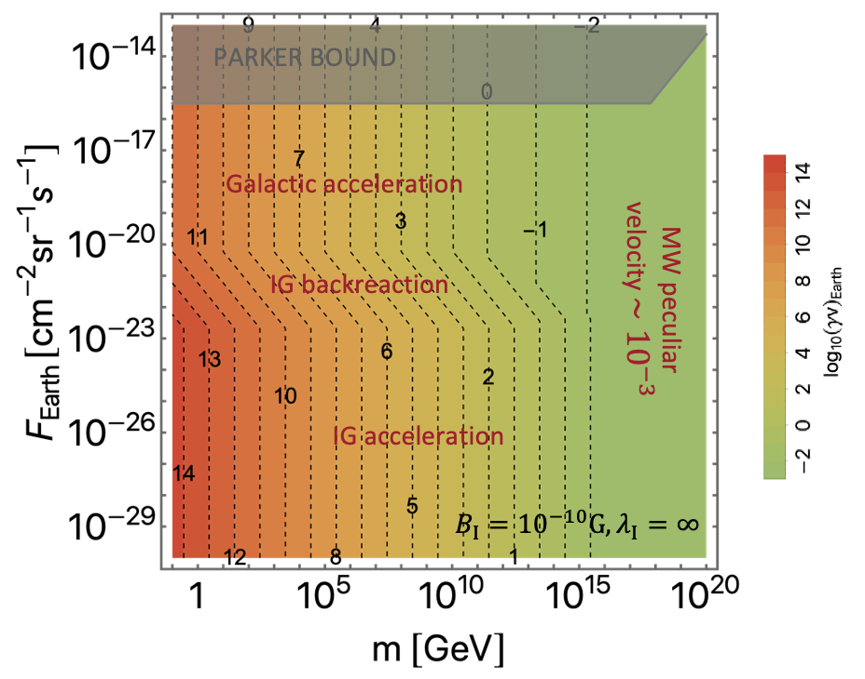
Straight to the points
1/
We have developed a framework to compute MM acceleration (according to MM mass) in
GMF and IGMF
Including backreaction

Slide 3
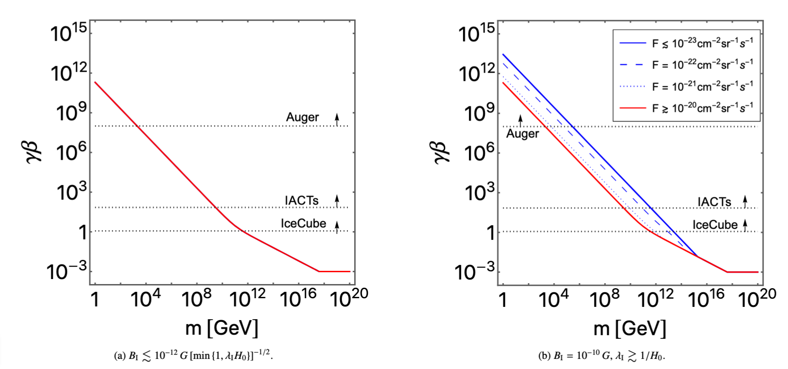
Straight to the points
2/
Generated MM mass-speed relation within this framework (for a given IGMF scenario)
1/ MM Acceleration

Slide 4
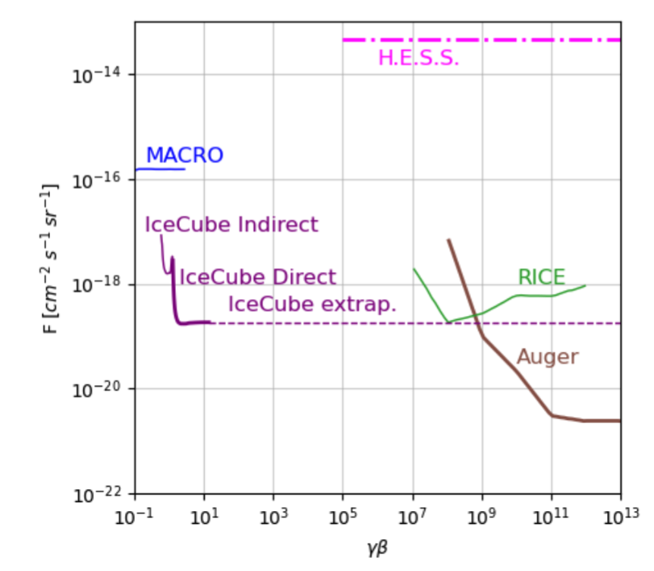
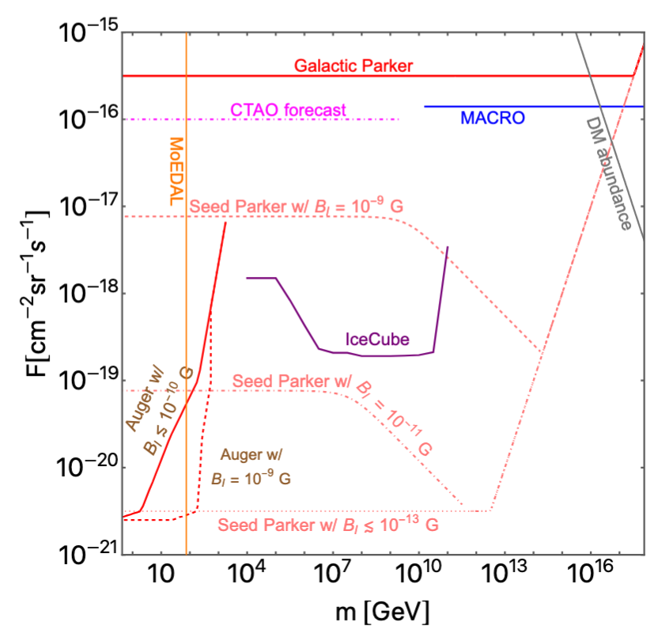
Straight to the points
3/
Taken current experimental bounds (in function of speed)
1/ MM Acceleration
And recast them into more physical MM mass limits
2/ MM mass-speed rel.

Slide 5

Straight to the points
In the following
A little more explanation
Some implications
1/ MM Acceleration
3/ Recast exp. limits
2/ MM mass-speed rel.

Slide 6

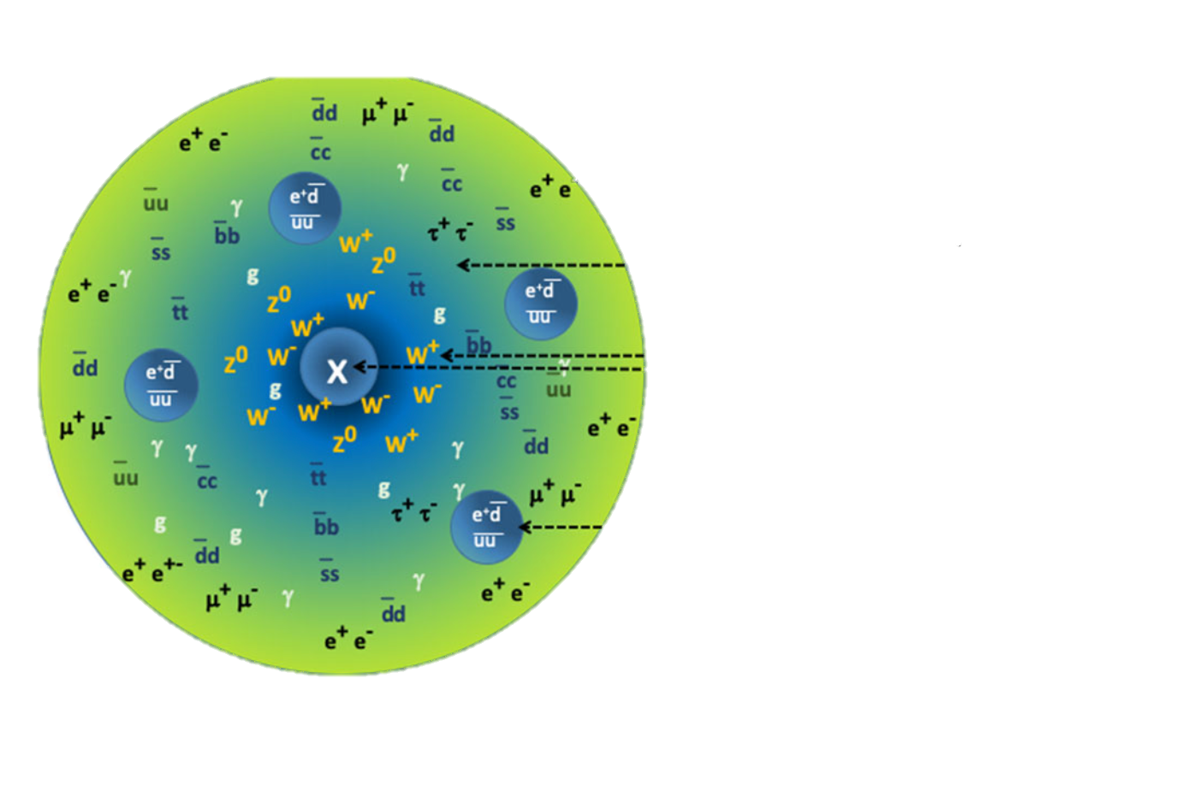
#1 MM ACCELERATION through gmf and igmf
MM

Slide 7
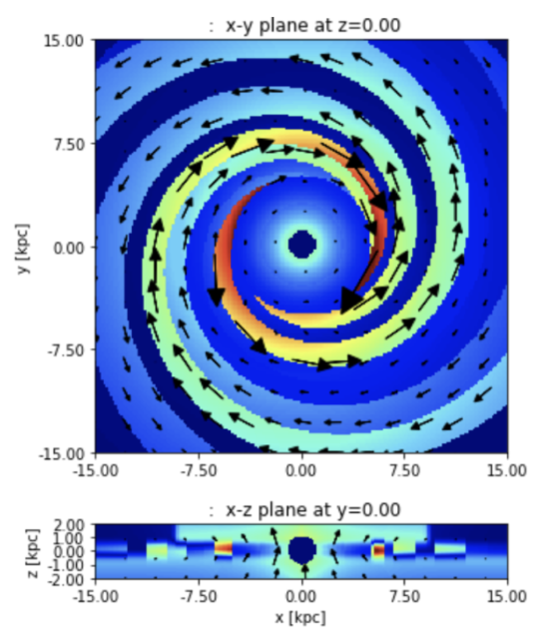
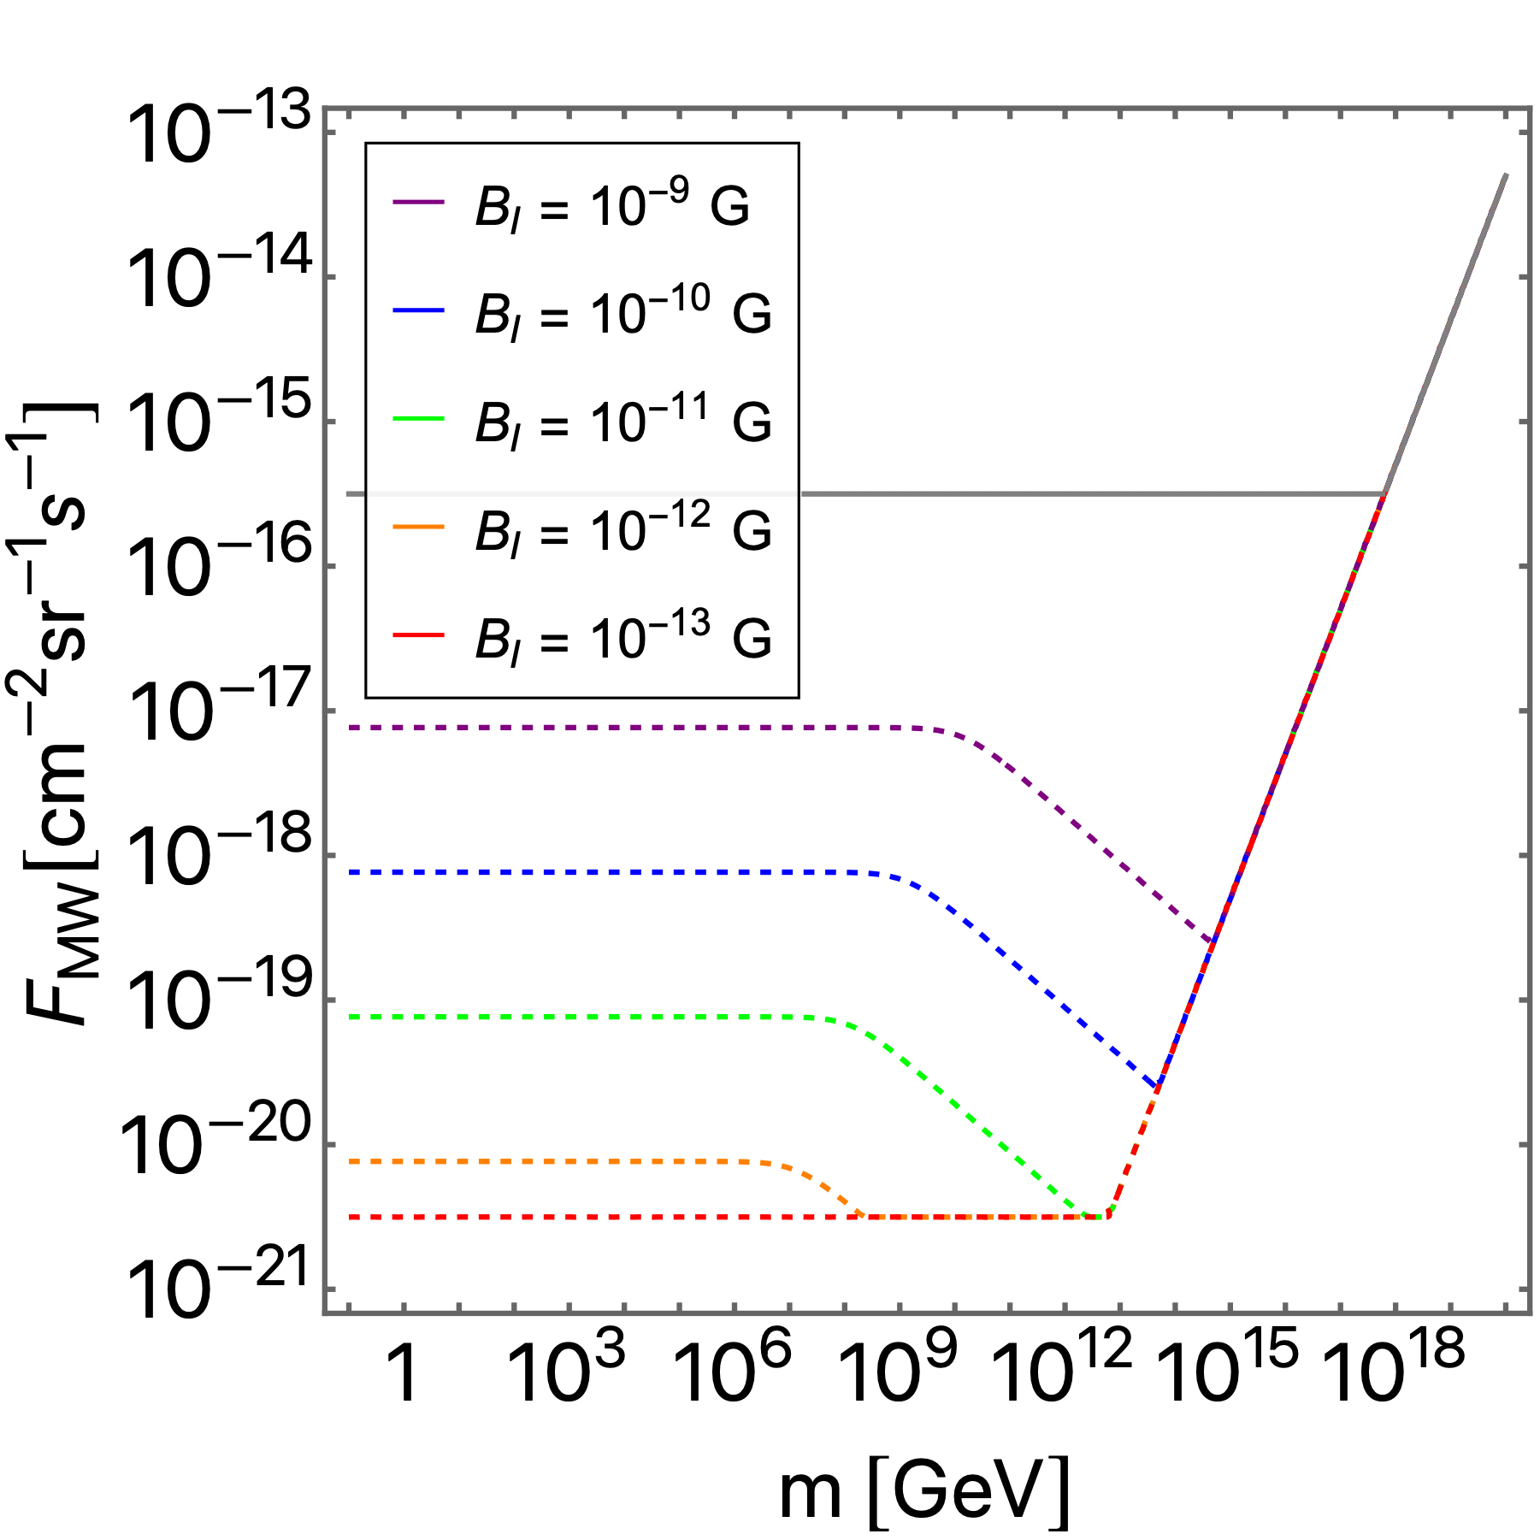
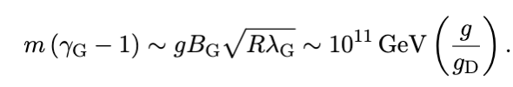
MM THROUGH GMF AND IGMF
Galactic Magnetic Fields (GMFs) are well modeled, see e.g. Farrar+ works
  More clear picture of GMF now, less clear picture of GMF history: were there MF seeds that grew?
Energy gain of MMs in the GMF can be computed in a single-cell model (for this purpose)
← Parker Bound
←Seed PB w/ maximum IGMF
We found that seed Parker bounds are weakened by acceleration into IGMF. Accelerated MMs extract less energy from GMF.
←Seed PB w/ negligible IGMF

Slide 8
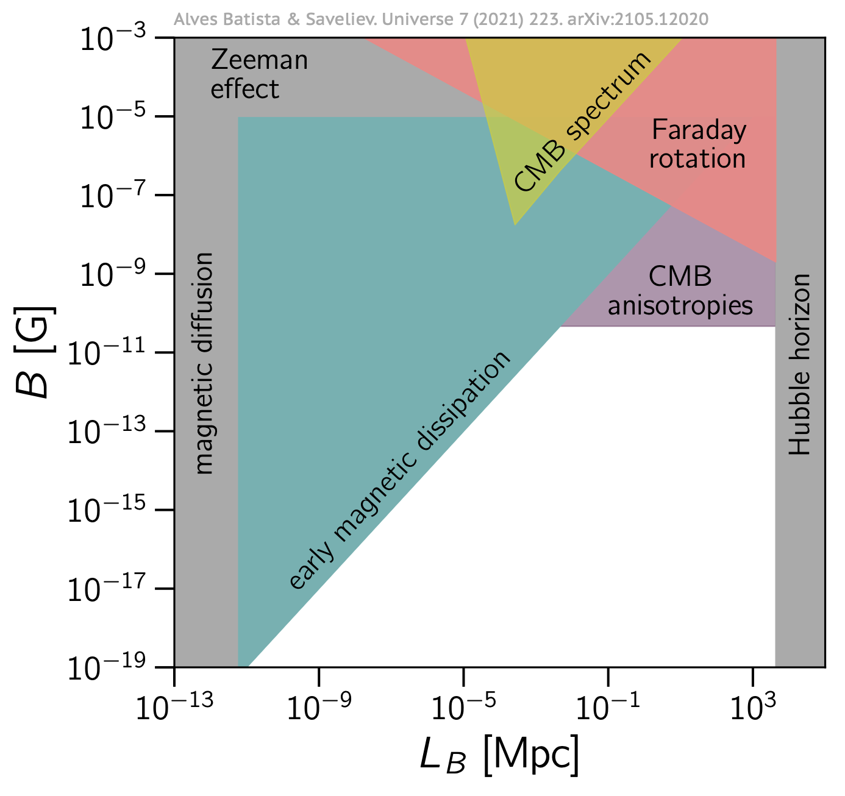
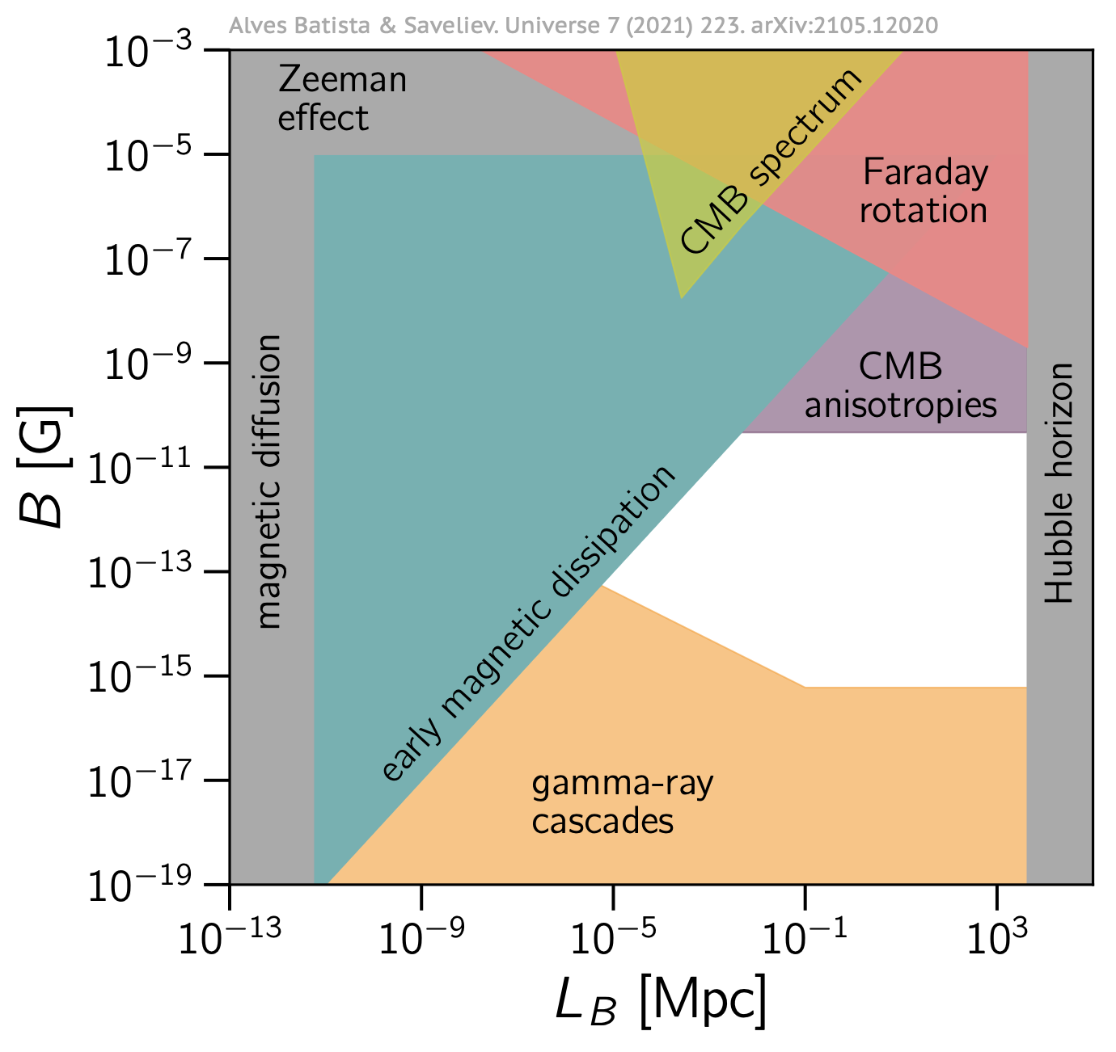
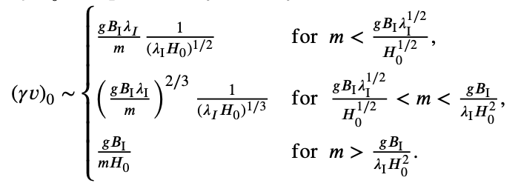
MM THROUGH GMF AND IGMF
IGMF constrained with several instruments to be below 10⁻⁹ G with preferred large coherence lengths
Recently, LOWER limits from gamma-ray telescopes
What is the effect on MM acceleration?
  Set B strengths and coherence length
  Compute acceleration in function of MM mass
  Consider back-reaction on B field (flux dependent)
  Compare GMF and IGMF

Slide 9
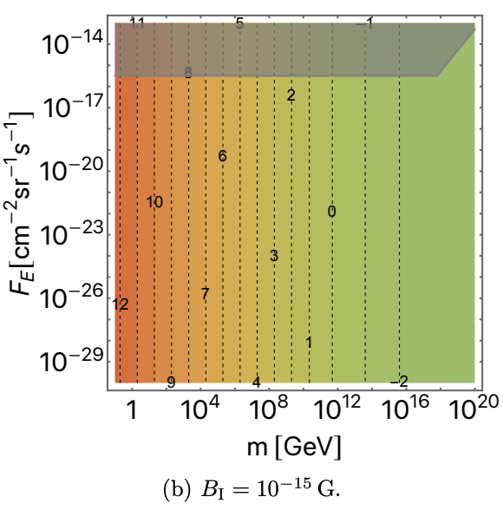
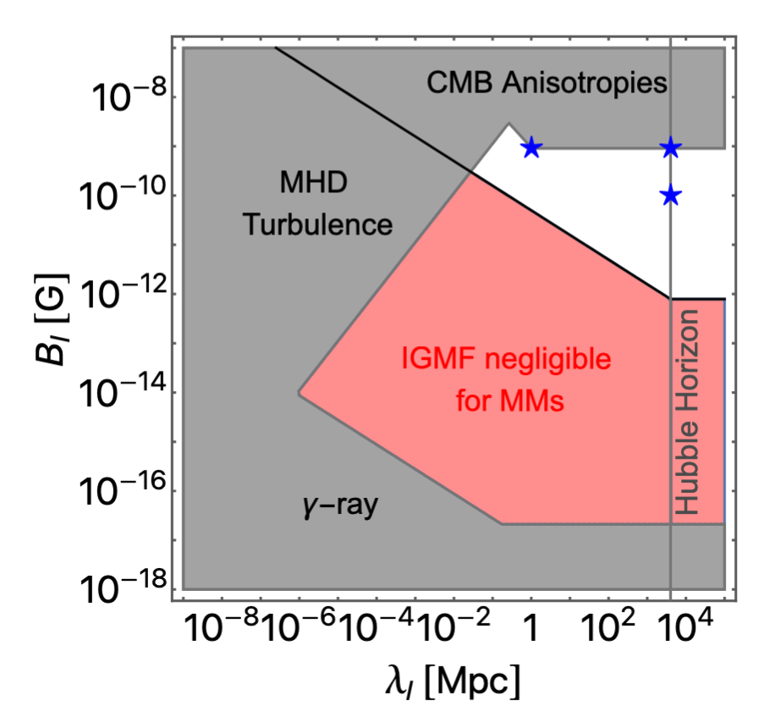
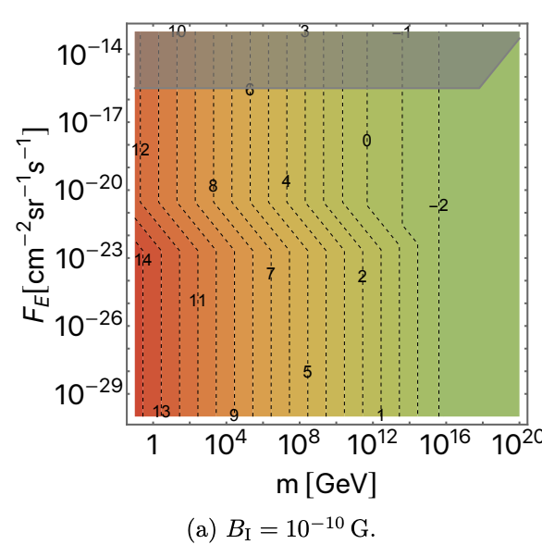
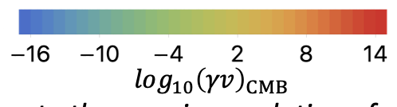
Conclusions
The maximum speed depends on flux: $max⁡(v_{MW},v_{IGMF},v_{GMF})$
Back reaction
Free Acceleration
IGMF below some strength to not contribute to acceleration
IGMFs contribute only if in at the largest strengths allowed
IGMFs can boost MM acceleration

Slide 10
#2 MM speed-mass relation
MM

Slide 11


A Speed-mass relation (dep. Flux)
One can compute the speed-mass relation for different scenarios of IGMF (and flux)
Weak IGFM
GMF dominates
No back-reaction
Strong IGMF →
IGMF contributes
Back-reaction matter

Slide 12
#3 experimental limits
MM

Slide 13
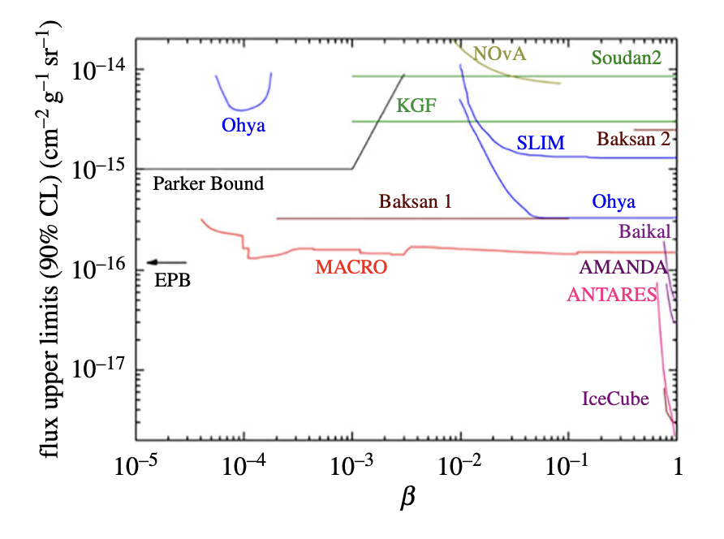
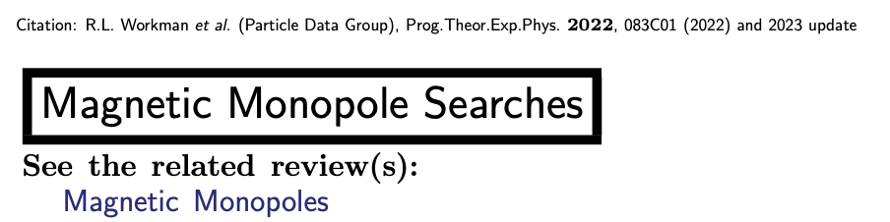
Current limits
A lot of direction detection experiments and indirect detectors (over the years), see PDG
Here after we report just the strongest limits

Slide 14
Current limits
D. Perri, MD, T. Kobayashi
Phys. Dark Univ. 50 (2025) 102134

Slide 15
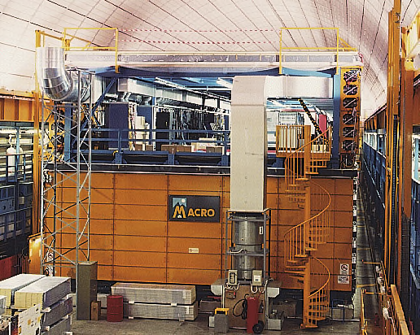
Current limits
Dedicated instrument for MMs at LNGS operating until 2000.
MACRO was composed of three sub-detectors, sensitive to different MM speeds, operated in combination:
  scintillation counters,
  limited streamer tubes,
  nuclear track detectors
M. Spurio, (this conference) was member

Slide 16
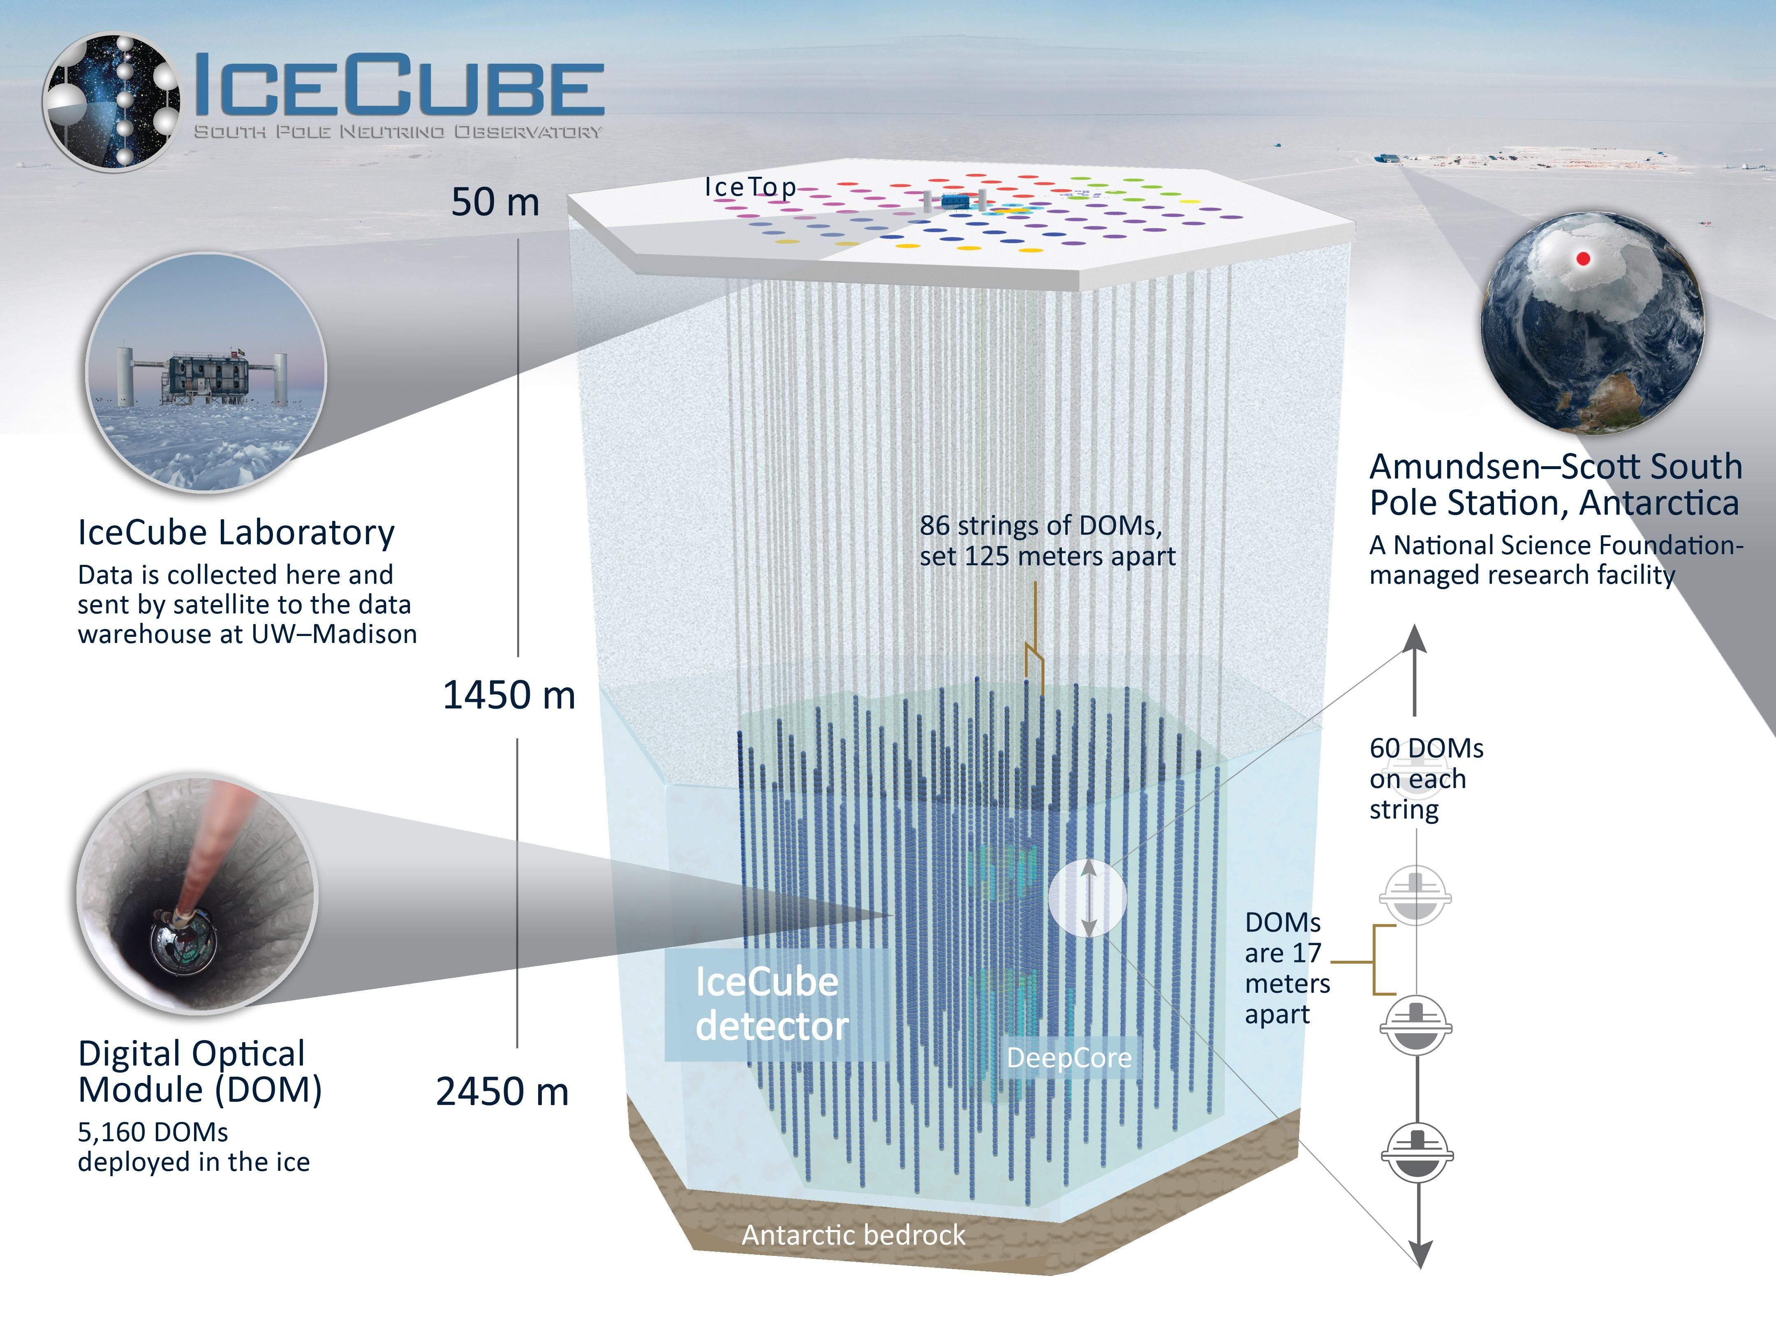

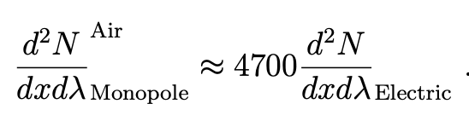
Current limits
IceCube. An array of thousands of optical sensors in the South Pole. They detect Cherenkov light from passage of charged leptons, in search of cosmic neutrinos.
MMs give similar signals (actually, much brighter than an average muon) and can be detected.
Three curves: Indirect (beta <0.7, Cherenkov threshold), Direct (beta> 0.7, with MC simulations) Extrapolated (without MC)

Slide 17
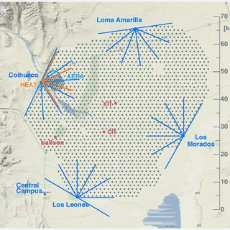
Current limits
Pierre Auger Observatory (PAO) is the largest (3, 000 km2, Argentina ) ultra-high-energy cosmic-ray detector currently in operation.
It detects fluorescence lights (telescopes), and particles from atmospheric showers (with water tanks)
MM crossing the atmosphere produce fluorescence, Cherenkov, secondary e.m showers
Require ultra-relativistic MMs

Slide 18
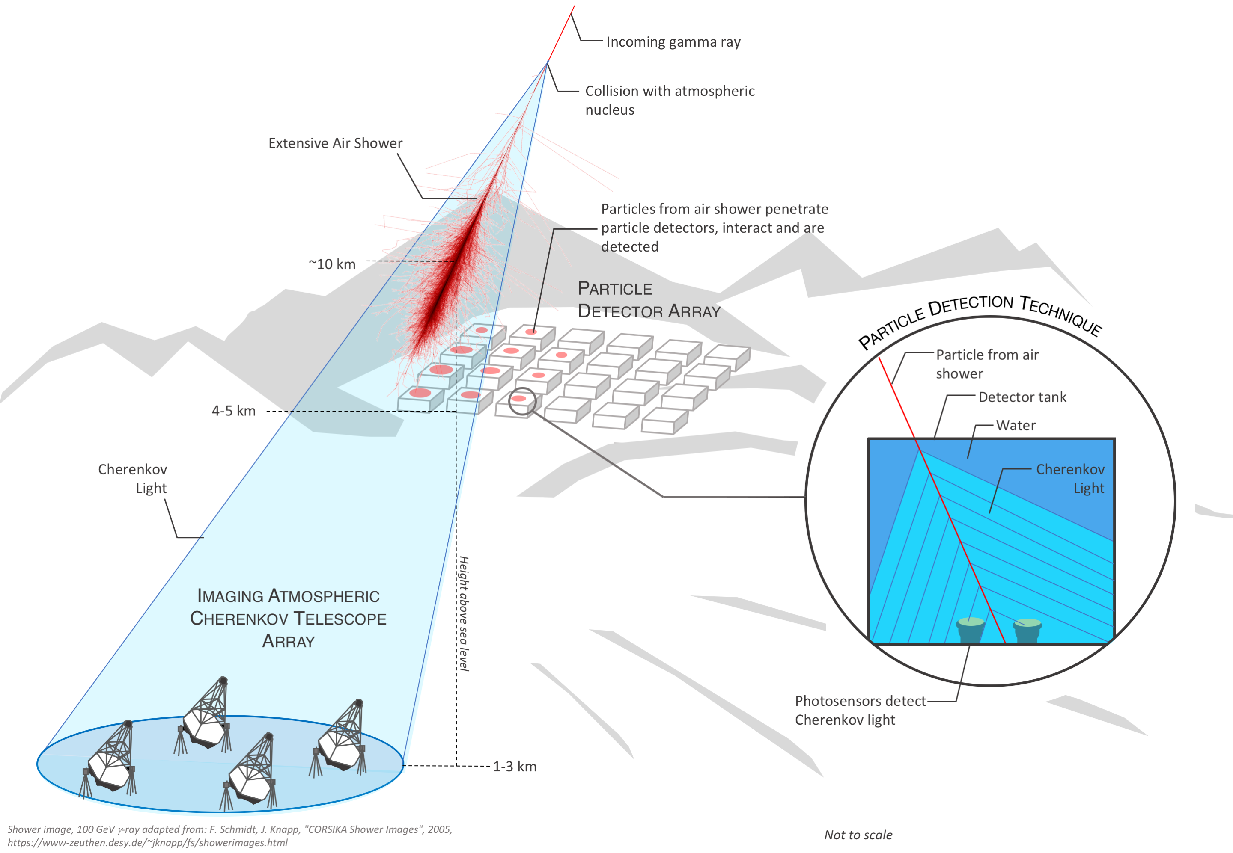
Current limits
Imaging Atmospheric Cherenkov Telescopes (IACTs) probe VHE gamma-rays through atmospheric showers. They detect Cherenkov light in the atmosphere
MM can make strong Cherenkov light in the atmosphere (bright signals), however, IACTs are pointed instrument with ~5x5 deg^2 field of view.
Require ultra-relativistic MMs

Slide 19
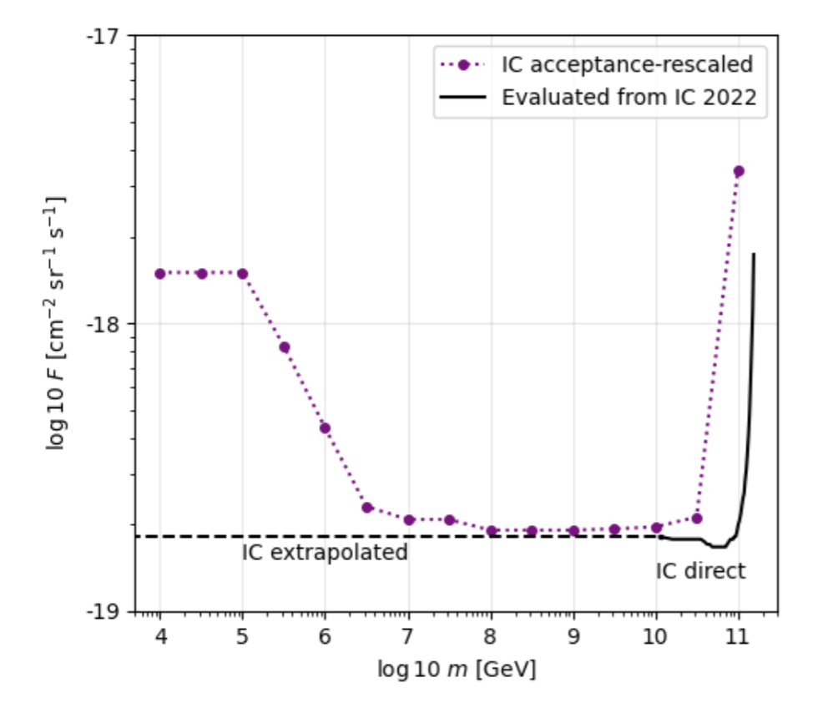
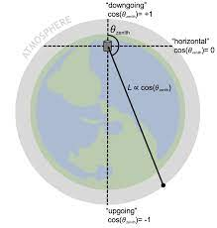
Instrument acceptance
Terrestrial experiments require relativistic and ultra-relativistic speeds
One should then consider ‘kinetic energy at the detector’
  Compute energy loss in matter (if required)
  Acceptance direction depedent
We carefully checked detectors differential acceptance and rescaled limits
e.g.: IC limits rescaled. Also done for MACRO

Slide 20



FINAL
Result
$$B_{IGMF}={10}^{−9}G$$
$$B_{IGMF}={10}^{−11}G$$
$$B_{IGMF}={10}^{−13}G$$
From speed limit to
MM mass
limits →

Slide 21
Conclusions

Slide 22
Take-home
We have developed a framework that computes the relation MM mass-speed in cosmic MFs (that includes back-reaction)
We have made assumptions on MFs, if better models come out, more accurate estimations can be made
Strong IGMFs impact MM acceleration (could contribute, could dominate)
Terrestrial instruments are sensitive to different MM mass (related to their formation mechanisms)
MM
Thanks!
Thanks!

Slide 23
BACKUPS

Slide 24
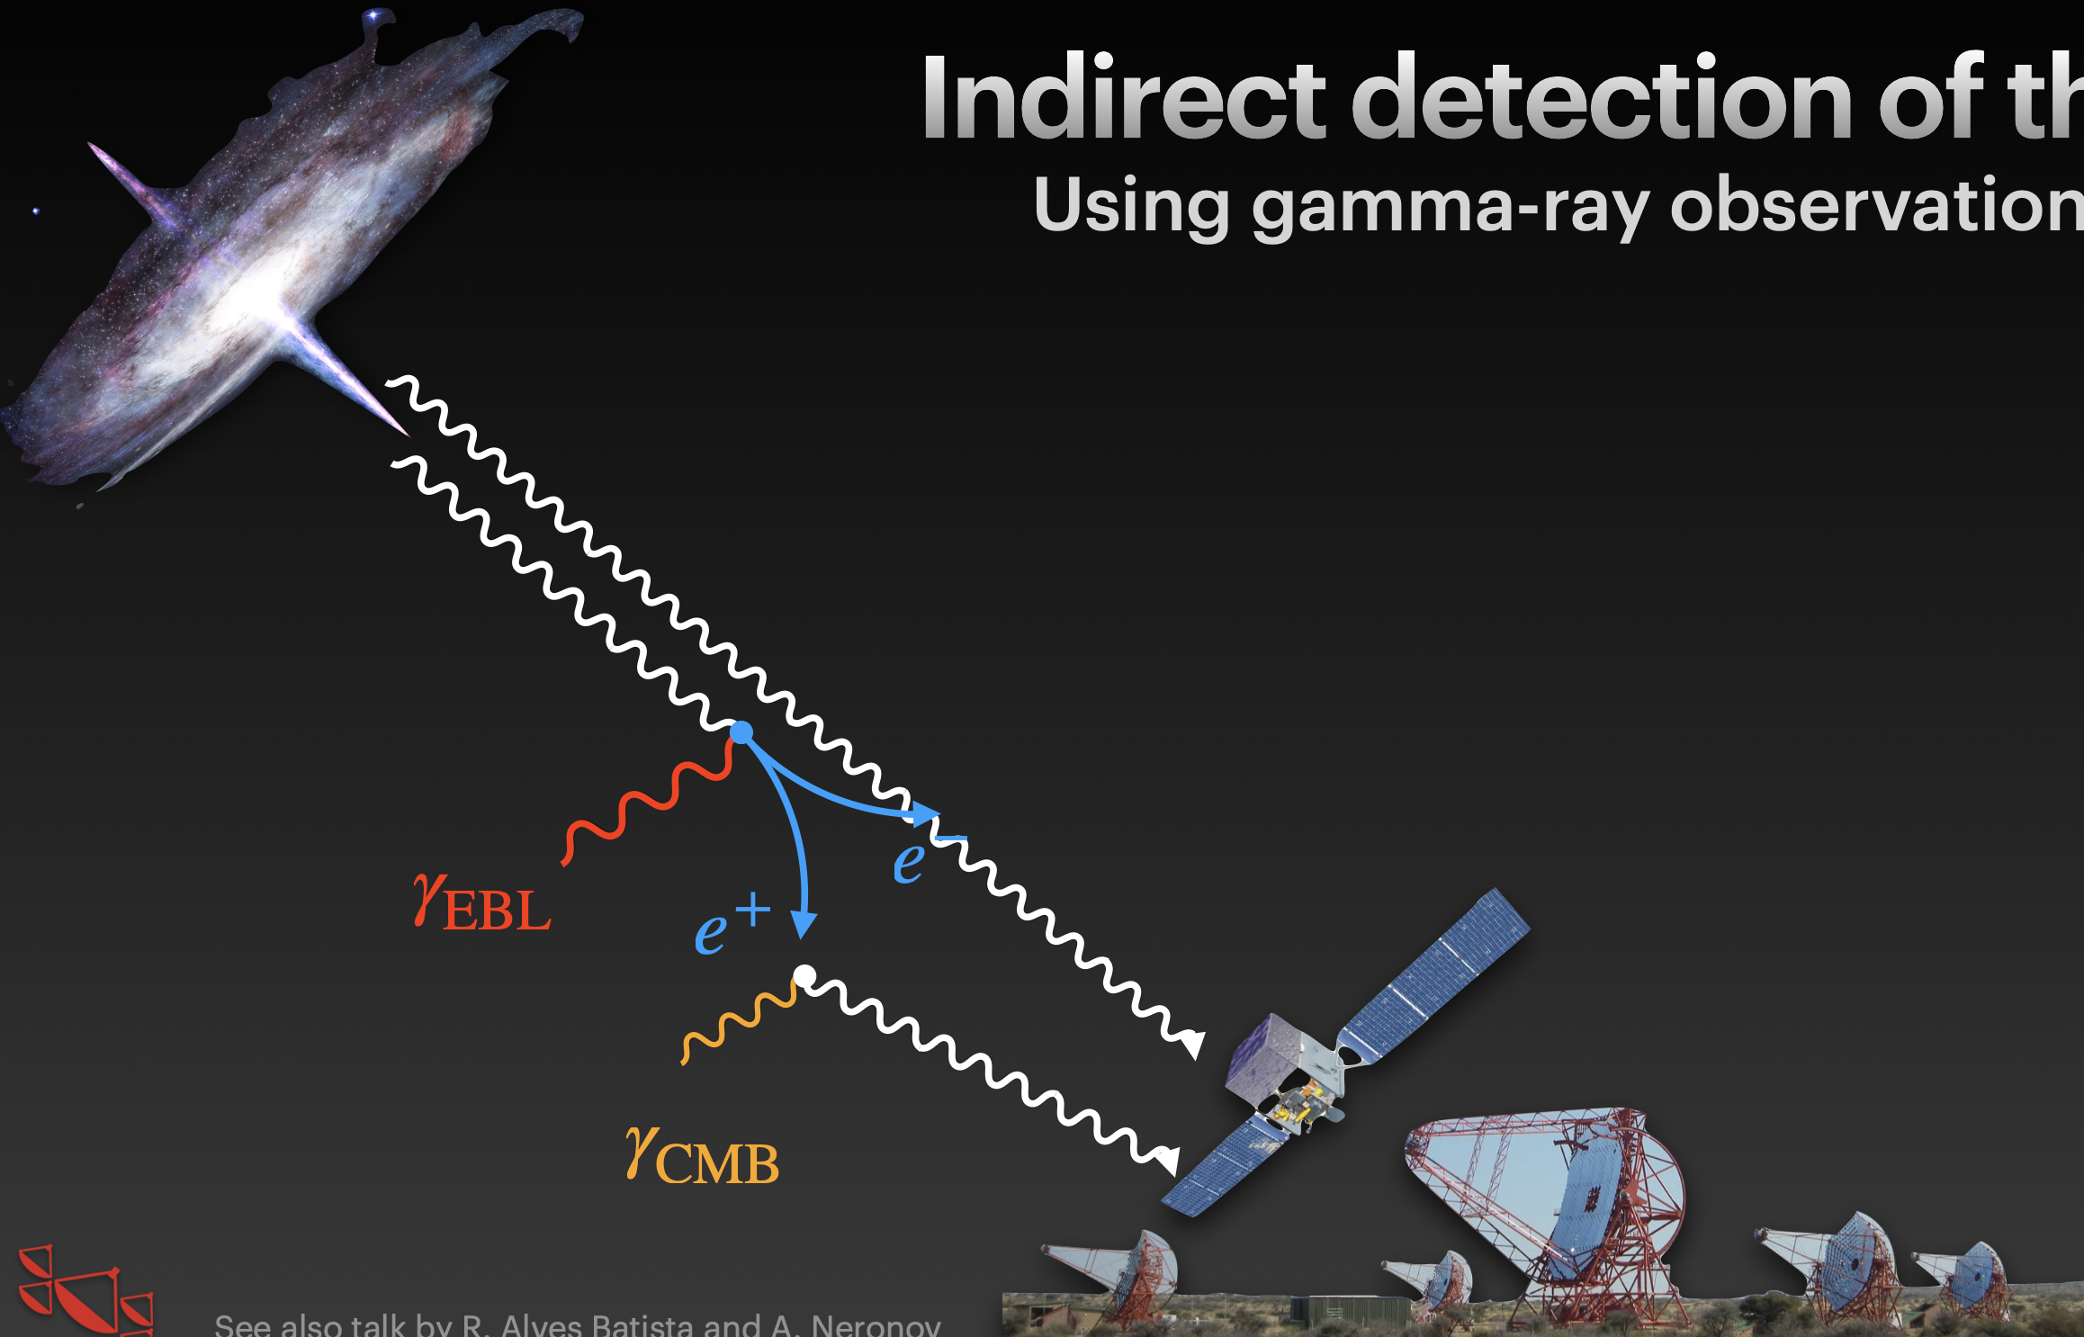

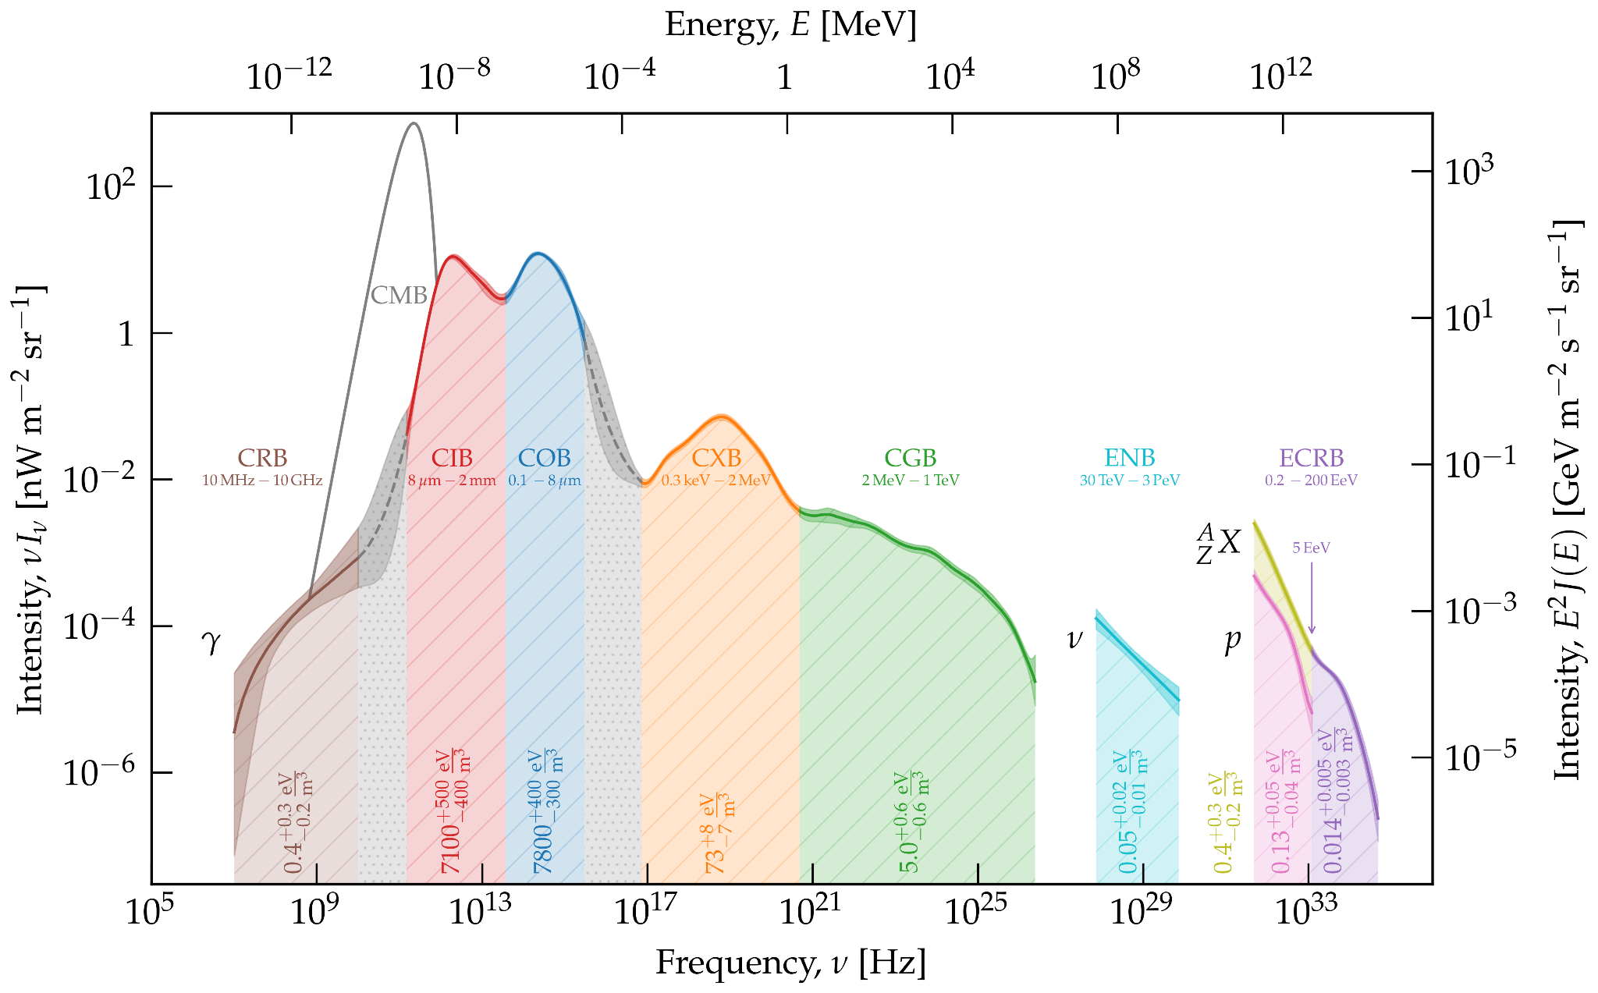

4/ Intergalactic Magnetic Fields
EBL light reprocess TeV gamma-rays to GeV gamma-rays
IGMF deflection
TeV
photons
GeV
photons
Credit: M. Meyer

Slide 25
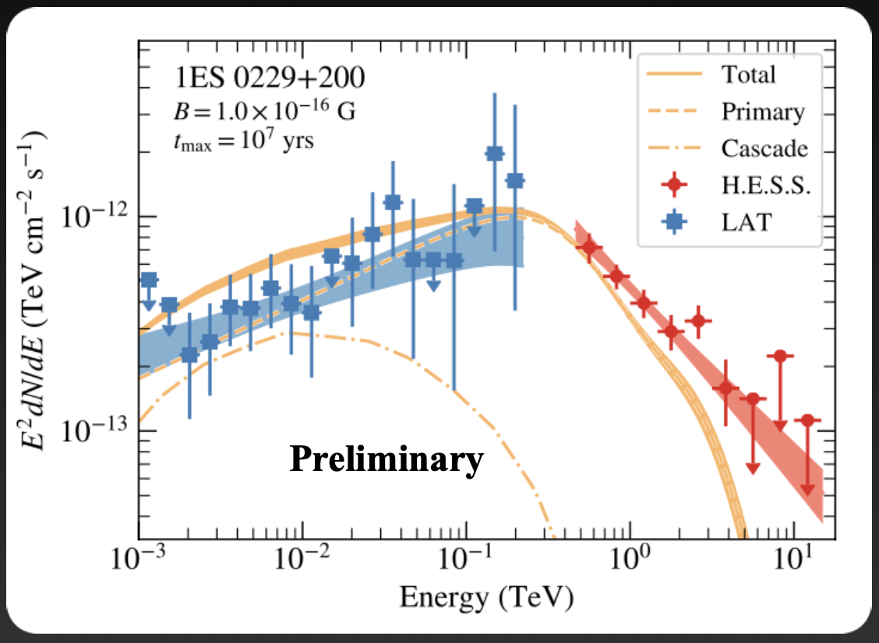
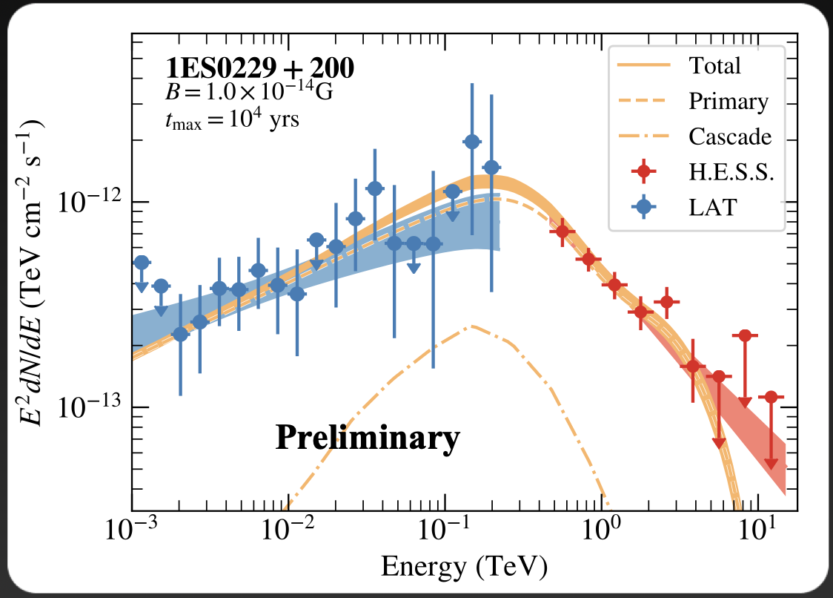
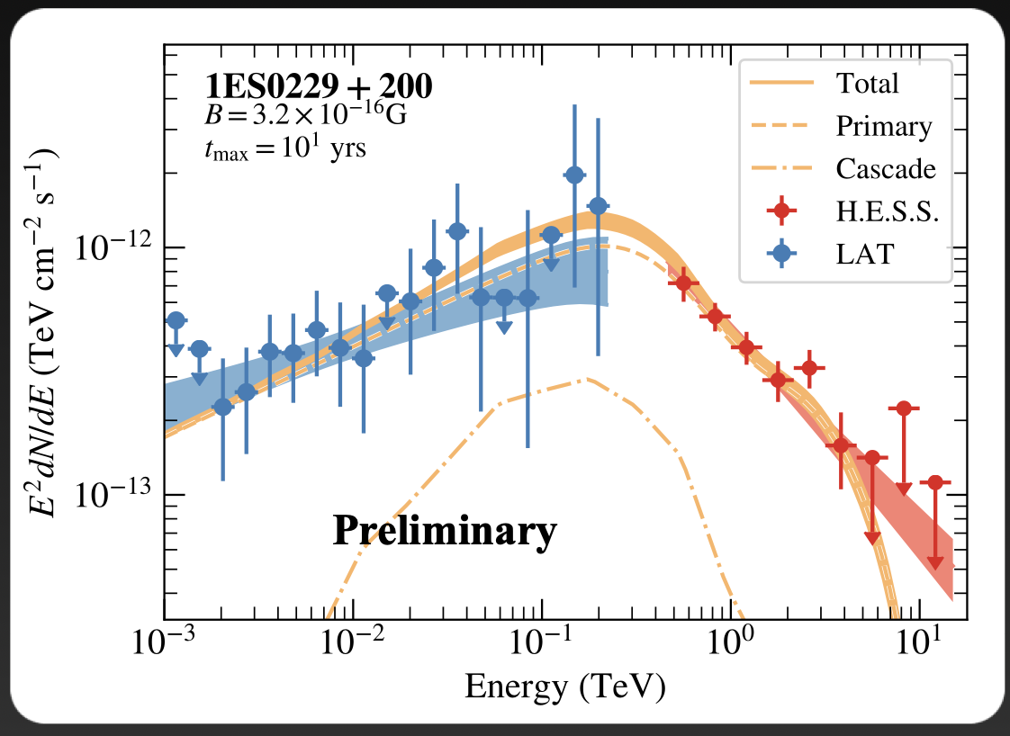
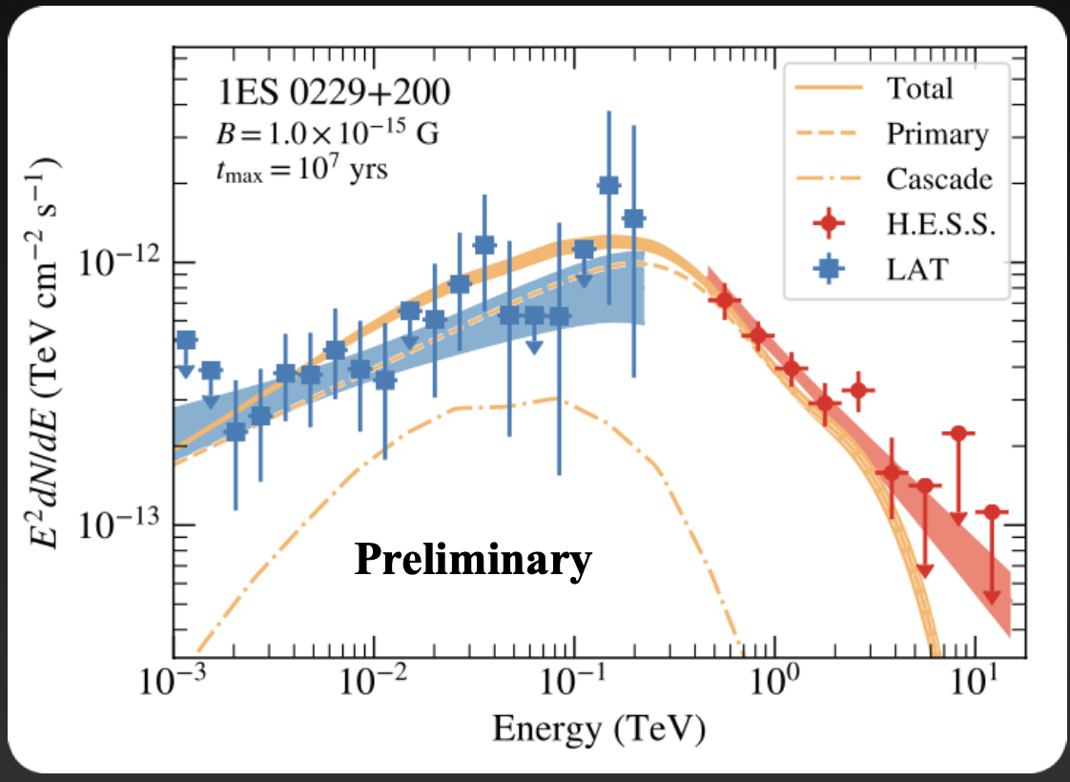
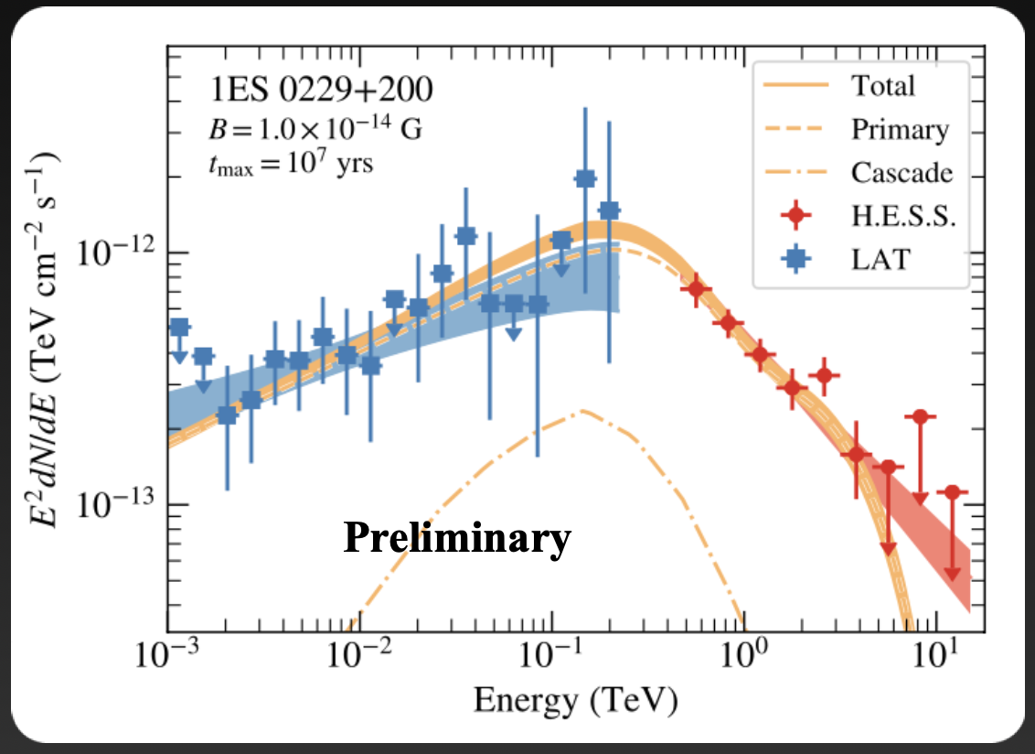
4/ Intergalactic Magnetic Fields
Credit: R. Batista
IGMF deflection
TeV
photons
GeV
photons
Credit: M. Meyer

Slide 26
4/ Intergalactic Magnetic Fields

Slide 27
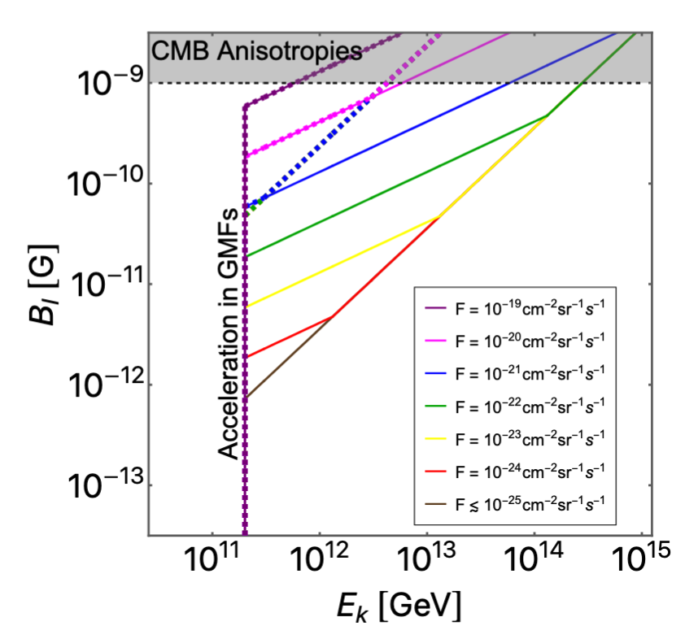
REVERSE BONUS: MM can limit IGMF
The argument can be reversed
A MM flux limit, assuming a certain kinetic energy, could be translated into an IGMF limit

