Slide 1
Introduction to the LHAASO Experiment
and Highlights of Key Results
Shoushan Zhang
on behalf of the LHAASO collaboration
Institute of High Energy Physics
Next Frontiers in Magnetic Monopole Searches, IHEP, Beijing, Sept. 11 – Sept. 14, 2026

Slide 2
Outline
Introduction to the LHAASO experiment
LHAASO Highlights in Cosmic-Ray Measurements
LHAASO Highlights in Gamma-Ray Astronomy
Progress in Searches for Ultra-Relativistic Magnetic Monopoles with LHAASO
Summary & Outlook

Slide 3

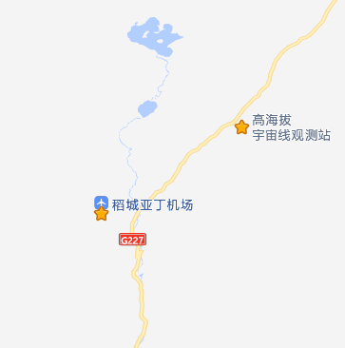
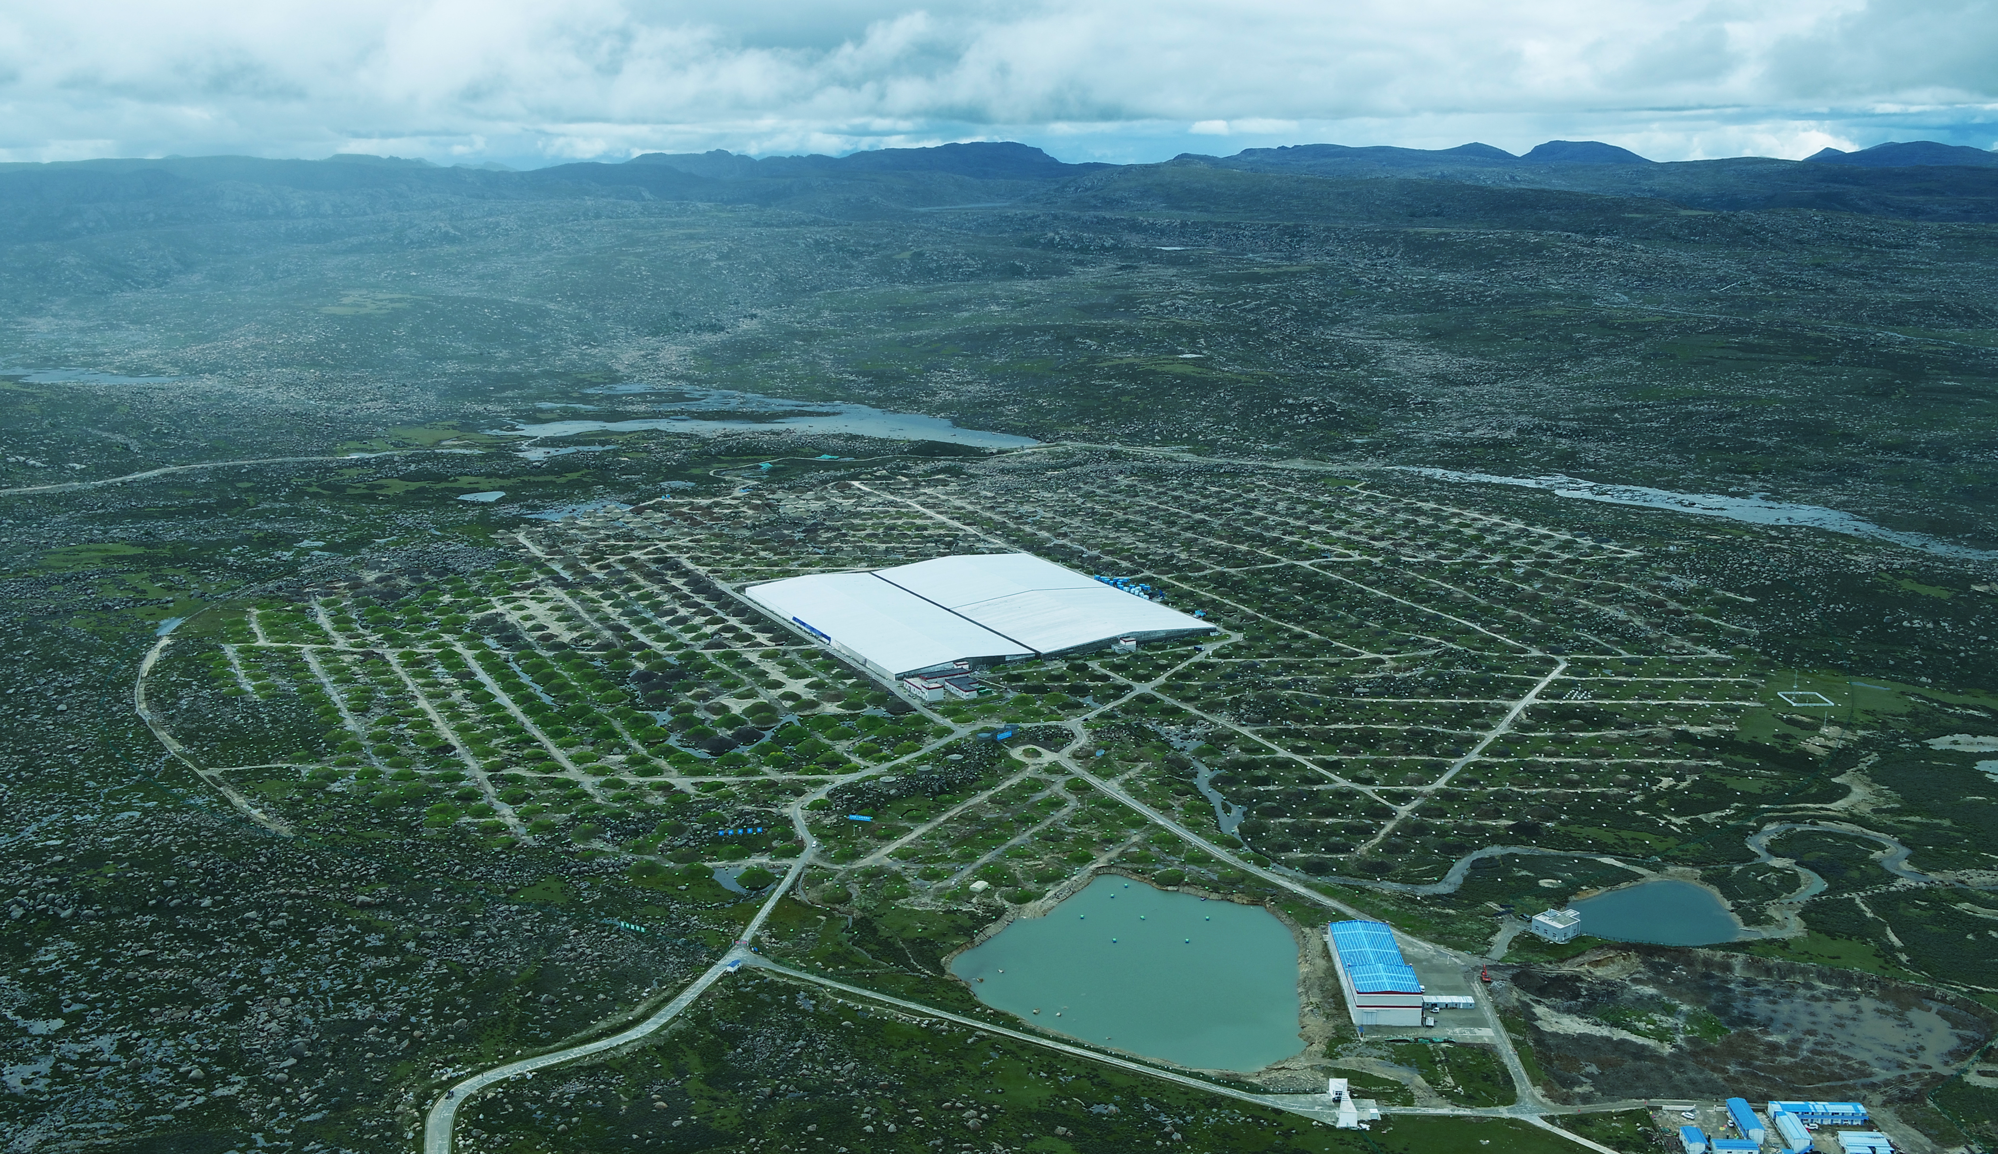
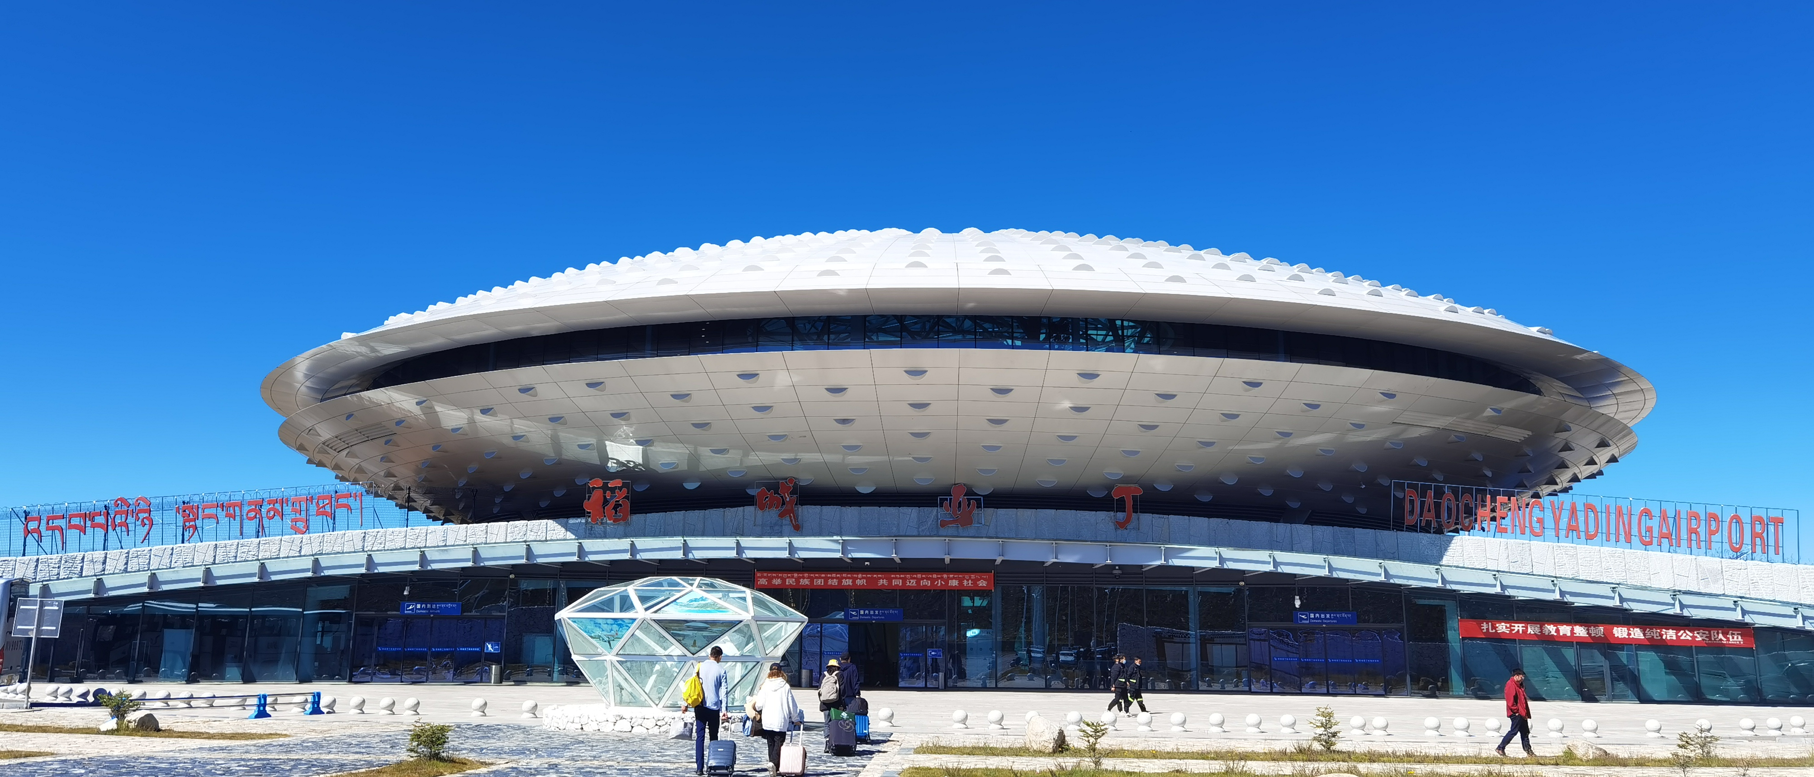
The Site
Bird’s eye view of LHAASO，2021-08
Location：located at Haizi Mountain, Sichuan, China (29º21’ 27.6” N , 100º08’19.6” E)
Altitude: 4410 m
LHAASO full array began operation in July 2021
LHAASO
~10KM
Airport
LHAASO, Nature Astronomy 5:849 (2021)
(Aug. 2018, at 4410 m a.s.l. )
Notes:
The LHAASO experiment located on Haizi mountain Sichuan China. The altitude is about 4400 meters. The LHAASO full array began operation in july 2021.

Slide 4
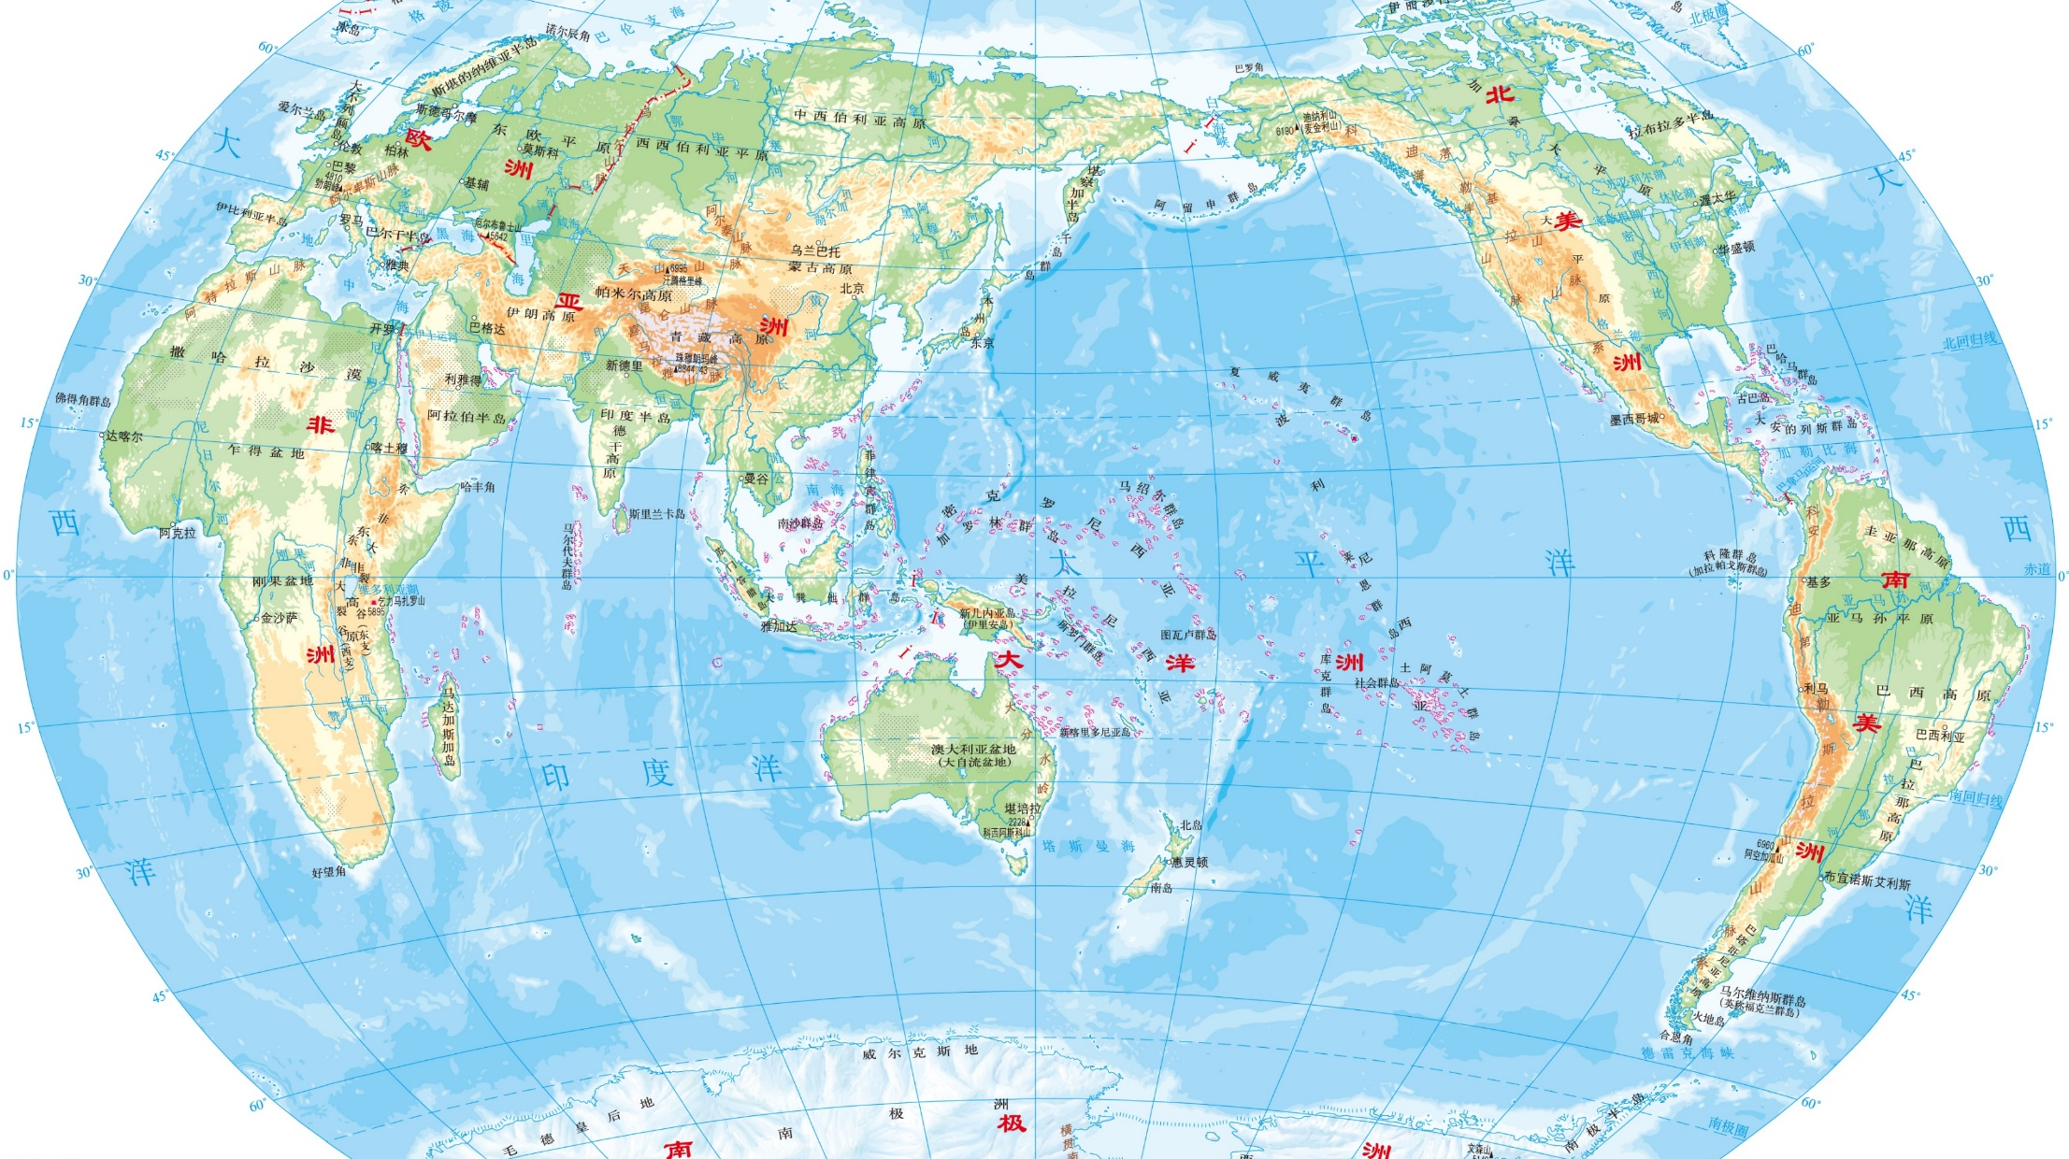
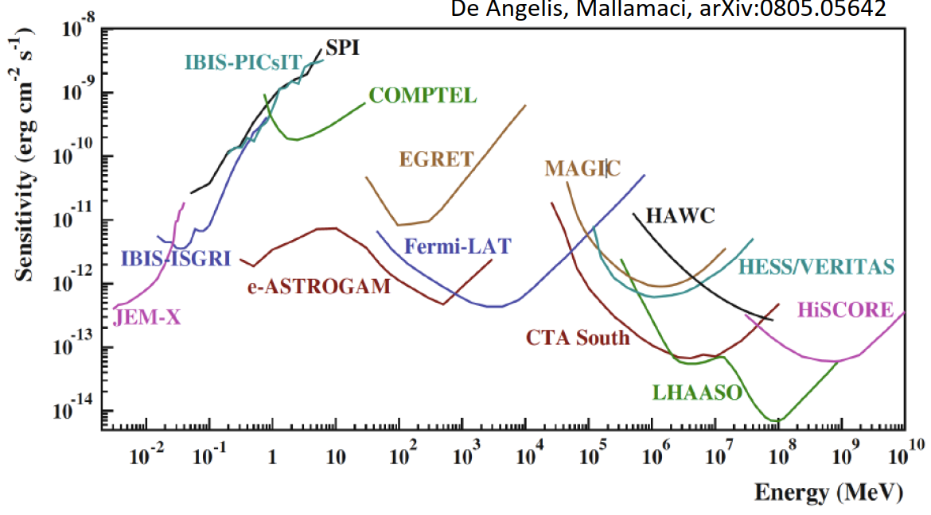
LHAASO: Multi-Messenger Collaboration Network
The LHAASO collaboration has signed MOUs with 8 international detector collaboration.
ANTARES (NT)
KM3Net (NT)
Baikal-GVD (NT)
VERITAS (CT)
LST/CTA-N (CT)
LHAASO Coll.：
6 countries
31 institutions
315 members
MAGIC(CT)
Space borne Exp.
eROSITA(X-ray)
DAMPE(γ-ray, CR)
Notes:
LHAASO has established a Multi-Messenger Collaboration Network and signed Memoranda of Understanding (MOUs) with eight international detector collaborations, including neutrino telescopes Antares, KM3NeT, and Baikal-GVD; Cherenkov telescope arrays CTA-LST, MAGIC, and VERITAS; as well as space-borne experiments eRosita and DAMPE. LHAASO collaborates with 300 scientists from six countries and 32 institutions.

Slide 5
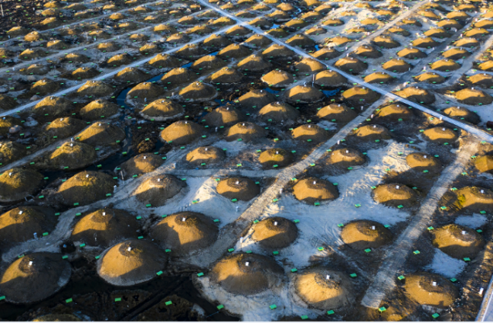
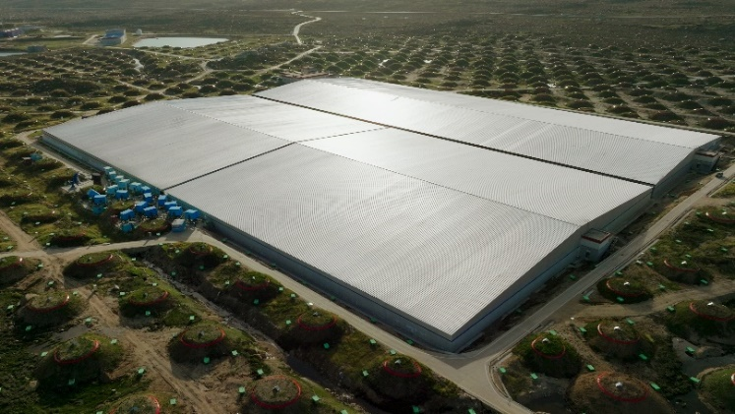
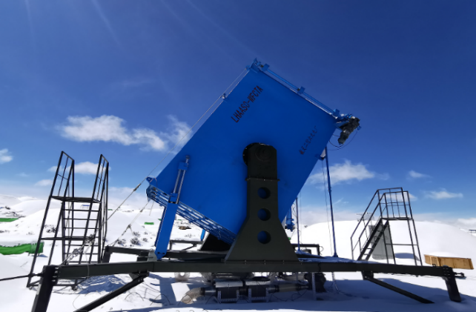
LHAASO
Array area: 1.3 km²
LHAASO Physics Topics
Gamma Ray Astronomy
Charged CRs measurement
New Physics Frontier
KM2A: muon detector and scintillator detector array
WCDA: water Cherenkov detector array
WFCTA: wide field Cherenkov telescope array
5216 EDs
18 telescopes
3120 cells
1188 MDs
Notes:
高海拔宇宙线观测站（LHAASO），位于四川甘孜州稻城海子山，海拔: 4410 m，是“膝区”宇宙线测量的理想位置，测量精度高
于2021年7月全面建成，2023年5月通过国家验收。拉索阵列的中心是水切伦科夫探测器阵列(WCDA)，外围是闪烁体探测器阵列和缪子探测器阵列，还有18台广角切伦科夫望远镜。整个阵列的面积是1.3平方公里。

Slide 6
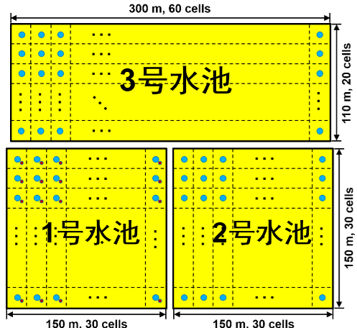
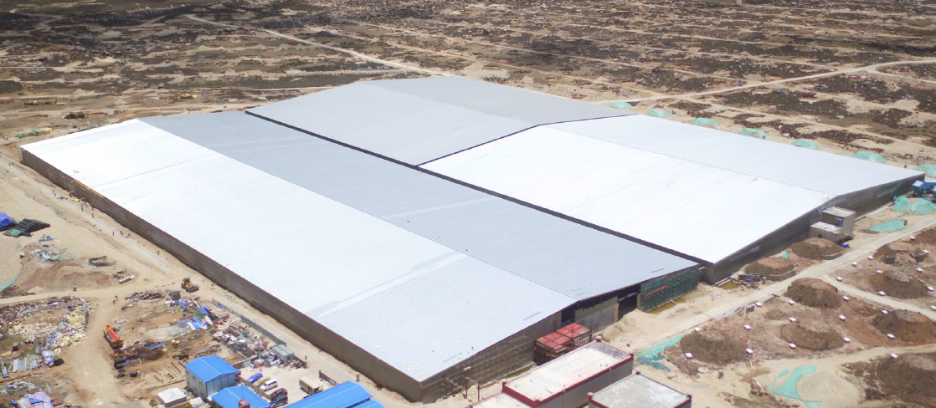
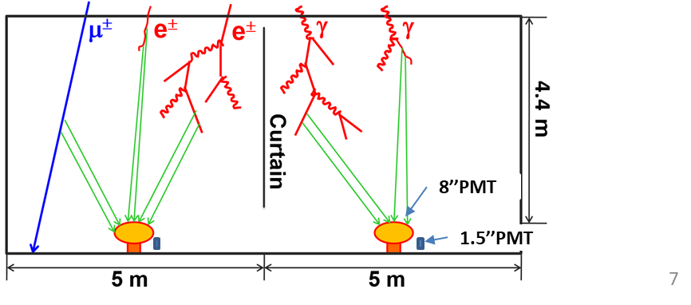
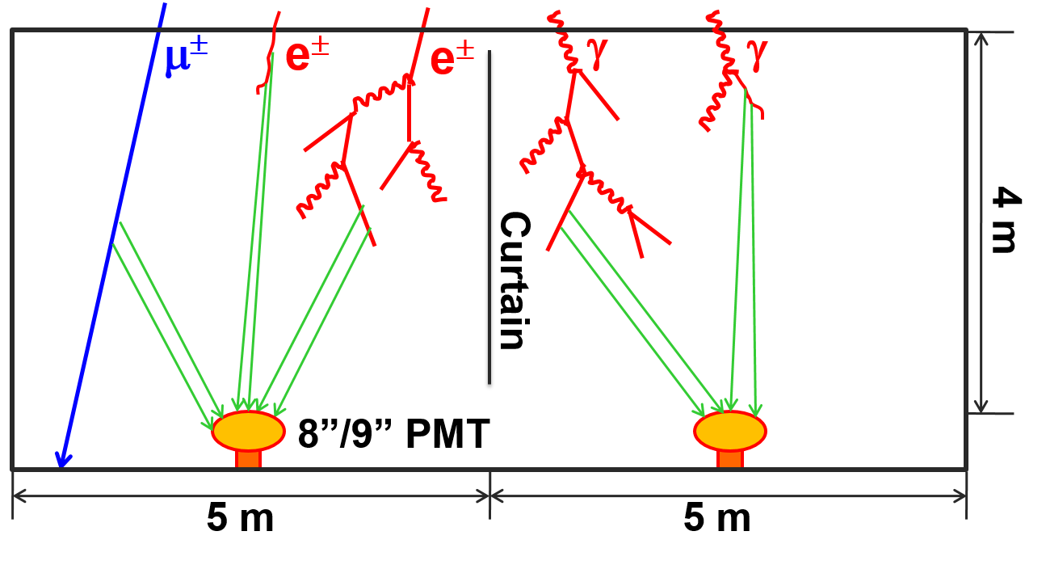
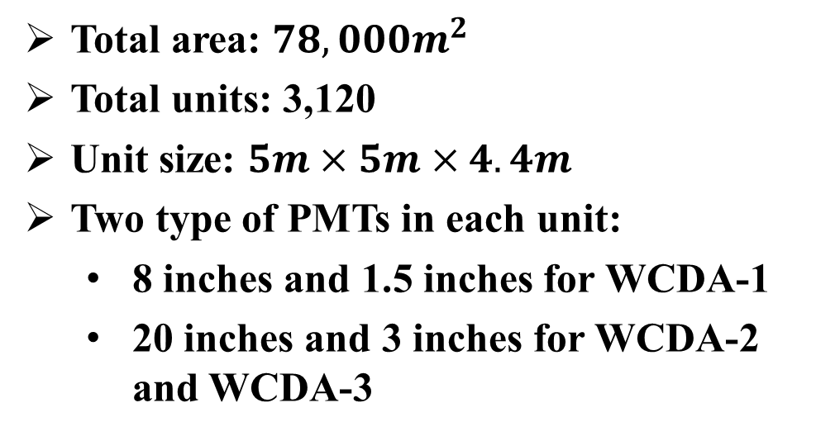
Water Cherenkov Detector Array (WCDA)
WCDA-3
Energy rang
  WCDA-1
    300 GeV – 10 PeV
  WCDA-2 and WCDA-3
    100 GeV - 10 TeV
WCDA-2
WCDA-1
WCDA-3
WCDA-1
WCDA-2
Total area: $78,000m^{2}$
Total units: 3,120
Unit size: $5m×5m×4.4m$
Two type of PMTs in each unit:
  8 inches and 1.5 inches for WCDA-1
  20 inches and 3 inches for WCDA-2 and WCDA-3
4.4
8’’PMT
PMT
1’’PMT
1.5’’PMT
Notes:
The water Cherenkov detector array (WCDA) has three large pools and 3120 units. The size of each unit is 5 meters by 5 meters, and the water depth is about 4.4 meters. There are two types of PMTs In each unit. 8 inches and 1.5 inches for WCDA-1. 20 inches and 3 inches for WCDA-2 and WCDA-3.

Slide 7
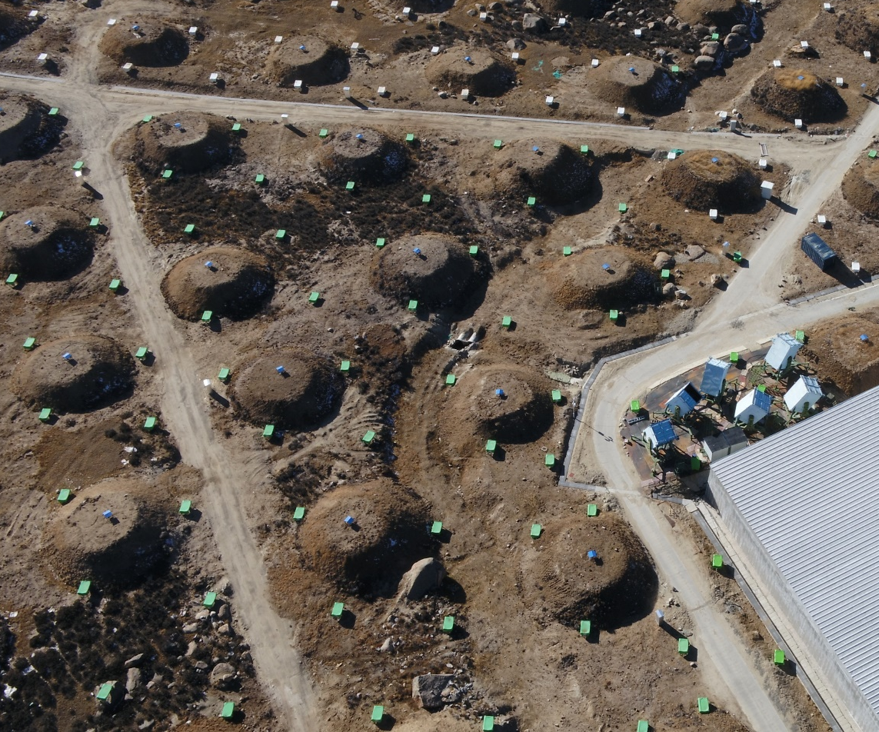
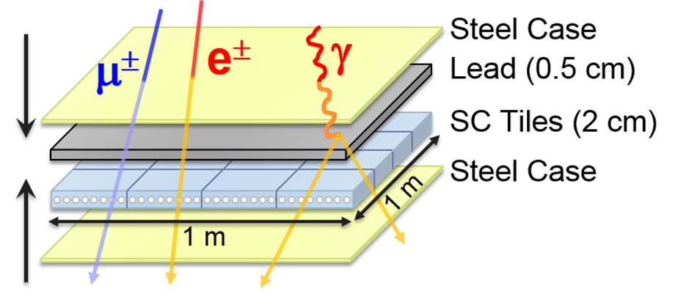
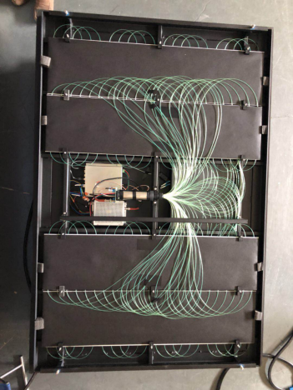
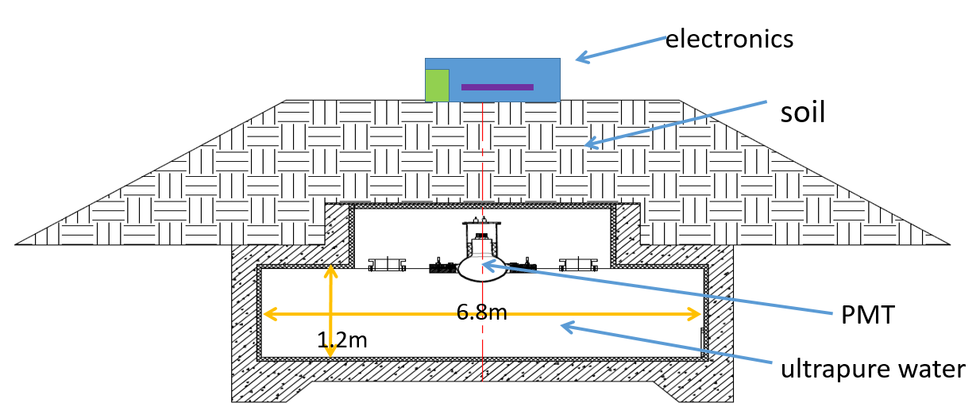
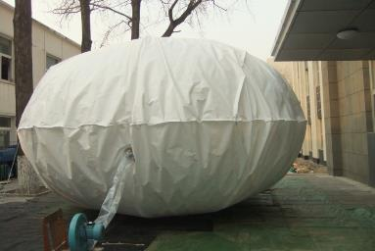
KM2A: 1.36 (km)²
5195 EDs
  1 m² each
  15 m spacing
1188 MDs
  36 m² each
  30 m spacing
30 m
15 m
Inner View of one ED
μ±
Muon detector（MD）
Notes:
This soil bag is a muon detector. A water bag is buried underground and covered by about 2.5 meters of soil. The spacing between muon detectors is about 30 meters. This small square is a scintillator detector with a spacing of about 15 meters.

Slide 8
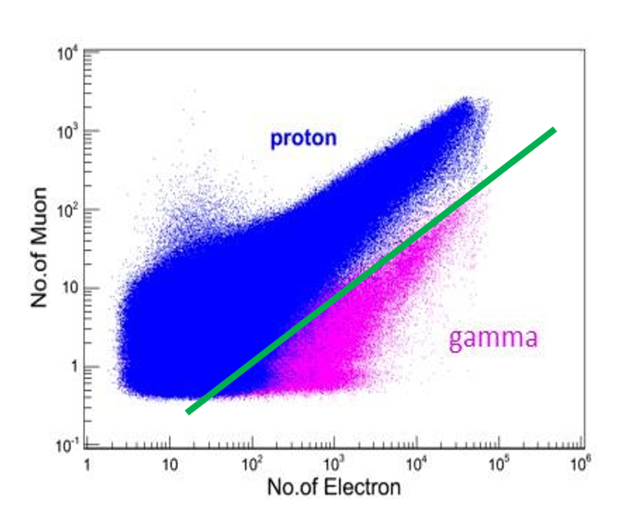
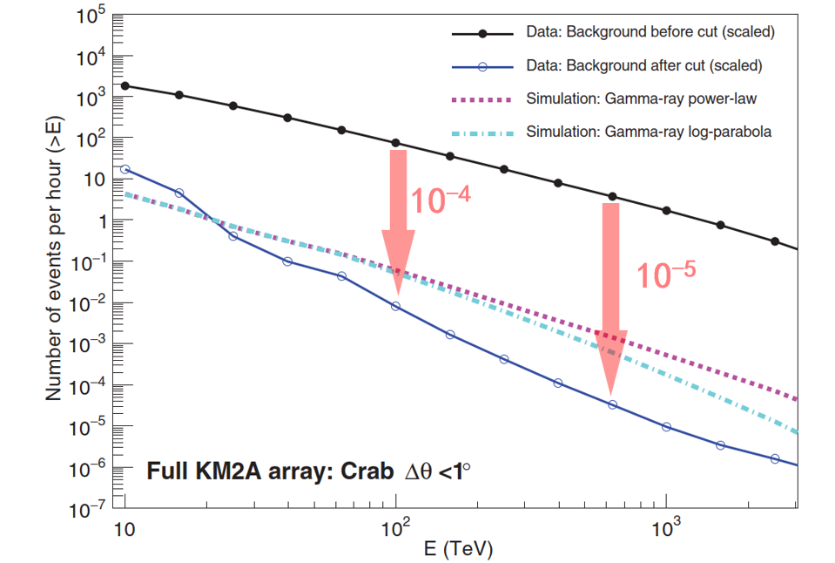
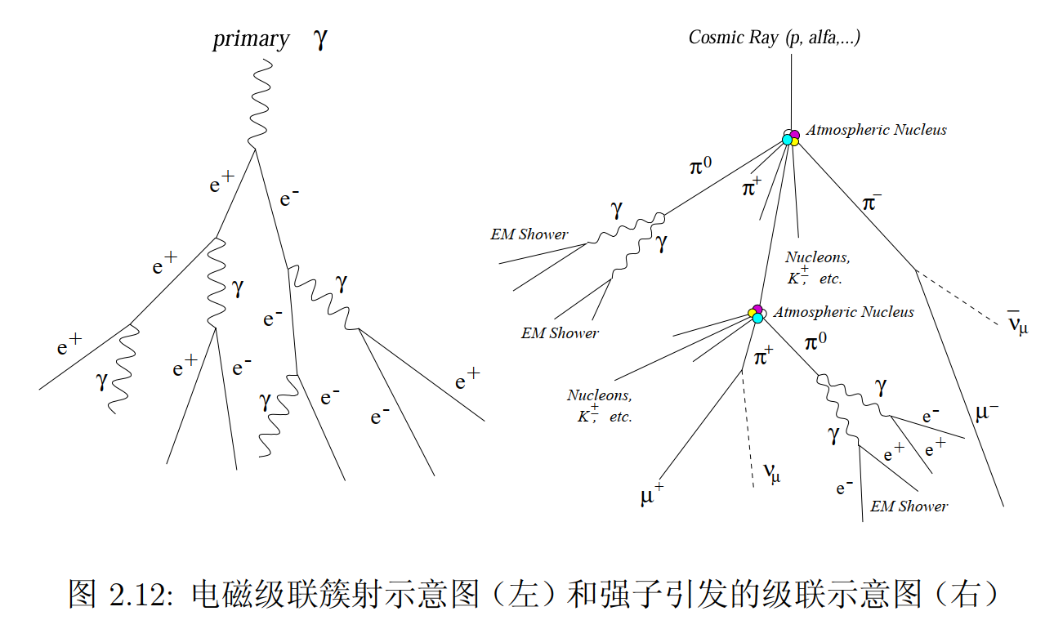
Particle identification variable: number of muons
Suppressing the cosmic-ray background by a factor of 10,000
Gamma rays: muon-free or muon-poor
Cosmic rays: muon-rich
Muon content: Iron > Helium > Proton

Slide 9

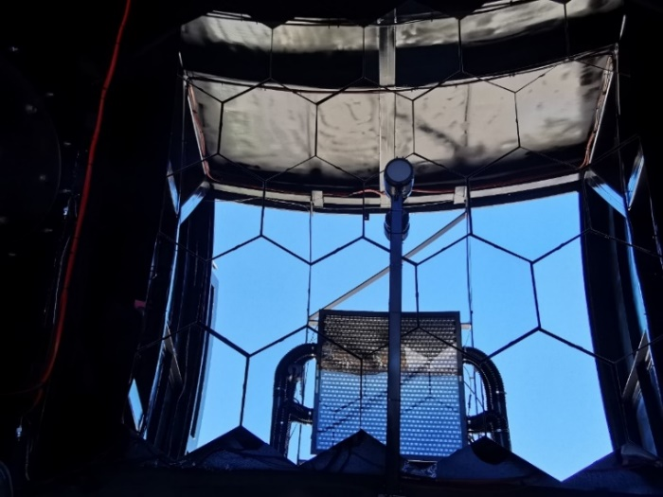
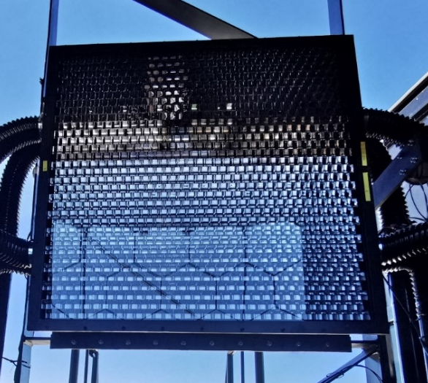


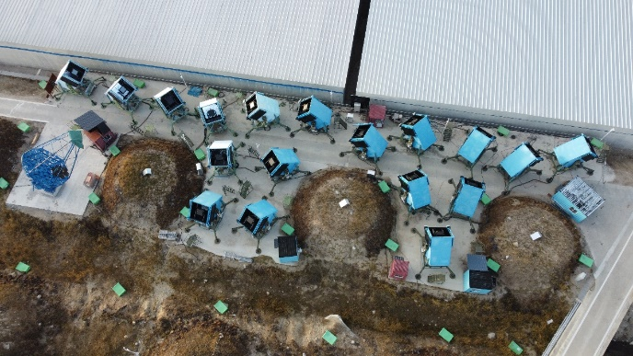
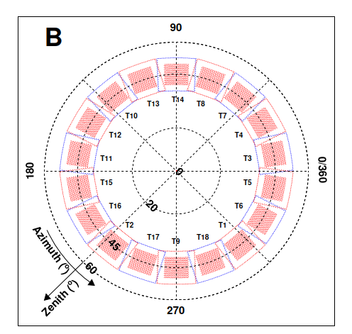
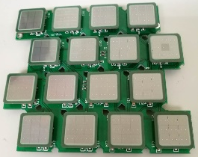
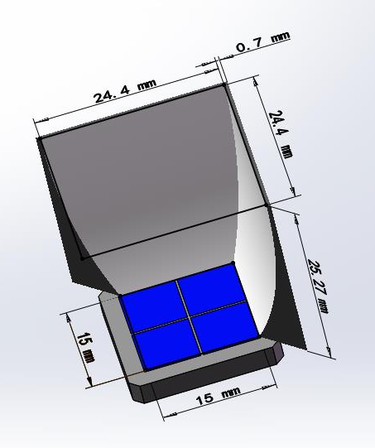
Wide Field of View Cherenkov Telescope (WFCTA)
~5 m² spherical mirror
Camera: 32×32 SiPMs array
FOV:
Pixel size:
Telescope parameters:
18 tels are pointed at a zenith angle of 45°
cover azimuth angle from 0°to 360°
Mirror
SiPM camera
18 Telescopes
SiPM and Winstone cone
Notes:
Eighteen wide-field-of-view Cherenkov telescopes are designed for cosmic ray measurements.
The diameter of the mirror is about 2.3 m. The SiPM camera is used. So, our Cherenkov telescopes can operate during moon nights, even on the full moon night.
This is very important to increase the observation time for such kind of Cherenkov telescopes.

Slide 10
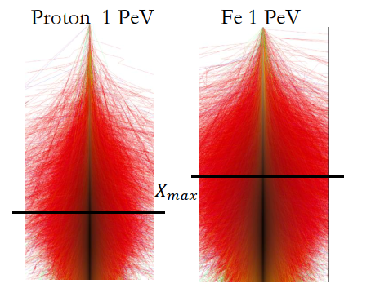
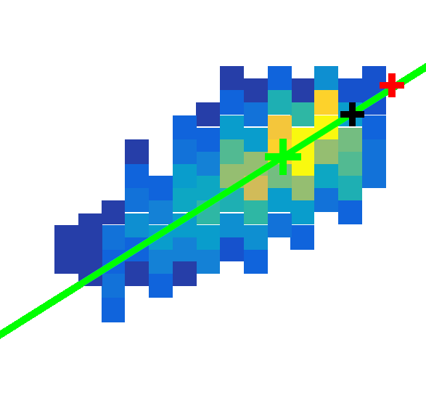
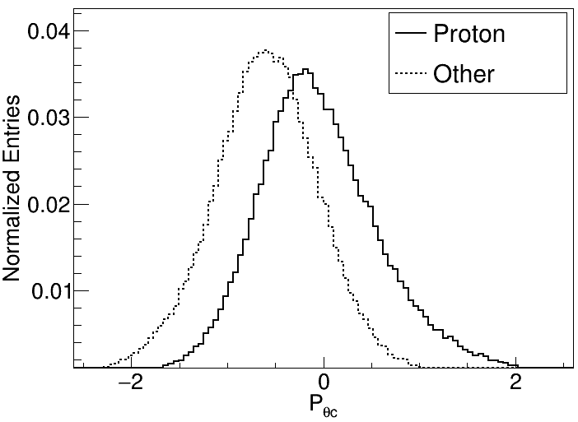

Particle identification variable: depth of shower maximum (X_{max})
$$θ_{c}$$
Source
Cherenkov image measured by WFCTA
Centroid
Xmax information

Slide 11
Outline
Introduction to the LHAASO experiment
LHAASO Highlights in Cosmic-Ray Measurements
LHAASO Highlights in Gamma-Ray Astronomy
Progress in Searches for Ultra-Relativistic Magnetic Monopoles with LHAASO
Summary & Outlook

Slide 12
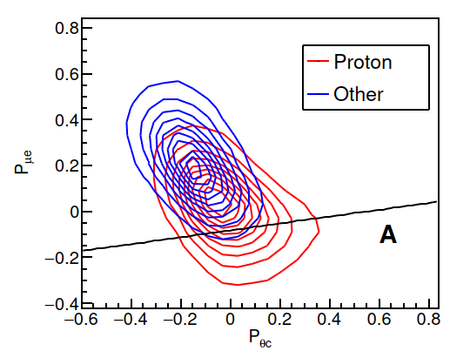
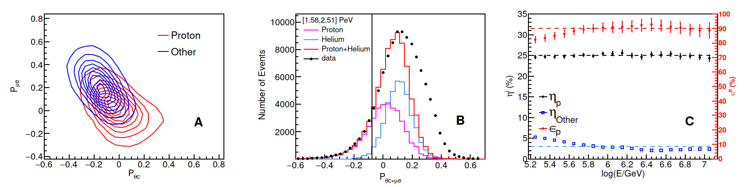
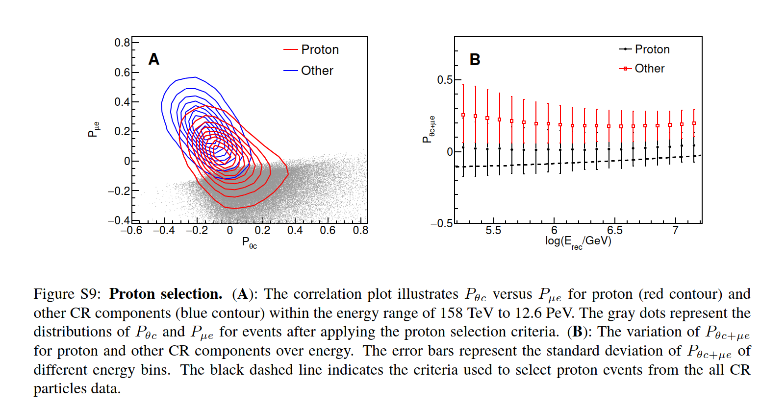


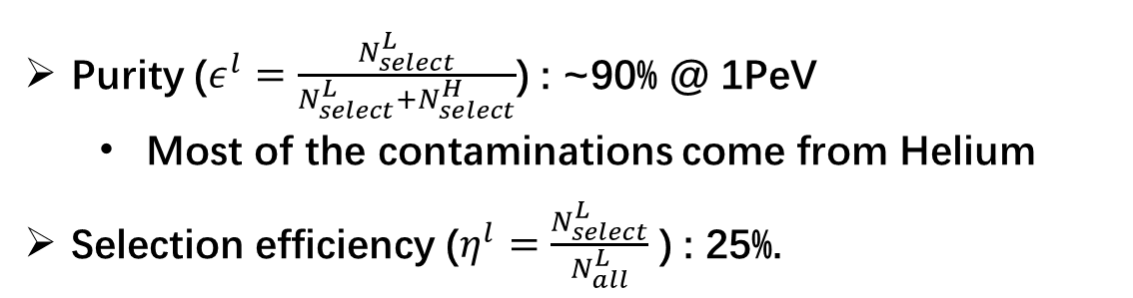
Cosmic Ray Proton Selection
CNO, MgAlSi, Iron dominant region
μ
信
息
Selection criteria at one energy bin
Dash line: selection criteria
Xmax信息
( )
Purity ($ε^{l}=\frac{N_{select}^{L}}{N_{select}^{L}+N_{select}^{H}}$) : ~90% @ 1PeV
  Most of the contaminations come from Helium
Selection efficiency ($η^{l}=\frac{N_{select}^{L}}{N_{all}^{L}}$ ) : 25%.
12
12

Slide 13
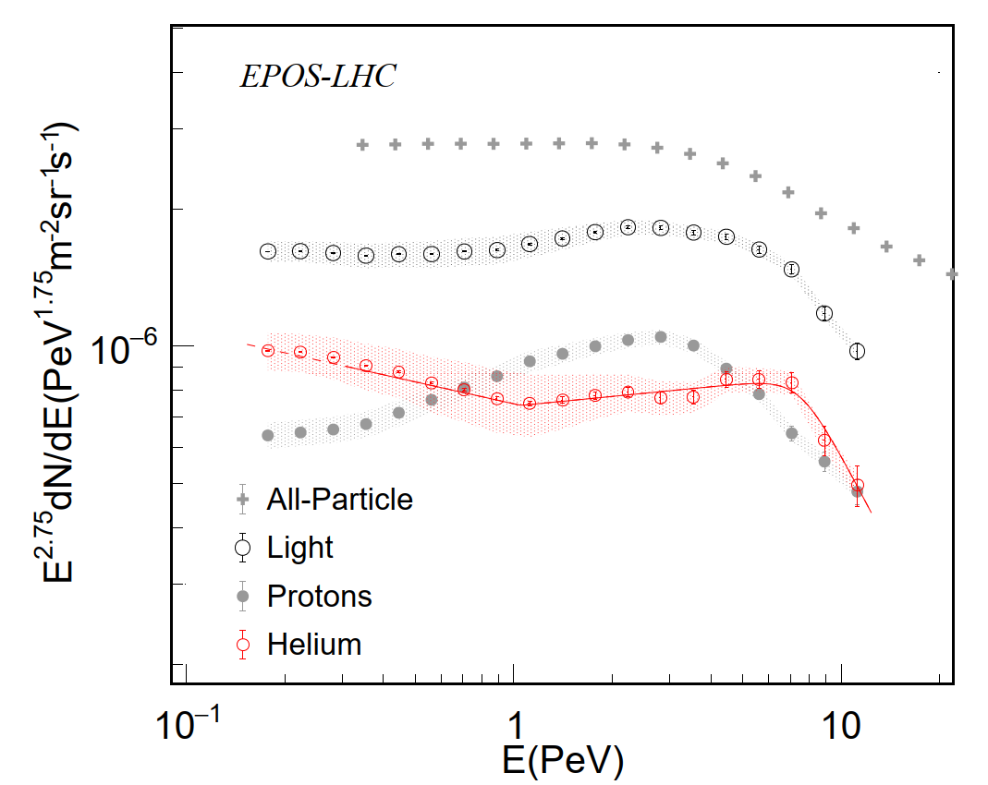
LHAASO Proton and Helium Spectra in the “Knee” Region
LHAASO reported the most precise cosmic-ray proton and helium spectra in 2025 and 2026, respectively, covering energy from 0.16 to 13 PeV
  Proton purity: ~90% above 100 TeV
  This approaches the purity (95%–99% ) achieved by space-based experiments such as DAMPE below 100 TeV.
  Unlike KASCADE and IceTop, which rely on unfolding, LHAASO enables event-by-event particle identification, extending precision measurements of individual cosmic-ray components into the “knee” region for the first time.
All particle
H+He
He
H
（2024）
（2026）
（2025）
（2026）
LHAASO Coll., Science Bulletin 70 (2025)
LHAASO Coll., Phys. Rev. Lett. 136, 121001 (2026)
Notes:
LHAASO has reported the most precise measurements of the proton and helium spectra in the 0.16–13 PeV energy range.
LHAASO proton purity: ~90% above 100 TeV
Space-based experiments (e.g., DAMPE):
95%–99% below 100 TeV
Other ground-based experiments, such as KASCADE and IceTop, rely on unfolding methods to reconstruct energy spectra and cannot perform event-by-event particle identification.
For many years, precise measurements of individual cosmic-ray components have relied primarily on space-based experiments, whose energy range has generally been limited to below 100 TeV. With the LHAASO experiment, we have overcome this limitation and achieved precise measurements of the proton and helium spectra in the cosmic-ray “knee” region above 100 TeV.

Slide 14
LHAASO Proton and Helium Spectra in the “Knee” Region
LHAASO proton and helium spectra from 0.16 to 13 PeV
  Both spectra show a pronounced bump—hardening followed by softening—rather than a simple break. This suggests a new high-energy cosmic-ray component, potentially dominated by micro-quasars rather than conventional supernova remnants.
  These findings offer a new perspective on the nearly 70-year-old cosmic-ray “knee” puzzle.
All particle
H+He
He
H
（2024）
（2026）
（2025）
（2026）
LHAASO Coll., Science Bulletin 70 (2025)
LHAASO Coll., Phys. Rev. Lett. 136, 121001 (2026)
Notes:
In November 2025 and March 2026, respectively, LHAASO reported the most precise measurements to date of the proton and helium spectra in the 0.16–13 PeV energy range, achieving a precision comparable to that of satellite experiments below 0.1 PeV.
These measurements revealed spectral features in the proton and helium spectra that differ from those of the all-particle spectrum: the spectra first harden and then soften, forming a new spectral bump rather than a simple transition between two power laws. This indicates the presence of a high-energy component contributed by a new class of cosmic-ray accelerators.
The microquasars recently identified by LHAASO—binary systems consisting of a black hole and a companion star—are likely the dominant sources of this high-energy component, rather than the traditionally favored supernova remnants.
These findings have transformed the field’s understanding of the cosmic-ray “knee,” a question that has remained open for nearly 70 years.

Slide 15
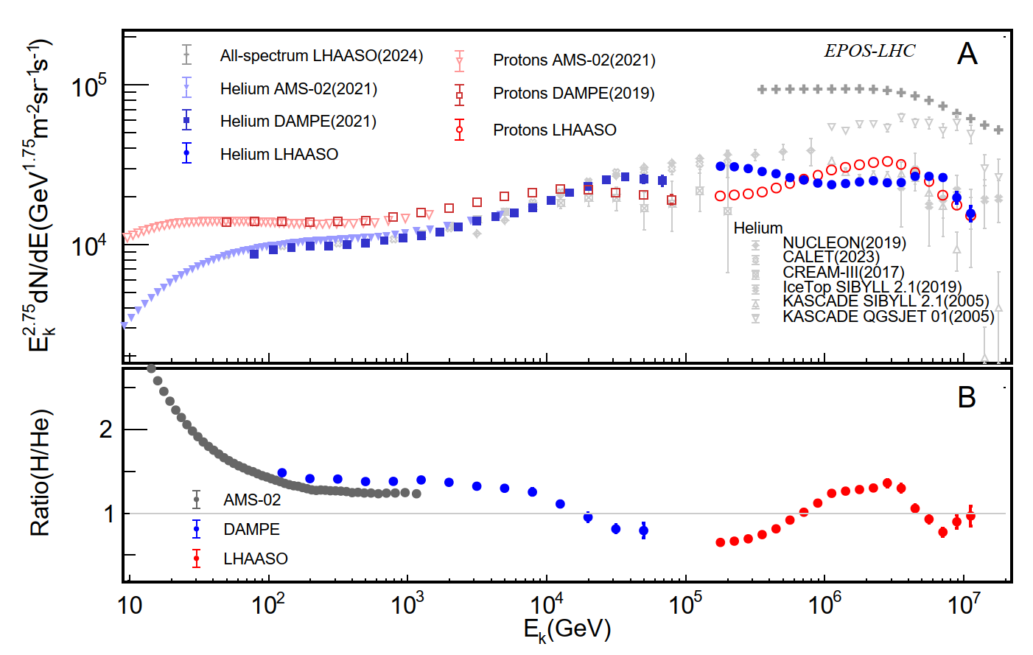
Wideband spectrum of proton and helium
H/He

Slide 16
Outline
Introduction to the LHAASO experiment
LHAASO Highlights in Cosmic-Ray Measurements
LHAASO Highlights in Gamma-Ray Astronomy
Progress in Searches for Ultra-Relativistic Magnetic Monopoles with LHAASO
Summary & Outlook

Slide 17
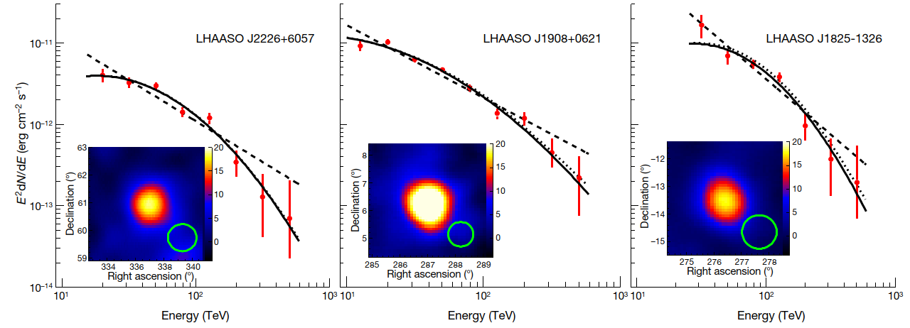
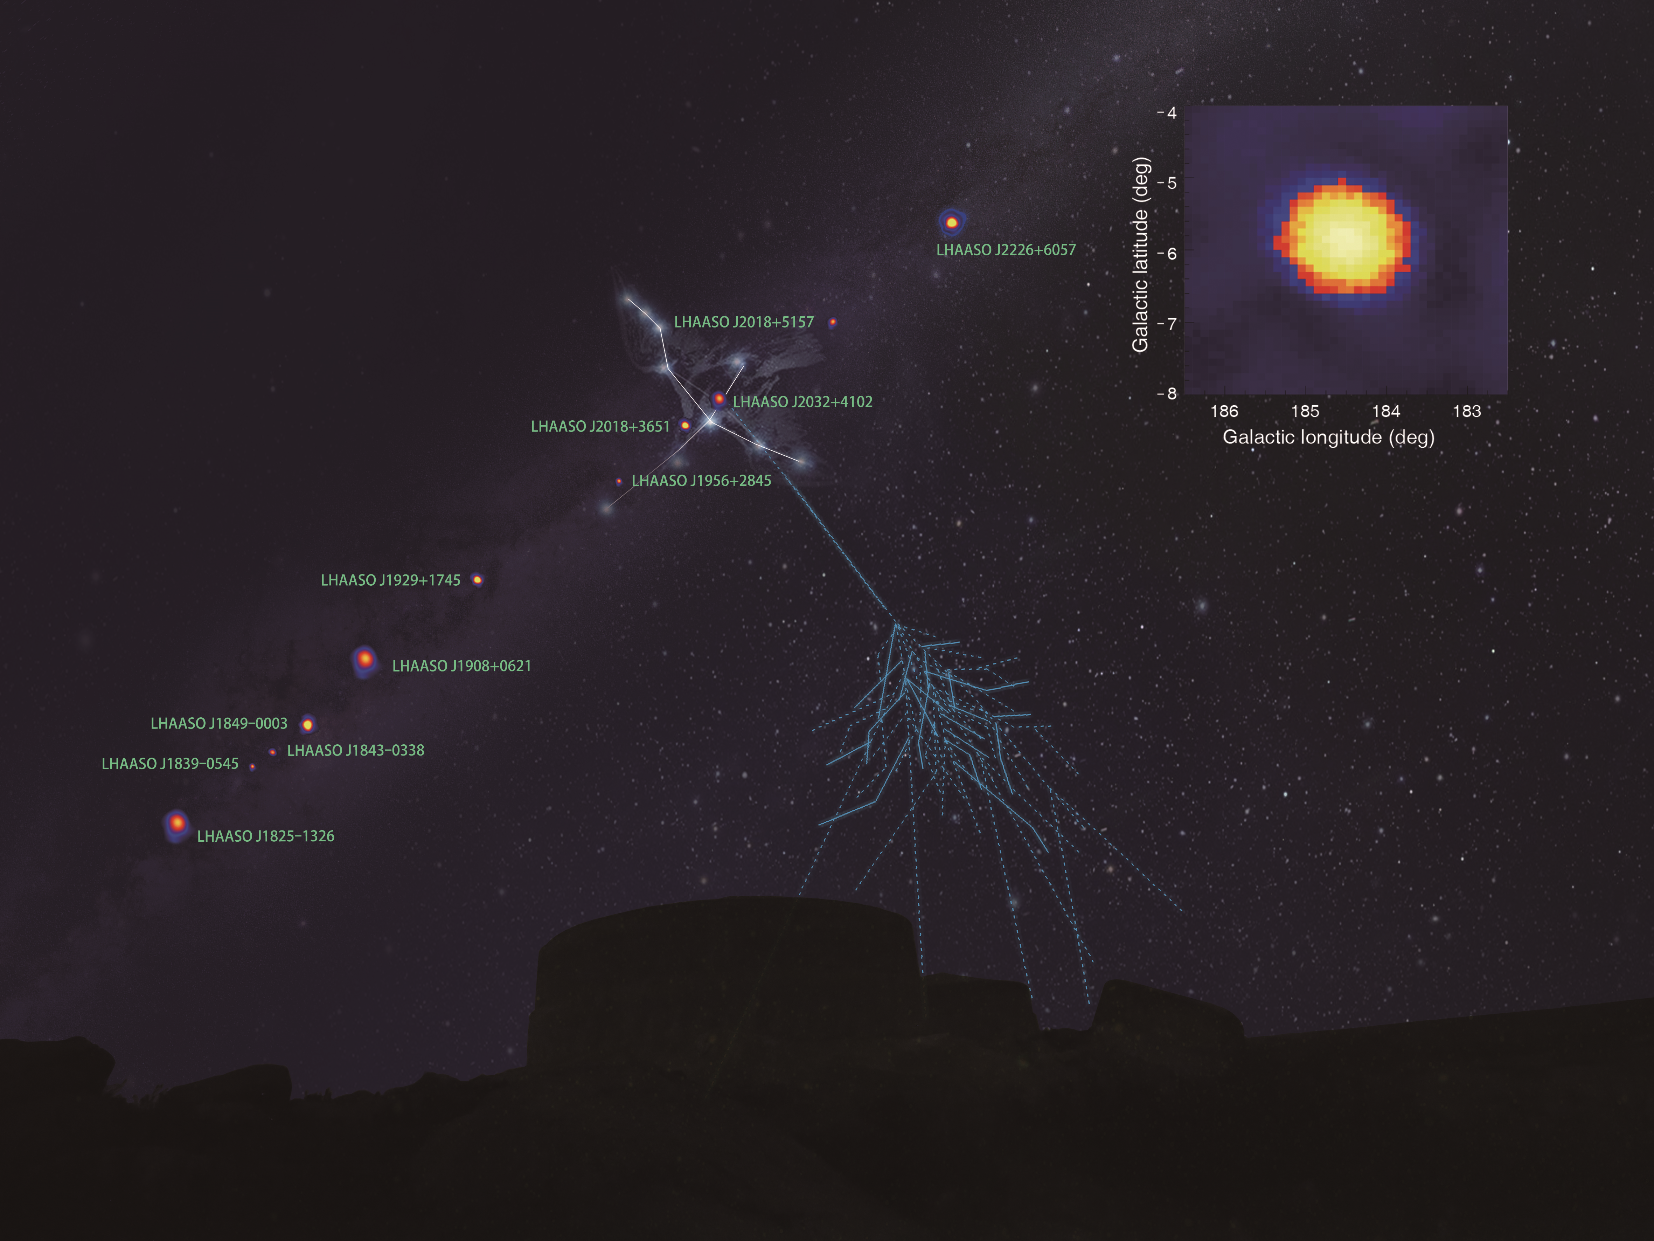
LHAASO started a new era of UHE γ-ray astronomy
2019/12-2020/12, 308 days，1/2 array
Do not observe clear cut-off up to ~1 PeV
For the first time, twelve ultra-high energy gamma-ray sources have been discovered in the Milky Way, revealing the widespread existence of “petaelectron particle accelerators” in the galaxy, whose acceleration capabilities have surpassed traditional understanding.
Highest photo：1.4 PeV
LHAASO, Nature, 594, p.33-36, 2021
Notes:
In 2021, using half array, about one year data, LHAASO discovered 12 ultra-high energy gamma-ray sources in our galaxy. The gamma ray energy spectrum from these sources displayed no clear cut-off up to ~1 PeV. This revealed the widespread existence of “petaelectron particle accelerators” in our galaxy, whose acceleration capabilities have surpassed traditional understanding. Consequently, LHAASO started a new era of UHE γ-ray astronomy.
.

Slide 18
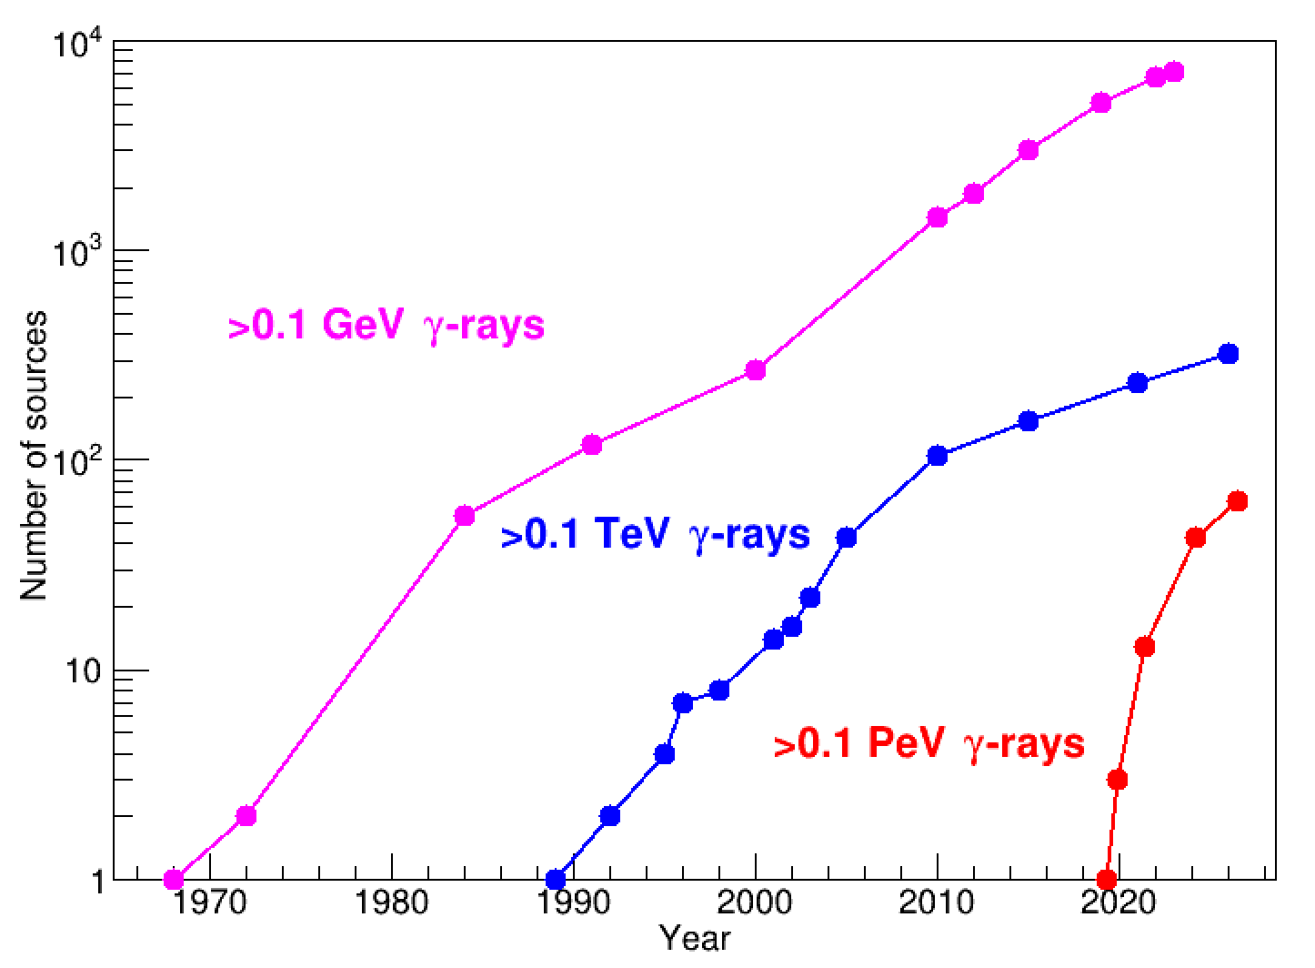
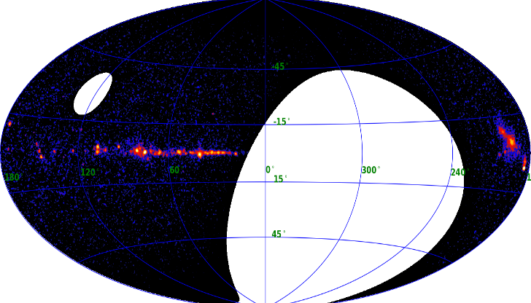
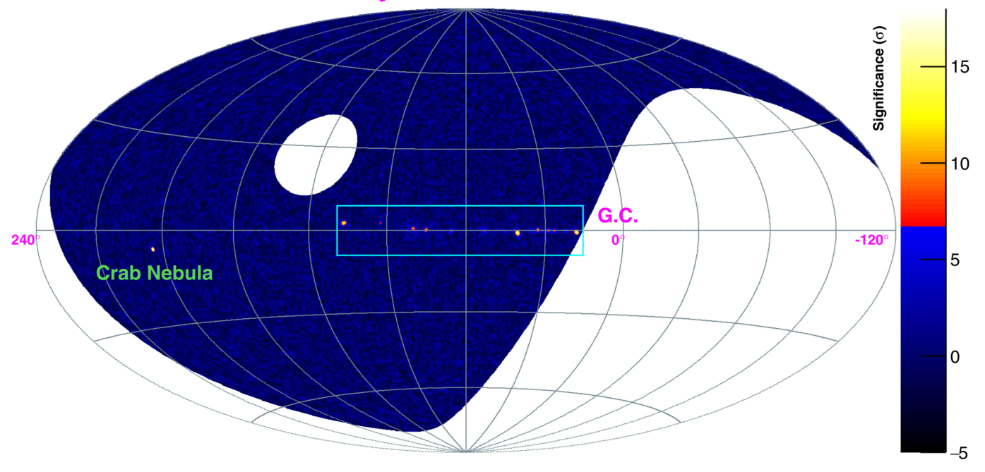
LHAASO Drives the Rapid Expansion of the UHE Gamma-Ray Source Population
5 years, full array
200 VHE sources
60 UHE sources
2 years, full array
90 VHE sources
43 UHE sources
11 month, 1/2 array
12 UHE sources (>7σ)
LHAASO coll. 2024
LHAASO coll. 2021

Slide 19
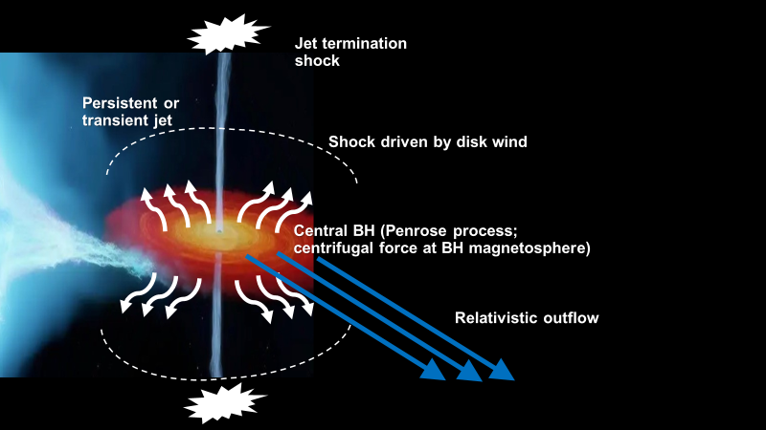
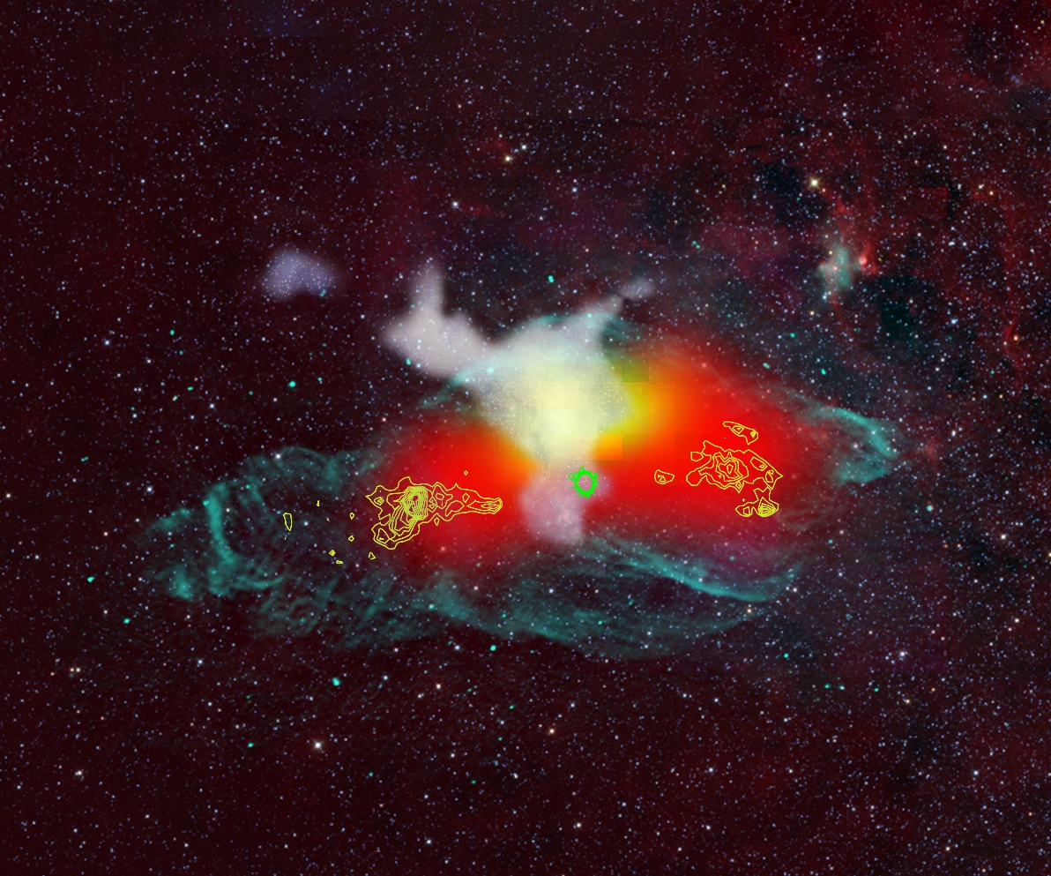
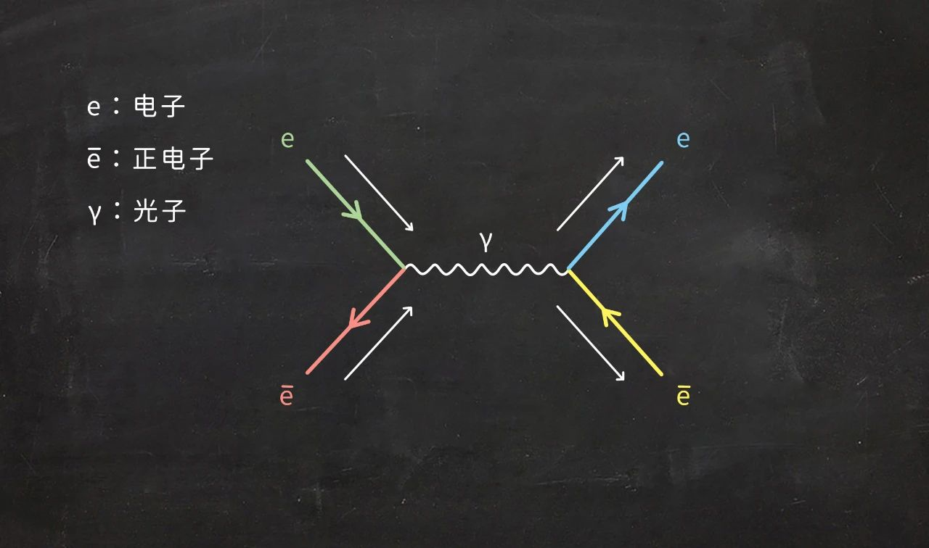
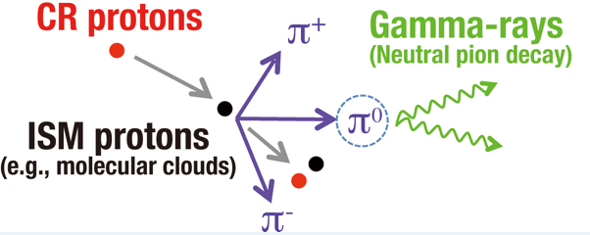
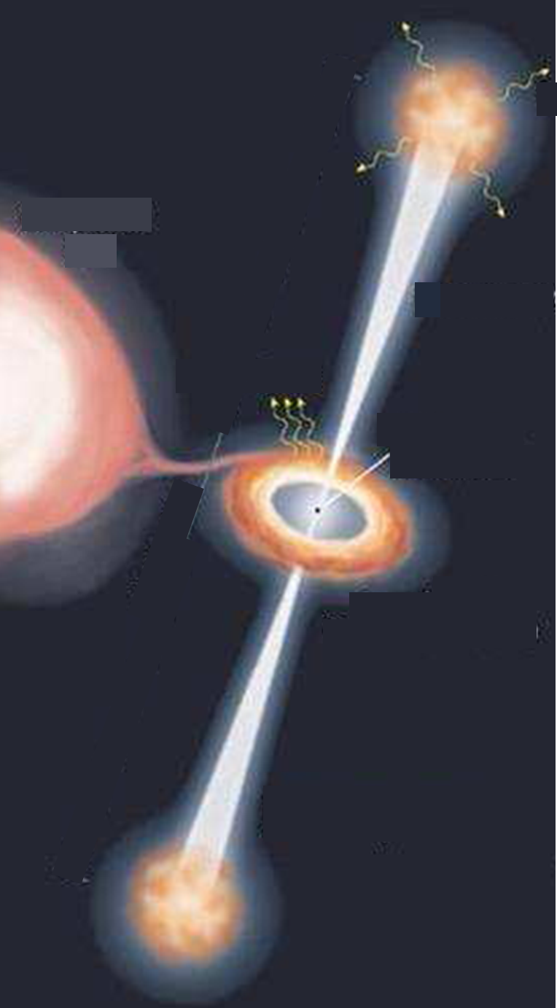
Micro quasars (black hole–companion star binaries)
LHAASO has identified six micro-quasars capable of accelerating particles to PeV energies.
Among them, SS 433 and Cygnus X-3 have been confirmed as PeV cosmic-ray sources.
The parent protons typically have energies about ten times those of the gamma rays.
UHE γ
CO cloud
SS433
PeV protons
TeV γ
SS433
  Distance: 4.6 kpc
  Primary: A black hole of 10–15 solar masses
  Companion: A white supergiant star
  Orbital period: 13.1 days

Slide 20
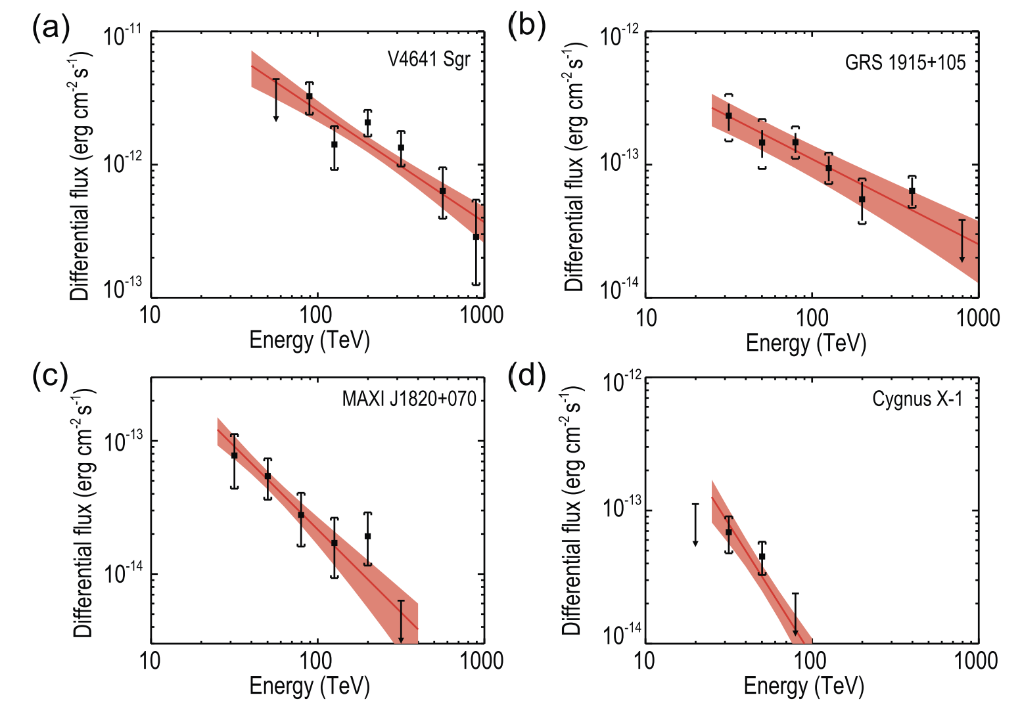
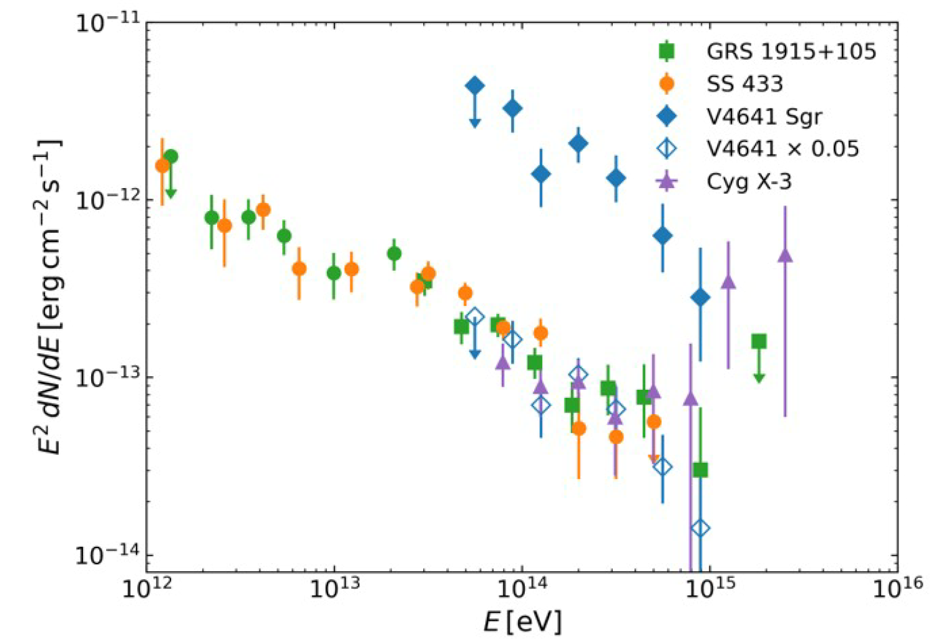
Micro quasars (black hole–companion star binaries)
Of the 12 microquasars within its field of view, LHAASO discovered six emitting ultra-high-energy gamma rays above 100 TeV, with the highest-energy photon reaching 3.7 PeV
  These observations indicate that micro-quasars can accelerate protons up to ~37 PeV;
  Roughly ten SS 433–like micro-quasars could account for the flux of the high-energy cosmic-ray component measured by LHAASO.
Cosmic Rays, SNRs and µ-Quasars in LHAASO’s View, Zhen Cao, 2026
LHAASO Coll., Natl Sci Rev, 2025
LHAASO Coll., Natl Sci Rev, 2026
Notes:
No significant break has yet been identified in the gamma-ray spectra due to limited statistics. As the proton and helium spectra break at ~3.3 PeV and ~7 PeV, respectively, more gamma-ray data are needed to search for corresponding spectral features.

Slide 21
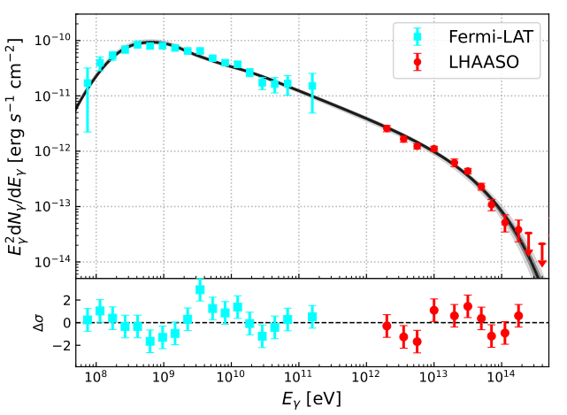
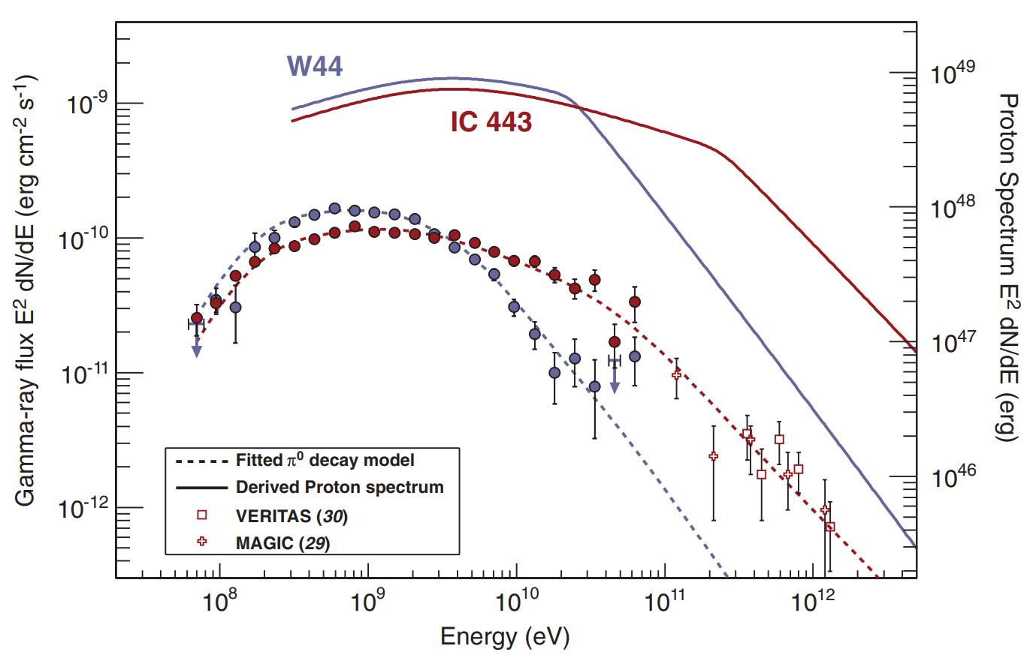


Can SNRs Accelerate Cosmic Rays to PeV and Beyond?
E_{p,cut}~100 GeV
E_{p,cut}~10 TeV
E_{p,cut}~400 TeV
Cas A
W51C
Fermi-LAT Coll. 2013
MAGIC coll. 2017
LHAASO coll. 2024
Notes:
Fermi-LAT在W44和IC 443等中年超新星遗迹中观测到低能端的“π⁰衰变隆起”特征，是质子或原子核与周围气体碰撞、产生中性π介子并衰变为伽马射线的直接证据。

Slide 22



Can SNRs Accelerate Cosmic Rays to PeV and Beyond?
Supernova remnants (SNRs) are undoubtedly important sources of Galactic cosmic rays, but they have not been observationally established as the dominant sources of cosmic rays around the “knee.”
1934: Baade and Zwicky first proposed that the energy released by supernova explosions could power Galactic cosmic rays.
SNRs such as W51, W44, IC 443, and Cassiopeia A can accelerate cosmic rays to very high energies.
However, the spectra of nearly all observed SNRs cut off at around 10 TeV or below.
IC 443
G150.3+4.7
Cas A

Slide 23





Micro-quasars are likely the dominant sources of new high-energy cosmic-ray component
2024： LHAASO released its first catalog of VHE and UHE gamma-ray sources
  based on two years of full-array observations
  contains 90 sources, including 43 UHE sources
The sources encompass nearly all major classes of high-energy astrophysical objects:
  Supernova remnants, Pulsars and pulsar wind nebulae, Massive star clusters, Gamma-ray binaries, Active galactic nuclei, Gamma-ray bursts
Crab
Nature, 594, 33-36, 2021
Science, 373,
425-430, 2021
LHAASO
开启了“超高能伽马天文学”新领域！
APJS，271:25 (26pp)，2024
PWN
SNR
YMC
Micro-quasars

Slide 24

Micro-quasars are likely the dominant sources of new high-energy cosmic-ray component
LHAASO
DAMPE
AMS
Supernova Remnants?
Micro-quasars ？

Slide 25
Outline
Introduction to the LHAASO experiment
LHAASO Highlights in Cosmic-Ray Measurements
LHAASO Highlights in Gamma-Ray Astronomy
Progress in Searches for Ultra-Relativistic Magnetic Monopoles with LHAASO
Summary & Outlook

Slide 26

Search for Ultra-Relativistic Magnetic Monopoles
with LHAASO-KM2A
Why LHAASO-KM2A?
Magnetic monopoles are topological relics predicted in theories beyond the Standard Model.
10⁵ ≤ γ ≤ 10⁷
Intermediate-mass monopoles in an ultra-relativistic region complementary to previous searches.
From S. D. Wick, T. W. Kephart, T. J. Weiler, and P. L. Biermann, Signatures for a cosmic flux of magnetic monopoles, Astroparticle Physics 18, 663 (2003).
Z. Zhang et al. (USTC) | Monopole search with LHAASO-KM2A
1
Notes:
Suggested narration (20–25 s): LHAASO-KM2A is being used to search for ultra-relativistic magnetic monopoles, targeting Lorentz factors from ten to the fifth to ten to the seventh. This intermediate-mass monopole search probes a region complementary to previous searches.
Source: PCC-MMsKM2A-2026xxxx.pdf, pp. 2, 6–7. Figure screenshot: p. 6, left panel. The comparison retains each experiment’s confidence-level label, including RICE at 95% C.L.

Slide 27

Distinctive signatures and a data-driven search
Muon-poor and Younger Showers
Much lower muon content at comparable electromagnetic shower size.
ED + MD arrays also probe young, penetrating shower development.
Muon-poor selection
↓
Background from adjacent data control regions
↓
6-variable MLP → profile-likelihood flux limit
Data templates avoid the sparse MC background tail.
Z. Zhang et al. (USTC) | Monopole search with LHAASO-KM2A
2
Notes:
Suggested narration (30–40 s): The key signature is a muon-poor, deeply penetrating air shower. The event displays compare a monopole with a proton shower at similar electromagnetic size; the monopole has far fewer muon-detector hits. KM2A combines its electromagnetic and muon arrays to exploit this difference. Because Monte Carlo statistics are sparse in the extreme muon-poor tail, the background is modeled using adjacent control regions in data. A six-variable MLP and a profile-likelihood fit then provide the flux limits.
Sources: PCC-MMsKM2A-2026xxxx.pdf, pp. 9, 12–13, 18–22 and results section. Screenshot: p. 9, right-hand event displays. Top: monopole, M=10^5 GeV, E=10^10 GeV; bottom: proton, E≈160 TeV. ED = electromagnetic detector; MD = muon detector.

Slide 28

Post-Fit Results
Z. Zhang et al. (USTC) | Monopole search with LHAASO-KM2A
3

Slide 29


First KM2A limits on ultra-relativistic monopoles
No significant excess
1438.81 days (~4 years) of KM2A data
20 Jul 2021 – 31 Jul 2025
Z. Zhang et al. (USTC) | Monopole search with LHAASO-KM2A
4
Notes:
Suggested narration (25–35 s): Using about four years of LHAASO-KM2A data, we performed a search for ultra-relativistic magnetic monopoles with Lorentz factors from ten to the fifth to ten to the seventh. No significant excess over the data-driven background prediction was observed. We set preliminary 90 percent confidence-level upper limits on the isotropic monopole flux, reaching 1.2 times ten to the minus eighteen and 8.1 times ten to the minus nineteen per square centimetre per second per steradian at gamma of ten to the sixth and ten to the seventh, respectively.
Sources: PCC-MMsKM2A-2026xxxx.pdf, pp. 27, 37–38. Figure screenshot: p. 37, flux-limit comparison. Original observed table is in units of 10^-19 cm^-2 s^-1 sr^-1: 973.2, 11.6, 8.1. The first number is rounded here to 9.73 × 10^-17. RICE is shown at 95% C.L.; other plotted experimental limits are at 90% C.L.

Slide 30


Monopole and Nuclear Detector At Tibet Elevation (MANDATE)
Synergy Between LHAASO and MANDATE
A MANDATE Pilot at the LHAASO Site
  LHAASO can provide key cosmic-ray shower information
    Shower-core resolution: ~2 m @ E>1PeV
    Angular resolution: ~0.25°@ E>1PeV
    Energy resolution: <10% @ E>1PeV
    Particle identification
      Proton, iron samples
      ~90% purity and ~30% selection efficiency
Installed on 13-May-2026

Slide 31
Summary & Outlook
LHAASO is a world-leading observatory for high-energy cosmic rays and gamma rays.
LHAASO has opened a new window onto ultra-high-energy gamma-ray astronomy, revealing at least 60 Galactic PeVatrons.
LHAASO has measured the proton and helium spectra around the cosmic-ray “knee” with space-experiment-level precision. The discovery of a new high-energy component has reshaped our understanding of the knee.
For the first time, LHAASO has identified micro-quasars (black hole–star binaries) as powerful Galactic PeVatrons and likely major sources of PeV cosmic rays.
Next Steps
  Precisely measure the iron spectrum and extend proton and helium measurements to higher energies.
  Conduct deep observations and wide-field surveys to discover more very-high and ultra-high energy gamma-ray sources.

Slide 32



Large Array of Cherenkov Telescopes（LACT）
LACT
  36 telescopes built on LHAASO site
  Angular resolution
    LACT: < 0.05° @ > 10 TeV
    LHAASO: ~0.2° @ > 100 TeV
  LHAASO MD array provides excellent γ/p discrimination
  To identify the gamma ray sources in PeVatrons and measure their morphology in details.
LACT Construction Timeline
  2025: Construction launched
  2026: Four telescopes completed
  2028: Full 36-telescope array completed
LACT at LHAASO site
SNR
32
PWN
LACT Expectations
L
H
A
A
S
O
SNR
PWN
Notes:
因此，我们提出了拉索提升计划，即LACT项目，角分辨比“拉索” 提升5倍以上，灵敏度和“拉索”相当
项目得到四川省委、省政府的大力支持，已获得了省发改委批复立项，项目预算是1.5亿，媲美欧美部署的耗资2亿欧元的同类项目（CTA）引起了全球高度关注；
拉索和LACT的分工是：拉索发现天体源，LACT将率先实现对“拉索” 发现的重要天体开展精细结构解析，把握突破性发现的重要机遇，“拉索” + LACT 进一步加固了我国在超高能伽马天文研究领域的领先地位。

Slide 33
Thanks !

Slide 35




Hybrid Detection of EAS
Cosmic Ray
H，He …
KM2A
Muon information
Relate to Xmax
WFCTA
Source
$$θ_{c}$$
e±，γ，μ，Č，…
Centroid
Notes:
宇宙线从外太空进入地球，首先和大气中的原子核发生多次碰撞，引发广延大气簇射，产生非常多的次级粒子，次级粒子中有正负电子、缪子、切伦科夫光等。KM2A测量的缪子信息是非常好的成分区分变量，望远镜测量的切伦科夫光像，像的质心和粒子方向的角距离，也是很好的成分鉴别变量。

Slide 36


A hardening feature is found bellow the knee.
The direct measurement results such as DAMPE, CALET, ISS-CREAM, further confirm the existence of the hardening before the knee.
<0.4PeV
0.4-3PeV
Notes:
Compared to the spectral index measurements around several tens of TeV obtained from direct measurements such as those by DAMPE, CALET, and ISS-CREAM, the existence of spectral hardening before the knee is further confirmed.

Slide 37


Helium energy spectrum measured by LHAASO in the knee region
H+He
The Helium energy spectra from
0.16 PeV to 13 PeV were measured
with high precision by LHAASO
Clear hardening emerges at
about 1.1 PeV
Knee: around 7 PeV
He
H
Double broken power law：

Slide 38
All-particle knee is dominate by the proton knee
All particle
  Knee: ~3.67 PeV
  γ1 = -2.74±0.005
  γ2 = -3.13±0.005
Proton
  Knee: ~3.3 PeV
  γ2 = −2.51±0.03
  γ3 = −3.5±0.2
The all-particle knee is dominate by the proton knee
Notes:
LHAASO has accurately measured all particle energy spectrum and composition around the knee.
From the correlation between the all particle energy spectrum and mean logarithm mass at the knee, the knee is contributed by the light component.
You can see here, the proton knee and the all particle knee. The all particle knee is dominate by the proton knee.

Slide 39
Wideband spectrum of proton and helium
The abundance of protons overtake helium again at around 0.7 PeV
The H/He ratio crosses unity twice within the energy range of 0.16–13 PeV.
  The crossing at 0.7 PeV shows that protons once again become the dominant component of cosmic rays, which is somewhat unexpected given the significant hardening of the helium spectrum previously observed in space-based measurements.
  A second crossing occurs at E ∼5 PeV, where the helium flux exceeds the proton flux once more
H/He
LHAASO Collaboration, Phys. Rev. Lett. 136, 121001 (2026)
DOI: https://doi.org/10.1103/d838-49gt

Slide 40

Wideband spectrum of proton and helium
The knee reflects the maximum acceleration energy of the sources
and shows a rigidity dependence.
The hardening of the proton spectrum occurs around 0.1 PeV, while the hardening for helium occurs around 1.1 PeV, and these hardening features do not exhibit rigidity dependence. This may be related to the superposition of multiple source classes with differing acceleration powers.

Slide 41


A joint analysis by LHAASO and DUMPE
To understand the absolute energy scale of cosmic rays, a joint analysis by LHAASO and DUMPE is in progress and is expected to be completed by the end of this year.

Slide 42





Helium
Proton
DAMPE (2019)
DAMPE (2021)
Bump：~13.6 TeV for Proton and
~34.4 TeV for Helium
Charge Z dependent？
  The ratio of Proton bump and Helium bump is 2.5 ± 0.8
Iron spectra from 100 TeV to several PeVs will be measured by LHAASO and can answer the question clearly.
Six telescopes are pointed at a zenith angle of 8° to lower the energy threshold of KM2A and WFCTA.
588
6877
LHAASO iron spectra expectation
42
Notes:
We also plan to measure the iron spectrum from 100 TeV to several PeVs, which can answer the question raised by Dump experiment:
whether the bumps of proton and helium below 100TeV depends on Charge Z.

Slide 43
Helium energy spectrum measured by LHAASO in the knee region
H+He
The Helium energy spectra from
0.16 PeV to 13 PeV were measured
with high precision by LHAASO
Clear hardening emerges at
about 1.1 PeV
Knee: around 7 PeV
He
H
Double broken power law：

Slide 44



Eq. 3：Two broken power laws
Proton （EPOS）
E_{h} = 365 ± 20
E_{k} = 3.2±0.3
γ1 = −2.67± 0.01
γ2 = −2.51±0.02
γ3 = −3.5±0.1
χ²/n.d.f. = 9.9/11
Eq. 3
Preliminary
Eq. 4：A broken power law + an exponential cutoff
Eq. 4
E_{h} = 436 ± 22
E_{cut} = 5.1 ± 0.3
γ1 = −2.66 ± 0.02
γ2 = −2.29 ± 0.05
χ²/n.d.f. = 27.1/13
Eq. 3：
Eq. 4：
Notes:
the entire spectrum does not follow a simple ‘knee’ shape feature.

Slide 45






Gamma rays vs. Cosmic rays
Active Area for Muons vs. Array Area: 4%
~1 PeV CR event: many muons
~ 1 PeV γ–ray event ：very few muons
from the Crab
Area：
1.3 km²
Detectors：
5216 ED
1188 MD
Energy Range：
0.01-10 PeV
Notes:
Muon detectors play a crucial role in identifying gamma rays and cosmic rays. This is an example of 1 PeV cosmic ray event. The circle represents the muon, you can see a large number of muons in this event. In contrast, the 1 PeV gamma ray events from Crab measured by LHAASO showed only a few muons.

