Slide 1
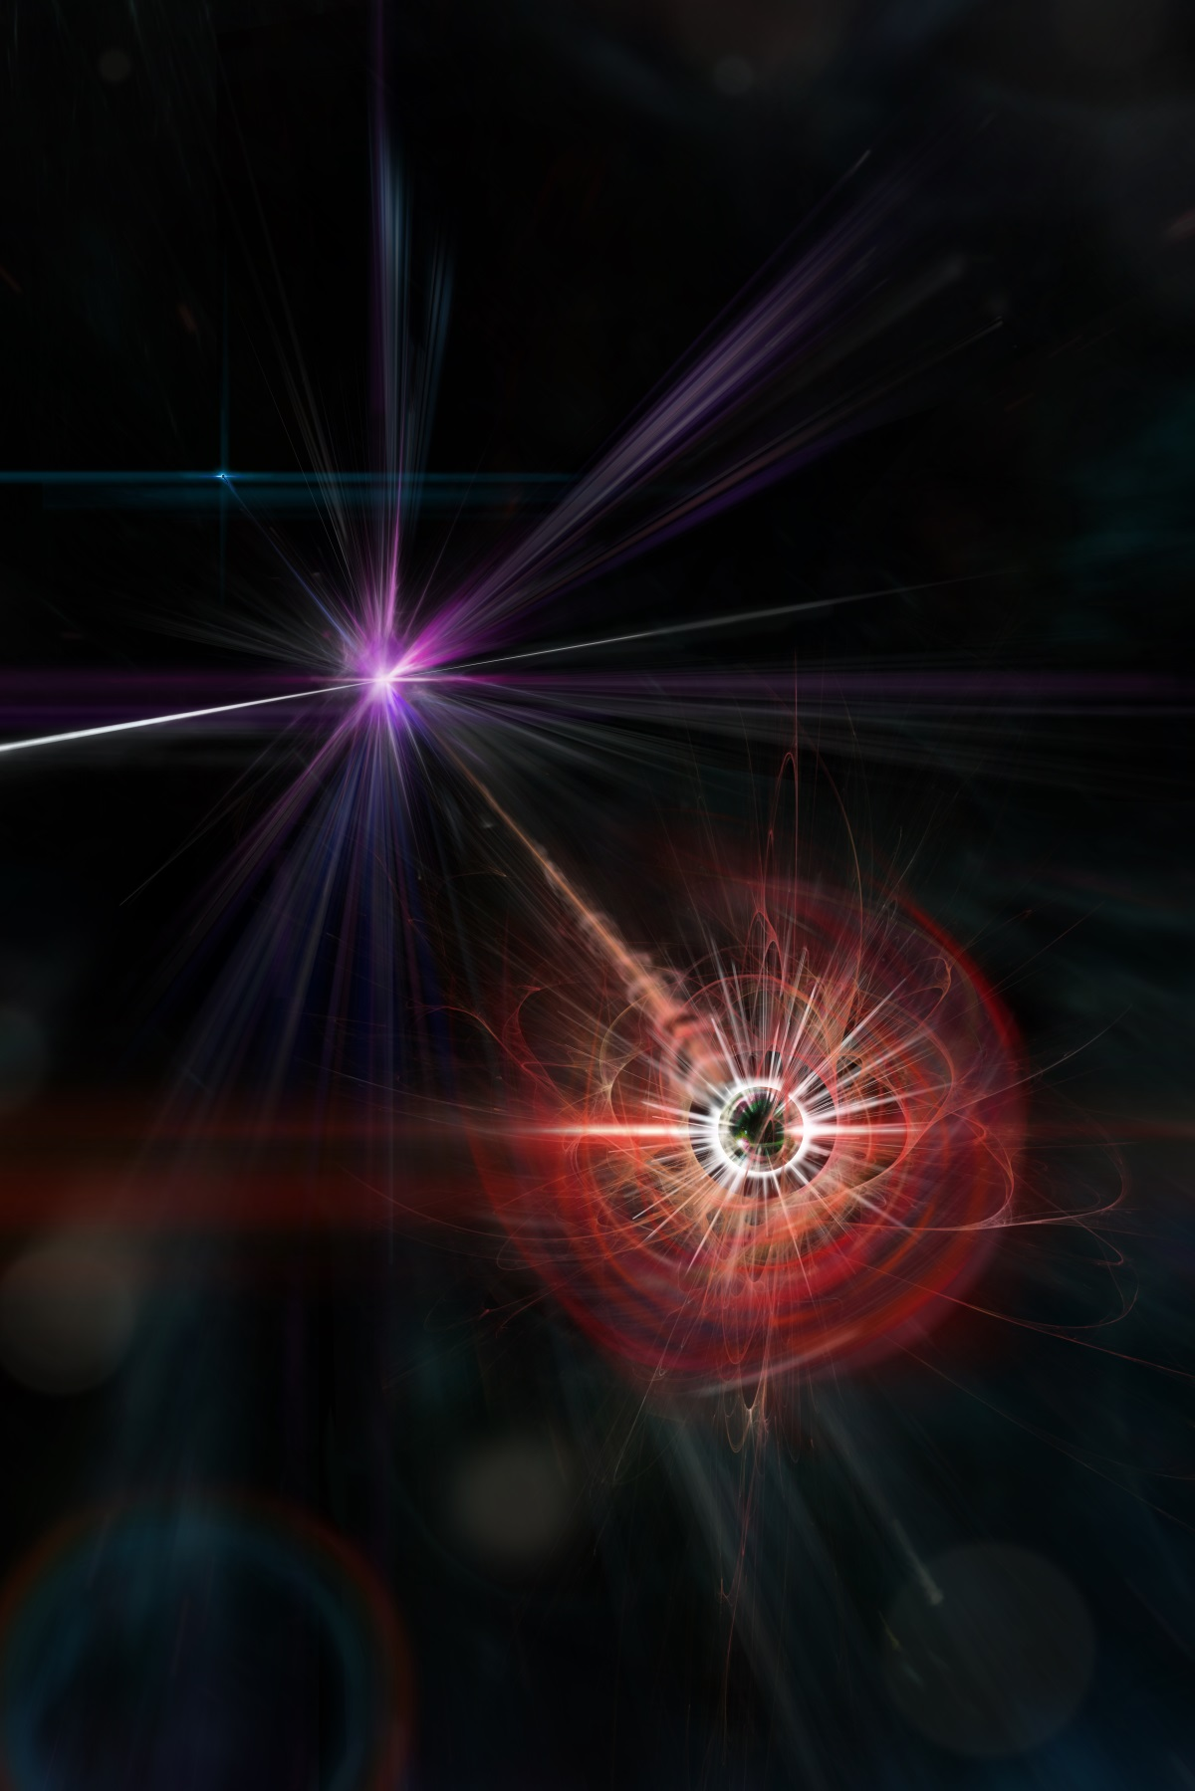

Monopole production by dual Schwinger process
Arttu Rajantie
Next Frontiers in Magnetic Monopole Searches,
Beijing, China, 14 September 2026

Slide 2
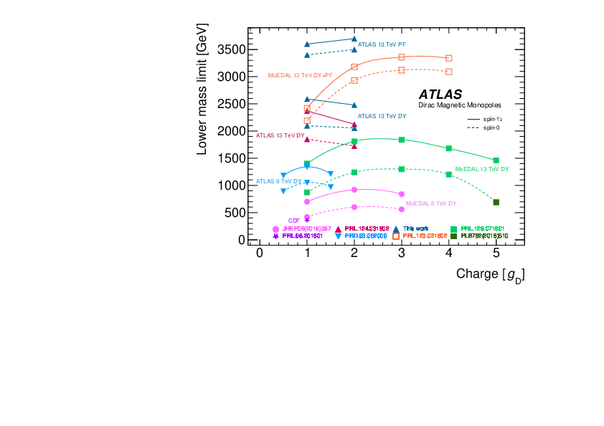
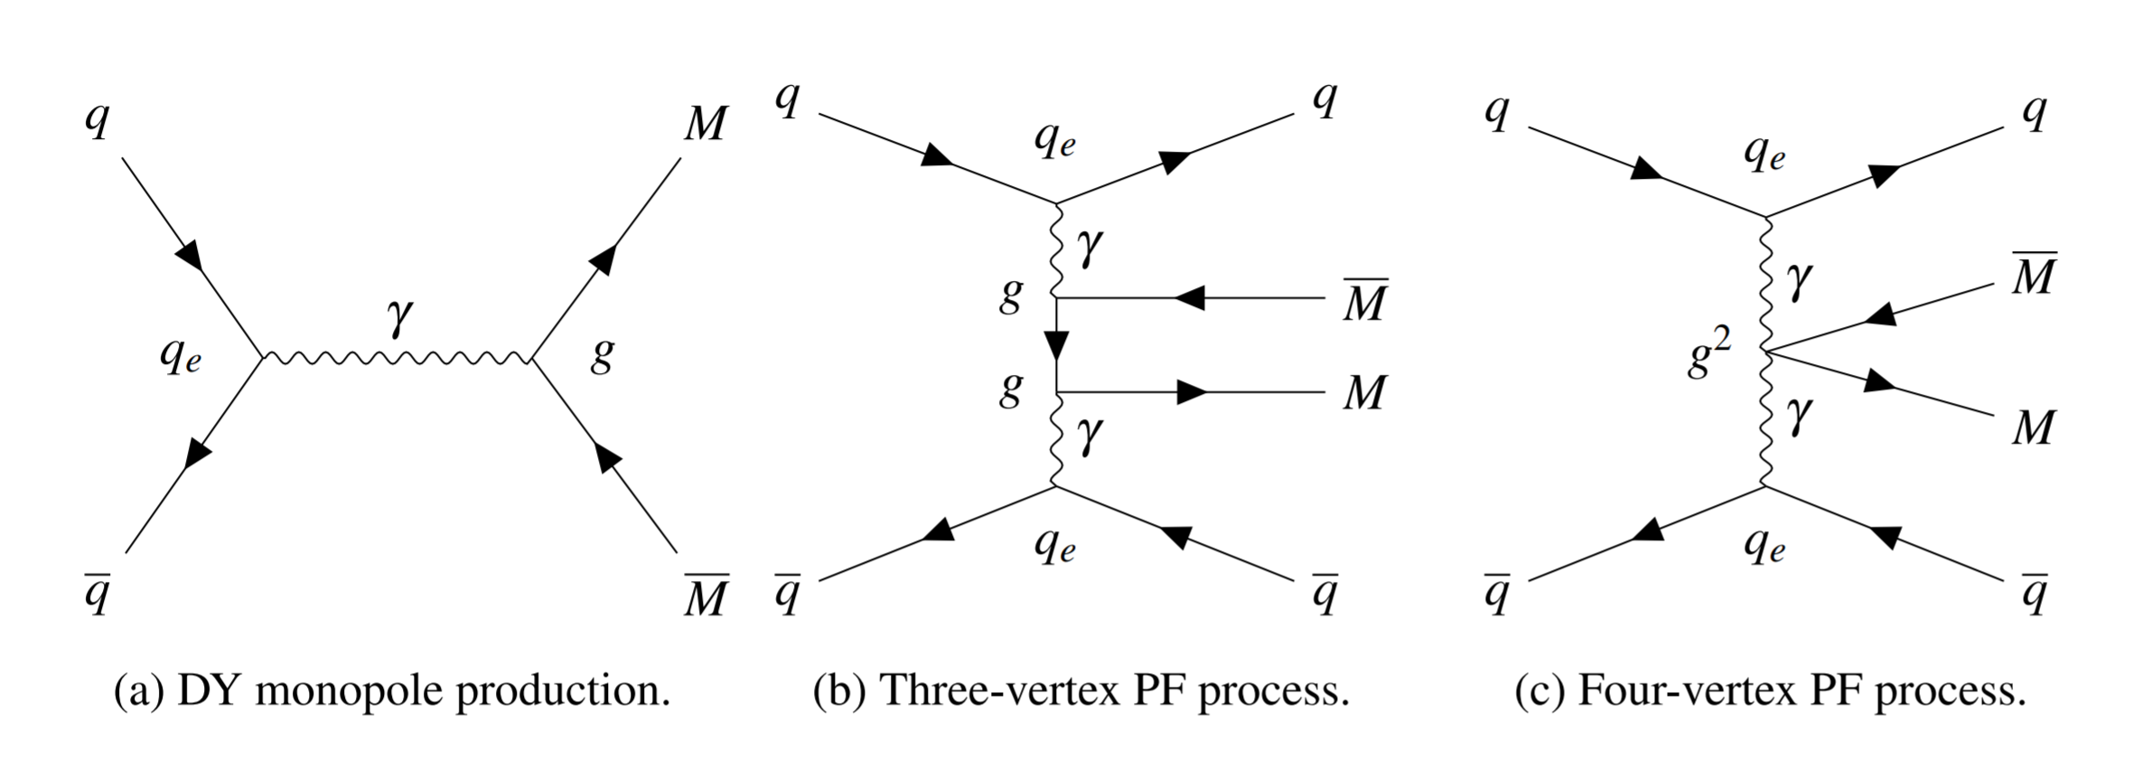


Monopole Searches in $pp$ Collisions
Nominal mass bound $M≳3 TeV$
Based on tree-level
Drell-Yan/photon fusion processes
But perturbation theory is not valid
because $g_{D}=2π/e≈20.7≫1$
(ATLAS Collaboration, 2023)

Slide 3

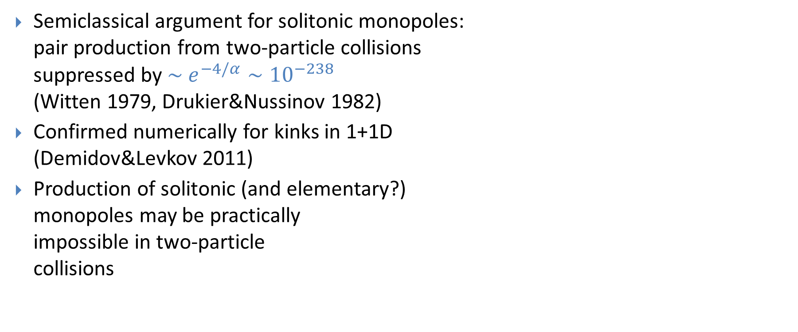
Exponential Suppression
Semiclassical argument for solitonic monopoles:
pair production from two-particle collisions
suppressed by $\sim e^{−4/α}∼{10}^{−238}$
(Witten 1979, Drukier&Nussinov 1982)
Confirmed numerically for kinks in 1+1D
(Demidov&Levkov 2011)
Production of solitonic (and elementary?)
monopoles may be practically
impossible in two-particle
collisions

Slide 4
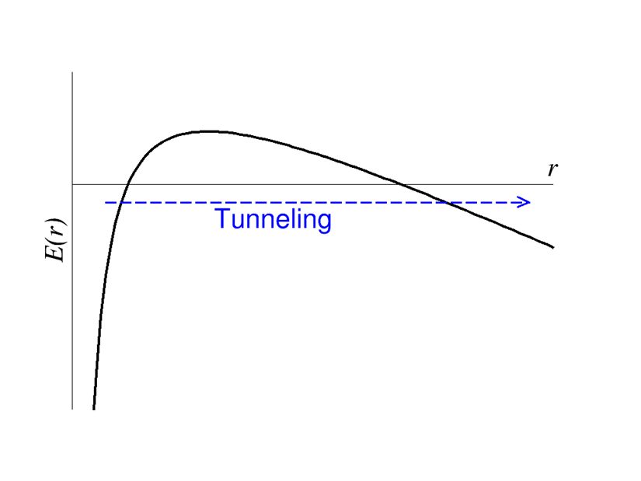


Schwinger Pair Production
Consider instead pair production from a strong magnetic field
Electromagnetic dual to usual Schwinger pair production:
(Sauter 1931, Heisenberg&Euler 1936, Schwinger 1951)
Tunneling through Coulomb potential barrier
No direct experimental
confirmation yet:
  $e^{+}e^{−}$ pairs need
  $\left|\vec{E}\right|≫\frac{m^{2}}{e}∼{10}^{18} V/m$
  1000 x stronger than the
  most powerful lasers
$$E\left(r\right)=2m−\frac{e^{2}}{4πr}−e\vec{E}⋅\vec{r}$$

Slide 5
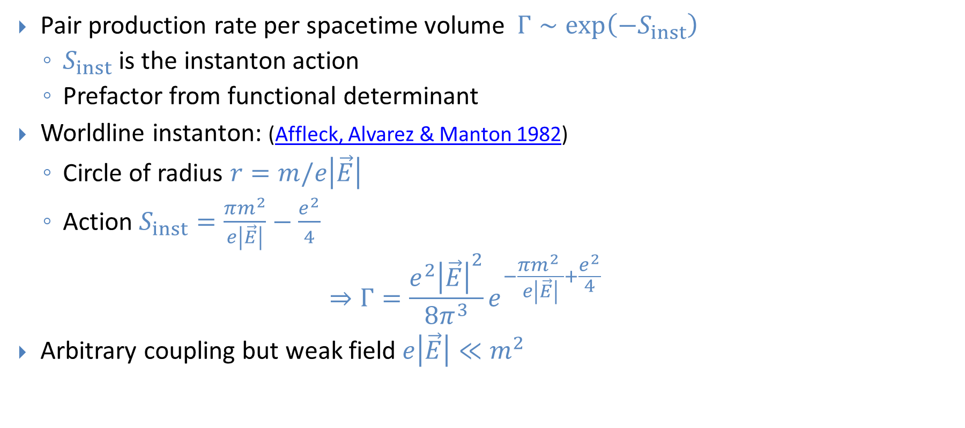


Schwinger Rate in Constant Field
Pair production rate per spacetime volume $Γ∼\exp\left(−S_{inst}\right)$
  $S_{inst}$ is the instanton action
  Prefactor from functional determinant
Worldline instanton: (Affleck, Alvarez & Manton 1982)
  Circle of radius $r=m/e\left|\vec{E}\right|$
  Action $S_{inst}=\frac{πm^{2}}{e\left|\vec{E}\right|}−\frac{e^{2}}{4}$
  $$⇒Γ=\frac{e^{2}{\left|\vec{E}\right|}^{2}}{8π^{3}}e^{−\frac{πm^{2} }{e\left|\vec{E}\right|}+\frac{e^{2}}{4}}$$
Arbitrary coupling but weak field $e\left|\vec{E}\right|≪m^{2}$
$$−$$
$$+$$

Slide 6


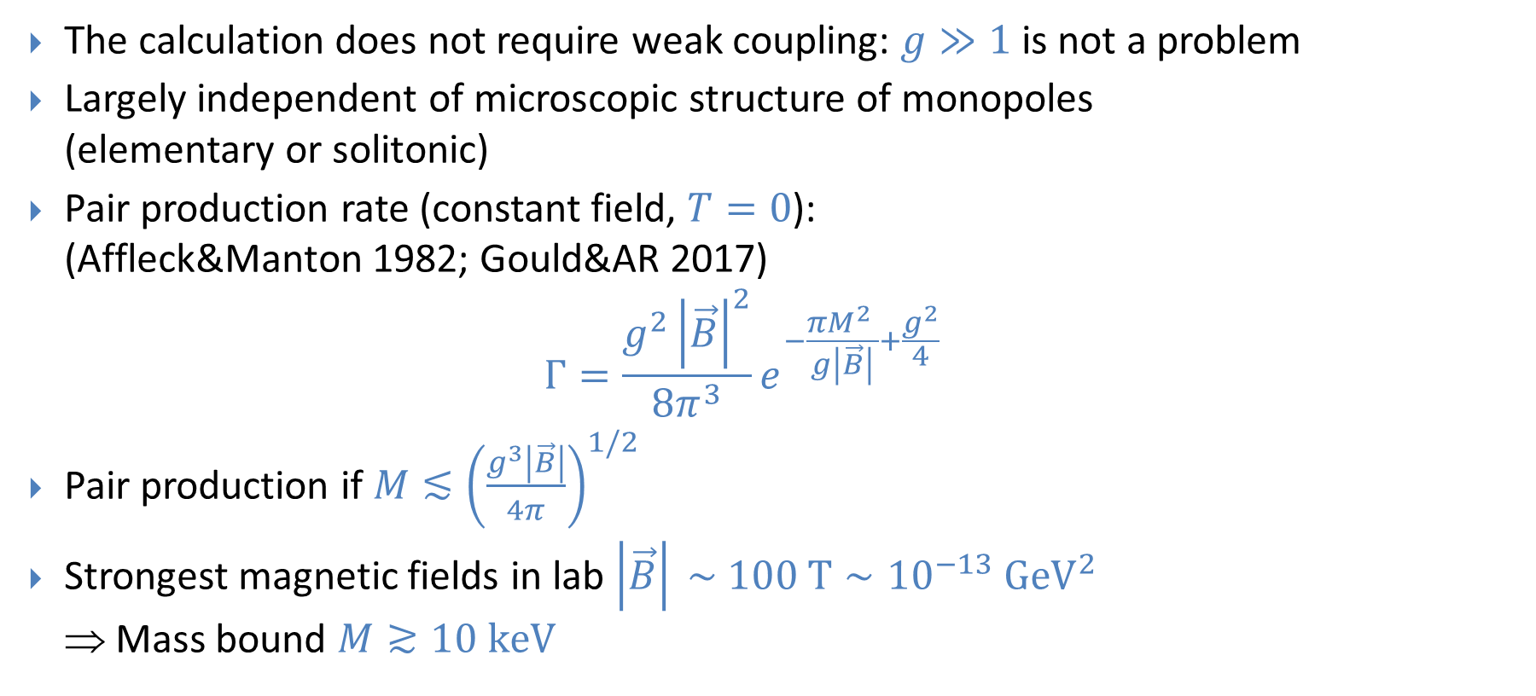
Monopoles from Schwinger Process
The calculation does not require weak coupling: $g≫1$ is not a problem
Largely independent of microscopic structure of monopoles
(elementary or solitonic)
Pair production rate (constant field, $T=0$):
(Affleck&Manton 1982; Gould&AR 2017)
$Γ=\frac{g^{2}{\left|\vec{B}\right|}^{2}}{8π^{3}}e^{−\frac{πM^{2} }{g\left|\vec{B}\right|}+\frac{g^{2}}{4}}$
Pair production if $M≲{\left(\frac{g^{3}\left|\vec{B}\right|}{4π}\right)}^{1/2}$
Strongest magnetic fields in lab $\left|\vec{B}\right| \sim 100 T∼{10}^{−13} GeV^{2}$
⇒ Mass bound $M≳10 keV$
$$N$$
$$S$$

Slide 7
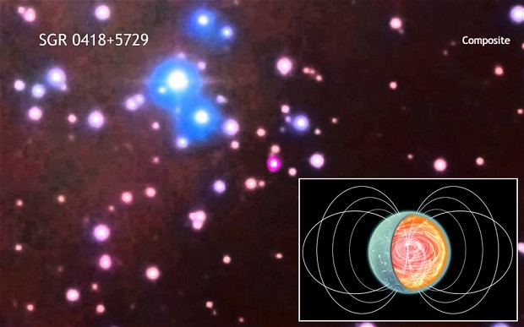

Magnetars
Neutron stars with very strong magnetic fields
Exterior: $B \sim {10}^{11} T≈{10}^{−4} GeV^{2}$
  Monopole pair production would
  make the field decay
  Bound
  $M≳0.3 GeV, g=g_{D}$
  $M≳0.7 GeV, g={2g}_{D}$
  (Gould&AR 2017)
Interior: $B \sim {10}^{13} T$ ?
  Monopoles production would
  lead to field fluctuations
  (Klyuev 2024)

Slide 8
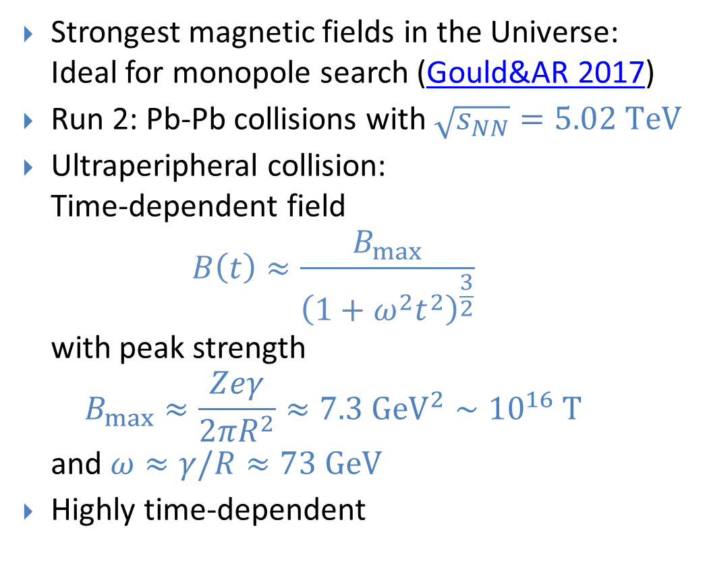
LHC Heavy Ion Collisions
Strongest magnetic fields in the Universe:
Ideal for monopole search (Gould&AR 2017)
Run 2: Pb-Pb collisions with $\sqrt{s_{NN}}=5.02 TeV$
Ultraperipheral collision:
Time-dependent field
$B\left(t\right)≈\frac{B_{max}}{{\left(1+ω^{2}t^{2}\right)}^{\frac{3}{2}}}$
with peak strength
$B_{max}≈\frac{Zeγ}{2πR^{2}}≈7.3 GeV^{2}∼{10}^{16} T$
and $ω≈γ/R≈73 GeV$
Highly time-dependent

Slide 9
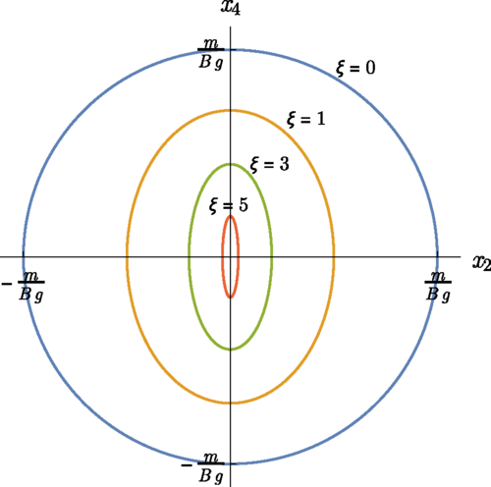
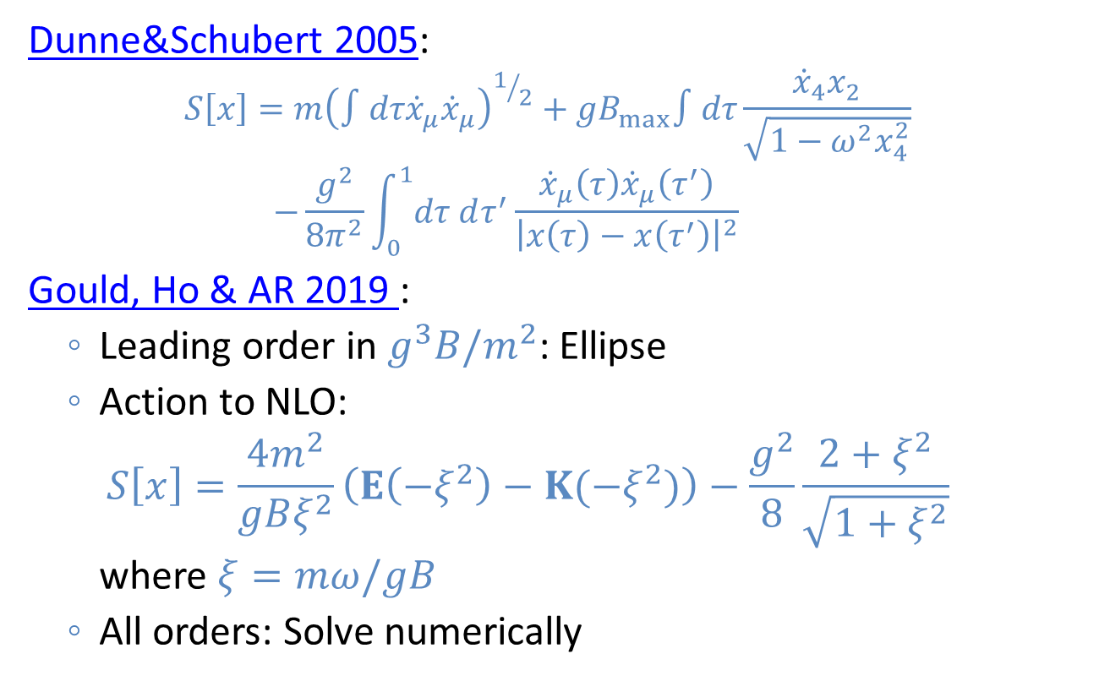
Worldline Instanton
Dunne&Schubert 2005:
$$S\left[x\right]=m{\left(∫dτ{\dot{x}}_{μ}{\dot{x}}_{μ}\right)}^{1/2}+gB_{max}∫dτ\frac{{\dot{x}}_{4}x_{2}}{\sqrt{1−ω^{2}x_{4}^{2}}} \\ −\frac{g^{2}}{8π^{2}}\int_{0}^{1}{dτ dτ^{′}}\frac{{\dot{x}}_{μ}\left(τ\right){\dot{x}}_{μ}\left(τ^{′}\right)}{{\left|x\left(τ\right)−x\left(τ^{′}\right)\right|}^{2}}$$
Gould, Ho & AR 2019 :
  Leading order in $g^{3}B/m^{2}$: Ellipse
  Action to NLO:
  $S\left[x\right]=\frac{4m^{2}}{gBξ^{2}}\left(E\left(−ξ^{2}\right)−K(−ξ^{2})\right)−\frac{g^{2}}{8}\frac{2+ξ^{2}}{\sqrt{1+ξ^{2}}}$
  where $ξ=mω/gB$
  All orders: Solve numerically

Slide 10
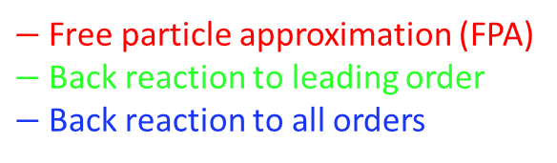



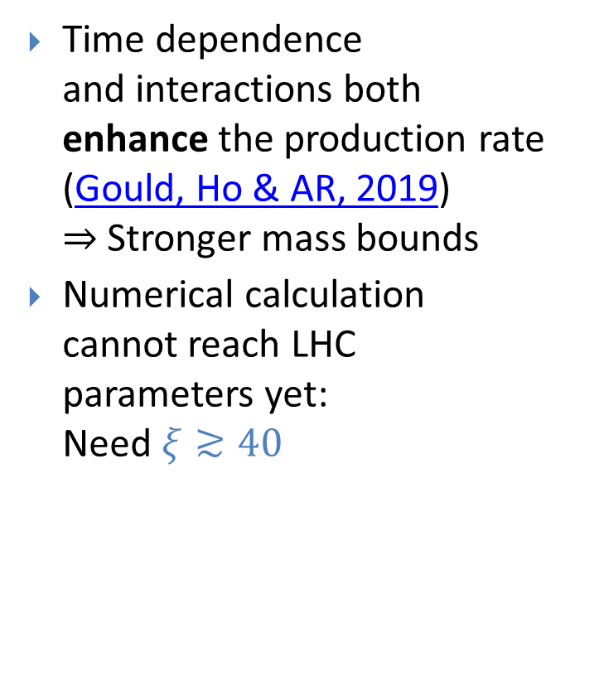
Time Dependence
Time dependence
and interactions both
enhance the production rate
(Gould, Ho & AR, 2019)
$⇒$ Stronger mass bounds
Numerical calculation
cannot reach LHC
parameters yet:
Need $ξ≳40$
$$Γ∼exp(−S)$$
Self-interactions:
None
Leading order
All orders
$−$Free particle approximation (FPA)
$−$Back reaction to leading order
$−$Back reaction to all orders
$$ξ≈M/(2nGeV)$$
$$=\frac{Mω}{gB}$$

Slide 11
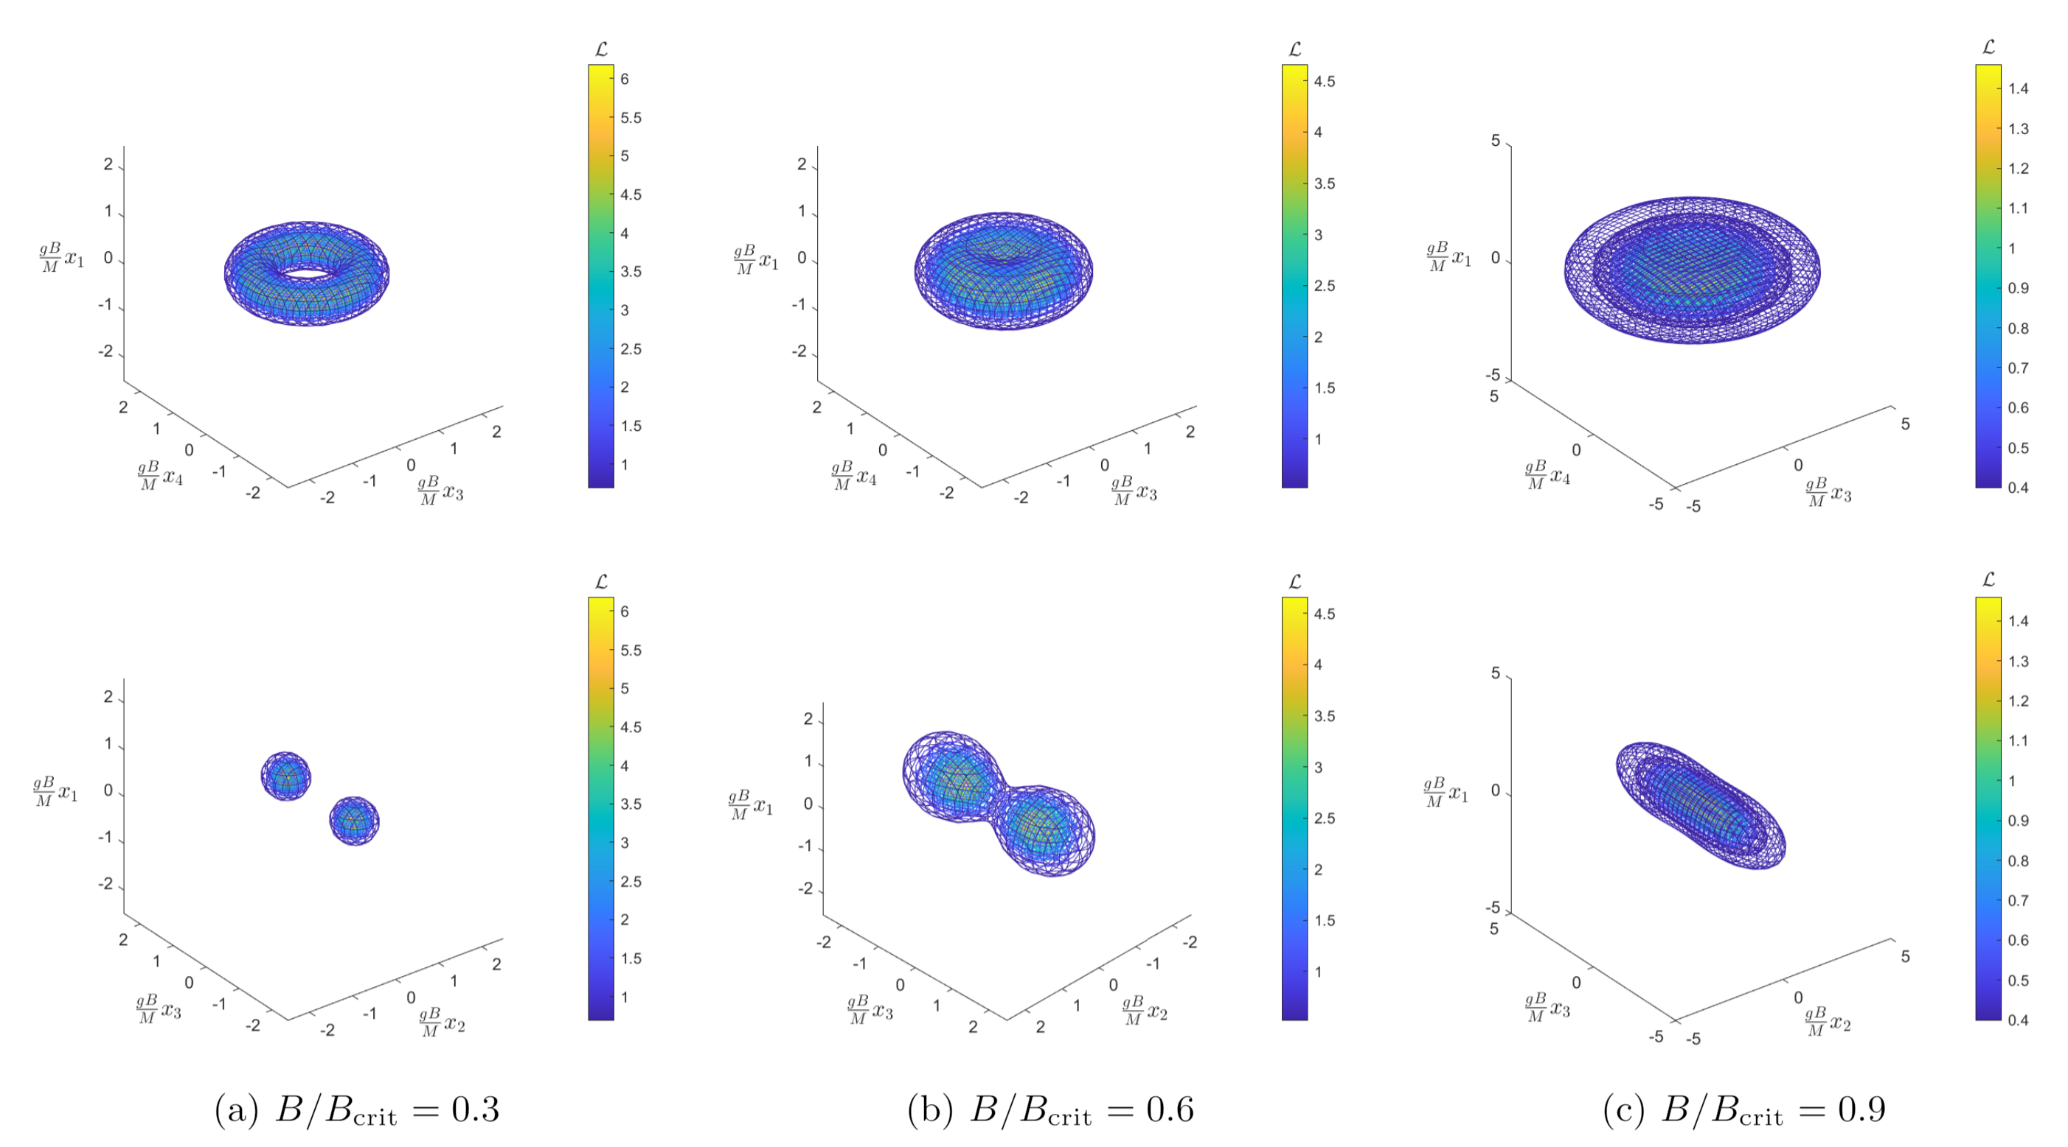

Effect of Monopole Size
4D field theory
instanton solution
(Ho&AR 2021)
Georgi-Glashow model:
SU(2)+adjoint scalar
Action determines the
quantum Schwinger rate
$Γ∝\exp\left(−S_{inst}\right)$
(Ho and AR, 2021)

Slide 12
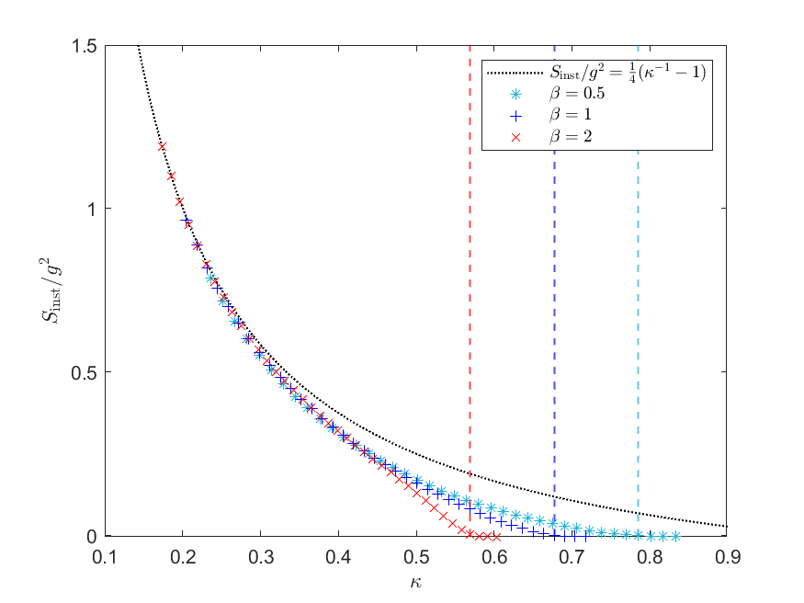



Effect of Monopole Size
$$β=m_{s}/m_{v}$$
4D field theory
instanton solution
(Ho&AR 2021)
Georgi-Glashow model:
SU(2)+adjoint scalar
Action determines the
quantum Schwinger rate
$Γ∝\exp\left(−S_{inst}\right)$
  Enhanced by nonzero size
  Becomes unsuppressed at
  critical field $B_{crit}=m_{v}^{2}/e$
$$=g^{3}B/4πM^{2}$$
(Ho and AR, 2021)

Slide 13
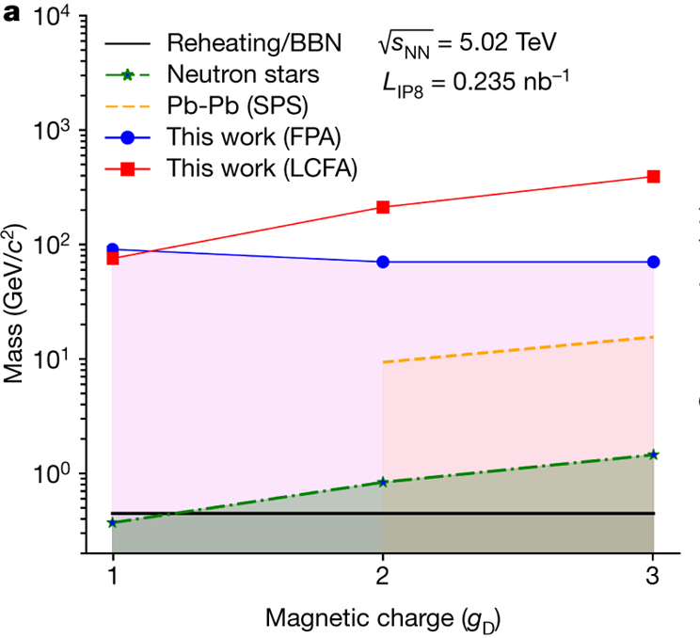
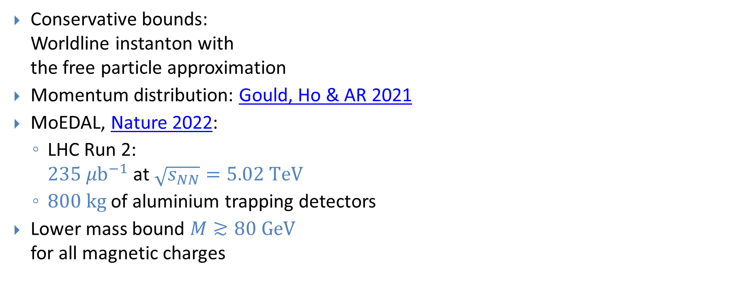
MoEDAL Monopole Searches
Conservative bounds:
Worldline instanton with
the free particle approximation
Momentum distribution: Gould, Ho & AR 2021
MoEDAL, Nature 2022:
  LHC Run 2:
  $235 μb^{−1}$ at $\sqrt{s_{NN}}=5.02 TeV$
  $800 kg$of aluminium trapping detectors
Lower mass bound $M≳80 GeV$
for all magnetic charges
(MoEDAL Collaboration, Nature 2022)

Slide 14
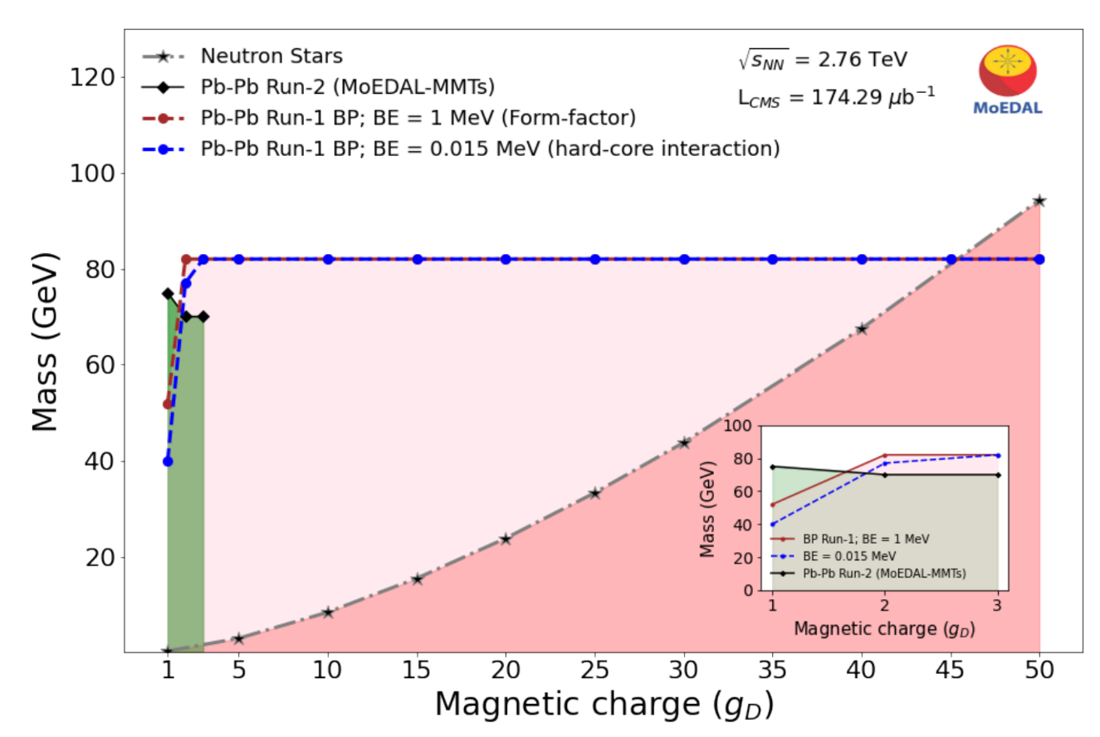
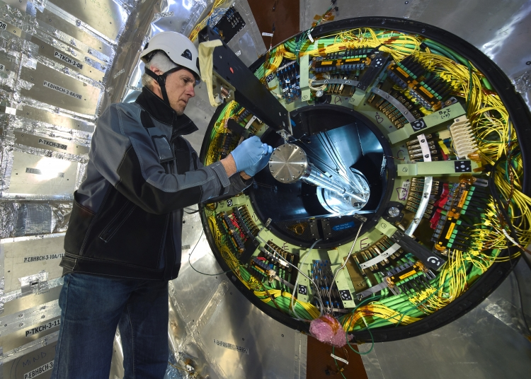

MoEDAL Monopole Searches
MoEDAL, PRL 2024
  CMS beam pipe from LHC Run 1:
  $174.29 μb^{−1}$ at $\sqrt{s_{NN}}=2.76 TeV$
Lower mass bound $M≳80 GeV$
for all magnetic charges
(MoEDAL Collaboration, PRL 2024)

Slide 15
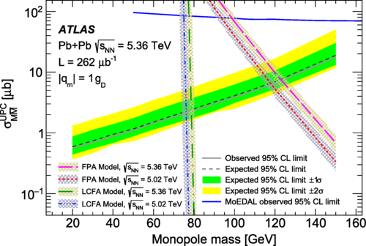

Other LHC Experiments
ATLAS (PRL 2025):
  LHC Run 3:
  $262μb^{−1}$ at $\sqrt{s_{NN}}=5.36 TeV$
  High ionisation signal
  in the ATLAS pixel detector
  No events:
  Mass bound $M>120 GeV$
  for $g=1g_{D}$
  with free-particle approximation
ALICE: See talk by M. Arslandok

Slide 16
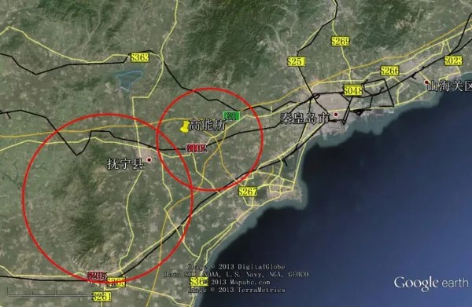
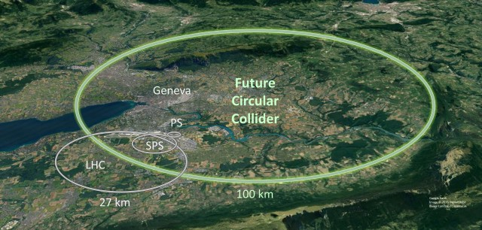

Future Prospects
Peak field strength $B≈\frac{Zeγ}{2πR^{2}}$ and $ω≈\frac{γ}{R}$
scales with collision energy
Free-particle approximation:
Reach masses $M∼\frac{\sqrt{s_{NN}}}{50}$
SPPC/FCC-hh : $\sqrt{s_{NN}}∼100 TeV$
$⇒$ $M∼2 TeV$ (EW monopoles?)
(see Gould et al. 2025)

Slide 17
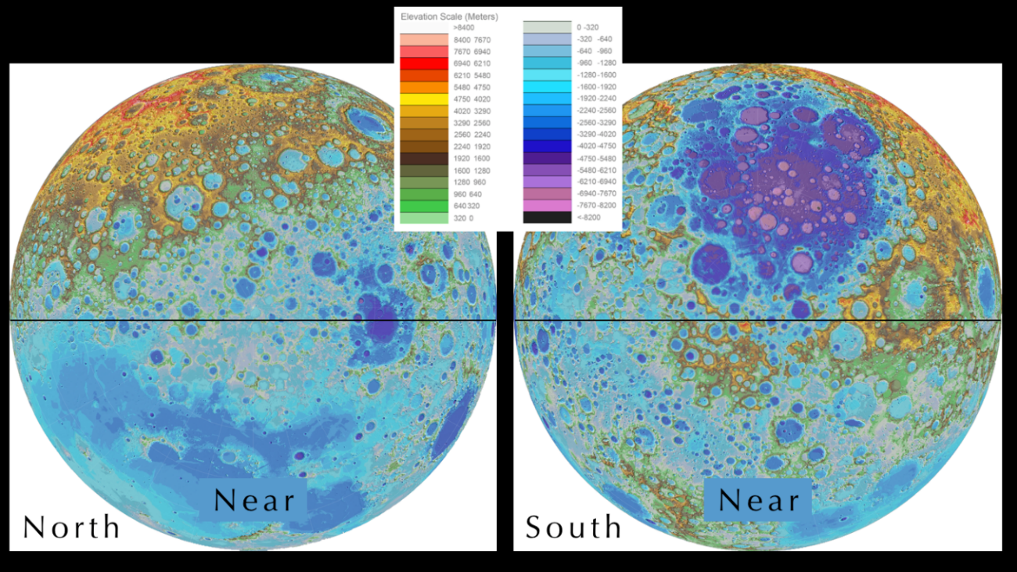
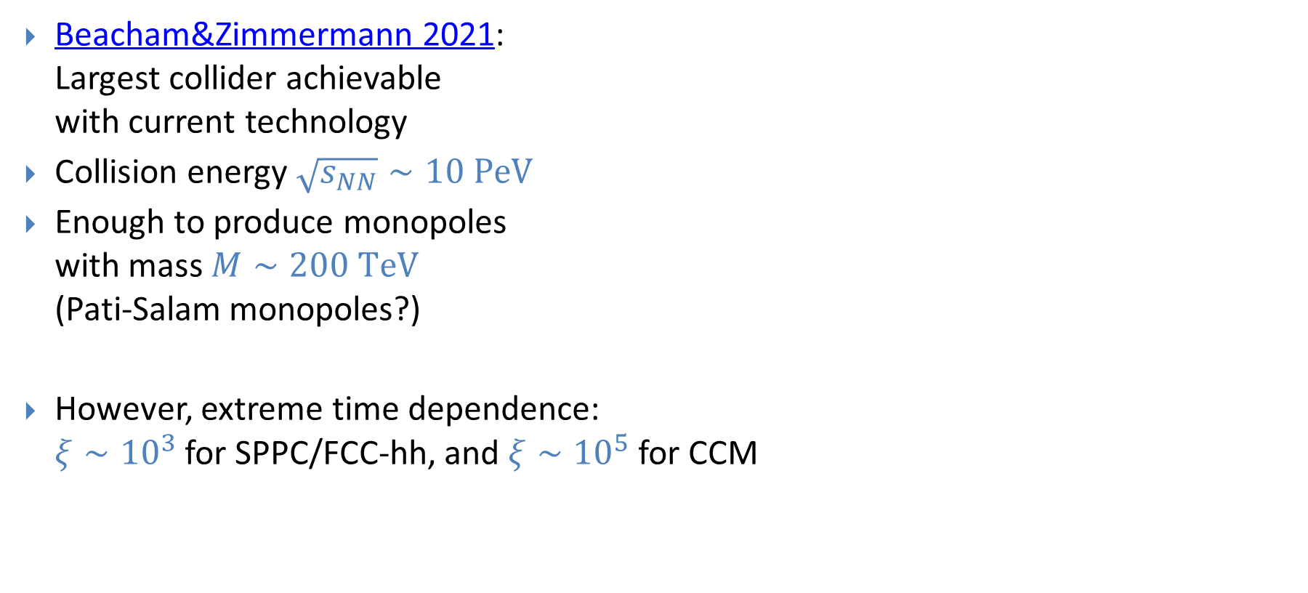
Circular Collider on the Moon
Beacham&Zimmermann 2021:
Largest collider achievable
with current technology
Collision energy $\sqrt{s_{NN}}∼10 PeV$
Enough to produce monopoles
with mass $M∼200 TeV$
(Pati-Salam monopoles?)
However, extreme time dependence:
$ξ∼{10}^{3}$ for SPPC/FCC-hh, and $ξ∼{10}^{5}$ for CCM

Slide 18



Classical Field Theory Simulations
Classical $SU\left(2\right)$ + adjoint Higgs theory
  Gaussian fluctuations with the same two-point correlator as the quantum vacuum
  Two planar Gaussian electromagnetic wave packets travelling in opposite directions (actually 2 positive + 2 negative to have zero net flux)
Collision:
  Electric fields cancel, magnetic fields add up
  $⇒$ Schwinger process
$$\vec{B}$$
$$\vec{E}$$

Slide 19
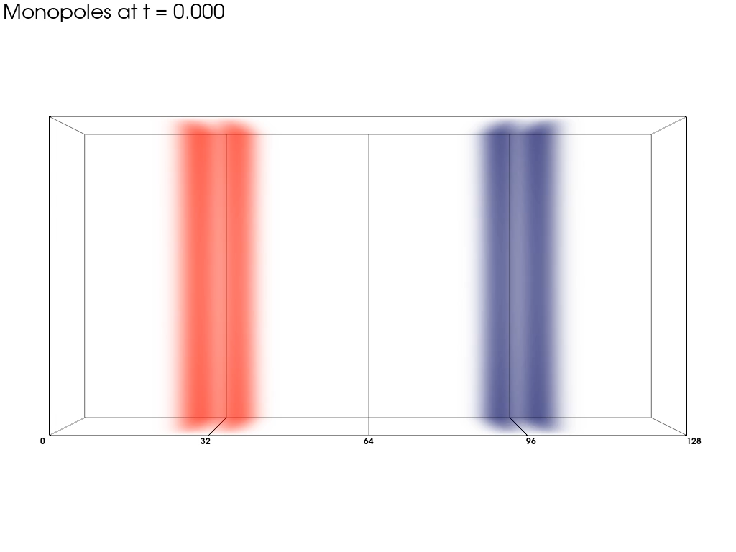


$512×16×64$ lattice, $Δx=0.25$, $Δt=0.025$
$g_{SU\left(2\right)}=0.6, λ=0.1, m=1.0$
$⇒$monopole mass $M≈66$
$ω=2.5, B_{max}=9.2, ξ≈0.87$
$$B_{z}$$

Slide 20
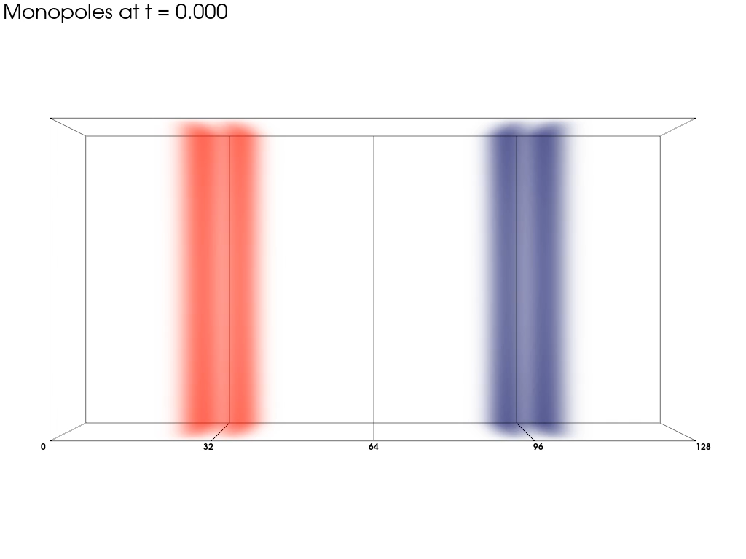
$512×16×64$ lattice, $Δx=0.25$, $Δt=0.025$
$g_{SU\left(2\right)}=0.6, λ=0.1, m=1.0$
$⇒$monopole mass $M≈66$
$ω=2.5, B_{max}=9.2, ξ≈0.87$
$$B_{z}$$

Slide 21
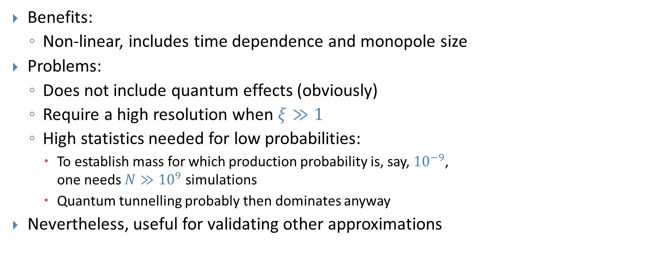
Classical Simulations
Benefits:
  Non-linear, includes time dependence and monopole size
Problems:
  Does not include quantum effects (obviously)
  Require a high resolution when $ξ≫1$
  High statistics needed for low probabilities:
    To establish mass for which production probability is, say, ${10}^{−9}$,
    one needs $N≫{10}^{9}$ simulations
    Quantum tunnelling probably then dominates anyway
Nevertheless, useful for validating other approximations

Slide 22
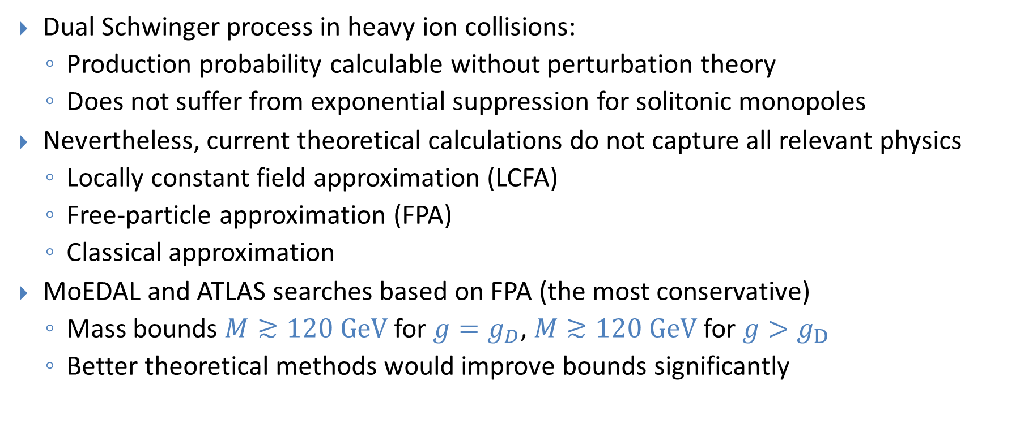
Summary
Dual Schwinger process in heavy ion collisions:
  Production probability calculable without perturbation theory
  Does not suffer from exponential suppression for solitonic monopoles
Nevertheless, current theoretical calculations do not capture all relevant physics
  Locally constant field approximation (LCFA)
  Free-particle approximation (FPA)
  Classical approximation
MoEDAL and ATLAS searches based on FPA (the most conservative)
  Mass bounds $M≳120 GeV$for $g=g_{D}$, $M≳120 GeV$for $g>g_{D}$
  Better theoretical methods would improve bounds significantly

