Slide 1
entanglement entropy from resolvent method
Hongan Zeng
20260108
basd on 1905.05768 2012.00703 2304.09906 2210.12109
1906.02207 1608.01283 casini2009 ………………

Slide 2
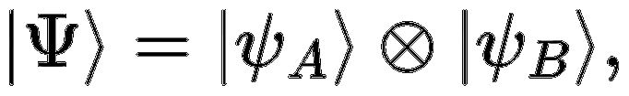
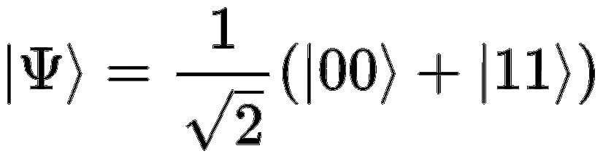
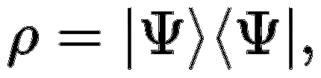

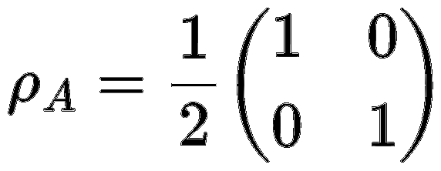
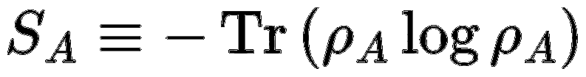

background
A
Pure state
entanglement
density matrix
von Neumann
mixed state

Slide 3
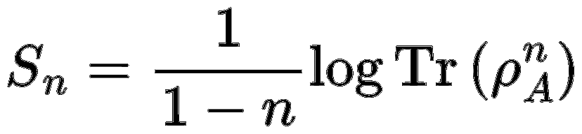
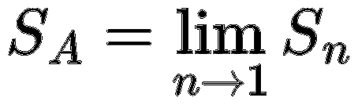
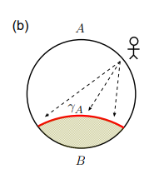
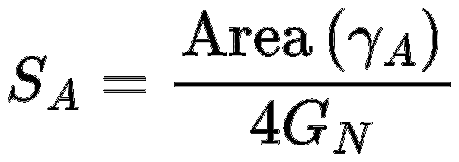
Rényi entropy
Ryu–Takayanagi

Slide 4
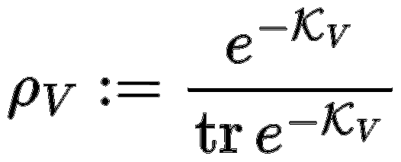
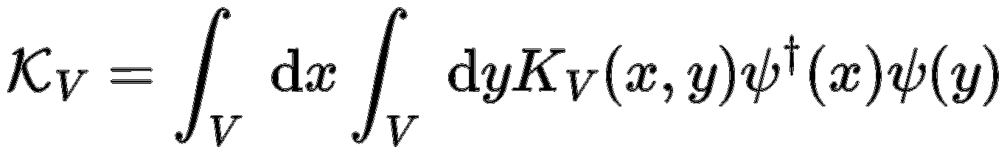
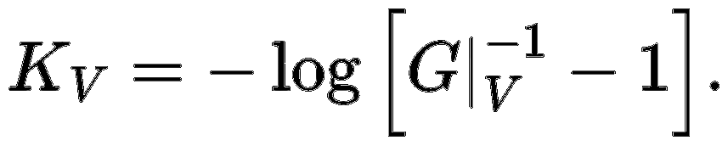
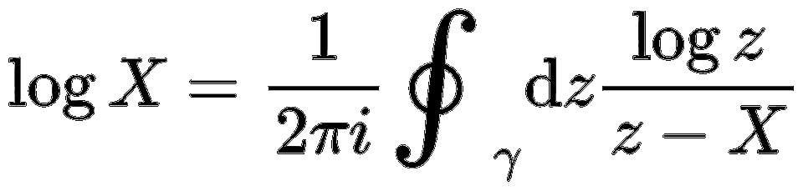
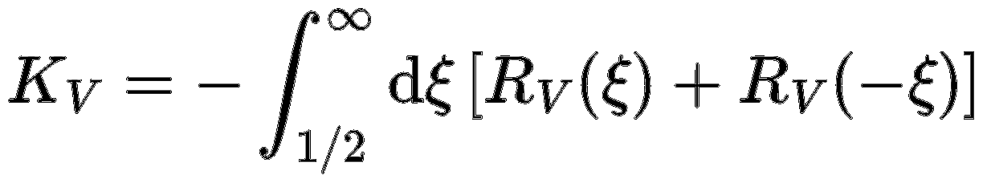
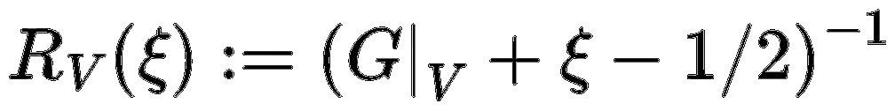
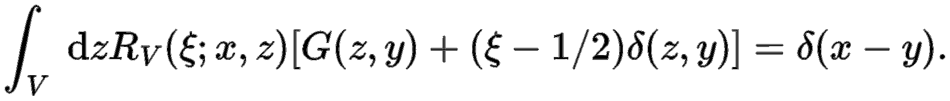
modular (or entanglement) Hamiltonian
for free fermions
Green’s function
Duo to

Slide 5
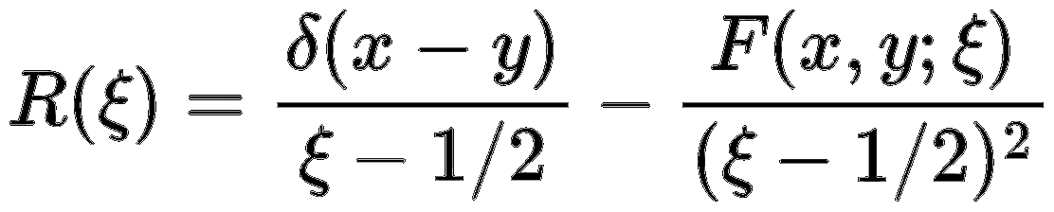


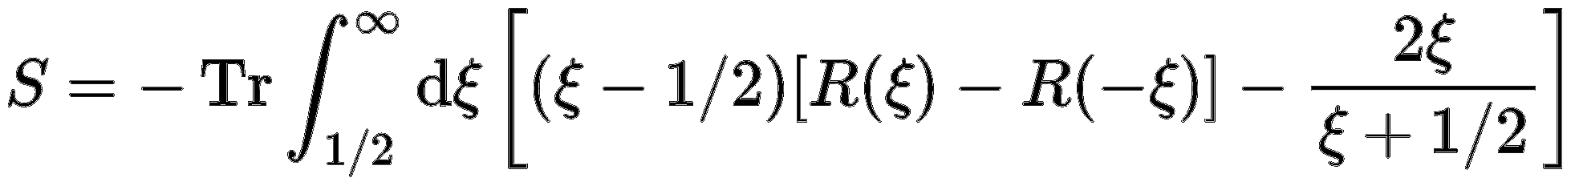
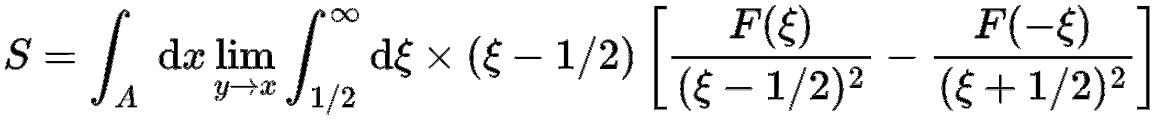
resolvent
Muskhelishvili N I 1953 Singular Integral Equations; Boundary Problems of Function Theory and their Application to Mathematical Physics ed J R M Radok (Groningen-Holland: P Noordhoff) (Engl. Transl.)

Slide 6
Outlook
Conclusion
For free fermions, the entanglement entropy can be directly computed from the two-point correlation function.
TTbar, Phase transition
Holographic entanglement properties in the QCD phase diagram from EMD models Zhibin Li

