Slide 1

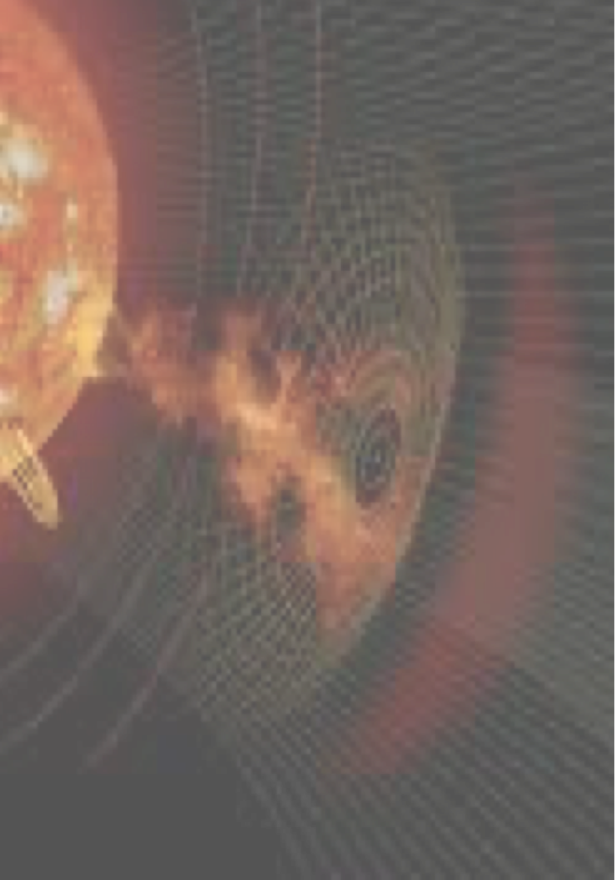

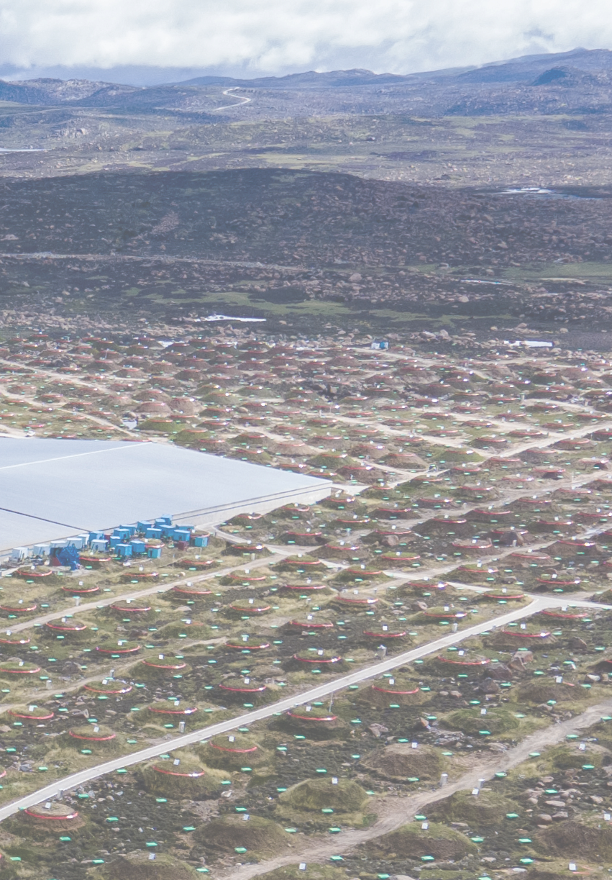
KM2A
Observations of the Sun
Zhe Li (李 哲)
Songzhan Chen(陈松战) Shanshan Xu(许杉杉)
Ruopu Han(韩若浦) Xiangting Liu(刘祥廷)
Institute of High Energy Physics，Chinese Academy of Sciences
lizhe@ihep.ac.cn
27 April 2026

Slide 2
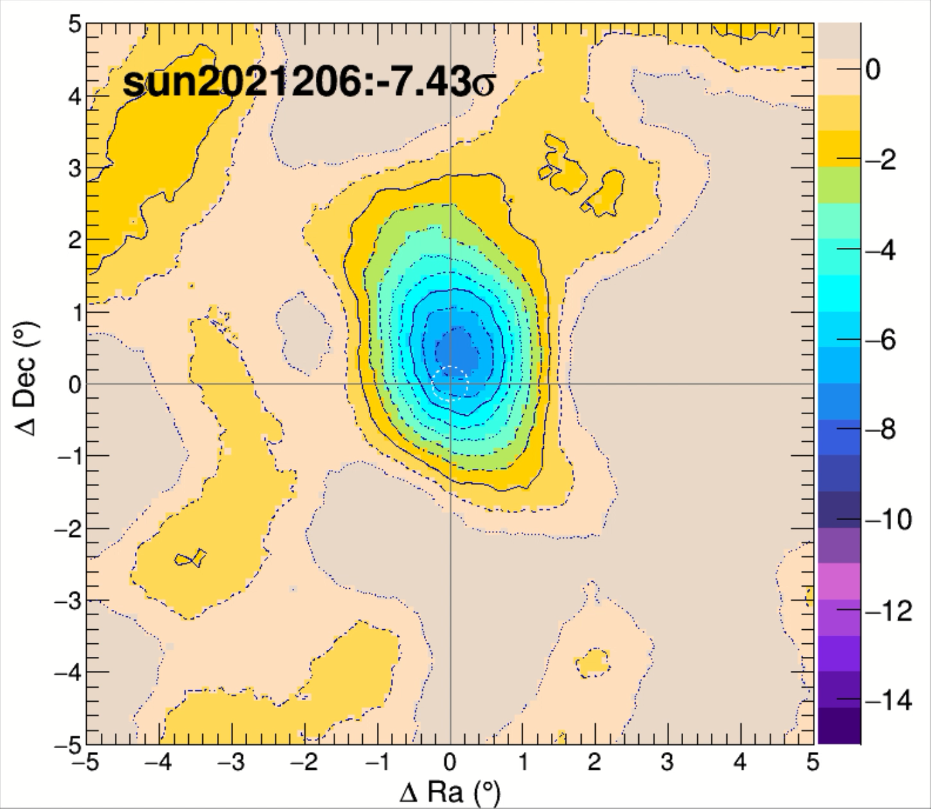
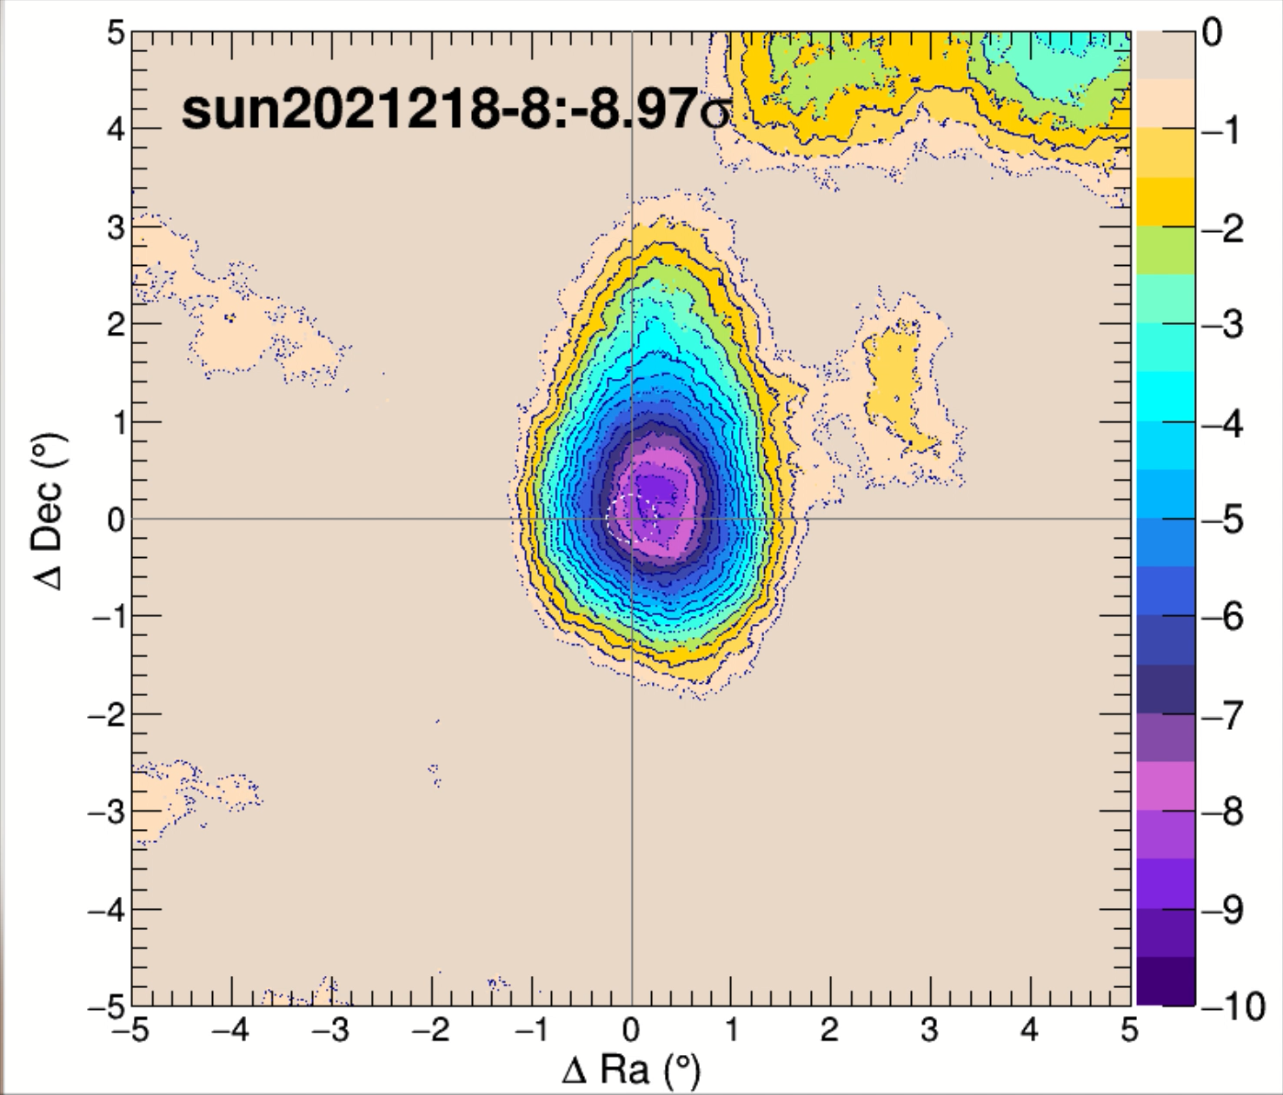
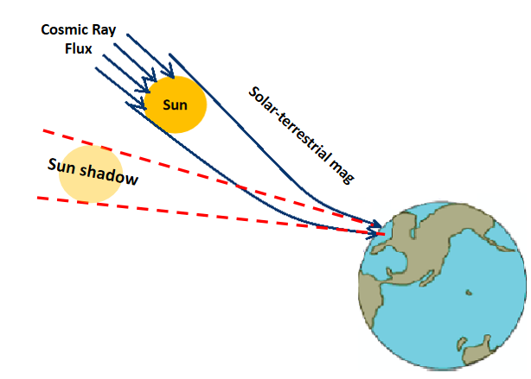
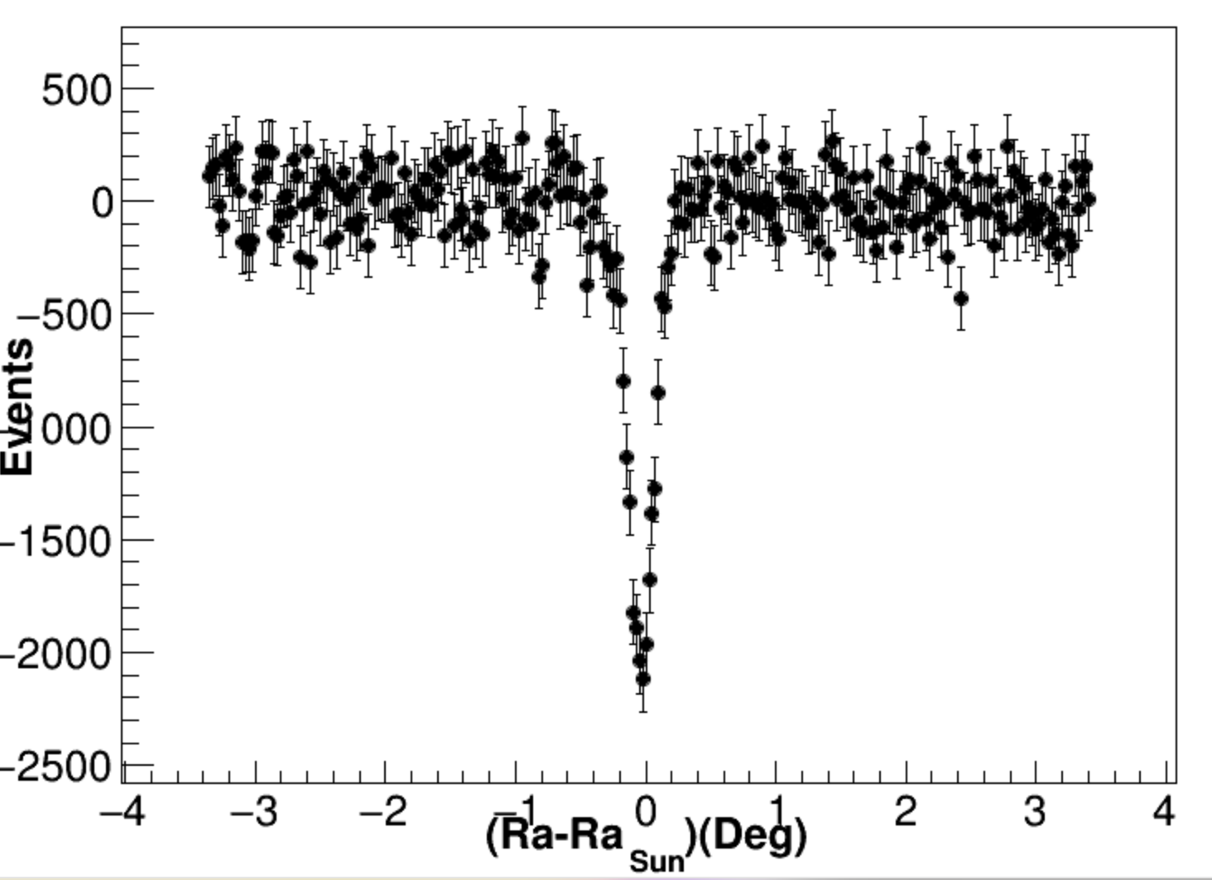
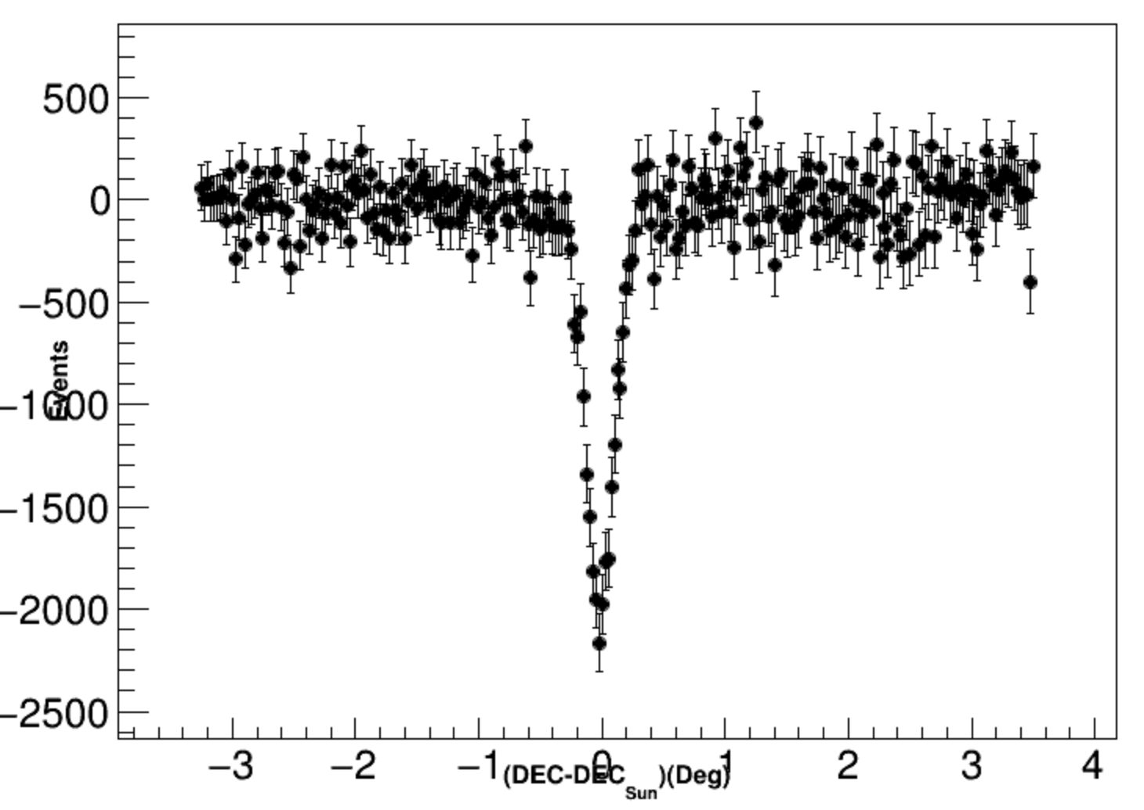
Galactic cosmic-ray Sun shadow
three hours
Each day
LHAASO is the first and currently the only experiment capable of achieving high-significance, at daily-scale observations of the GCR Sun shadow.

Slide 3
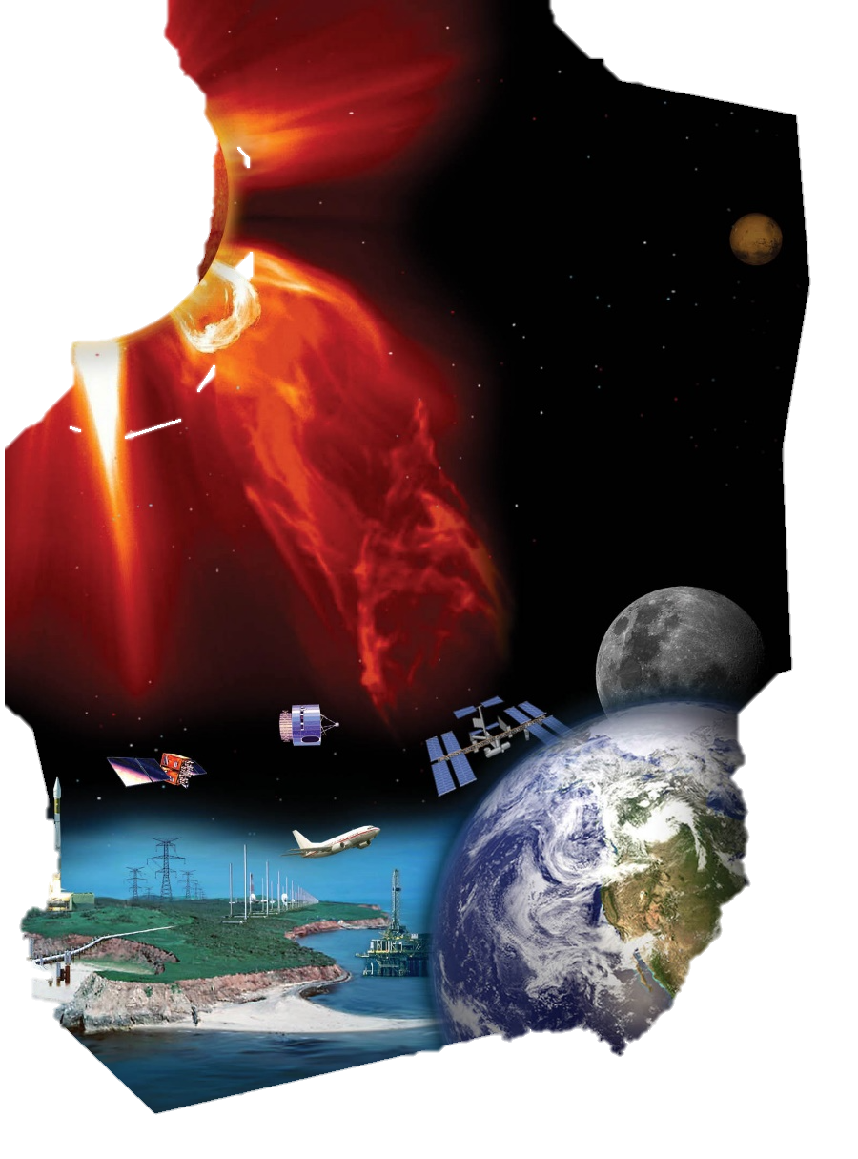
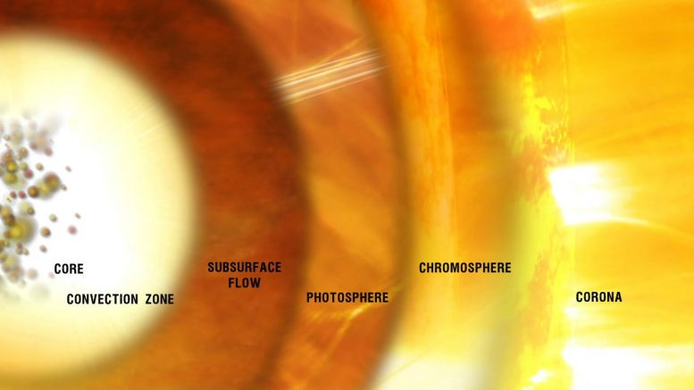
Since
High-energy cosmic rays serve as a unique tool for investigating the solar magnetic field and the interplanetary space environment.
-- The coranal magetic field
Cosmic rays with energies exceeding 10 TeV can reach the dense layers of the lower corona or even the photosphere before scattering out of the Sun, they can also propagate through the Interplanetary Magnetic Field (IMF) to reach the Earth. Consequently, this allows us to study:
--the Major Solar Phenomena: CMEs
--the solar storms: space weather

Slide 4
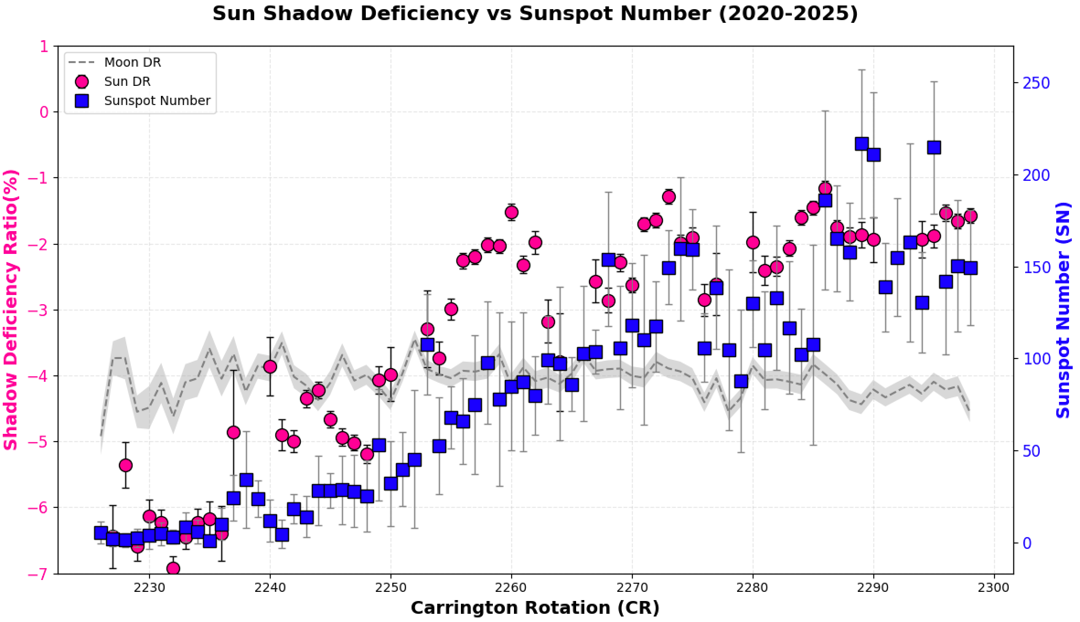
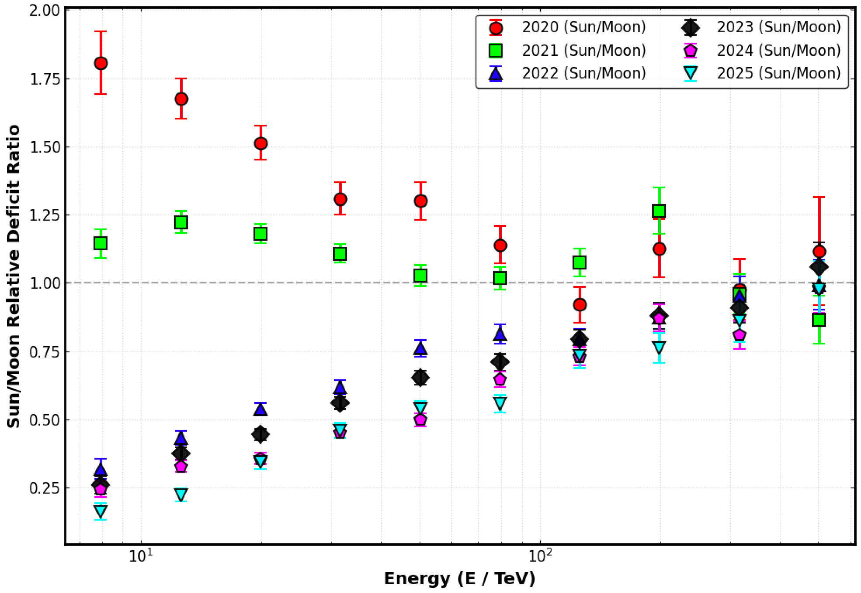
:
Sun Shadow Deficit Ratio (DR) exhibits significant anti-correlation with the Sun-spot number (SN);
Moon Shadow DR remains stable around −4%, The observed variations in the Sun‘s shadow are solar-driven.
All curves converge toward a ratio of 1.0 as energy increases. This demonstrates that high-energy cosmic rays have larger Larmor radii and higher rigidity, making them less susceptible to deflection by the coronal and interplanetary magnetic fields.
The Sun's deficit ratio notably exceeded that of the Moon in 2020 depicts a unexpected effect, which need to understand by simulation.

Slide 5
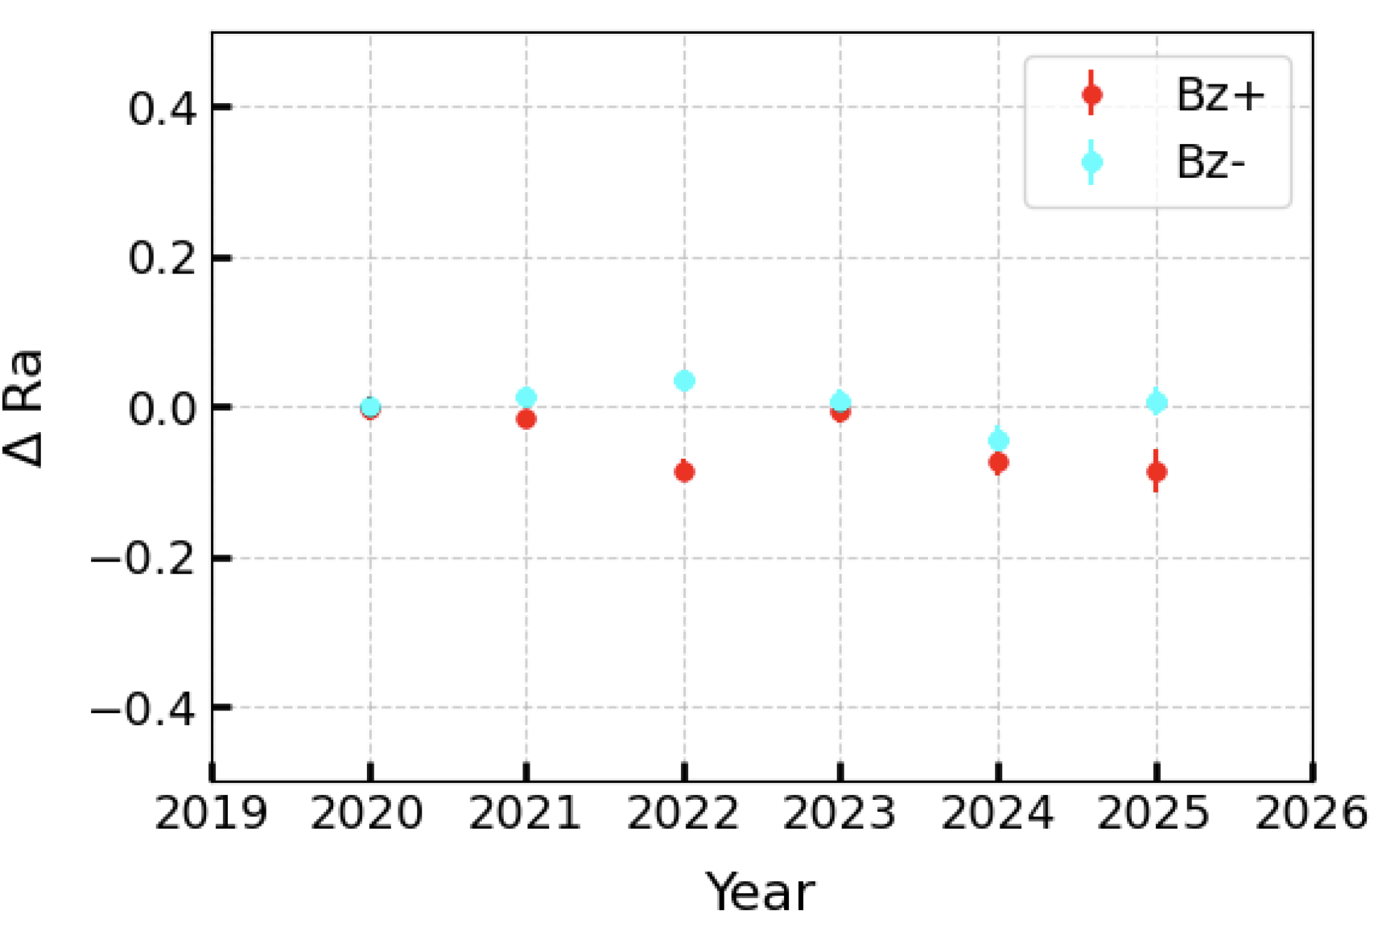
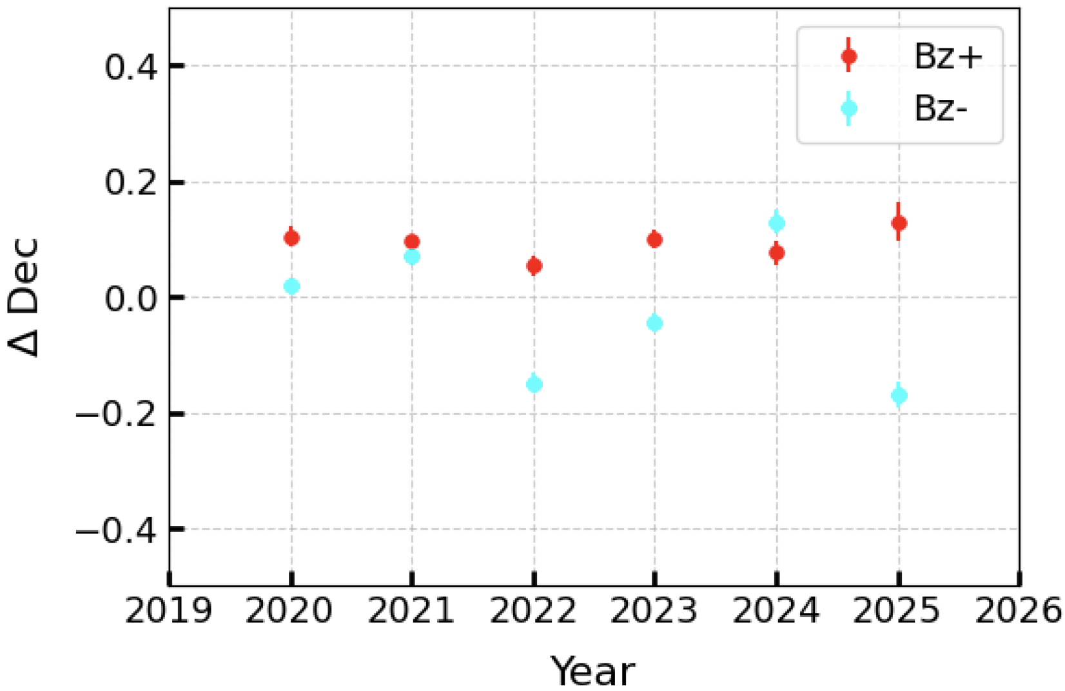
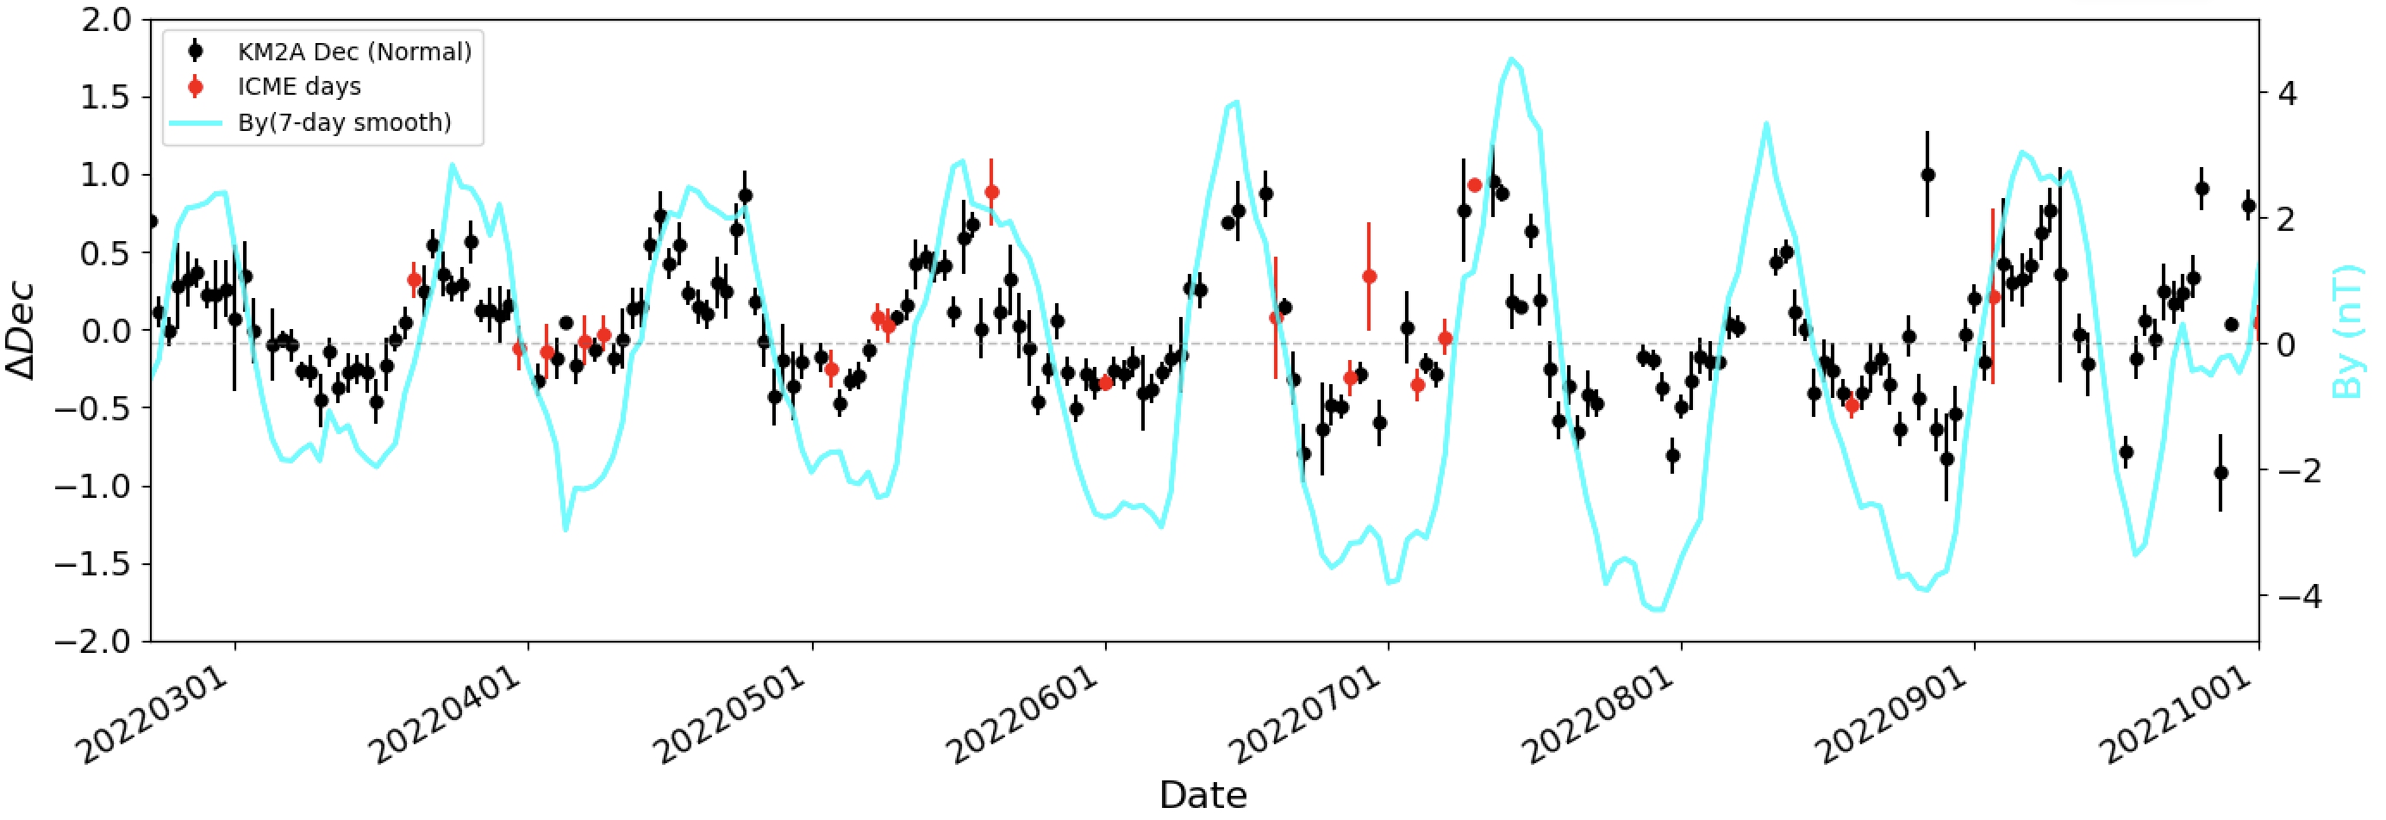
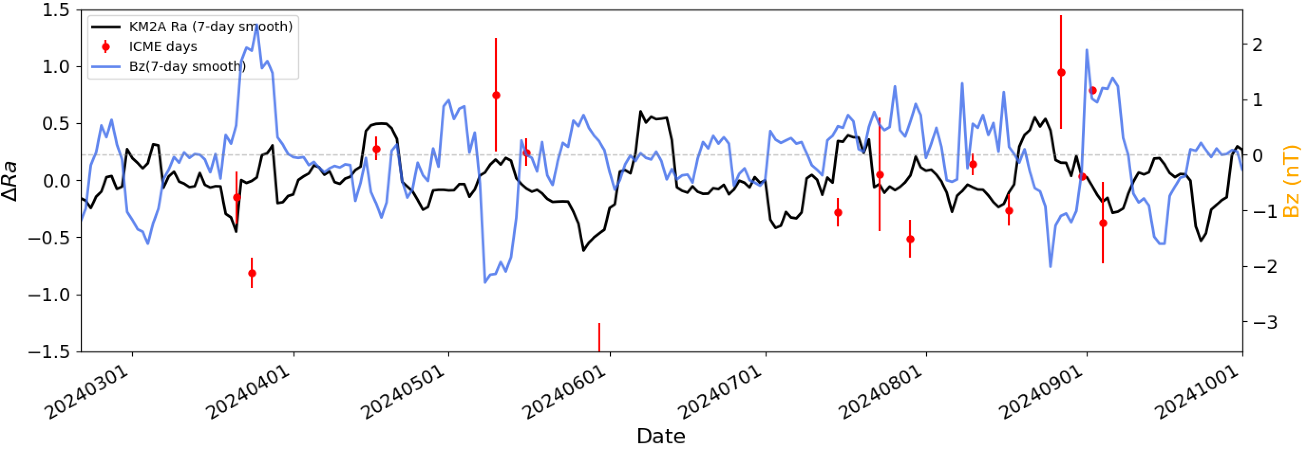
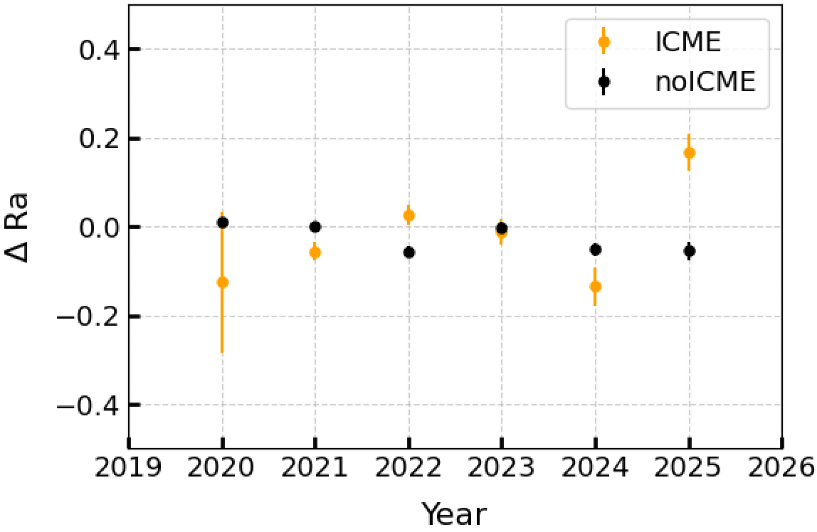
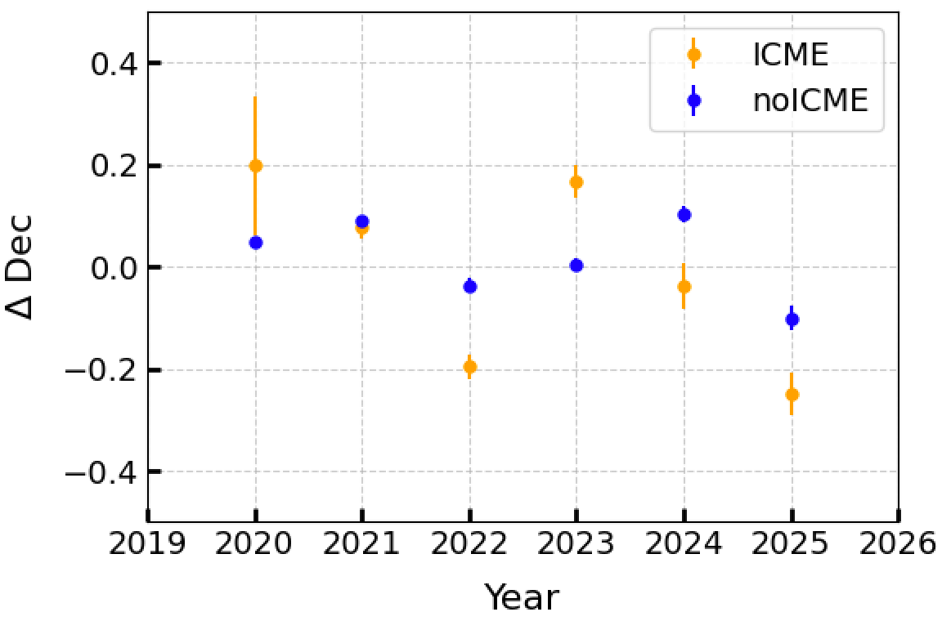
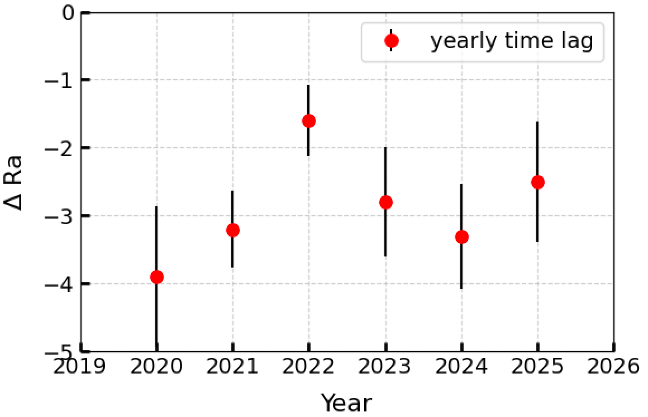
Bz and ICME events do not show a clearly significant overall effect on the modulation of the Sun shadow displacement.
Dec displacement exhibits a positive correlation with the By component, while Bz shows a relatively weak negative correlation with Ra.
The time lag between ΔDec and By for these six years ranges from −3.9 to −1.6 days, consistently indicating LHAASO’s capability to forecast IMF conditions.
ΔDec

