Slide 1



Gamma-ray observations of LHAASO J2005+3415 with LHAASO and Fermi
Fangyu Liu, Huicai Li, Shicong Hu, Kun Fang
on behalf of LHAASO collaboration
1

Slide 2
Outline
✓ Introduction
✓ LHAASO and Fermi-LAT results
✓ Discussion and Summary
2

Slide 3
Introduction: LHAASO J2005+3415
 | WCDA | KM2A
RA | 301.30 | 301.81
Dec | 34.25 | 33.87
Index | 2.58 | 3.79
sigma | 0.74 | 0.33
TS | 388.1 | 127.7
LHAASO J2005+3415: an unclassified TeV source
Location: (l, b) ~ (71.32°, 1.16°) in Cygnus region
No clear counterpart in the low-frequency band
Origin unclear: SNR? PWN? Other?
3

Slide 4
✓ Introduction
✓ LHAASO and Fermi-LAT results
✓ Discussion and Summary
4

Slide 5
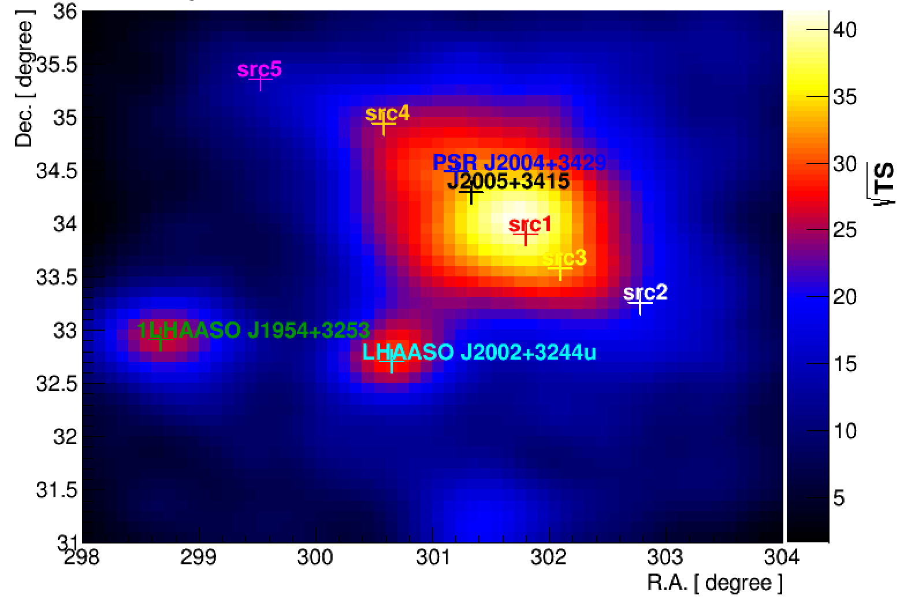
LHAASO Data
Data:
WCDA Full-Array: 2021-03-05 to 2025-07-31
KM2A Full-Array: 2021-07-20 to 2025-07-31
N_{hit} Range: [30, 60, 100, 200, 300, 500, 800, 2000]
E Range: [10^{1.4}-10^{3.4}]
Analysis:
Selection:
WCDA: Employs hit-multiplicity segmentation and Pincness thresholds to select gamma-like events.
KM2A: Same as Crab analysis (CPC paper)
Backgroud estimation: direct integration method
Method: 3D Likelihood analysis
DGE: Planck Dust model
5

Slide 6

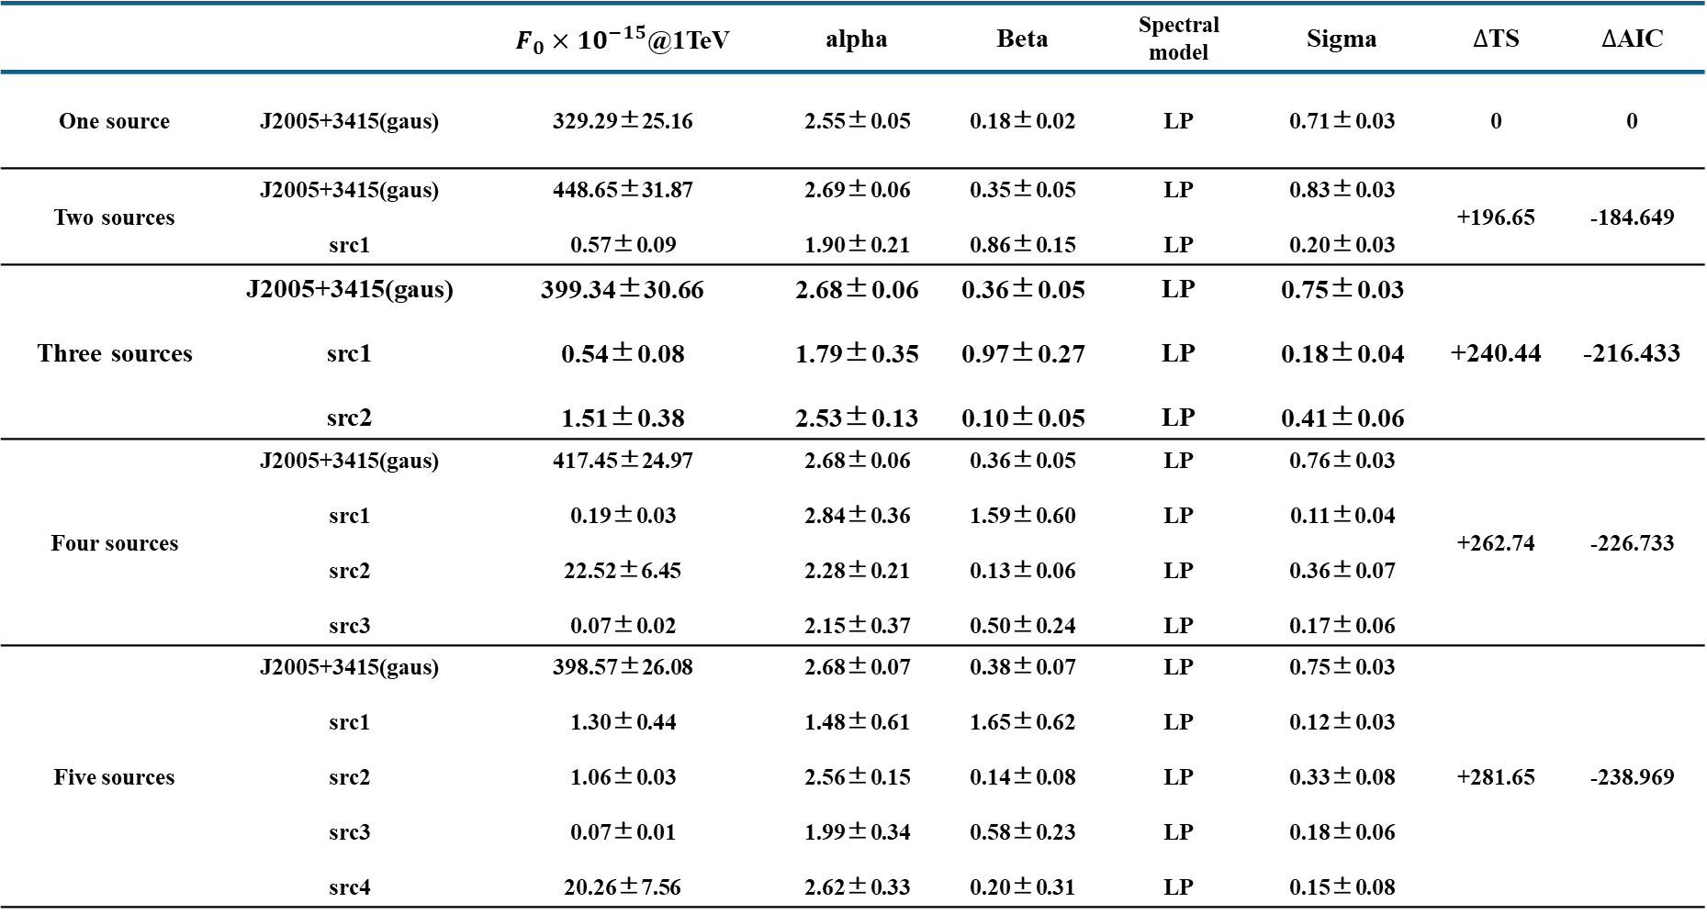
LHAASO Results
 |  | $F_{0}{×10}^{−15}$@1TeV | alpha | Beta | Spectral model | Sigma | $∆$TS | $∆$AIC
One source | J2005+3415(gaus) | 329.29±25.16 | 2.55±0.05 | 0.18±0.02 | LP | 0.71±0.03 | 0 | 0
Two sources | J2005+3415(gaus) src1 | 448.65±31.87 0.57±0.09 | 2.69±0.06 1.90±0.21 | 0.35±0.05 0.86±0.15 | LP LP | 0.83±0.03 0.20±0.03 | +196.65 | -184.649
Three sources | J2005+3415(gaus) src1 src2 | 399.34±30.66 0.54±0.08 1.51±0.38 | 2.68±0.06 1.79±0.35 2.53±0.13 | 0.36±0.05 0.97±0.27 0.10±0.05 | LP LP LP | 0.75±0.03 0.18±0.04 0.41±0.06 | +240.44 | -216.433
Four sources | J2005+3415(gaus) src1 src2 src3 | 417.45±24.97 0.19±0.03 22.52±6.45 0.07±0.02 | 2.68±0.06 2.84±0.36 2.28±0.21 2.15±0.37 | 0.36±0.05 1.59±0.60 0.13±0.06 0.50±0.24 | LP LP LP LP | 0.76±0.03 0.11±0.04 0.36±0.07 0.17±0.06 | +262.74 | -226.733
Five sources | J2005+3415(gaus) src1 src2 src3 src4 | 398.57±26.08 1.30±0.44 1.06±0.03 0.07±0.01 20.26±7.56 | 2.68±0.07 1.48±0.61 2.56±0.15 1.99±0.34 2.62±0.33 | 0.38±0.07 1.65±0.62 0.14±0.08 0.58±0.23 0.20±0.31 | LP LP LP LP LP | 0.75±0.03 0.12±0.03 0.33±0.08 0.18±0.06 0.15±0.08 | +281.65 | -238.969
$$√$$
6

Slide 7
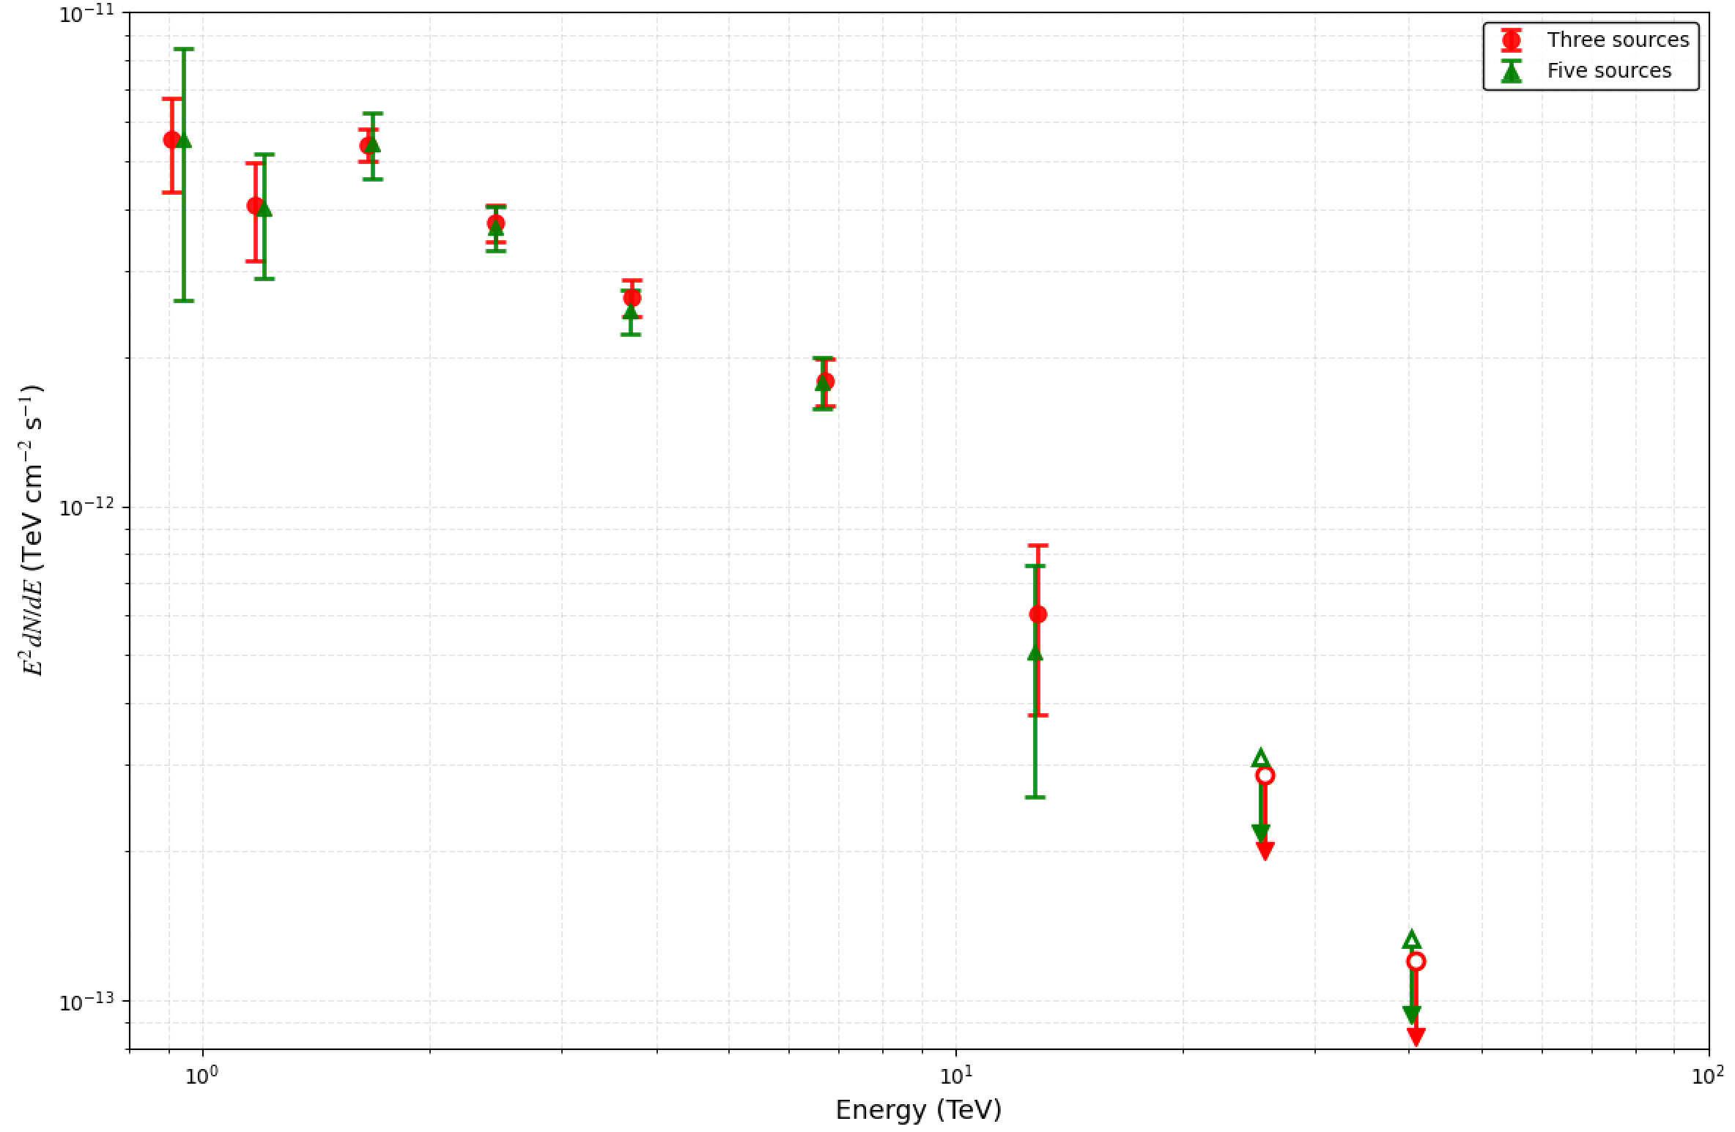
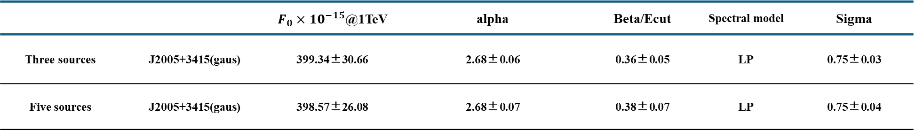
LHAASO Results
 |  | $F_{0}{×10}^{−15}$@1TeV | alpha | Beta/Ecut | Spectral model | Sigma
Three sources | J2005+3415(gaus) | 399.34±30.66 | 2.68±0.06 | 0.36±0.05 | LP | 0.75±0.03
Five sources | J2005+3415(gaus) | 398.57±26.08 | 2.68±0.07 | 0.38±0.07 | LP | 0.75±0.04
When neighboring sources src3 and src4 are introduced into the model, the spectral parameters and shape of J2005+3415 remain highly stable.
7

Slide 8

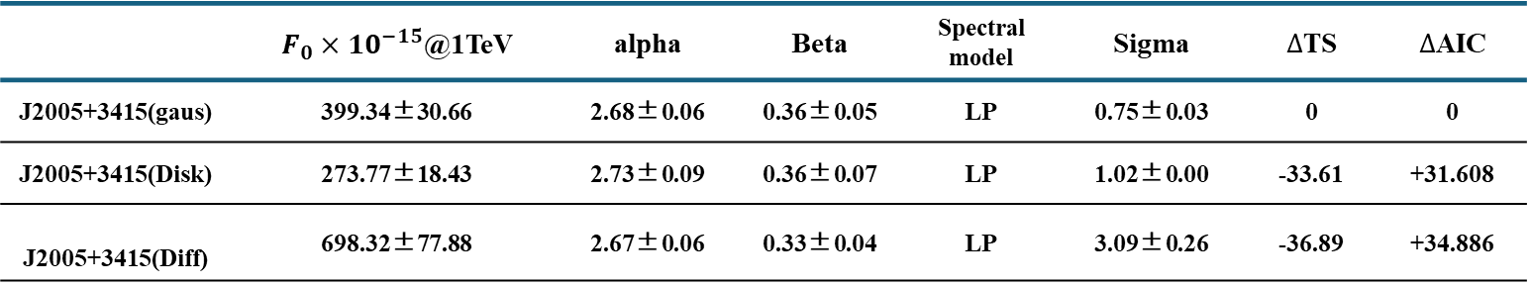

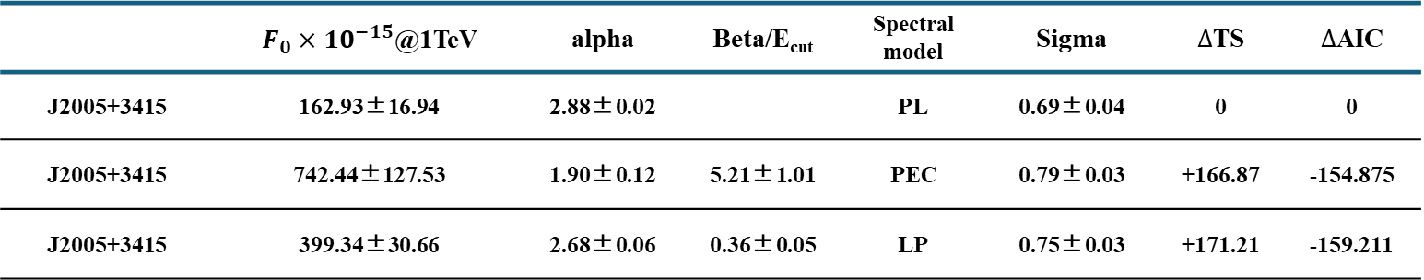
LHAASO Results
 | $F_{0}{×10}^{−15}$@1TeV | alpha | Beta | Spectral model | Sigma | $∆$TS | $∆$AIC
J2005+3415(gaus) | 399.34±30.66 | 2.68±0.06 | 0.36±0.05 | LP | 0.75±0.03 | 0 | 0
J2005+3415(Disk) | 273.77±18.43 | 2.73±0.09 | 0.36±0.07 | LP | 1.02±0.00 | -33.61 | +31.608
J2005+3415(Diff) | 698.32±77.88 | 2.67±0.06 | 0.33±0.04 | LP | 3.09±0.26 | -36.89 | +34.886
$$√$$
The Gaussian model is significantly superior to the other two models in terms of goodness of fit.
 | $F_{0}{×10}^{−15}$@1TeV | alpha | Beta/E_{cut} | Spectral model | Sigma | $∆$TS | $∆$AIC
J2005+3415 | 162.93±16.94 | 2.88±0.02 |  | PL | 0.69±0.04 | 0 | 0
J2005+3415 | 742.44±127.53 | 1.90±0.12 | 5.21±1.01 | PEC | 0.79±0.03 | +166.87 | -154.875
J2005+3415 | 399.34±30.66 | 2.68±0.06 | 0.36±0.05 | LP | 0.75±0.03 | +171.21 | -159.211
$$√$$
8

Slide 9
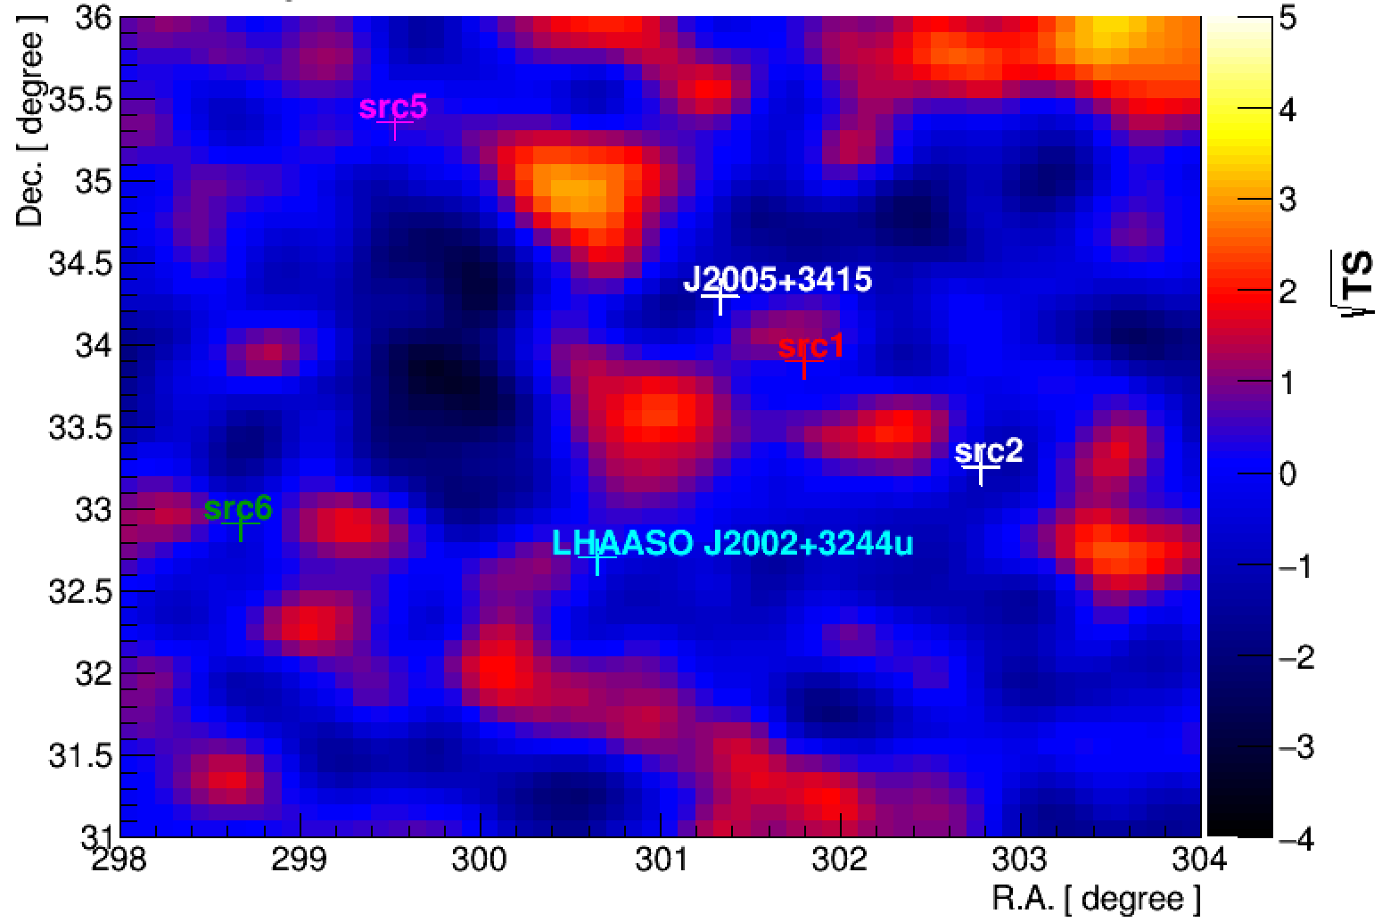
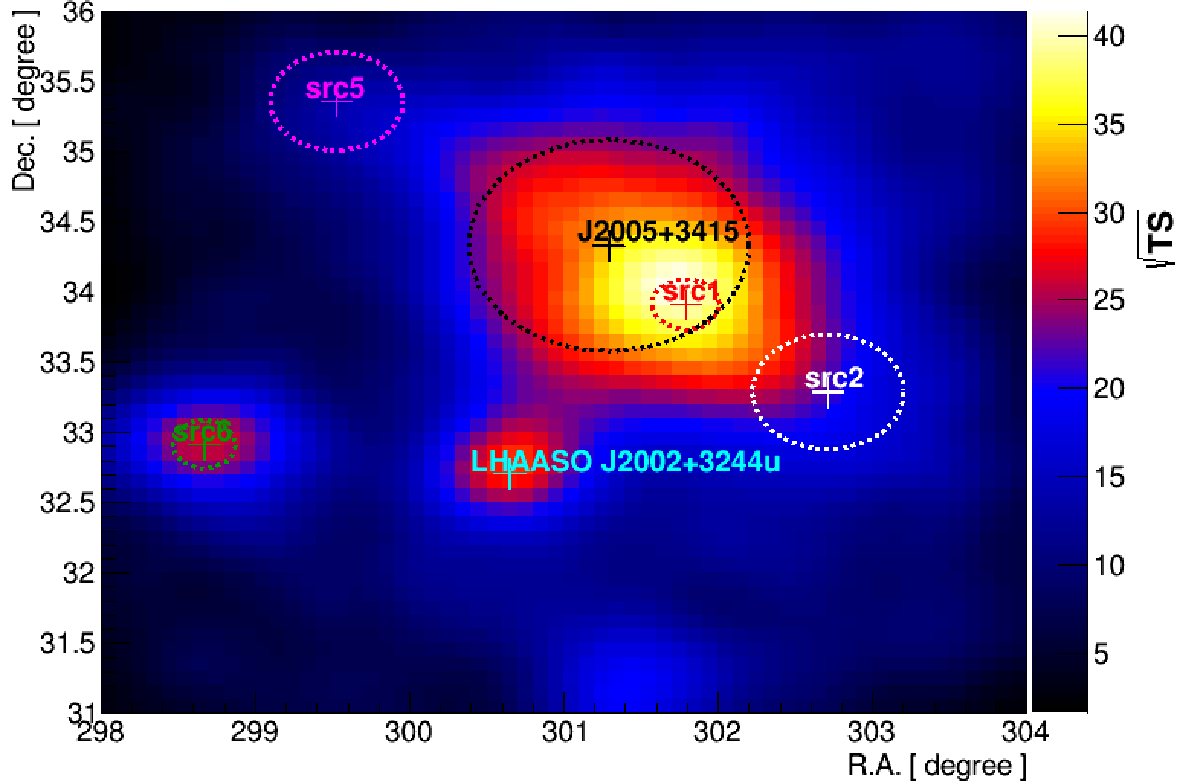
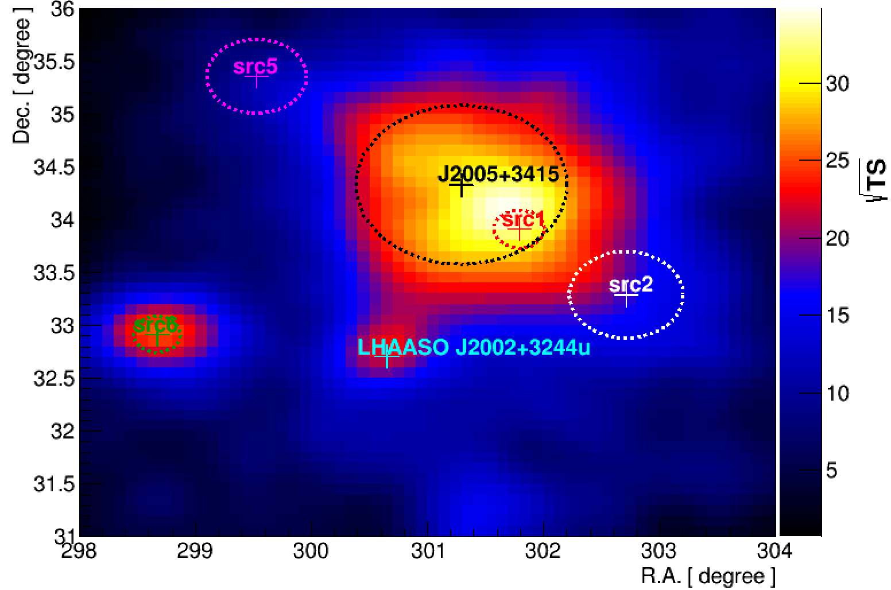
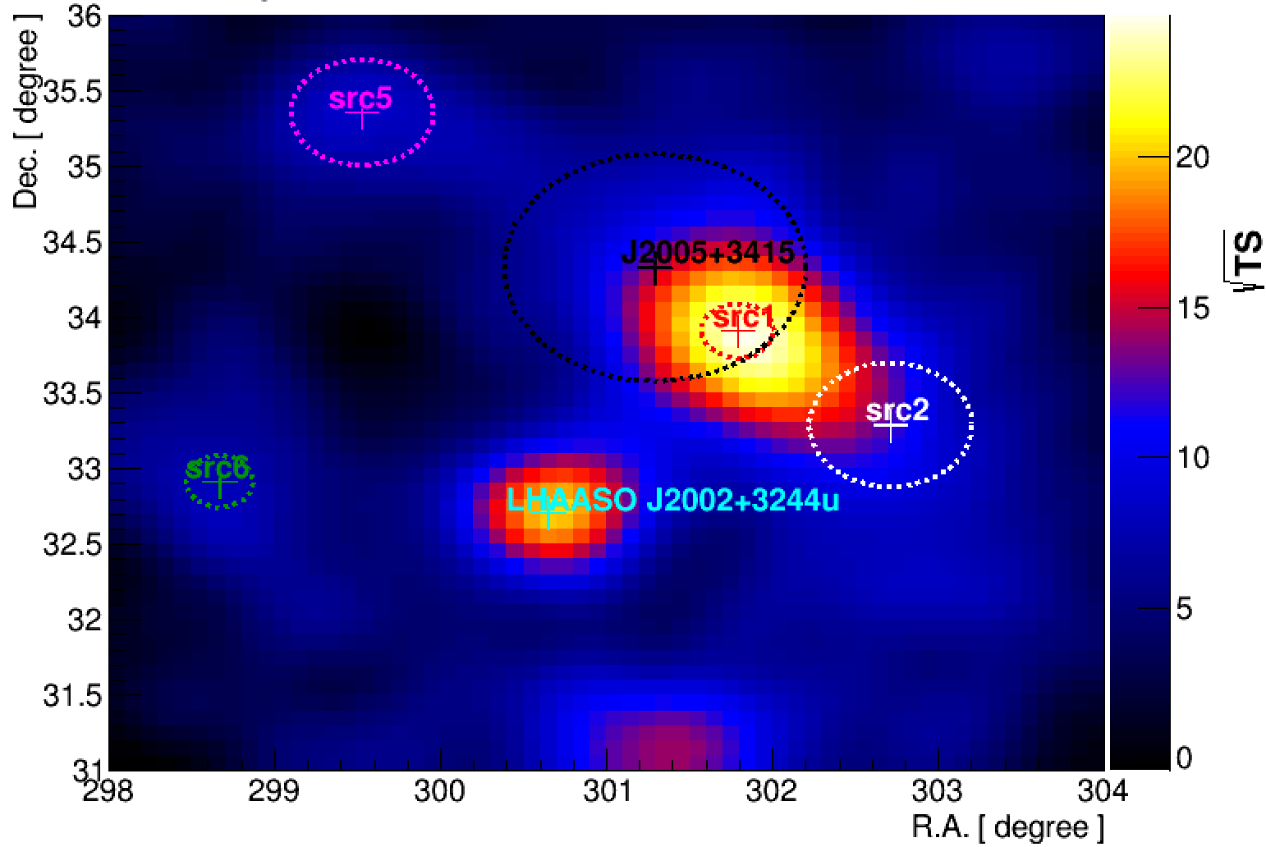
LHAASO Results
Residual Map
WCDA&KM2A
WCDA
KM2A
9

Slide 10
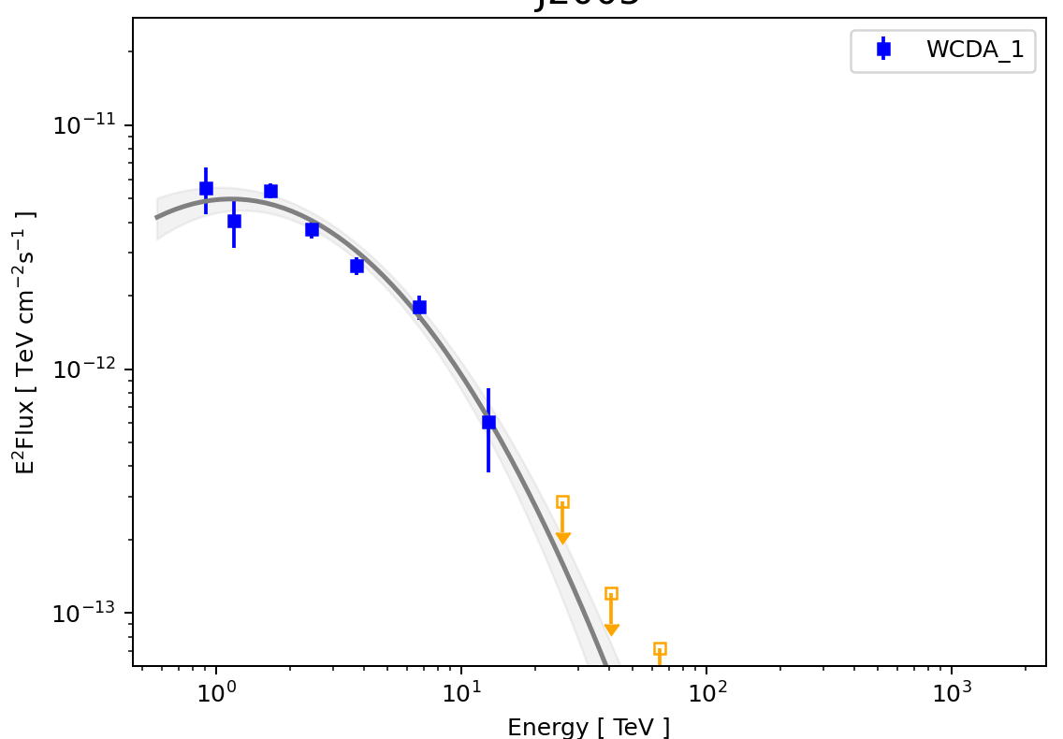
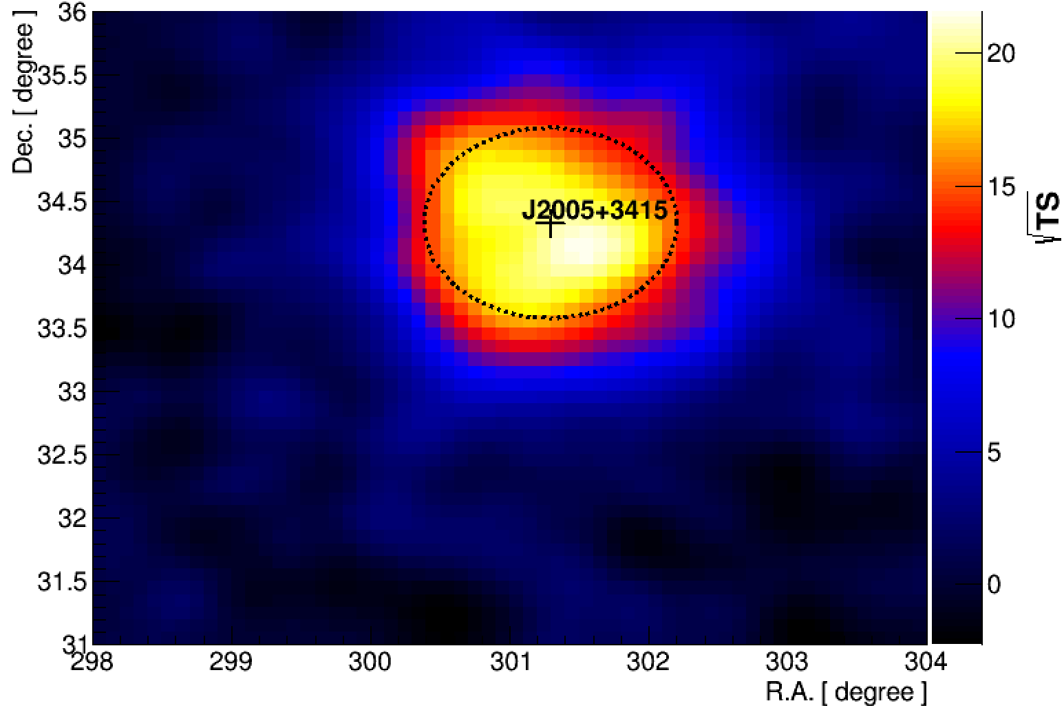

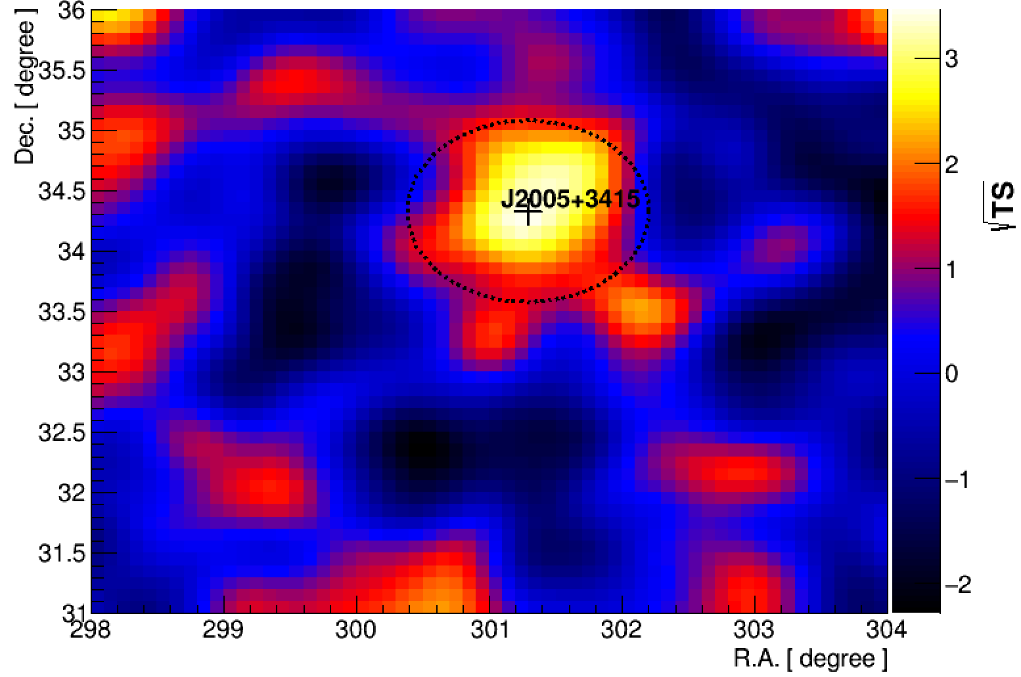
LHAASO Results
WCDA & KM2A
WCDA
KM2A
LHAASO observations of the target source
10

Slide 11
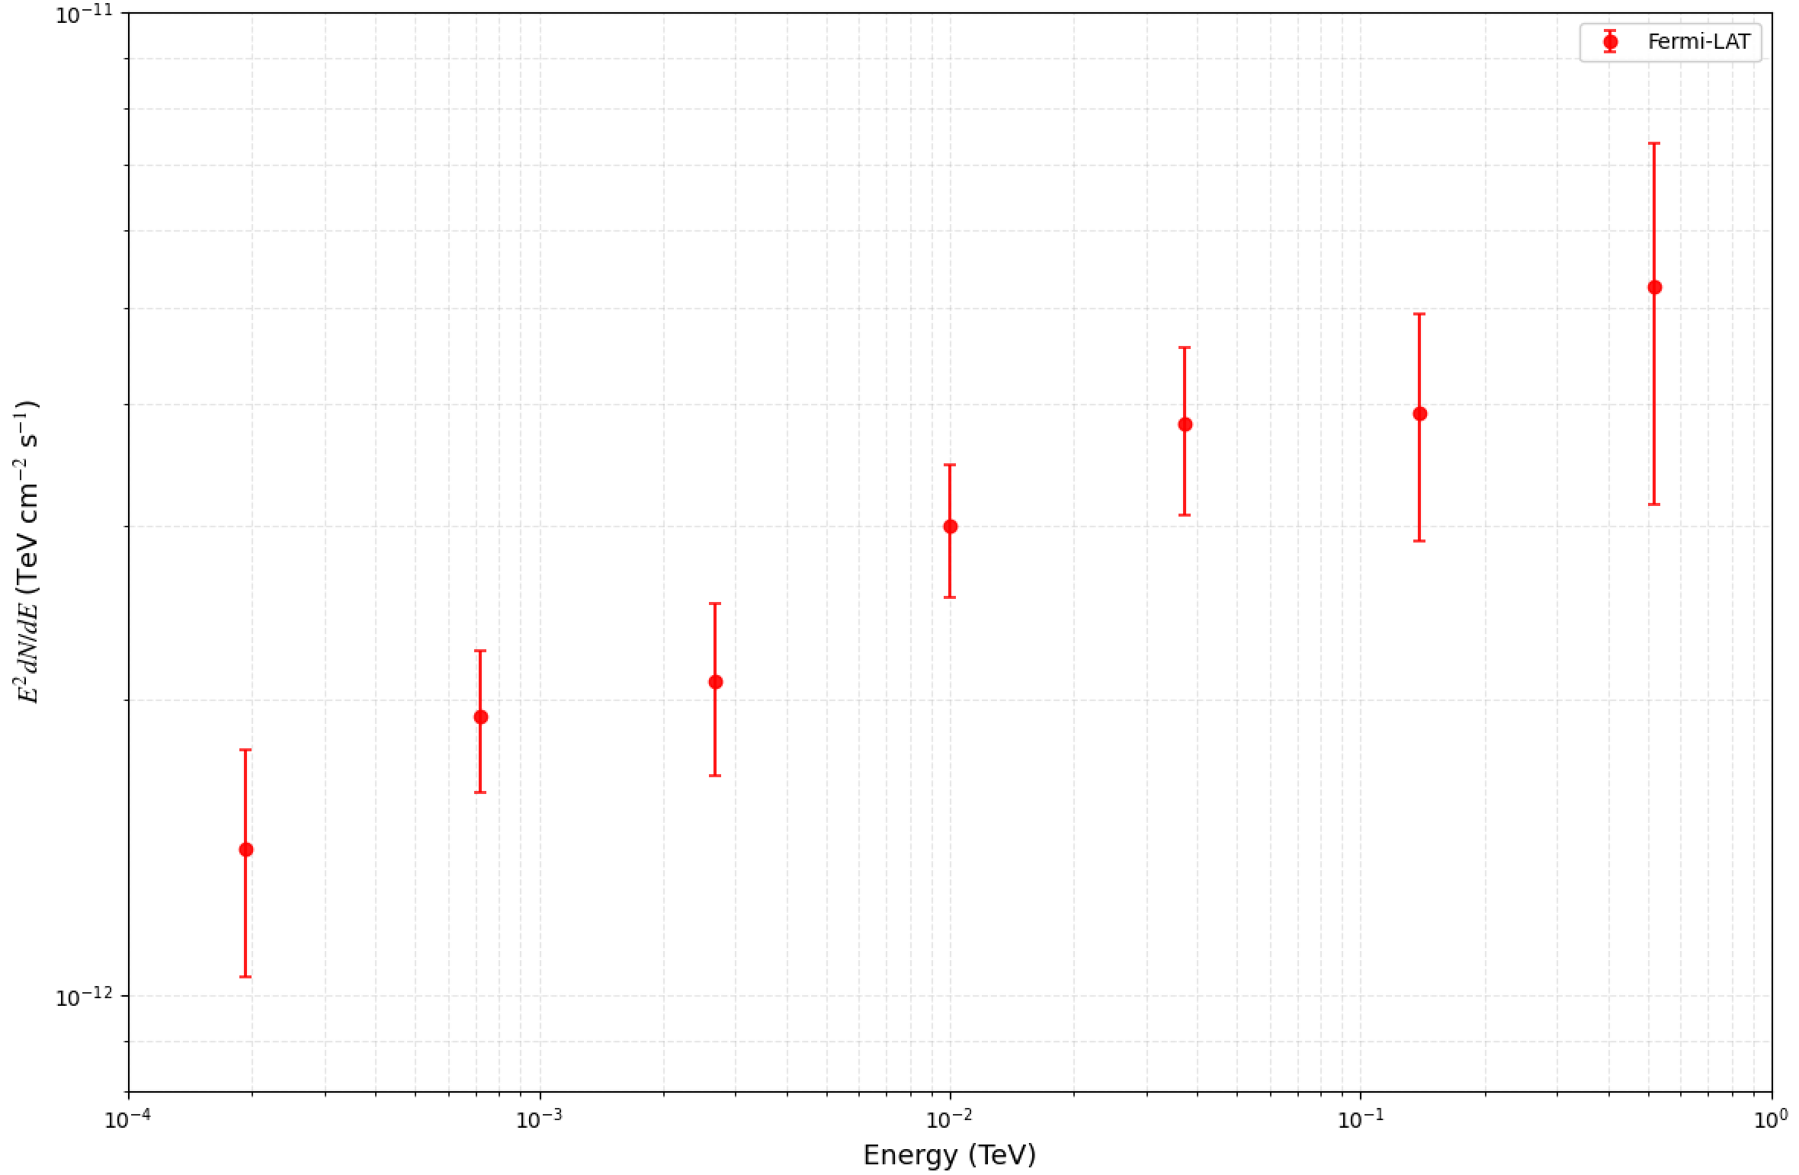
Fermi analysis
Data:
 | Model | TS
4FGL J2005.8+3357 | Point | 65.8
4FGL J2005.8+3357 | Gaussian | 164.8
Time: 2008-08-04 to 2026-4-09
Energy: 0.1-1000 GeV
ROI: 15°× 15°
Results:
RA: 301.29, 34.33
SpatialModel: Gaussian
SpectrumType: PowerLaw
Index: -1.801
Sigma: 0.66
TS: 164.78
11

Slide 12
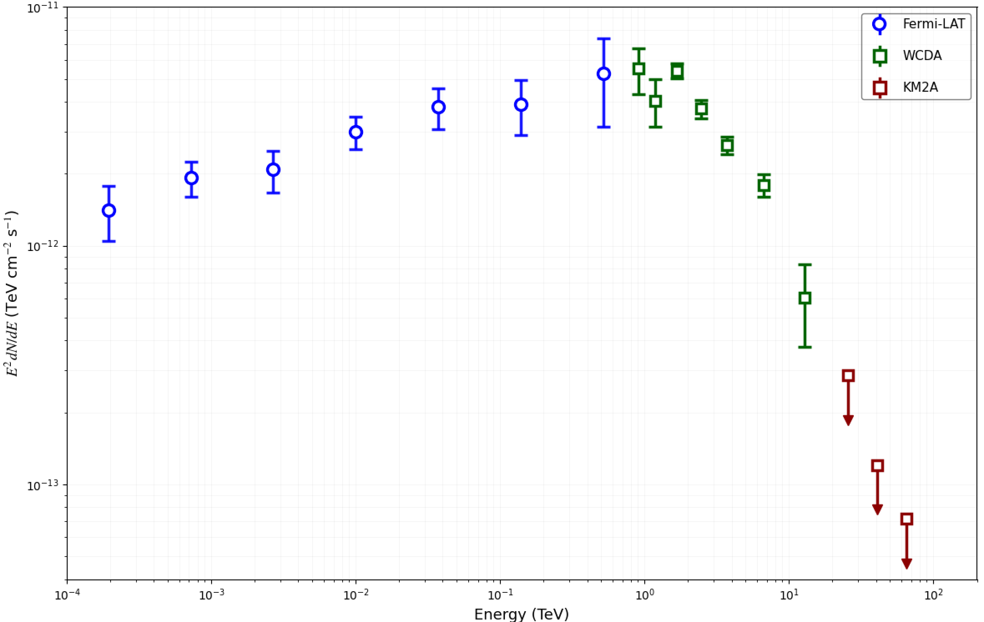
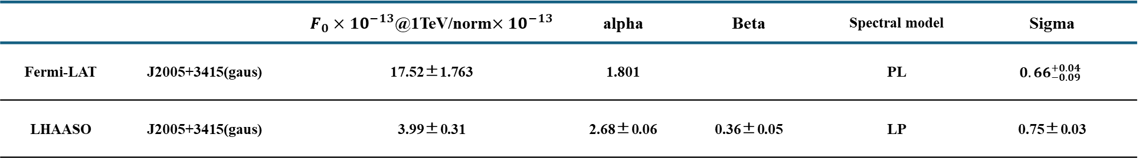
Multiwavelength SED
 |  | $F_{0}{×10}^{−13}$@1TeV/norm${×10}^{−13}$ | alpha | Beta | Spectral model | Sigma
Fermi-LAT | J2005+3415(gaus) | 17.52±1.763 | 1.801 |  | PL | $${0.66}_{−0.09}^{+0.04}$$
LHAASO | J2005+3415(gaus) | 3.99±0.31 | 2.68±0.06 | 0.36±0.05 | LP | 0.75±0.03
LHAASO J2005+3415
12

Slide 13
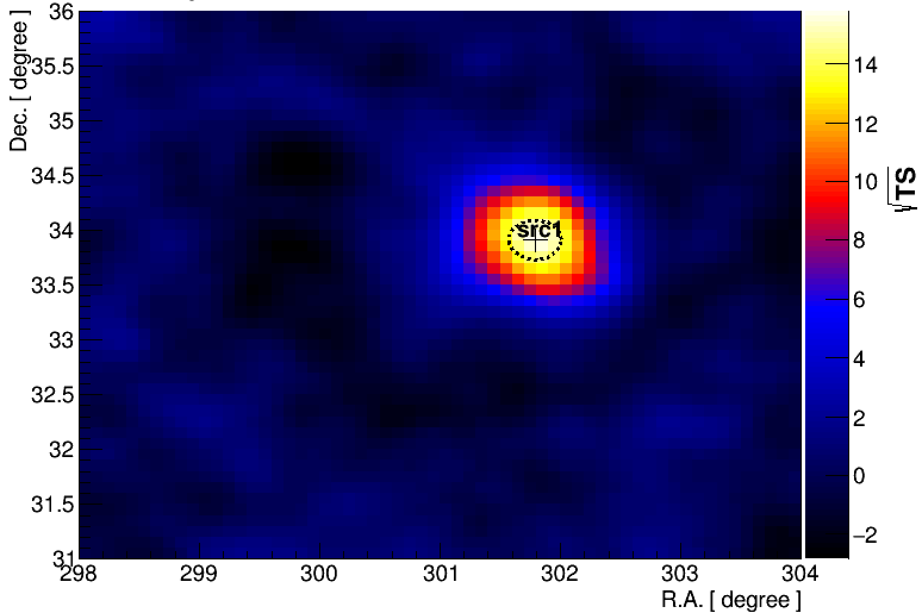
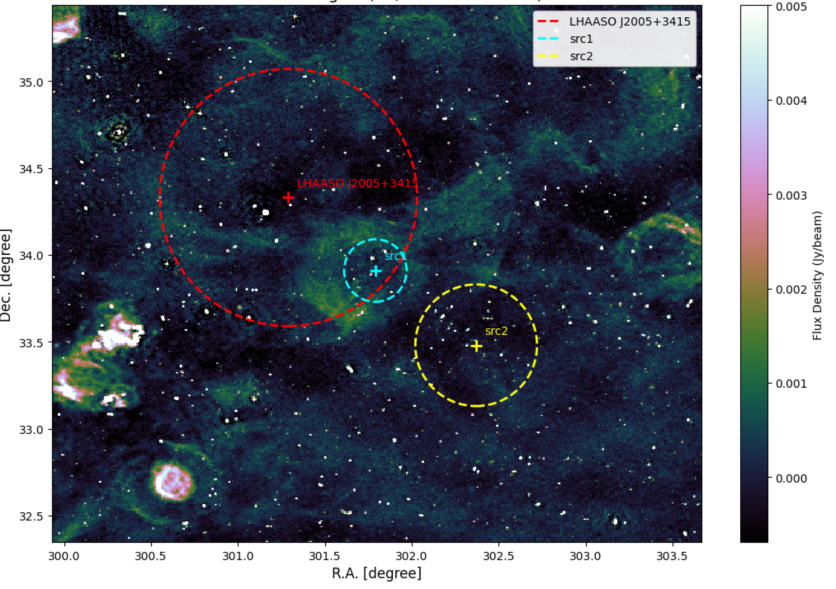
Radio observations
✓ LOFAR LoTSS DR3 (120-168 MHz)
Although no significant radio emission is detected within the extended region of J2005+3415.
we found a radio structure spatially associated with src1.
13

Slide 14
✓ Introduction
✓ LHAASO and Fermi-LAT results
✓ Discussion and Summary
14

Slide 15
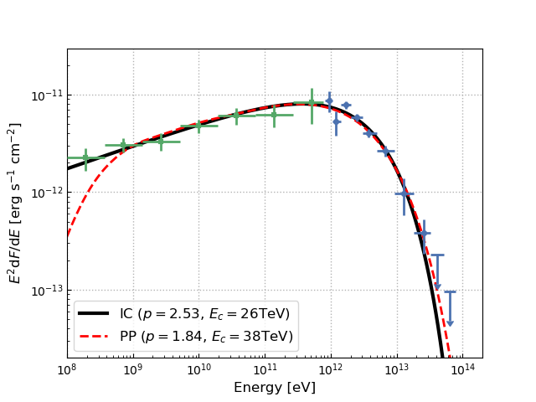
Discussion: Origin of LHAASO J2005+3415
Hadronic Origin —— Disfavored
No pion-decay bump in Fermi-LAT data.
Power-law index is smaller than standard DSA theory (2.0)
Leptonic origin 1: PWN/pulsar halo
Inconsistent with known pulsar halos
Spectral index is consistent with expectation from DSA theories
A shell-type SNR + escaping electrons?
Electrons diffuse from a shell-like source → no sharp peak at the centroid, could be similar to a Gaussian template
Higher-energy electrons escaped earlier from SNR, may be consistent with “TeV extension > GeV extension”
15

Slide 16
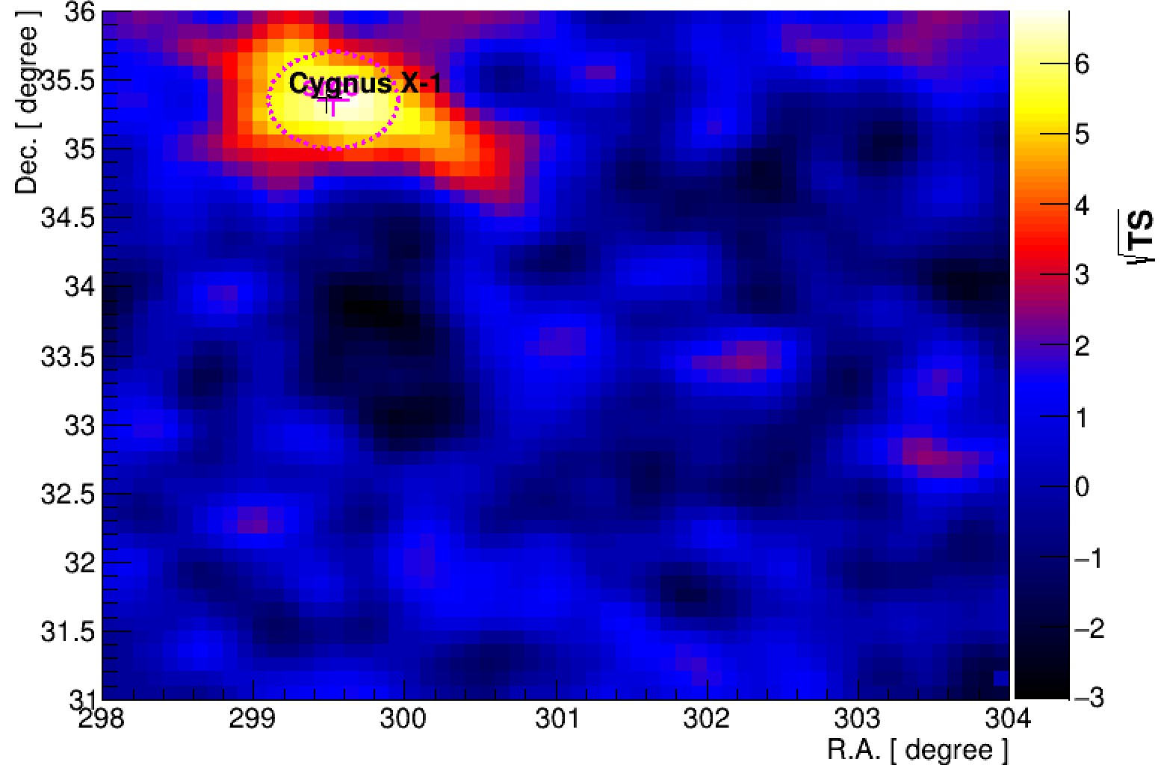
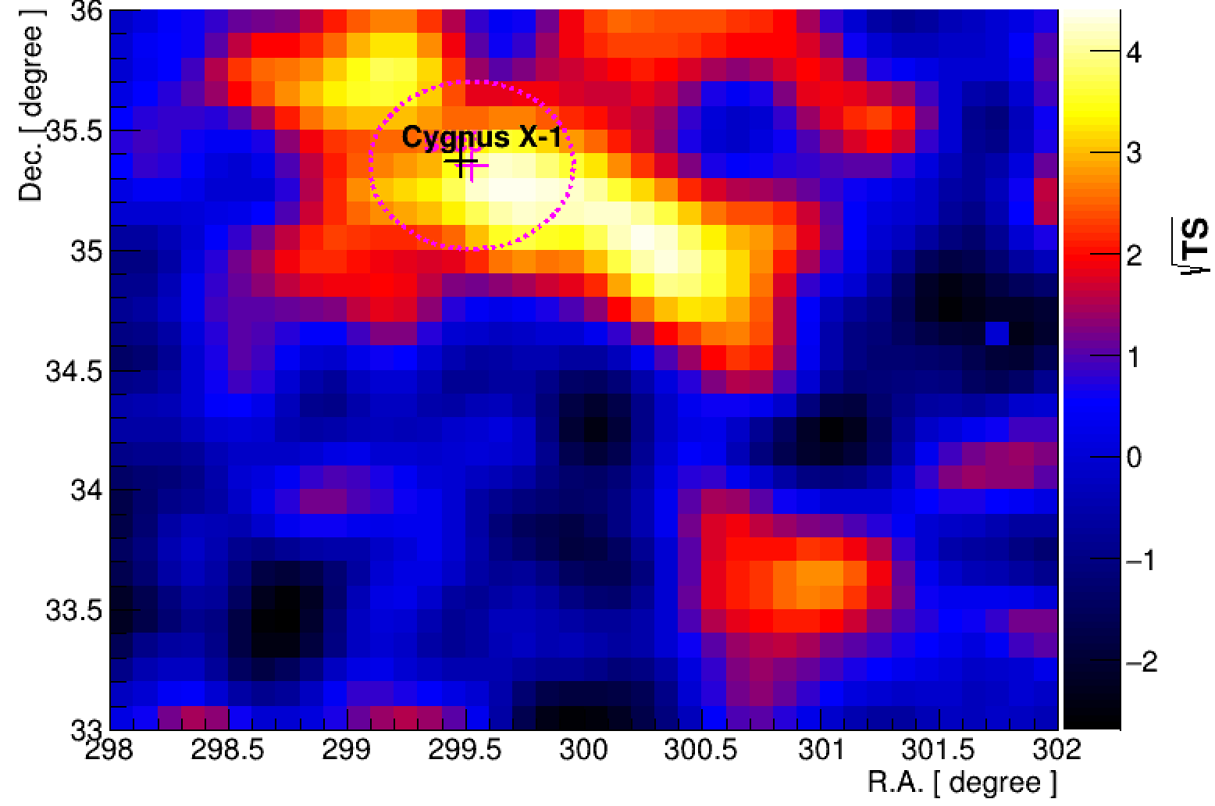
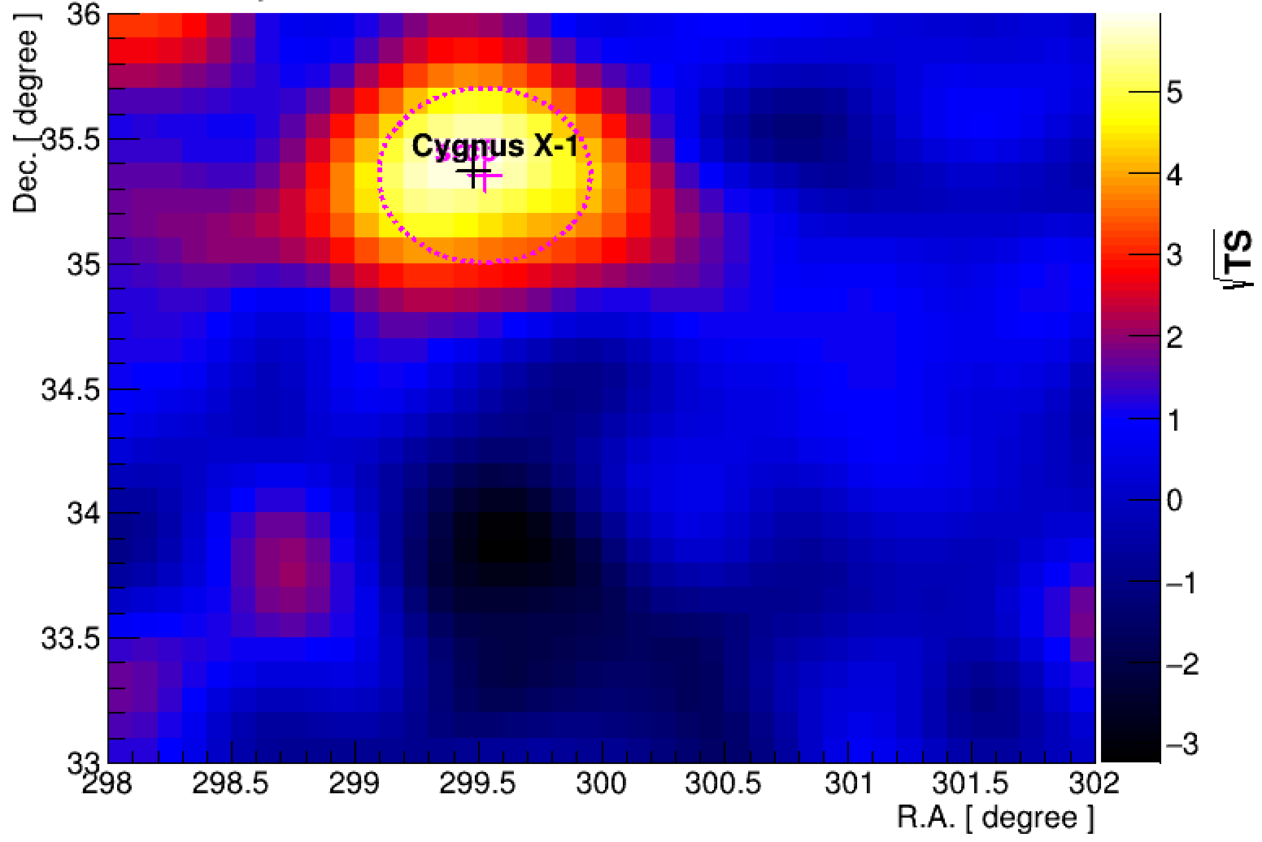
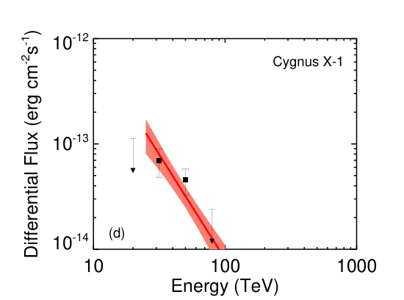
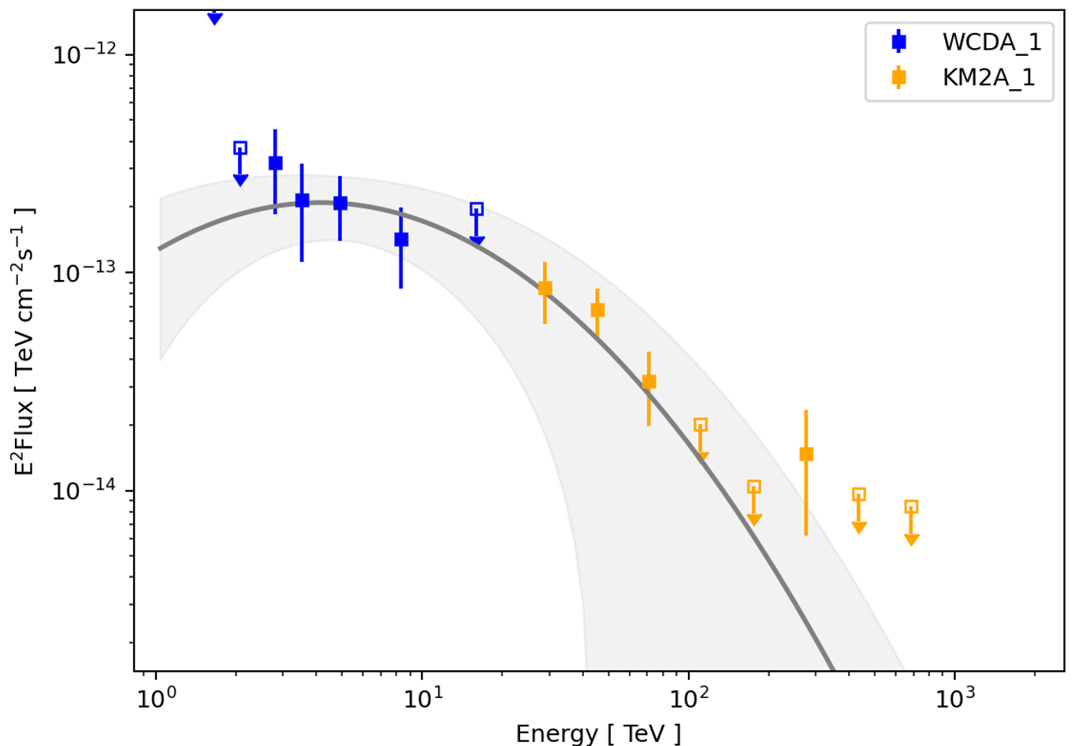
Additional Discovery
WCDA &KM2A
KM2A
WCDA
16

Slide 17
Summary
J2005+3415 is detected with a significance exceeding 20σ
✓
Providing clear morphological identification (Gaussian is significantly better than disk and diffusion templates)
✓
Fermi-LAT spectrum to <1GeV, indicating no pion-decay bump
✓
✓
Discovering new sources (src 1 and src 2)
17

Slide 18
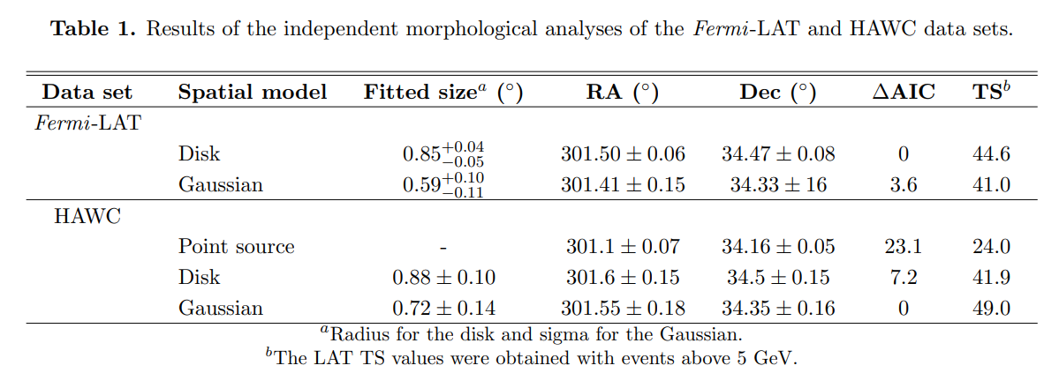
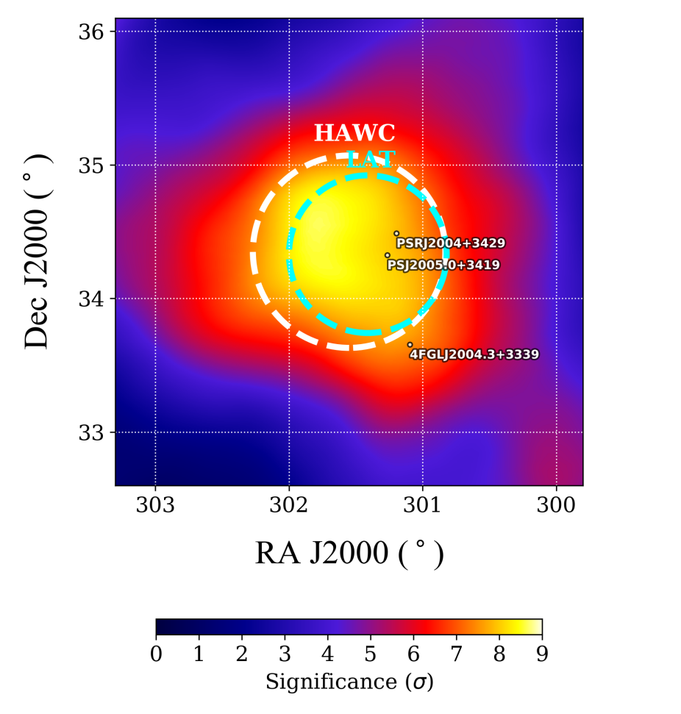
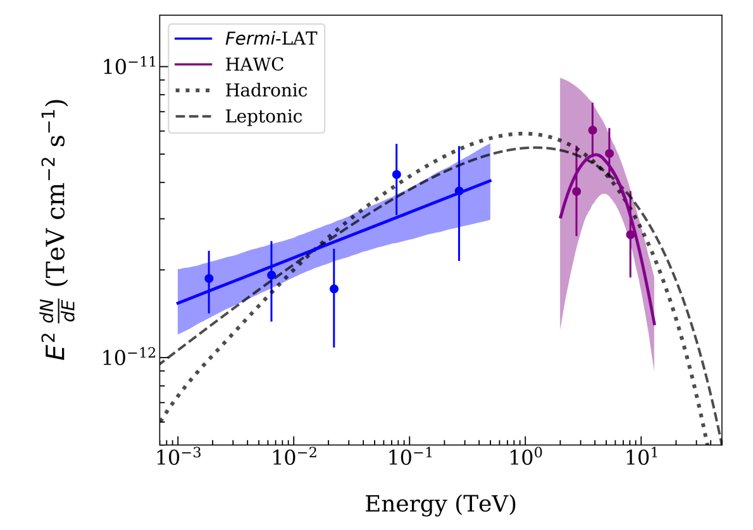
Introduction: Gamm-ray observations
The GeV and TeV gamma rays likely originate from the same physical source
Albert et al. 2020

Slide 19
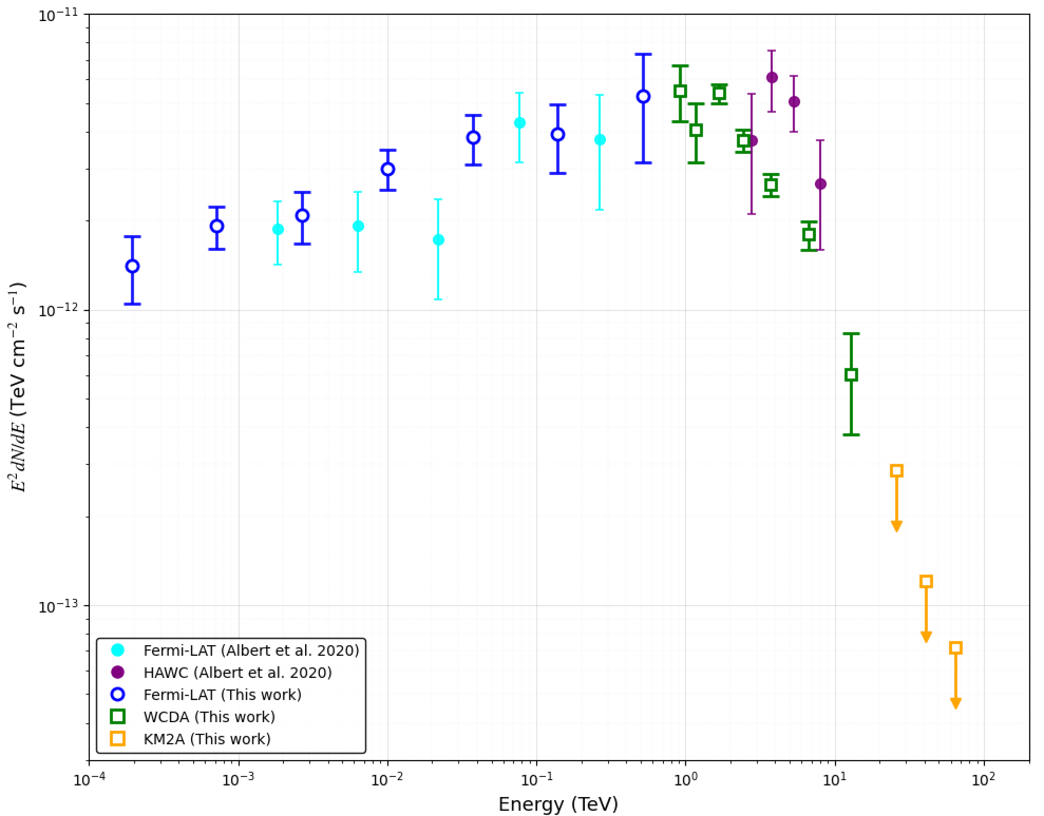

Slide 20
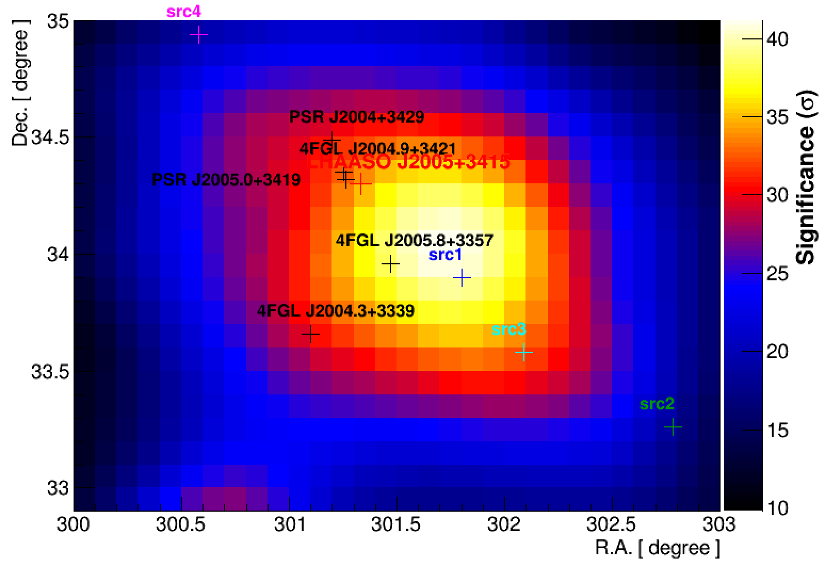
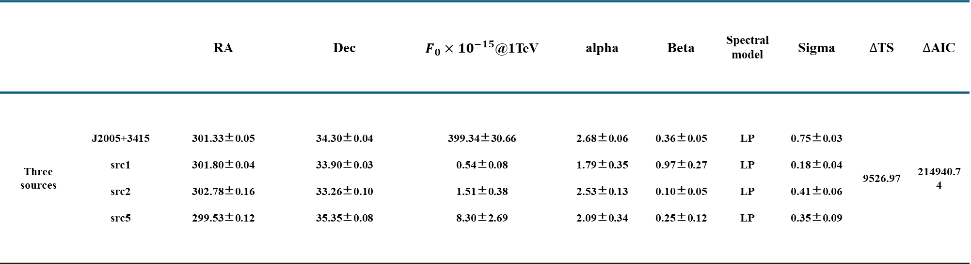
 |  | RA | Dec | $F_{0}{×10}^{−15}$@1TeV | alpha | Beta | Spectral model | Sigma | $∆$TS | $∆$AIC
Three sources | J2005+3415 src1 src2 src5 | 301.33±0.05 301.80±0.04 302.78±0.16 299.53±0.12 | 34.30±0.04 33.90±0.03 33.26±0.10 35.35±0.08 | 399.34±30.66 0.54±0.08 1.51±0.38 8.30±2.69 | 2.68±0.06 1.79±0.35 2.53±0.13 2.09±0.34 | 0.36±0.05 0.97±0.27 0.10±0.05 0.25±0.12 | LP LP LP LP | 0.75±0.03 0.18±0.04 0.41±0.06 0.35±0.09 | 9526.97 | 214940.74

Slide 21
Discussion: Origin of LHAASO J2005+3415
Hadronic or Leptonic?
Hadronic Origin —— Disfavored
Fermi-LAT data does not exhibit a pion-decay bump
Power-law index for the hadronic scenario (1.84±0.03) is significantly smaller than that expected by standard DSA theory (>2.0)

Slide 22
Discussion: Origin of LHAASO J2005+3415
Hadronic or Leptonic?
Leptonic origin 1: PWN/pulsar halo
Spectral feature is inconsistent with known (or candicate) pulsar halos (Ec~20-30TeV for those sources, see the poster of Chen E.S.) and the Gaussian template is significantly better than diffusion template
Leptonic origin 2: SNR
Fitted spectral index (2.53) is consistent with expectation from DSA theories
a pure shell-type SNR is disfavored

Slide 23
Discussion: Origin of LHAASO J2005+3415
Hadronic or Leptonic?
A shell-type SNR + escaping electrons?
Electrons diffuse from a shell-like source → no sharp peak at the centroid, could be similar to a Gaussian template
Higher-energy electrons escaped earlier from SNR, may be consistent with “TeV extension > GeV extension”

Slide 24
Discussion: Origin of LHAASO J2005+3415
Hadronic or Leptonic?
Leptonic origin 1: PWN/pulsar halo
PSR J2004+3429 association disfavored, no other plausible pulsars
Required electron energy: 10⁴⁹–10⁵⁰ erg ≫ pulsar spin-down energy (~4×10⁴⁷ erg)
Implied physical size: >300 pc (too large for a PWN/halo)
GeV extension is smaller than TeV, not expected for PWN/halo
Spectral feature is inconsistent with known (or candicate) pulsar halos (Ec~20-30TeV for those sources, see the poster of Chen E.S.)
Gaussian template is significantly better than diffusion template → the morphology is inconsistent with a pulsar halo

Slide 25
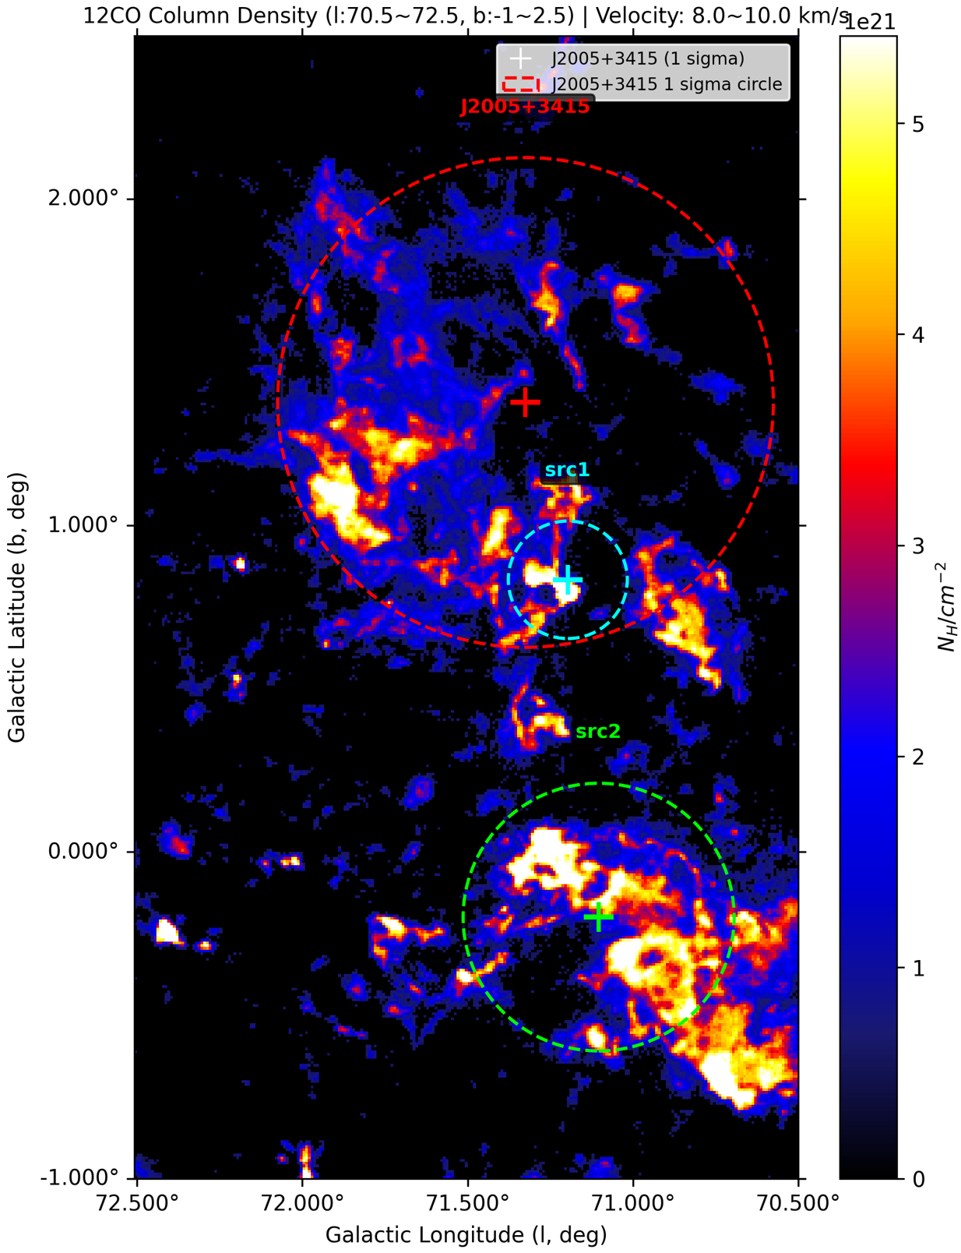
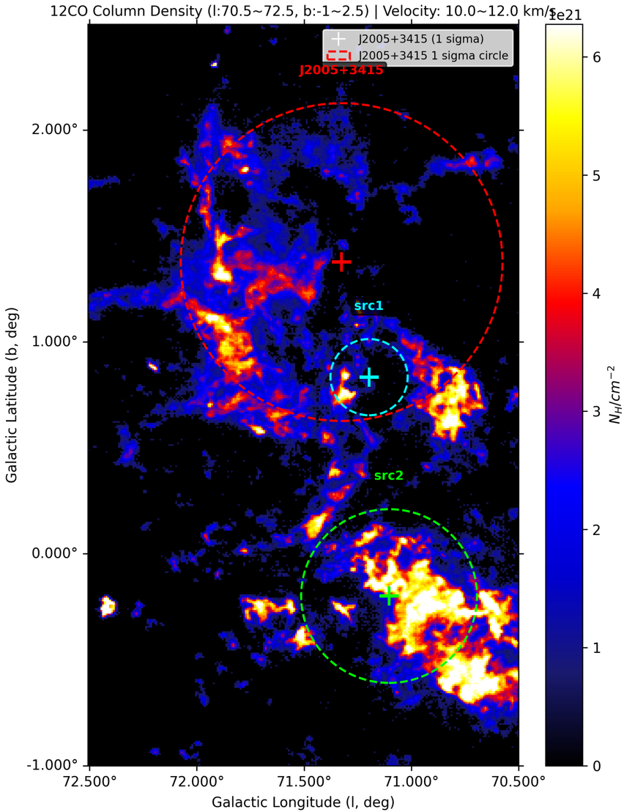
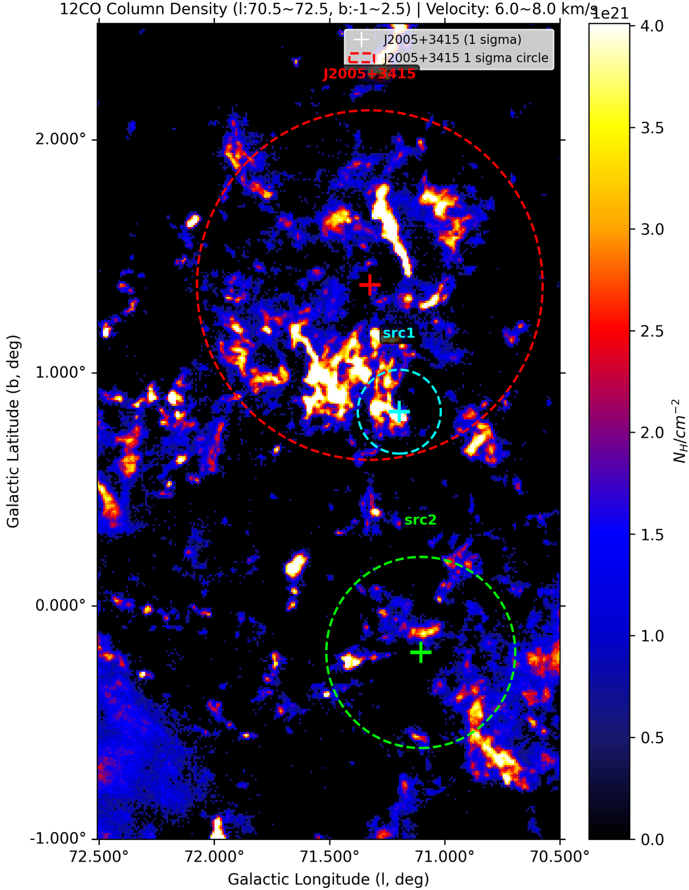
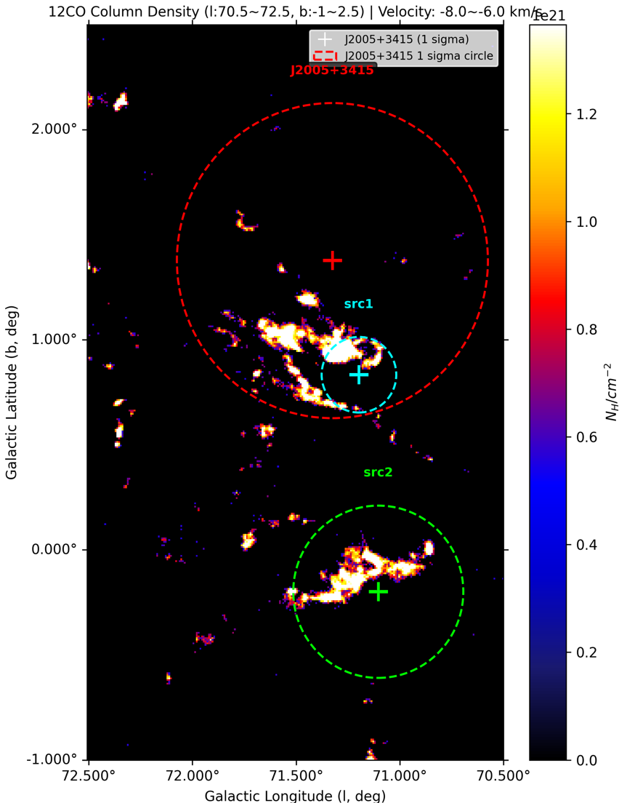
CO分析

Slide 26
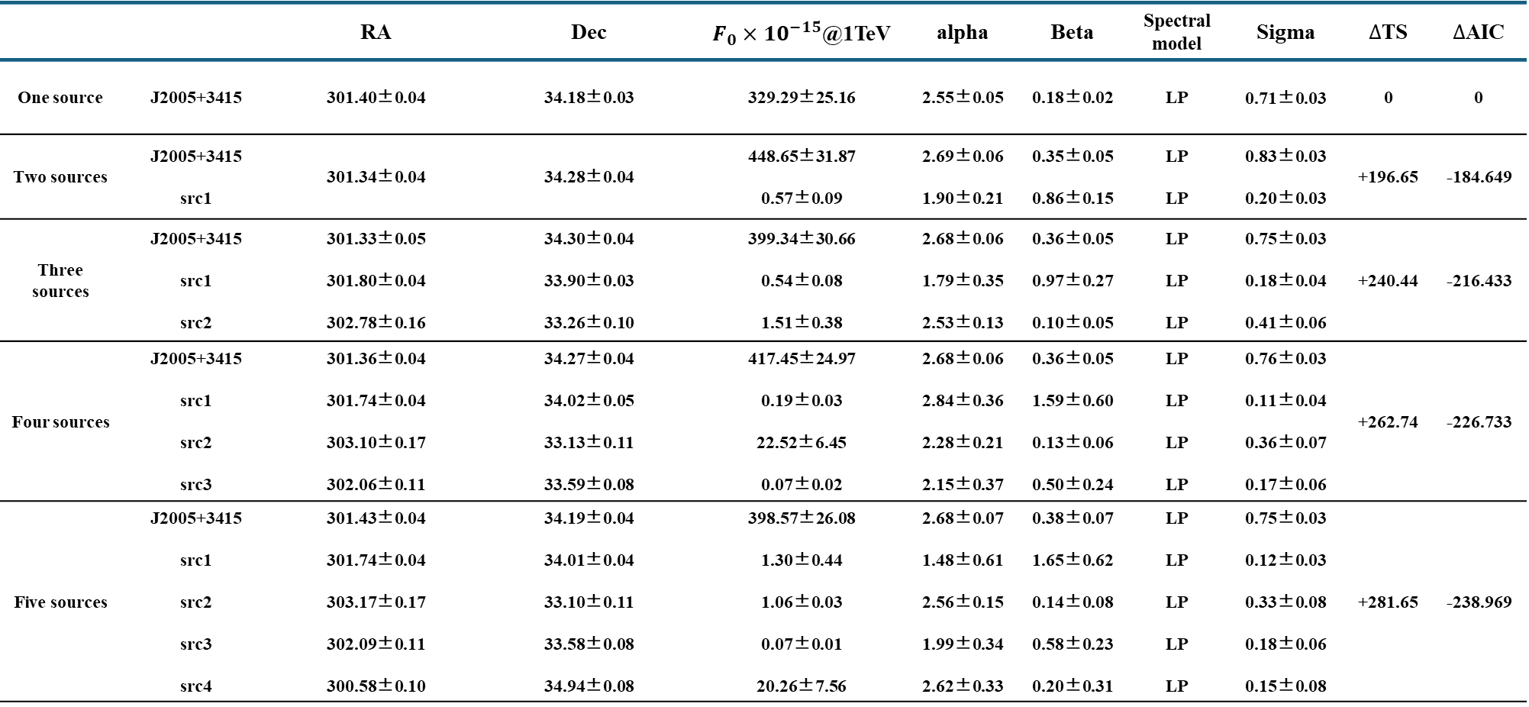
LHAASO Results
 |  | RA | Dec | $F_{0}{×10}^{−15}$@1TeV | alpha | Beta | Spectral model | Sigma | $∆$TS | $∆$AIC
One source | J2005+3415 | 301.40±0.04 | 34.18±0.03 | 329.29±25.16 | 2.55±0.05 | 0.18±0.02 | LP | 0.71±0.03 | 0 | 0
Two sources | J2005+3415 src1 | 301.34±0.04 | 34.28±0.04 | 448.65±31.87 0.57±0.09 | 2.69±0.06 1.90±0.21 | 0.35±0.05 0.86±0.15 | LP LP | 0.83±0.03 0.20±0.03 | +196.65 | -184.649
Three sources | J2005+3415 src1 src2 | 301.33±0.05 301.80±0.04 302.78±0.16 | 34.30±0.04 33.90±0.03 33.26±0.10 | 399.34±30.66 0.54±0.08 1.51±0.38 | 2.68±0.06 1.79±0.35 2.53±0.13 | 0.36±0.05 0.97±0.27 0.10±0.05 | LP LP LP | 0.75±0.03 0.18±0.04 0.41±0.06 | +240.44 | -216.433
Four sources | J2005+3415 src1 src2 src3 | 301.36±0.04 301.74±0.04 303.10±0.17 302.06±0.11 | 34.27±0.04 34.02±0.05 33.13±0.11 33.59±0.08 | 417.45±24.97 0.19±0.03 22.52±6.45 0.07±0.02 | 2.68±0.06 2.84±0.36 2.28±0.21 2.15±0.37 | 0.36±0.05 1.59±0.60 0.13±0.06 0.50±0.24 | LP LP LP LP | 0.76±0.03 0.11±0.04 0.36±0.07 0.17±0.06 | +262.74 | -226.733
Five sources | J2005+3415 src1 src2 src3 src4 | 301.43±0.04 301.74±0.04 303.17±0.17 302.09±0.11 300.58±0.10 | 34.19±0.04 34.01±0.04 33.10±0.11 33.58±0.08 34.94±0.08 | 398.57±26.08 1.30±0.44 1.06±0.03 0.07±0.01 20.26±7.56 | 2.68±0.07 1.48±0.61 2.56±0.15 1.99±0.34 2.62±0.33 | 0.38±0.07 1.65±0.62 0.14±0.08 0.58±0.23 0.20±0.31 | LP LP LP LP LP | 0.75±0.03 0.12±0.03 0.33±0.08 0.18±0.06 0.15±0.08 | +281.65 | -238.969

Slide 27

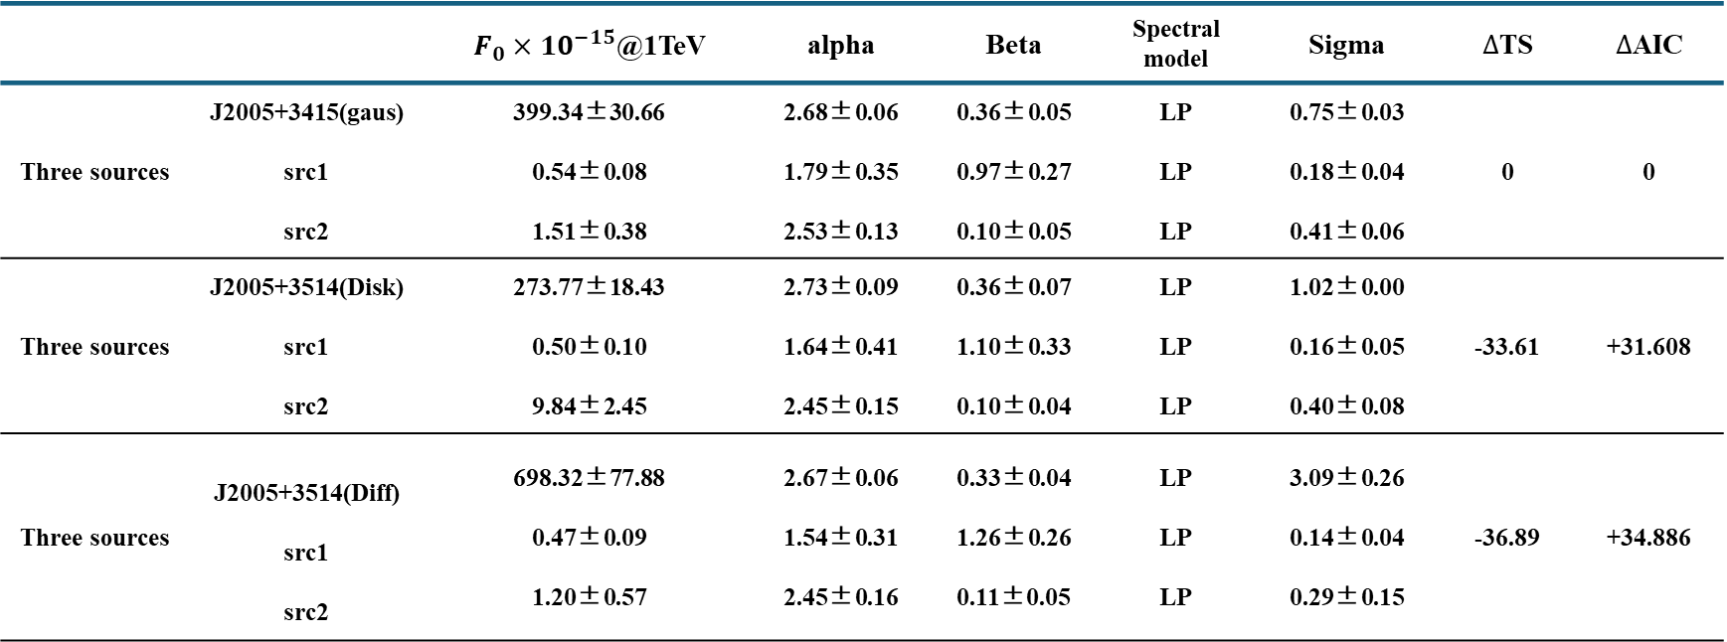
LHAASO Results
 |  | $F_{0}{×10}^{−15}$@1TeV | alpha | Beta | Spectral model | Sigma | $∆$TS | $∆$AIC
Three sources | J2005+3415(gaus) src1 src2 | 399.34±30.66 0.54±0.08 1.51±0.38 | 2.68±0.06 1.79±0.35 2.53±0.13 | 0.36±0.05 0.97±0.27 0.10±0.05 | LP LP LP | 0.75±0.03 0.18±0.04 0.41±0.06 | 0 | 0
Three sources | J2005+3514(Disk) src1 src2 | 273.77±18.43 0.50±0.10 9.84±2.45 | 2.73±0.09 1.64±0.41 2.45±0.15 | 0.36±0.07 1.10±0.33 0.10±0.04 | LP LP LP | 1.02±0.00 0.16±0.05 0.40±0.08 | -33.61 | +31.608
Three sources | J2005+3514(Diff) src1 src2 | 698.32±77.88 0.47±0.09 1.20±0.57 | 2.67±0.06 1.54±0.31 2.45±0.16 | 0.33±0.04 1.26±0.26 0.11±0.05 | LP LP LP | 3.09±0.26 0.14±0.04 0.29±0.15 | -36.89 | +34.886
$$√$$

Slide 28
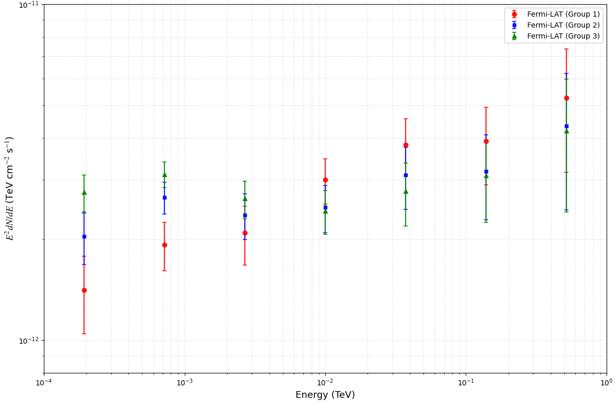
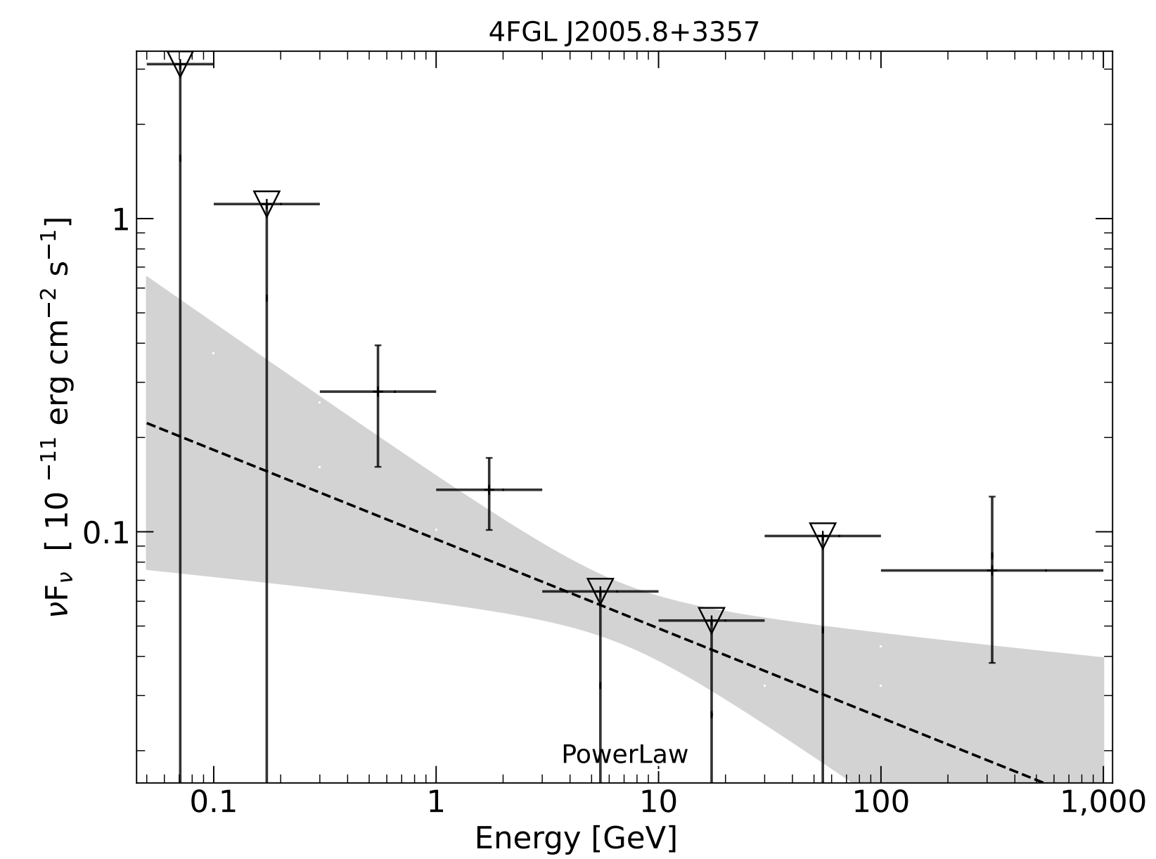
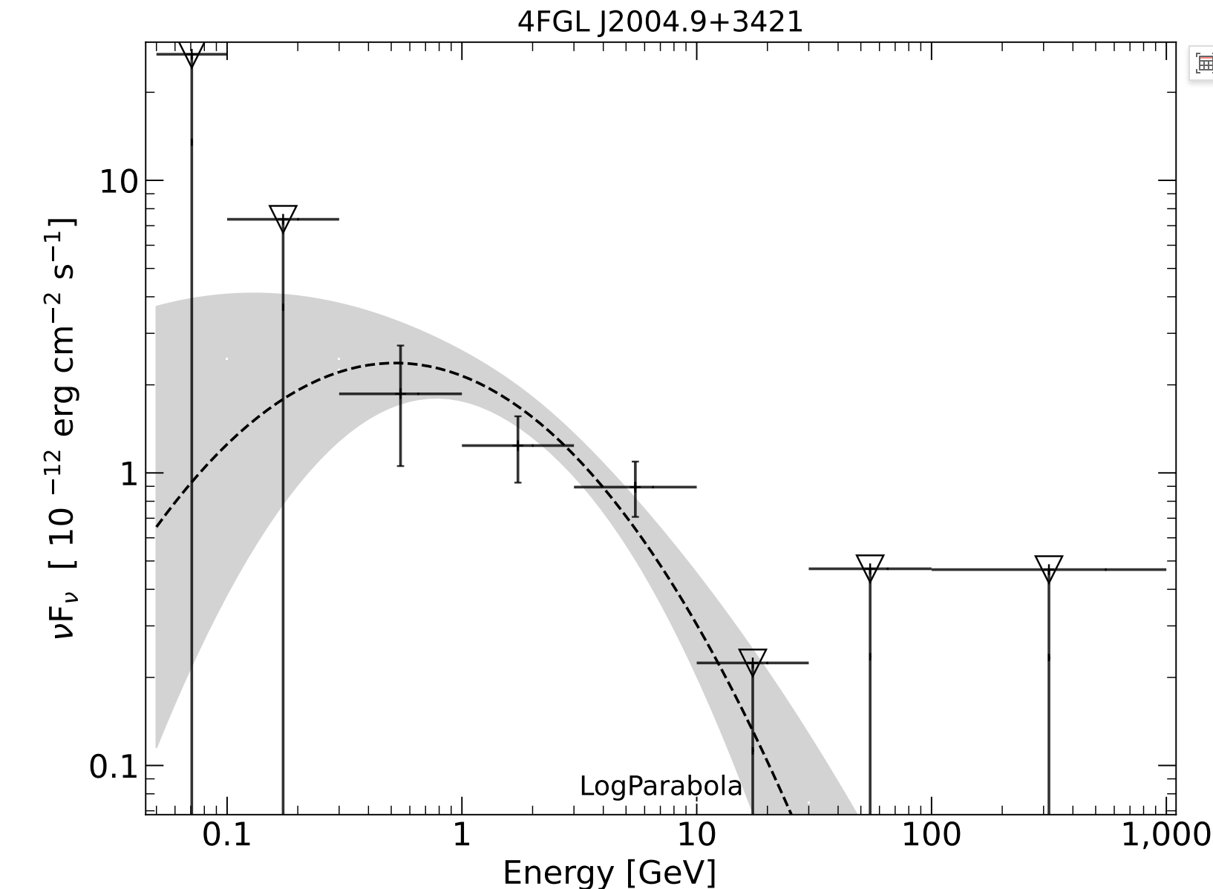
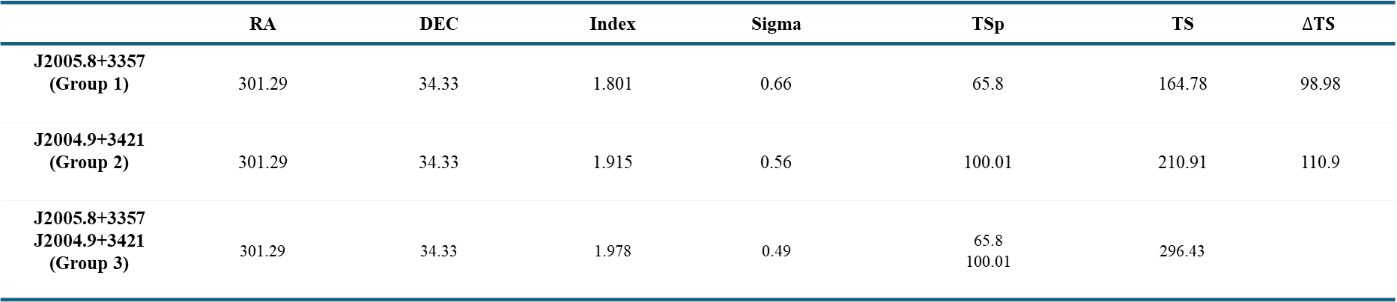
Fermi
 | RA | DEC | Index | Sigma | TSp | TS | $$∆TS$$
J2005.8+3357 (Group 1) | 301.29 | 34.33 | 1.801 | 0.66 | 65.8 | 164.78 | 98.98
J2004.9+3421 (Group 2) | 301.29 | 34.33 | 1.915 | 0.56 | 100.01 | 210.91 | 110.9
J2005.8+3357 J2004.9+3421 (Group 3) | 301.29 | 34.33 | 1.978 | 0.49 | 65.8 100.01 | 296.43

Slide 29
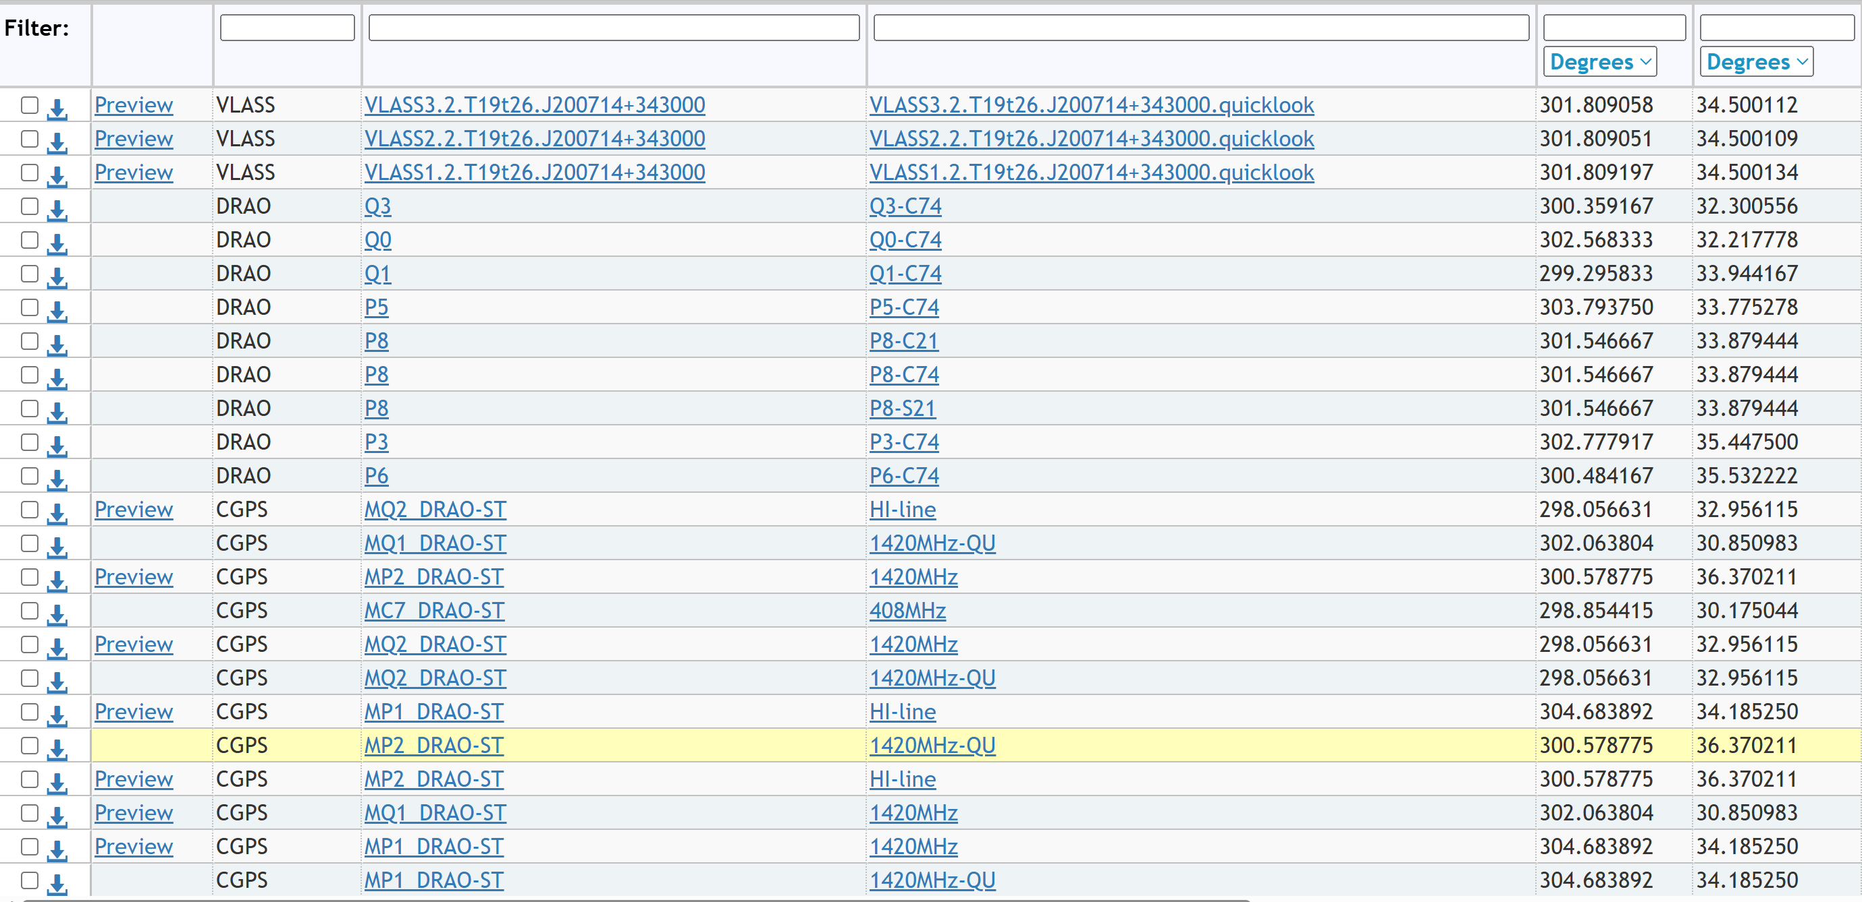
Radio observations
✓ VLA Sky Survey (VLASS)
✓ Dominion Radio Astrophysical Observatory (DRAO)
✓ Canadian Galactic Plane Survey (CGPS)
LHAASO J2005+3415:
RA:301.37 Dec:34.20

Slide 30
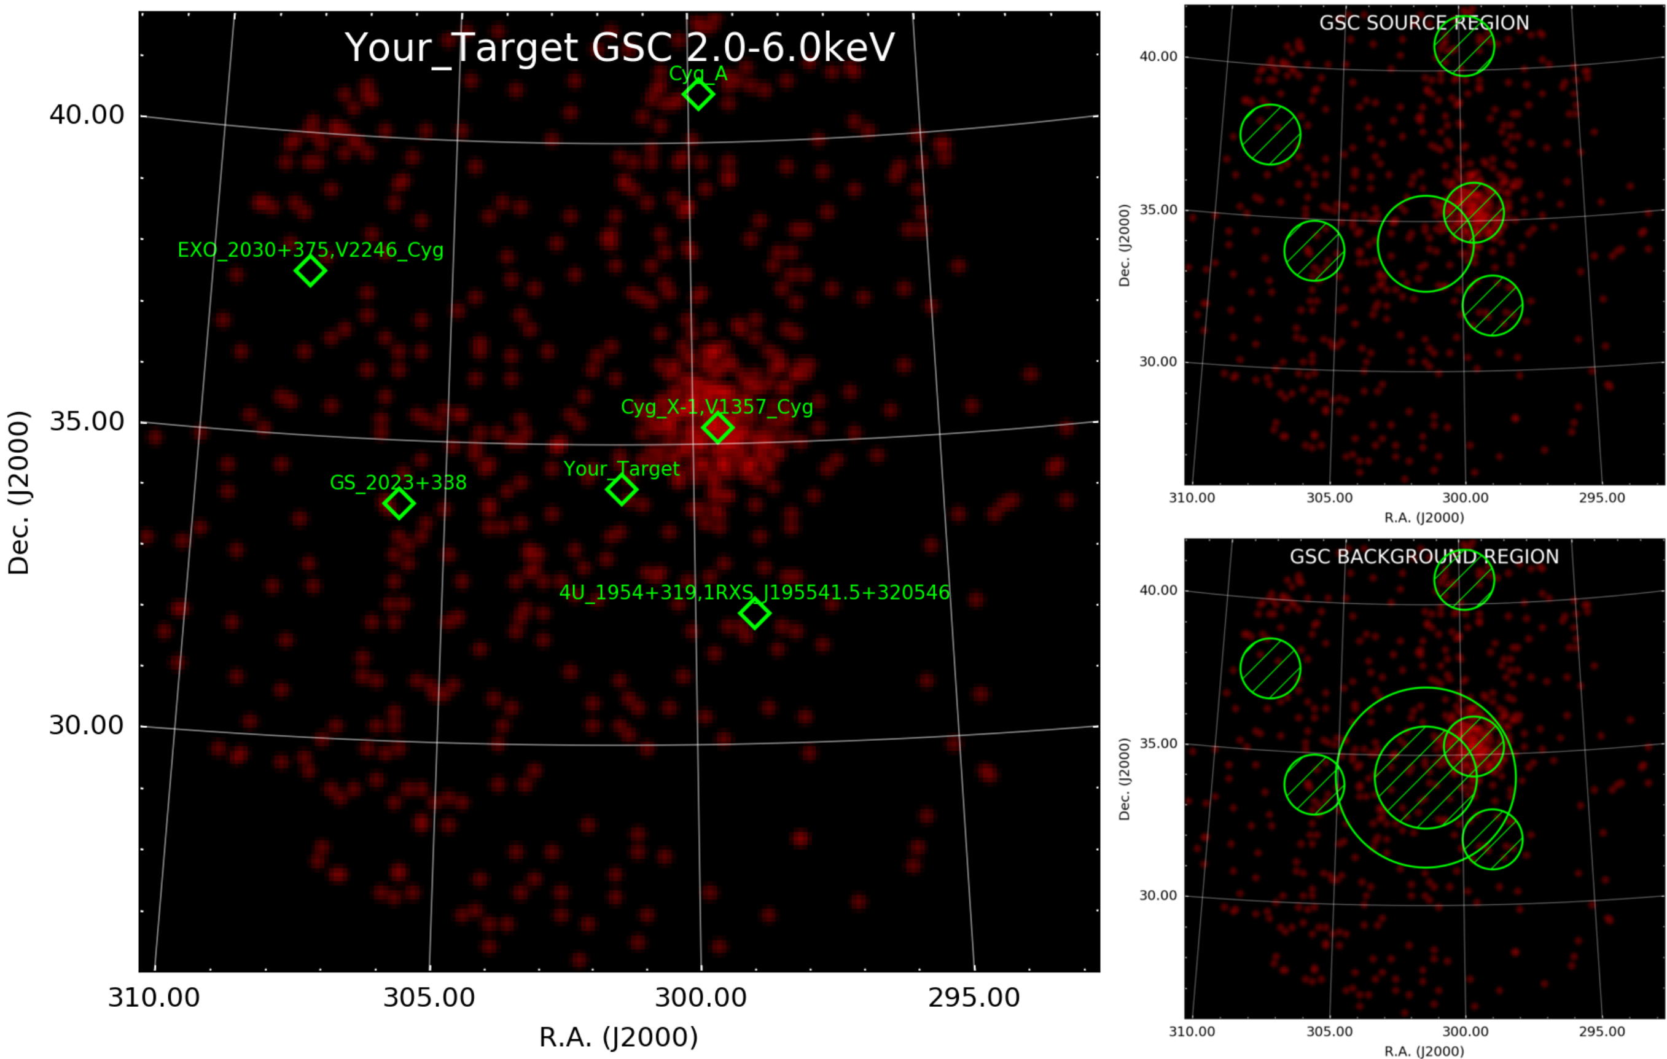

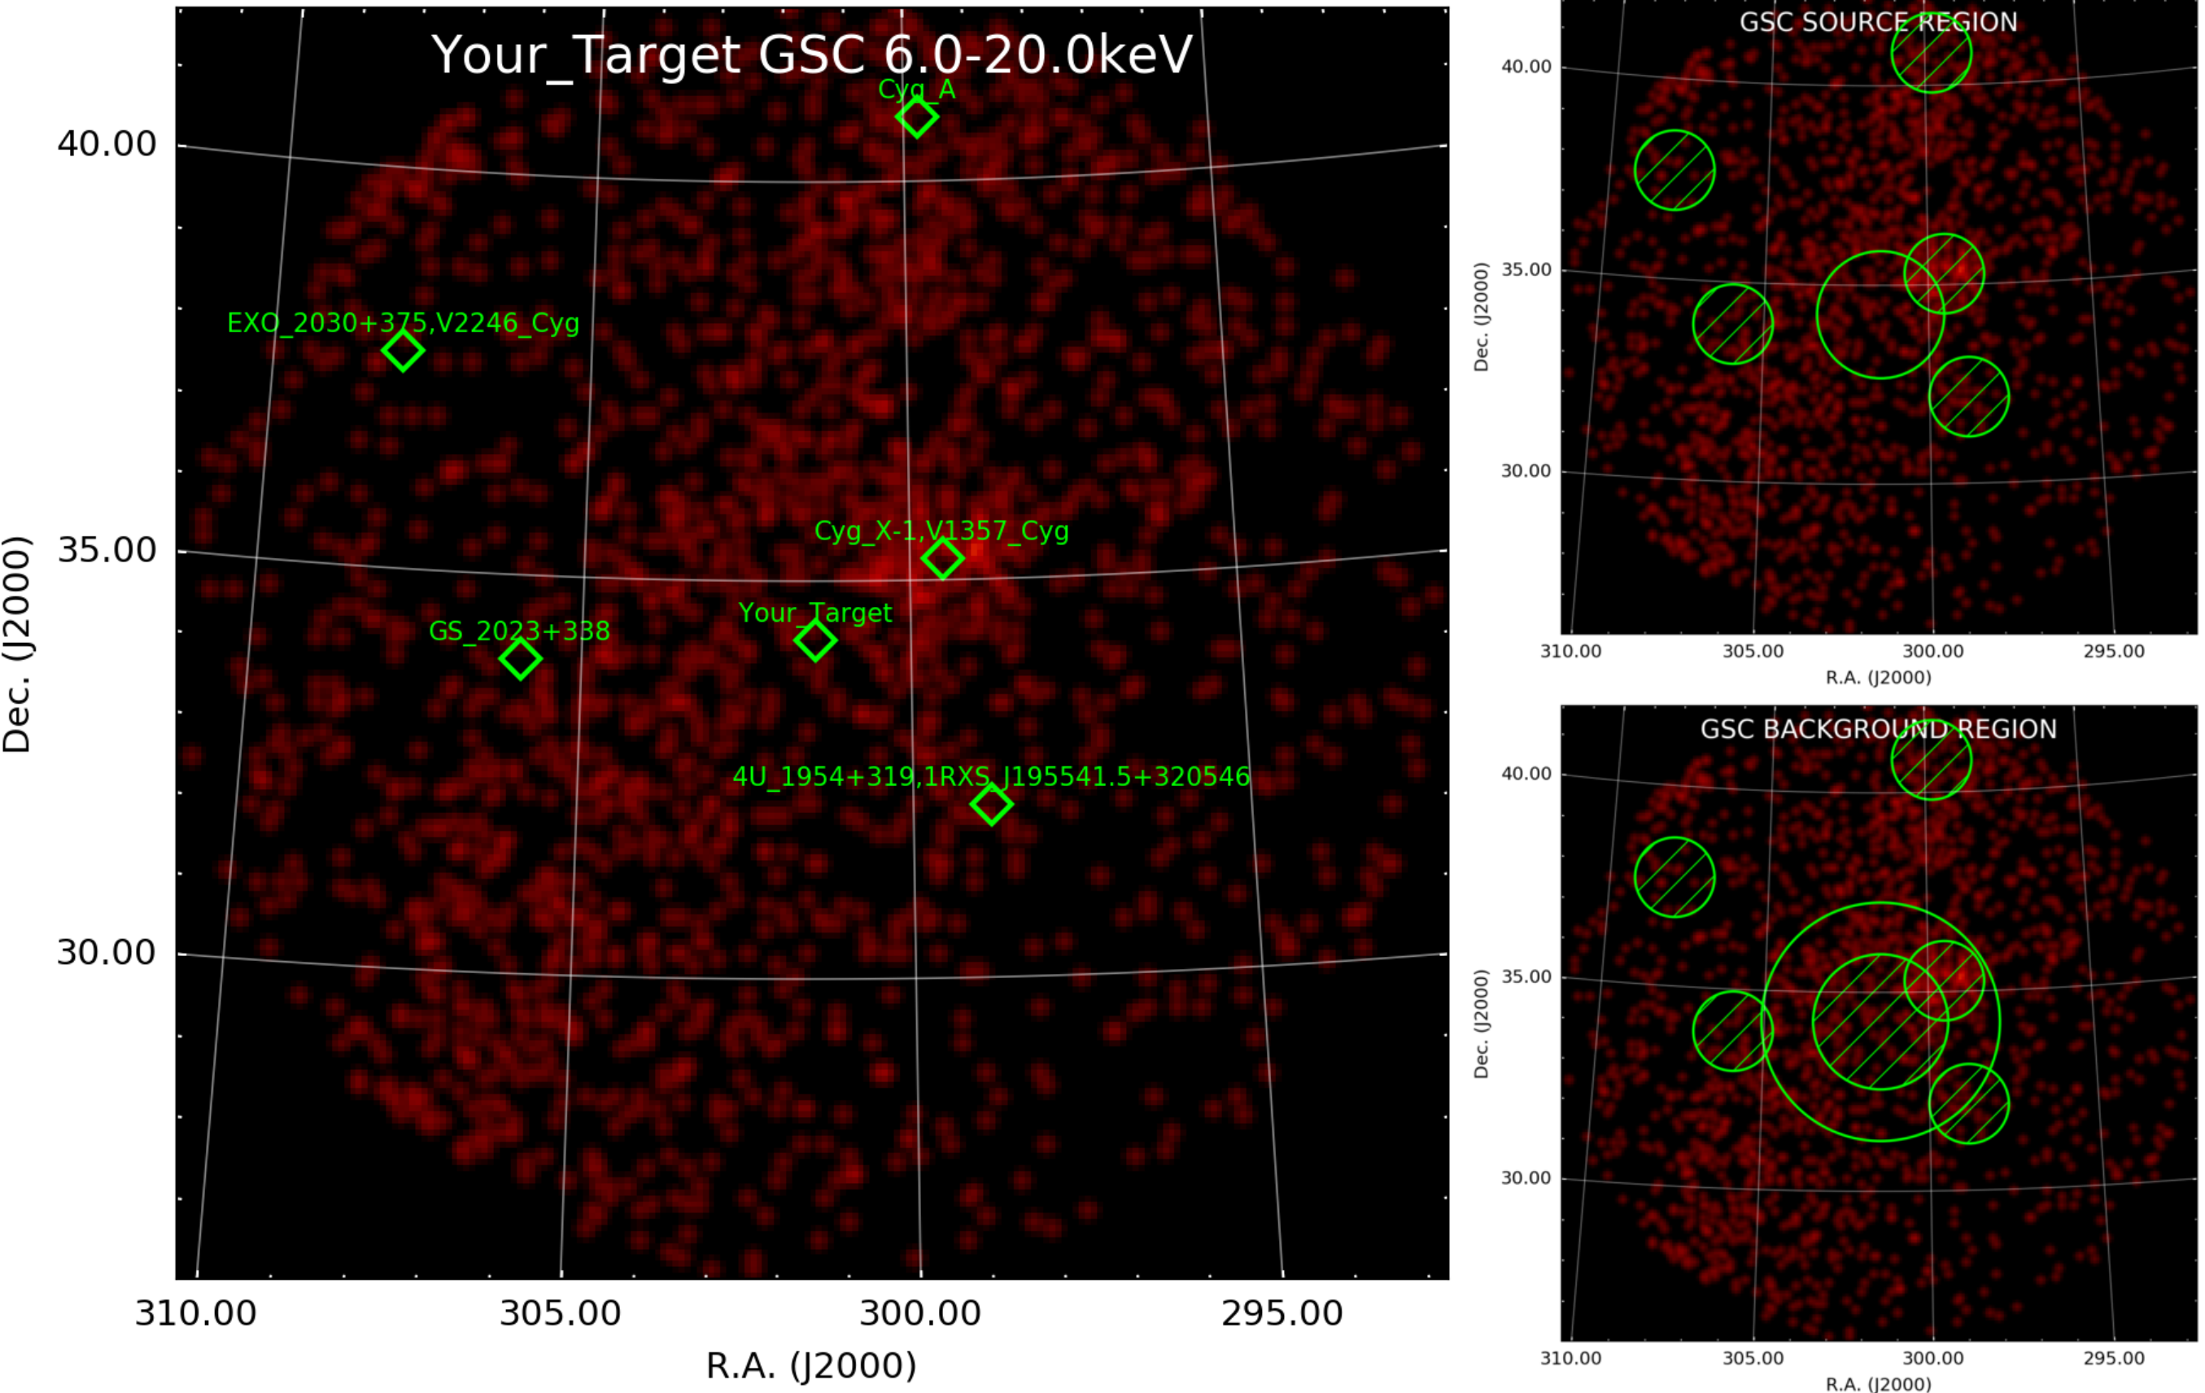
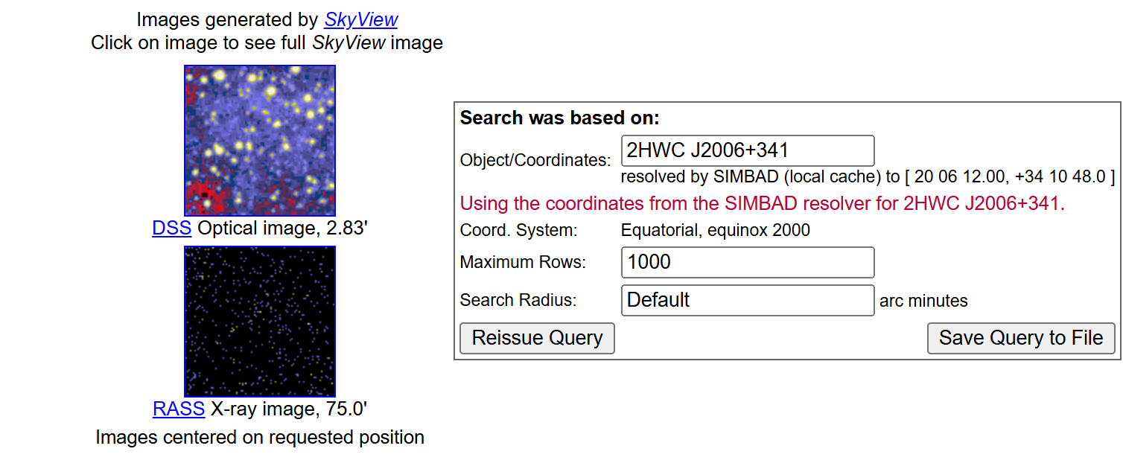
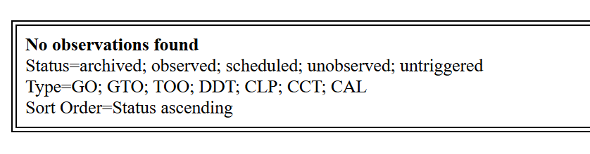
Introduction: X-ray observations
✓ XRT:
✓ MAXI:
0.3-10keV
✓ Chandra:
✓ XMM-Newton:

