Slide 1
LHAASO
Physics Coordination Committee
Report
Songzhan Chen
IHEP
2026.04.26@Suzhou

Slide 2
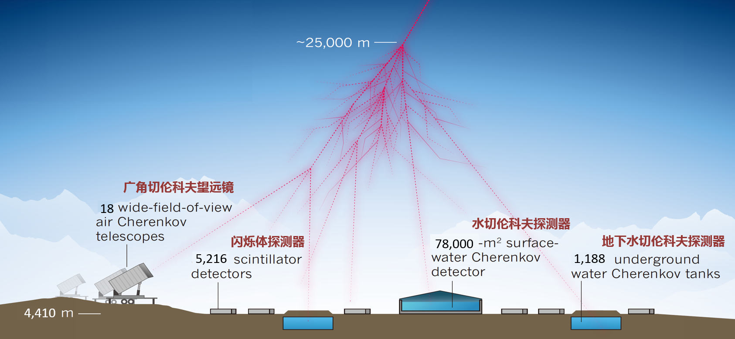
LHAASO detectors

Slide 3
Status of LHAASO data
Arrays | Detector configuration | Time | Data
KM2A | 1: ½ KM2A: 2365EDs+578MDs 2: 3/4 KM2A: 3978EDs+917MDs 3: Full KM2A: 5216EDs+1188MDs | 2019-12 --- 2020-11 2020-12 --- 2021-07 2021-07-20 --- now | 6.3 Years
WCDA | 1: ¼ WCDA: 1#pool 2: ½ WCDA: 1#pool+2#pool 3: Full WCDA | 2019-04 --- 2020-03 2020-03 --- 2021-03 2021-03-05 --- now | 5.0 Years
WFCTA | 6 telescopes 18 telescopes | 2019-10 2021-05-06 --- 至今 | 6.5 Years

Slide 4
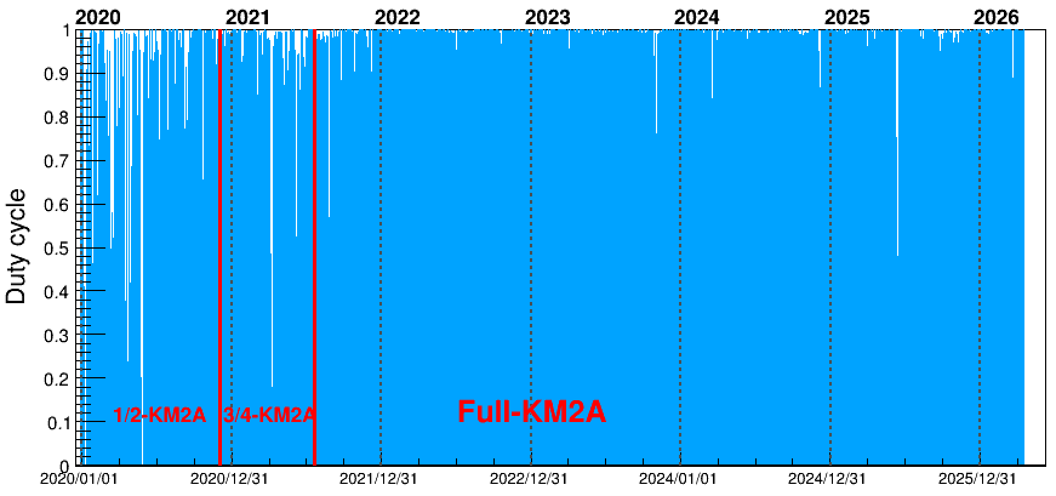
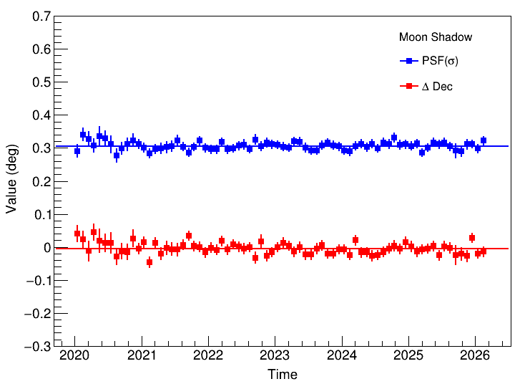
Status of the LHAASO detectors
Detectors status in 2025
KM2A long-term Status
Array | Running Time (h) | Duty cycle
KM2A | 8681 | 99.1%
WCDA | 8397 | 95.9%
WFCTA | 1436
Pointing and Angular resolution
Detector | Detector units | Normal rate
EDs | 5195 | 99.6%
MDs | 1180 | 99.3%
WCDA | 3026 | 97.0%
WFCTA | 18429 | 100.0%
PSF
Pointing

Slide 5
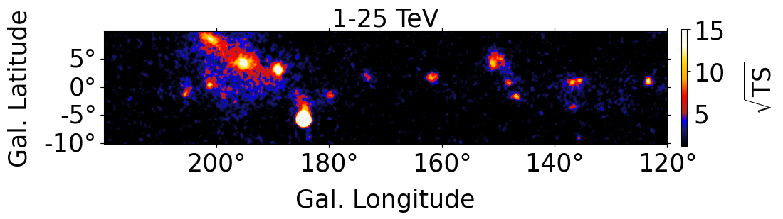
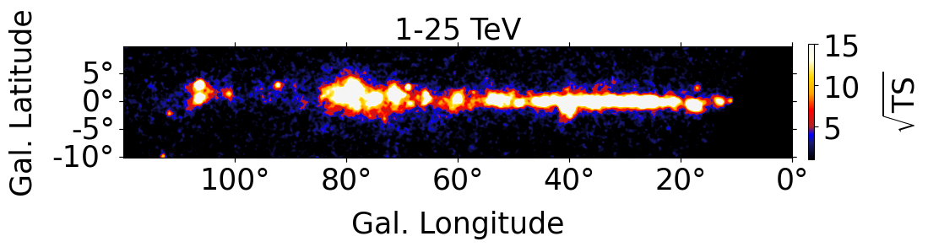




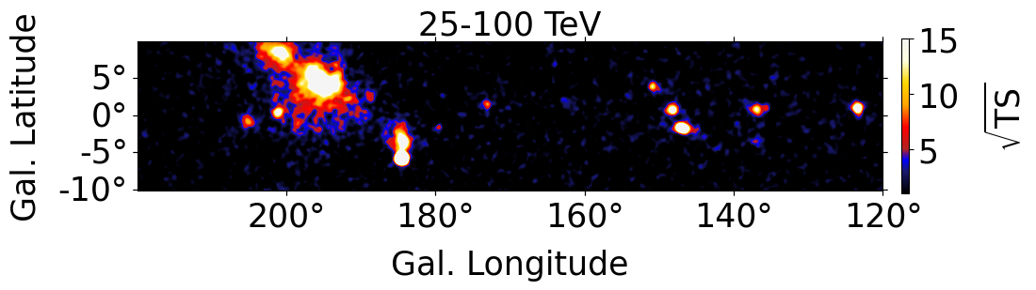
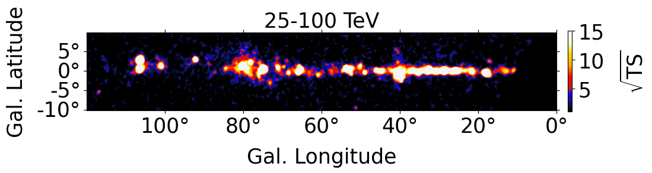
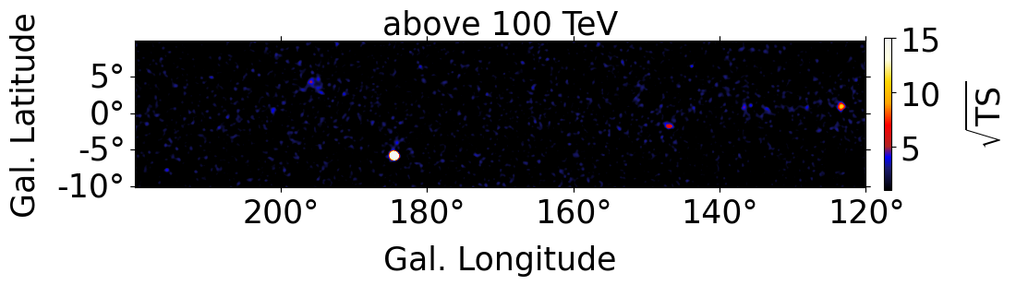
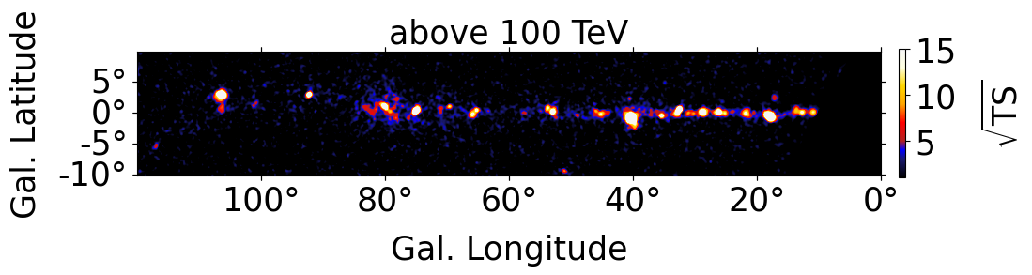
The Status of the 2nd catalog (137 sources)
2LHAASO (preliminary)
> 25 TeV
118
WCDA & KM2A
108
WCDA
127
KM2A
118
> 100 TeV（>4σ）
61

Slide 6
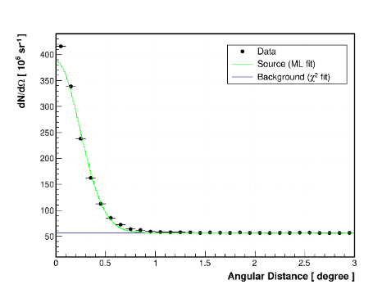
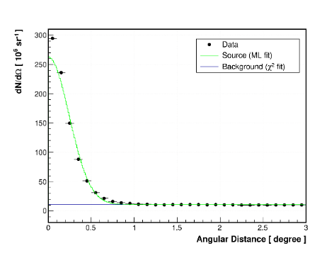
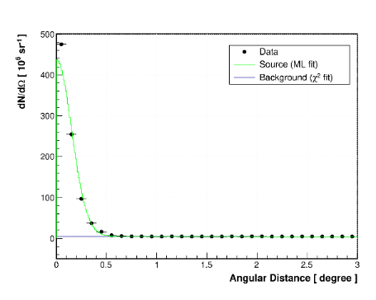
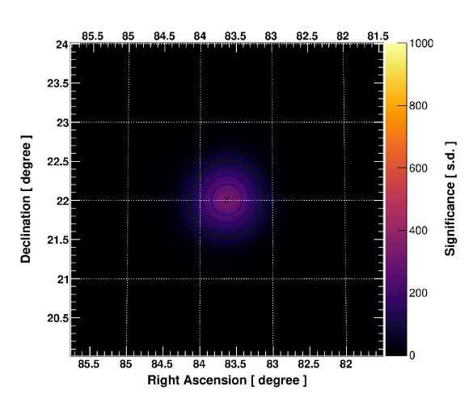
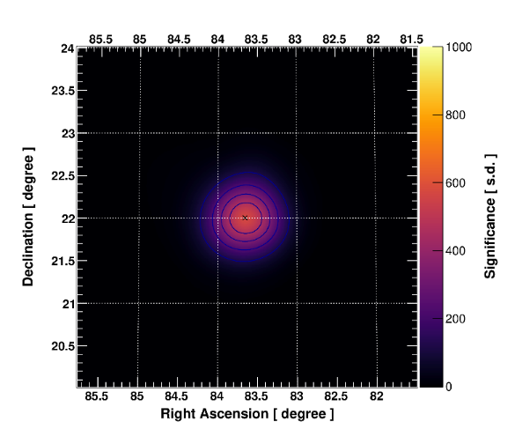
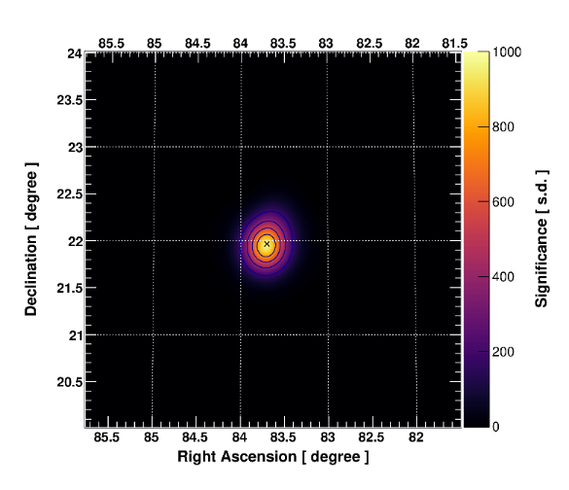






AI4LHAASO : WCDA Crab(2022）
The sensitivity of WCDA is improved by 1.5x1.7=2.55
$$φ_{70}=0.38^{∘}$$
$$φ_{70}=0.38^{∘}$$
$$φ_{70}=0.24^{∘}$$
AI direction
+ AI γ/P
AI γ/P
$$σ_{max}=380$$
$$σ_{max}=570$$
$$σ_{max}=950$$
+50%
+150%

Slide 7
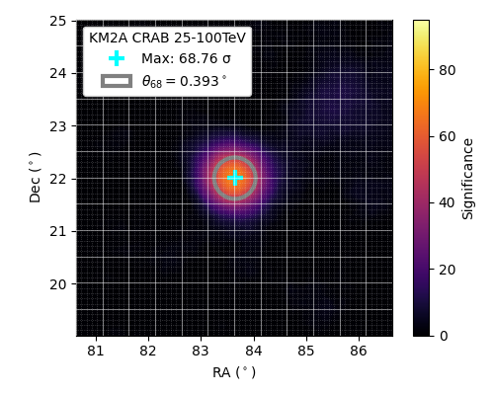

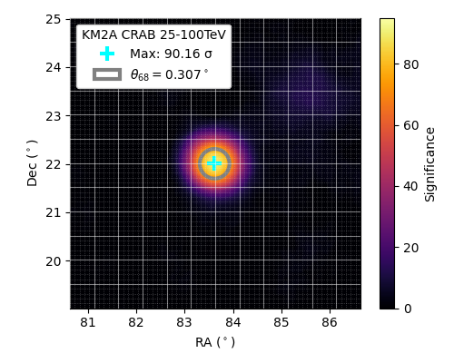
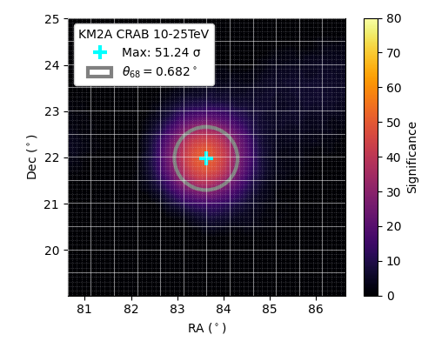

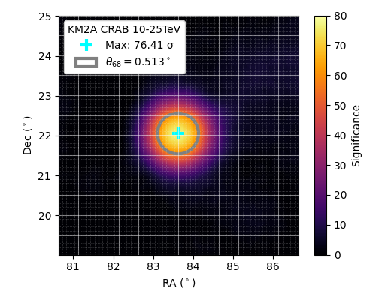
AI4LHAASO : KM2A Crab(2024.01-06)
25-100 TeV
AI direction
AI direction
+ AI γ/P
+15%
+31%
10-25 TeV
AI direction
AI direction
+ AI γ/P
+49%
+22%

Slide 8
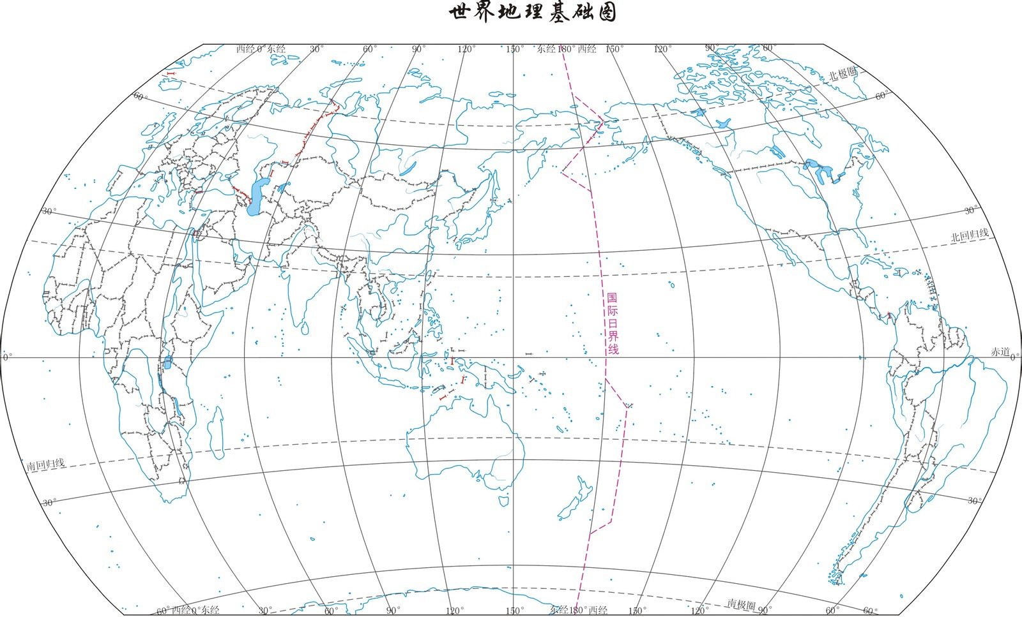

Joint Analysis & Observation with LHAASO (Ma xh)
KM3NeT
BAIKAL(GVD)
ANTARES
MAGIC
LEI
VERITAS
LST/CTAO
LHAASO拉索
CRAFTS
(FAST天眼)
space
eROSITA(DE)
DAMPE悟空
Multiwavelength Astronomy
Multi-messenger Astroparticle Physics
Multi-method Cosmic ray Physics
Multidisciplinary Physics
At present, 10 collaborations have MoUs with LHAASO.

Slide 9
Joint Analysis & Observation with LHAASO
 | collaboration | Convenor of JAWG | status
Multiwavelength Astronomy | CRAFTS | Jianli Zhang | analysis
 | MAGIC-transient -stable | Min Zha, Elisa Bernardini Ruoyu Liu | WCDA provides alert
 | VERITAS | Ruoyu Liu | MoU
 | LST/CTAO | ? | MoU
 | eROSITA(DE) | Ruoyu Liu | MoU
Multi-messenger Astronomy | ANTARES | Xinhua Ma, Tianqi Huang, Francisco Salesa Greus | LHAASO provides skymap, and ANTARES provides neutrino events
 | KM3NeT | Min Zha, Silvia Celli, Paco Salesa | LHAASO provides skymap, and KM3NeT is preparing for neutrino events
 | BAIKAL | Mingjun Chen | MoU
Multi-method Cosmic ray Physics | DAMPE | Qiang Yuan | analysis
Multidisciplinary Physics | LEI | Xiangdong Sheng, Xunxiu Zhou | analysis
MoU with eROSITA(DE) is extended more 3 years.
In 2026, 3 MoUs with VERITAS, MAGIC and LST(CTA) will be expired. Should they be extended?

Slide 10
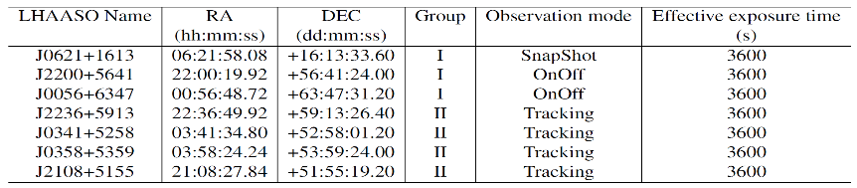
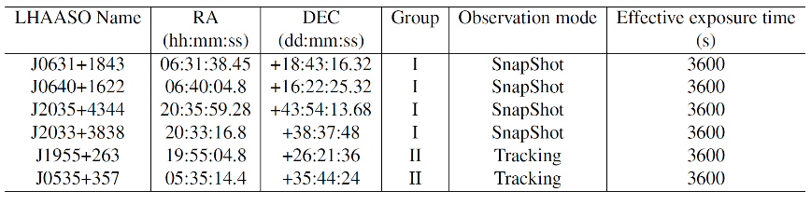
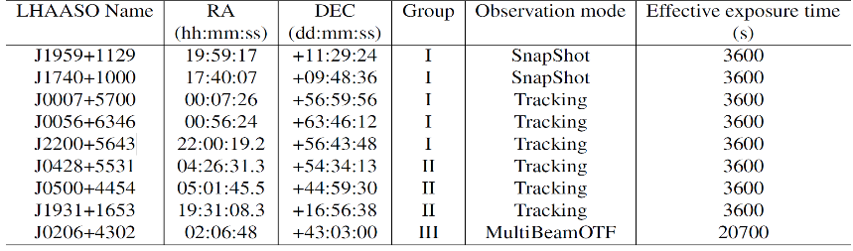
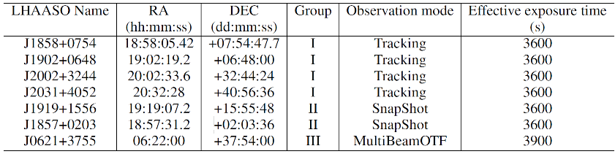
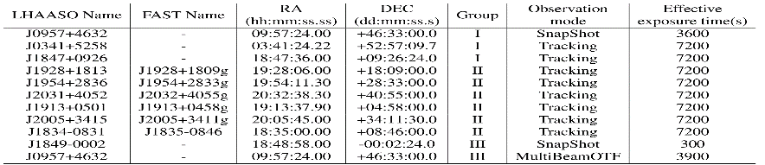
FAST observations for LHAASO( Zhang jl)
28.8 hours approved with FAST
25 LHAASO targets observed by FAST
Discovered PSR J2238+5903 (LHAASO J2238+5900 )
HI and continuum maps were obtained for LHAASO peanut, J0621+3755, J0957+4632 and the Crab
2021
2022
2023
2024
2025

Slide 11
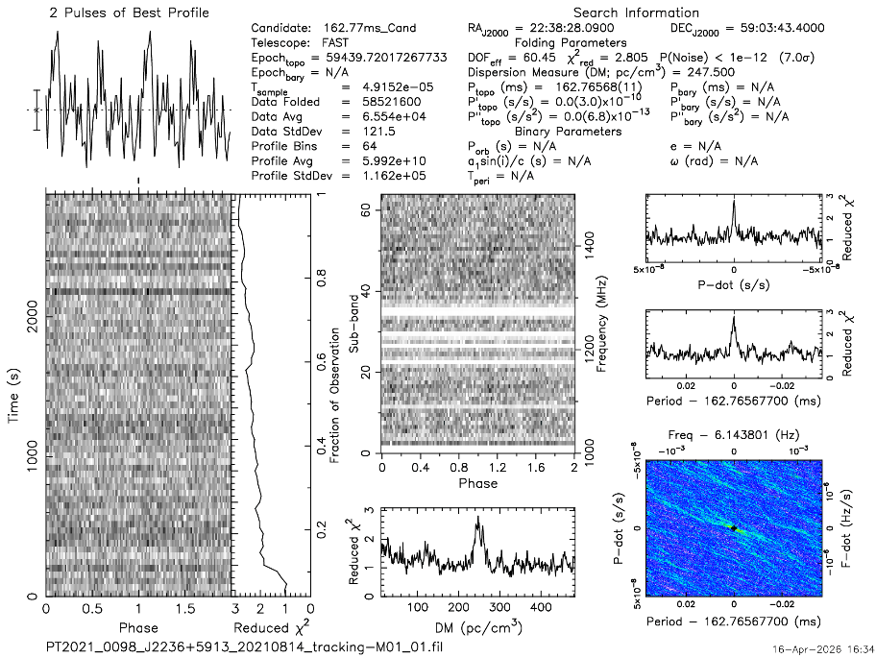
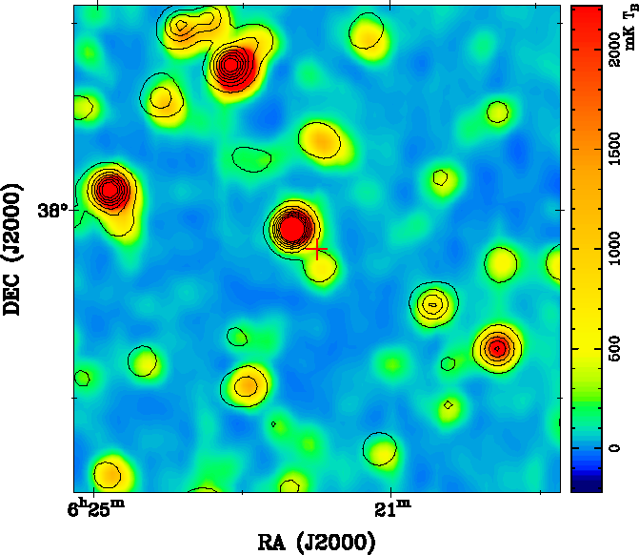
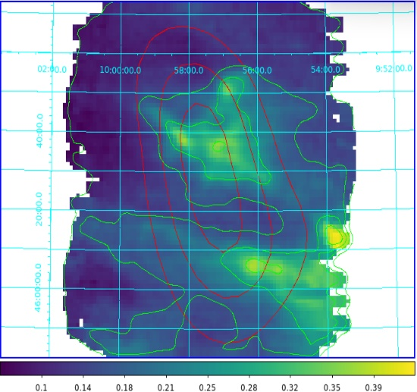
FAST observation results
PSR J2238+5903 (LHAASO J2238+5900)
LHAASO J0621+3755
LHAASO J0957+4632

Slide 12
P-FXT observations for LHAASO(Zhou p)
Total exposure 536 ks with X-ray Images and fluxes (or limits)
Cycle | Target | exposure (ks) | Publication | Diffuse X-ray emission
1 and PV | 1LHAASO J1740+0948 | 57 | Submitted | Y
 | 1LHAASO J0206+4302u | 34 |  | N
 | 1LHAASO J0216+4237u | 40 |  | N
 | 1LHAASO J0428+5531 | 24 |  | N
 | 1LHAASO J1839-0548u | 38 |  | Y
 | 1LHAASO J1843-0335u | 51 |  | Y?
 | 1LHAASO J1908+0615u | 81 |  | ?
 | 1LHAASO J1959+1129u | 39 |  | N
2 | V4641 Sgr | 37 | Draft | Y
 | 1LHAASO J0056+6346u | 55 |  | Y?
 | 1LHAASO J2000+3023 | 39 |  | Y?
 | 1LHAASO J2007+3314 |  |  | N
 | 1LHAASO J0007+5659u | 15 |  | N
 | 1LHAASO J1857+0203u | 19 | obs. unfinished | ？
 | LHAASO J1850-0004u | 9 | obs. unfinished | ？

Slide 13
LHAASO related physical topics
Sky survey：V0 catalog, V1 catalog, V2 catalog……
Galactic γ-ray sources：PWN, Pulsar Halo, YMC, SNR, Micro quasar, Binary, Pulsar, Nova……
Extra-galactic γ-ray sources：GRB, EBL, AGN, Starburst, ….
Galactic diffuse γ-ray ：low latitude, Giant Molecular Clouds, high latitude
New physics：LIV, dark matter (Dwarf, Galactic), Primordial Black Hole,…
Gamma-ray astronomy
Cosmic ray physics
Cosmic ray spectrum：all particles, Proton, He, Fe,…
Anisotropy：all particles, light nuclei
Particle physics：cross section,….
Solar physics：IMF, Solar magnetic field, space weather,….
Atmosphere physics：cosmic ray and lightning,…

Slide 14
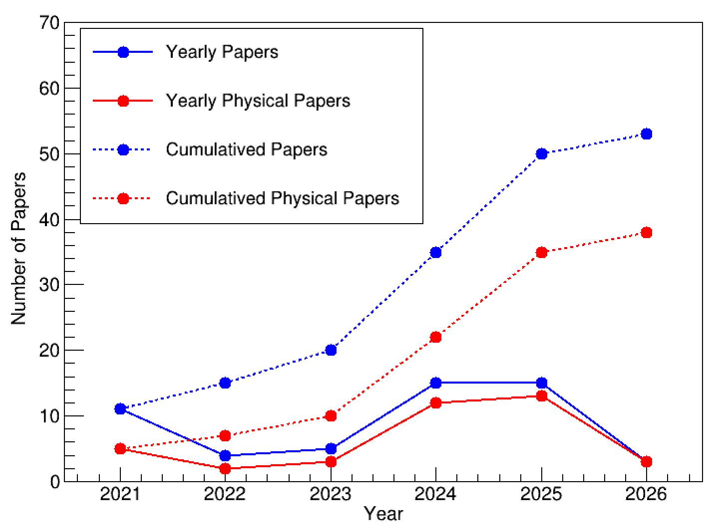
Formal Published LHAASO coll. papers
53 coll. papers
38 Physical papers

Slide 15
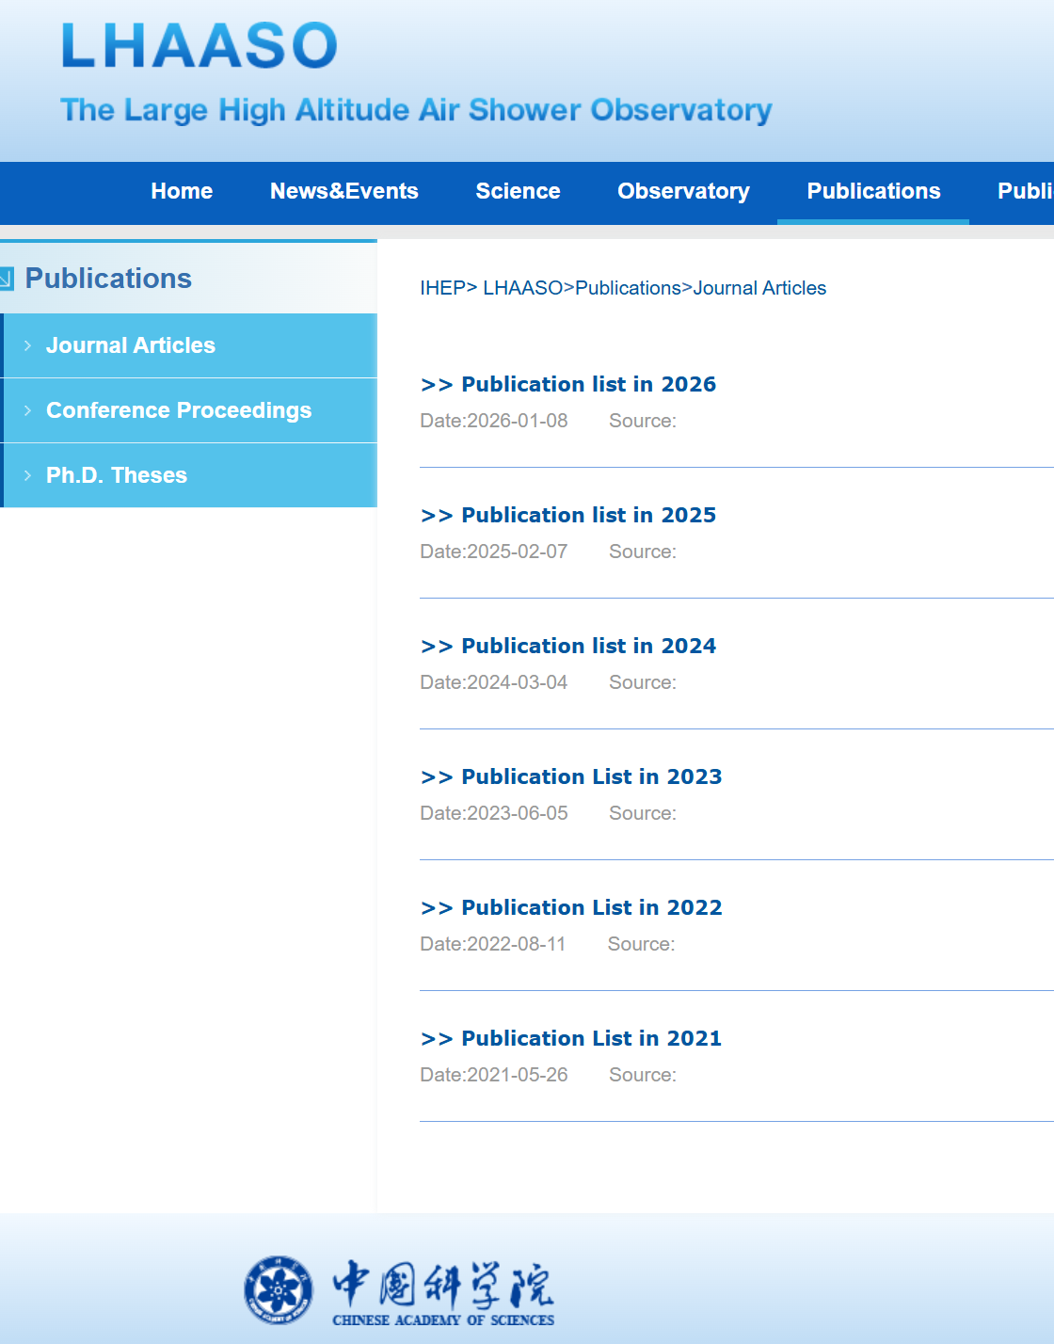
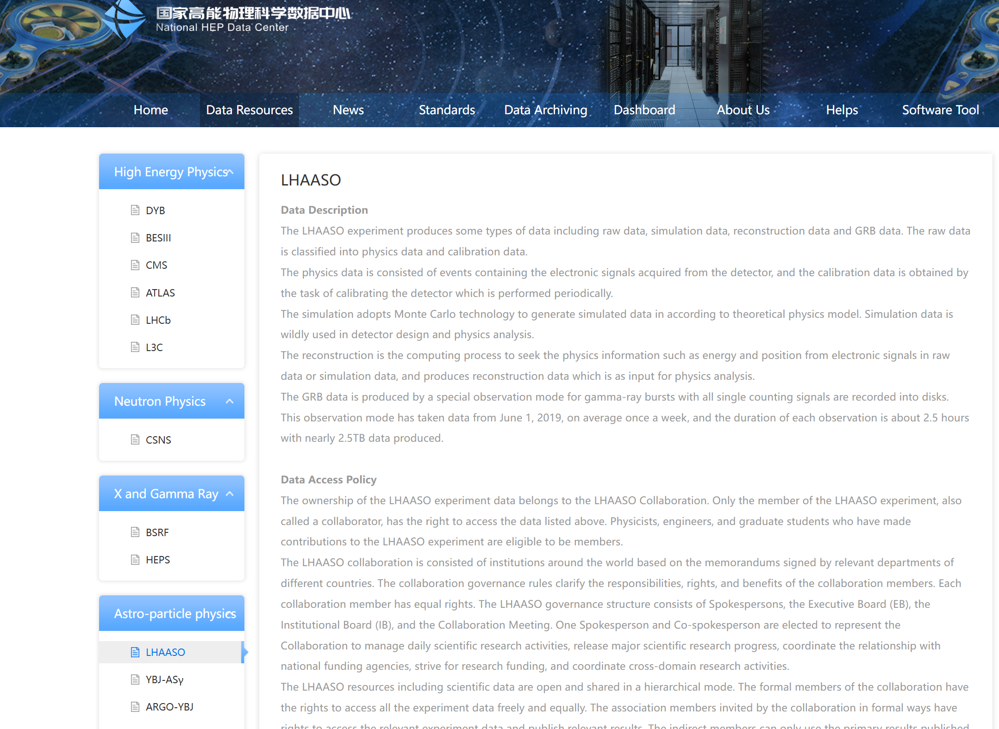
LHAASO published paper and data
All the published collaboration paper is presented in the LHAASO official website:
http://english.ihep.cas.cn/lhaaso/
All the figure data for LHAASO papers need to upload to the National HEP data center:
https://www.nhepsdc.cn/resource/astro/lhaaso?ignoreheadhttps://www.nhepsdc.cn/resource/astro/lhaaso?ignorehead
lizhe@ihep.ac.cn
zengshan@ihep.ac.cn

Slide 16
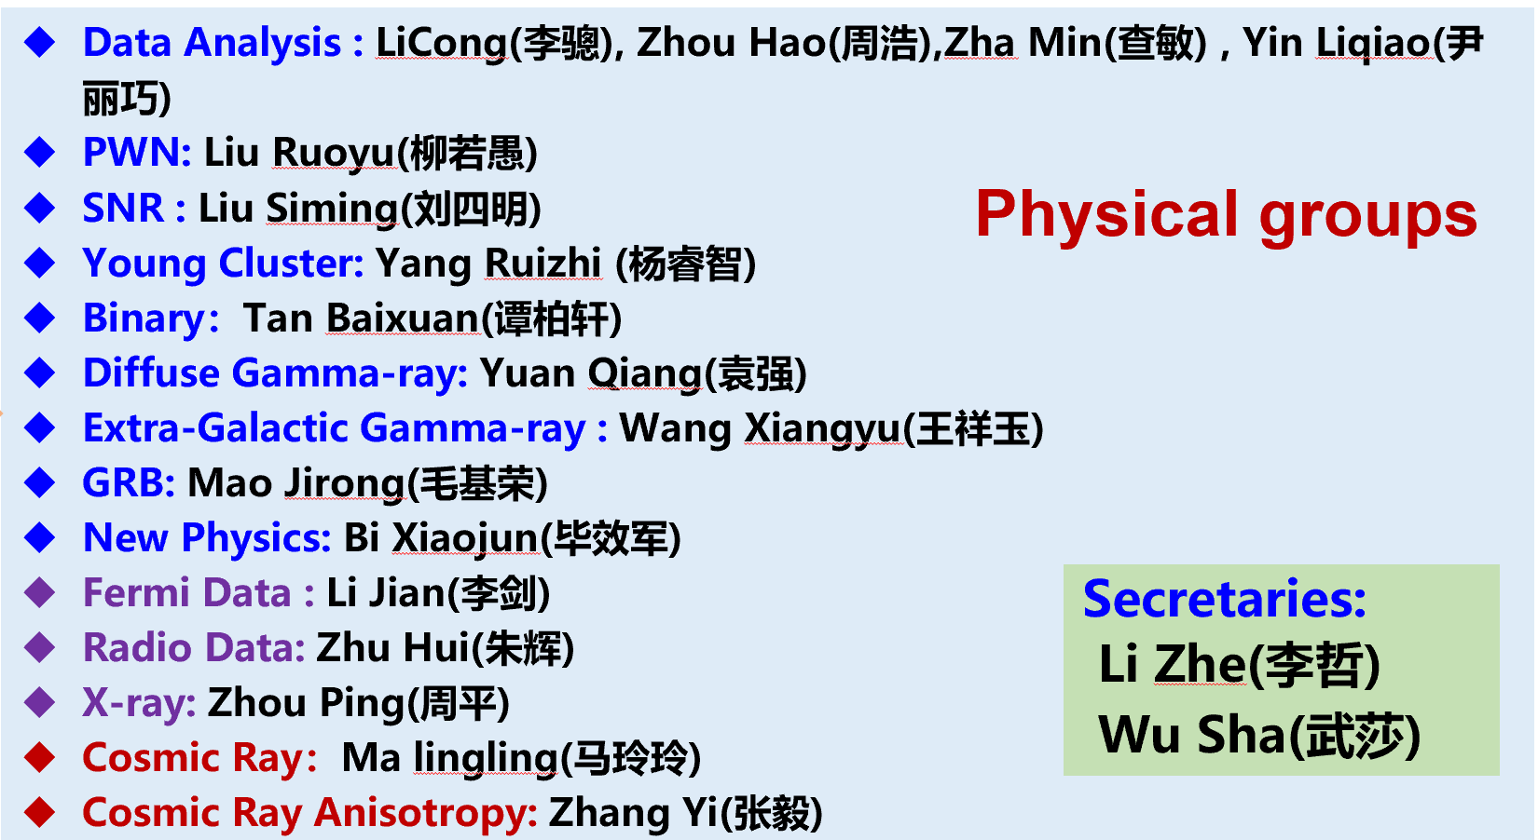
Physics Coordination Committee
1st PCC
2nd PCC
Self-recommendation solicitation: From 2026-1-23 to 2-26
Received 21 applications
2nd PCC will be formed after IB meeting.

Slide 17
This Collaboration conference
53 oral talks +51 posters
Only mature work are given oral talk
Please contact to the corresponding convener of PCC if you want to apply oral talk in the future collaboration conference!
We completely use the indico system since last conference.
Please register and submit your talk via indico in the future.

Slide 18
The Best Poster Award selection
The Best Poster Award
Strict selection discipline： Please don’t ask for vote
严肃评选纪律：不要拉票！不要商量投票！
Only for Junior and mid-level researchers
10% award rate
Professional + Public judges

Slide 19
Please enjoy the conference here!
Thank you!

