Slide 1


Neutron Calibration of EN-detector with Am-Be neutron source
Dayu Peng², Huiqian Zhang², Xinhua Ma¹, Shuwang Cui², Wei Gao¹, Wenchao Gao¹,
Key Laboratory of Particle Astrophysics, Institute of High Energy Physics, Chinese Academy of Sciences, Beijing 100049, China
College of Physics, Hebei Normal University, Shijiazhuang 050024, China
Date: 4/28/2026
Notes:
Good morning. I am peng dayu, representing prof cui.
Today I’ll present our work <Neutron Calibration of EN-detector with Am-Be neutron source>

Slide 2
CONTENTS
  Motivation
  Experiment
  Simulation
  Results
Notes:
The report consists of four sections: Motivation, Experiment, Simulation, and a summary of our Results.

Slide 3
01 Motivation

Slide 4
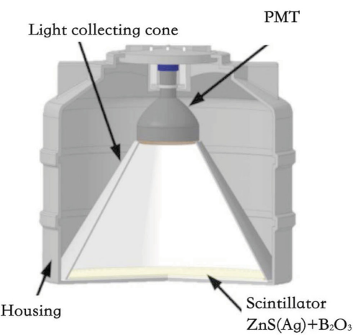
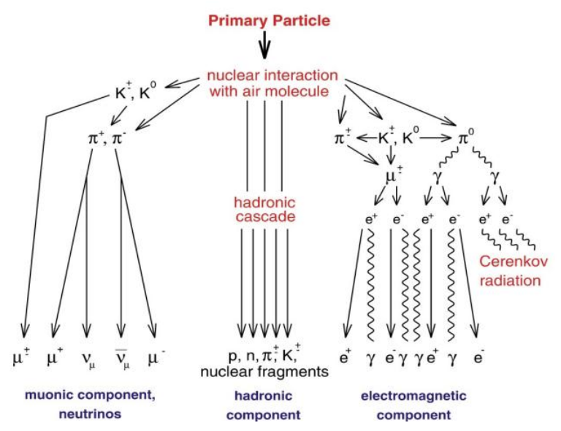
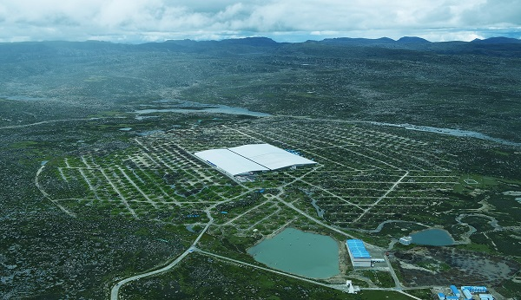
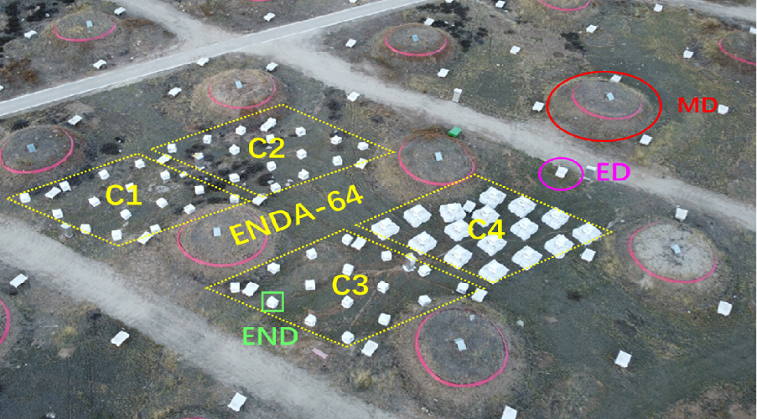
ENDA-64
The Electron-Neutron Detector Array (ENDA) is designed to measure the hadronic component in the core range of extensive air showers (EAS), serving as a complementary instrument for the LHAASO experiment.
64 detectors deployed into 4 clusters, with an equidistant spacing of 4.5 meters; total array area covers approximately 800 𝑚².
Measure electrons in the core range of EAS and thermal neutrons generated from the interaction of hadronic components of EAS with the environment.
EN Detector
ENDA-64
LHAASO+ENDA
Notes:
ENDA-64 is a 64-unit array at LHAASO designed for detecting hadronic components.
As shown here, we use Zinc Sulfide, or simply ZnS, and mixed with Boron Oxide as the primary scintillation material to measure both neutron and electron.

Slide 5
Motivation
Calibrate the detection efficiency of the EN-detector.
Study factors affecting detection efficiency.
Notes:
Moving to the core of this report:
I will present the calibration of the EN-detector's efficiency and analyze the key factors affecting its performance.

Slide 6
02 Experiment

Slide 7
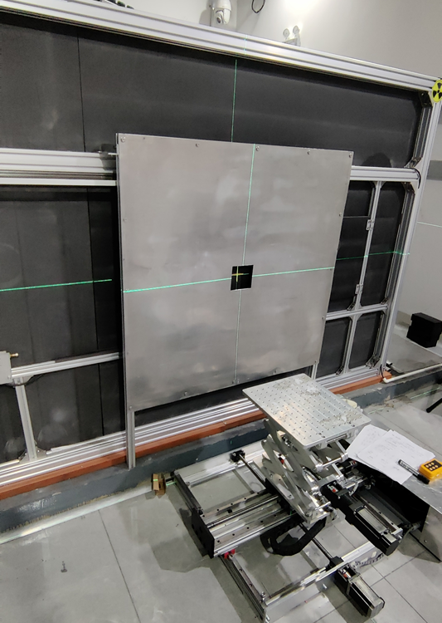
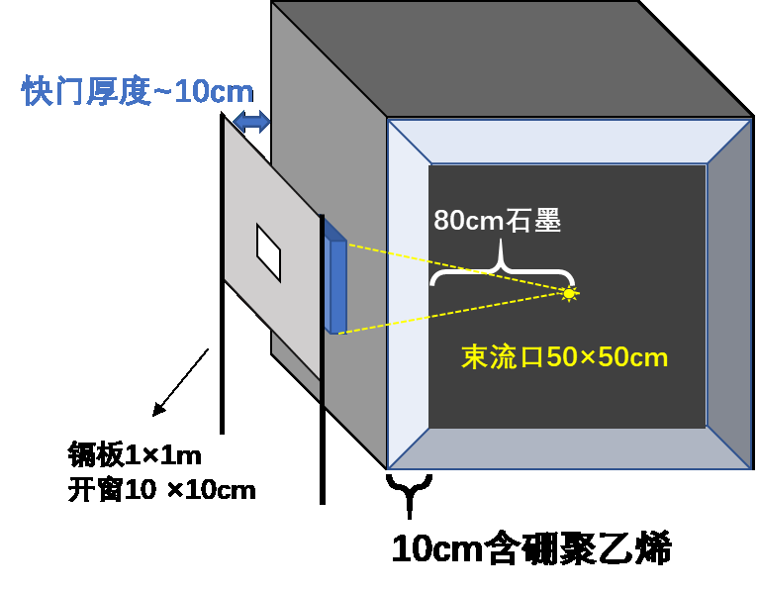
Am-Be neutron source
Shutter Thickness: ~10 cm
5mm Steel
3mm Lead
80 cm Graphite
Am-Be
Shutter: 50×50 cm
Cadmium (Cd) Plate
size 1×1 m
10 cm Borated Polyethylene
The neutron emission rate 1.17~1.22×10⁷neutrons/s.
Distance to Shutter (cm) | Neutron Flux (n/cm²/s) | Error
4.3 | 72.8 | 1.4%
6.3 | 66.7 | 1.75%-2%
10 | 58.2
27.3 | 32.2
Measurement methods:
Gold activation(Cd-difference method)
Cut-off: E<0.5eV
4.3cm from shutter / 25cm from graphite surface
Unit: China Institute of Atomic Energy (CIAE)
Notes:
This is our experimental setup at CIAE. The photo shows the Am-Be source inside an 80 cm graphite moderator.
The neutron emission rate is twelve million neutrons per second.
Using gold activation, we measured the flux at 4.3 cm to be 72.8 without the cadmium plate.
Based on this, we determined the flux for other distances as shown in the table

Slide 8
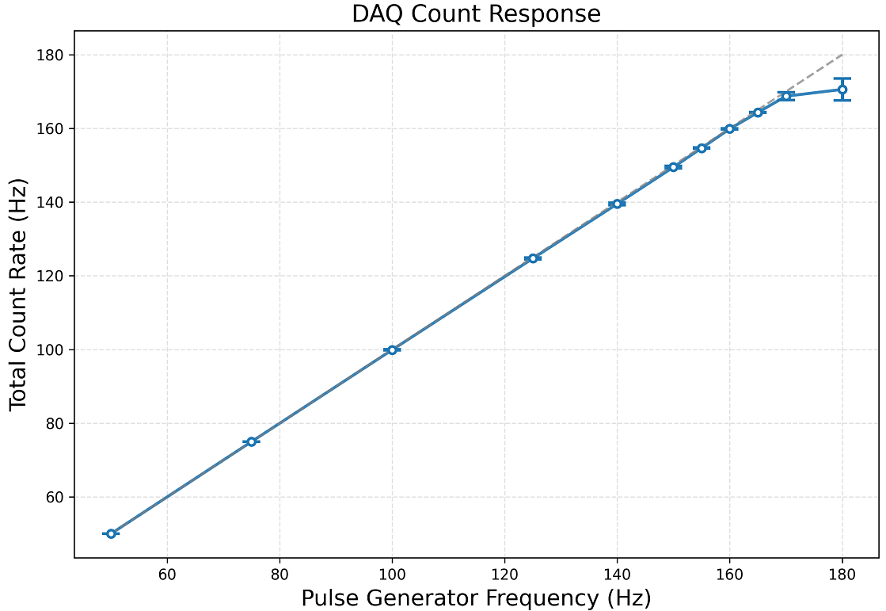
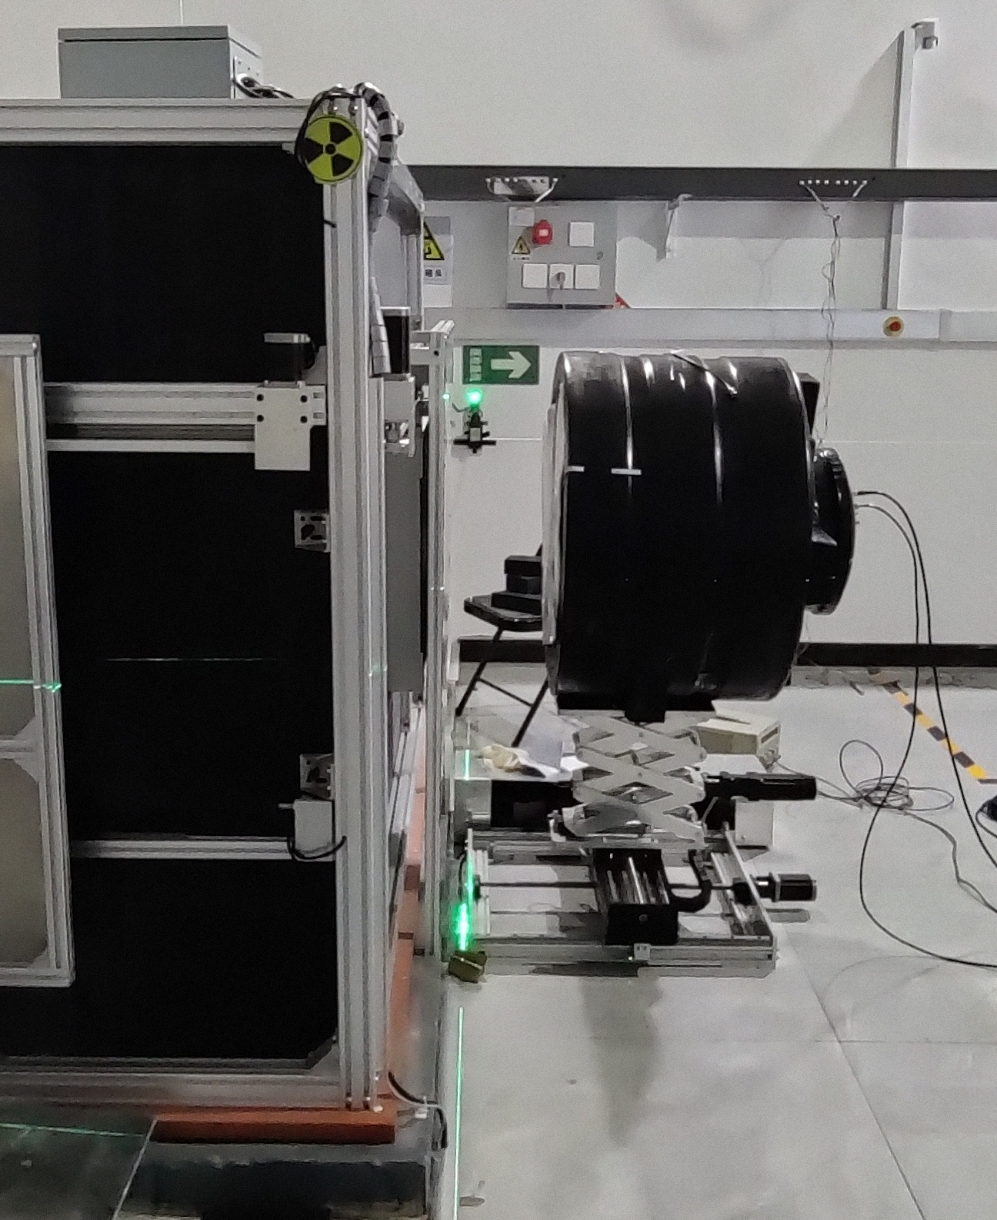
Setup Overview
G0)
Detector
Shutter
(G1)
Electronics system count rate range: up to 165 Hz.
Solution: Beam intensity control via G0 (10×10cm hole) and G1 cadmium plates.
Layout of the Experiment
Distance to Shutter = 27.3 cm
Scintillator Area = 226.98 cm²
Notes:
As shown in the left plot, the DAQ system reaches saturation at a count rate of 165 Hz.
To operate within the linear range, we added a G1 cadmium plate to attenuate the thermal neutron flux like this figure.
And this photo shows the actual setup, where the detector is positioned 27.3 cm from the shutter.

Slide 9
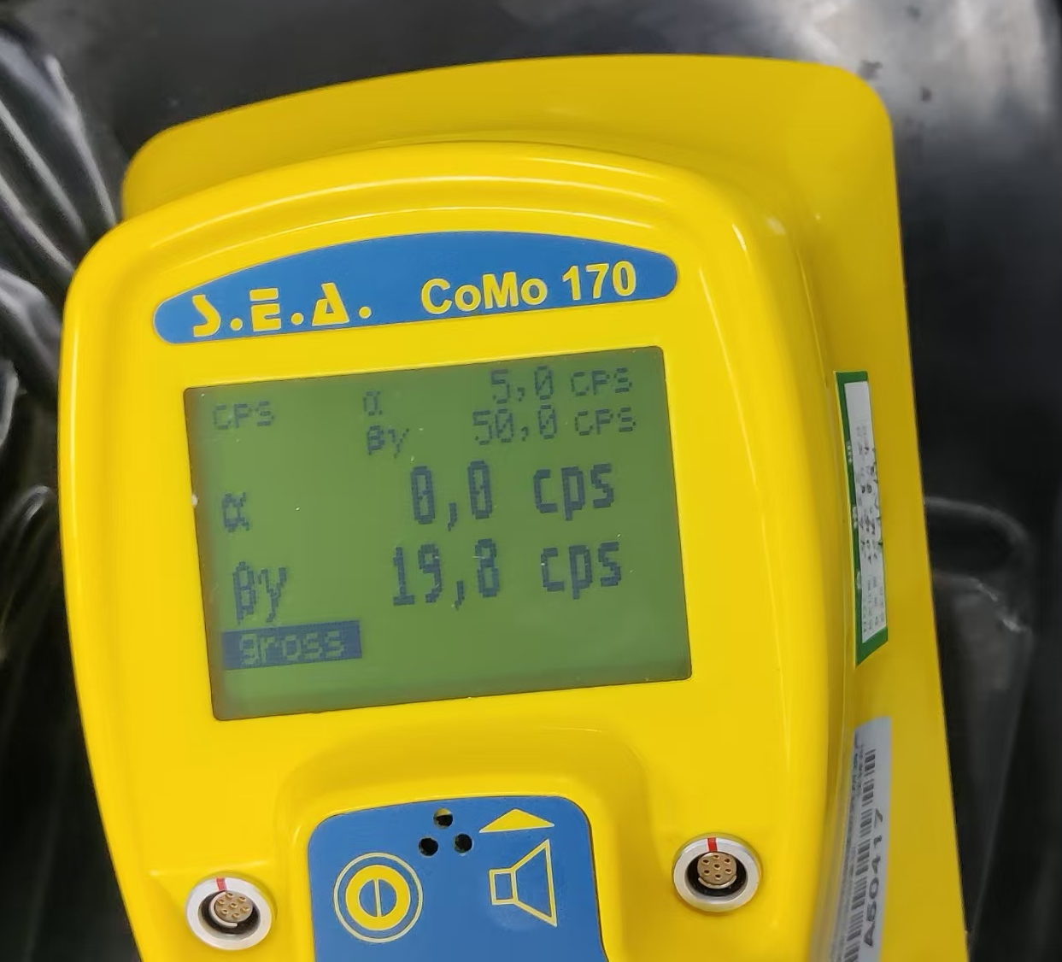
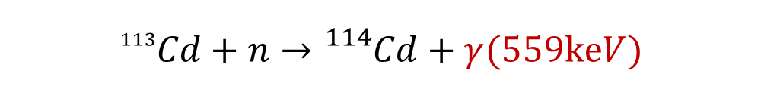
α/β Surface Contamination Monitor
$${}_{}^{113}{Cd}+n→{}_{}^{114}{Cd}+γ(559keV)$$
Measurement Range | Background Count Rate (s⁻¹) | Surface Emission Response | Relative Intrinsic Error (%) | Repeatability (%)
α | 0 | 0.40 | -7.3 | 0.60
β+γ | 16.9 | 0.63 | 10.9 | 3.30
Measuring range: 0~10⁴ s⁻¹
β energy range: 150keV~2.5Mev
Notes:
We used this monitor to measure the additional gamma background caused by neutron capture in the cadmium plates.
This table shows the manufacturer's specifications.
our actual field measurements are used to cross-check against our detector’s charge counting.

Slide 10
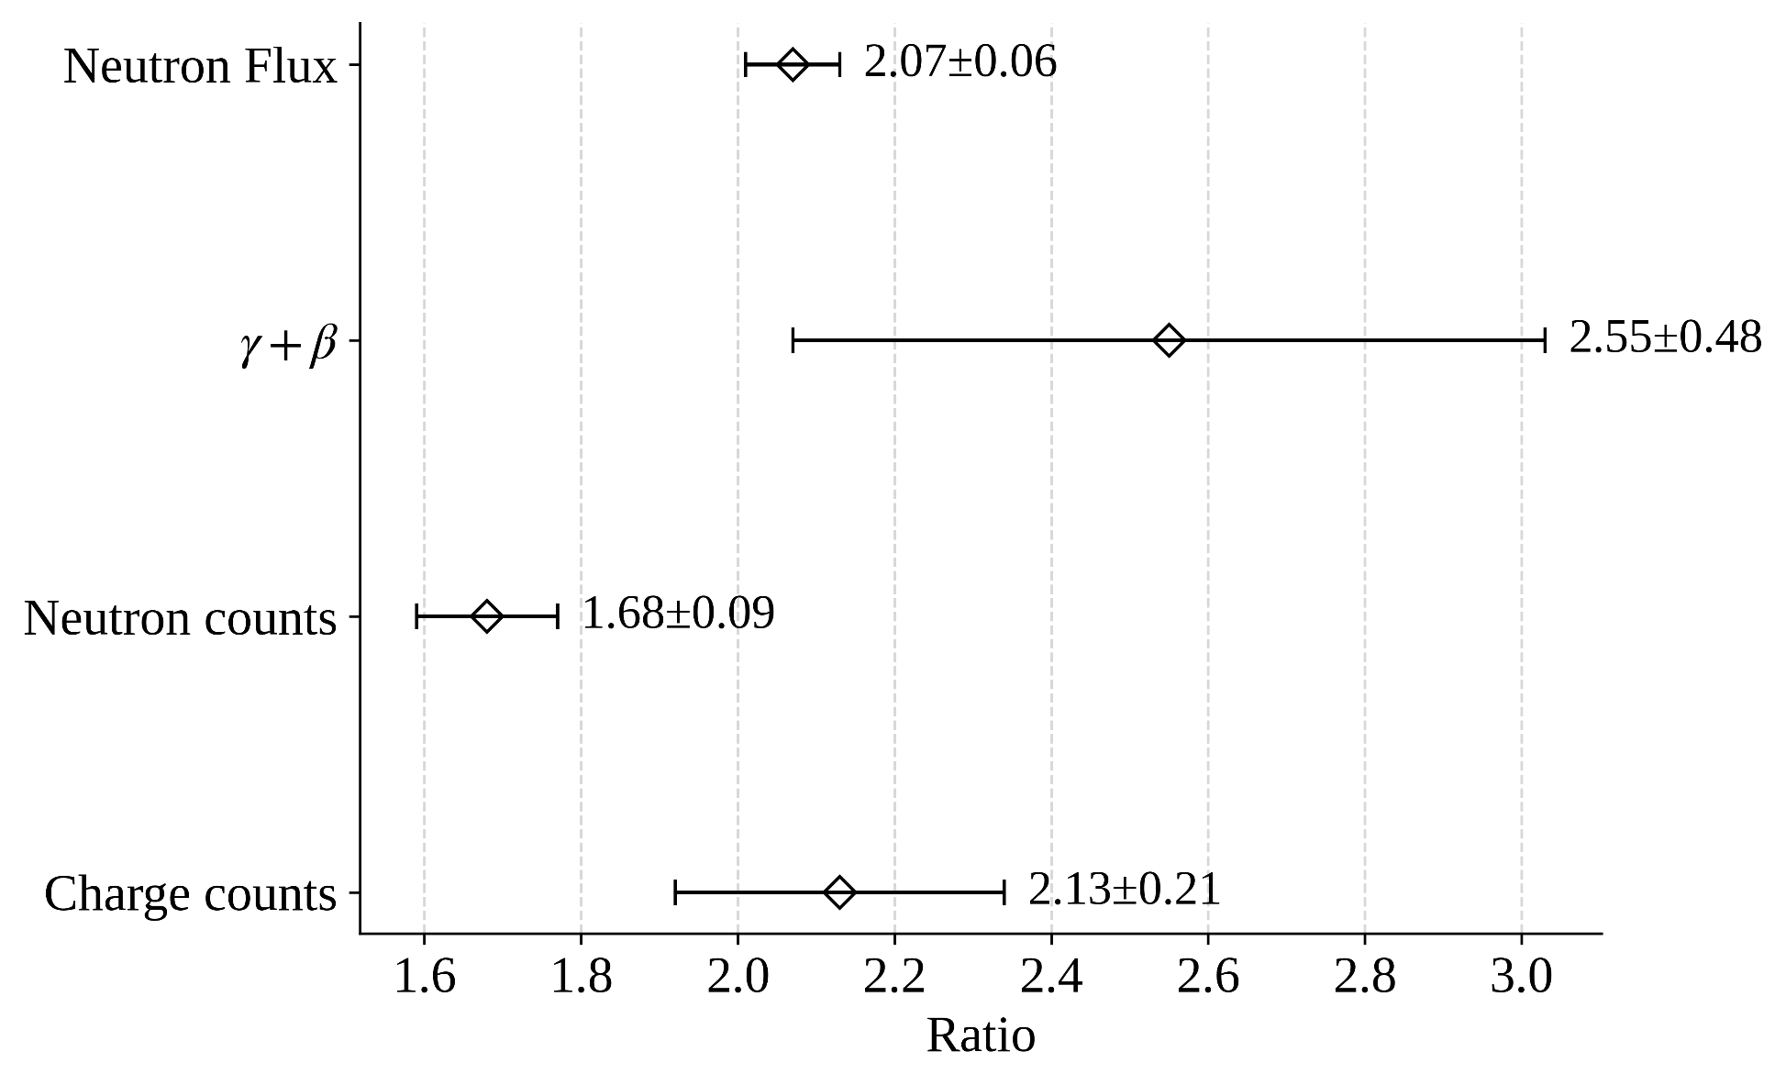
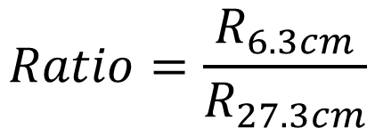
Ratio of counts at 6.3cm to 27.3cm from shutter
$$Ratio=\frac{R_{6.3cm}}{R_{27.3cm}}$$
Notes:
We compared the 6.3 cm to 27.3 cm ratio from both the detector and the external monitor. The Charge counts ratio(2.13) and the gamma add beta ratio(2.55) are consistent within their error bars.
The difference in neutron ratios is due to the cadmium-blocking effects.

Slide 11
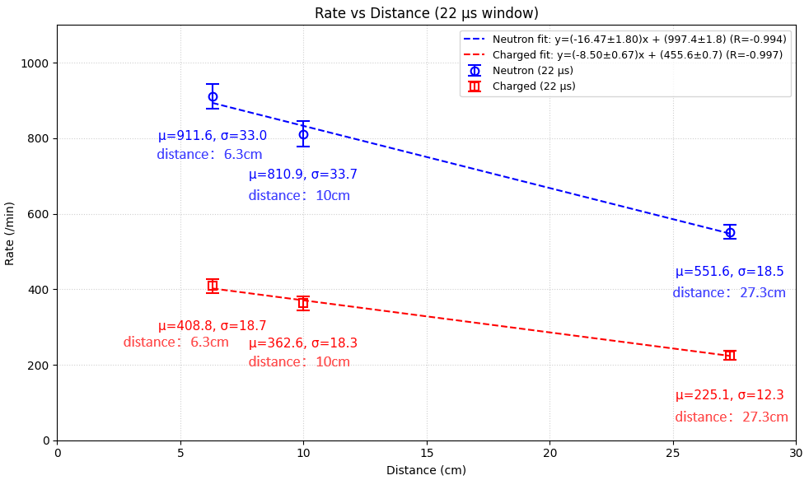
Notes:
This plot confirms the expected linear decrease in count rates for both neutrons and charged particles as the distance from the shutter increases

Slide 12
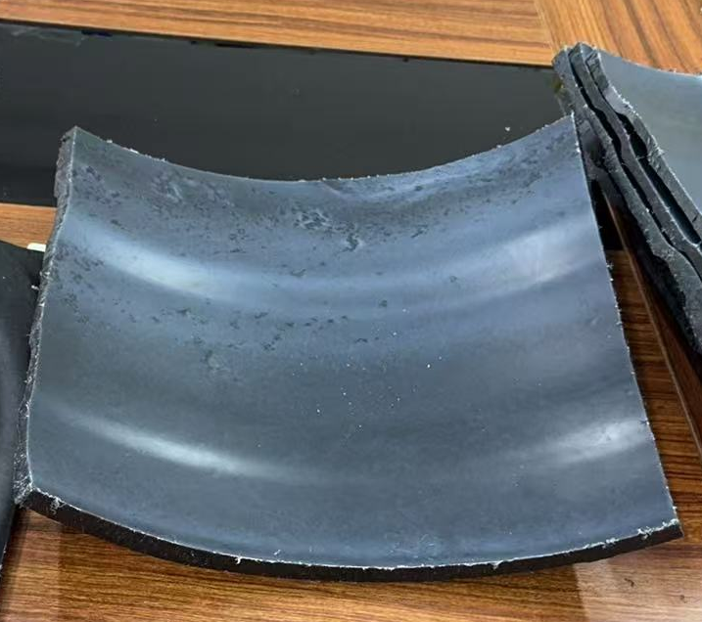
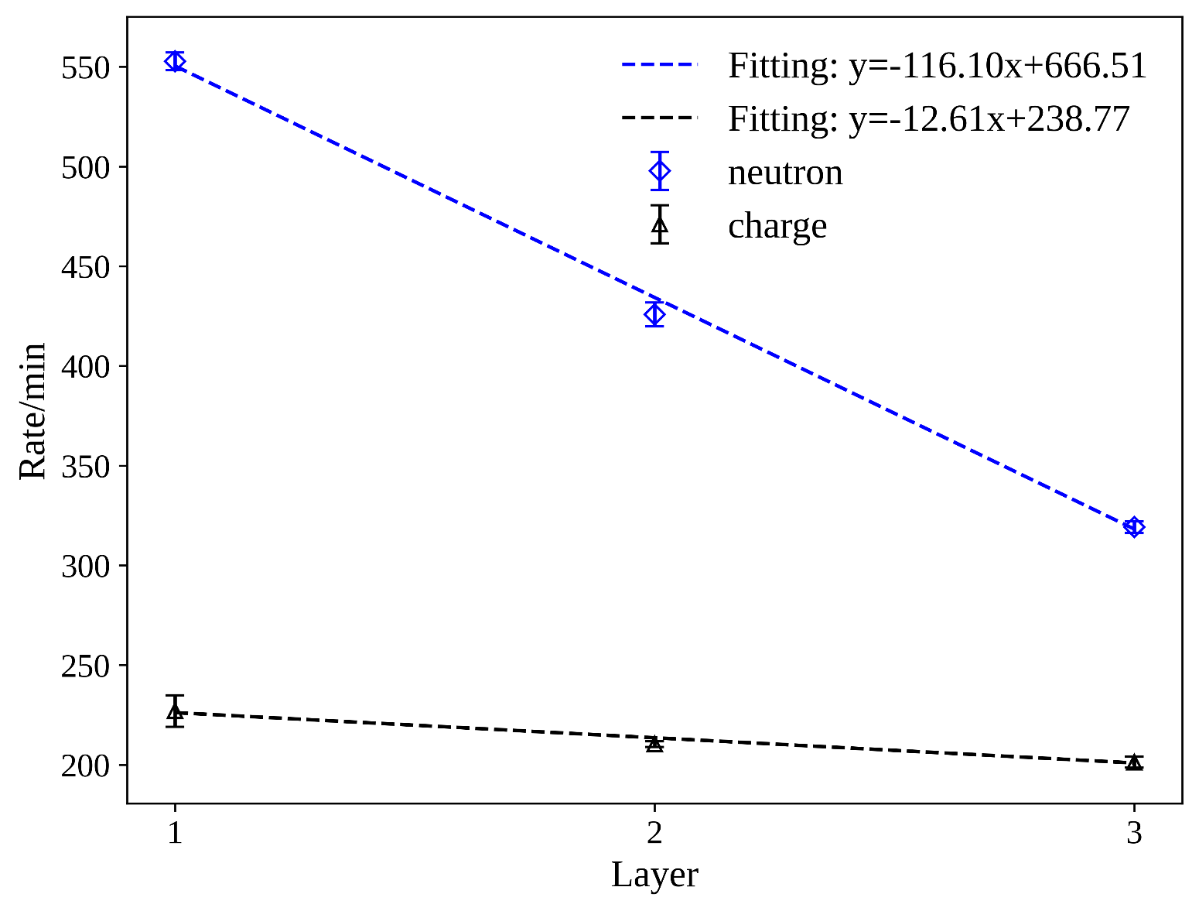
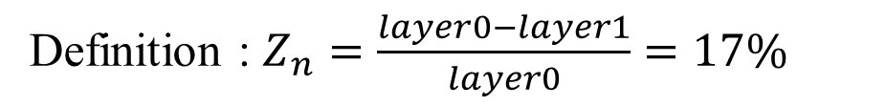
Tank Absorption Ratio
When no tank, i.e., x=0, the mean value is 667.
Layer | 0 | 1
Rate/min | 667 | 553
number of tank thickness
Definition : $Z_{n}=\frac{layer0−layer1}{layer0}=17\%$
Notes:
We performed a study and found the tank wall absorbs 17% of the incident neutrons.
By measuring [prepared tank wall samples, 鼠标指向筒壁] these and extrapolating the linear fit to zero thickness, we obtained this essential correction factor.

Slide 13
03 Simulation

Slide 14
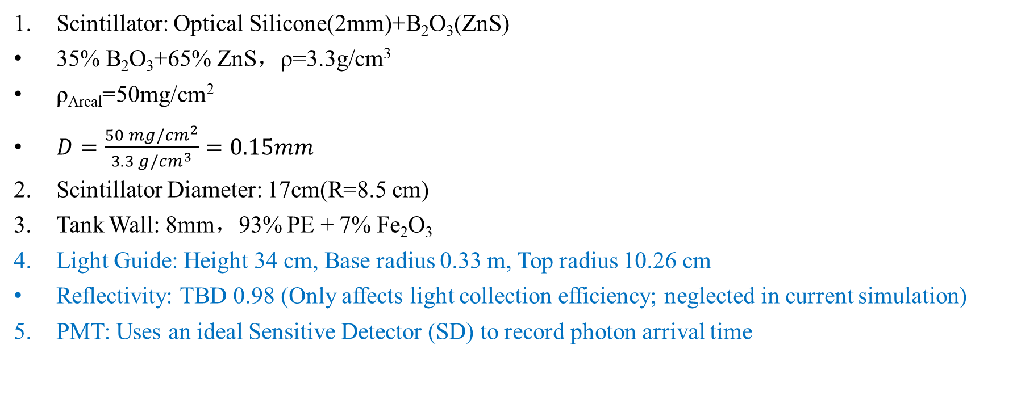
Simulation Geometry & Setup
Scintillator: Optical Silicone(2mm)+B₂O₃(ZnS)
35% B₂O₃+65% ZnS，ρ=3.3g/cm³
ρ_{Areal}=50mg/cm²
$D=\frac{50 mg/{cm}^{2}}{3.3 g/{cm}^{3}}=0.15mm$
Scintillator Diameter: 17cm(R=8.5 cm)
Tank Wall: 8mm，93% PE + 7% Fe₂O₃
Light Guide: Height 34 cm, Base radius 0.33 m, Top radius 10.26 cm
Reflectivity: TBD 0.98 (Only affects light collection efficiency; neglected in current simulation)
PMT: Uses an ideal Sensitive Detector (SD) to record photon arrival time
Geant4 Version 11.04 MT
G4NDL 4.7.1
QGSP_BIC_HP
Notes:
For the Geant4 simulation, we modeled the full detector geometry, including the 0.15 mm ZnS scintillator and the 8 mm tank wall.
The light guide and PMT were also integrated to record photon arrival times under ideal sensitive detector conditions.
The simulation was performed using Geant4 version 11.04 with the QGSP_BIC_HP physics list for high-precision neutron transport.

Slide 15
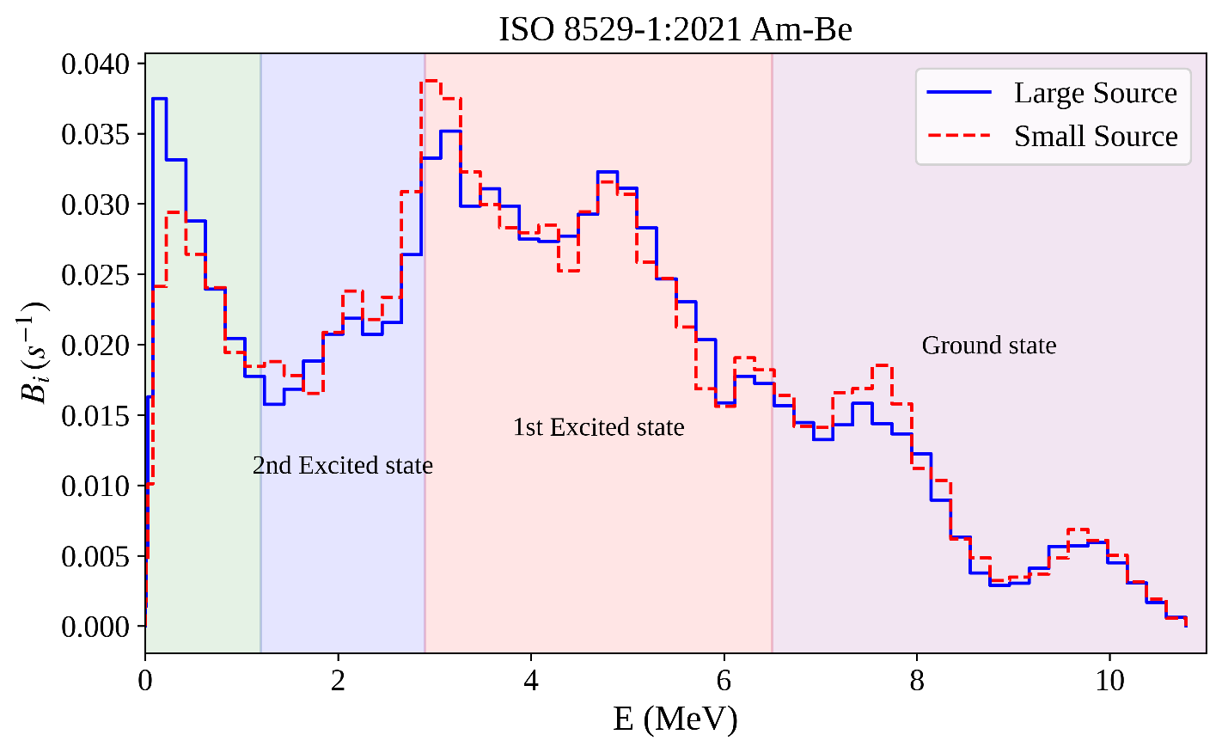

Emission Spectrum of Am-Be Source
(α, n) Reaction of Am-Be source
$${}_{2}^{4}α+{}_{4}^{9}{Be}→{}_{6}^{12}{C∗}+{}_{0}^{1}n$$
Final ¹²C state | Alpha energy[MeV] | Preferred c.m. angle | Calculated neutron energy[MeV] | Observed neutron energy[MeV]
Ground state | 4.2 | 0° | 9.8 | 9.9
 | 4.2 | 90° | 8.0 | 7.7
 | 4.2 | 180° | 6.2 | 6.5
 | 2.1 | 0° | 7.8 | 7.7
1st Excited state，4.43MeV | 4.0 | 0° | 5.0 | 5.0
 | 5.1 | 180° | 3.1 | 3.2
 | 1.9 | 0° | 3.1 | 3.2
2nd Excited state，7.66MeV | 5.3 | 40° | 2.35 | 2.25
Nominal Activity: 185 GBq; classified as "Large Source" for neutron emission rate per ISO standards.
Marsh J W, Thomas D J, Burke M. High resolution measurements of neutron energy spectra from AmBe and AmB neutron sources[J]. Nuclear Instruments and Methods in Physics Research Section A: Accelerators, Spectrometers, Detectors and Associated Equipment, 1995, 366(2-3): 340-348.
Notes:
For the neutron source, we used a standard Am-Be energy spectrum based on the ISO 8529-1 standard.
The spectrum involves three reaction channels of C-12, while accounting for the preferred center-of-mass angle effect on the neutron emission energy.
In our Geant4 model, we choose the ‘Large Source’ spectrum to match the Am-Be source of CIAE.

Slide 16
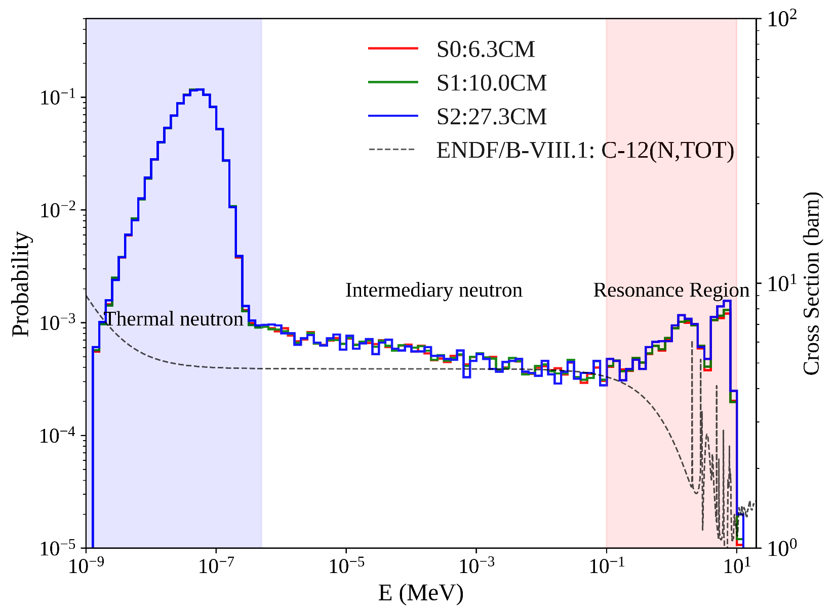
Moderated Am-Be Spectrum
S2
S0
shutter
S1
Size 5×5m | S0 | S1 | S2
Distance from shutter(cm) | 6.3 | 10 | 27.3
Distance from graphite(cm) | 27 | 30.7 | 48
No significant difference in spectra observed at varying distances under experimental distance.
  Moderated Am-Be spectrum at 293.15 K
Notes:
This plot shows the moderated Am-Be spectra at three distances, which can be analyzed in three energy regimes:
First, the thermal region below 0.5eV follows a Maxwellian distribution.
Second, the intermediary region up to 0.1MeV. This neutrons follow the one-over-E law.
In the fast region above 0.1MeV, the spectral fluctuations -- the rise, fall, and rise again-- are directly driven by the C-12 cross-section, specifically the competition between decreasing cross-sections and prominent resonance absorption peaks.

Slide 17
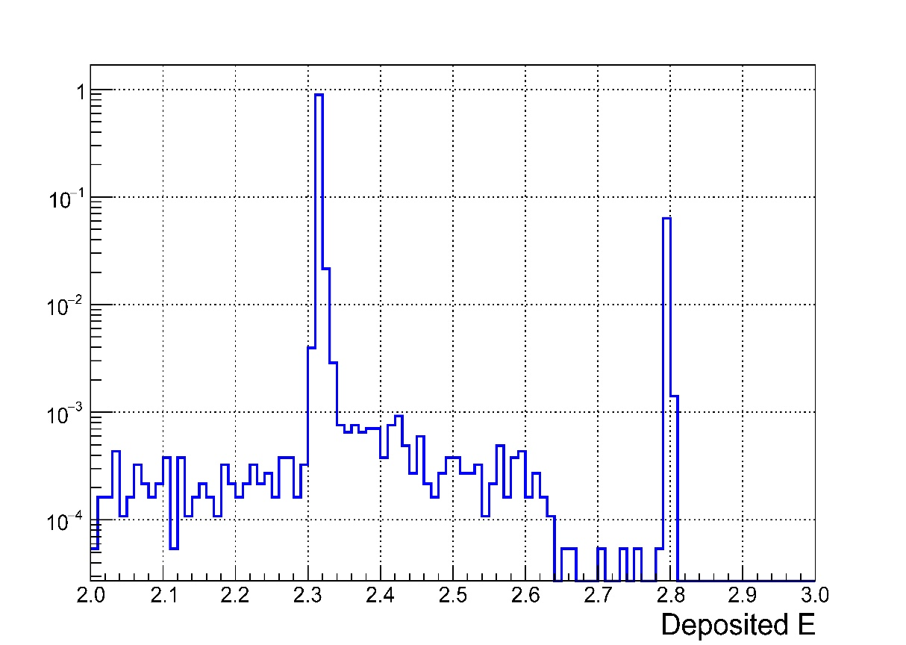

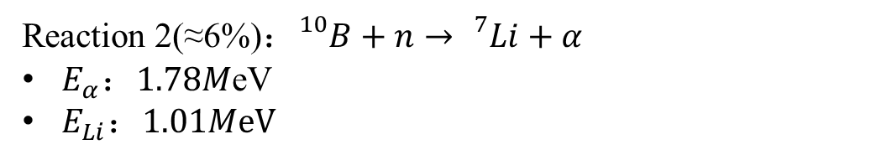
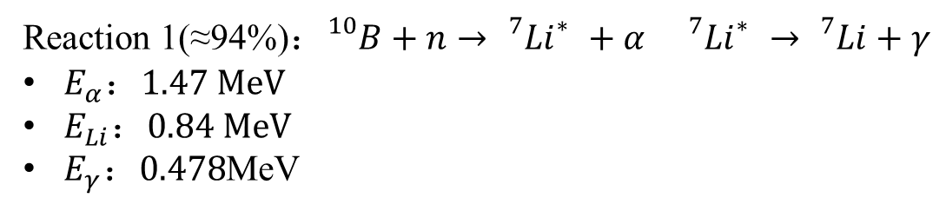
B₂O₃+ZnS
1mm Optical Silicone [C₂H₆OSi]_{n}
Scintillator Configuration:
0.15mm $B_{2}O_{3}(35\%)+ZnS(65\%)$
Reaction 1(≈94%)：${}_{}^{10}{B+n}→{}_{}^{7}{{Li}_{}^{∗}}+α {}_{}^{7}{{Li}_{}^{∗}}→{}_{}^{7}{Li}+γ$
$E_{α}：1.47 MeV$
$E_{Li}：0.84 MeV$
$E_{γ}：0.478$MeV
Energy Deposition Peak (Reaction 1)
Energy Deposition Peak (Reaction 2)
Reaction 2(≈6%)：${}_{}^{10}{B+n}→{}_{}^{7}{Li+α}$
$E_{α}：1.78M$eV
$E_{Li}：1.01MeV$
Base on the ¹⁰B capture reaction, the criteria for identifying neutron capture events in subsequent simulations are:
Neutron entrance into the scintillator;
Detection of secondary α and ⁷Li within the scintillator.。
Notes:
Next, we focus on the 0.15 mm sensitive layer, where neutron detection relies on the B-10 capture reaction.
There are two primary reaction channels:
the first, with a 94% leads to an excited Li-7 state, while the second, at 6% goes directly to the ground state.
these reactions produce total kinetic energies of 2.31MeV and 2.79MeV respectively.
As shown in the energy deposition plot, these two values correspond precisely to the two distinct peaks [鼠标指向图中的两个峰], which confirm that our scintillation model is functioning correctly.
To calculate detection efficiency, we defined a 'neutron capture event' based on the two criteria shown here: first, ---, and second,--.

Slide 18
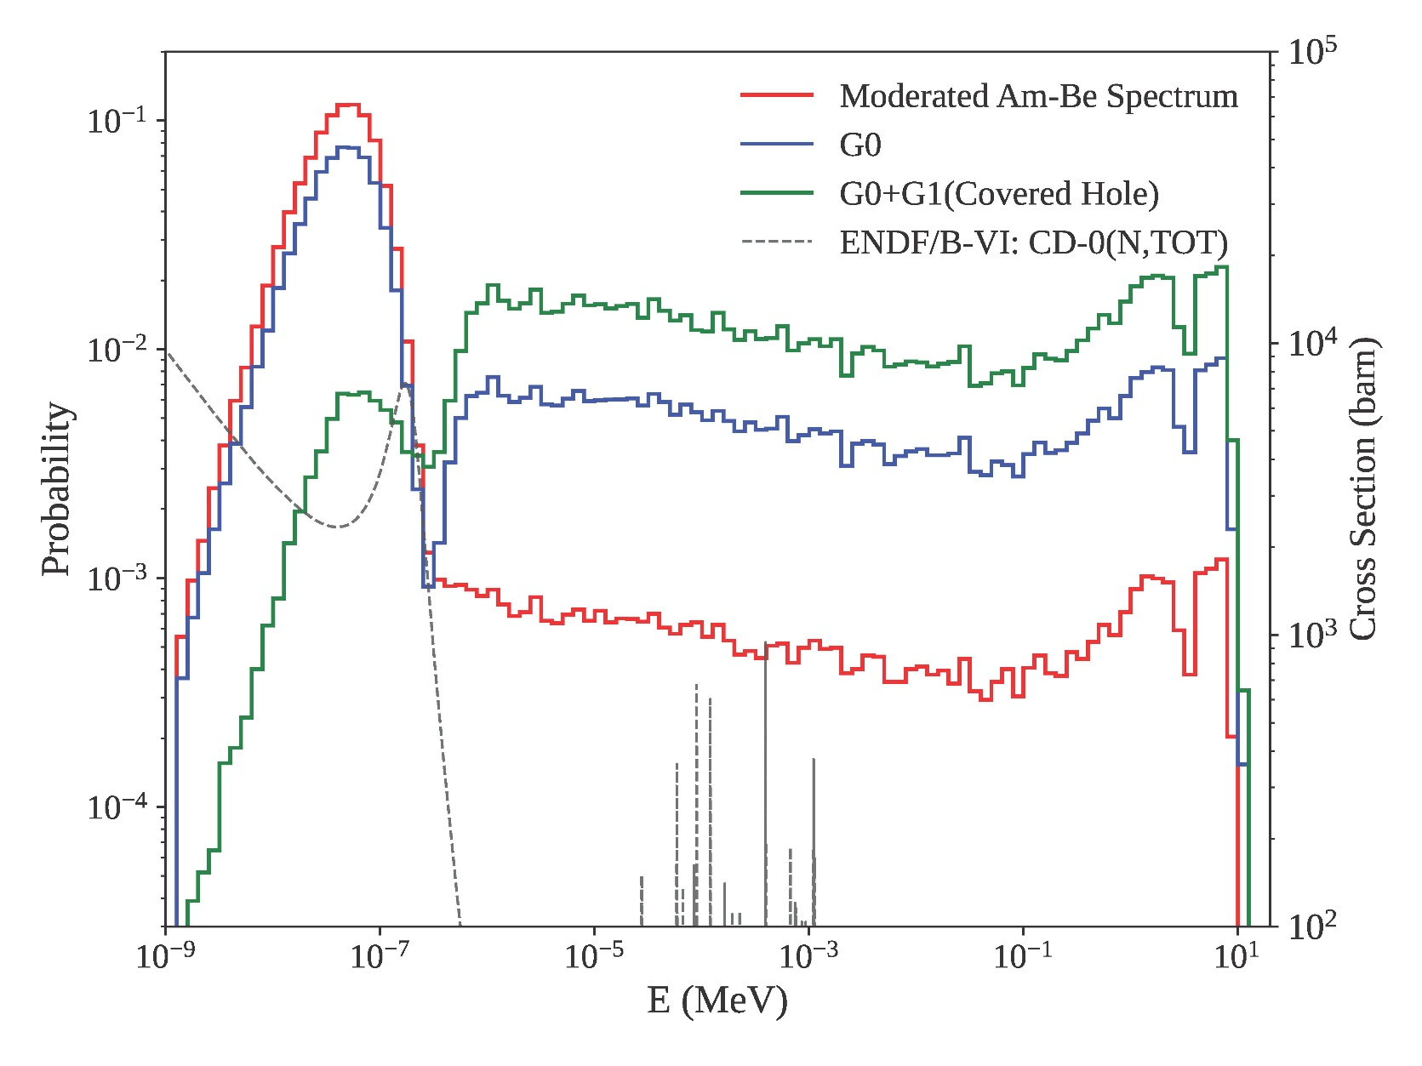
G0+G1neutron spectrum
Current Issue: Detector saturation occurred under the G0-only
Solution: Addition of G1 for further attenuation and comparative testing
G0)
Detector
Shutter
(G1)
Notes:
To maintain full consistency with our experimental conditions, we simulated the neutron spectra after the addition of the G1 cadmium plate.
As shown in the energy spectra, the original moderated Am-Be spectrum (red line) has a high thermal component.
After adding G0 (the blue lines) and adding G1(the green line), the thermal neutrons are almost entirely suppressed due to the capture cross-section of Cadmium, which is indicated by the dashed line.

Slide 19
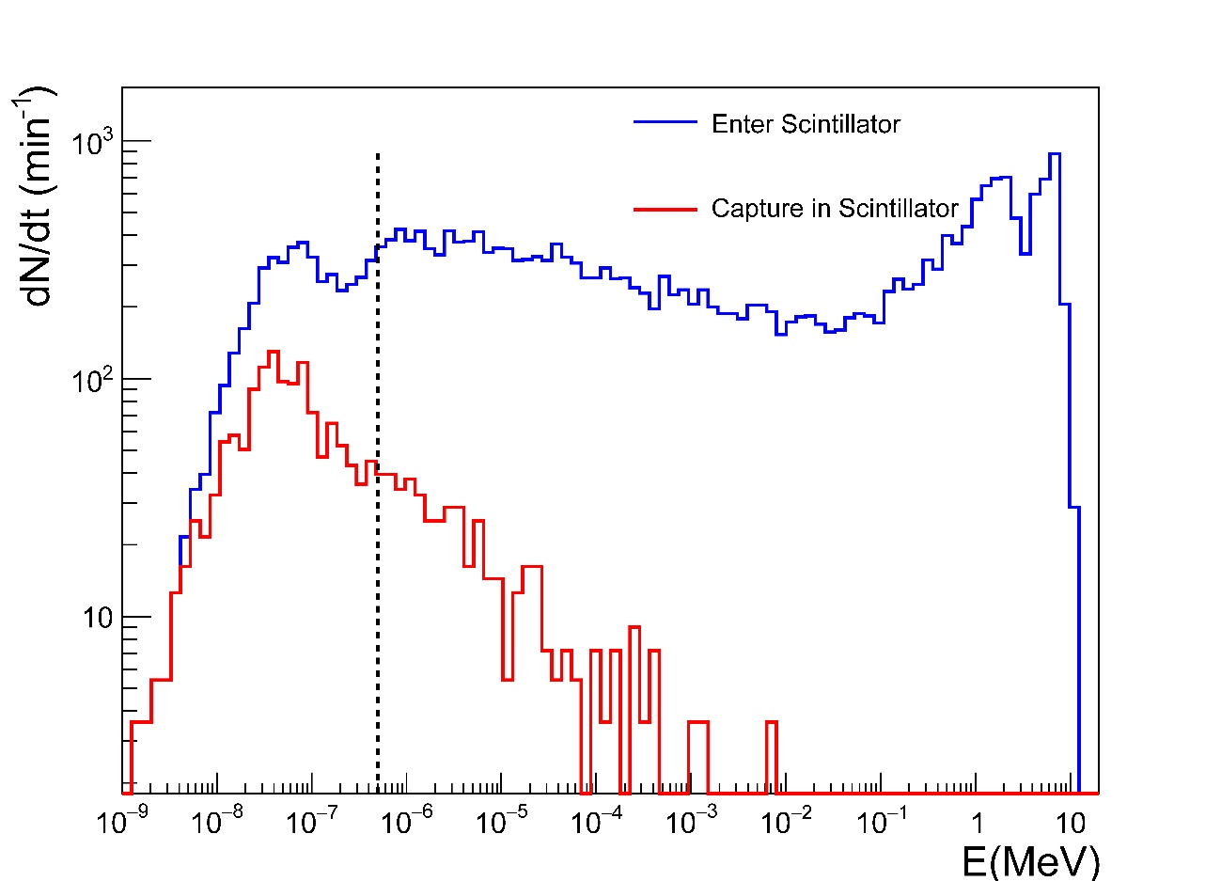
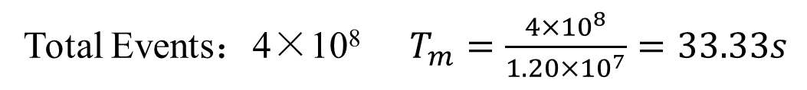
Incident & Capture Distributions: G0 + G1
Total Events：4×10⁸ $T_{m}=\frac{4×{10}^{8}}{1.20×{10}^{7}}=33.33s$
E=0.5eV
G0+G1
 | Incident |  | Capture
 | E<0.5eV | E≥0.5eV | E<0.5eV | E≥0.5eV
Simulation Events | 2465 | 12491 | 721 | 275
Normalized to 1 min | 4437 | 22486 | 1298 | 495
Neutron energy distribution (G0+G1)
Distance to Shutter = 27.3 cm
Scintillator Area = 226.98 cm²
Notes:
To bridge our simulation with real-world measurements, we normalized the results to 1-minute experimental count rate.
Starting with 400 million simulated events, and based on the actual source emissivity, we calculated an equivalent experimental duration of approximately 33 seconds. Then we scale the raw simulation data to 1 min.
As shown in the plot and table, we chose 0.5 eV as our threshold for defining 'thermal neutrons.’
This choice aligns directly with the principle of the Cadmium Difference Method.
where a 1 mm cadmium plate is expected to block most neutrons below this energy level.

Slide 20
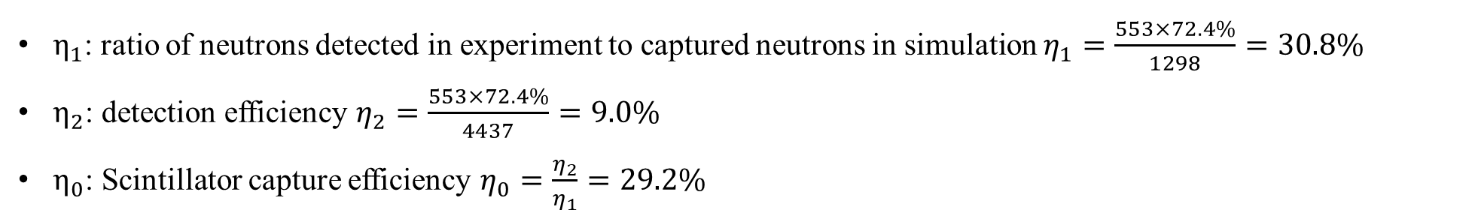
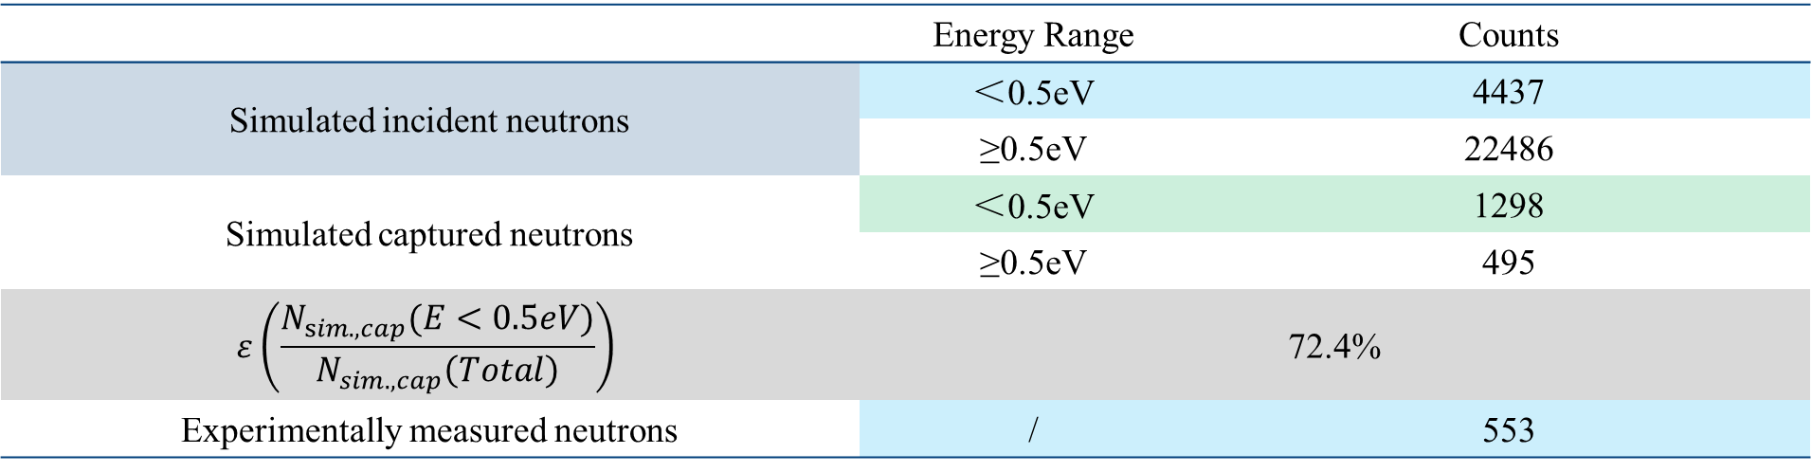
Capture & Detection Efficiency
 | Energy Range | Counts
Simulated incident neutrons | ＜0.5eV | 4437
 | ≥0.5eV | 22486
Simulated captured neutrons | ＜0.5eV | 1298
 | ≥0.5eV | 495
$$ε\left(\frac{N_{sim. , cap}(E<0.5eV)}{N_{sim.,cap}\left(Total\right)}\right)$$ | 72.4%
Experimentally measured neutrons | / | 553
 | $$η_{0}$$ | $$η_{1}$$ | $$η_{2}$$
E≤0.5eV | (29.2±1.2)% | (30.8±1.5)% | (9.0±0.5)%
$η_{1}$: ratio of neutrons detected in experiment to captured neutrons in simulation $η_{1}=\frac{553×72.4\%}{1298}=30.8\%$
$η_{2}$: detection efficiency $η_{2}=\frac{553×72.4\%}{4437}=9.0\%$
$η_{0}$: Scintillator capture efficiency $η_{0}=\frac{η_{2}}{η_{1}}=29.2\%$
Notes:
we calculate based on the proportion of captured neutrons with energies below 0.5 eV obtained from simulations, the efficiency of the detector would be eta2 is 9%.
the ratio of neutrons detected in experiment to captured neutrons in simulation eta1 is 30%.
Combining eta1 and eta2, we can obtain the scintillator capture efficiency eta0 is 29%.

Slide 21
04 Results

Slide 22
Summary
Conclusion
Based on experiment and simulation, the detection efficiency of EN-detector is 9.0%±0.5% in E<0.5eV；
Next Step
tank wall material composition will be tested and input simulation
Simulate detector response at varying distances and compare the results with experimental measurements.
Notes:
The preliminary conclusions of the current calibration experiment:

Slide 23
THANK YOU

Slide 24
Backup

Slide 25

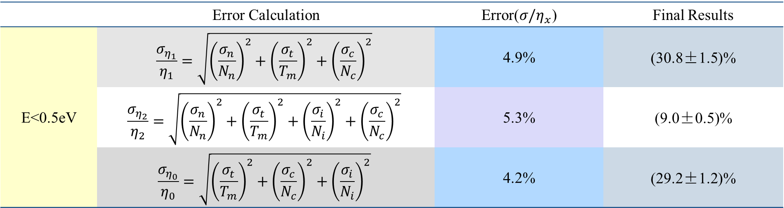
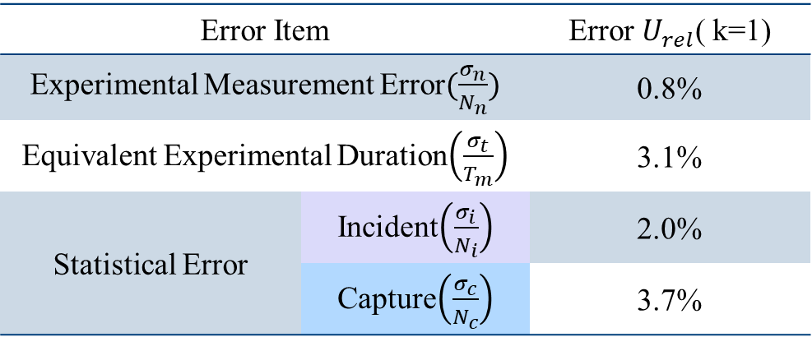
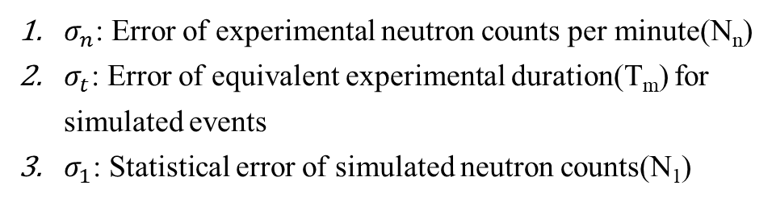
Simulation Error
Error Item |  | Error $U_{rel}$( k=1)
Experimental Measurement Error$(\frac{σ_{n}}{N_{n}})$ |  | 0.8%
Equivalent Experimental Duration$\left(\frac{σ_{t}}{T_{m}}\right)$ |  | 3.1%
Statistical Error | Incident$\left(\frac{σ_{i}}{N_{i}}\right)$ | 2.0%
 | Capture$\left(\frac{σ_{c}}{N_{c}}\right)$ | 3.7%
$σ_{n}$: Error of experimental neutron counts per minute(N_{n})
$σ_{t}$: Error of equivalent experimental duration(T_{m}) for simulated events
$σ_{1}$: Statistical error of simulated neutron counts(N₁)
 | Error Calculation | Error($σ/η_{x}$) | Final Results
E<0.5eV | $$\frac{σ_{η_{1}}}{η_{1}}=\sqrt{{\left(\frac{σ_{n}}{N_{n}}\right)}^{2}+{\left(\frac{σ_{t}}{T_{m}}\right)}^{2}+{\left(\frac{σ_{c}}{N_{c}}\right)}^{2}}$$ | 4.9% | (30.8±1.5)%
 | $$\frac{σ_{η_{2}}}{η_{2}}=\sqrt{{\left(\frac{σ_{n}}{N_{n}}\right)}^{2}+{\left(\frac{σ_{t}}{T_{m}}\right)}^{2}+{\left(\frac{σ_{i}}{N_{i}}\right)}^{2}+{\left(\frac{σ_{c}}{N_{c}}\right)}^{2}}$$ | 5.3% | (9.0±0.5)%
 | $$\frac{σ_{η_{0}}}{η_{0}}=\sqrt{{\left(\frac{σ_{t}}{T_{m}}\right)}^{2}+{\left(\frac{σ_{c}}{N_{c}}\right)}^{2}+{\left(\frac{σ_{i}}{N_{i}}\right)}^{2}}$$ | 4.2% | (29.2±1.2)%
Notes:
In current methods for calculating detector efficiency, errors mainly arise from the following three aspects:
1. Experimental measurement errors;
2. Neutron source emissivity errors;
3. Statistical fluctuations in simulated events.

Slide 26
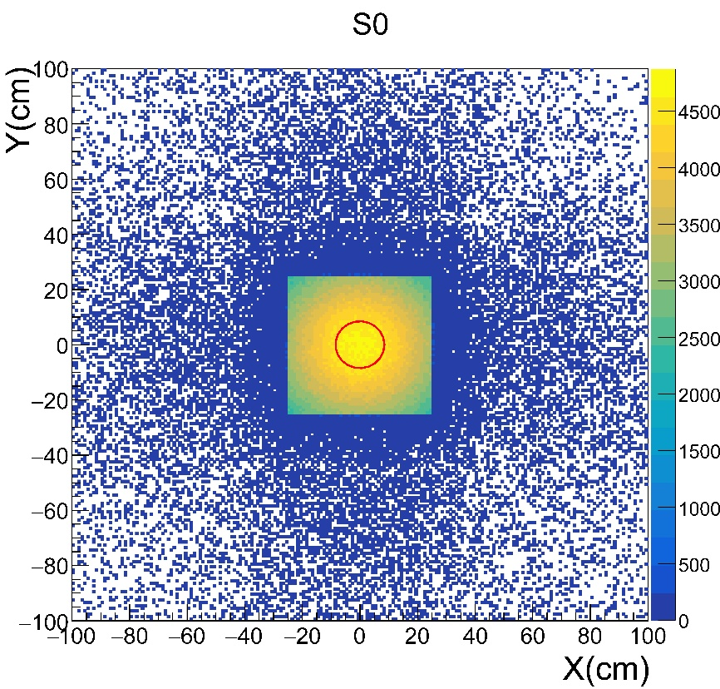
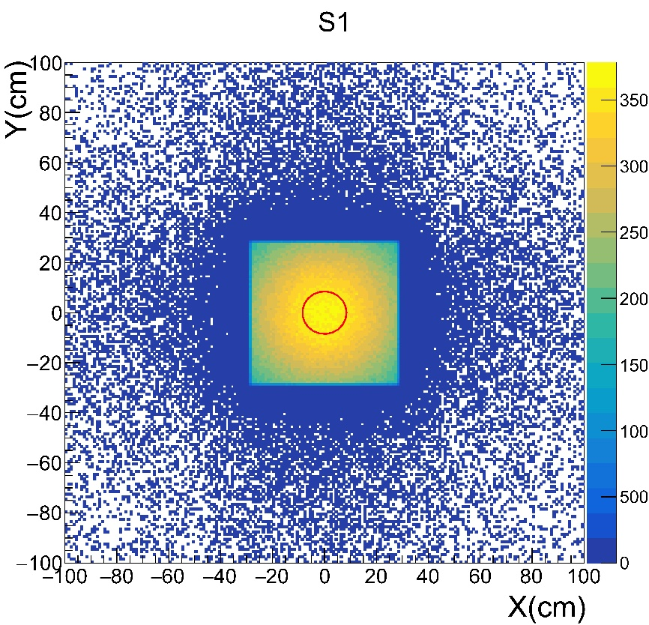
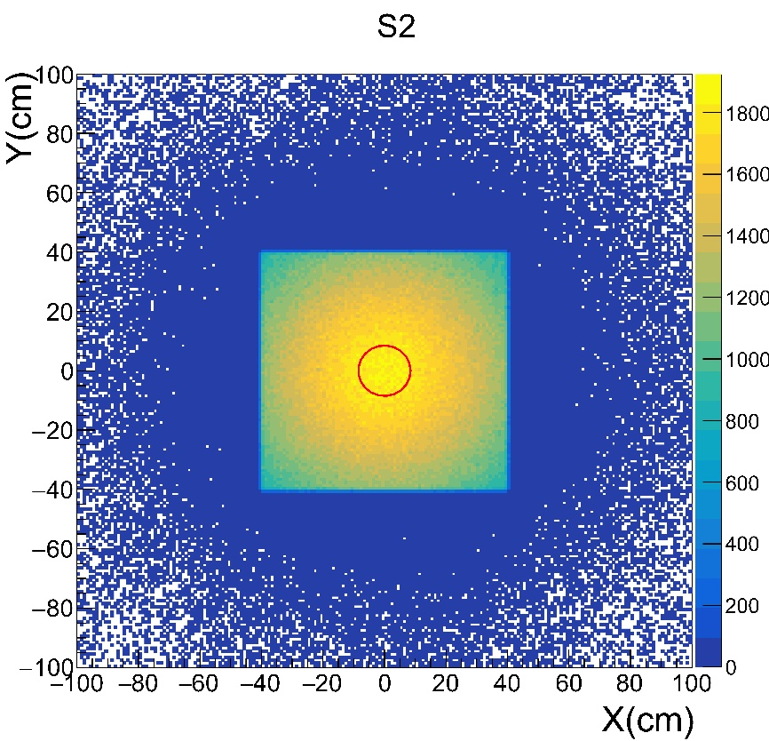
Neutron distribution
Spatial distribution: The projected area of the shutter expands with increasing distance R.
Calibration: Red circles denote the projected positions of the scintillator.
Notes:
Neutrons exiting the shutter diffuse to varying degrees at different distances. Generally, the projected area increases with increasing distance.
In the experiment, our scintillator remained centered in the projection, as indicated by the red circle in the figure.

Slide 27
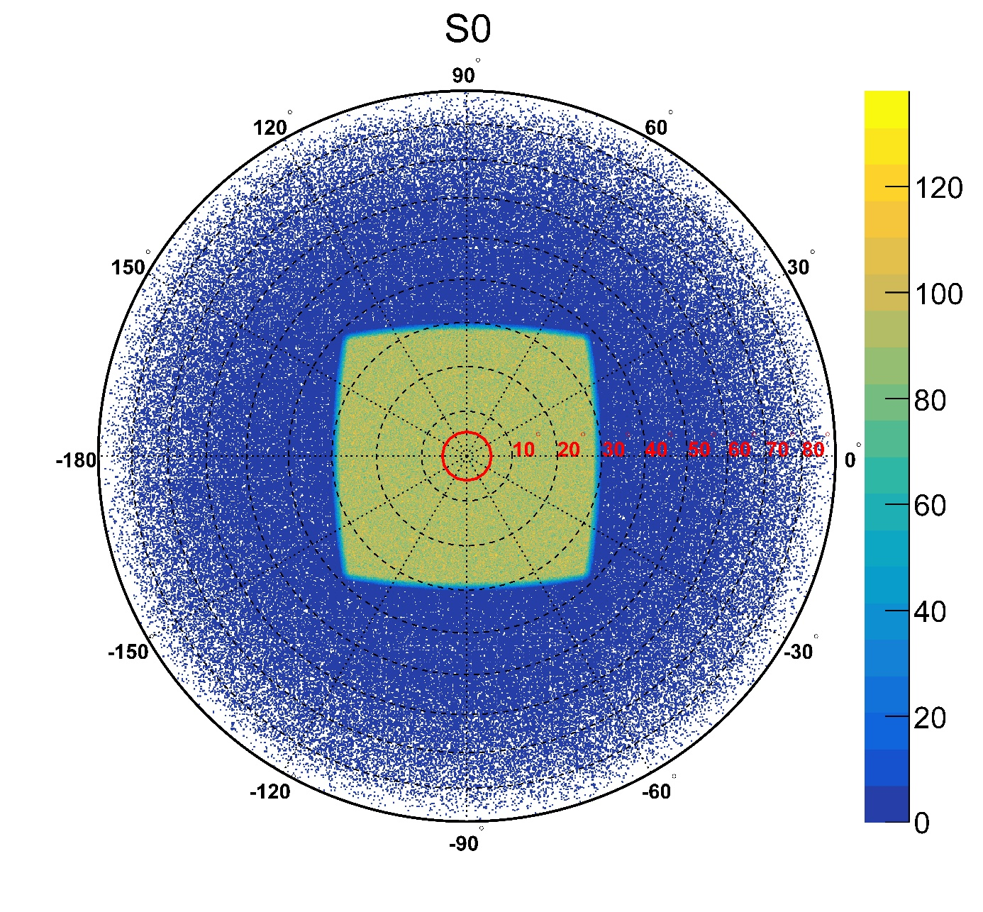
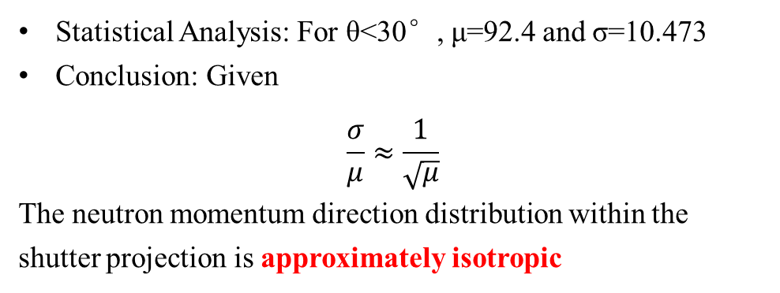
Neutron directional distribution
Statistical Analysis: For θ<30°, μ=92.4 and σ=10.473
Conclusion: Given
$$\frac{σ}{μ}≈\frac{1}{\sqrt{μ}}$$
The neutron momentum direction distribution within the shutter projection is approximately isotropic
Notes:
Meanwhile, we plotted the neutron incident angle distribution observed from the +Z direction.
Analysis confirmed that the neutrons exiting the shutter exhibit isotropic properties at S0 when theta < 30°.
We have now completed the modeling process for the Am-Be neutron source.

Slide 28
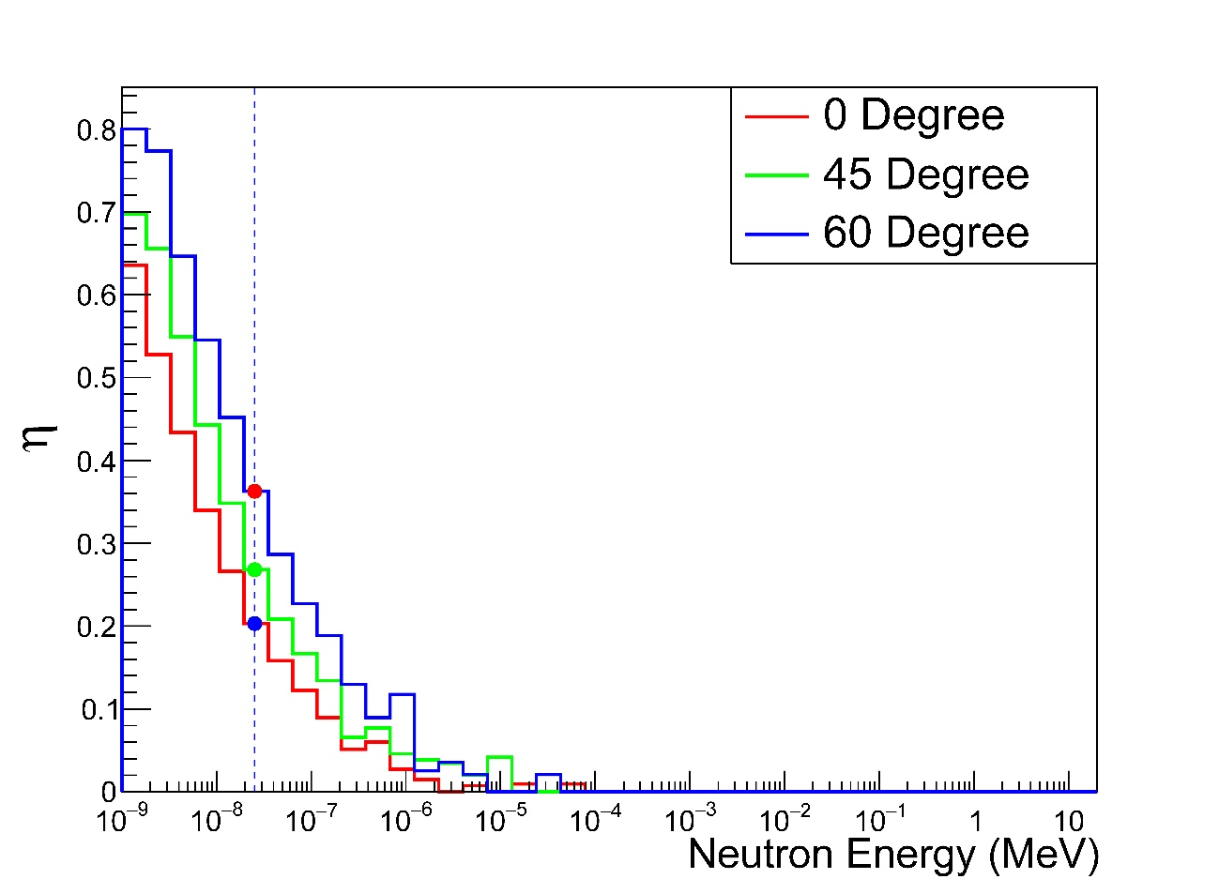
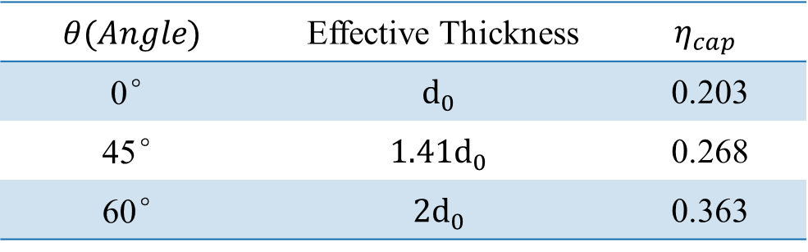
Capture efficiency
d₀
B₂O₃+ZnS
$$θ(Angle)$$ | Effective Thickness | $$η_{cap}$$
0° | $$d_{0}$$ | 0.203
45° | $$1.41d_{0}$$ | 0.268
60° | $$2d_{0}$$ | 0.363
Note: Capture efficiency calculated for 0.0253 eV thermal neutrons.

Slide 29
Scintillator Setup
Material | Properties
Optical Silicone | Refractive index(To air) | 1.43
 | Absorption length(2.0~3.7 eV) | 5 m
B₂O₃+ZnS^{[1]} | Light yield(Scintillation efficiency) | 30000/MeV
 | Refractive index(To air) | 2.30~2.36
 | Emission spectrum | 2.7~3.7 eV
 | Scintillation decay time | 110ns~2μs
 | Fast-to-slow ratio | 0.2:0.8
 | Absorption length(2.0~3.7 eV) | 100 μm
 | RAYLEIGH | 30 μm
Reflector | Reflectivity | 0.985
PMT | Gain | 后续处理
[1]. Foster J. A comparison of the ZnS (Ag) scintillation detector to the silicon semiconductor detector for quantification of alpha radioactivity in aqueous solutions[J]. 2006.

Slide 30


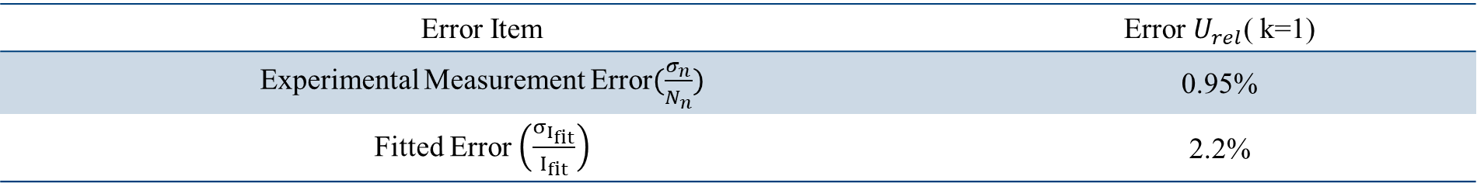
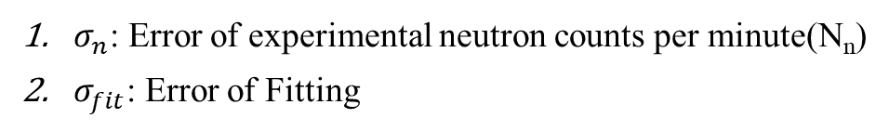
Experiment Error
$σ_{n}$: Error of experimental neutron counts per minute(N_{n})
$σ_{fit}$: Error of Fitting
Error Item | Error $U_{rel}$( k=1)
Experimental Measurement Error$(\frac{σ_{n}}{N_{n}})$ | 0.95%
Fitted Error $\left(\frac{σ_{I_{fit}}}{I_{fit}}\right)$ | 2.2%
$$\frac{σ_{I_{fit}}}{I_{fit}}=\sqrt{σ_{A}^{2}+T^{2}σ_{k}^{2}+2TCov\left(C,k\right)}$$
$$T=x_{0}−\frac{1}{k}$$
Notes:
In current methods for calculating detector efficiency, errors mainly arise from the following three aspects:
1. Experimental measurement errors;
2. Neutron source emissivity errors;
3. Statistical fluctuations in simulated events.

