Slide 1
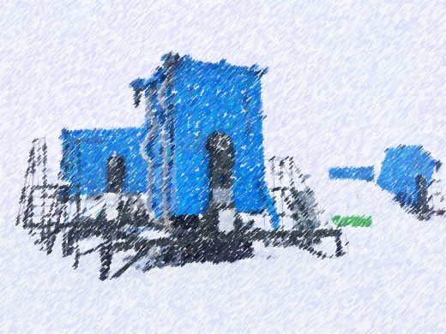
The self calibration for LHAASO-WFCTA SiPM camera
Mingjie Yang ^{1,2} , Ming Wei ³
Institute of High Energy Physics, Chinese Academy of Sciences
TIANFU Cosmic Ray Research Center
Sichuan University
The 1st LHAASO Collaboration Conference in 2026 @ Suzhou

Slide 2
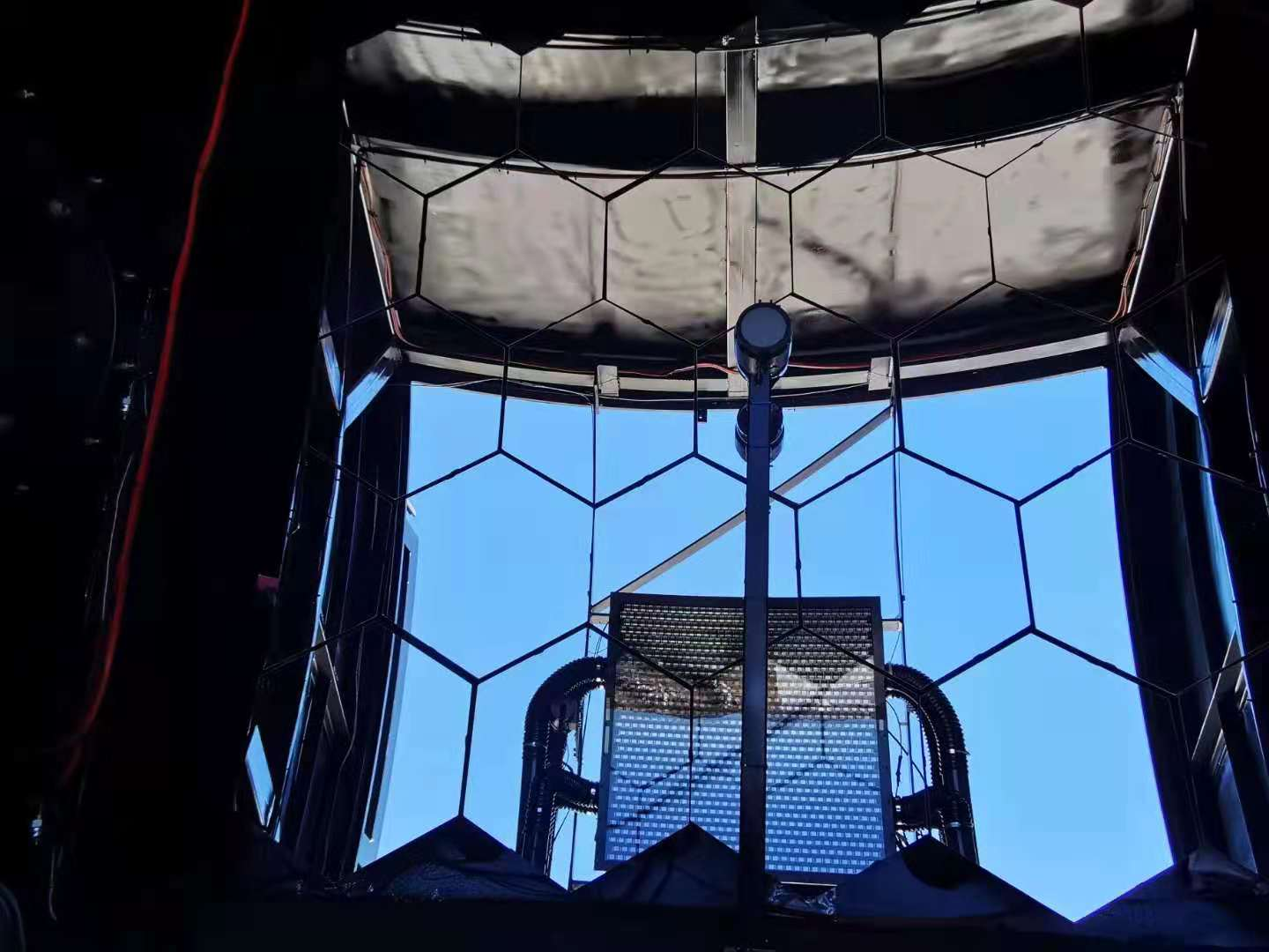
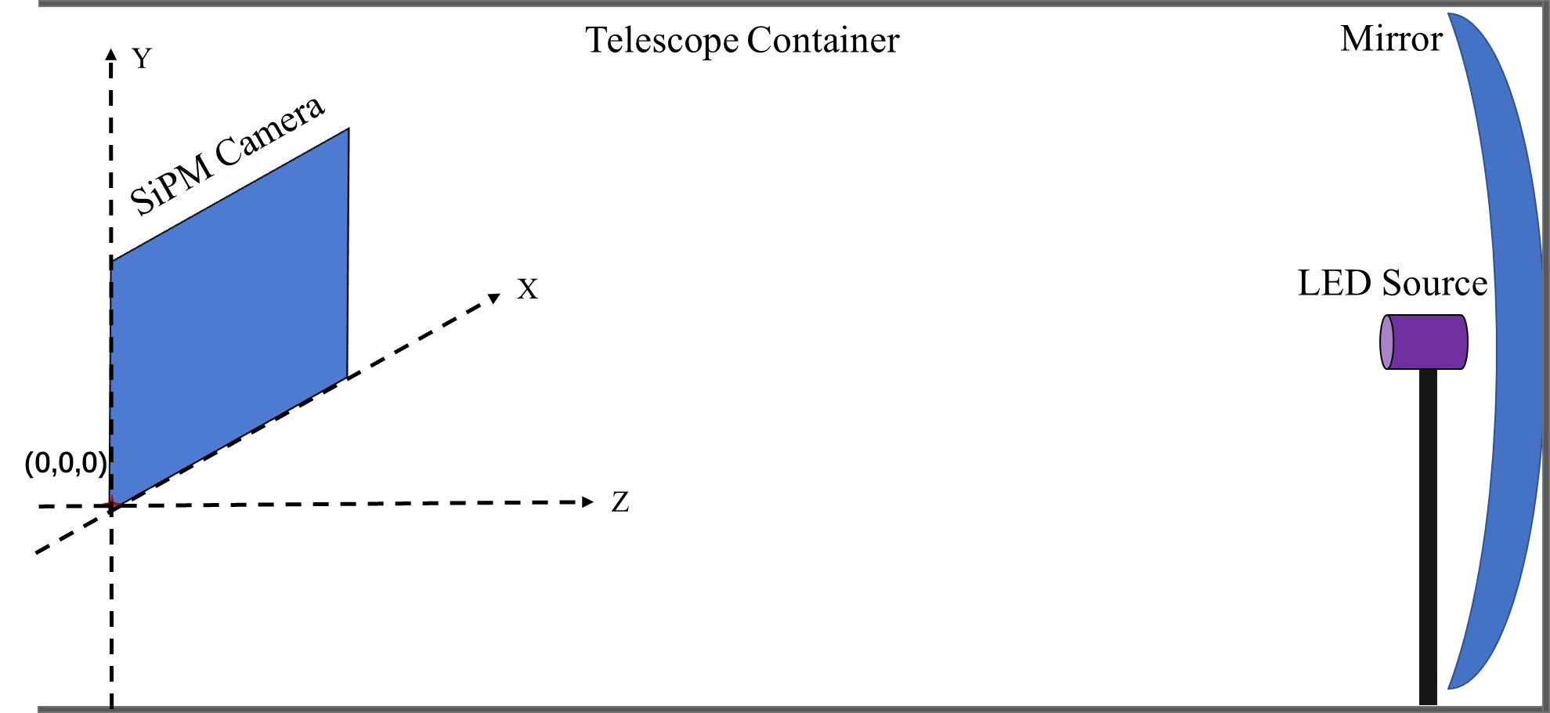
Introduction
The WFCTA camera measures the intensity and shape of Cherenkov light arriving at the telescope focal plane.
Using SiPM as its photon sensor, the camera can work normally under the Moon.
The gain of the SiPM camera is effected by the environment temperature and the night sky background light.
The WFCTA experiment uses a LED light source to calibrate the camera in real-time during the observation.
A camera calibration method based on the variation rule between the SiPM gain and background is reported and cross-checked with the LED calibration method.

Slide 3
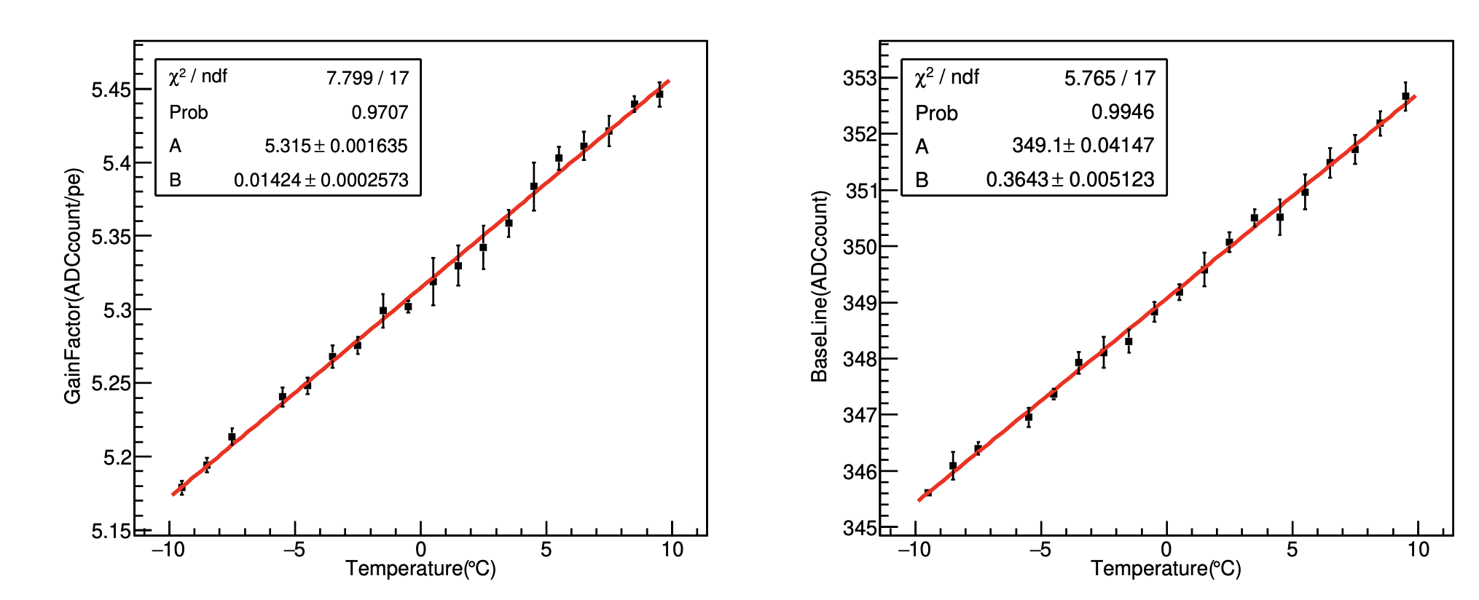
The Self Calibration Method For SiPM Camera
A. Online temperature compensation for SiPM camera
The LED calibration can calibrate the gain factor for the SiPM camera every 30 seconds, hence the temperature effect does not influence the stability of the WFCTA observation.
The final temperature elfect of the SiPM sensor and baseline in dark environment during the WFCTA observation. The baseline refers to the basic state without any signal from LED light, laser light, fluorescent light, or Cherenkov light. In the WFCTA experiment, the baseline is the average noise level obtained at a 5.12 µs time window and a 50 MHz sampling rate, which is 5.12 µs earlier than the rising edge of the elfective signal pulse. Left: The temperature effect of gain factor of the SiPM camera. Right:The temperature effect of baseline of the SiPM camera.

Slide 4
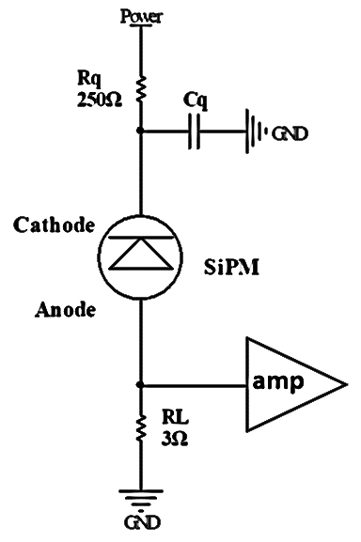
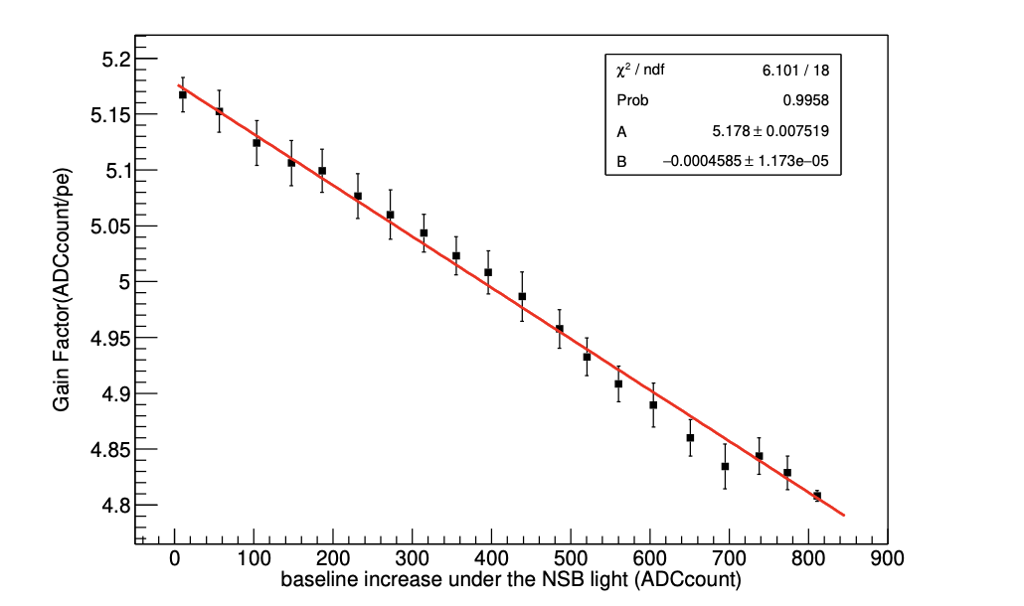
The Self Calibration Method For SiPM Camera
B. SiPM gain with night sky background
With the rise of the intensity of the night sky background light, the voltage division on the resistor Rq and resistor RL will increase, and then the gain of SiPMs will decrease. Due to the DC coupling mode between the SiPMs and the readout electronics, the baseline can be used the characterize the intensity of night sky background light.
The linear relationship between the gain factor of SiPMs and the baseline changes under the night sky background light. The baseline changes is defined as B_{obs}− B_{dark} , where B_{obs} is the baseline during the observation, and B_{dark} is the baseline in the dark environment.

Slide 5
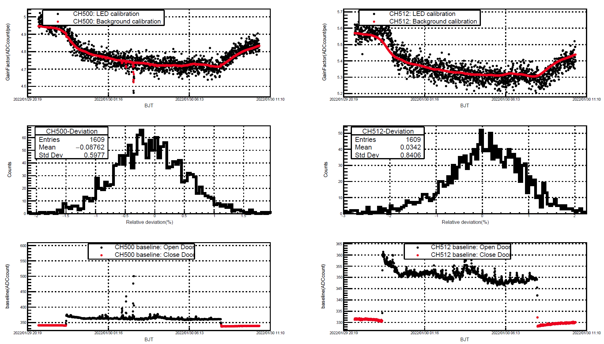

The Self Calibration Method For SiPM Camera
C. The self calibration result
After fully considering the temperature effect of both the SiPM gain and the baseline, the gain factor of the SiPM camera can be calculated with the formula in real-time during the WFCTA observation.
The LED calibration results can faithfully reflect the real-time gain of each SiPM pixel inside the camera. The gain factor of the camera rapidly changes in the early stage of the WFCTA observation with the doors open. At this stage, the working temperature of the SiPM camera changes rapidly.
${GF}_{(obs,T)}$=${GF}_{(dark,T)}−f_{GB}×(B_{\left(obs,T\right)}−B_{(dark,T0)})$

Slide 6
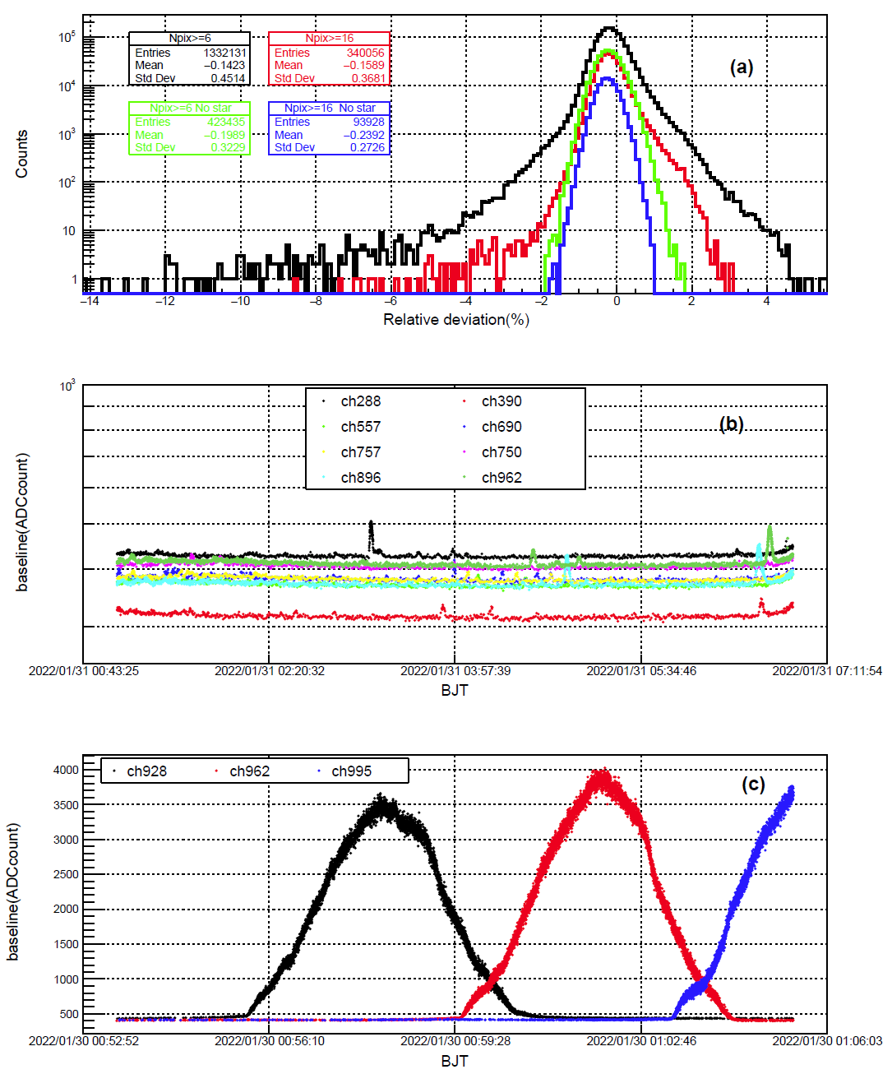
The Cherenkov Light Intensity Measurement Result
A. Observation under the starlight
Considering the rotation of the Earth and considering stars as non-point sources, it takes 2 to 4 minutes for stars to pass through the field of view of a SiPM pixel inside the WFCTA camera. The bright stars can cause much significant fluctuation in the baseline of a SiPM pixel within 2 to 4 minutes. The LED calibration for SiPM camera is obtained from the median of the LED signals in 30s. When the background light intensity changes within a short time and with a large amplitude, the LED calibration cannot follow the change of gain factor of the SiPM camera, which is very sensitive to the variation of the background light intensity. For large Cherenkov light cones that trigger more SiPM pixels, the impact of starlight will be weakened.

Slide 7
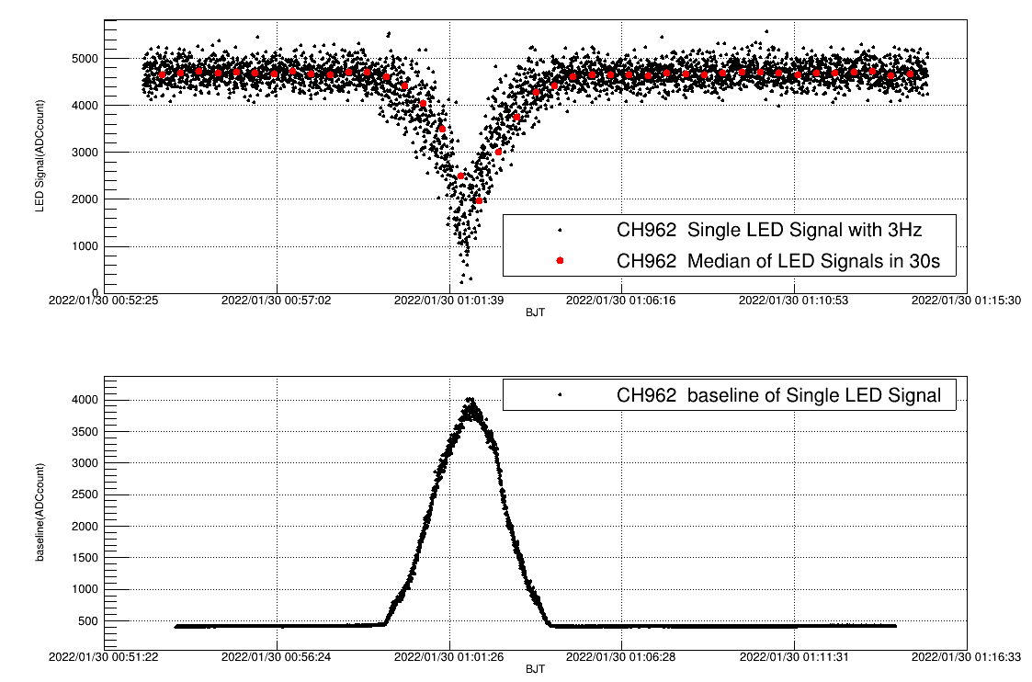
The Cherenkov Light Intensity Measurement Result
B. Observation under the moonlight
When the intersection angle between the moon and the telescope bellow 35°, the avalanche current rises rapidly. When the current exceeds 0.8A, the baseline does not rise with the current regularly. As a result, the calibration method based on the background cannot provide a reliable result, when the moon is near the field of view of the telescope in the full moon period. In addition, the calibration based on background can match with the LED calibration with a deviation bellow 5%, when the intersection angle is over 35°.

Slide 8
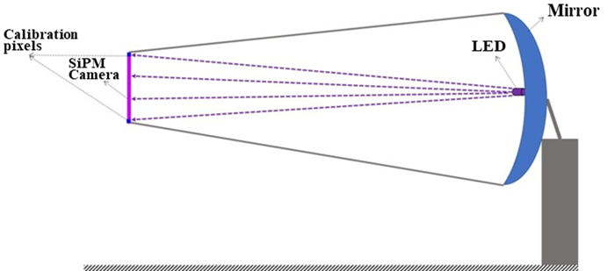
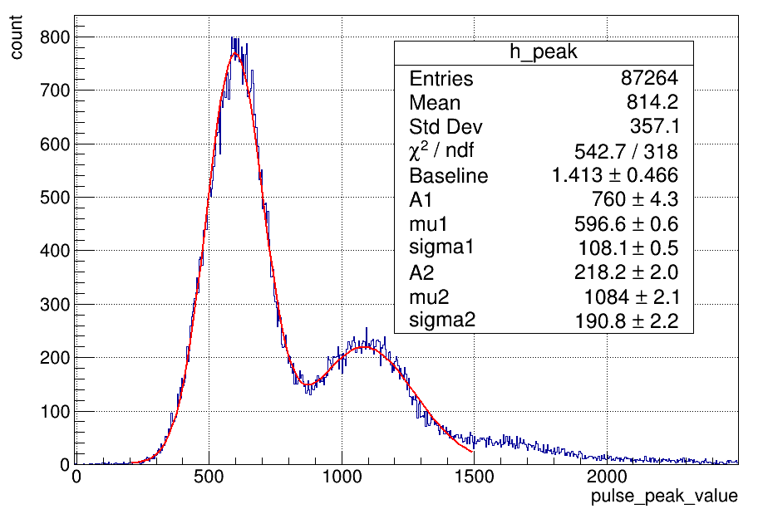
Outlook
A. Calibration for the LACT SiPM camera
A calibration pixel is placed at the corner of the LACT SiPM camera.
Under night sky background conditions, as the event rate of background light increases, both the average baseline level and its fluctuation of the calibration pixel rise significantly. Most background pulse signals are on the order of several photoelectrons, and baseline fluctuation considerably affects the calculation of background pulse amplitude. By using the single-pulse baseline start-point valley subtraction method, a background light pulse amplitude spectrum with improved resolution is obtained.
The absolute gain of the calibration pixel is obtained based on the pulse amplitude spectrum of night sky background light. The number of photons incident on the camera surface from the LED is calibrated using the calibration pixel, and the calibration coefficient is transferred to the SiPM camera.

Slide 9
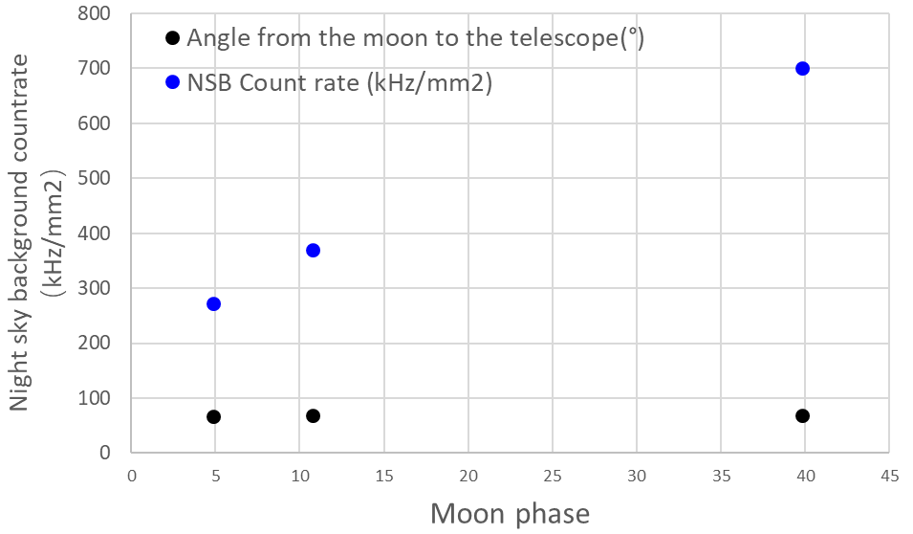
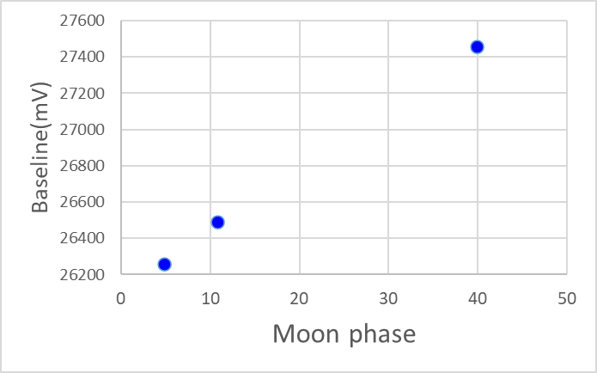
Outlook
B. Night sky background light
Based on limited available observational data, the frequency and intensity variations of night sky background light with lunar phases are quantitatively analyzed.
Subsequently, an observation plan will be formulated to investigate the effects of lunar phases, the angular separation between the telescope and the Moon, weather conditions, and other relevant factors on night sky background light.

Slide 10
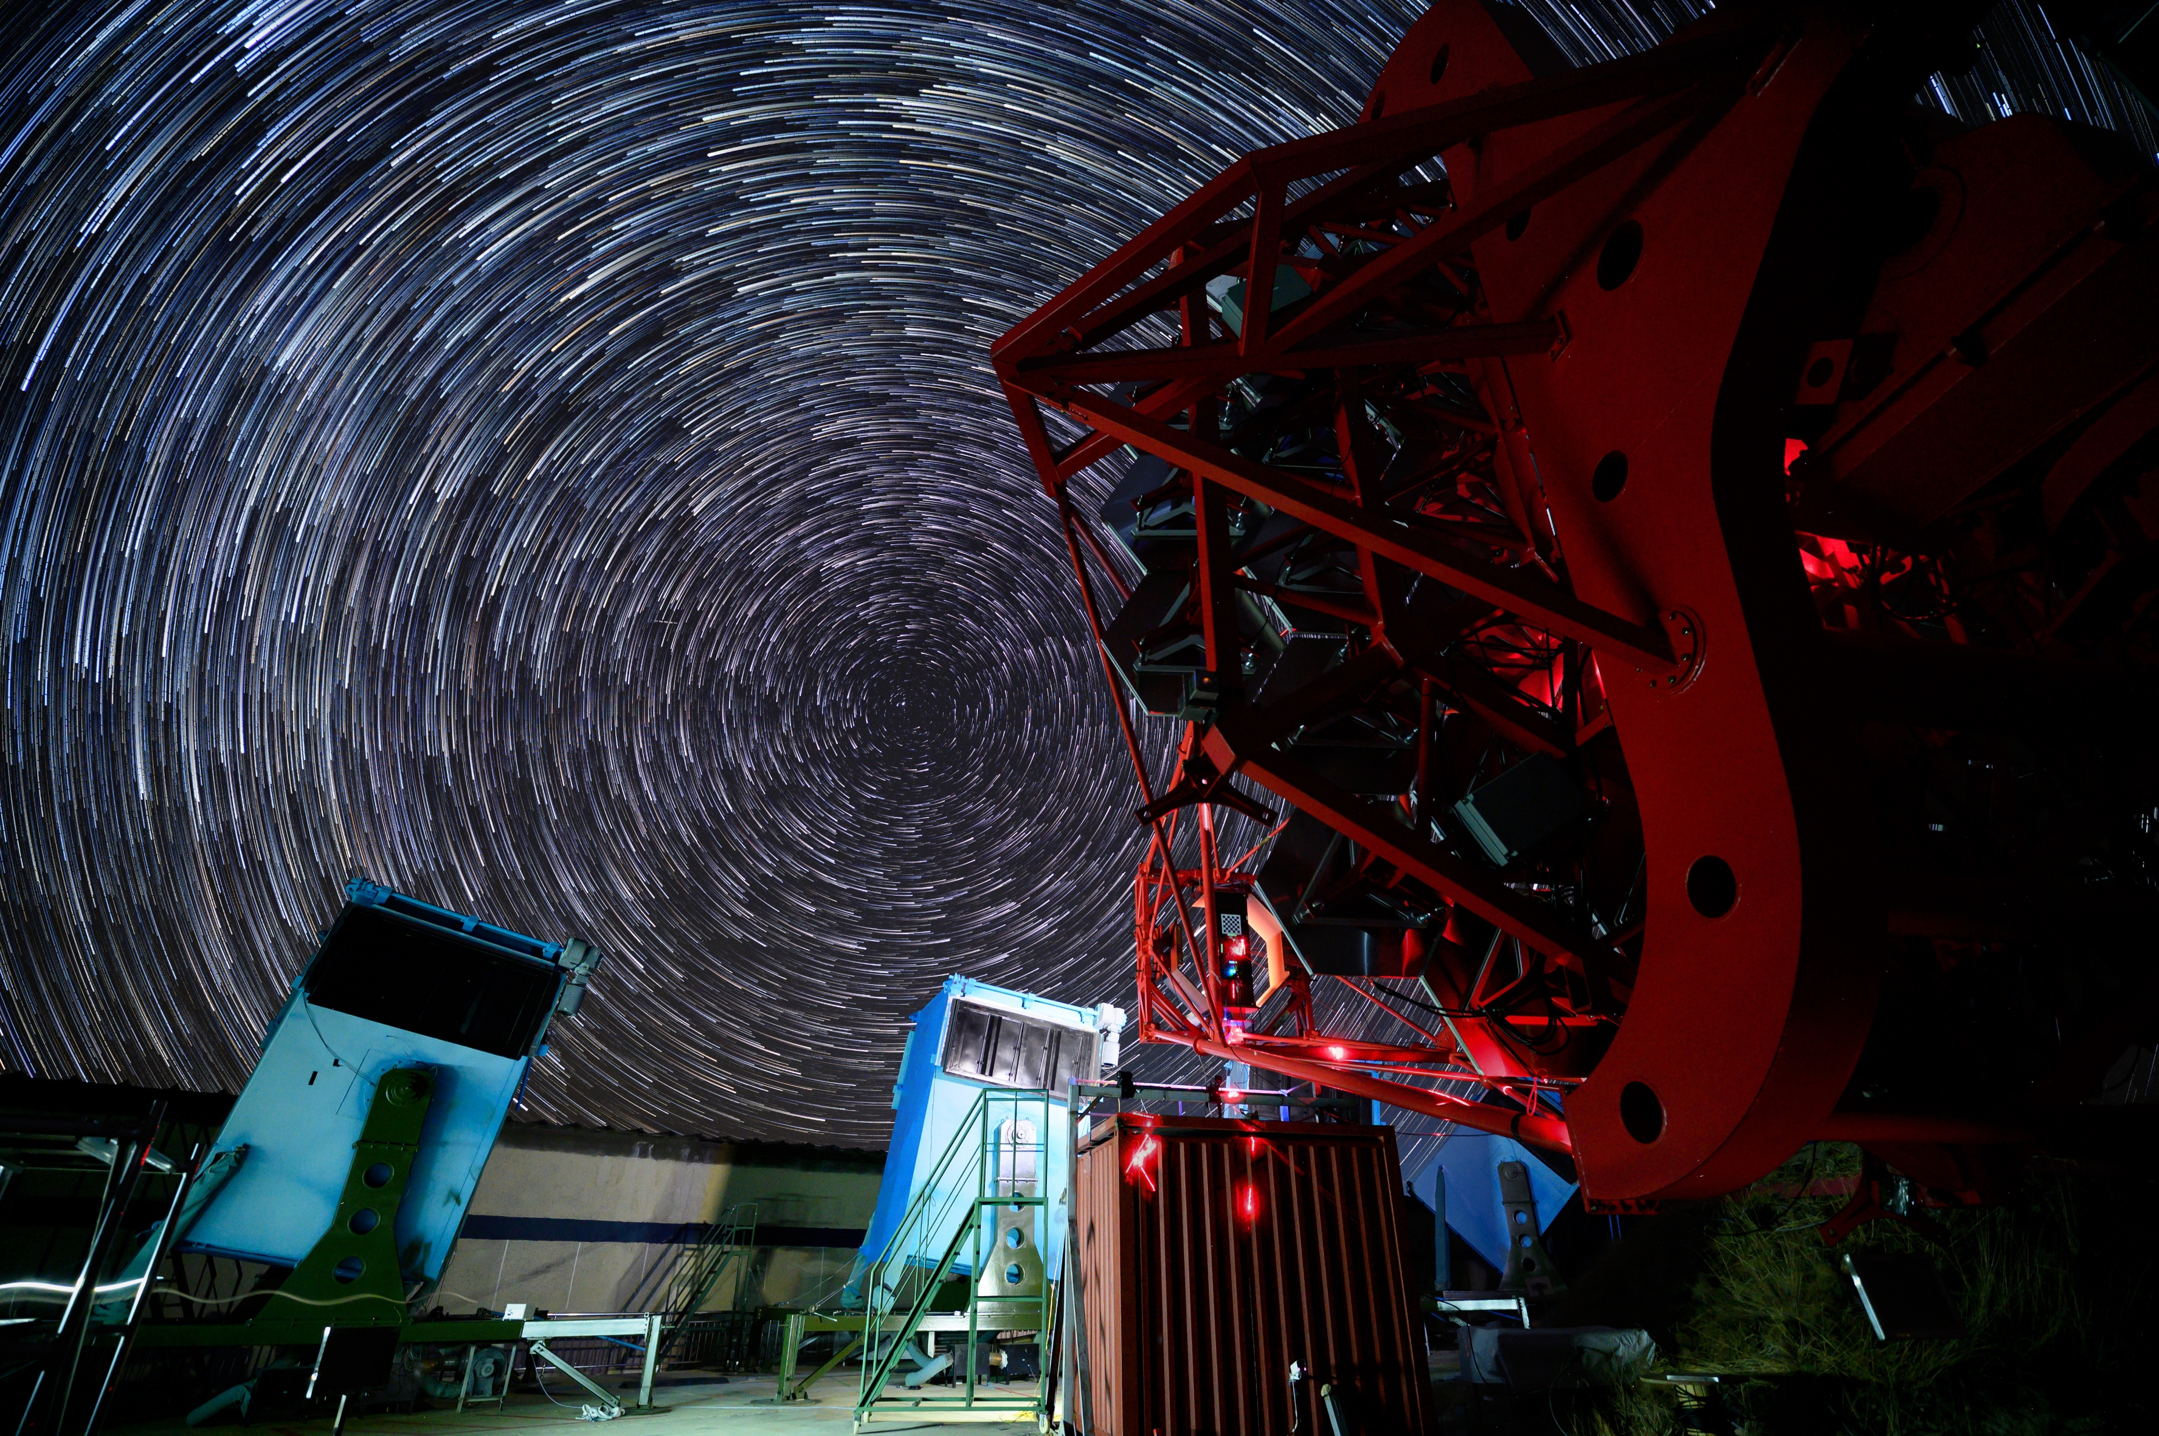
Thank you！

