Slide 1
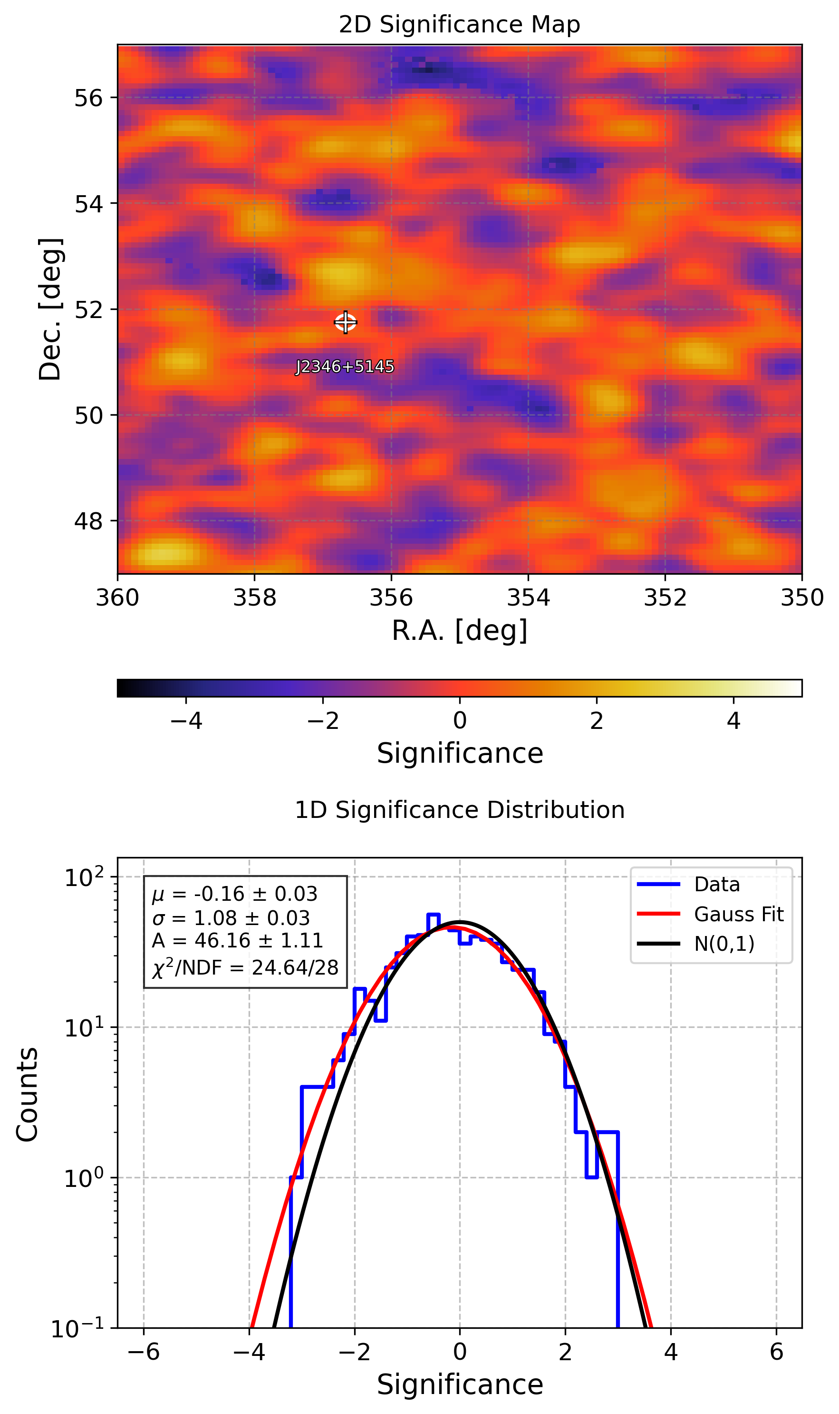
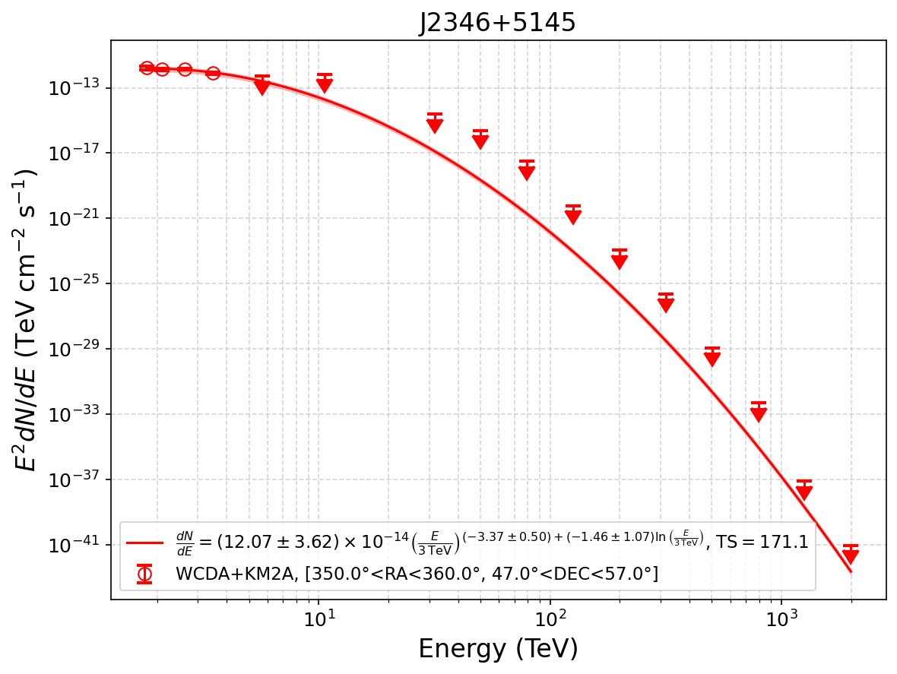
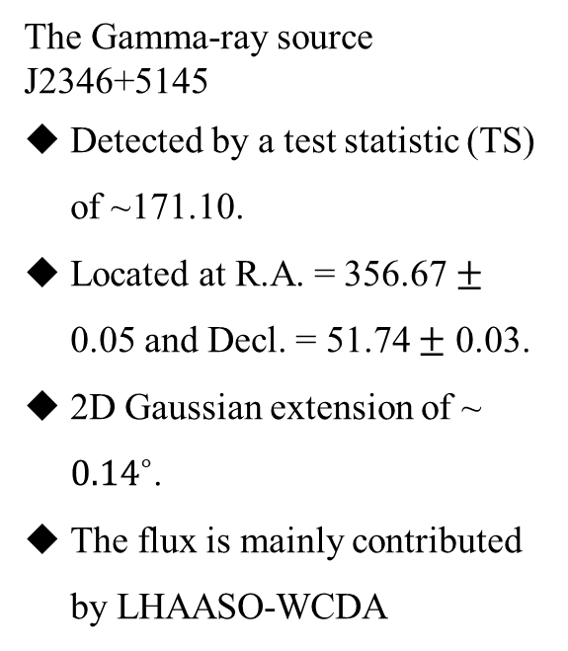
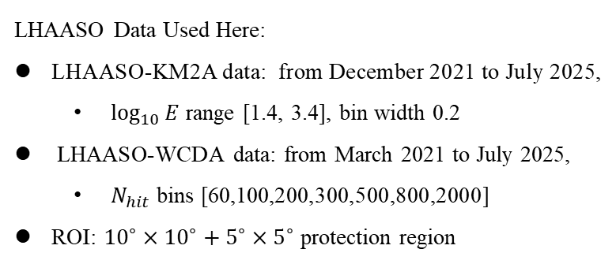
LHAASO Analysis of the Gamma-Ray Source J2346+5145
LHAASO Data Used Here:
LHAASO-KM2A data: from December 2021 to July 2025,
  $\log_{10}{E}$ range [1.4, 3.4], bin width 0.2
LHAASO-WCDA data: from March 2021 to July 2025,
  $N_{hit}$ bins [60,100,200,300,500,800,2000]
ROI: ${10}^{∘}×{10}^{∘}+5^{∘}×5^{∘}$ protection region
The Gamma-ray source J2346+5145
Detected by a test statistic (TS) of ~171.10.
Located at R.A. = 356.67 $±$ 0.05 and Decl. = 51.74 $±$ 0.03.
2D Gaussian extension of ~ ${0.14}^{∘}$.
The flux is mainly contributed by LHAASO-WCDA
Figure 1. The SED of J2346+5145 (right) and the resid map (left) in the JOINT analysis.

Slide 2
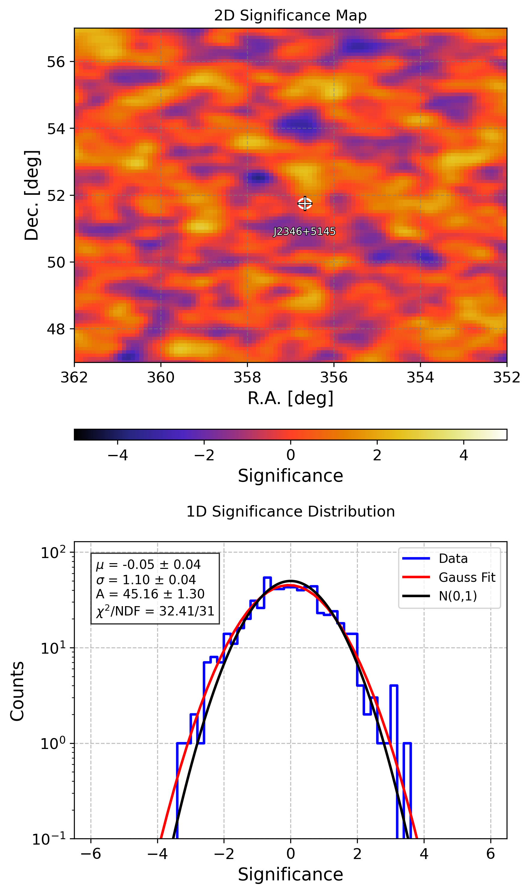
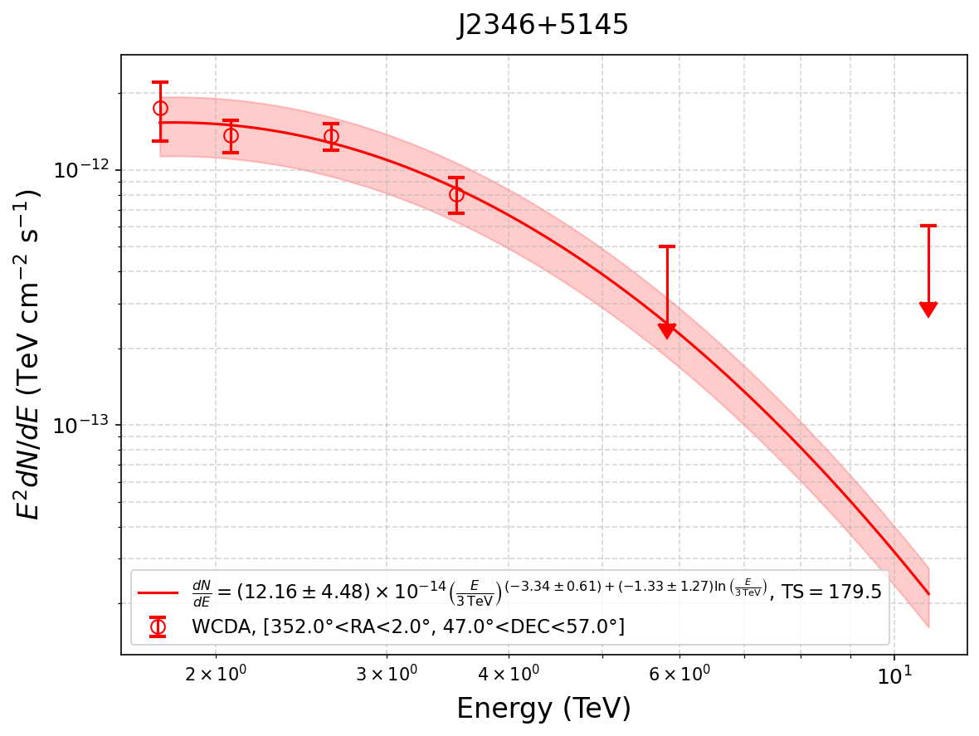
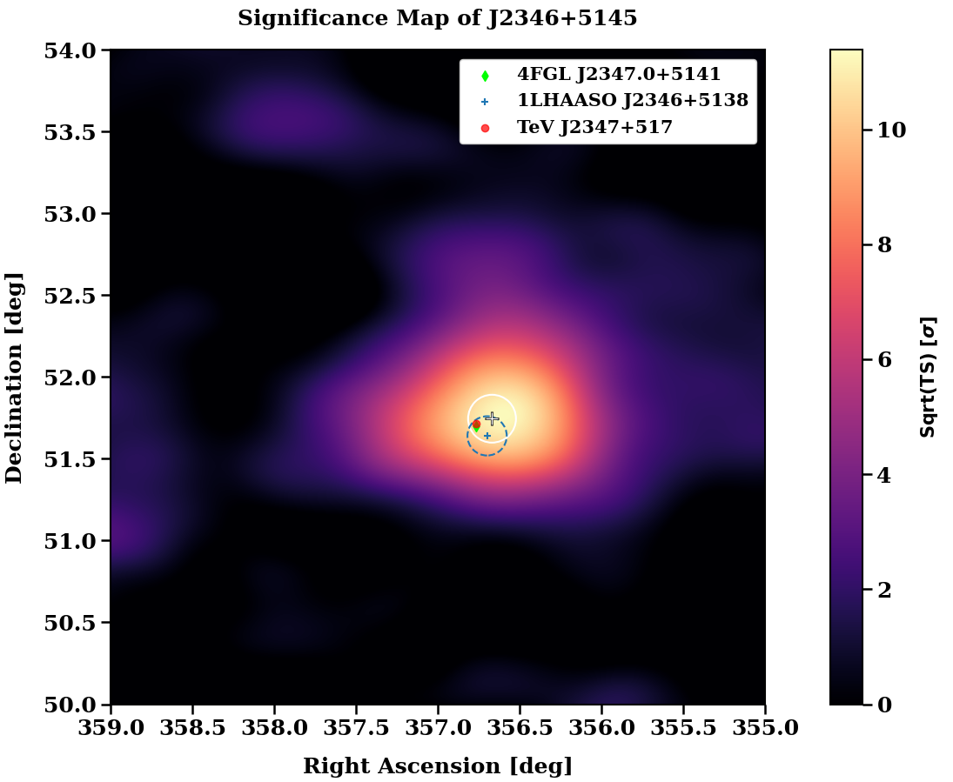
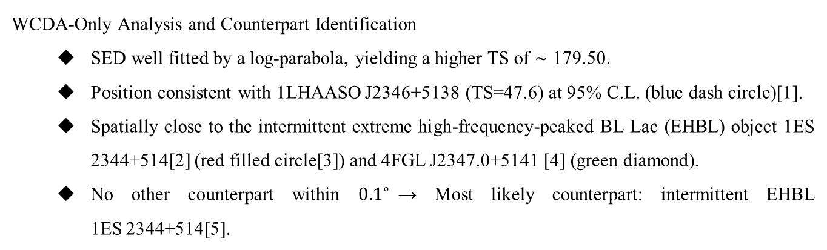
LHAASO Analysis of the Gamma-Ray Source J2346+5145
WCDA-Only Analysis and Counterpart Identification
  SED well fitted by a log-parabola, yielding a higher TS of ∼ 179.50.
  Position consistent with 1LHAASO J2346+5138 (TS=47.6) at 95% C.L. (blue dash circle)[1].
  Spatially close to the intermittent extreme high-frequency-peaked BL Lac (EHBL) object 1ES 2344+514[2] (red filled circle[3]) and 4FGL J2347.0+5141 [4] (green diamond).
  No other counterpart within ${0.1}^{∘}$→ Most likely counterpart: intermittent EHBL 1ES 2344+514[5].
Figure 2. The SED of J2346+5145 (left) , the zoom-in significance map (middle) and the resid map (left) in the WCDA analysis.

Slide 3
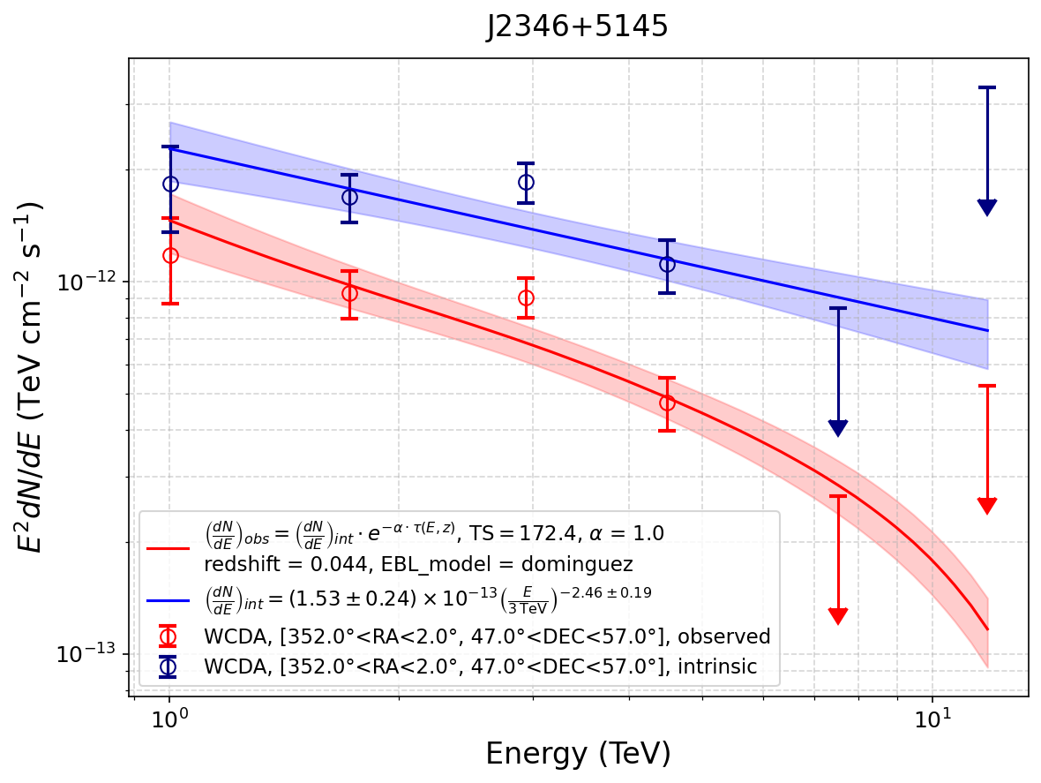
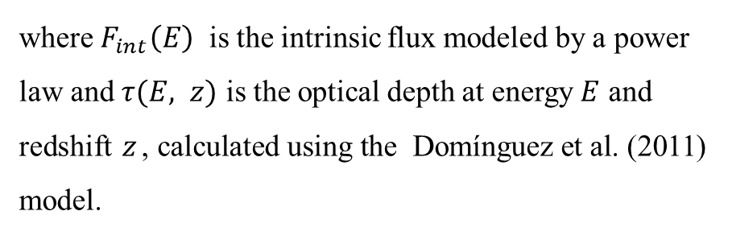

LHAASO Analysis of the Gamma-Ray Source J2346+5145
Extragalactic Background Light (EBL) Absorption Correction[6]
The observed flux:
$$F_{obs}\left(E\right)=F_{int}\left(E\right) ⋅e^{−τ(E, z)}$$
where $F_{int}\left(E\right)$ is the intrinsic flux modeled by a power law and $τ(E, z)$ is the optical depth at energy $E$ and redshift $z$, calculated using the Domínguez et al. (2011) model.

Slide 4
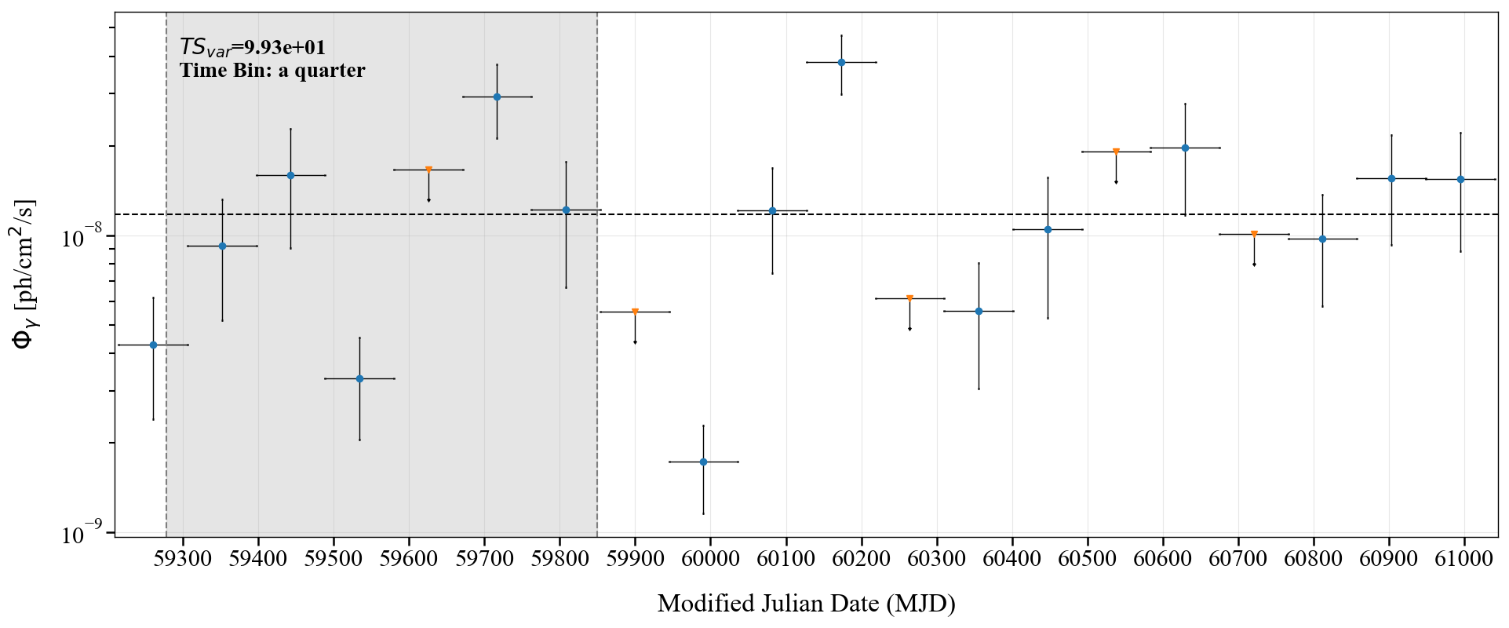
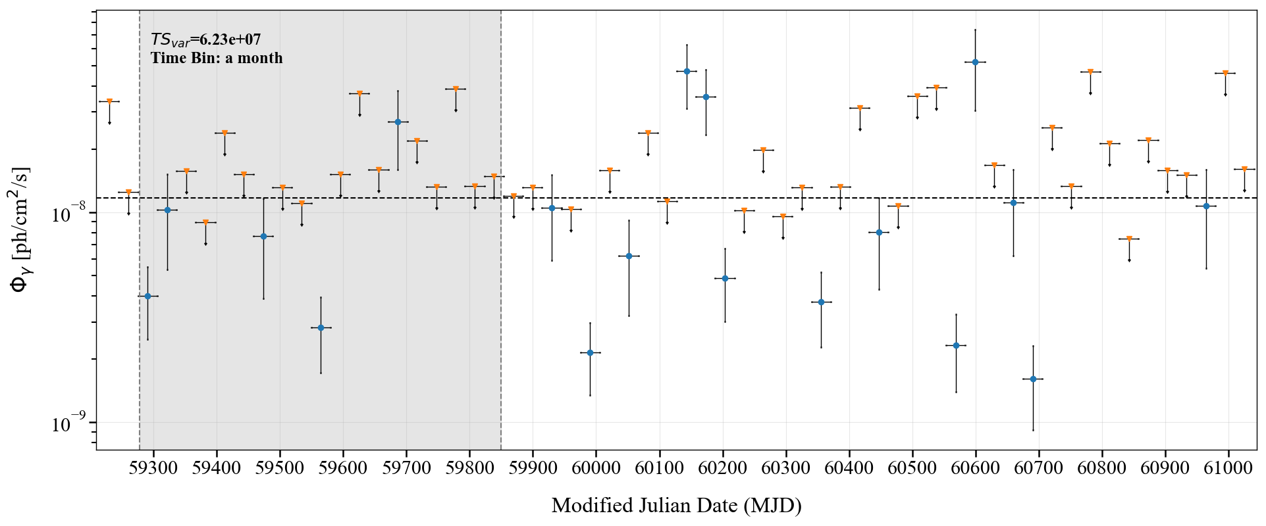
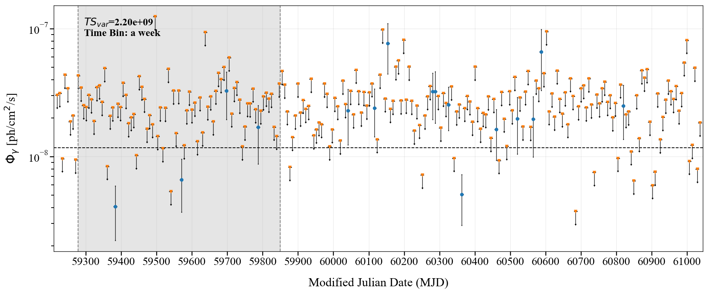
LHAASO Analysis of the Gamma-Ray Source J2346+5145
The variability of J2346+5145 over the time span covered by the LHAASO data
Shaded area: WCDA time span used for 1LHAASO J2346+5138 in the First LHAASO Catalog.
Horizontal dash: constant flux from max‑likelihood fit.
Variability statistic[7]:
$$TS_{var}=2Σ_{i}\left[\log{L_{i}\left(F_{i}\right)−\log{L_{i}(F_{const})}}\right]\frac{ΔF_{i}^{2}}{ΔF_{i}^{2}+f^{2}F_{const}^{2}}$$
Notable peak exceeding 3× constant flux between MJD 60100–60200 → possible flaring episode?

Slide 5
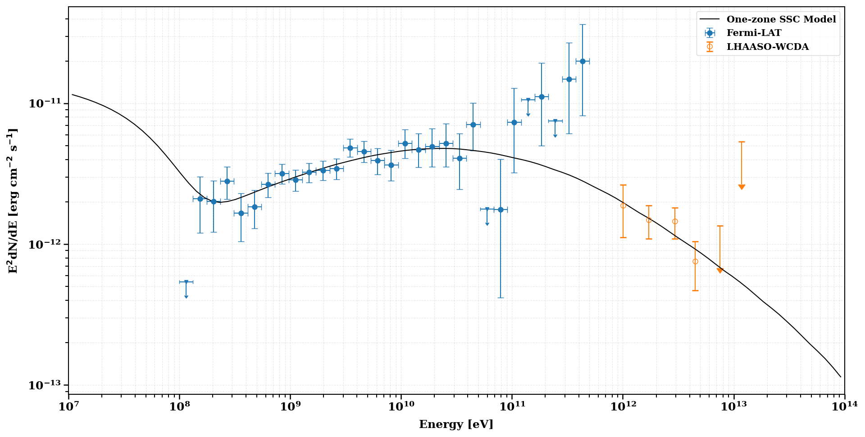
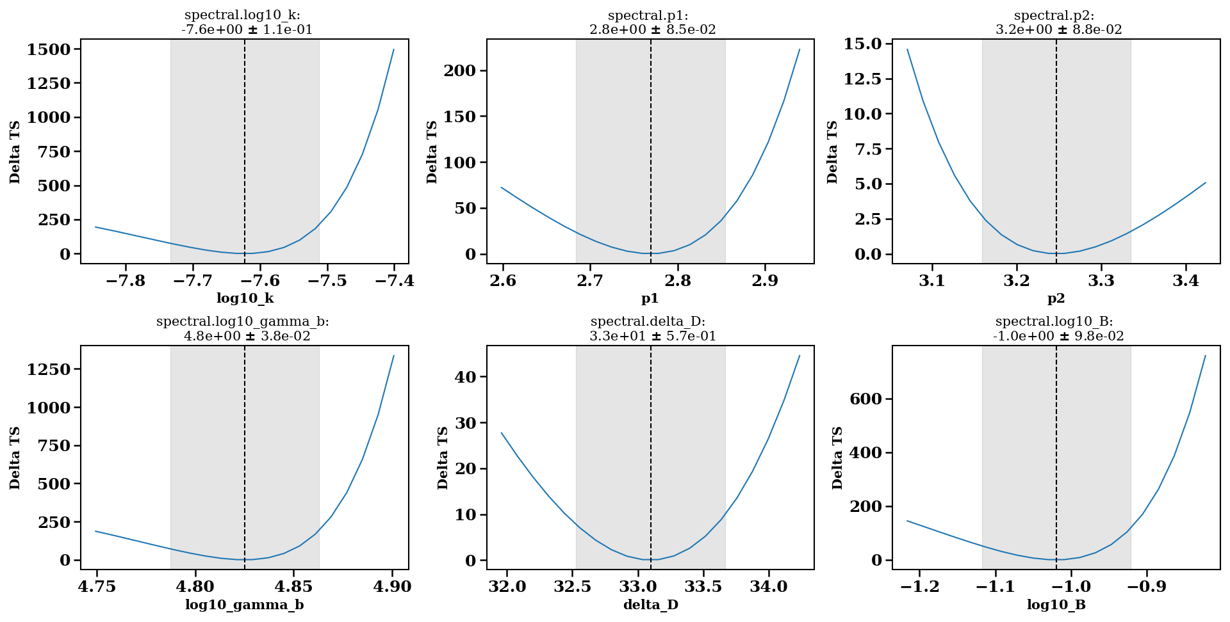
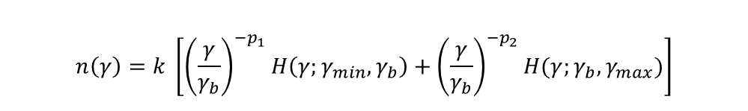
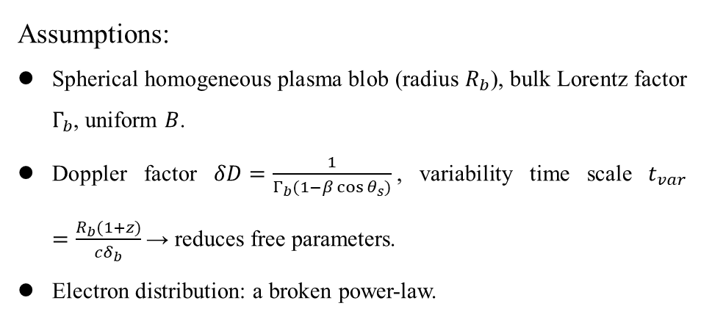
LHAASO Analysis of the Gamma-Ray Source J2346+5145
A preliminary fit to the radiation of source J2346+5145
A one-zone synchrotron-self-Compton (SSC) model with synchrotron self-absorption
Assumptions:
Spherical homogeneous plasma blob (radius $R_{b}$), bulk Lorentz factor $Γ_{b}$, uniform $B$.
Doppler factor $δD=\frac{1}{Γ_{b}(1−β\cos{θ_{s}})}$, variability time scale $t_{var}=\frac{R_{b}(1+z)}{cδ_{b}}$ → reduces free parameters.
Electron distribution: a broken power‑law.
$$n\left(γ\right)=k \left[{\left(\frac{γ}{γ_{b}}\right)}^{−p_{1}}H\left(γ;γ_{min}, γ_{b}\right)+{\left(\frac{γ}{γ_{b}}\right)}^{−p_{2}}H(γ;γ_{b}, γ_{max})\right]$$

Slide 6
LHAASO Analysis of the Gamma-Ray Source J2346+5145
REFERENCES
[1] Cao, Z., Aharonian, F., An, Q., Axikegu, et al. 2024, The First LHAASO Catalog of Gamma-Ray Sources, ApJS, 271, 25
[2] MAGIC Collaboration et al. 2020, An intermittent extreme BL Lac: MWL study of 1ES 2344+514 in an enhanced state, MNRAS, 496, 3912
[3] Wakely, S. P. & Horan, D. 2008, TeVCat: An online catalog for Very High Energy Gamma-Ray Astronomy, in ICRC, 3, 1341
[4] Abdollahi, S., Acero, F., Ackermann, M., Ajello, M., Atwood, W. B., Axelsson, M., Baldini, L., Ballet, J., Barbiellini, G., Bastieri, D., et al. 2020, Fermi Large Area Telescope Fourth Source Catalog, ApJS, 247, 33
[5] Elvis, M., Plummer, D., Schachter, J., & Fabbiano, G. 1992, The Einstein Slew Survey, ApJS, 80, 257
[6] Dwek, E. & Krennrich, F. 2005, Simultaneous Constraints on the Spectrum of the Extragalactic Background Light and the Intrinsic TeV Spectra of Markarian 421, Markarian 501, and H1426+428, ApJ, 618, 657
[7] Nolan, P. L., et al. 2012, Fermi Large Area Telescope Second Source Catalog, ApJS, 199, 31
[8] Nigro, C., Sitarek, J., Gliwny, P., Sanchez, D., Tramacere, A., & Craig, M. 2022, agnpy: An open-source python package modelling the radiative processes of jetted active galactic nuclei, A&A, 660, A18
[9] Nigro, C., Sitarek, J., Gliwny, P., Sanchez, D., Craig, M., Vuillaume, T., Viale, I., & Maniadakis, D. (2023). agnpy (0.5.0). Zenodo. https://doi.org/10.5281/zenodo.18505251
[10] Donath, A., Terrier, R., Remy, Q., Sinha, A., Nigro, C., et al. 2023, Gammapy: A Python package for gamma-ray astronomy, A&A, 678, A157
[11] Acero, F., et al. 2025, Gammapy: Python toolbox for gamma-ray astronomy, Zenodo, v2.0, doi:10.5281/zenodo.1781429

