Slide 1
High-energy gamma-ray spectral measurement of the source J1858+0330 with LHAASO
Shipeng Wang¹, Fengrong Zhu², Huicai Li², Shicong Hu²
1. School of Pyhsical Science and Technology, Southwest Jiaotong University, Chengdu, China
2. Institute of High Energy Physics, Chinese Academy of Sciences

Slide 2

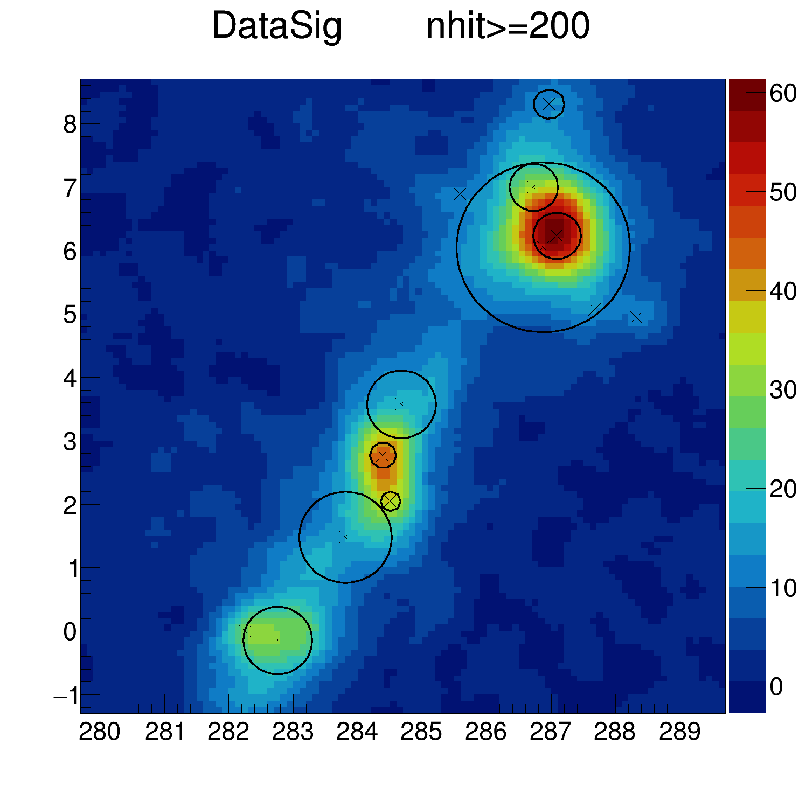
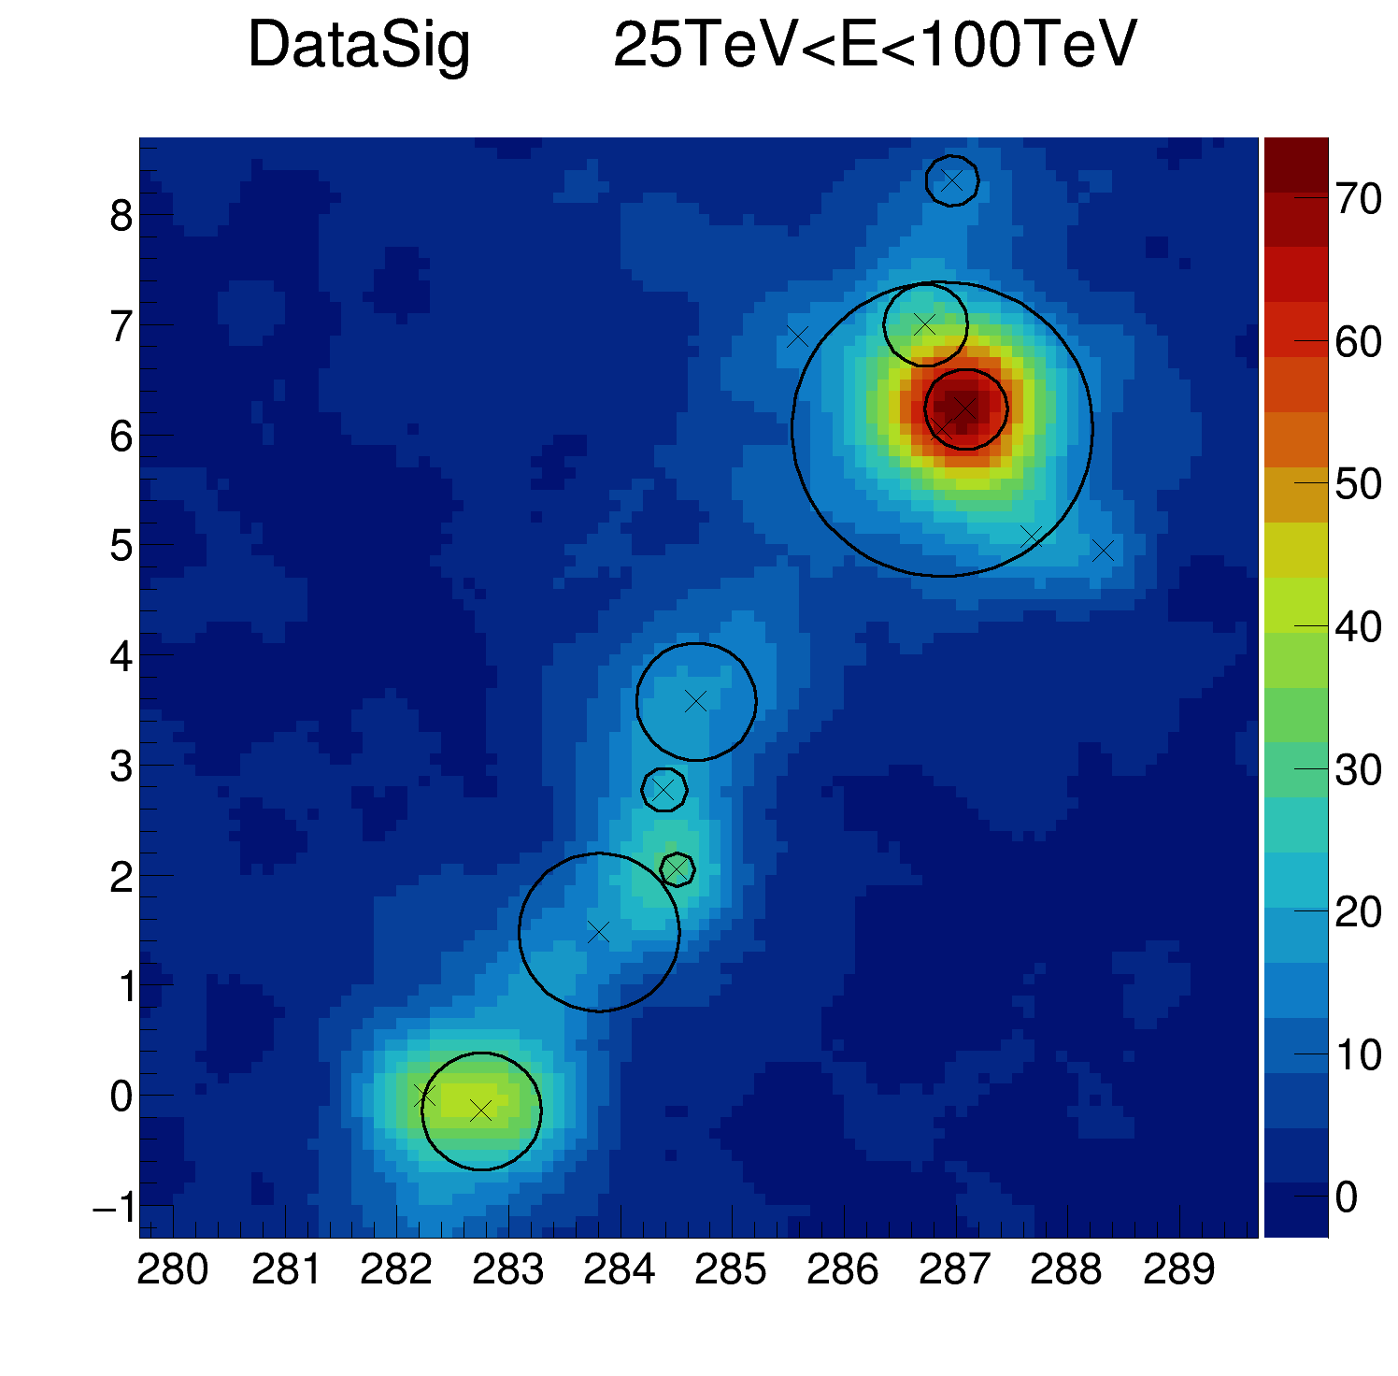
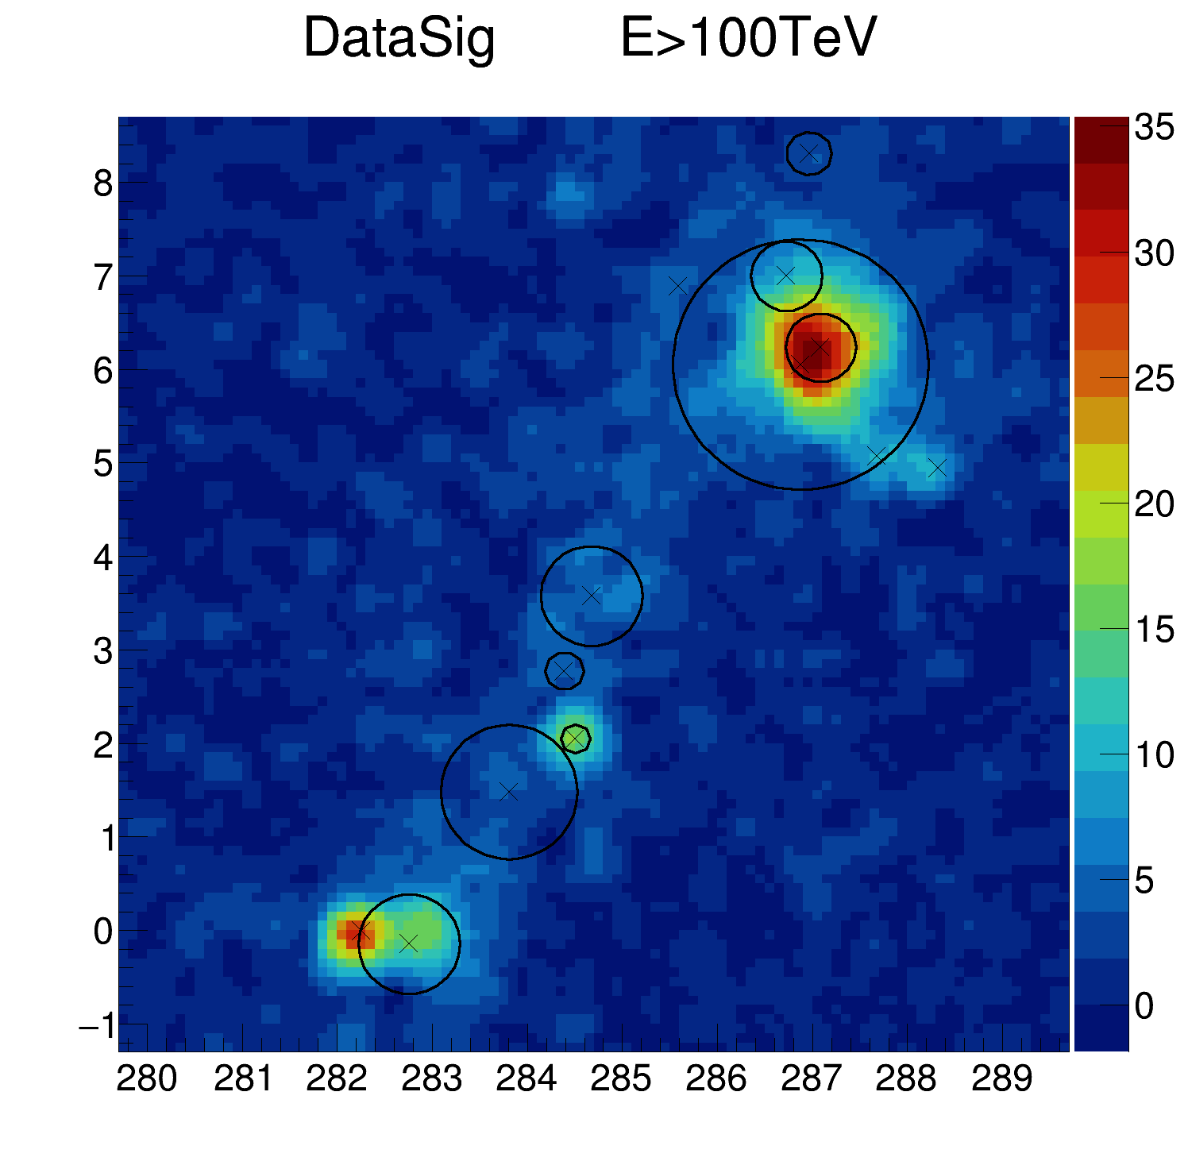
Source Morphology of J1858+0330
J1858+0330
J1858+0330
J1858+0330
Three energy bands: 2–25 TeV (WCDA), 25–100 TeV (KM2A), >100 TeV (KM2A)
ROI：5°×5°
The region around the source is complex, with 13 confirmed sources within the field
At low energies, the source is more extended, At high energies, it becomes more concentrated，Above 100 TeV, it does not collapse into a point source

Slide 3



Spectral Model Comparison
Modle | F0[×10⁻¹⁵] | index1 | index2 | Ext | position | TS
PL | 1.49±0.08 | 2.77±0.01 | - | 0.66±0.03 | 284.73±0.03 3.69±0.03 | 80685
LP | 2.21±0.16 | 2.43±0.05 | 0.40±0.04 | 0.53±0.02 | 284.67±0.02 3.57±0.03 | 82593
PEC | 2.84±0.27 | 1.97±0.08 | - | 0.53±0.02 | 284.65±0.02 3.54±0.03 | 82500
$$F=F0{(\frac{E}{E_{piv}})}^{−α}$$
PL :
$$F=F0{(\frac{E}{E_{piv}})}^{−α−β\log{\frac{E}{E_{piv}}}}$$
LP :
$$F=F0{(\frac{E}{E_{piv}})}^{−α}\exp^{−\frac{E}{E_{cut}}}$$
PEC :
Compared three models: power - law (PL), log - parabola (LP), power - law with cutoff (PEC)
Analysis tool: hushicong v0.99
The log - parabola model is the best
Using the latest data
  WCDA: 20210305-20250731
  KM2A: 20210720-20250731

Slide 4
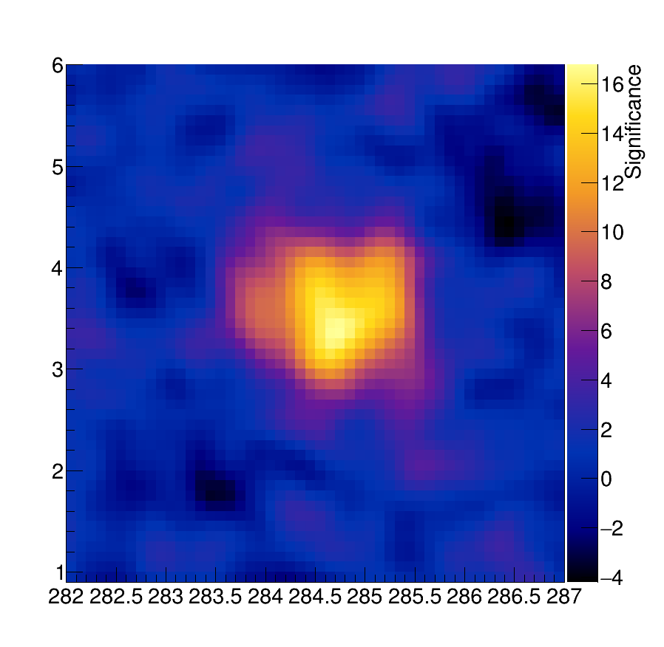
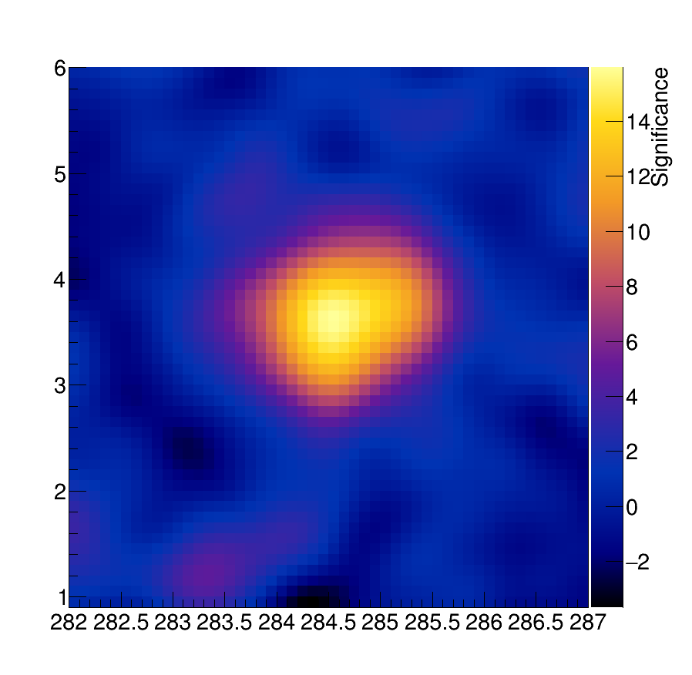
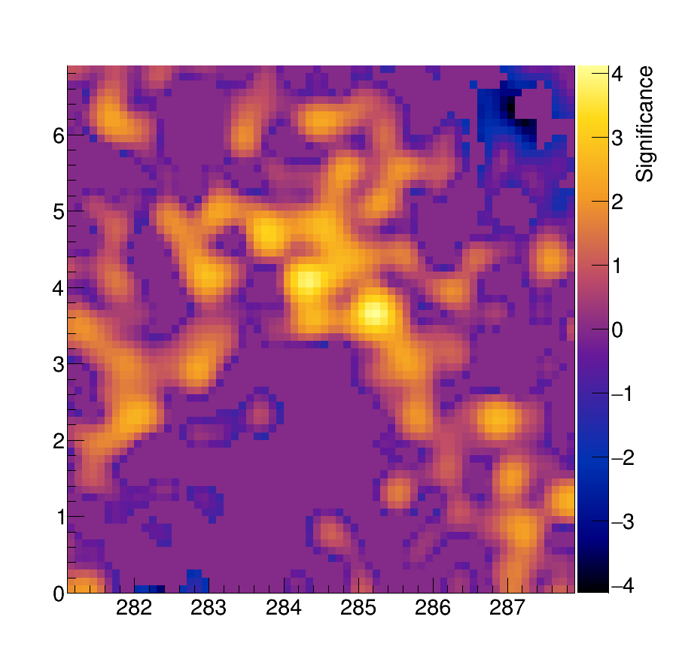
TS Maps in Three Energy Bands
Three bands: left 2–25 TeV (WCDA), middle 25–100 TeV (KM2A), right >100 TeV (KM2A)
The bright region shrinks as energy increases
Consistent with the morphological change in Figure 1
Background is clean with no significant contaminating sources

Slide 5
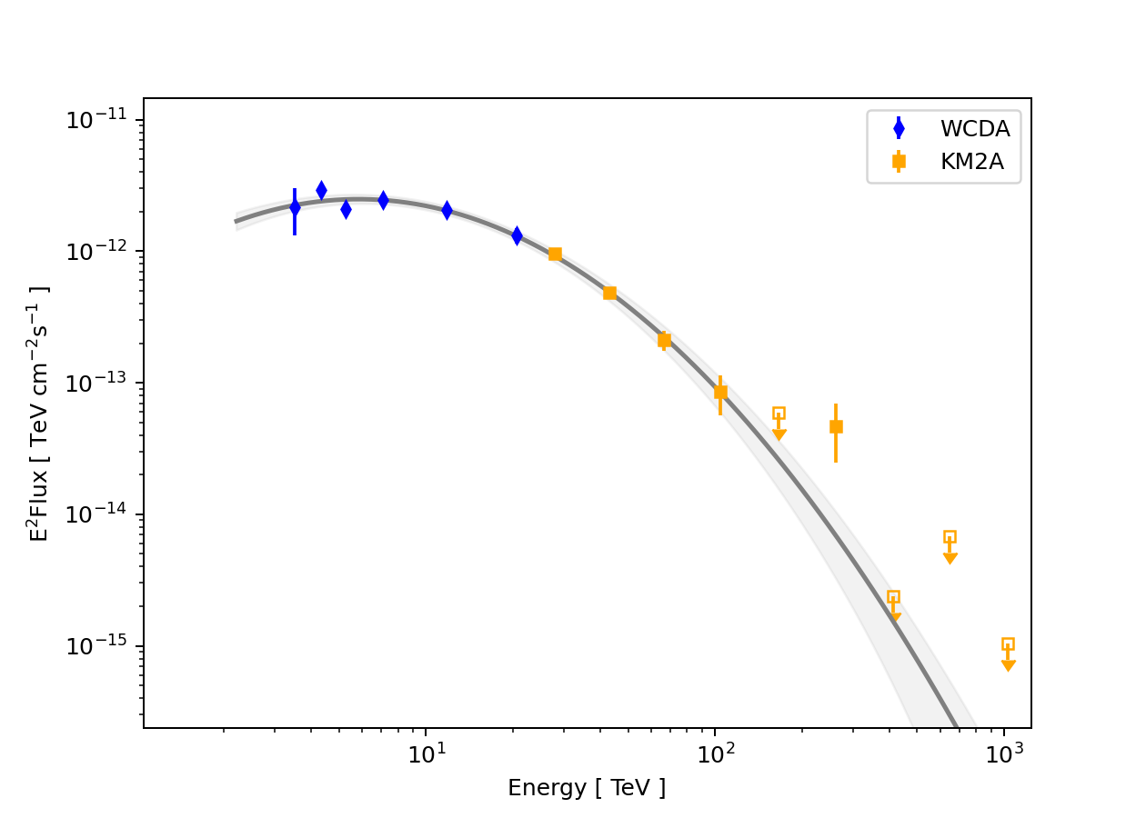
Differential Gamma - Ray Spectrum
Solid line: best - fit log - parabola model
WCDA and KM2A data connect smoothly around 25 TeV, no break
No significant emission above 100 TeV

Slide 6
Summary
The log - parabola (LP) model best describes the gamma - ray spectrum and morphology of J1858+0330
Morphology is energy - dependent: extended at low energies, concentrated at high energies, but not a point source even above 100 TeV
TS maps confirm the morphological evolution with clean background
WCDA and KM2A spectra connect smoothly around 25 TeV, no break
No significant emission above 100 TeV → hints at a high - energy cutof
THANK YOU

