Slide 1
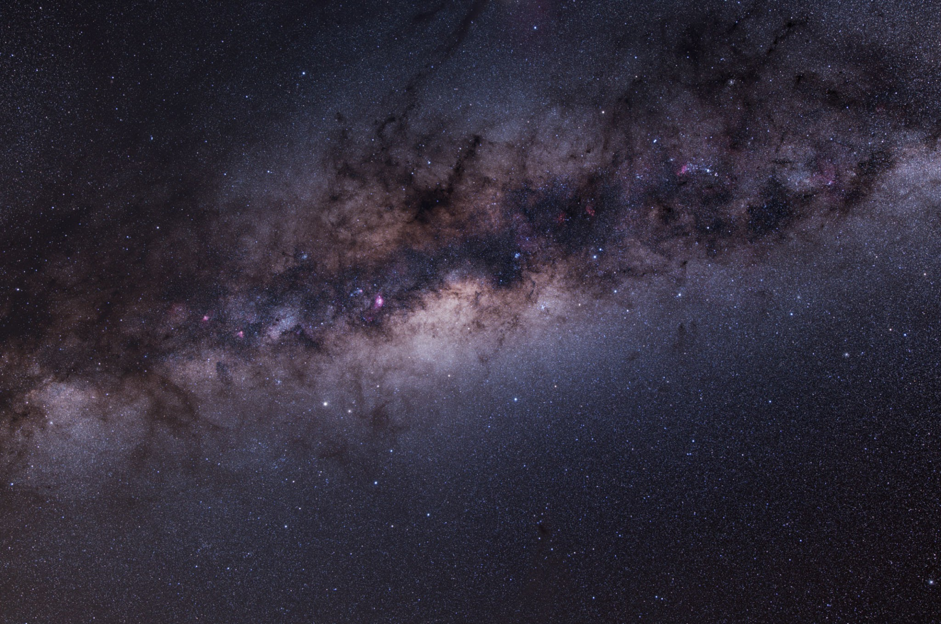
Optimizing LHAASO-KM2A Performance at Large Zenith Angles
Ben-Yang Zhu, Wenlian Li, Cong Li, Xiaoyuan Huang and Huihai He
29/4/2026 @ suzhou

Slide 2
01
Scientific Motivation
02
Energy Reconstruction
03
Particle identification
CONTENTS
04
Performance Validation
05
Experimental Verification
06
Conclusions
07
Anomalous shower

Slide 3
01
Scientific Motivation

Slide 4

Galactic Center: A Forbidden Treasure
Zenith Angle Limitation
Key Astrophysical Targets
Standard LHAASO analysis restricts zenith angles to below 50°, excluding the scientifically rich Galactic Center region from observation.
The Galactic Center contains Sgr A* supermassive black hole, Central Molecular Zone, and supernova remnant G0.9+0.1, crucial for high-energy astrophysics research.

Slide 5
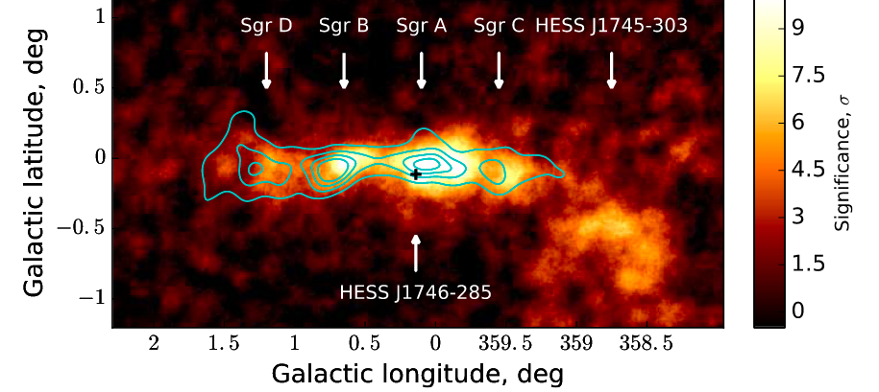
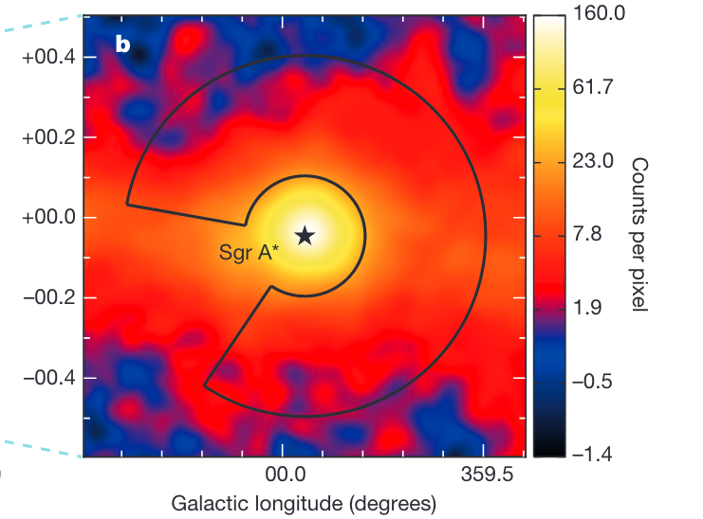
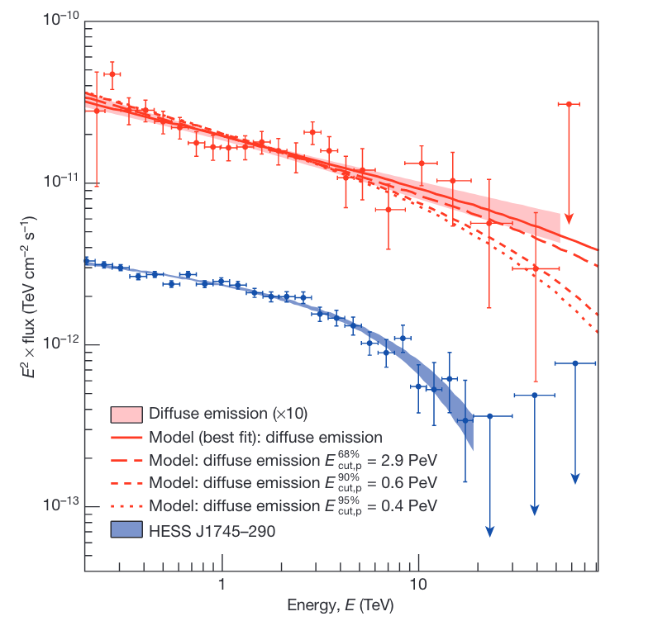
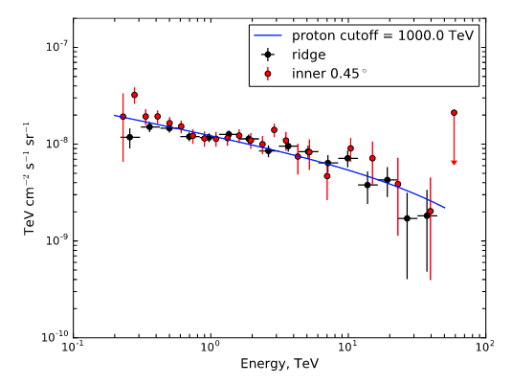

Galactic Center: A Forbidden Treasure
H.E.S.S. collaboration. 2018
GC inner ${45}^{∘}$
GC ridge
H.E.S.S. collaboration. 2016

Slide 6
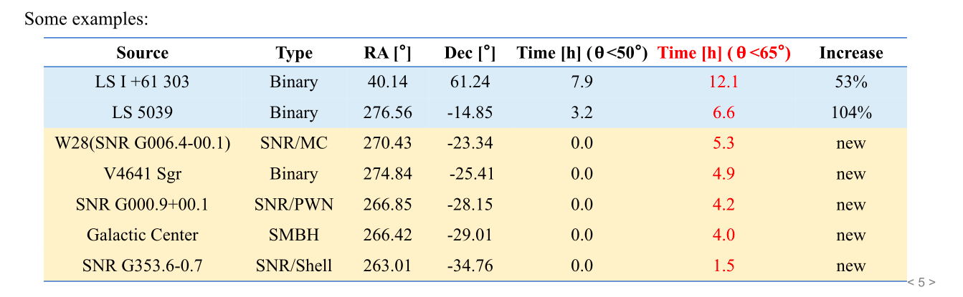
Other sources in large zenith angle region
Provided by Wenlian Li

Slide 7
02
Energy Reconstruction

Slide 8
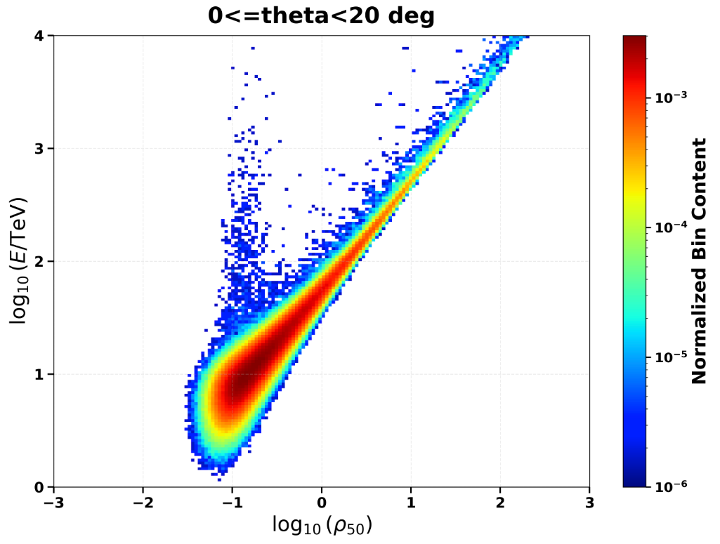

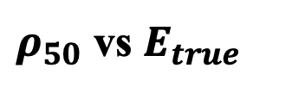
Standard Energy Reconstruction Framework
Quadratic Reconstruction Formula
Standard method uses particle density at 50m (ρ₅₀) as estimator:
$log(E_{\text{rec}}/\text{TeV}$) = $a\left(θ\right) ⋅{\left(\log\left(ρ_{50}\right)\right)}^{2}+b\left(θ\right)⋅\log\left(ρ_{50}\right)+c(θ)$
Coefficients are zenith-dependent and fitted from MC simulations of ρ₅₀ versus E_true distributions.
$ρ_{50}$ vs $E_{true}$

Slide 9
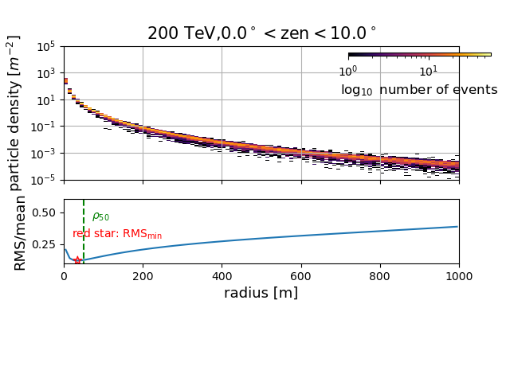
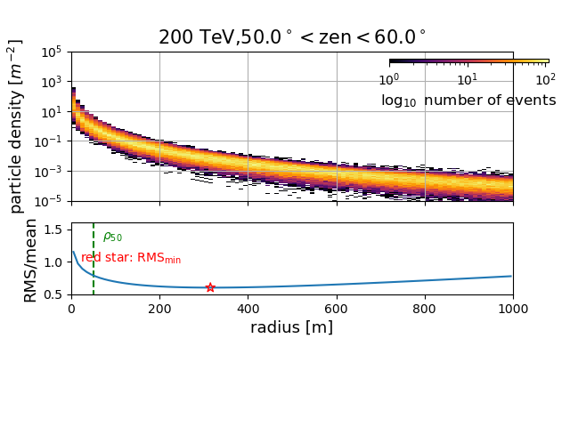

Optimal Distance for Density Measurement
Density Fluctuation Analysis
Stability at Extended Distance
Revised Energy Estimator
Particle density fluctuations vary with core distance; larger angles show different radial characteristics.
Measurements at 150m demonstrate significantly reduced fluctuations compared to 50m reference point.
Energy reconstruction reoptimized using ρ₁₅₀ with recalibrated quadratic parameters for large zenith angles.
$log(E_{\text{rec}}/\text{TeV}$) = $a\left(θ\right) ⋅{\left(\log\left(ρ_{150}\right)\right)}^{2}+b\left(θ\right)⋅\log\left(ρ_{150}\right)+c(θ)$

Slide 10
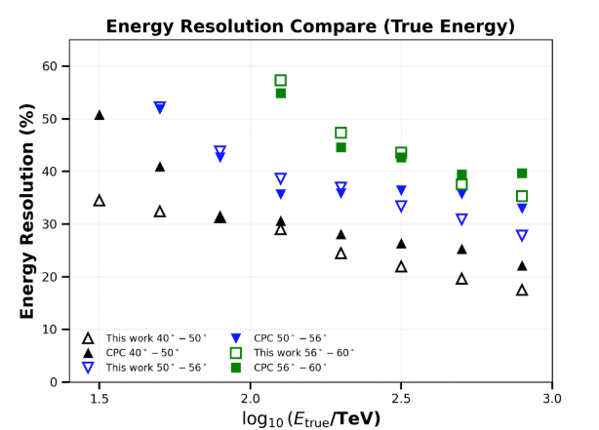
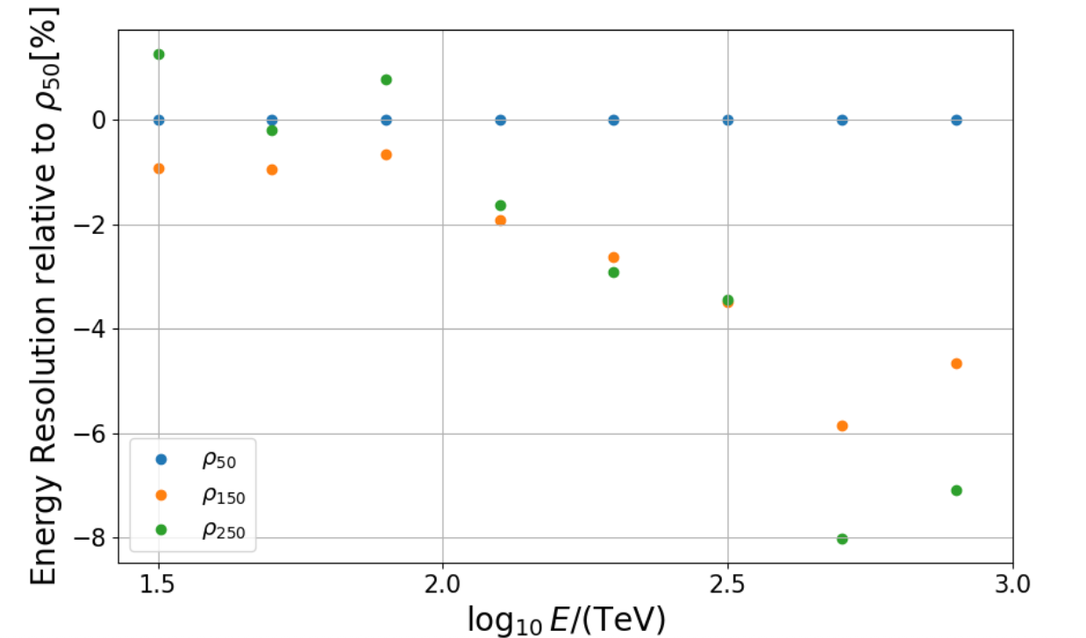
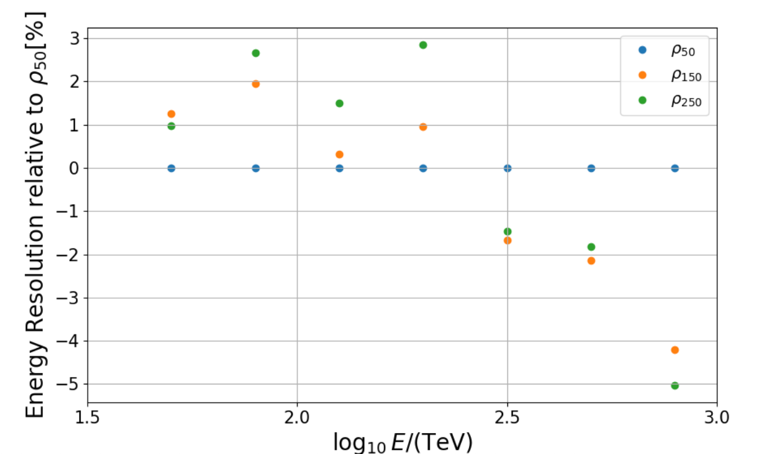

Resolution
Energy resolution variation along $ρ$
z40-50
z50-56
Best energy estimator changes along energy & zenith angle

Slide 11
03
Particle identification

Slide 12
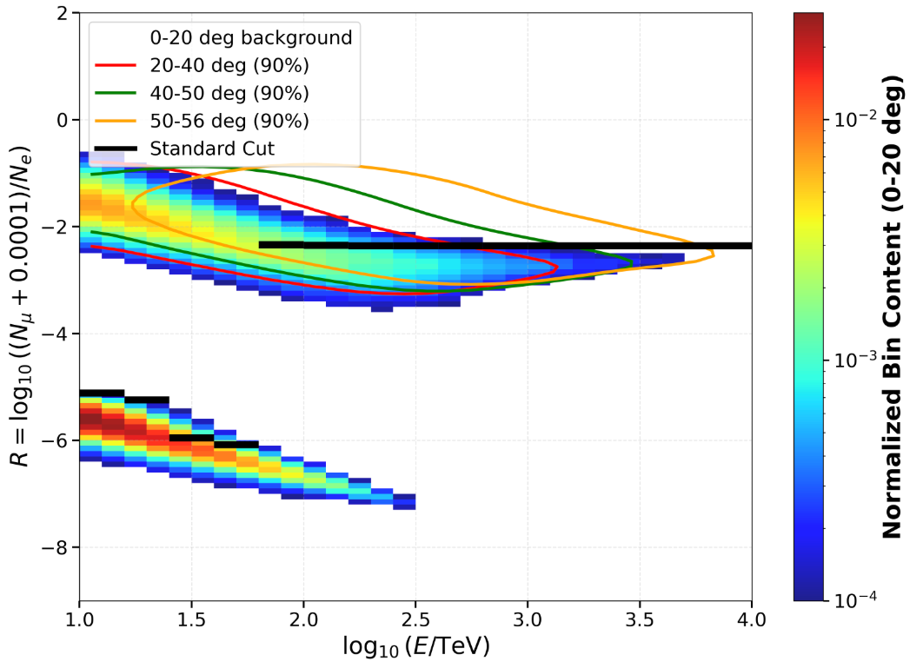
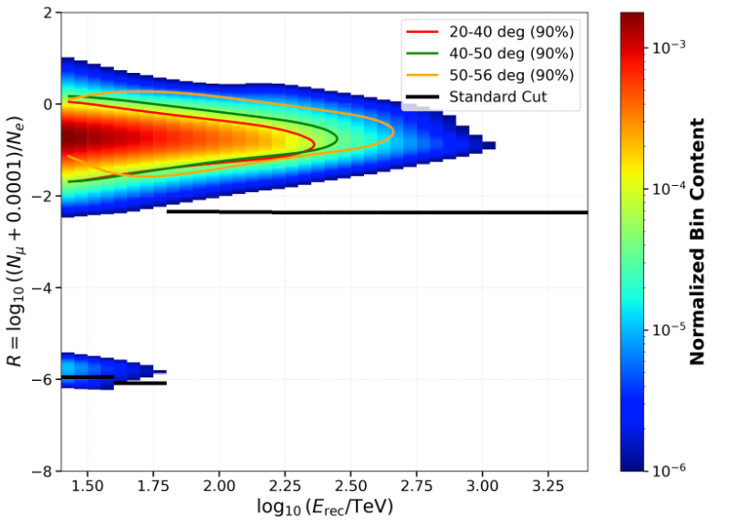
Zenith-Dependent Particle Identification Evolution
R profile
Cosmic rays from experimental data in mask region (up to end of 2024)
Gamma-rays from Monte Carlo
R distribution shifts systematically upward with zenith angle.
Uniform selection thresholds severely suppress valid gamma-ray events at large angles, making reevaluation essential.

Slide 13
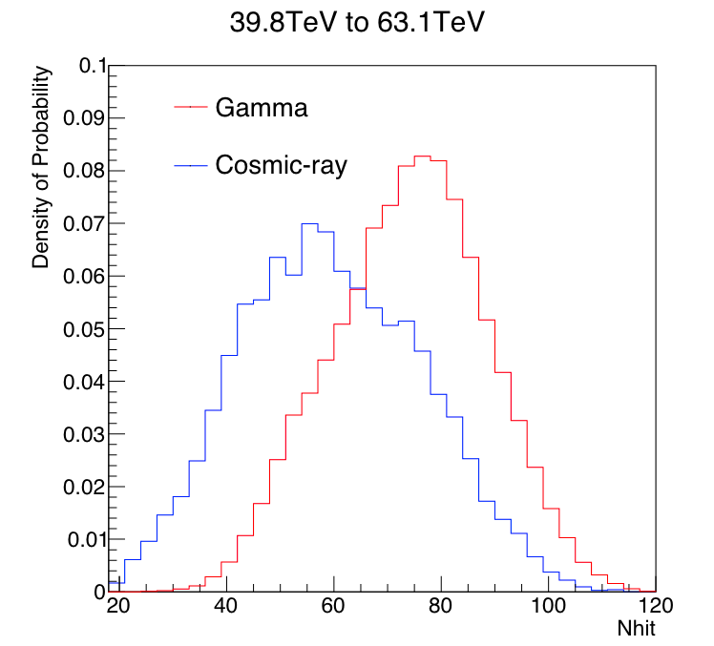
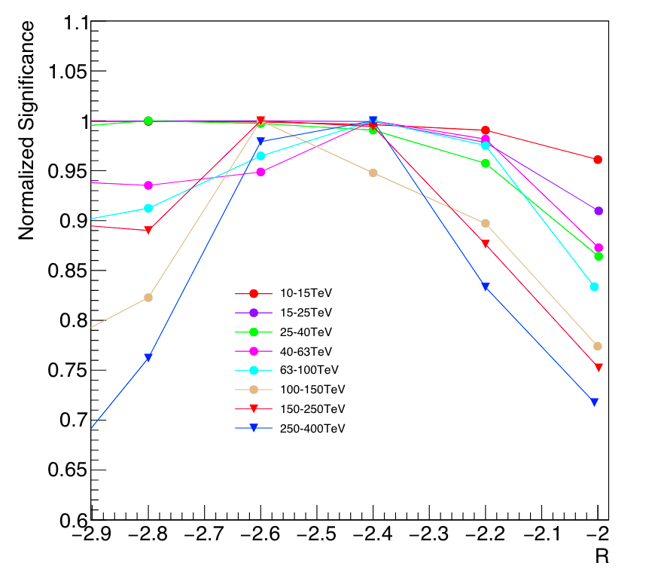
Optimization threshold of Nhit and R
Cao et al. 2024
Nhit provides strong γ/CR separation complementary to R parameter
Energy dependent Nhit a constant R thresholds derive a maximum significance of Crab Nebula

Slide 14
Simulation-Based Optimization Strategy
Artificial Source Injection Method
Due to lack of bright standard candles (e.g., Crab Nebula) at large angles, artificial source (~tens of σ point source) is injected into MC data.
Optimization performed across 40°-50°, 50°-56°, and 56°-60° bins, significance of the injected source as performance metric for establishing optimal selection criteria.

Slide 15
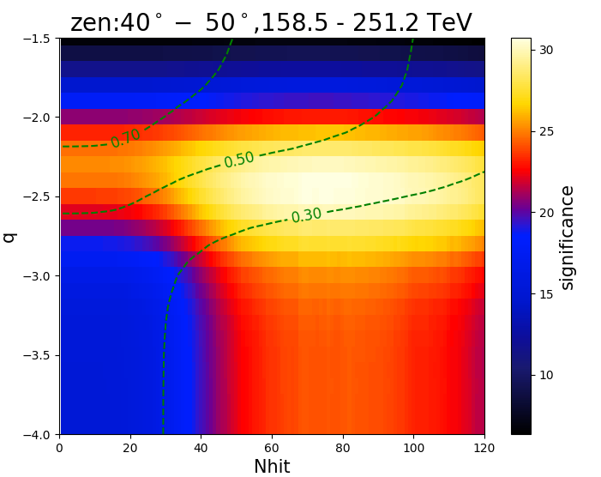
Optimized Selection Criteria Results
Green line: Keep enough gamma-rays survival
Significance of fake source as a judgement
R

Slide 16
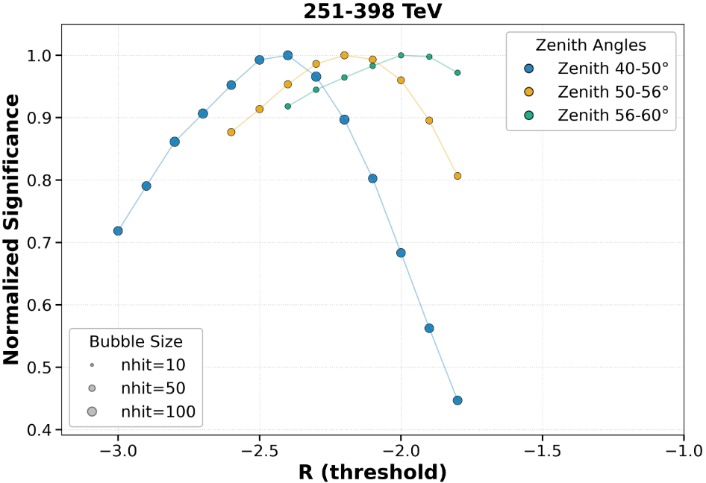
Optimized Selection Criteria Results
Optimized Thresholds
e.g., @ 251 – 398 TeV
Results align with Cao et al. 2024 findings: energy- dependent Nhit thresholds and constant R thresholds maximize detection significance.
Nhit and R thresholds is looser as zenith angles increase .

Slide 17
04
Detection Performance

Slide 18
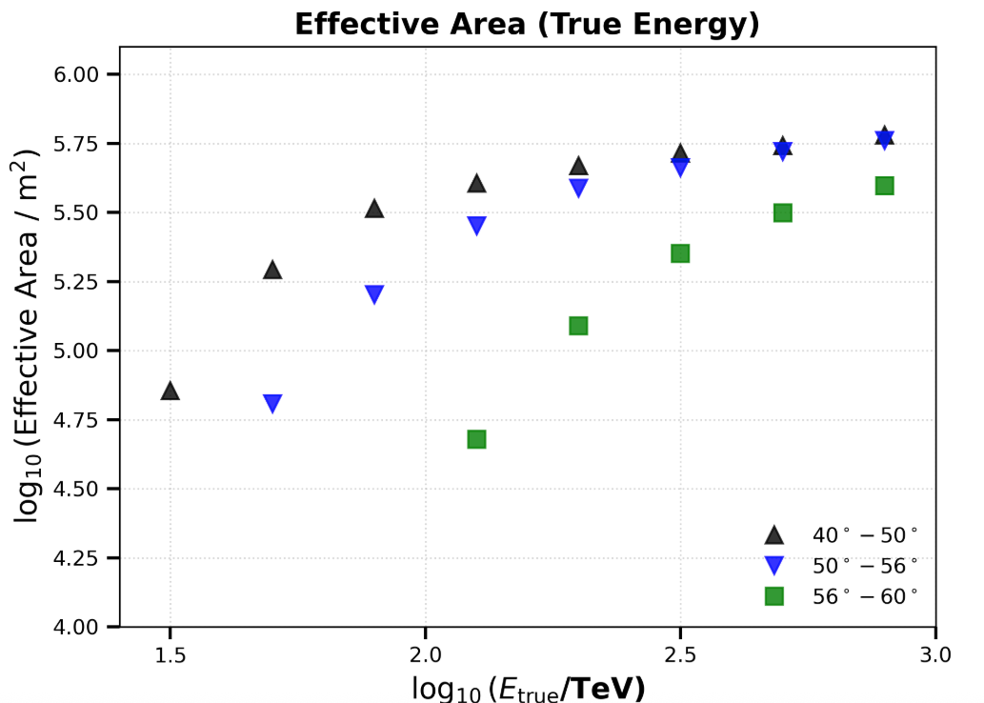
Effective area & efficiency cut
10% efficiency peak efficiency (27%) at zenith 40-50 cut is applied to filter the data with bad performance

Slide 19
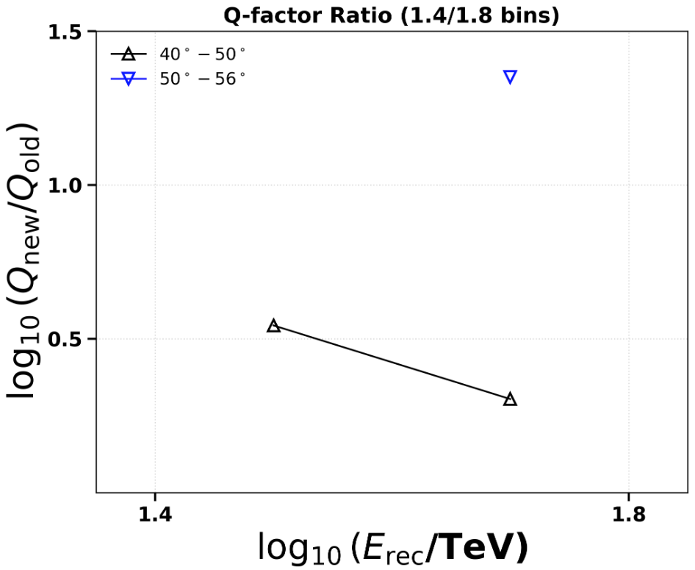
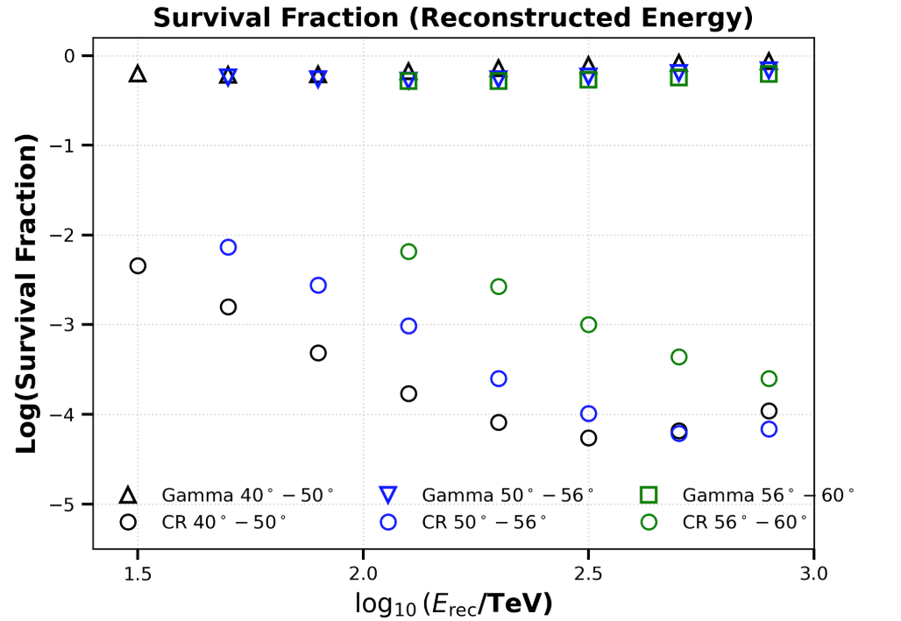
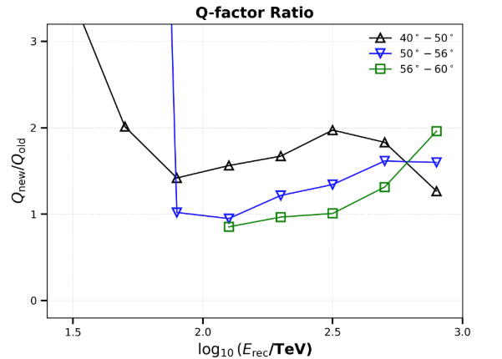
Survival fraction & Q-factor [Rcut+Nhit]
Great Q-factor improvement in the energy range below 10^1.8 TeV, due to the increase of survival fraction of Gamma ray at large zenith angle

Slide 20
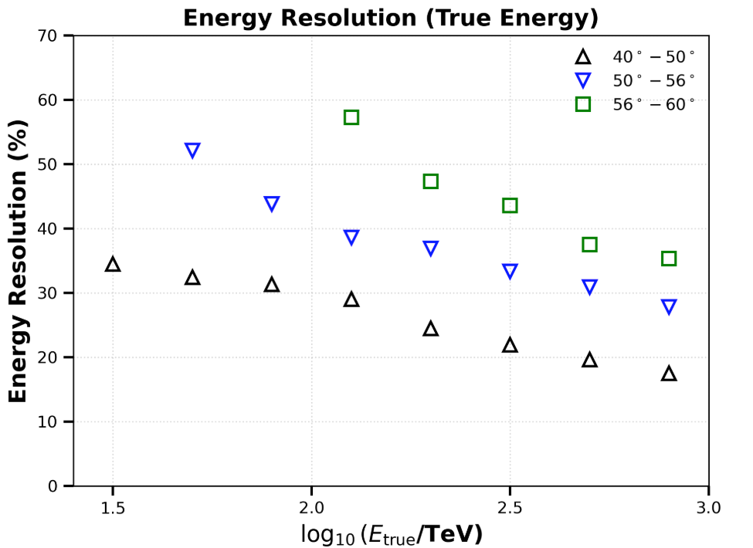
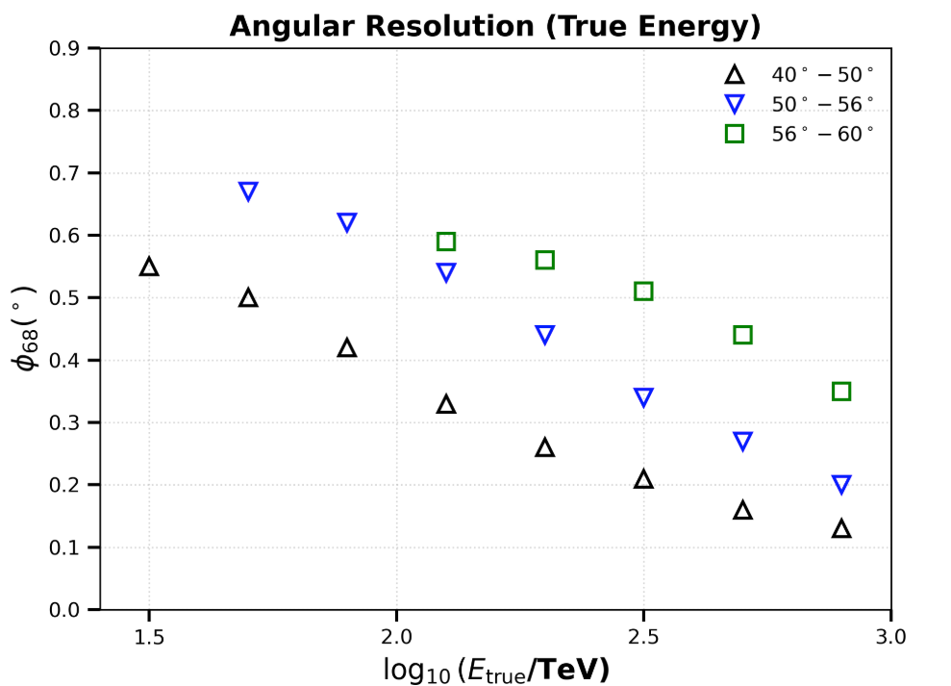
Resolution

Slide 21
05
Experimental Verification

Slide 22


Spectral Validation
Standard Candle Verification
J1825 region
J1825 region hosts in galactic plane with a significant detection significance even at a relative zenith angle (~ ${42}^{°}$),due to complex environment (3 sources + DGE), spatial model at large zenith angle is assumed as a single gaussian source and fixed as the parameter measured at ${40}^{°}−{50}^{°}$.
Crab Nebula corresponding to a ~ 6 $σ$ significance above 25 TeV at zenith angle > ${50}^{°}$ (Cao et al. 2025), the validation of optimization can be tested.

Slide 23
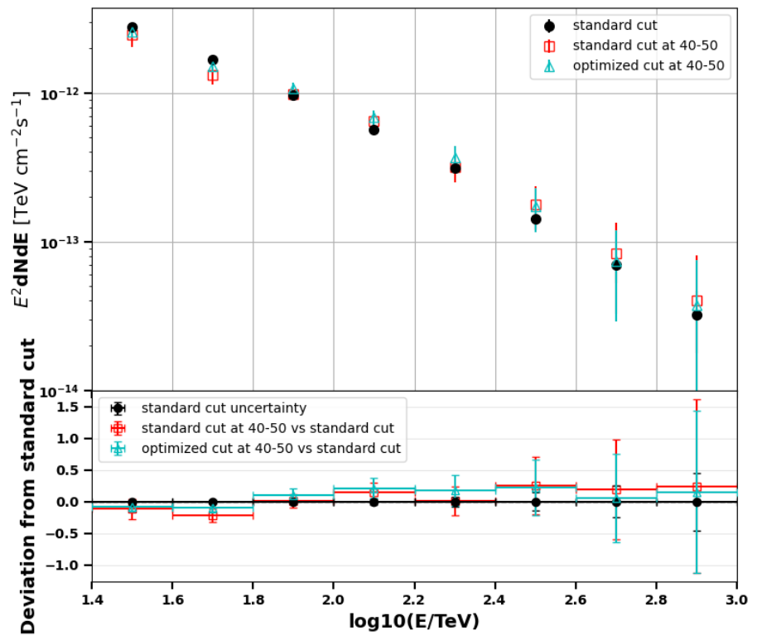
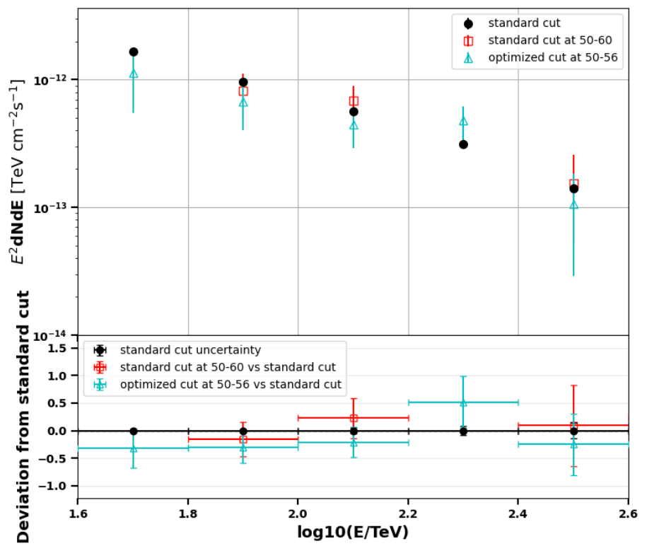
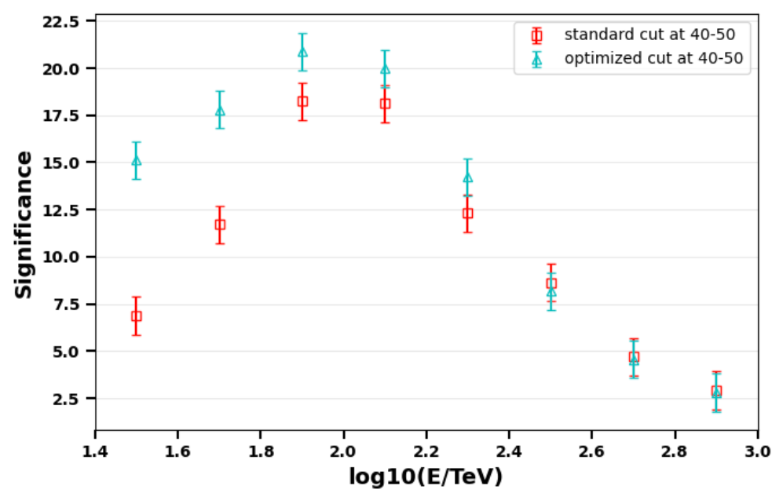
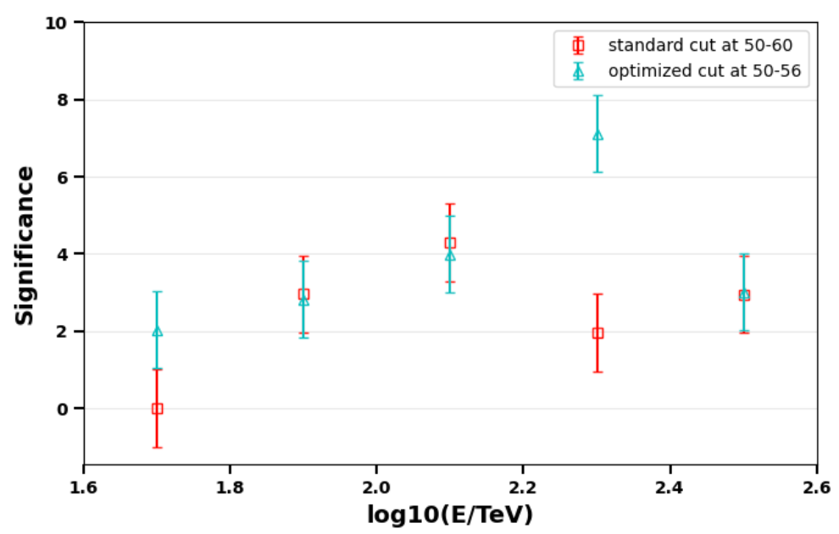
Crab Nebula Spectral Validation
z 50-56
> 40 TeV red-> cyan
TS:~41->~78
z 40-50
> 25 TeV : red-> cyan
TS:~1098->~1673

Slide 24
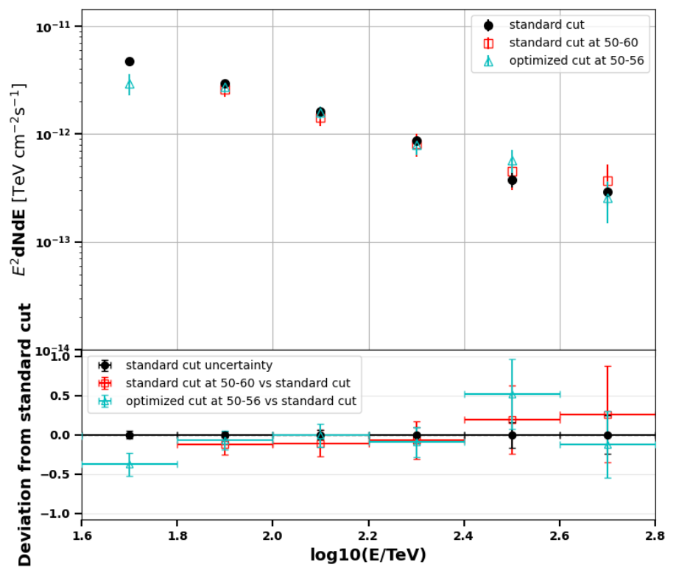
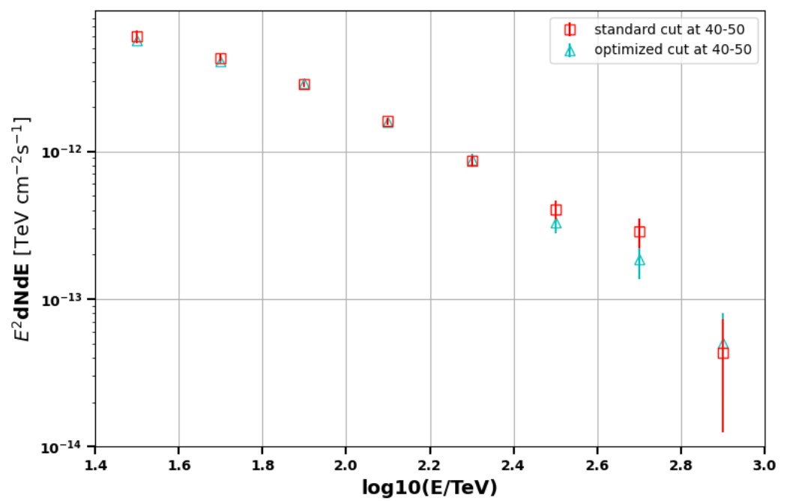
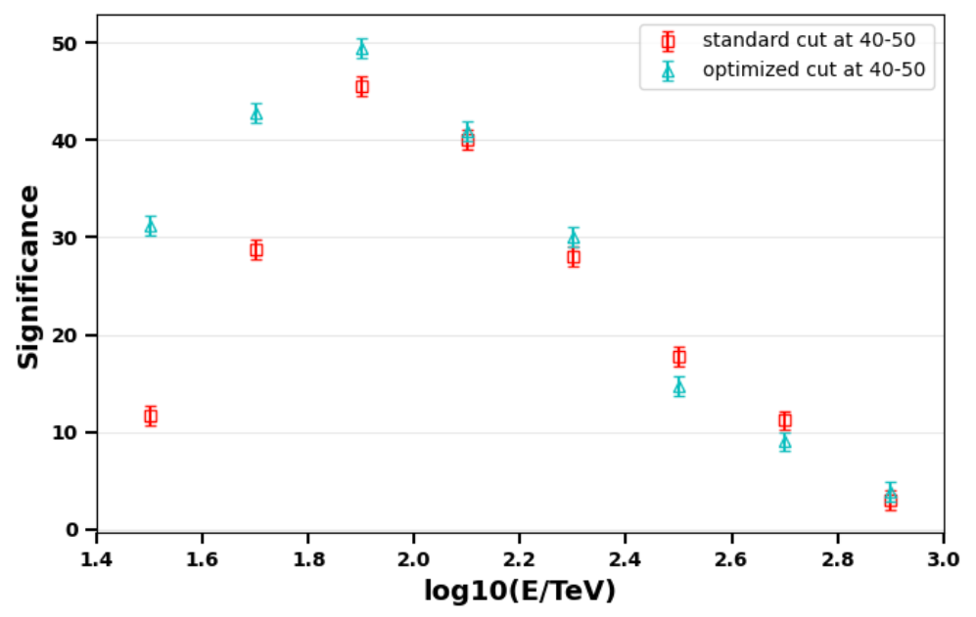
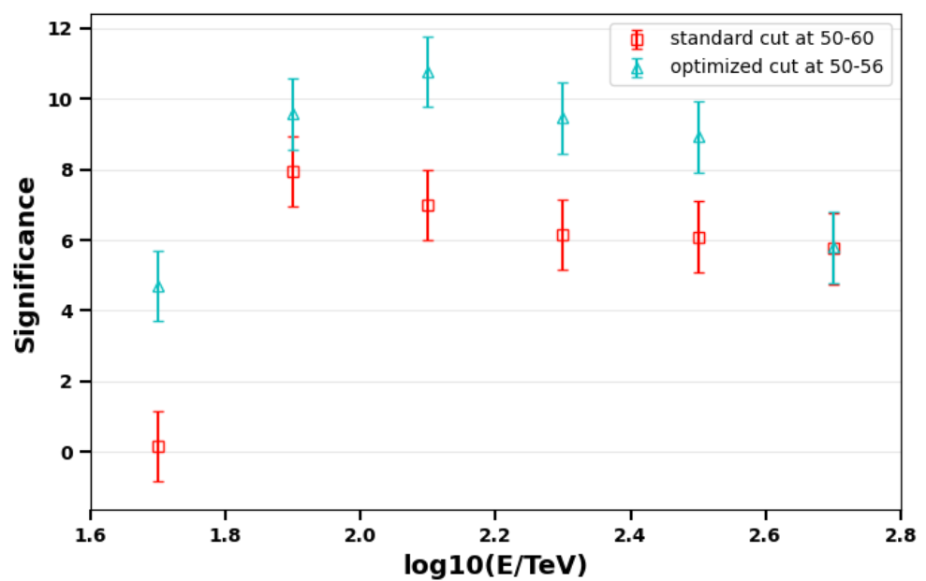
J1825 region Spectral Validation
z 50-56
> 40 TeV red-> cyan
TS:~216->~443
z 40-50
> 25 TeV red-> cyan
TS:~5859->~6902

Slide 25
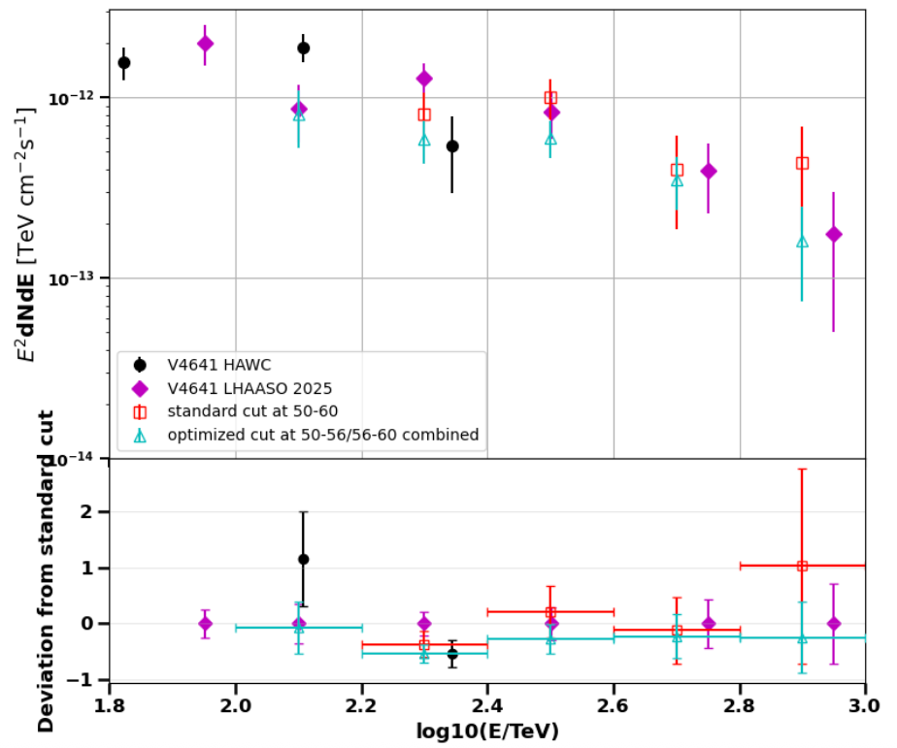
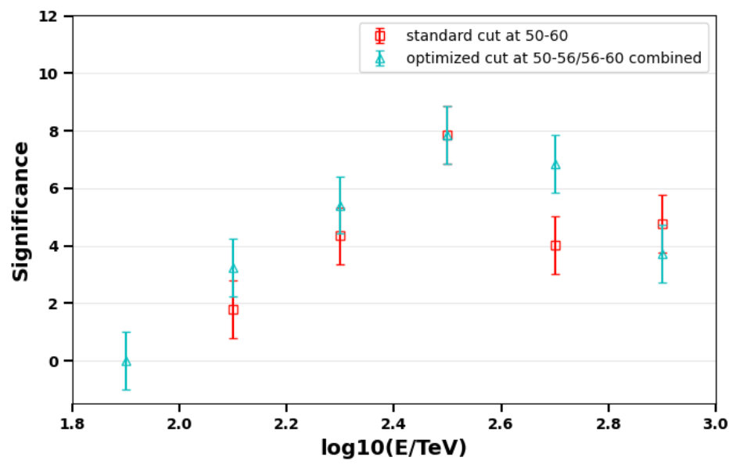
Bright Source V4641 sgr as an additional test
z 50-60
> 100 TeV red-> cyan
TS:~115->~168
Data at 56-60 is applied to analysis as a separation dataset to avoid the higher background discrimination due to a tighter cut

Slide 26
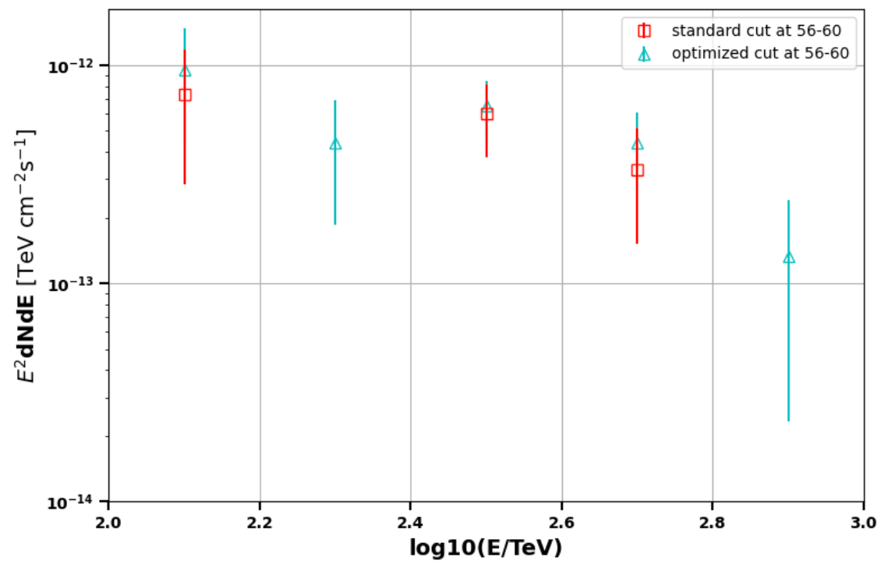
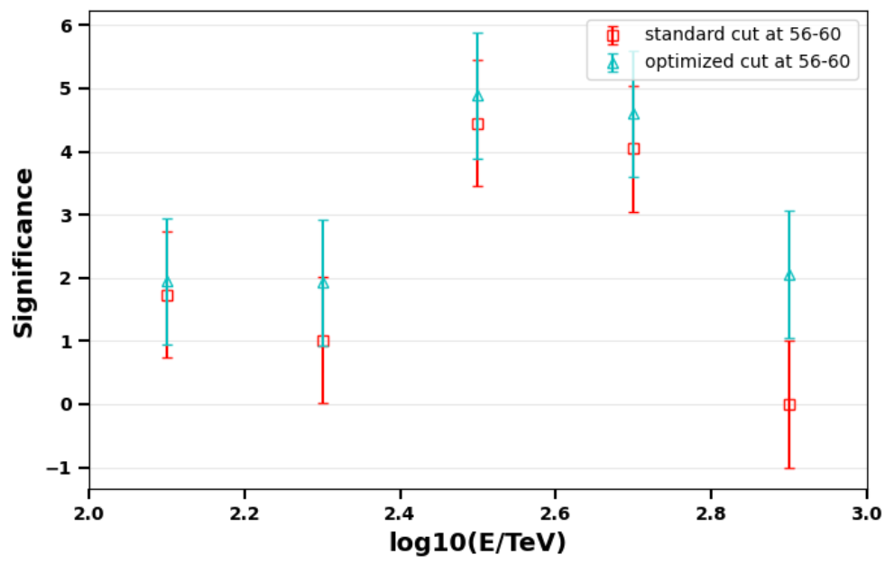
V4641 at higher zenith angle
z 56-60
> 100 TeV red-> cyan
TS:~34->~55

Slide 27
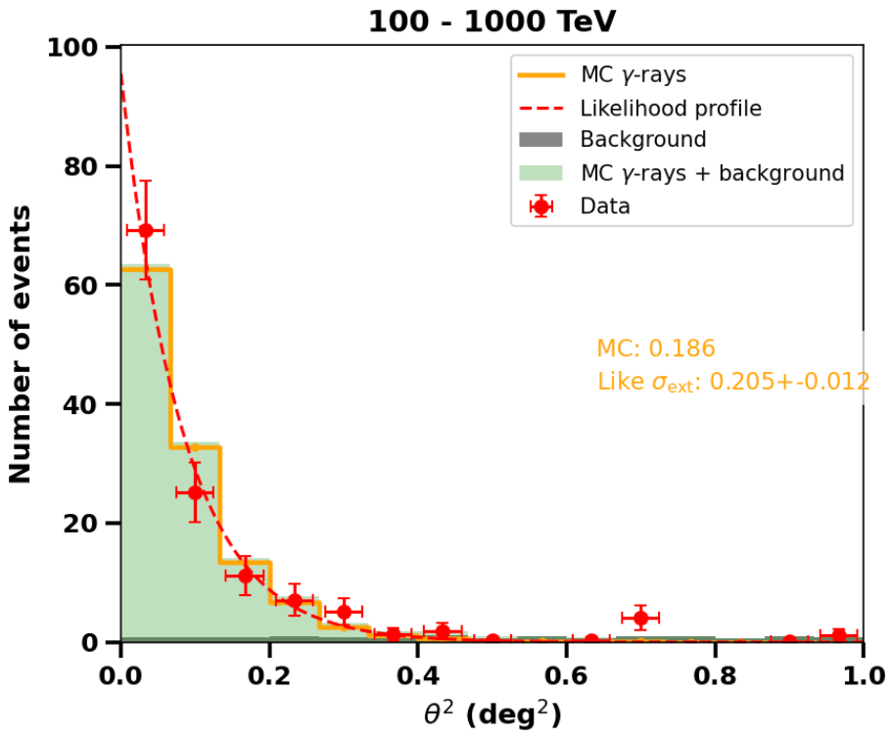
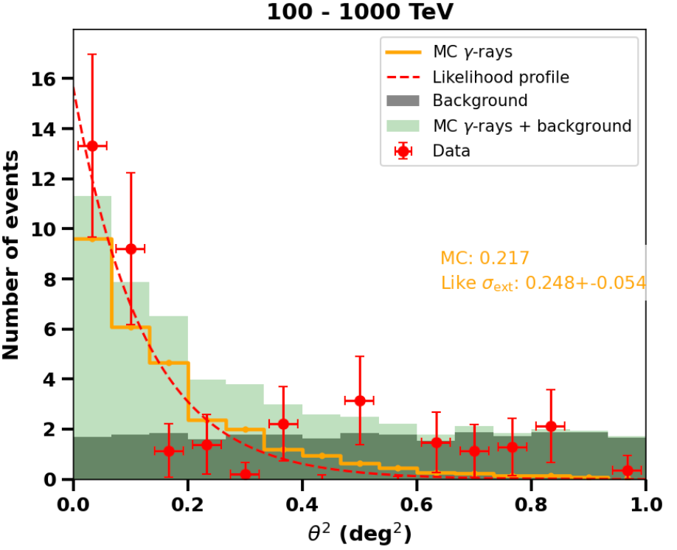
PSF from experimental from Crab
z 40-50
z 50-56
PSF is consistent between the Monte Carlo & experimental data in Crab region

Slide 28
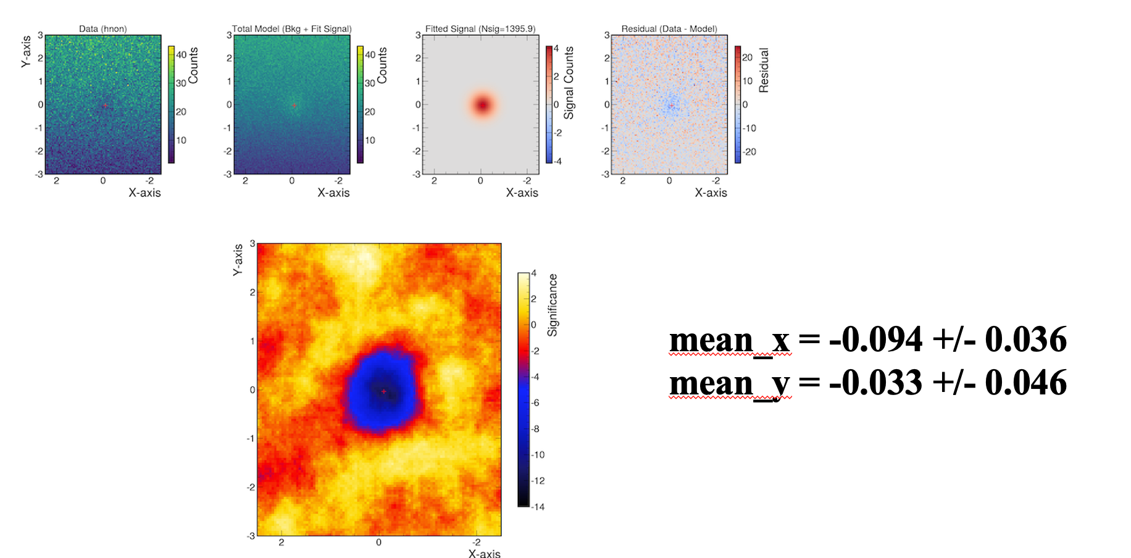
Moon shadow

Slide 29
06
Conclusions

Slide 30
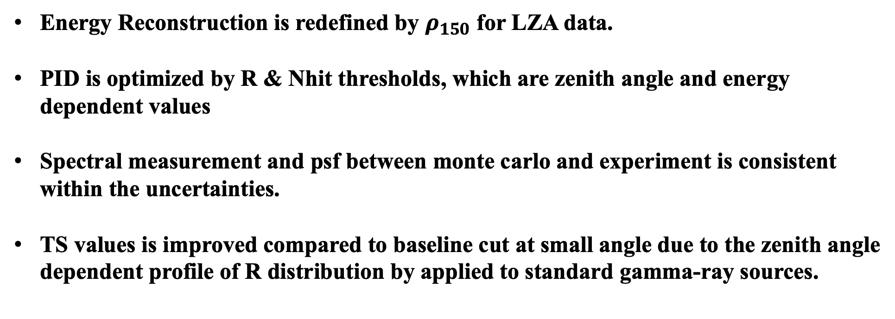
Conclusions
Energy Reconstruction is redefined by $ρ_{150}$ for LZA data.
PID is optimized by R & Nhit thresholds, which are zenith angle and energy dependent values
Spectral measurement and psf between monte carlo and experiment is consistent within the uncertainties.
TS values is improved compared to baseline cut at small angle due to the zenith angle dependent profile of R distribution by applied to standard gamma-ray sources.

Slide 31
07
Anomalous shower

Slide 32
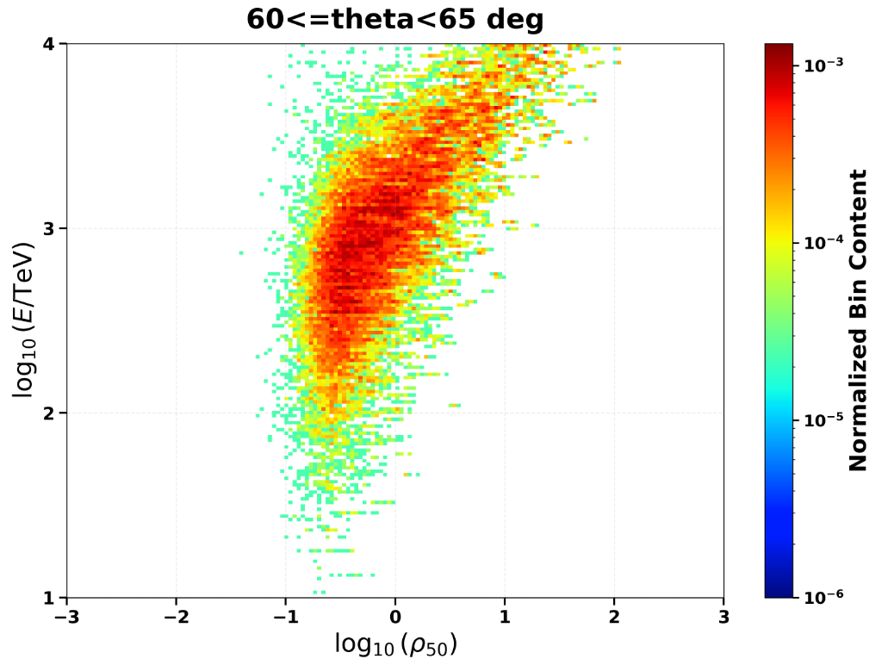
Anomalous Distribution at Large Angles
Anomalous Population
Figure: ρ₅₀ vs E_true Distribution
[FIGURE PLACEHOLDER: 2D distribution showing ρ₅₀ versus true energy at large zenith angles]
Some events exhibit small true energy but abnormally large ρ₅₀, causing severe energy overestimation.

Slide 33
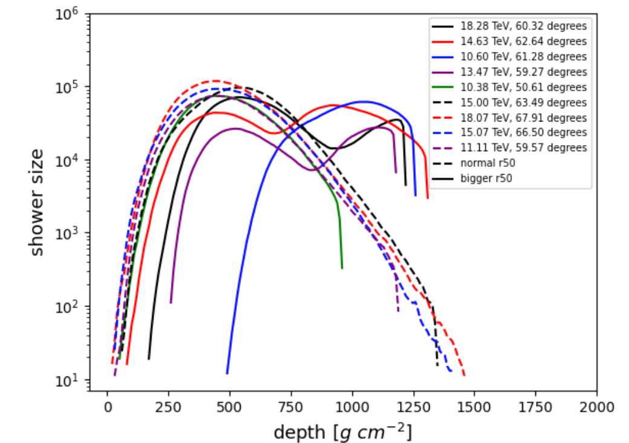
Multi-Maxima Shower & Late Shower
Figure: ρ₅₀ vs E_true Distribution
[FIGURE PLACEHOLDER: 2D distribution showing ρ₅₀ versus true energy at large zenith angles]
Longitude distribution of corsika shower

Slide 34
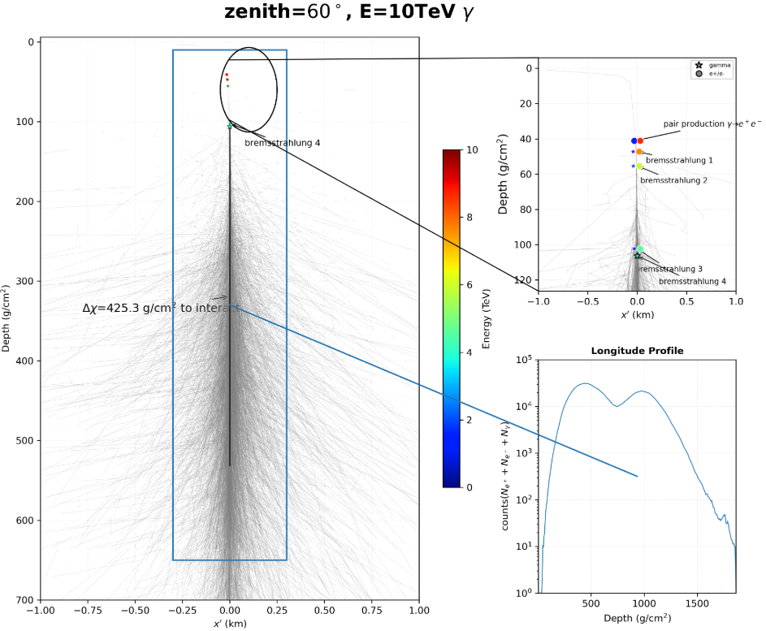
Multi-Maxima Shower Phenomenon
High-energy photon traveled through several interaction lengths before interacting & initiating a new shower maximum.

Slide 35
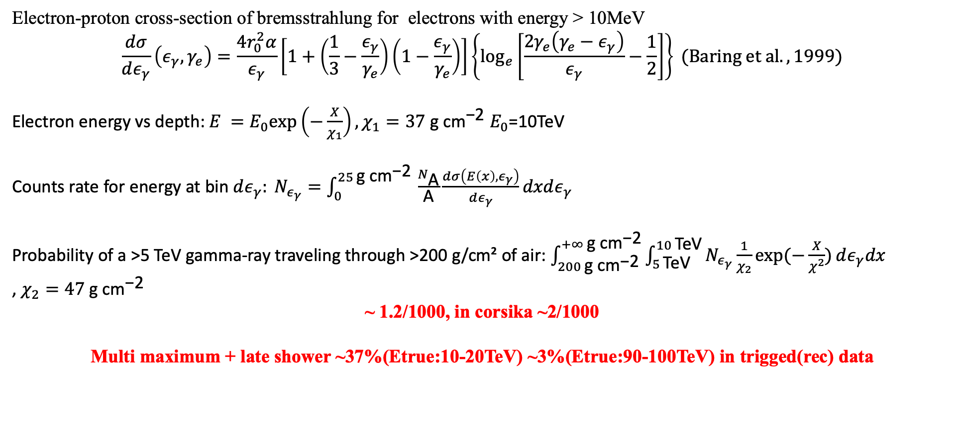
Possibility of double maximum shower
Electron-proton cross-section of bremsstrahlung for electrons with energy > 10MeV
$$\frac{dσ}{dε_{γ}}\left(ε_{γ},γ_{e}\right)=\frac{4r_{0}^{2}α}{ε_{γ}}\left[1+\left(\frac{1}{3}−\frac{ε_{γ}}{γ_{e}}\right)\left(1−\frac{ε_{γ}}{γ_{e}}\right)\right]\left\{\log_{e}\left[\frac{2γ_{e}\left(γ_{e}−ε_{γ}\right)}{ε_{γ}}−\frac{1}{2}\right]\right\} (Baring et al., 1999)$$
Electron energy vs depth: ${E =E}_{0}exp\left(−\frac{X}{χ_{1}}\right),χ_{1}=37 \text{g} \text{c}{\text{m}}^{\text{−2}}$ $E_{0}$=10TeV
Counts rate for energy at bin $dε_{γ}: N_{ε_{γ}}=\int_{0}^{25 \text{g} {\text{cm}}^{\text{−2}} }{\frac{N_{\text{A}}}{\text{A}}\frac{dσ\left(E\left(x\right),ε_{γ}\right)}{dε_{γ}}dxdε_{γ}}$
Probability of a >5 TeV gamma-ray traveling through >200 g/cm² of air: $\int_{200 \text{g} \text{c}{\text{m}}^{\text{−2}}}^{+∞ \text{g} {\text{cm}}^{\text{−2}}}{\int_{5 \text{TeV}}^{10 \text{TeV}}{N_{ε_{γ}}}\frac{1}{χ_{2}}\exp{(−\frac{X}{χ^{2}})}dε_{γ}dx}$
, $χ_{2}=47 \text{g} \text{c}{\text{m}}^{\text{−2}}$
~ 1.2/1000, in corsika ~2/1000
Multi maximum + late shower ~37%(Etrue:10-20TeV) ~3%(Etrue:90-100TeV) in trigged(rec) data

Slide 36
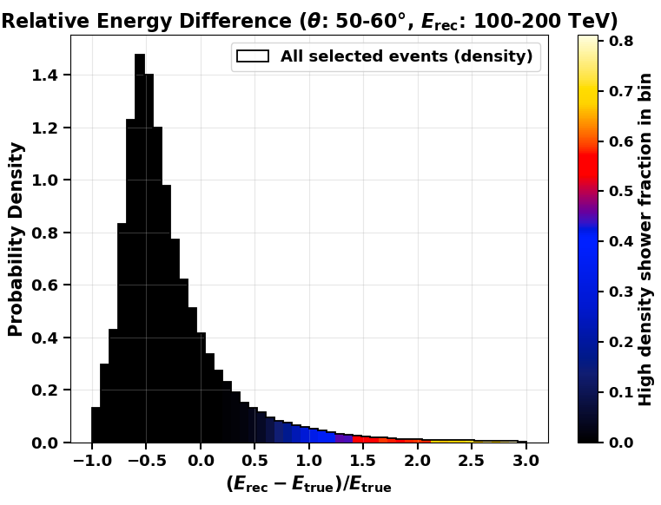

> ~50% events with $δE/E$ come from
density shower

Slide 37
THANK YOU FOR WATCHING

Slide 38
08
Backups

Slide 39

Quality factor including Nhit filter

Slide 40



Survival fraction vs zenith angle

Slide 41


Resolution

Slide 42

Resolution

Slide 43


Combined data at different zenith angles
z 40-56
> 100 TeV red-> cyan
TS:~464->~570

Slide 44

Skymap in crab region
New cut at z50-56
Cpc cut at 50-60

Slide 45





Source analysis pipeline
Origin spectrum & trace of source
Weighting
Reconstructed
MC data
( ~ spectrum convolving response
e.g., energy resolution )
Fitting by scanning source
[by reweighting spectrum distribution]
& spatial parameter
Best-fit spectrum with statistics uncertainties (including energy resolution)
Expected source distribution (spatial/energy)
at observed data

Slide 46

Spatial & strength of fake source

Slide 47

Double check for spectral measurement
Provided by Wenlian Li

Slide 48

Double check for spectral measurement
z 40-50

Slide 49

Double check for spectral measurement
Provided by Wenlian Li

Slide 51

Double check for Moon shadow
Provided by Xiajie

