Slide 1
Systematic-Uncertainty Study for Robust LHAASO Characterization of J0956+4622
Reporter：Xuanling Zhang
PI: Songzhan Chen, Jianli Zhang (NAOC); Co-I: Xuanling Zhang, Jin Zhao, Hui Zhu (NAOC), Qiang Yuan (PMO)
2026/04/02

Slide 2
Overview
I. Why J0956+4622 Is Unusual ?
II. Basic Source Information
III. Systematic-Uncertainty Estimates
IV. Summary

Slide 3
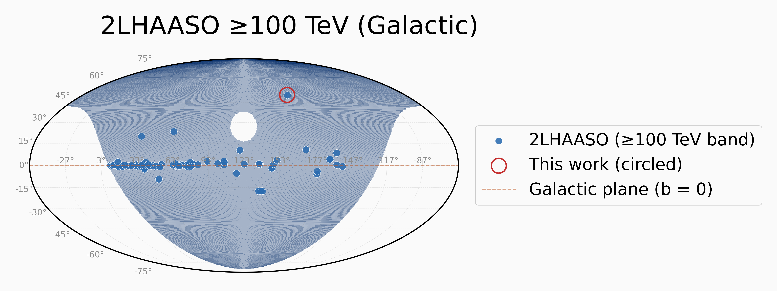
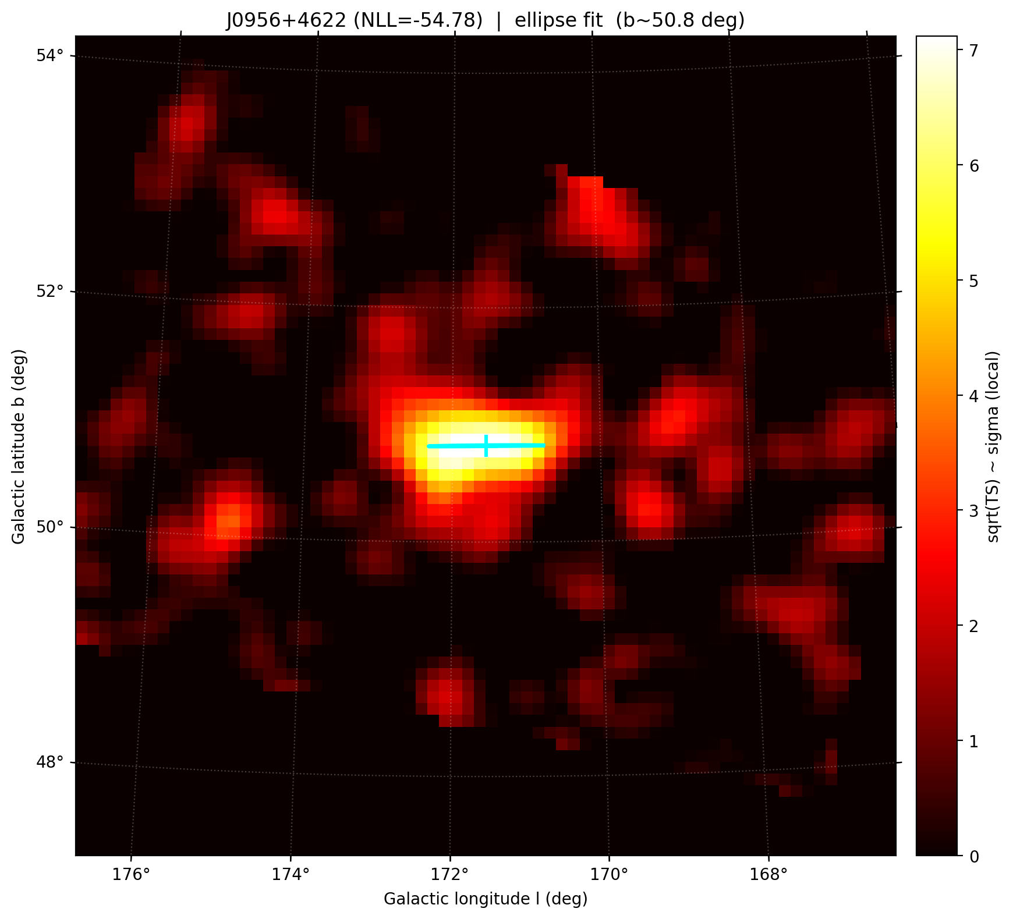
I. Why J0956+4622 Is Unusual
LHAASO finds many ultra-high-energy gamma-ray sources; most sit on the Galactic disk—crowded, messy, hard to identify.
J0956+4622 is so far the only LHAASO source above 100 TeV with |b| > 20 deg; it is off-plane, cleaner, and weak-field—useful for cosmic-ray origin, acceleration, and propagation.

Slide 4
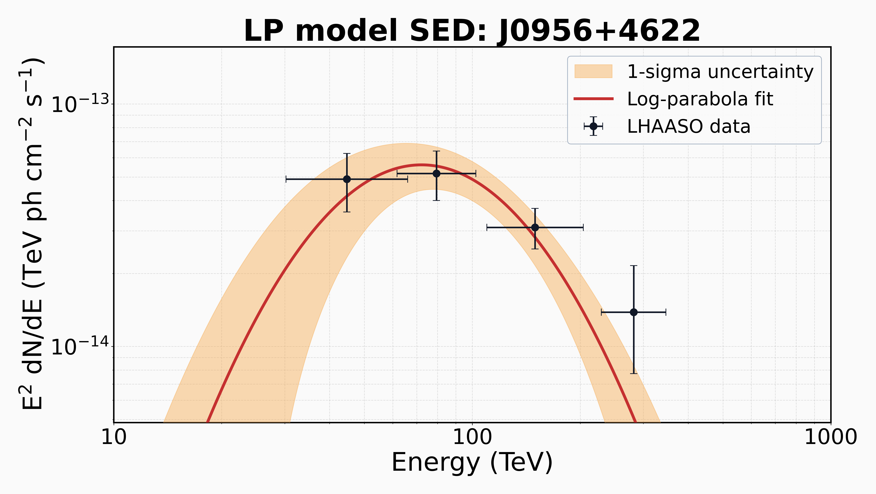
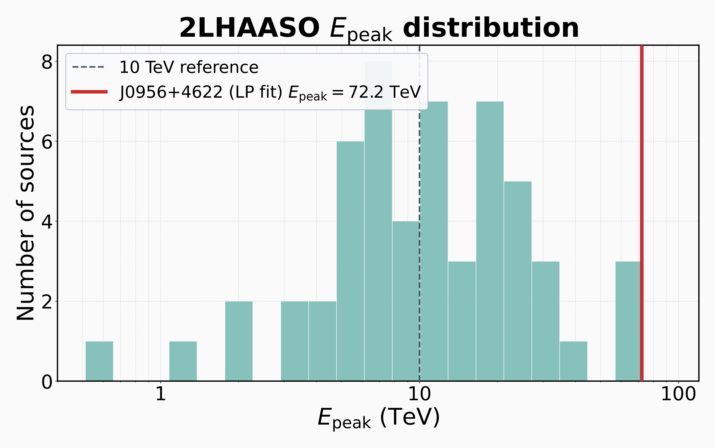
I. Why J0956+4622 Is Unusual
Spectrum:
log-parabola
E_peak ranks 3rd among LHAASO sources.

Slide 5
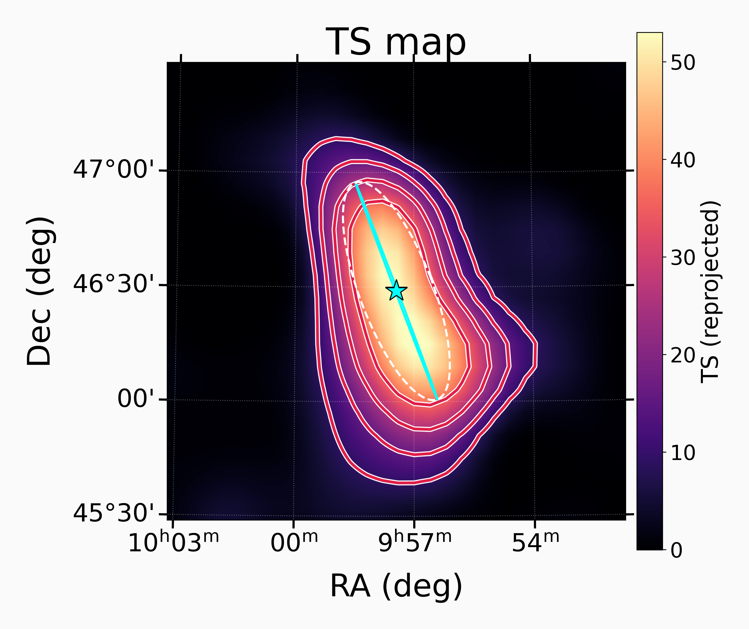
II. Basic Source Information
Spatial morphology | Npar | TS | △TS
Point source | 3 | 63.1
2D symmetric Gaussian | 4 | 92.9 | 29.8（5.5σ）
2D elliptical Gaussian | 6 | 109.4 | 16.5（4.1σ）
RA = 149.36° ± 0.06°
Dec = 46.48° ± 0.09°
Semi-major axis = 0.50° ± 0.10°
Semi-minor axis < 0.16° (95% C.L.)
Position angle = 110.68° ± 4.58

Slide 6
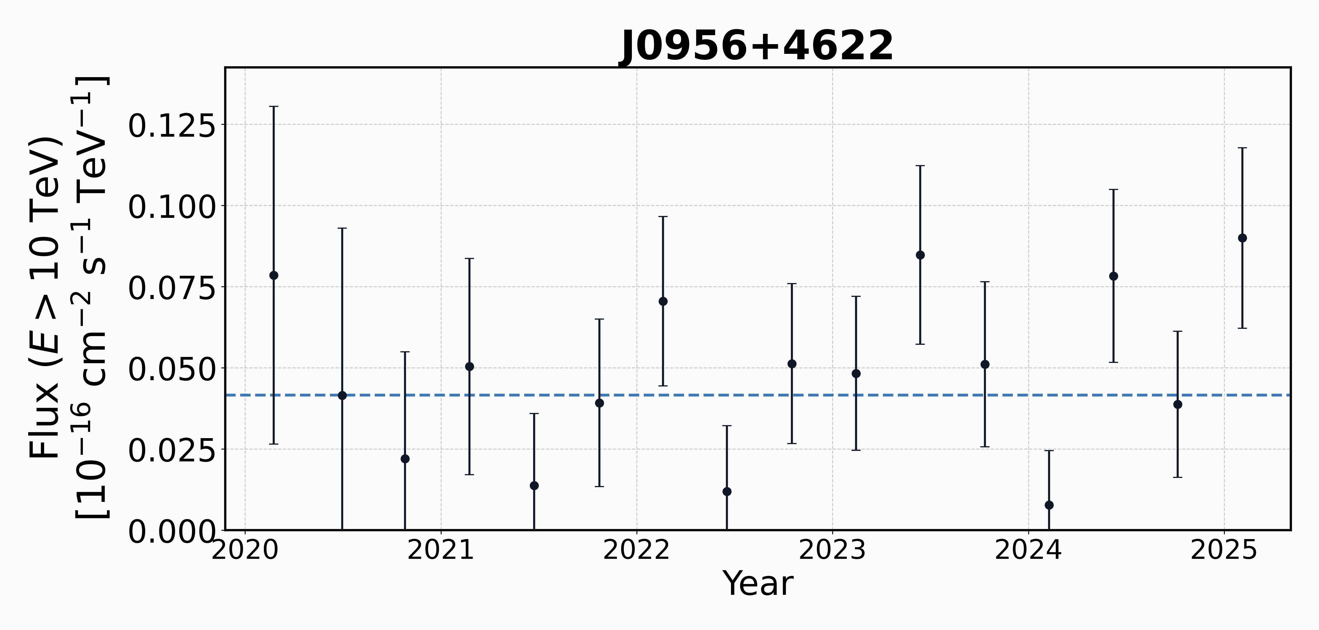
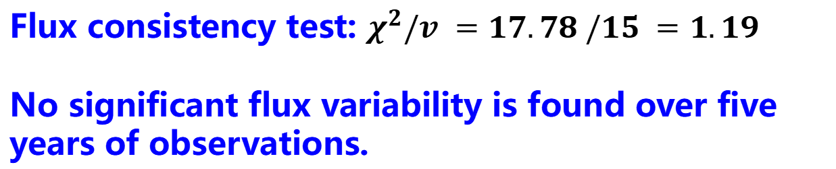
Lightcurve
Flux consistency test: $χ^{2}/v =17.78 /15 =1.19$
No significant flux variability is found over five years of observations.

Slide 7

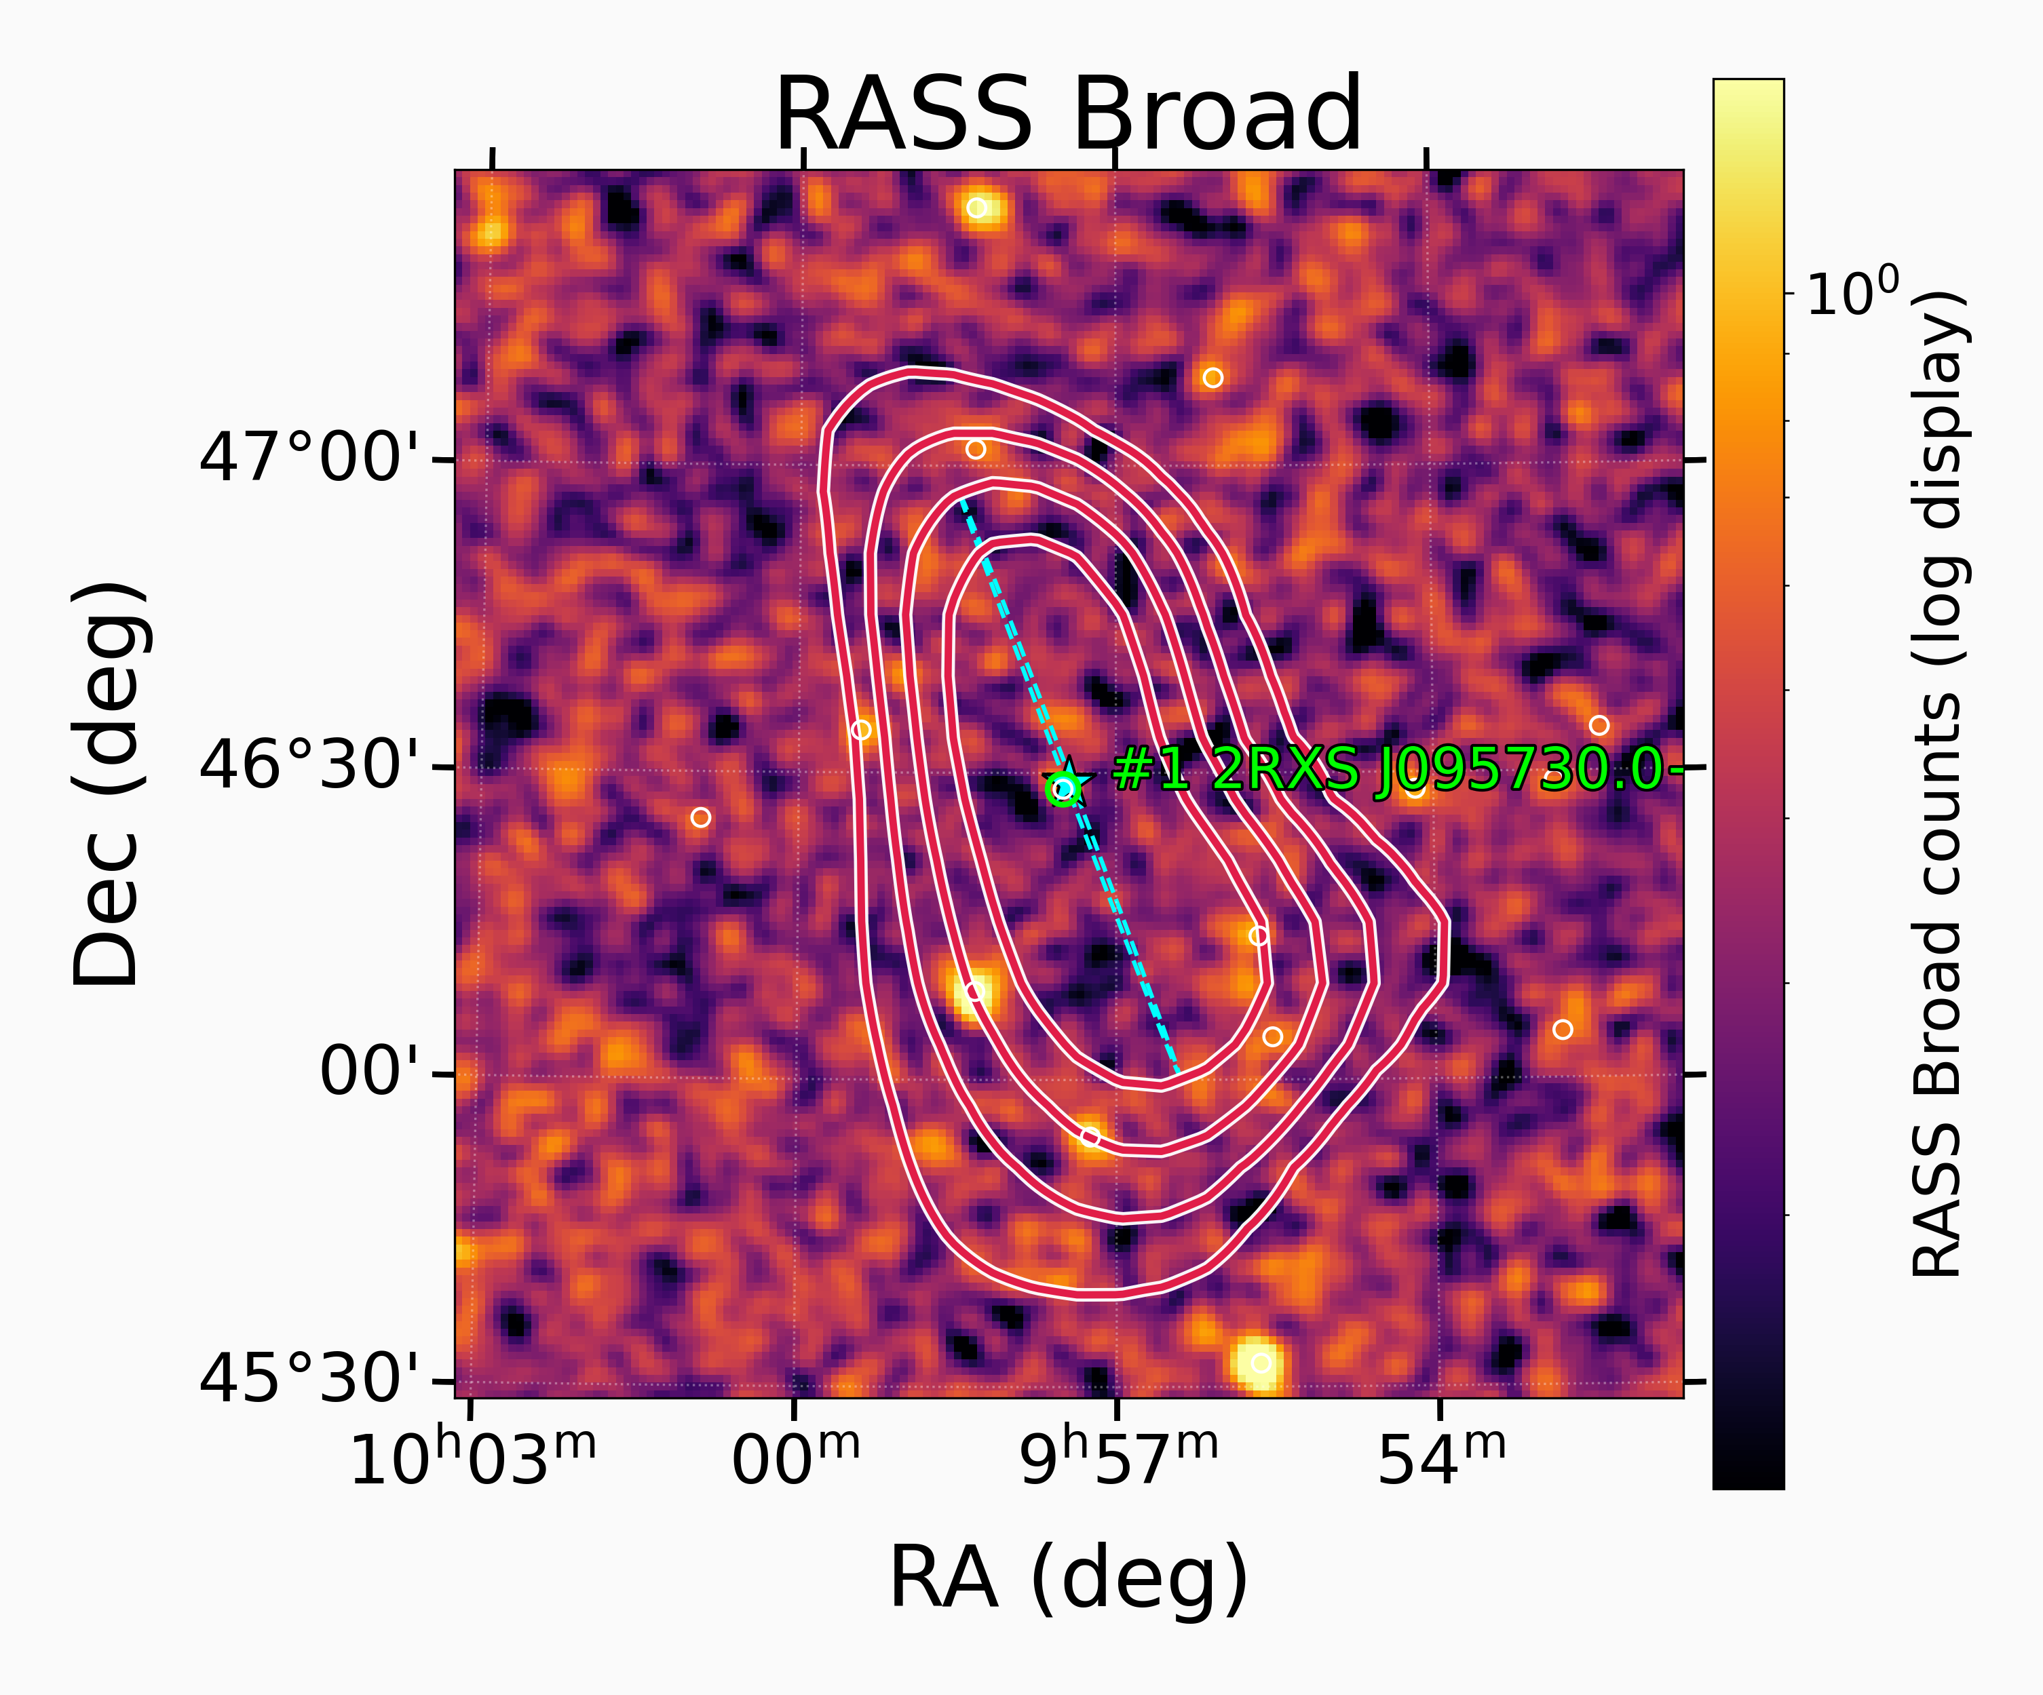
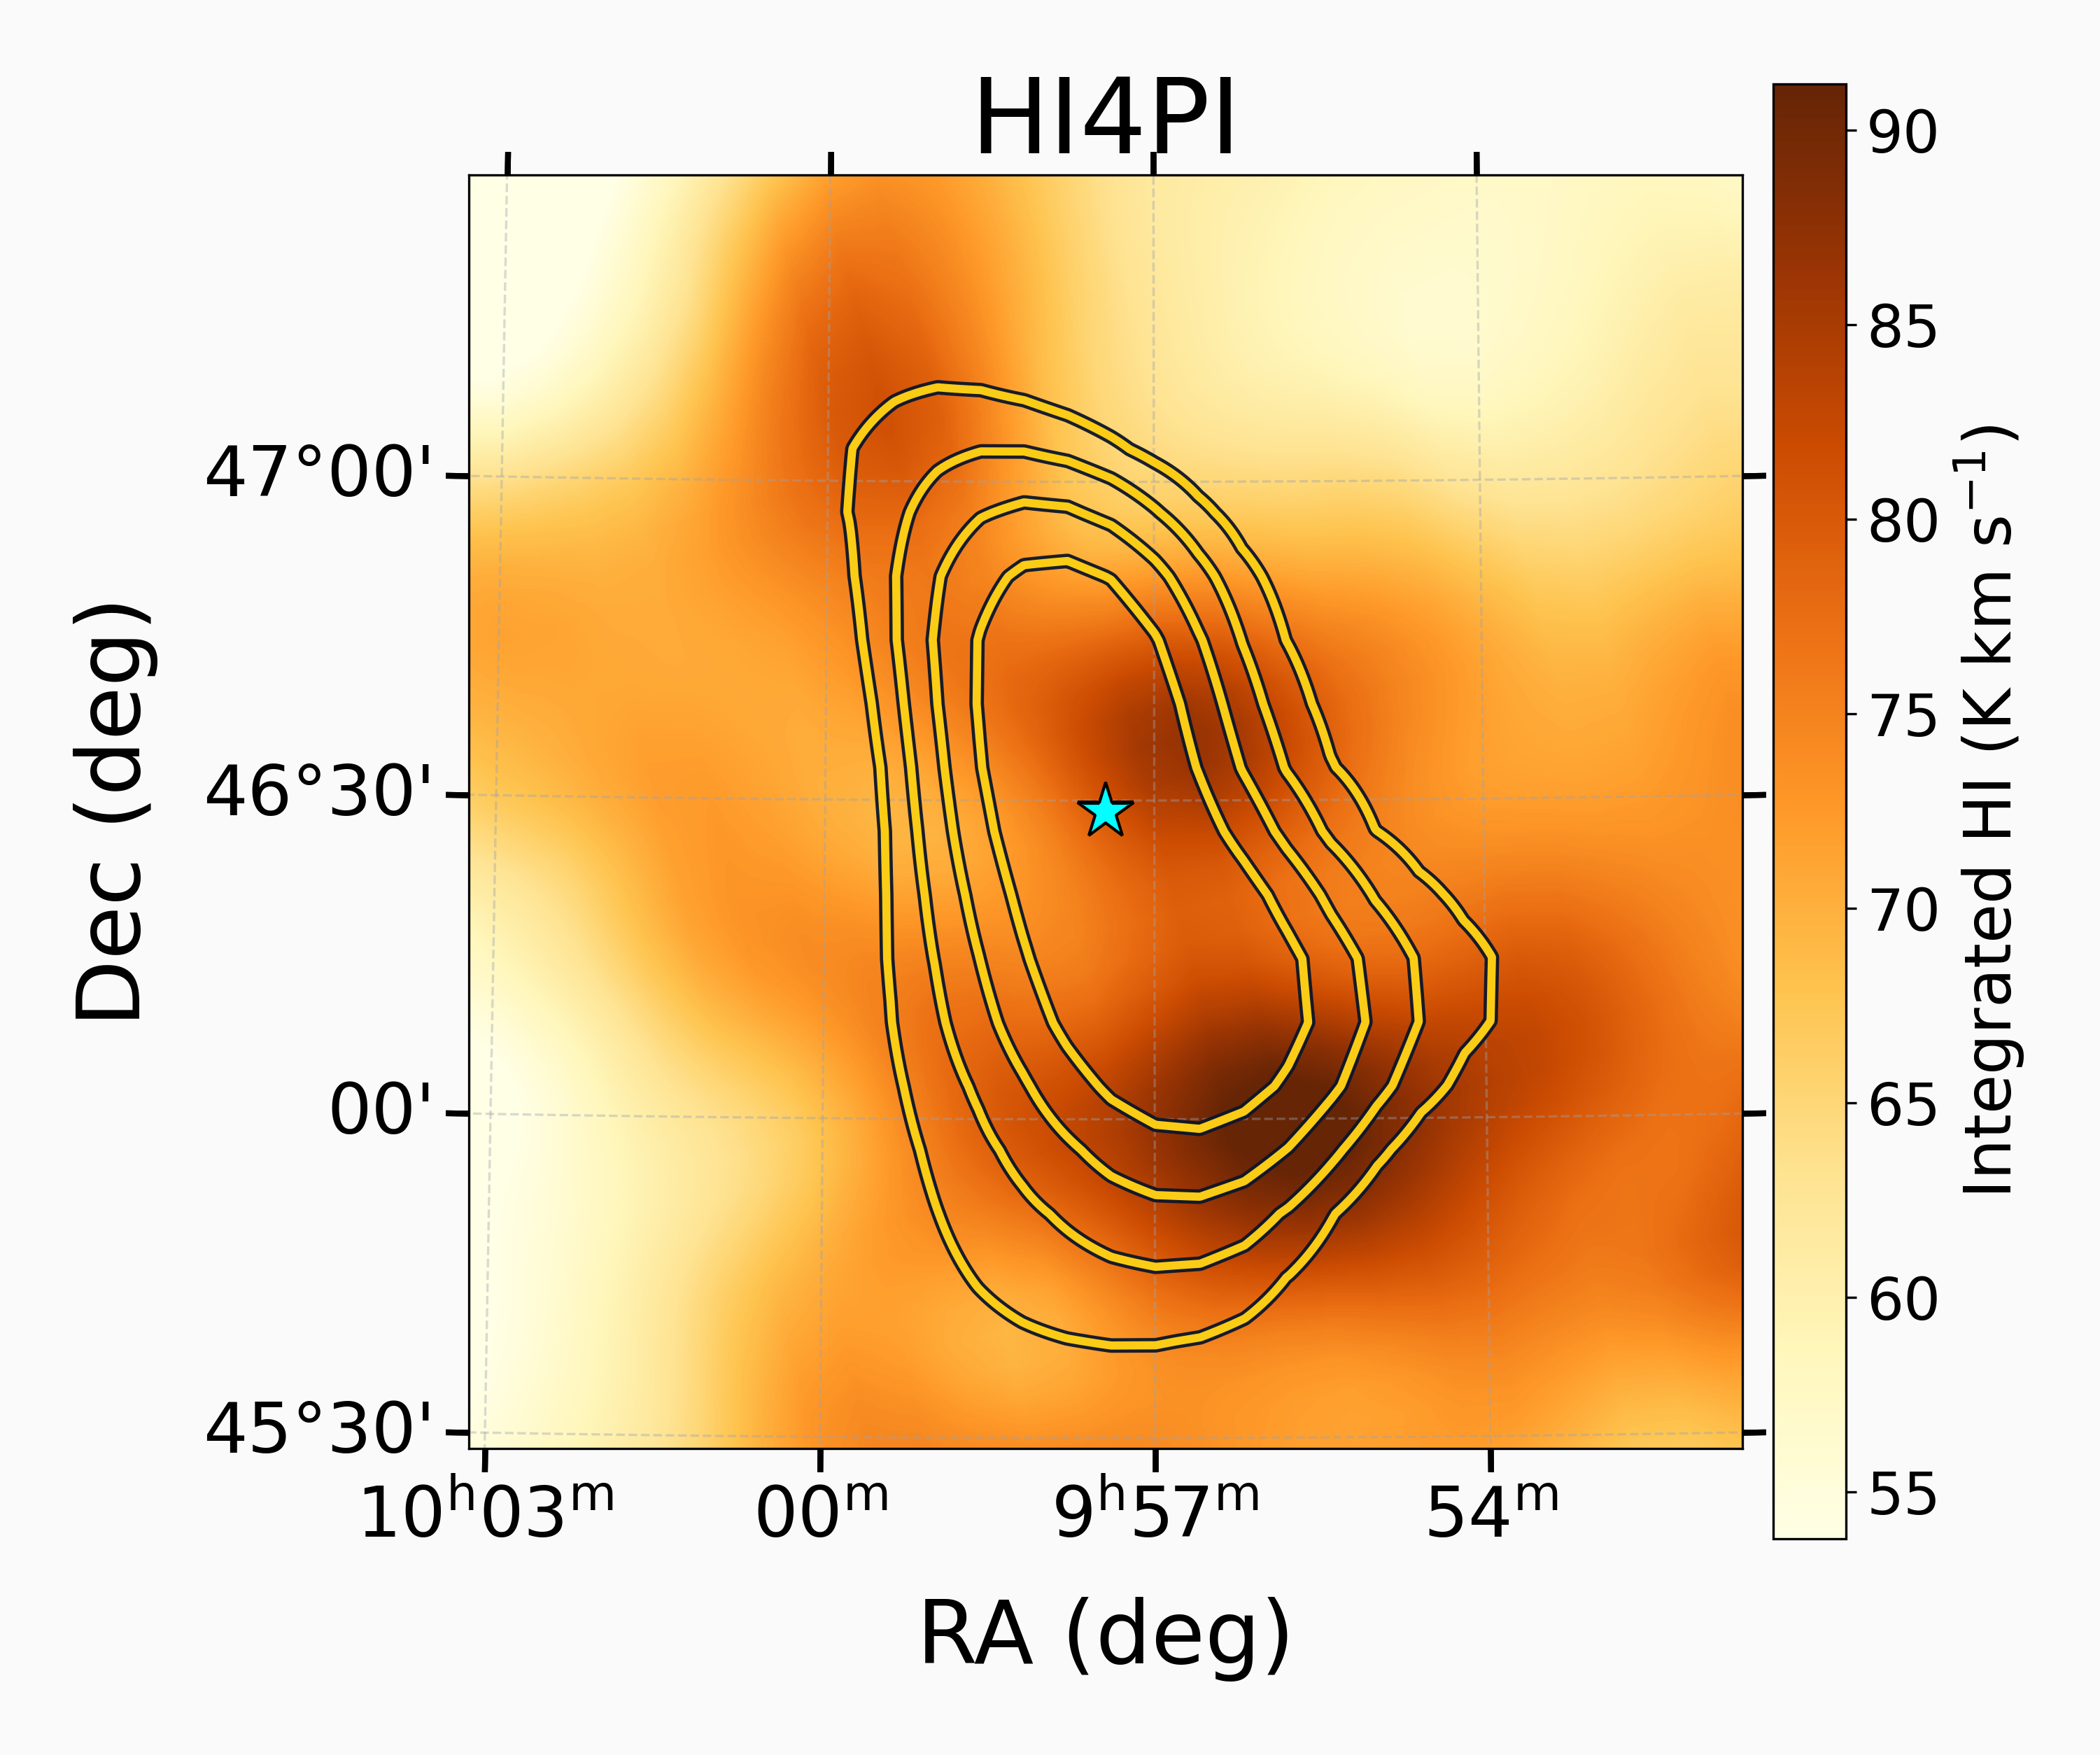
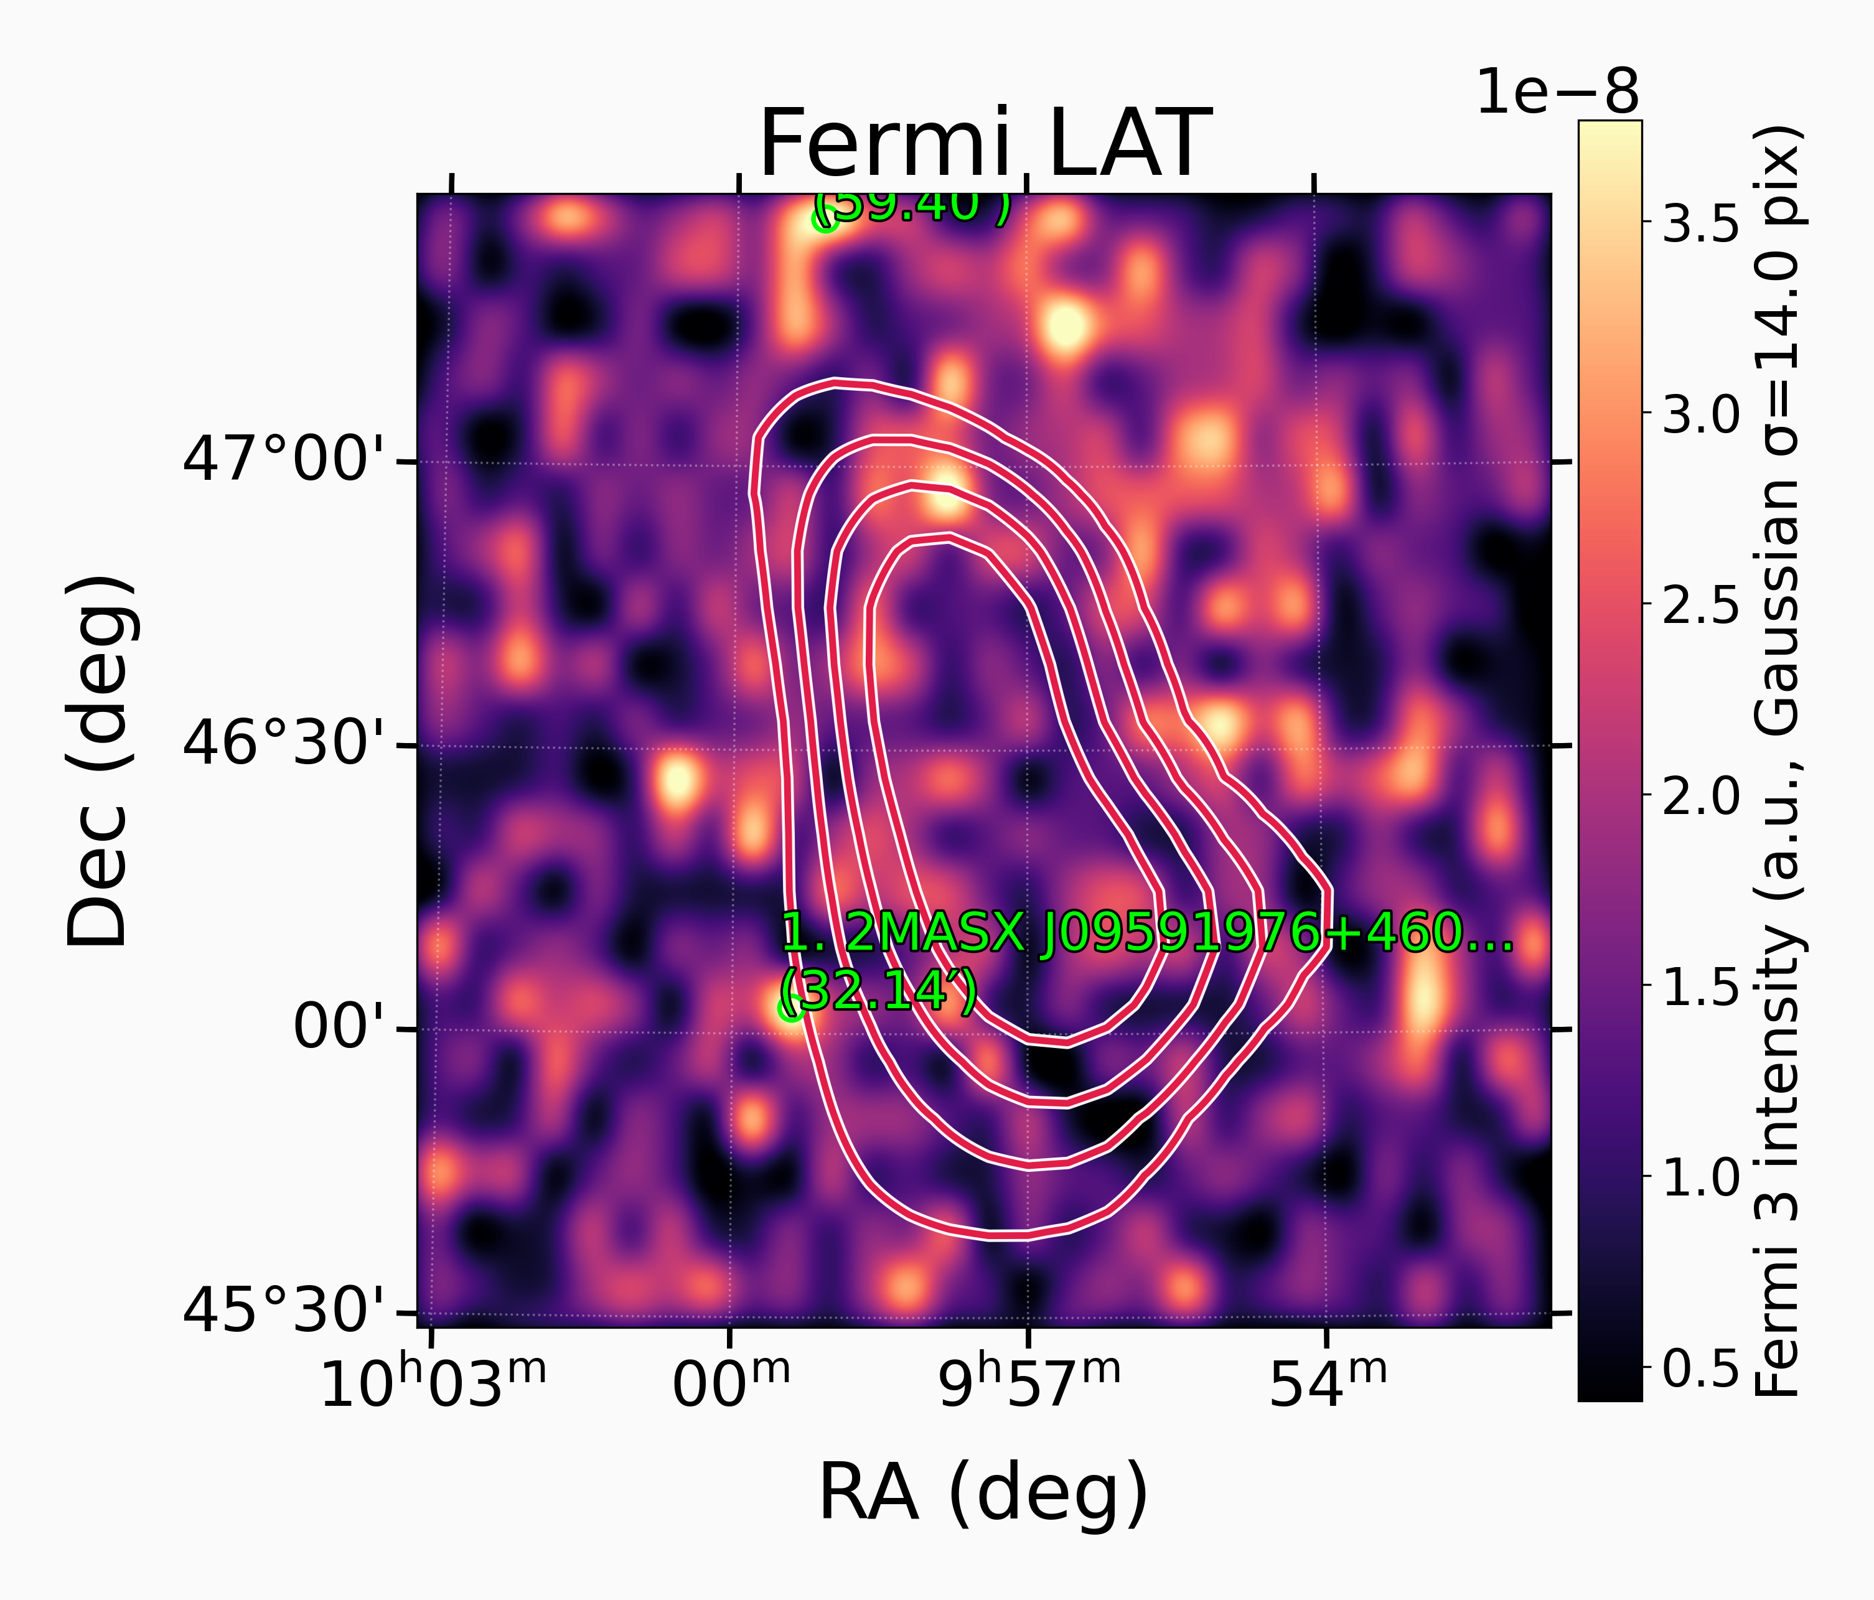
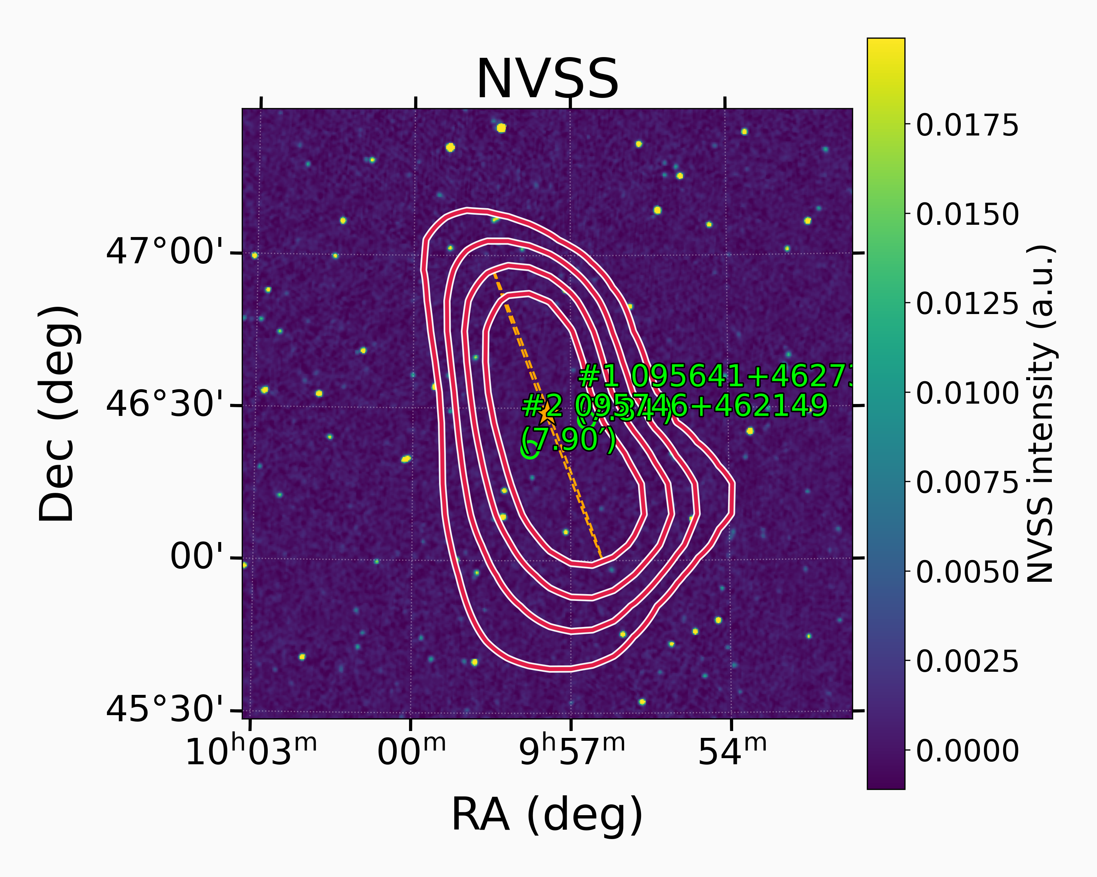
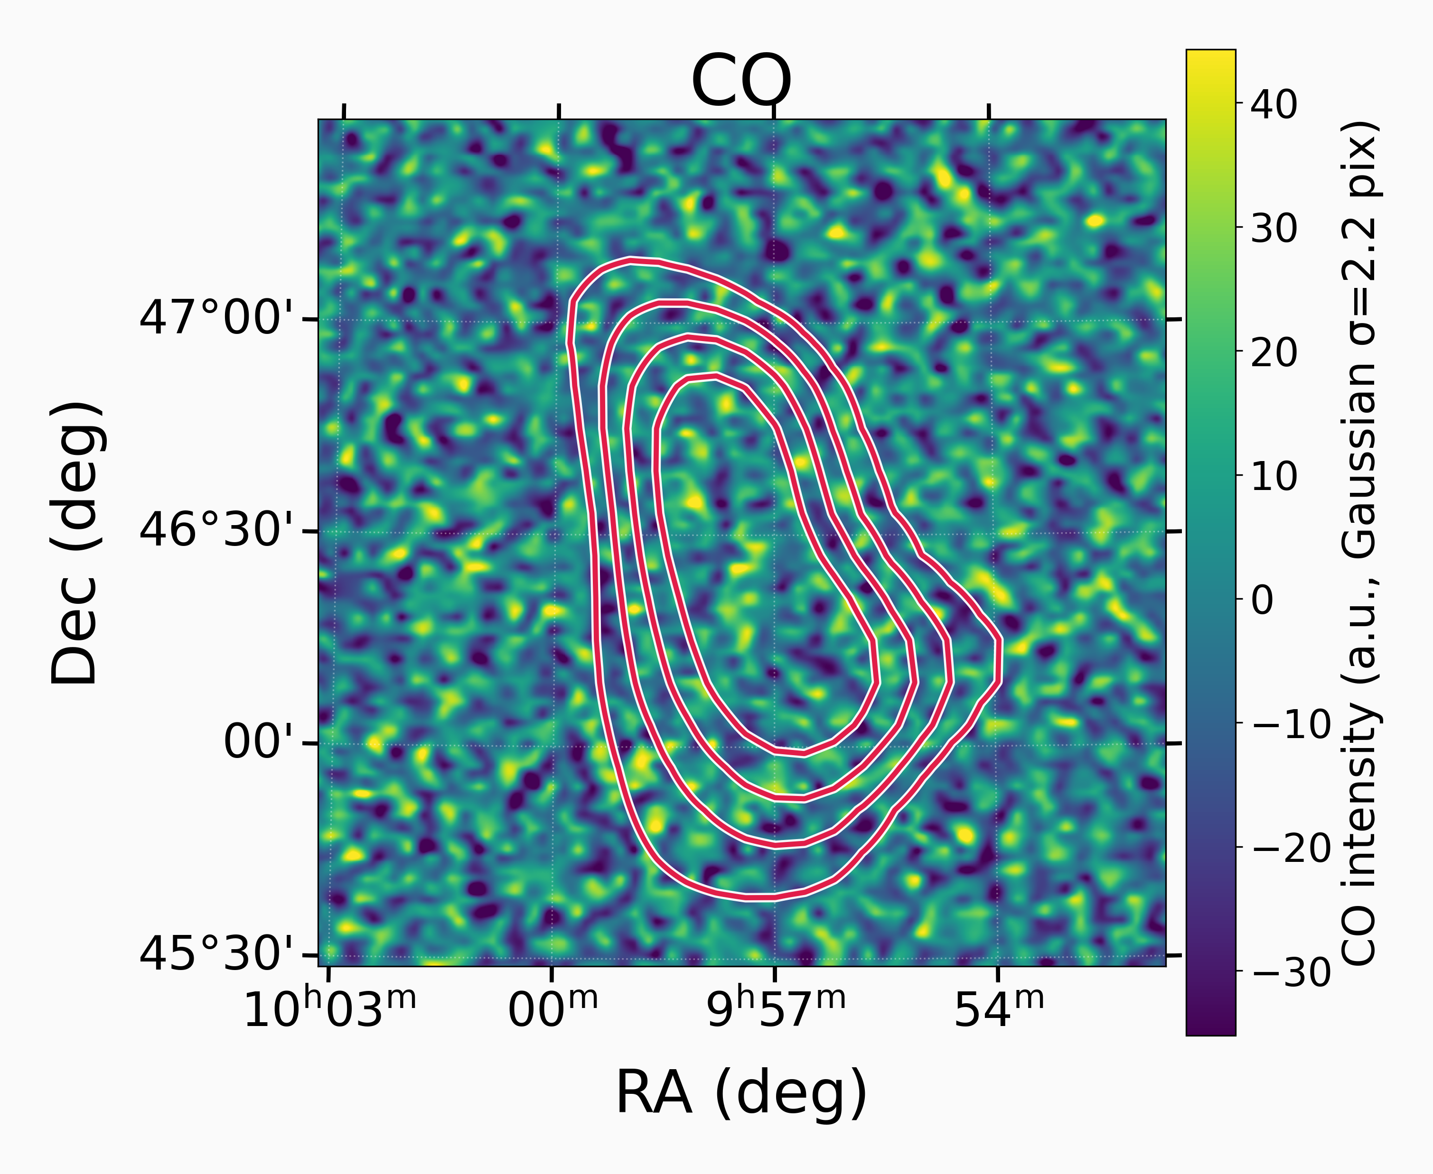
Multiwavelength Counterparts: Current Status
>25 TeV
0.1–2.4 keV
中性氢 21 cm
0.3–1 GeV
1.4 GHz
CO J=1–0
10

Slide 8
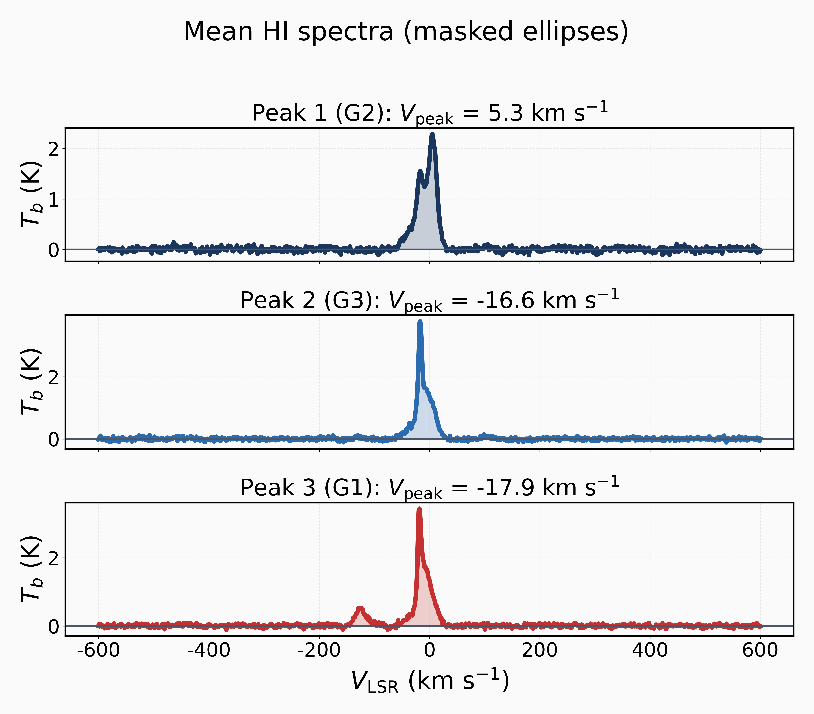
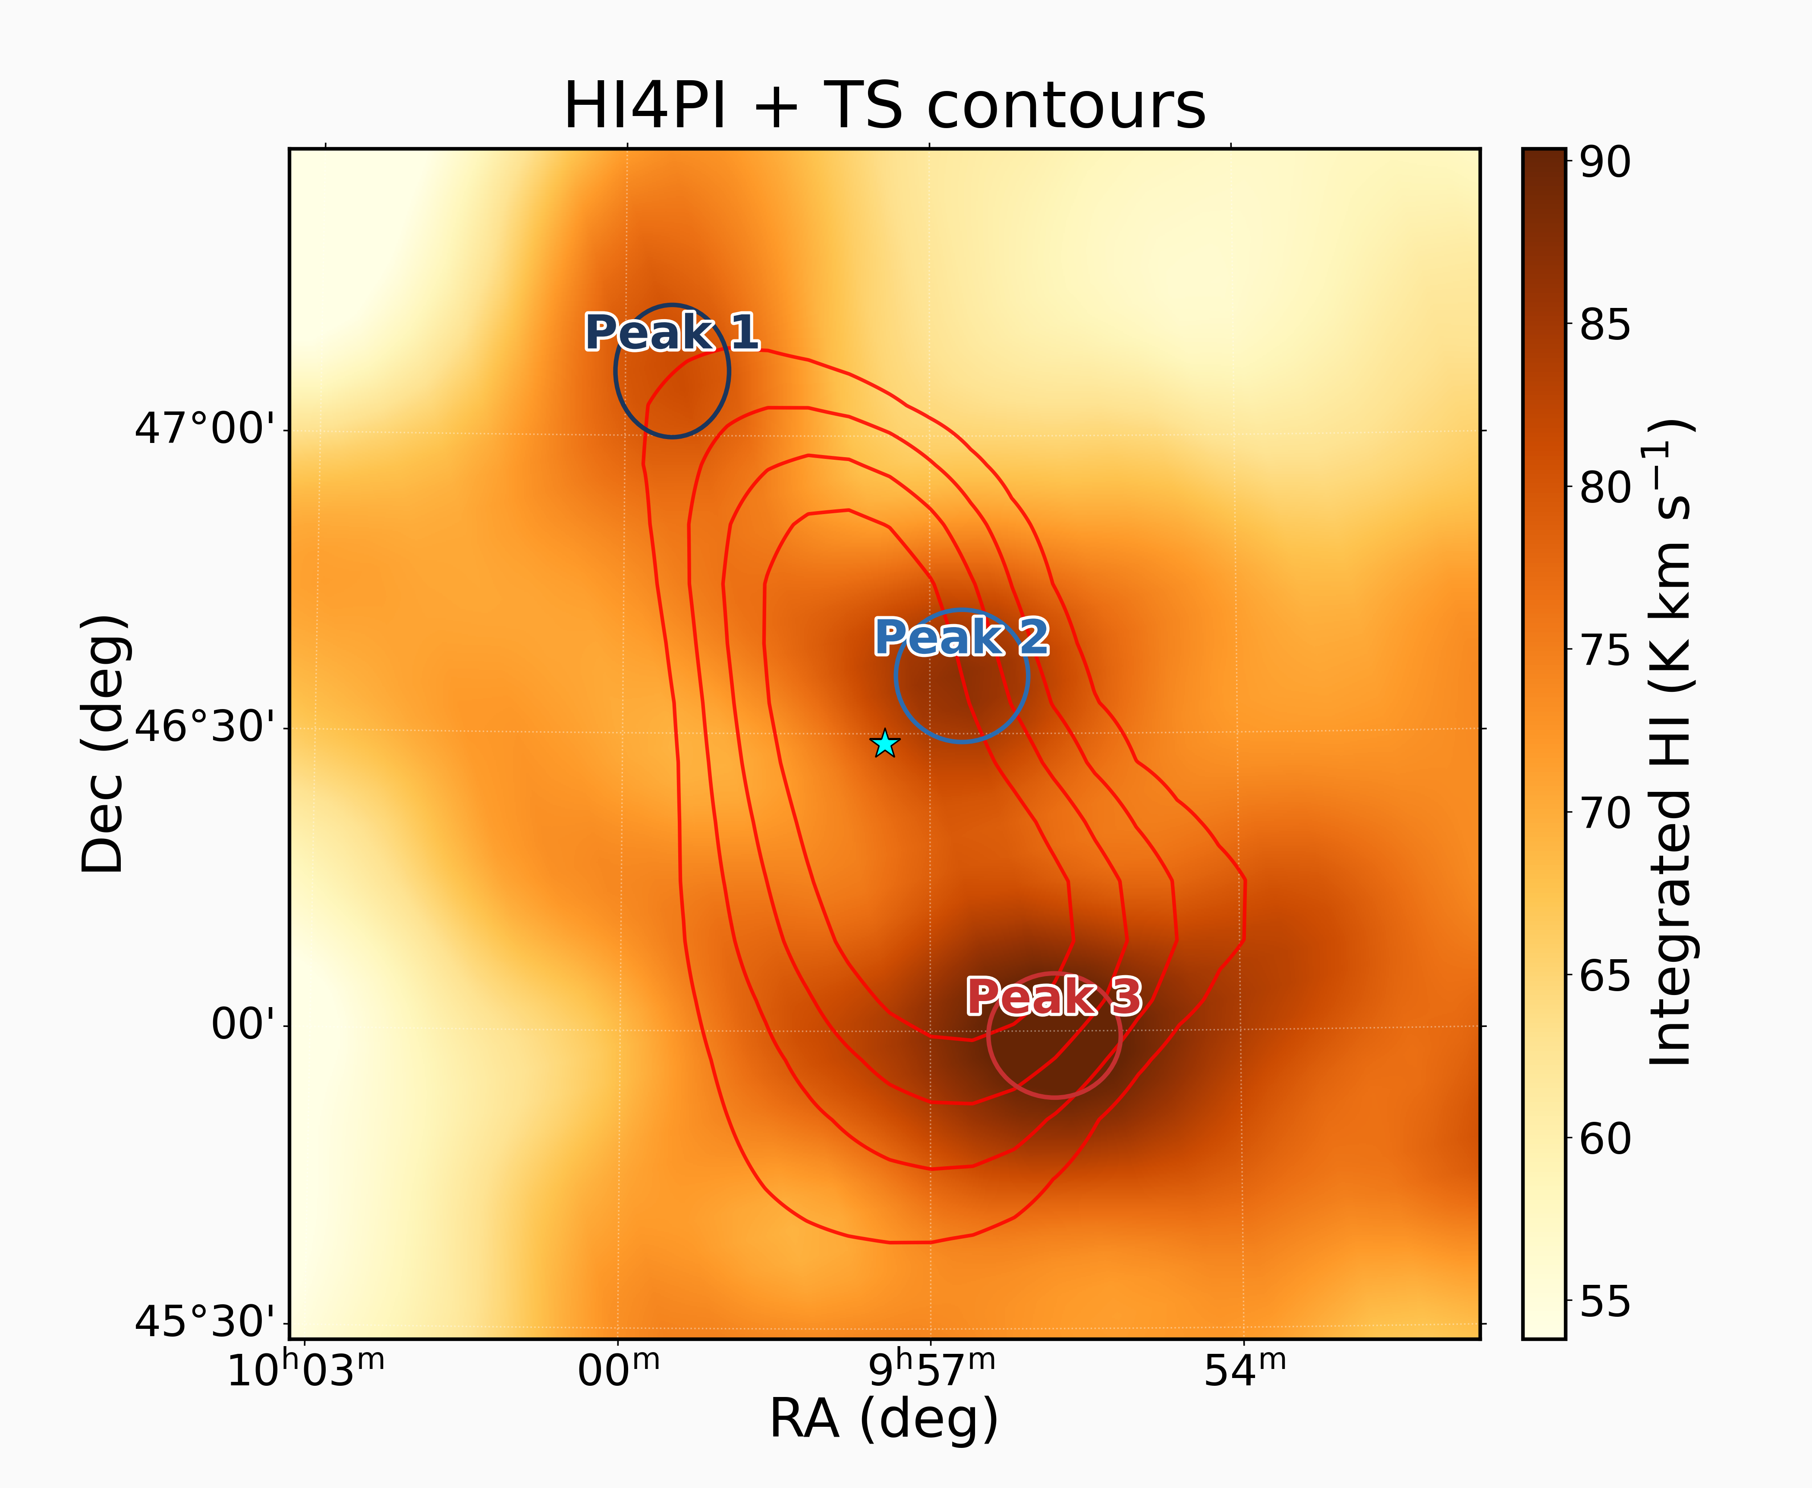
Multiwavelength Counterparts: Current Status
neutral hydrogen (HI) at 21 cm
Only one faint X-ray match: 2RXS J095730.0+462824 (ROSAT);
EP follow-up applied for.
TeV TS correlates with HI at v_{LSR} ≈ -17 km/s—local gas, likely.

Slide 9
III. Systematic-Uncertainty Estimates
Previously quoted uncertainties are dominated by statistical errors from data fluctuations. In addition, systematic effects arise from atmospheric pressure, ADC/TDC calibration, and so on .
We estimate KM2A systematics for gamma-ray source measurements mainly from Crab Nebula studies.
13

Slide 10
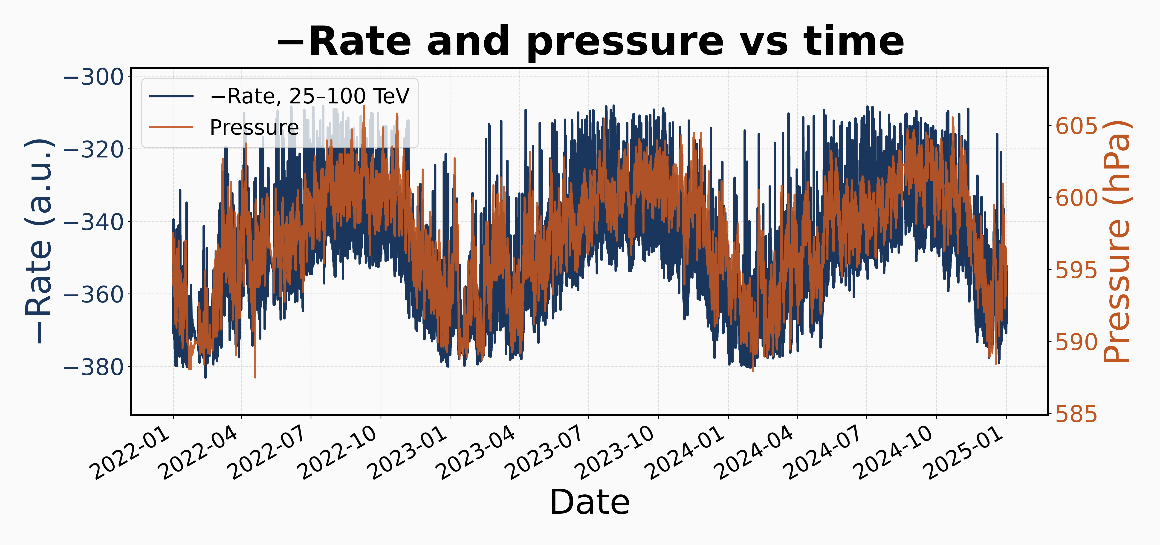
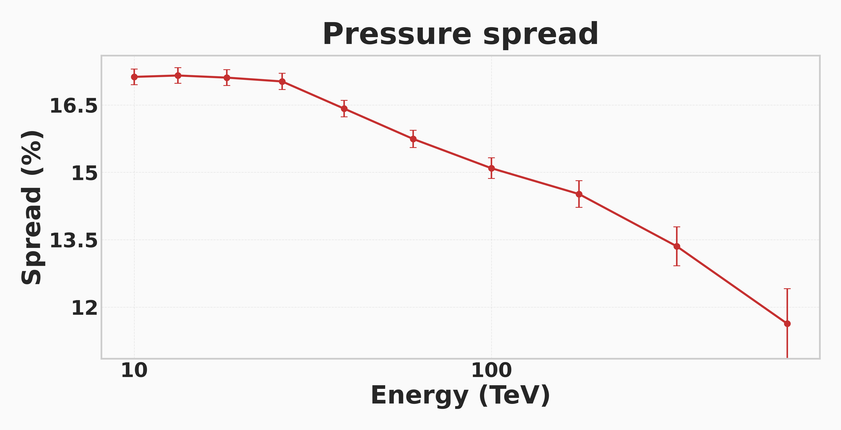
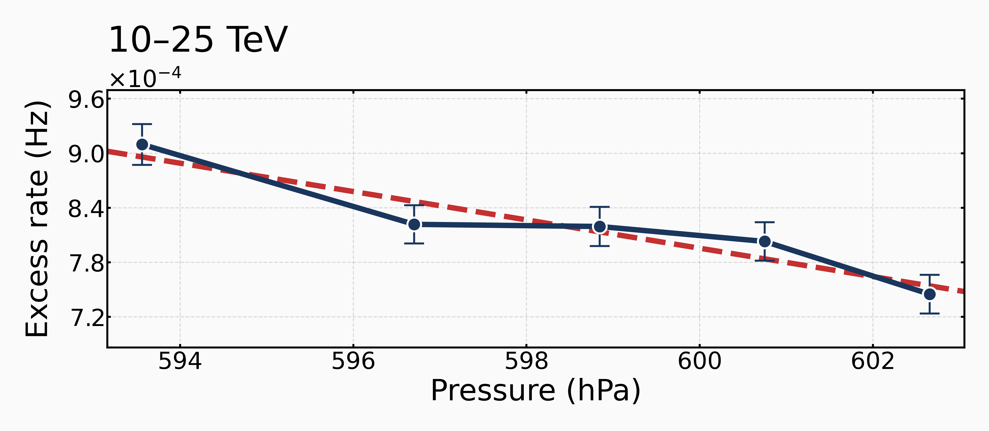
Atmospheric depth drives event-rate changes
Cosmic-ray event rate vs. atmospheric pressure：±6–8%
Crab gamma-ray flux vs. pressure: behaves similarly to cosmic rays.
14

Slide 11
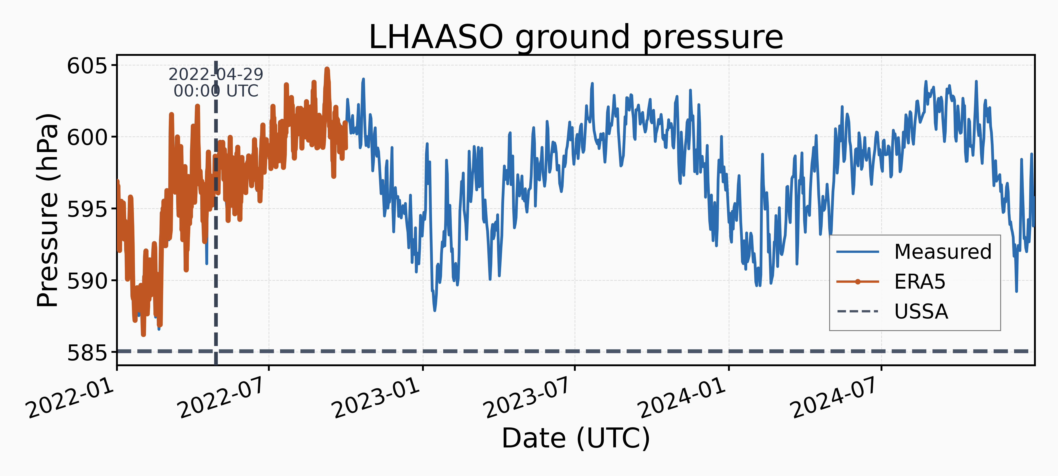
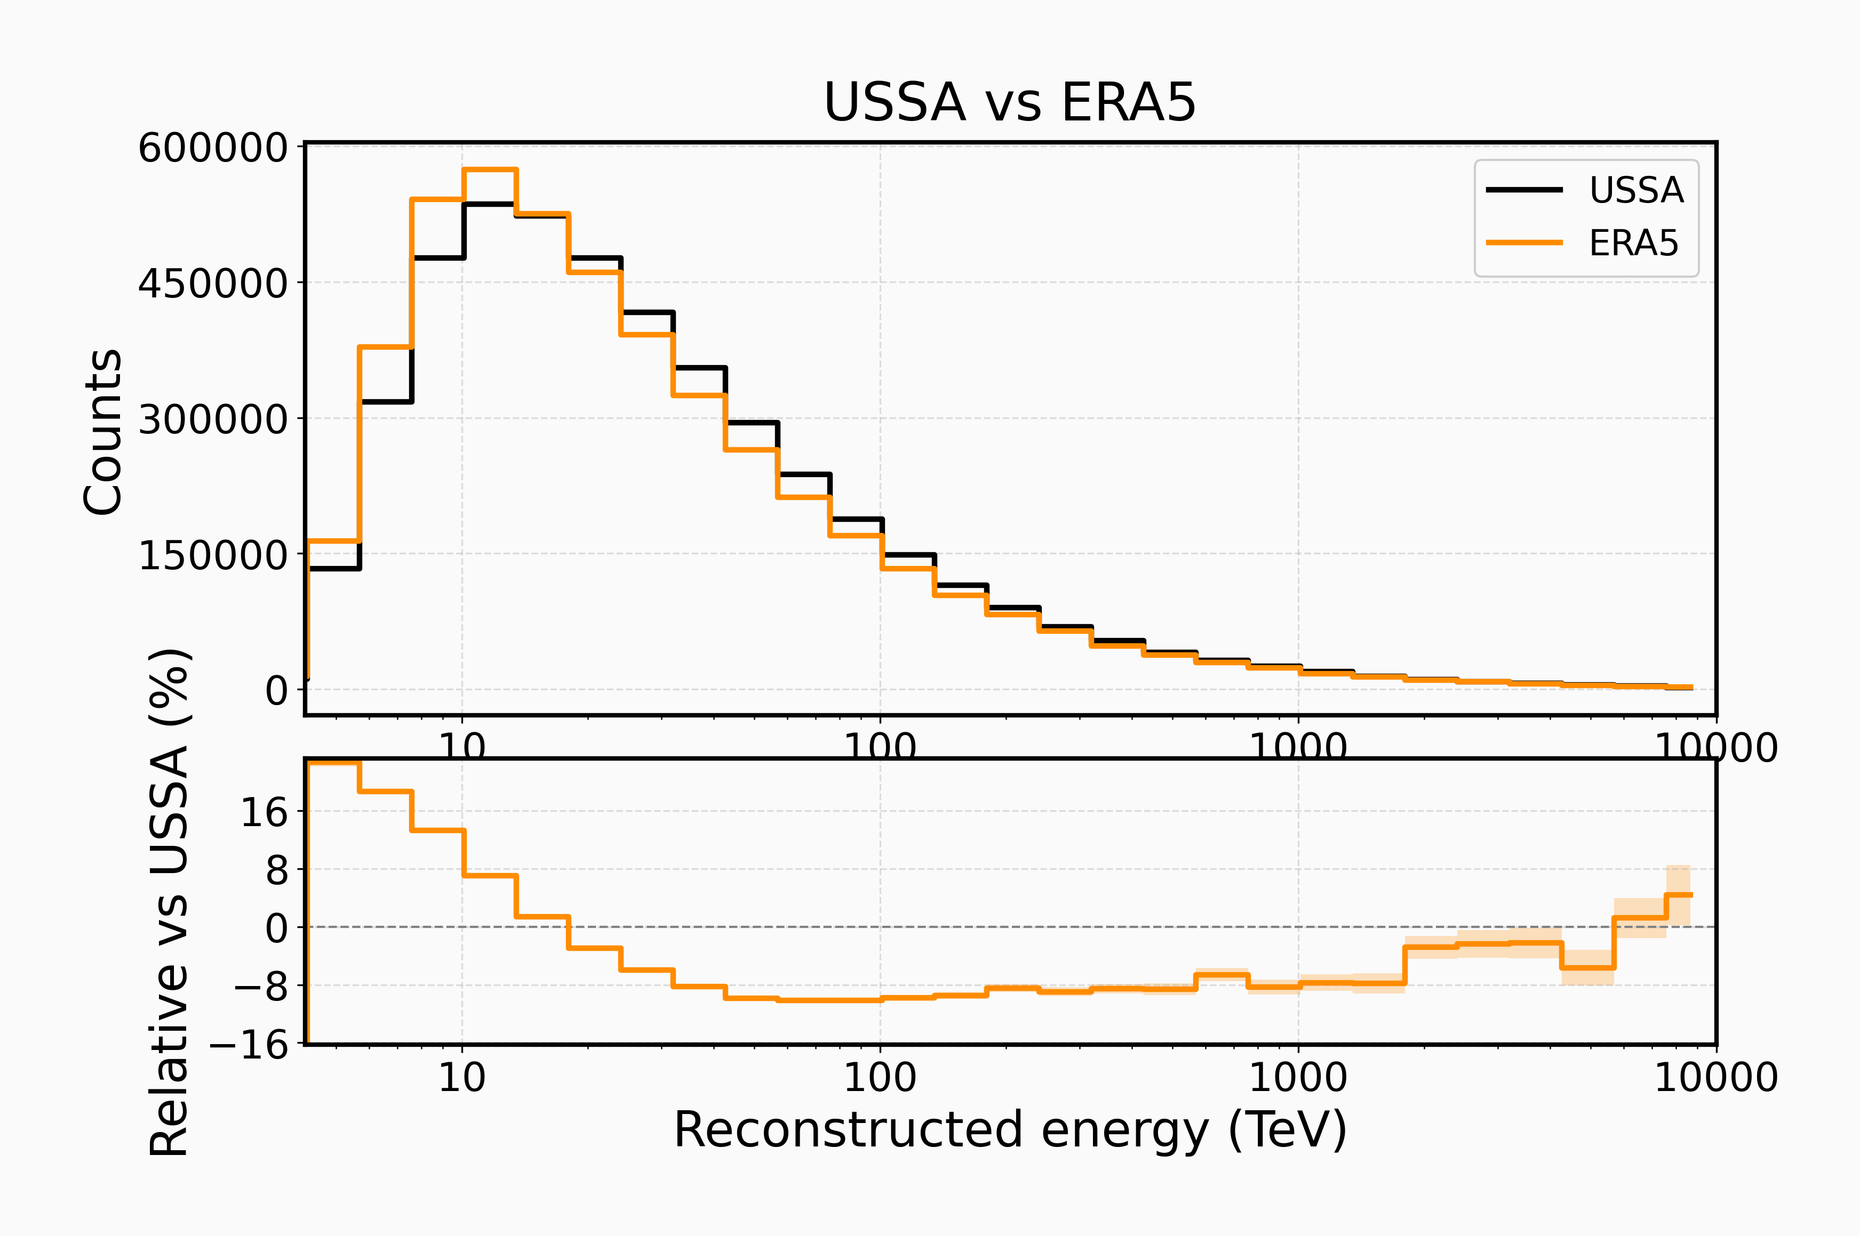
Simulation: estimate the bias from the choice of atmosphere model in MC
Current MC: uses the USSA atmosphere model
ERA5 matches measured pressure better
Comparison of trigger-level energy distributions between the two atmosphere models in simulation
Preliminary estimate: ~9.1% difference between ERA5 and USSA simulations
15

Slide 12
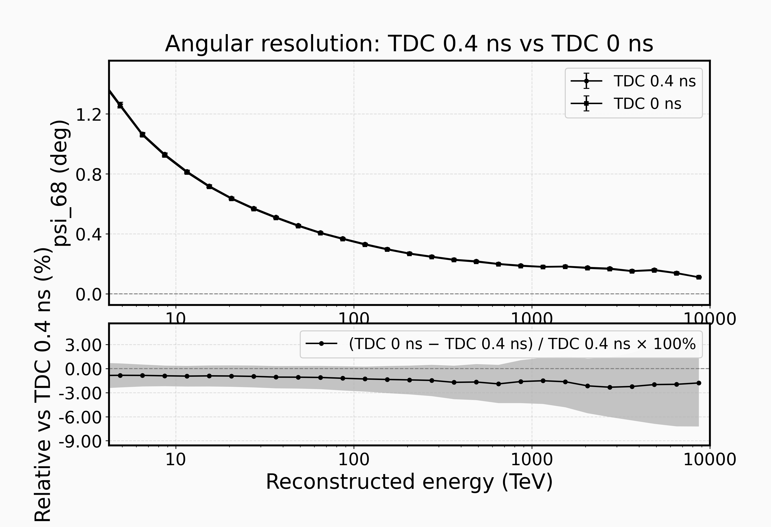
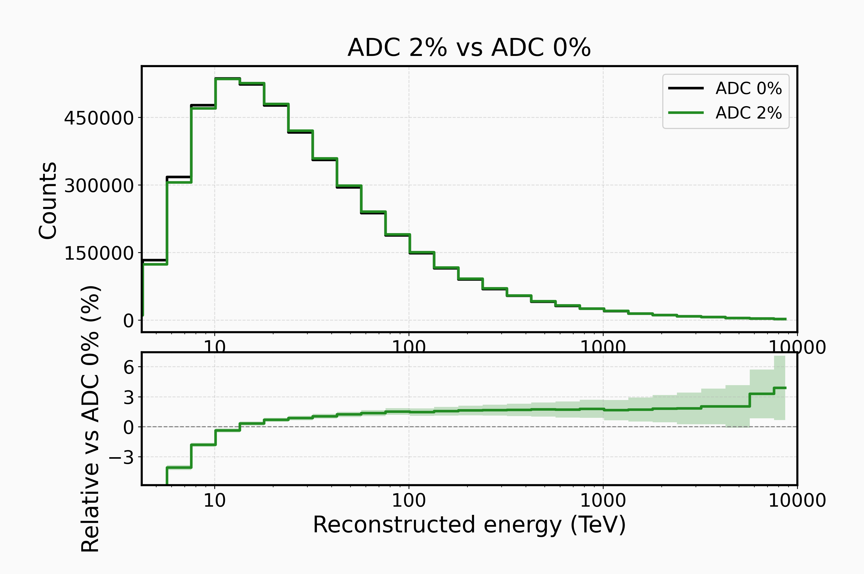
Impact of ADC/TDC calibration uncertainties
ADC calibration shift (+0.02):leading to an average ~2% upward shift in reconstructed energy.
TDC timing jitter (0.4 ns):degrading the angular resolution by about ~1.5% on average.

Slide 13
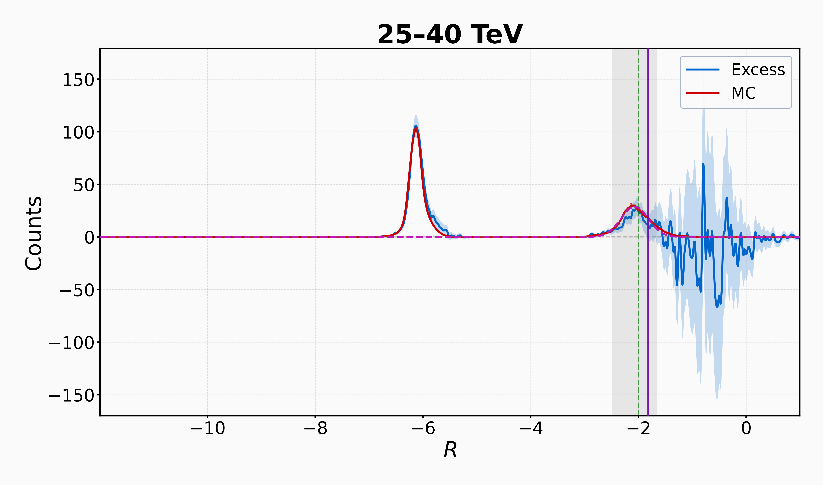
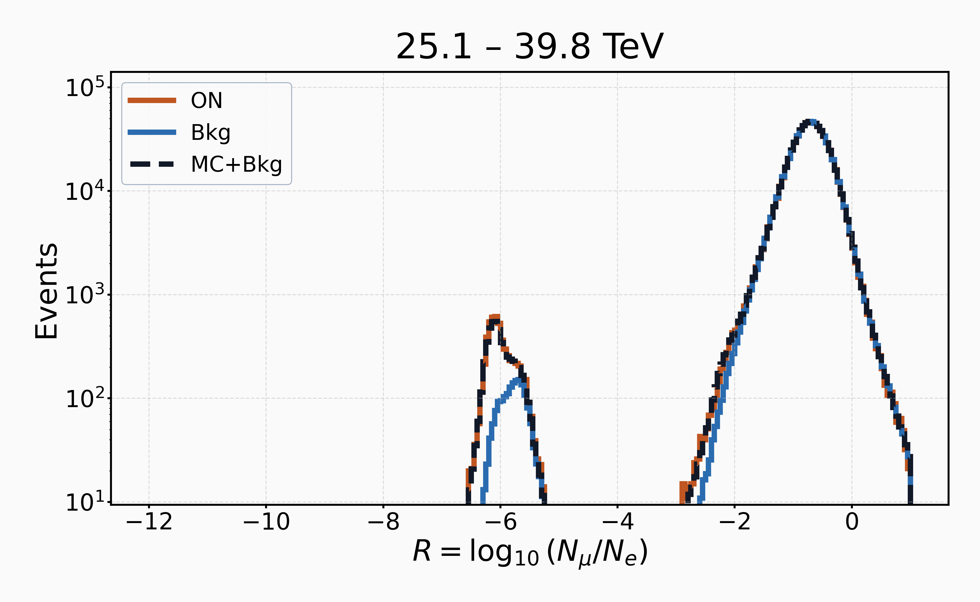
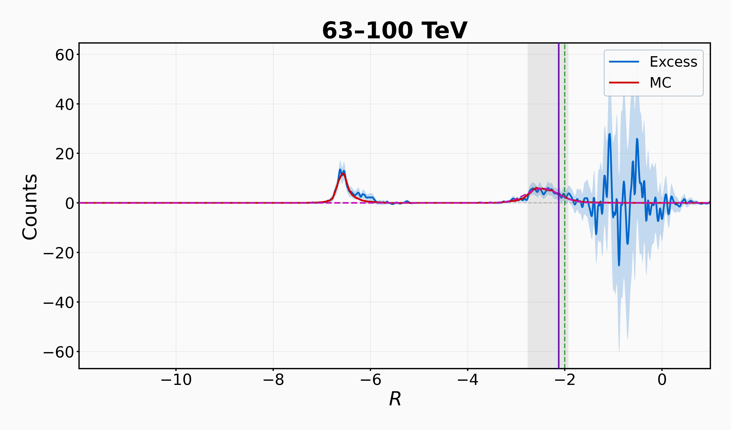
Differences between MC and Crab data on γ/p
These differences still need further check and study

Slide 14
IV. Summary
poster 46
J0956+4622 (summary)
Position: Galactic l ≈ 171.6 deg, b ≈ 50.8 deg.
Morphology: extended; major axis ~0.5 deg.
Spectrum: νFν (or E²dN/dE) peak ~70 TeV—among the top three LHAASO sources.
Counterparts: one faint X-ray candidate; EP data needed for a firm call. HI gas suggests a possible link at ~50–100 pc.
Systematics (preliminary)
Event rate vs. pressure: ~±6–8%.
Energy scale (MC atmosphere): USSA vs. ERA5 → ~9.1% low bias (dominant term).
TDC/ADC calibration: ~1–2%

Slide 15
Thanks !

