Slide 1

Study on Cosmic Ray Energy Reconstruction at 50–500 TeV with LHAASO-KM2A
Yinan Wu* , Hengying Zhang
Yunnan University, Kunming650500,China （wuyinan_07@163.com)
The First LHAASO Collaboration Conference in 2026
2026.4.28

Slide 2
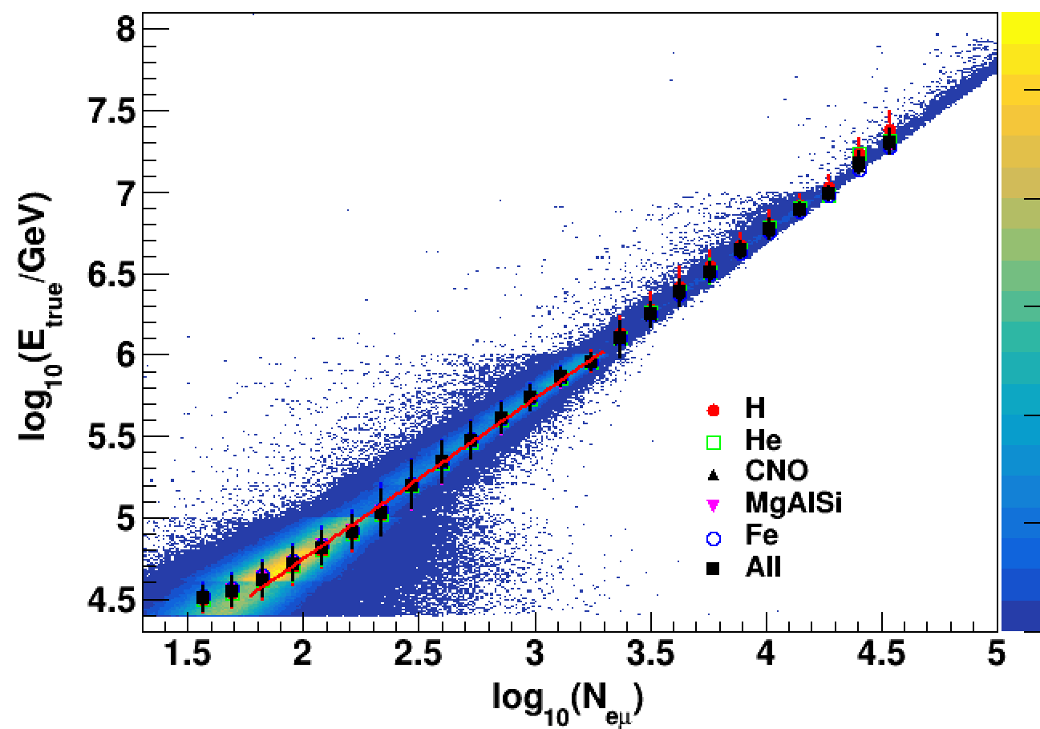
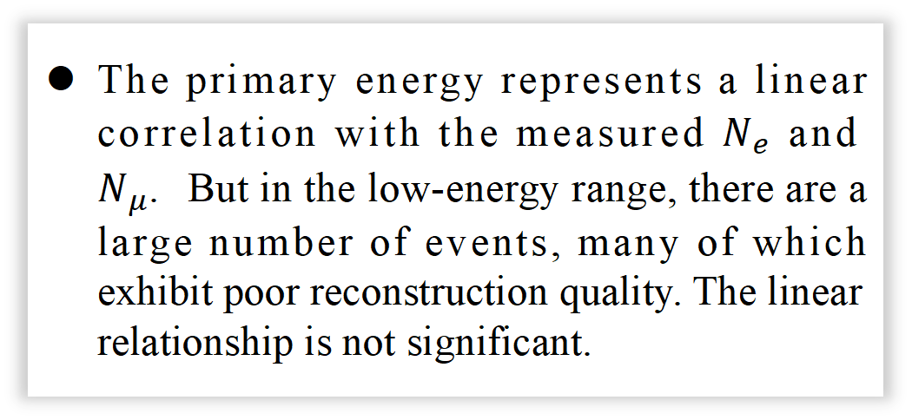

Motivation
The primary energy represents a linear correlation with the measured $N_{e}$ and $N_{μ}.$But in the low-energy range, there are a large number of events, many of which exhibit poor reconstruction quality. The linear relationship is not significant.
The 50–500 TeV energy range represents a bridging gap between direct measurements of cosmic rays and ground-based indirect measurements. Precise determination of the all-particle energy spectrum in this region can fill this gap.
LHAASO-KM2A, with its high altitude and hybrid detectors, is suited to fill this gap.
The relationship between primary energy and $N_{e}$, $N_{μ}$ is strongly affected by cosmic-ray composition in the low-energy region, so it is important to develop a reconstruction method with weak composition dependence.
Notes:
111

Slide 3
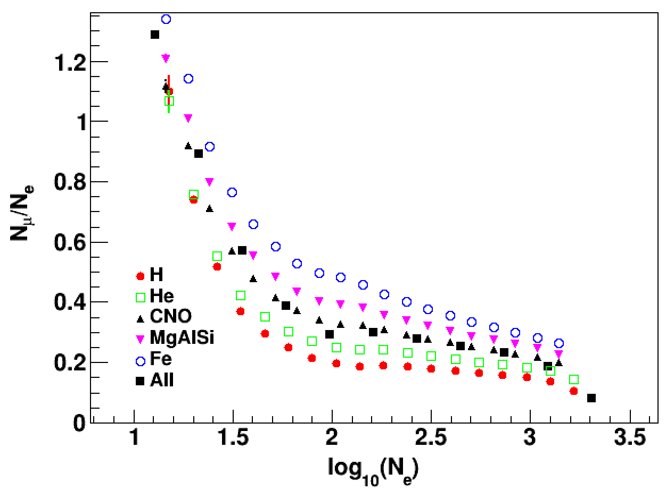
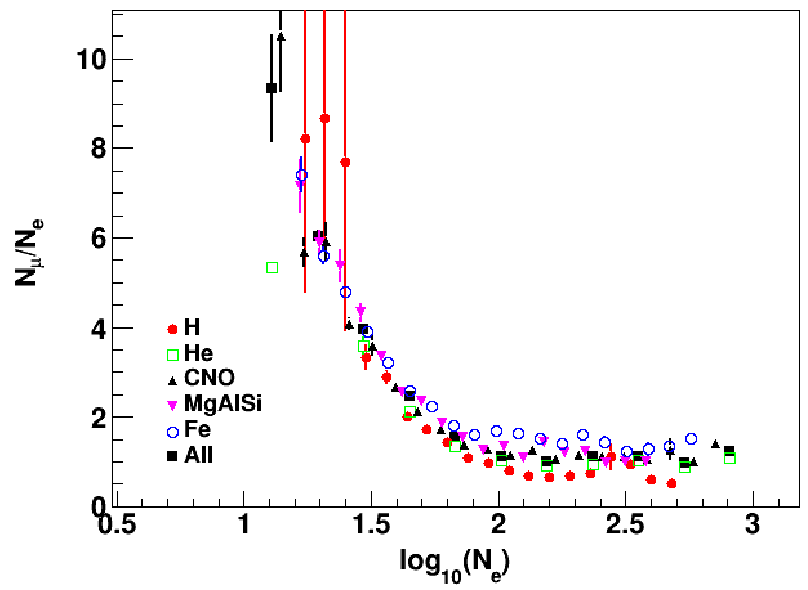
Data Simulation & Event Selection
Simulation: CORSIKA (QGSJETII-04) + G4KM2A 25 TeV – 10 PeV H, He, CNO, MgAlSi, Fe
Parameters | Conditions
location of the reconstructed shower core | 320-420m
zenith angle | 0 - 18°
N_{e} (40-200m) | >15
N_{μ} (40-200m) | >0
NtrigE | >20
N_{μ}/N_{e} | <1.5
Good Events Bad Events
N_{μ} / N_{e} < 1.5 N_{μ} / N_{e} > 1.5
Most effective
Event Selection Criteria

Slide 4
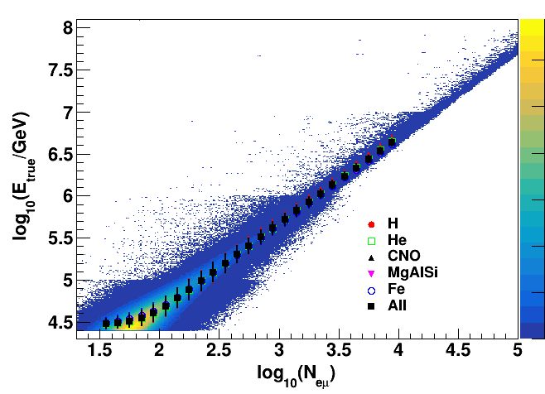
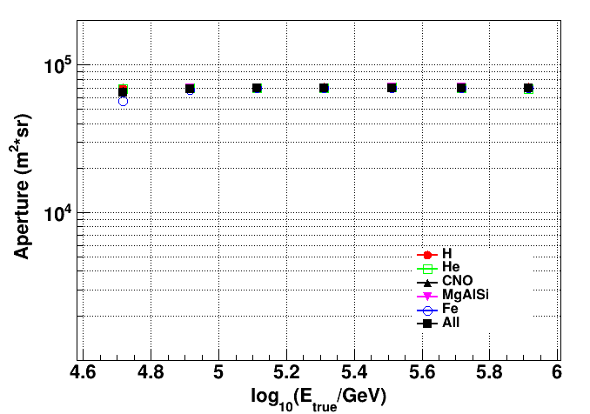
Data Simulation & Event Selection
Simulation: CORSIKA (QGSJETII-04) + G4KM2A 25 TeV – 10 PeV H, He, CNO, MgAlSi, Fe
Left ：Relationship between primary energy and combined parameter after event selection.
Right：Relationship between effective aperture and primary energy for selected events.

Slide 5
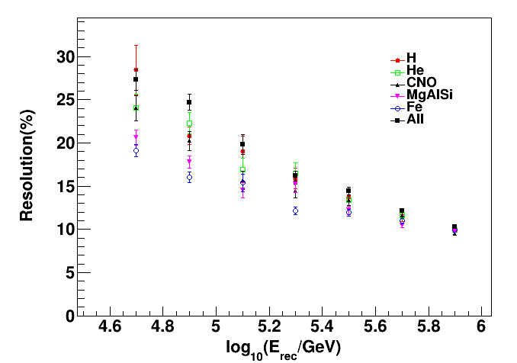
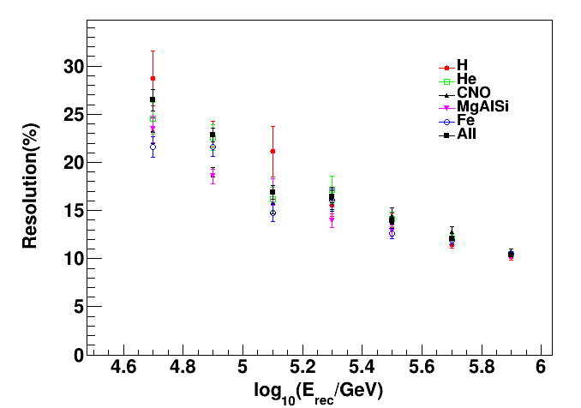
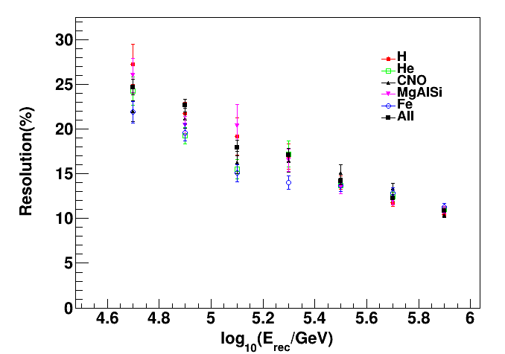
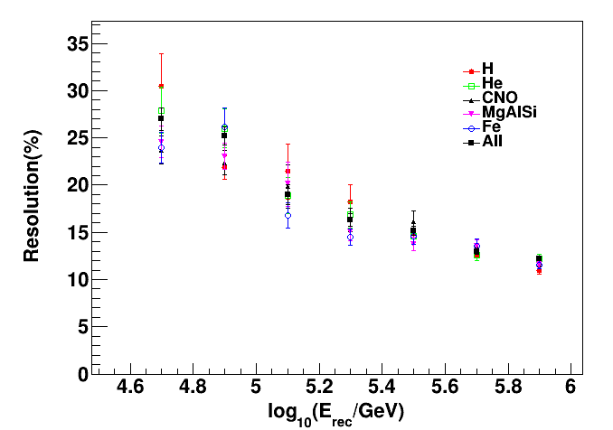
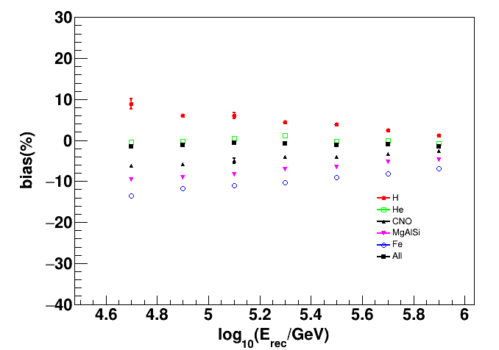
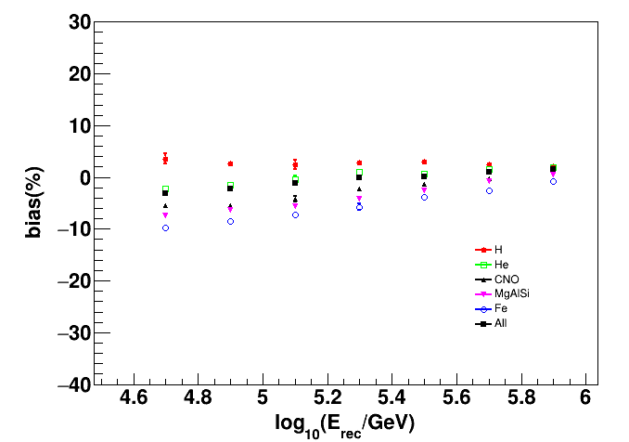
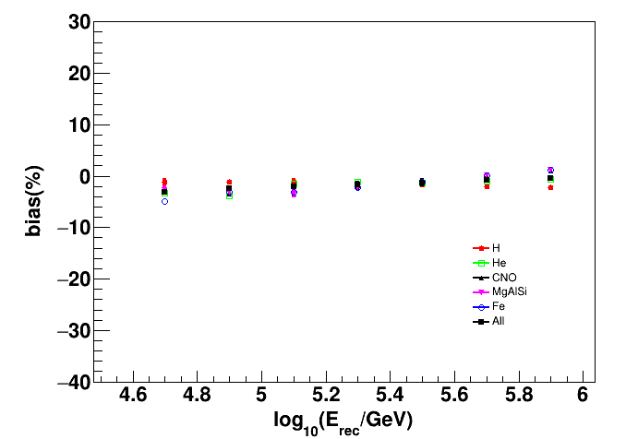
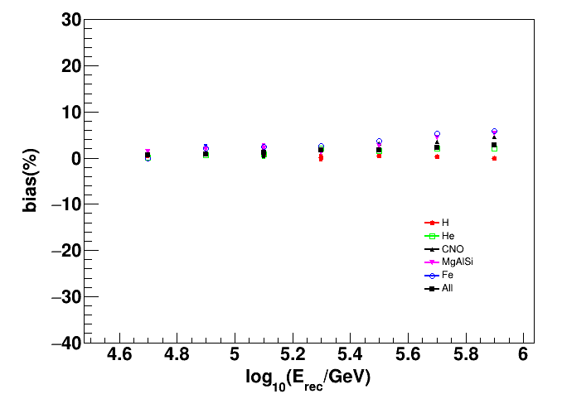




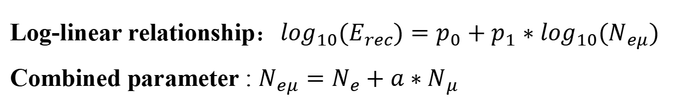
Energy Reconstruction Optimization
Log-linear relationship：$\log_{10}(E_{rec})=p_{0}+p_{1}∗\log_{10}(N_{eμ})$
Combined parameter : $N_{eμ}=N_{e}+a∗N_{μ}$
The parameter value of 2.8 adopted for high energies is not suitable for low-energy studies.
$a$ = 2.0
$a$ = 2.6
$a$ = 4.0
$a$ = 4.6
smallest composition dependence
Notes:
1111

Slide 6
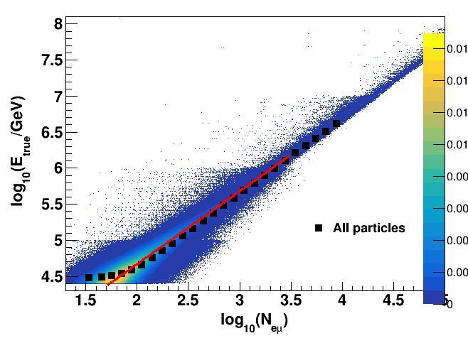
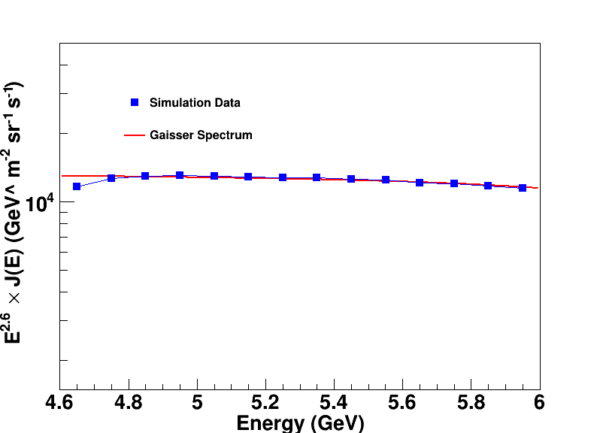
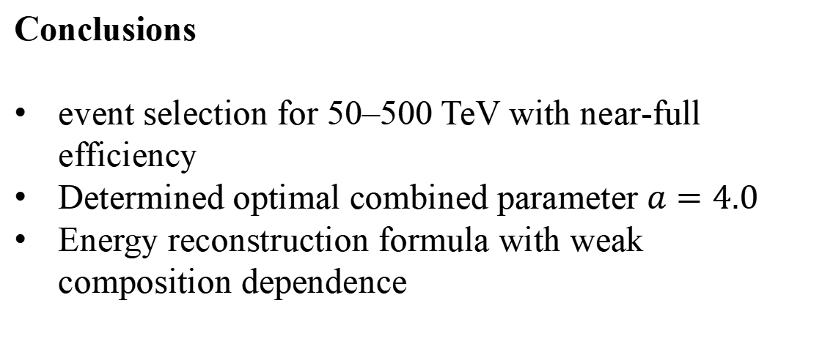
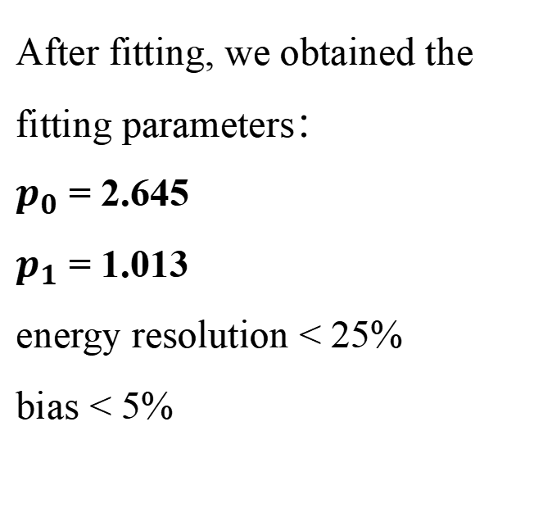
Energy Reconstruction Optimization
After fitting, we obtained the fitting parameters：
$p_{0}$ = 2.645
$p_{1}$ = 1.013
energy resolution < 25%
bias < 5%
Energy Reconstruction Formula：$\log_{10}(E_{rec})=2.645+1.013∗\log_{10}(N_{eμ})$
Comparison with the Gaisser energy spectrum.
Conclusions
event selection for 50–500 TeV with near‑full efficiency
Determined optimal combined parameter $a=4.0$
Energy reconstruction formula with weak composition dependence
Future work
analyze simulation data from other hadronic models(EPOS-LHC, SIBYLL)
Use the method on LHAASO experimental data
Finalize the 50–500 TeV all-particle spectrum

Slide 7
Thank you!
2026.4.28

