Slide 1


Research on the Lateral Distribution of Electromagnetic Particles and Muons
Based on the LHAASO-KM2A Experiment
Ziyi Chen*¹, Hengying Zhang¹, Cunfeng Feng², Xiaoting Feng²
1.Yunnan University, Kunming650500, China， lqxzjyg11@163.com
2. Shandong University, Qingdao266237, China
1th LHAASO Collaboration Conference in 2026 @ NJU Suzhou

Slide 2
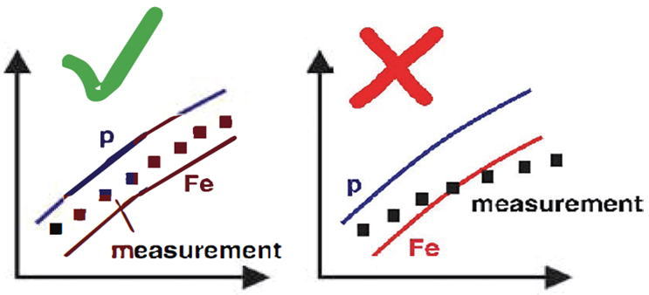
Motivation
Cosmic rays are streams of high-energy particles originating from outer space, however the fundamental questions regarding their origin and acceleration remain largely unanswered
Muon lateral distribution is highly sensitive to hadronic-interaction models and carries key information about the characteristics of primary cosmic rays

Slide 3
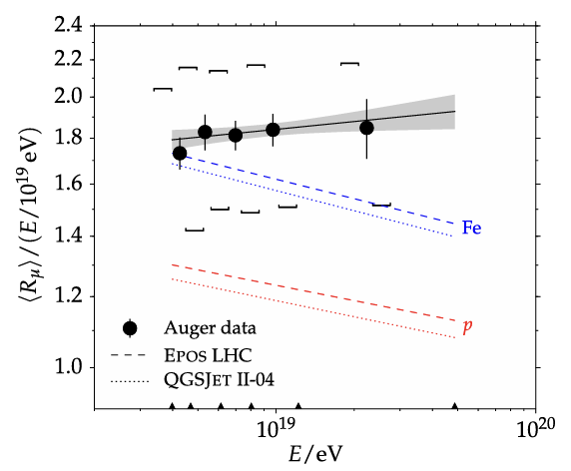
Motivation
Several experiments have reported the muon excess phenomenon, where the measured muon density significantly exceeds model predictions, implying deficiencies in existing hadronic models when describing particle production in extreme energy regions
The results of the
Pierre Auger Observatory.

Slide 4
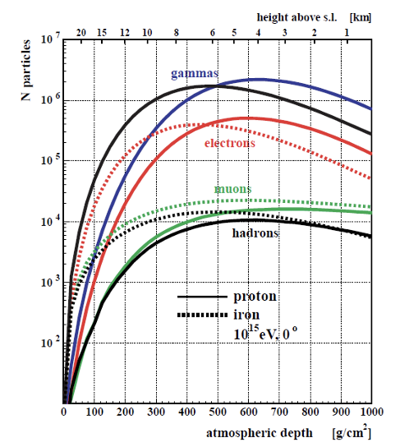
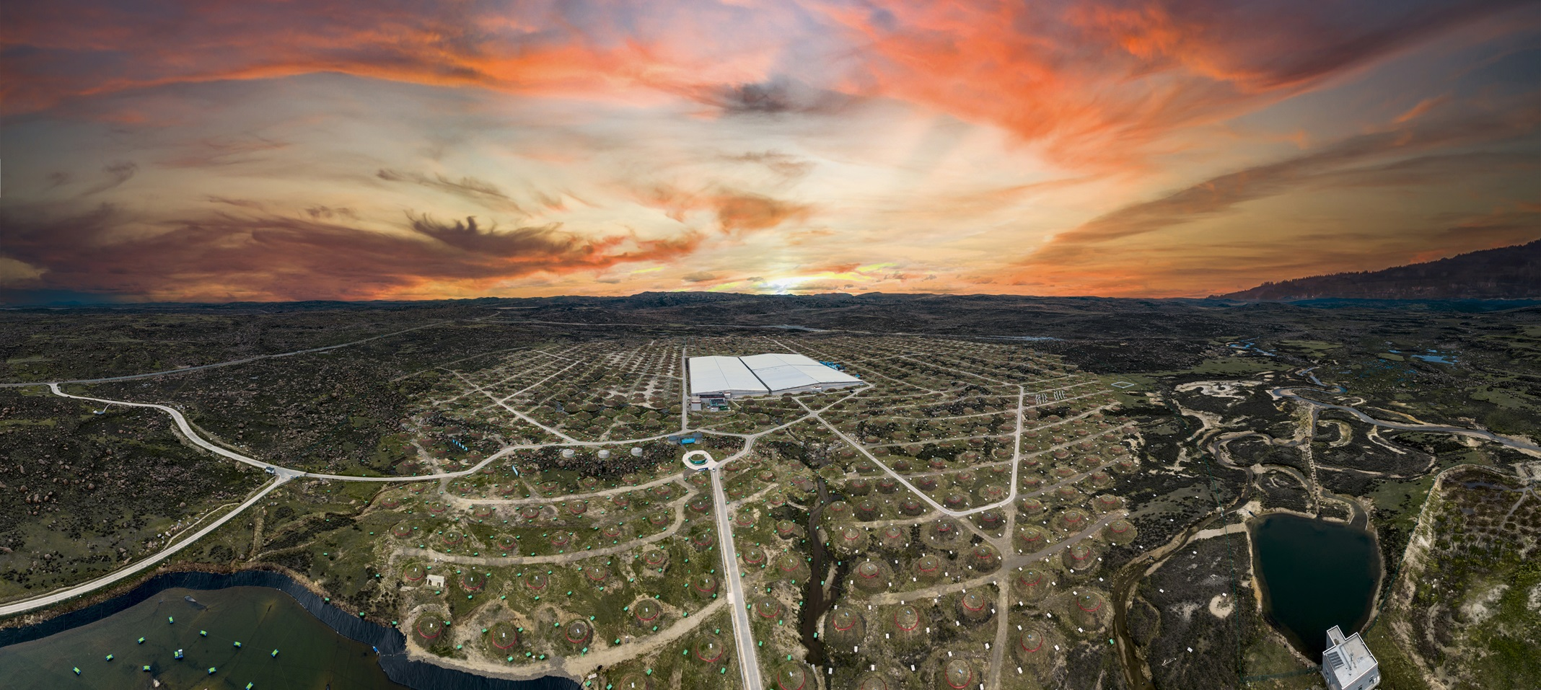
Motivation
It is currently the world’s highest-altitude, largest-scale and most sensitive cosmic-ray detector
At the peak of the shower, the number of secondary particles is at its highest
Minimal fluctuations and high measurement accuracy
Longitudinal Evolution of Particle Components in the 1 PeV Proton and Iron Nucleus EAS.
Notes:
The advantages of LHAASO provide a more accurate data foundation

Slide 5
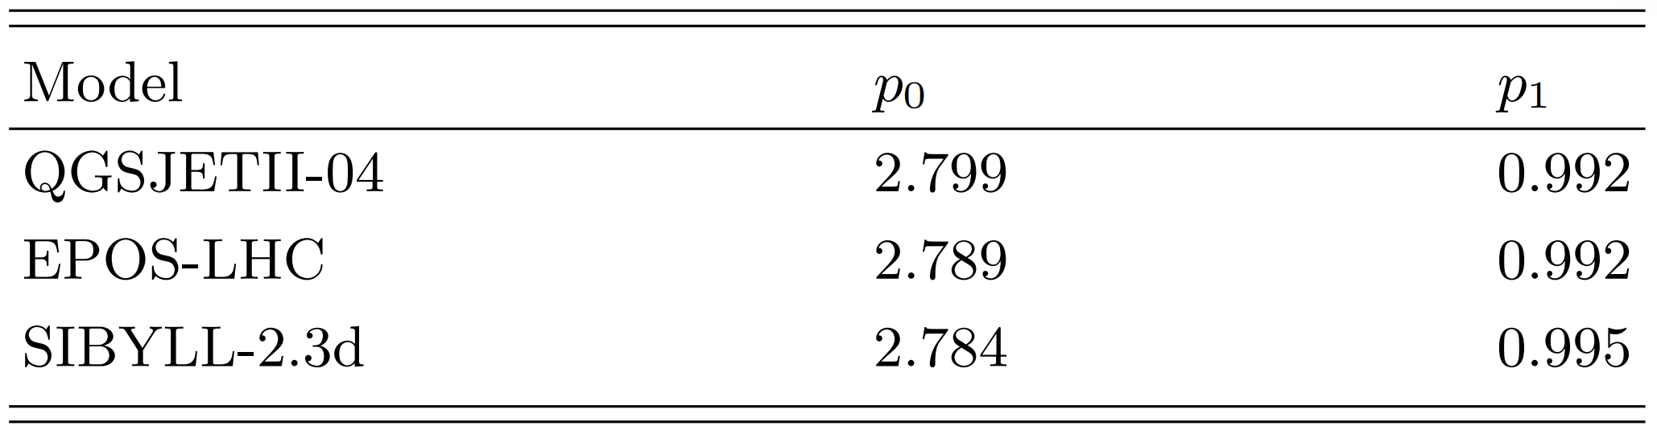
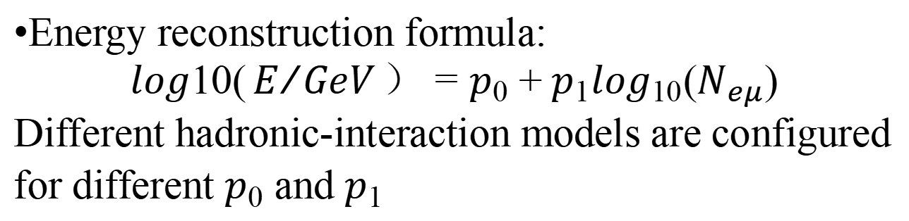
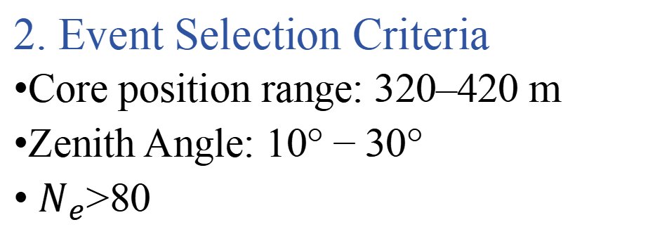
Method
1. Data
Monte Carlo data: data for Extensive Air Showers processes were generated using the CORSIKA simulation based on the LHAASO experiment. The CORSIKA version used was CORSIKAv77410, and the hadronic-interaction models employed in the high-energy region were EPOS-LHC, QGSJETII-04 and SIBYLL2.3d.
Experimental data: Observation data covering 31 days in 2025 were used.
2. Event Selection Criteria
Core position range: $320–420 m$
Zenith Angle: $10°−30°$
$N_{e}$>80
Energy reconstruction formula:
$$log10(E/{GeV}）=p_{0}+p_{1}\log_{10}(N_{eμ})$$
Different hadronic-interaction models are configured for different $p_{0}$ and $p_{1}$

Slide 6
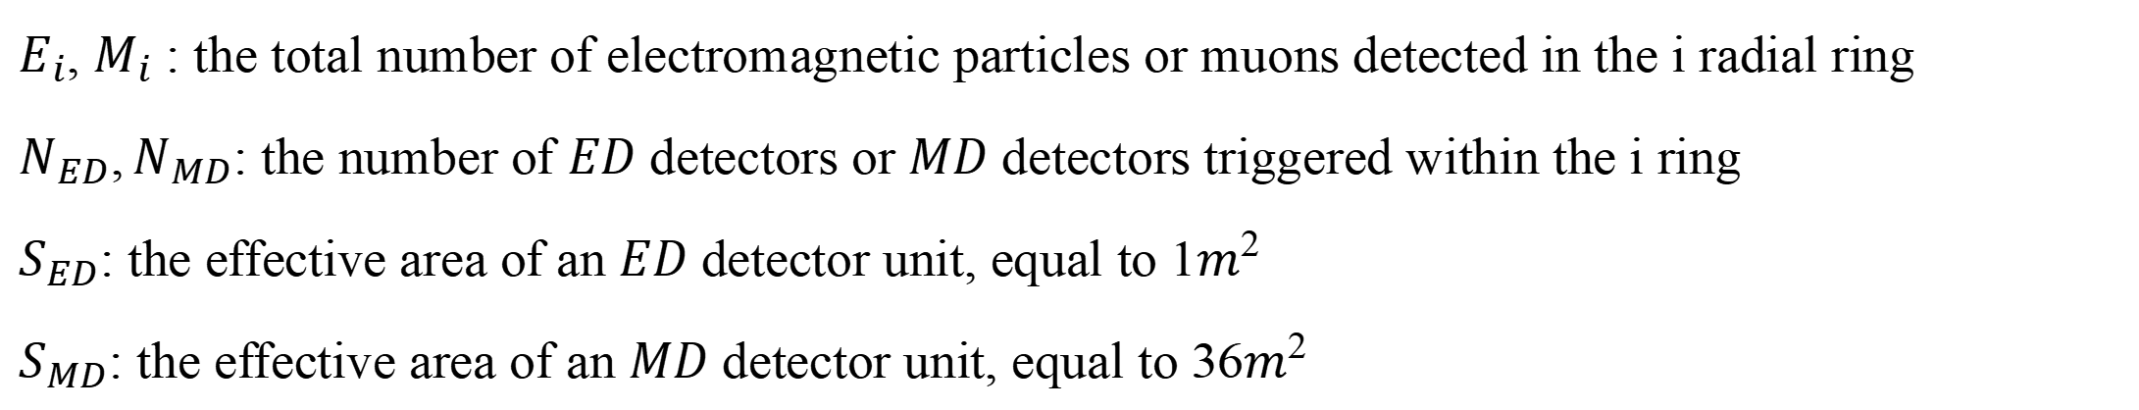
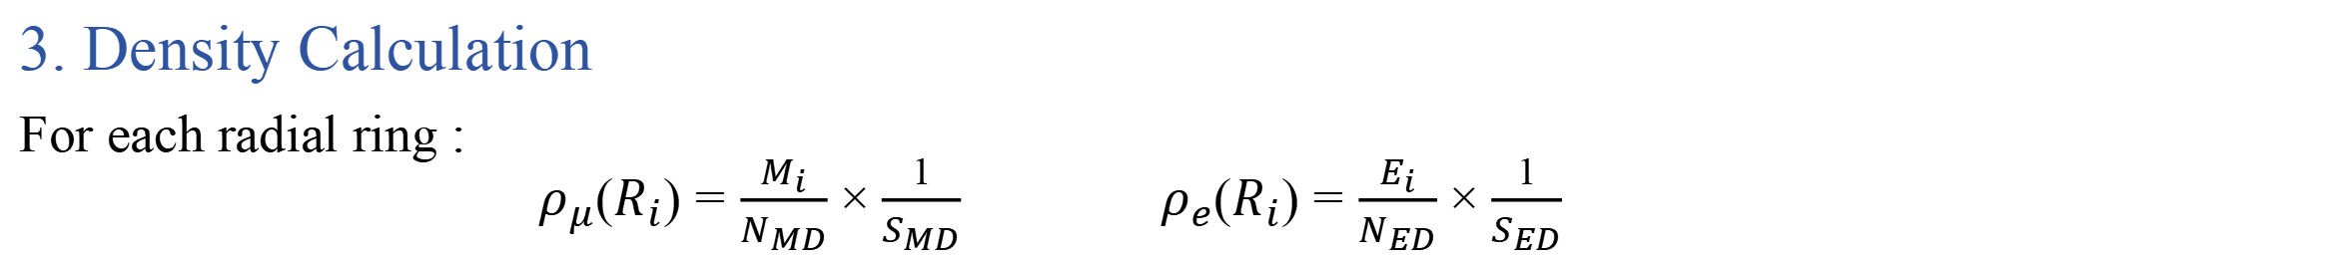
Method
3. Density Calculation
For each radial ring :
$ρ_{μ}(R_{i})=\frac{M_{i}}{N_{MD}}×\frac{1}{S_{MD}}$ $ρ_{e}(R_{i})=\frac{E_{i}}{N_{ED}}×\frac{1}{S_{ED}}$
$E_{i}, M_{i}$: the total number of electromagnetic particles or muons detected in the i radial ring
$N_{ED},N_{MD}$: the number of $ED$ detectors or $MD$ detectors triggered within the i ring
$S_{ED}$: the effective area of an $ED$ detector unit, equal to $1m^{2}$
$S_{MD}$: the effective area of an $MD$ detector unit, equal to $36m^{2}$

Slide 7
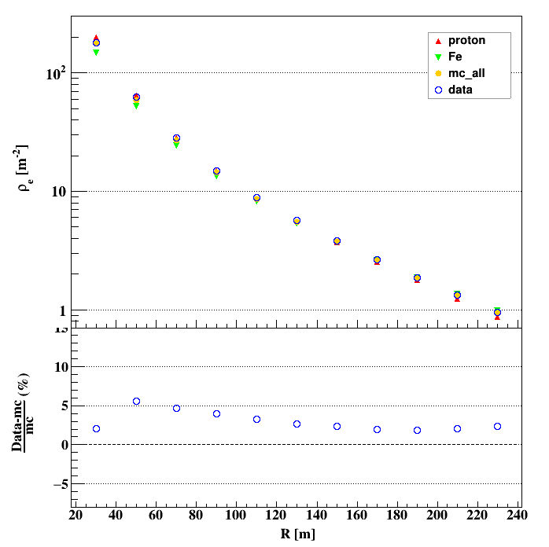
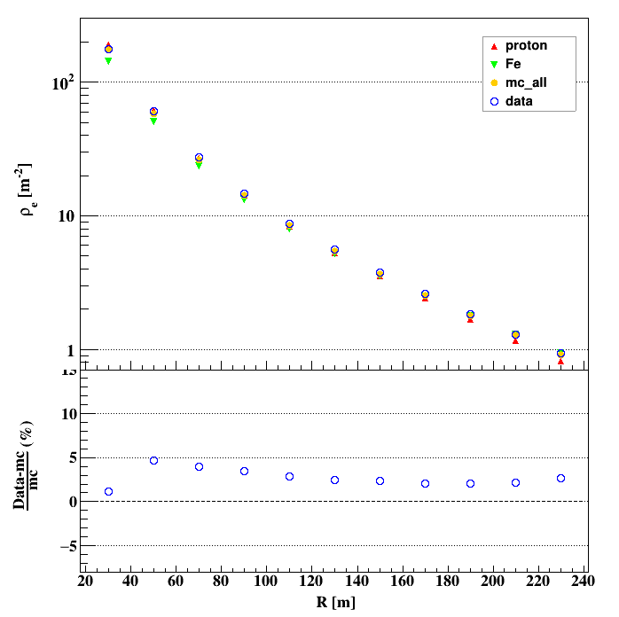
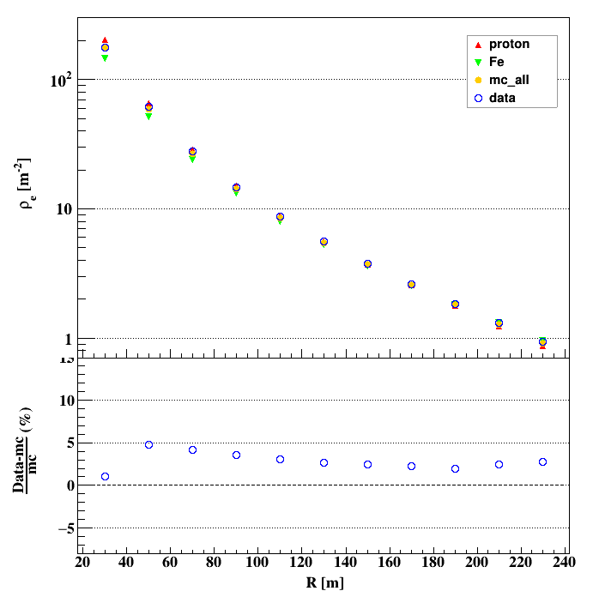
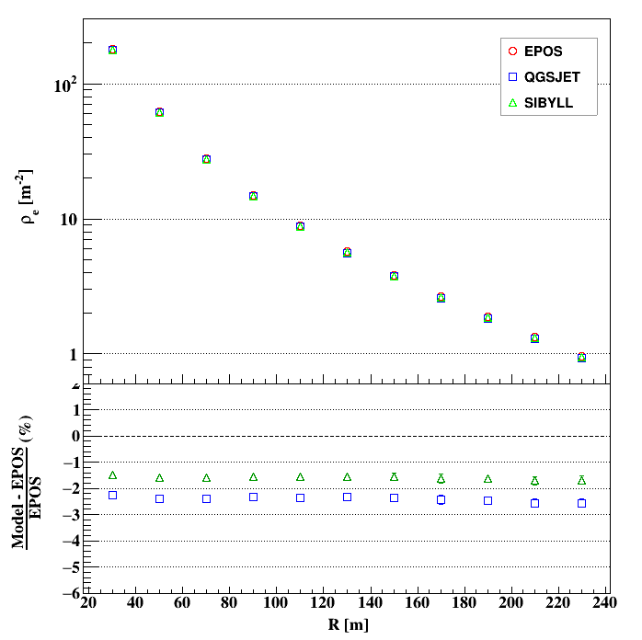
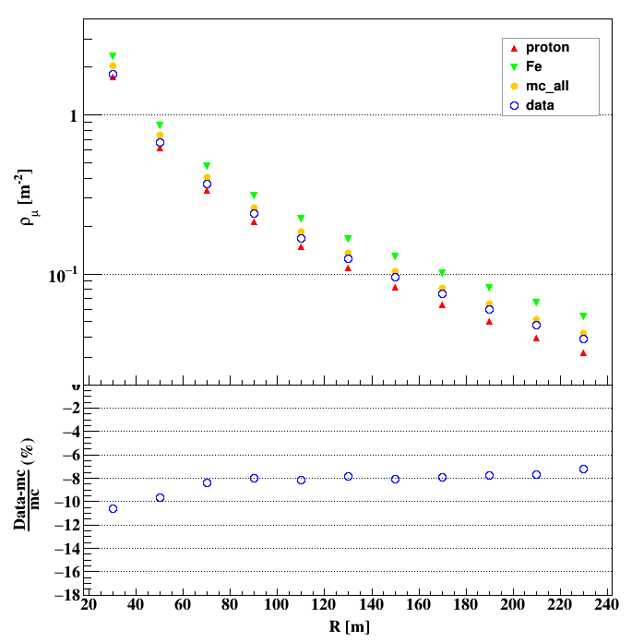
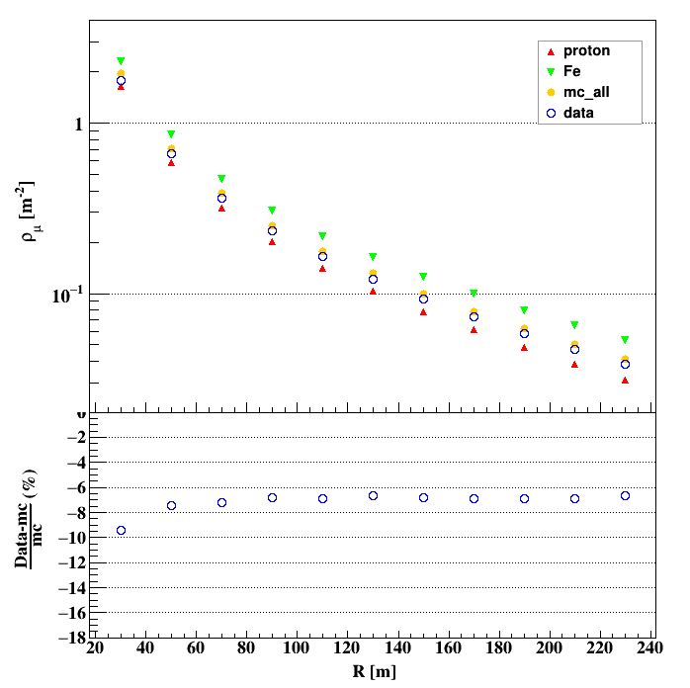
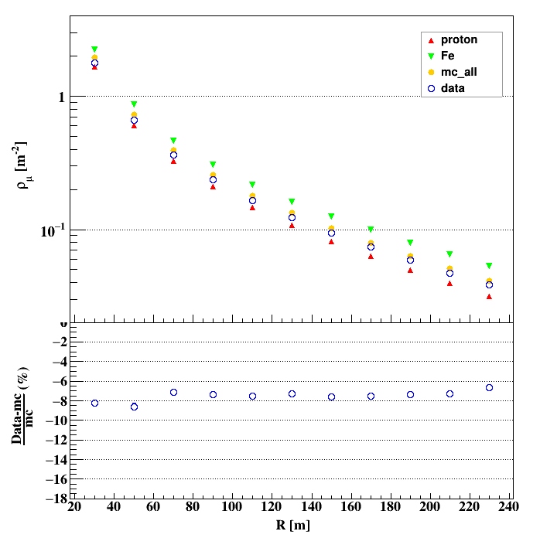
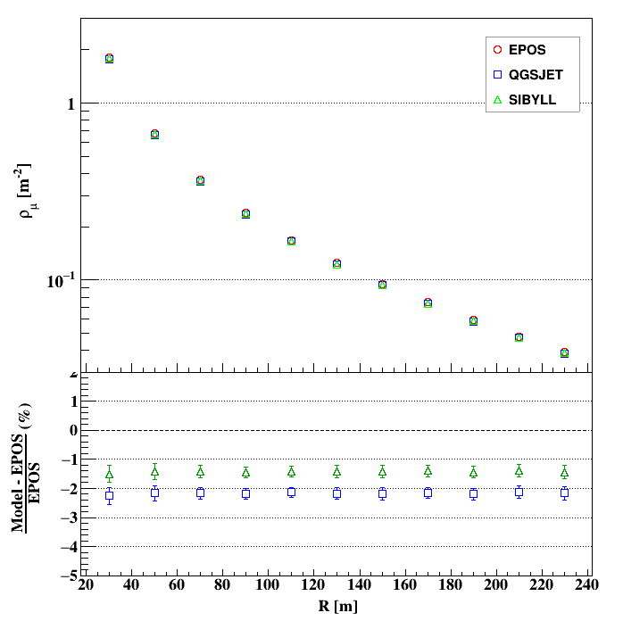
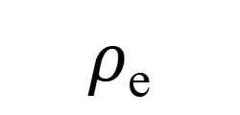
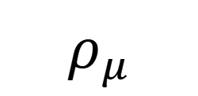
Result
lateral distributions of electromagnetic particles and muons with the energy range between 4.0 and 6.4PeV
EPOS-LHC
QGSJETII-04
SIBYLL2.3d
$$ρ_{e}$$
$$ρ_{μ}$$

Slide 8
Summary
The discrepancies between the simulated and experimental data are within 10%, and the differences between the hadronic-interaction models in this energy range are minimal, with errors of less than 3%. indicating that these models can adequately describe Extensive Air Showers in this energy range.
The experimental data for muons are generally lower than the simulation results, while for electromagnetic particles experimental data more than simulation results. These observations may provides some guidance for improving the model.
We will analyse the spatial distribution in higher energy range to investigate the accuracy of the model at higher energies.

Slide 9
Thank you !
1th LHAASO Collaboration Conference in 2026 @ NJU Suzhou

