Slide 1
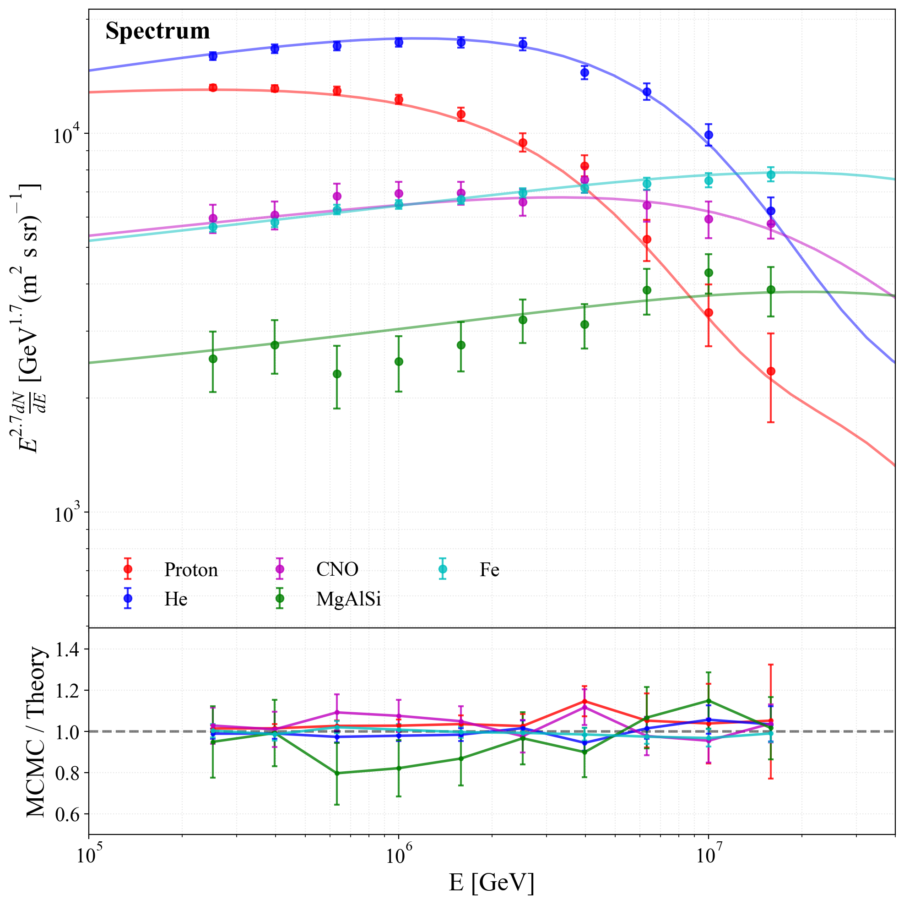
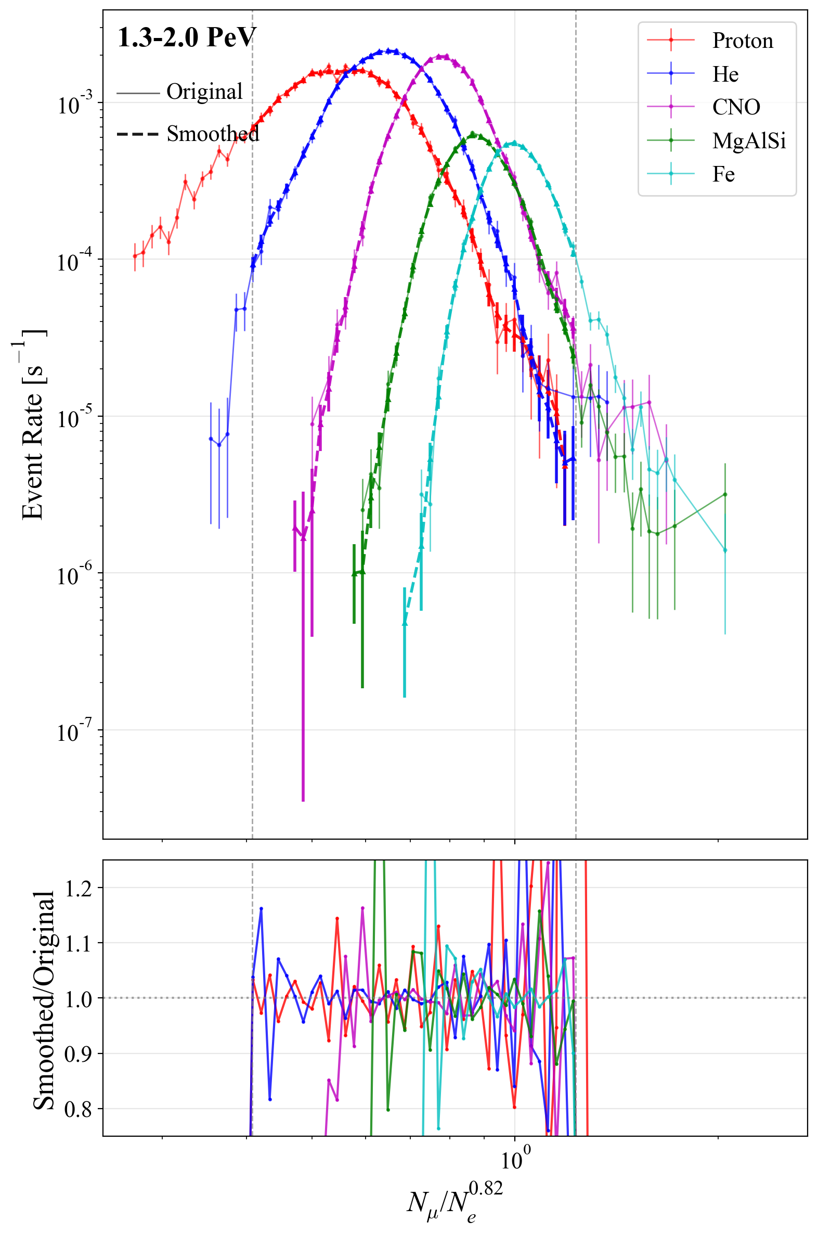
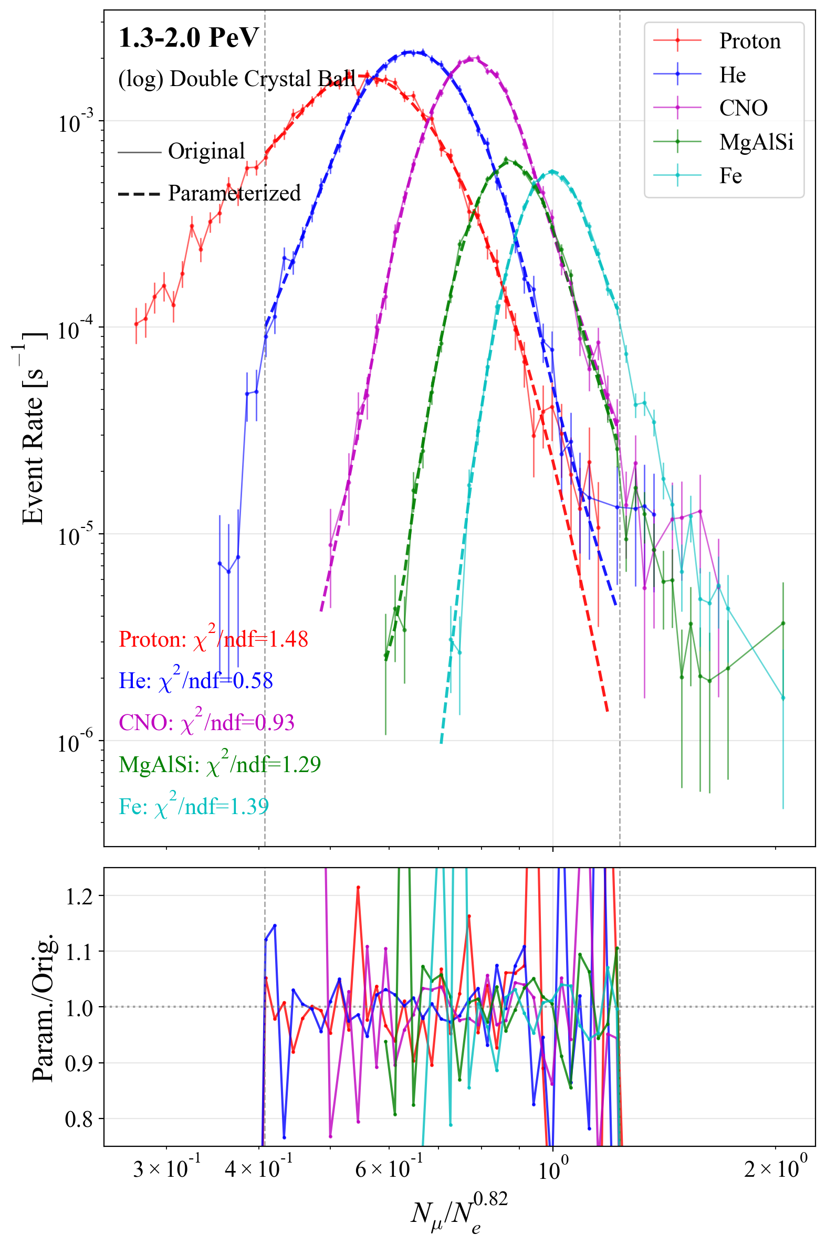
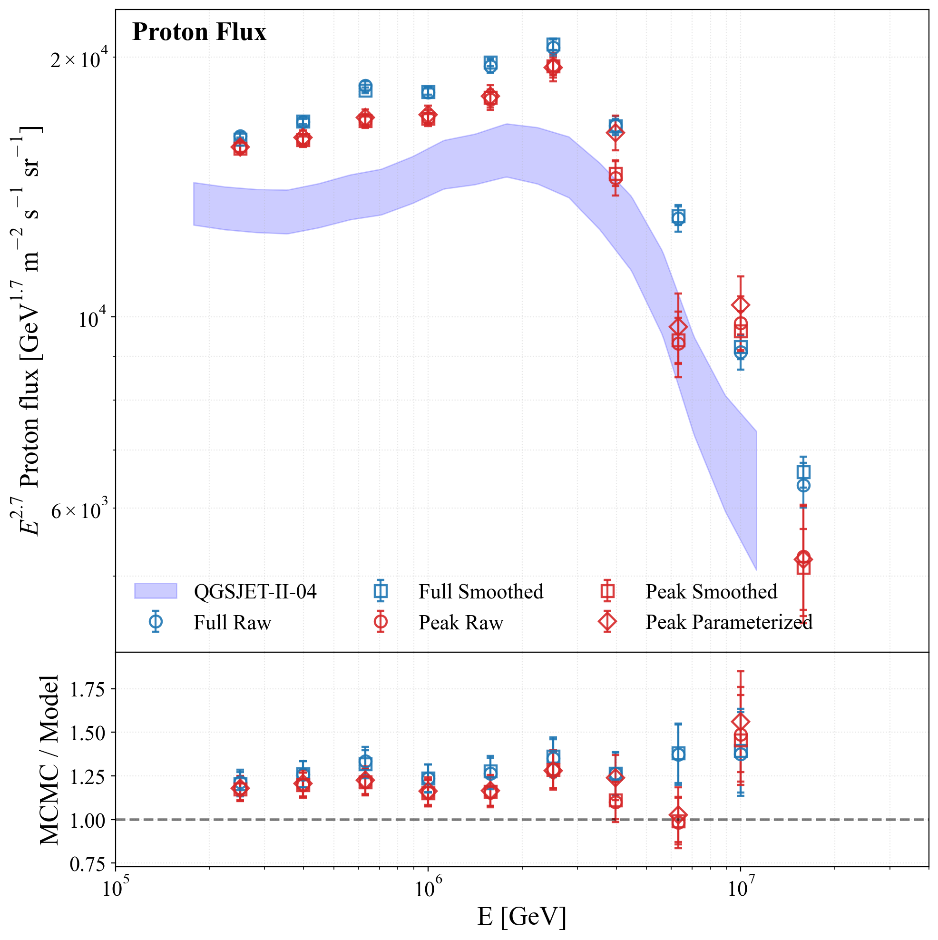
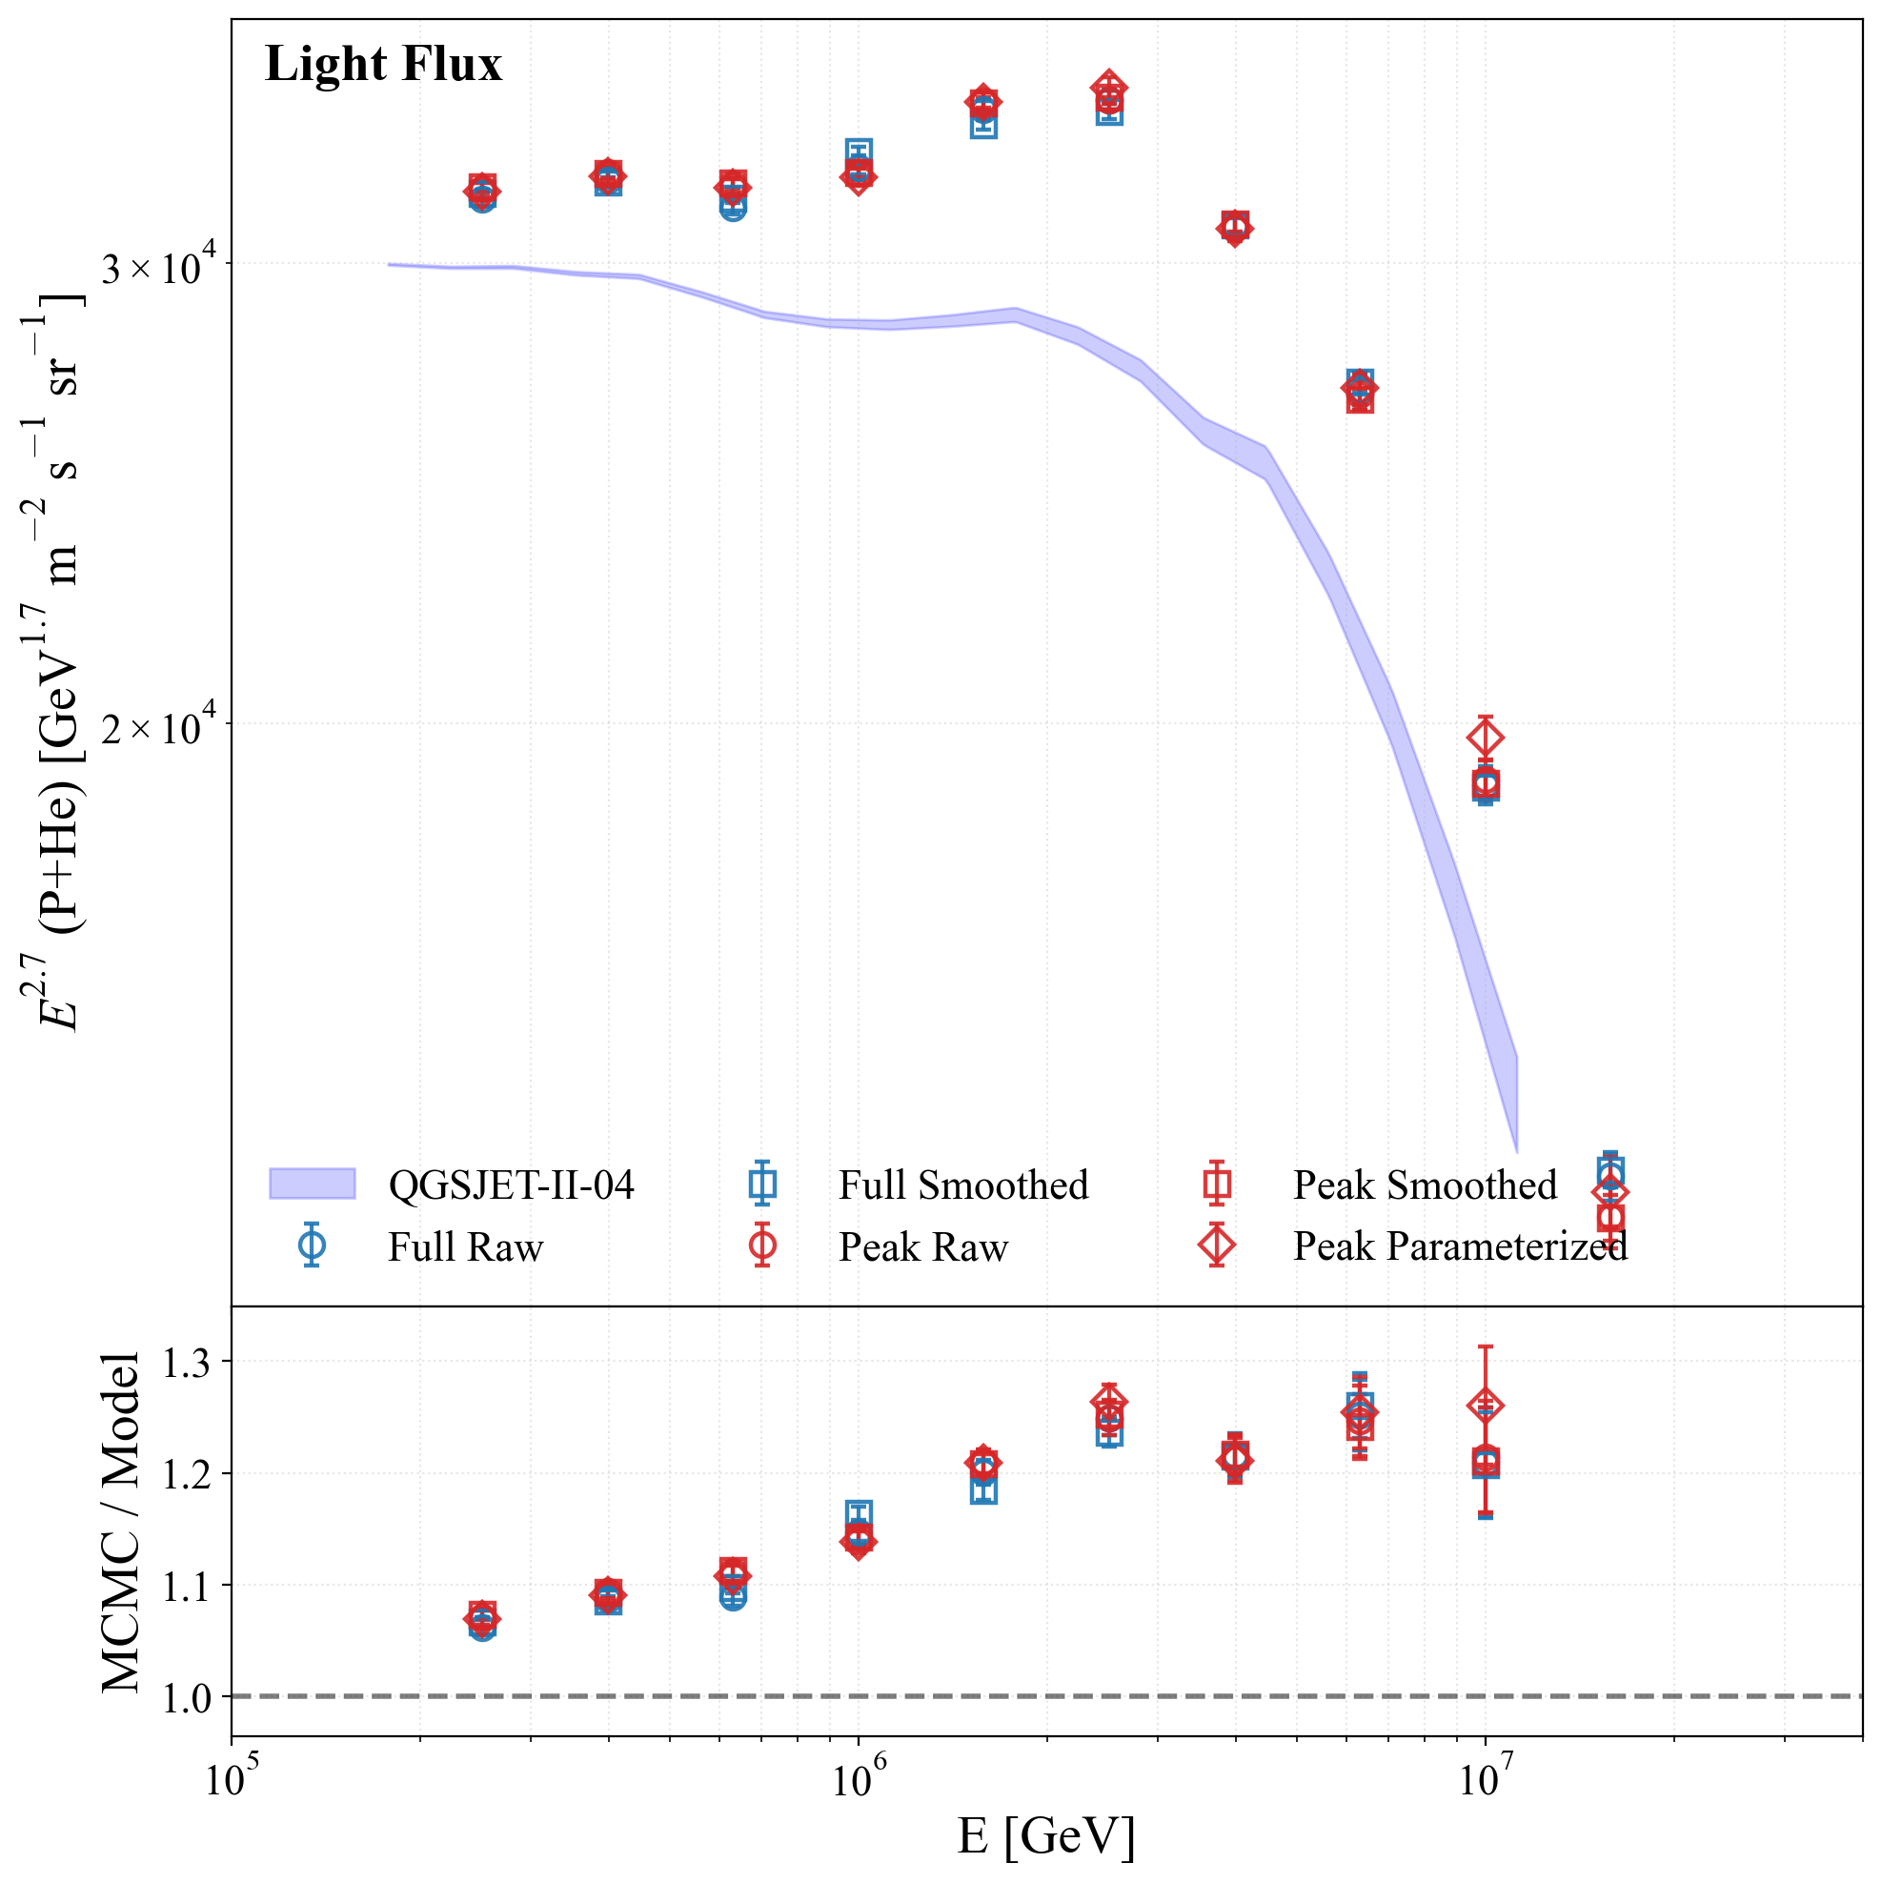
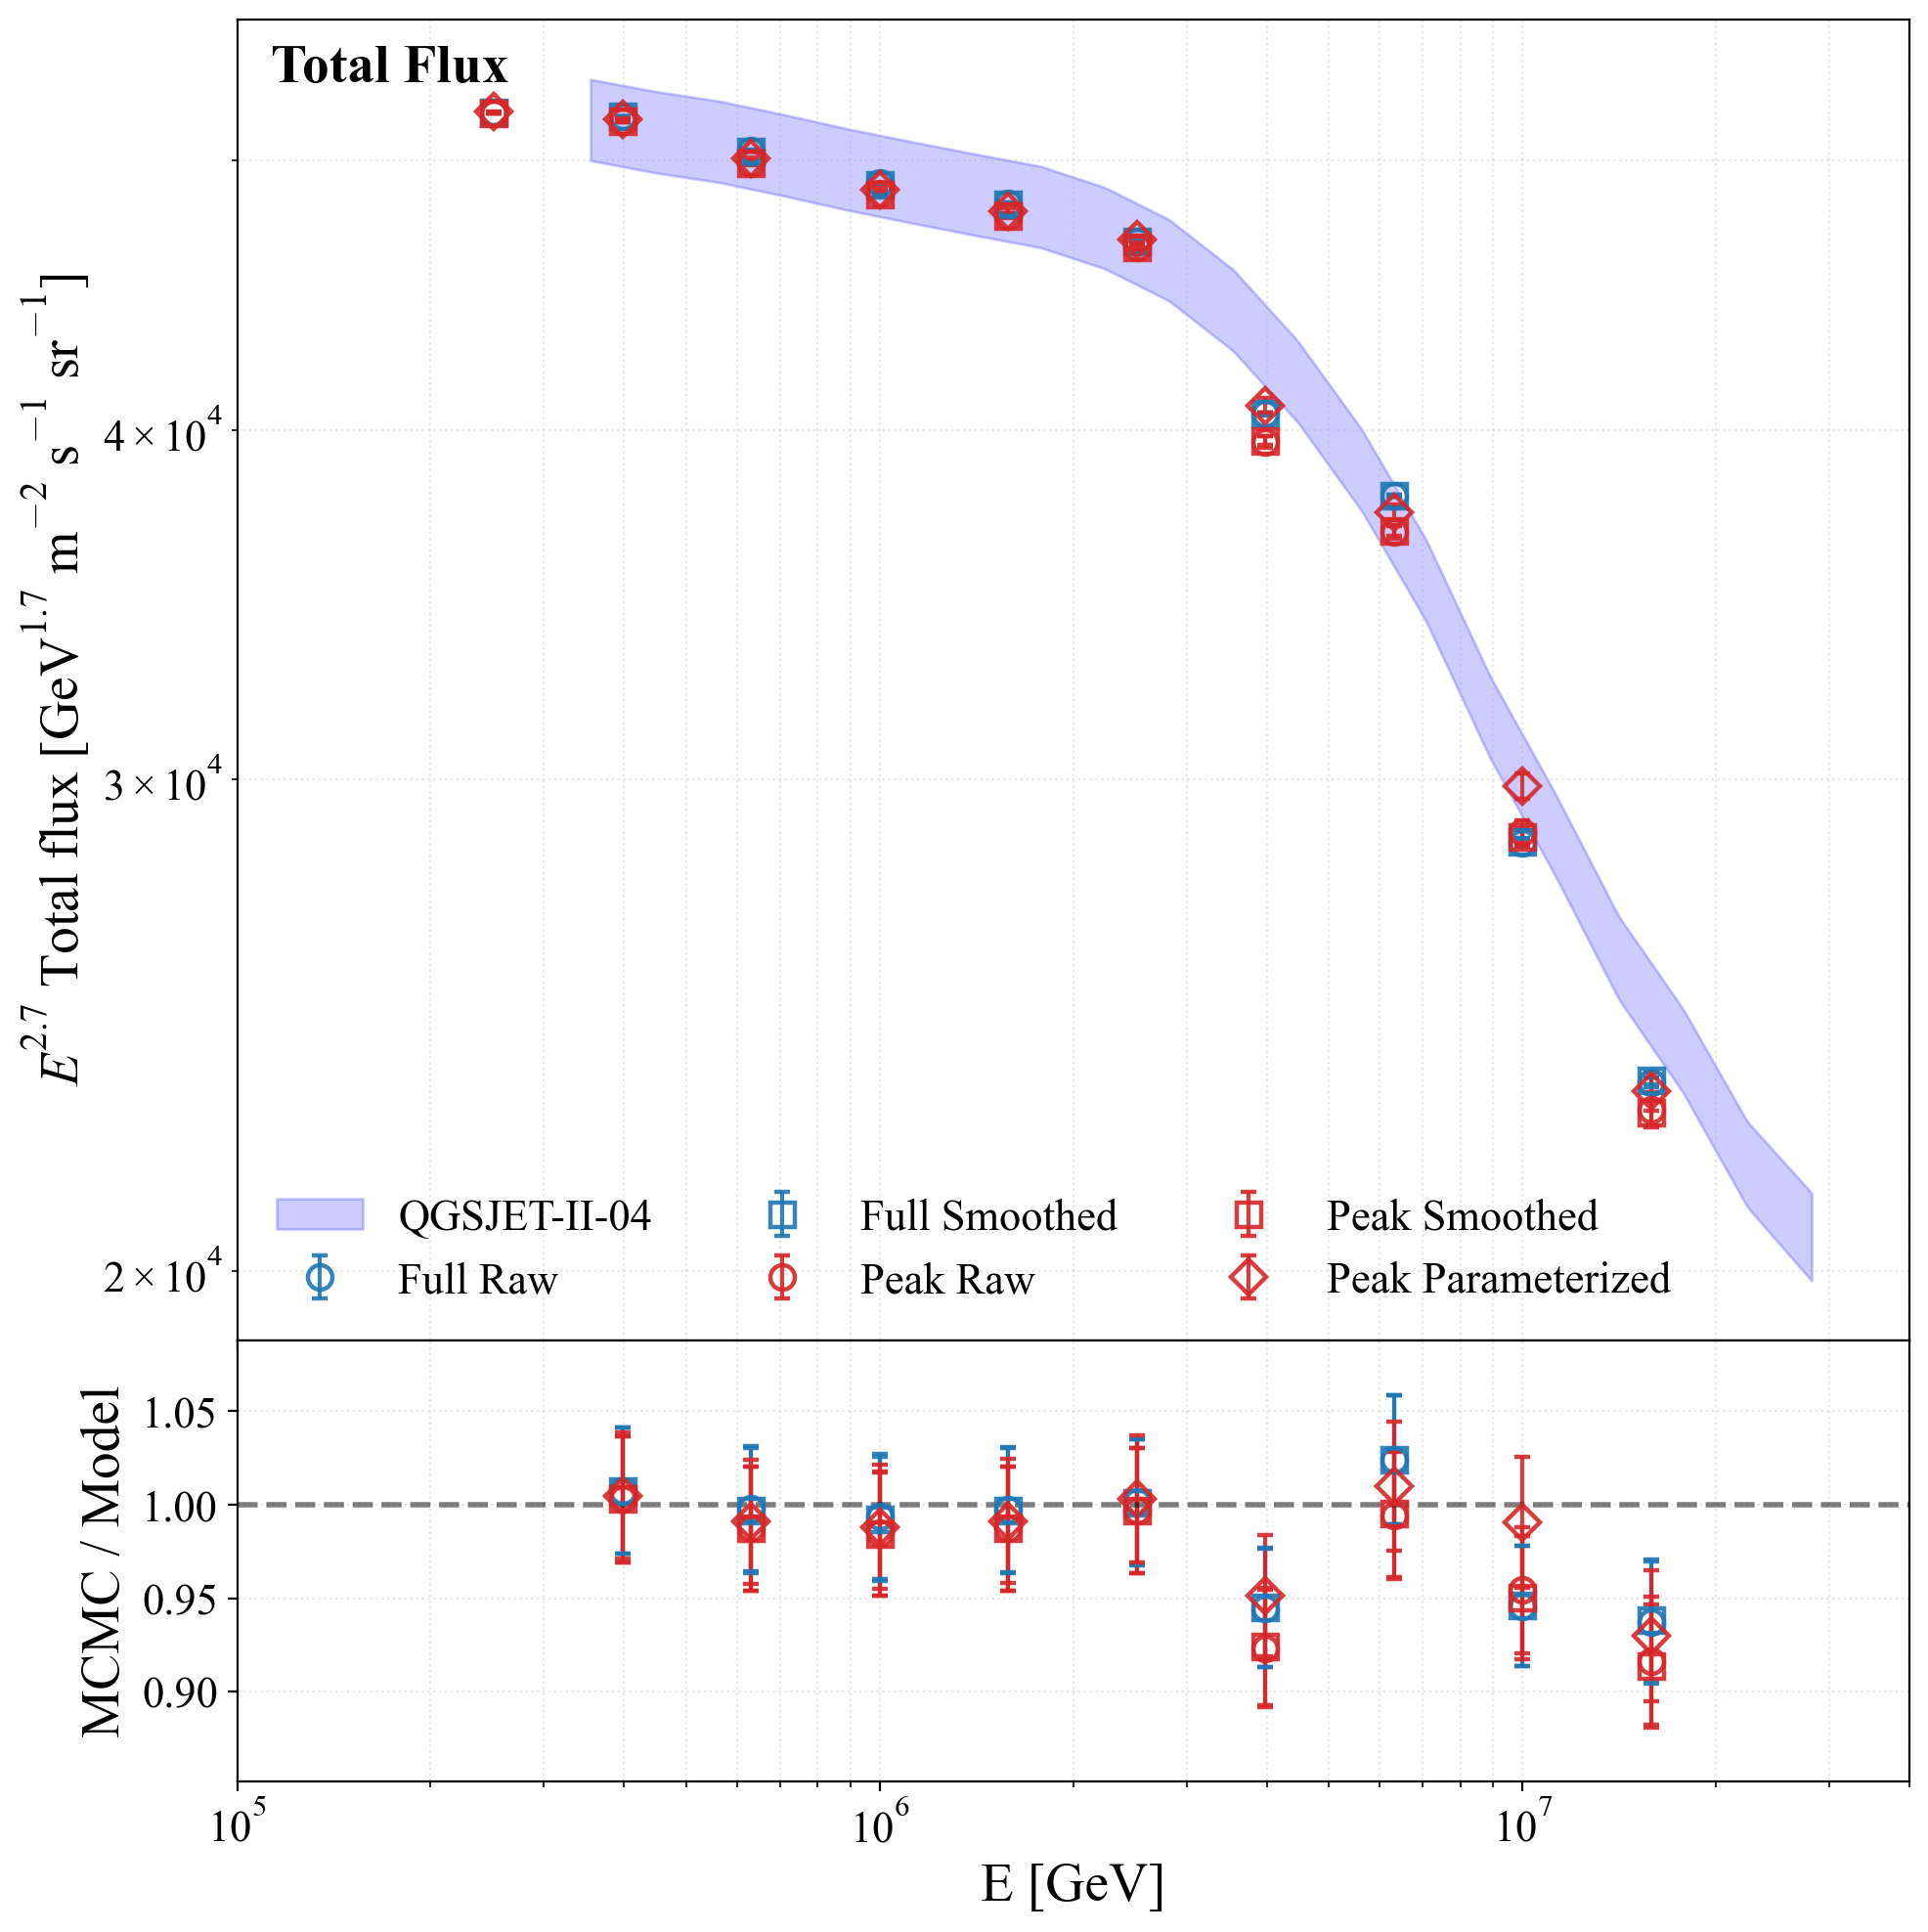
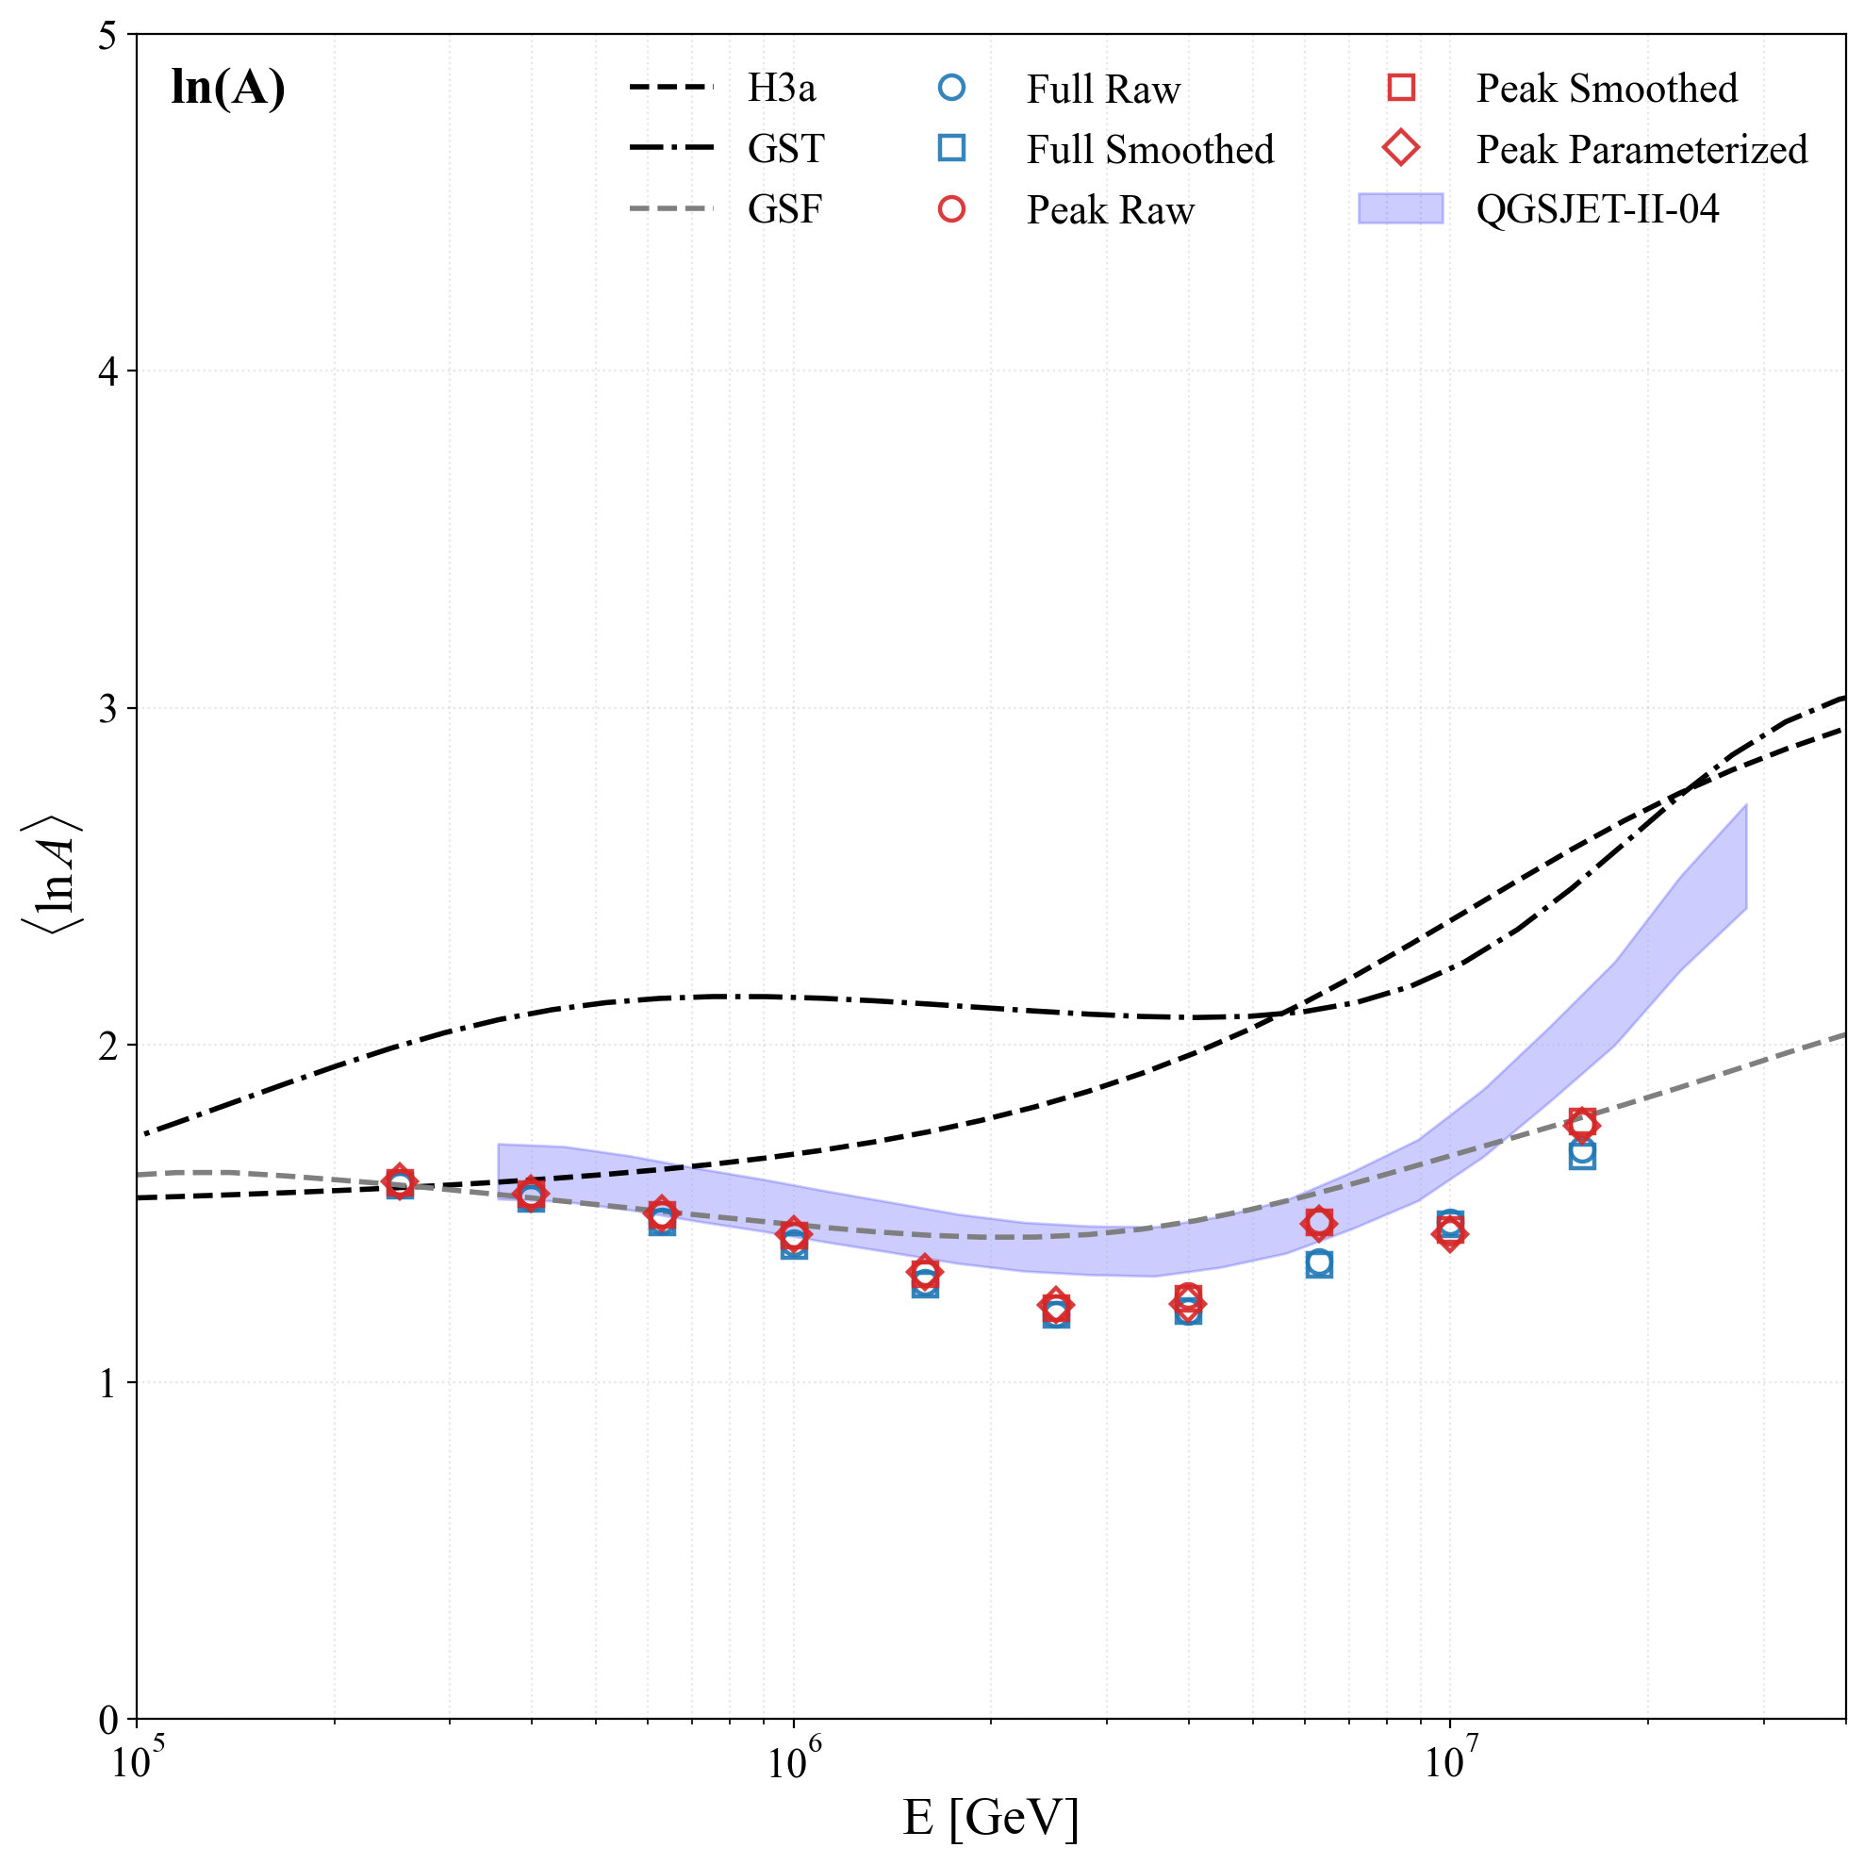
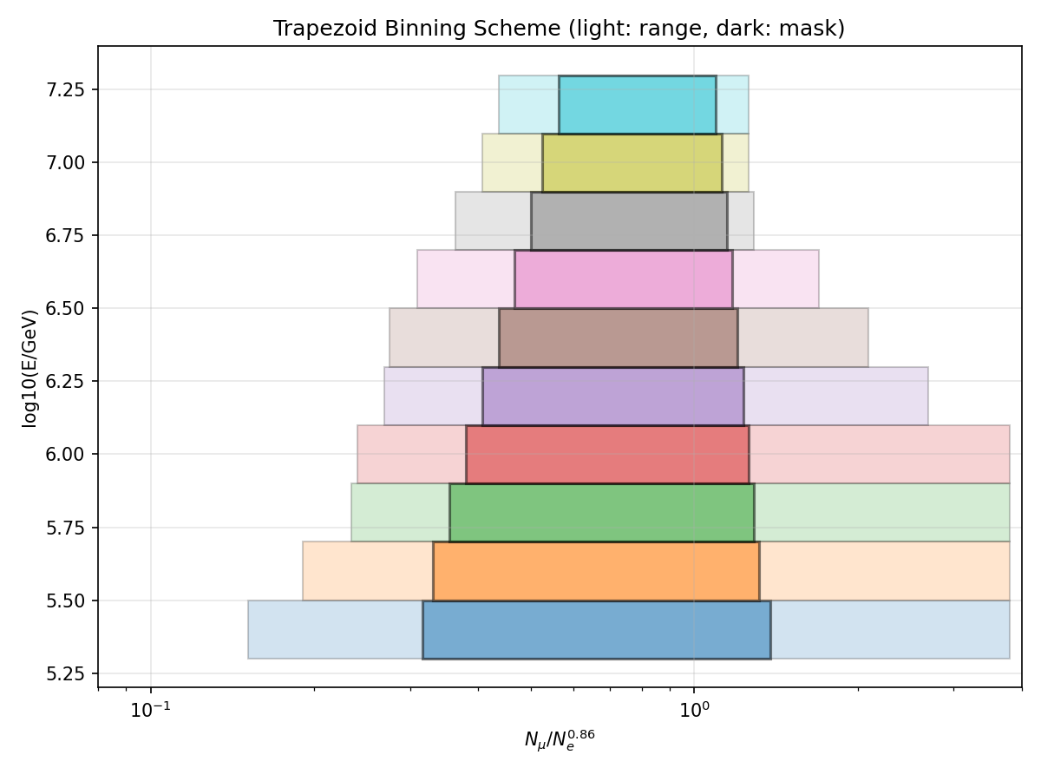
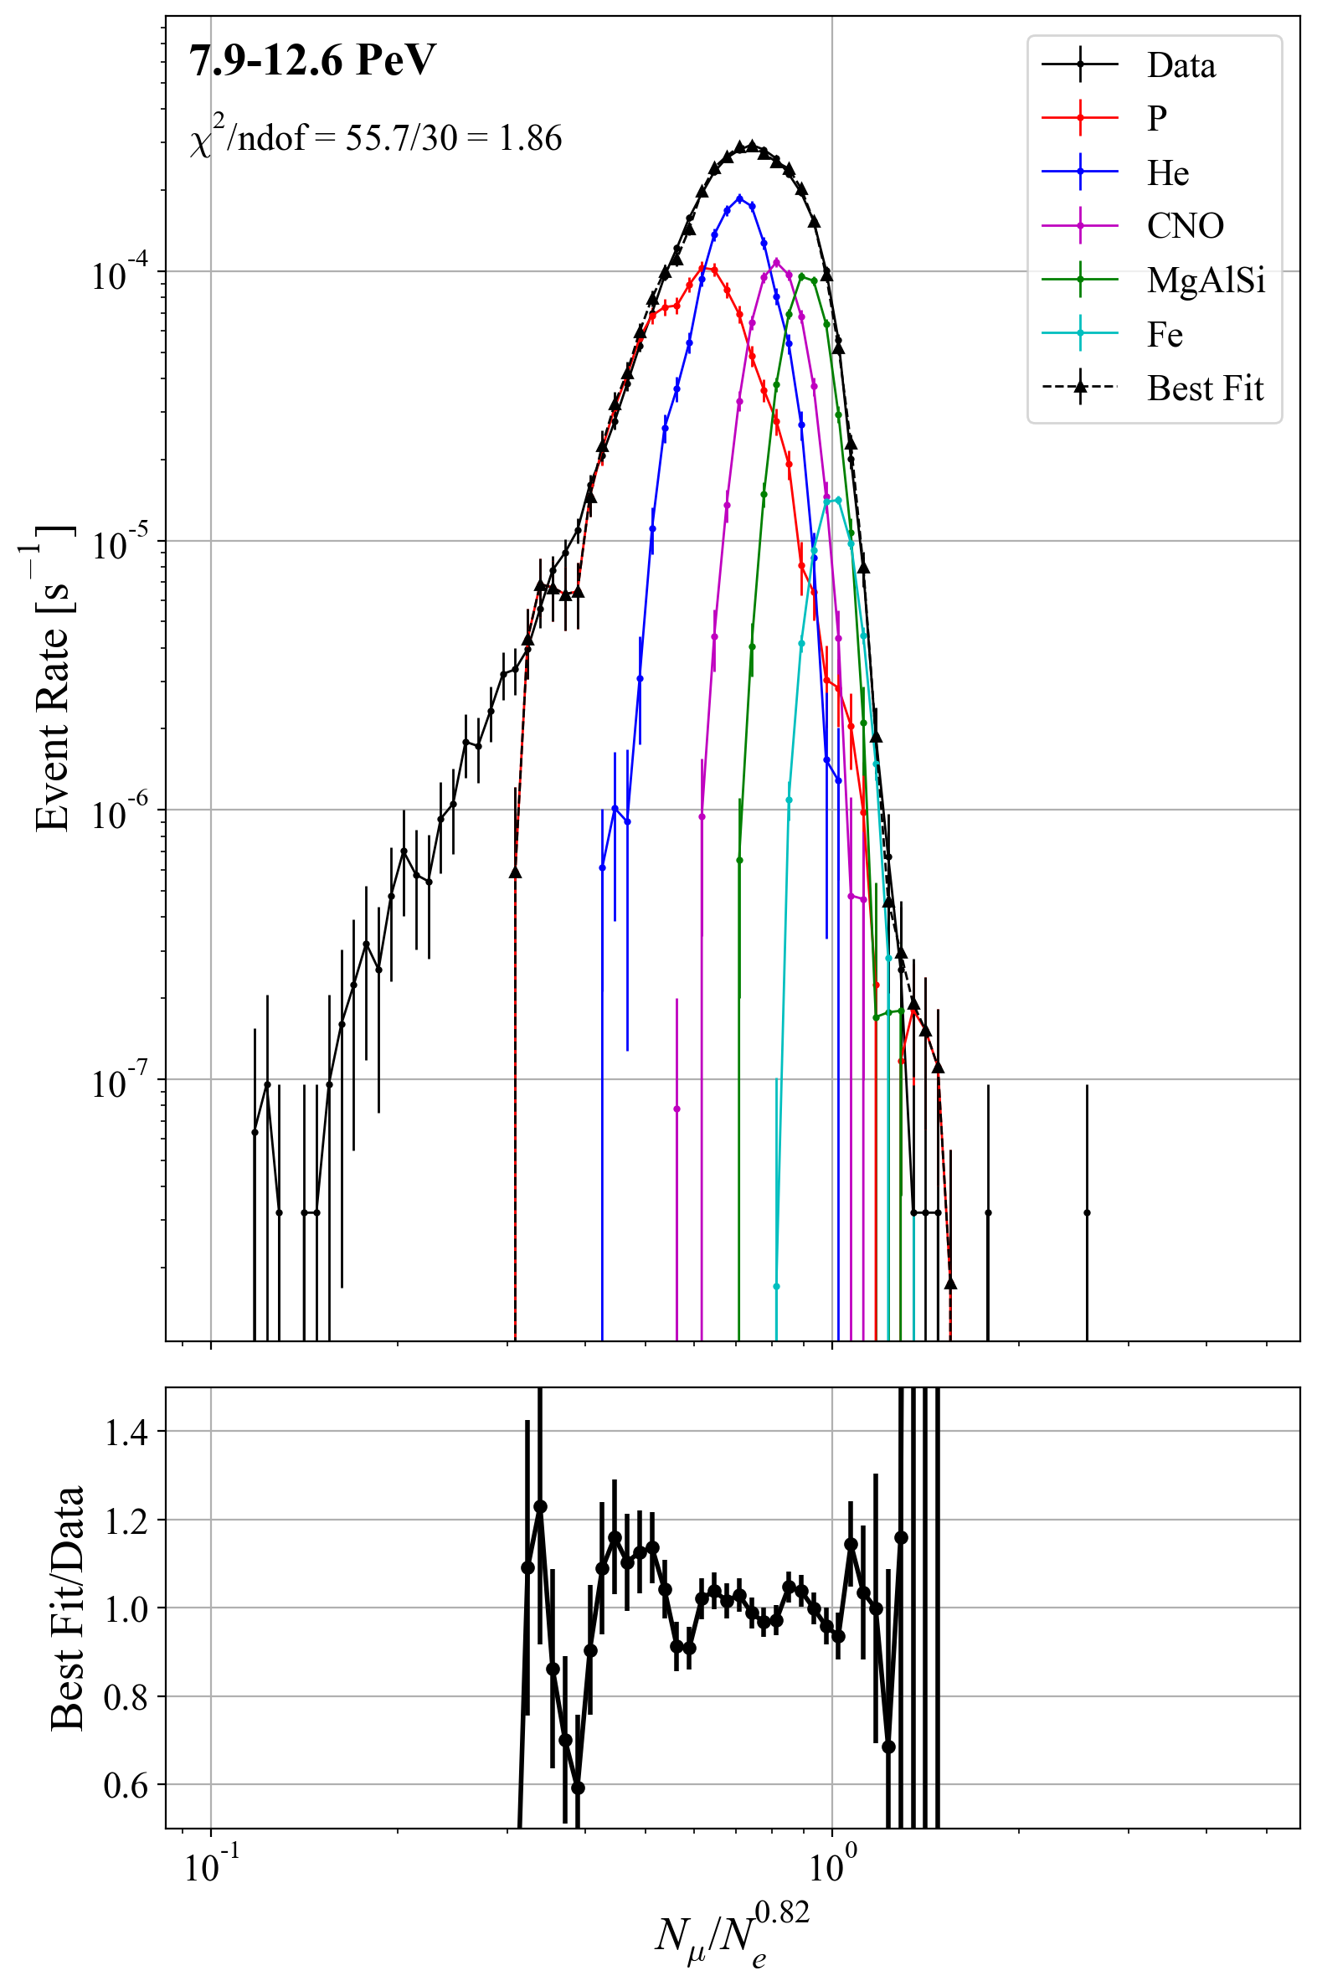
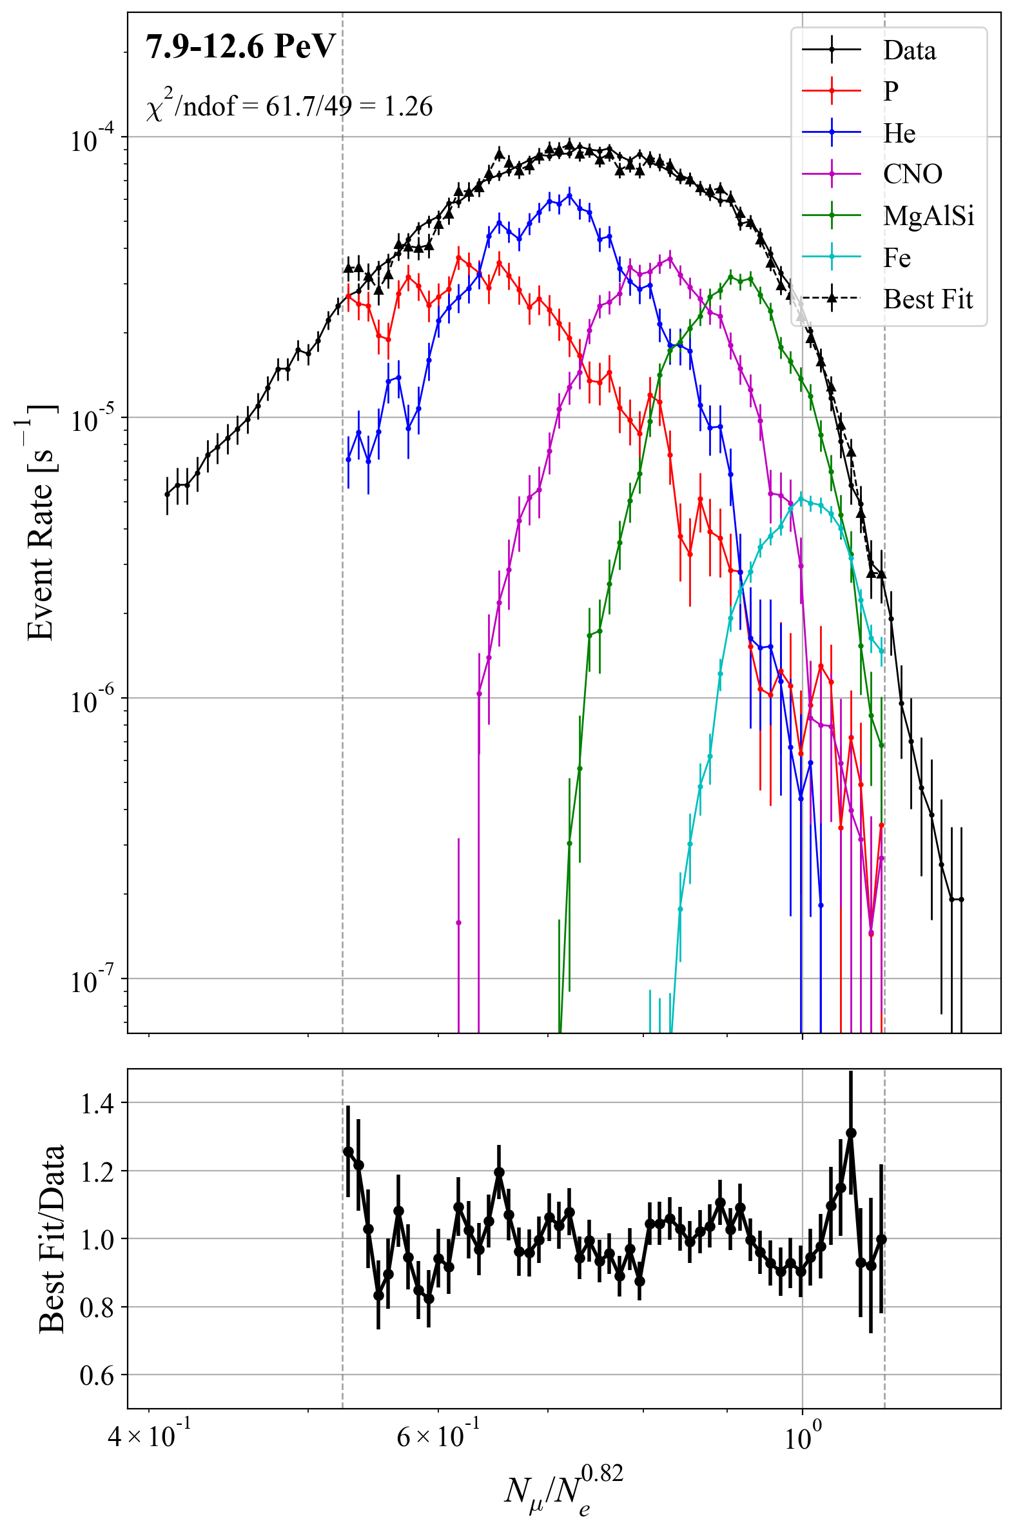
Composition Analysis of KM2A Data with QF&GSF Templates
Xiangting Liu,^{1,2} Xishui Tian,^{3,5} Quanbu Gou,¹ Zhuo Li^{3,4}
¹Institute of High Energy Physics, Chinese Academy of Sciences, 100049 Beijing, China
²University of Chinese Academy of Sciences, 100049 Beijing, China
³Department of Astronomy, School of Physics, Peking University, Beijing 100871, China
⁴Kavli Institute for Astronomy and Astrophysics, Peking University, Beijing 100871, China
⁵Purple Mountain Observatory, Chinese Academy of Sciences, Nanjing 210008, China
01 · Abstract
04 · Mock Validation: Method's Self-Response
MCMC template fits to the muon-to-EM ratio in KM2A reconstructed-energy bins recover the composition fractions per bin. With peak-region fitting plus smoothed / parameterized templates we suppress MC fluctuations. On data the all-particle spectrum is stable across pipelines, while composition observables depend more on template details — current results favor a lighter composition (enhanced proton / light) with total flux compatible with references.
Method chain: 5-component ratio templates → stick-breaking (4 free params → 5 fractions) → likelihood + emcee posterior → elemental energy spectra and ⟨ln A⟩.
Key questions:
Are the two pipelines self-consistent on data?
If the reconstruction compatible with the published LHAASO results?
Does trapezoidal binning preserve a workable high-energy analysis space?
Why Mock first
Under known H3a input we test the method's response — confirming the 4-parameter stick-breaking + template pipeline recovers each component's main structure.
Validation
Total flux and main component structures are recovered.
Mock is methodological context, not a data substitute; differences in the main results reflect genuine method differences, not instability.
Fig 6 Mock input QF / H3a · Trap Param
05 · Main Results: Spectra / ⟨ln A⟩ vs LHAASO Pub
02 · Template Treatment Upgrades
Fig 7 A · Proton flux
Fig 8 B · Light flux
Fig 9 C · Total flux
Fig 10 D · ⟨ln A⟩
Fig 1 Savitzky–Golay smoothing
Fig 2 Two-sided Crystal Ball parameterization
Switching binning from rectangular to trapezoidal (Fig 3) enables refined full-energy template treatment: peak-region masked Savitzky–Golay smoothing (Fig 1) and two-sided Crystal Ball parameterization (Fig 2).
The legacy rectangular scheme cannot support parameterization (high-energy bins too tight); smoothing-only is kept as a reference pipeline.
Fig 3 Trapezoidal binning grid
Legend:
Blue / Red — rectangular / trapezoidal pipelines;
blue band — LHAASO Published QGSJET-II-04 result.
A Proton & B Light: overall elevated;
C Total agrees with the Published result, with high-energy fluctuations.
D ⟨ln A⟩: slightly lower, consistent with the light-leaning composition.
Discrepancy comes from composition splitting, not total-flux distortion; ⟨ln A⟩ correspondingly reduced.
03 · MCMC Fit Example: High-Energy Bin
06 · Summary & Outlook
Feasibility: template-based composition reconstruction with KM2A is shown feasible around the knee. MC closure is acceptable and weakly model-sensitive; on data the all-particle spectrum is pipeline-stable while composition observables depend more on template details and fit configuration.
Current results: light composition exceed LHAASO Pub by ~20 % overall, ⟨ln A⟩ correspondingly reduced; total flux compatible with references — discrepancy stems from composition splitting, not normalization.
Next steps: investigate the discrepancy.
Template construction: different cuts / different energy reconstruction methods and different separation variable;
Template-model dependence: extend QF / GSF baseline to EF / H3a / PG combinations for cross-validation;
Fit configuration: vary peak-mask and fit interval, or try the 1-amplitude + 4-ratio formulation.
Fig 4 Rectangular Smoothed · Data · bin 8
Fig 5 Trapezoidal Smoothed · Data · bin 8
At 7.9–12.6 PeV the original binning is too tight for smoothing or parameterization; trapezoidal binning restores template treatment.
Conclusion: trapezoidal binning becomes the main parameterization interval, keeping high-energy curves comparable to the rest.

