Slide 1
LHAASO Data Monitor and Quality Check
Cong Li, Sha Wu,Songzhan Chen,Min Zha,Liqiao Yin
Institue of High Energy Physcis(IHEP)

Slide 2
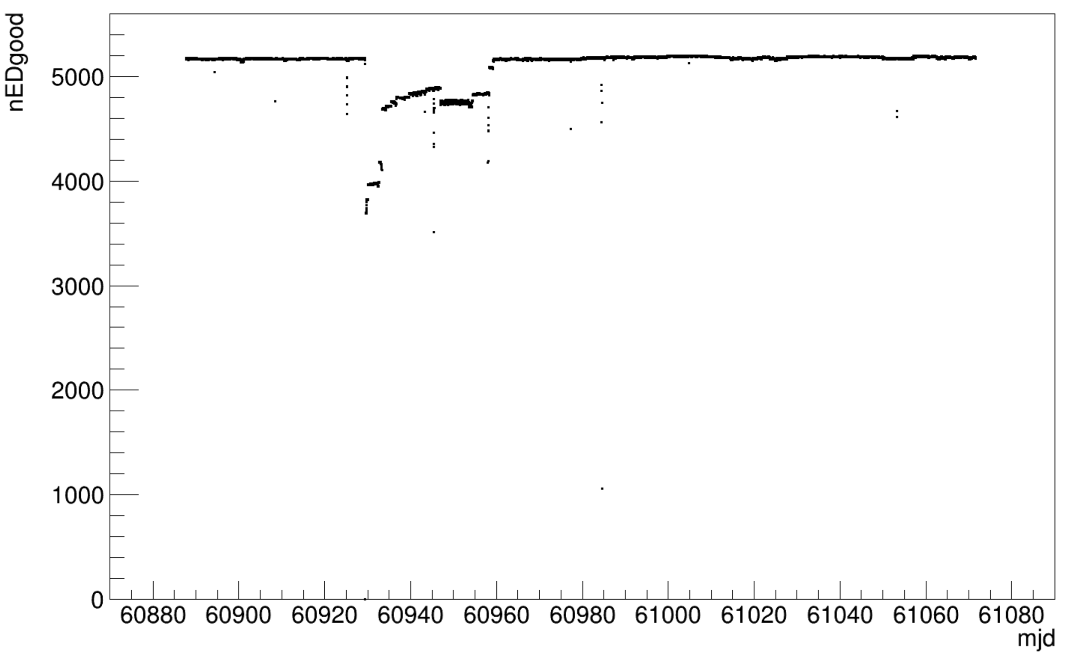
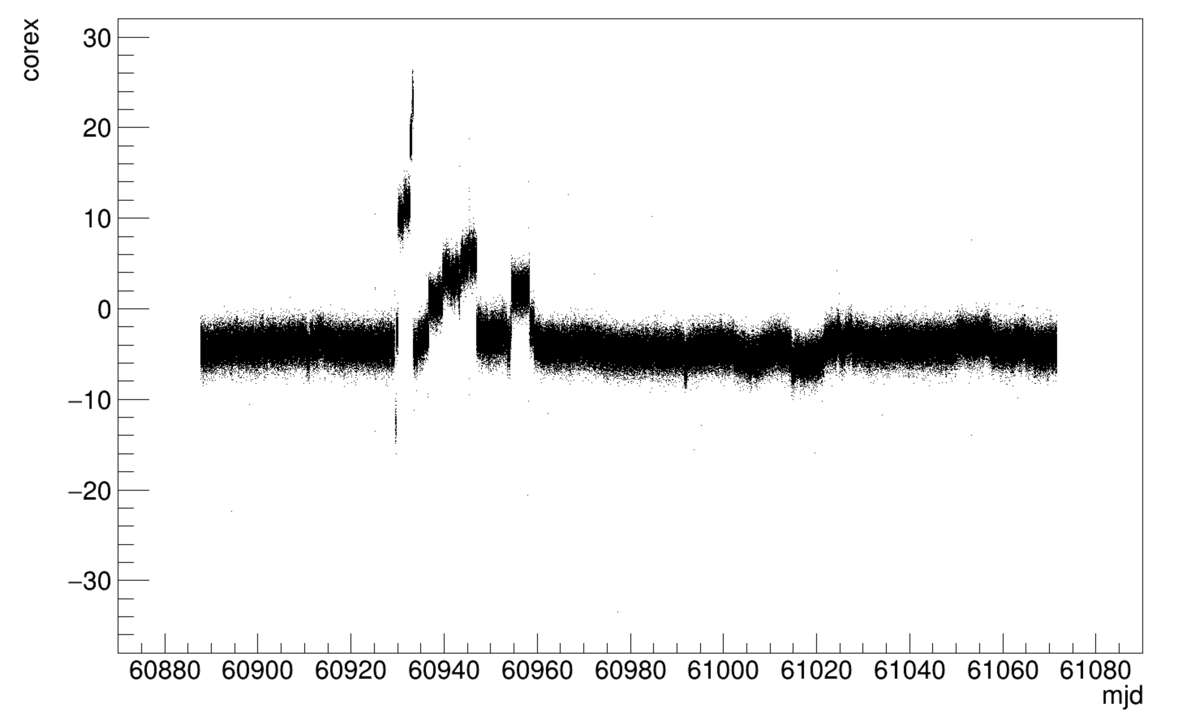
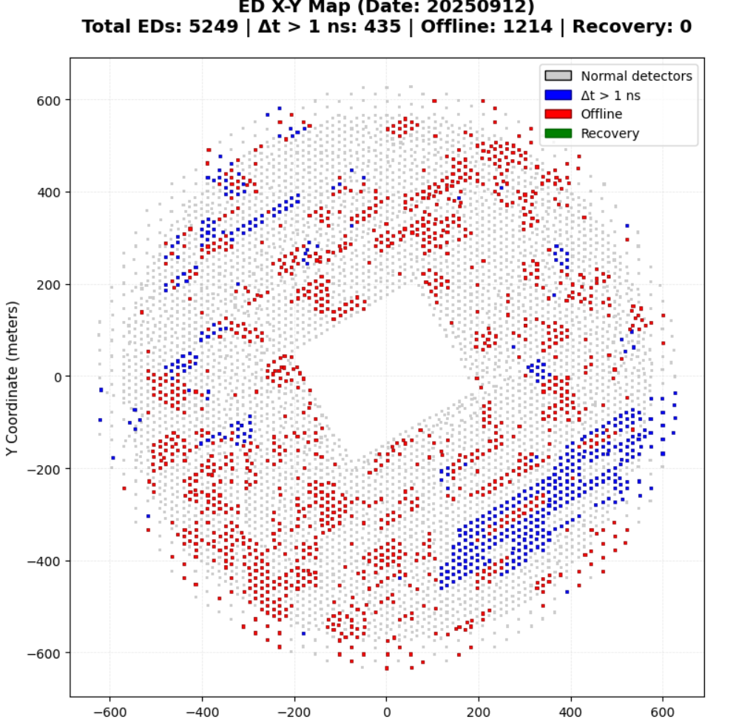
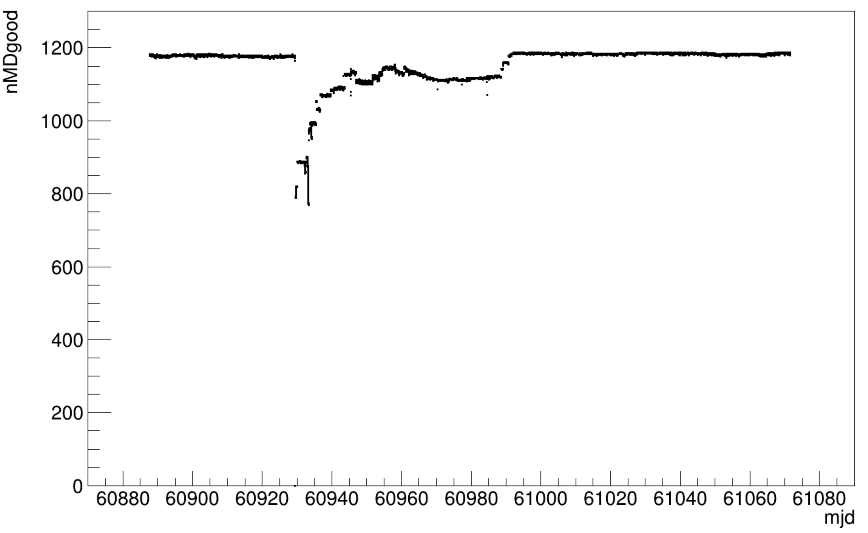
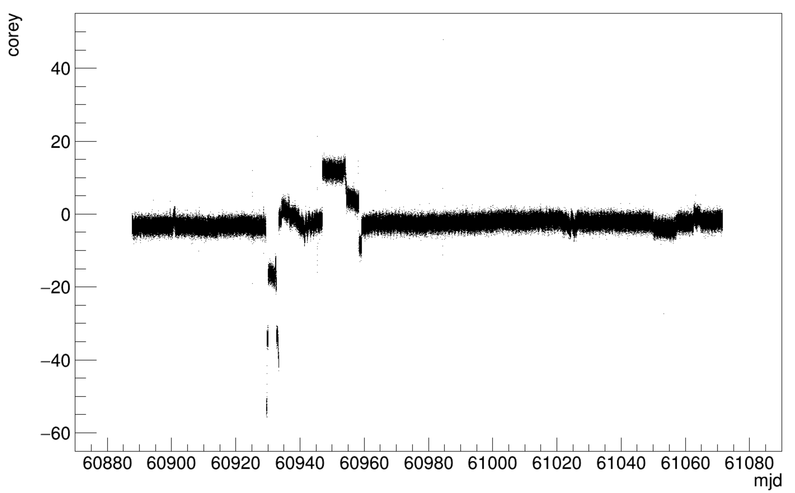
Serious damage from huge lighting(KM2A)
On September 12, 2025, the KM2A was attacked by a huge lightning:
> 1000 ED and > 400 MD units went offline.
From ED group

Slide 3
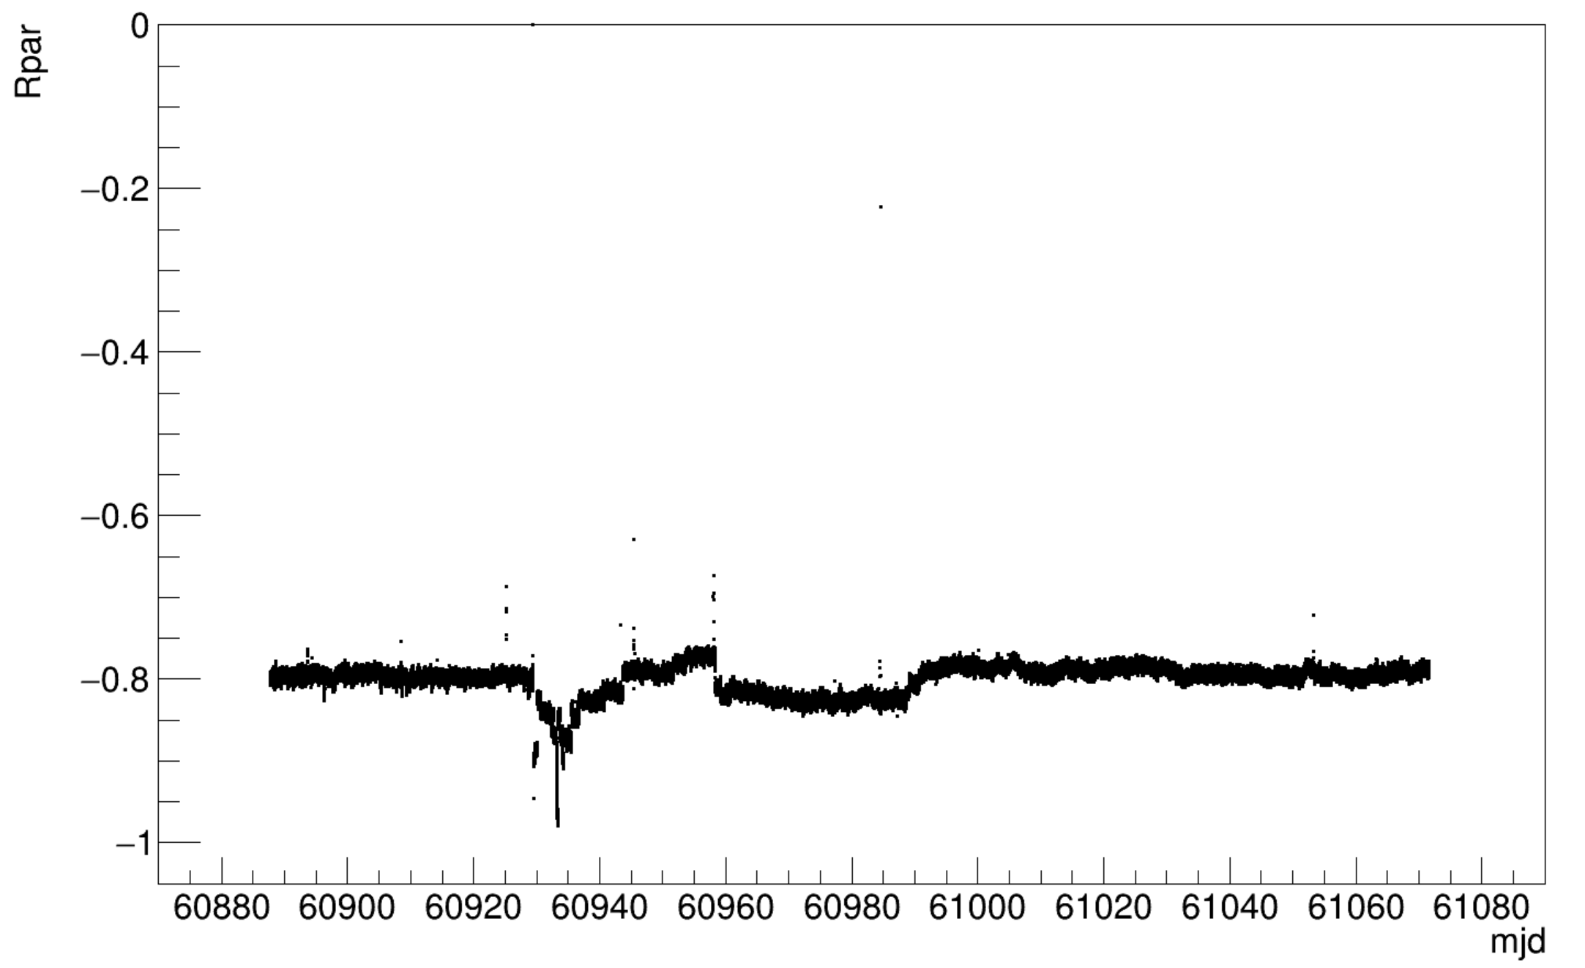
More time need for MD array
Up to 2025.10.11, the ED array was recovered.
2025.9.12-2025.11.10: the number of MD <1128 (95% requirement); The mean value of the discrimination parameter Rpar (g/P) falls below the normal value.
9.12-10.11
10.12-11.10
9.12-10.11
10.12-11.10

Slide 4
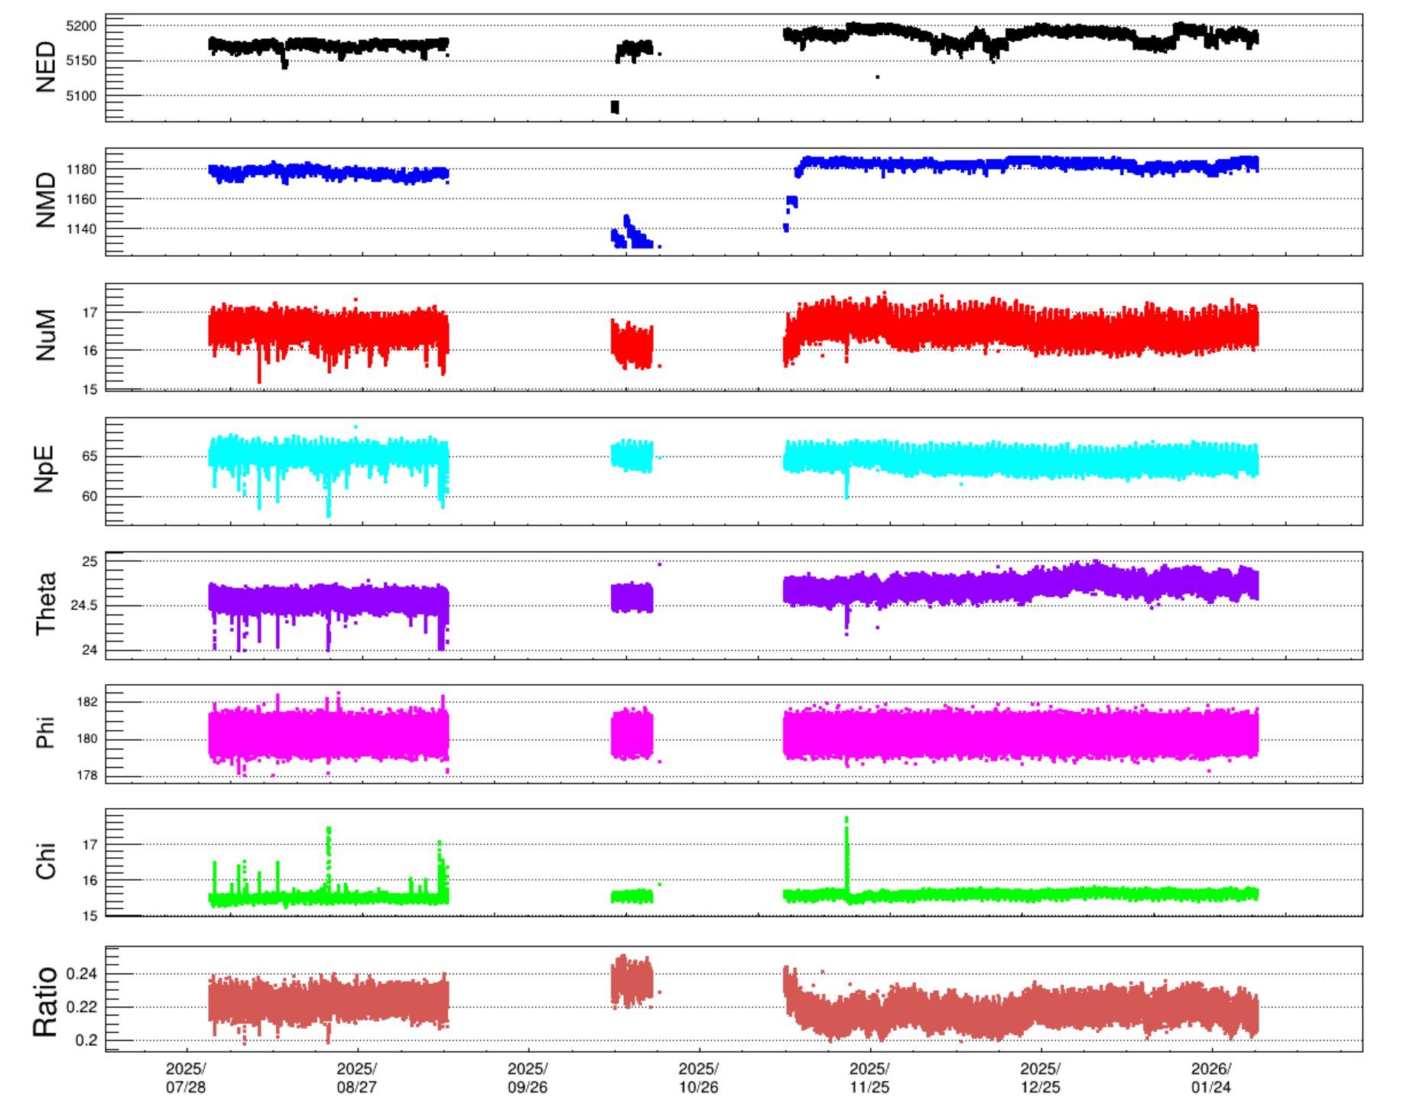
Long-term Monitoring of the KM2A Data
Criteria
1. ED>4955, MD>1128（0.95）
2. 50≤NpE≤70, 14≤NuM≤18
3. 24≤Theta≤25.5， 178≤Phi≤182.5
4. 0.197≤ratio≤0.26
5. NhitM
Only six days of data (October 11–16) passed citeria from the period September 12 to November 10.

Slide 5
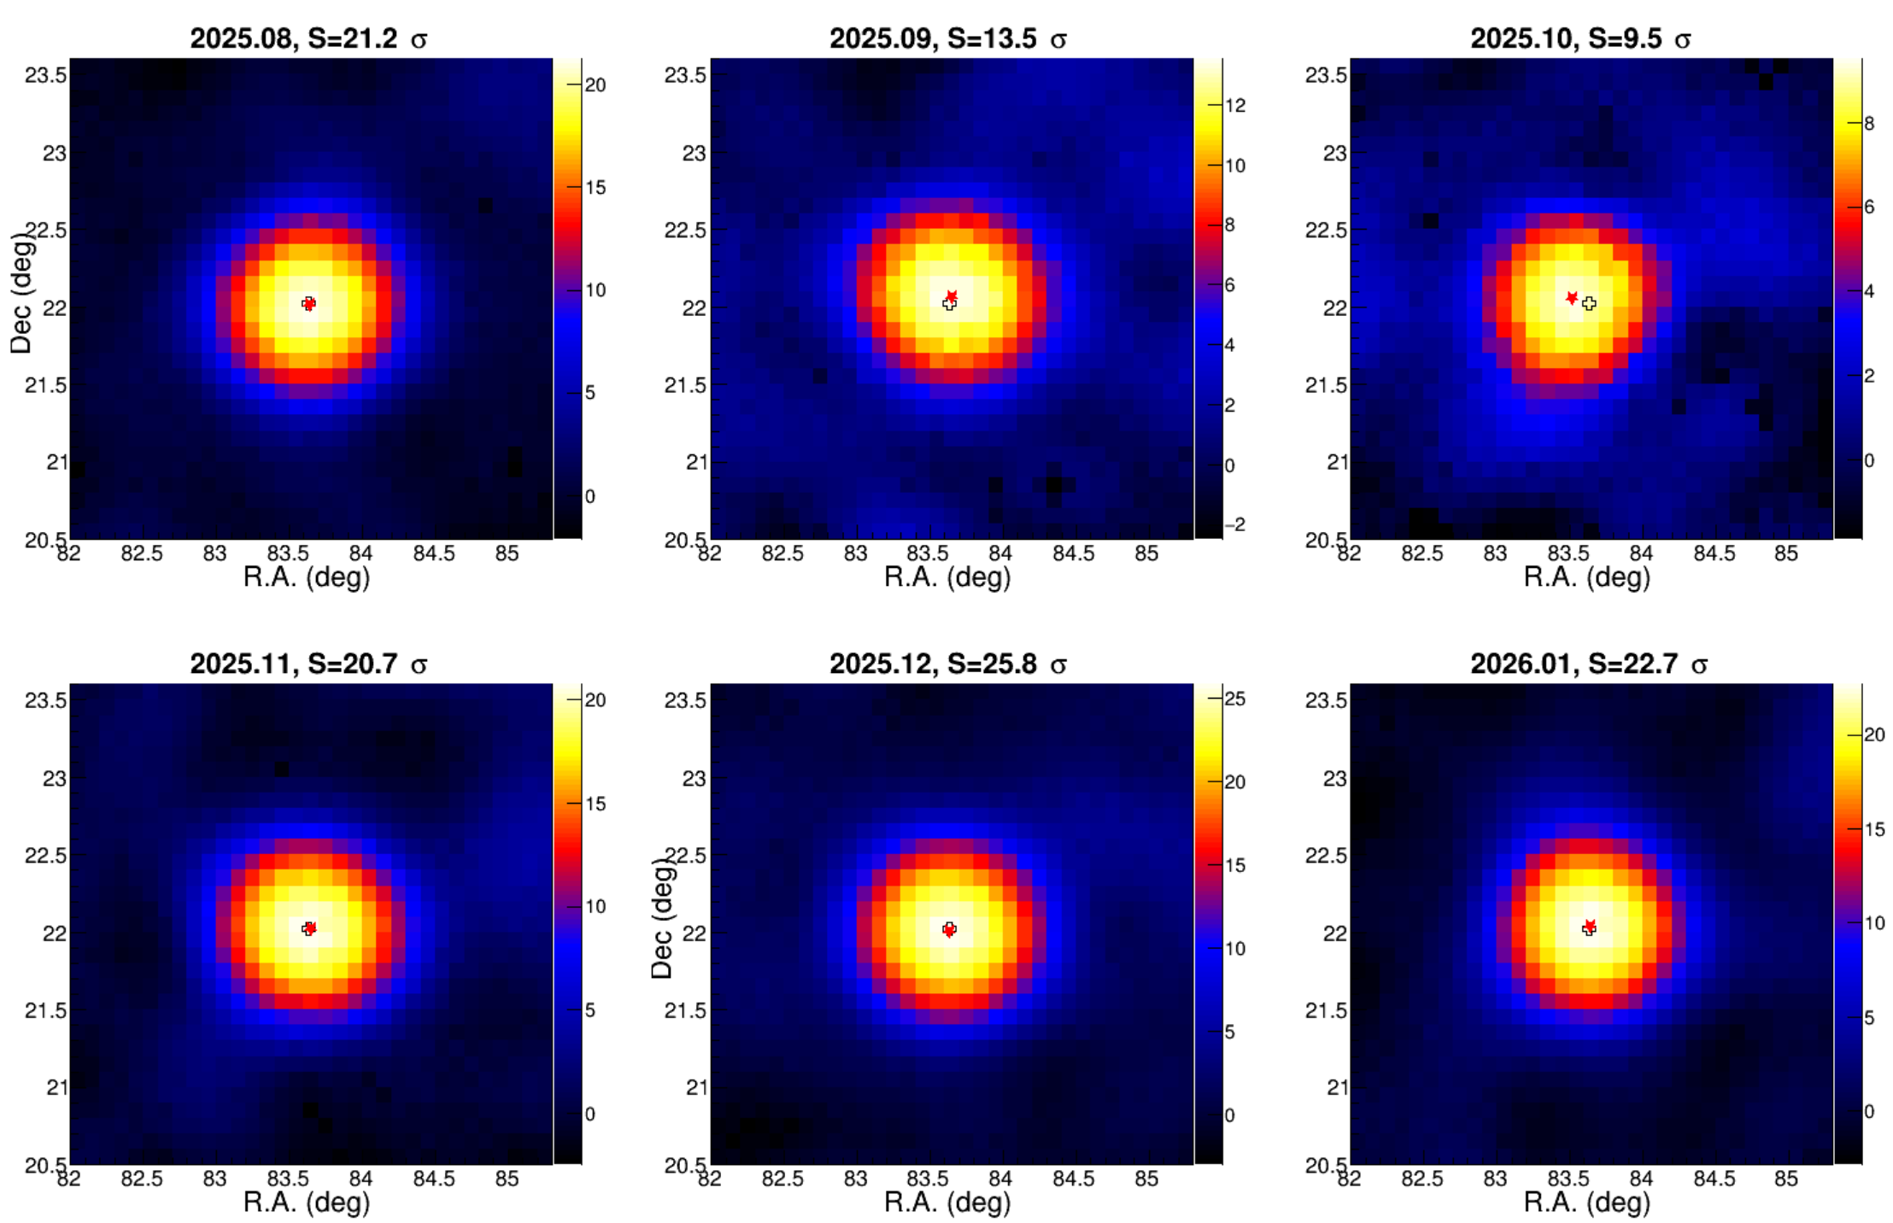
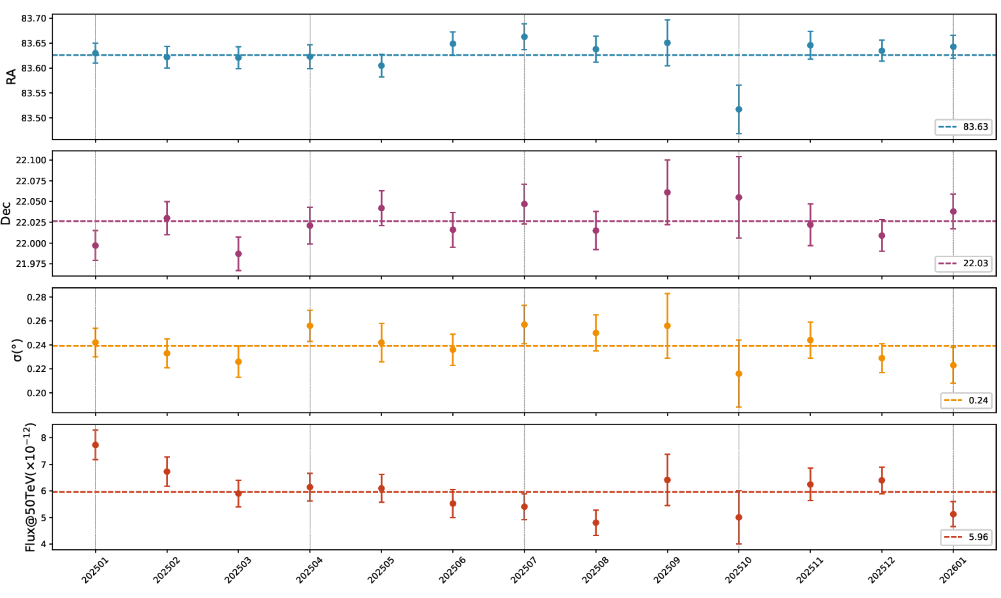
Monitering with Crab
The position, extension and flux of Crab is stable with time after data selection.

Slide 6
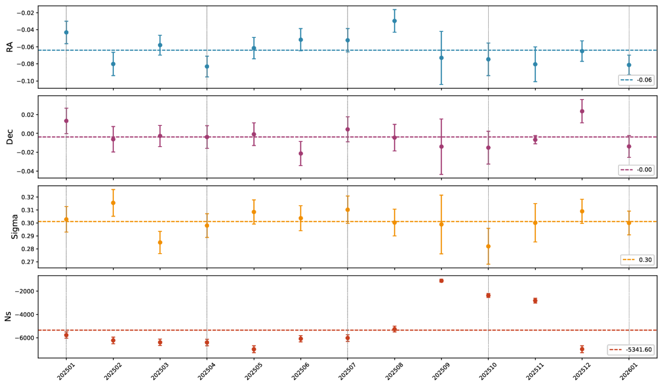
Monitoring with Moon Shadow
No.of missed events decreased significantly from September to November.

Slide 7
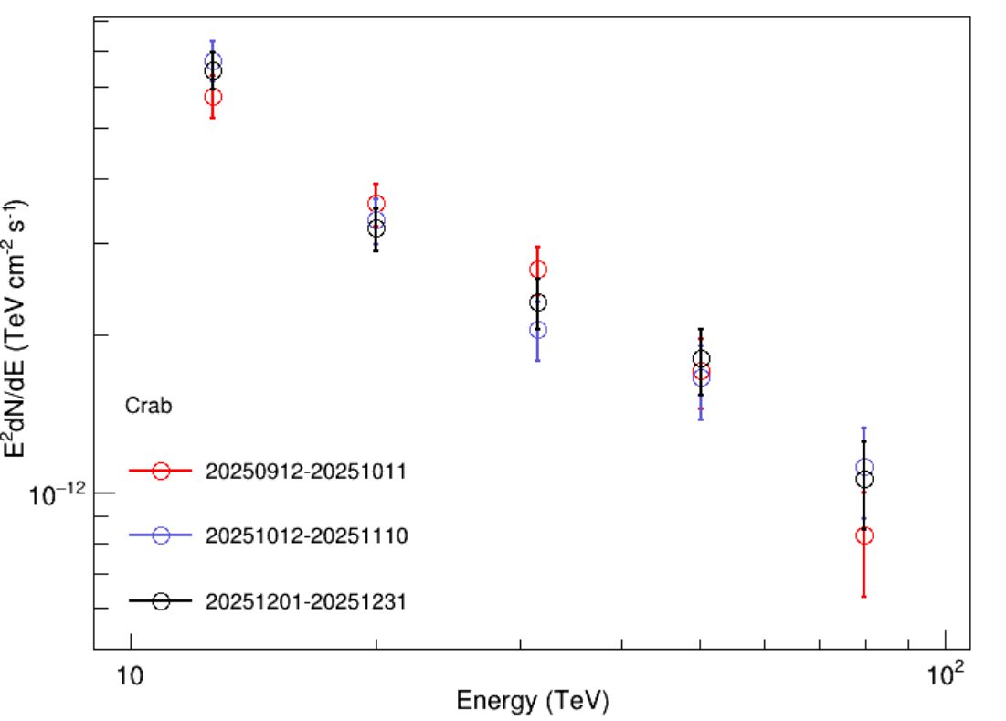
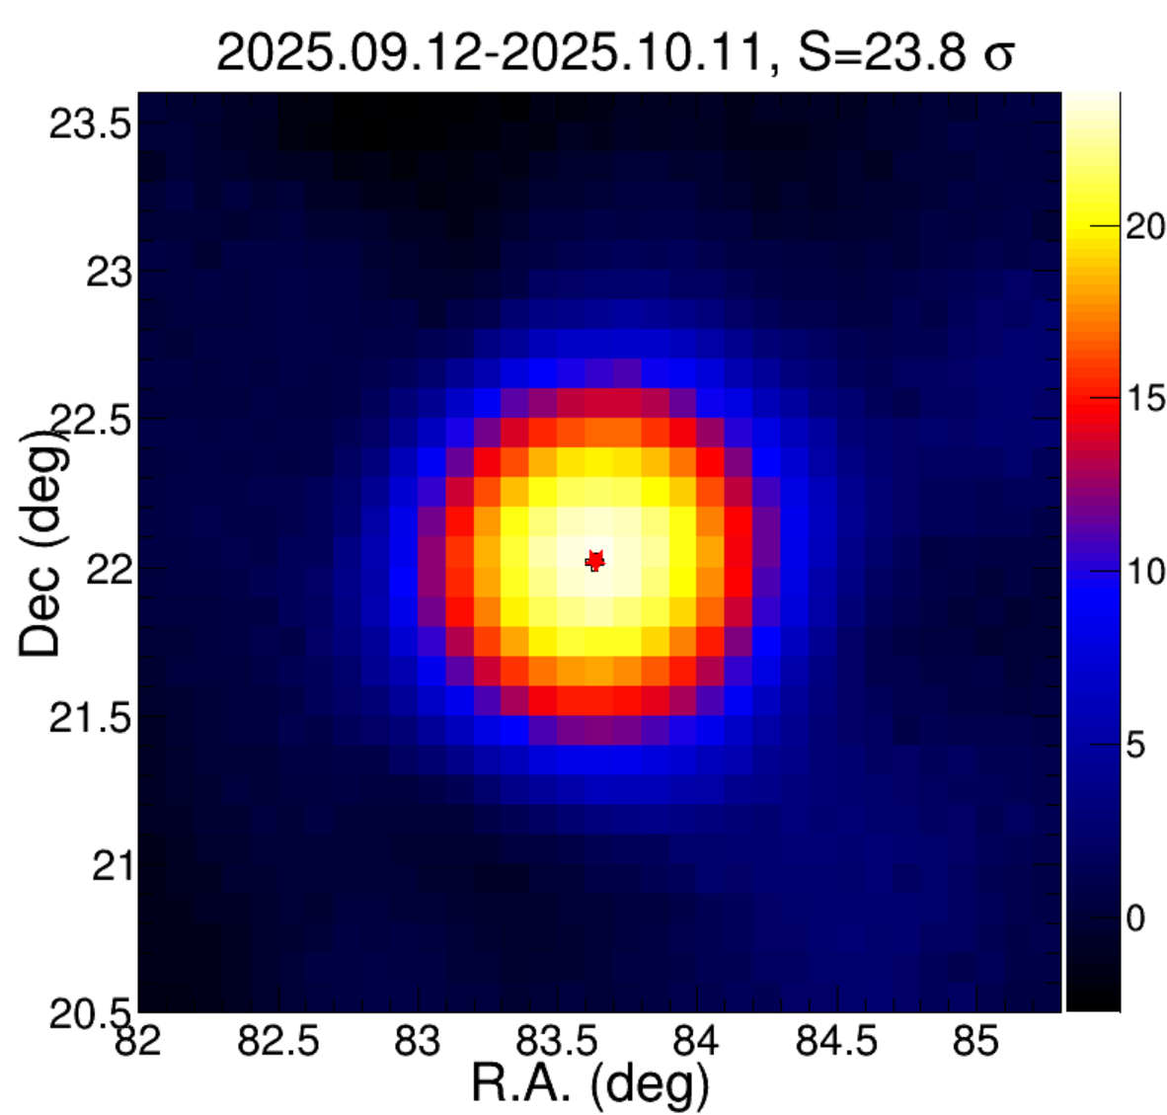
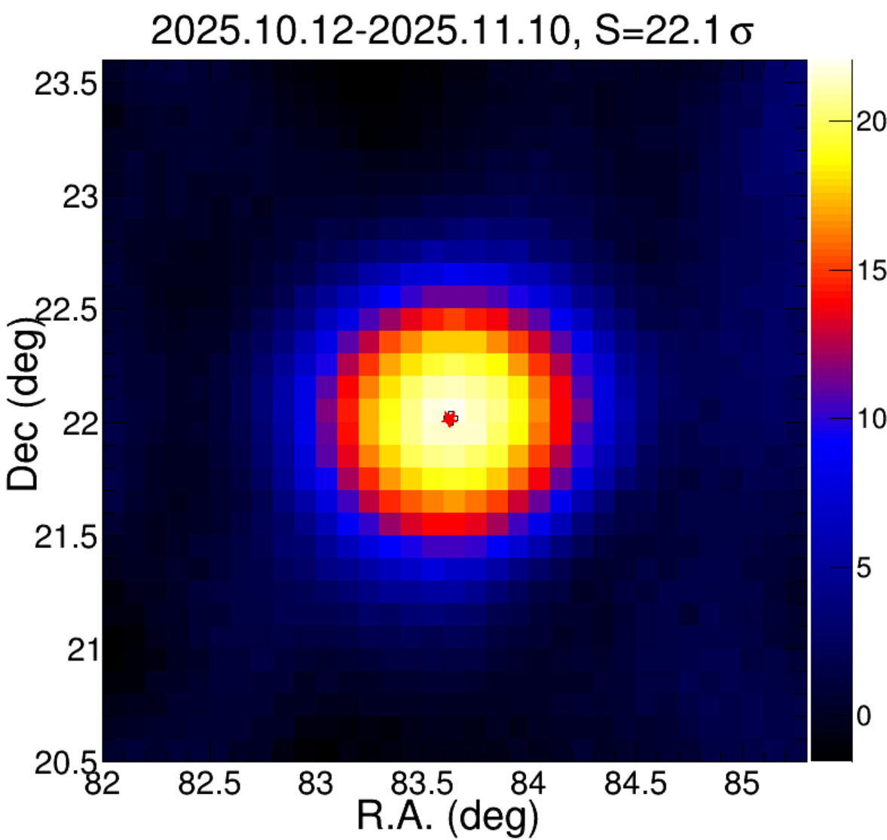
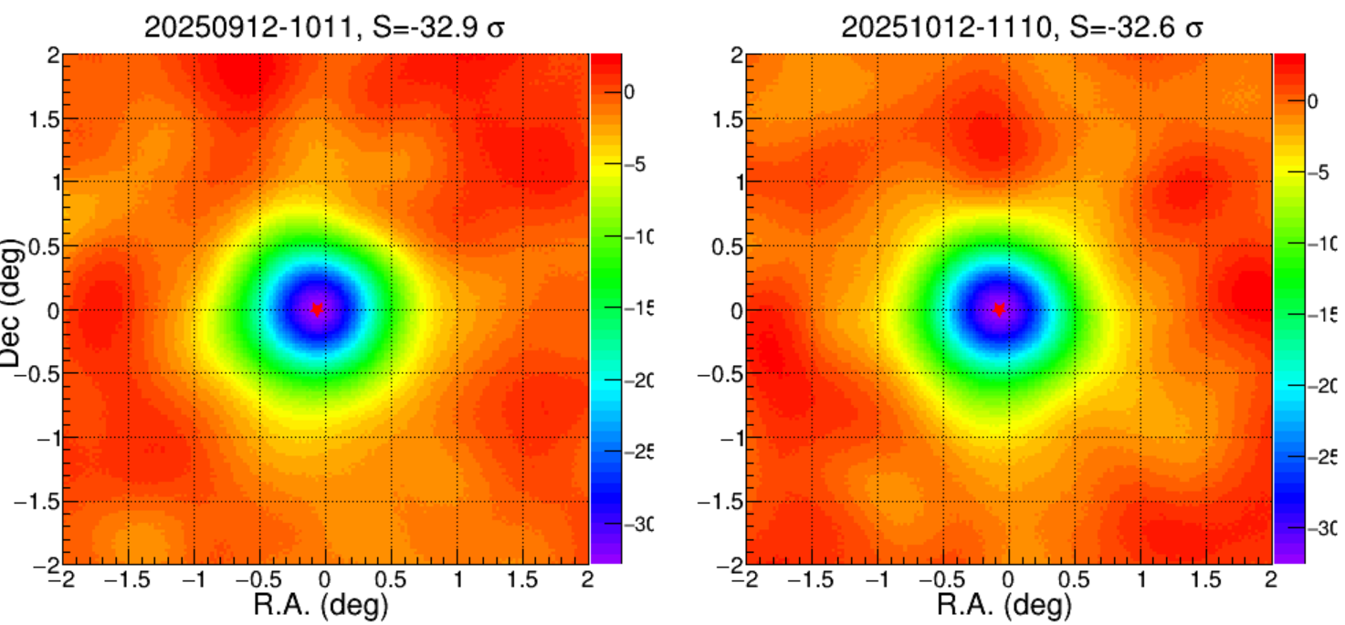
Further check for the Anomalous Periods data
If we loose criteria (ED>4694, MD>1069,90% of total Detectors), there is also no bias for position and flux.

Slide 8
Summary
Using previous criteria, The data before 2026-01-31 are published: /lhaasofs/user/lhaasorec/publish/km2arecfilelist/year
Anomalies are seen in the mean of the core (2025.9.12–2025.10.11) and the Rpar (2025.9.12–2025.11.10). However, no significant positional shifts are observed in the analysis of the Moon shadow or the Crab. These data may be useful for studying certain time-variable sources or the Solar Magnetic Field and will be released with loose criteria:
/lhaasofs/user/lhaasorec/publish/km2arecfilelist/ LooseFilter
Please use with caution and perform careful checks.

Slide 9
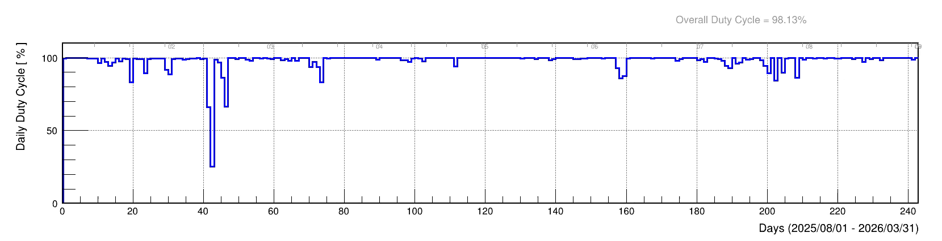
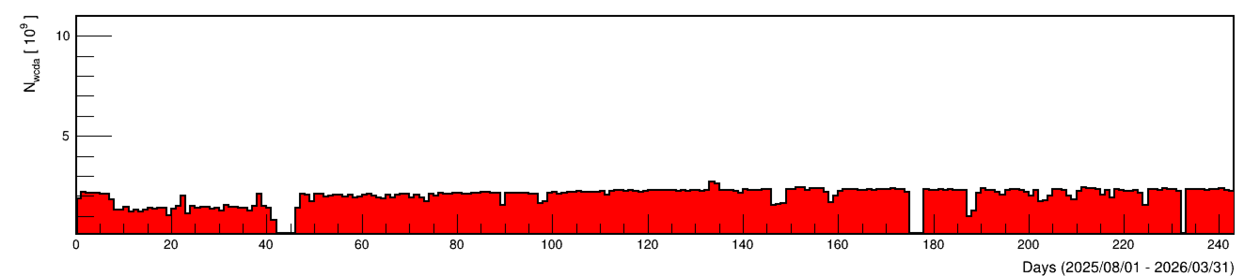
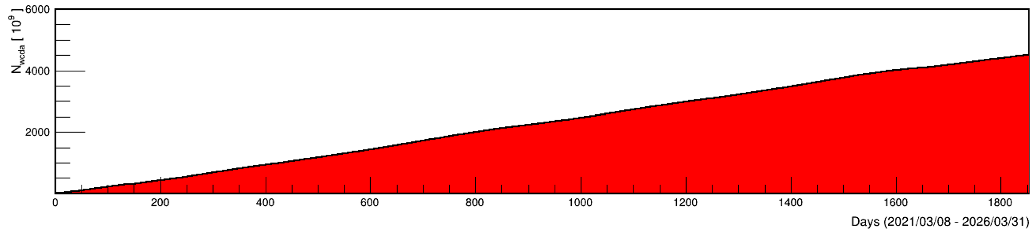
WCDA status
Duty cycle
Daily events
Accumulated events

Slide 10
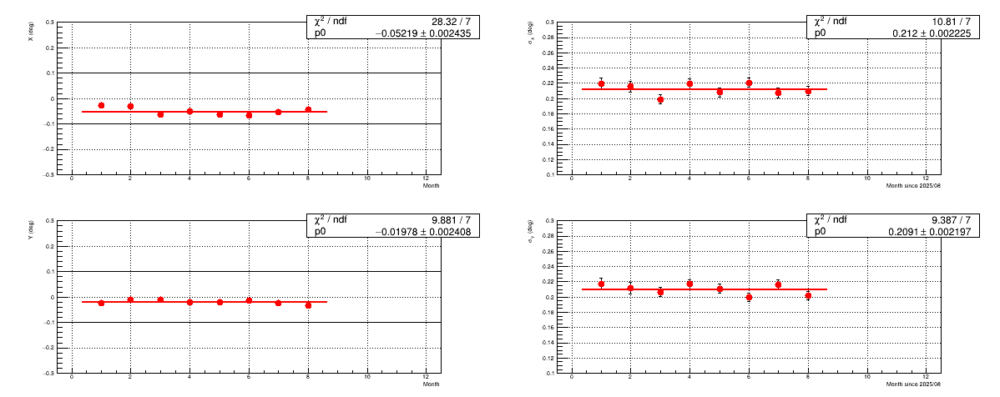
WCDA performance @ Crab
A ${0.05}^{0}$ westward shift existed in the past half year; we will re-do the timecalibation based on WR configuratioin

Slide 11
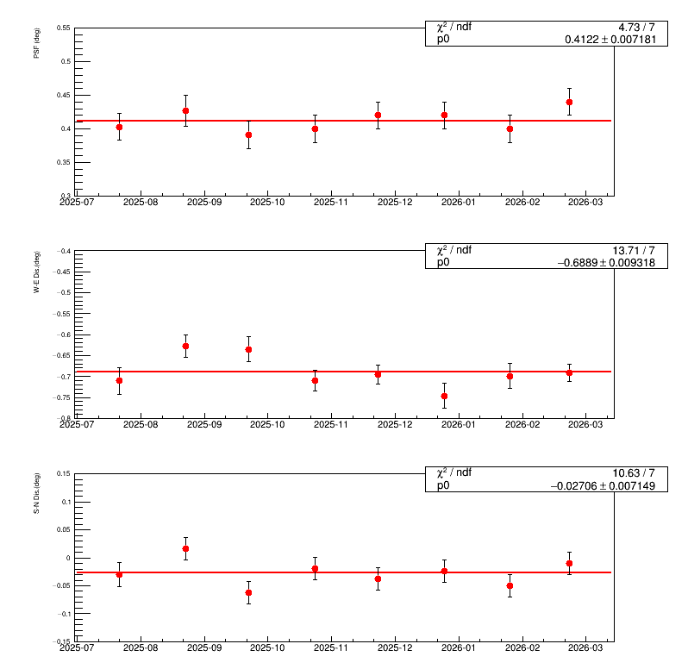
WCDA performance @ moon shadow

Slide 12
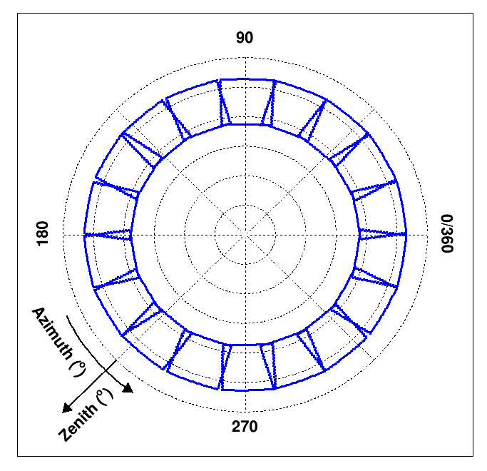
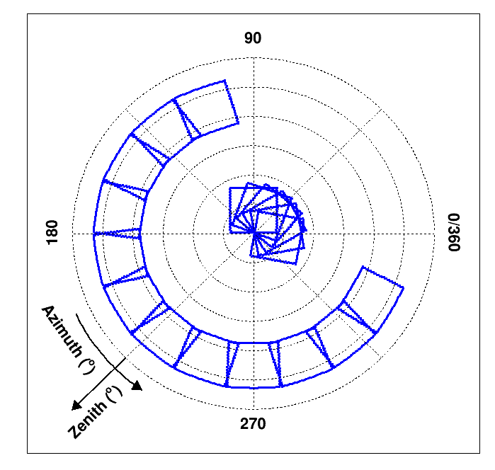
Status of LHAASO-WFCTA data
Oct 2021-May 2022: the FOV of 18 telescopes. For knee of light component cosmic ray spectra.
Oct 2022-May 2023: Added shelter at the door to reduce camera saturation above 10PeV. For the knee of heavy component cosmic ray spectra.
Oct 2023-May 2026: Six telescopes have pointed to 8° in zenith and analysis energy threshold cloud be lower than 100 TeV. For low-energy cosmic ray spectral observation.

Slide 13
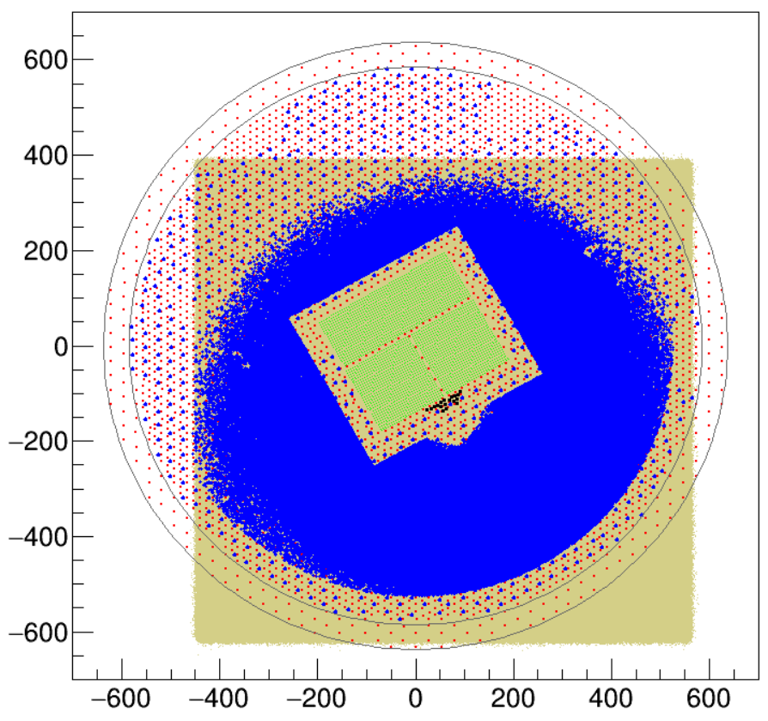
WFCTA's operating environment
Hybrid Data path：
/eos/lhaaso/rec/wfcta_merge/merge_km2a/V4.3
Data Read and image shown:
/workfs2/lhaaso/wfctarec/Public_Lib/software/Read
Two program : EventShow.cc
Read.cc
Compile
First: >>>source setup.bsh
Second: >>make clean
Third: >>>make
Usage
./EventShow inputfile outputdir
./Read outputfile inputfiles
Infrared brightness temperature < -65
the angle between telescope and the moon >30°
Hybrid events count: Rp ~ 100-300 meters.
3

Slide 14
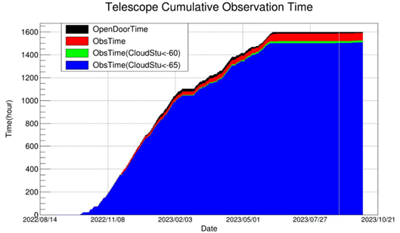
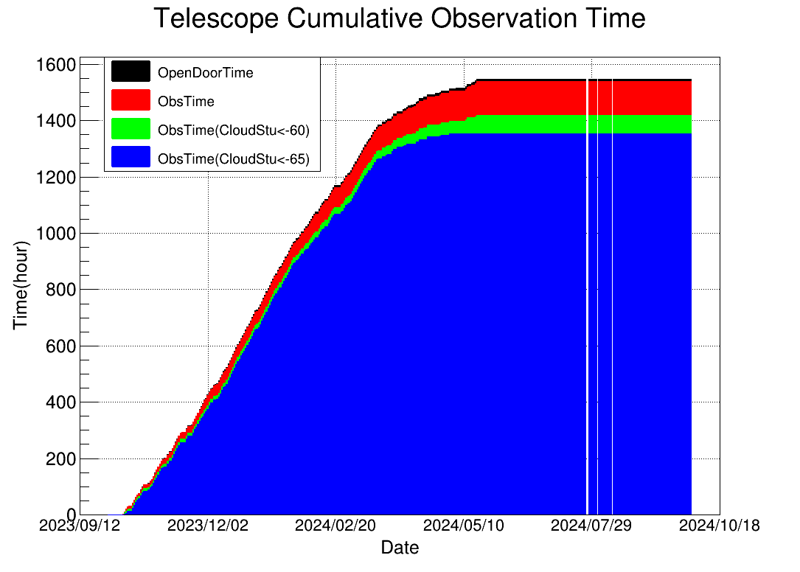
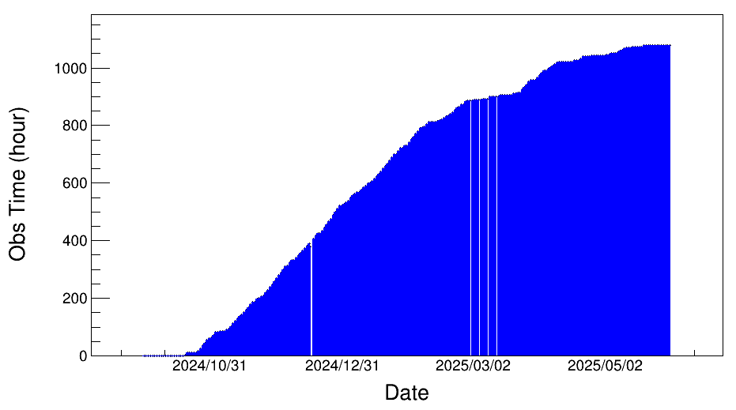
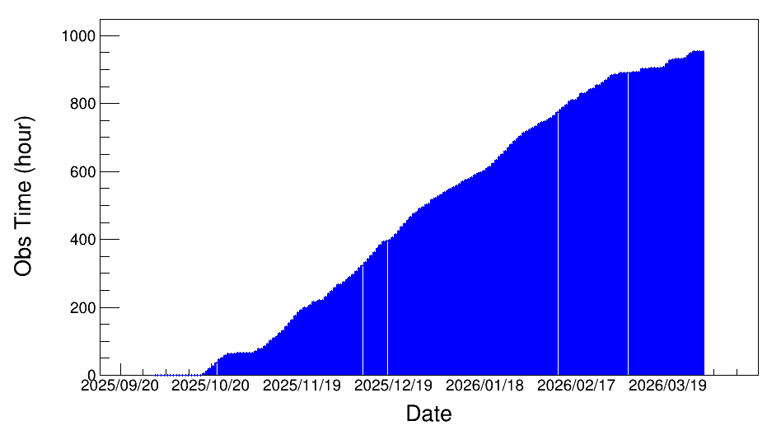
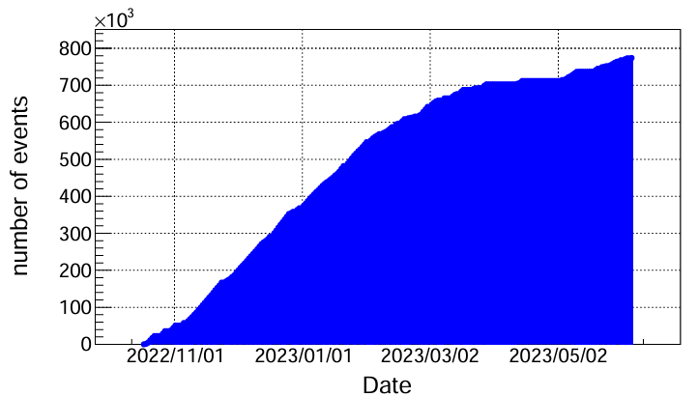
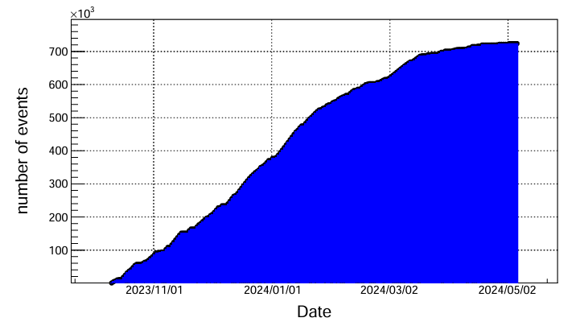
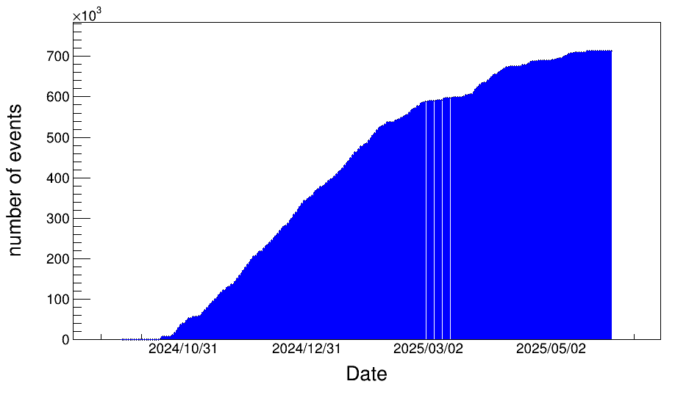
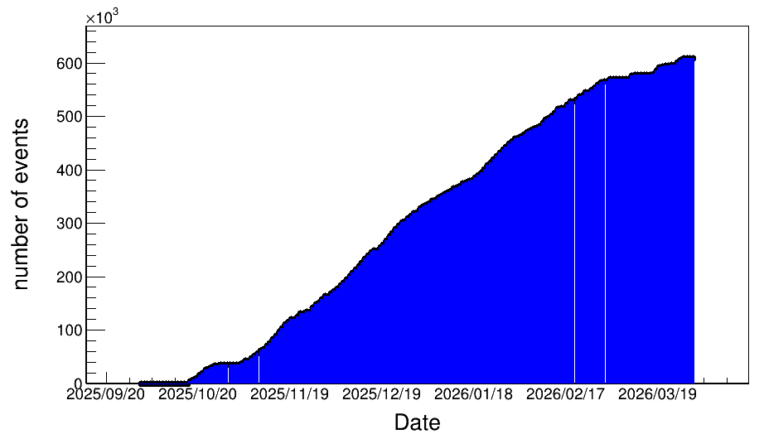
Status of LHAASO-WFCTA data
Observation time
Number of events
E>1PeV
Number of events
E>1PeV
4

Slide 15
Conclusion
KM2A and WCDA were attacked by a huge lighting. A lager fraction of ED and MD were in trouble. The time-offset for WCDA is re-calibrating.
The performance for rest of time is stable.
WFCTA is in stable operation status.

Slide 16
Thanks!

