Slide 1
Status of LHAASO
Computing Platform
Yaosong Cheng
On Behalf of IHEP-CC
April 27, 2026

Slide 2
Outline
Local Computing Platform Status
  Job & Computing Resource
  Storage & CTA Tape
  Network & Data Transfer
Progress of the Applications and Services
Operating System Upgrade
Summary

Slide 3
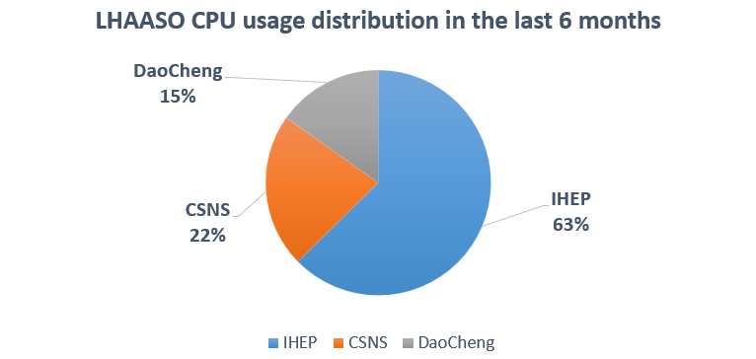
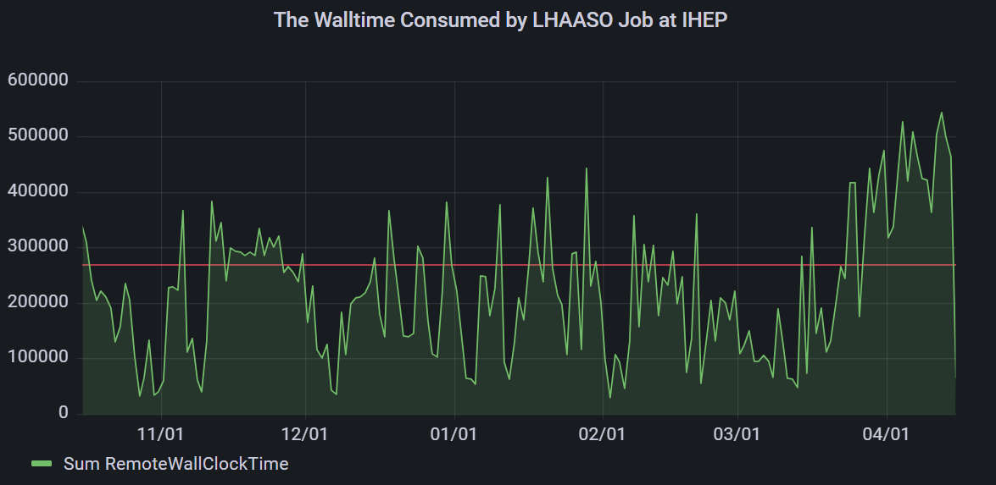
Local Computing Platform Status
——Job Statistics – HTCondor Cluster
HTCondor Cluster at IHEP Local
  LHAASO contributed 12,480 CPU cores
    28.36% of the total
  40,389,231 Jobs Completed
  40,959,631 CPU Hours Consumed
Daocheng site
  2,779,649 Jobs Completed
  9,928,946 CPU Hours Consumed
Dongguan site
  2,794,604 Jobs Completed
  14,470,407 CPU Hours Consumed

Slide 4
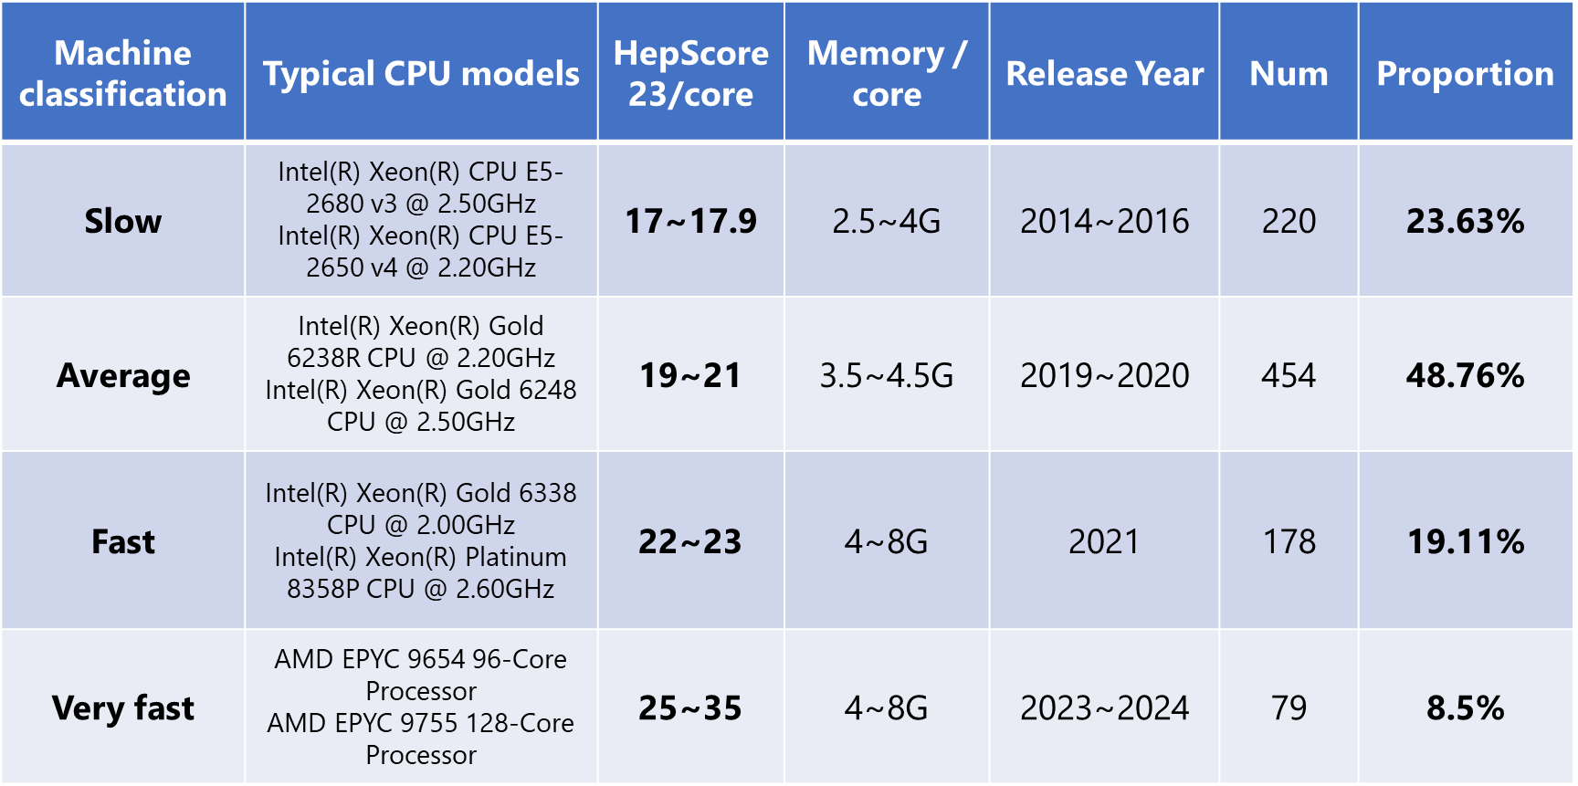
Local Computing Platform Status
——Next Plan: Job Performance by Device Class
Test Baseline and Scale
  Classification of Machinery and Equipment
  Conducted the tests using the baseline BESIII environment (v7.1.3) and the J/psi rhopi JobOption.
    10K events & RunIdList：{-27255, 0, -28236}
Job Sensitivity Differences
  Compute-intensive jobs (SIM) are more sensitive to machine performance
  I/O-intensive jobs (REC and ANA) are much less affected
Refined Scheduling Scheme
  Node-Side Prioritization by jobtype
  Job-Side preference for specific nodetypes(fast / normal / slow)
  Will be integrated into hepsub in the next step
Maximize cluster scheduling efficiency
  Every job runs on the most suitable machine
  Reduce the completion time variance among jobs of the same batch
Machine Classification

Slide 5
Local Computing Platform Status
——Storage Status
Resource: (Capacity)
  IHEP data center
    Disk storage: 32.08 PB capacity
      /eos/user/: 1TB of space and 250,000 files per user
      /home/lhaaso: 200GB of space and 500,000 files per user
    Tape storage: 54.6 PB
  On-site data center
    Disk storage: 5.31 PB capacity
Status
  28.1 PB of data and 528 million files stored
    /eos/lhaaso: 26.6 PB
    /eos/user: 1.5 PB
Update
  Expand the disk space of /home/lhaaso by 50TB
Location | Mount Path | Total Capacity | Used Space | Free Space
IHEP Data Center | /eos/lhaaso | 29.76 PB | 26.6PB | 3.16PB
 | /eos/user | 2.32 PB | 1.5 PB | 0.82PB
 | /home/lhaaso | 119 TB | 60 TB | 60 TB
On-site Data Center | /eos/daocheng | 5.31 PB | 3.44PB | 1.84PB
 | /lhmtfs/user | 87 TB | 38 TB | 45 TB

Slide 6
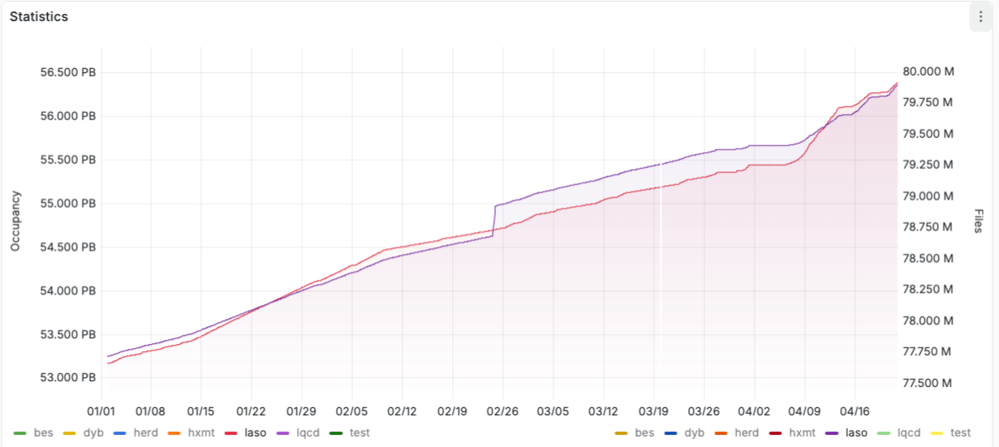
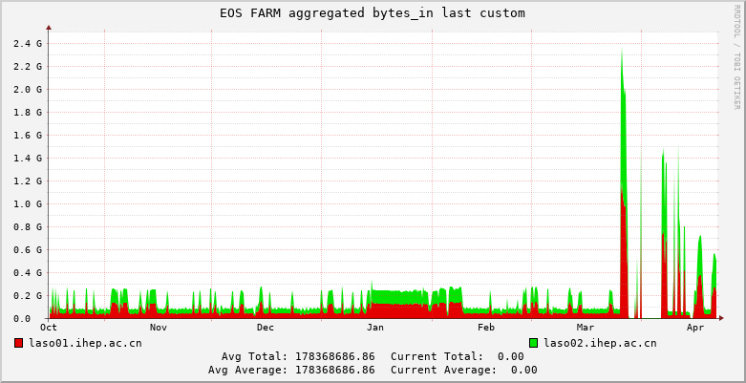
Local Computing Platform Status
——CTA Tape Service
CTA manages data backup for all detectors of LHAASO automatically
  WCDA, WFCTA, KM2A, GRB, ed_cluster_rate, lact …
Statistics
  20 drives and ≥9000 LTO7 tapes in LHAASO Tape Pool
  56.4 PB used and 79.9M files stored, 4.8PB and 3.36M files added ( 2 replicas )

Slide 7
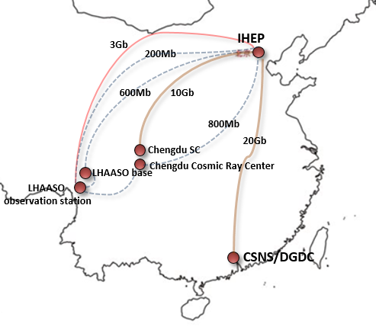
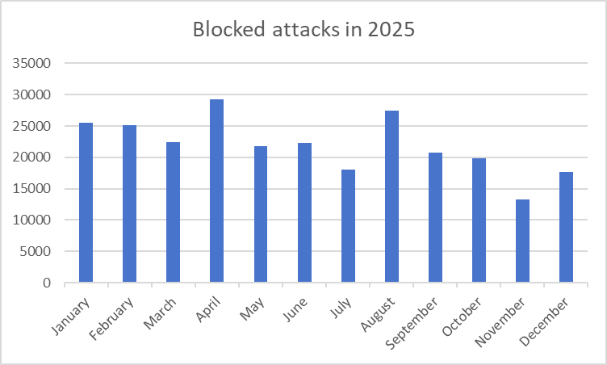
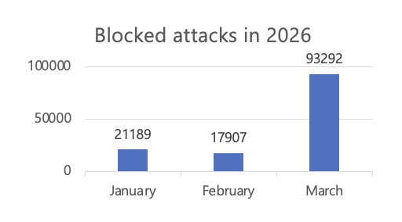
Local Computing Platform Status
——Network Status
LHAASO ChengDu
  Network is ready , works well.
LHAASO (haizi mountain)
  Network bandwidth ：LHAASO←→IHEP 3Gpbs works well！
    Total bandwidth( 2 links) up to 3.4Gbps
Cyber security
  Development of Network Security Management Regulations
    Access control, identity management and Emergency response management
    Security is the most important thing!
  Construction of the IHEP Security Operational Center (SOC)
    Achieve closed-loop protection：covering network risk discovery, threat detection and response
  A total of 132,388 attacks were automatically blocked in the past three months
    We have added monitoring and automatic blocking against brute-force attacks on 5 login nodes since Mar. 2026

Slide 8
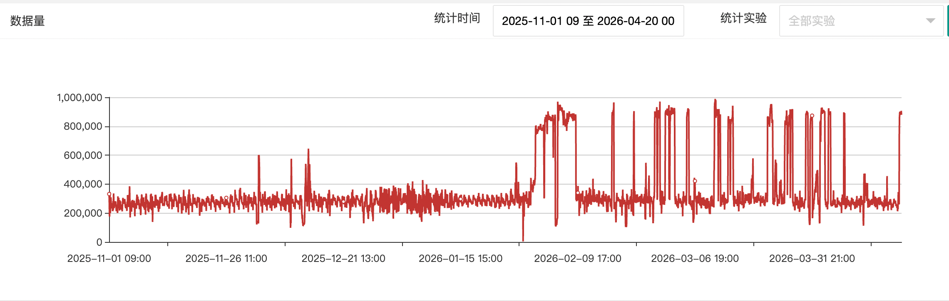
Local Computing Platform Status
——Data Transfer System
Work stable and total data transfer volume since last workshop is 1.1PB
 | KM2A | WCDA | GRB | WFCTA
Total data transferring volume (2025.11-2026.4) | 345.06TB | 561.6TB | 130.98TB | 66.92TB

Slide 9
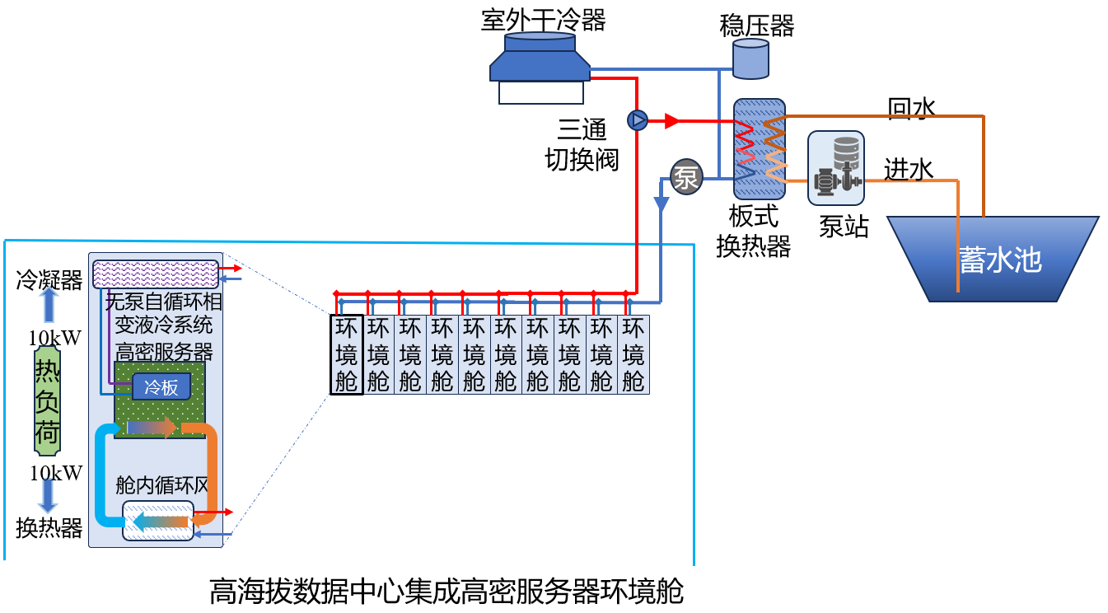
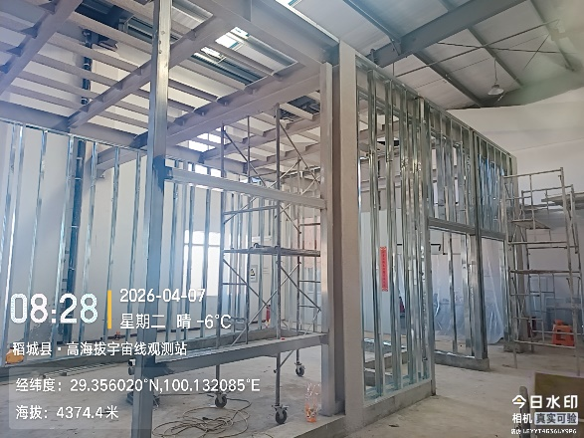
Intelligent Data Hall Construction
Facility Overview
  Size: ~50 m² data center
  IT Deployment: 10 racks (20 kW per rack)
  Power Supply: 1 × 300 kVA UPS system
Advanced Cooling Solution
  Phase-change liquid cooling + water cooling
  Efficient heat dissipation for CPU and GPU
  In-rack air circulation for auxiliary cooling
Infrastructure construction in progress
  Steel structural framework: Completed
  Cooling water pool: Expected completion by April 30, 2026
  Overall facility completion: Expected by June 30, 2026
  Full completion and acceptance expected by end of June 2026

Slide 10
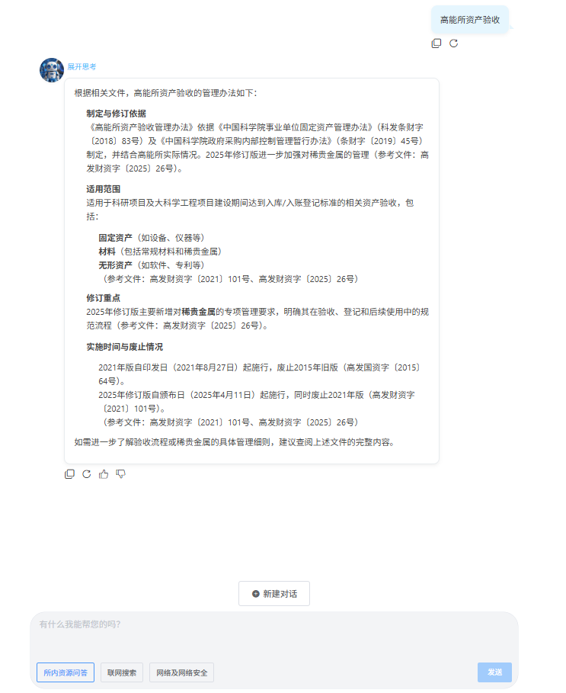
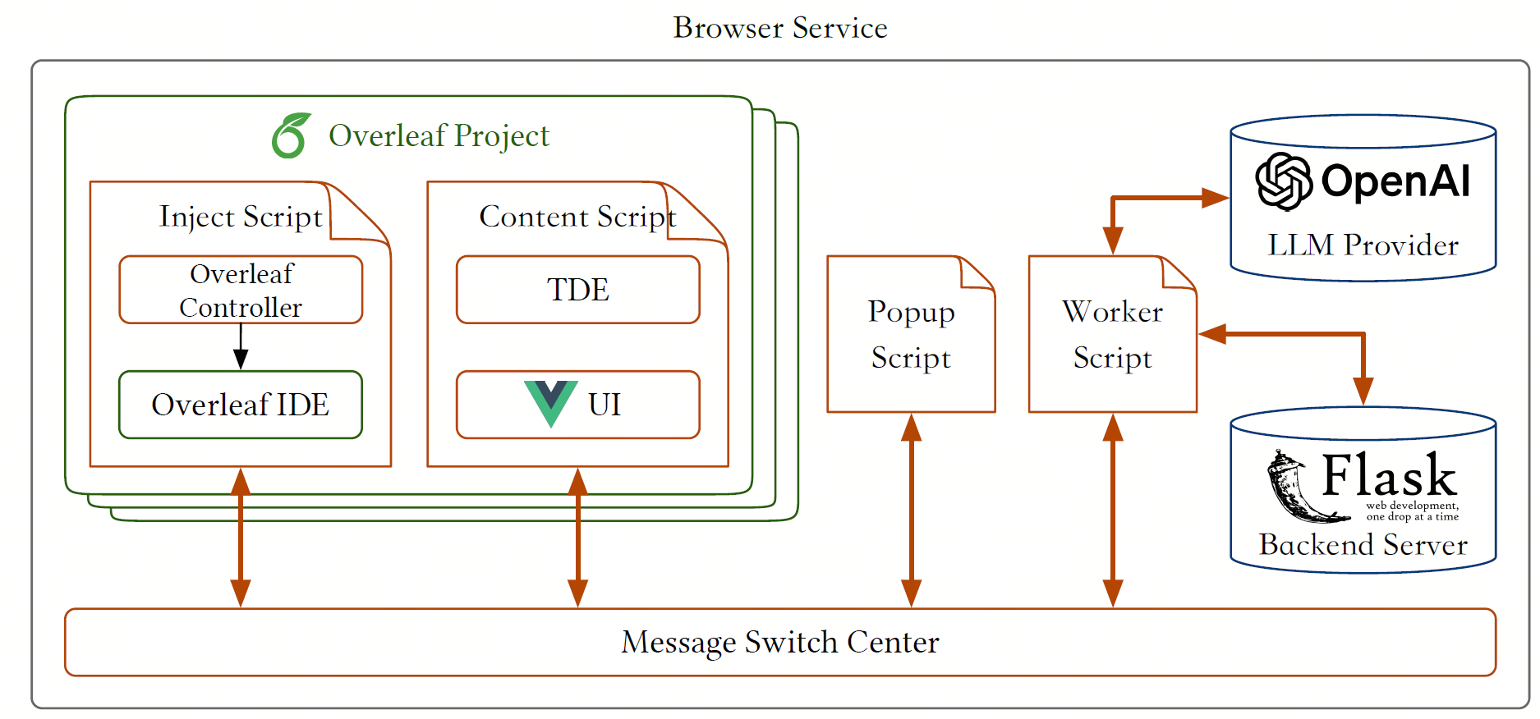
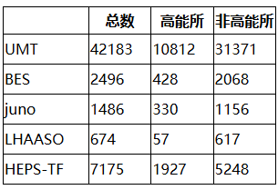
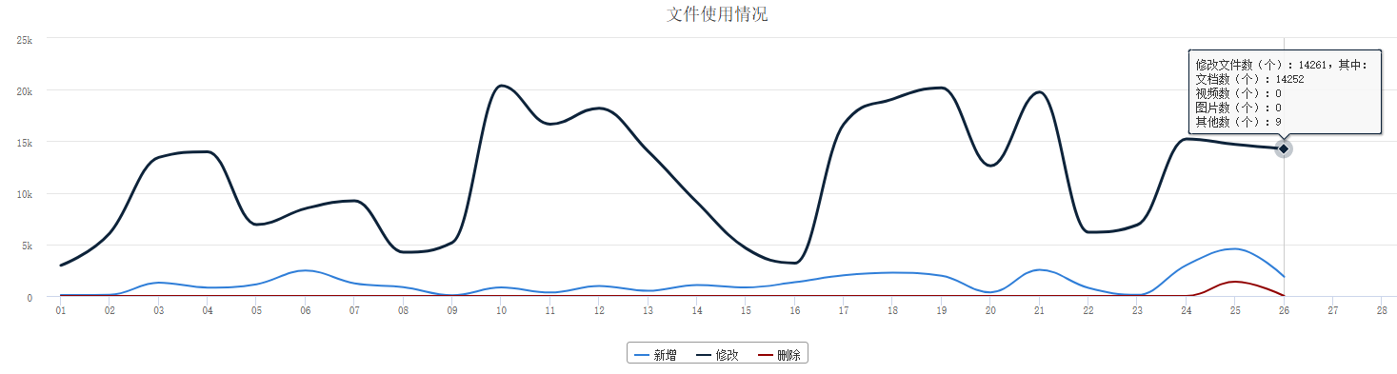
Public application & service at IHEP
Intelligent Assistant （Continuously improving）
  Released the High Energy Physics Institute's Institutional Document Intelligent Assistant，providing rapid and intelligent Q&A services for institutional documents to the entire institute
  Integrated institutional documents and IT operations knowledge base
  DeepSeek R1（local）&RAG
Unified authentication
  The unified authentication system supports 2FA functionality.
  Add support for AD and support unified authentication for Windows
  Total users：42,183; LHAASO：674…
Overleaf
  Overleaf browser extension( LaTeX Copilot Plugin), integrating large models, providing functions such as manuscript editing, article translation, and grammar checking
IHEP DOCS
  Document collaboration service, 370+ daily active users on average
  Total users: 1500+, Space usage: 1.5T/200T, files :2270597
HEPAI 平台
(DeepSeek R1)
Unified authentication
DOCS
Overleaf

Slide 11
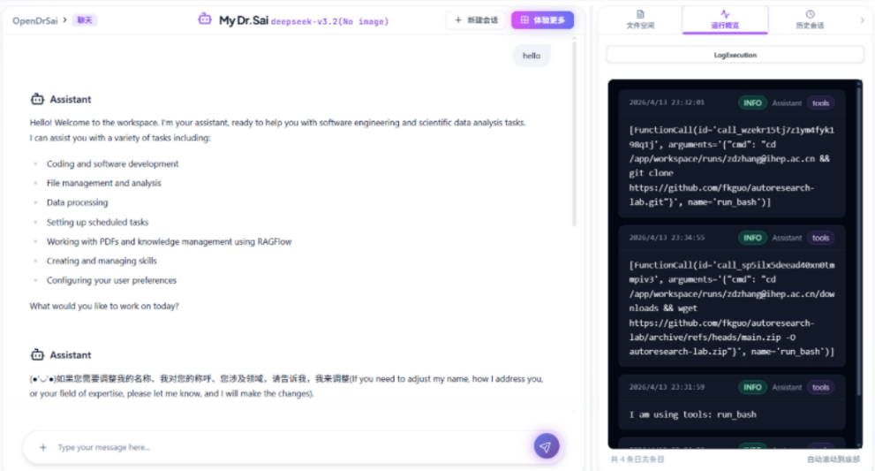
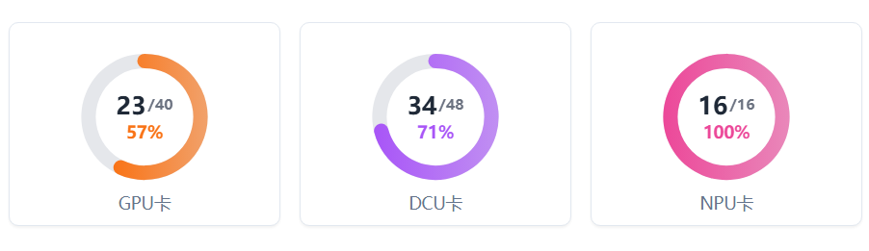
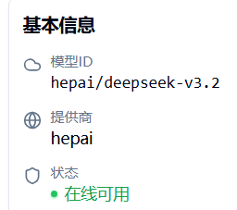
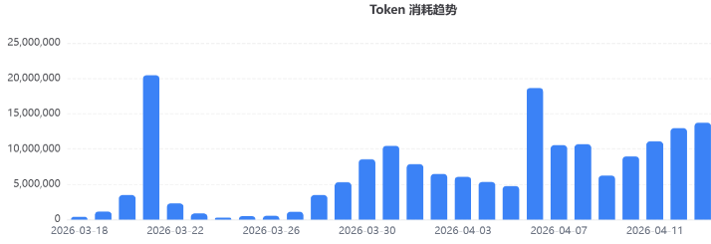
Status of AI platform
Provide a powerful and user-friendly AI infrastructure for researchers in high-energy physics and related fields, allowing you to focus on innovation, not computational challenges.
AI computing power
  40 GPU+48 DCU: for all ai task, from daily training to large-scale model training.
  New: 18*RTX 5090, accelerate model iteration and training cycles
Model & Dataset Services
  local deploy deepseek-v3.2 and qwen3-30B
    Use local LLM: sensitive research data never leaves the internal network,
    ensuring complete privacy
  Use ai model by API:
    Easily incorporate AI capabilities into your existing analysis workflows and tools
Plan
Computing power of AI
Accept
Execution

Slide 12
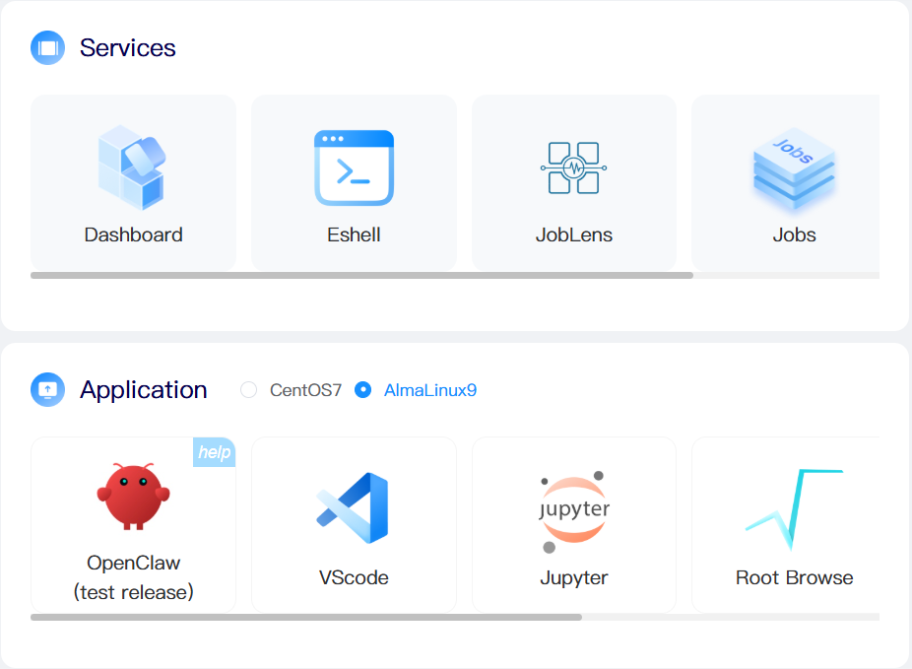
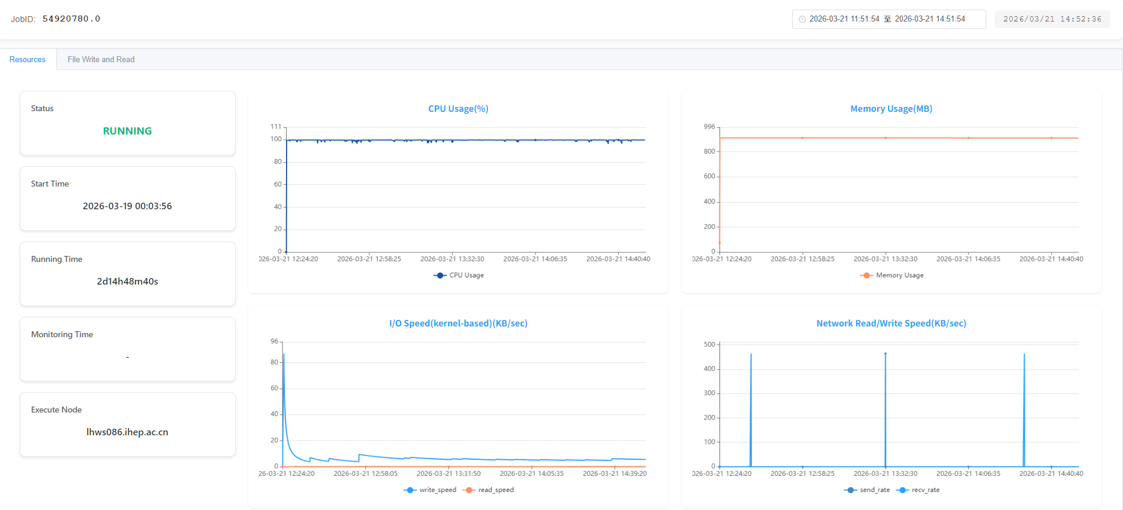
Progress of INK Computing Platform
Architecture Optimization
  Response time: 10s+ → <1s
Service New Features
  Added batch file download
  Job Tracing Service: JobLens
    Users can self-select jobs to trace
    Trace metrics: CPU / memory /file access / network……
    http://afsapply.ihep.ac.cn/cchelp/zh/others/ink/#8535-openclaw
Openclaw integration
Ensuring Openclaw Runtime Security
  Openclaw runs as a regular user inside containers
  Openclaw instances are isolated between users
Ensuring Experiment & User Data Security
  Using internally deployed IHEP models → direct access to experiment data (read-only, including users' personal home directories)
  Selecting external models → experiment data is not mounted
Job Tracing – Resource Usage

Slide 13
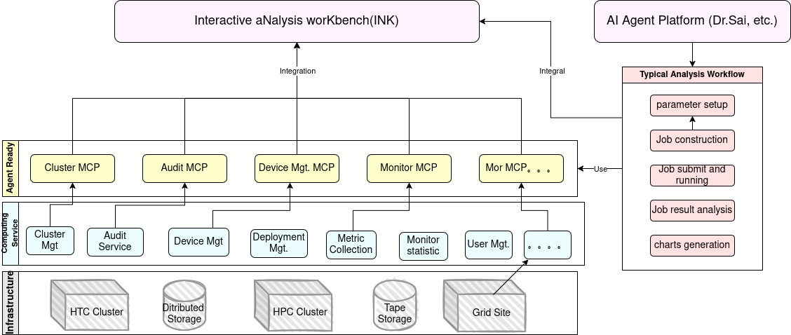
INK MCP: Implementation plan for the LHAASO data processing workflow
MCP & SKILL: Foundation for Agent Interaction
  MCP (Model Context Protocol) standardizes service communication
  SKILL packages specific platform capabilities for easy invocation by agents
  Can be used to implement the data processing workflow of LHAASO
MCP & SKILL Based Intelligent services for the Computing Platform Infrastructure
  Transform computing platform infrastructure (clusters, storage, monitoring) into MCP-enabled intelligent services
  Providing a unified access point for external agents (e.g. OpenClaw.)
  Permission control carefully considered based on the computing and data management policy from each experiment
  Seamlessly integrated with INK
Implementation plan: User-facing agent entry
  Step 1: Integrate OpenClaw into INK for initial testing and to collect real-world application scenarios.
  Step 2: Develop a proprietary AI Agent to enable users to drive custom agents via natural language for end-to-end workflows.
Use Flow:
  User Command (Natural Language) → AI Agent → MCP Services → Computing Infrastructure → Results

Slide 14
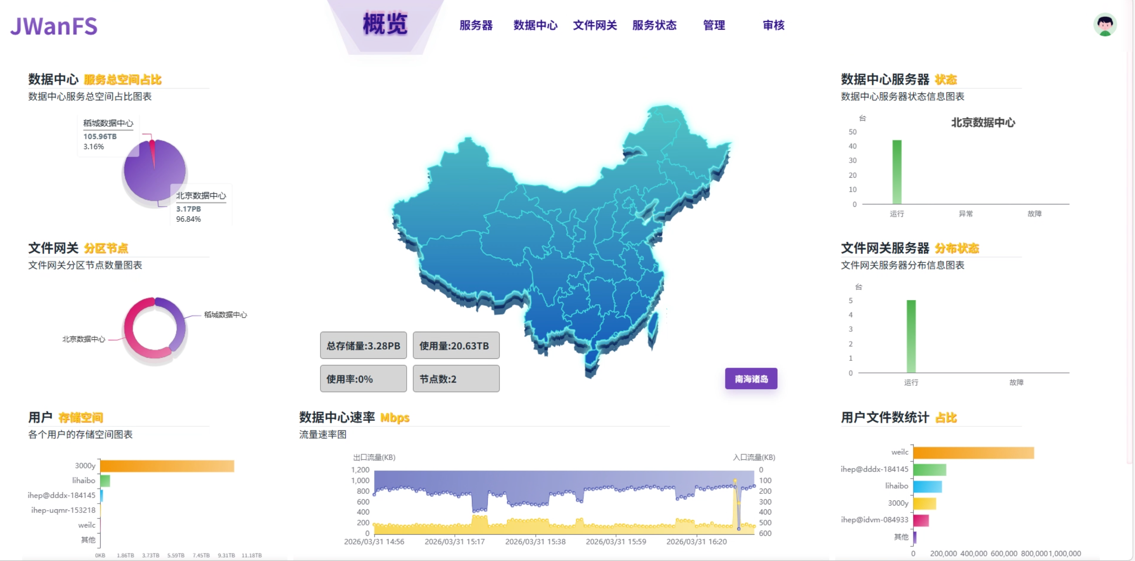
GFS—Object Storage for LHAASO AI Computing
What is gfs?
An IHEP-built distributed object storage platform designed for experiments. It is tailored for AI training workloads, managing massive scientific datasets, and enabling efficient cross-site collaborative research.
Comparison with EOS/Lustre
Globaly Accessable： GFS enables international partner members to access data directly, without the need for a VPN or dedicated line.
Cross-platform Availability：GFS provides native clients for Windows, Linux, and macOS, ensuring a consistent user experience across diverse operating environments.
Seamless Data Sharing：gfs enables instant data sharing via simplified links

Slide 15
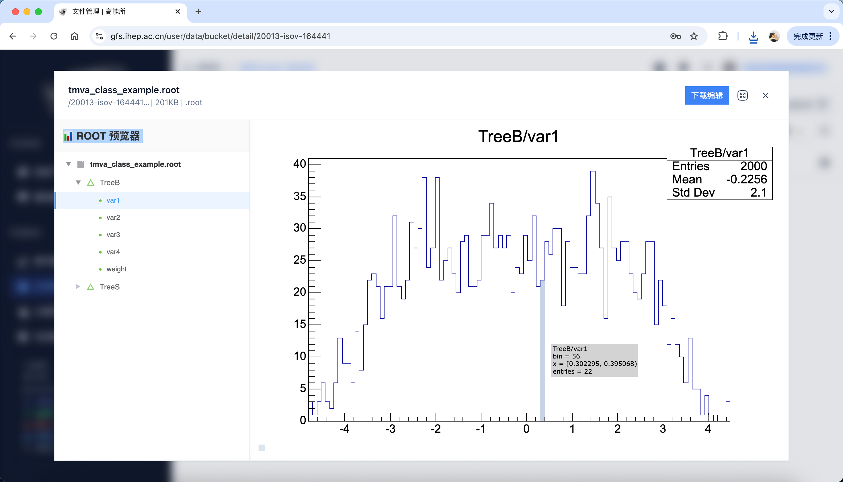
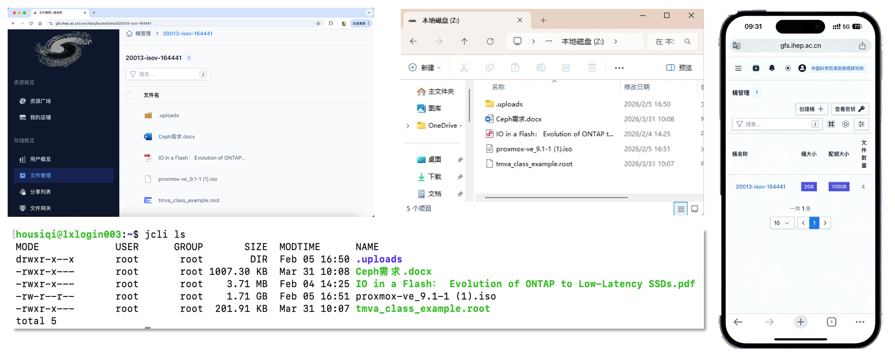
gfs-AI-Optimized Core Features
ROOT File Support
  Native support for physics ROOT files with online preview capabilities for instant data access.
Secure Collaboration
  User-isolated data buckets and secure, one-click URL sharing for efficient team collaboration.
Multi-Protocol Access
  Full access via Web UI, jcli, system mount, and SDKs (Python/Go) for maximum flexibility.
Direct AI Workflow Integration
  Eliminates data migration delays by enabling direct dataset access for AI training jobs.
High Reliability
  Cross-region data replication ensures business continuity.

Slide 16


gfs-Deployment, Usage & Future Plan
Current Deployment
  Public Cluster: 3.28 PB total capacity https://gfs.ihep.ac.cn/login
  LHAASO Cluster: 80 TB dedicated storage http://jwanfs.lhaaso.ihep.ac.cn/login
Access & Quota
  Default: 1 TB/user (Team quotas scalable)
  User Manual: https://note.ihep.ac.cn/s/EWOiLc4sy
  Usage Methods: Web Interface, jcli Command Line, FUSE-based mounting, SDK Programming Interfaces
  AI Best Practice:
    Use SDK for direct access & jcli for auto-uploads
    Use the web interface to generate shareable URLs and online previews.
Future Roadmap
  Integration: Auto-mount with Slurm & HTCondor & hai-ecs
  Upgrade: Cloud-native refactoring on Kubernetes
Scan the QR code with your mobile phone.
User Group

Slide 17
Plan for Operating System Upgrade
Background
  Alma Linux releases a new minor version every 6 months, with the previous version no longer supported
  Would like to follow the new release schedule and regularly upgrade the LHAASO computing platform’s operation system
Upgrade Workflow
Operating system of LHAASO computing platform will be upgraded to Alma Linux 9.7
Operating System Version Management Strategy
  Normally, the computing platform runs 1 or 2 minor versions behind the latest release
  The upgrade plan can be modified according to the special needs of the experiment
Alma Linux release new minor version
CC provides test machine with the new version
Software group test
Upgrade computing platform OS

Slide 18
Next Plan
Due to market conditions, including rising prices for computing and storage, related procurement may be postponed
The construction of the LHAASO Digital and Intelligent Data Platform will be launched
  The new data center will adopt liquid cooling technology and built on Haizi Mountain
  6P Flops GPU,0.4P Flops CPU, 1.5PB NVMe storage, 10PB disk storage
  Expected to be available for use in 2026

Slide 19
Summary
LHAASO computing platform runs stably
  It makes full use of the resources including CPU, disk and network
INK service works well, new Job Trace and OpenClaw services added, continuously improving user experience
Supporting LHAASO with LLM-based data analysis in AI platform
New object storage service is now available to LHAASO
For any IT problem, please feel free to ask for help through https://helpdesk.ihep.ac.cn/

Slide 20
Thanks for your attentions!

Slide 21
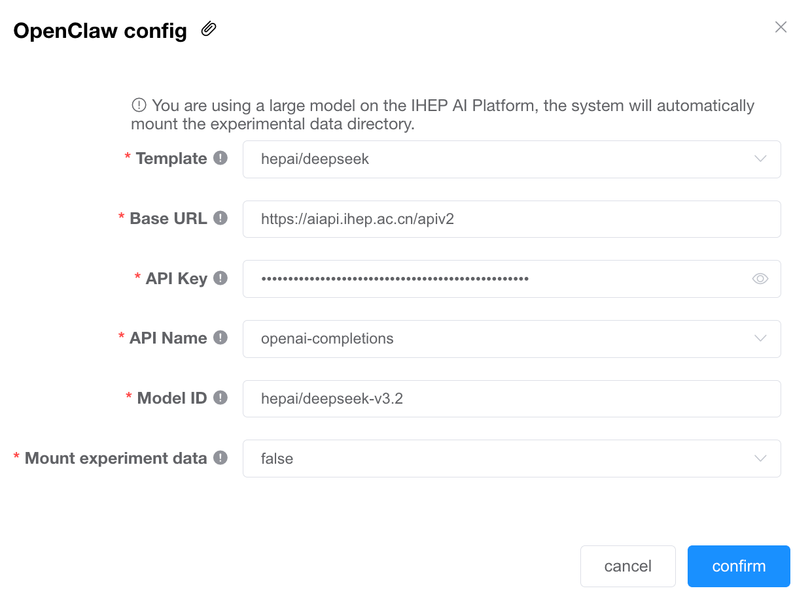
backup

