Slide 1



The 1st LHAASO Collaboration Conference in 2026
9
Numerical Simulation Method for Reconstructing the Cosmic Ray Sun Shadow Observed by LHAASO-KM2A Using G4Solar
Shan-Shan Xu^{1*}, Zhe Li¹, Song-Zhan Chen¹, Hou-Di Xing¹
1 Institute of High Energy Physics, Chinese Academy of Sciences
*xuss@ihep.ac.cn

Slide 2

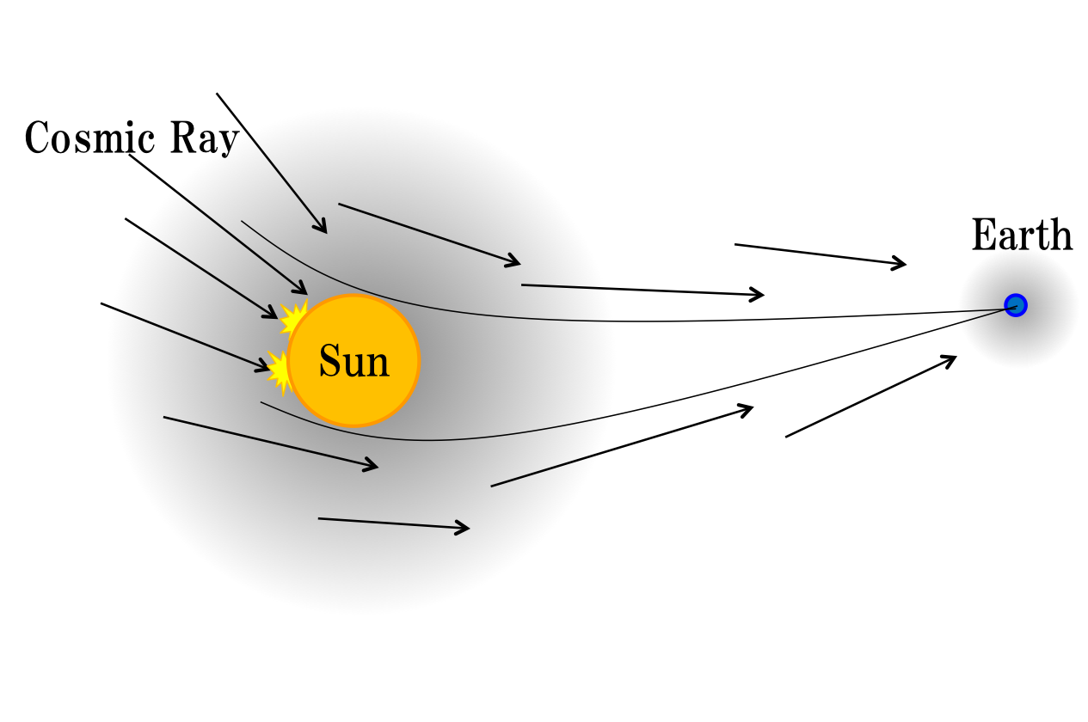
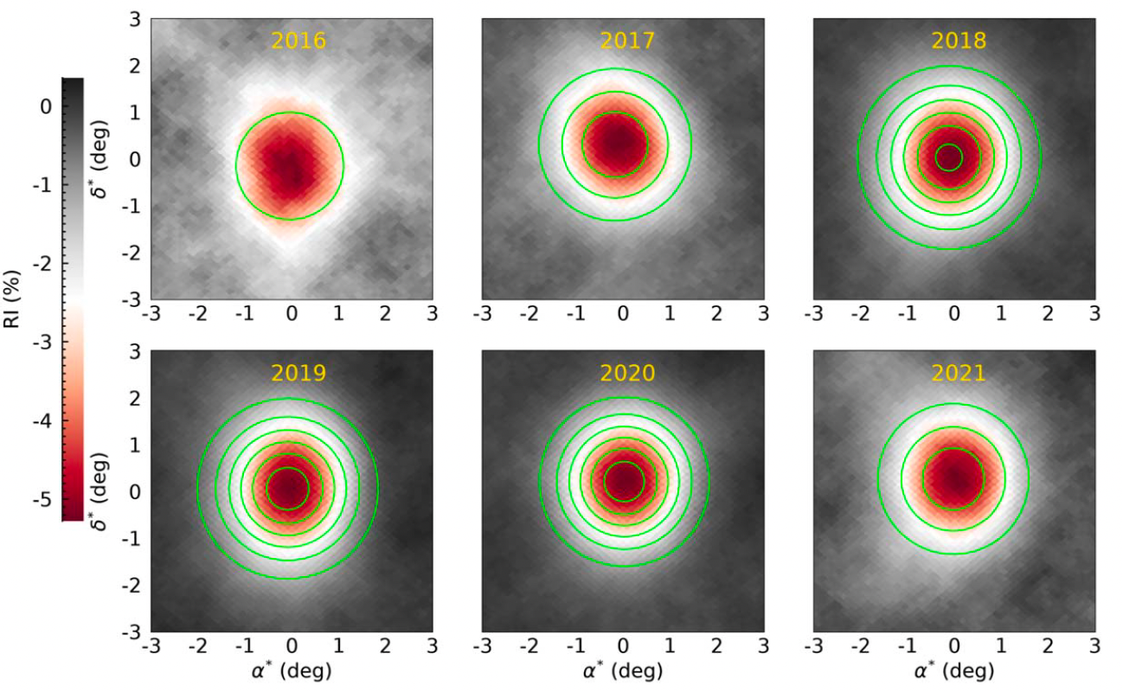
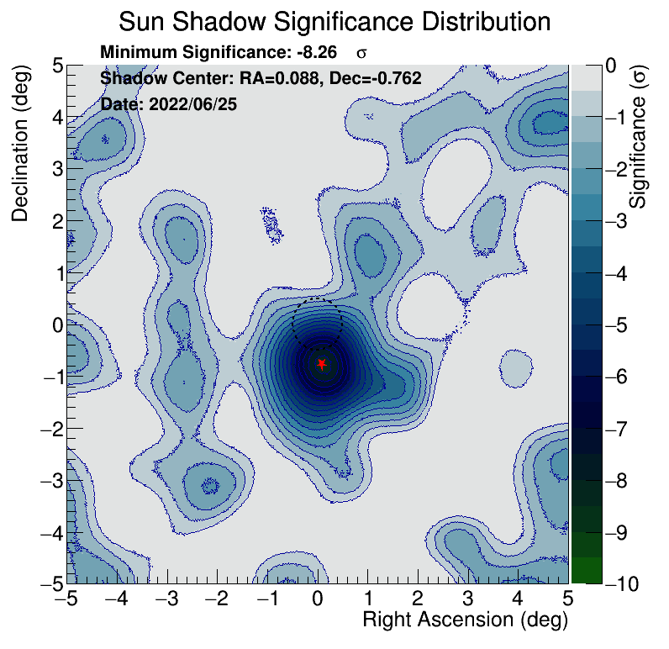
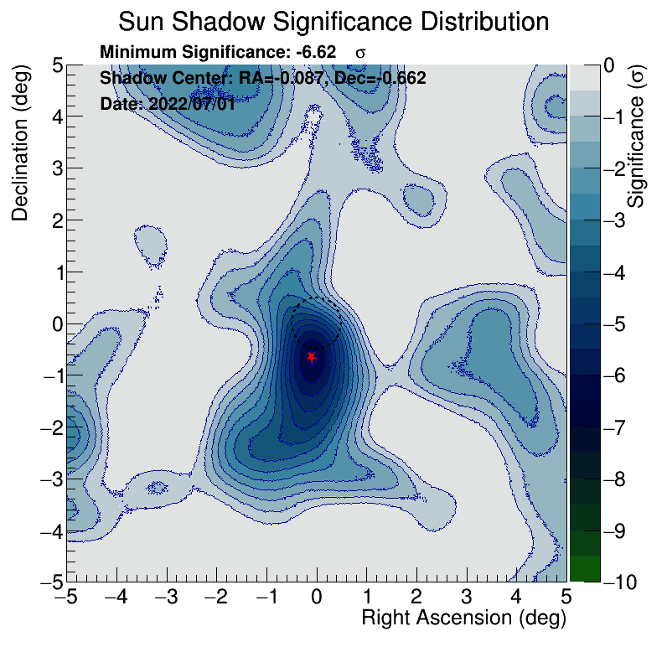
9
Numerical Simulation Method for Reconstructing the Cosmic Ray Sun Shadow Observed by LHAASO-KM2A Using G4Solar
Introduction
Cosmic Ray Sun Shadow: A Natural Probe for Detecting the Solar Magnetic Field
Advantages of LHAASO
With daily sampling, LHAASO enables single-day sun shadow imaging for the first time, demanding daily-scale simulations.
Clark, G. W. 1957, PhRv, 108, 450
Daily Sun Shadow Map of LHAASO-KM2A
PRELIMINARY
2024, HAWC, APJ

Slide 3
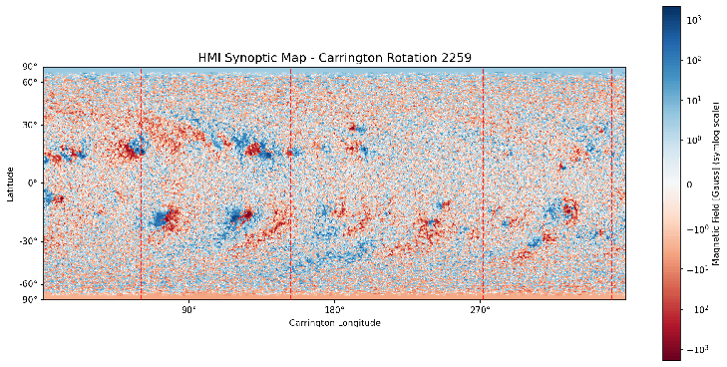
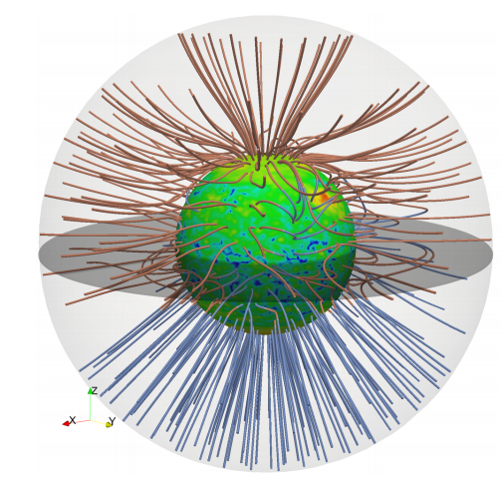
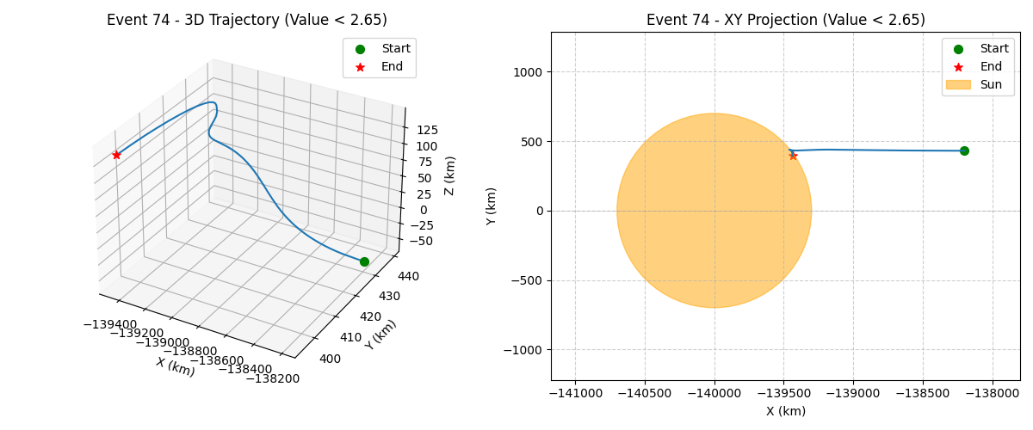
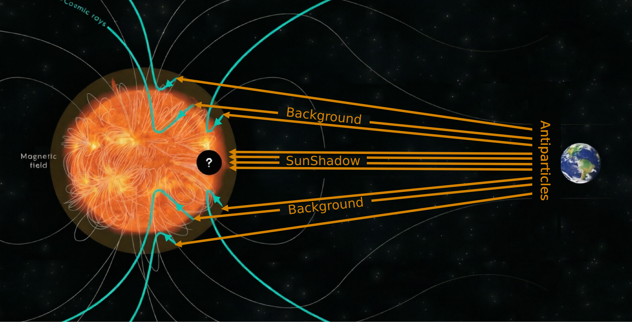
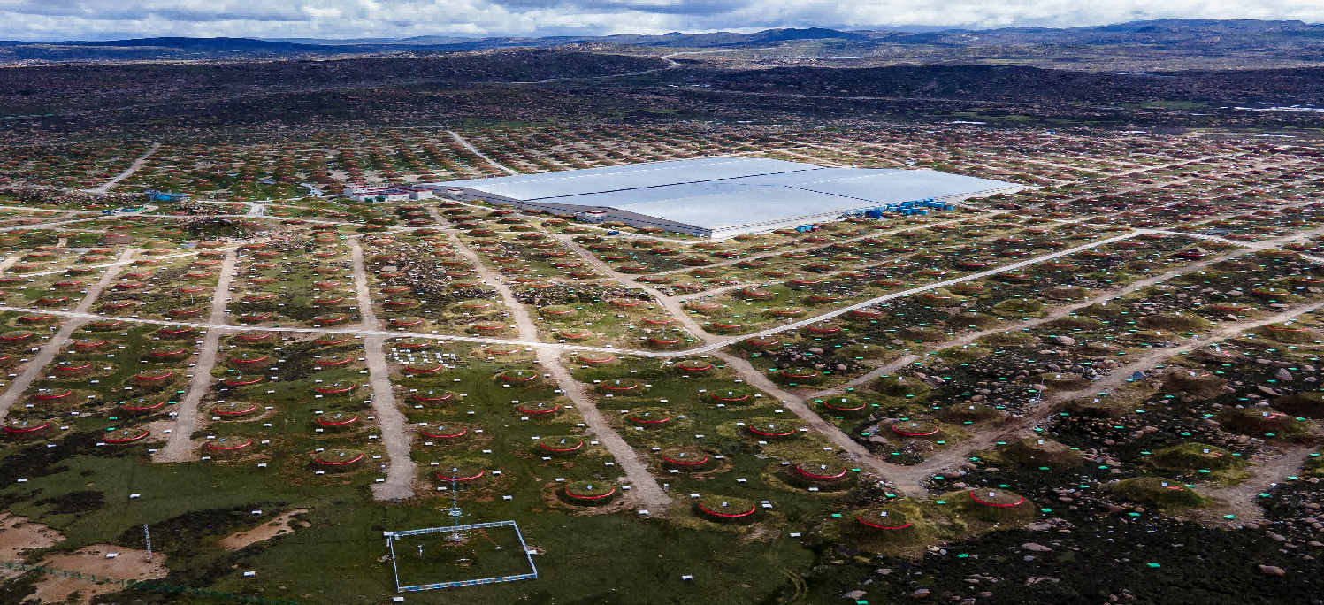



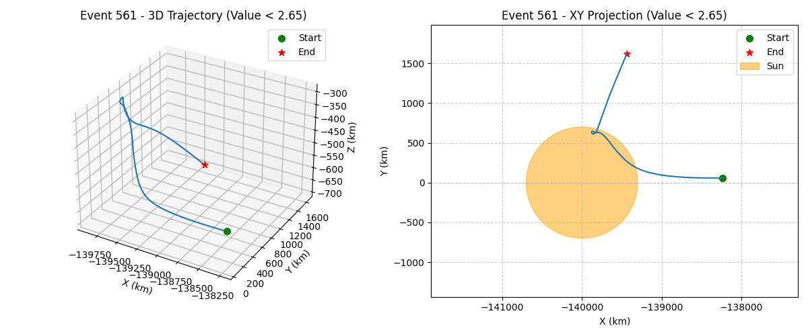
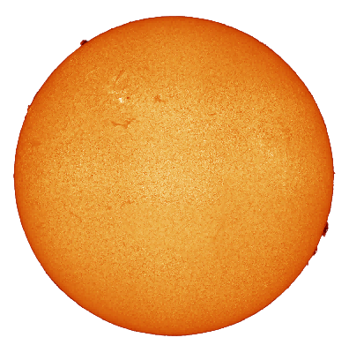
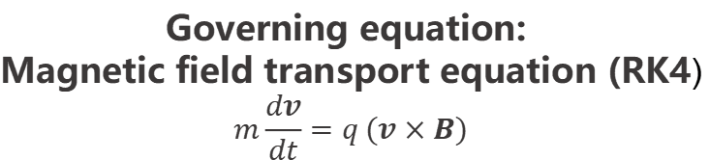
9
Numerical Simulation Method for Reconstructing the Cosmic Ray Sun Shadow Observed by LHAASO-KM2A Using G4Solar
Methods
Numerical Simulation of the Cosmic Ray Sun Shadow
Particles hitting the Sun
Forming the sun shadow
1、Input solar photospheric magnetogram
2、Magnetic field calculation model
3、Particle simulation process
4、Comparison between LHAASO and simulation
HMI magnetogram
Construct expected sun shadow
Carrington magnetogram for solar rotation
PFSS (coronal magnetic field)
Particle back-tracking (G4Solar)
Observed sun shadow
Simulated sun shadow
Particles deflected away from the Sun
Forming the background
Sun shadow simulation program developed based on Geant4
Magnetic field filling layer:
PFSS 2.5R⊙ 0.67°
Record the initial RA and DEC of particles
G4Solar
z
Sun
0.26°
Antiparticles
y
x
Governing equation:
Magnetic field transport equation (RK4)
$$m\frac{dv}{dt}=q (v×B)$$
Particle gun
215R⊙ Earth
Sun shadow particle recording layer: Solar surface photosphere

Slide 4

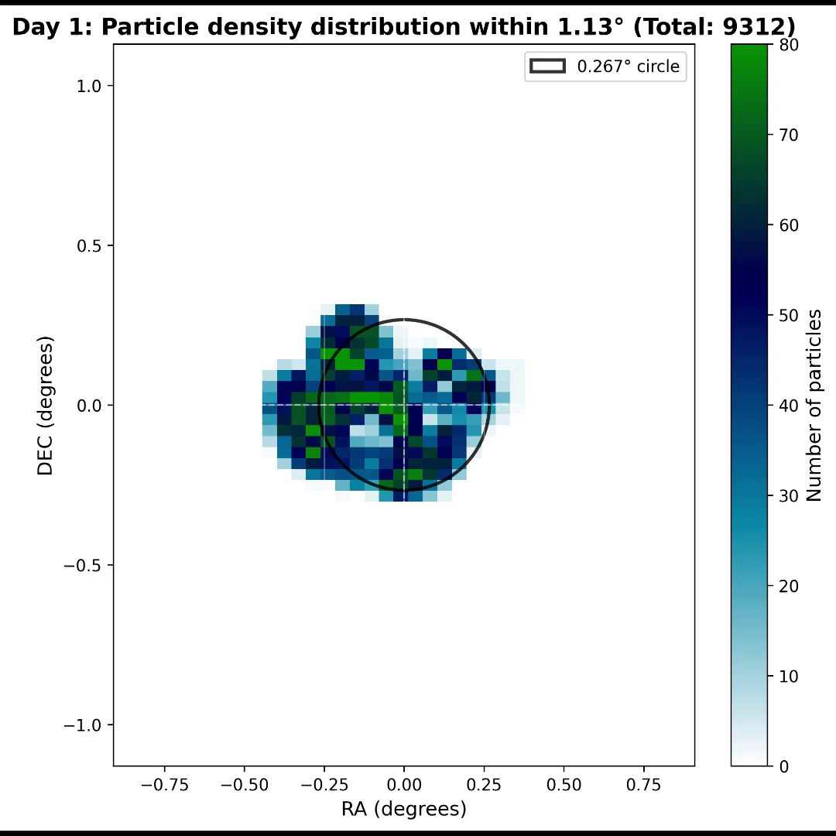
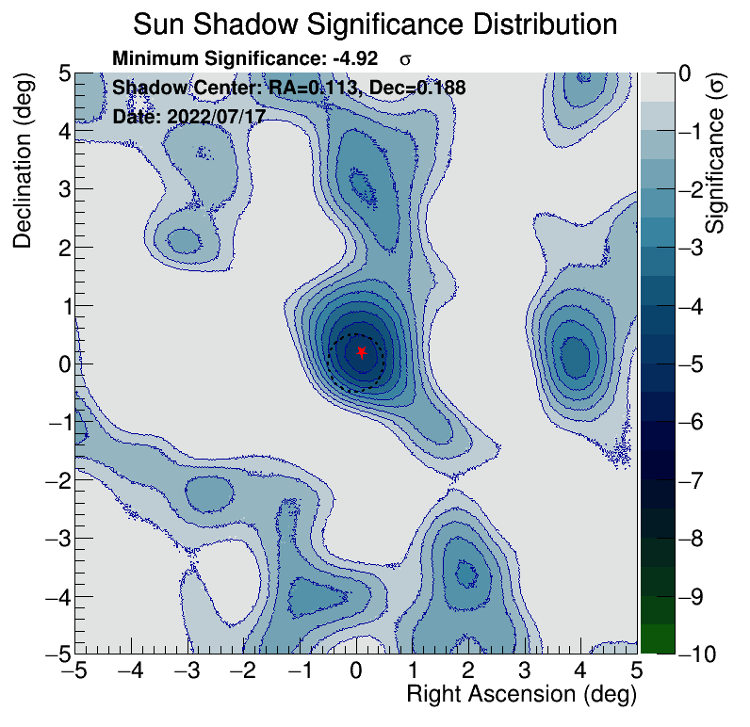
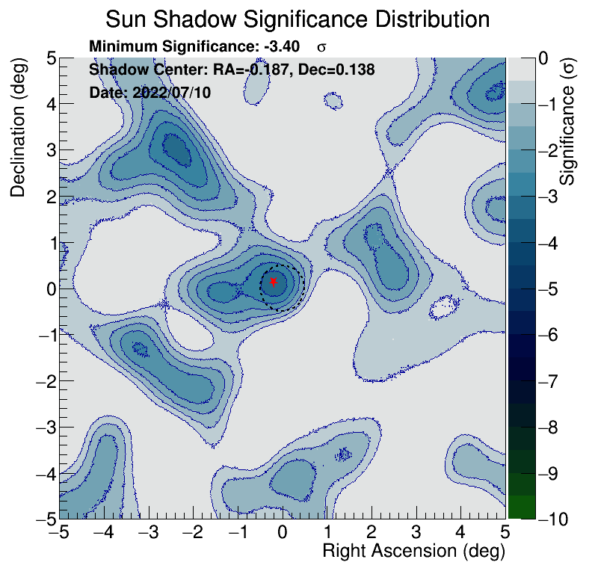
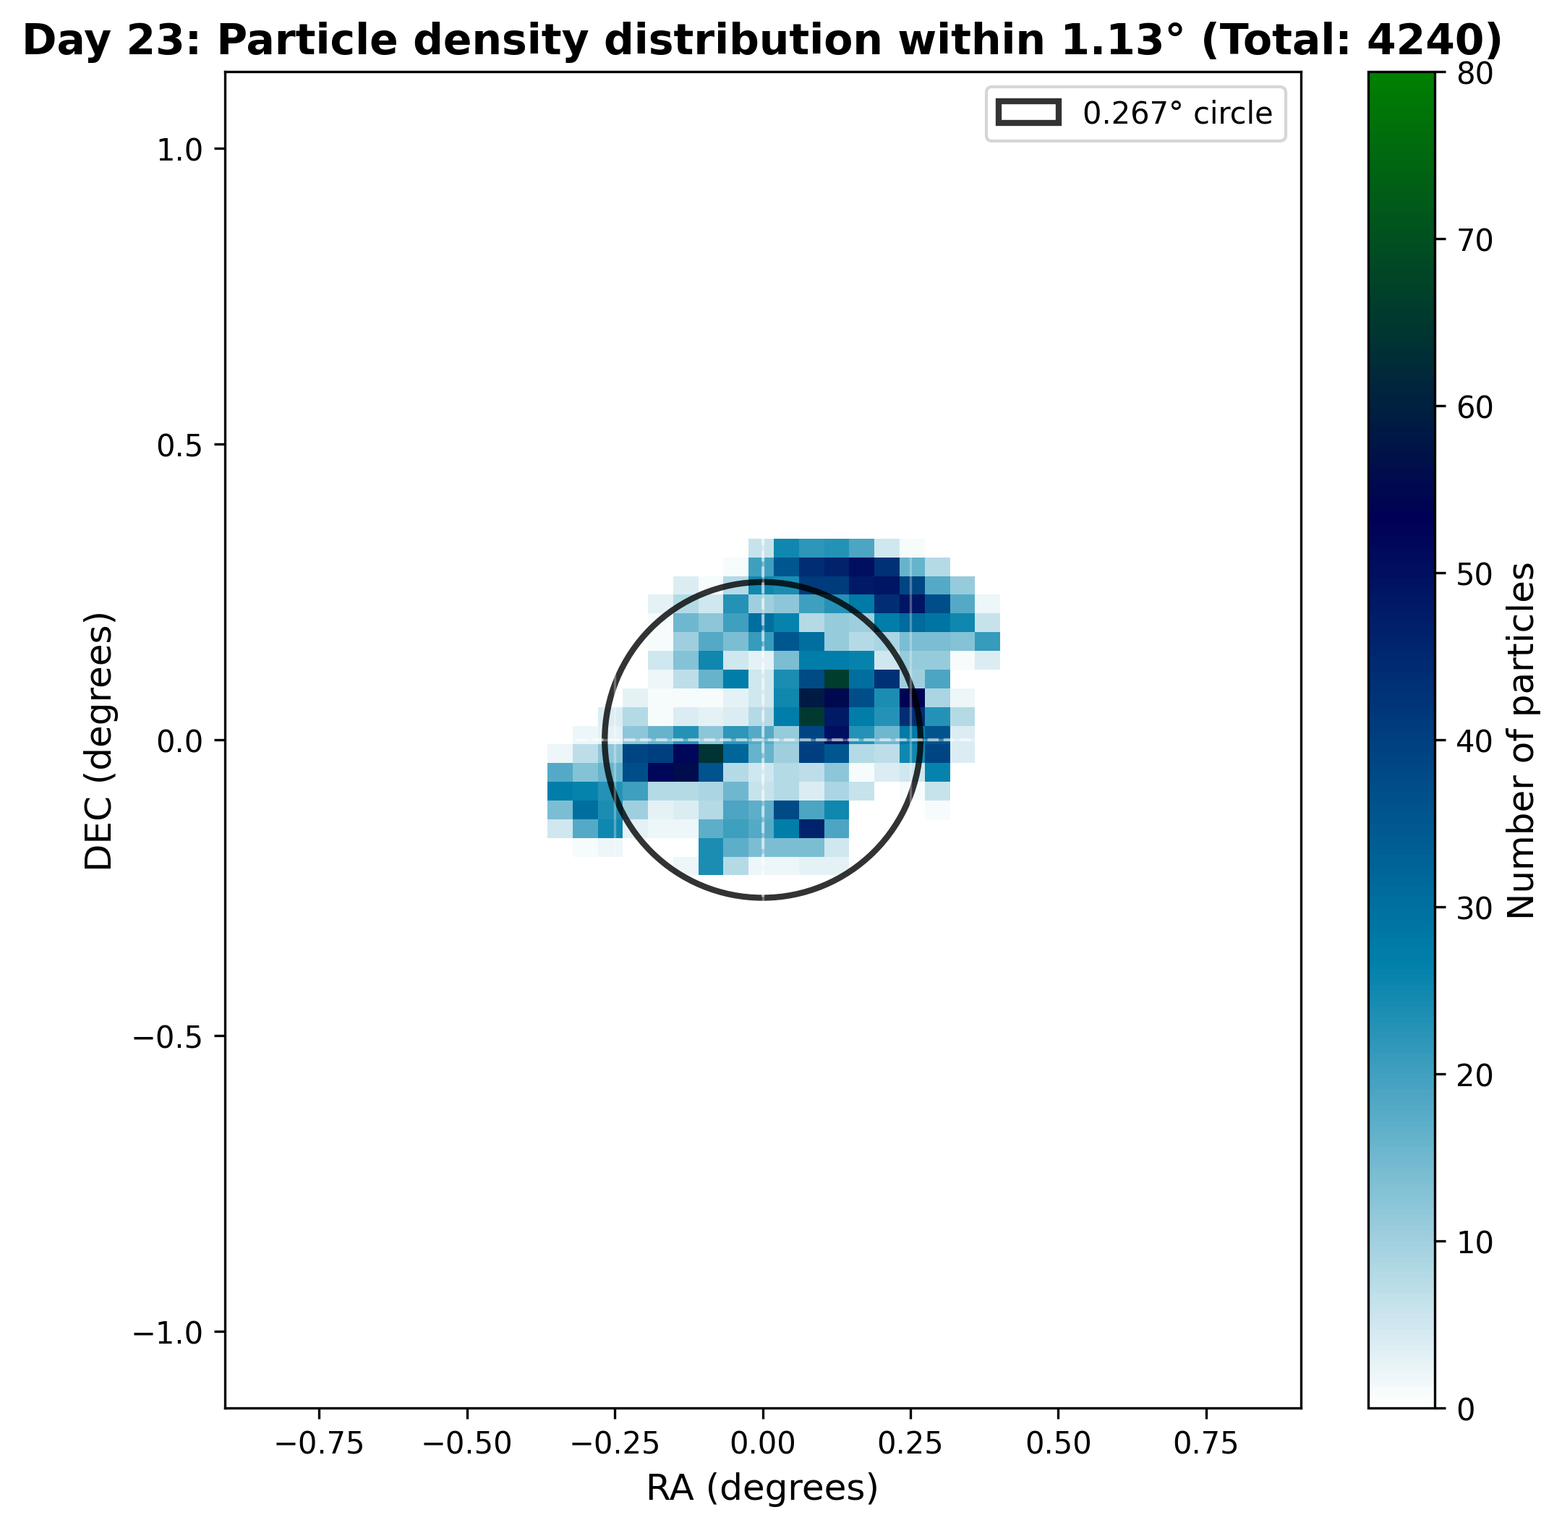
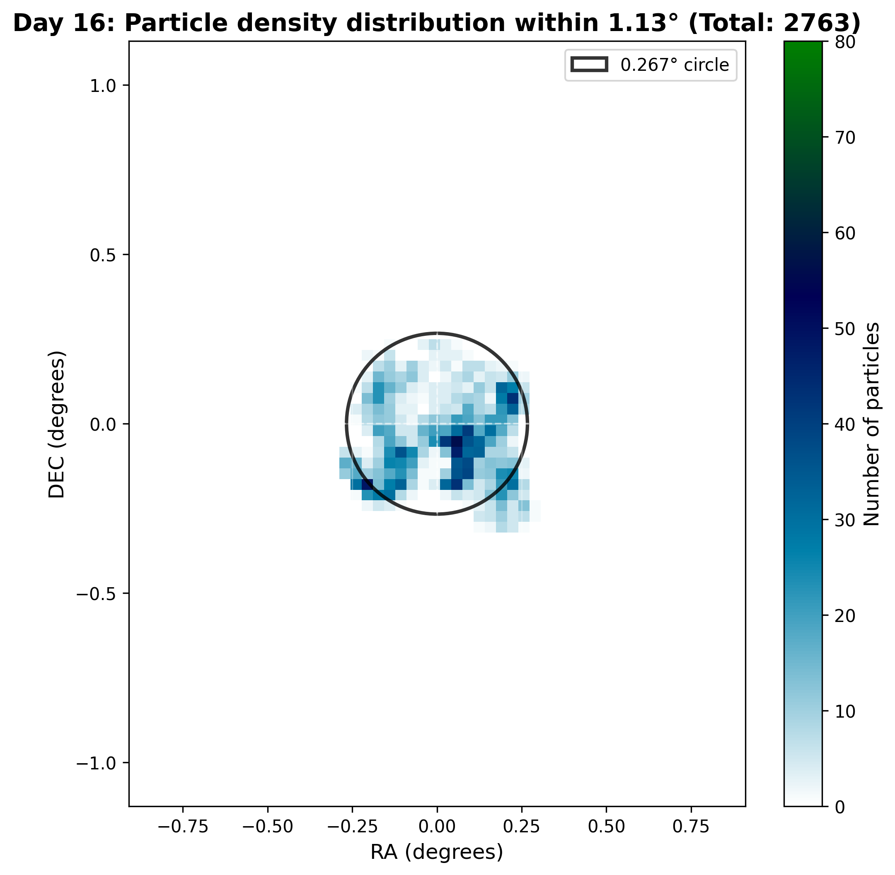
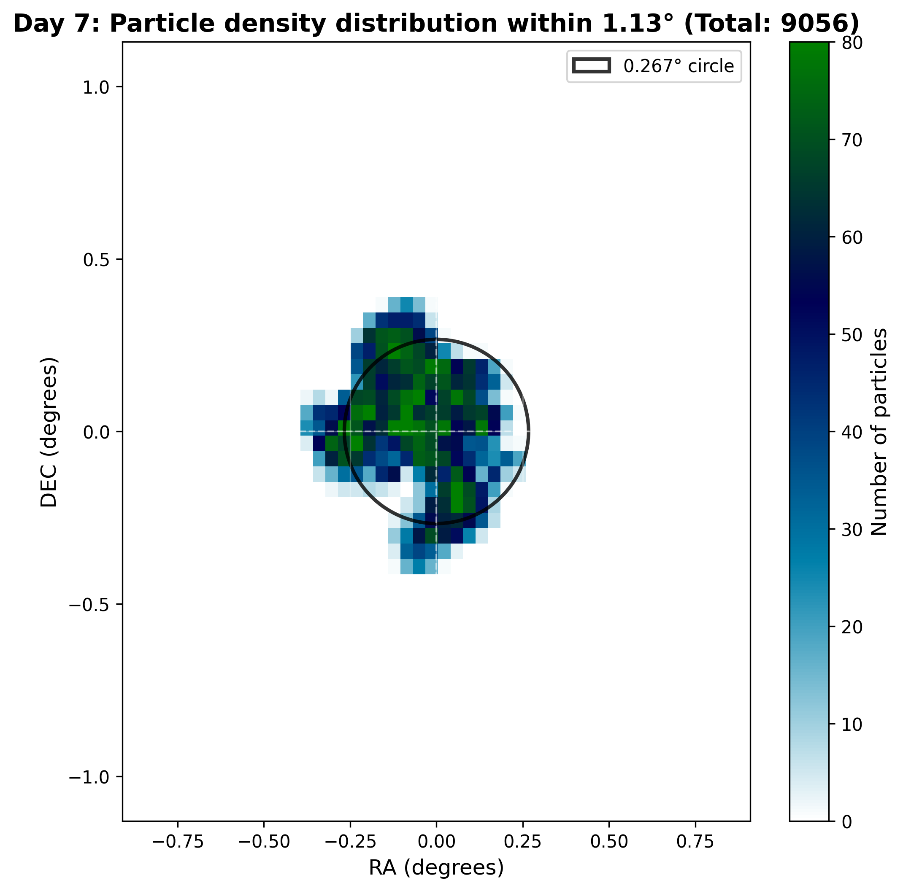
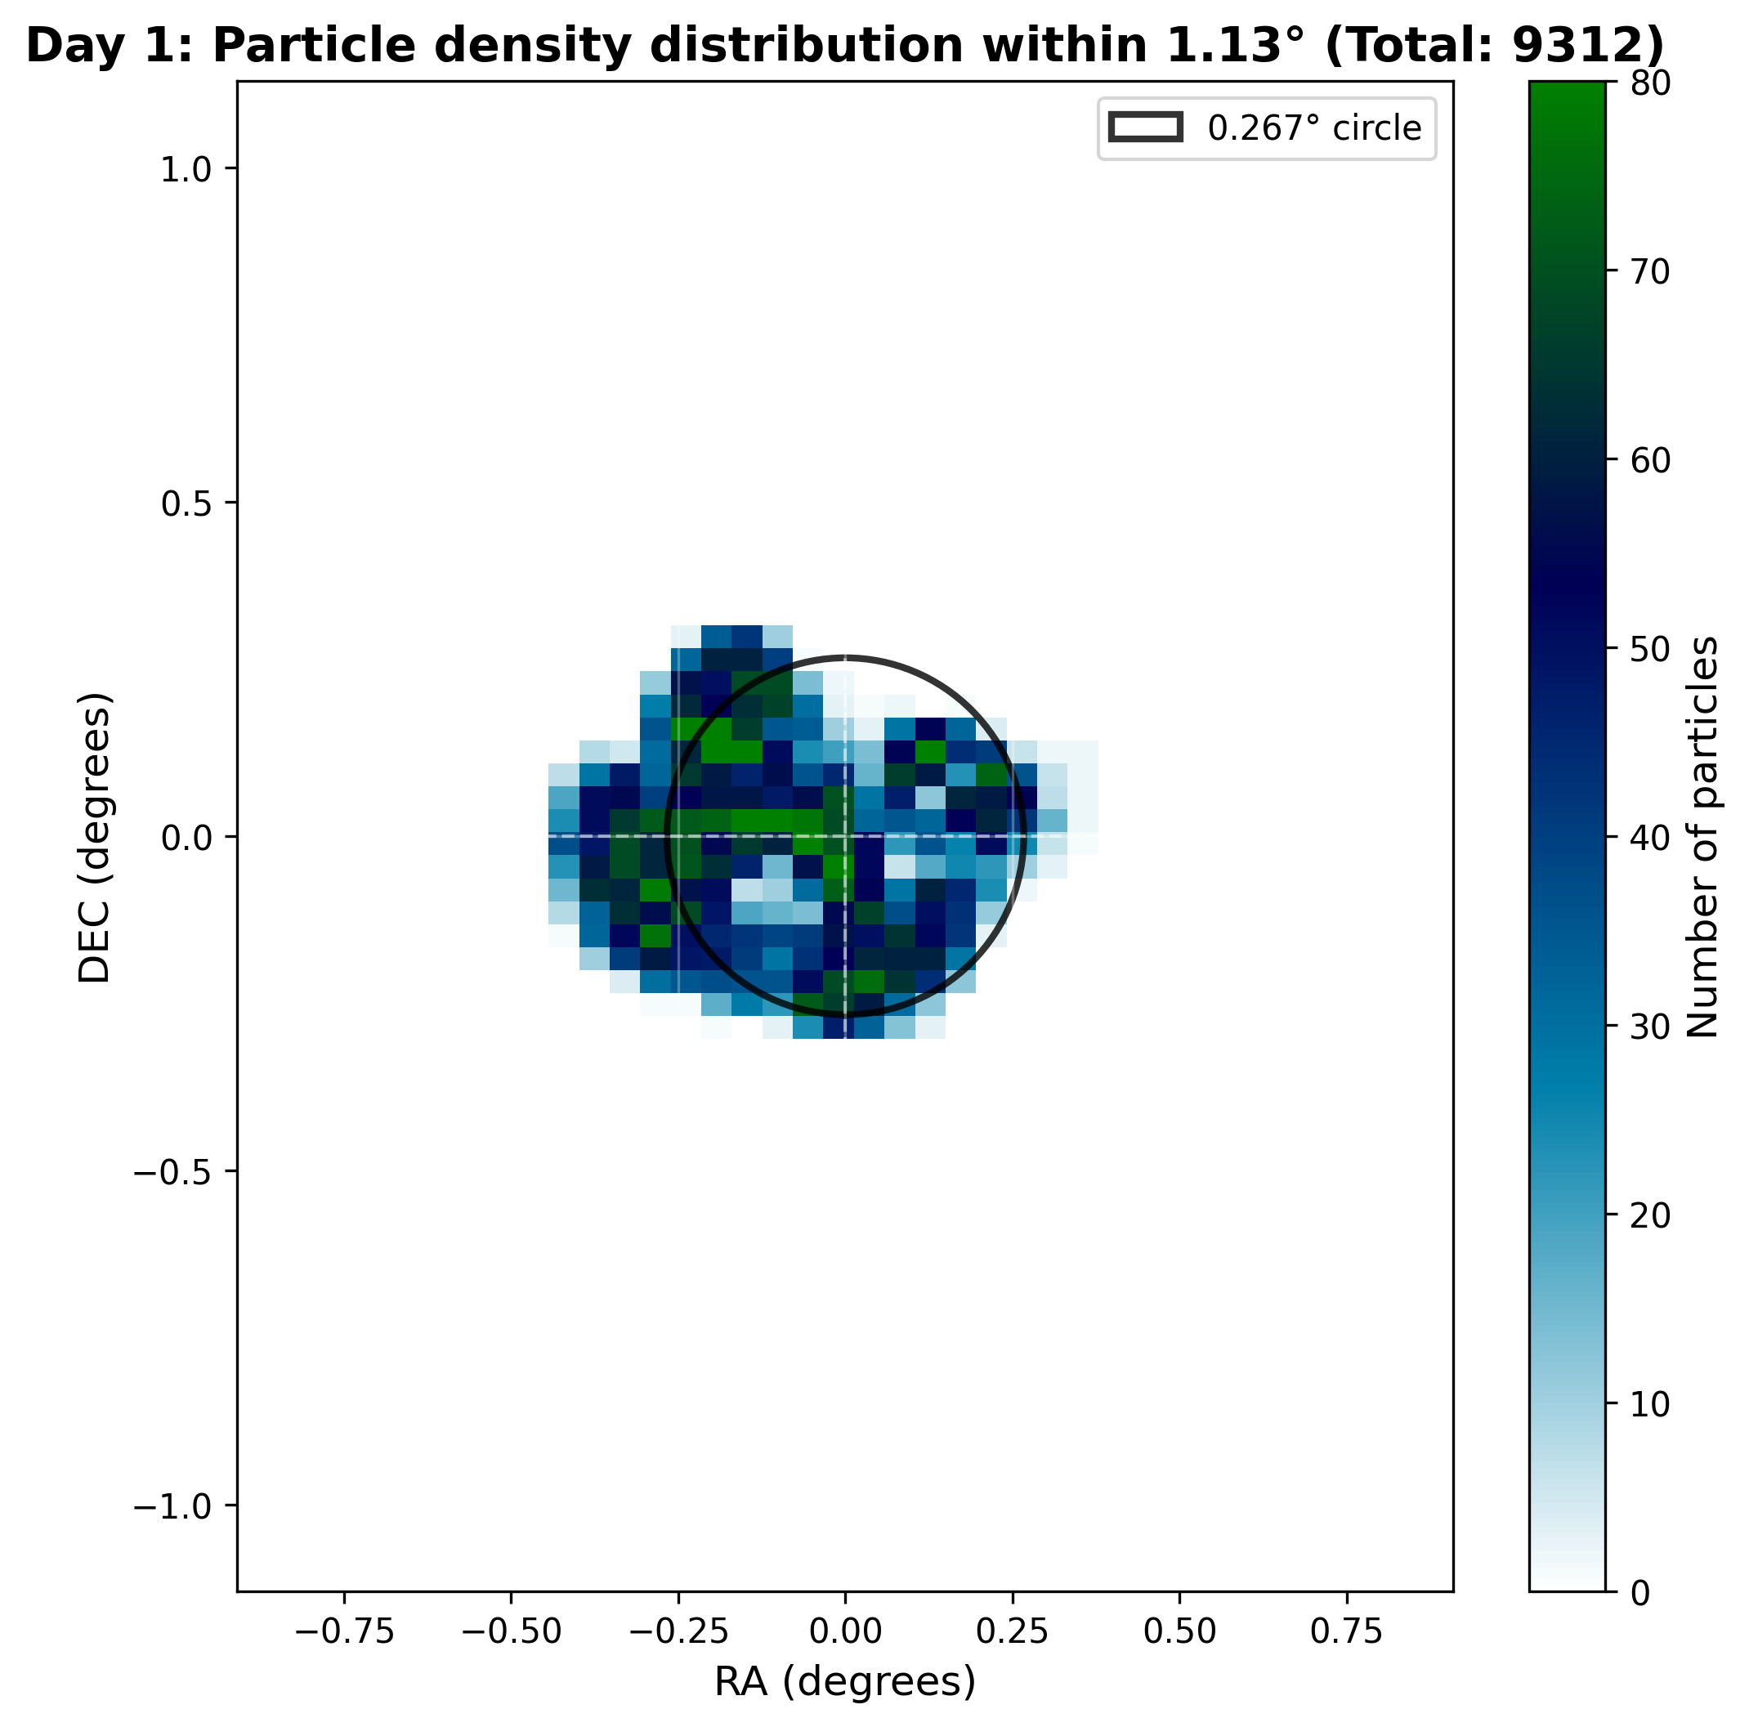
9
Numerical Simulation Method for Reconstructing the Cosmic Ray Sun Shadow Observed by LHAASO-KM2A Using G4Solar
Analysis and Results
2022 Daily sun shadow in CR2259 (27days)
Solar Active Region
Observed sun shadow
Simulated sun shadow
PRELIMINARY
2022-07-17
2022-07-10
2022-07-01
2022-06-25
PRELIMINARY

Slide 5
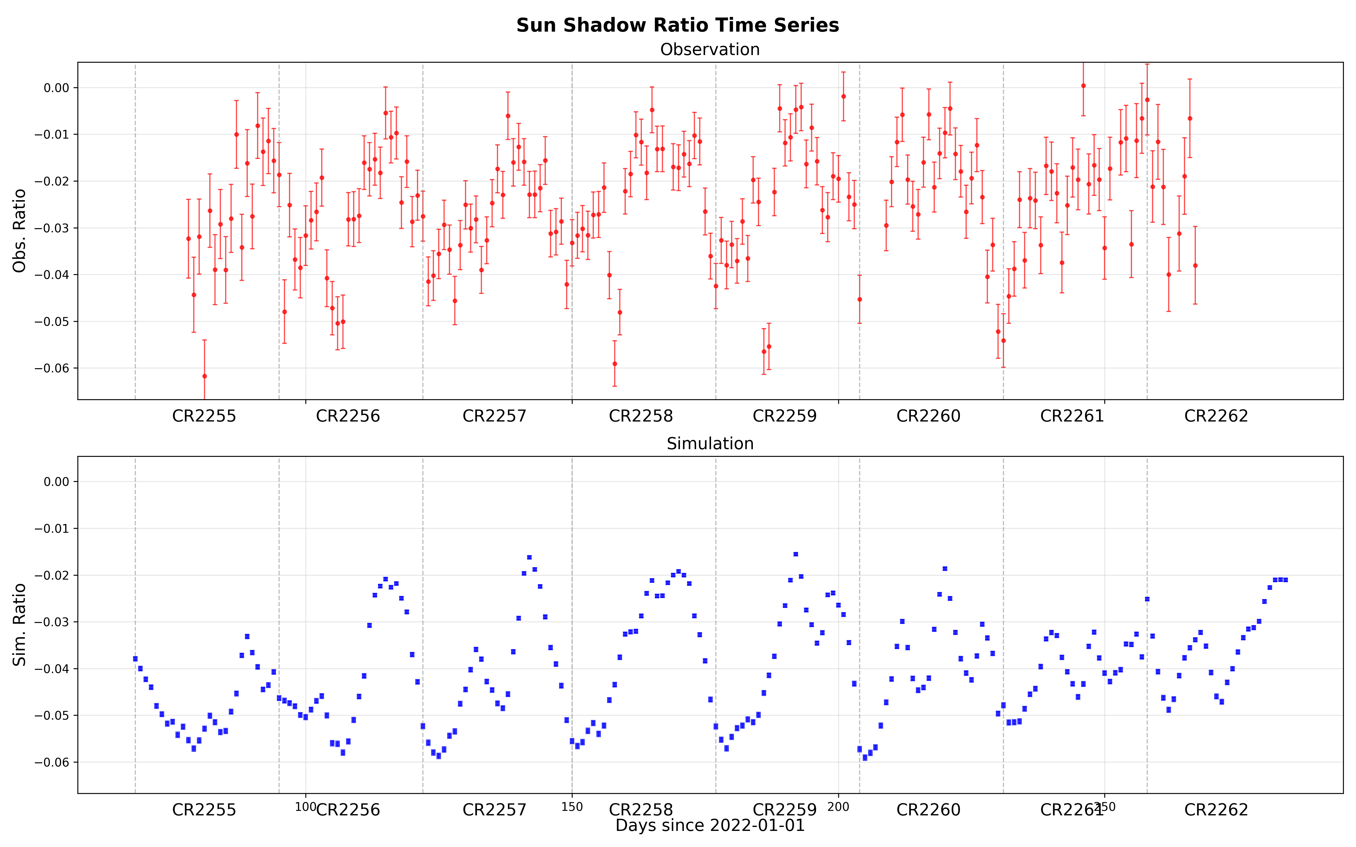
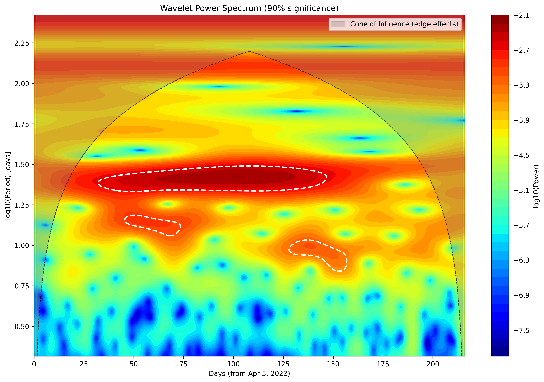
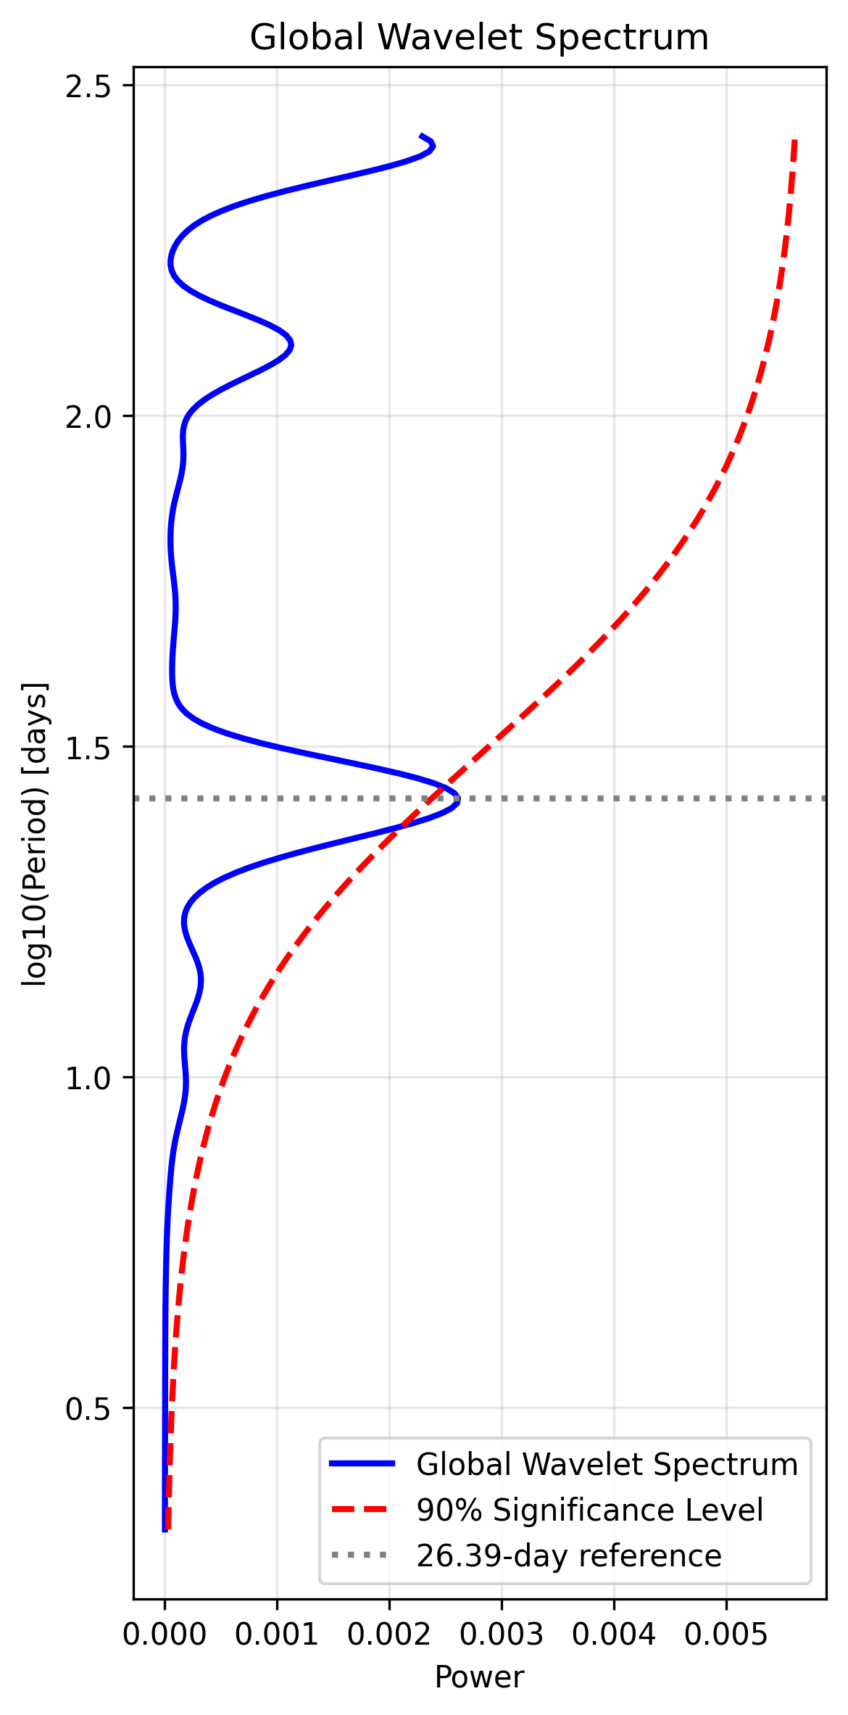
9
Numerical Simulation Method for Reconstructing the Cosmic Ray Sun Shadow Observed by LHAASO-KM2A Using G4Solar
Analysis and Results
Comparison of the time series of sun shadow deficit ratio of 2022
$Dobs = \frac{\sum_{∆θ<1.13}{{(N_{on}−N}_{b})}}{\sum_{∆θ<1.13}{N_{b}}}$ $Dsim = \frac{N_{hit}}{\sum_{∆θ<1.13}{N_{pri}}}$
Consistent periodic variation：
Observed：25.88 days
Simulated：26.39 ± 4.3 days
HMI magnetic field：26.68 days
The periodicity of sun shadow deficit is caused by the periodic solar active regions, and the coronal magnetic field is the key factor.
Observed sun shadow deficit ratio
PRELIMINARY
26.39
Simulated sun shadow deficit ratio

