Slide 1
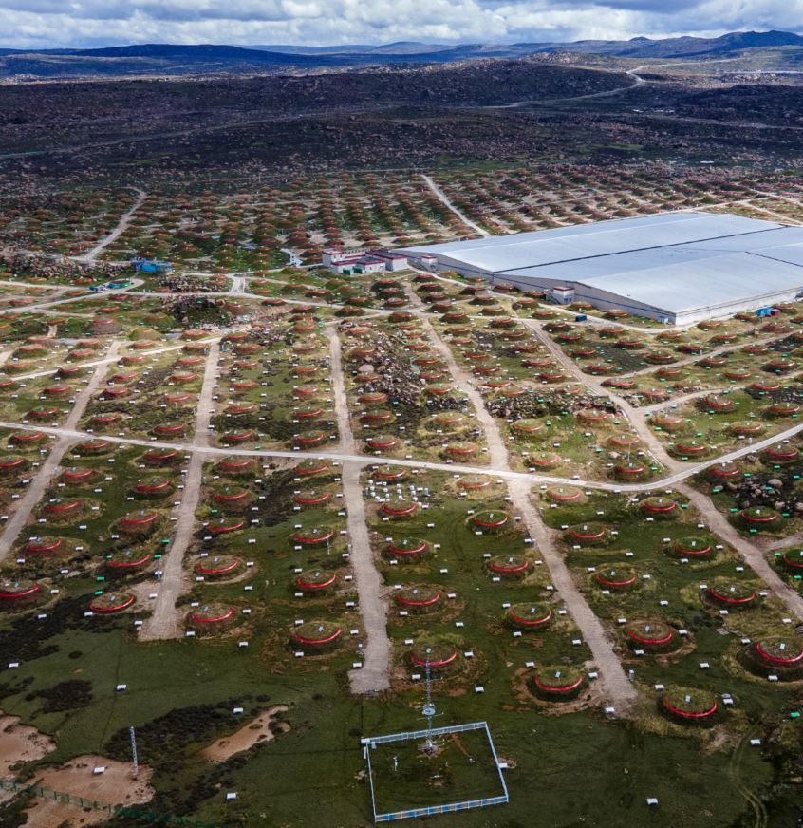
AI for WCDA
Improve WCDA performance using
transformer-backbone AI models
Shicong Hu, Zhiguo Yao, Zijie Huang, Yong Huang | IHEP
Weiwei Li | Z.AI Co., Ltd.
XiaoXiao Wang, Bingke Zhu | IA, CAS
Chenyuan Xu | ZHEJIANG LAB
1st LHAASO General Meeting, 2026
@NJU, Suzhou

Slide 2
Outline
CONTENTS
01
02
Research Background and Overall Plan
Optimization performance of AI model
LHAASO data -> Image, ViT and Overall technical route
Effect of color augment, patch number and model architecture on AI performance
03
Verification on BOAT GRB and Outlook
Q factor and Significance, Plan

Slide 3
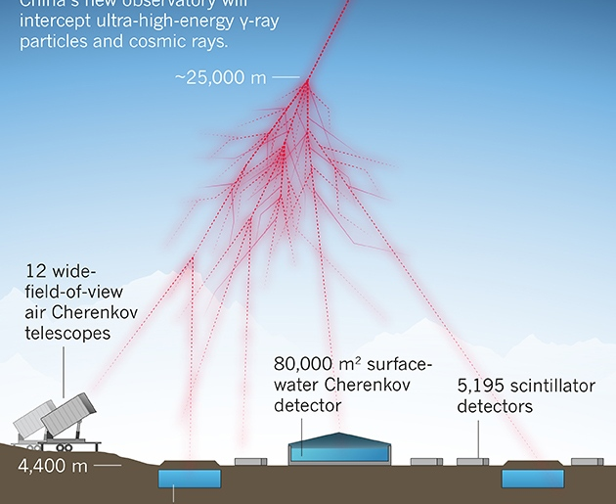
01
CHAPTER 01
Background and Technical route
WCDA performance and AI

Slide 4
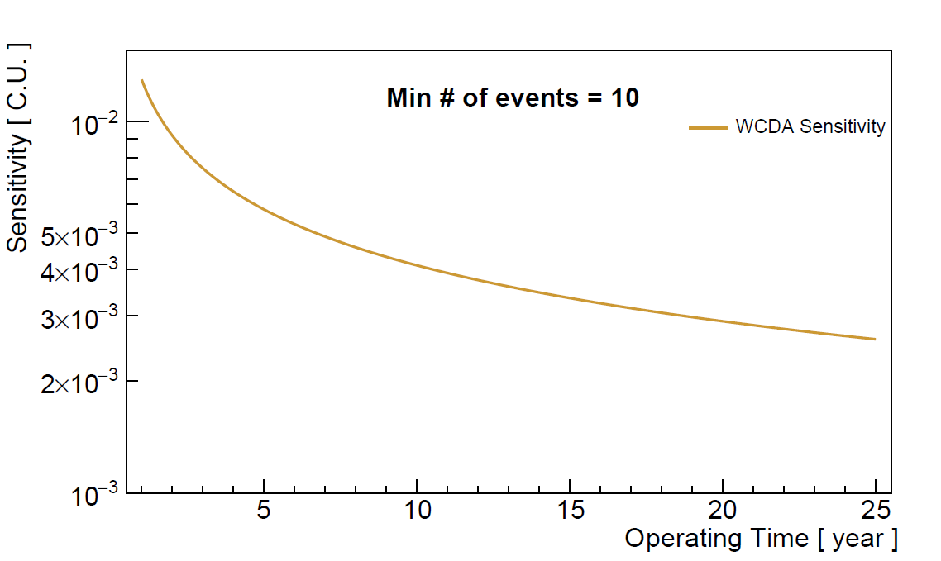
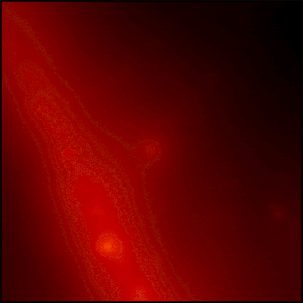
WCDA sensitivity
For steady source
For transient source
The increasement of sensitivity is slowing down as sqrt(T).
Sensitivity for short time-scale transient source not particularly good
By now, 1 GRB, ~20 AGN (~100 at TeV)
1.3% CU
@ 1 year
credit: NASA, DOE, Fermi-LAT
this year
4 / 19
Notes:
We urgently need to develop some new methods to enhance the performance of WCDA.

Slide 5


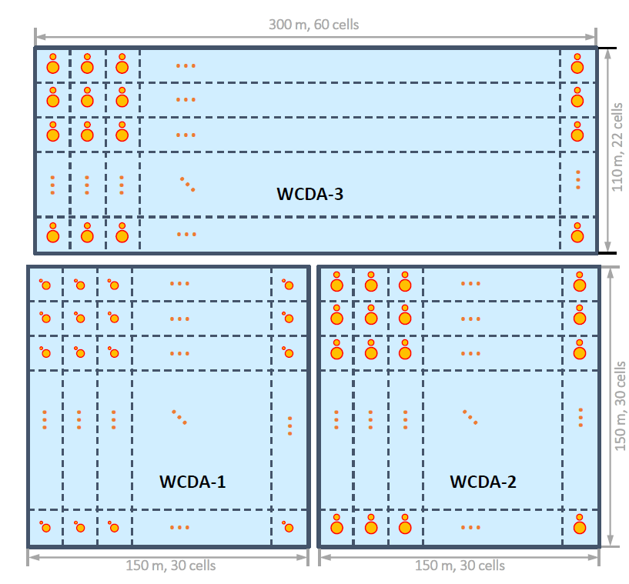
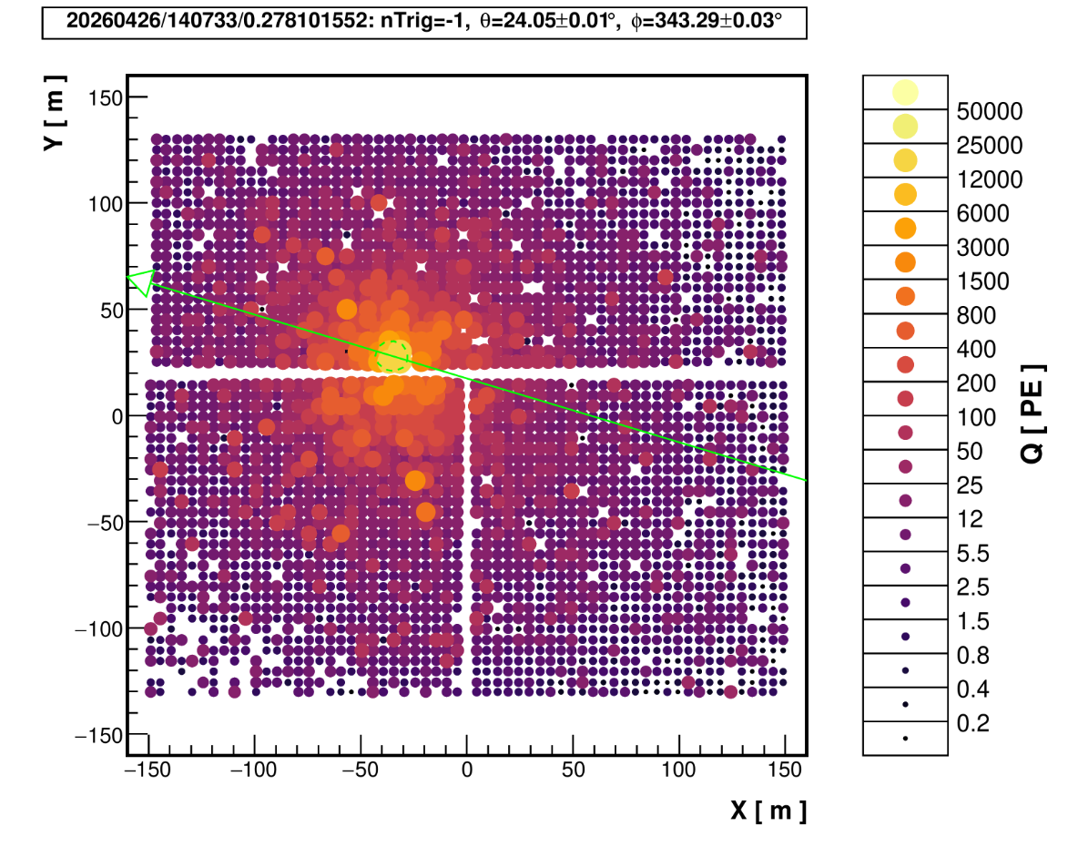
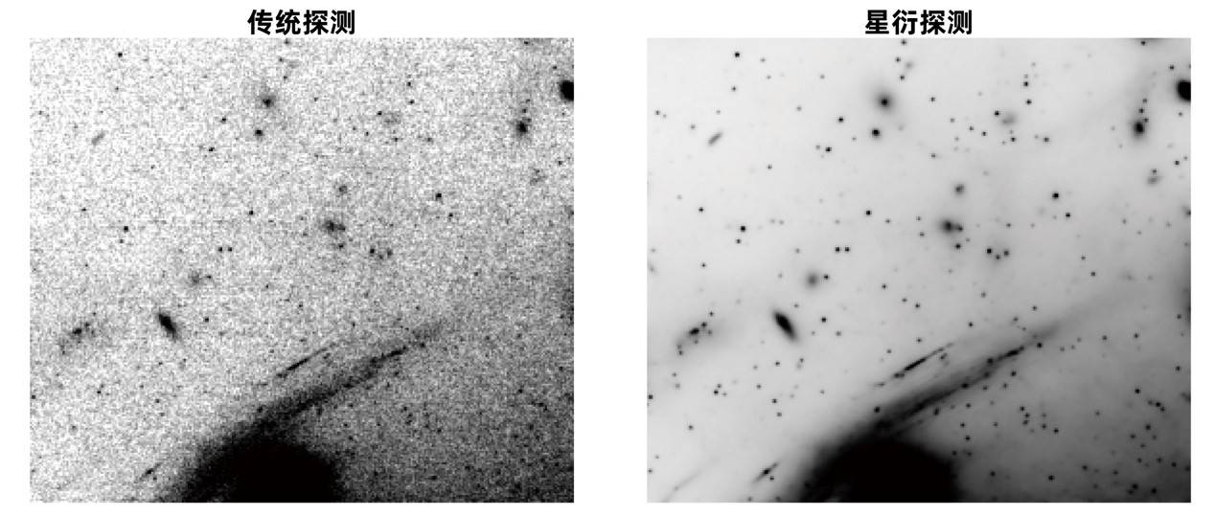
AI for LHAASO
AI for Science
AI for WCDA
AI significantly increased the detection depth of the James Webb Space Telescope by 1 magnitude (Y.D. Guo, et al, Science, 2026)
Traditional
ASTERIS
WCDA is a planar detector, and its events are suited to be represented as an image.
5 / 19
Notes:
至于AI，like ChatGPT、Alpha fold、ASTERIS Significantly increased the detection depth of the James Webb Space Telescope (JWST) (by 1 magnitude)

Slide 6
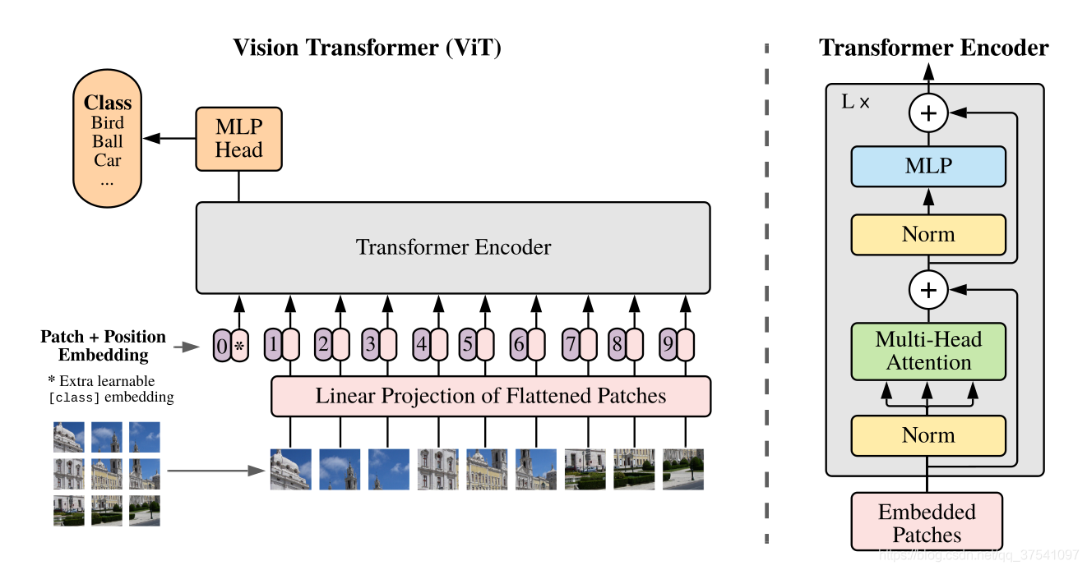
Vision Transformer
vit-base-patch16-224-in21k | ~80M parameters
Merge the tokens and extract the features
Patch
Patch -> 768-dimension vector space (token)
Transformer
Encoder
Multi-Head Attention
MLP + LayerNorm
Gamma probability
Patch Embedding
+ Position Embedding
+ [CLS] Token
768-dimension -> 2-dimension
MLP
Head
CRs probability
Classification
Input Image
Linear Projection
L × Blocks
Key feature
Base: model size ~86M parameters
Patch16: 16×16 pixel/patch
224: input image size 224×224 pixels
in21k: pre-training on ImageNet-21k
→ 224×224 image → 14×14 = 196 patches
6/ 19

Slide 7
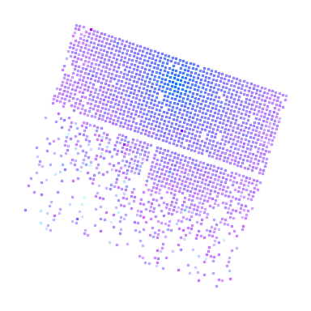
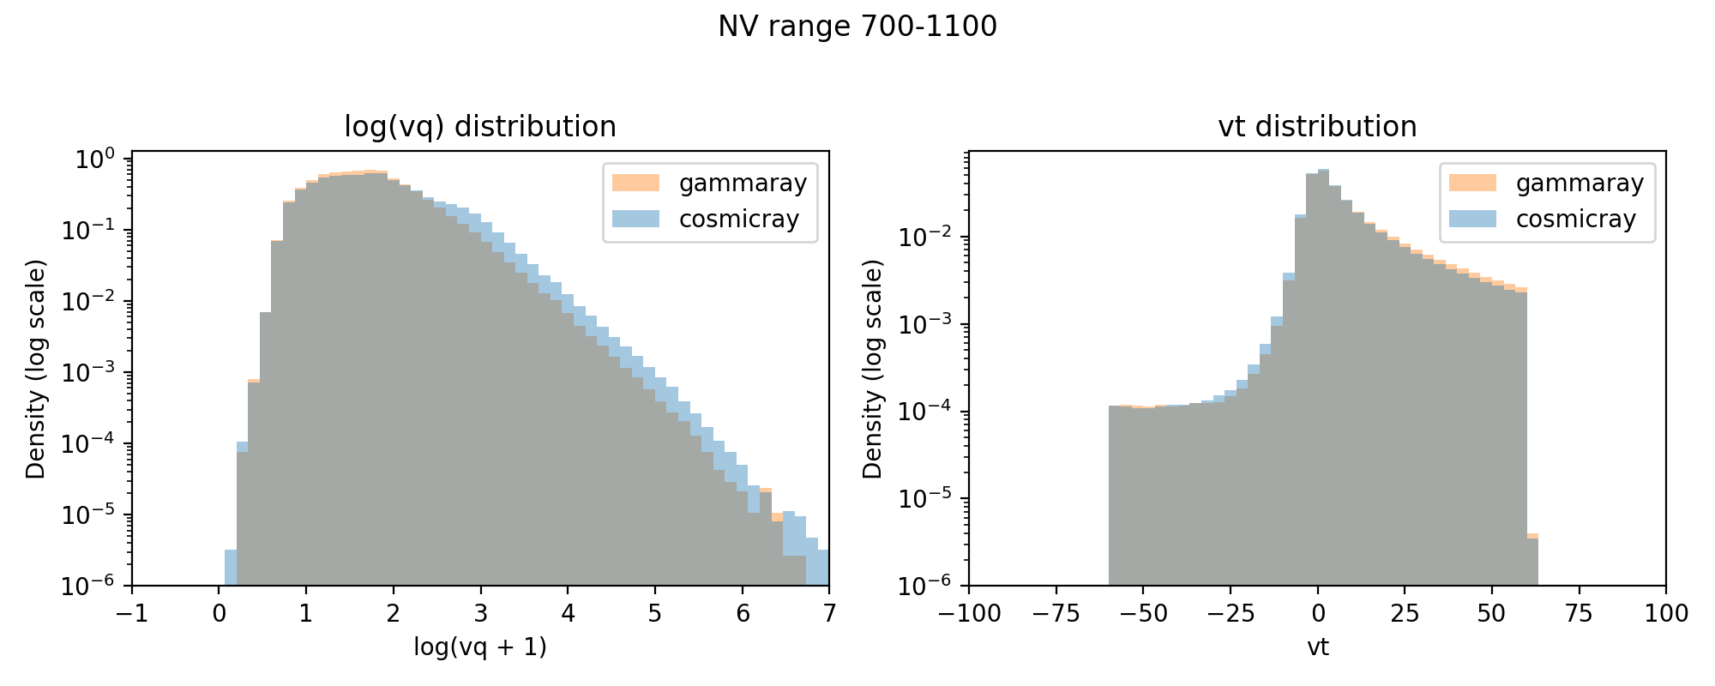
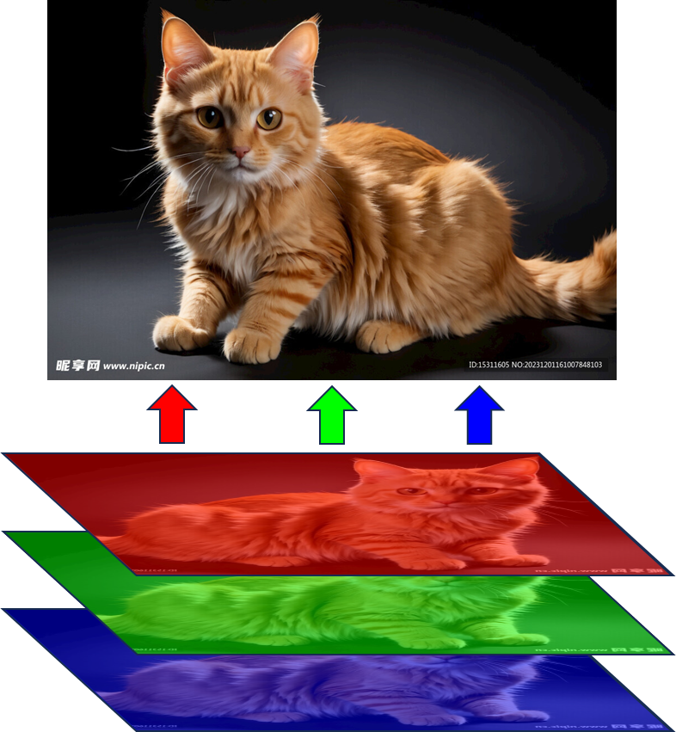
LHAASO Data -> Image
Process of data projection
Q
T
log10(q)+2
• Q → Red channel of image
• T → Green channel of image
• Linear projection and discretization to 0-255
• image size: 224×224
Q, T are aligned at the pixel level
Q, T
Linear projection
224×224
7 / 19

Slide 8
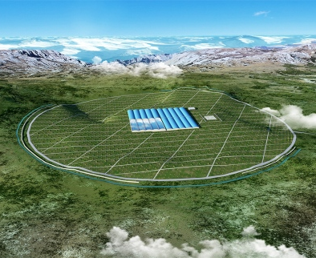
02
CHAPTER 02
Optimization performance of AI model
Effect of color augment, patch number and model architecture
on AI performance

Slide 9
Optimization on classification of Gamma/CRs
Experiment setting
Testing of image preprocessing
Train simulation dataset: ~1.3e7 events, Gamma:CRs 1:1
Test simulation dataset: ~3e6 events
Verify on real data: Crab, half month
The typical preprocessing includes color augment, and experiments have shown that removing it leads to better results.
• remove color augment (~4%↑)
• Increase patch number (~10%↑)
• Resize 1024→224/384
• Rotation, flip
Removing color augment ~4% performance up
Crab significance @ N_{hit}>125 (~2 TeV)
Version | Crab Significance
with augment | 1.29 times
without augment | 1.34 times
9 / 19

Slide 10
Optimization on classification of Gamma/CRs
vit-base-patch16-224
vit-base-patch16-384
Testing of image preprocessing
• image size: 224 × 224
• Patch number: 14 × 14 = 196 patches
• Each patch: 16 × 16 pixels
• image size 384 × 384
• Patch number: 24 × 24 = 576 patches
• Each patch: 16 × 16 pixels
• remove color augment (~4%↑)
• Increase patch number (~10%↑)
• Resize 1024→224/384
• Rotation, flip
Patch Division Illustration (14×14 vs 24×24)
14 × 14 = 196
24 × 24 = 576
Patch 14×14 → 24×24: Crab significance ~10% up
Crab significance: ×1.34 → ×1.47
10 / 19

Slide 11
Optimization on classification of Gamma/CRs
ViT -> Swin transformer
Testing of image preprocessing
Characteristic | ViT | Swin
Attention mechanism | Global self-attention | Shifted Window Attention
Position embedding | Absolute embedding | Relative embedding
Feature extraction | Single scale | Multi scale
Computation complexity | O(n²) | O(n)
• remove color augment (~4%↑)
• Increase patch number (~10%↑)
• Resize 1024→224/384
• Rotation, flip
Swin's multi-scale feature extraction and relative position embedding are more suitable for the local structural features of event images, and can further increase by ~7%
Exploration of Model Architecture
• ViT → Swin Transformer
• Multi-scale feature extraction
• Relative position embedding
Crab Significance: ×1.47 → ×1.57
Overall factor of Crab significance
×1.57
improved by 57% compared to traditional methods
11 / 19

Slide 12
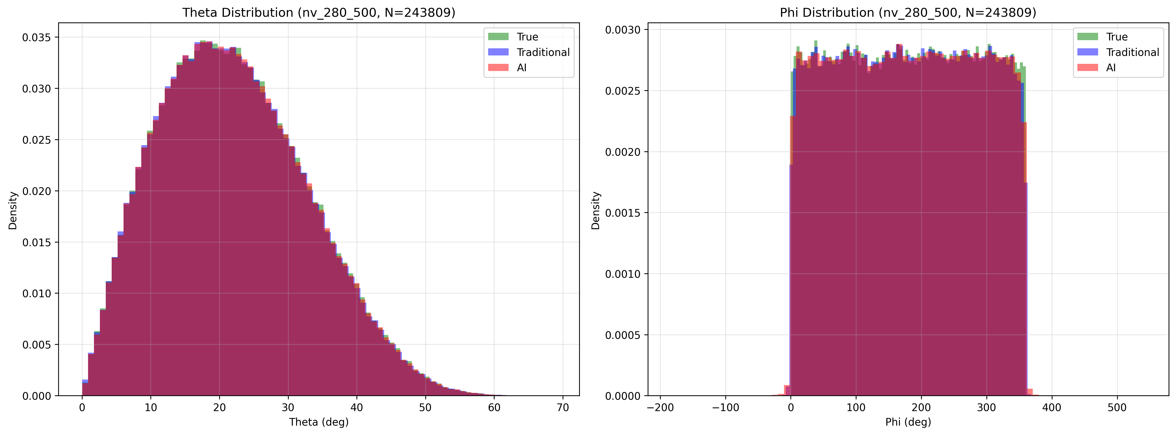
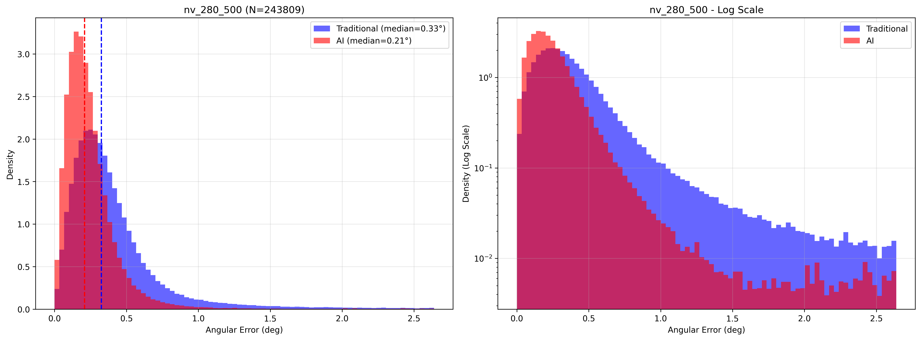
Applied to direction reconstruction
Zenith angle
Azimuth angle
Testing of image preprocessing
• remove color augment (~4%↑)
• Increase patch number (~10%↑)
• Resize 1024→224/384
• Rotation, flip
Angular distance between true and rec
Exploration of Model Architecture
• ViT → Swin Transformer
• Multi-scale feature extraction
• Relative position embedding
12 / 19

Slide 13
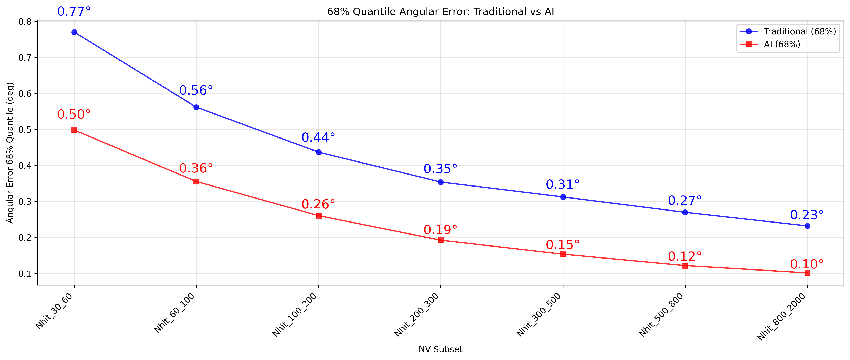
Applied to direction reconstruction
Testing of image preprocessing
• remove color augment (~4%↑)
• Increase patch number (~10%↑)
• Resize 1024→224/384
• Rotation, flip
Direction resolution
@ Simulation data
×~0.60
Exploration of Model Architecture
• ViT → Swin Transformer
• Multi-scale feature extraction
• Relative position embedding
Crab significance improvement
with AI direction
Overall Crab significance factor
~1.5×
~2.35×
improved by ~50% compared to traditional methods
improved by ~135% compared to traditional methods
13 / 19

Slide 14
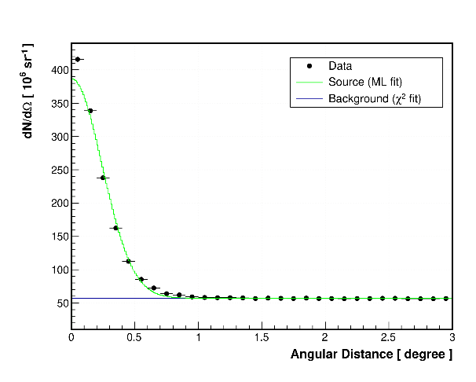
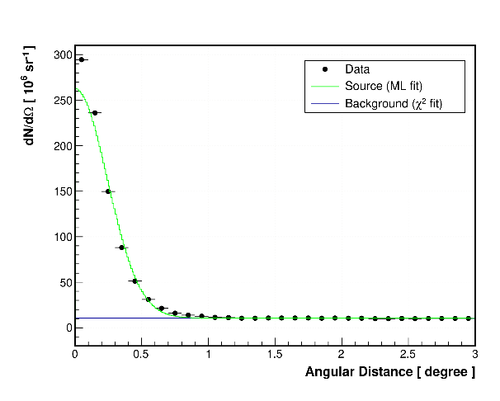
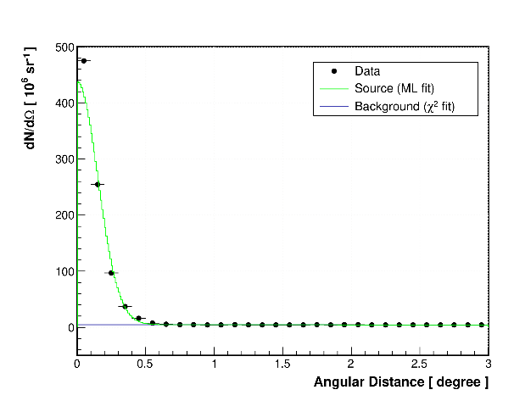
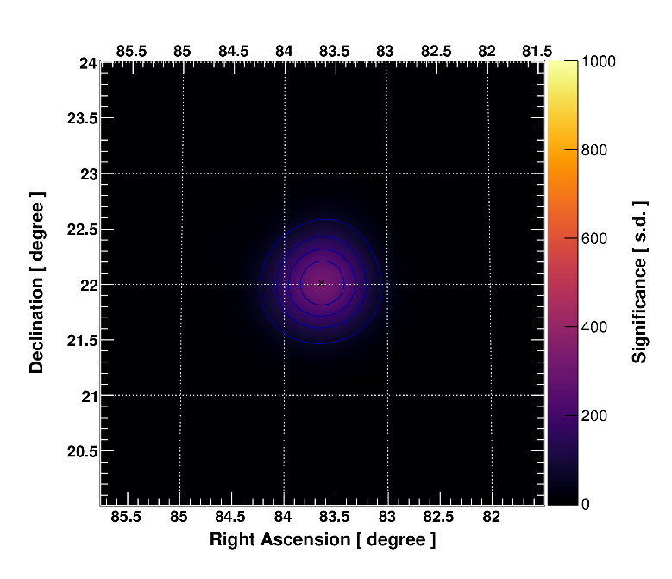
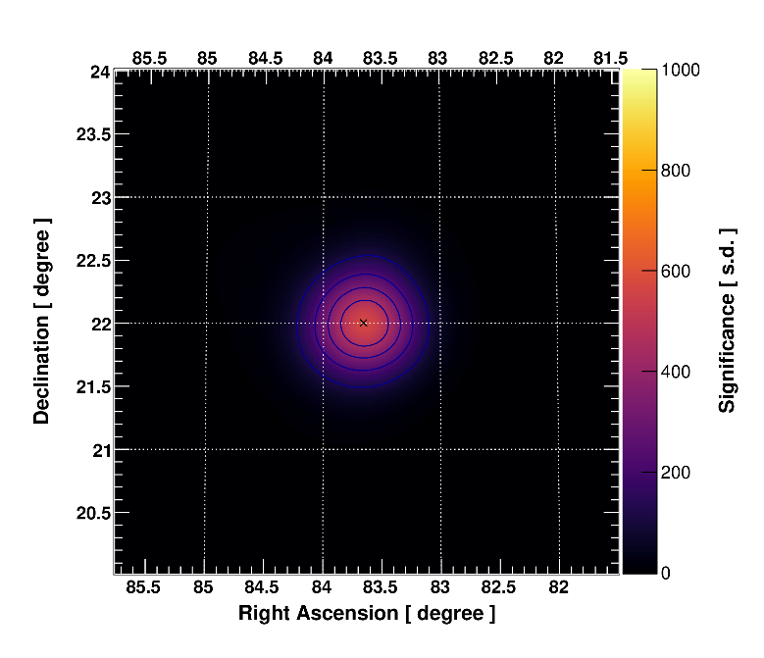
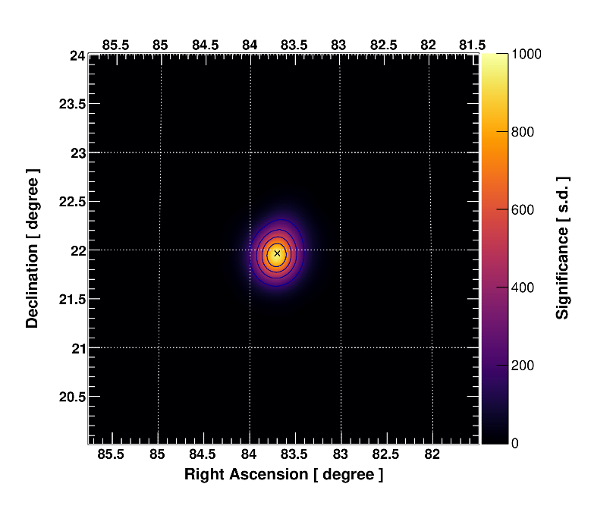








AI-powered WCDA: CRAB In 2022
@N_{hit}≥125, ~2 TeV
$$φ_{70}=0.38^{∘}$$
$$φ_{70}=0.38^{∘}$$
$$φ_{70}=0.24^{∘}$$
$$Classification$$
$$Reconstruction$$
$$σ_{max}=380$$
$$σ_{max}=570$$
$$σ_{max}=950$$
14/ 19

Slide 15
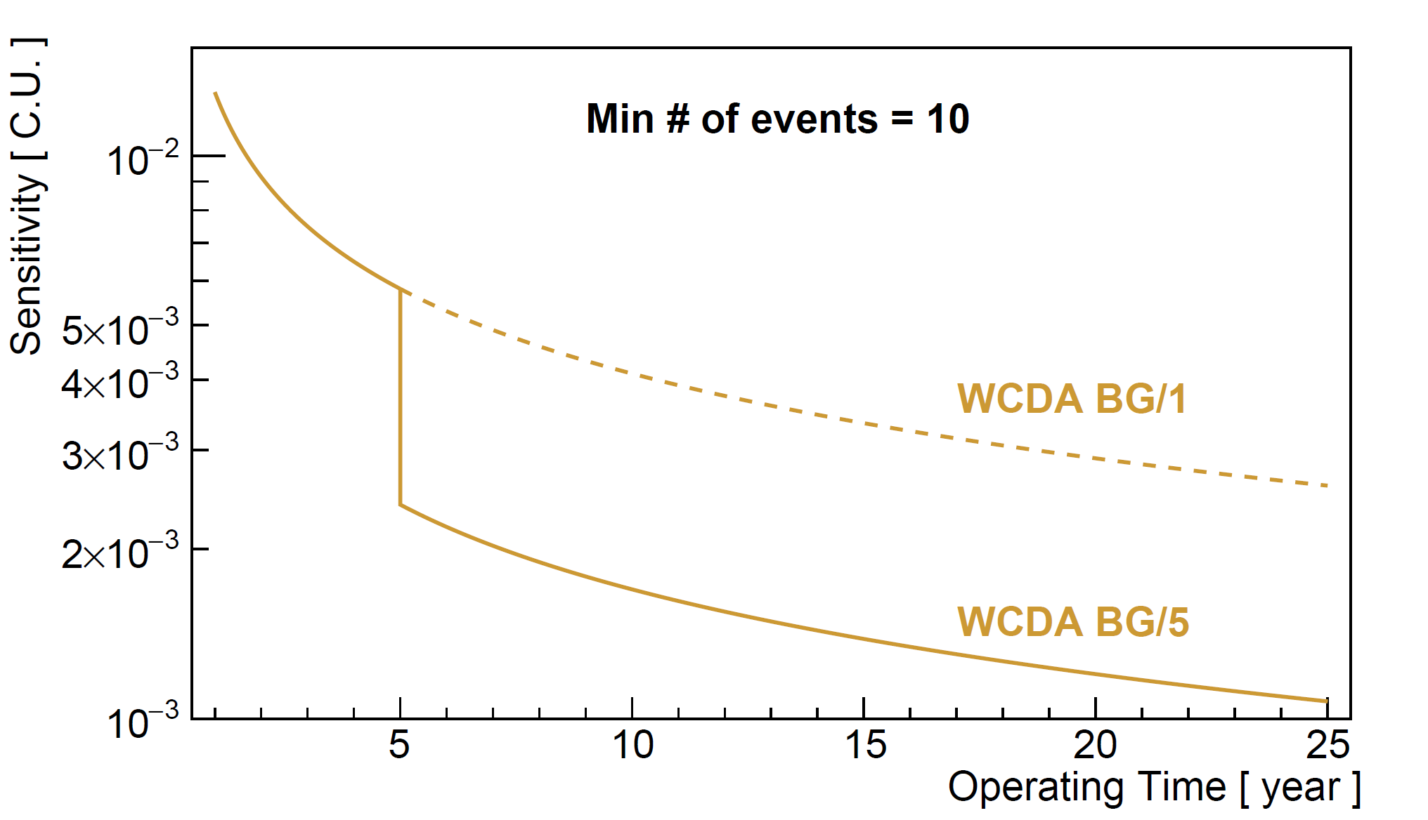
AI-powered WCDA
15/ 19

Slide 16
03
CHAPTER 03
Verification on BOAT GRB and Outlook
Q factor and Significance, Plan

Slide 17
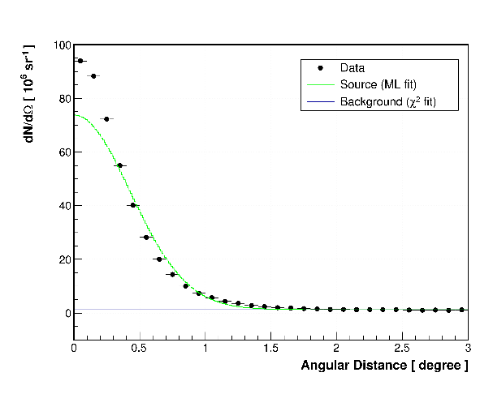
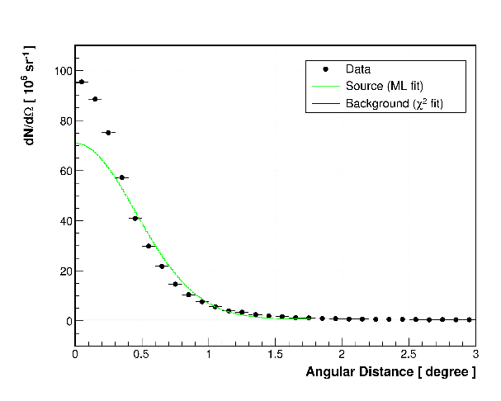
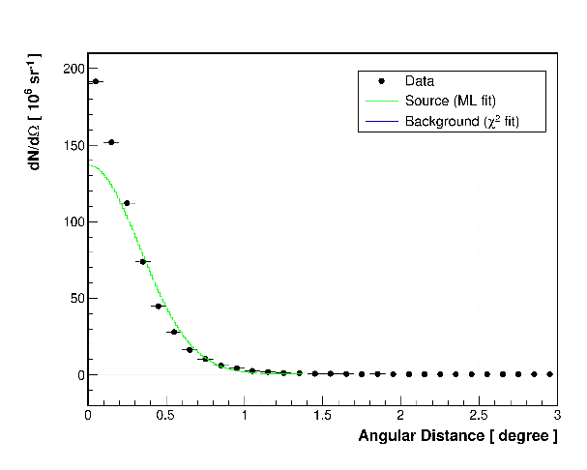
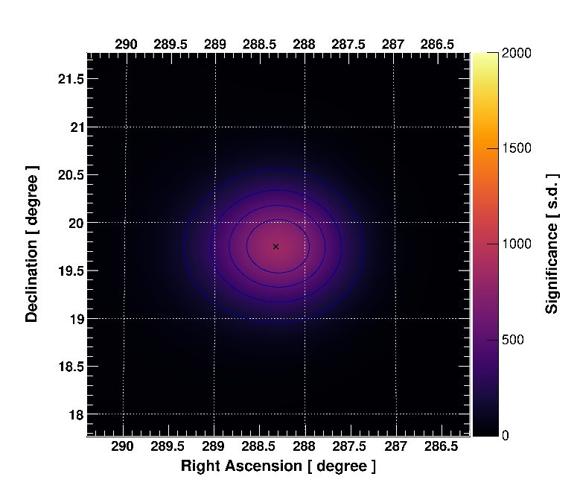
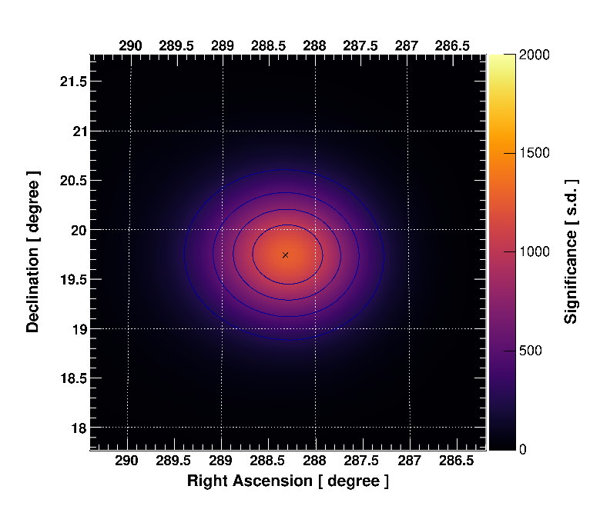
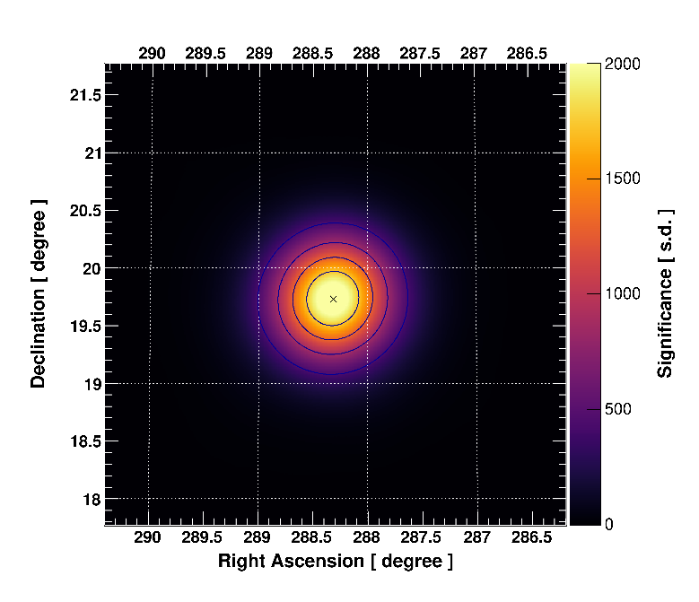


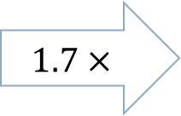

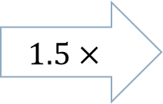



AI-powered WCDA: GRB 221009A (2 Hours)
N_{hit}≥5
$$Classification$$
$$Reconstruction$$
$$σ_{max}=830$$
$$1.5×$$
$$σ_{max}=1280$$
$$1.7×$$
$$σ_{max}=2160$$
First Look At Light Curve of AI-Enhanced BOAT GRB will be presented in the last talk tomorrow morning.
17 / 19

Slide 18

Summary & Outlook
Key conclusion
Plan
• Gamma/CRs classification: Crab significance ×1.57
• Direction reconstruction: Crab significance ~1.5×
• BOAT GRB: background reduced by ~10×
Developing AI models for improving WCDA performance
• Scaling on patch number and model size
• Deep research of model architecture: CNN$⊗$transformer, MOE, ViT->Swin
• Multi-tasks synergistic enhancement
• More sources used for verification: Mrk 421, J2226+6057 etc.
Simulation vs. Experiment
Use AI-powered data to do physical analysis
We are here now.
Shicong Hu | IHEP
1st LHAASO General Meeting, 2026 @ NJU, Suzhou

Slide 20
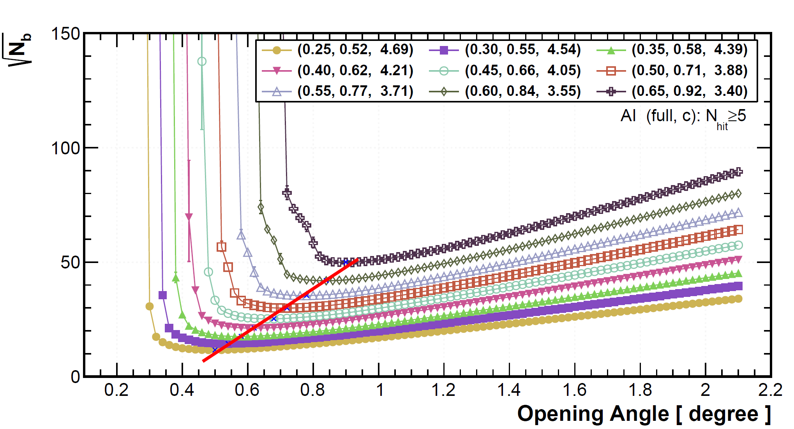
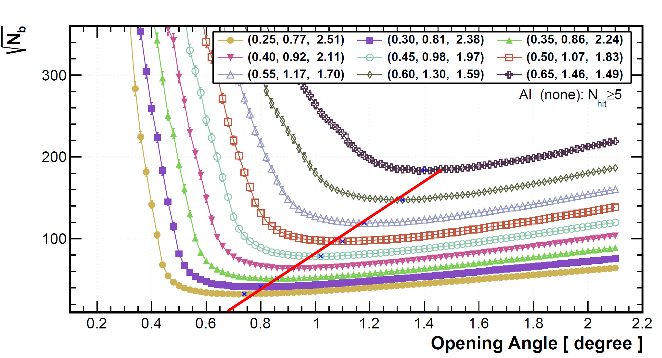
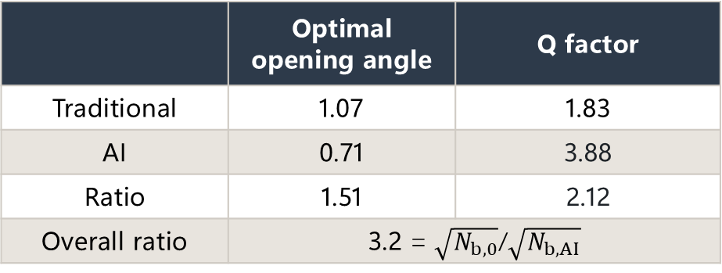
Q factor and angular resolution of BOAT GRB
AI
( Gamma ray retention ratio,
Optimal opening angle,
Q factor of Gamma/CRs classification )
 | Optimal opening angle | Q factor
Traditional | 1.07 | 1.83
AI | 0.71 | 3.88
Ratio | 1.51 | 2.12
Overall ratio | 3.2 = $\sqrt{N_{b,0}}$/$\sqrt{N_{b, AI}}$
Traditional
→ With the same gamma retention ratio, the background level is reduced by 10 times.
First Look At Light Curve of AI-Enhanced BOAT GRB will be presented in the last talk tomorrow morning.
18 / 19

Slide 21
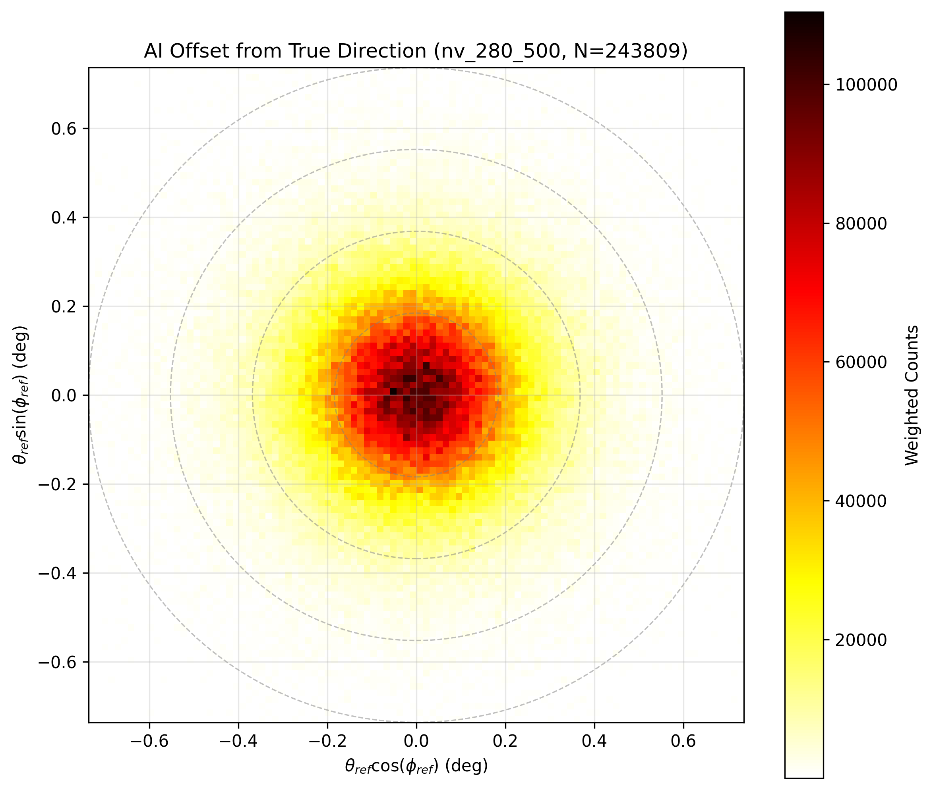
Applied to direction reconstruction
12 / 19

Slide 22
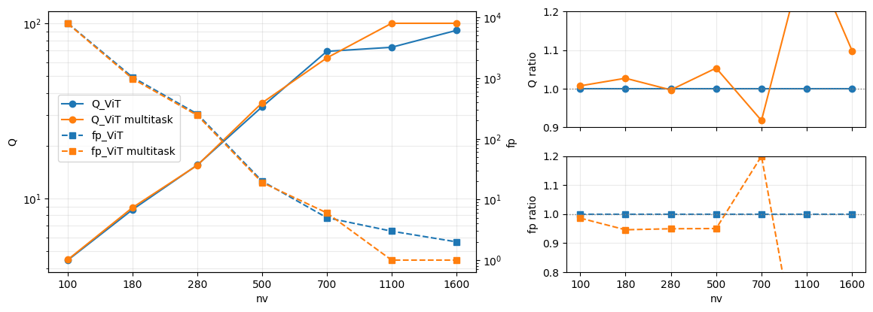
Multi task: Gamma/Proton & Energy reconstruction
Same Setting as optimal G/P

Slide 23
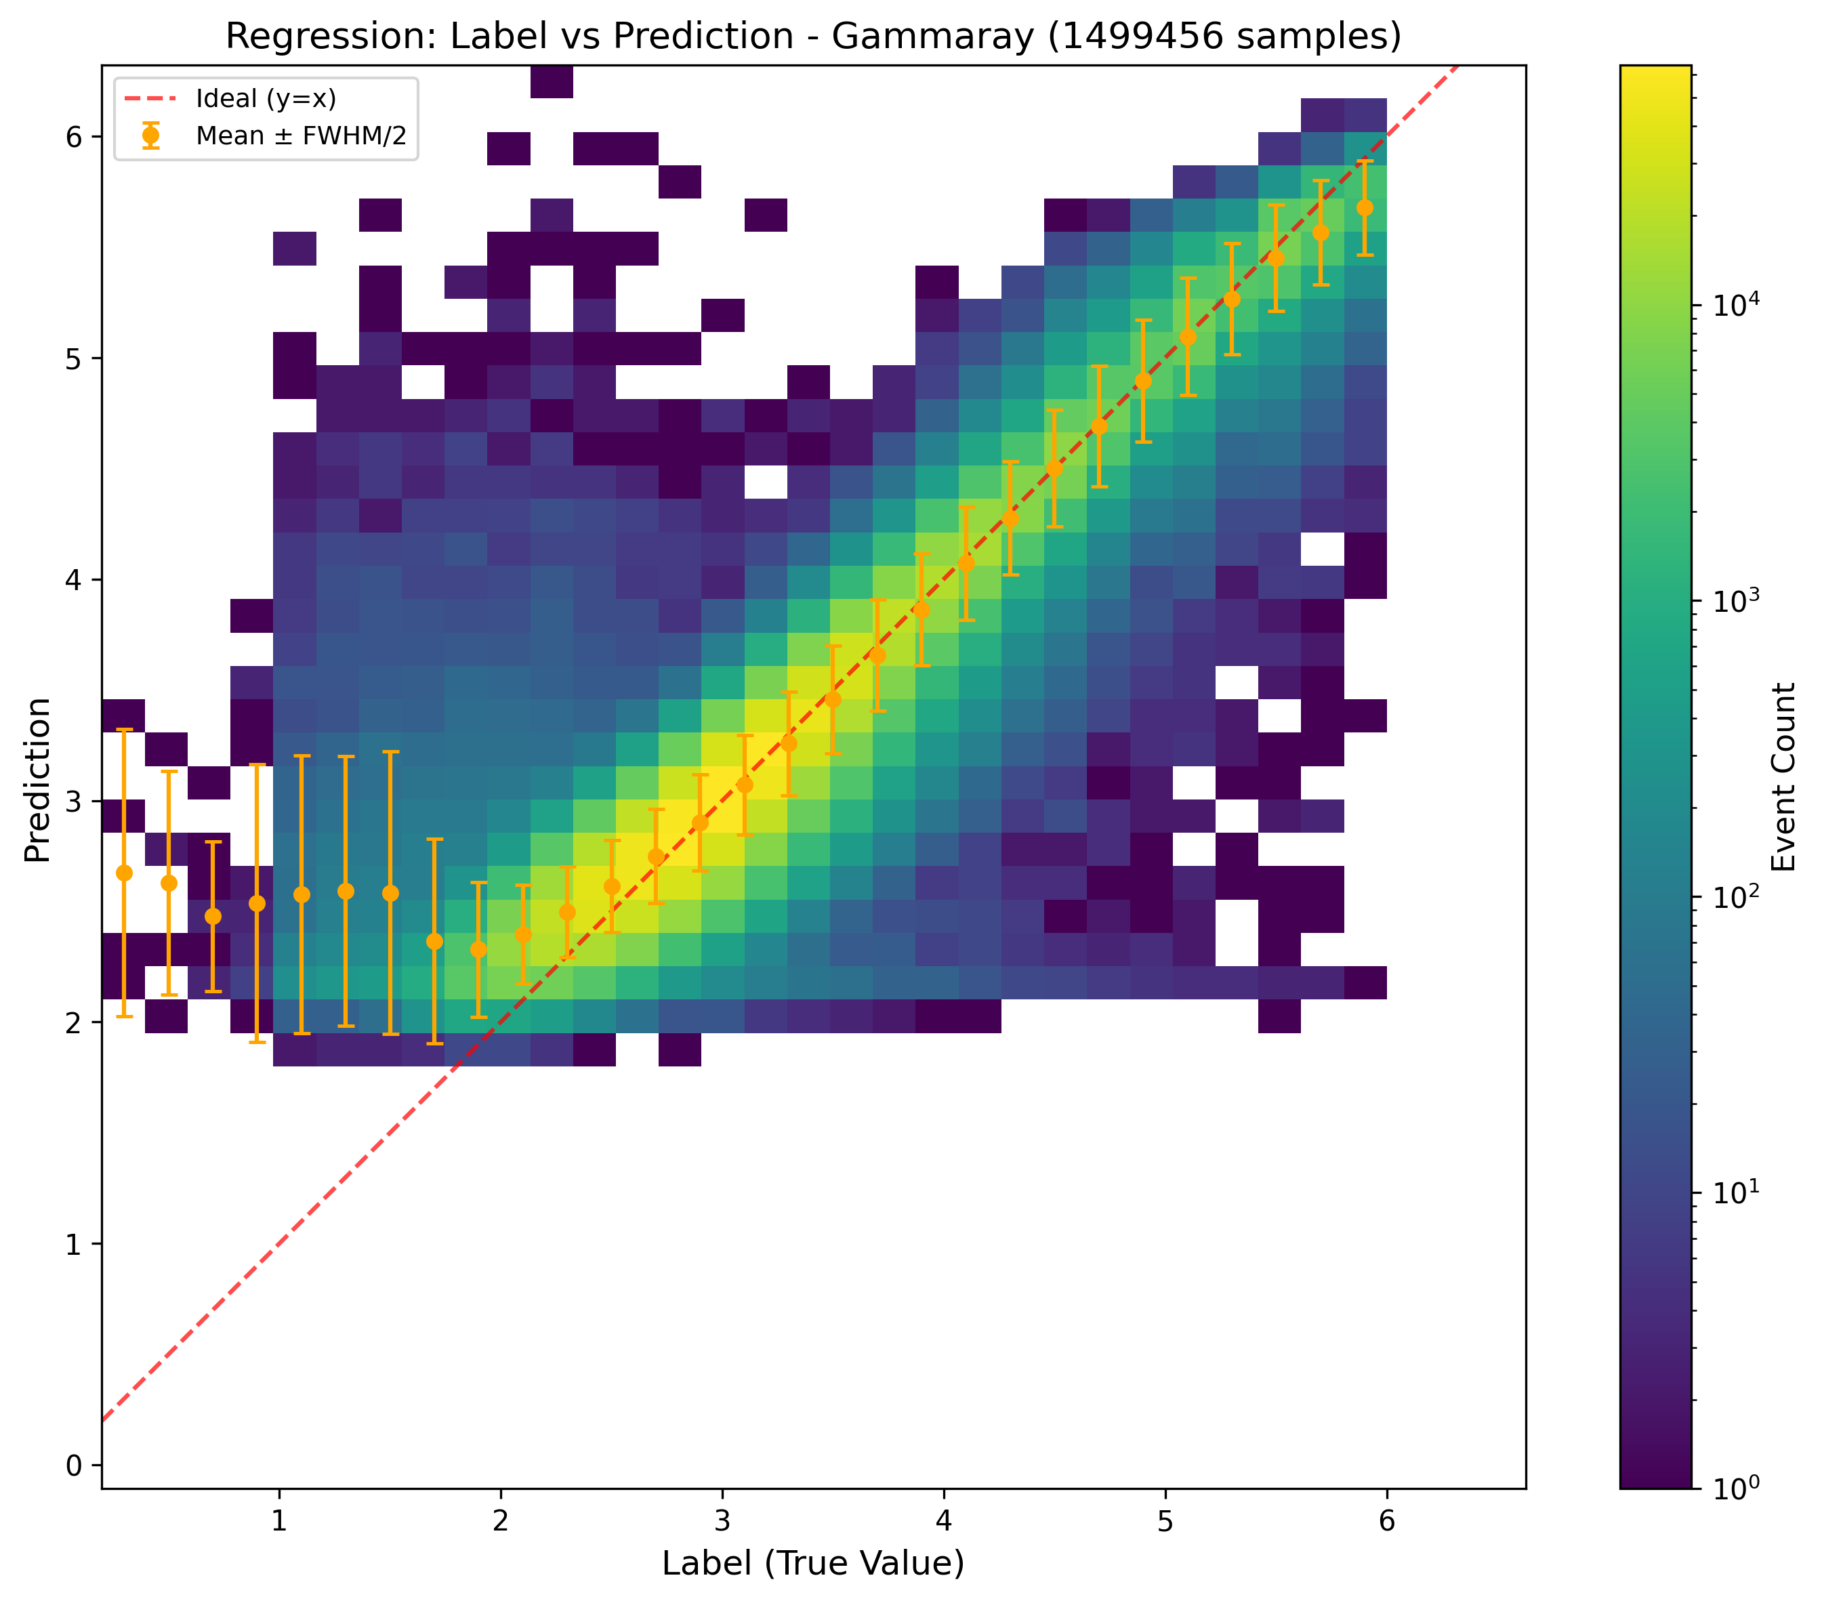
Preliminray energy reconstruction
Error bar: FWHM at linear scale, i.e. energy resolution, ~50%

