Slide 1


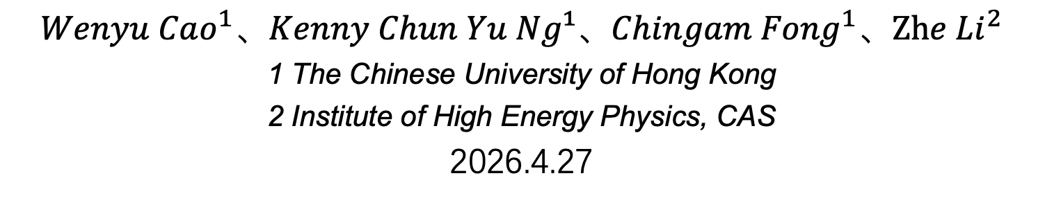
Secondary Electron-Positron Pairs as a Key Component of the Solar Disk TeV Emission
$$Wenyu Cao^{1}、Kenny Chun Yu Ng¹、{Chingam Fong}^{1}、{Zhe Li}^{2}$$
1 The Chinese University of Hong Kong
2 Institute of High Energy Physics, CAS
2026.4.27
Notes:
The title of my presentation is Secondary Electron-Positron Pairs as a Key Component of the Solar Disk TeV Emission‘

Slide 2
Outline
Motivation & Background
G4Solar Simulation
Results
1
Notes:
Here is the content of my report.

Slide 3
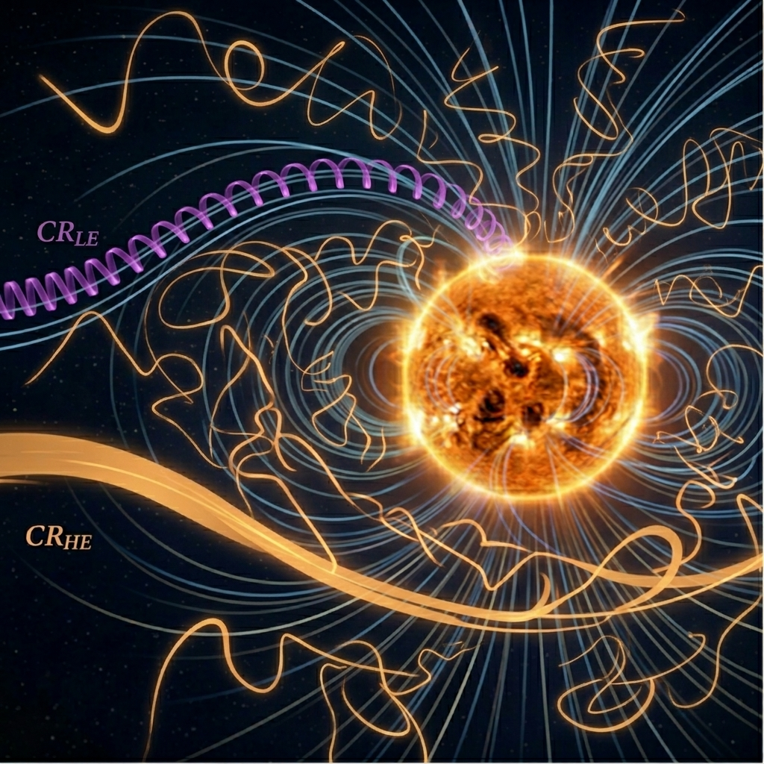
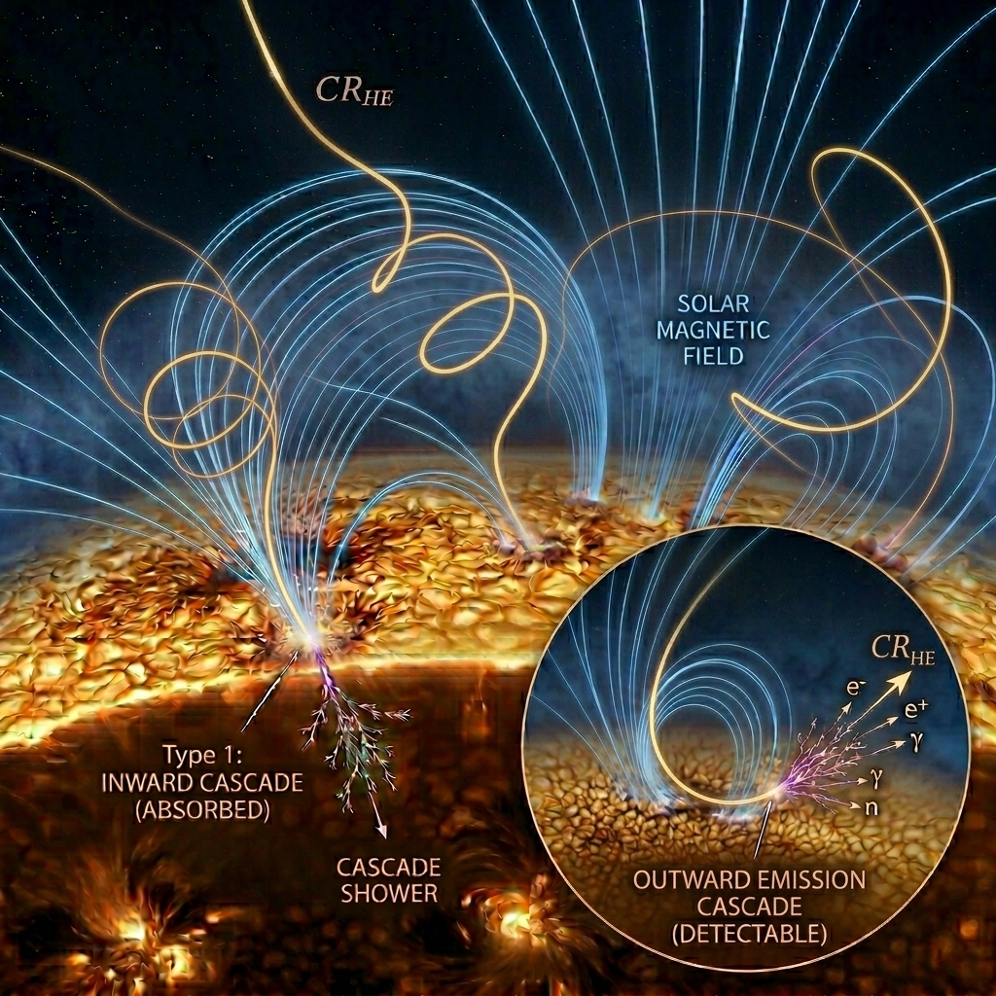
Motivation & Background
2
Notes:
First, let me give you a brief background. As we know, galactic cosmic rays constantly bombard the Sun and trigger cascade showers. But we can't detect all of them. We can only observe the ones that get deflected by the magnetic field and end up traveling outward or tangentially.

Slide 4
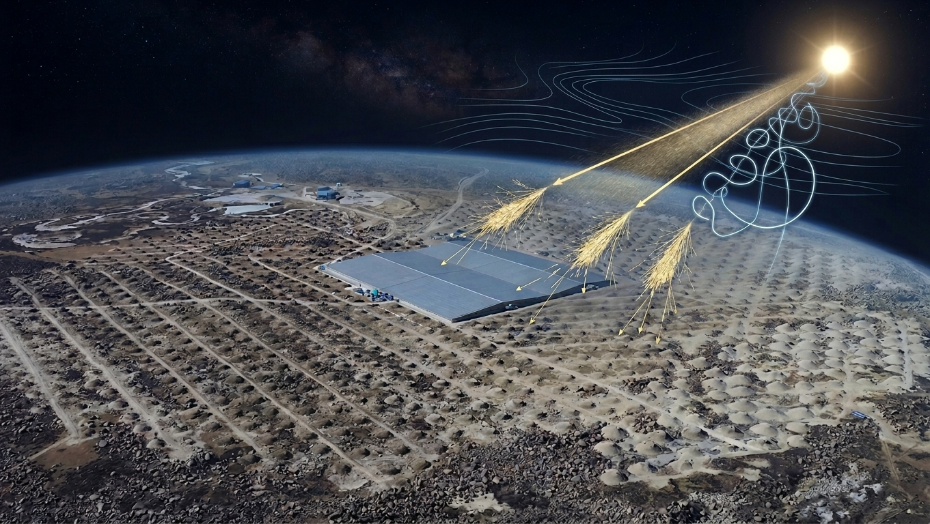

Motivation & Background
γ
n
$$e^{+}/e^{−}$$
Electromagnetic cascade
(gamma, electron, positron)
3
Notes:
The interactions between cosmic rays and the solar atmosphere produce gamma rays, neutrons, and electrons and positrons, all of which can be detected by EAS arrays such as LHAASO. In particular, it is difficult to distinguish between gamma rays and electrons/positrons because they both induce electromagnetic showers.

Slide 5
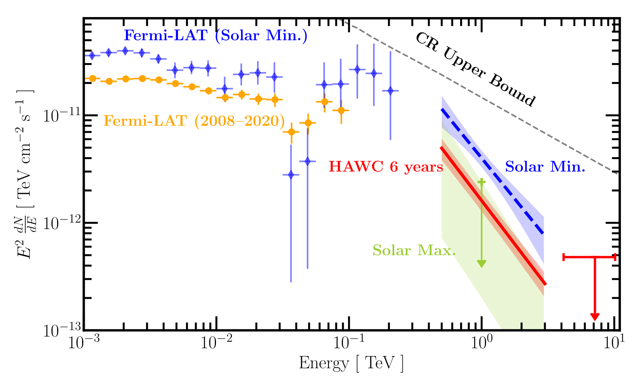
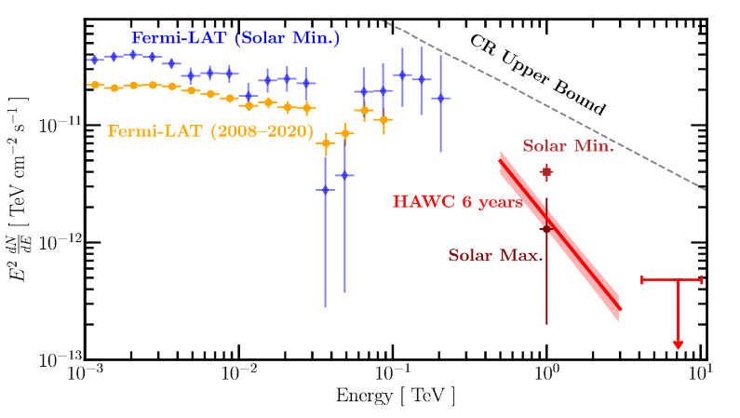
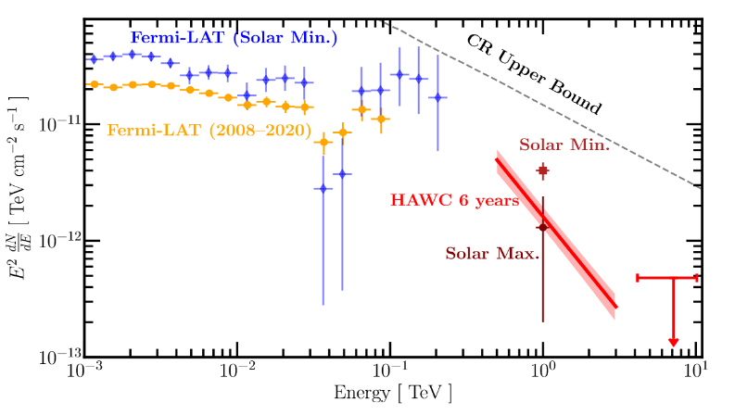
Motivation & Background
HAWC Collaboration, 2022
Phys. Rev. Lett. 131, 051201, HAWC Collaboration
4
Notes:
So, a natural question to ask is: how much of the signal detected by EAS arrays actually comes from electrons and positrons? Actually, HAWC has detected this TeV signal from the Sun in 2023, with a flux that far exceeds theoretical predictions. We need to quantify the contribution of solar secondary electrons and positrons to the observation.

Slide 6

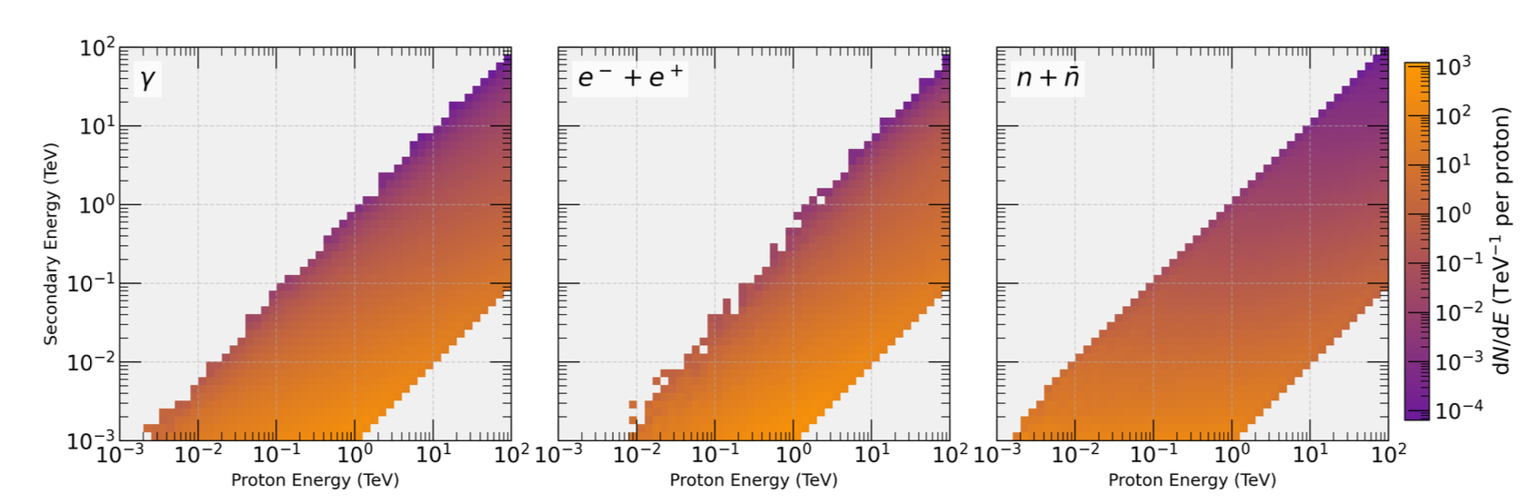
G4Solar Simulation
Main Assumptions:
CR are deflected by the B field and emitted outward from a specific Depth within the Sun with a specific Spectrum and Angular Distribution. We refer to such cosmic rays as Outward CRs (OCRs).
G4SOLAR
developed by Li Zhe
arXiv:2009.03888v2
5
Notes:
To answer this question, we performed Monte Carlo simulations. Since only outward-developing showers are detectable, we assume that cosmic rays have been deflected by the magnetic field and directed outwards from the solar interior. We then used Geant4 to simulate the distribution of secondary particles emitted from the Sun.

Slide 7
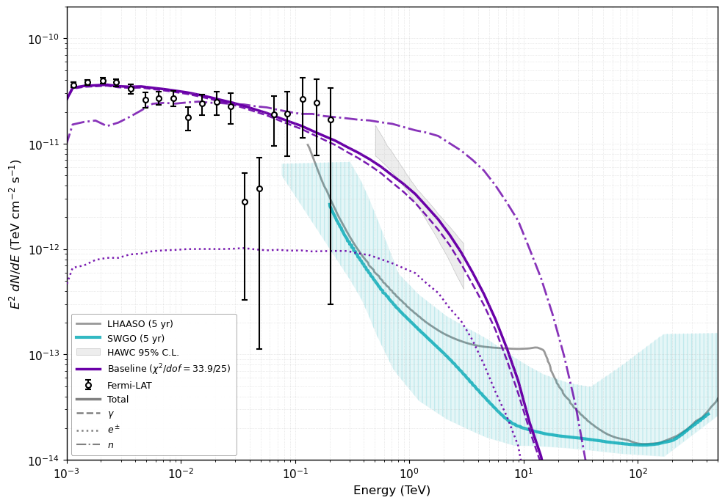
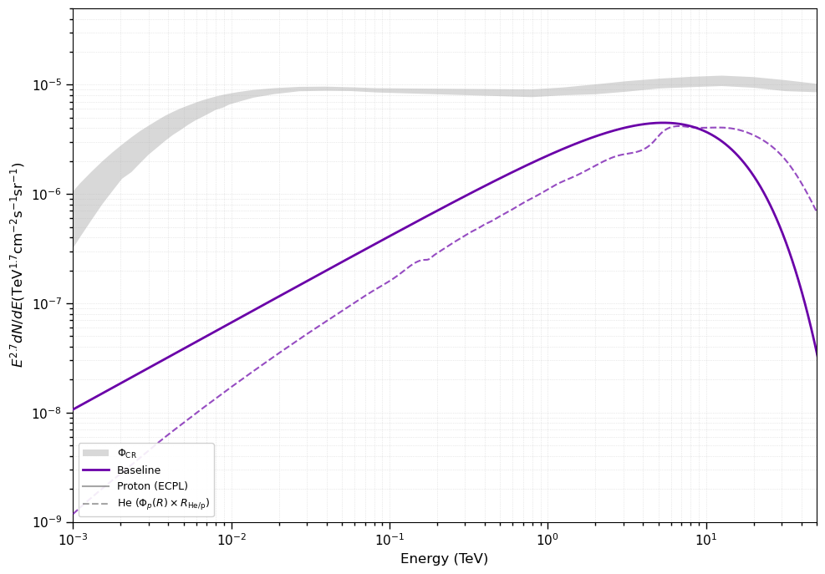
Results
Fitting Results
GCR Energy Spectrum
The best-fit OCR Spectrum
6
Notes:
Here, we present the results of fitting our simulations to the Fermi and HAWC observational data, from which we inferred the spectral parameters of the outward-directed cosmic-ray protons and helium. A comparison with the energy spectra of Galactic cosmic rays is also provided.

Slide 8
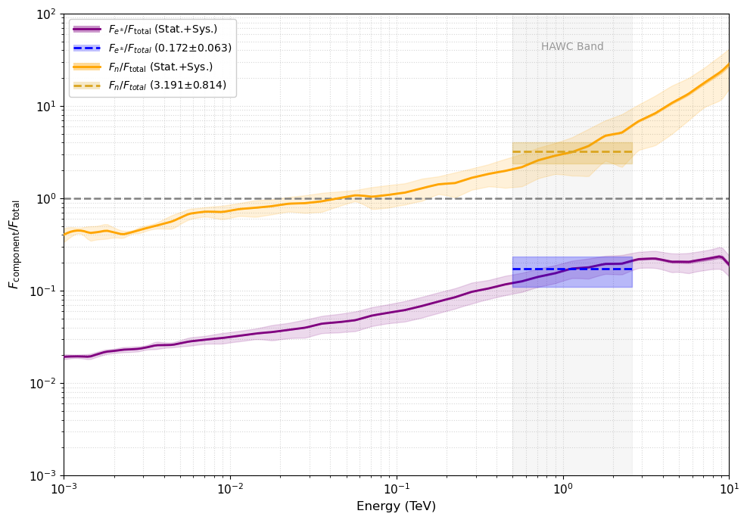
Results
We simulated and successfully fitted the Fermi and HAWC observations of solar gamma rays, and inferred the energy spectrum of the outward-deflected cosmic rays at the solar surface.
Our simulations indicate that the electron-positron signal accounts for approximately ~20% of the total observed signal.
We predicted the energy spectra of solar secondary electrons, positrons, and neutrons at Earth. These signals are expected to be detected by future detectors such as LHAASO and VLAST.
7
Notes:
Finally, based on the fitting results, we determined that the fraction of electrons and positrons is approximately 20%. Simultaneously, we predicted the flux of solar secondary neutrons. Since electrons and positrons develop irregular morphologies during their propagation, LHAASO holds the potential to detect this extended solar emission. In the future, detectors such as VLAST have the potential to collect and attempt to extract solar neutron signals. Thank you.

